Slide 1
Trouble Shorting of CW Operation of Superconducting Linac for Chinese ADS
TTC meeting, Feb. 6-9, 2018, Milan
Yuan He, Yongming Li, Xinmeng Liu, Zheng Gao, Guirong Huang, Weiming Yue, Shenghu Zhang
On behalf of Linear Accelerator Center
Institute of Modern Physics, Chinese Academy of Sciences
Supported by “Strategic Priority Research Program” of the Chinese Academy of Sciences.

Slide 2
Outlines
Operation status of Chinese ADS front-end Demo Linac
Pickup-drop caused by field emission
Phase-error trips
Summary

Slide 3
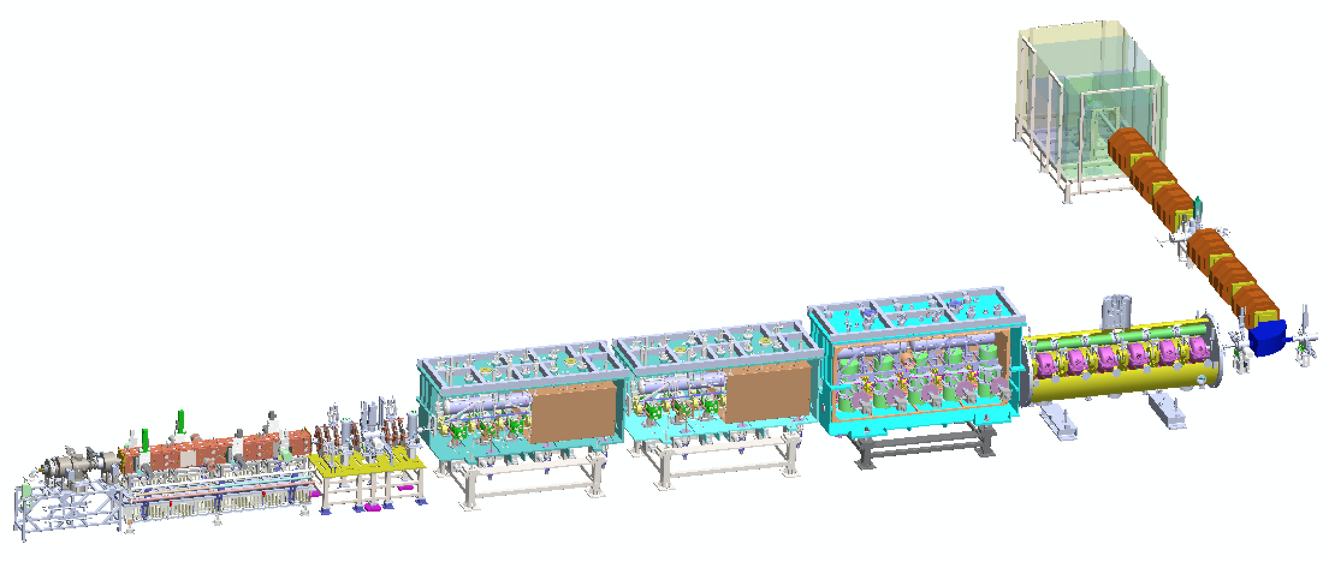
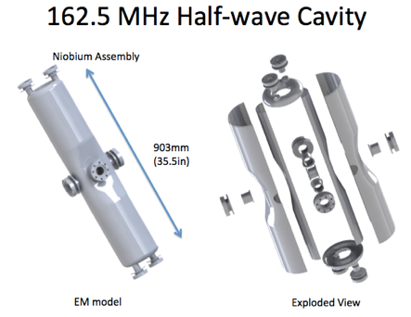
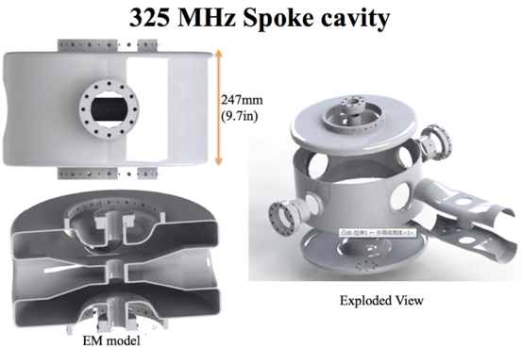
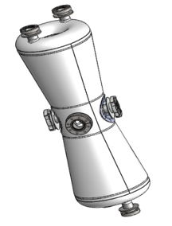
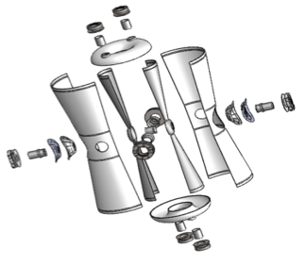
Overview of Chinese ADS Front-end Demo Linac
Goal: to demonstrate the technology of 10 mA CW beam of superconducting front-end Linac for ADS technology.
Design: 25 MeV, 10 mA, CW
IMP collaboration with IHEP 2011 ~ 2017
DUMP
HEBT
Beta=0.1
Injector II
IMP
162.5 MHz Taper HWR
Beta=0.21
Beta=0.15
IHEP
IMP
Supported by “Strategic Priority Research Program” of the Chinese Academy of Sciences.

Slide 4
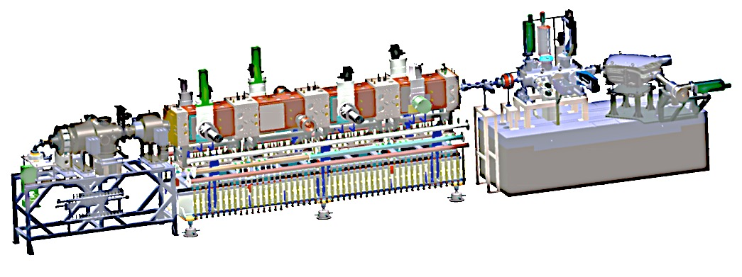
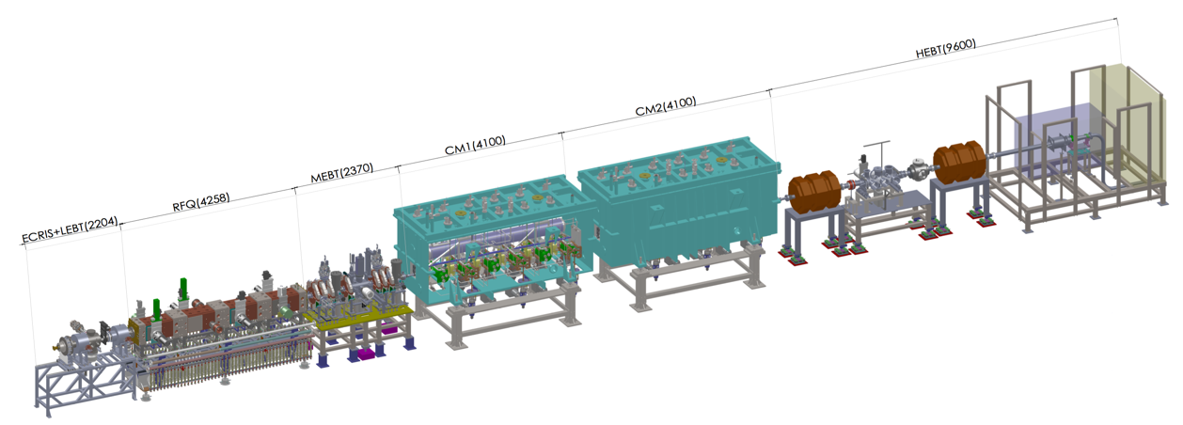
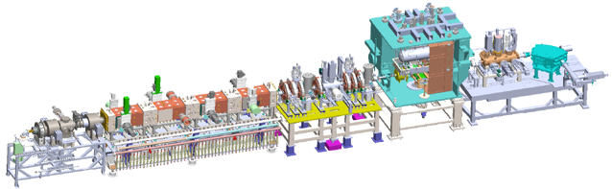
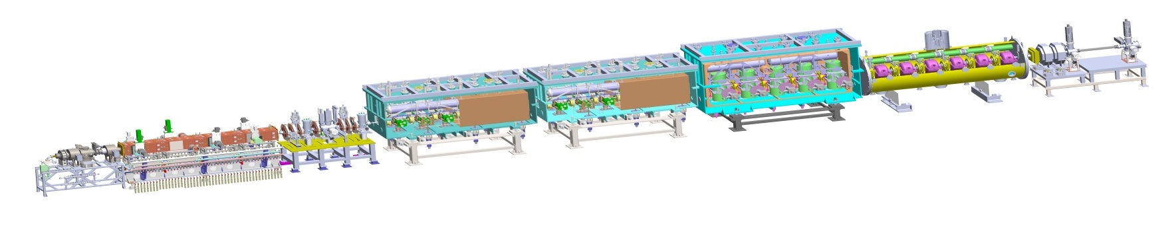
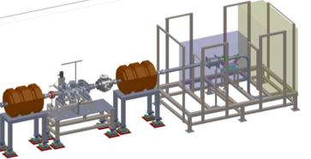
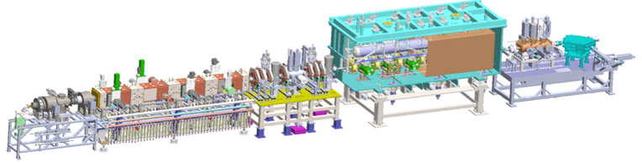
Operation of Chinese ADS Front-end Demo Linac
Commission Stage | First beam | First CW beam | E Max (MeV) | Beam time (hours) | CW beam time (hours) | Pulse Current Max (mA) | CW Current Max (mA) | CW Power Max (kW)
RFQ | Jun. 06, 14 | Jun. 21, 14 | 2.15 | 3007 | 105 | 18 | 11 | 23
TCM1 | Sep. 29, 14 | Nov. 24, 14 | 2.55 | 208 | 22.5 | 11 | 11 | 28
TCM6 | Jun. 06, 15 | Jun. 24, 15 | 5.30 | 438 | 11 | 10 | 4 | 21
Injector II | Sep. 09, 16 | Sep. 24, 16 | 10.2 | 735 | 30 | 10.6 | 2.7 | 26
Demo front-end Linac | May 23, 16 | Jun. 06, 17 | 26.2 | 355 | 27 | 12.6 | 0.3 | 5.4
1
4
162.5 MHz RFQ
2
162.5 MHz HWR010
162.5 MHz HWR010
5
3
162.5 MHz HWR010

Slide 5
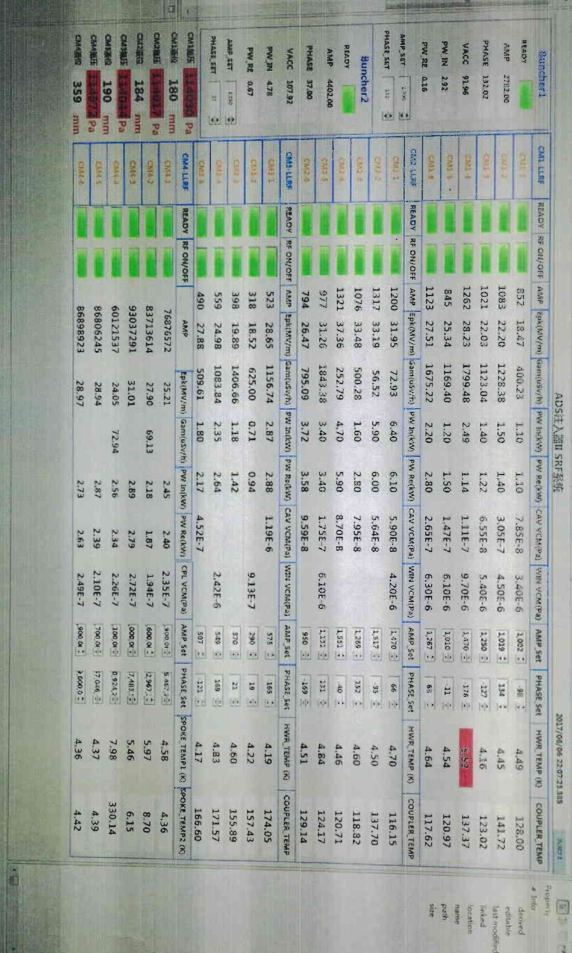
Cavities configuration of first CW operation
23 low beta cavities
AMPs for CM1 and CM2 are 12 kW
AMPs for CM3 and CM4 are 24 kW
RF power ranges from 1 kW to 6 kW due to different coupling Coef. and Epk.
Epk ranges from 18 MV/m to 38 MV/m
Qe of CM2-3 is far from designed value. It makes troubles.

Slide 6
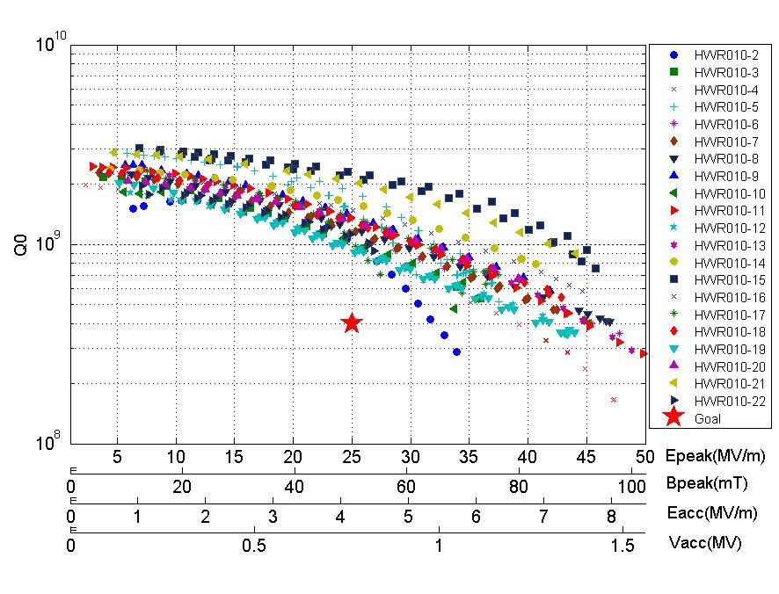
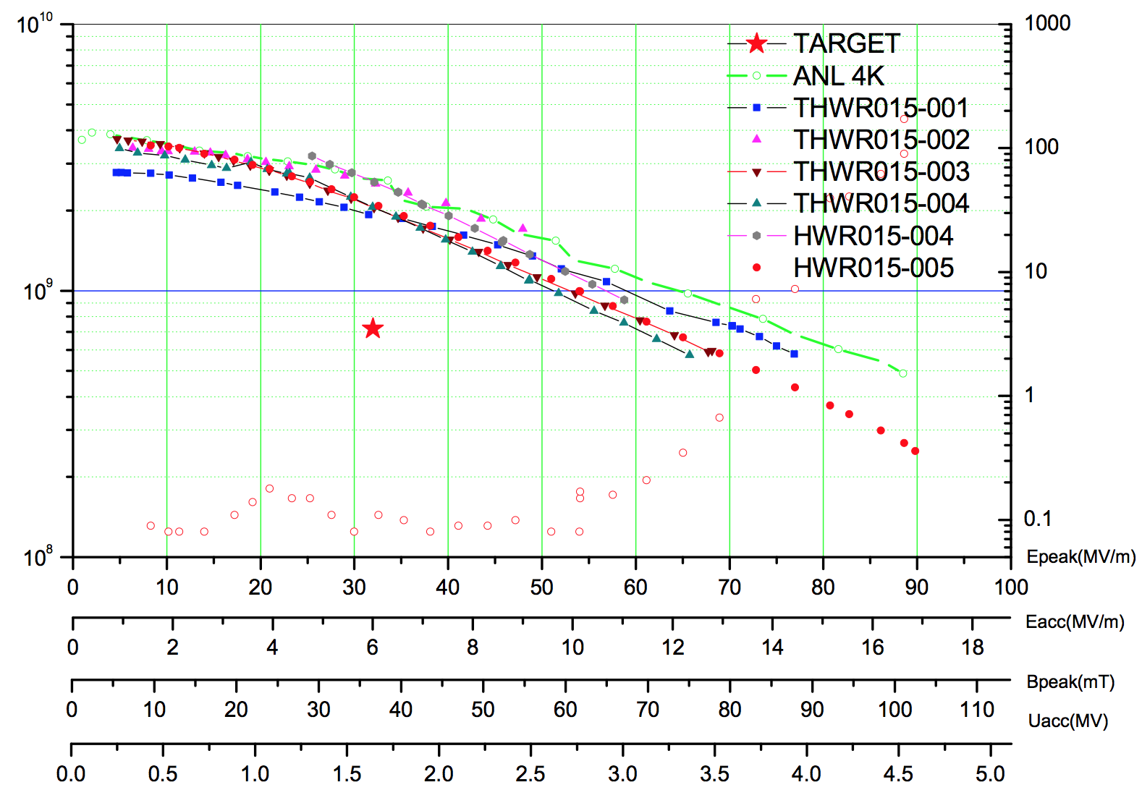
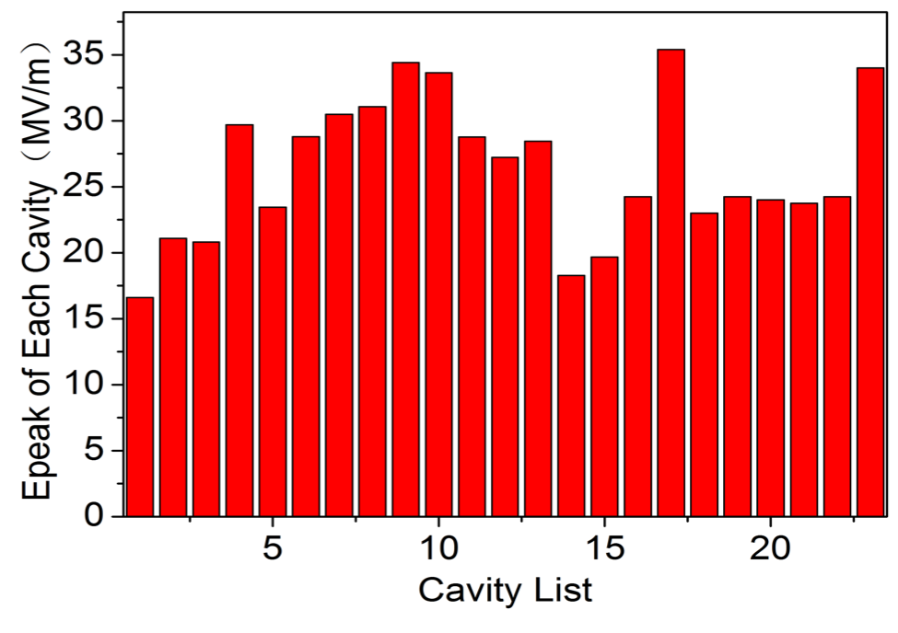
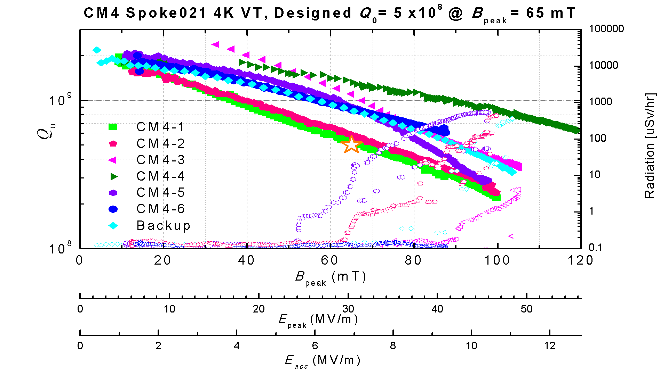
SRF specifications in the first commission
Trips during conditioning
Trips during beam commission

Slide 7
Outlines
Operation status of Chinese ADS front-end Demo Linac
Pickup-drop caused by field emission
Phase-error trips
Summary

Slide 8
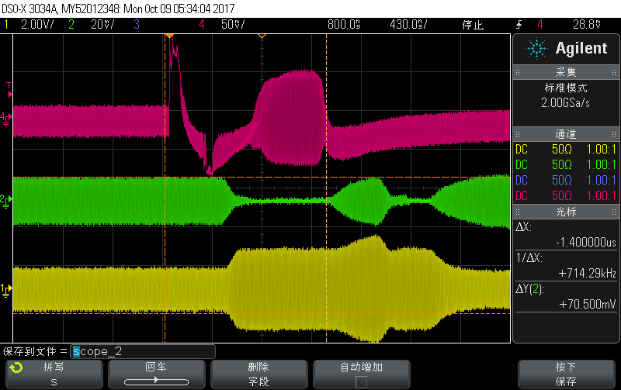
Typical signals of pickup-drop
Pickup from
cavity
Forward
RF signal
Reflected
RF signal
Amplitude, phase, frequency loops activated, SEL
250 us

Slide 9
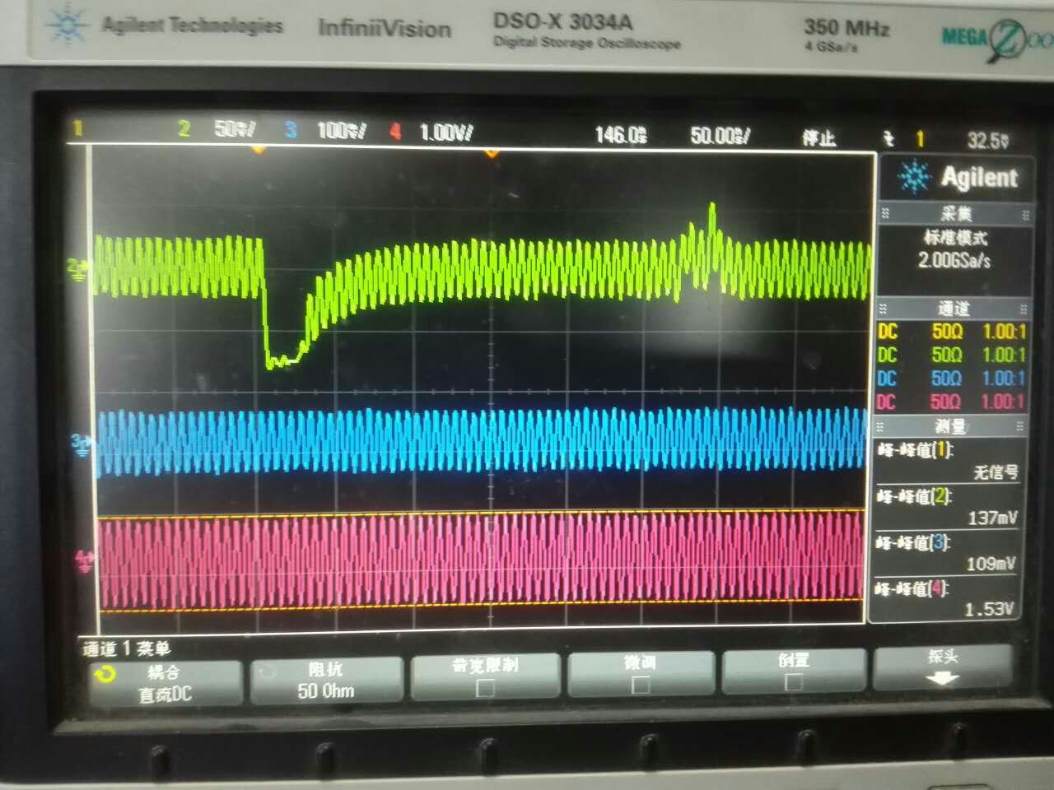
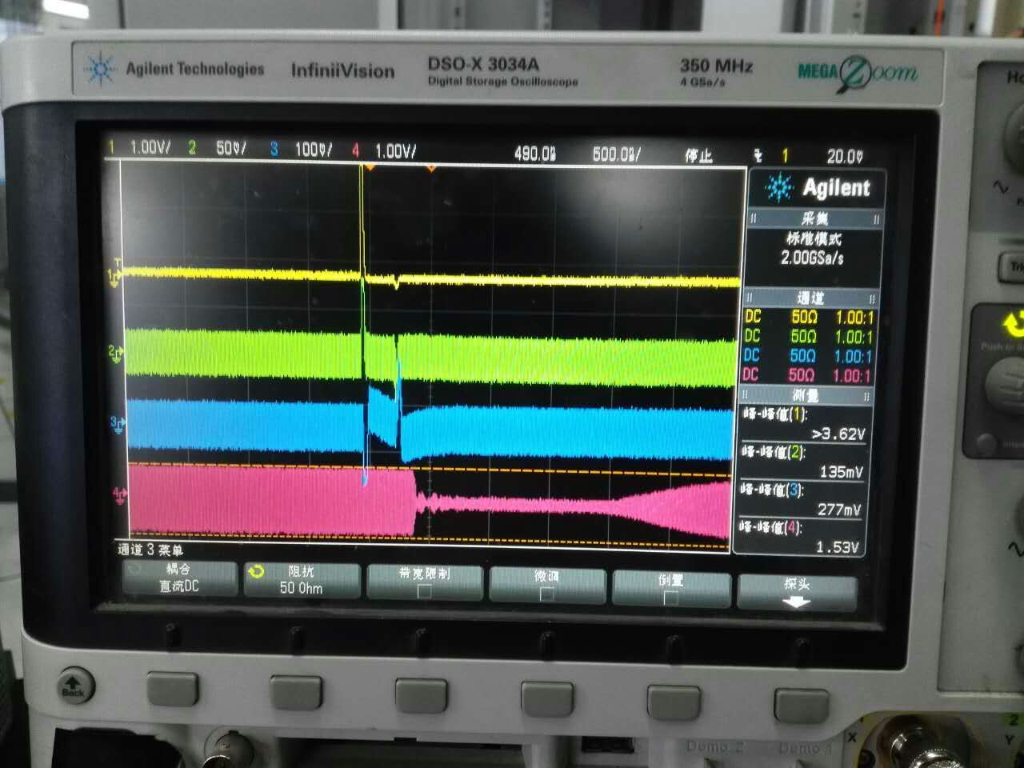
Signals of pickup-drop
Generator-Drive Resonator
Self-Excited loop
Pt
Pt detection
Pt
LLRF output
LLRF output
Power forward
Power forward

Slide 10
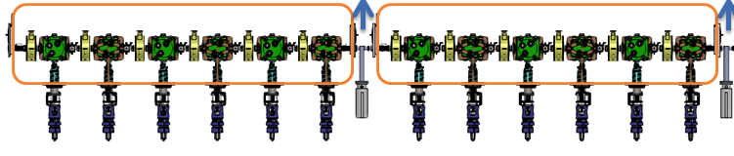
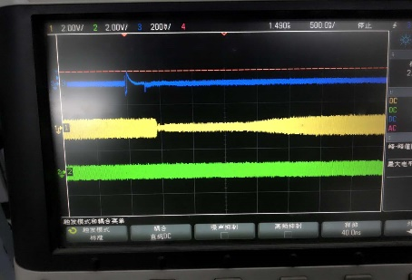
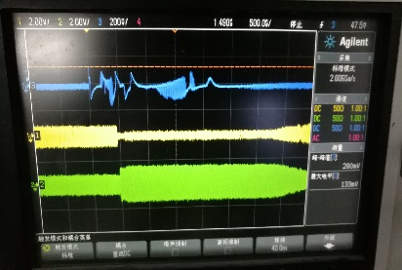
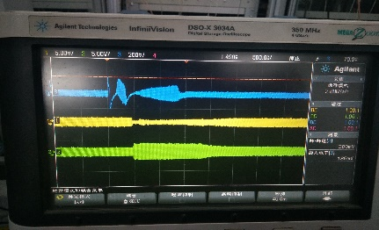
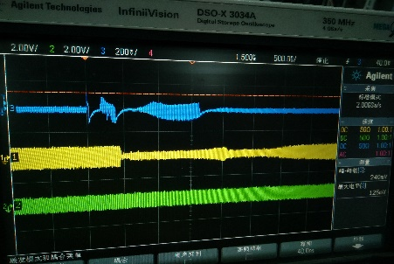
Experimental setup
CM1-2
Agilent Technologies DSO-X 3034A oscilloscope
350MHz, 4GSa/s, input impedance 50Ω
Vertical scale: 50 mV
Horizontal scale: 500 ns
CM1-1
CM1-3
CM1-4
CM1-5
CM1-6
CM1-2：Epk= 20.53 MV/m Gam：751 uSv/h
CM1-1：Epk= 18.94 MV/m Gam：355 uSv/h
CM1-3 : Epk= 21.82 MV/m Gam : 236 uSv/h
CM1-4 : Epk= 27.36 MV/m Gam : 364 uSv/h
CM1-5 : Epk= 23.27 MV/m Gam : 394 uSv/h
CM1-6 : Epk= 24.52 MV/m Gam : 132 uSv/h

Slide 11
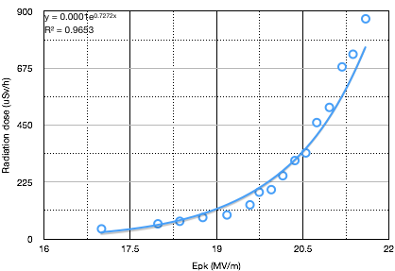
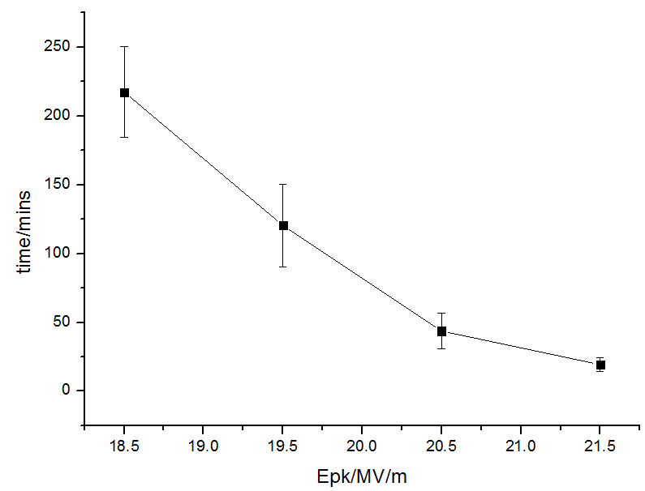
Pickup-drops Relative to FE
Monitor 12 hours for each point

Slide 12
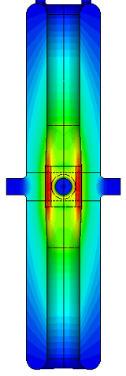
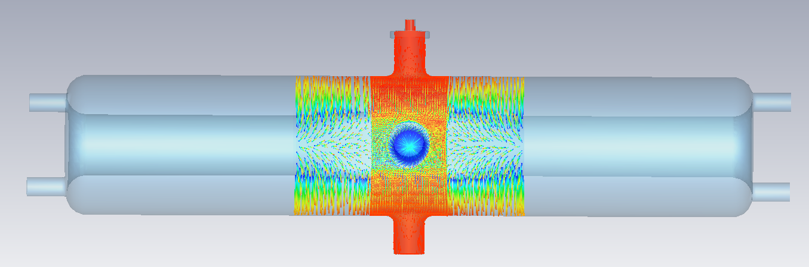
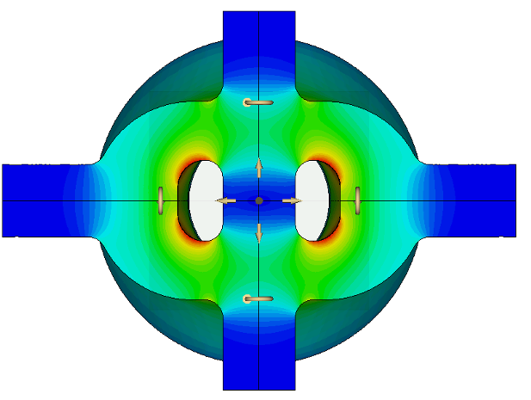
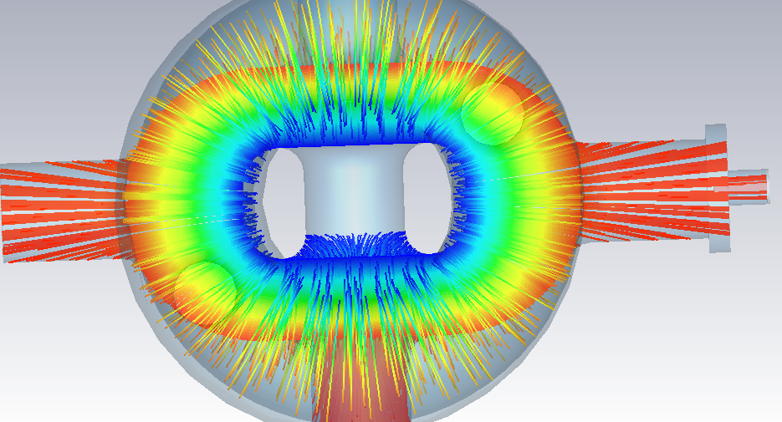
Reason of pickup-drop
beam port
H
E
L
0
Trajectory of FE electrons
Pt port
beam port
The coupler and Pt ports are located at the strong electric area of coaxial structure.
Highest surface field areas were designed not to face the pickup ports.
FE electrons can see the windows of FPC and Pt.
Electrons on ceramic discharge when accumulating to a certain value
FPC port

Slide 13
Outlines
Operation status of Chinese ADS front-end Demo Linac
Pickup-drop caused by field emission
Phase-error trips
Summary

Slide 14
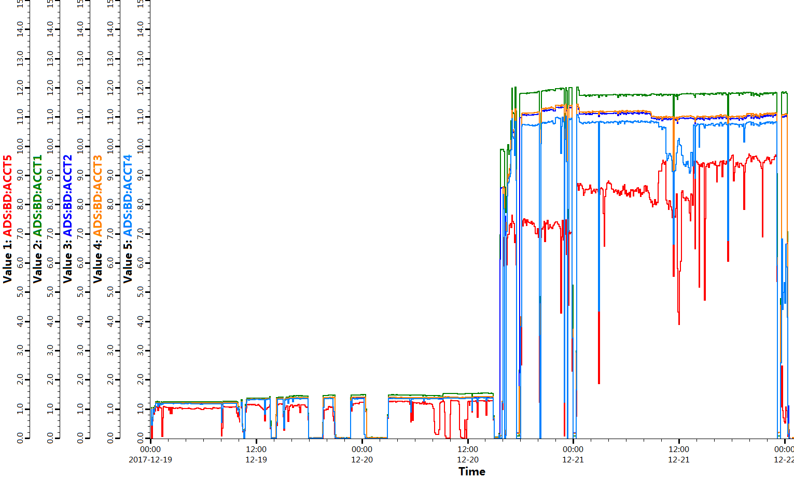
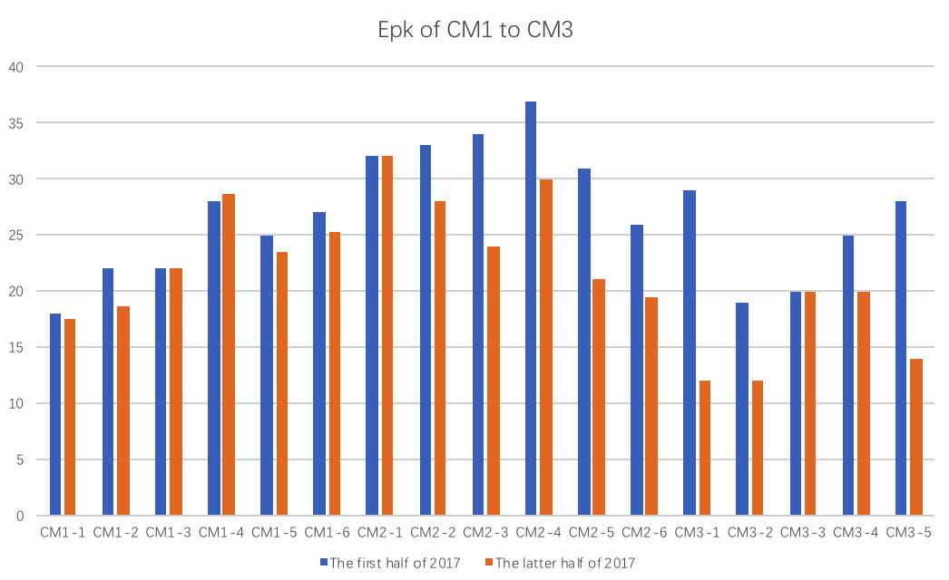
Operation Reliability Test
2017-12-19-00：00 ~ 2017-12-22-00：00；72 hours operation test
CW RF and Pulse beam (w/o MPS)
18MeV@1mA@1Hz@10uS & 18MeV@10mA@1Hz@10uS
ECR
HV
RFQ AMP
Diagnostics
test
PS
Cryo-plant
Mag-quench
13

Slide 15
Preliminary RAMI analysis
Beam trip required by ADS demo facility
Beam trips（10s-5min） | 2500/year
Beam trips（>5min） | 300/year
Availability | 80%
Some long time repair failures (> 5 min), such as HV, AMP, Cryo-plant, PS, have very clear reason, can be avoided in the nest stage.
10s-5min-trip number is less than the requirement. Root cause of trips of SRF are still under investigation.
Operation time | Beam time | Down time | Availability
4050 min | 3566 min | 484 min | 0.88
Mean time between failure MTBF (min) | Mean time to repair MTTR (min) | Beam trips (10s-5min) | Beam trips (>5min)
111.4 | 16.1 | 20 | 10
 | ECR HV | RFQ AMP | SRF (incl. LLRF) | Cryo-plant | Power supply
Beam trips | 6 | 2 | 21 | 1 | 1
Down time | 53 min | 77 min | 78 min | 183 min | 100 min

Slide 16
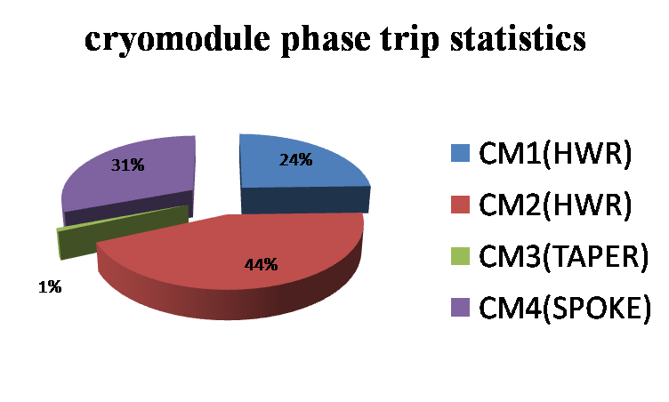
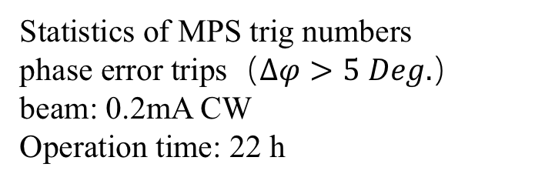
MPS Trigs of phase-error during CW Beam
Statistics of MPS trig numbers
phase error trips（$∆φ>5 Deg.$）
beam: 0.2mA CW
Operation time: 22 h
Weakness FPC coupling of CM2-3, at least 1/3 of the others, means narrow bandwidth, might be the reason.

Slide 17
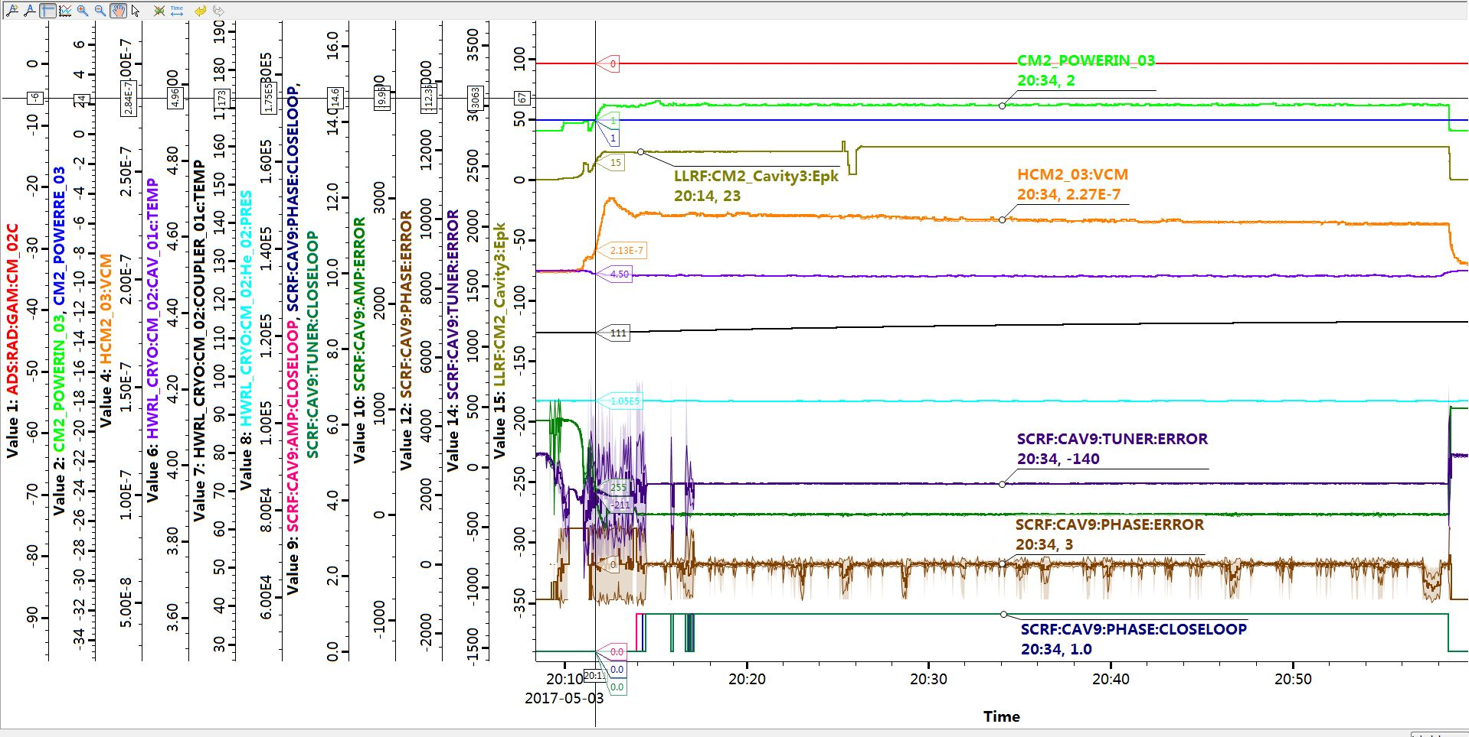
Trips with phase vibrate w/o open loop
Phase vibrate with loop-close

Slide 18
Outlines
Operation status of Chinese ADS front-end Demo Linac
Pickup-drop caused by field emission
Phase-error trips
Summary

Slide 19
Summary
Multipacting and Field emission
  Fundamental Power Couplers （coupler operation and activity at IMP, Tiancai Jiang）
    Multipacting? -> contamination -> FE -> ceramic window broken -> worse case
  Pickup couplers
    FE -> discharging -> LLRF instability
Phase-error trips
  Tuner Hysteresis (C-ADS tuner system, Tiancai Jiang)
  Microphonic and Vibration (electromagnetic-mechanical vibration , Zheng Gao)

Slide 20
Thanks for your attention
Acknowledgement:
ADS accelerator team at IMP and IHEP
Helps from PKU, SINAP, LBL, JLab, and Review experts

