Slide 1
Fundamental Studies of Flux Trapping
Sam Posen, Mattia Checchin, Curtis Crawford, Anna Grassellino, Martina Martinello, Alex Melnychuk, Alex Romanenko, Dmitri Sergatskov, Zuhawn Sung, Yulia Trenikhina
TTC Workshop Milan
February 2018

Slide 2
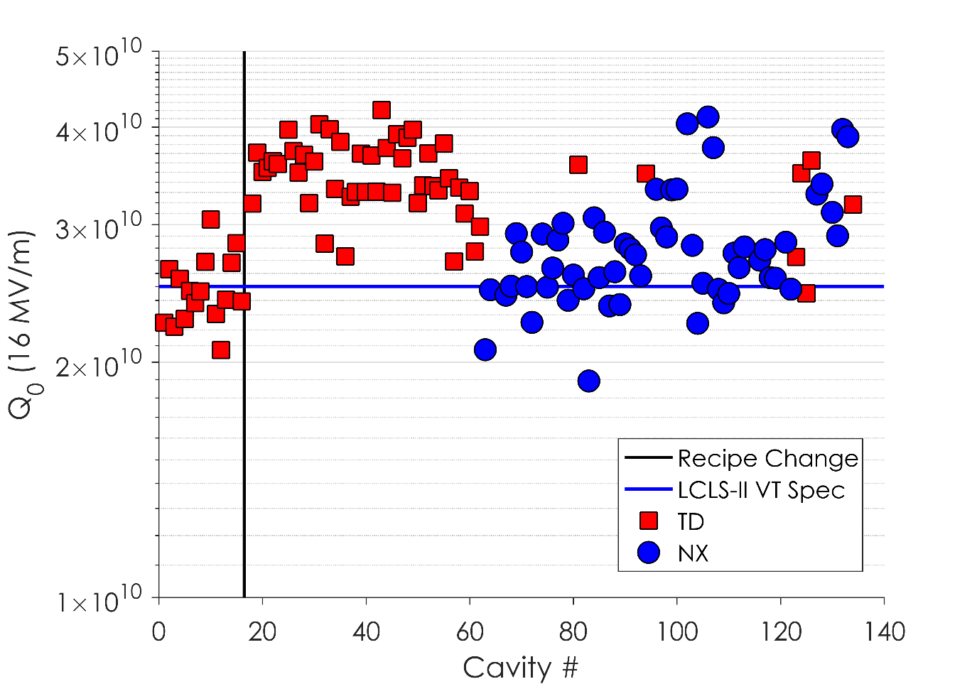
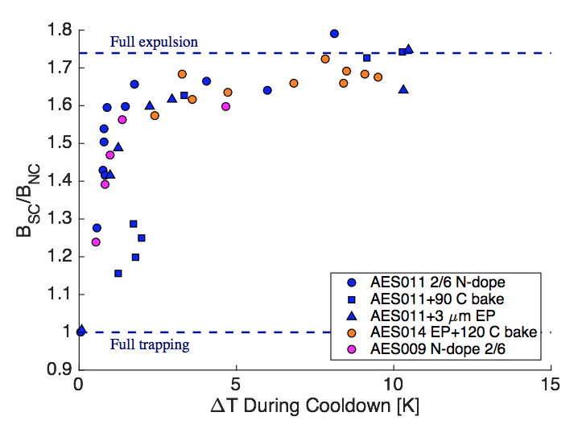
Flux Expulsion – What we know and what we don’t
Cavity Q0 Performance in VT
Expelling ambient flux substantially reduces Q-degradation due to trapped field [4]
Can avoid Q-degradation via improved expulsion by:
  Cooling through T_{c} with a spatial thermal gradient [1,2]
  Furnace treatment at high temperatures (~900 C) [3]
Surface treatment: insignificant impact on expulsion [3] (though it does impact sensitivity [nΩ/mG])
Some niobium requires higher temp treatment to expel [3], but it isn’t understood why this is the case
What is primary determination of trapping vs expulsion in state-of-the-art cavities? Impurities? Lattice defects?
How can we directly measure and compare these properties in material that expels well versus in material that traps?
LCLS-II Spec
800/140 in Low B_{amb}
900/200 in 5-10 mG
Wah Chang
Tokyo Denkai
900°C- 1000°C
[1] A. Romanenko et al., Appl. Phys. Lett. 105, 234103 (2014)
[2] A. Romanenko et al., J. Appl. Phys. 115, 184903 (2014)
[3] S. Posen et al., J. Appl. Phys. 119, 213903 (2016)
[4] D. Gonnella et al., NIM A 883 143–150 (2018)

Slide 3
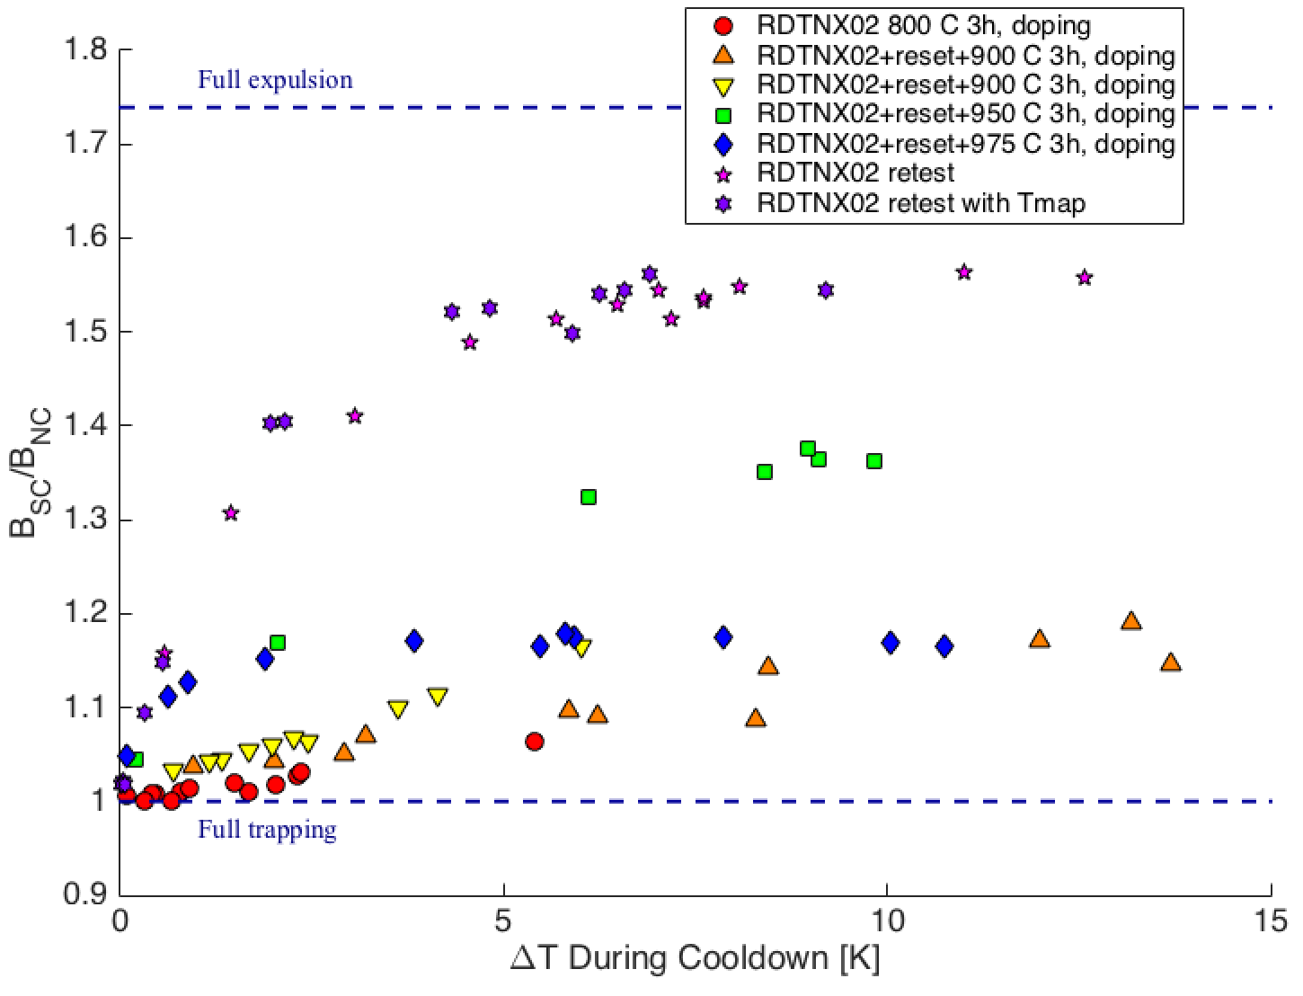
New Experiment – T-map with Partial Expulsion
Several 1-cell cavities were made with LCLS-II material
We put a T-map on the 1-cell cavity that showed the worst expulsion (RDT-NX-02) and measured after different cooldowns – made with “stubborn” material
LCLS-II Cavity Performance in VT
FNAL & JLab data assembled by D. Gonnella, SLAC
800/140 in Low B_{amb}
900/200 in 5-10 mG

Slide 4
Experimental Setup
Instrumentation on cavity:
  T-map
  RTDs (to measure ΔT at T_{c})
  Fluxgates (to measure B_{SC}/B_{NC})
  Coils (to apply field ~20 mG)
Cooldowns
  Fast in <1 mG field
  Fast in ~20 mG field
  Slow in ~20 mG field
  Medium in ~20 mG field

Slide 5
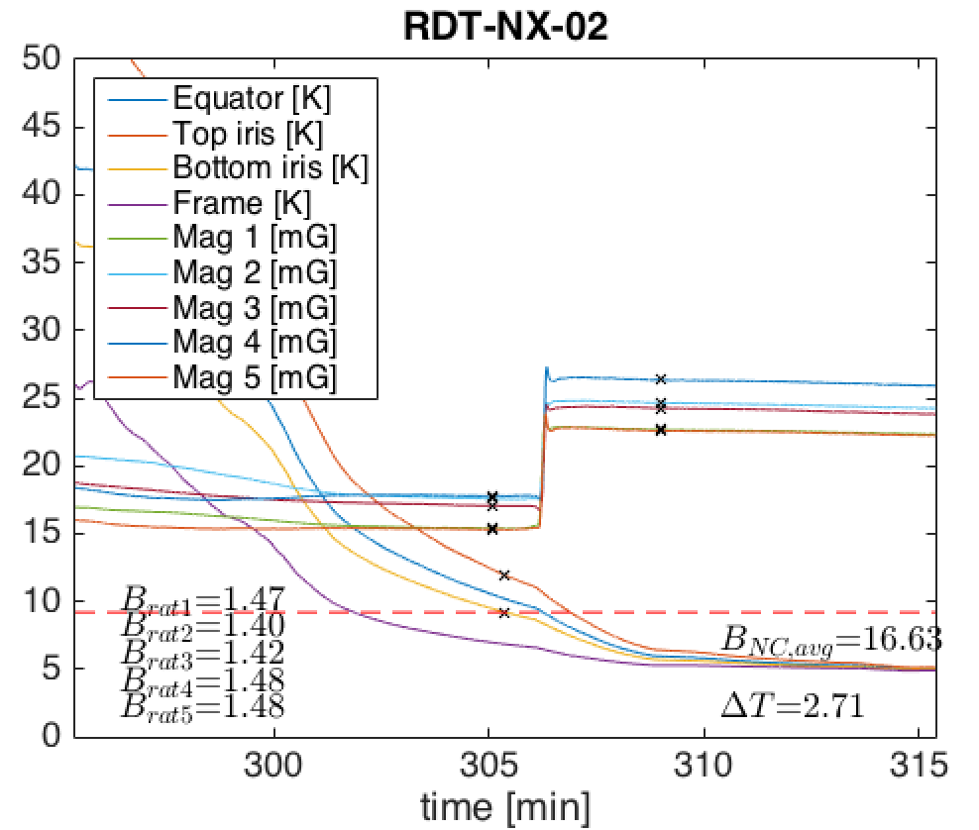
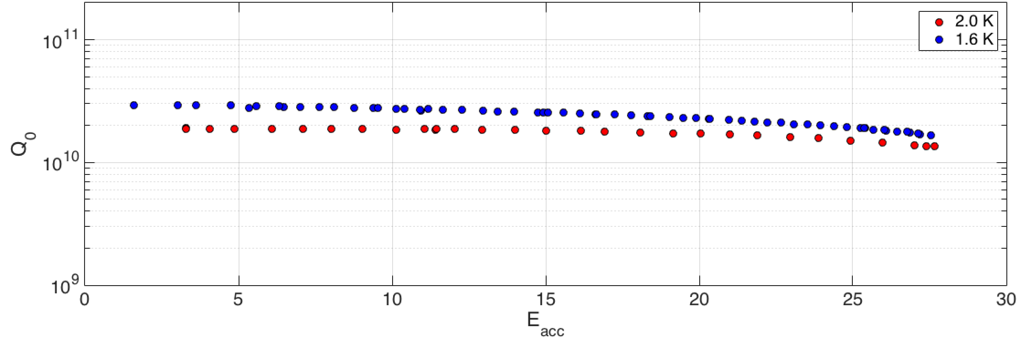
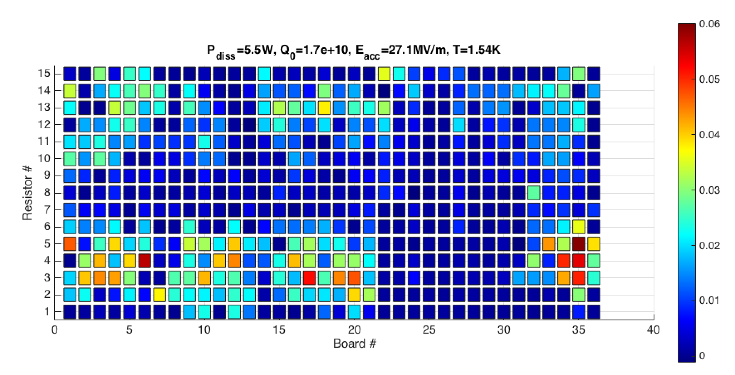
16 mG Medium

Slide 6
16 mG Medium
Top-bottom asymmetry
Equator/flat asymmetry
Azimuthal asymmetry

Slide 7
16 mG Medium
Top-bottom asymmetry
Equator/flat asymmetry
Azimuthal asymmetry
Are these real differences in expulsion? Other effects? We needed a second test

Slide 8
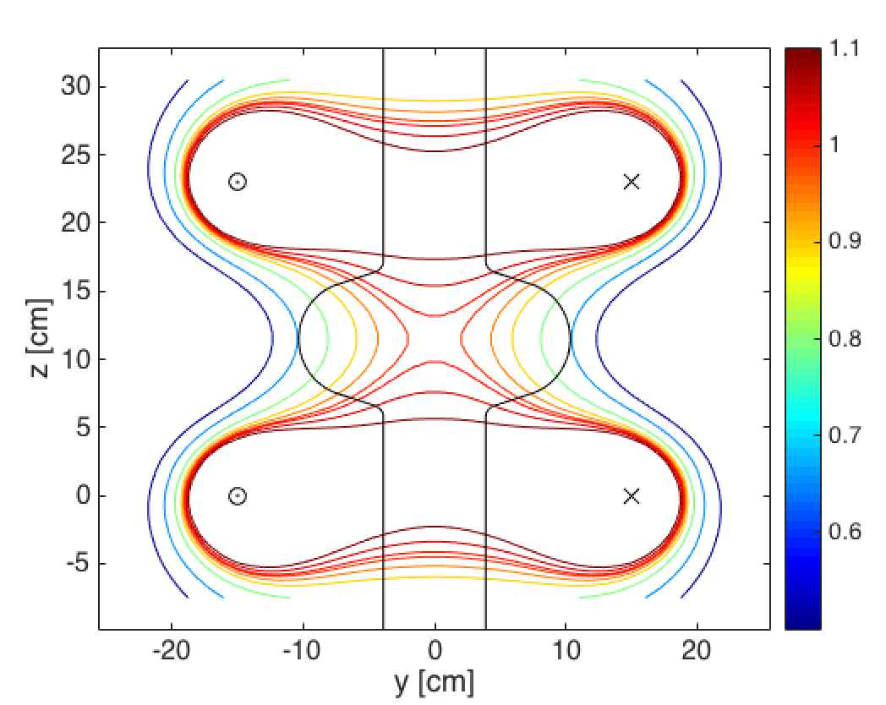
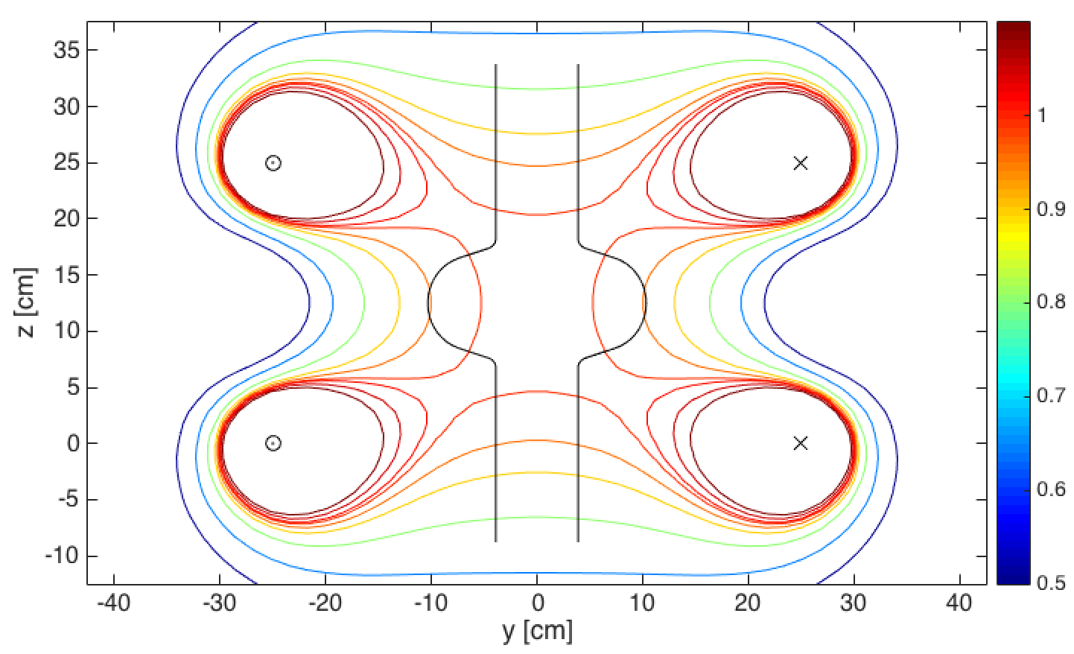
Changes to Setup for Second Test
Rotate T-map by 180 degrees
  Check against possible errors in T-map (e.g. poor contact)
Use larger coils
  Smaller coils were pushed by T-map to larger than Helmholtz separation
  (d = r_{coil})
Contours: [0.50 0.65 0.80 0.90 0.95 0.99 1.01 1.05 1.10]

Slide 9
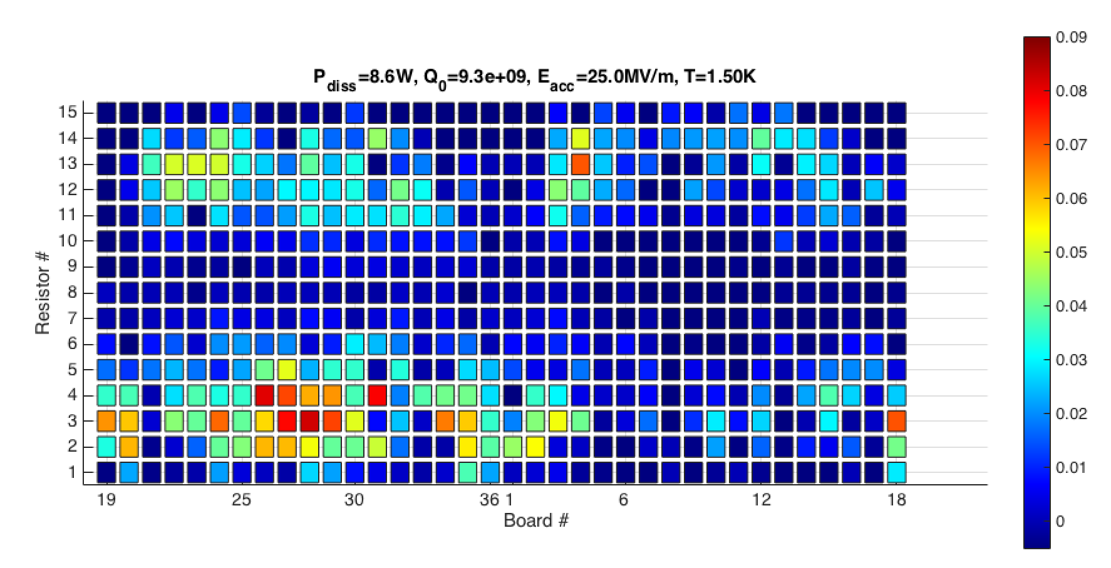
Compare Week 1 to Week 2 – ~20 mG Medium Cool
Top: week 1, bottom: week 2
Note shifted board numbers for week 2

Slide 10
Compare Week 1 to Week 2 – ~20 mG Medium Cool
Top: week 1, bottom: week 2
Note shifted board numbers for week 2
Top-bottom asymmetry
Equator/flat asymmetry
Azimuthal asymmetry

Slide 11
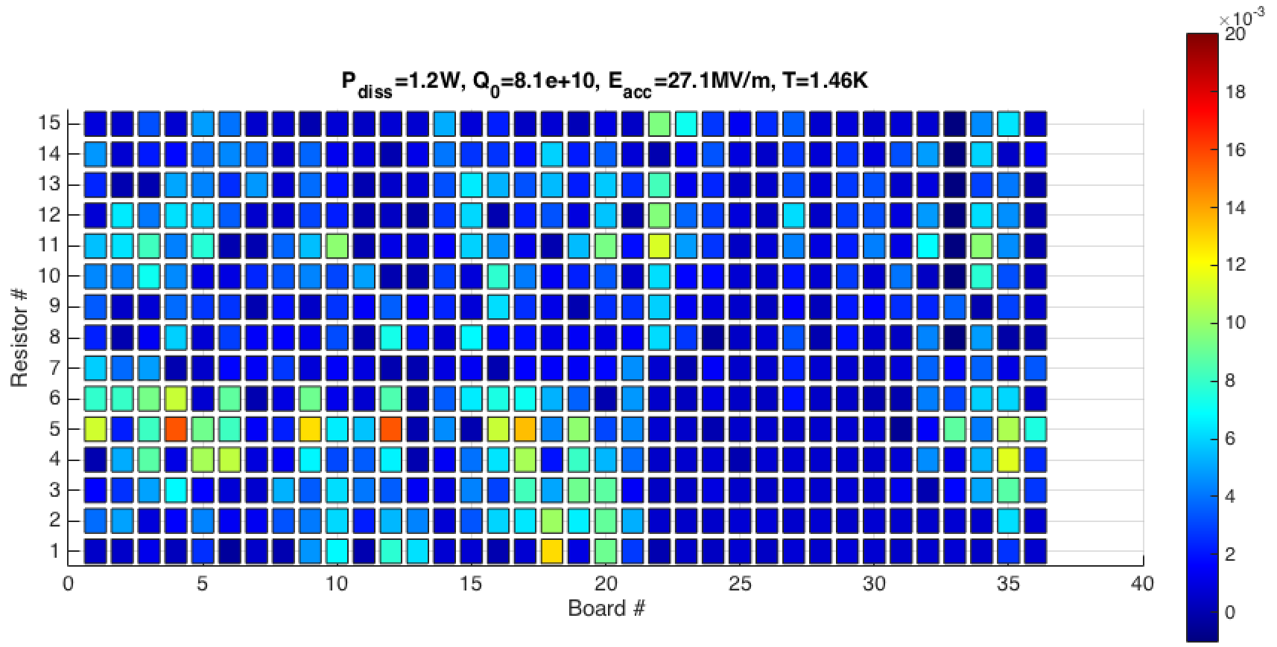
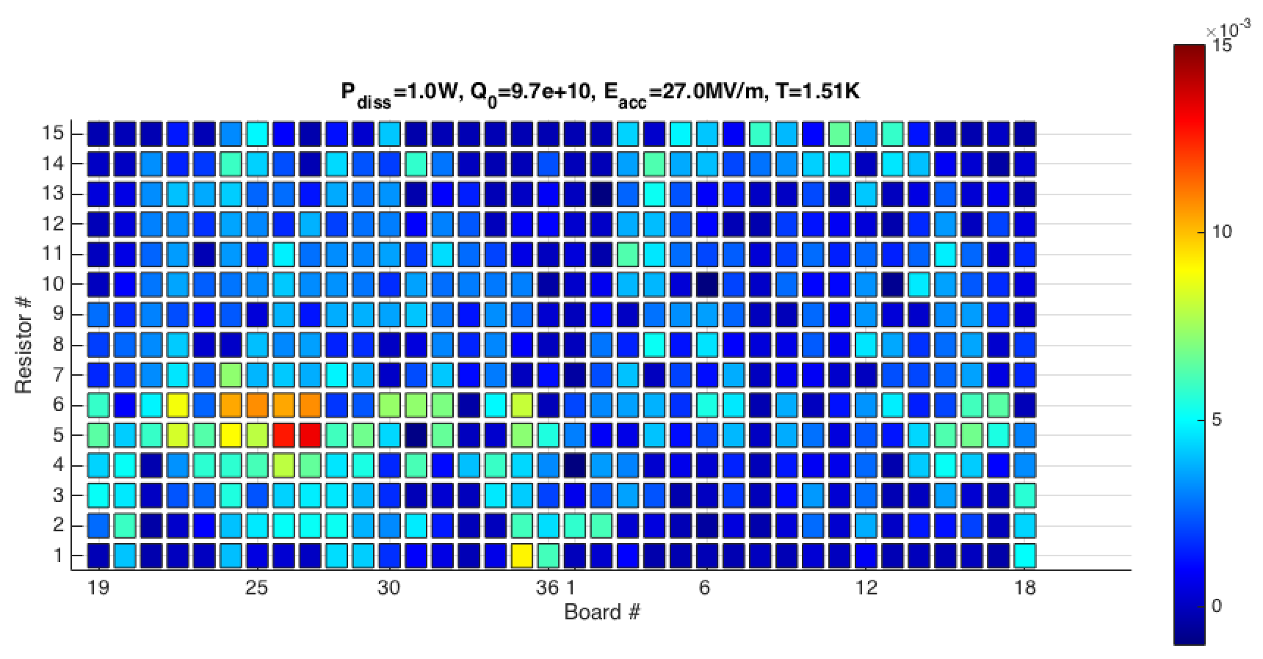
Compare Week 1 to Week 2 – 0 mG Fast Cool
Top: week 1, bottom: week 2
Note shifted board numbers for week 2

Slide 12
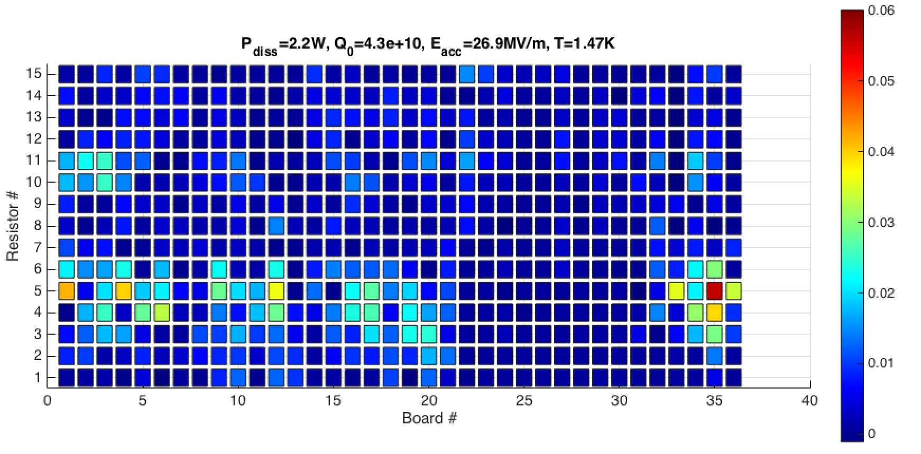
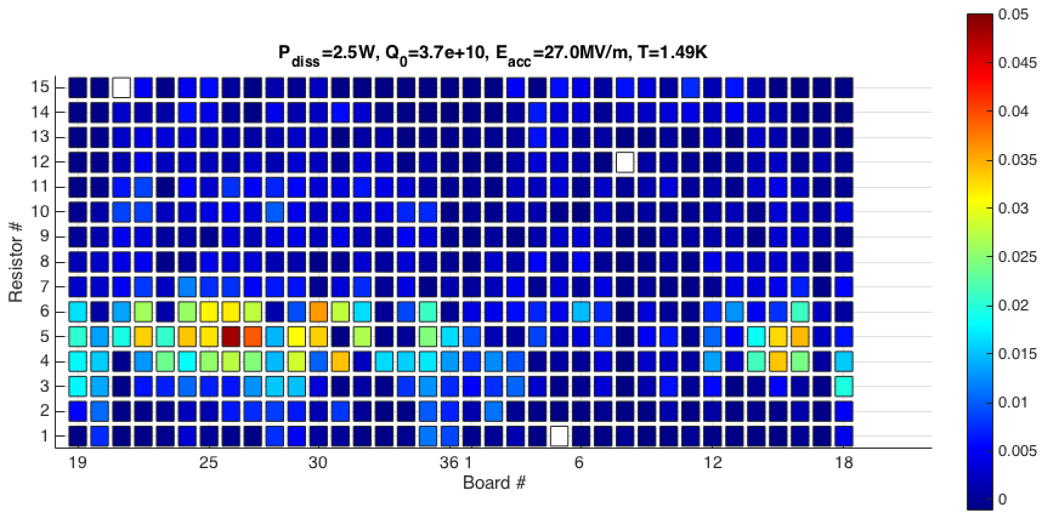
Compare Week 1 to Week 2 – ~20 mG Fast Cool
Top: week 1, bottom: week 2
Note shifted board numbers for week 2

Slide 13
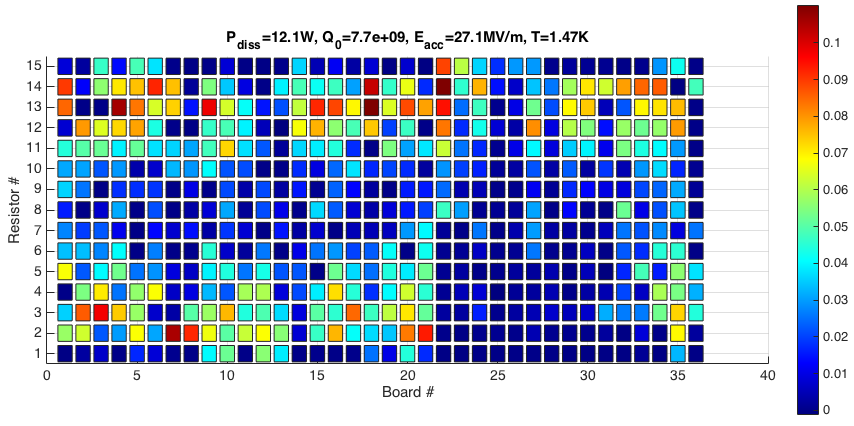
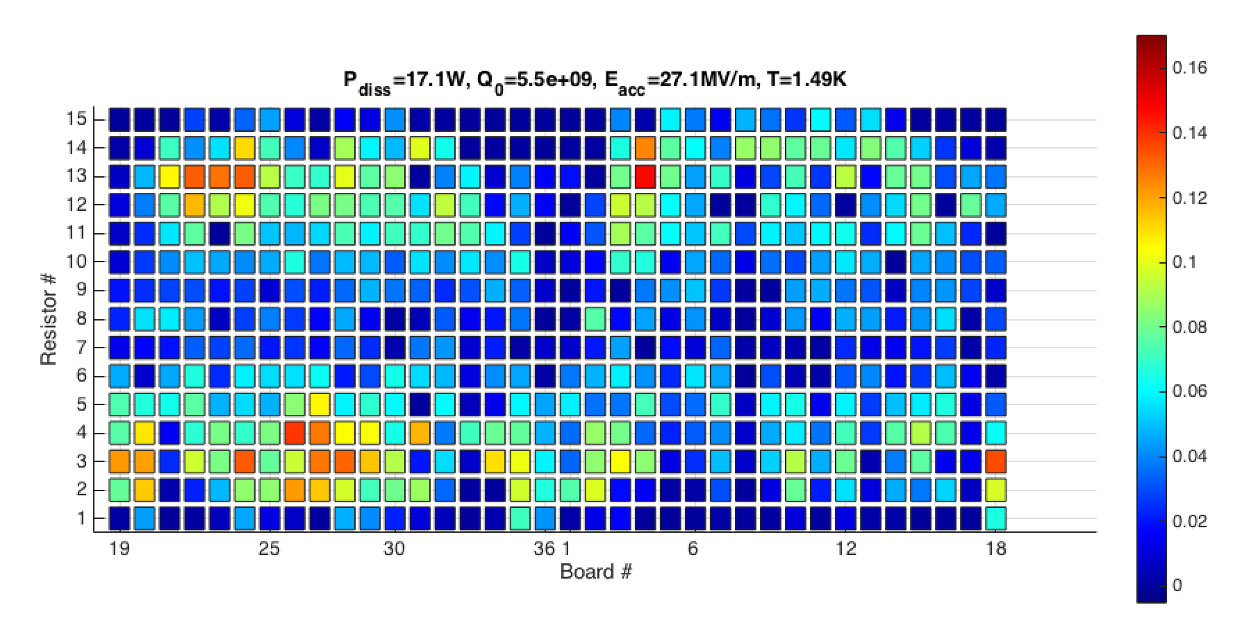
Compare Week 1 to Week 2 – ~20 mG Slow Cool
Top: week 1, bottom: week 2
Note shifted board numbers for week 2

Slide 14
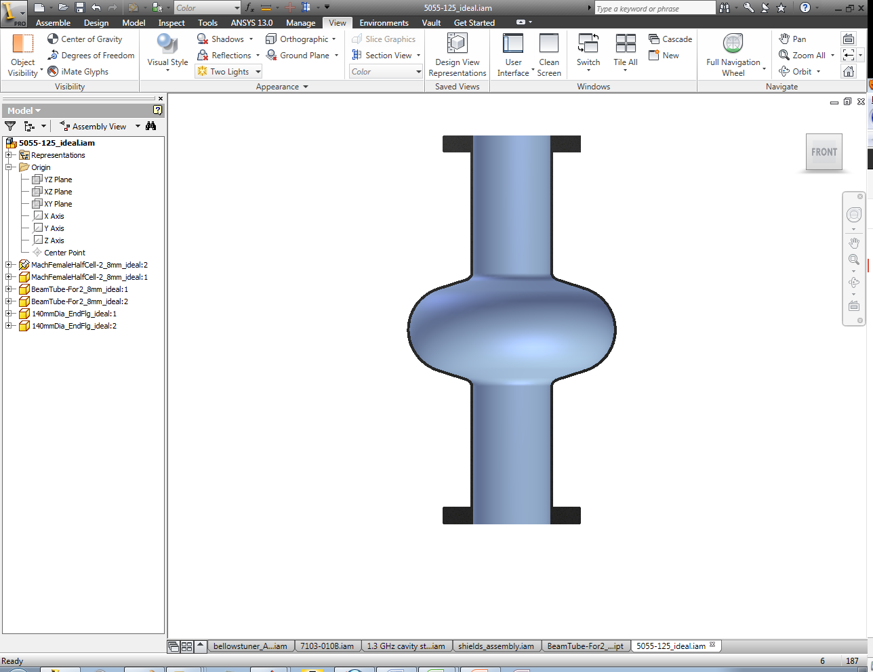
Top-Bottom Asymmetry
Top-bottom asymmetry appears to be enhanced during fast and medium cooldowns – but not during slow
  Possible difference in material in top and bottom? (cavity was not flipped)
  Possible influence of partial trapping?
Fast – 16 mG
Medium – 16 mG

Slide 15
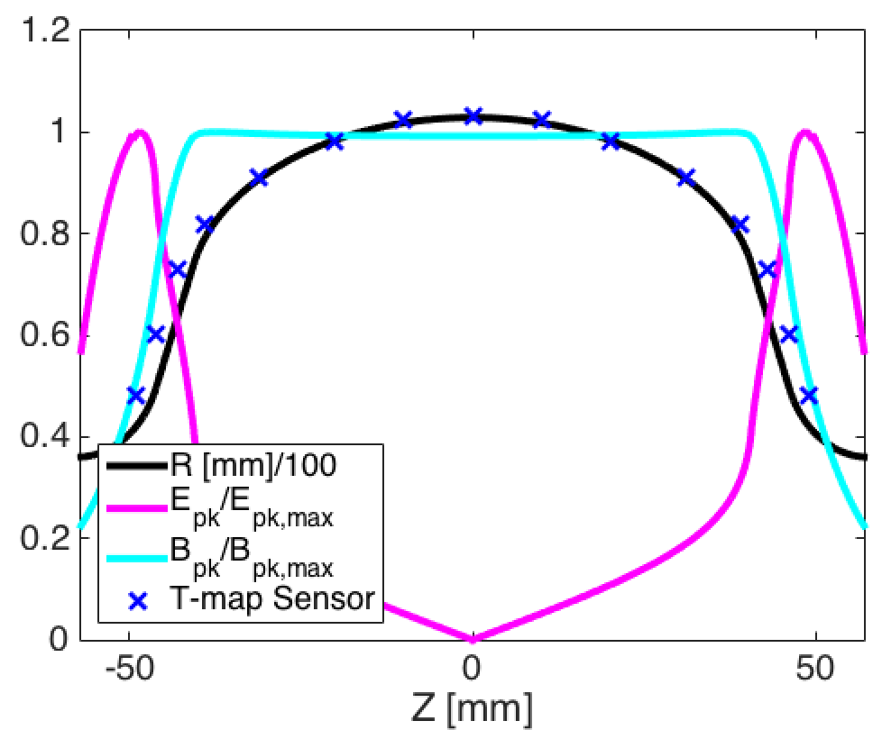
Equator-Flat Asymmetry
In all cooldowns, sensors 6-10 (8 is equator) have fairly low heating
Possible reasons include:
  Extra heat treatment due to proximity to equator weld (for slow cooldowns, small ΔT may be sufficient to move flux away?)
  Surface topology relative to applied field
  Maybe relative orientation of trapped magnetic field compared to RF current
  Material in these regions has different stress in forming step

Slide 16
Azimuthal Symmetry
This appears to be real based on both weeks of testing and in most cooldowns
It will be very interesting to compare hot to cold with material studies

Slide 17
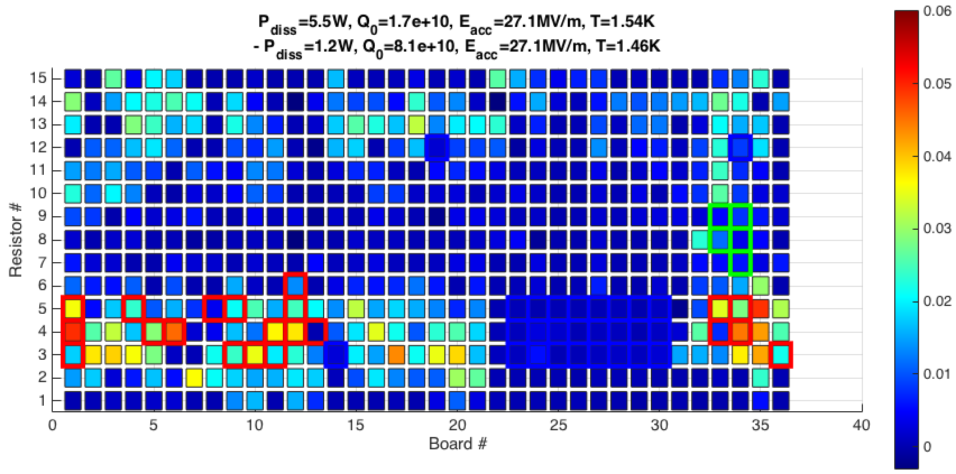
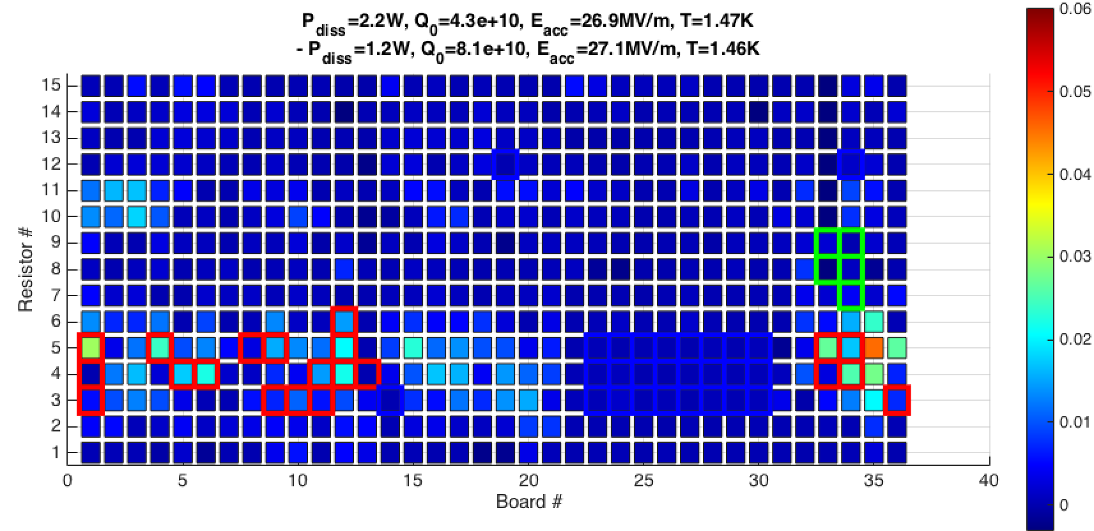
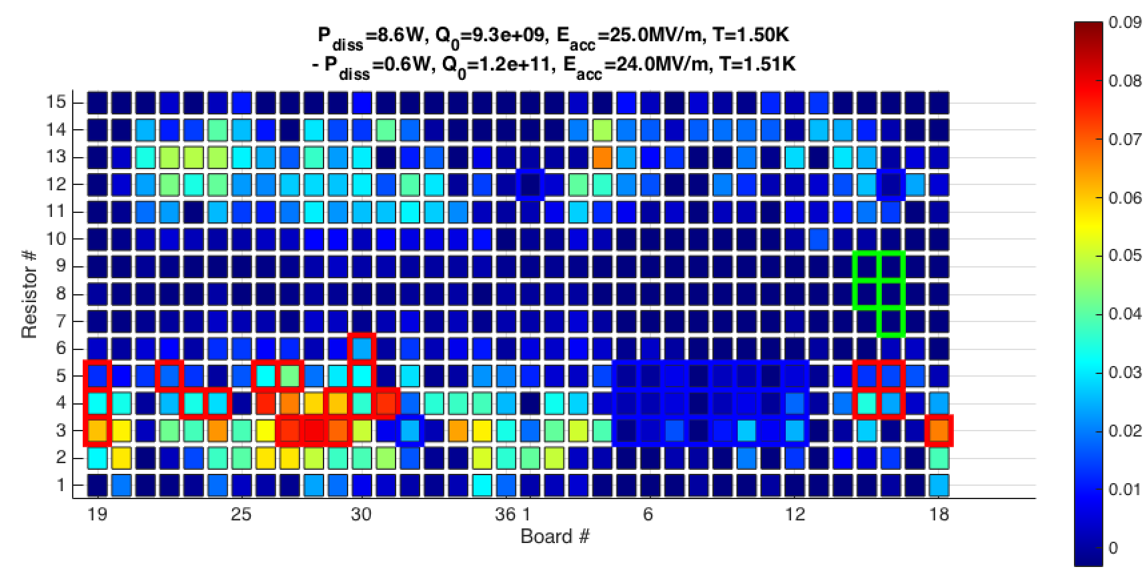
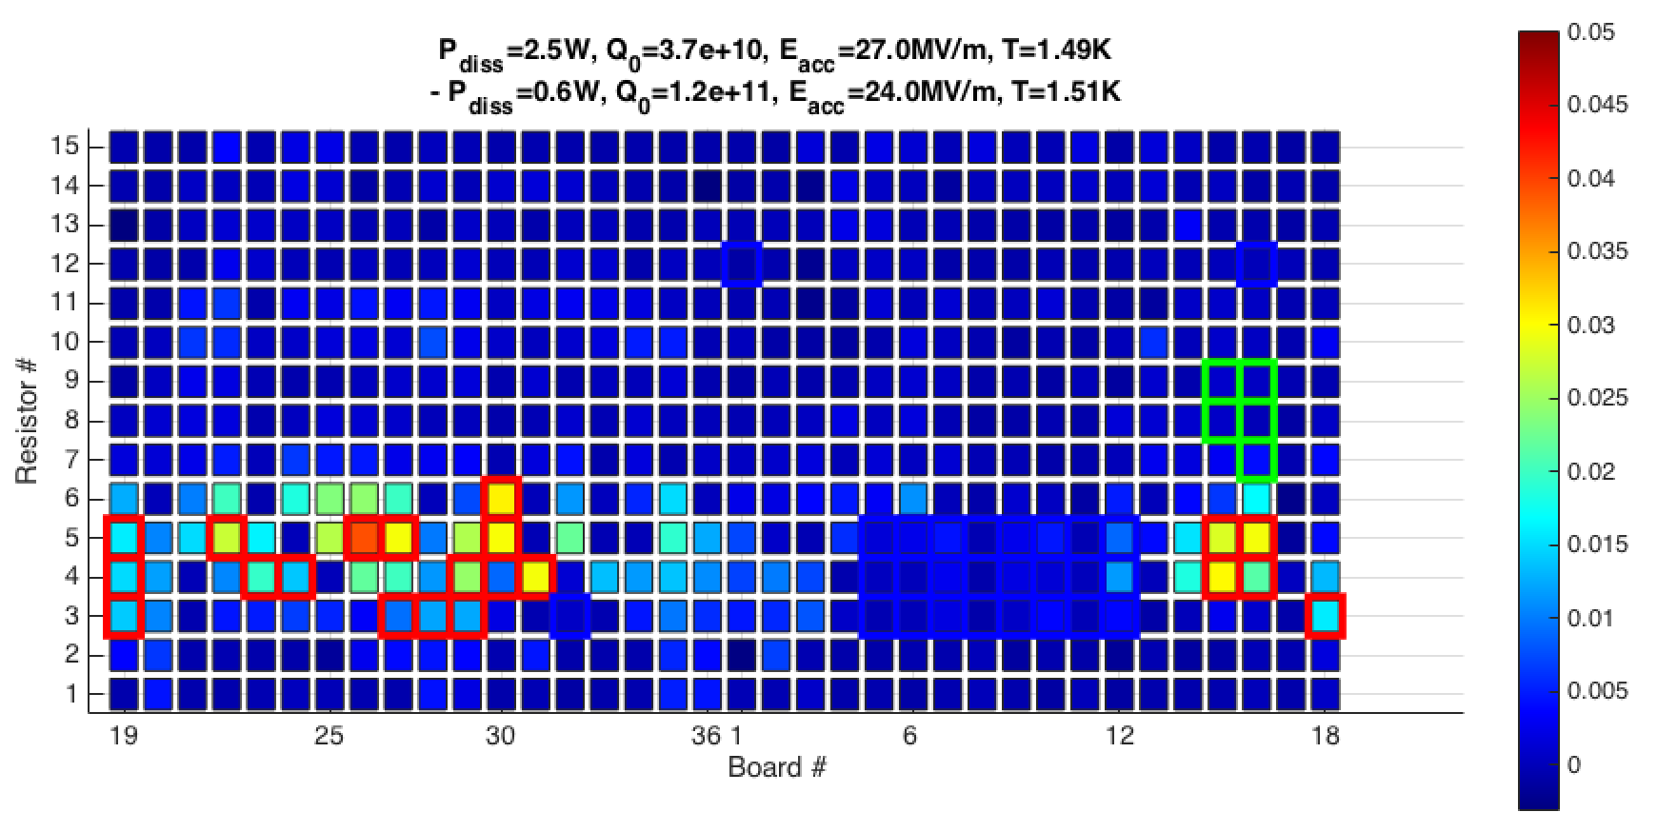
Subtracted T-maps and Regions of Interest
Use T-map from 0 mG Fast as an offset
Subtract this from Slow and Medium T-maps
Highlight some hot and cold spots as well as the quench
Week 1, 16 mG
Medium
Week 2, 16 mG
Fast
Week 2, 22 mG
Medium
Week 2, 22 mG
Fast

Slide 18
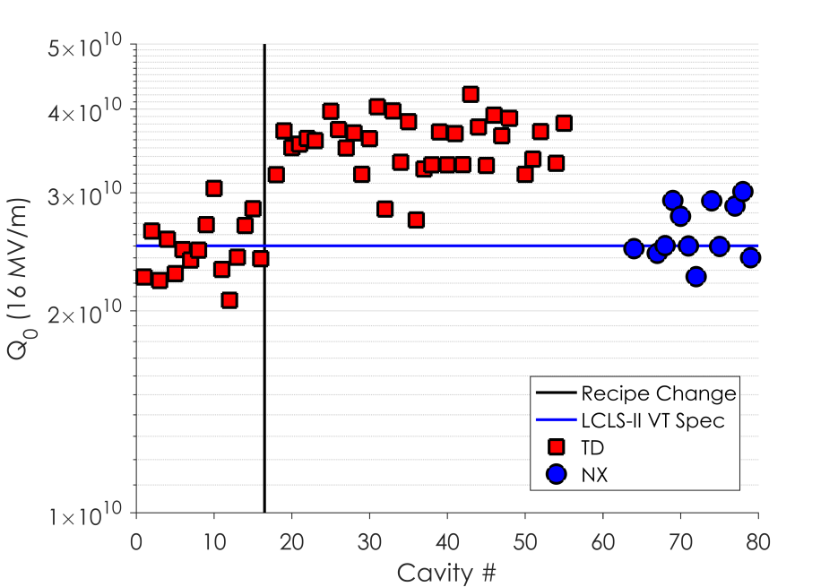
Materials Studies
What about the materials studies we’ve performed so far?
Whatever the key difference is between strong and weak expelling material, it appears to be subtle
Several studies focusing on dislocations/strain in the material, as well as impurities
Samples were prepared by 400 μm EP to expose bulk
Compare samples of TD and NX
Cavity Q0 Performance in VT
LCLS-II Spec
800/140 in Low B_{amb}
900/200 in 5-10 mG

Slide 19
Comparison of curved samples before the furnace
Curved Ningxia 11301
Curved Tokyo Denkai 10974
No significant difference in grain size observed
First 400um of the surface was removed

Slide 20
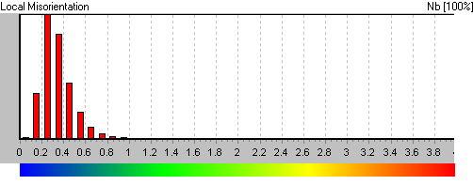
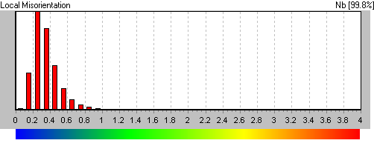
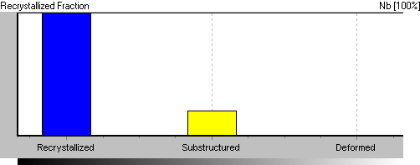

Comparison of curved samples before the furnace
Curved Ningxia 11301
Curved Tokyo Denkai 10974
Local Misorientations
Local Misorientations
Recrystallized Fraction
Recrystallized Fraction
No significant difference in local misorientation
Notes:
Show quick

Slide 21
Strain before furnace treatment (note cutoff at 1)
Grain=50um, up to 1 for both
Curved Ningxia 11301
Curved Tokyo Denkai 10974
No significant difference observed in strain
Notes:
Show quick

Slide 22
Comparison of curved samples after 1000C bake
Curved Ningxia 11301
Curved Tokyo Denkai 10974
Significant grain growth in Tokyo Denkai and SOME areas of Ningxia
Notes:
Yulia – take this slide

Slide 23
Comparison of curved samples after 1000C bake
Curved Ningxia 11301
Curved Tokyo Denkai 10974
Significant grain growth in Tokyo Denkai and SOME areas of Ningxia
Weak trapping??
Strong trapping??
Notes:
Yulia – take this slide

Slide 24
Comparison of curved samples after 1000C bake
Curved Ningxia 11301
Curved Tokyo Denkai 10974
5x5 Kernel, subgrain=2
Significant grain growth in Tokyo Denkai
No difference in local misorientations
Notes:
Include for sure – very similar

Slide 25
Impurities in the Material
Guaranteed by niobium vendors: N<10ppm, O<10ppm, C<10ppm, Ta<500ppm, W<70ppm, Ti<50 ppm, Fe<30ppm, Si<30ppm, Mo<50ppm, Ni<30ppm
Use secondary ion mass spectrometry (SIMS) to compare elemental makeup in TD and NX material
Notes:
Consider including this – we’re talking about tiny amounts of impurities, especially N2, O2 – pick just the PPM

Slide 26
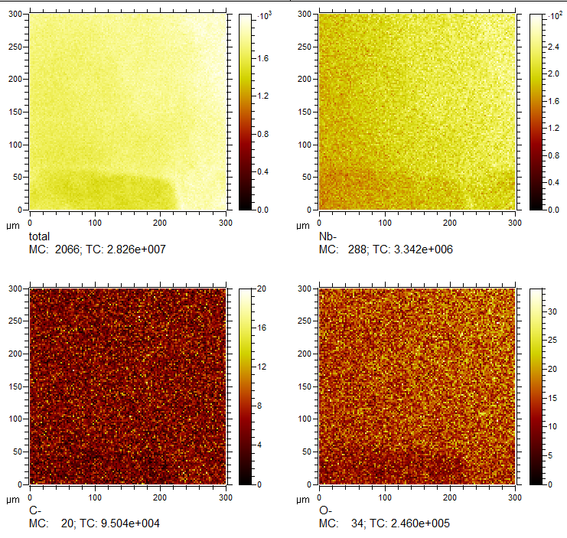
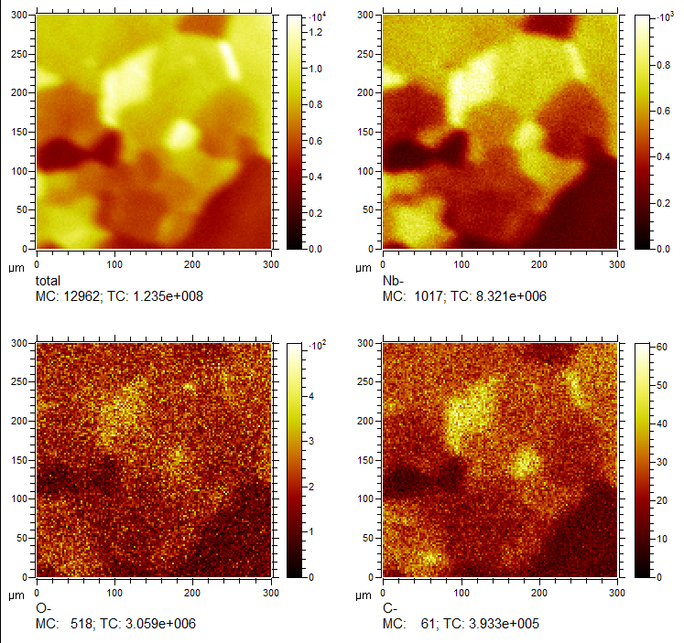
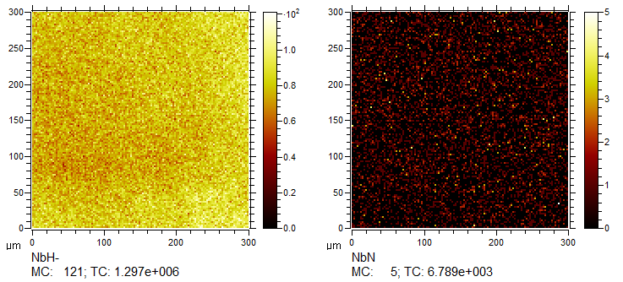
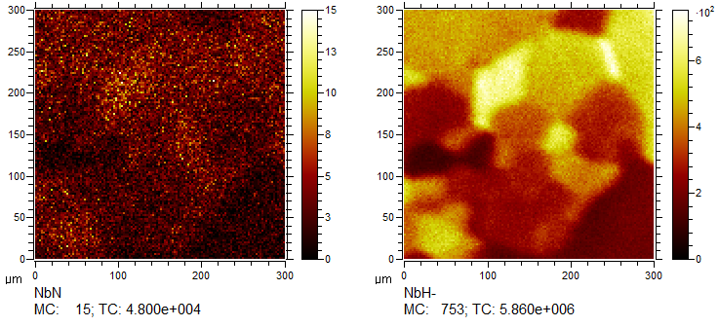
Accumulated elemental images (negative polarity)
TD 10974
Ningxia 11301

Slide 27
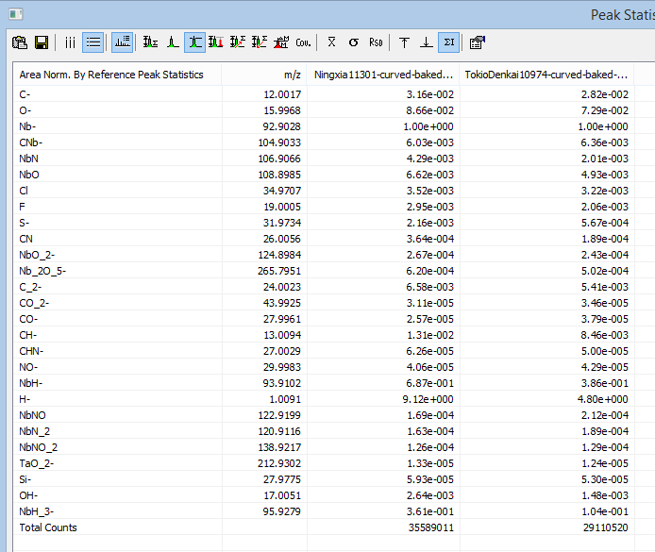
Ningxia vs Tokyo Denkai, negative polarity
Oxygen
Nitrogen
First ~800nm was ignored due to EP influence on the surface. Data was reconstructed from 800nm to 1100nm.
Elements of interest: carbon, oxygen, nitrogen, chlorine, hydrogen.

Slide 28
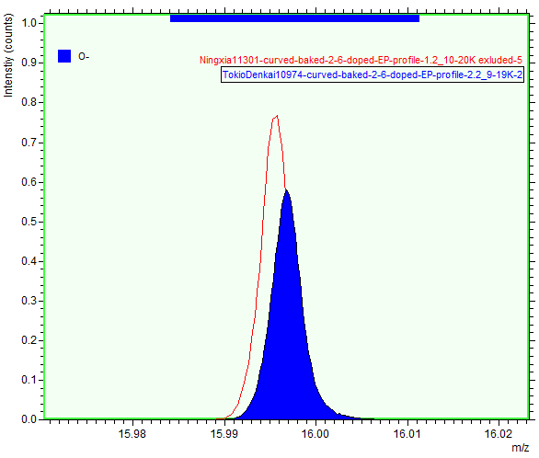
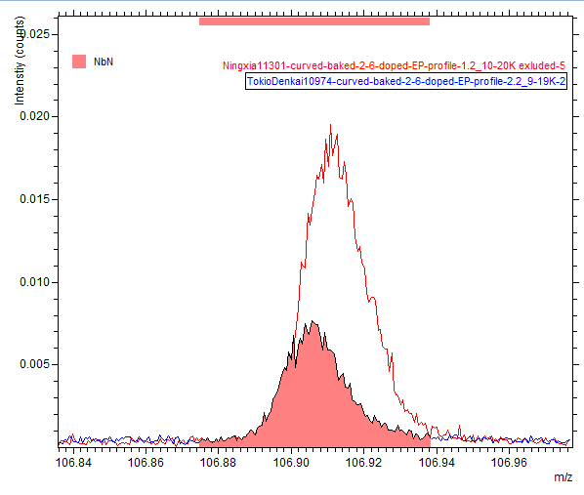
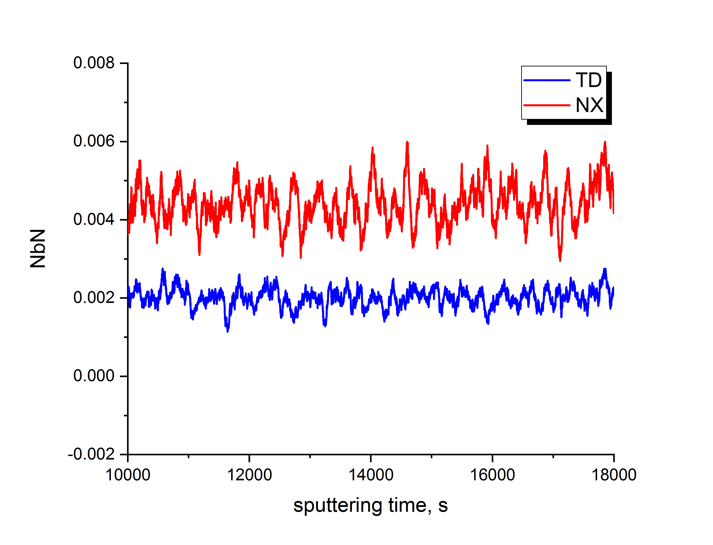
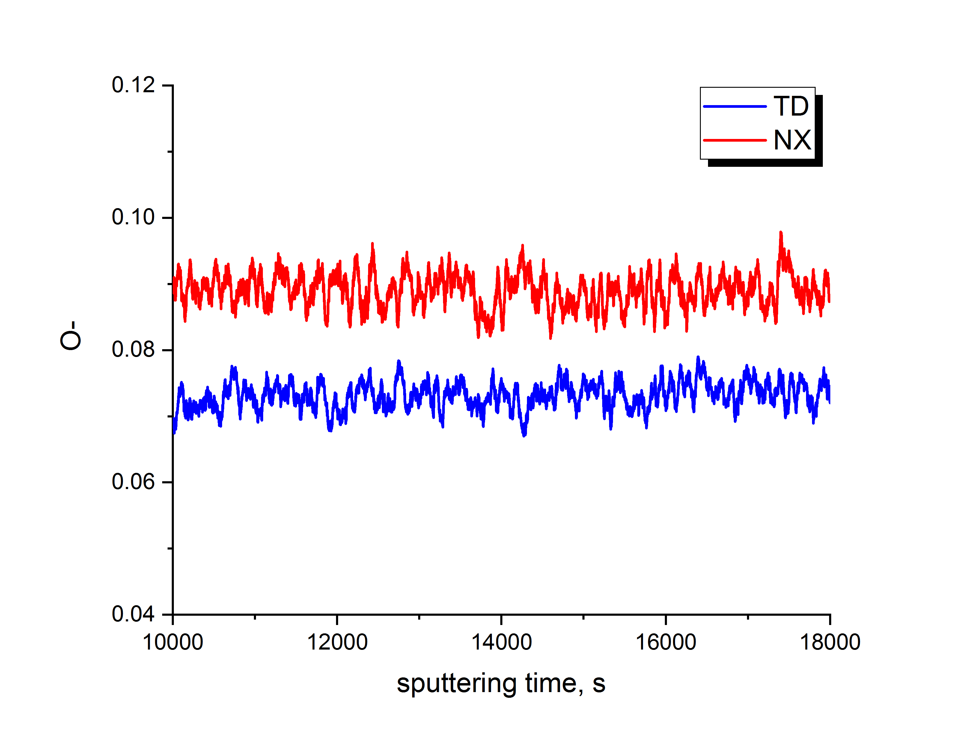
Chemical difference NX vs TD
O-
NbN-
Some difference in light elements between TD and NX
Notes:
SHOW THIS

Slide 29
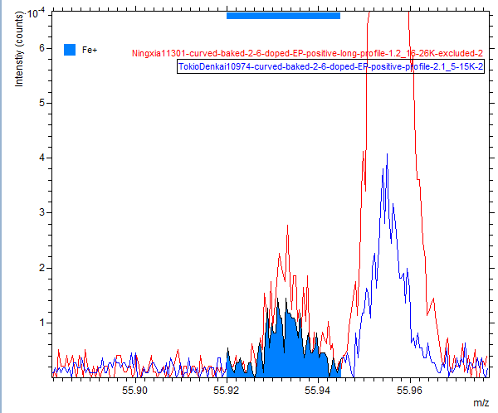
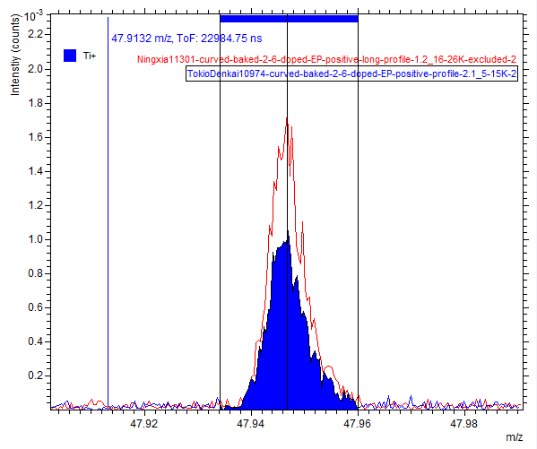
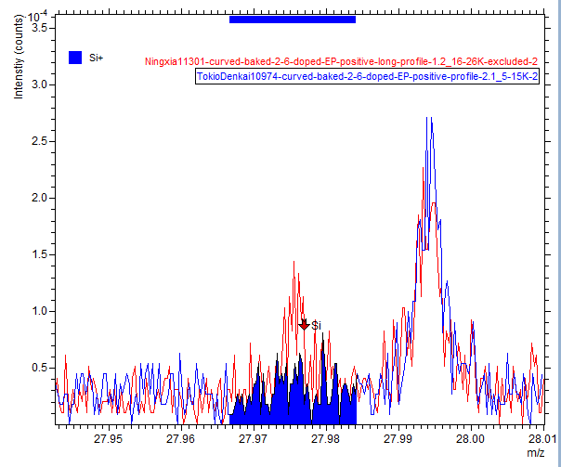
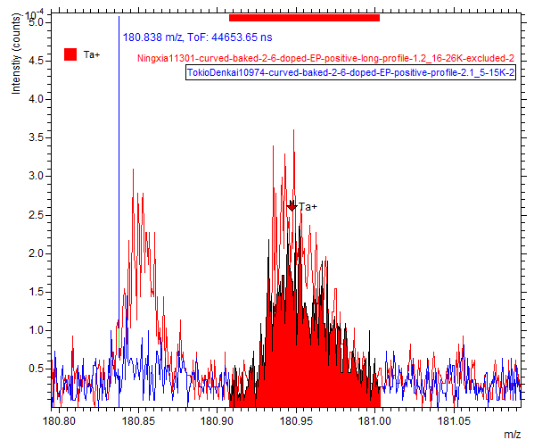
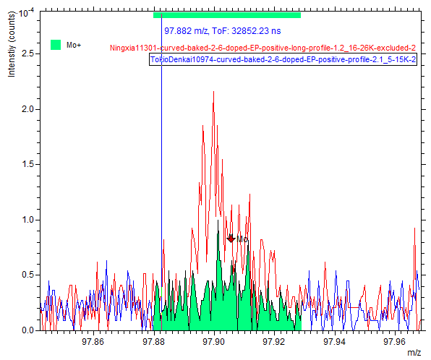
Chemical difference NX vs TD
Fe
Ti
Si
Mo
No striking difference between heavier impurities in TD and NX*
Ta
*Optimized analysis will be continued.
Notes:
Don’t see major difference, including Ta

Slide 30
Summary of Microscopy on Non-Cavity Samples
No substantial difference in local misorientation angle/recrystallized fraction/strain in material as received; difficult to see any after 1000 C heat treatment
Grain size certainly different after heat treatment
Maybe some small differences in impurity content observed, but only by a factor of 2 in most extreme cases
Difference appears to be subtle. Use cavity coupons to help bring out differences between trapping and expelling material.

Slide 31
Proposed Sample Cut Locations
Circular sample
Tensile dogbone
Cylinder for PPMS
MFM strip
RRR strip

Slide 32
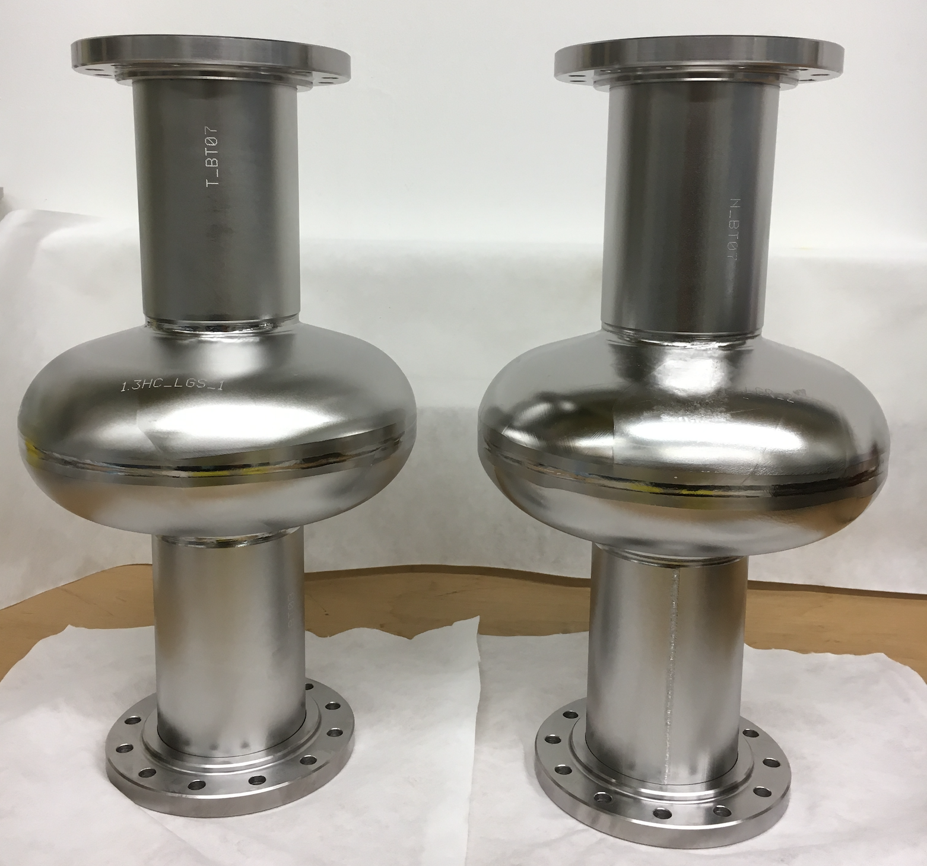
Large Grain Cavity Study – Cavities Now Welded
Cavity LGS: formed from 2.8 mm sliced large grain sheets
Cavity LGR: formed from 5 mm sliced large grain sheets that were rolled to 2.8 mm and never annealed
See SRF2017 talk for more details of planned study
Thanks to RI for carrying out difficult fabrication!
Measurements coming soon…

Slide 33
Summary
Partially expelling cavity made with NX material from LCLS-II has been thoroughly characterized with T-map
Coupon study to come will focus on comparing expelling vs trapping regions – first coupons have been cut
Microscopy studies to date show that difference is subtle
Large grain cavities will be received soon and undergo first measurements

Slide 34
Backup Slides

Slide 35
*What Local Misorientations and Recrystallized Fraction are?
Local misorientations
This component is for displaying small orientation changes on the map, highlighting regions of higher deformation. The component calculates the average misorientation between every pixel and its surrounding pixels, and assigns the mean value to that pixel. Misorientations over a certain value are discarded, so that the misorientations associated with discrete subgrain and grain boundaries are excluded.
Local Misorientation Maps – the average misorientation between each measurement and its 8 neighbors is calculated, excluding any higher angle boundaries (>5 in this case). These maps will highlight local strain variations, independent from the grain size.
Recrystallized fraction
What is recrystallized fraction?
1) Tango does a grain reconstruction;
2) Then it takes each grain and measures the internal average misorientation angle within the grain.
3) If the average angle in a grain exceeds the user-defined minimum angle to define a subgrain (theta), the grain is classified as being "deformed".
4) Some grains consist of subgrains whose internal misorientation is under theta but the misorientation from subgrain to subgrain is above theta. In that case the grain is classed as "substructured“.
5) All the remaining grains are classified as recrystallized.
Notes:
Backup slide

Slide 36
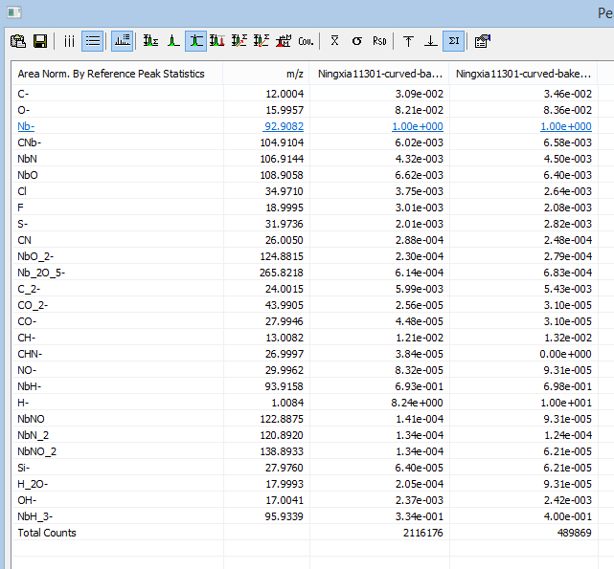
Large grain vs small grain in NX (SIMS, negative 2nd run)
Large Grain
Small Grain
Normalized to Nb- matrix data reconstructed from large and small grains don’t show significant difference in O-, C-, NbN-, Cl-.
Notes:
Maybe put in backup – LG vs SG

Slide 37
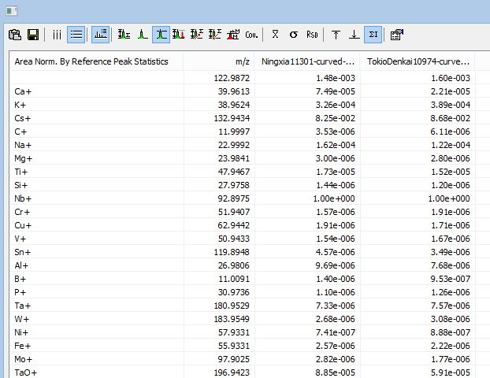
Positive polarity comparison after the furnace
Elements of interest: Ti, Si, Ta, W, Ni, Fe, Mo
Titanium
Silicone
Tantalum
Tungsten
Practically NO peak
Nickel
Practically NO peak
Iron
Molybdenum
Notes:
Consider in backup

Slide 38
