Slide 1
WG3 Summary
TTC 2018 Milan
09.02.2018
Curt Hovater (JLAB), Mathieu Omet (DESY)

Slide 2
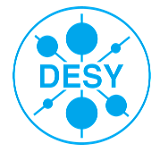





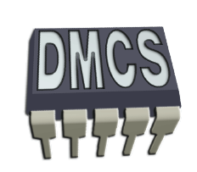



Overview
Commissioning Experience, LLRF & Microphonics conditions
4 Sessions over 2 days
16 Speakers from 10 labs covering America, Asia and Europe

Slide 3
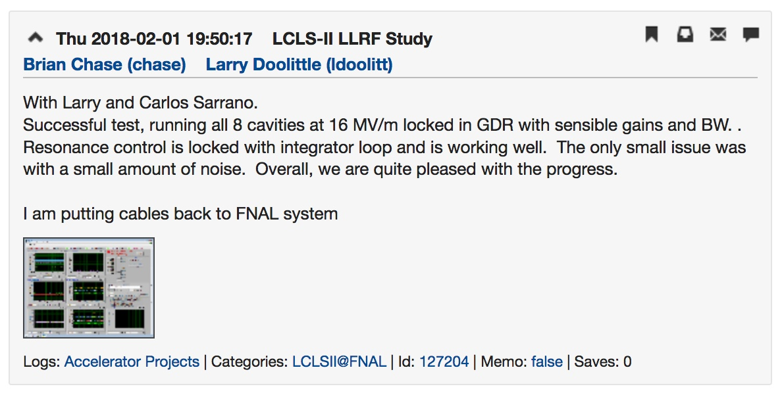
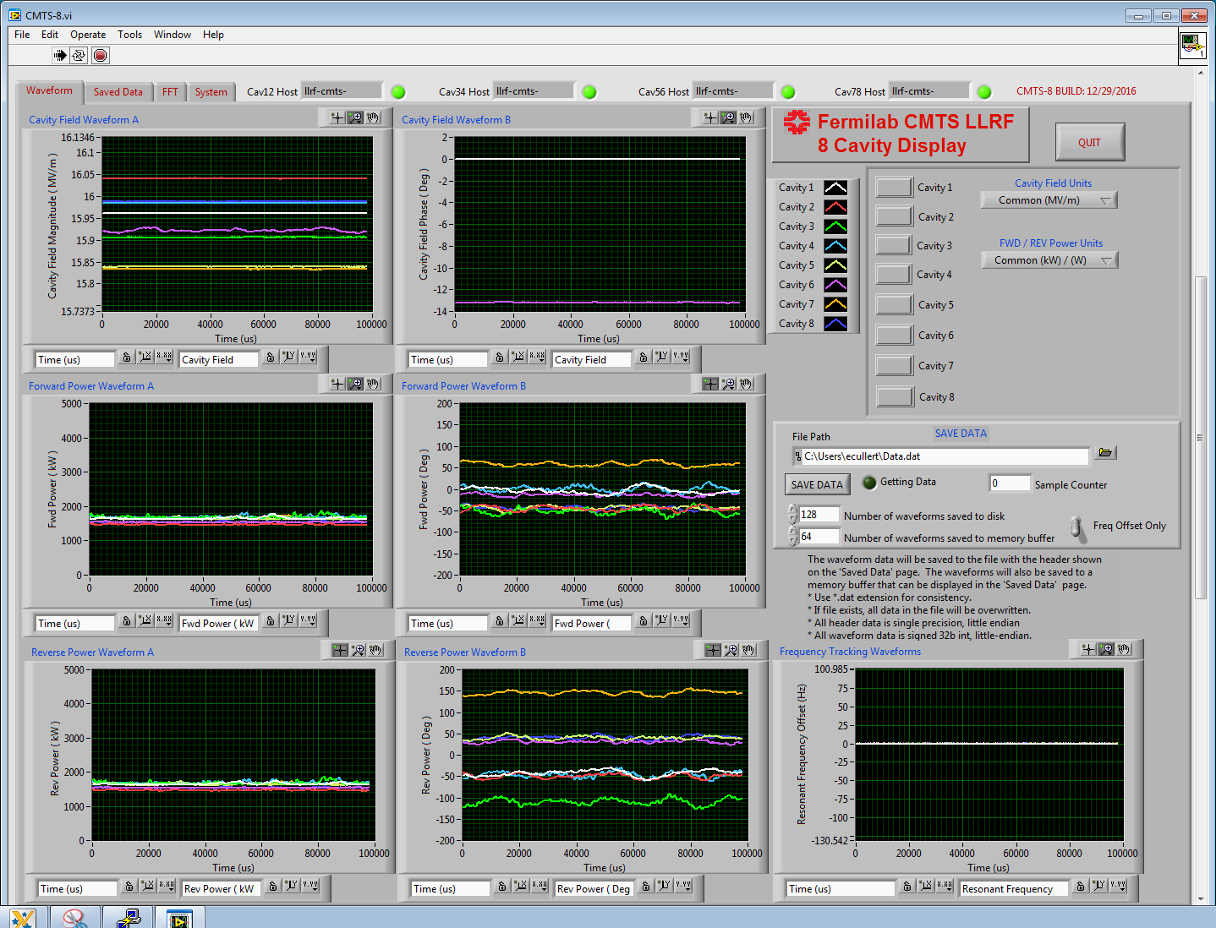
F1.3-07 resonance control results (SLAC)
from the CMTS1 elog:
All 8 Cavities in GDR mode at nominal
16 MV/m
B. Chase, L. Doolittle,
C. Serrano
Notes:
First Results for the LCLSII LLRF system running at Spec gradient for 8 cavities on a CM.

Slide 4
Measuring SSA Characteristics (SLAC)
L. Doolittle
Notes:
Automation. Know your amplifier! Calibrate it on each start up.

Slide 5
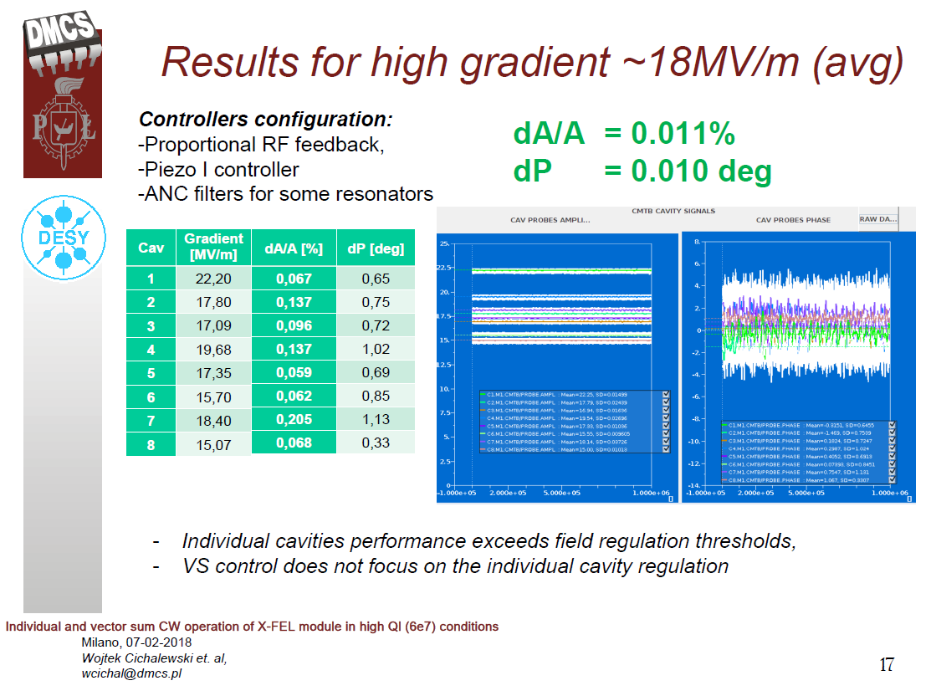
(DMCS)

Slide 6
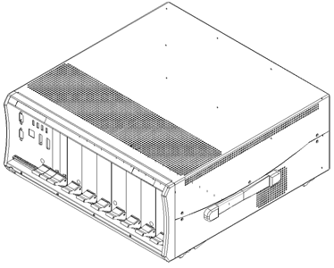
The LLRF design for CiADS SC linac (IMP)
4U LLRF crate
The llrf control system conceptual design is implementing, the under-sampling technique will be tested and as a altenative choice of replacing the analog RF downconverter architecture.
Notes:
The last part of my report is the llrf control system conceptual design, this block diagram is the conceptual design architecture of 162.5 MHz and 325 MHz,
And the undersampling technique will be tested, it’s digital LLRF system based on high speed ADC and ZYNQ FPGA chip.
Under sampling eliminates down converter...adds other problems phase jitter increases with higher cavity frequency. may not be a problems for ads system where 0.5% and 0.5 degree field control is required.

Slide 7
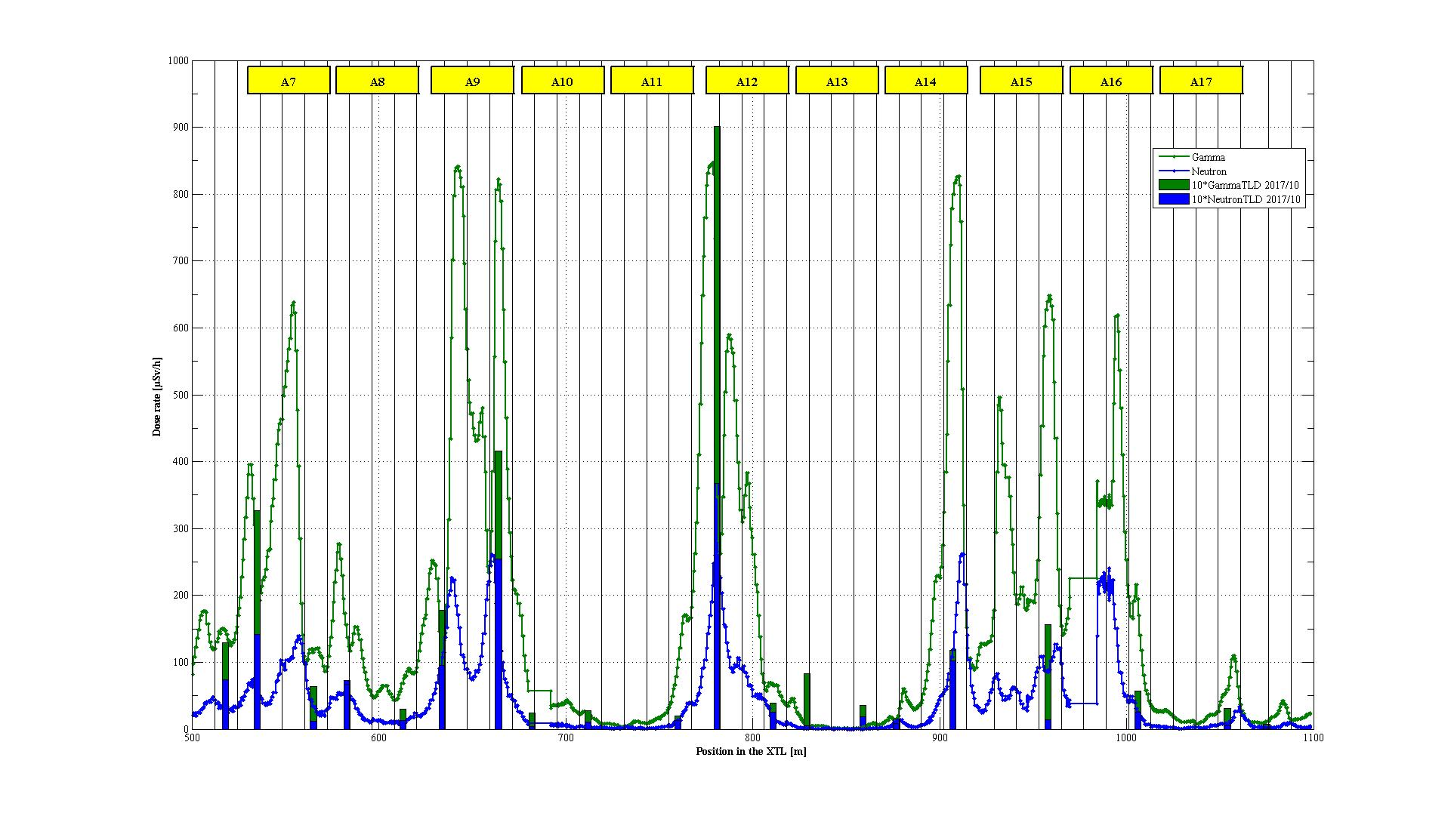
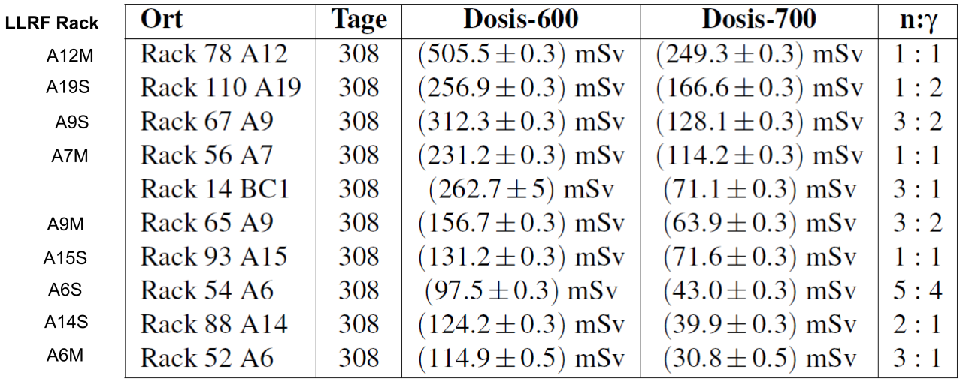
Radiation Measurements (European XFEL, DESY)
Marwin-Pandora on 26.09.2017 vs TLD data and residual activity
One SSD of LLRF system failed
so far, for now no correlation to
radiation spikes, more statistics
needed
1 mG/year for electronics
Notes:
Radiation along the XFEL CMs.
CW systems are not alone in the radiation issue.

Slide 8
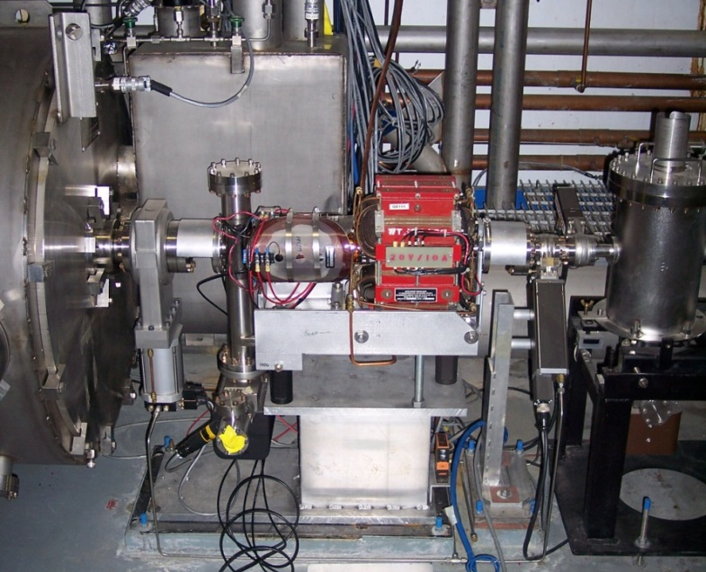
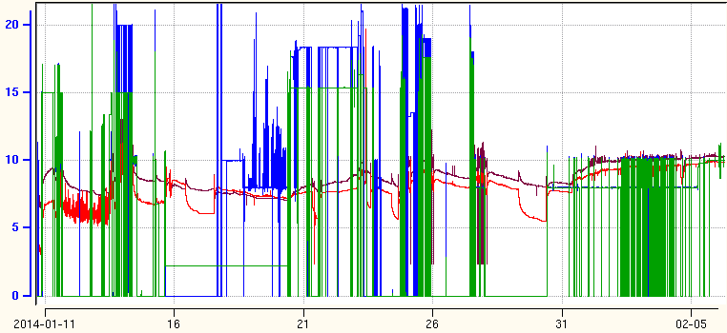
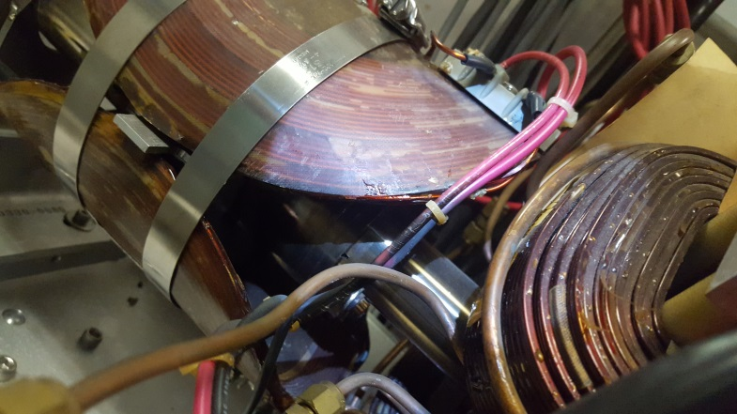
Operational Experience: Field Emission (CEBAF, JLAB)
H&V nested Air Core correctors over BPM
Field emission heats beamline
Vacuum pump faults
Vacuum interlock drops cryomodule out of RF
Viewer & pump drop cross
Quad
End of Cryomodule
Cavity Gradients impacting Beamline Vacuum activity
BEAMLINE VACUUM
C100-10 Cav 6
C100-10 Cav 7
GMES
MV/m
Radiation Damage
Notes:
Immediately Down stream of 100 MV CM. With Cavity gradients up to 20 MV/m.
As higher gradient cavities (especially cw) become more common high energy field emitted electrons will have to be considered more carefully. this shows external damage ...what about inside cryomodule!
Internal issues?

Slide 9
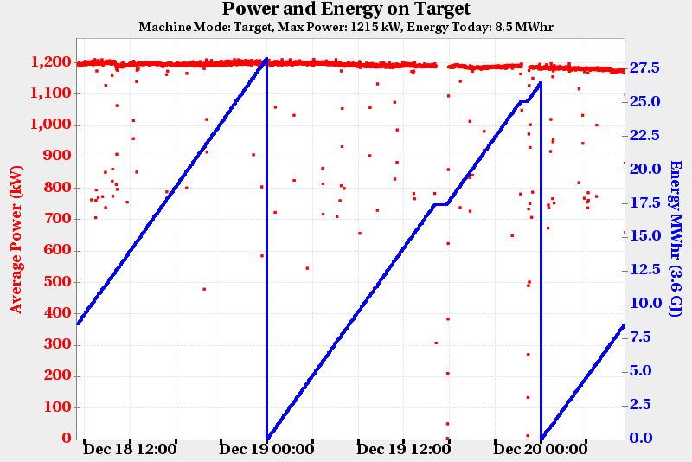
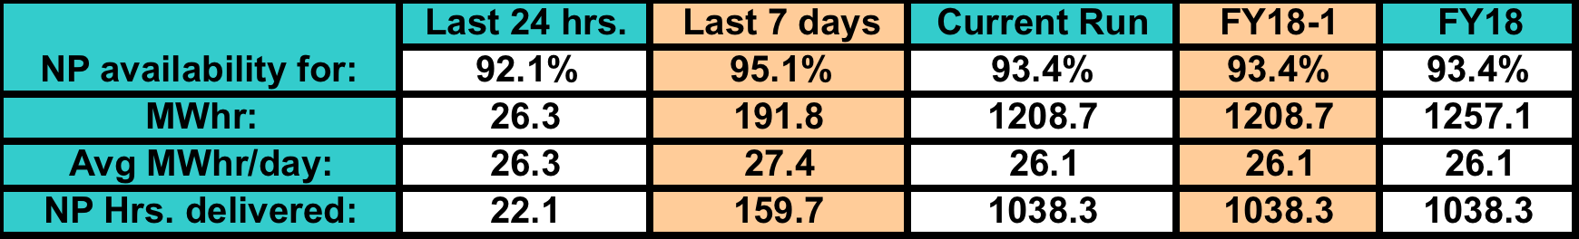
SNS Accelerator Availability is Excellent (Oak Ridge)
Operational goals:
  4500 hours of neutron production
  Greater than 90% availability
1.2 MW operation is routine, accelerator is 1.4 MW capable
During the run completed on December 22nd 2017 availability of the accelerator was 93.4% over 63 days
Notes:
90% overall availability implies very high rf/cavity availability ...notable

Slide 10
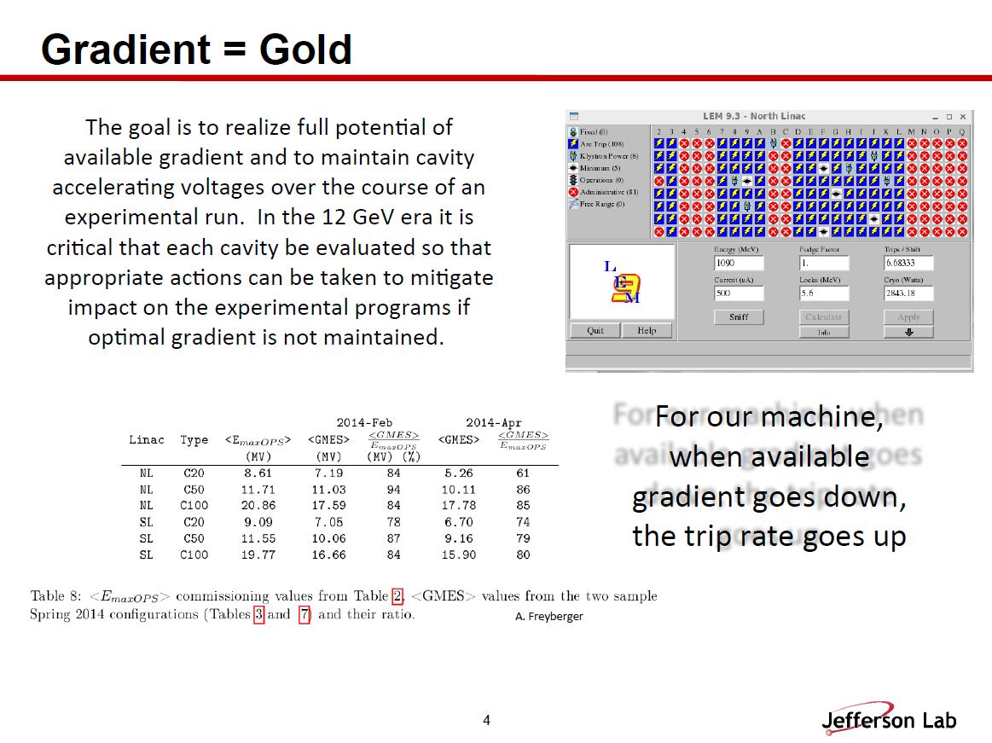
(JLAB)
Notes:
For operating accelerator need to be vigilant on each cavity gradient and its limitations.

Slide 11
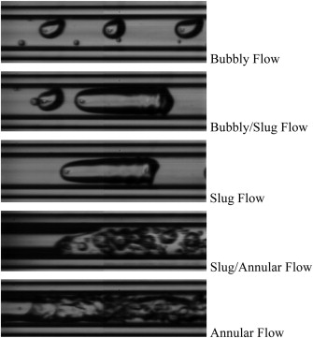
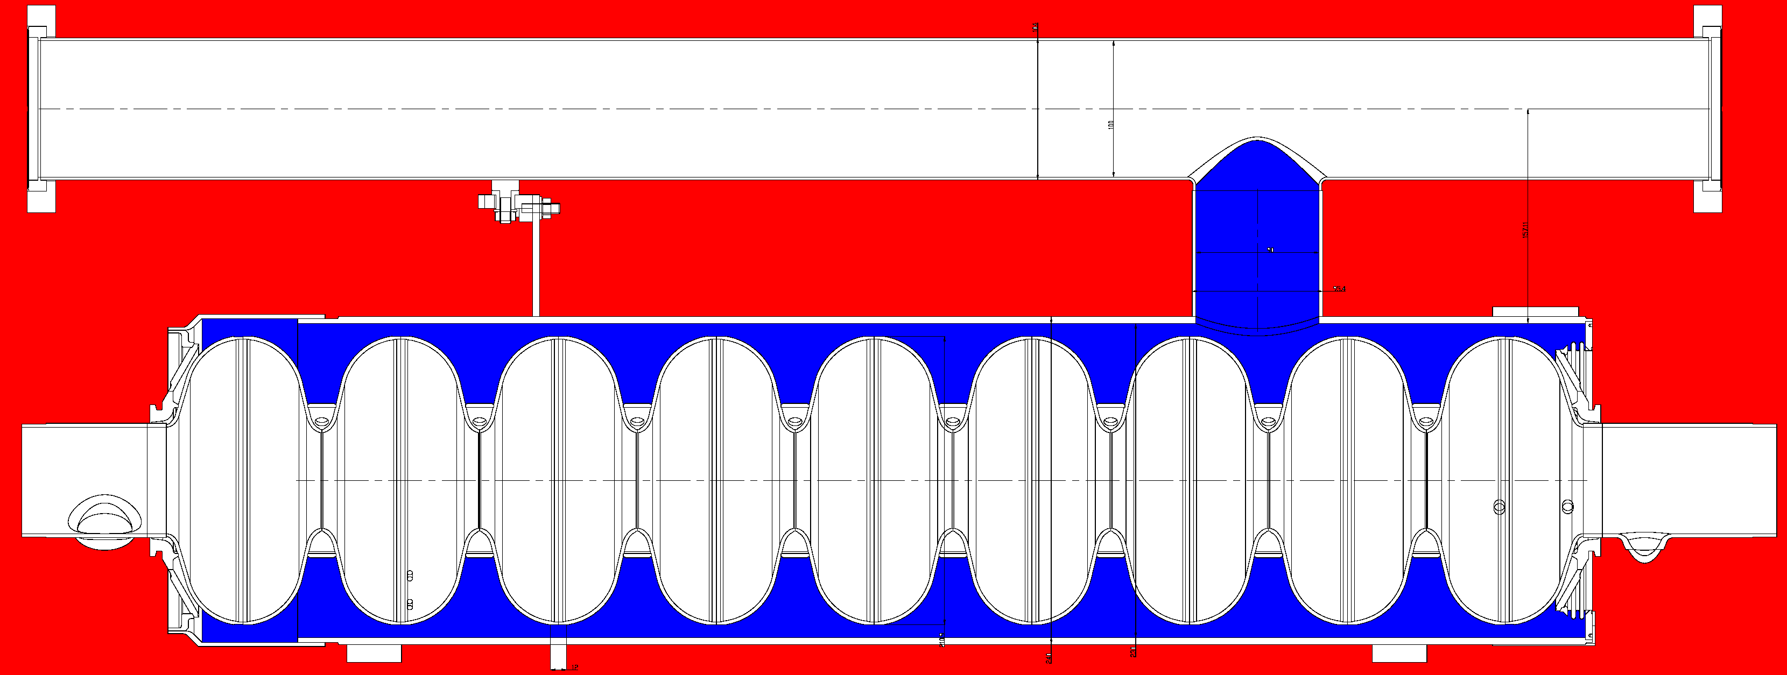
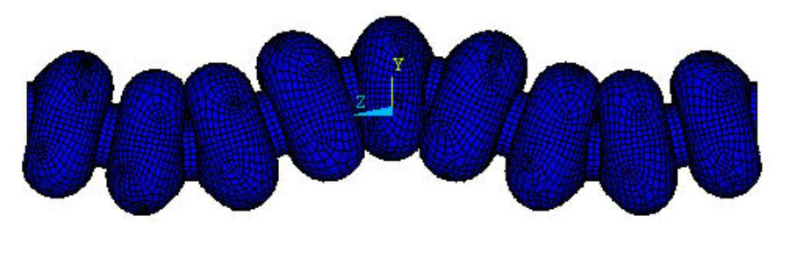
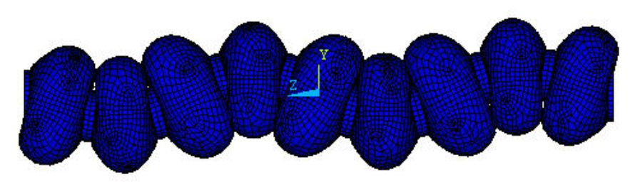
Microphonics: How does it appear? (HZB)
Field amplitude variation:
Dynamic Lorentz force, Δf/ΔE_{acc}² = 1Hz/(MV/m)²
→ Ponderomotive instability
Helium pressure fluctuations
Δf/Δp = 50-60 Hz/mbar,
SRF Gun:30-100 Hz/mbar
16 mbar±30 µbar
2.5-3 mm Niobium walls
Heat transport
dynamics in LHe
Thermo-acoustic
oscillations
(cryo valves…)
Stochastic
background
noise
Deterministic,
narrow-band
sources:
Vacuum pumps
Mechanical oscillations of the Cavity:
Microphonics
Response of the
Cavity-Helium vessel-Tuner
system:
Mechanical Eigenmodes
222 Hz
G. Bissofi
Lowest modes:
Transverse
151 Hz
Is that the whole story?
G.P. Gelata et al. International Journal of Thermal Sciences
Volume 58, August 2012, Pages 1-8
Notes:
NICE PICTURE OF ALL THE MICROPHONIC ISSUES A CAVITY HAS TO DEAL WITH ...

Slide 12
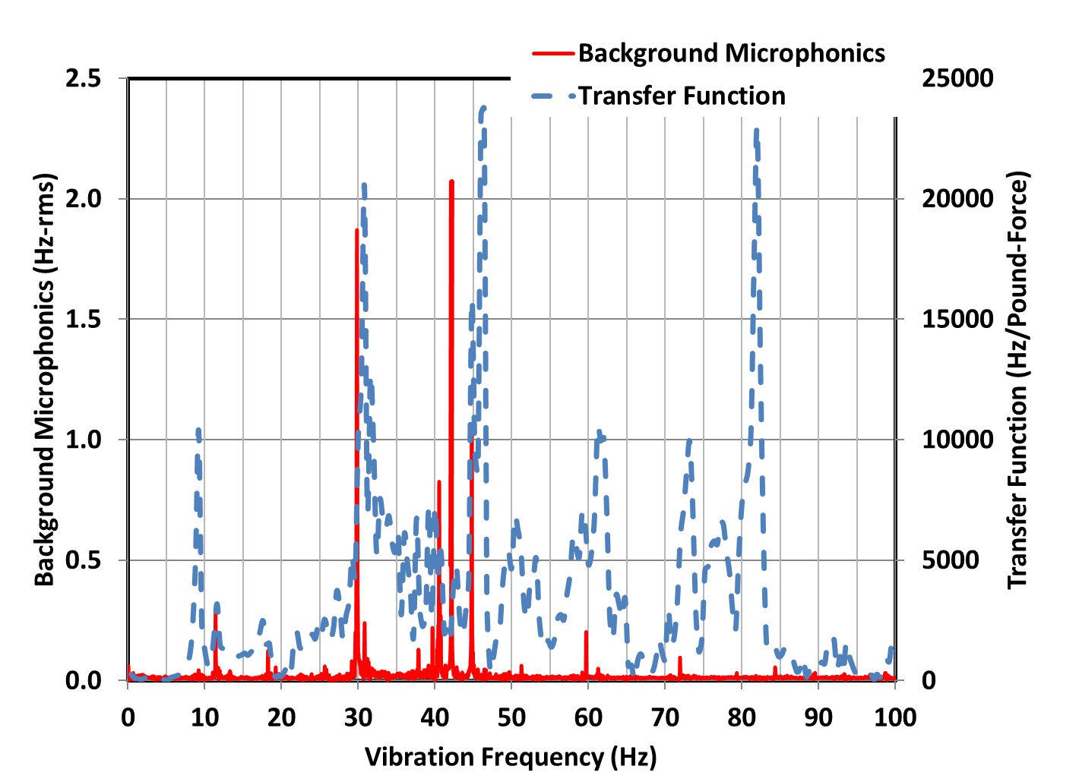
Example Excited Modal Resonances (JLAB)
Overlap of high Q transfer functions and narrow band excitation is problematic, even if they do not exactly overlap
Transfer function source term location was beam pipe at cavity 8 end of cryomodule.
Transfer function from cavity 8 beampipe to deltaF
Overlay of background microphonics (RED) and transfer function (BLUE) for Cavity 1 of the LCLS II string. Data taken with cryogenics in a quiet state.
End effects and adjacent cryogenic piping vibrations transmitted from machinery are suspects.
29.8 and 41 Hz were driven by machinery vibrations coupled through the cryogenic piping.
*Cavity 1, LCLS II Prototype Cryomodule In JLAB Cryomodule Test Facility, Low Power Test Data
Notes:
Why it is important to understand the CM mechanical modes and the microphonic environment.

Slide 13
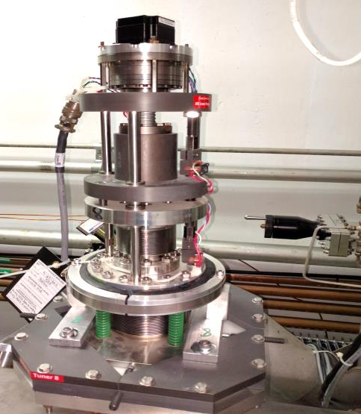
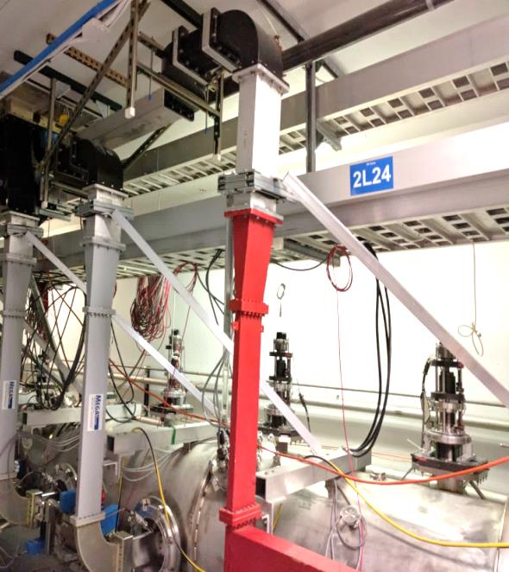
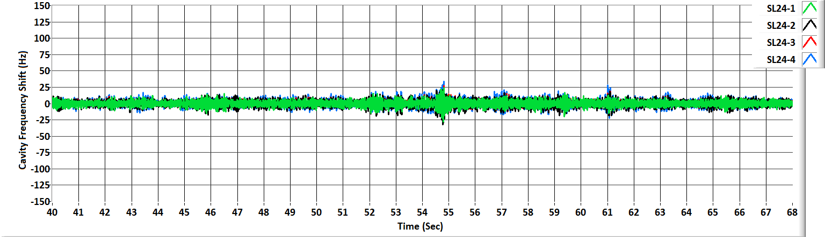
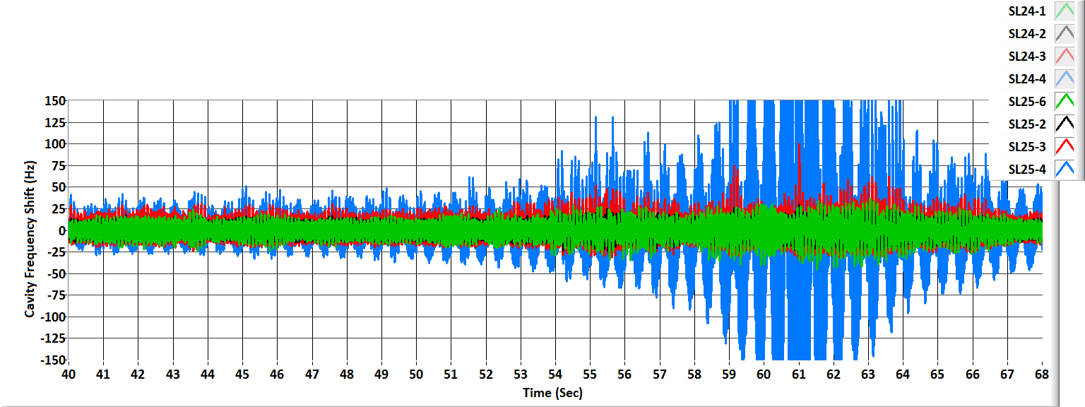
Comparison of a Hardened (SL24) and
Zone With No Improvements (SL25) During Truck Drive By (CEBAF, JLAB)
SL 24 Hardened Cryomodule
SL25 No Improvements
Notes:
Good example of what can be achieved with targeted passive controls.

Slide 14
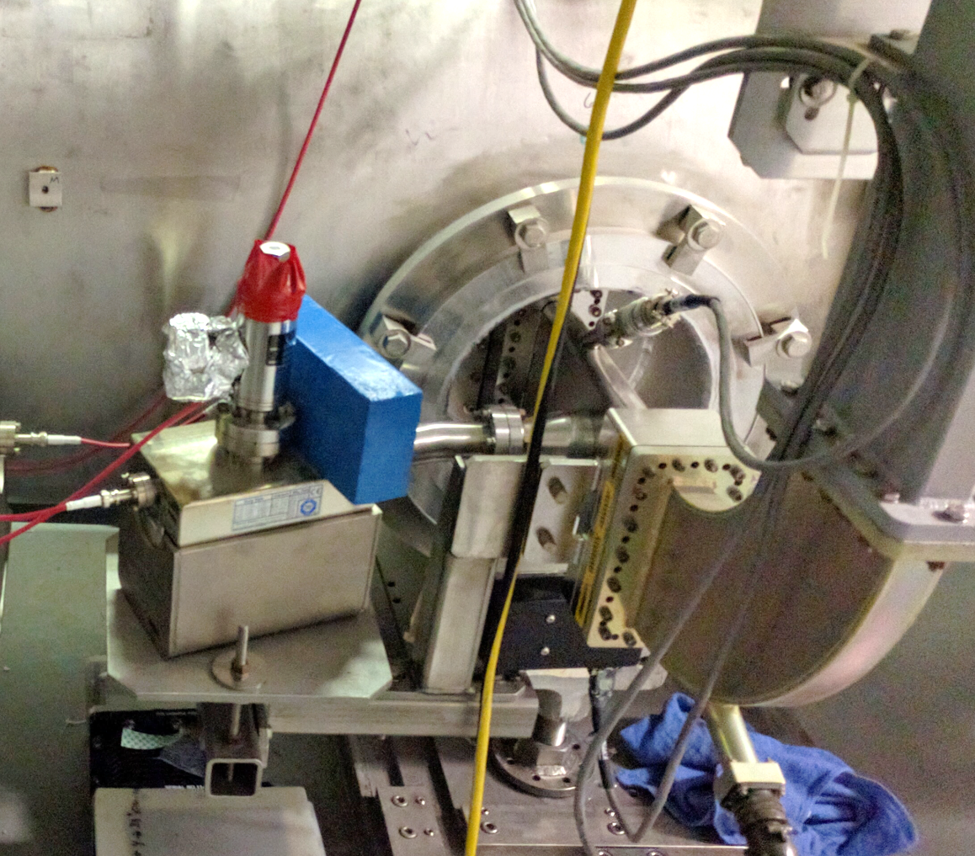
Simple Fix, Move the Frequency of the Mode (CEBAF, JLAB)
After installing tuner dampers, waveguide struts and waveguide dampers we found that there was a 41 Hz vibration on all of the cavities in SL24.
41 +/- 1 Hz is a known excitation the source being a very large compressor in the central helium liquefier.
The first approach was to move an accelerometer around the structure looking for excessive 41 Hz. We found it on some of the waveguide window vacuum ion pumps.
We did impulse transfer function measurements of the ion pump assembly and found a ~40 Hz resonance.
After insuring that they were properly installed, torqued, etc. we added a lead brick to each pump in order to move the resonance.
TTC Milan, IT 6 Feb. 2018
Notes:
KISS ...saves the day!

Slide 15
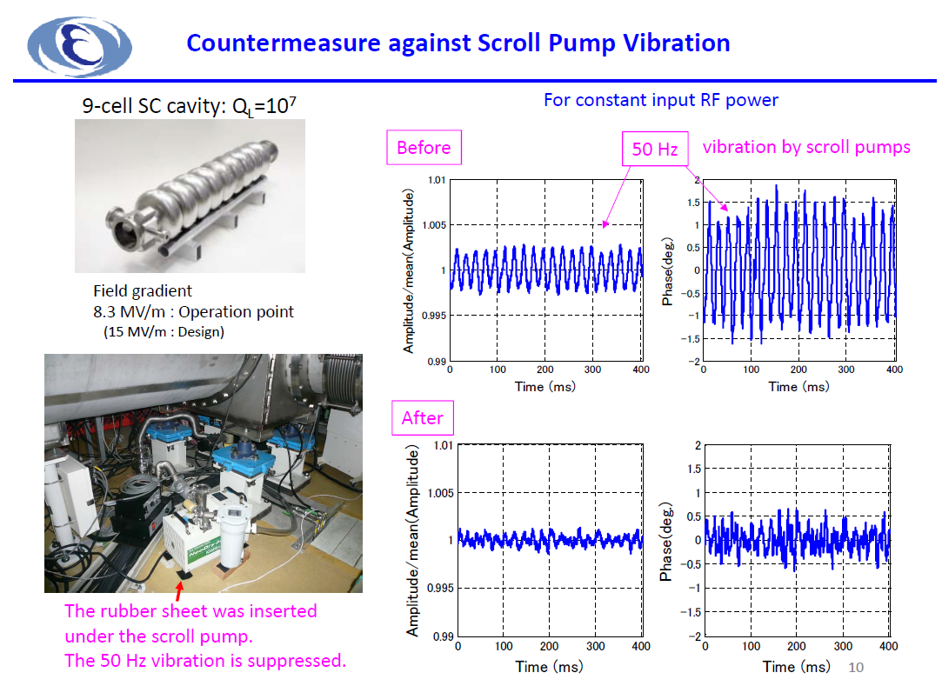
(cERL, KEK)
Notes:
GOOD EXAMPLE OF PASSIVE MICROPHONIC CONTROLS

Slide 16
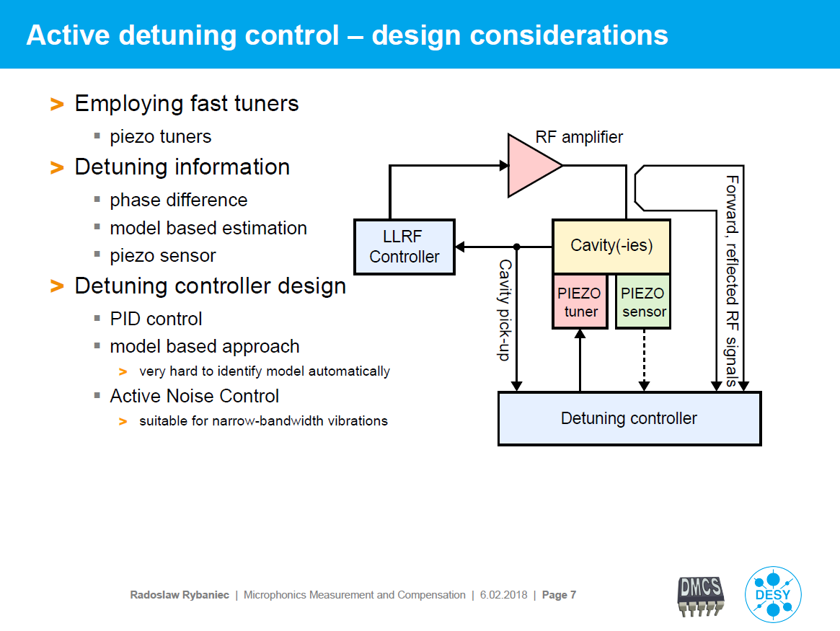
(DESY)
Notes:
Options for Active Resonance Control...

Slide 17
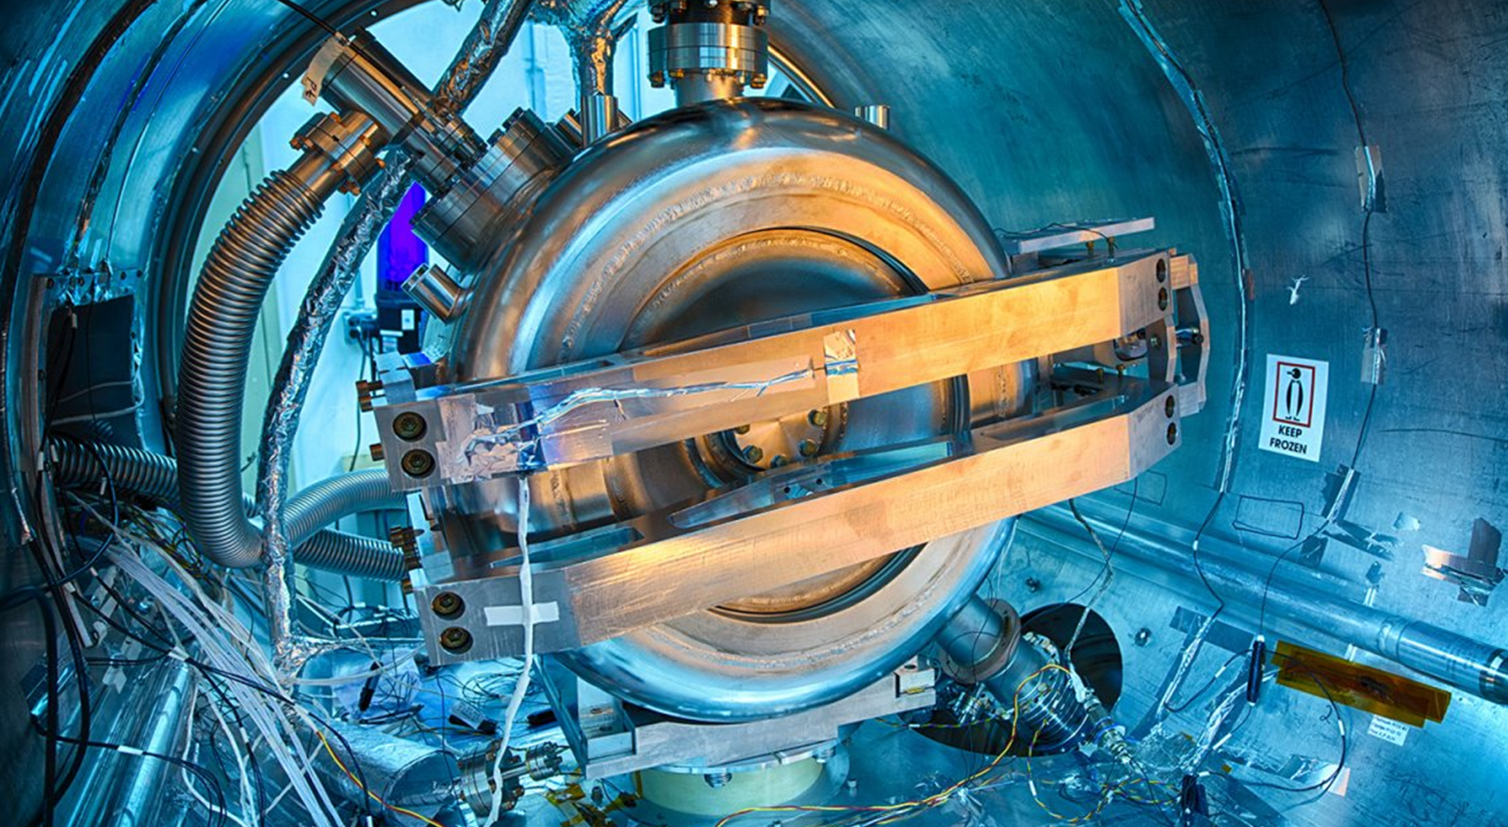
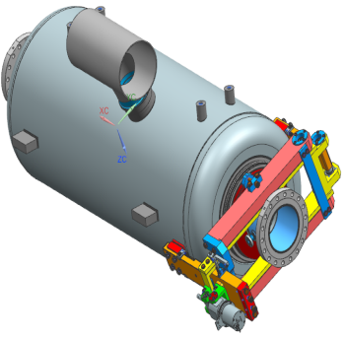
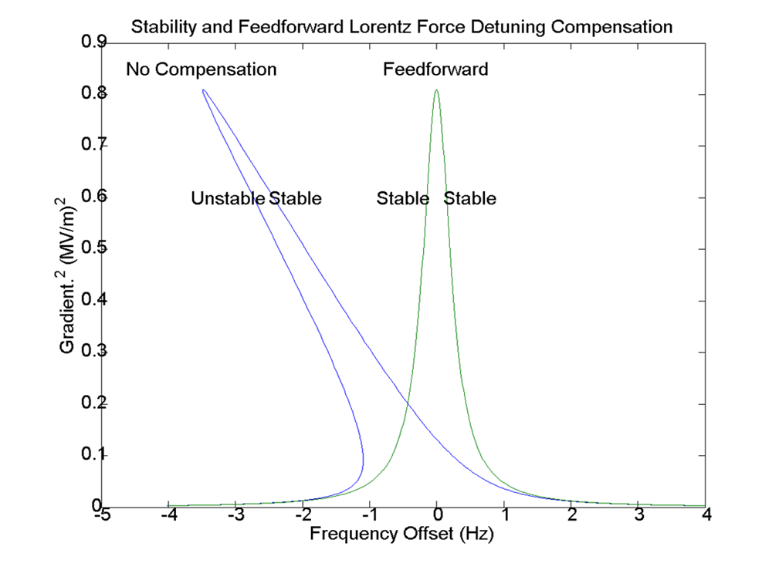
PIP II specific requirements for SRF Cavities Resonance Control (FNAL)
SSR1
650MHz
Low beam loading → narrow bandwidth of the cavities
High accelerating gradient (~20MV/m)
  → large Lorentz Force Detuning
  → significant residual vibration/ excessive microphonics
Resonance control of the PIP II (SSR1) cavity operated at Pulse mode
Removing the ponderomotive instability by driving piezo feed-forward with amplitude proportional to E_{acc} ²
2. Adaptive LS LFD algorithm (feed-forward)
Large dynamic detuning of the cavity by RF-pulses (LFD)
3. Feed-back ..bank of filters targeting dominant driving terms (20Hz&200Hz)
significant residual vibration/excessive microphonics
Notes:
Pulsed system need FF algorithms for piezo control for LDF.

Slide 18
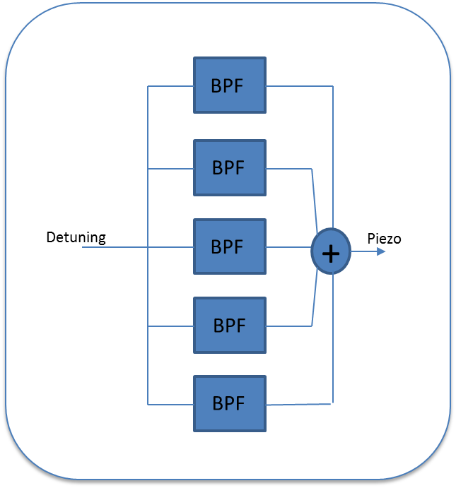
Feedback (FNAL)
Non-Deterministic (Microphonics)
Online detuning calculation fed to filter bank
Frequency, decay time and gain can set for each filter in the bank
Outputs summed and fed to piezo
0 Hz stabilizes cavity against pressure drift
Dominant resonances observed at 20 and 200 Hz
Filter parameters set manually
Notes:
For CW systems need to apply feedback on piezos
Slow < 10 Hz PI ...integrator mostly is fine
Fast > 10 Hz ...need targeted fieedback for the modes ...filtyerbanks, LMS and Kalman appear to be best suited for this.

Slide 19
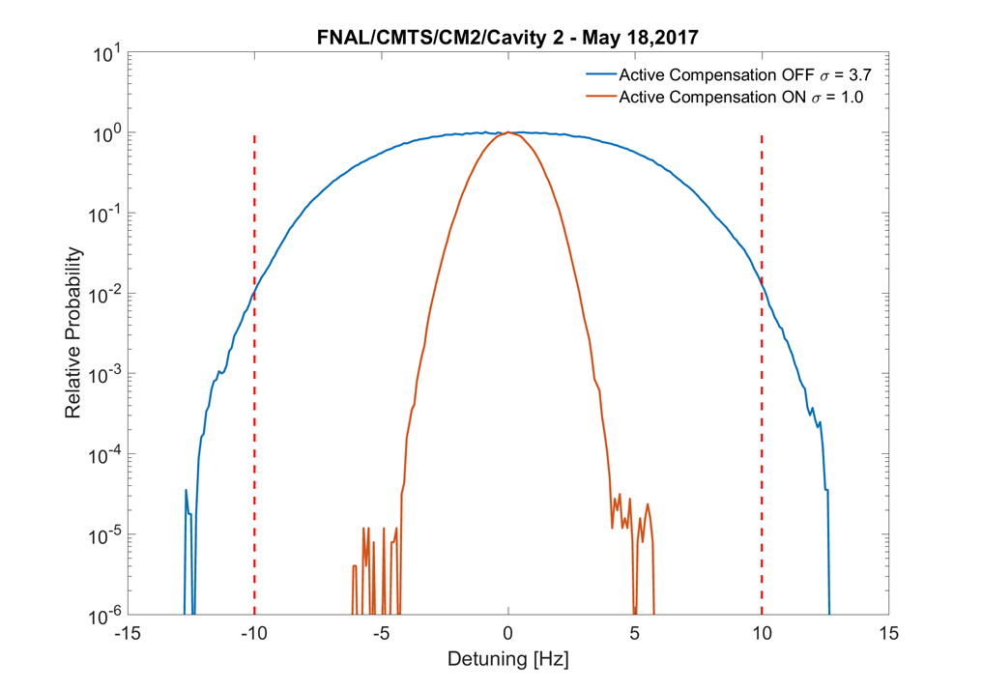
Active Resonance Control (microphonics compensation)
(using LYRTECH stand-alone R&D system)
(FNAL)
The forward/reflected and probe signals are down-converted to base-band and used to calculate the cavity detuning.
The detuning is fed to a bank of up to 16 parallel 2nd order IIR filters with programmable coefficients. The output of the filter bank is fed to a DAC and drives the piezo actuator through an amplifier.
During tests of CM2 (F-1.3-02) we were able to manually tune the filter coefficients and reduce RMS detuning in Cavity 2 (the second worst cavity in CM2) from 3.7 Hz to 1.0 Hz
Notes:
What you can achieve.
Easier to reduce large single mode microphonic.
As the microphonics decrease the precision of the algorithm may limit what you can achieve.

Slide 20
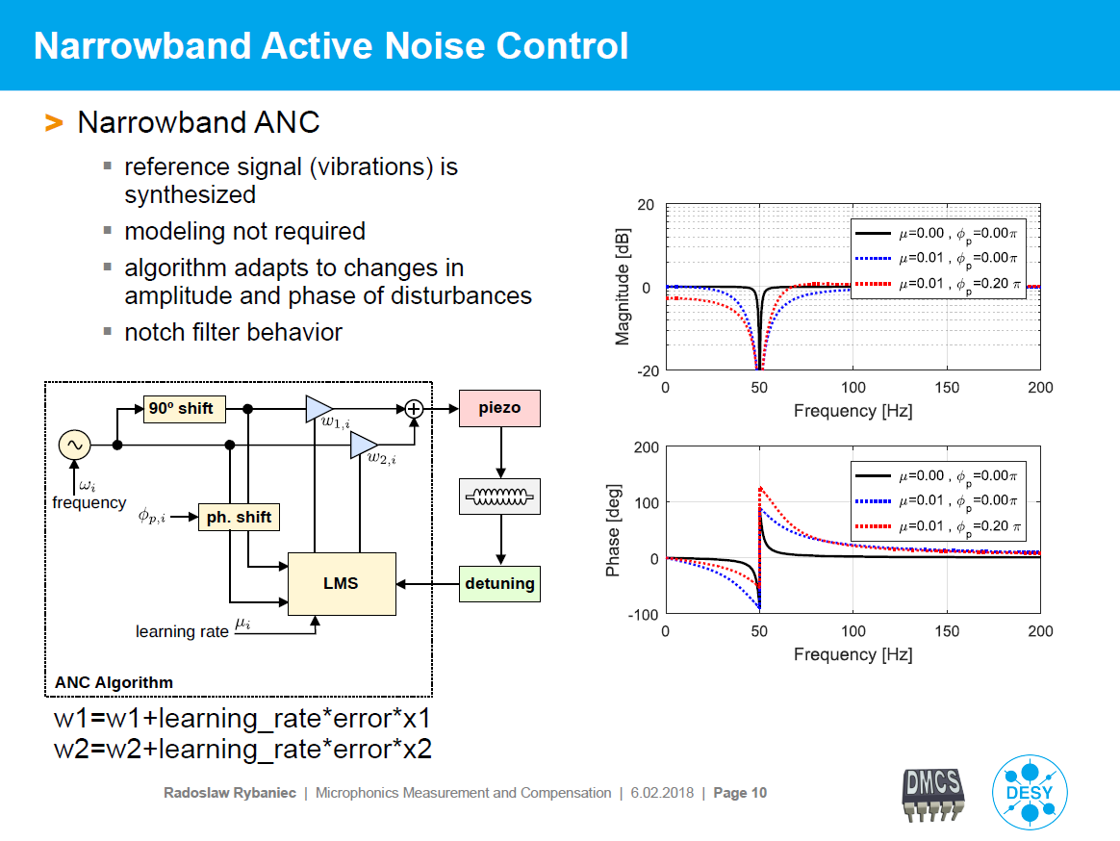
(DESY)
Notes:
Nice application of adapting an algorithm from another field (acuostics) that is very mature and applying it to cavity ARC.

Slide 21
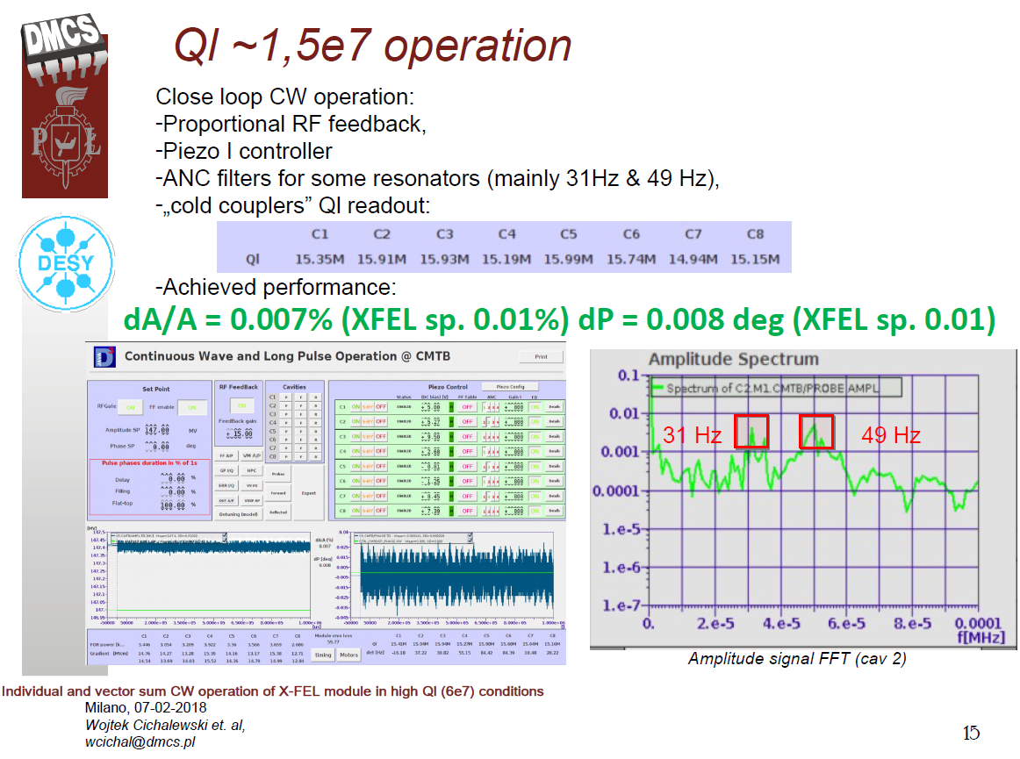
(DMCS)
Notes:
What can be achieved in a VS sum system.

Slide 22

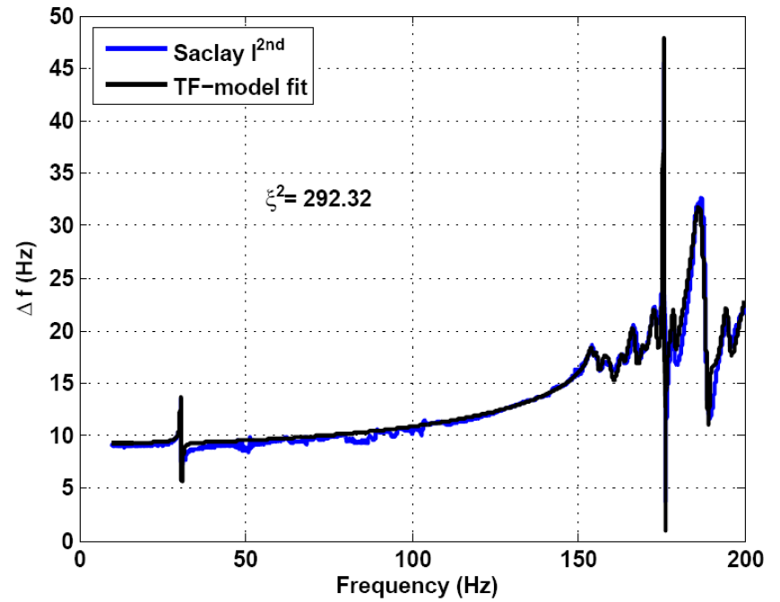
Model based controller: Fit of the system (HZB)
TESLA Cavity
Fit: Parallel acting 2nd
order systems
Evaluate response of higher
modes at lower frequencies
>20 modes needed for fit
Systems complexity complicates
use of model based feedbacks
(e.g. Kalman filter)
Individual for:
Each cavity tuner combination
Changes with coarse tuning
Affected by cav. mech. design
Transfer function as
look-up table
Kalman approach tested
with cavity simulator
Cav. Test in preparation
See Ushakov et al. IPAC17
Relevant for tuning
Notes:
Moving beyond pid algorythms for arc...kalman filter

Slide 23
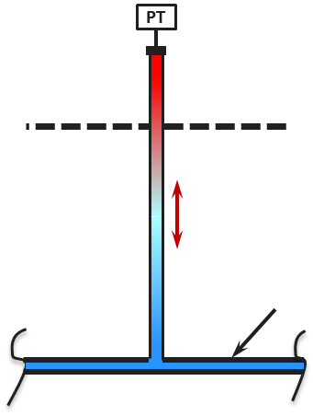
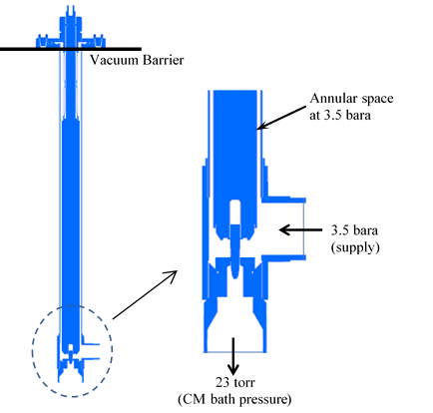
Thermoacoustic Oscillations (Brief Introduction) (FNAL)
Thermoacoustic oscillations generally occur in long gas-filled tubes with a large temperature gradient.
Acoustic modes couple to mass transport up and down column especially well when gas density is strongly tied to temperature.
  E.g. Warm gas from the top of a valve column moving to the cold bottom contracts, reducing pressure at warm region, driving the now cold gas back.
Long valves and very low speed of sound in cold helium can easily give lowest acoustic modes at dangerous frequencies.
Signs of TAOs:
  High heat loads
  Ice-balls at vacuum side of oscillating line
  Disturbances in temp or pressure measurements
  Mechanical vibration
Taking into account sensitivity of the SRF cavities to vibrations (10 Hz detuning == ~3nm of cavity length change) TOAs can significantly dynamically detuning the cavities.
Notes:
TAOs need to be considered when designing CM cryogenic piping. CM needs to be an integrated design between scientists, mechanical and electrical engineers.

Slide 24
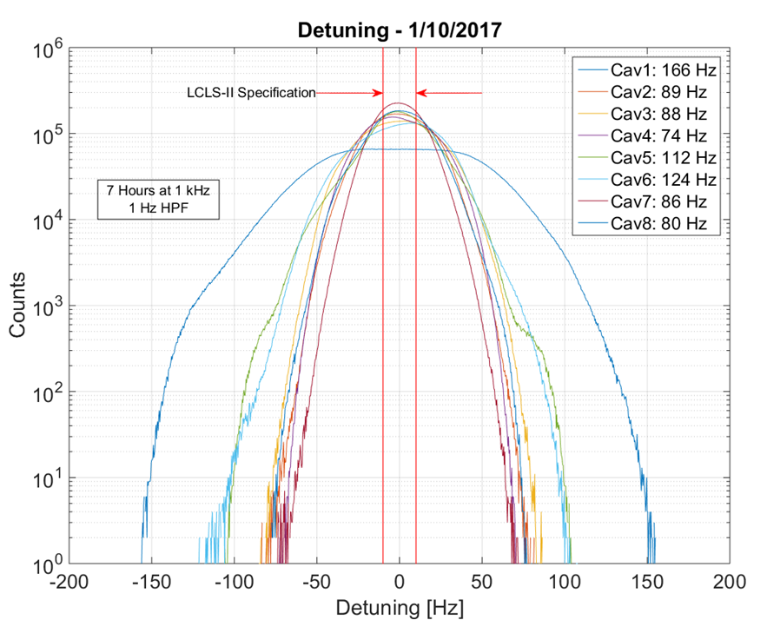
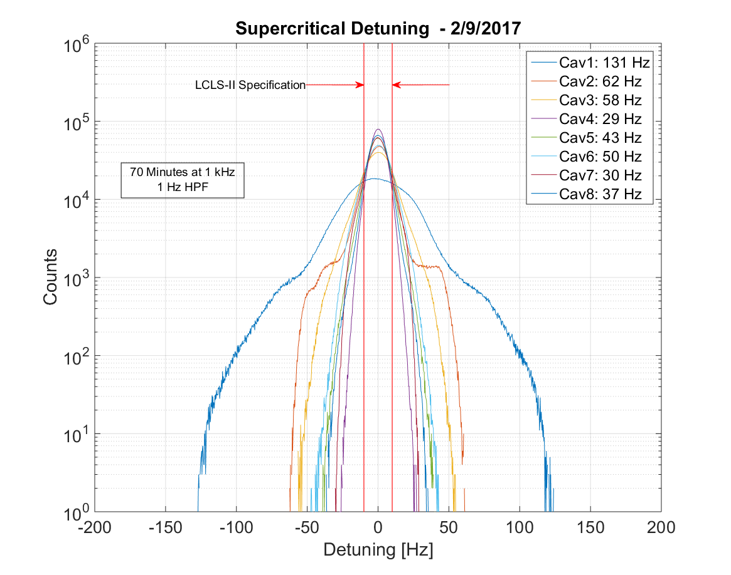
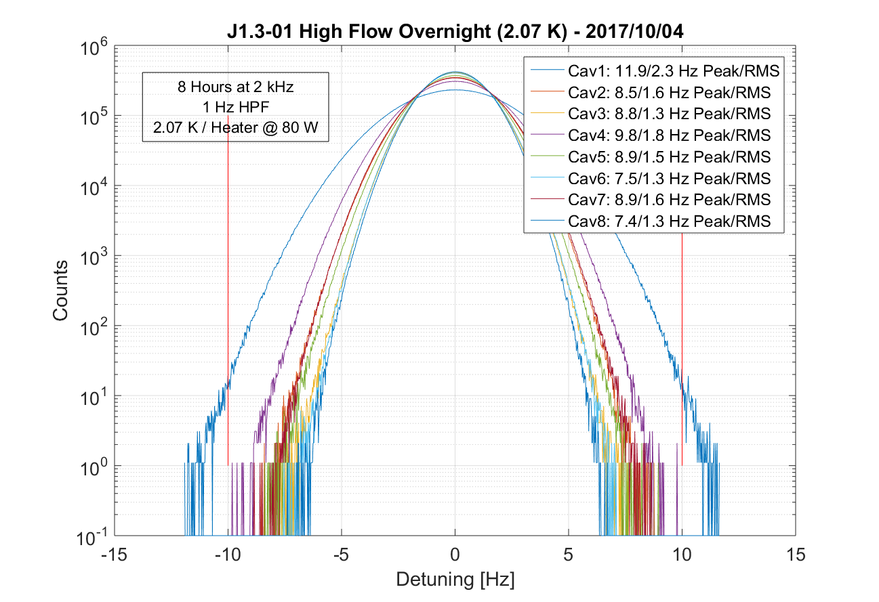
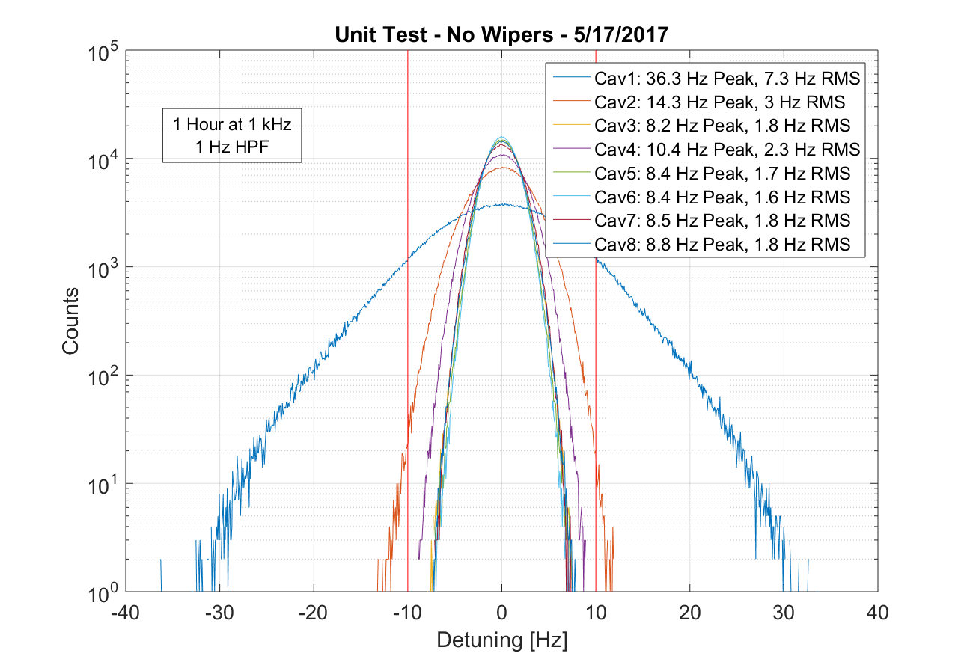
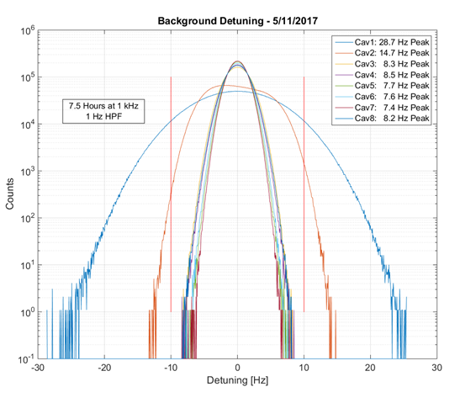
Microphonics level at LCLS II CMs for different modifications of Cryogenic Valve (FNAL)
No-wipers
Single-wipers
Five-wipers
NON-reversed Valve
No-wipers
Five-wipers
Reversed Valve
Average for cavities 2-8
Notes:
TAO solution on LCLSII CM, simple fixes yield big results.

Slide 25
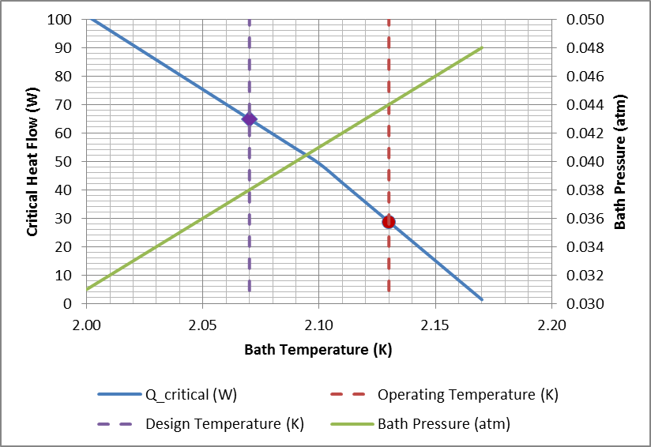
Critical Heat Flow HV Riser & Pressure vs Temperature (CEBAF, JLAB)
New Hall
Upgrade arc magnets
and supplies
Add 5 cryomodules
2014
20 cryomodules
CHL upgrade
Add arc
20 cryomodules
Enhanced capabilities
in existing Halls
Notes:
Microphonics due to He pressure increase down the transfer line. Cavities at the end of the line see high pressure (higher bath temp).

Slide 26
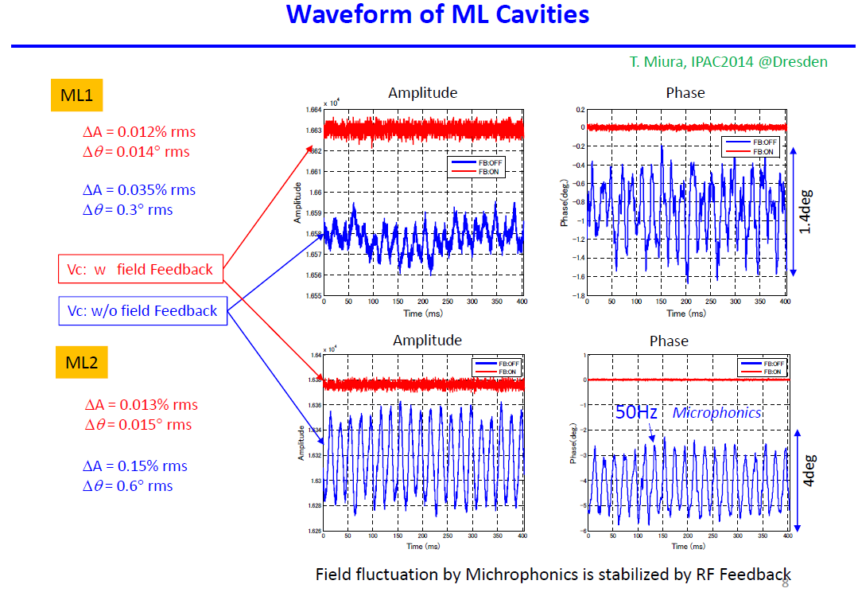
(cERL, KEK)
Notes:
Compact ERL.
Shows that slow ARC is useful too.

Slide 27
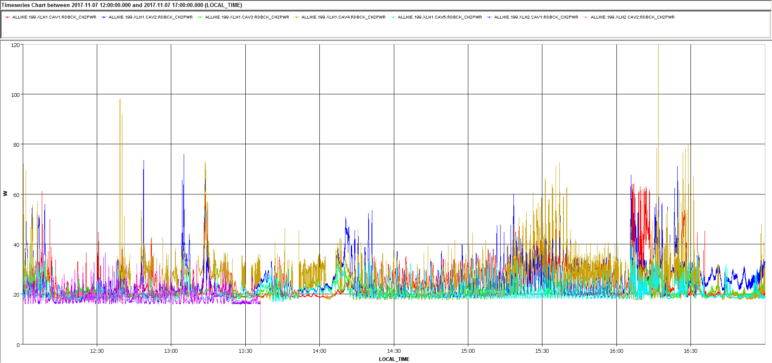
Profit from the thick FWD power margin (HIE-Isolde, CERN)
Peaks >100W
Average ~30W
Baseline ~20W
Let the excessive power to keep the field stable, do not touch the tuner!!
Notes:
Sometimes you have limited ways to control your destiny! May have to limit accelerator performance to keep the system stable.

Slide 28
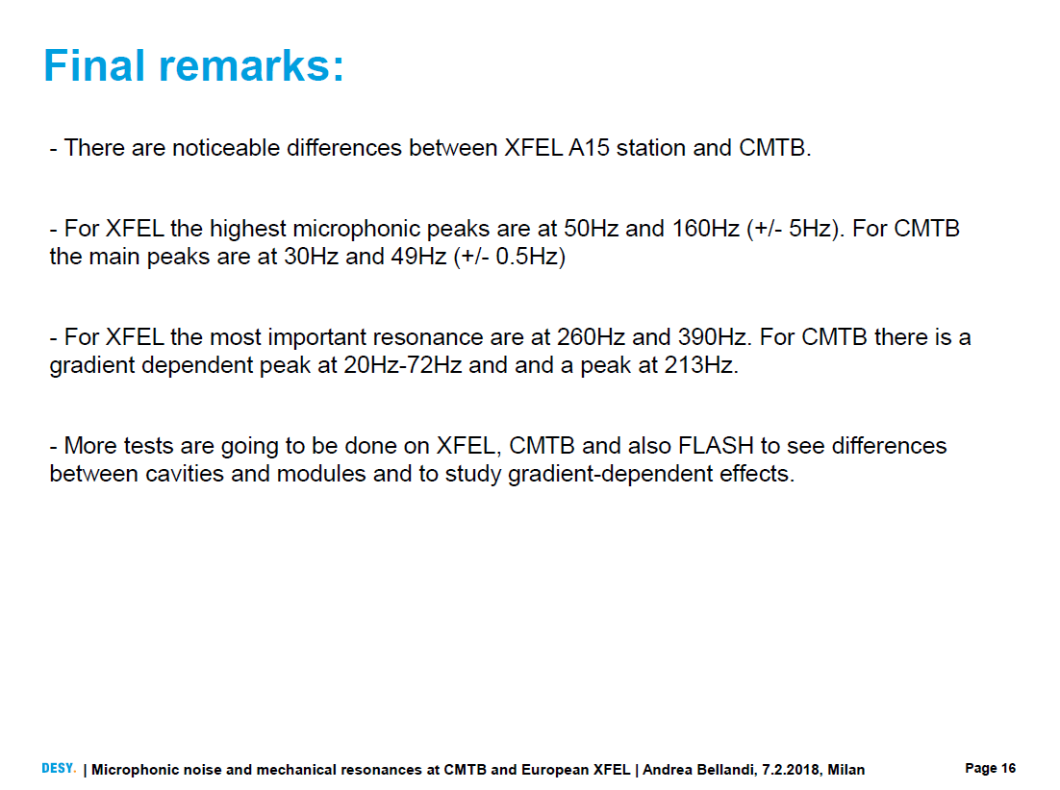
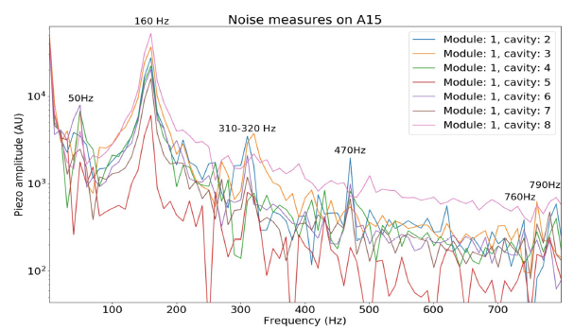
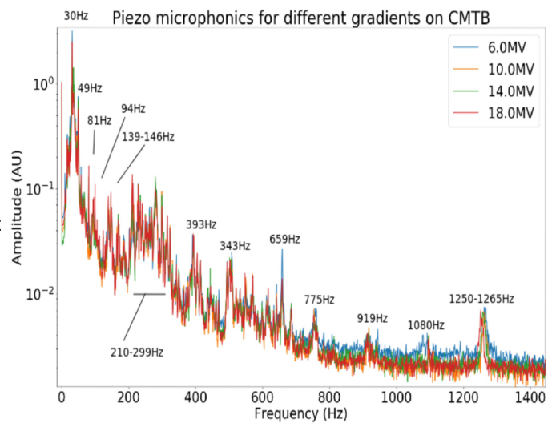
(DESY)
Notes:
Know your environment. Test facility and the accelerator tunnel will have different backgrounds and microphomnic entry points.

Slide 29
Some Common Themes
Obsolescence
Automation is the key to smooth commissioning and operation
Reach high availability and keep it this way means constant effort
Fault diagnostics
Typical sources of microphonics (e.g. pumps, poor suspension, etc.)
Several ways to detect microphonics
Several ways to mitigate microphonic disturbances
  Passive measures (e.g. mechanical changes)
  Active measured (e.g. adaptive FF, ANC, etc.)
  Use power overhead
Sometimes it is hard to track down sources of microphonics

