Slide 1
Current Understanding of Field Emission in SRF Cavities in CEBAF Linacs
Rong-Li Geng
Jefferson Lab
TTC Meeting in Milano, February 6 - 9, 2018
Root causes: solid particulates input & gas molecules input
Mitigations: helium processing, gradient re-distribution
Counter-measures: controlling source particulates/molecules; blocking particulate/molecule transportation; eliminating resident particulate/molecules

Slide 2
Outline
CEBAF and its SRF linacs
Field Emission (FE) and its impact
Machine energy reach
Machine operation reliability
Current understanding of FE in CEBAF linacs
Root-causes
Mitigations
Counter-measures
Open questions and discussions

Slide 3
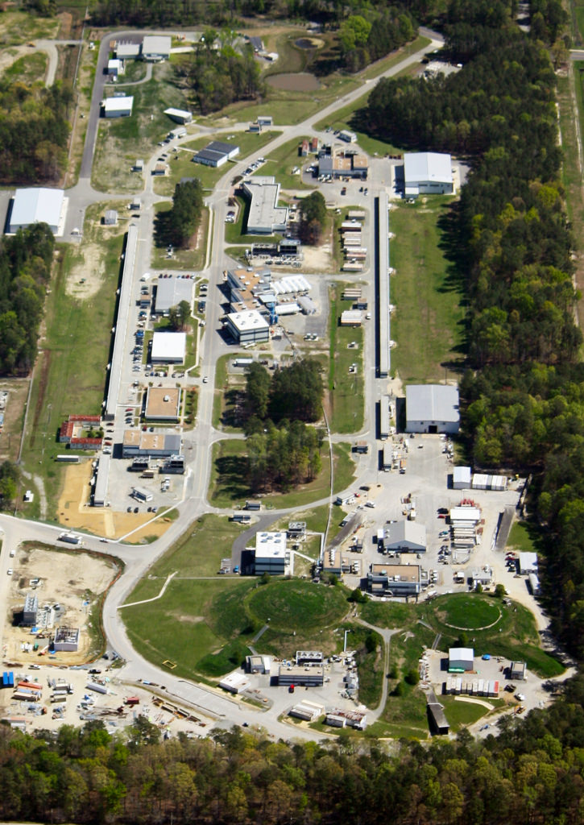
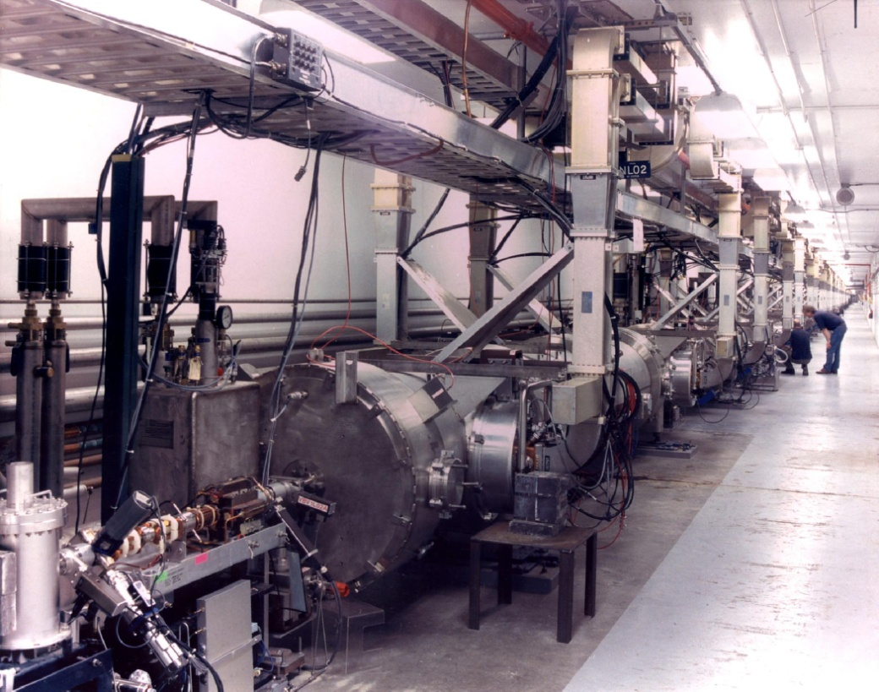
CEBAF: Continuous Electron Beam Accelerator Facility
Basic research of atoms’s nucleus
Construction 1987-1993
Upgrade 2008-2015
First large-scale application of SRF linac technology

Slide 4
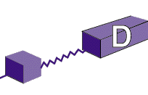
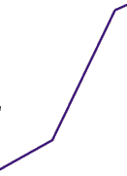
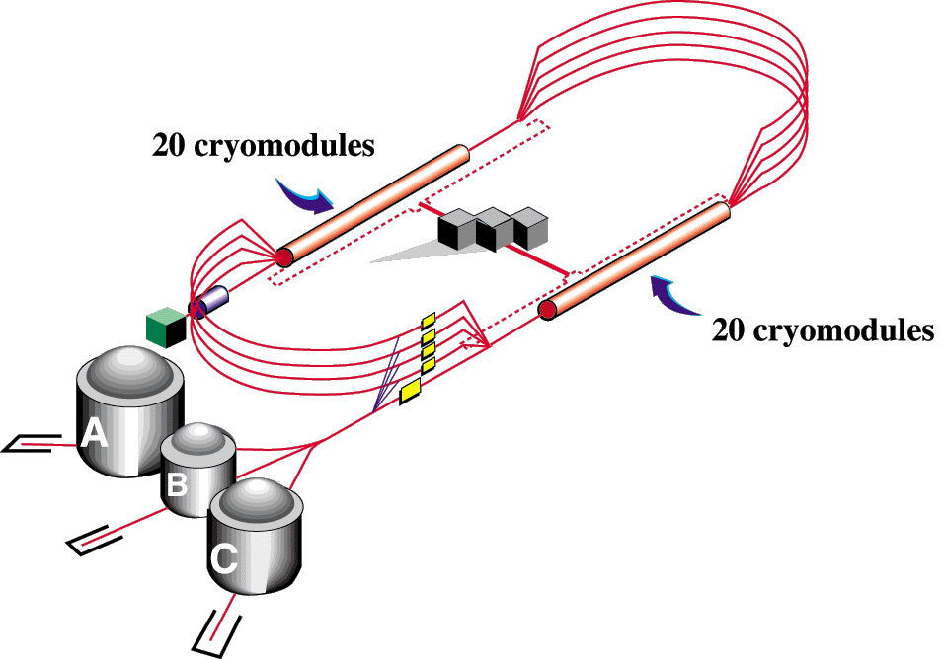
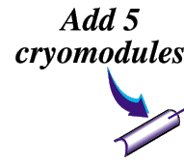
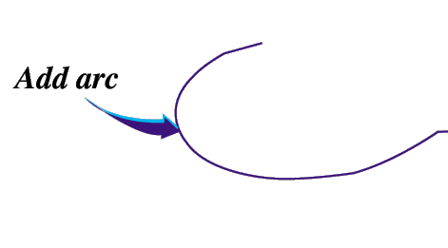
CEBAF Evolution
2011 – present
12 GeV Upgrade
Two 1.1 GeV linacs
1995 - 2011
6 GeV improvement
Two 0.6 GeV linacs
1987 - 1994
4 GeV, 200 µA CW
Two 0.4 GeV linacs
Add beamline
Upgrade magnets and power supplies
Add 5 cryomodules
CHL-2
Add arc
Add 5 cryomodules
R.L. Geng

Slide 5
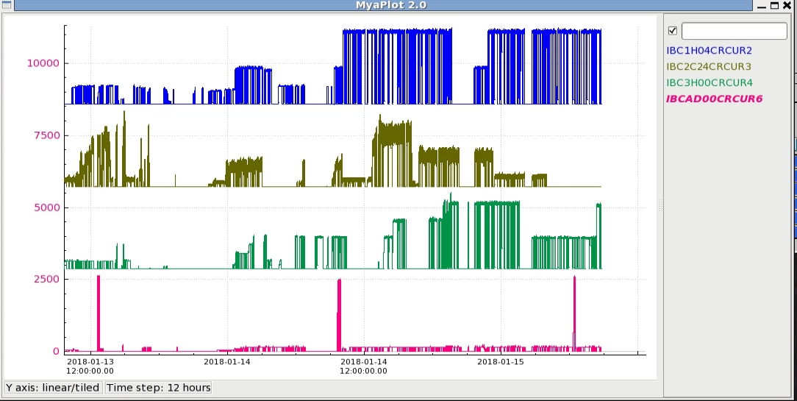
Latest News: CEBAF Operation Enabling
Simultaneous Data Collection in 4 Experimental Halls

Slide 6
CEBAF SRF Cavities
Together for 12 GeV nuclear physics run
Original CEBAF cavity
CEBAF 12 GeV upgrade cavity
5-cell, Cornell-Type
338 cavities in 42-1/4 moduels
Design
Ea=5 MV/m (Epk = 5 X 2.56 = 12.8 MV/m)
Q₀=2.4×10⁹ @ 5 MV/m
Achieved
<Ea>=7.5 MV/m, <Q₀>=5×10⁹@ 5MV/m
Helium processing
Acheived
<Ea>=12.5 MV/m, <Q₀>=5×10⁹@ 5MV/m
Refurbishing
2x 600 MV
5 kW 2K cooling power
5 MW liquefier operation power
7-cell, Low-Loss Shape
80+8 cavities in 10+1 moduels
Design
Ea=19.2 MV/m (Epk = 19.2 X 2.17 = 41.7 MV/m)
Q₀=7.2×10⁹ @ 19.2 MV/m
Achieved
<Ea>=22.2 MV/m
<Q0 @ 19.2 MV/m>=8.1×10⁹
2x (600 + 500) MV
Add ~5 kW 2K cooling power
Add ~ 5 MW liquefier operation power

Slide 7
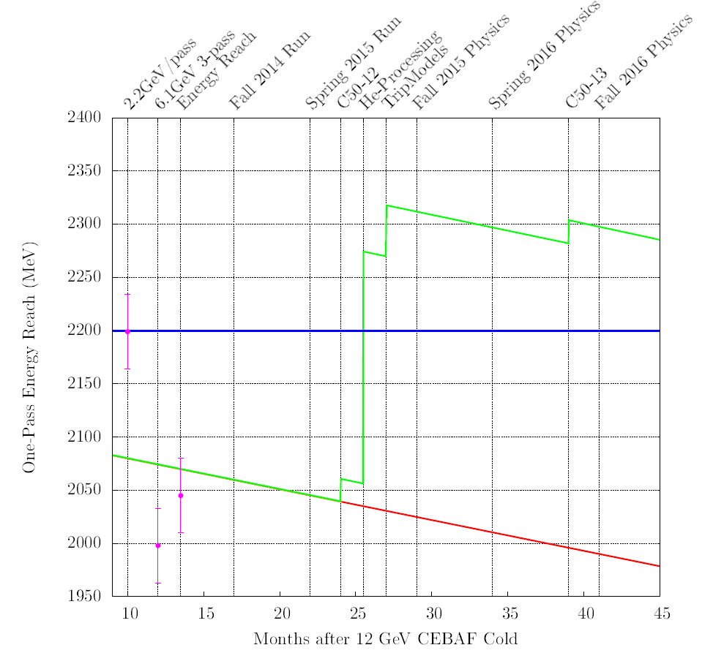
CEBAF “Gradient Degradation” - I
Mitigation:
helium processing
module refurbishment
(C50 -> C75)
Loss rate: 34 MeV/pass-year.
Cryomodules consisting original 5-cell cavities
based on operations data since 1995.
Root cause ???
R. Bachimanchi, J. Benesch, M. Drury, A. Freyberger, R. Geng, J. Mammosser, “2014 Update: CEBAF Energy Reach and Gradient Maintenance Needs”,
JLAB-TN-14-024

Slide 8
CEBAF “Gradient Degradation” - II
New 12 GeV upgrade7-cell Low-Los shape cavities
Fantastic!
Cryomodule
Final qualification
individual cavity
Linac
Cavities “possess” high gradient capability. Good cryomodule results.
Why can’t cavities run in linacs at gradients as in cryomodules?
Interlock protection – trip rate limit
Root causes being studied: FE a principal issue of interest (also other topics)

Slide 9
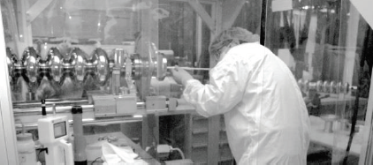
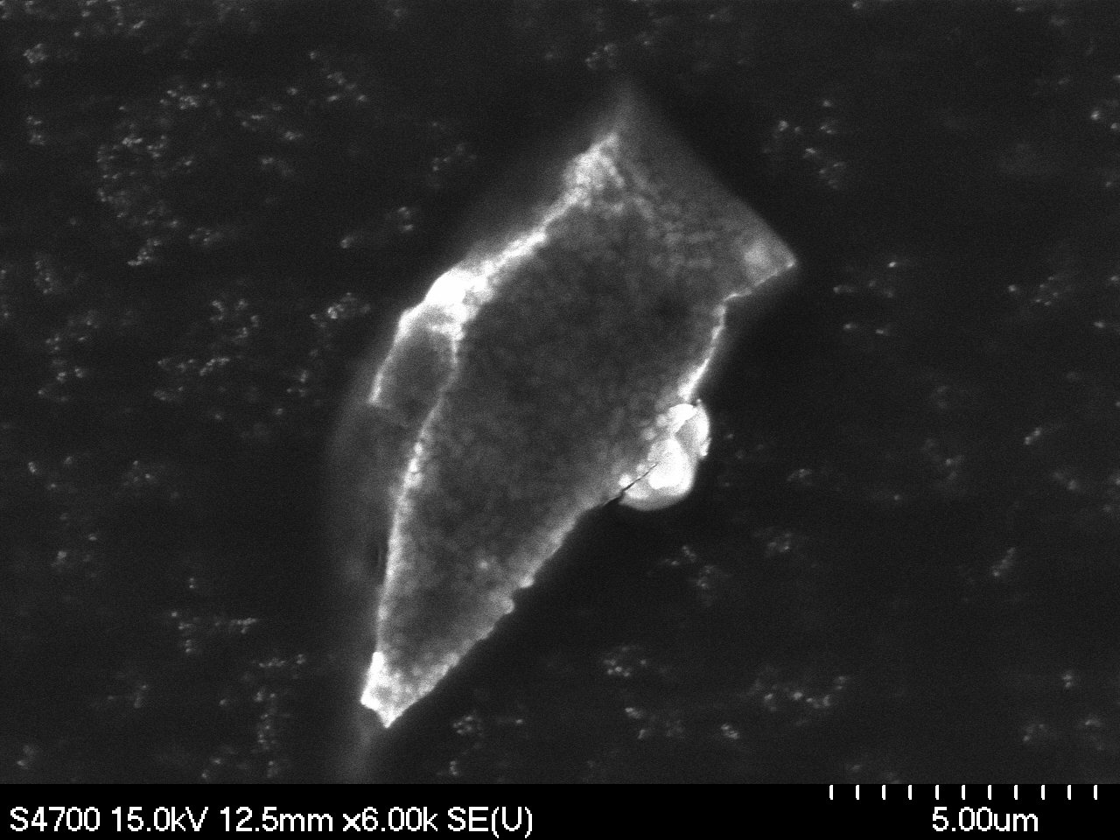
Current Understanding of FE in CEBAF Linacs
Root causes
Solid particulates input
Direct evidence by identification of particulates collected from cavities extracted from linac following long term beam operation (the 11th refurbishment cryomodule C50-11)
“Clay” particulates
Stainless-steel particulates
Titanium/Tantalum particulates (from beam line ion pump external to cryomodule)
Particulate collection from cavities extracted from linac
SRF2015, MOPB035

Slide 10
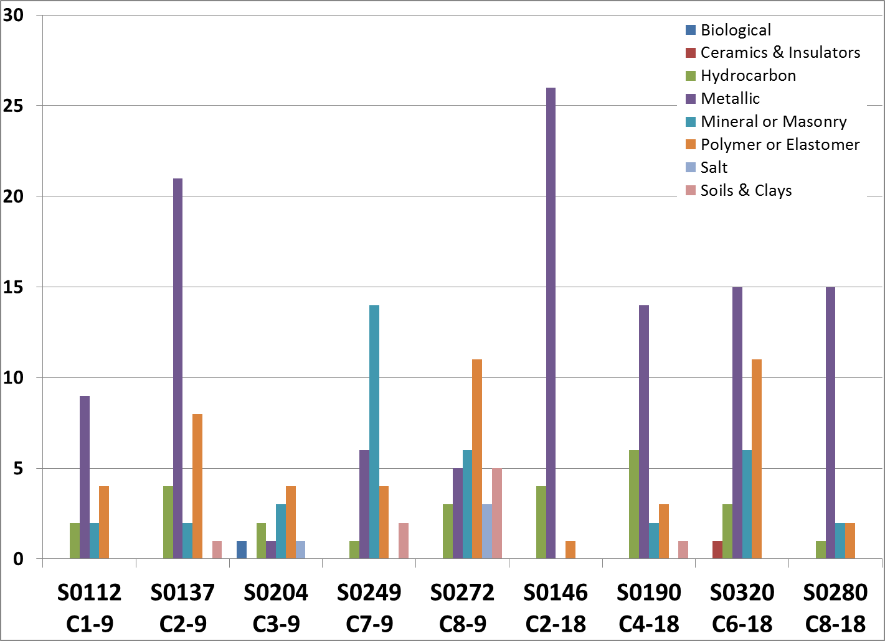
Solid Particulates Input - continued
Further particulate collection and identification from cryomodules (C50-12 and C50-13) as well as from warm girders near them
Large population of metallic particulates:
copper
stainless-steel
aluminium
titanium…
Species found in cavity match those found in warm girders
Cavity 2nd Equators
Beamtubes btw cavities
S0137 – C2-9 – Area 14
Copper
From Franklin cavity #2, cell 2
A-M Valente-Feliciano et al., Particulate Sampling & Analysis - 2017 Ops StayTreat

Slide 11
Current Understanding of FE in CEBAF Linacs
Root causes: Gas molecules input
Molecular species identification with RGA during controlled warm up of CEBAF 12 GeV upgrade cryomodule 2L25
H₂ being the leading species

Slide 12
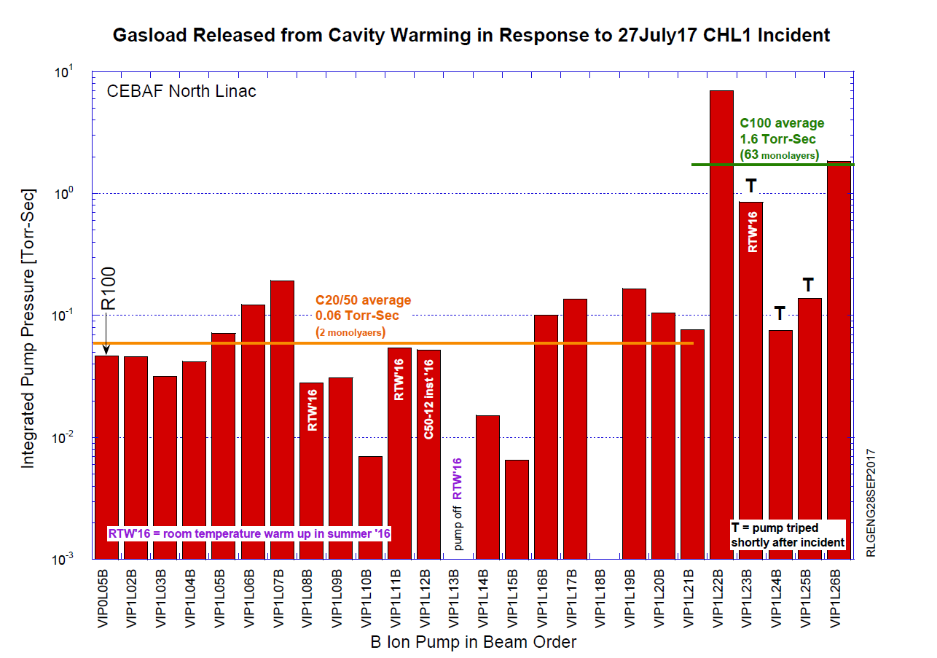
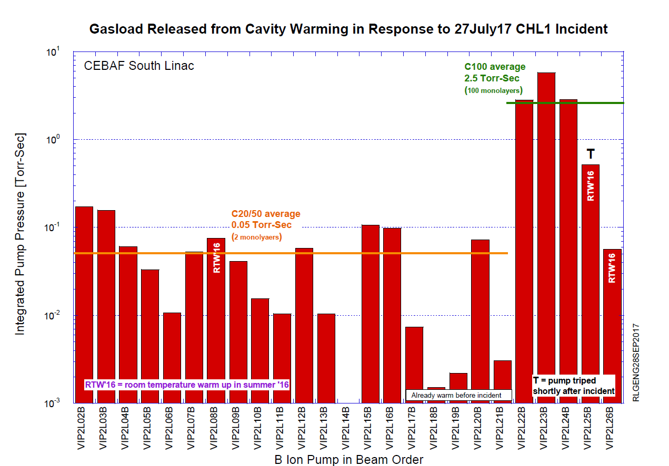
Gas Molecules Input - continued
Further analysis of gas loading during unplanned linac warm following 27july17 cryo plant incident
100 monolayers of H2 equivalent gases frozen onto 7-cell Cavities; 2 monolayers onto 5-cell cavities
Data being collected to compare FE of Spring17 with Spring16

Slide 13
Current Understanding of FE in CEBAF Linacs
Mitigations
Gradient re-distribution: reduce FE induced radiation while preserving integrated accelerating voltage of cryomodule
Requires dedicated FE instrumentation in accelerator tunnel
Demonstration at CEBAF injector cryomodule: radiation at its beamline exit reduced by 5 orders w/ total voltage preserved (see IBIC17 talk, TH1AB1)
Eliminates inter-cryomodule and long-distance propagation of FE electrons
Effectively reduce radation production (see IBIC17 talk)
Helium processing
Successful application of helium processing against 5-cell cavities (C.E. Reece et al, PAC1997)
Enabled cavities limited to 4–6 MV/m to operate stably at 6–9 MV/m
Massive effort in helium processing during 2015 summer shut down (A. Drury et al., NAPAC16, THA1IO02)
Average increase in FE free gradient was 0.93 MV/m

Slide 14
Current Understanding of FE in CEBAF Linacs
Counter-measures
Controlling source particulates/molecules
Improved procedure for cavity-string assembly, cryomodule UHV assembly
Reduce beamline gate valve actuation
Outlaw ion pump hi-potting
Replace ion pump by NEG pump
Blocking particulate/molecule transportation
Study of beam-enabled particulate transportation (next slide)
Electrostatic precipitator (old idea)
Eliminating resident particulate/molecules
Cryomodule warmup
In-situ processing beyond helium processing or plasma processing (TBD)
Cost-effective refurbishment (TBD)

Slide 15
Study of Beam Enabled Particulate Transportation in CEBAF
The motion of charged dust particle in accelerators has been studied from 1990 to 1995 by P. Marin, H. Saeki, D. Sagan, F. Zimmermann, et al.
Charged dust particles can be picked up by the field of the electron beam.
insulating surface (no space charge)
conducting surface (space charge field)
Dynamic equations of the charged dust particle has been developed.
Quadrupole or higher order magnetic field and RF field can be ignored.
Horizontal motion is driven by the electron beam field and the image charge field.
Vertical motion is driven by the electron beam field, image charge field and gravity.
Longitudinal motion is driven by collisions with the electron beam and the magnetic dipole field.
If the transverse size of the electron beam varies, it induces longitudinal force on the dust particle and the coupling of the transverse motion with the longitudinal motion of the dust particle.
Modeling and simulation for charged dust particles in CEBAF is in progress.
He Zhang, CASA

Slide 16
Open Questions and Discussions
What is the reason for heavy gas loading in C100 cryomopdules as compared to C20/C50?
Is helium processing the right tool for recovering gradient in cavities operated at > 15 MV/m?
How particulates are transported in SRF linac beamline vacuum?
What is needed for dislodging resident particulates and transport them out of cavities in cryomodules installed in accelerators?

Slide 17
Backup slides

Slide 18
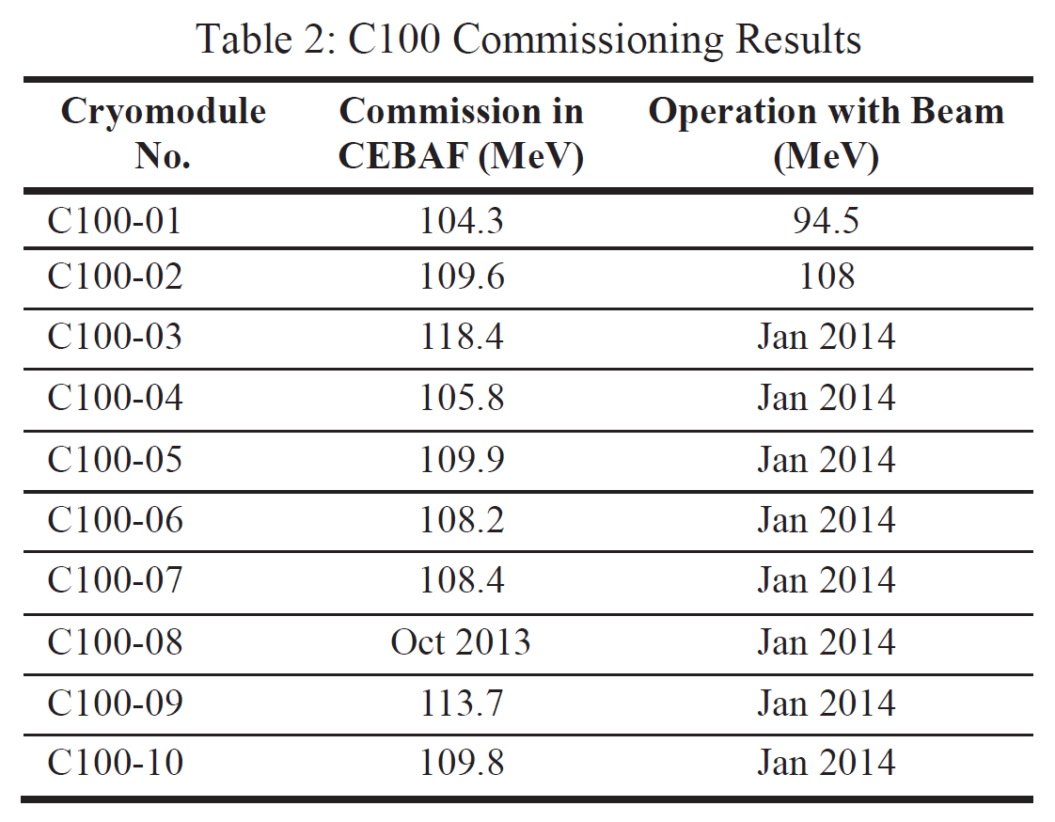
Low-Loss Shape Cavity Accelerating Beam
CEBAF 12 GeV Upgrade Cavity
1.5 GHz, Low-loss Shape, 53mm bore dia.
C. Reece, TTC Meeting, Feb. 28-Mar.3, 2011
J. Hogan et al., PAC2013, WEZAA2

Slide 19
Radiation Reduction by Gradient Redistribution
Lower gradient of FE source cavities
Raise gradient of FE free cavities
0L04 at constant gradient
0L03 total gradient maintained at constant
Radiation reduced by 5 order of magnitude
With total accelerating voltage preserved
0L03-3 lowered by 3 MV/m
0L03-7 lowered by 3 MV/m
0L03-5 raised by 3 MV/m
oL03-6 raised by 3 MV/m
IBIC17, TH1AB1

Slide 20
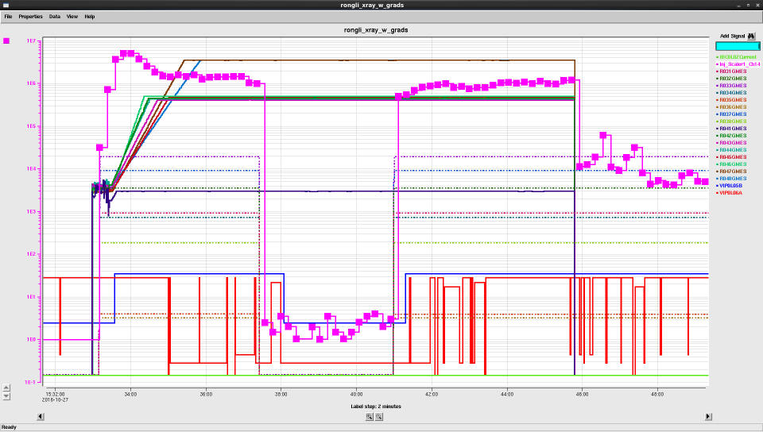
Observed Radiation Enhancement due to FE Electron Exportation across Cryomodules
0L04 on 0L03 on
Count rate ~ 1E6
0L04 off 0L03 on
Count rate ~ 1E4
0L04 on 0L03 off
Barely any count
IBIC17, TH1AB1

