Slide 1
Nb₃Sn Coatings from Cornell
Ryan Porter Cornell University
Supported by:
U.S. DOE award DE-SC0008431.
This works make use of: Center for Bright Beams , NSF Award PHY-1549132
Cornell Center for Materials Research, NSF MRSEC program (DMR-1120296)

Slide 2
Outline
Introduce Nb₃Sn—why we care and how we make it
How it currently performs
Current quality factors
Current field limits
Advancing maximum fields and current work
Conclusion/Future outlook

Slide 3
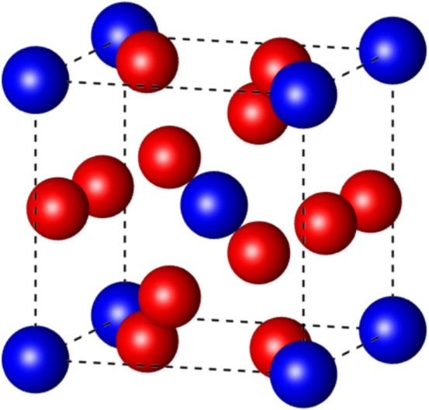
Properties of Nb₃Sn
Higher critical temperature
→ Operation at 4.2 K
Higher superheating field
→ Double the limit of niobium
Blue: tin
Red: niobium
Parameter | Niobium | Nb₃Sn
Transition temperature | 9.2 K | 18 K
Superheating field | 219 mT | 425 mT
Energy gap Δ/k_{b}T_{c} | 1.8 | 2.2
λ at T = 0 K | 50 nm | 111 nm
ξ at T = 0 K | 22 nm | 4.2 nm
GL parameter κ | 2.3 | 26
Lower losses
Higher gradients
~90 MV/m

Slide 4
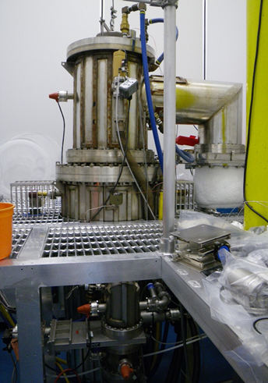
Cornell Nb₃Sn Program
We have a program at Cornell for creating Nb₃Sn coatings
Coat Nb with 2-3 µm of Nb₃Sn
Vaporize tin in high temperature vacuum furnace
Can (currently) coat:
samples
~1.3 GHz single cells

Slide 5
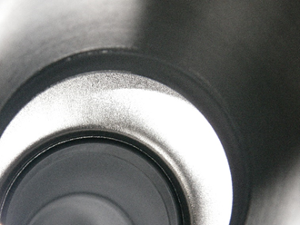
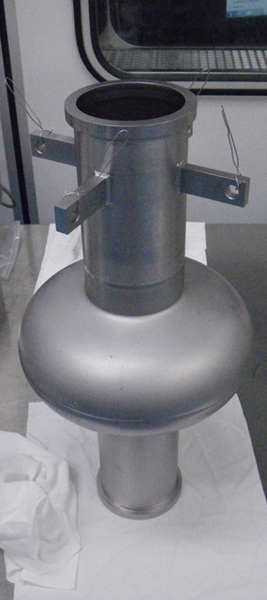
Before/After Coating
Doesn’t look that much different than before coating…
Before
After

Slide 6
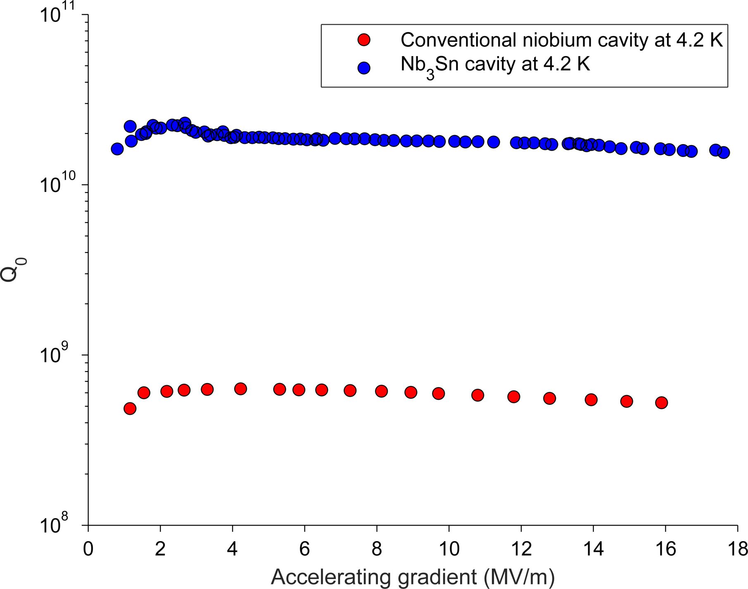
Comparison to niobium
20× more efficient than Nb at 4.2 K!

Slide 7
Current performance
Data taken at 4.2 K
1.3 GHz ILC single-cells

Slide 8
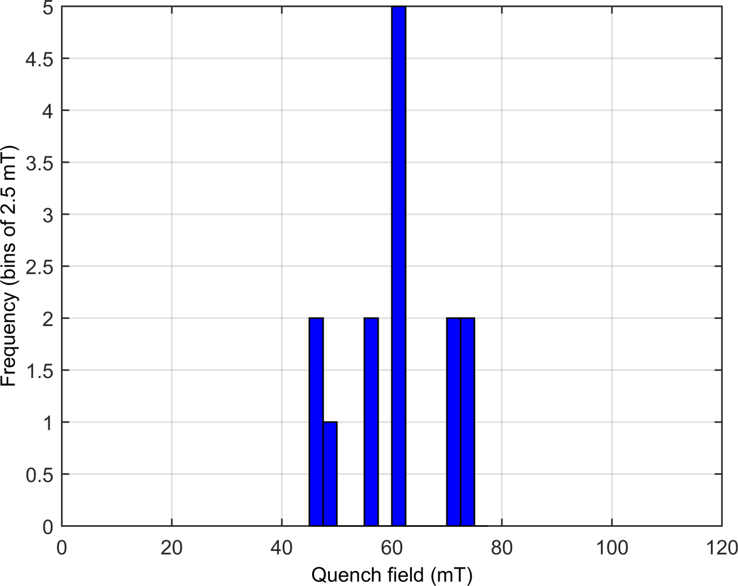
Limitations in quench field
Nb₃Sn cavities quench consistently at fields between 14 and 18 MV/m in continuous wave operation, even in spite of some perturbations to the coating recipe.
The superheating field suggests we can achieve fields up to 90 MV/m!

Slide 9
Pulsed quench field
Pulsed→26 MV/m
Continuous→17 MV/m

Slide 10
Localised quench
Nb₃Sn cavities are limited by a quench at a defect
What sort of defect could be at fault?

Slide 11
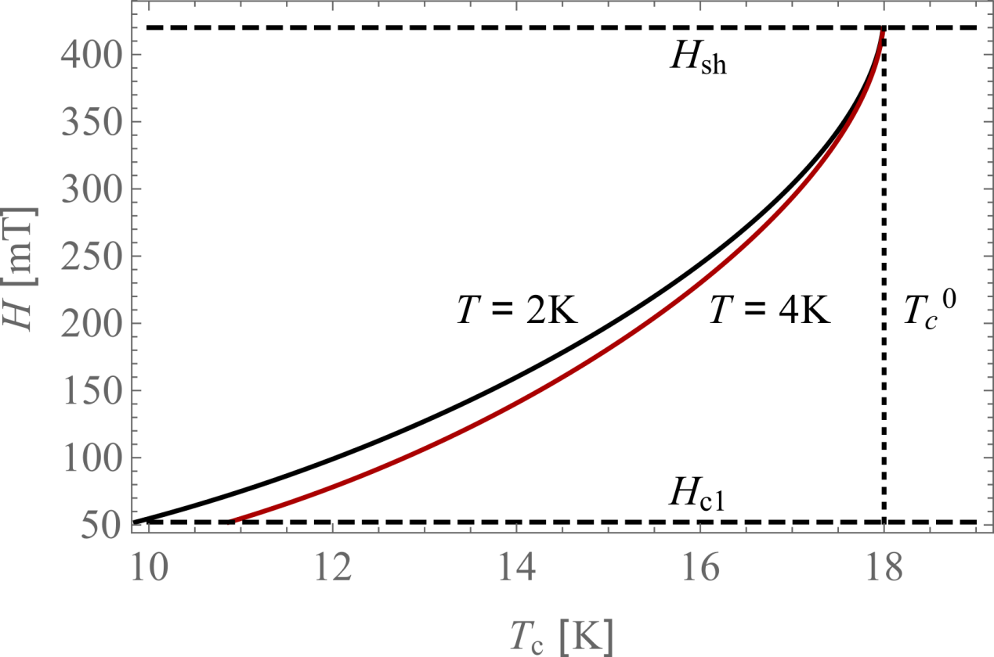
T_{c} suppression
A tin depletion of only 3% reduces H_{sh} by 75%
Flux entry could occur at tin-depleted surface defects

Slide 12
Tin-depletion in grains
Cross-section of the Nb₃Sn RF surface
Grain boundary
Have only about 1% Sn depletion → more statistics needed

Slide 13
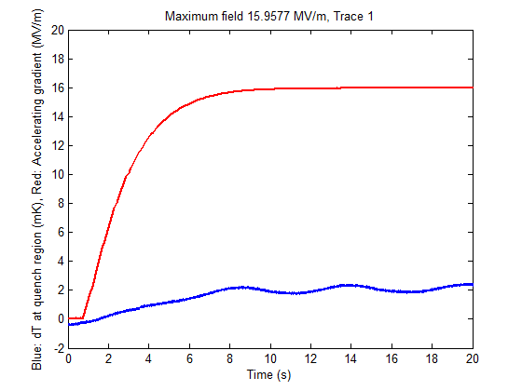
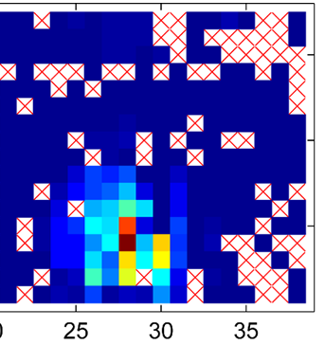
Near quench behavior
Measure temperature of sensor near the quench point as field is increased
Sudden jumps in temperature
Max Field
Temperature
Time

Slide 14
Near quench behaviour
2 K
The sudden nature of these jumps and hysteresis strongly suggests flux entry

Slide 15
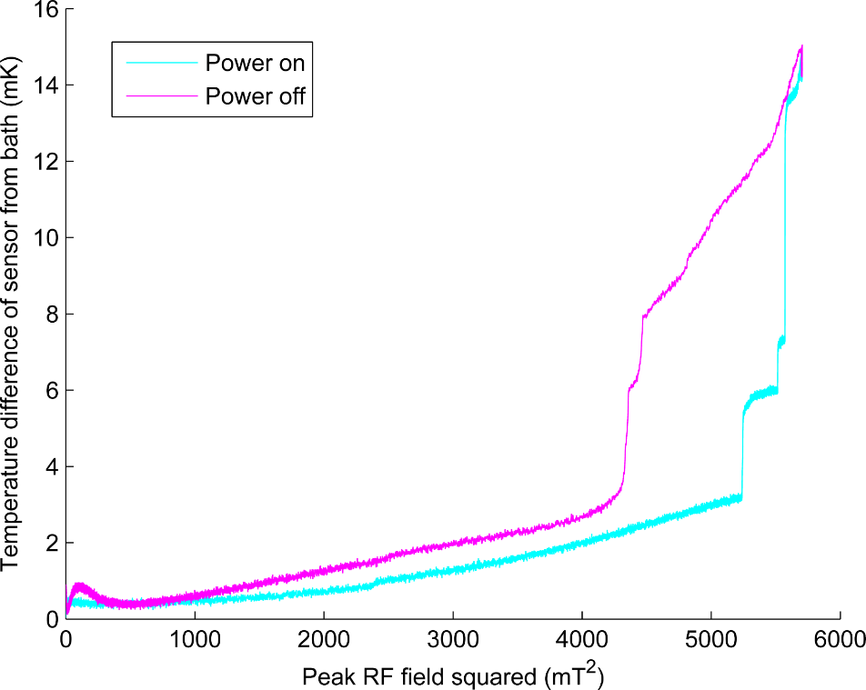
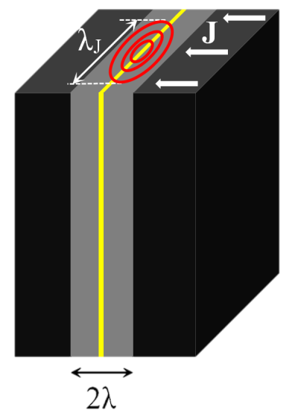
Grain boundary flux penetration
Power dissipated
Increasing current across boundary
Ahmad Sheikhzada and Alex Gurevich
Physical Review B 95, 214507 (2017)
arXiv:1702.02843

Slide 16
Grain Boundaries
Looking at grain boundaries
SEM scan with atomic resolution
Sn concentration across grain boundaries
More investigation needed
5 nm
1 nm

Slide 17
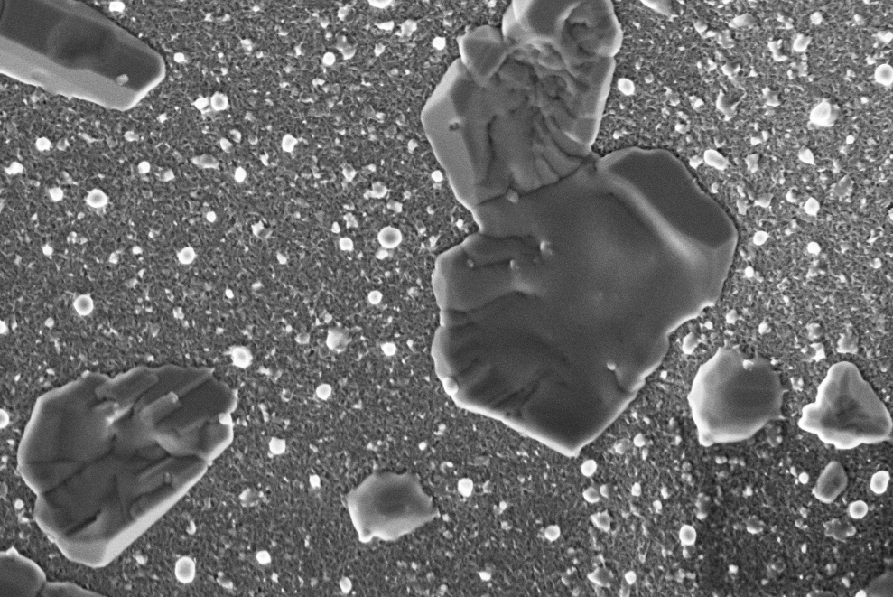
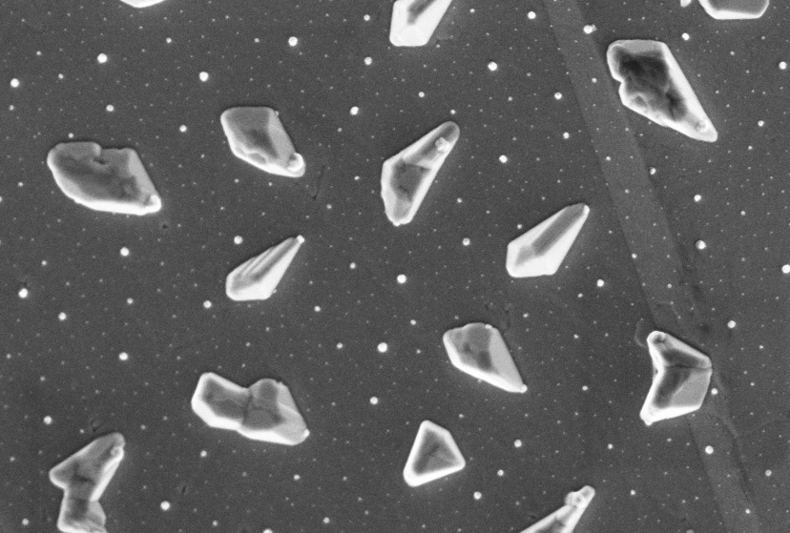
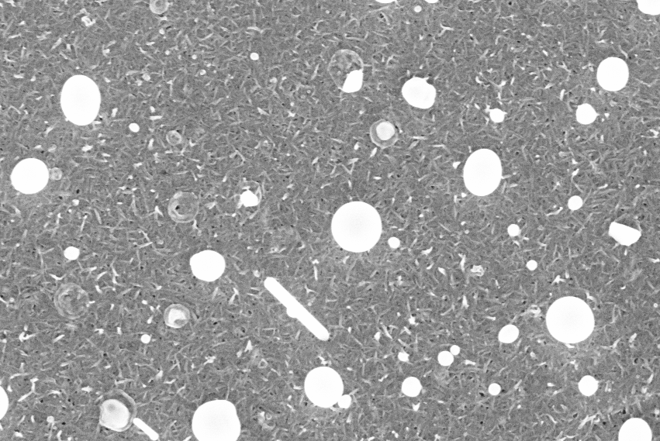
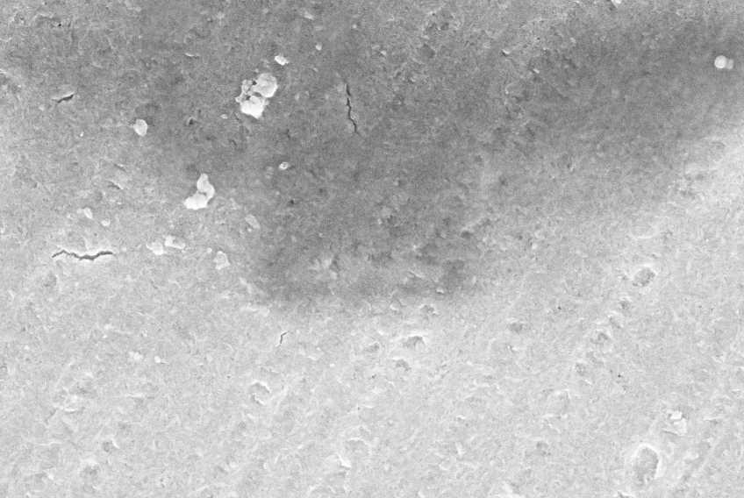
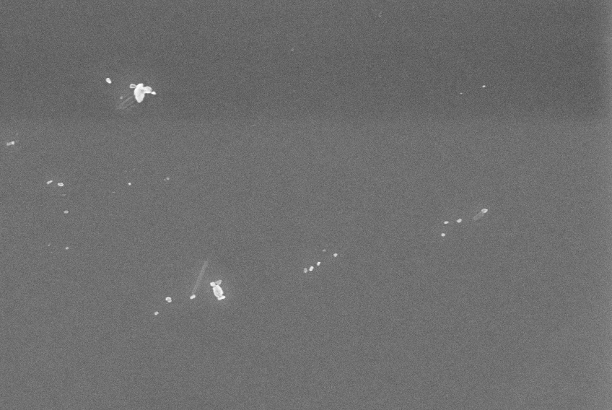
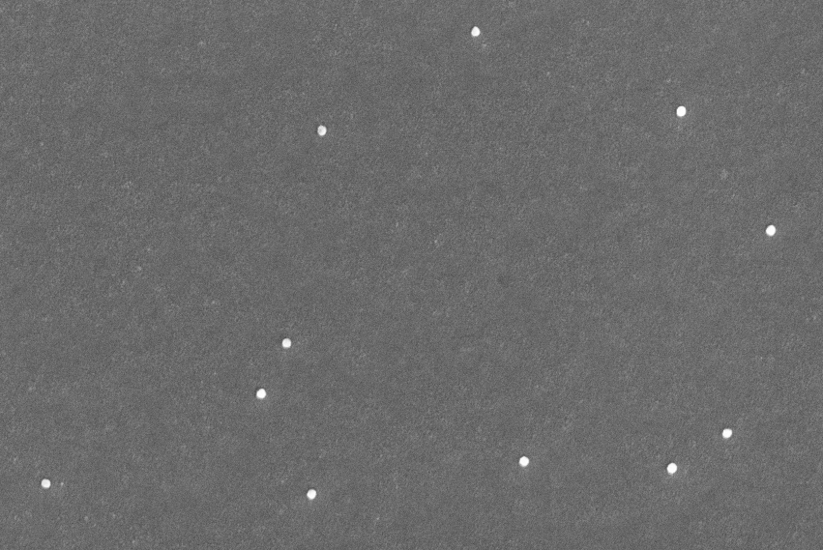
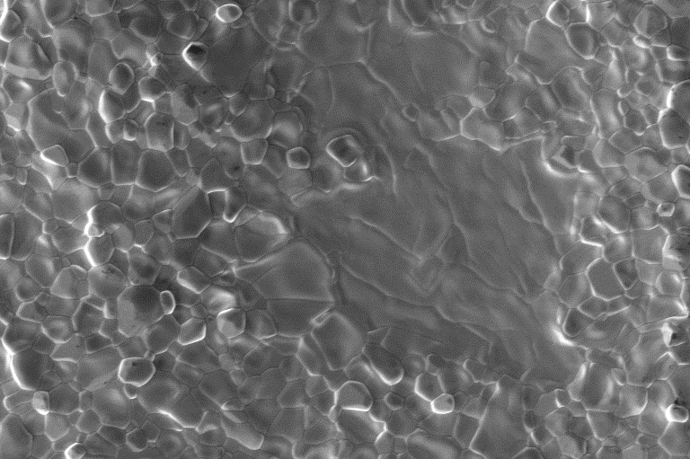
Layer growth during ramp
Pre-anodised
Not anodised
1120°C
Start
500°C
800°C
2 μm
950°C

Slide 18
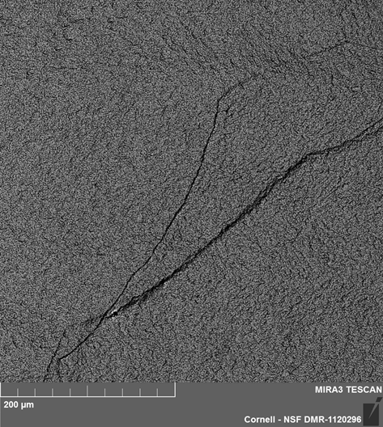
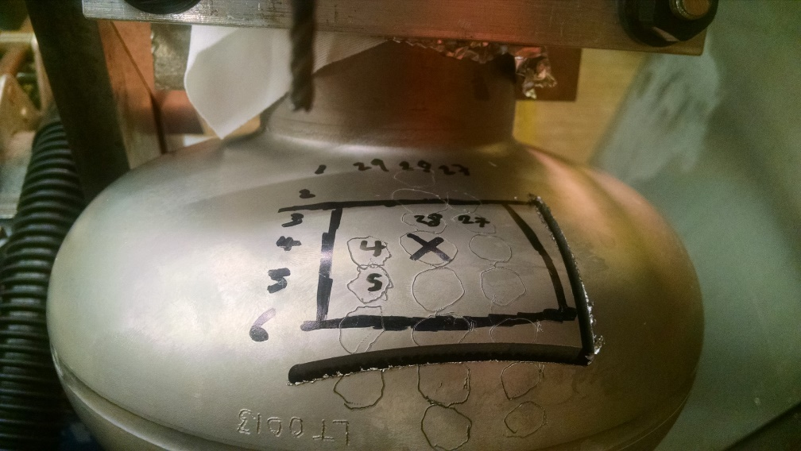
What is happening at the surface?
We cut out this region and examined it with microscopy
Nothing suspicious except jump
Rough Surface
Nb₃Sn surface
Nb substrate grain boundary?
Quench Site

Slide 19
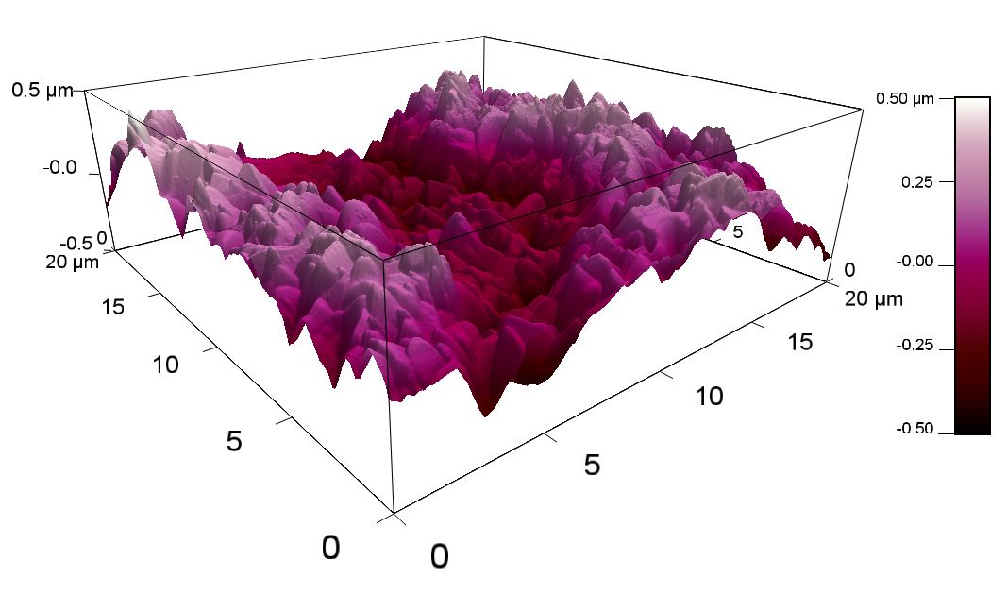
Surface Roughness
Nb₃Sn we create is rougher than electropolished Nb
~1 µm peak to peak
This causes large enhancement of the surface magnetic field

Slide 20
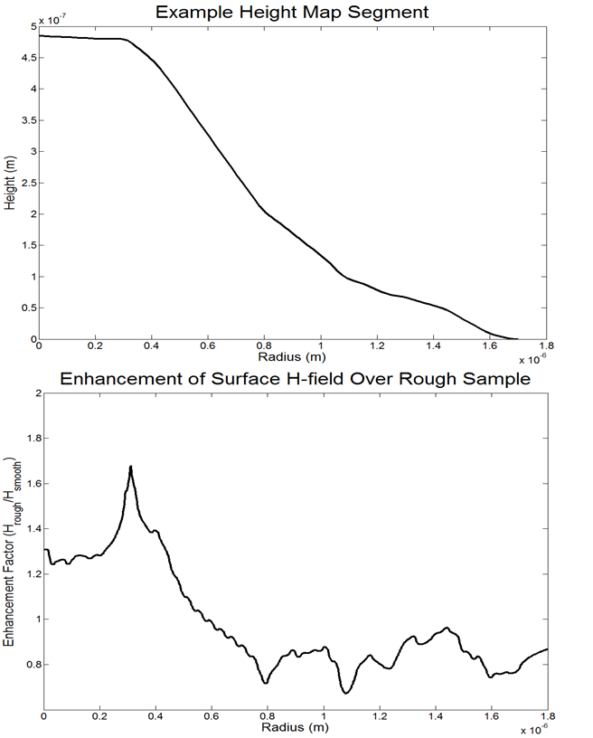
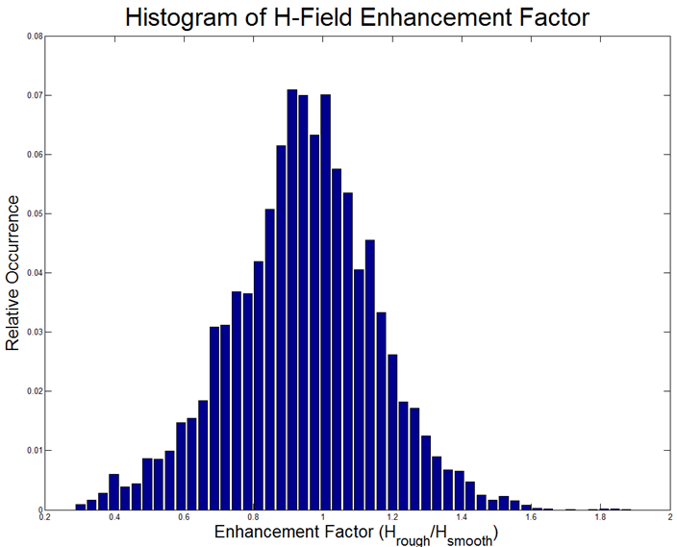
Field Enhancement
1% of the surface has surface fields at least 50% higher than for a flat surface
Limits maximum quench fields 60 MV/m for perfect surface
Lowers field before defects become an issue

Slide 21
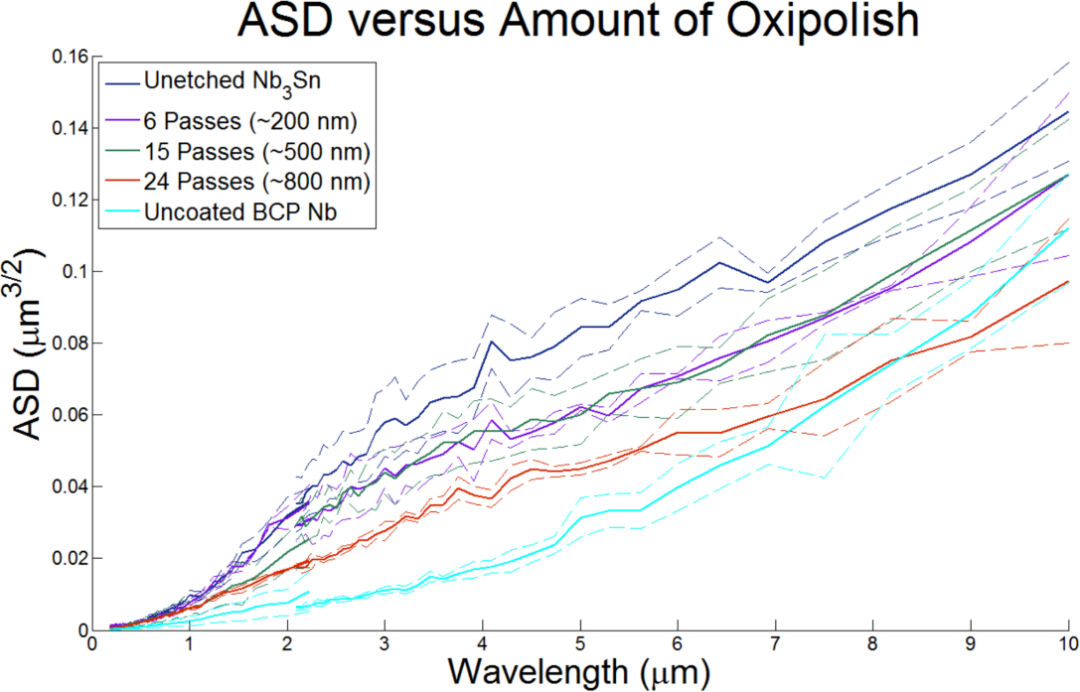
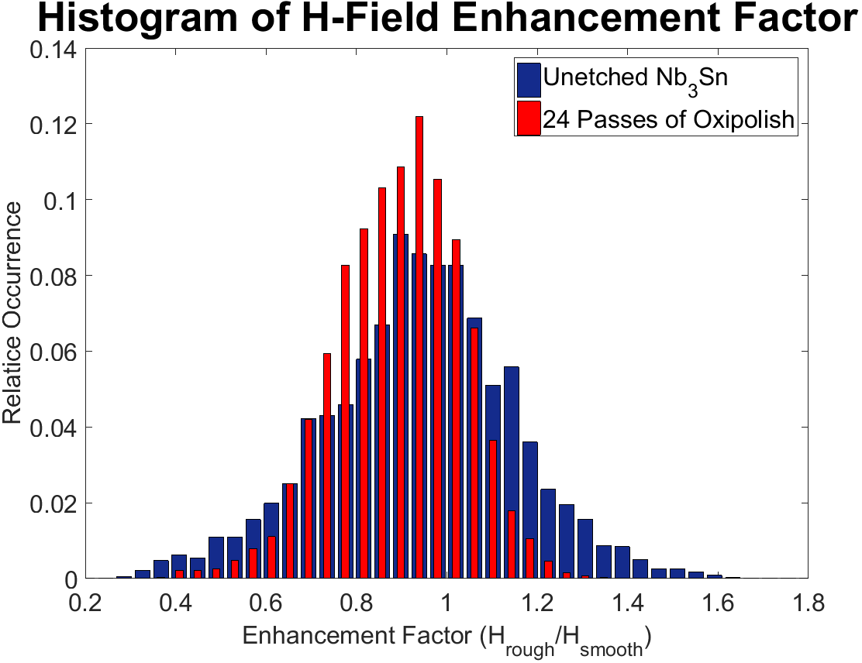
Surface Treatment
Developing surface treatments to reduce surface roughness
Early results found oxypolishing could half roughness and surface field enhancement while removing < 1 µm

Slide 22
Conclusions
Can reach 2·10¹⁰ at 4.2 K
Achieve 16-17 MV/m in continuous mode
Achieve 26 MV/m in pulsed mode
Have identified main sources of performance limitations
Quench Fields
Surface roughness
Vortex entry (at grain boundaries?)

Slide 23
Looking Forward
Reducing surface roughness may gain us 50% improvement in quench fields
Continuous: 17 MV/m → 25 MV/m
Pulsed: 26 MV/m → 39 MV/m
If we can fix grain boundaries
Continuous & pulsed: → 90 MV/m?
Improving in magnetic shielding and cooldown could ~1.5x Q at 4.2 K

Slide 24
Acknowledgements
The Cornell Nb₃Sn program is primarily supported by the U.S. Department of Energy
with special thanks to
Prof. Matthias Liepe
Prof. Tomas Arias
Prof. David A. Muller
Prof. James P. Sethna
Danilo Liarte
Daniel Hall
Paul Cueva
Nathan Sitaraman
James Maniscalco
James Sears
Greg Kulina
John Kaufman
Holly Conklin
Terri Gruber

