Slide 1
C-ADS tuner systems at IMP
Lubei Liu, Ruoxu WANG, Fengfeng Wang, Lei Zhang
Tiancai Jiang, Zheng Gao, Weiming Yue, Shenghu Zhang
SRF Group
On behalf of ADS Linac Team
Institute of Modern Physics, CAS

Slide 2
Outline
Introduction
Tuner experience on the Helium Pressure Fluctuation
Summary

Slide 3
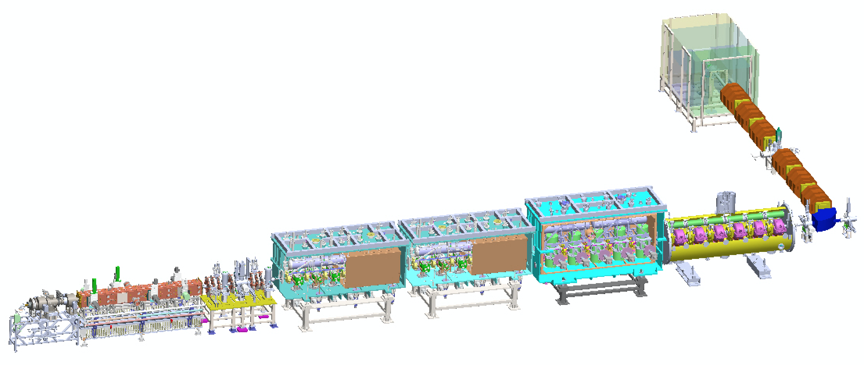
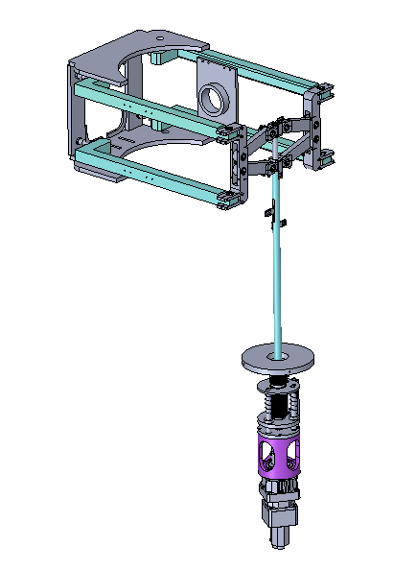
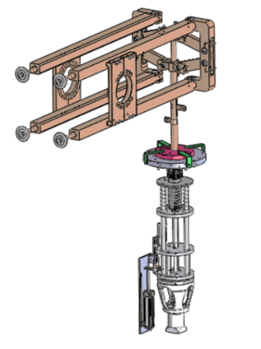
The Demo 25 MeV SRF Linac
IMP
HEBT
162.5 MHz HWR015
162.5 MHz HWR010
RFQ
MEBT
ECRIS
IHEP
12 scissor tuner for HWR010
5 scissor tuner for Taper HWR015

Slide 4
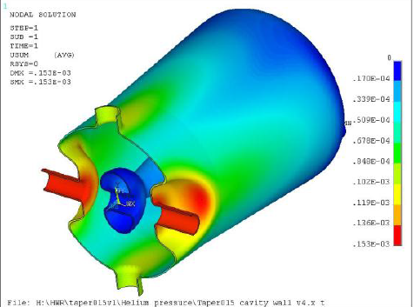
Specifications
Parameters | HWR010 Design | HWR015 Design
Frequency(MHz) | 162.5 | 162.5
Tuning sensitivity(KHz/mm) | 180 | 110
Tuning force(KN/mm) | 2.2 | 1.2
Tuning resolution(Hz) | 9 | 9
Tuning resolution (step/nm) | 44 | 64
Tuning range(KHz) (push condition) | 160 | 110
Fine tuning range(Hz) | 180 | 180
Backlash Tolerance(Hz) | ＜2 | <2
Max. Stress - 460Mpa/mm
Max. Stress - 330Mpa/mm

Slide 5
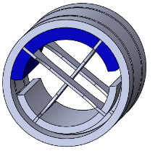
Tuner Structure
HWR010 Tuner
HWR015 Tuner
dual-member lever arms
anti-backlash pivot
Beam flange
zero backlash
pivot joints
scissor
Tuner Attachment Points
Cryomodule flange
speed reducer
stepper motor
Material: TC4
condition: pre-pressing
Tuner sketch

Slide 6
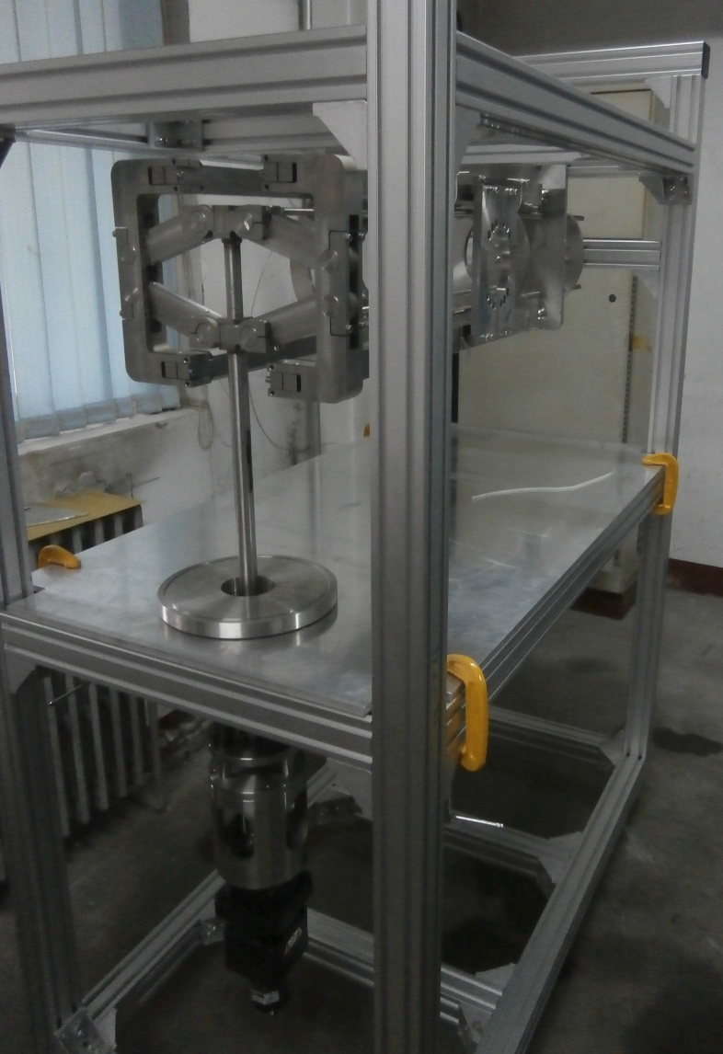
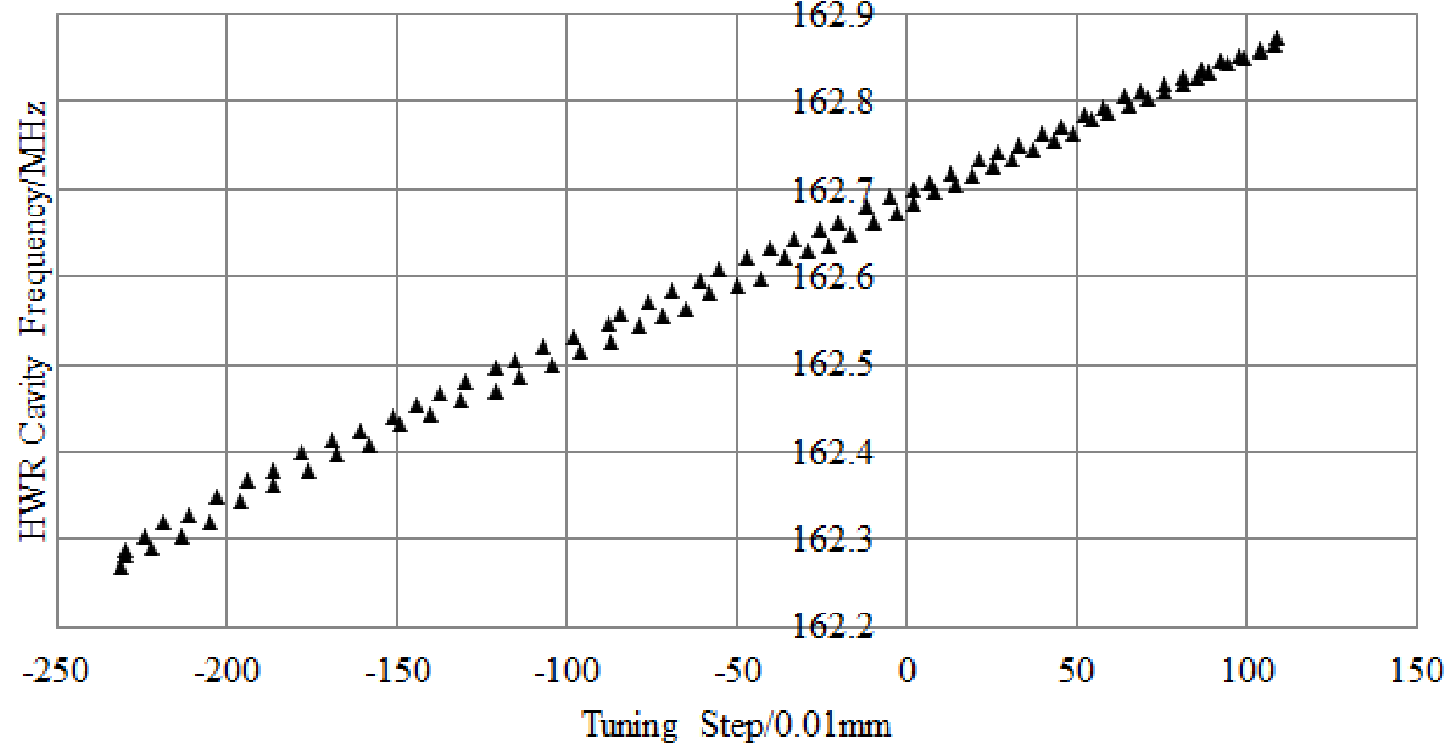
HWR010 Tuner Test Result at Stand
Enhancing the strength of the arm
Δf/ ΔL=170KHz/mm

Slide 7
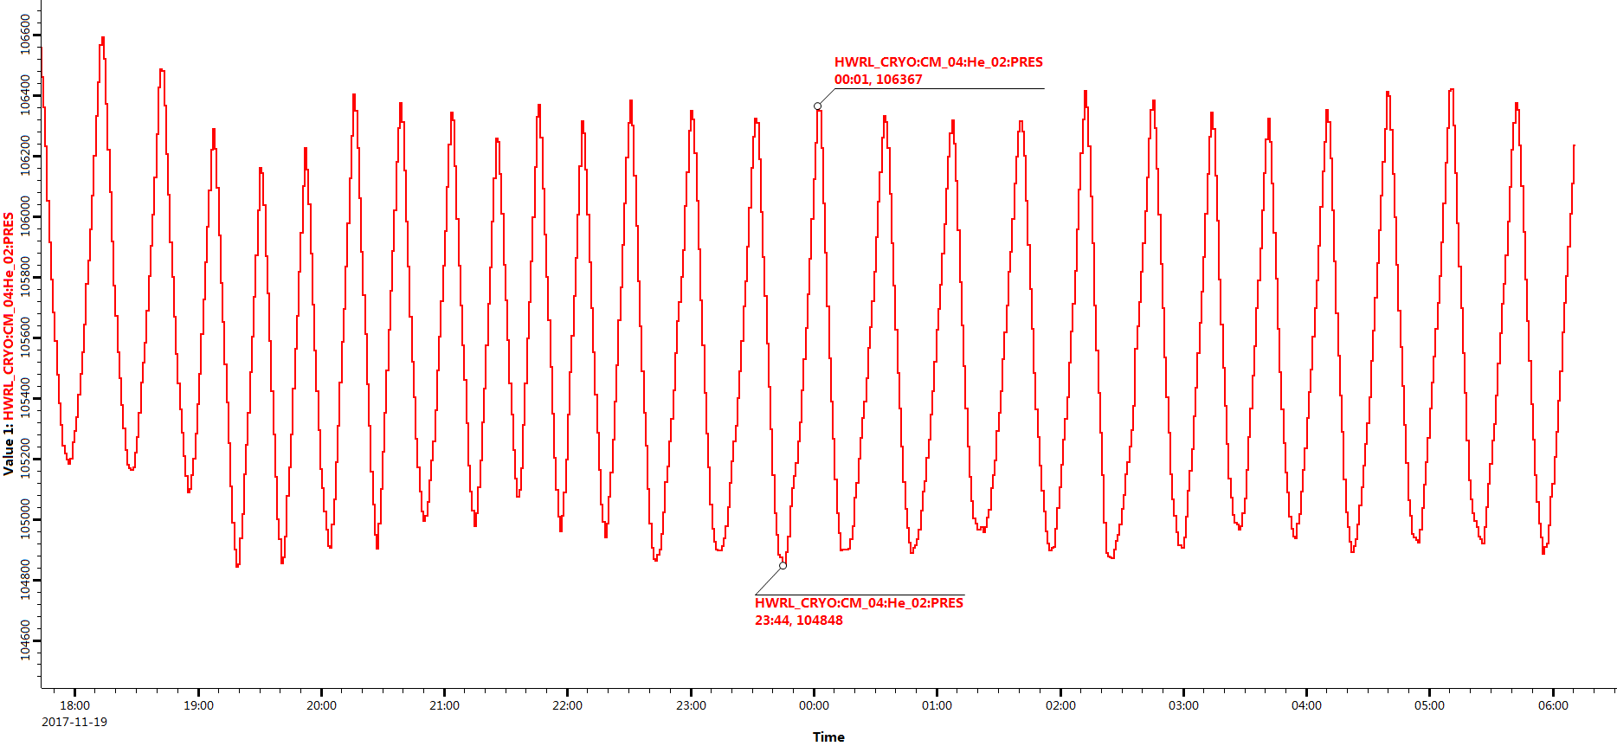
Helium Pressure Fluctuation
For the same helium pressure fluctuation, the frequency of the phase loop unlock of HWR015-CM is higher than HWR010-CM.
Varing in one direction, the phase loop can be locked more stable
For fluctuation, phase loop sometimes will be unlocked
Helium Pressure

Slide 8
Possible Reasons
Q_{ext} of the coupler is different, bandwith of HWR015-CM is less than half of HWR010-CM.
Require faster response of HWR015 CM3 tuner
Tuner performance
Return difference
 | Qe | Bandwith
HWR010 CM1 | 5.2E5 | 312
HWR015 CM3 | 1.2E6 | 136

Slide 9
Return Difference
Flexible joint
Machining and assembly accuracy of the linear motion unit
Control system
...
Possible Reason ?

Slide 10
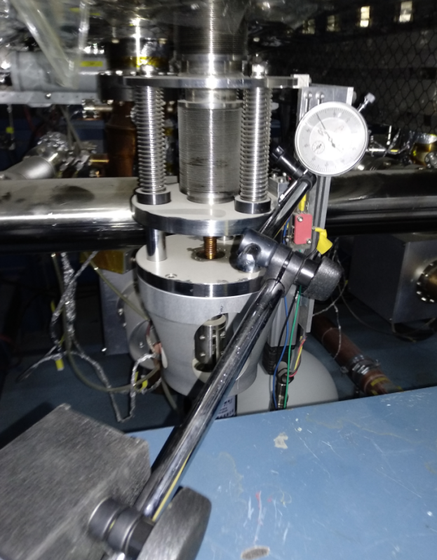
Test The Linear Motion Unit
A constant step of motor motion (5000 steps)
Corresponding displacement of movable plate is measured by micrometer gauge
micrometer gauge
Movable
plate

Slide 11
Linear Part Test Result
Machining and assembly accuracy of the linear motion unit is the problem.

Slide 12
Improvement
Reduce the return difference
Increase the stability of cavity

Slide 13
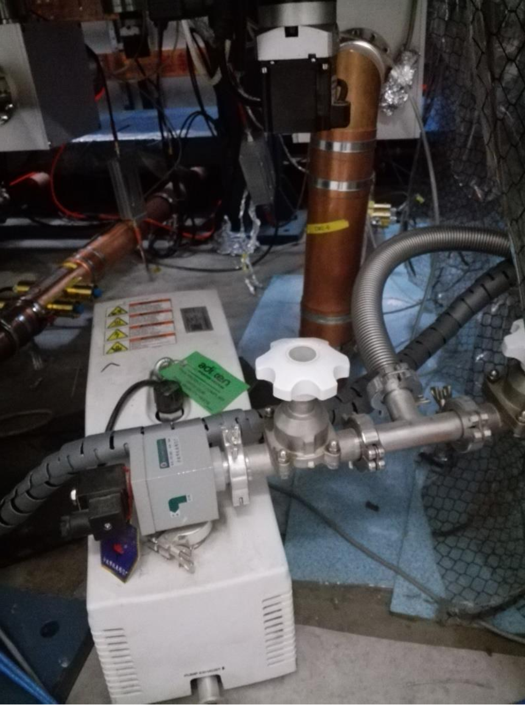
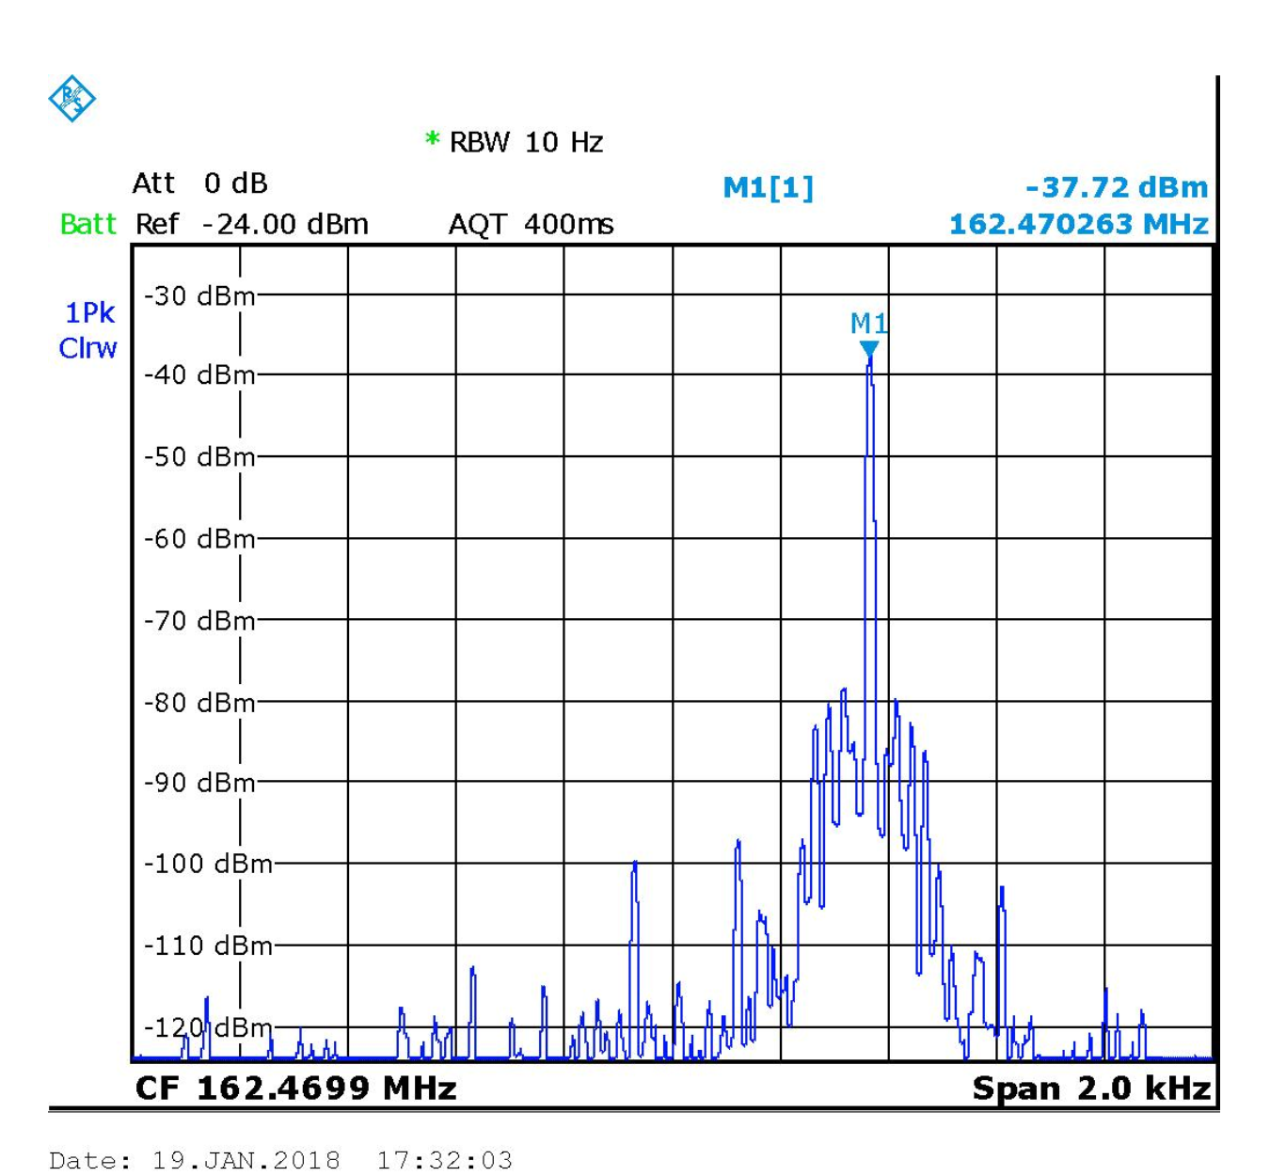
Microphonics*
25.7dBc
CM2-6 works unstable
The sideband of reflected signal from coupler appeared when the RF drive signal of solide state amplifer set to -30 dBm (0.001 mW).
Pick up
Vibration source removed
*Zheng GAO, “LLRF commissioning of 25 MeV Proton SC Linac and design for 500 MeV CW Linac”, this meeting.

Slide 14
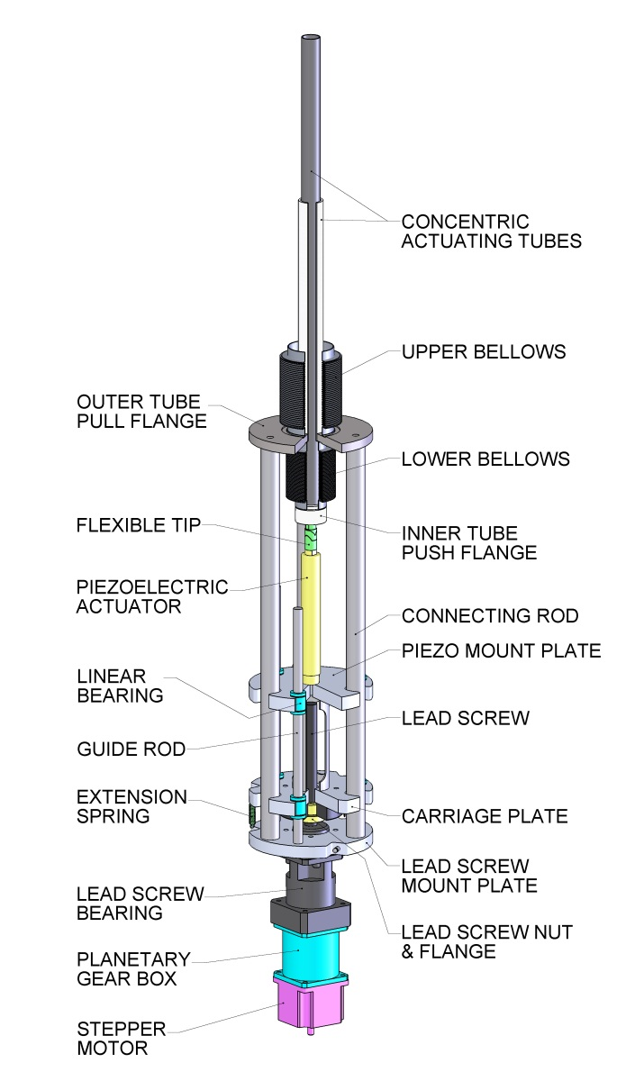
Future HWR010 Tuner -- Piezo
Stochastic background noise
Microphonics
Electromagnetic-mechanical vibration
Thermal acoustic oscillation
Piezo
PIEZO
PI Corp.：
the length 147mm
In-series piezoelectric actutaor is in the design

Slide 15
Summary
HWR010 tuners work for more than four years, they can work out slow helium pressure fluctuation. The speed, force and resolution of the tuner to be fully adequate to the requirements.
HWR015 tuners have return difference due to machining errors.
To compensate the microphonics effect, an in-series piezoelectric actuator is considering to be exploited.

Slide 16
Thanks for your attention

