Slide 1


XFEL commissioning and operation
Julien Branlard
MSK, DESY
on behalf of the LLRF group
TTC 2018, Milan, 08.02.2018

Slide 2
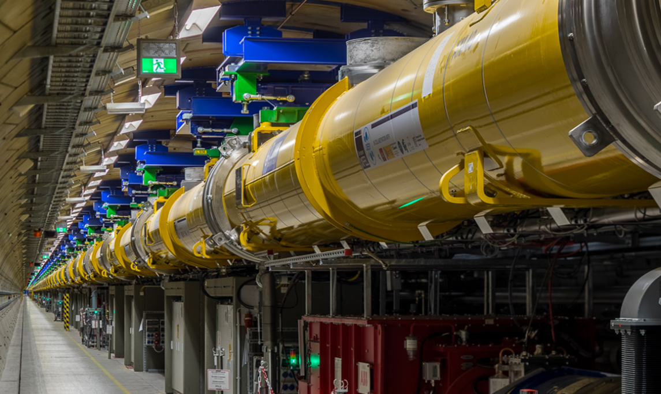
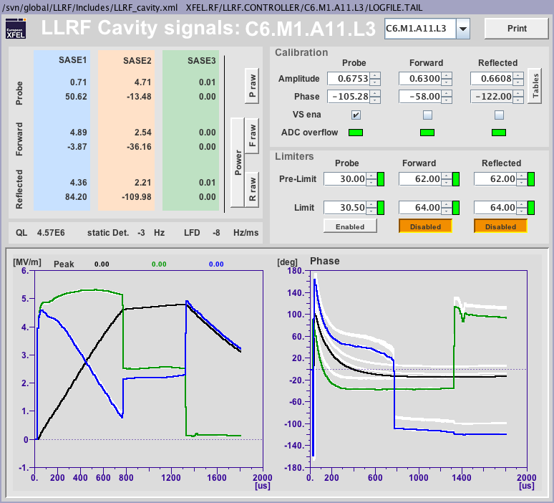
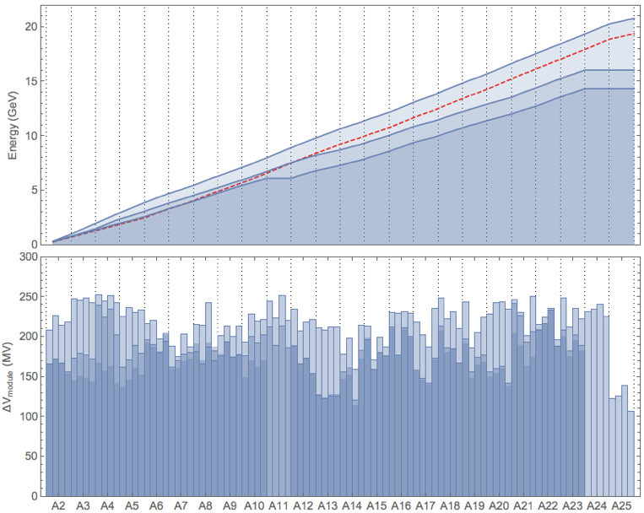
OUTLINE
Introduction: the European XFEL accelerator
  Key figures
  An RF station
RF commissioning
  Organization
  Tool automation
  Issues: multipacting, coupler heating, field emission
  From commissioning to user run
Operation
  Energy reach
  Radiation
  Availability
  Cryo-RF
Summary and outlook

Slide 3
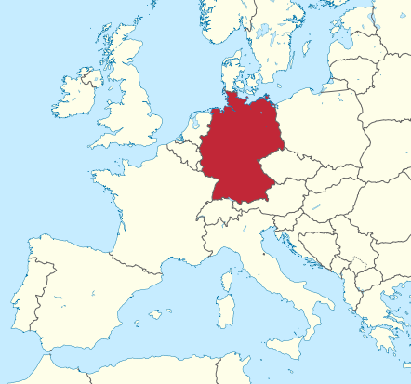
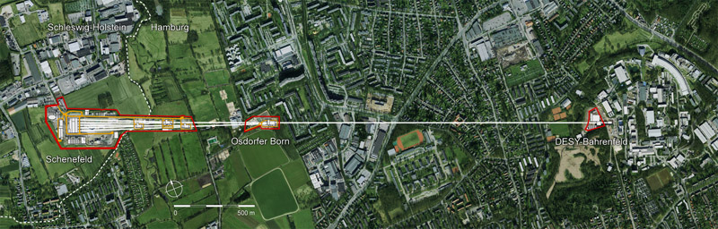


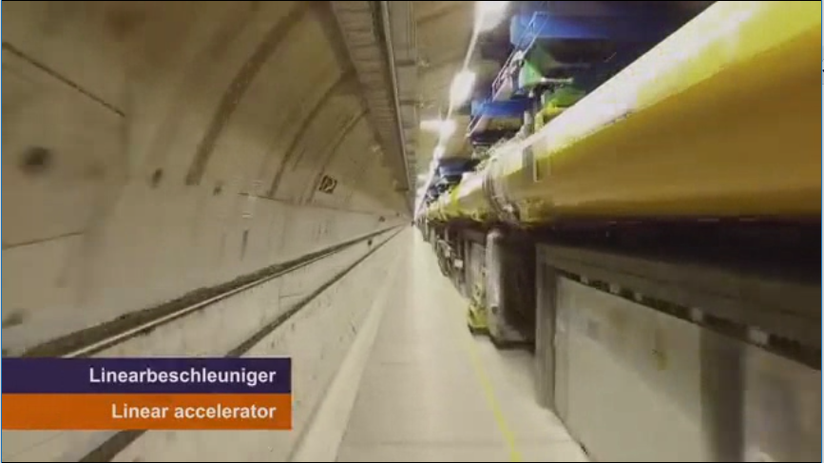

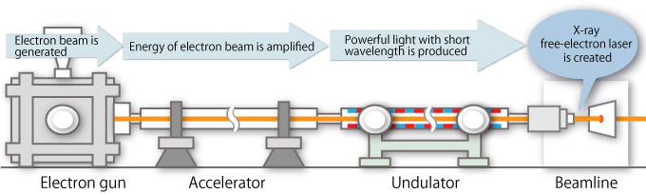

INTRODUCTION: the European XFEL
Hamburg
3.4 km
DE
The European X-ray Free Electron Laser
  17.5 GeV light source user facility
  TESLA superconducting 1.3 GHz RF cavities
  1.4 msec RF pulses at 10 Hz
  e- beam 1.35 mA nom., up to 500kW beam power
  The XFEL accelerator
  800 SRF cavities, couplers, tuners
  (720 in operation for now) + 64 next months
  101 cryomodules, 26 RF stations
  2 years of cavity / cryomodules tests / tunnel installation
watch online:
https://www.youtube.com/watch?v=p3G90p4glQA

Slide 4
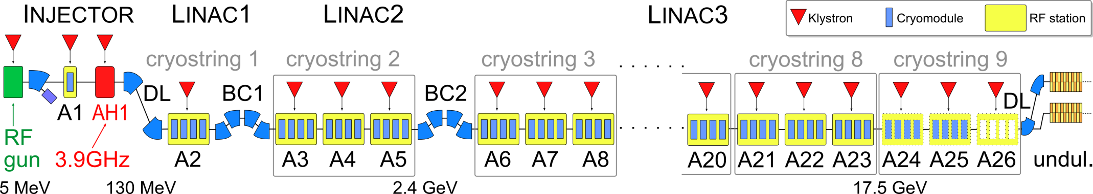
INTRODUCTION: an RF station
CM1 (8 cav.)
CM2 (8 cav.)
CM3 (8 cav.)
CM4 (8cav.)
KLYSTRON
One RF station comprises:
  1x 10 MW klystron
  32x TESLA type cavities housed in 4 cryomodules
  32x motorized power couplers
  32x motorized tuners
  64x piezo (actuator / sensor)
  36x motorized phase shifters (1/ cav + 1/ cryomodule)
  100+ RF channels (probe, forward, reflected)
  600+ RF connections
Technical commissioning represents >50% of the commissioning time
Intersystem commissioning is a key factor of the commissioning time

Slide 5

COMMISSIONING

Slide 6

COMMISSIONING of the European XFEL
RF
  First RF
  Required RF gradient and stability
Beam
  First beam
  Required beam transmission at desired current
Photons
  First lasing
  Required photon energy for user
Not covered in this talk
[MOXAA1] “Commissioning of the European XFEL Accelerator”, W. Decking, H. Weise
[THOAA3] “Installation and first Commissioning of the LLRF System for the European XFEL”, J. Branlard et al.

Slide 7
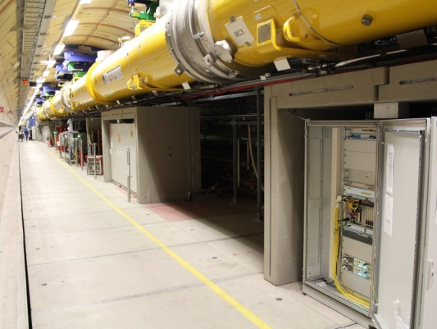
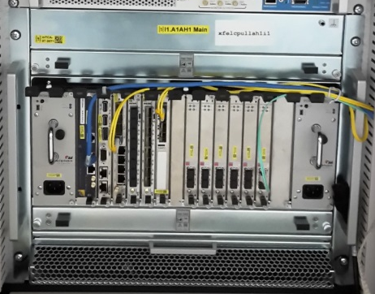
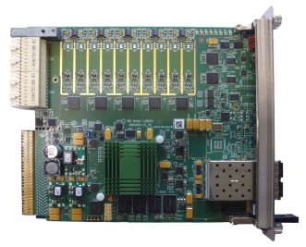
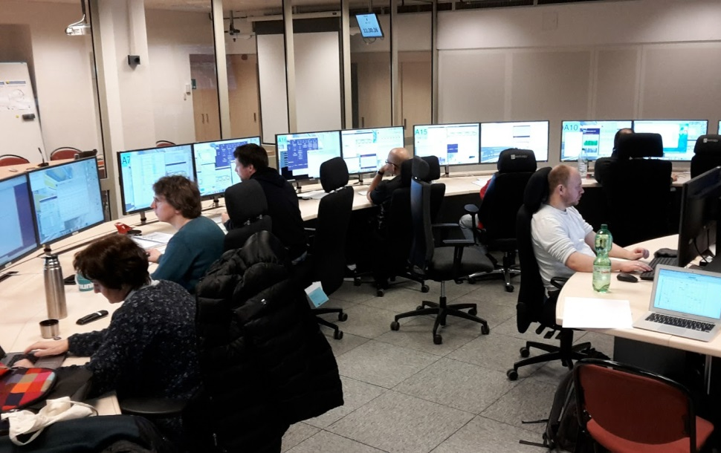
RF COMMISSIONING
Pre-commissioning
  Board level
  Crate level
  Rack level
Large machine → large team
  e.g. for XFEL
    20 people
    8 LLRF experts
    Support from other institutes
Parallel work
  RF station wise
See Talk:
Mathieu Omet: [WG-3 Session 1] Monday AM
LLRF of the European XFEL
INTEGRATION TEST !!!

Slide 8
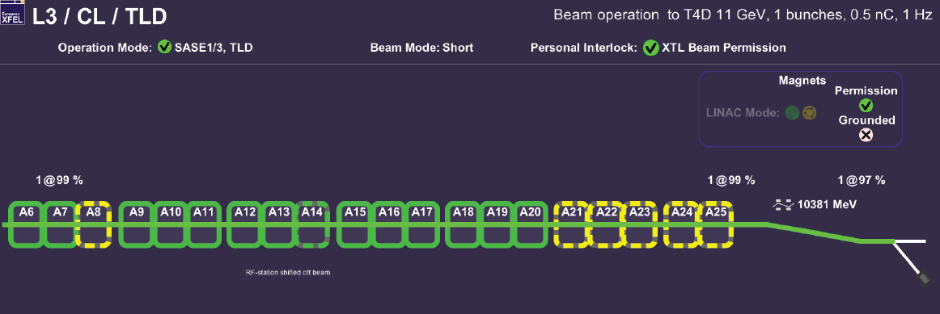
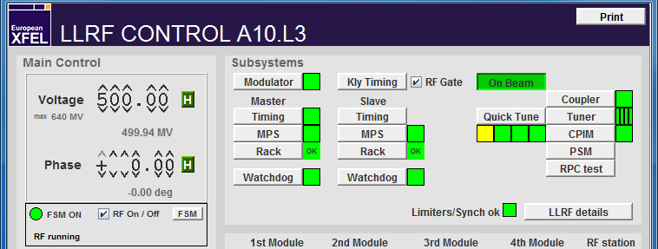
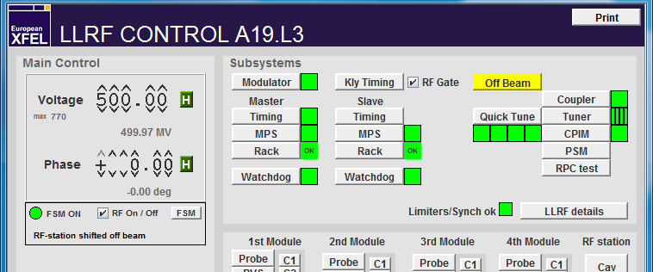
RF COMMISSIONING
IN operation
ON beam
IN operation but
shifted OFF beam
Not ready for beam
operation hence
shifted OFF beam
A21

Slide 9
RF COMMISSIONING LLRF milestones
RF ONLY
Initial checks. LLRF system ready for commissioning ?
RF signal checks: Forward and Reflected. Cabling issues? Signal saturation?
Frequency tuning. From parking position to resonance.
RF signal checks: Probe. Cabling issues? Signal saturation?
Coupler tuning. Target Q_{L} = 4.6e6.
Power-based gradient calibration. Coarse
Closed-loop operation. Feedback, learning feedforward, …
Establish beam transport. 30 bunches, 0.5nC.
Cavity phasing. Using waveguide phase shifters.
Beam-based gradient calibration. Fine relative calibration.
Absolute validation using energy server.
READY FOR BEAM

Slide 10



RF COMMISSIONING
2 weeks
12/16 Linac cool down to 4K
01/17 Injector to 130 MeV (3 RF stations)
01/17 Linac 1 (+1 RF station)
02/17 Linac 2 (+3 RF stations)
02-04/17 Linac 3 (+15 + 3 RF stations)
04/17 First beam through undulator section (SASE1)
05/17 First lasing
05-08/17 SASE1 photon beamline + experimental hall
09/17 First users (total 800 hours)
2018 Further commissioning + 2000 hours users
2019 Nominal operation with 6 experiments + 4000 hours users
Milestone:
RF ready
4 months
2 weeks
1 month
Milestone:
First lasing
5 months
2 weeks
2 months
Milestone:
First users
9 months
Photo: shutterstock.com

Slide 11
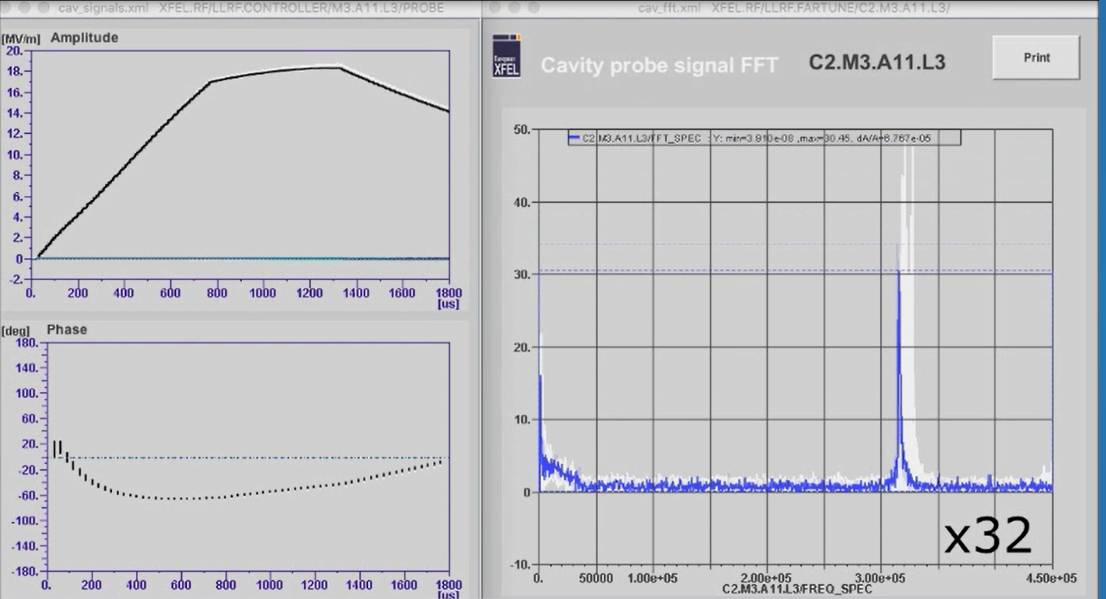


COMMISSIONING: tool automation

Slide 12
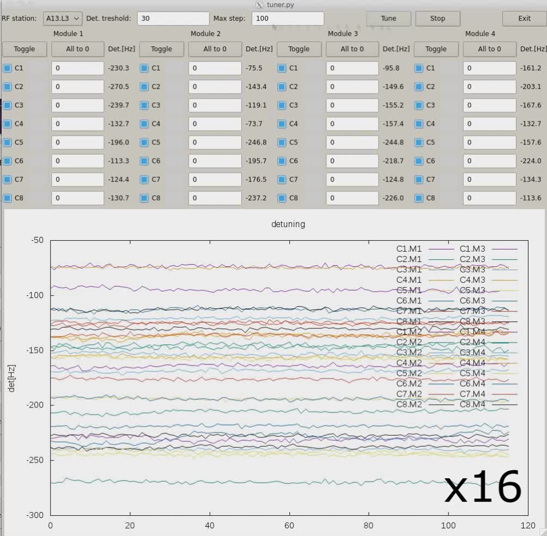
COMMISSIONING: tool automation
Cavity tuning

Slide 13
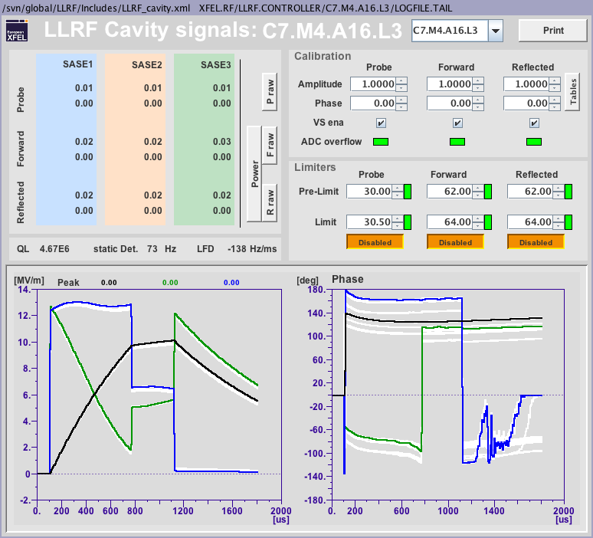
COMMISSIONING: tool automation
RF signal checks (1/2)
“what’s wrong with this picture?”

Slide 14
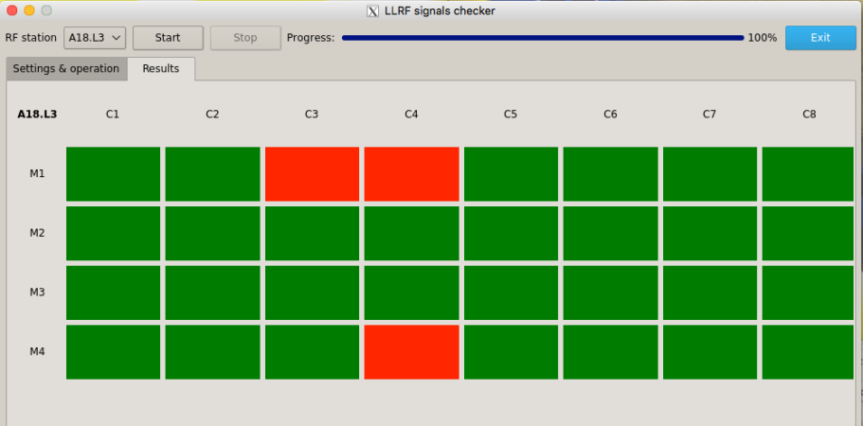
COMMISSIONING: tool automation
RF signal checks (2/2)
  3-4 mins per RF station
  Verify phase shifter functionality (32x)
  Identify cabling errors:
    FORW ↔ REFL
    C1 ↔ C2
Reminder:
  LLRF has 2500+ RF signals
    Probe
    Forward
    Reflected
  x2 counting int/ext cabling
Cabling issues
  15 cabling issues (outer rack) identified before cool down
  11 cabling issues (outer rack) identified after cool down
  0 cabling issues (inner rack) identified so far
< 1%

Slide 15
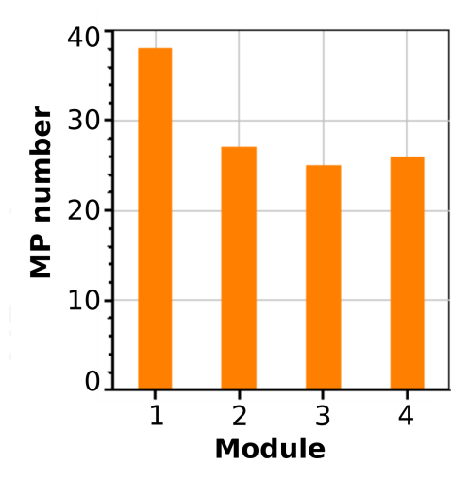
COMMISSIONING: multipacting conditioning (1/2)
Multipacting
  Observed on nearly all stations tested so far (A2-A23)
  Start appearing around 17-18 MV/m
  Conditionable on all stations
  Required couple of hours per station (@10 Hz)
Courtesy D. Kostin
See Talk:
Denis Kostin
[HT Session ]
Wednesday PM
Multipacting and conditioning cases for EU-XFEL

Slide 16
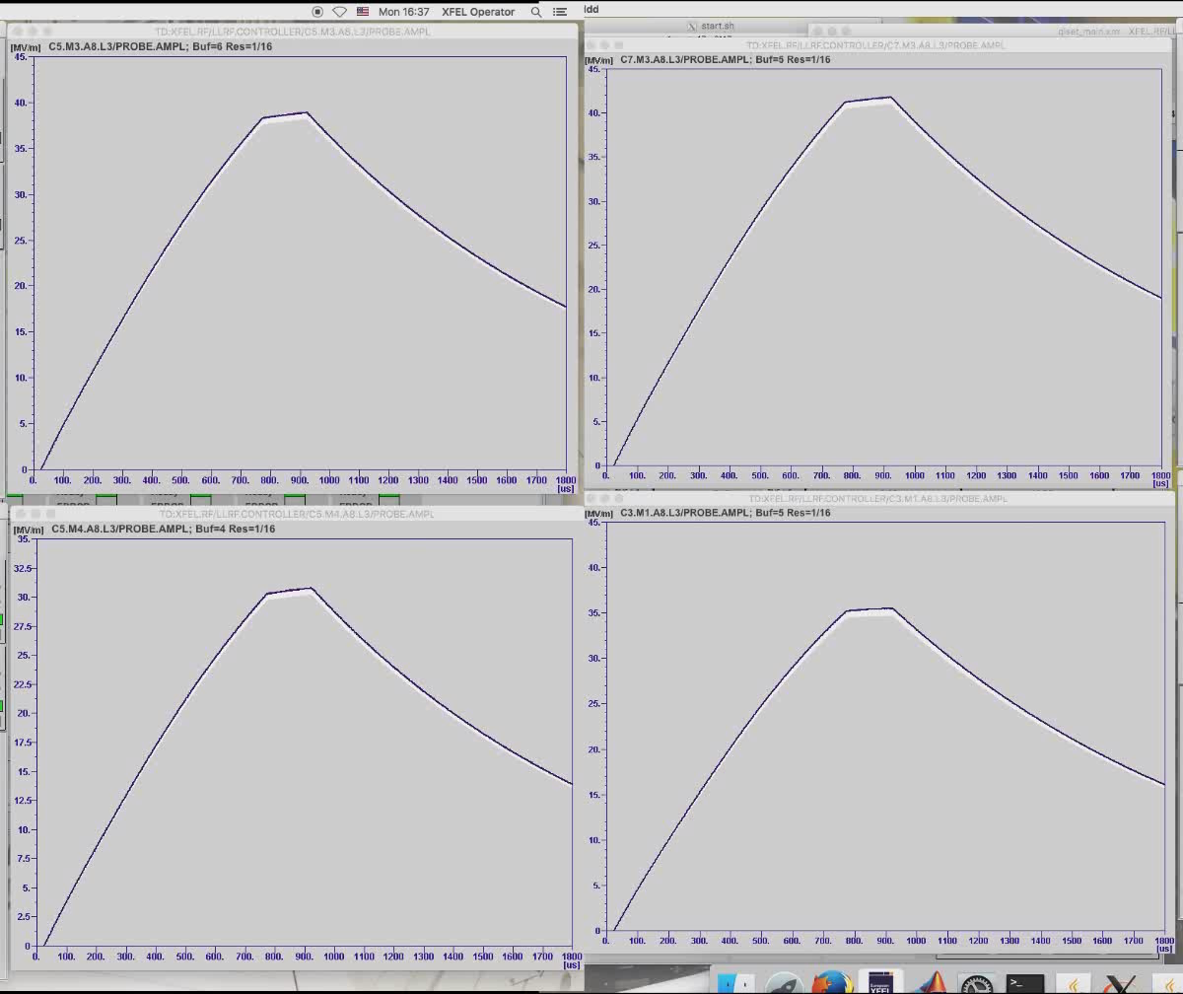
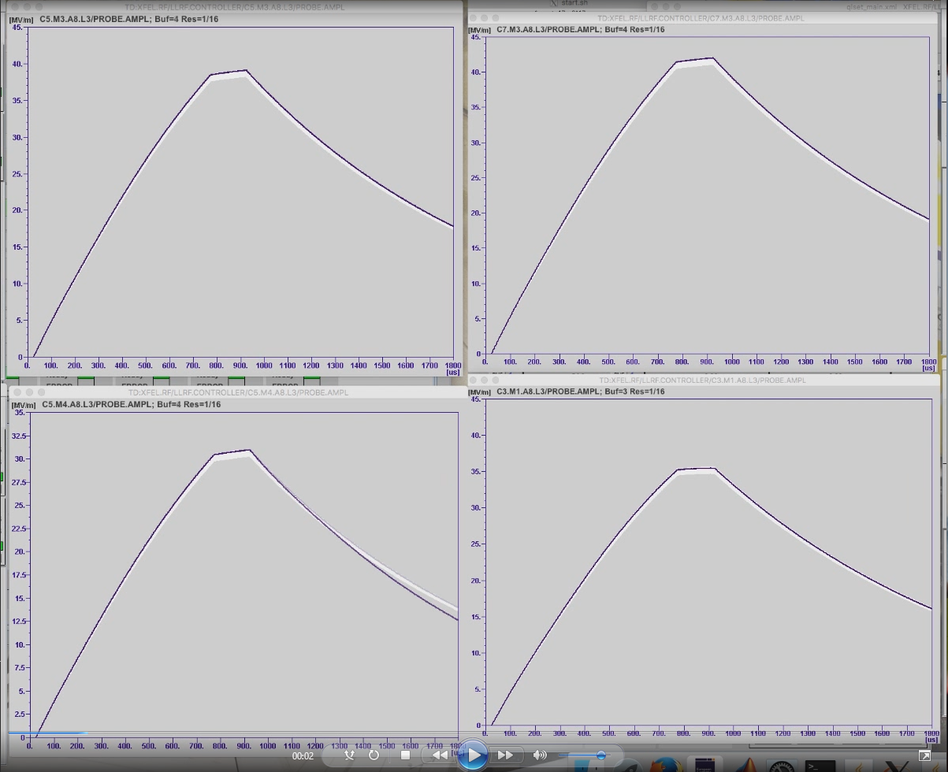
COMMISSIONING: multipacting conditioning (2/2)

Slide 17
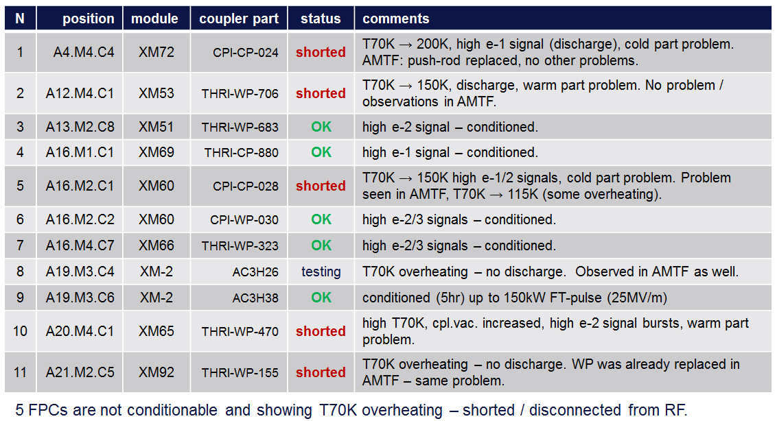
COMMISSIONING: coupler issues
< 1%
5 out of 720 couplers shorted after test in XTL
  A4.M4.C4 coupler problem: T70K [shorted]
  A12.M4.C1 coupler problem: T70K [shorted]
  A16.M2.C1 coupler problem: T70K [shorted]
  A20.M4.C1 coupler problem: T70K [shorted]
  A21.M2.C5 coupler problem: T70K [shorted]
Courtesy D. Kostin
See Talk:
Denis Kostin
[WG-2 Session 1]
Thursday AM
Main coupler R&D at DESY
Notes:
A18.M4.C4 (1e-2 mGy/min) @ 23 MV/m

Slide 18
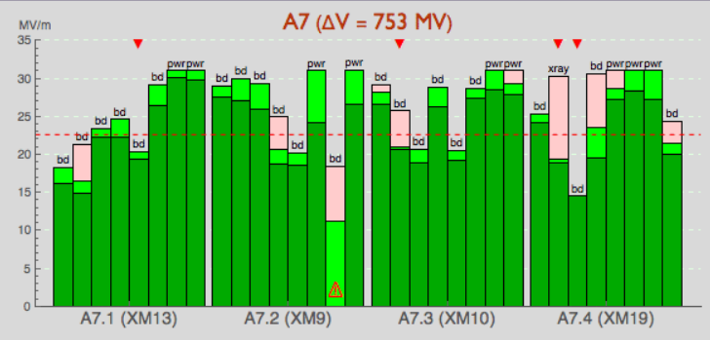
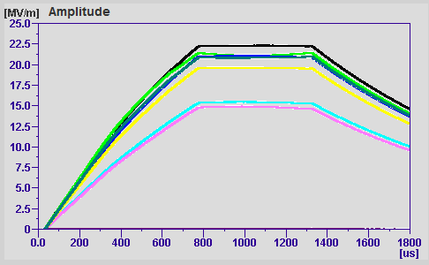
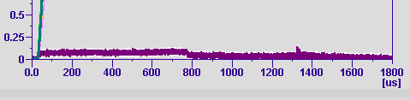
COMMISSIONING: field emission
< 1%
5 out of 720 cavities not used due to AMTF results
  A5.M1.C5 temporary, shorted pick up
  A6.M3.C1 high FE/X-ray (10 MV/m limit)
  A7.M2.C7 high FE/X-ray (11 MV/m limit)
  A10.M1.C3 low Eacc BD (no FE) (13 MV/m limit)
  A18.M4.C4 high FE/X-ray (23 MV/m limit + wrong P_{FORW})
A7.M2.C7
Courtesy N. Walker
Notes:
A18.M4.C4 (1e-2 mGy/min) @ 23 MV/m

Slide 19
COMMISSIONING: how many cavities per RF stations
11 out of 22 RF stations actually operate all 32 cavities (50%)
14 GeV
  ~ 80% of maximum reachable based on cryomodule HTS results
  Cavities operated at 21.4 MV/m on average
data from 05.02.2018
Linac | L1 | L2 |  |  | L3
Station | A2 | A3 | A4 | A5 | A6 | A7 | A8 | A9 | A10 | A11 | A12 | A13 | A14 | A15 | A16 | A17 | A18 | A19 | A20 | A21 | A22 | A23
Cav. in operation | 32 | 32 | 31 | 32 | 31 | 30 | 32 | 32 | 31 | 32 | 31 | 32 | 31 | 31 | 30 | 32 | 31 | 32 | 31 | 30 | 32 | 32
AMTF gradient | 867 | 983 | 989 | 924 | 827 | 753 | 843 | 827 | 860 | 939 | 880 | 843 | 748 | 770 | 919 | 842 | 911 | 858 | 948 | 923 | 870 | 919
Typ. operation | 616 | 593 | 593 | 593 | 710 | 630 | 718 | 700 | 750 | 740 | 600 | 701 | 620 | 630 | 780 | 600 | 740 | 540 | 650 | 800 | 660 | 750
Ratio to AMTF | 71% | 60% | 60% | 64% | 86% | 84% | 85% | 85% | 87% | 79% | 68% | 83% | 83% | 82% | 85% | 71% | 81% | 63% | 69% | 87% | 76% | 82%
Avg gradient | 19.3 | 18.5 | 19.1 | 18.5 | 22.9 | 21.0 | 22.4 | 21.9 | 24.2 | 23.1 | 19.4 | 21.9 | 20.0 | 20.3 | 26.0 | 18.8 | 23.9 | 16.9 | 21.0 | 26.7 | 20.6 | 23.4
2.4 GeV at BC2
14 GeV
Notes:
A18.M4.C4 (1e-2 mGy/min) @ 23 MV/m

Slide 20
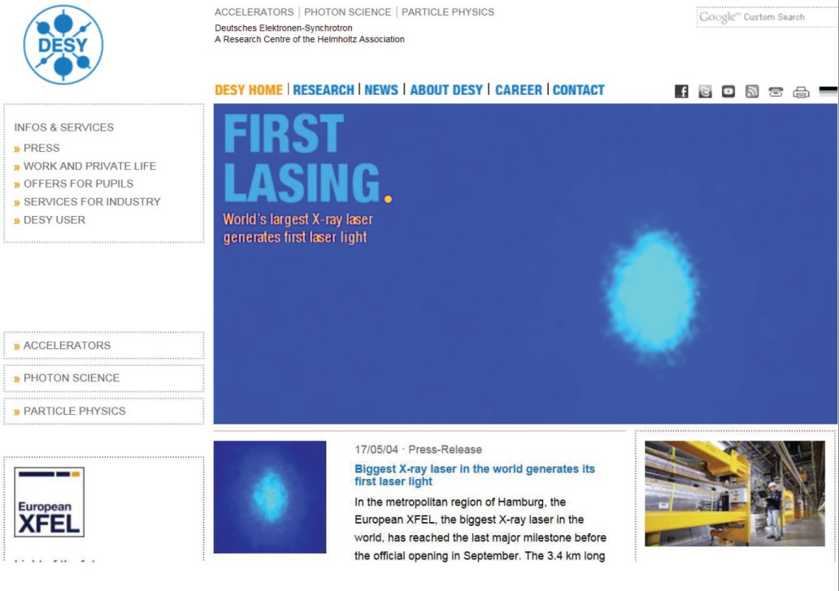

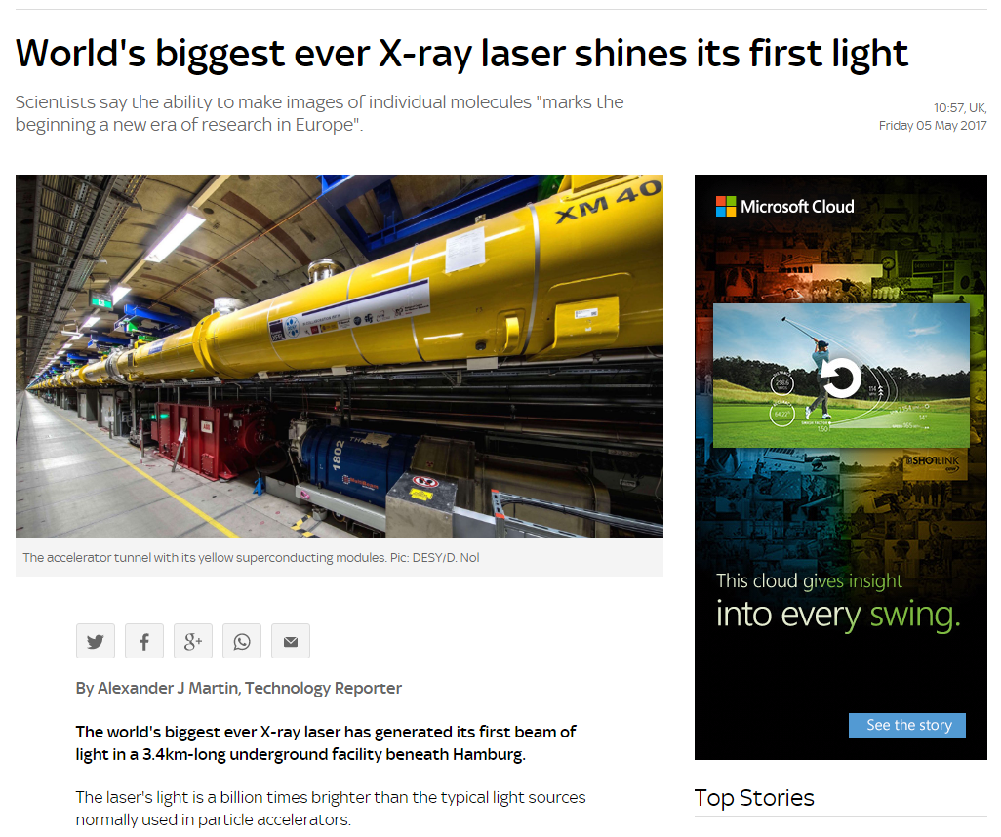
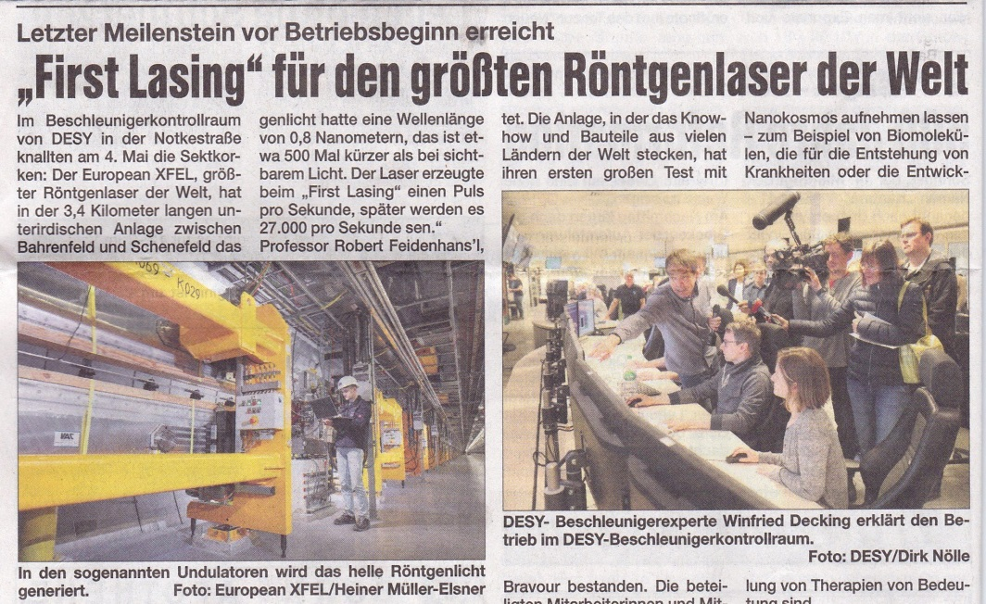
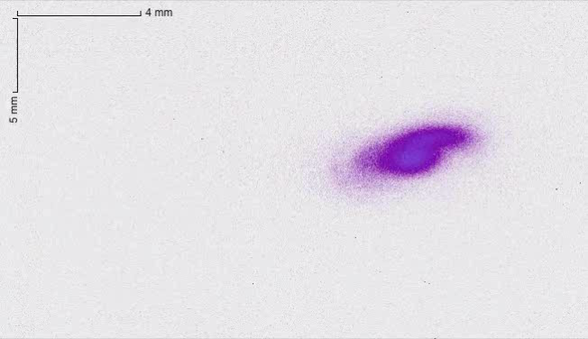
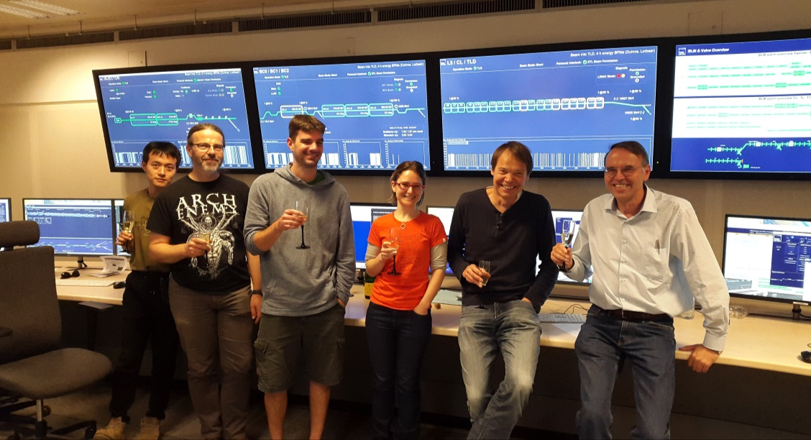
First RESULTS: Lasing!
First lasing 02-03 May 2017
E = 6.4 GeV
K = 3.5
1.3 keV

Slide 21
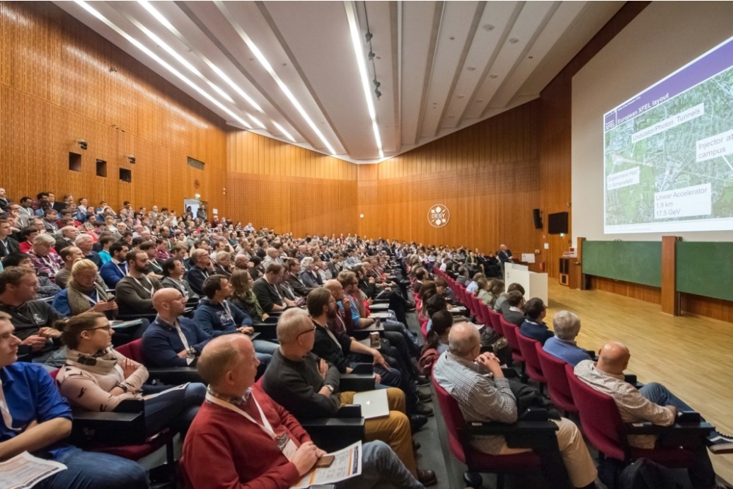
User meeting
May 2017: more than 1000 participants

Slide 22
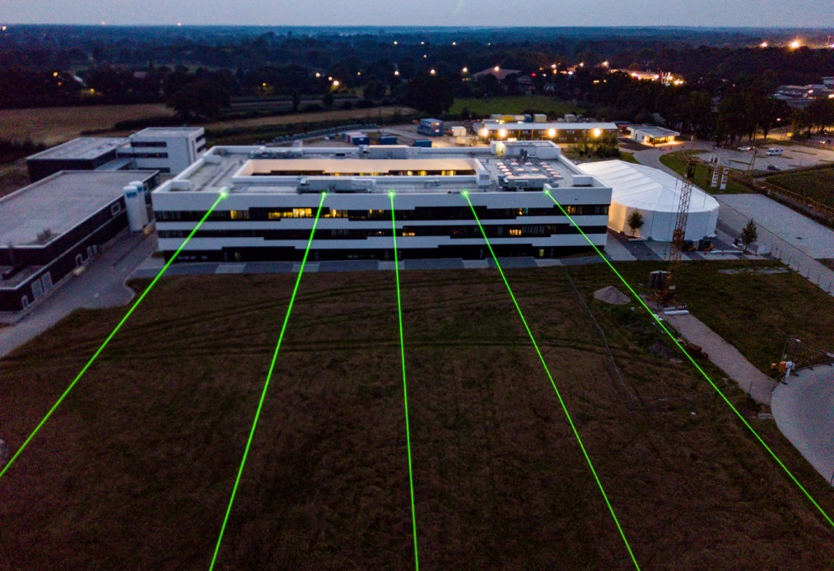
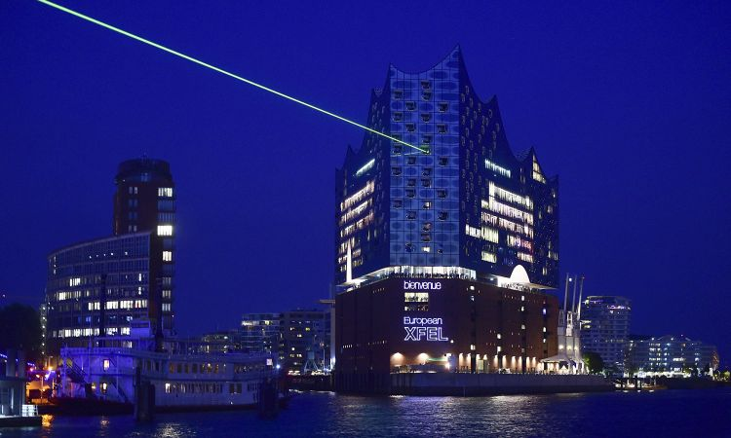
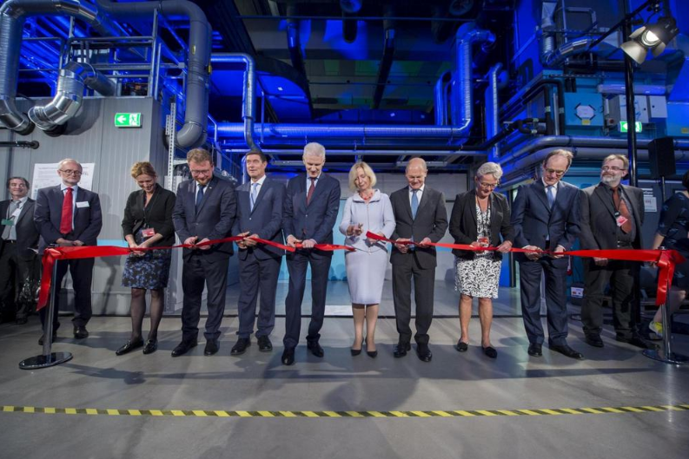
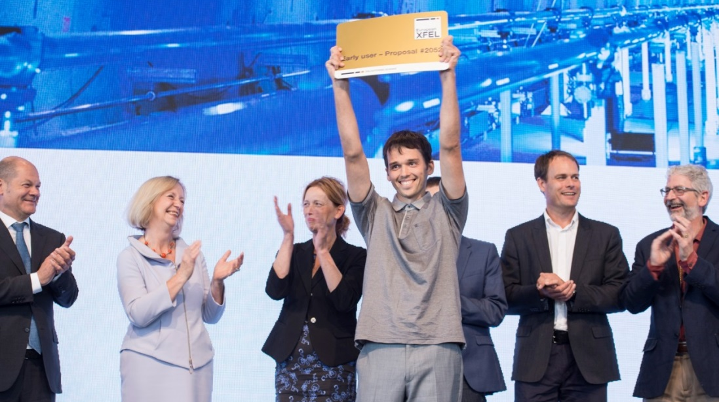
INAUGURATION: Sept. 1st 2017

Slide 23
OPERATION

Slide 24
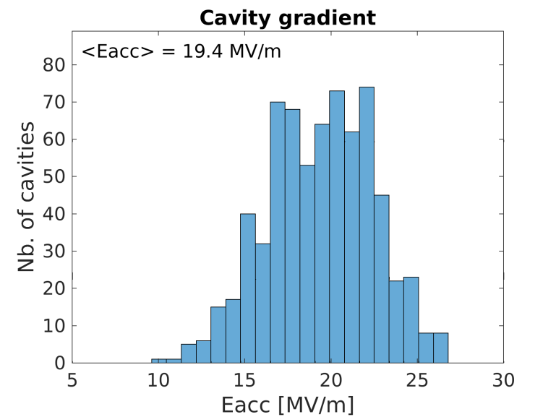
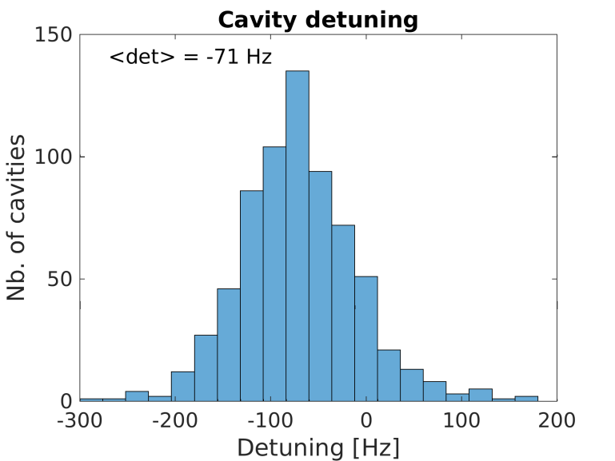
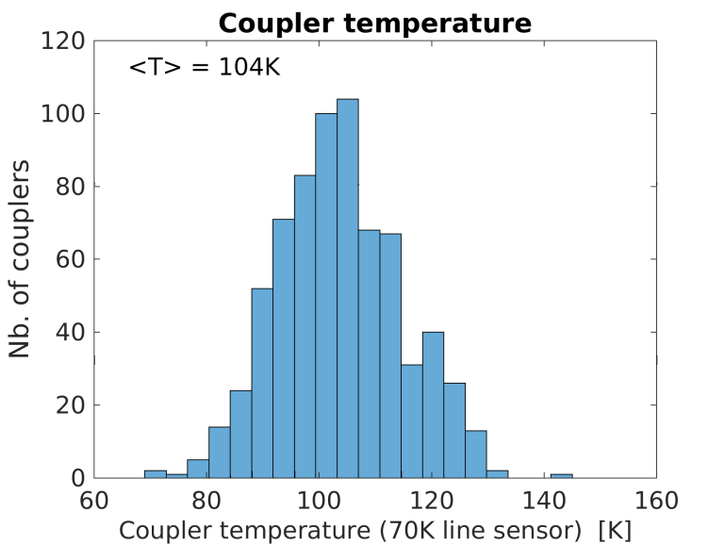
OPERATION: some statistics
Data taken during machine setup, just as an example (Feb. 6th 2018)
Data “as is” : no particular effort made to optimize parameters
14 GeV total energy → “only” 19 MV/m average energy (up to 28 MV/m)
Detuning offset + large spread → clearly piezo compensation is missing
Coupler temperature spread, within acceptable range

Slide 25
OPERATION: Energy reach (1/2)
Courtesy N. Walker
21 GeV (AMTF max)
XFEL design 17.5 GeV
19 GeV (AMTF max, nom. BC)
18 GeV (as above w/o CS9)
16 GeV (current possible)
14 GeV (current operation)
L1
L2
L3
CS9 soon to be commissioned (A24, A25)
CS9 not commissioned
Operational spare

Slide 26

OPERATION: Energy reach (2/2)
On-going effort to assess the maximum operation gradient for every RF station
Note: gradient calibration at AMTF and XFEL are different (power-based vs beam-based)
Courtesy M. Omet
RF station | AMTF [MeV] | XFEL [MeV] | XFEL / AMTF | Limitation
A10  | 860 | 770 | 89.5% | M3.C8 quenches at 19.8 MV
A11 | 939 | 800 | 85.2% | Coupler heating
A13  | 843 | 750 | 89.0% | M4.C1 quenches at 25.4 MV
A14 | 748 | 620 | 82.9% | Soft quench + field emission at M3.C5 and M3.C7
A15 | 770 | 710 | 92.2% | M4.C2 quenches at 19.4 MV
A18 | 911 | 750 | 82.3% | Klystron interlock
A19  | 858 | 703 | 81.9% | M3.C8 quenches at 18 MV
A20 | 920 | 620 | 67.4% | Waveguide sparking
A21 † | 893 | 870 | 97.4% | Missing piezo operation, M1.C5 quench at 30.3 MV
A22 | 870 | 845 | 97.1% | M3.C5 quenches at 19.9 MV
⧫ Could be improved with waveguide modifications
† Cavity gradient degradation (M4.C2: > 31 MV → 22.3 MV) → excluded from VS
See Talk: Mathieu Omet [WG-4 Session 3] Thursday PM
Experience with Commissioning of High-Gradient Cryomodules for Euro-XFEL

Slide 27
OPERATION: LLRF system, isolated failures
SSDs exchange
  RAID redundancy lost, slow writing to disk
  5 occurrences so far:
  FLASH: 20 occurrences in 6 years
Device needs to be reprogrammed
  MCH (x1)
  TCK7 (x1)
  FLASH: 2-3 occurrences
Lost Ethernet communication with device
  1 occurrence so far: (Nov. 2017 TMCB REFM-OPT)
  FLASH: 5-6 times (PDU)
radiation related ?

Slide 28
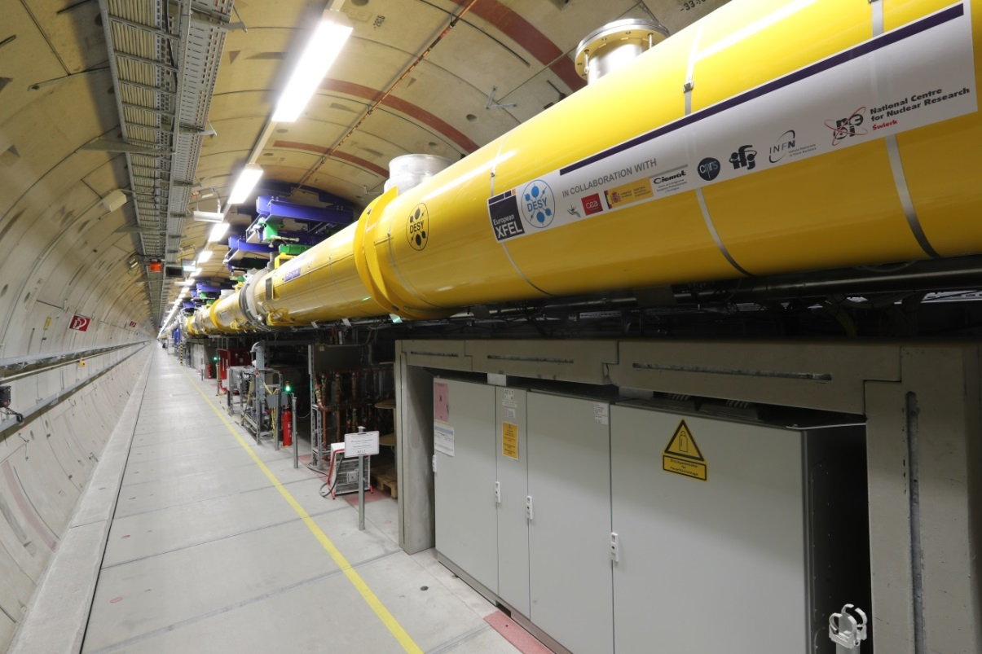
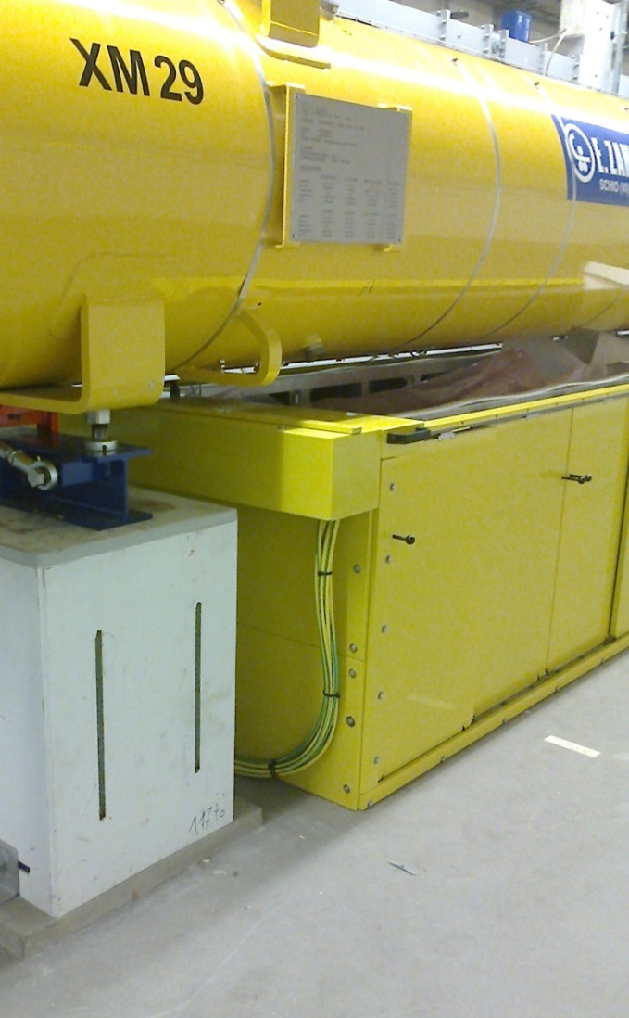
OPERATION: is radiation an issue ?
XTL
Regular TLD read outs
On-line dark current beam loss monitors
Weekly survey (MARWIN)
INJ

Slide 29
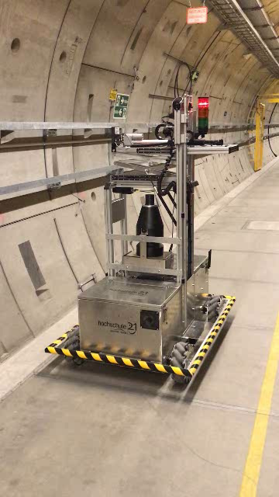
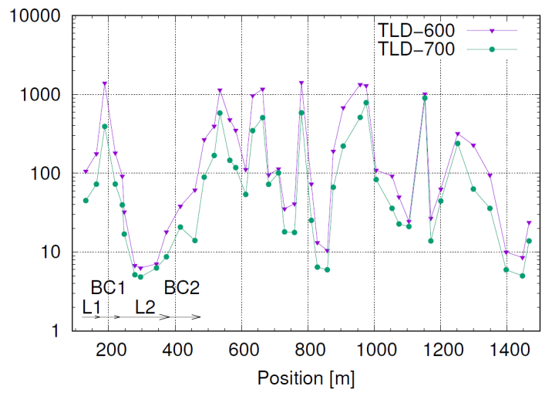
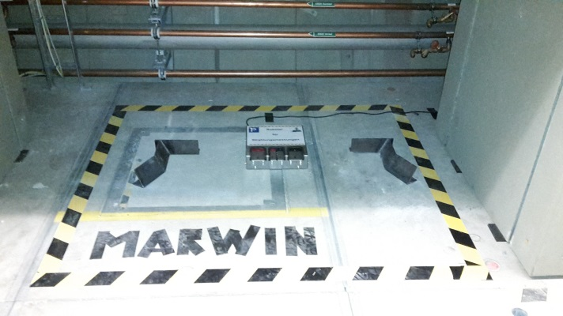
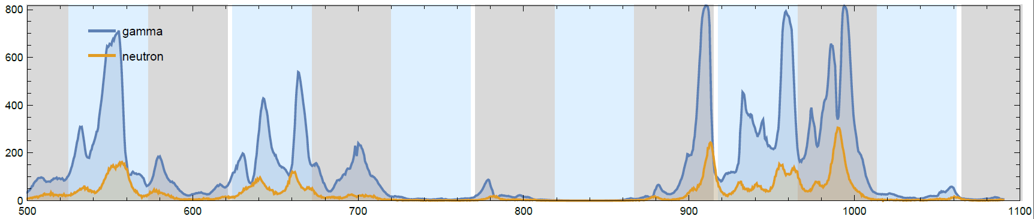
OPERATION: is radiation an issue ?
Radiation
  Online monitor
  Regular survey
  XFEL : MARWIN
Limit for electronics : 1 Gy / year
TLD readouts
Courtesy M. Hoffmann
2 month period:
12.10.2017 – 13.12.2017
Dose rate [μSv/day]
MARWIN: Mobiler und Autonomer Roboter für Wartung und INspektion
Film: M. Omet
A6
A7
A8
A9
A10
A11
A12
A13
A14
A15
A16
A17
A18
Dose rate [μSv/h]
Courtesy N. Walker
Tunnel position [m]

Slide 30
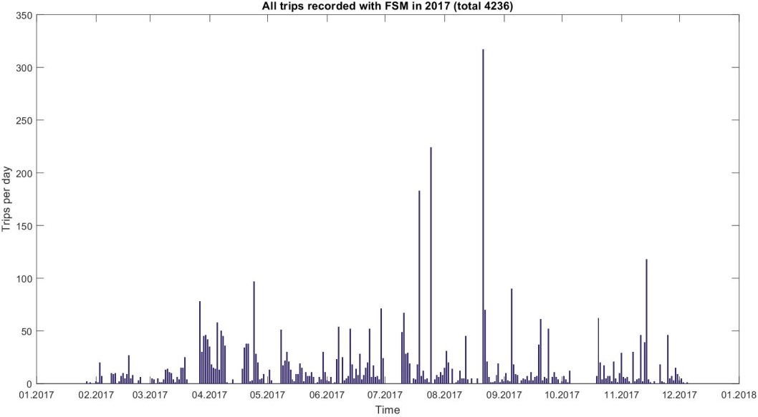
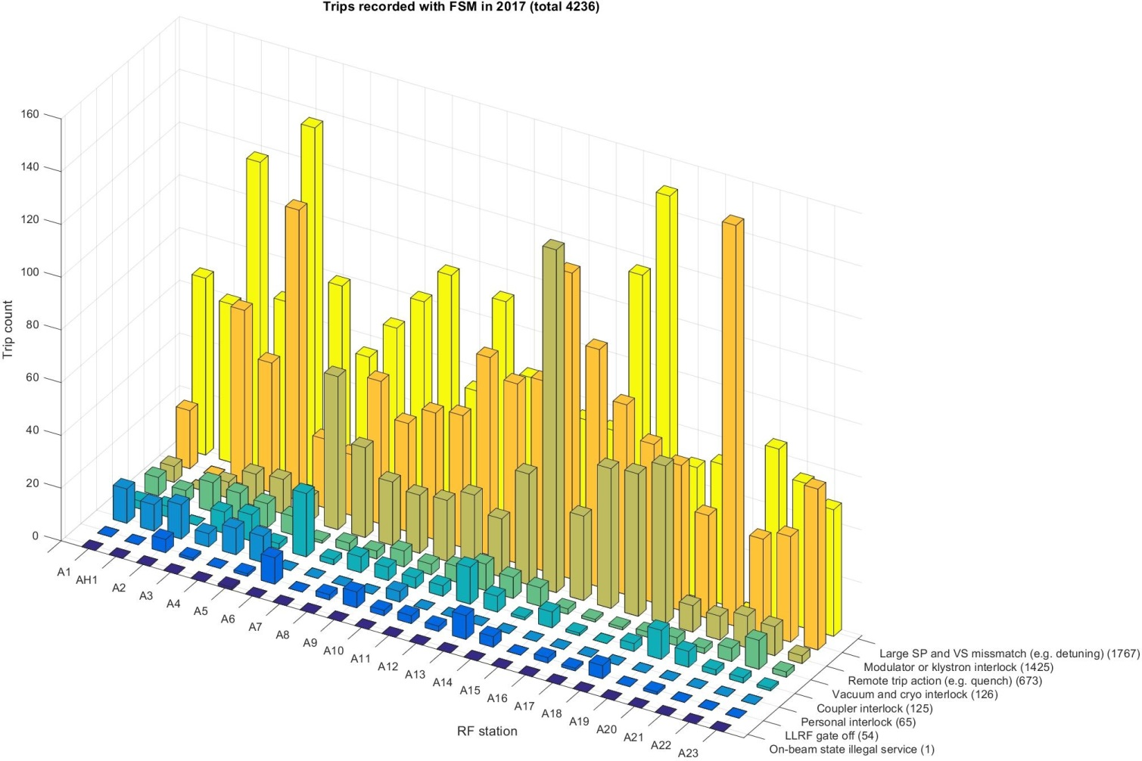

OPERATION: first look at availability
First time analysis
  Data source: FSM log files of RF stations A1 to A23 for 2017
  Total trip count: 4236
  8 categories of failures
  Mean time between failure: 1h 08m 43s
350
Trips per day
300
detuning related
250
high power RF related
200
150
100
50
0
Jan.
Feb.
Mar.
Apr.
May
Jun.
Jul.
Aug.
Sep.
Oct.
Nov.
Dec.
2017
Preliminary results → not published yet
Courtesy M. Omet
quench related
> 90%

Slide 31
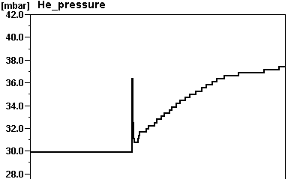
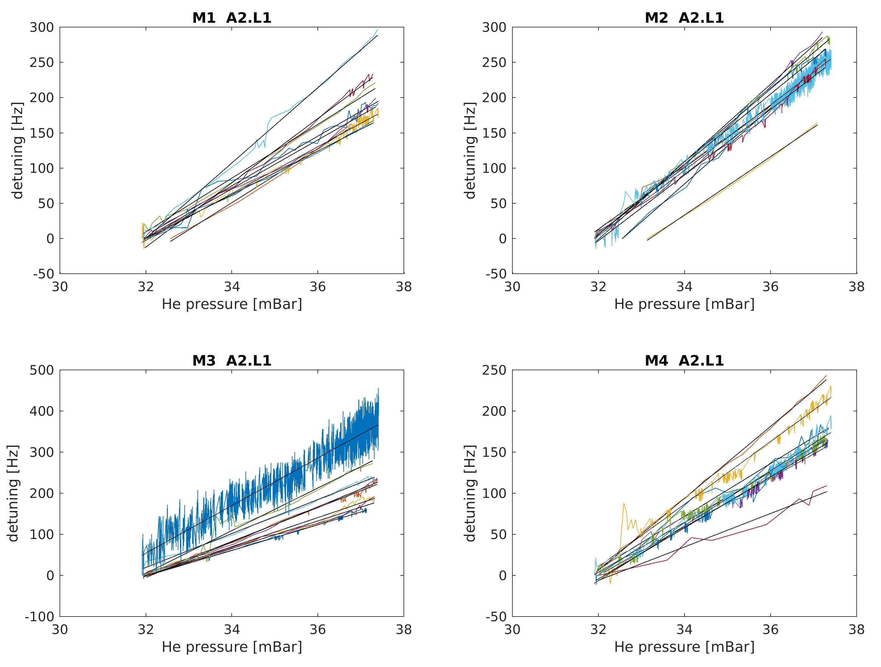
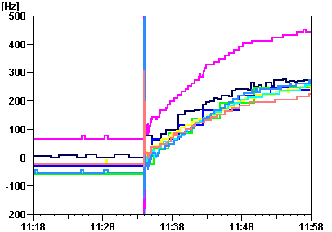

OPERATION: He pressure – RF tuning correlation
cryo event (cold compressor stops)
initial burst (shockwave ?)
He pressure
increase
nominal
Detuning M1.A2.L1
detuning burst
detuning
increase
nominal

Slide 32
SUMMARY
AND
OUTLOOK

Slide 33






SUMMARY and OUTLOOK
Very fast commissioning
  No fundamental issues (cryo, vacuum, RF)
  Automation + large team
2 successful user runs last year
  Sep. and Dec. 2017 (3 weeks each)
  Beam delivery above expectation
  (beam power, beam time)
BUT
Commissioning NOT complete
  Multi beamline
  LLRF : missing piezos drivers
  Performance commissioning
  Weekly study time reserved
Data analysis starts
  Big data analysis
  Availability analysis
  Smarter diagnostics
FXE
Femtosecond X-ray Experiment
May 2017 Jun. 2017 Jan. 2018
LLRF - METER

Slide 34
THANK YOU FOR YOUR ATTENTION!

Slide 35
BACKUP SLIDES

Slide 36







COMMISSIONING: tool automation
Power-based calibration
  1. Dynamic range optimization
  “Adjust attenuation so that available signal uses the optimal range of the digitizers”
  2. Forward power calibration
  “Scale forward power signals so they read actual kW, based on the power meter measurements”
  3. Probe and Reflected signal calibration
  “Scale reflected and probe signals so
  that Probe = Forward – Reflected”

Slide 37










OPERATION: RF performance
RF stability (in-loop)
Intra-pulse
Pulse-to-pulse
Preliminary results → not published yet
Intra-pulse
Pulse-to-pulse
Specifications:
Courtesy S. Pfeiffer

Slide 38


OPERATION: beam stability
05.16.2017 16:15:42 600 shots 10Hz
BC2
Energy measurements:
BC0: σ_{y} = 147 μm, D_{y}= -222 mm ⇒ σ_{E}/E = 6.6e-4
BC1: σ_{y} = 225 μm, D_{y}= -490 mm ⇒ σ_{E}/E = 4.6e-4
BC2: σ_{y} = 149 μm, D_{y}= -382 mm ⇒ σ_{E}/E = 3.9e-4
BC1
Preliminary results → not published yet
Energy stability:
1.6e-4 after the injector
1.1e-4 after L3
BC0
Courtesy: L. Fröhlich

Slide 39




OPERATION: waveguide sparks
Data from A13 – 7.11.2017 12:48

Slide 40
OPERATION: Energy reach
Courtesy M. Omet
On-going effort to assess the maximum operation gradient for every RF station
CS9 soon to be commissioned (A24, A25)

