Slide 1

Recent Progress in SRF Cavity Components and Module Test at FRIB
K. Saito on behalf of FRIB Cryomodule Department
MSU/FRIB SRF Development Manager

Slide 2
Outline
FRIB SRF Scope, Baseline Schedule, and SRF Overall Status
Progress with FRIB Cavity Components
  Cavity
    Low Q issue in the 0.085QWR production cavities and the resolution
    Certification yield
  HWR coupler
    MPF coupler
    Delivery ready for assembly
Cryomodule Test
  Module assembly
  Bunker test

Slide 3
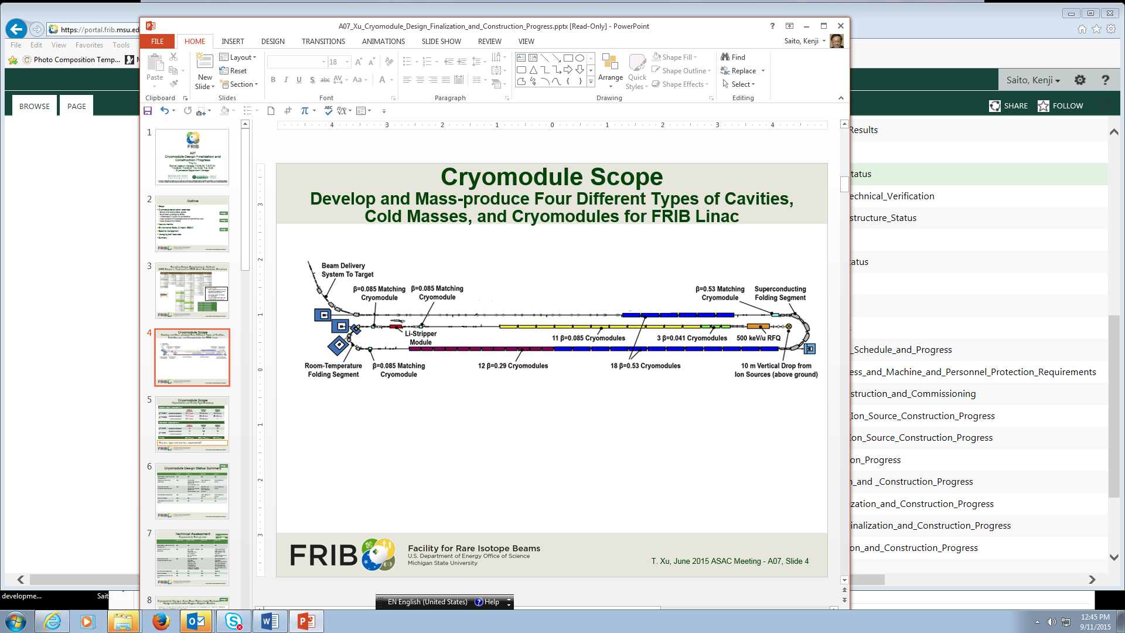
FRIB SRF Scope
SL1
SL3
SL2
Quarter Wave Cryomodule
β | Type | Component Counts (baseline + spares)
 |  | Cryomodules | Cavities | Solenoids
0.041 | accelerating | 3 + 1 | 12 + 4 | 6 + 2
0.085 | accelerating | 11 + 1 | 88 + 8 | 33 + 3
 | matching | 1 + 1 | 4 + 4 | -
Half Wave Cryomodule
0.29 | accelerating | 12 | 72 | 12
0.53 | accelerating | 18 | 144 | 18
 | matching | 1 | 4 | -
TOTALS |  | 46 + 3 | 324 + 16 | 69 + 5
2T Superconducting Dipole Magnets |  |  | 4
Largest heavy ion SRF linac and Half scale of UX-FEL
  Number of cryomodule 49
  Number of cavity 340
Early beam commissioning
  First three 0.041 CMs, May 2018
  SL1, SL2, and SL3
Cryomodule
  Built 13 CMs in 2017

Slide 4
FRIB SRF Baseline Schedule and Status
Cavity vendor production completes FRIB by Mid-2018.
  Accepted 315/340(93%) as date of January 31 2018
Cryomodule assembly/bunker test complete by 2019
  β=0.041 cryomodule production (4) by early 2017 (LS1)
  β=0.085 cryomodule production (11) by end- 2017 (LS1), completed all.
  β=0.29 cryomodule production (12) by mid-2019 (LS2), tow completed so far
  β=0.53 cryomodule production (18) by end-2019 (LS3), tow completed so far
Cryomodule production
  Totally 20 CMs were built so far, 13 CMs in 2017. All CMs meet FRIB specification.
  Planned to build 14 CMs in 2018 and 13 CMs in 2019
  Cryomodule production is on track for the baseline schedule
FRIB master schedule related to SRF construction
1 CM | 6 CMs | 13 CMs | 14 CMs | 13 CMs

Slide 5
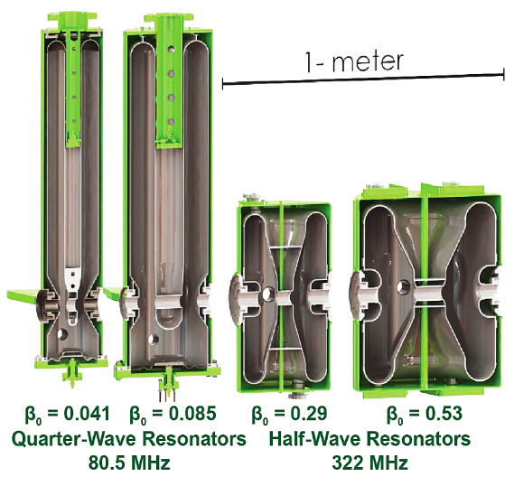
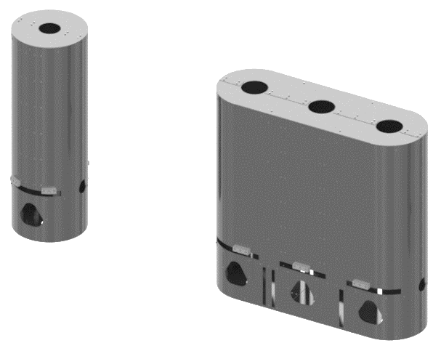
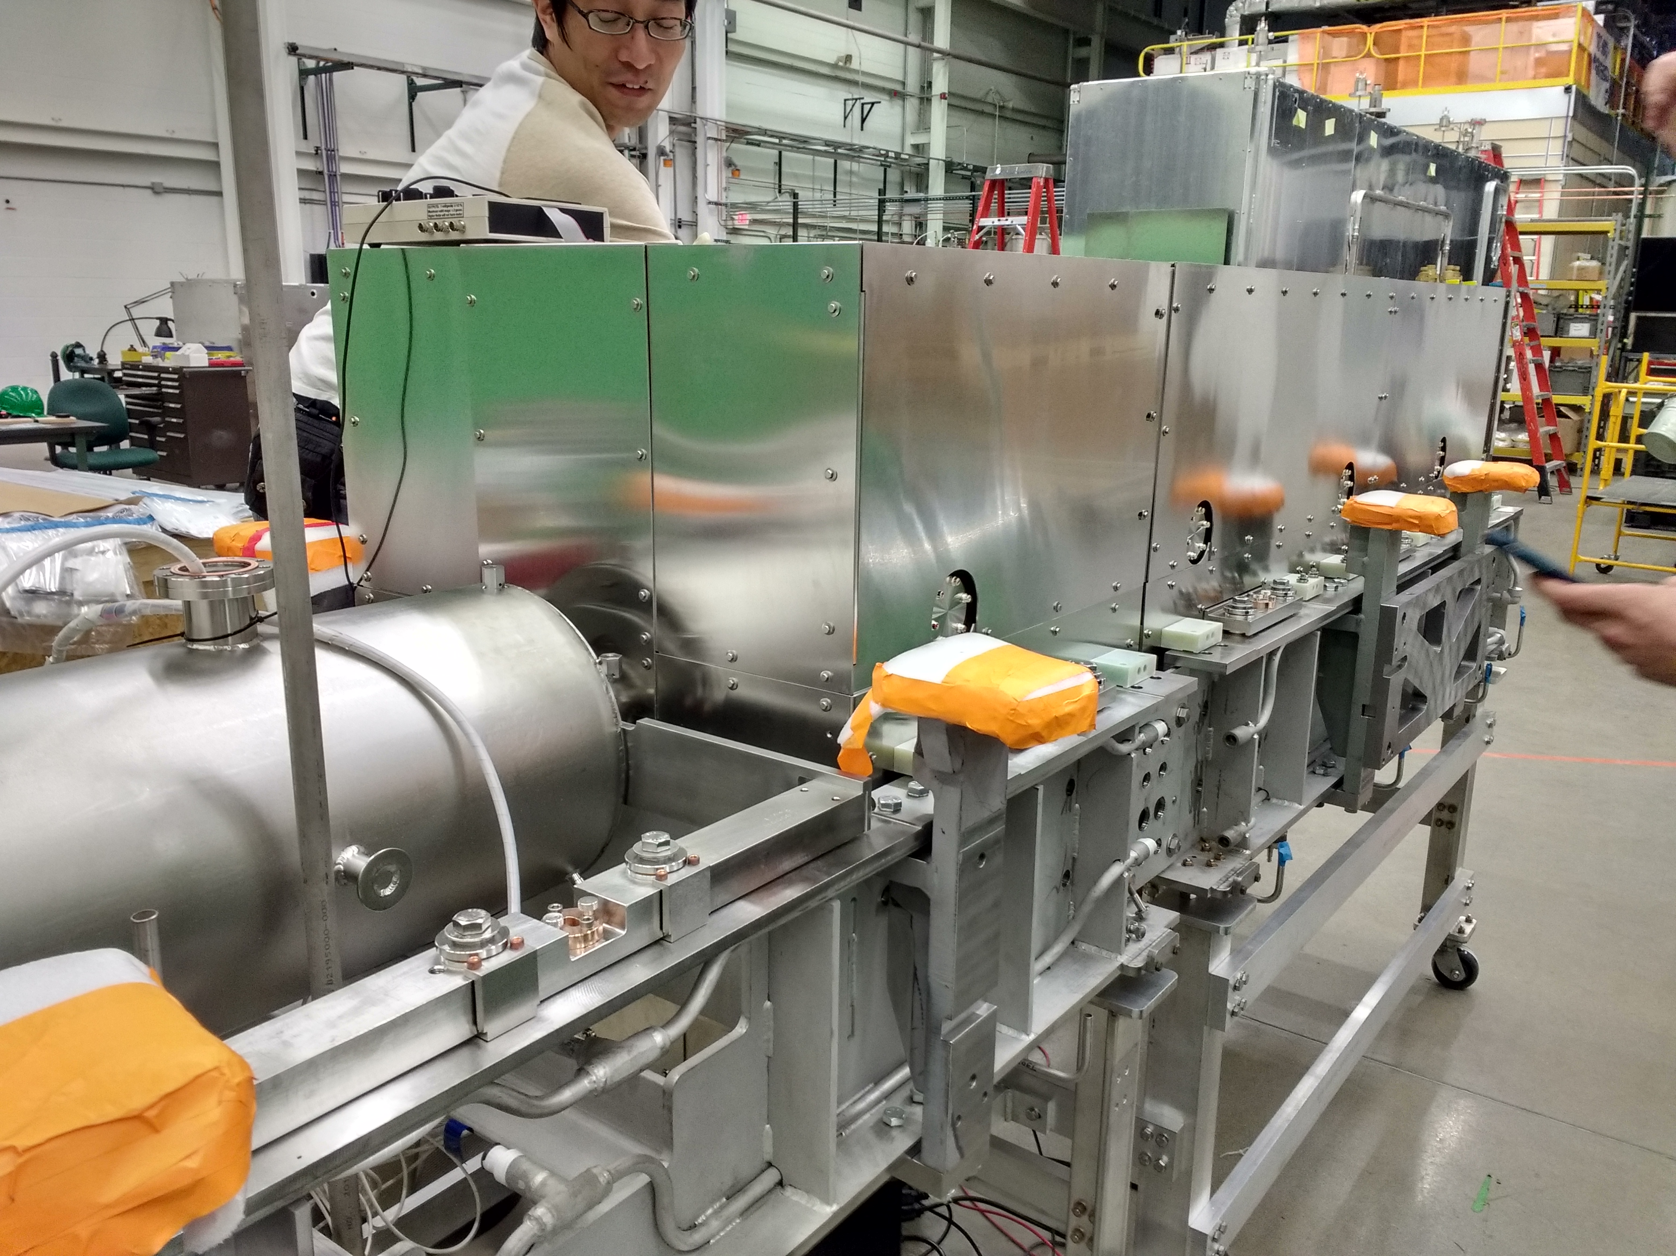
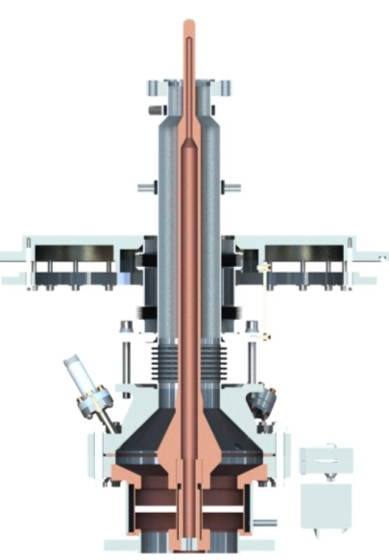
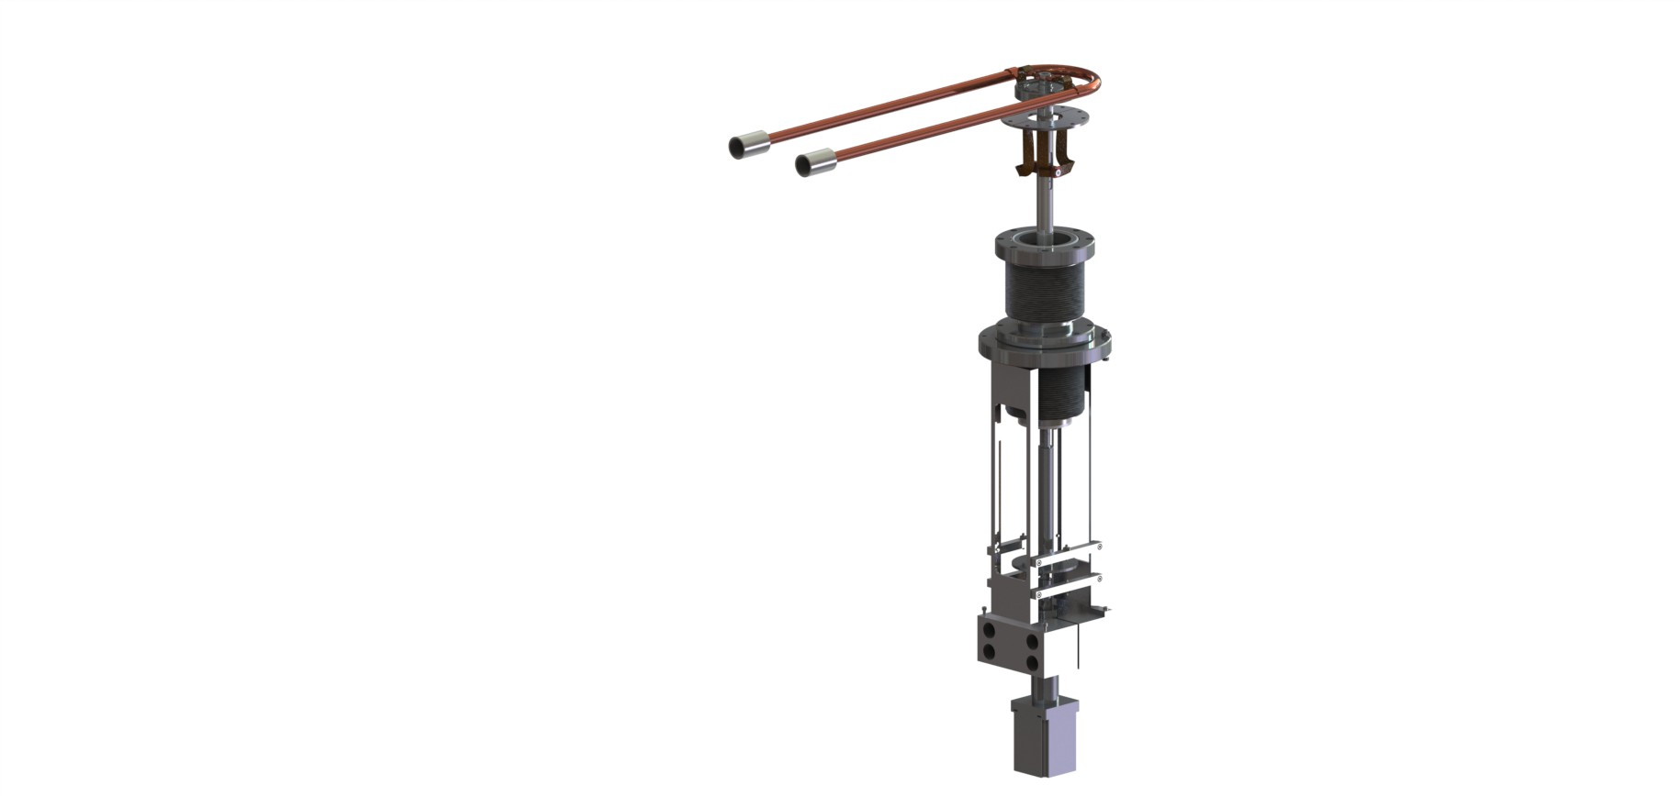
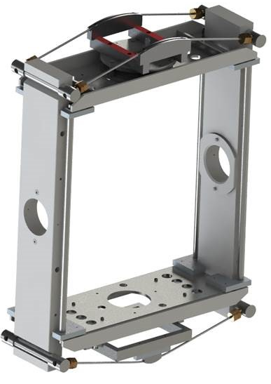
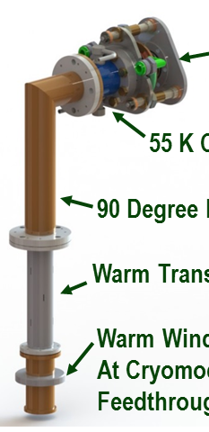
FRIB SRF Components
Cavities, FPCs, Tuners, Magnetic shields, and solenoid packages
Cavity Type | Frequency & Cavity type | Quantity of Cavities (baseline + spare) | Quantity of Modules (baseline + spare) | Quantity of Solenoids
β=0.041 | 80.5 MHz, QWR | 12 + 4 | 3 + 1 | 6
β=0.085 | 80.5 MHz, QWR | 88 + 8 | 11 + 1 | 33
β=0.29 | 322MHz, HWR | 72 | 12 | 12
β=0.53 | 322MHz, HWR | 144 | 18 | 18
Matching Cryomodules | 0.085QWR 0.53HWR | 4 + 4 4 | 1 + 1 1 | n/a
Total |  | 324 + 16 | 46 + 3 | 69
(4) QWR/HWR Magnetic shields
(2) QWR/HWR
power couplers
(3) QWR/HWR Tuners
Cavities
(5) SC 25cm (b=0.041CMs)/50cm (others) solenoid packages

Slide 6
FRIB Cavity Components Production
ACL at FRIB
Dimension
Surface inspection
Cold shock
Processing
BCP
Hydrogen degassing
HPR
Cavity, Vendor
VTA certification at 2K
HWR Coupler, Vendor
Fabrication
RF conditioning
Magnetization check
Coldmass Assembly
Coupler RF conditioning at FRIB
Assembly ready delivery
ACL at FRIB
Dimension
Leak check
Magnetization
Tuner
Solenoid, Vendor
Fabrication
Cold test
Degaussing
Cleaning
Vendor production
Magnetic shield,
Thermal shield,
Baseplate,
Vacuum cover
Cryomodule Assembly
Pipe welding
MIL
Cleaning
ACL at FRIB
Dimension
Magnetization
Alignment rails and Hoods, Vendor
Tunnel Installation
Bunker Test

Slide 7
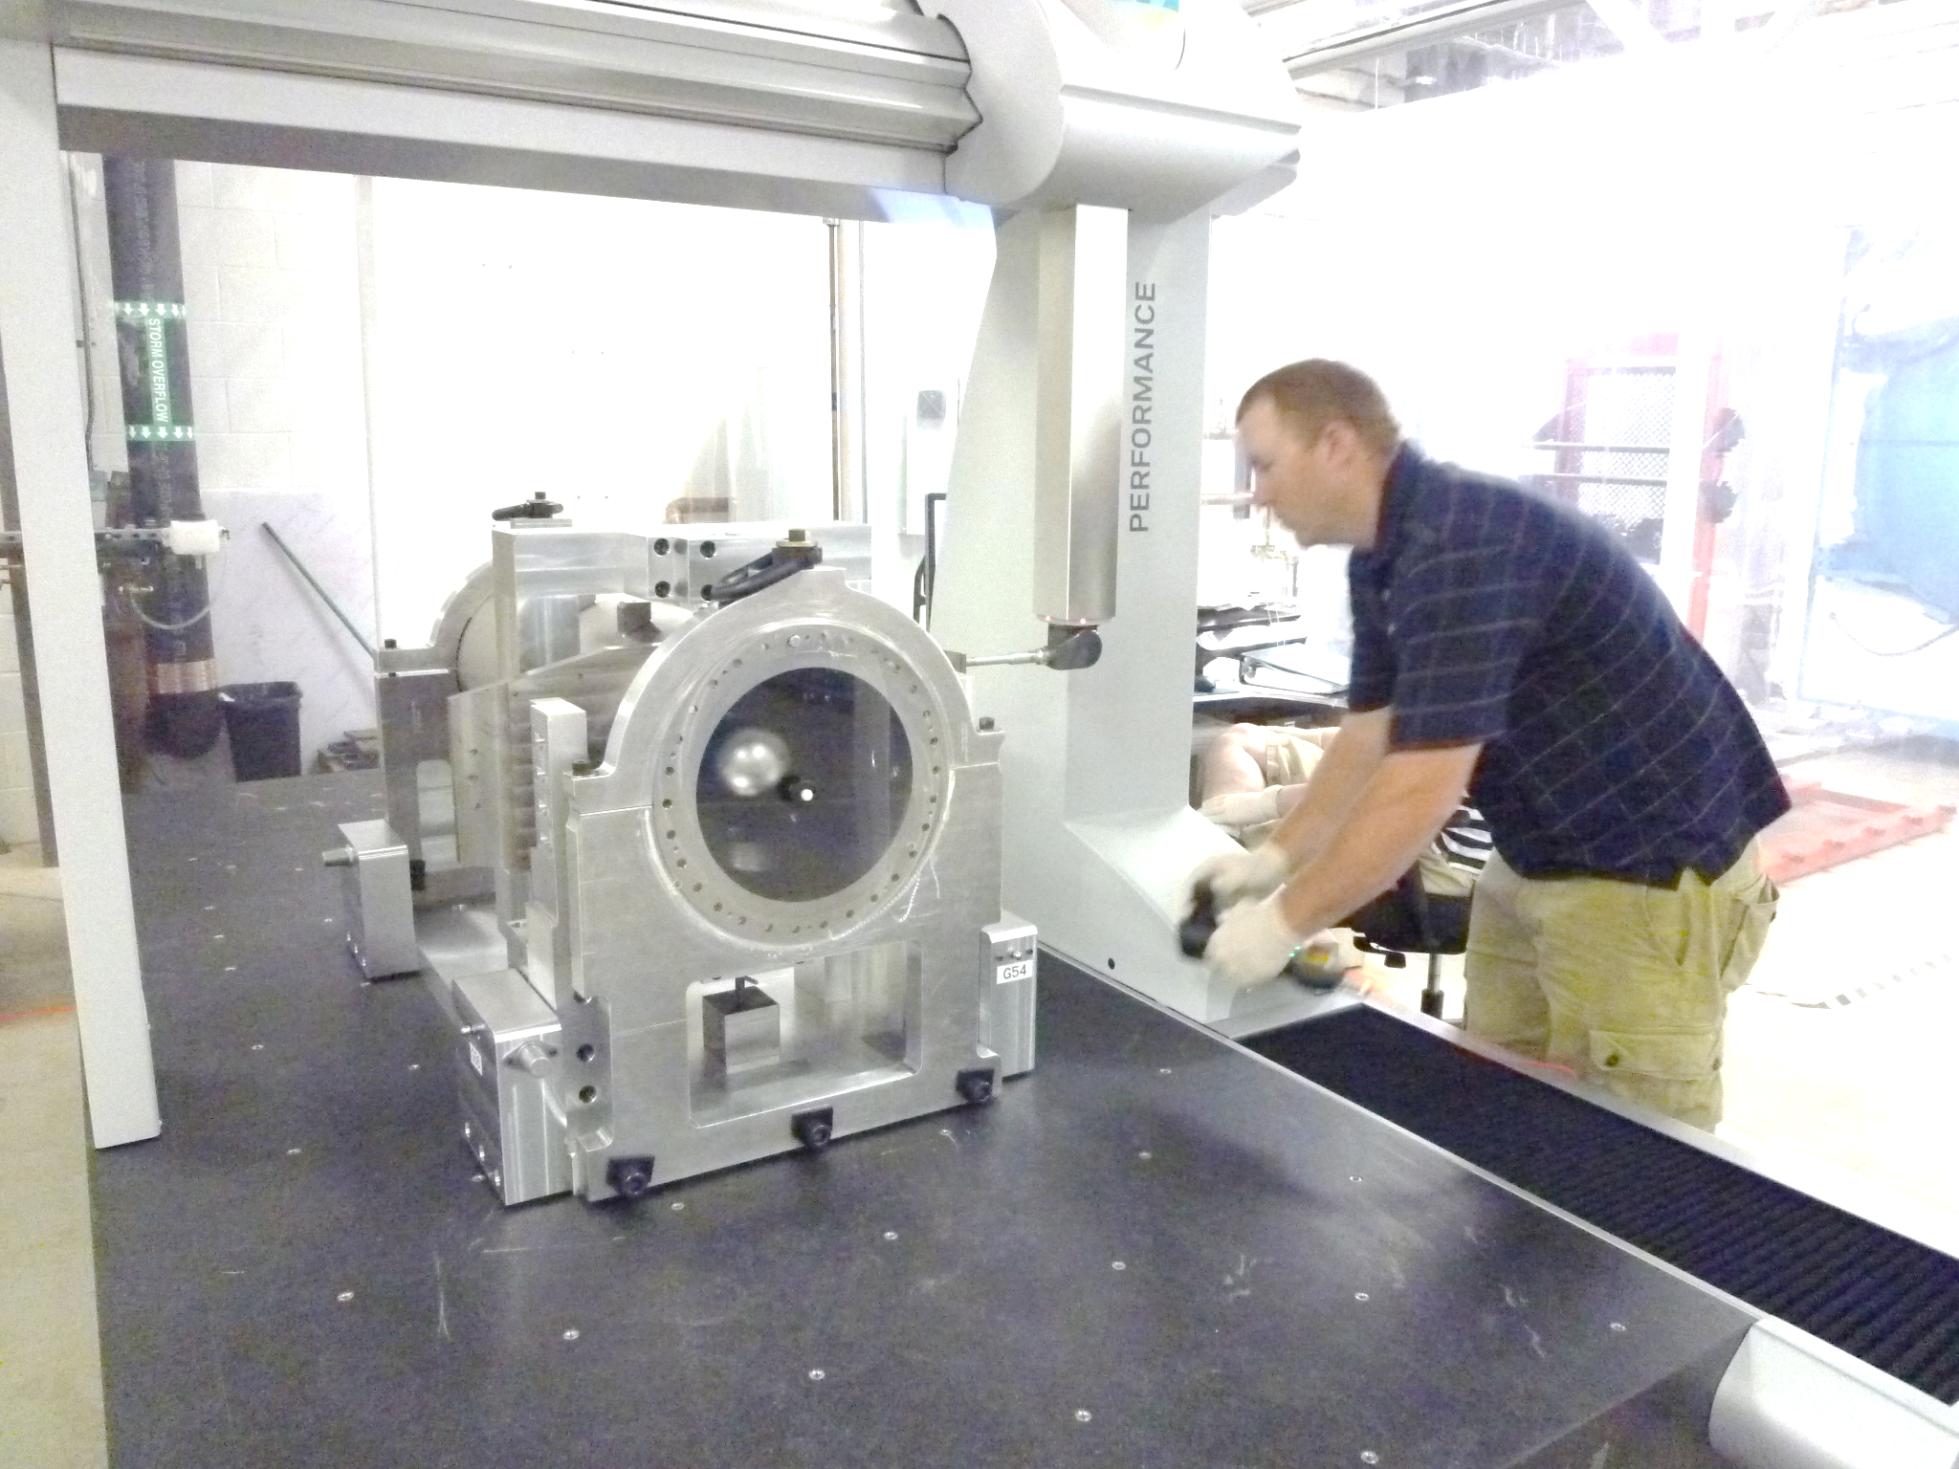
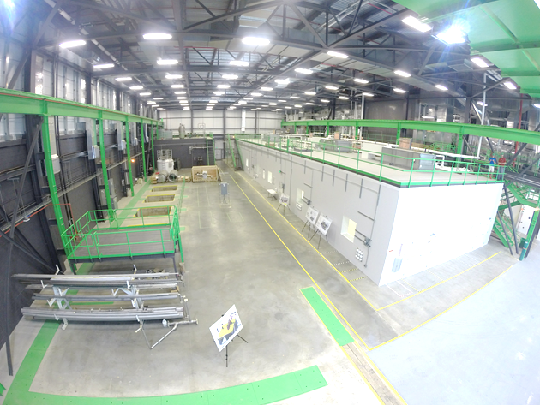
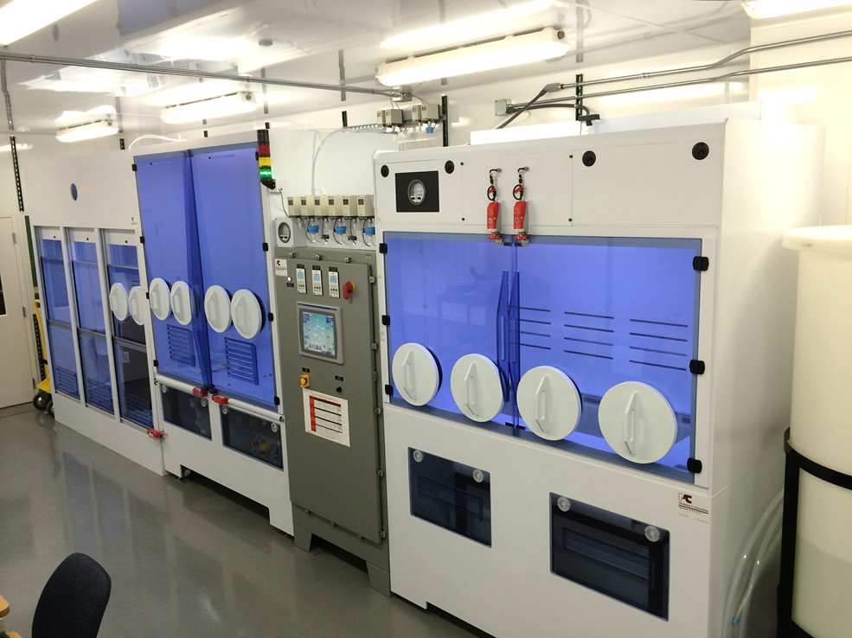
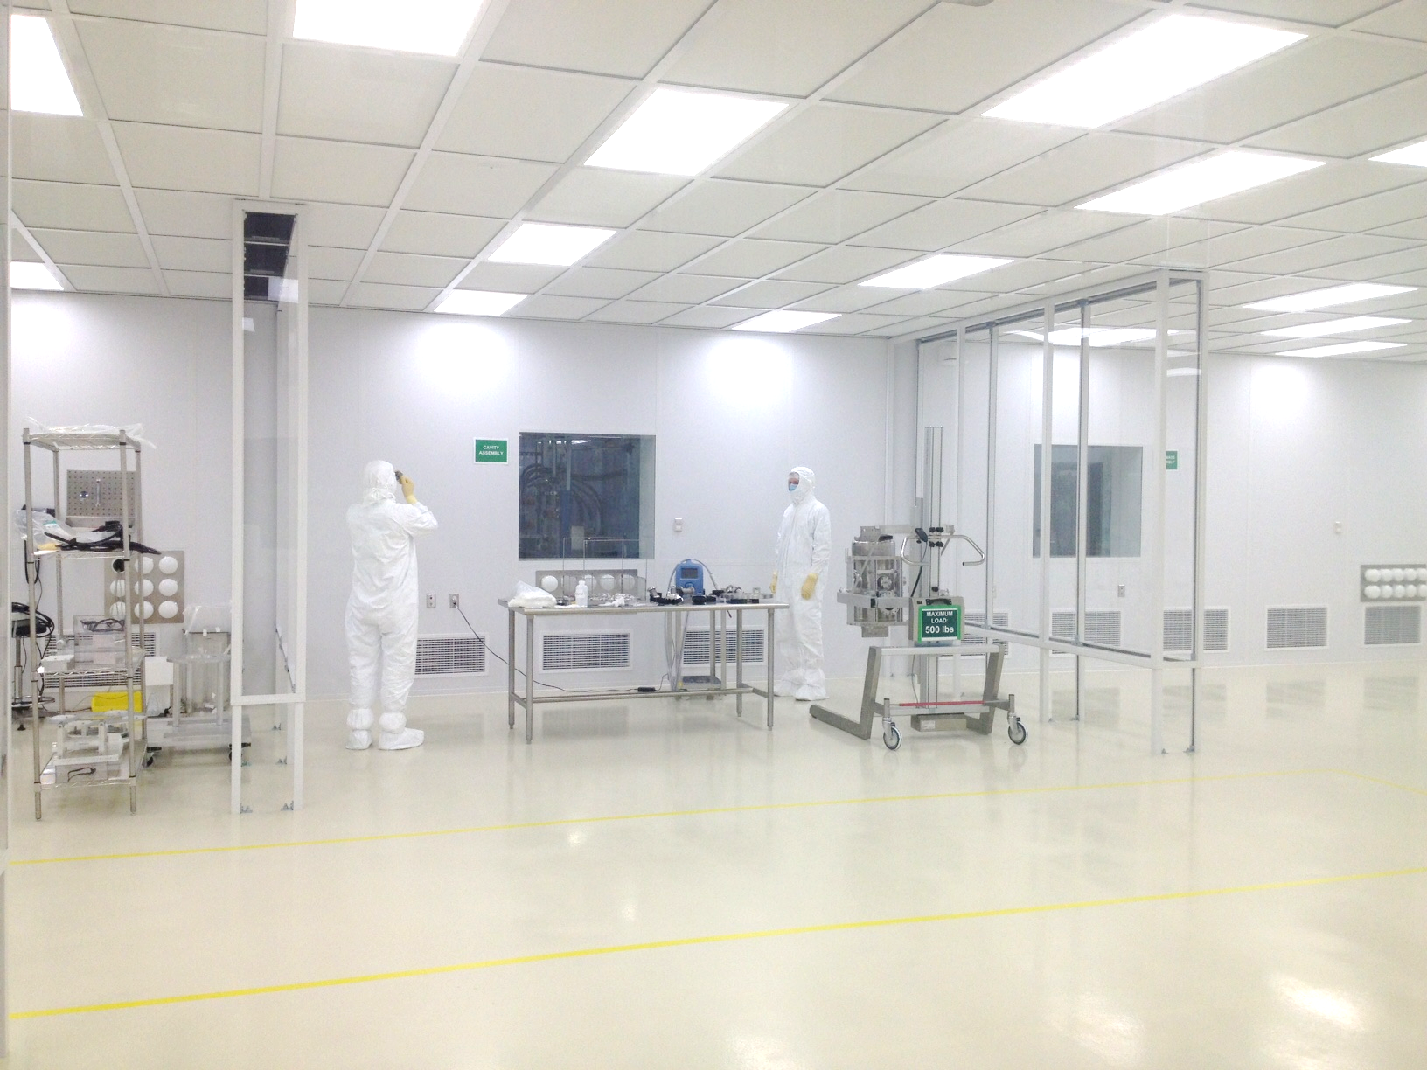
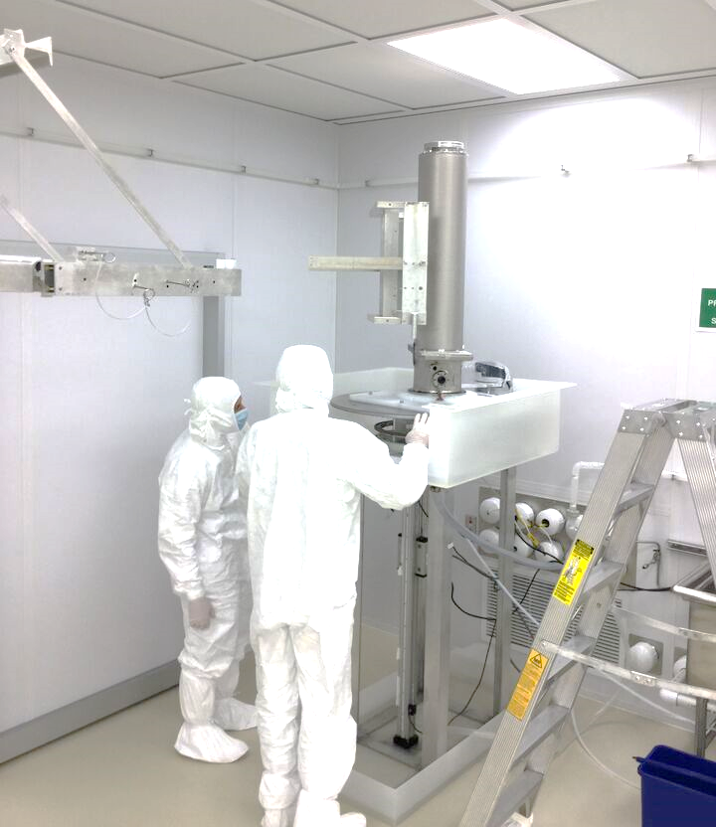
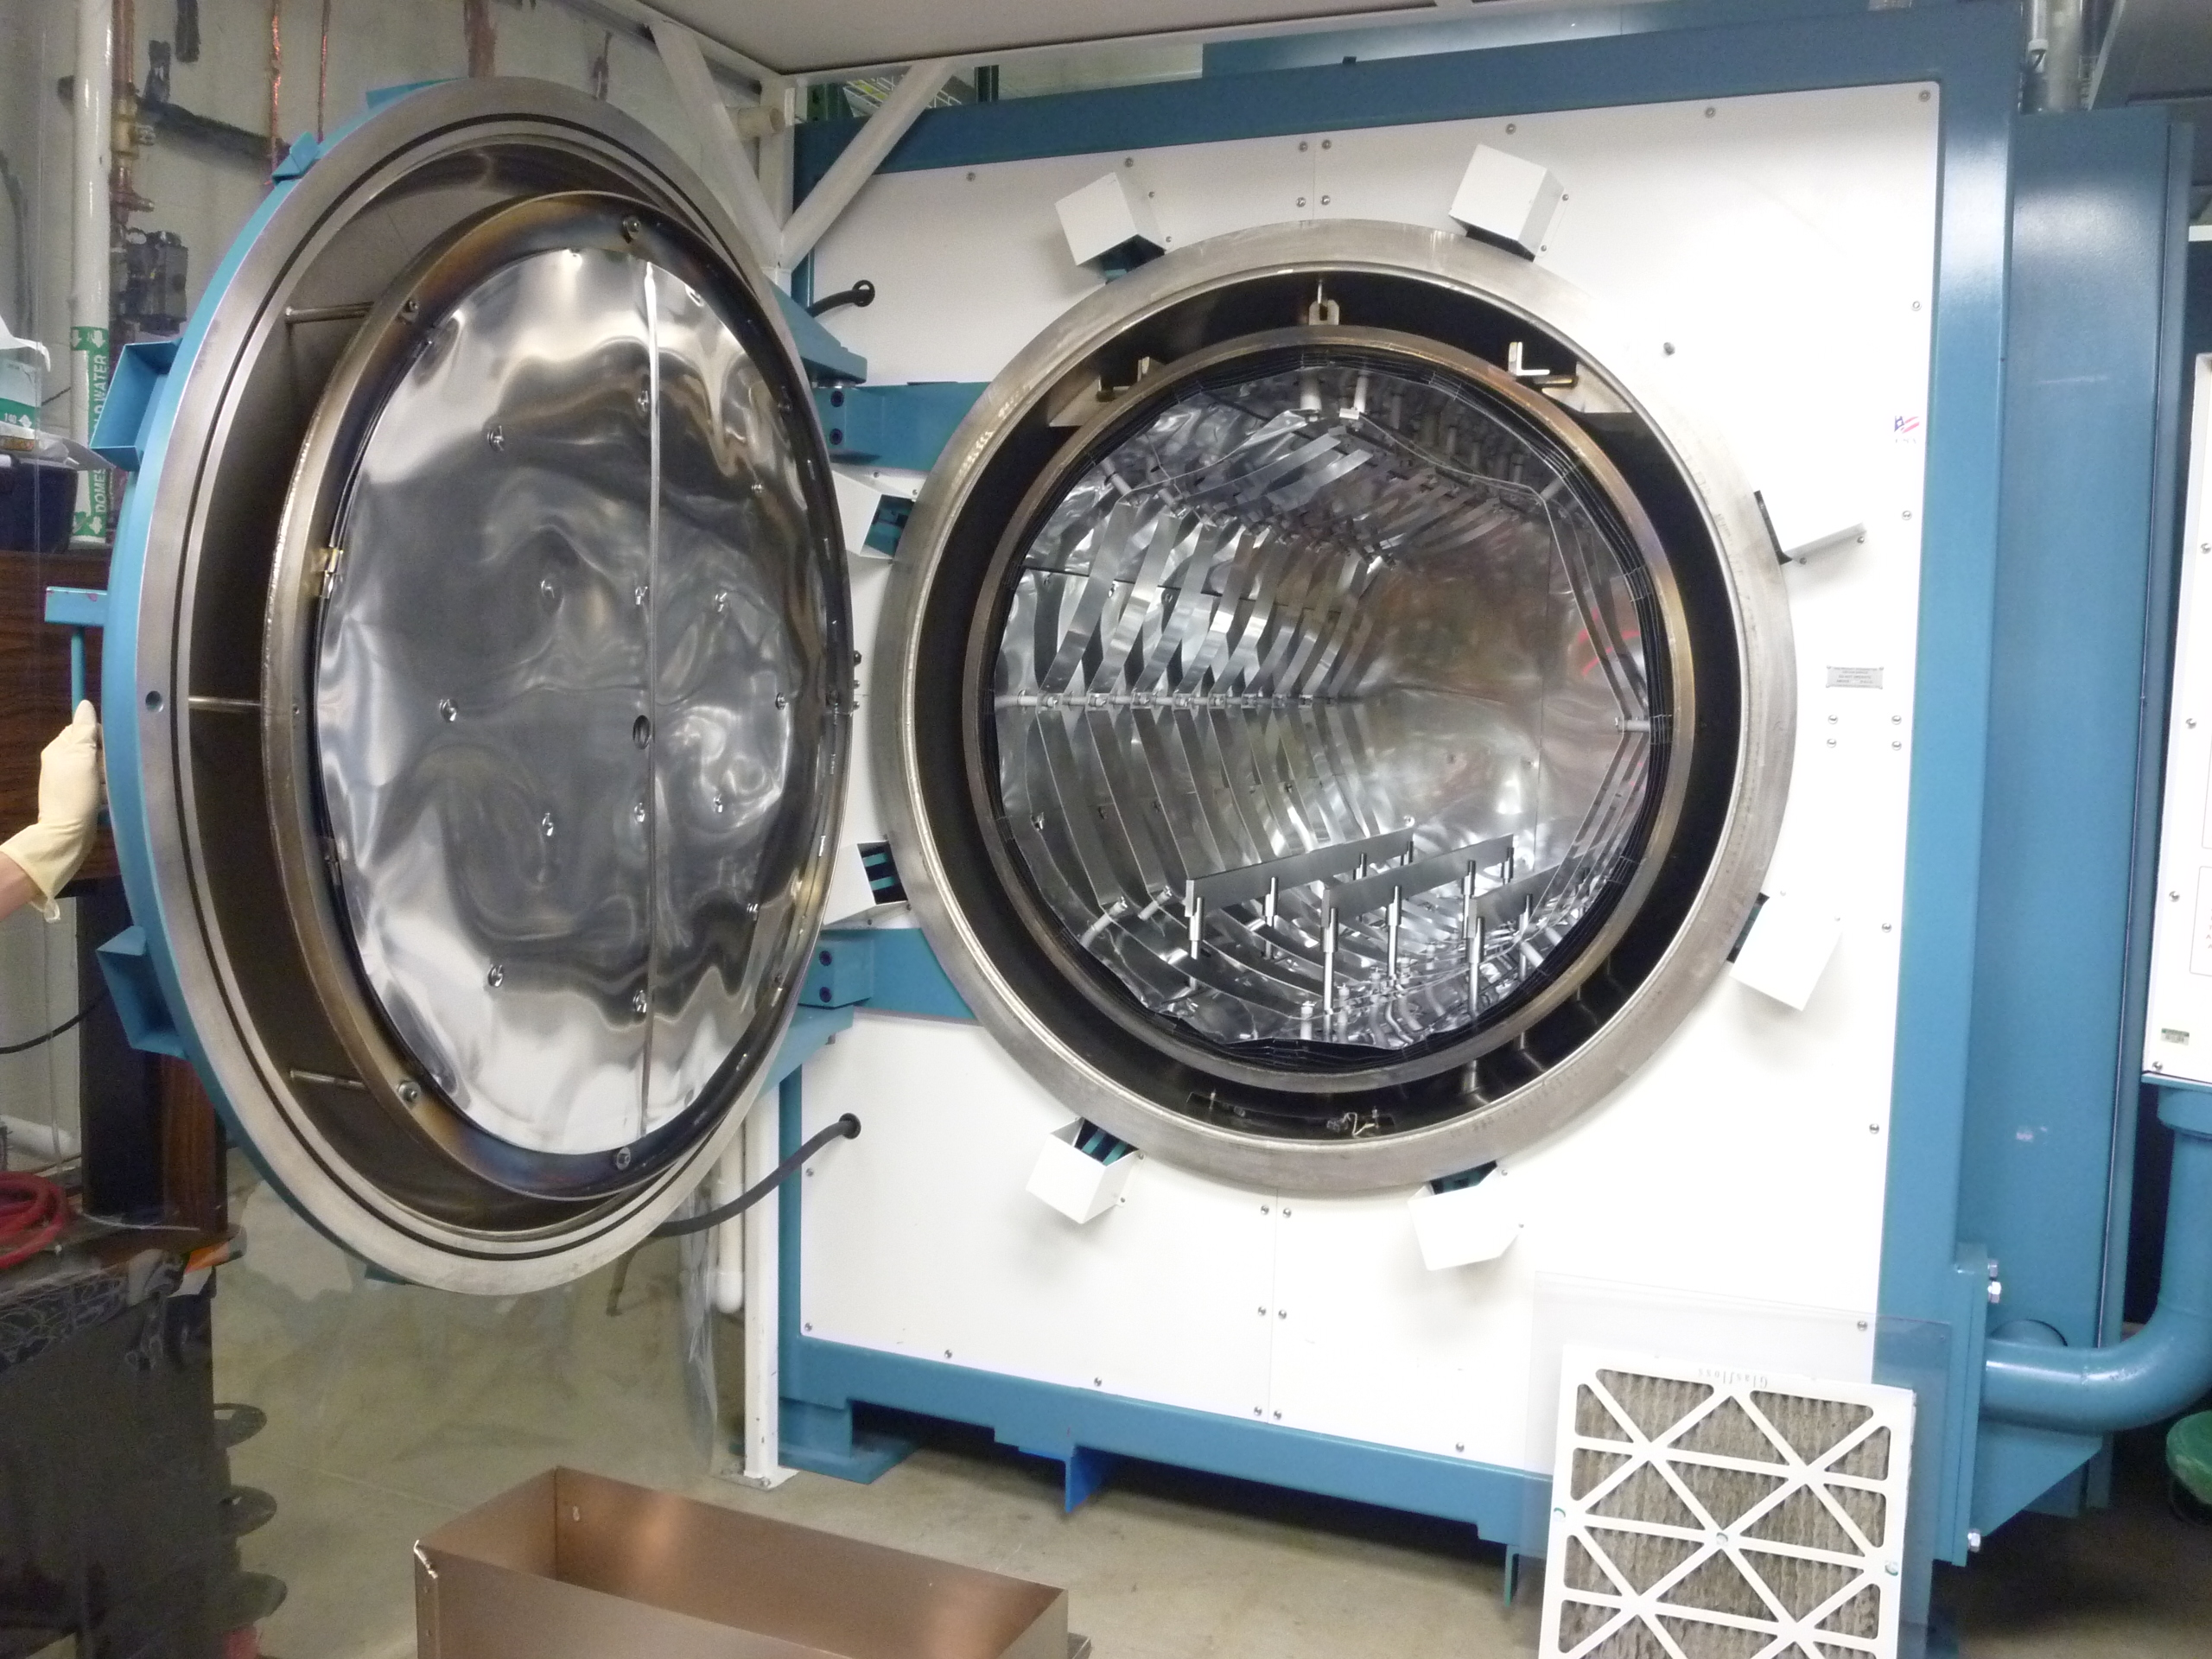
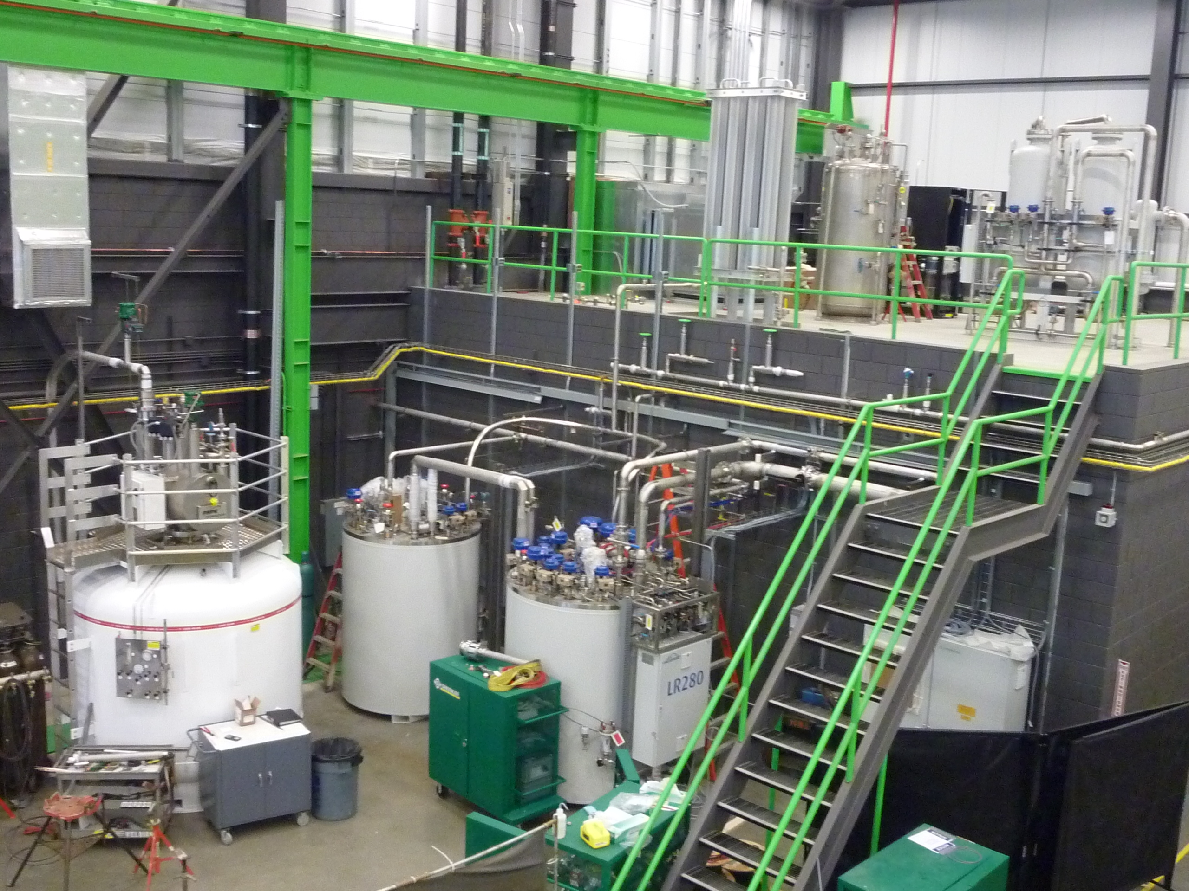
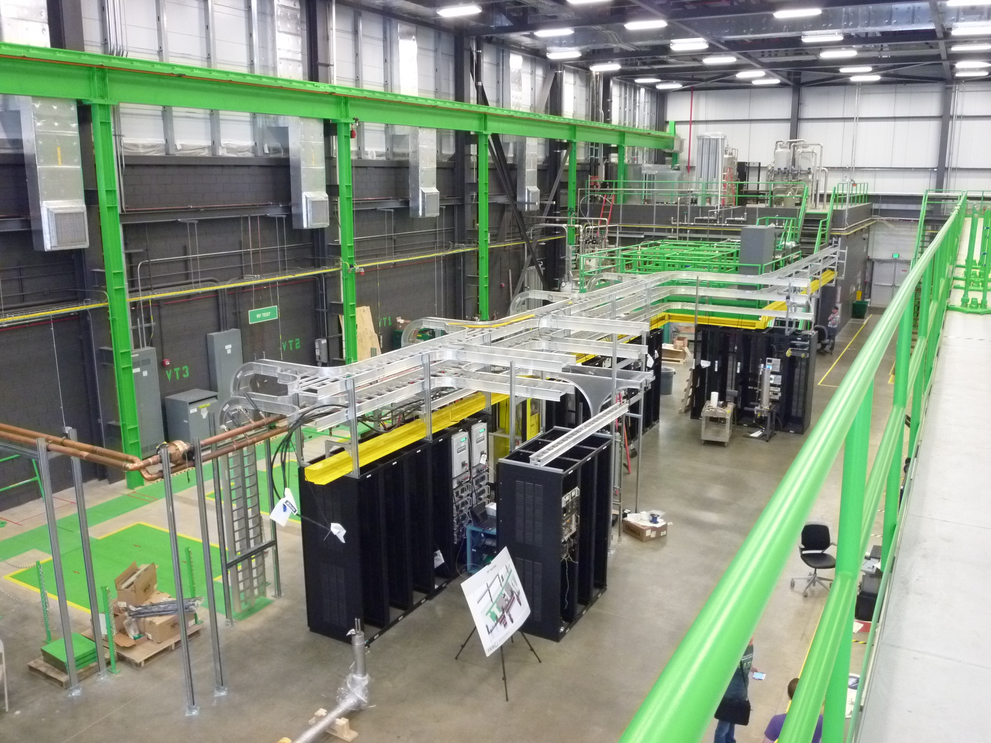
Infrastructure for FRIB Production
SRF Highbay, constructed by MSU fund, in full production since Sept. 2015
FRIB has excellent infrastructure for the production in SRF Highbay fund by MSU
Functionalities of the SRF Highbay
  Acceptance inspection
    Dimensional inspection by CMM
    Cold shock test, Leak check
  Cavity processing and assembly
  Large cleanroom
  Cavity etching (BCP) system
  Robotic high pressure rinsing system
  Ultrapure water system
  Hydrogen degassing furnace
  Demagnetizing SRF components
  Cavity vertical test system,
  2 Dewars and 4 cold inserts
  Cold mass assembly
  900W liquid helium system, liquid helium in 3000L Dewar
  Cryomodule bunker test system in SRF Highbay
    One bunker test system is working in NSCL East Highbay, total two bunker test systems for FRIB
CMM measurement
Large cleanroom
BCP facility
Cavity assembly
HPR system
Vacuum furnace
Cold box and 3000L Dewar
Vertical test area

Slide 8
Cavity and Coupler Status
93% (315/340) of total cavities for FRIB project accepted as date of January 31 2018.
66% (225/340) of the required cavities for FRIB were certificated successfully so far.
Certification first test success rate is > 80 %.
0.9 % (3/326 delivered) was rejected to vendor: scraped cavities.
FRIB project is to receive all cavities by May of 2018 or earlier.
HWR coupler production completed on December 2017.
  HWR coupler production yield ~97% (6/220)
  Assembly ready delivery has been successfully verified.

Slide 9
Typical VTA Work Day Breakdown and Acceptance Criteria
The vertical test insert is prepared in the evening before the test is scheduled.
VTA cooldown starts by 9AM (not a dunk test, we cool only cavity in the helium vessel and a tank above)
4K testing, thorough multipacting conditioning takes 1-4 hours 2K testing is completed by 5PM
Cavity insert is warmed up and removed before the next day
(Dewar warms up in <1 day, can be used every other day requiring only 2 Dewars for 1 cavity test per day)
Acceptance criteria
β / parameter | 0.041 | 0.085 | 0.29 | 0.53
Q_{O} | > 1.4 x10⁹ | > 2.0 x10⁹ | > 6.7 x 10⁹ | > 9.2 x10⁹
Eacc {MV/m} | > 6.1 | > 6.7 | > 9.2 | > 8.9
Cavity vacuum [torr] | < 1 x10⁻⁸ | < 1 x10⁻⁸ | < 1 x10⁻⁸ | < 1 x10⁻⁸
Qext | 7.8 x 10⁹ to 7.8 x 10¹⁰ | 4.4 x 10¹⁰ to 4.4 x 10¹¹ | 9.4 x 10¹⁰ to 9.4 x 10¹¹ | 2.8x 10¹¹ to 2.8 x 10¹²
Frequency | 80.506 MHz ± 10 kHz | 80.506 MHz ± 10 kHz | 322.088 MHz ± 25 kHz | 322.070 MHz ± 40 kHz
Other measurements include Lorentz for detuning coefficient, X-rays, df/dP, and we can verify there is no cold helium vessel leak.

Slide 10
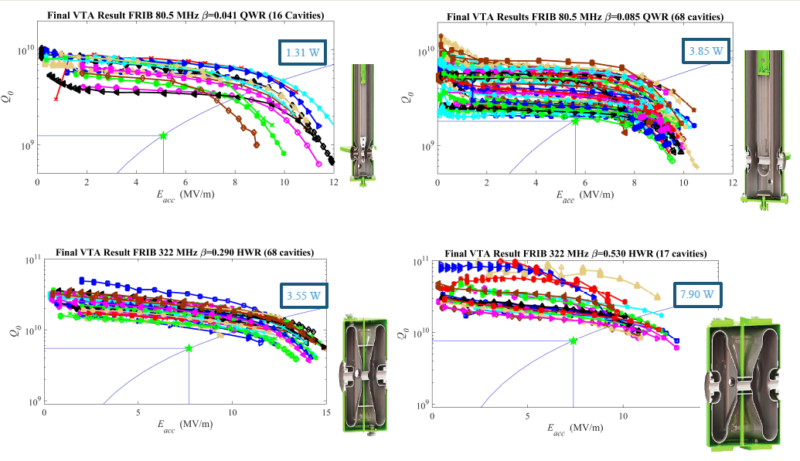
Cavity VTA Performance Staticstics
Comfortable Performance Margin above FRIB Goals
cavity | 0.041 QWR | 0.085 QWR | 0.29 HWR | 0. 53 HWR
E_{a} (MV/m) | ☑ >5.1 | ☑ >5.6 | ☑ >7.7 | ☑ >7.4
Q₀ | ☑ >1.4×10⁹ | ☑ >2×10⁹ | ☑ >6.7×10⁹ | ☑ >9.2×10⁹
Df/dP (Hz/mBar) | ☑ -2.7 | ☑ -1.85 | ☑ -2.2 | ☑ -6.7
LFD (Hz/(MV/m)²) | ☑ -3 | ☑ -2.9 | ☑ -5 | ☑ -4

Slide 11
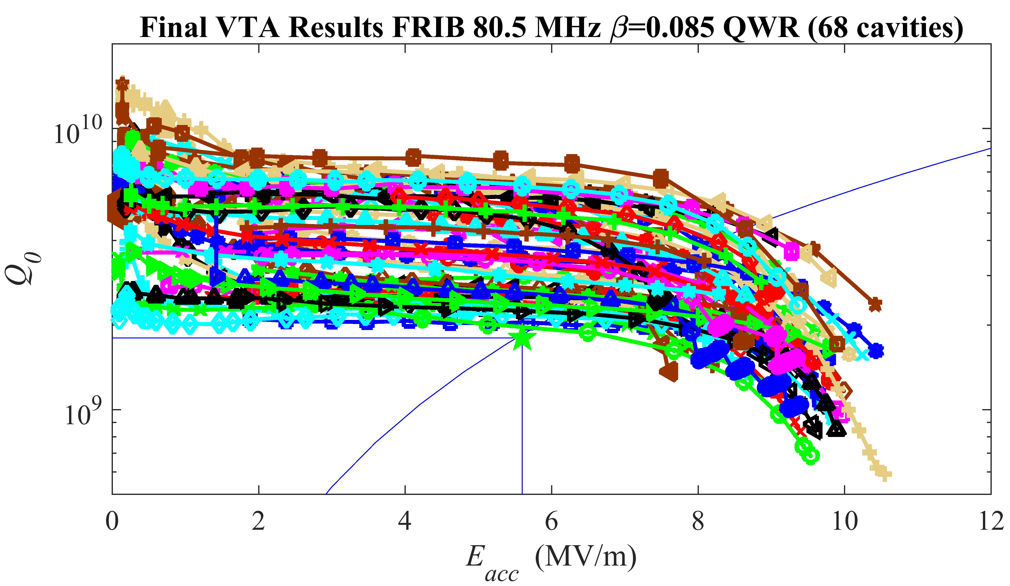
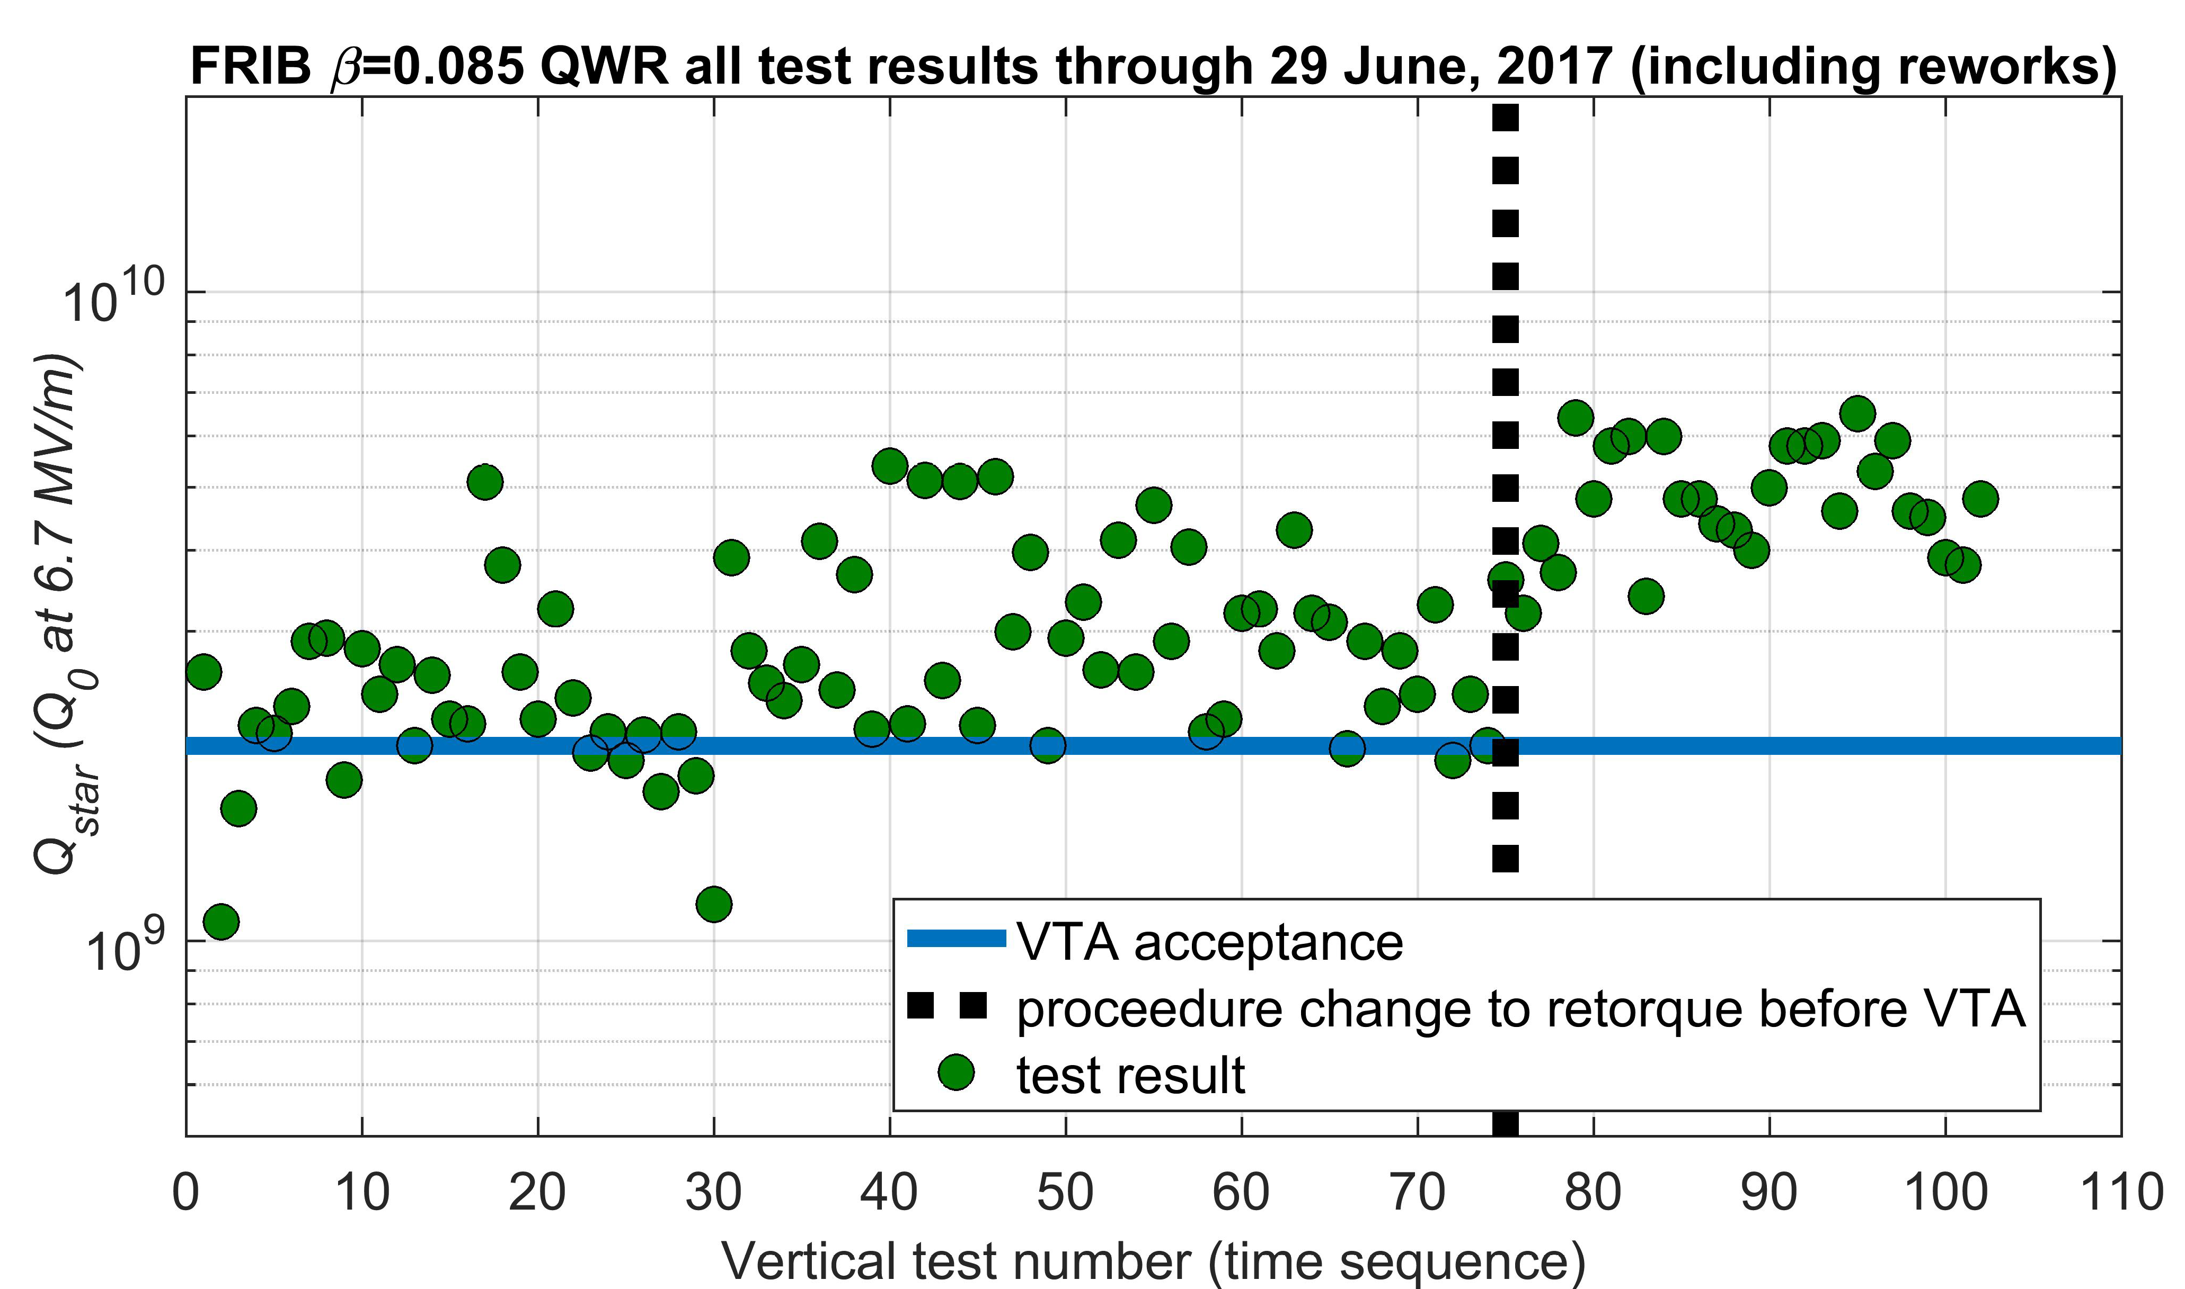
Resolved Low Q issue in the Production 0.085QWRs
Re-torqueing resolved this issue practically.
The bottom flanges have been always re-torqued before installing VTA.
Thermal cycle test up to room temperature was reaped several times with one cavity and the high Q performance was confirmed to be kept.
Indium RF contact is the cause.
  Continues investigation
  Indium RF contact resistance happened about ~ 30μΩ at Qo = 2x10⁹ (2.5W additional heating).

Slide 12
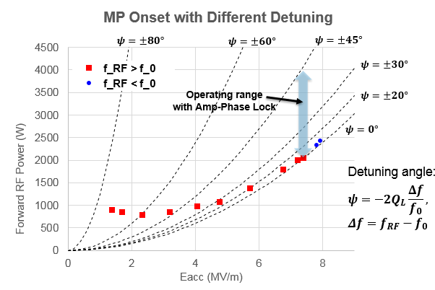
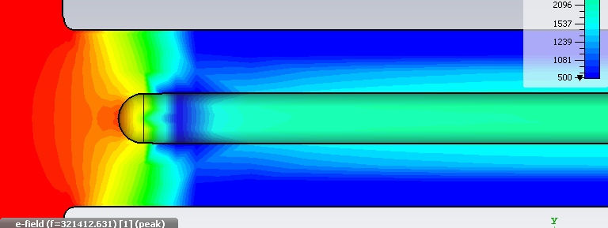
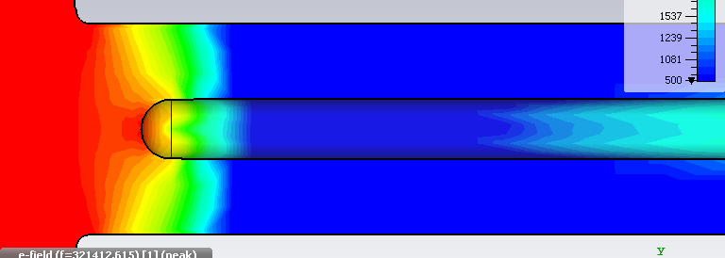
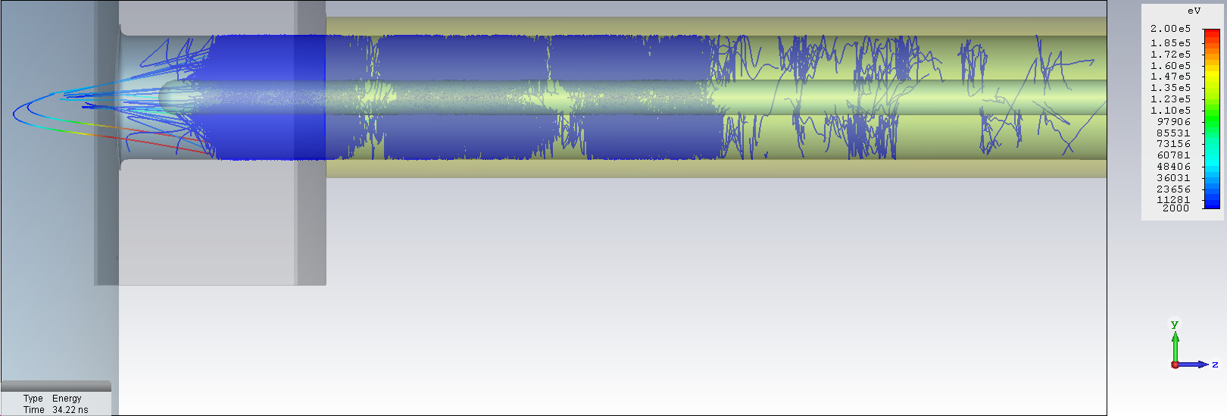

HWR MPF Coupler Validation in FRIB Cryomodule
SCM502 test without coupler bias
  Multipacting free (MPF) coupler works fine on on-resonance operation, Eacc ~ 7.4 MV/m
  Multipacting burst happens on off-resonance operation below 7.4 MV/m
High magnetic field around antenna tip by more standing wave on off-resonance operation
  More investigation with beam operation condition
Bias could mitigate the problem
  Bias resolve the problem but additional cost ~ 0.7M$ for FRIB
$Δf=+0.6BW$ , $ψ=−30°$ , Higher MP Onset
On Resonance

Slide 13
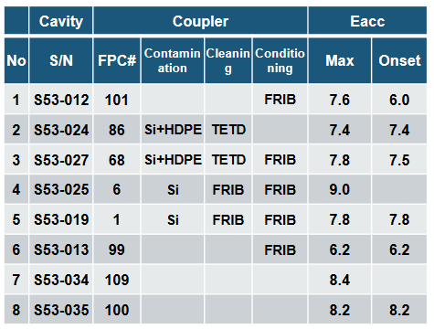
Assembly Ready Delivery Validation
Validated successfully
Vendor investment
  Cleaning system, Cleanroom , 200^{O}C baking system, Clean shipping
FRIB responsibility
  RF conditioning boxes, RF amplifier (20kW), RF conditioning control system
FRIB early validation at RT conditioning
  Contamination issue in shipping tool
    Coupler flange contaminated by high density polyethylene
    Contaminated vacuum seal by Silicon Oring
    FRIB RF condition for decontaminated couplers at vendor, condition time 2 - 7 hr
    Refined coupler assembly procedure by help from KEK
  Validation of assembly ready delivery in SCM502
    Three couplers for assembly ready deliver : #2, #7, and #8
    Very smooth cavity RF conditioning up to FRIB operation gradient goal
    “Assembly ready delivery” has been successfully validated
Non contaminated
Non contaminated
Non contaminated
Non contaminated

Slide 14
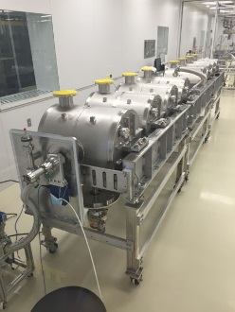
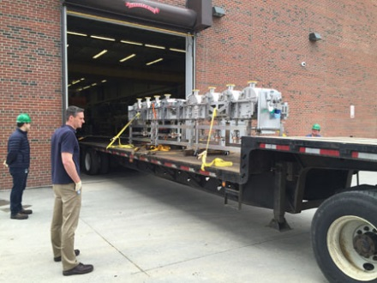
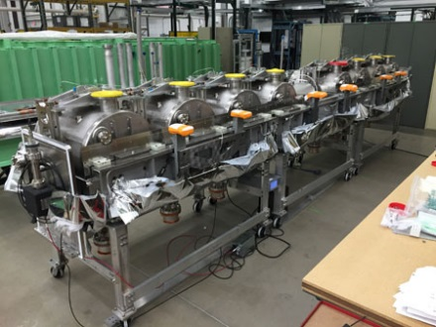
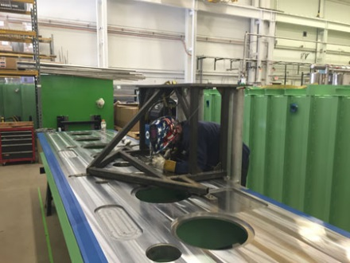
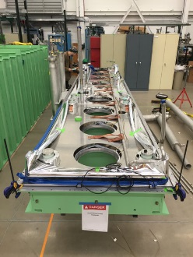
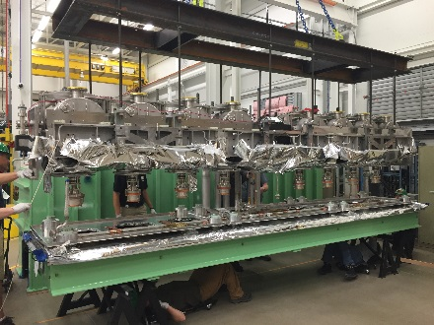
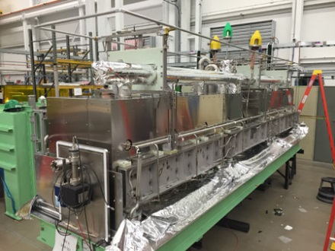
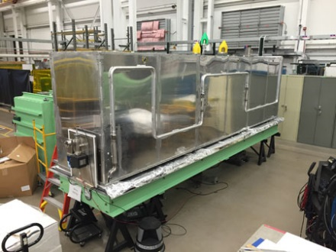
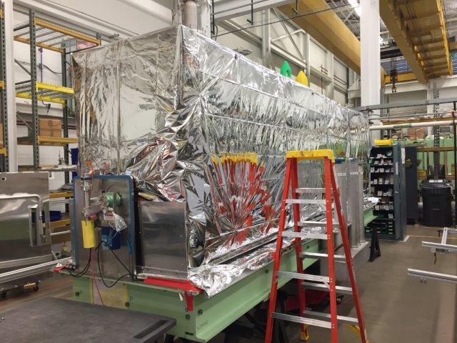
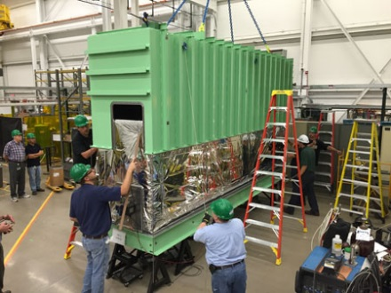
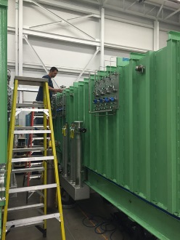
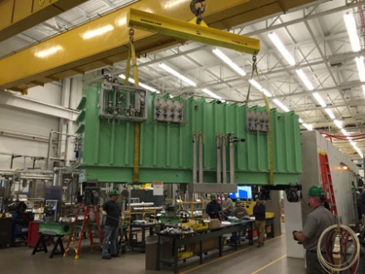
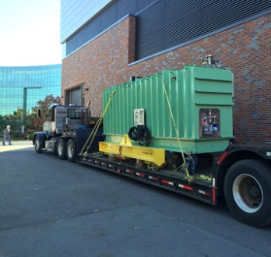
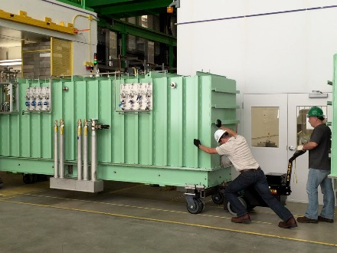
Cryomodule Assembly Sequence (β=0.53)
C1
C2
C3
1
2
Completed cold mass assembly in clean room
Cold mass assembly transport to cryomodule assembly area
Cold mass ready for baseplate
Start baseplate assembly
Baseplate ready for cold mass
C4
4
5
6
7
3
Cold mass on baseplate
Completed cryogenic circuit
Thermal shield installation
MIL dressing
8
9
10
Vessel cover installation
Tuner valve manifold installation
Transport to SRF High Bay
Transport into test bunker

Slide 15
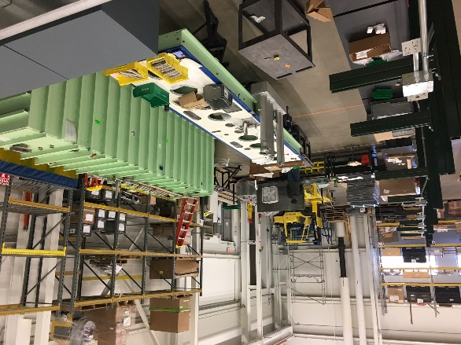
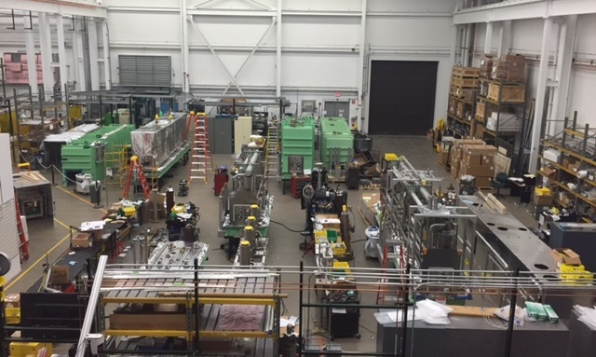
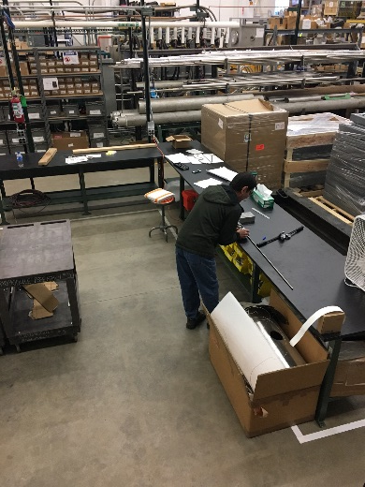
Cryomodule Assembly and Bunker Test
Bay #5
Cryomodule Test Bunker
Bay #4
Bay #3
Bay #2
Bay #1
Subassembly Fabrication
Five assembly bays ongoing in parallel
Two commissioned cryomodule test bunkers
Additional assembly space for subcomponents (solenoid leads, O-rings, G-10 posts)
2 overhead cranes
2 loading bays for transport of coldmass in and completed cryomodule out

Slide 16
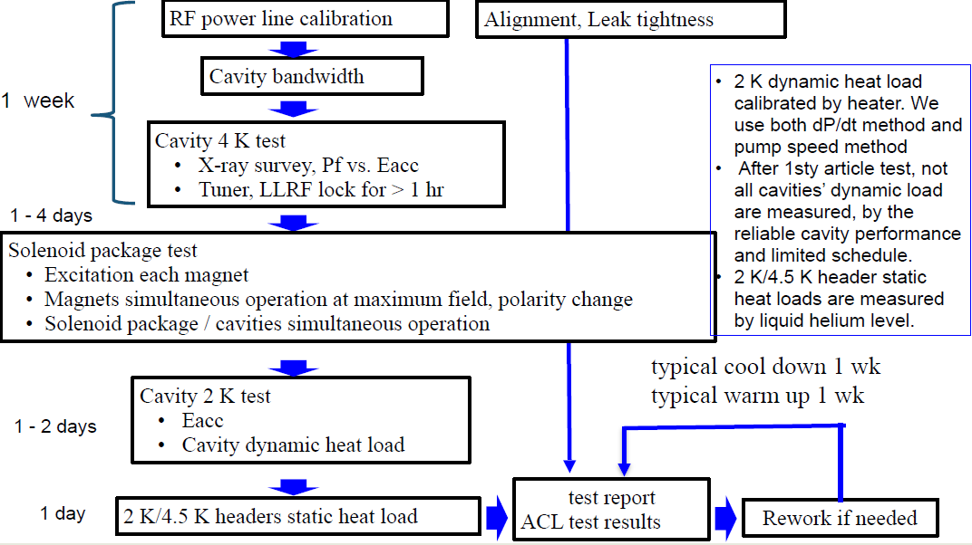
Cryomodule Bunker Test Procedure

Slide 17
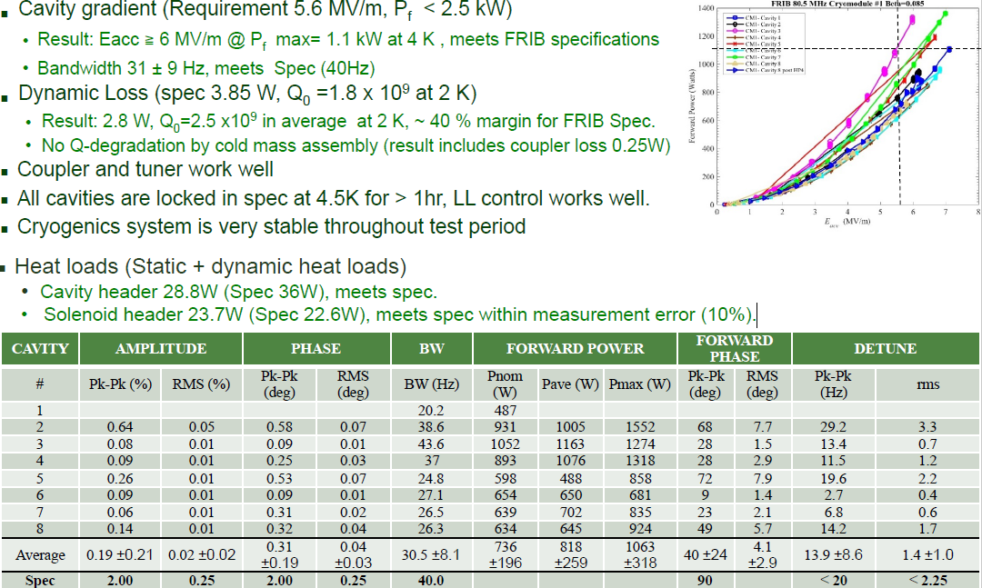
Bunker Test Performance Example: SCM801 (FRIB First 0.085QWR Cryomodule)

Slide 18
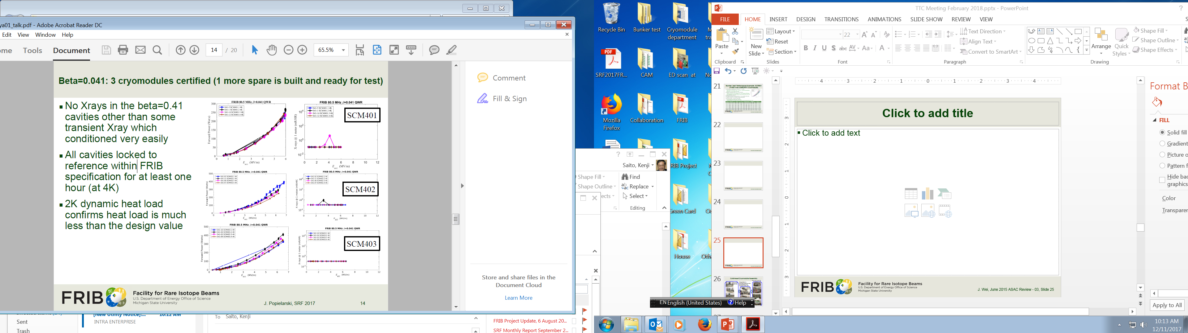
β=0.041: 3 Cryomodules Certified
(1 more spare is built and ready for test)
No X-ray in the b=0.041 cavities other than some transient X-ray during RF processing which conditioned very easily.
All cavities RF locked to reference within FRIB specification for at least one hour at 4 K.
2 K dynamic heat load confirms heat load is much less than the design value.

Slide 19
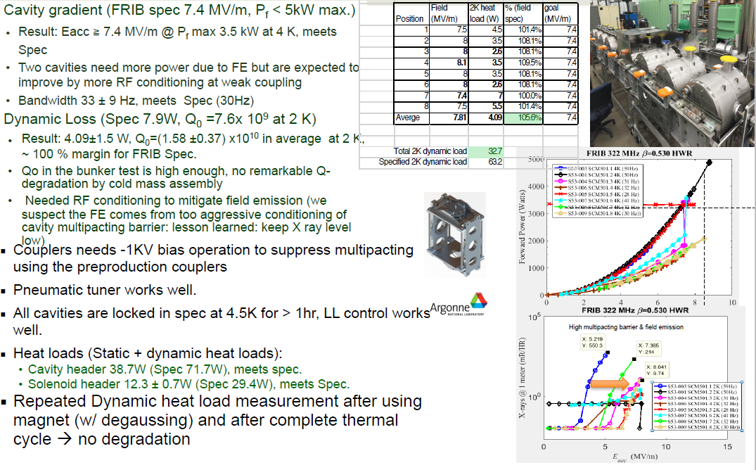
SCM501 (FRIB First β = 0.53 HWR Cryomodule)

Slide 20
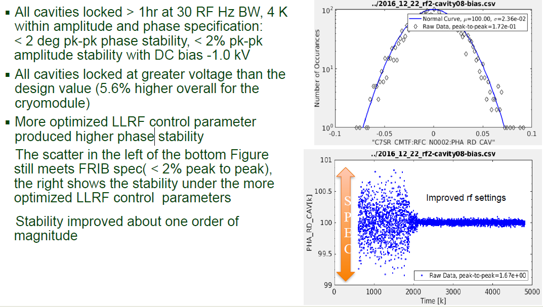
β=0.53 HWR LLRF Locking Validation

Slide 21
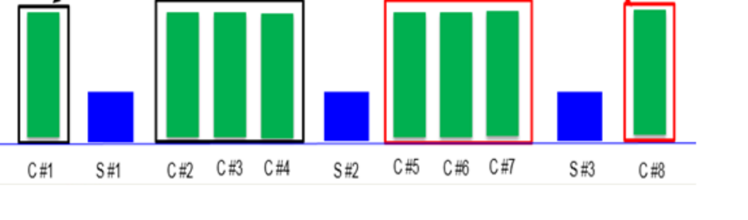
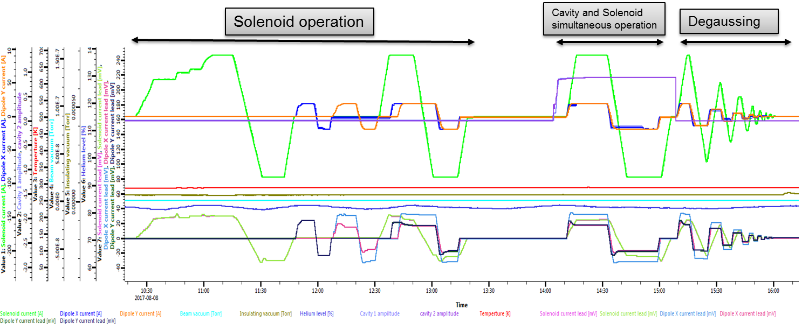
Solenoid Package
Very robust, no quench
Solenoid package (solenoid and dipoles for beam steering):
Solenoid field 8T (25cm/50cm )
Dipole field 0.032 Tm (25cm), 0.064Tm (50cm)
Vendor production completed on January 2017
Cold tested at vendor
  Measurement of field distribution
  Measurement of error between solenoid field center and mechanical center
Bunker test
  Magnet excitation test, never quenched
  Magnet mutual operation
  Magnets/cavity integrated operation
  Degaussing
Successful demonstrated
very robust operation
Confirmed high Q cavity
Performance by thermal
cycling up to 30K (SCM501)
SCM8-sires cryomodule
Bunker test (SCM806 S#3)

Slide 22
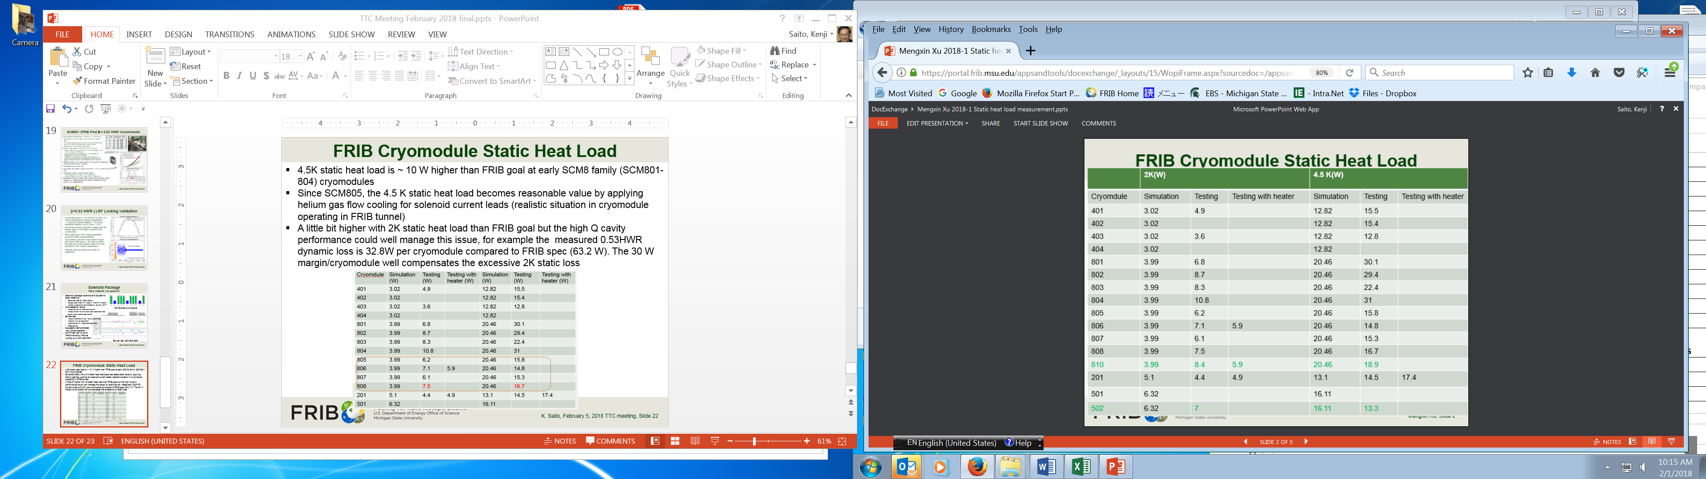
FRIB Cryomodule Static Heat Load
4.5 K static heat load is ~ 10 W higher than FRIB goal at early SCM8 family (SCM801-804) cryomodules.
Since SCM805, the 4.5 K static heat load becomes reasonable value by applying helium gas flow cooling for solenoid current leads (realistic situation in cryomodule operating in FRIB tunnel)
2 K static heat load is little bit higher than FRIB goal but the high Q cavity performance could manage this issue, for example the measured 0.53HWR dynamic loss is 32.8W per cryomodule compared to FRIB spec (63.2 W). The 30 W in RF dynamic loss can compensate the excessive 2K static loss.

Slide 23
Summary
FRIB cavities and the cavity components are well produced and meet FRIB specifications.
Low Q issue with production 0.085QWRs has been solved by re-torqueing practically.
FRIB strategy for “assembly ready delivery” with HWR coupler has been successfully validated.
MPF coupler will be more investigated with necessity of bias to retire FRIB cost risk.
Cavity high Q/high gradient performance is preserved in the cryomodule. So far FRIB has no issue for cavity coldmass and cryomodule assembly.
Totally 20 CMs were built so far, 1 CM in 2015, 6 CMs in 2016, and 13 CMs in 2017, 14 CMs in 2018 and 13 CMs are planned to build.
Cryomodule assembly is on track for the FRIB baseline schedule.

