Slide 1
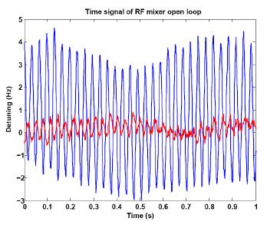
Microphonics
A. Neumann
Helmholtz-Zentrum
Berlin
….a quick excursion to studies performed at HZB
for high Q_{L} CW SRF systems
BESSY FEL (past)
bERLinPro (present)
BESSY VSR (future)

Slide 2
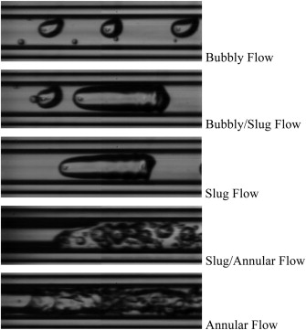
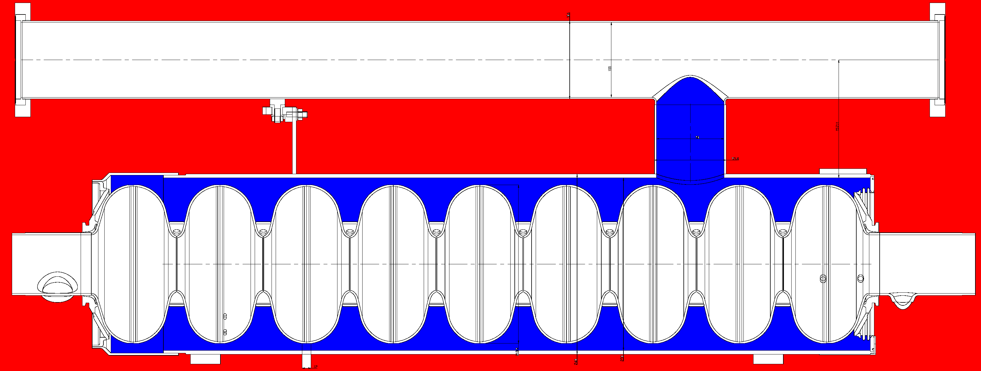
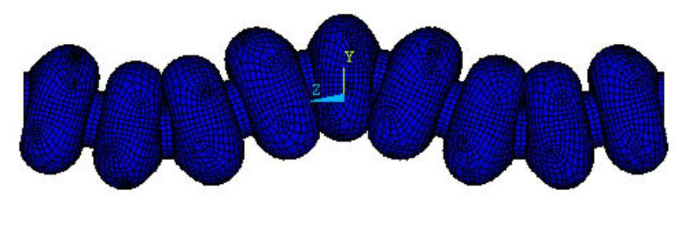
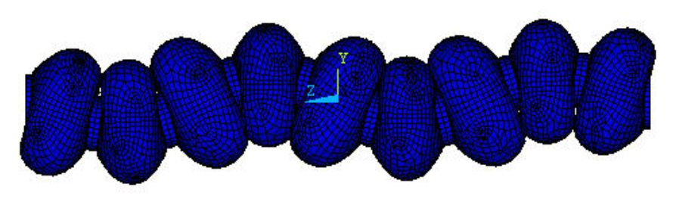
Microphonics: How does it appear?
Field amplitude variation:
Dynamic Lorentz force, Δf/ΔE_{acc}² = 1Hz/(MV/m)²
→ Ponderomotive instability
Helium pressure fluctuations
Δf/Δp = 50-60 Hz/mbar,
SRF Gun:30-100 Hz/mbar
16 mbar±30 µbar
2.5-3 mm Niobium walls
Heat transport
dynamics in LHe
Thermo-acoustic
oscillations
(cryo valves…)
Stochastic
background
noise
Deterministic,
narrow-band
sources:
Vacuum pumps
Mechanical oscillations of the Cavity:
Microphonics
Response of the
Cavity-Helium vessel-Tuner
system:
Mechanical Eigenmodes
222 Hz
G. Bissofi
Lowest modes:
Transverse
151 Hz
Is that the whole story?
G.P. Gelata et al. International Journal of Thermal Sciences
Volume 58, August 2012, Pages 1-8

Slide 3
Microphonics: What do we see?
The cavity is the best sensor of mechanical excitation itself, true?
→ What deformation affects actually the RF mode (TM_{0yz} different than TM_{1yz})?
Cavity design: Cavity sensitivities
Detuning is often obtained by comparing forward and transmitted (reflected) wave
of the TM₀₁₀ π-mode (or FPC excited RF mode).
→ We only see what affects the RF mode, not all oscillations, do we care?
Is this always what we consider microphonics (oscillations in acoustic regime)?
Can we compensate every oscillation which affects the wanted cavity RF mode
using tuner with e.g. piezos?
Be aware of other contributions to appear in the signal:
  Transient beam-loading (hopefully repetitive, but what about beam losses in
  recirculating machines?) ←→ beam arrival jitter, synchrotron oscillations
  Multipacting in more special cavities (e.g. SRF gun, coaxial parts)
  Loop oscillates as stability criterion is not met
  Coaxial FPC: Oscillation of inner conductor (cooling media)
  → Some of them alter the measurement, some are real detuning, but
  eventually not tackled by tuners

Slide 4
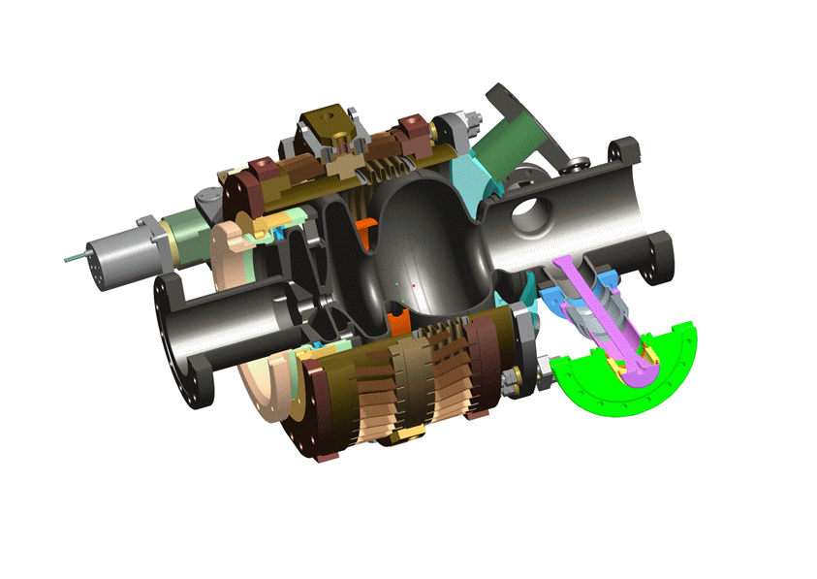
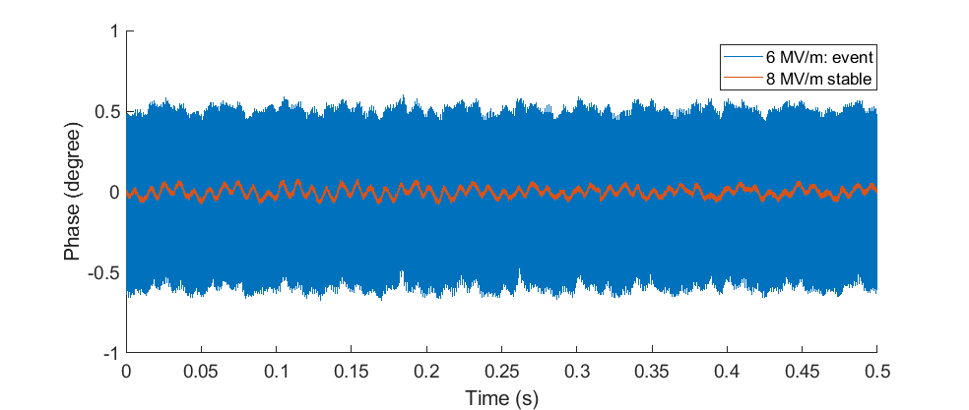
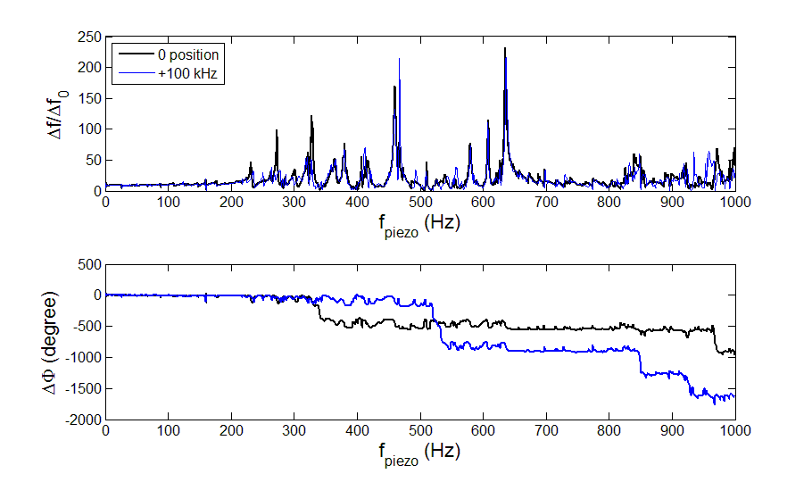
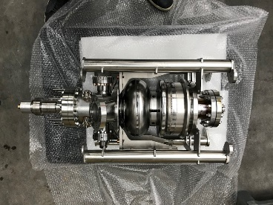
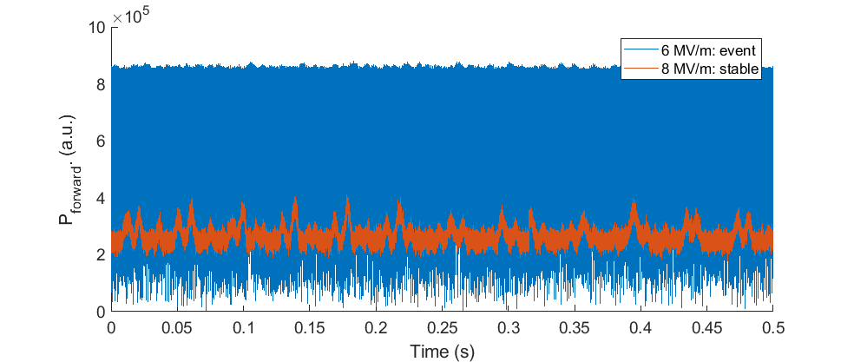
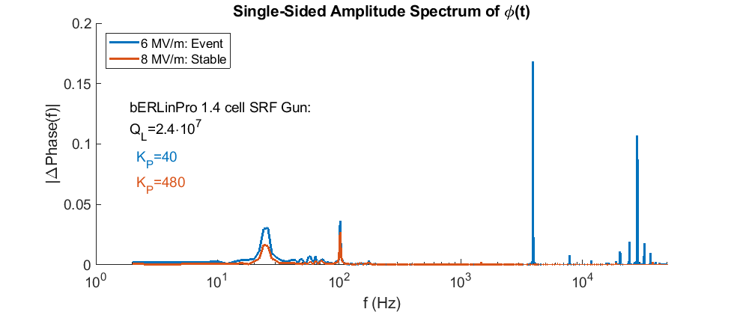
Some example during SRF gun operation
RF Phase
σ_{f}=9 Hz
σ_{f} → ∞
Forward Power
No direct correlation to loop gain!
This instability was affected
by DC bias voltage in
cathode channel
This is used to mitigate
Multipacting
Strong correlation with
vacuum activity
Piezo in lowpass PI loop
Multipacting?
Detuning

Slide 5
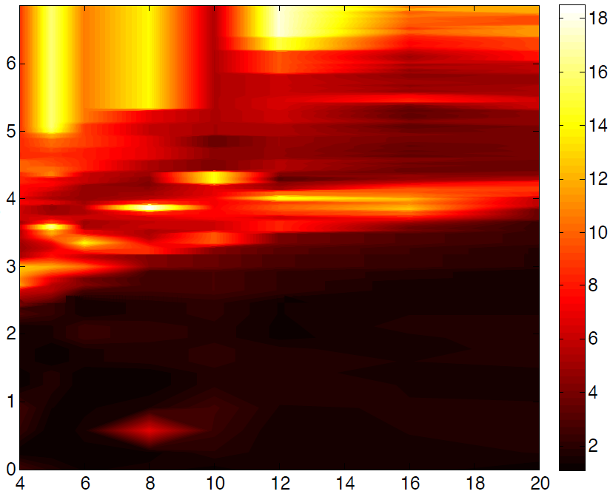
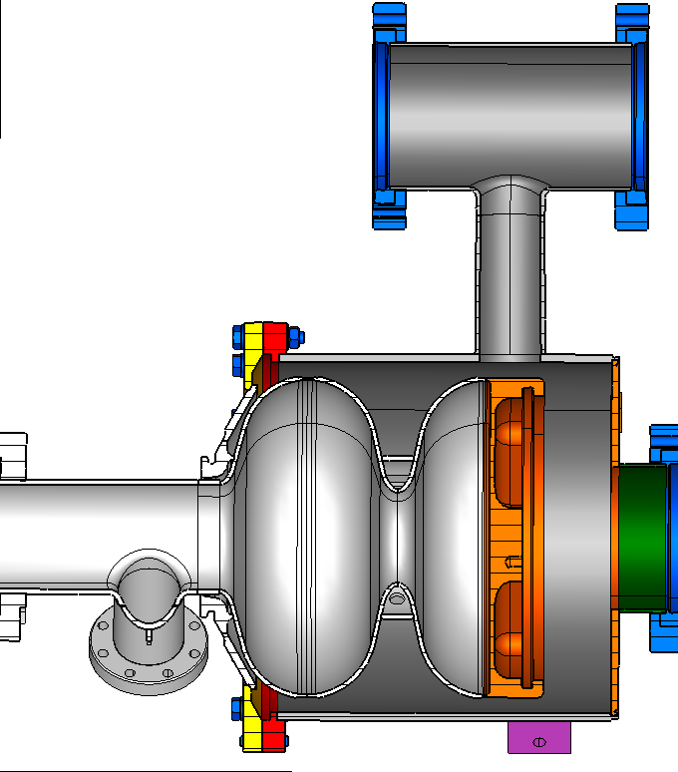
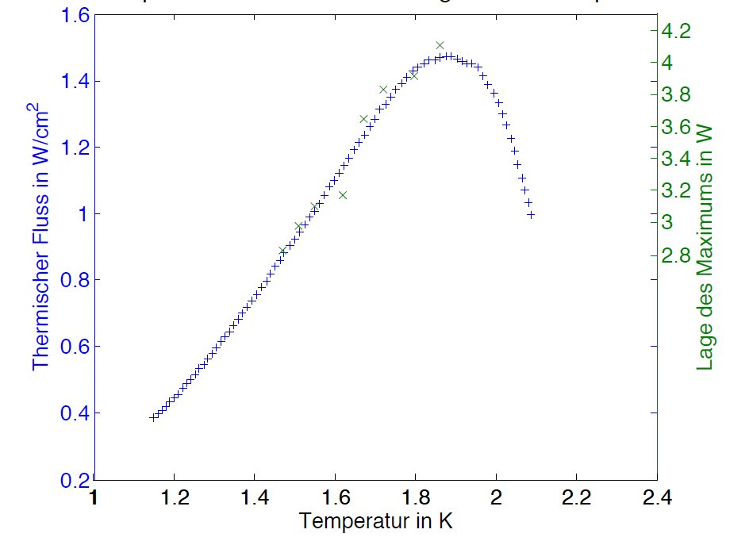
CW operation: A electro-magnetic-mechanical
-thermo-acoustic coupled problem?
P_{heater} (W)
Δf (Hz) rms
Resonances of the liquid?
Q_{crit} (W/cm²)
P_{heater} (Δf_{max}) (W)
Here maximum of
Second sound velocity
T_{LHe} (K)
T. Peterson, TESLA-Report 1994-18
T=1.5-1.9K
P_{LHe} (mbar)
Cavity driven by LLRF at E₀=15 MV/m
Piezo compensation in PI loop mode
with low-pass filtering, Q_{L}=1.4.10⁷
Additional power dissipated in L_{He} bath
by heater (few cm²) within liquid
Microphonics recorded while heater is powered

Slide 6
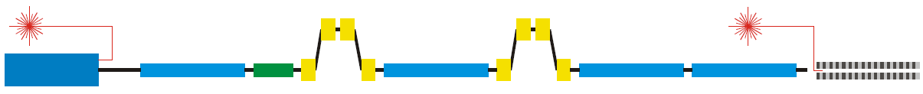
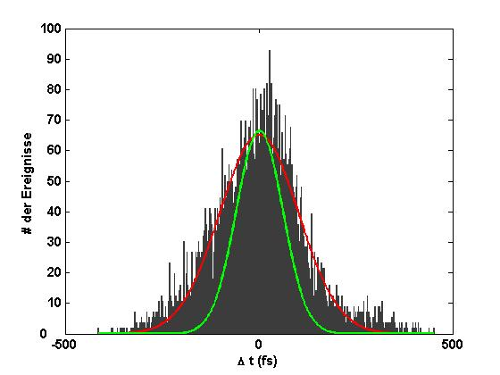
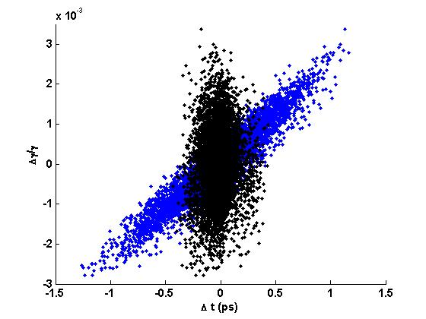
Microphonics impact: Single pass FEL
RF-
Photoinjector
Linac-
modules
3rd harmonic-
cavity
Bunch-
compression
Linac-
modules
Seedlaser,
Undulators
e⁻ →
Time jitter
Laser
Velocity
effects
Acceleration-
errors
Energy dependent
path length
Time jitter
Laser
σ_{Φ} < 0.05°!
LLRF simulation of the accelerator
V_{acc}
Energy chirp
t
σ_{t} = 60 fs
# Events
Dispersive section
Δγ/γ
Dispersive section
E<E₀
E<E₀
E>E₀
E>E₀
z
z
Δt (fs)
Δt (ps)
Analysis of errors in acceleration process

Slide 7
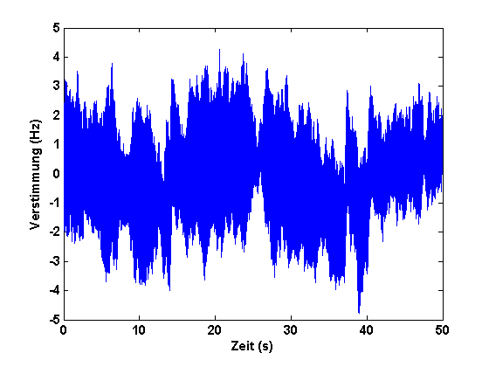
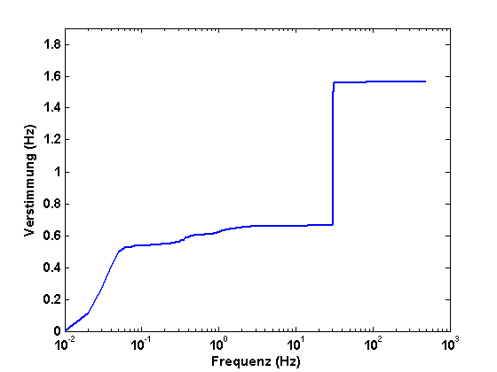
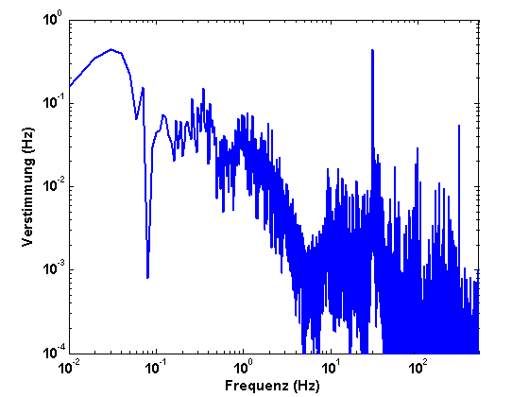
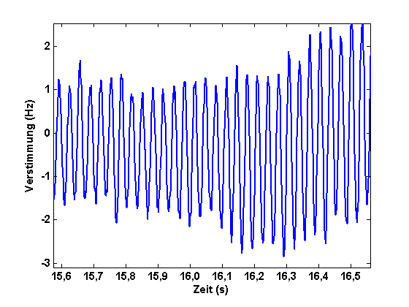
Detuning characterization of a TESLA cavity, short-term
Characterisation: Measurement results
σ_{f} = 1.56 Hz
He pressure-
variations
Detuning (Hz)
ΣFFT
FFT
Excited Eigenmode
HoBiCaT: σ_{f} = 1 - 5 Hz (rms)
←→ 2-13° phase error (Aim: 10⁻² °)
„open loop“ „closed loop“
He pressure variations: f_{mod} < 1 Hz
Cavity specific: Lines at 30 or 41 Hz
Spectrum can appear more populated
→ depends on cavity system
Detuning (Hz)
Time (s)

Slide 8
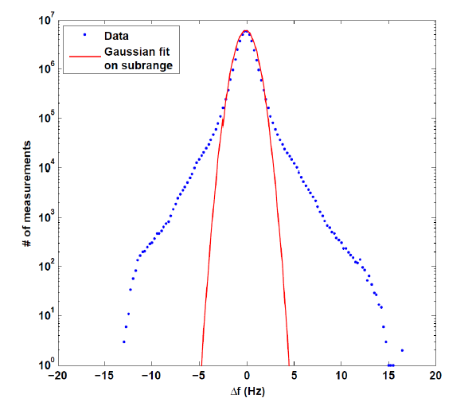
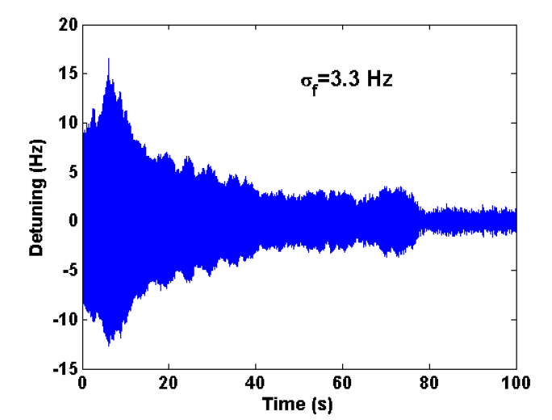
Longterm stability: Peak events→ how much, how often?
Microphonics recorded at HoBiCaT with TESLA cavity for 48 hours at E_{acc}=8MV/m
RMS Values around 1-5 Hz ← Determines field stability and thermal loading of RF system (5 kW)
Peak values extend out to 17 σ! ← Determines RF power installation (15 kW)
Peak events occur 10-20 times a day!
(This was partly improved by changes to
the control settings of the under-press.
pumps.)
Expected field stability: 0.02 - 0.1°
For „comfort“ want to reduce
the microphonics
Gaussian sub-range
0.8 Hz rms
Excited 1st mech. resonance: Transverse mode

Slide 9
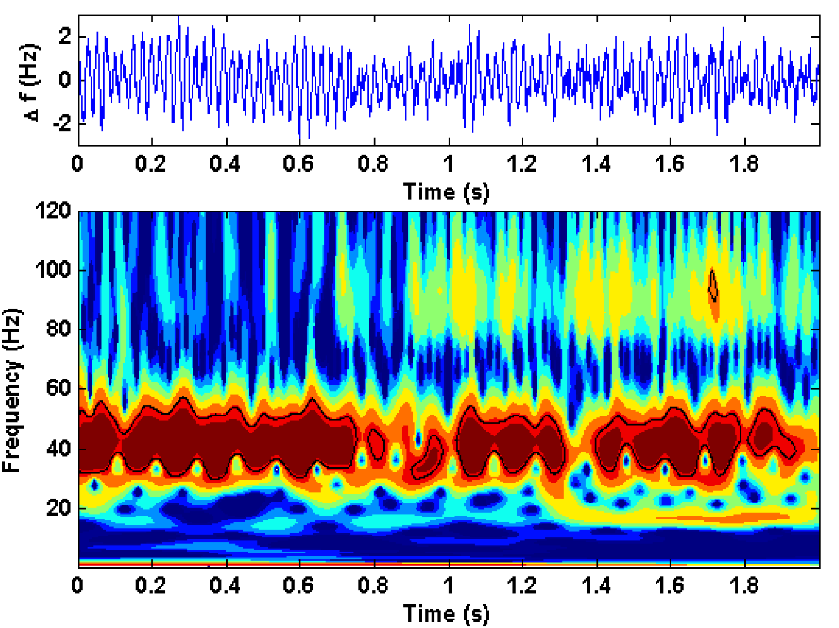
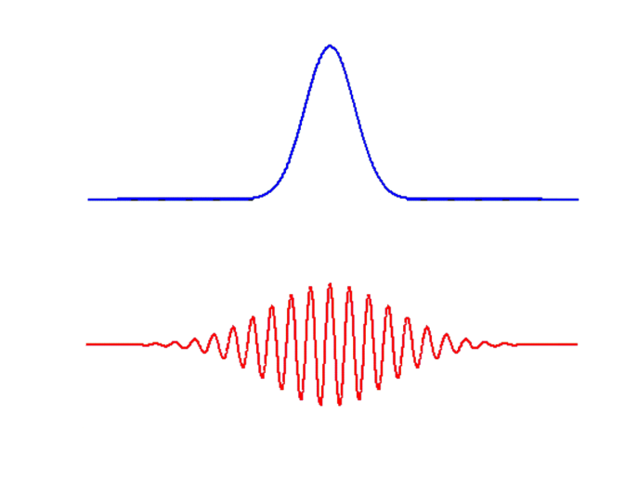

Time-frequency analysis by Wavelets
^
ψ
Morlet
Δf (Hz)
ψ
s. ω
0
t/s
Variation up to Δf =10 Hz
on a ~100 ms time scale
Spectrum of He-pressure variations of
stochastic nature
Adaptive, „learning“ (dynamic)
compensation mandatory
Need for classic feedback control

Slide 10
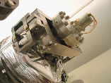
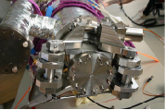
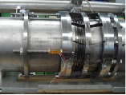
Tuner qualification
Tested 3 different
tuner systems
 | Saclay I* | Saclay II | INFN Blade**
Mech. principle | 1-lever+flexures | 2-levers+flexures | Knee-lever+blades
Tuning resolution | 0.176Hz/step | 0.09 Hz/step | 2.6 Hz/step
Drive | Phytron / HD 1:88 | Phytron / HD 1:88 | Sanyo / PG 1:100
Max remanence | 30 Hz | 55 Hz | 380 Hz
Coarse tuning range | 750 kHz | 500 kHz | 720 kHz
Coercitive steps | 180 (no backlash) | 350-500 (backlash) | 100 (backlash)
Used piezo type | HV (0-1000V) | LV (-10-150V) | LV (0-200V)
Piezo tuning range | 750 Hz | 1420 Hz | 800 Hz
Group delay (dφ/dω) | 290 µs | 150 µs | 650 µs (138 µs)***
Lowest resonance | 40 Hz | 40 Hz (double) | 35 Hz
→ Important for CW piezo based detuning control
* Increased stiffness of piezo holder frame
** Several versions exist
*** 138 µs for 1.4 cell SRF gun with Cornell blade tuner

Slide 11

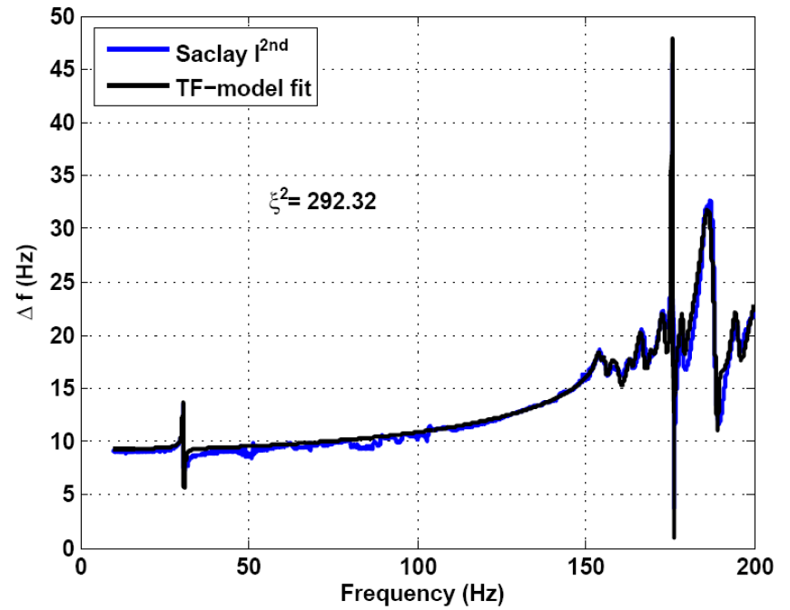
Model based controller: Fit of the system
TESLA Cavity
Fit: Parallel acting 2nd
order systems
Evaluate response of higher
modes at lower frequencies
>20 modes needed for fit
Systems complexity complicates
use of model based feedbacks
(e.g. Kalman filter)
Individual for:
Each cavity tuner combination
Changes with coarse tuning
Affected by cav. mech. design
Transfer function as
look-up table
Kalman approach tested
with cavity simulator
Cav. Test in preparation
See Ushakov et al. IPAC17
Relevant for tuning

Slide 12
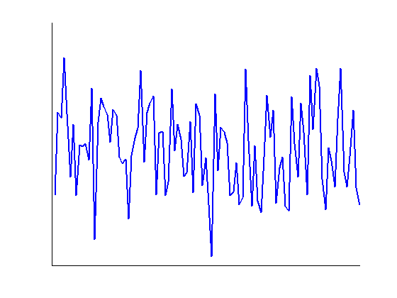
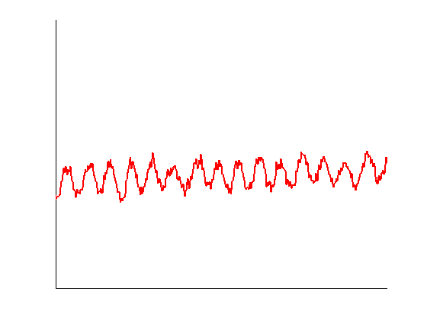
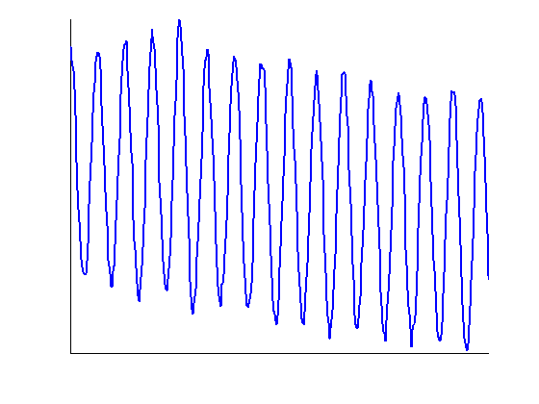
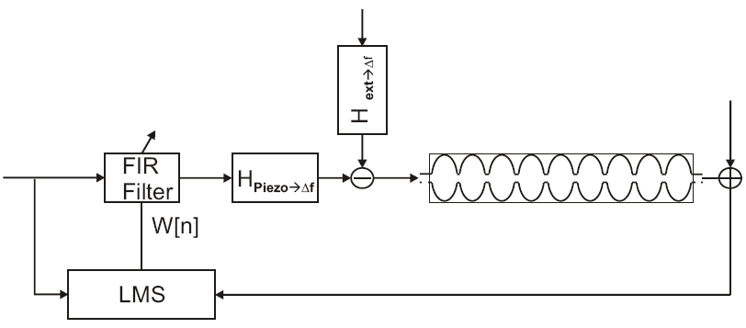
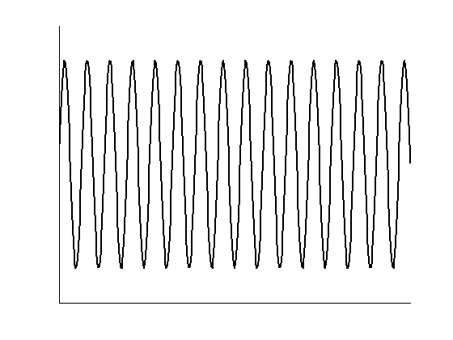
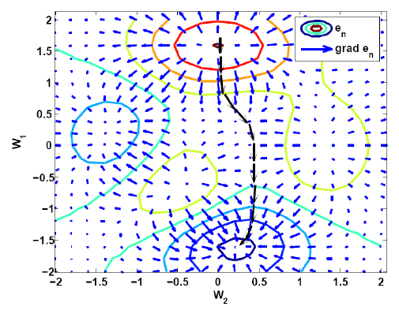
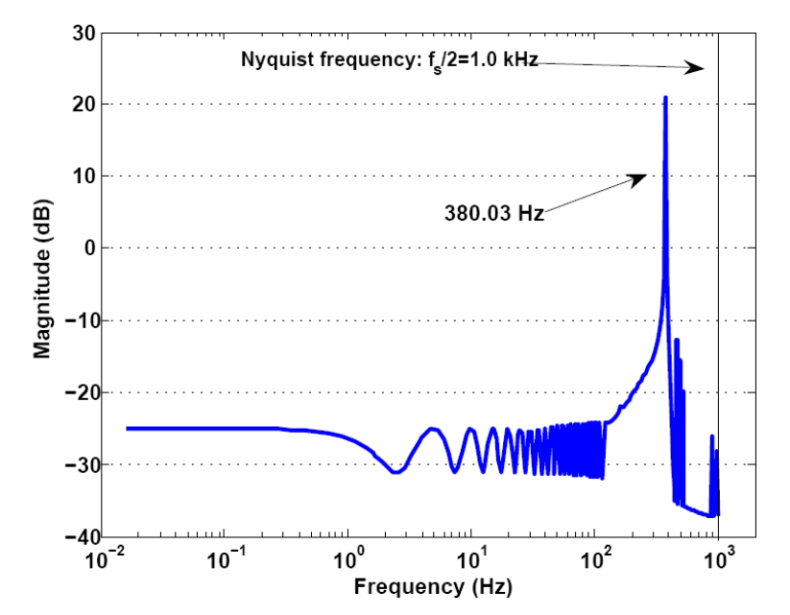
A tested scheme: Least-mean-square based adaptive feedforward
External mechanical
oscillations
Δl (nm)
FFT
Compensating
signal
t (s)
Detuning
of the cavity
Δf (Hz)
ΔU (V)
IFFT
∙H⁻¹
t (s)
t (s)
Calculation
of optimal
FIR filter
parameters
For white noise excitation
The FIR filter would be
H⁻¹_{piezo→Δf}

Slide 13
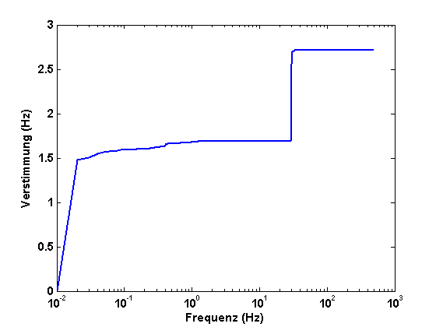
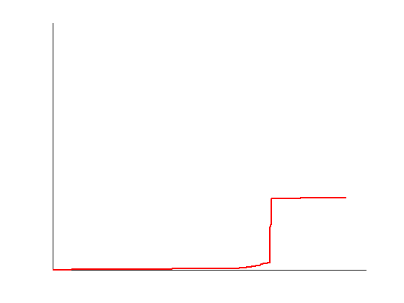
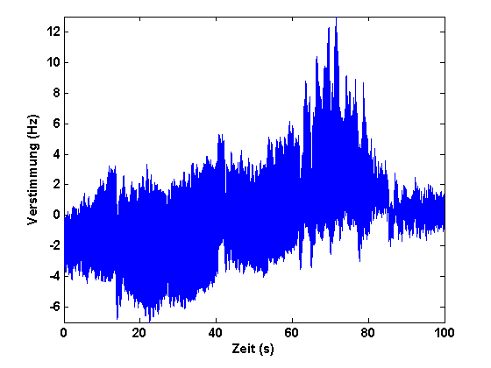
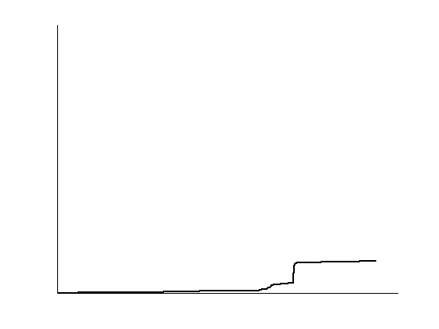
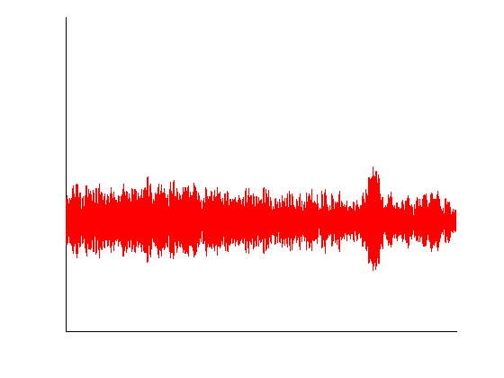
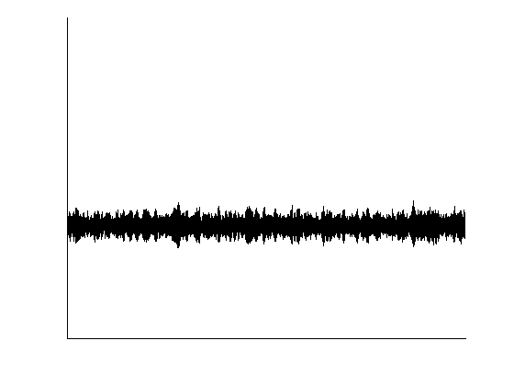
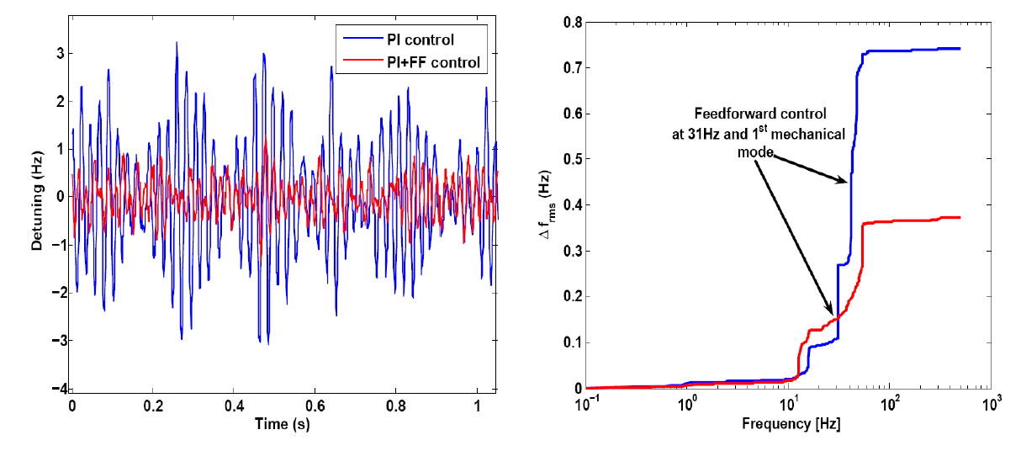
Compensation results
Single-resonance control:
Results:
ΣFFT
Q_{L}=6.4.10⁷
σ_{f} = 2.52 Hz
Open
loop
Feedback only
σ_{f} = 0.89 Hz
Feedback
and Feed-
forward
σ_{f} = 0.36 Hz
14 deg phase mod. down to 2 deg → sub-promille stability in theory possible
Multi-resonance control:
Piezo resolution seems
to limit control of
neighboring modes
→ transfer of energy

Slide 14
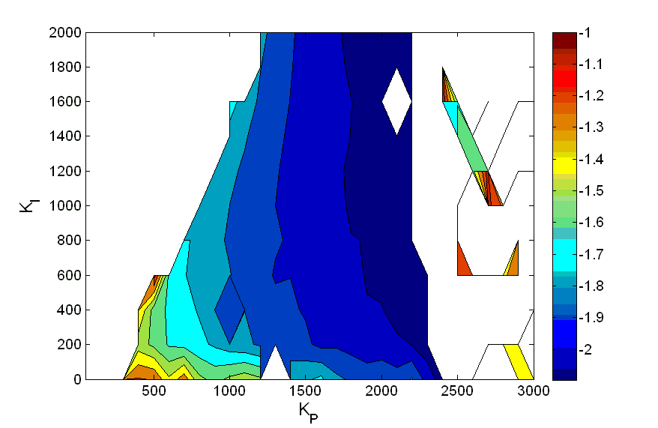
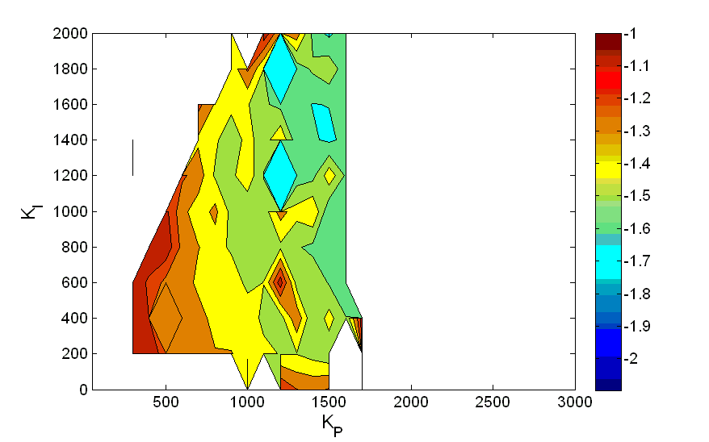
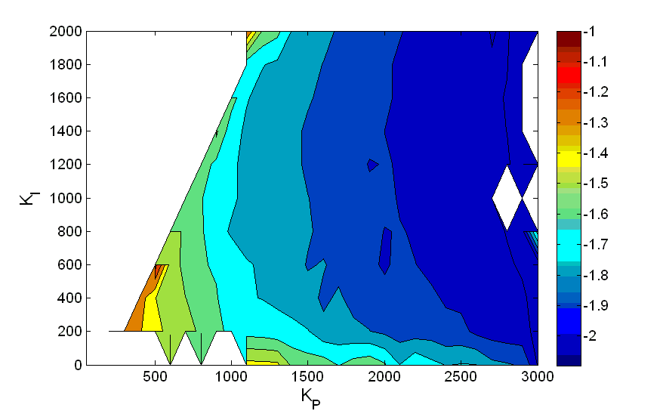
LLRF studies with U Cornell: Limits of Q_{L}
log(σ_{φ})
Q_{L}=5.10⁷, f_{1/2}=13 Hz
Best results:
5.10⁷ 0.008°
1.10⁸ 0.0093°
2.10⁸ 0.0236°
Q_{L}=2.10⁸ , f_{1/2}=3.25 Hz
9 cell TESLA cavity
E_{acc}= 10-12 MV/m
T_{bath}= 1.8 K
PI piezo loop
8/9-π filter optimized
σ_{f} = 5-10 Hz, peak 15-20 Hz
Q_{L}=1.10⁸, f_{1/2}=6.5 Hz
LF detuning → IOT beam instable
Cavity field trip
Areas with σ_{φ}>0.1 were blanked out

Slide 15















Questions?
Thanks to all collaborators and partners of the past, present and future
projects and co-workers at HZB:
Further readings:
A. Neumann, W. Anders, O. Kugeler, J. Knobloch (2010).
“Analysis and active compensation of microphonics in continuous wave
narrow-bandwidth superconducting cavities“,
Phys. Rev. ST Accel. Beams 13, 082001.
O. Kugeler, A. Neumann, W. Anders, J. Knobloch (2010).
“Adapting TESLA technology for future cw light sources using HoBiCaT”,
Rev. Sci. Inst. 81 (7).
A. Ushakov, P. Echevarria, A. Neumann
Detuning Compensation in SC Cavities Using Kalman Filters
Proc. of IPAC 2017, Copenhagen, Denmark, THPAB095

Slide 16
Back-up slides down here

Slide 17
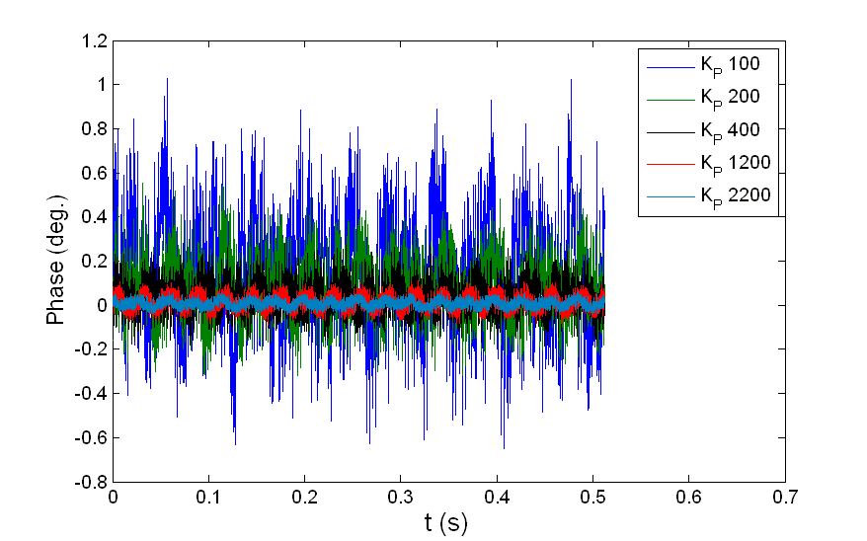
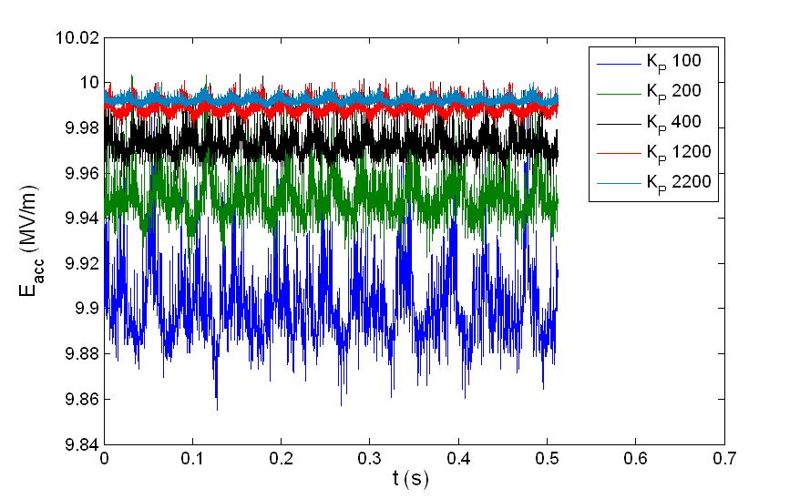
LLRF studies: Summary
Q_{L} | σ_{f} (Hz) | σ_{φ} (deg) | σ_{A}/A | P_{f} (kW)
5.10⁷ | 9.5 | 0.008 | 1.10⁻⁴ | 1.106
1.10⁸ | 7.9 | 0.009 | 2.10⁻⁴ | 0.595
2.10⁸ | 4.2 | 0.024 | 3.10⁻⁴ | 0.324

Slide 18
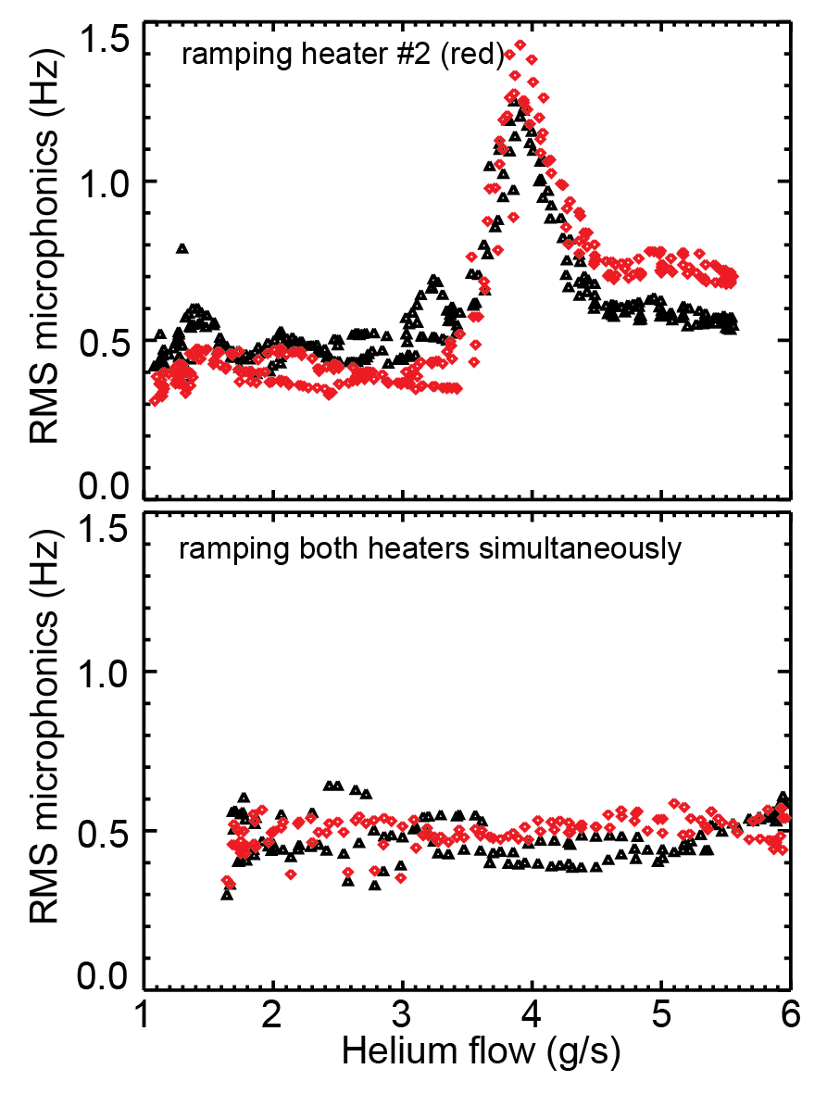
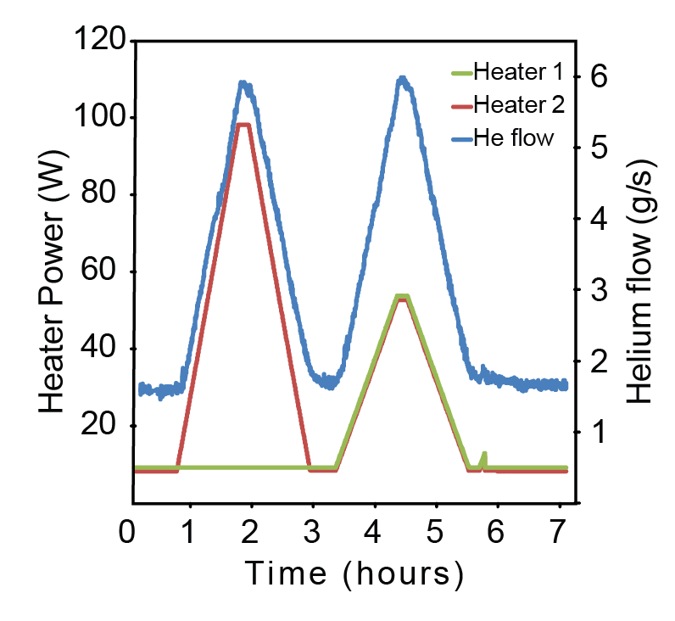
Microphonics and thermal load on cavity tank
30mbar
Simultaneous 2 cavity operation
(TESLA cavities)
Heaters attached at each tank
Monitor microphonics due to thermal
load on cavities
Onset of non-laminar Helium flow?

Slide 19


Correlation of Helium pressure and detuning of cavity
TESLA cavity
Open loop measurement of cavity frequency and He pressure
50-60 Hz/mbar down to resolution limit of pressure meters (~1Hz)
Evidence that main contribution of microphonics mediated through superfluid Helium

Slide 20

Tuner dynamics: Blast from the past?
(appeared at TTC at KEK)
Microphonics
background
substracted
Here complete
detuning spectrum taken
at a given excitation
frequency
Usually transfer functions
taken with lock-in
amplifier to reduce
noise content
(Stanford Research,
SR850)
Transfer function
Higher harmonics
Measured with first version of piezo frame (2005-2006)
Higher harmonic content most probably by piezo amplifier (even within drive signal?)
Measured at high excitation amplitudes (above 20 Hz)

Slide 21



Detuning spectrum versus bandwidth
For two different tuning schemes (Saclay I and
INFN Blade) open loop measurements of
microphonics vs. Q_{L} were performed
Both tuners showed to have different transfer
functions and thus detuning spectra
on the same cavity type!
Q_{L,Saclay}: 3.10⁷-4.10⁸
Q_{L,Blade}: 7.10⁵-2.10⁷
Blade: Mechanical eigenmode
at 300 Hz, vacuum pump freq.
Saclay: Excitation of 1st
mechanical eigenmode sets in

