Slide 1
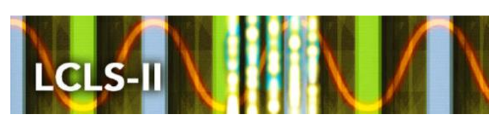

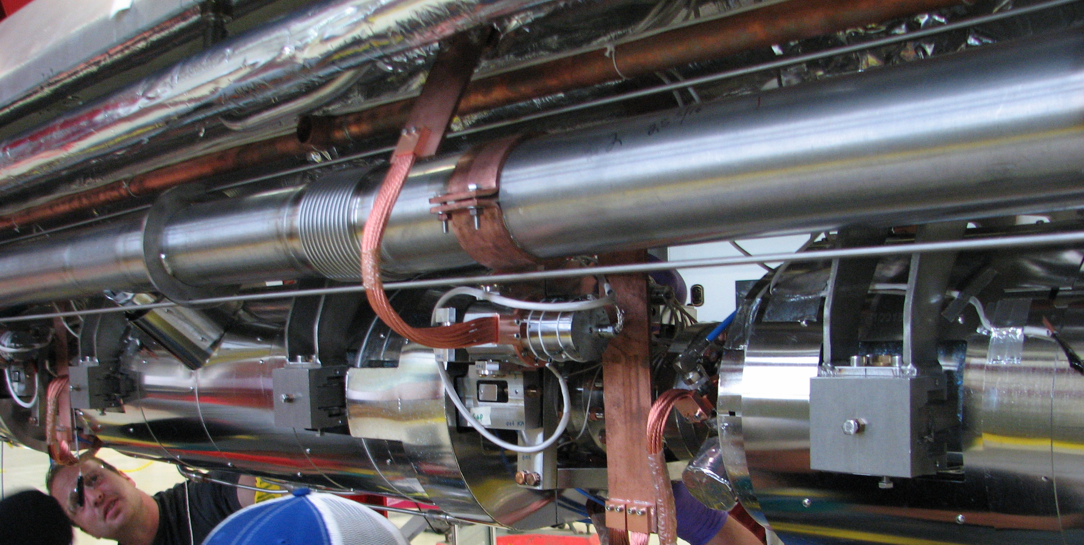
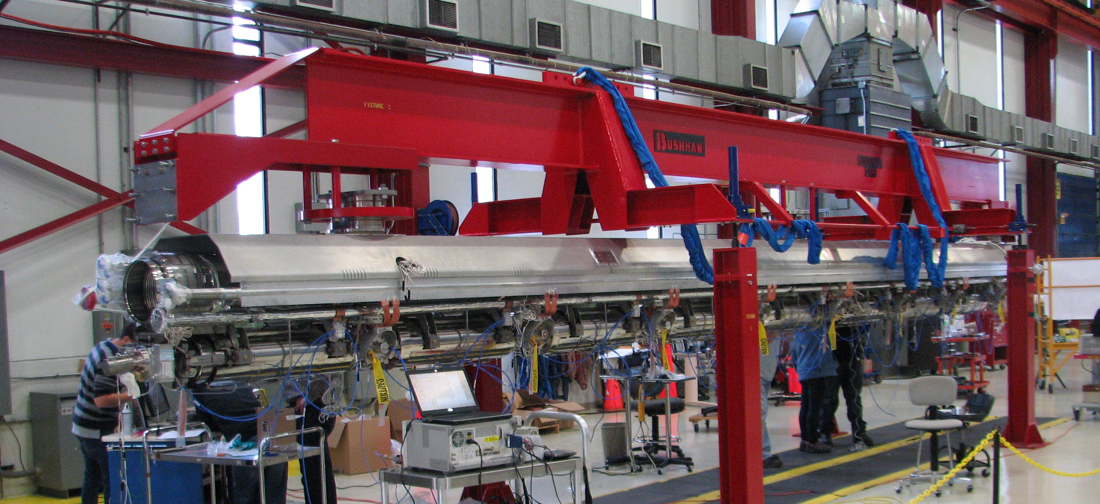
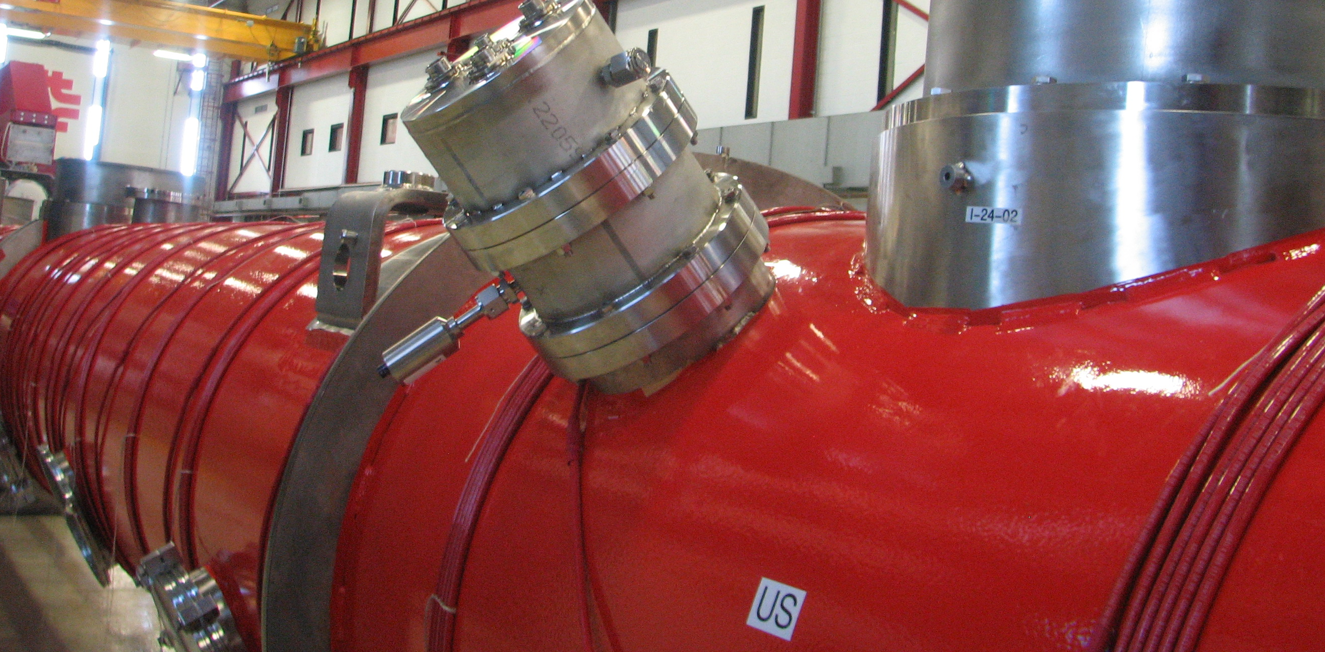
Impact of Thermo-acoustics oscillations on the LCLS II CM microphonics
Presented by Yuriy Pischalnikov
on behalf of FNAL’s MWG
TTC2018, Milan, Italy
WG3
February 6, 2018.

Slide 2
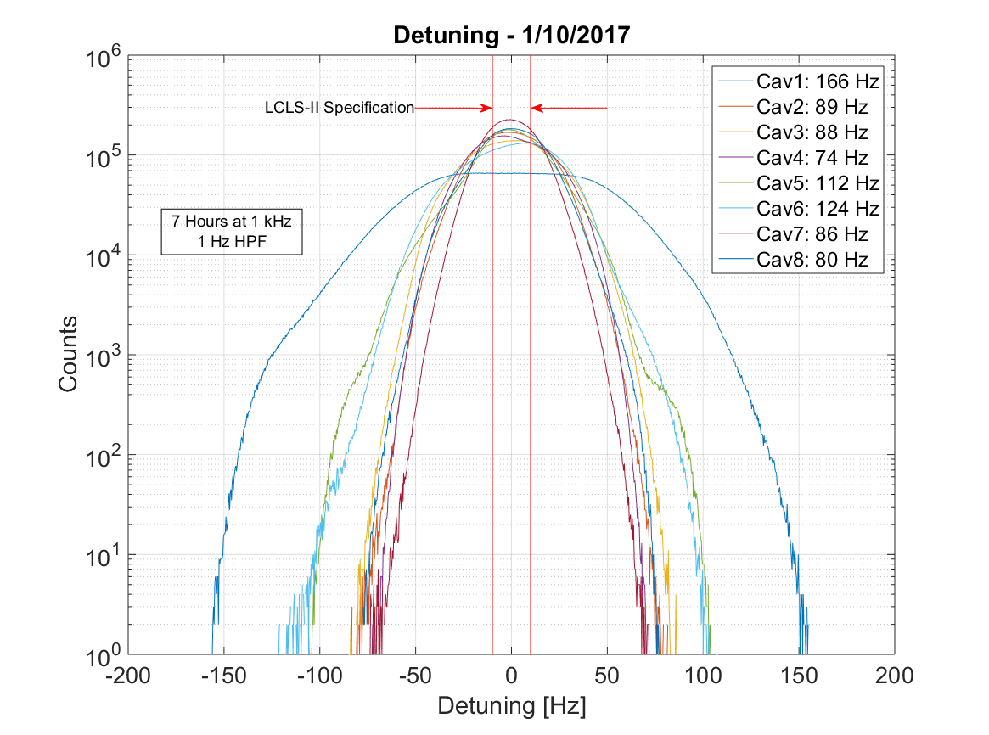
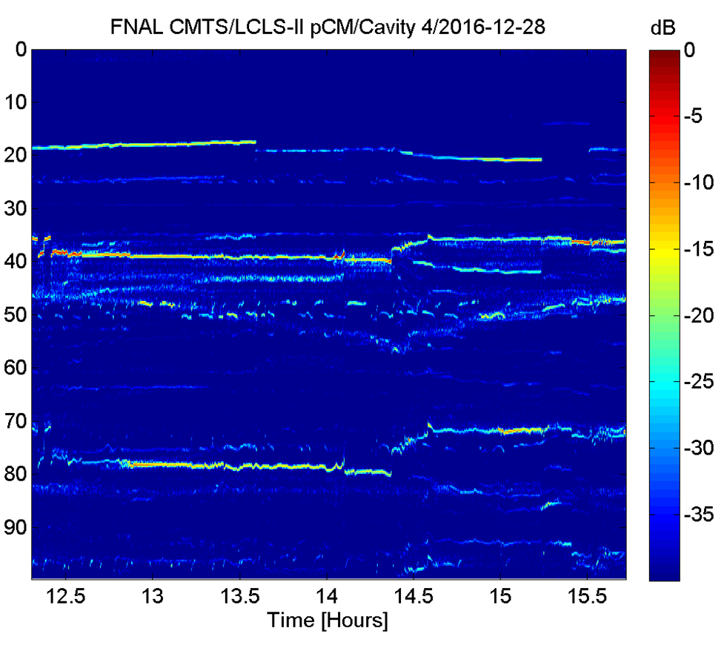
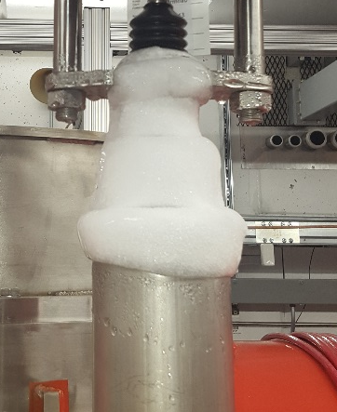
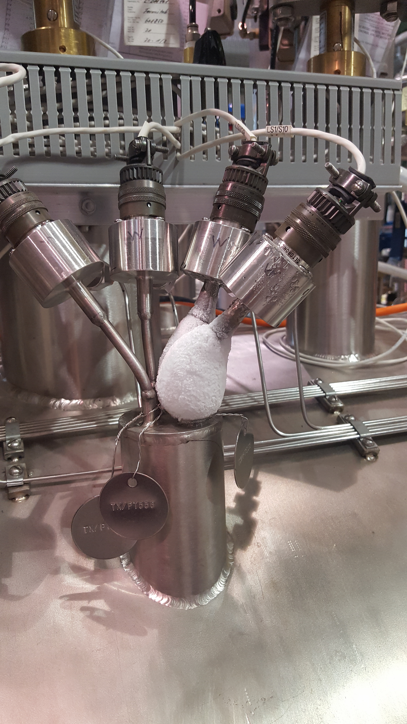
Fermilab’s First CM (F1.3-01) at CMTF – Initial Start-up
Detuning Spectrum [Hz]
At the start of pCM cold testing:
  102 Hz pk detuning average (with LCLS II specs 10Hz pk)
  42 W of 2K static heat load
Detuning spectrum had a very complex and dynamic amplitude spectrum
Spectrum lines shifted rapidly, drifted and oscillated in both frequency and amplitude
This dynamic behaviour suggested unstable sources (i.e. Cryogenics)
Ice balls were found on top of the pCM’s JT and CD valves, and on various Pt and Tx instrumentation lines

Slide 3
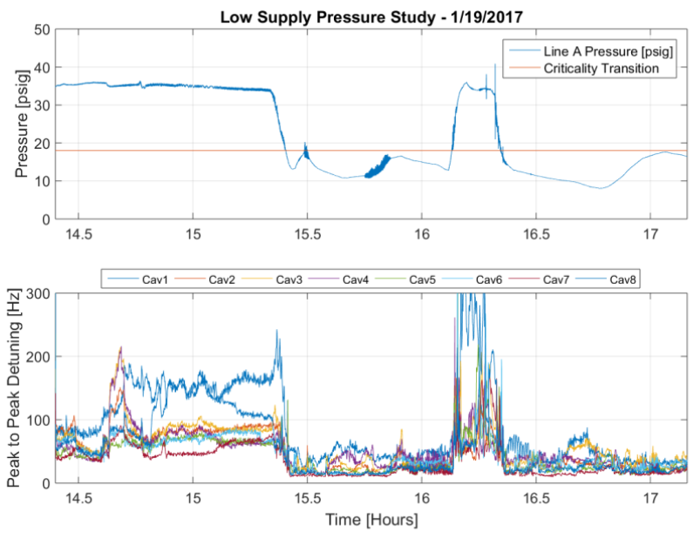
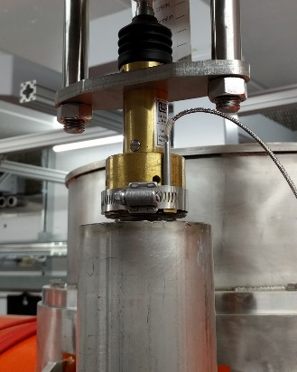
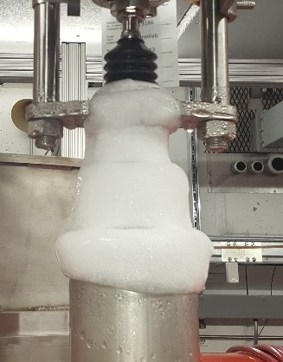
Systematic studies of the Microphonics vs Cryogenic System conditions
Initially is was unknown that TAOs were the the reasons for suspect the excessive microphonics
Performed extensive testing with CM1.. Recorded >350hours of cavity data… Looked for correlations of microphonics to RF Data/ Impact/Vibration Measurements/ Temperature/Pressure, etc.
Several cryogenic variables were varied during long data captures to find any correlations.
Discovered that dropping the helium supply pressure to below the critical point (subcritical - 18psig) the microphonics improved by factor of 10 ! (Wow ! Moment )
In addition: reduction in steady-state flow rate from 4.7 g/s to 1.75 g/s, supply pressure stabilized, valve ice melted
Although obviously not a realistic configuration, diagnostically, this was critical in our understanding of the detuning correlation with TAOs in the CM and Test Stand Valves.
super
sub

Slide 4
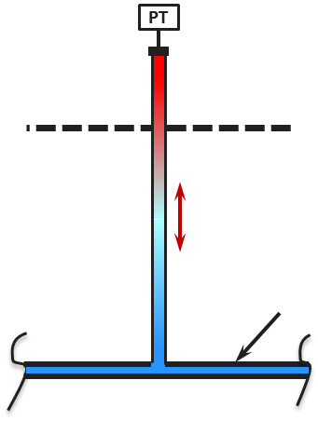
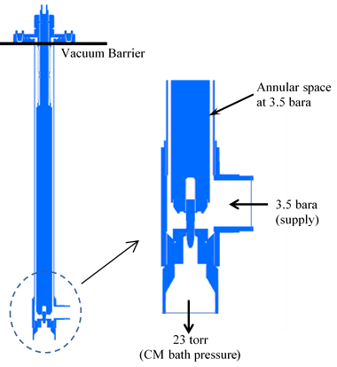
Thermoacoutic Oscillations (Brief Introduction)
Thermoacoustic oscillations generally occur in long gas-filled tubes with a large temperature gradient.
Acoustic modes couple to mass transport up and down column especially well when gas density is strongly tied to temperature.
  E.g. Warm gas from the top of a valve column moving to the cold bottom contracts, reducing pressure at warm region, driving the now cold gas back.
Long valves and very low speed of sound in cold helium can easily give lowest acoustic modes at dangerous frequencies.
Signs of TAOs:
  High heat loads
  Ice-balls at vacuum side of oscillating line
  Disturbances in temp or pressure measurements
  Mechanical vibration
Taking into account sensitivity of the SRF cavities to vibrations (10 Hz detuning == ~3nm of cavity length change) TOAs can significantly dynamically detuning the cavities.

Slide 5
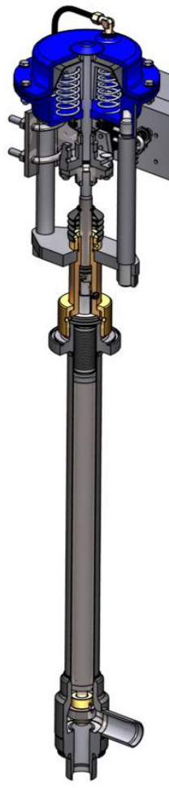
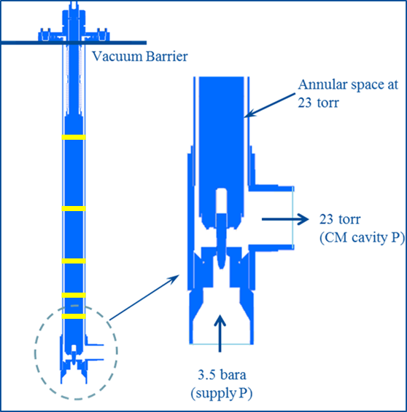
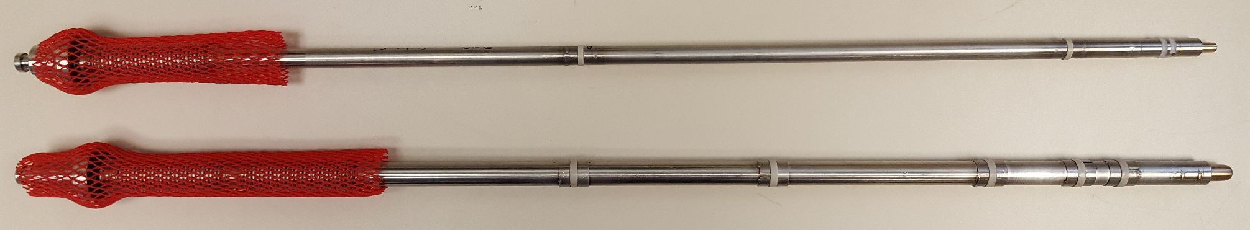
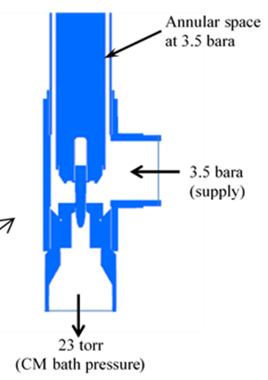
TAO mitigation strategy (Valves modifications)
Two methods applied:
  CM valves were reversed so stem is at low (23torr) pressure
  Wipers or Convection Brakes were added to the valve to close up the annular space
Five (5) wipers, positioned to keep temperature ration ~2-3 (theory predicts TAOs cannot exist with warm/cold temperature ratio < 6)
180K
90K
32K
PEEK wiper
16K
SS Banding
8K
Valve Stem

Slide 6
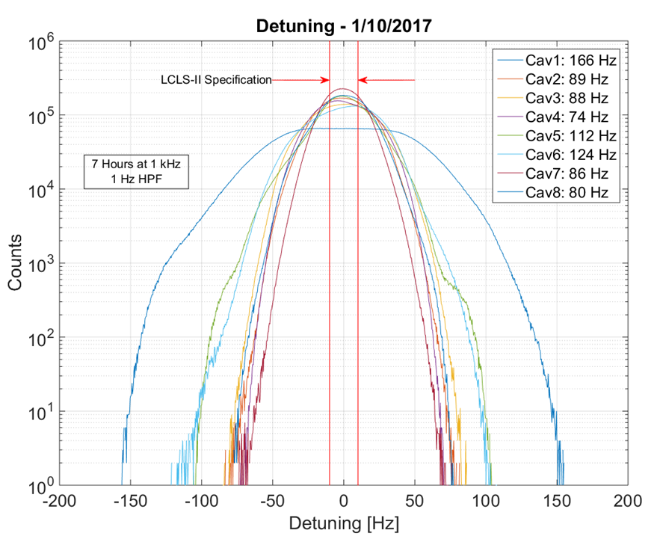
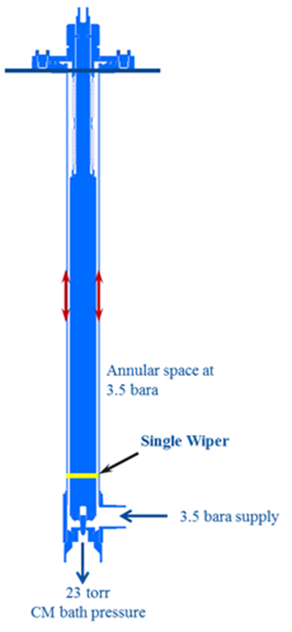
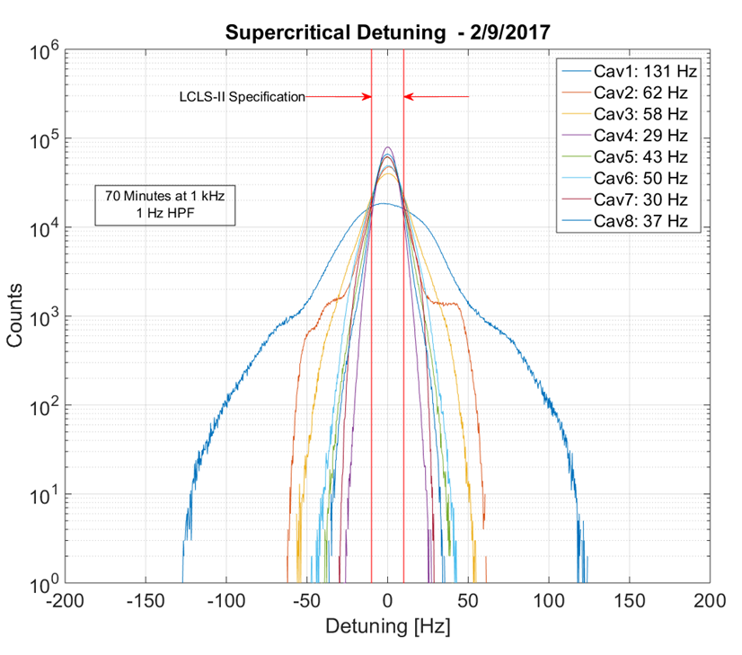
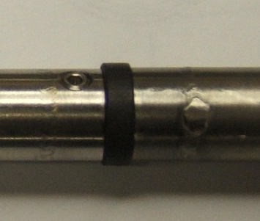
First TAO mitigation results - Single Wipers on CM1
No Wiper
Single wiper added to the CM JT and CD valves of a non-reversed valve (supercritical annular space)
2K Static heat load reduced from 42 W to 11 W
Microphonics better but still poor (~55 Hz ave pk detuning)
Temp sensors mounted to top of valve body indicate some TAO activity remains in valve
Conclusion:
TAOs were confined to the volume above the wiper so no longer contributed to static heat load, but still induced mechanical vibrations and poor microphonics
Multiple wipers are needed and/or valve reversal
100Hz average Peak
Single Wiper
55Hz average Peak

Slide 7
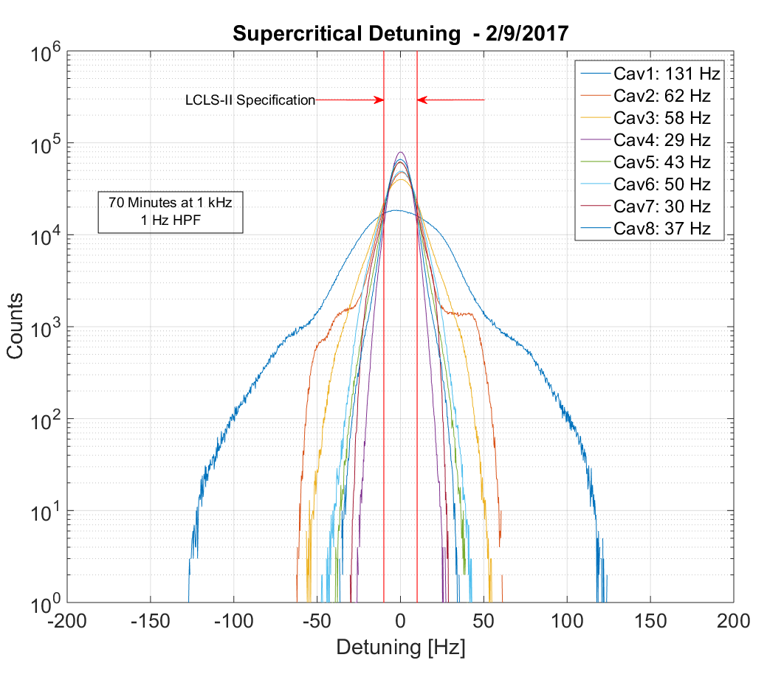
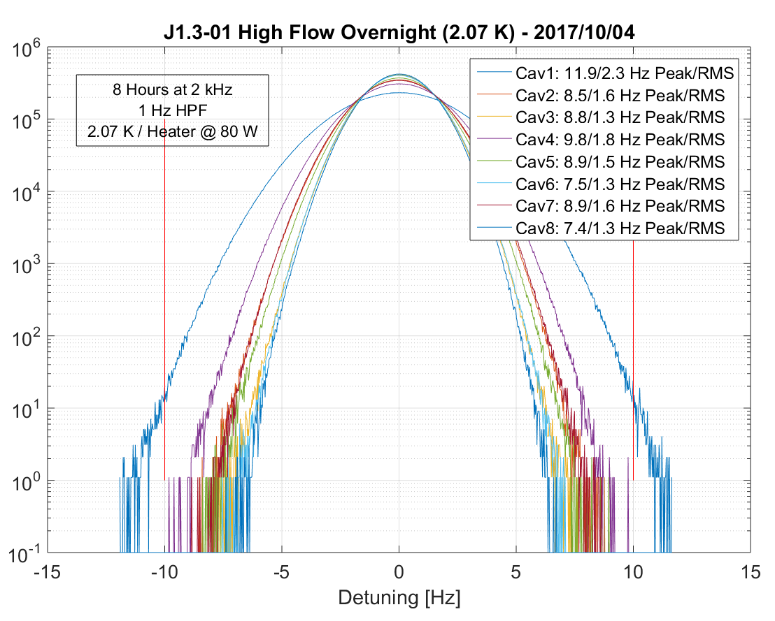
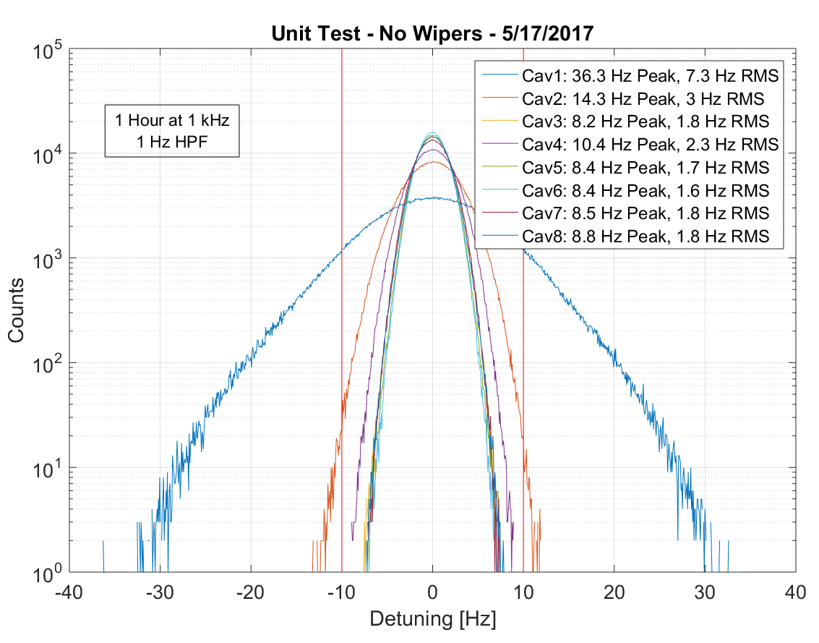
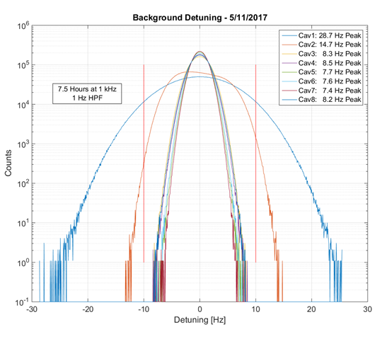
Microphonics level at LCLS II CMs for different modifications of Cryogenic Valve
No-wipers
Single-wipers
Five-wipers
NON-reversed Valve
No-wipers
Five-wipers
Reversed Valve
Average for cavities 2-8

Slide 8
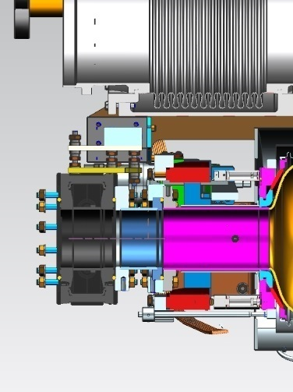
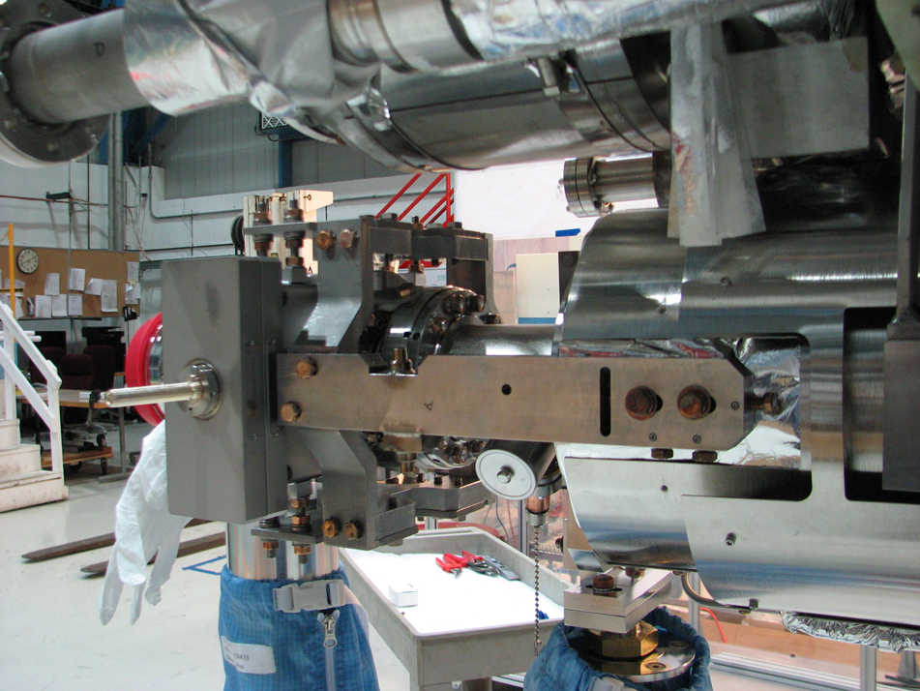
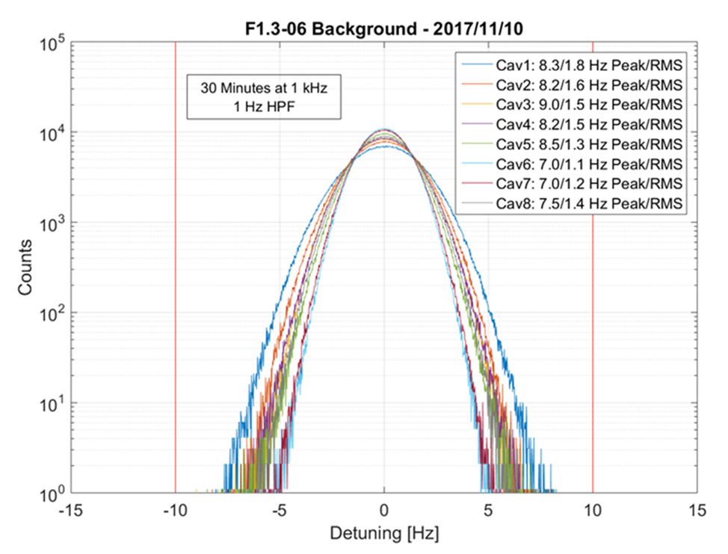
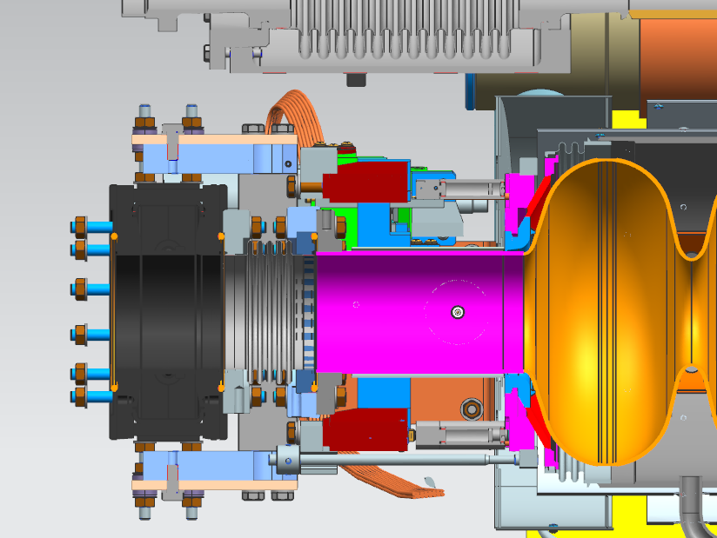
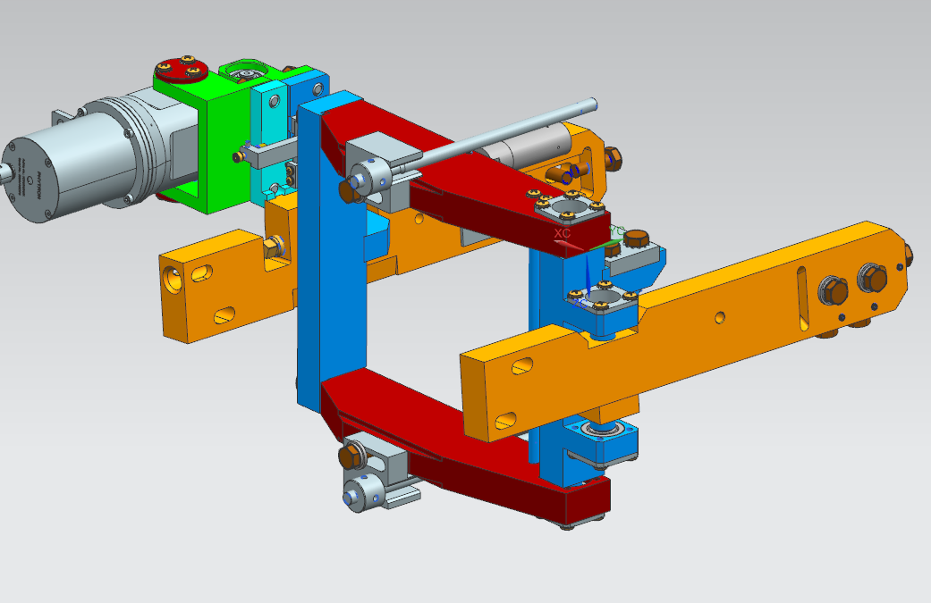
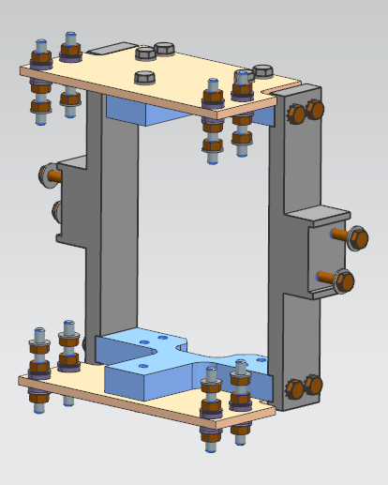
Additional Modifications to mitigate microphonics
Cavity#1-to-GV interface modifications
Solid (through spool piece) connections between cavity#1 and heavy beamline Gate Valve led to factor 2-3 large microphonics on the cavity#1
Support
Bracket
CM2
–spool between GV&Cav1
Pk(#1)/Pk(#2-8)= 3
Gate Valve
Spool Piece
Cavity 1
CM6
–bellow between GV&Cav1
Pk(#1)/Pk(#2-8)= 1
Cryomodules after F1.3-06 now have short bellow between GV and Cavity#1. GV connected to Cav#1 helium vessel (not 300mm pipe) via extended tuner arms and mounting fixture
Tuner with
extended arms
Bellow

Slide 9
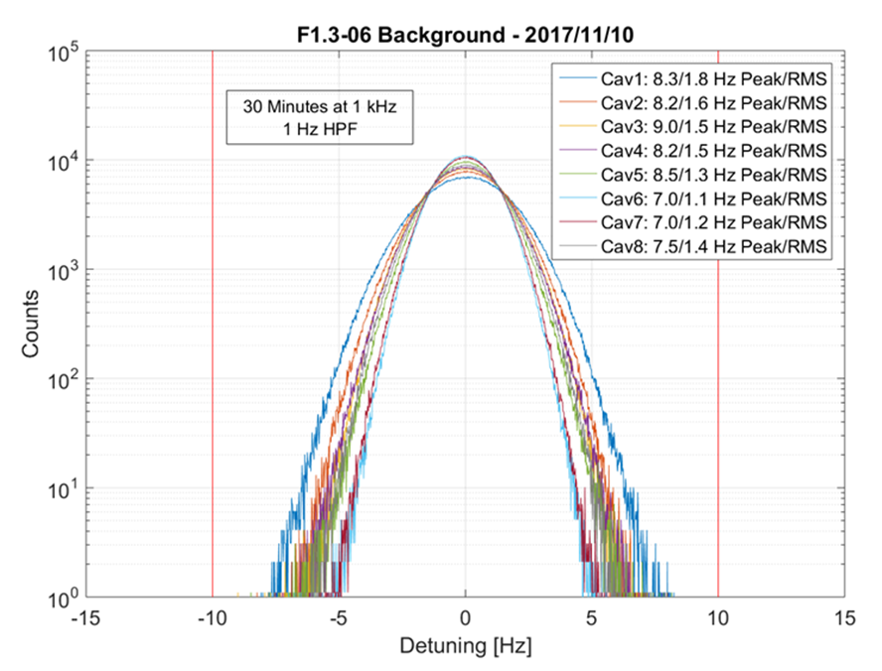

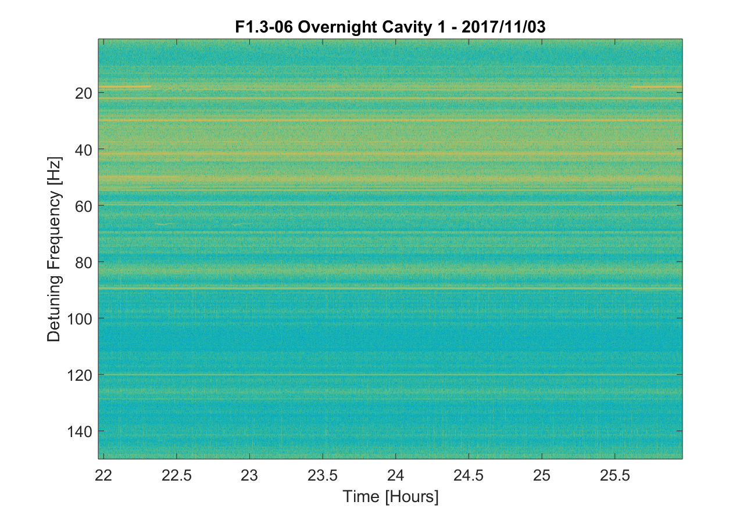
Progress in Passive Microphonics Mitigations at FNAL’s CMTF
CM1
CM6
From average Peak detuning 102Hz with CM 1 at start
To average Peak detuning 8Hz with CM6
(LCL S II specifications is 10Hz peak)
Detuning spectrum changed from a very complex and dynamic (lines shifted rapidly, drifted and oscillated in amplitude and frequency)
to quite stable detuning spectrum.
8 Hz
102 Hz

Slide 10
Summary
First LCLS-II cryomodule showed significantly higher (~100Hz peak) that expected and specified (10Hz peak) microphonics
A cross-disciplinary working group (MWG) was formed to find source of microphonics and implement design modifications to mitigations microphonics to the specifications level
It was found that TAO oscillations into the CM’s cryogenic control valve (JT-valve) contributed to the high level of microphonics
Modifications of the cryogenic valves: 1) valves reversal and 2)adding to the valve stem multiple wiper suppress microphonics in ~10times
Additional mechanical modifications of the CM, included re-design of cavity#1 and GV interface, suppress overall microphonics to the level 8-10Hz (peak) (on CM6&7)
Passive mitigations studies have now shifted from unstable sources of microphonics (i.e. cryogenics) to stable sources (e.g. rotating machinery)
In parallel with passive mitigation FNAL’s Resonance Control Group are working on Active Resonance Control of SRF cavities for LCLS II project

Slide 11
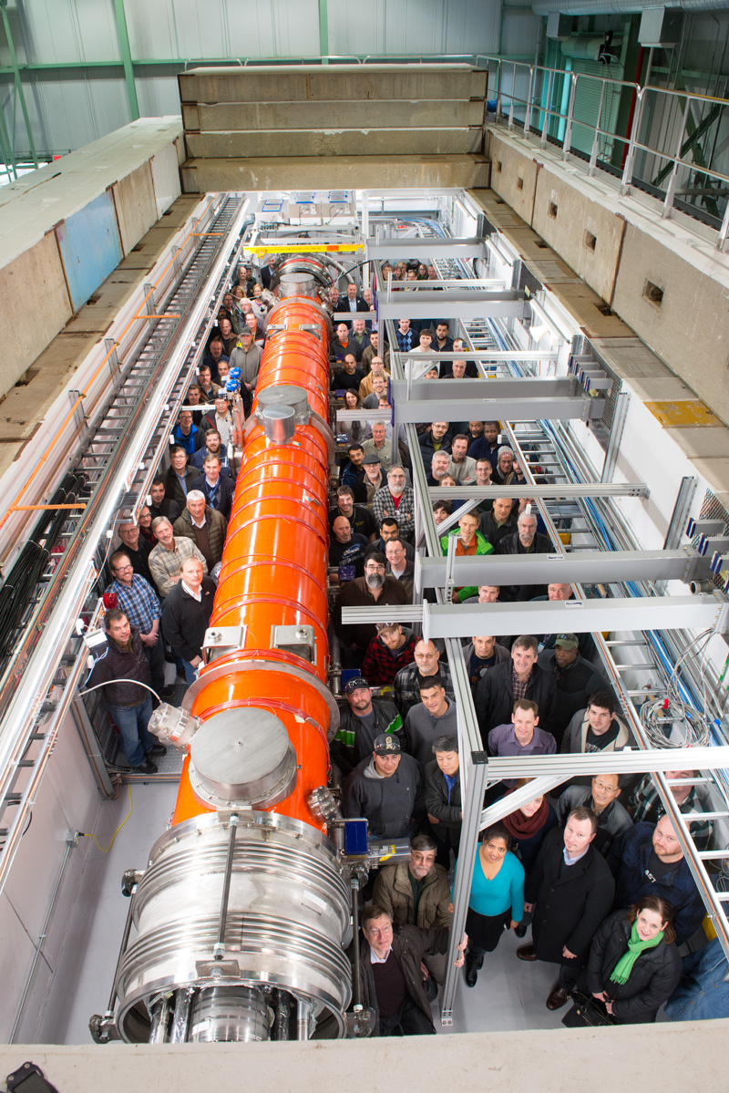
Thank you
Acknowledgement
to FNAL LCLS II team (and especially MWG –team of the experts in several fields: cryogenics, RF, SRF, resonance control, etc.)
Special thanks to B.Hansen and J.Holzbauer for help in prep. of this talk.

Slide 12
Additional Slides

Slide 13
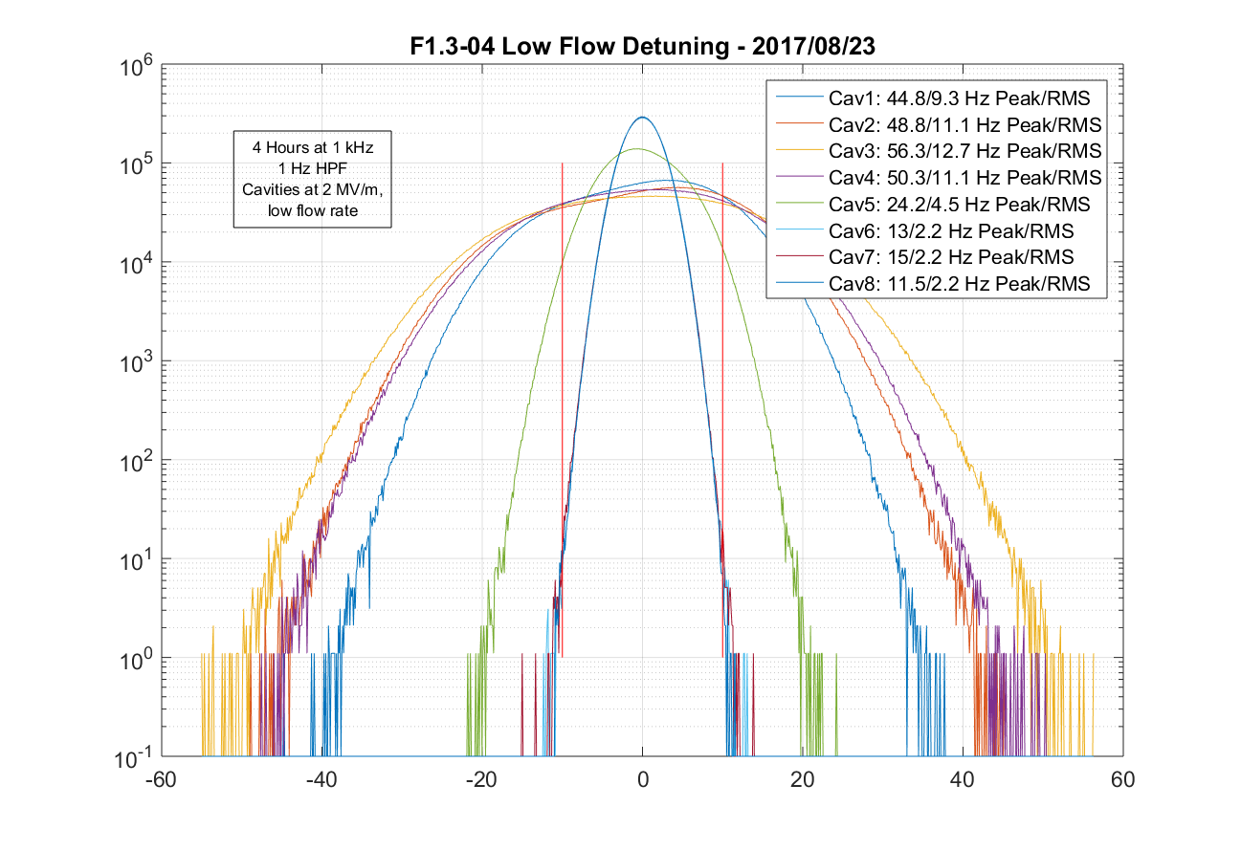
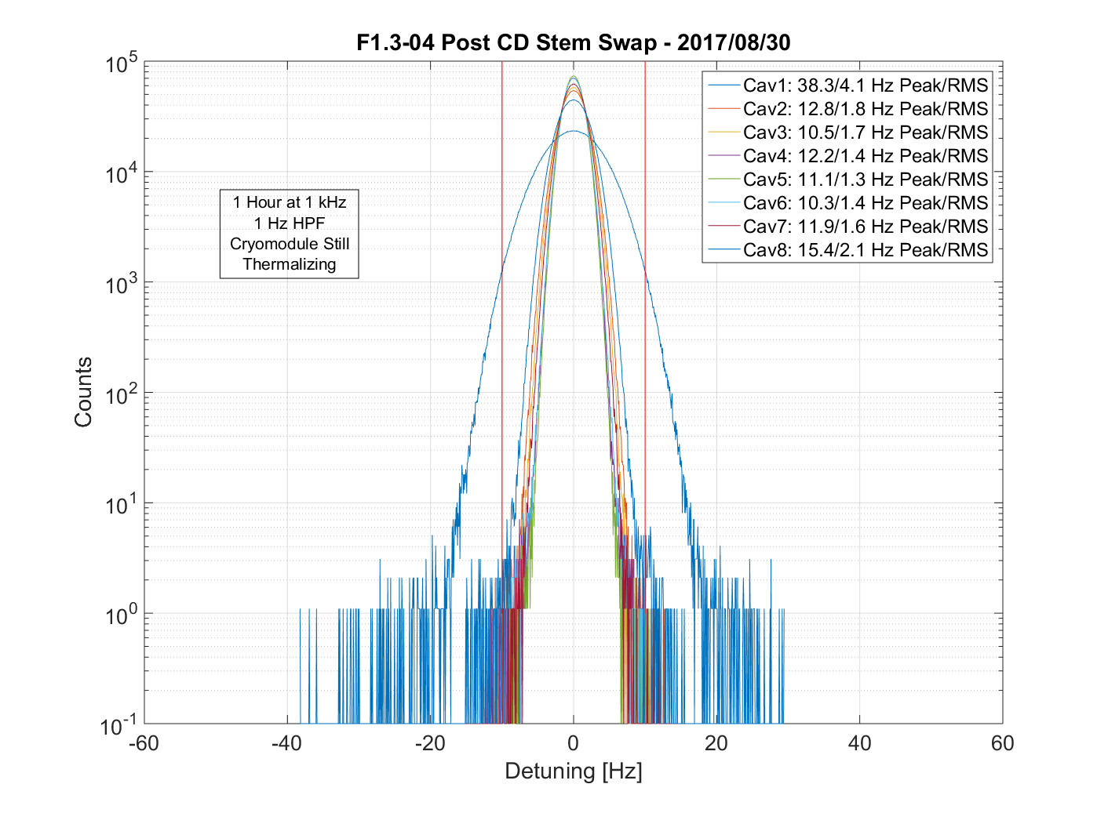
Cryogenic Valve Plumbing – Fast Cool Down Valve Leakage (CM4 experience)
F1.3-04 presented with higher than expected microphonics, worsening as the cryomodule thermalized
Noise was narrowband and showed complex spatial and spectral distribution in cryomodule
Testing showed strong correlation with cooldown circuit, eventually proven to be coherent bubbling due to cooldown valve leakage
Swapping valve stem returned expected performance, although testing schedule prevented detailed studies
Tails seen in ‘post-swap’ data are likely due to continued thermalization of cryomodule after cooldown
Additional QA check step now included to prevent valve leakage in the future
Thermalized Detuning
Post CD Stem Swap

Slide 14
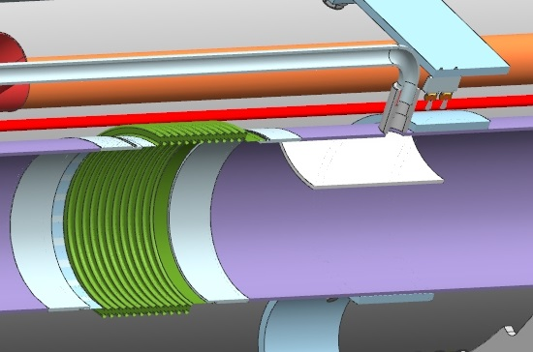
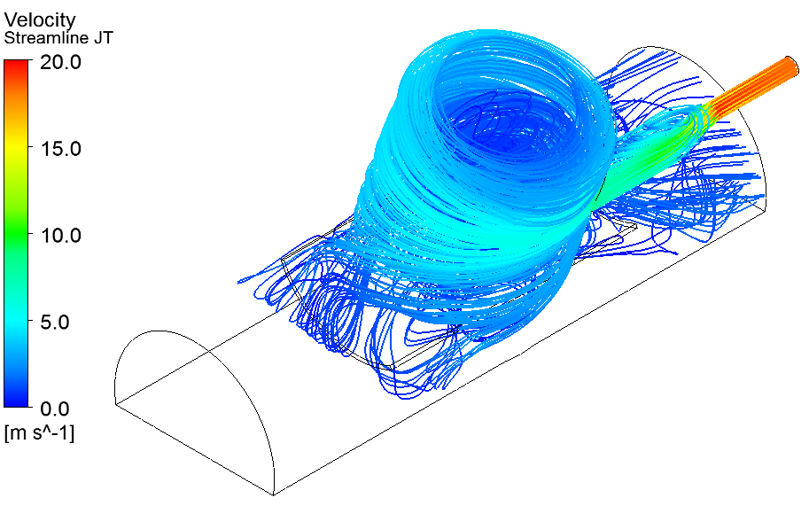
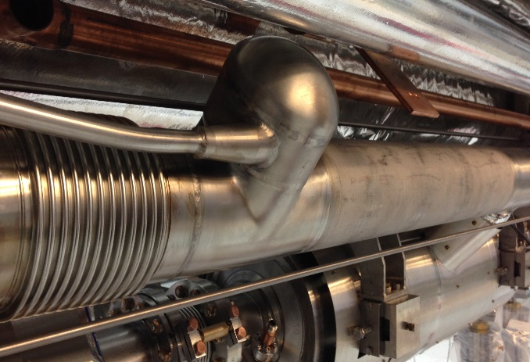
Mitigation Steps in Cryomodule Design – 2 Phase Injection
Liquid level control was coupled to input flow rate and the amount of flash gas generated across JT valve
  Helium injection line impinged on liquid surface
  Flash gas from JT caused liquid dragging
  CM2 has baffles to protect liquid surface
  CM3 has tangential injection into cap to reduce velocity and allow phase separation in addition to baffles
  Should greatly reduce liquid dragging and improve liquid level stability, especially at high flow rates
  Fluid simulation gives good confidence in improved injection behavior
CM2
CM3

Slide 15
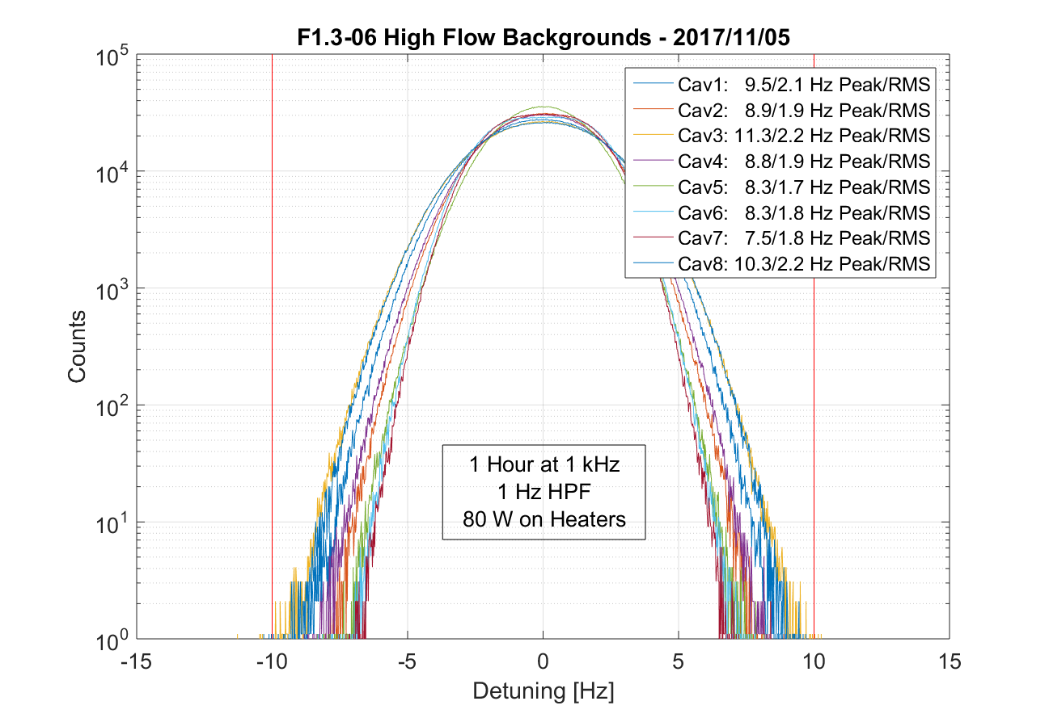
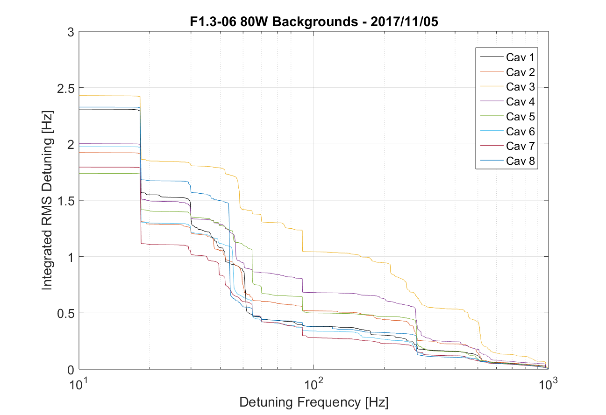
CM6 Detuning
with high power/ cryo-flow
An hour capture of the detuning background showed no dynamic behavior.
Detuning is close to specifications (10Hz peak).
‘Major’ contribution from the 18 Hz line.

