Slide 1
Evaluating the Impact of Return Pressure Variation on C100 Cryomodule Performance
Ed Daly, Clyde Mounts, Larry King and Curt Hovater
February 6, 2018
CEBAF Performance Improvement Team Meeting

Slide 2
Introduction
Performance of SRF cavity performance depends in part on the local surface resistance – a function of the bulk Nb temperature
Surface temperature is maintained by convective heat transfer into the superfluid helium (SFHe) surrounding the cavity
Dissipated RF power is conducted through the SFHe to the liquid-vapor interface where helium gas evolves
Gas is pumped away through the cryomodule (CM) internal piping into the u-tubes and then into the return transfer line.
Saturated pressure at the liquid vapor interface determined by the local gas evolution rate and the piping sizes sets the local bath temperature
Local pressure directly impacts the cavity performance
In the C100 CMs, there is pressure-dependent heat transfer limitation due to its particular internal piping configuration

Slide 3
C100 vs Original CEBAF Helium Vessel
For the original CEBAF CMs, each cavity pair is immersed in SFHe inside the 24” diameter helium vessel
  Large area for pumping away helium gas
C100 has individual helium vessels and helium piping
  Eliminates seals between the cavity vacuum and the helium bath
  Original CEBAF CMs suffered from some number of superfluid leaks
  Large area for pumping away helium gas
Helium enters the C100 HV through the fill line from the bottom directly below the center cell and exits through the riser or “chimney” directly above the center cell.

Slide 4
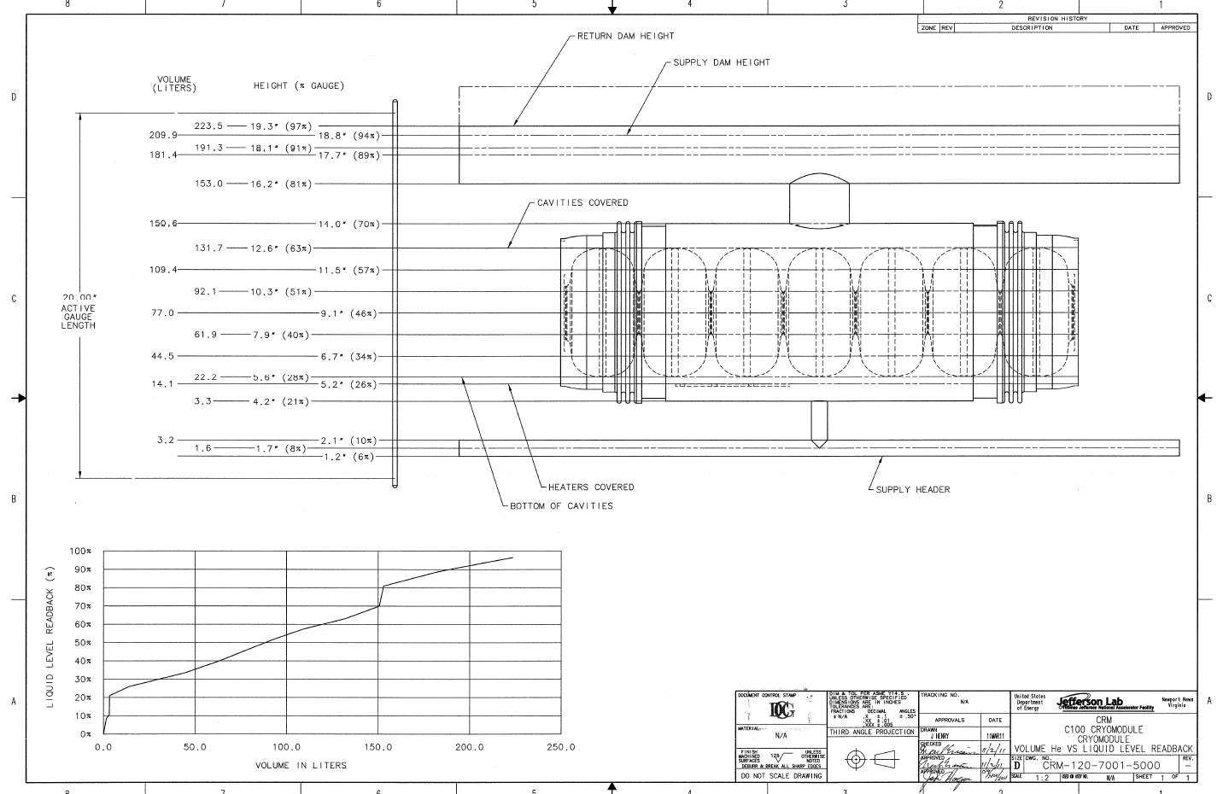
C100 HV Helium Volume vs. Liquid Level Readback

Slide 5
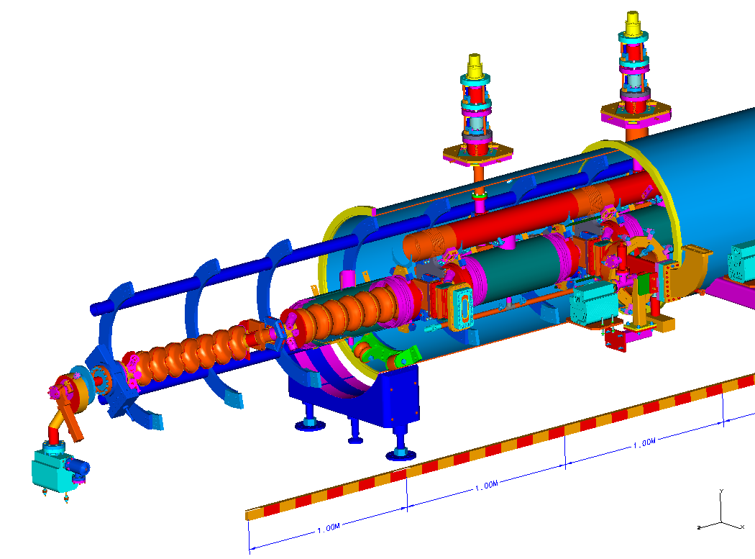
C100 CM Cut-away
Return header is normally just below half full – 92% liquid level readback

Slide 6
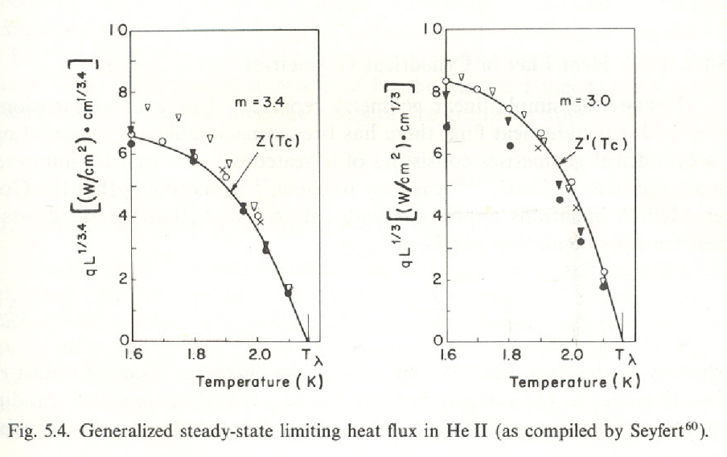
Critical Heat Flux in Superfluid Helium
SFHe is an excellent conductor of heat up to a critical heat flux beyond which the properties change dramatically – transition from liquid to gas occurs
Empirical relationship observed in experiments in narrow channels and internal flow configurations
Relatively strong function of bath pressure and temperature and weak function of length
The critical heat flux in saturated liquid at 2 K is two times larger than at 2.1 K

Slide 7
Specifications for Bath Temperature and Pressure
For C100 cavities, Qo value is 8 x 10^9 at 19.2 MV/m
  27 W dissipated in each cavity; 3 W for coupler; Total = 30 W
  Design value for power dissipation was doubled and the lines were sized to avoid any type of limitation in the heat flow due to the critical heat flux.
Interface point for the CM pressure was defined as 0.0375 atm at the bottom of the return bayonet in the end can assuming a total design heat load of 300 W
  Pressure corresponds to a temperature of 2.07 K
  Critical heat flow for a single riser is 65 W; More than 500 W for the CM
  As the bath pressure rises, the critical heat flow is reduced.
If the bath pressure rises to 0.044 atm, or about 2.13 K, the critical heat flow is about 30 W per cavity
  Neglecting increased surface resistance due to increase BCS losses, operating a C100 CM set at design gradient at this bath pressure would cause the critical heat flux to be exceeded in the riser.
Operating cavities at higher bath pressure increases BCS losses which adversely impacts Qo values used by LEM for machine set-up
  The actual dissipated power could be ~50% larger than computed by LEM.

Slide 8
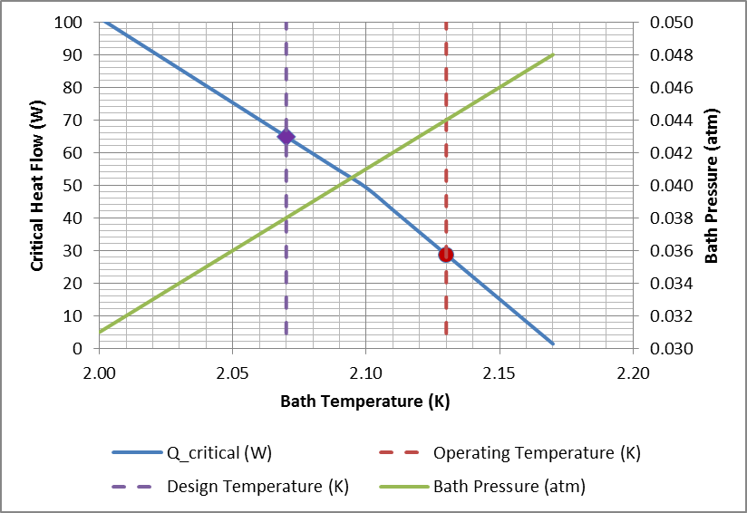
Critical Heat Flow HV Riser & Pressure vs Temperature

Slide 9
0L04 - Estimation of Pressure in Helium Bath
0L04 is a C100-style CM located in the CEBAF Injector
Use known heater power settings to determine when the transition was occurring by observing the change in liquid level (LL) readback
At measured pressure of 0.041 atm, a heater heat of 142 W was applied uniformly over the eight cavity heaters
  The LL readback was stable.
Ramped Heater heat until LL readback fluctuated
  Measured pressure was 0.0435 atm
  Heater heat was 240 W, or 30 W per cavity
  30 W corresponds to bath temperature and pressure of 2.13 K and 0.044 atm
Using the cavity heaters and the LL as an indicator, the local bath pressure can be estimated.

Slide 10
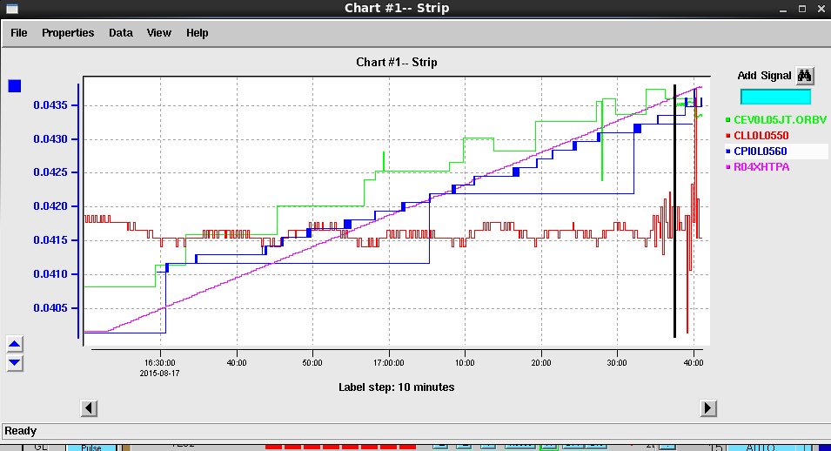
Liquid Level readback becomes unstable at transition
Valve Position
Pressure
Heater Ramping
Liquid Level

Slide 11
Cavity Performance
(Microphonics Workshop Talk by C. Mounts)
An additional set of measurements was made to determine if resistive heat, RF heat or both causes any type of detuning instability that would affect RF performance.
First the heater heat was set to 200 W while monitoring the cavity detune angles (TCDETA). As the resistive heat was ramped down, the detune oscillations decreased. At a value of 50 W, the detune angles returned to expected amplitudes.
Then RF was turned on in the cavities while monitoring the liquid level and JT valve position. The cavity gradients were increased. At about 80 watts of dissipated power (87 MV), the detune instability began. This persisted and increased in magnitude with increasing gradients up to a heat load of about to 168 watts
The gradients were then ramped down and the detune oscillations abated.

Slide 12
Addition of Pressure Transducers
Measurements on 0L04 show that the mass flow from each CM can affect local pressures and the overall pressure drop in the cryogenic distribution system
Absolute pressure is lowest at the inlet to the cold compressors and highest at the ends of the linacs.
Proposal:
  Place one sensor near the tee in each linac to monitor the exhaust pressure from each linac adjacent to the inlet to the CHL cold compressors
    The change in pressure at this location will be related to the total mass flow coming from the linacs.
  Place sensors at the ends of each linac to monitor the highest absolute pressure. For the north linac, use the injector modules
  All of the sensors would be placed on the CM end can nearest the desired location.
  Existing purge lines enable the installation of the sensors using VCR fittings.
  Use calibrated sensors that can be verified on the benchtop to understand any systematic differences
For installations with a C100 CM, the heater and liquid level response can be used as a cross check against pressure readbacks.
Over time, these six pressures can be monitored to ensure that operating limits for individual CMs are maintained.

Slide 13
Summary
C100 CM thermal performance (ability to remove cavity dissipated power) is dependent on local bath pressure
Exceeding critical heat flux in riser causes instabilities that can be observed in LL readback values and cavity detune angles
Plan implemented for monitoring pressure at key points in the cryogenic distribution system provides feedback on CM operating conditions

