Slide 1
Preparation, processing, assembling and testing of spoke resonators: from SSR1 jacketed cavities to string assembly
Mattia Parise
TTC Meeting, Milan
6-9 February, 2018

Slide 2
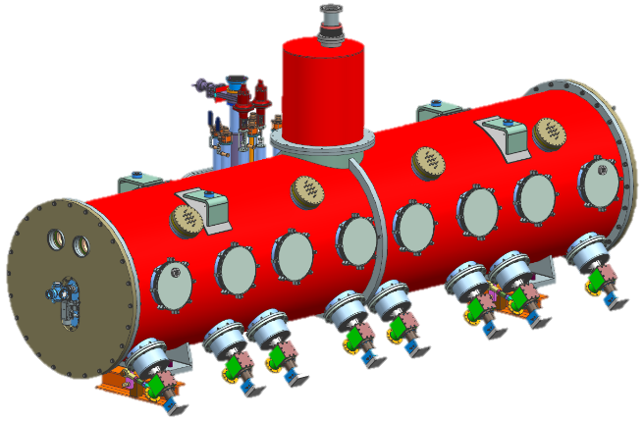
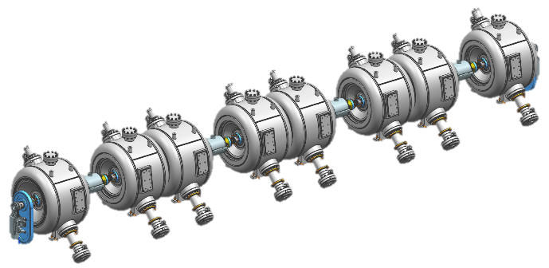
SSR1 cryomodule for PIP-II
PIP-II Linac
SSR1
SSR1 cryomodule
SSR1 cavity string

Slide 3
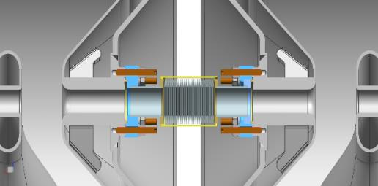
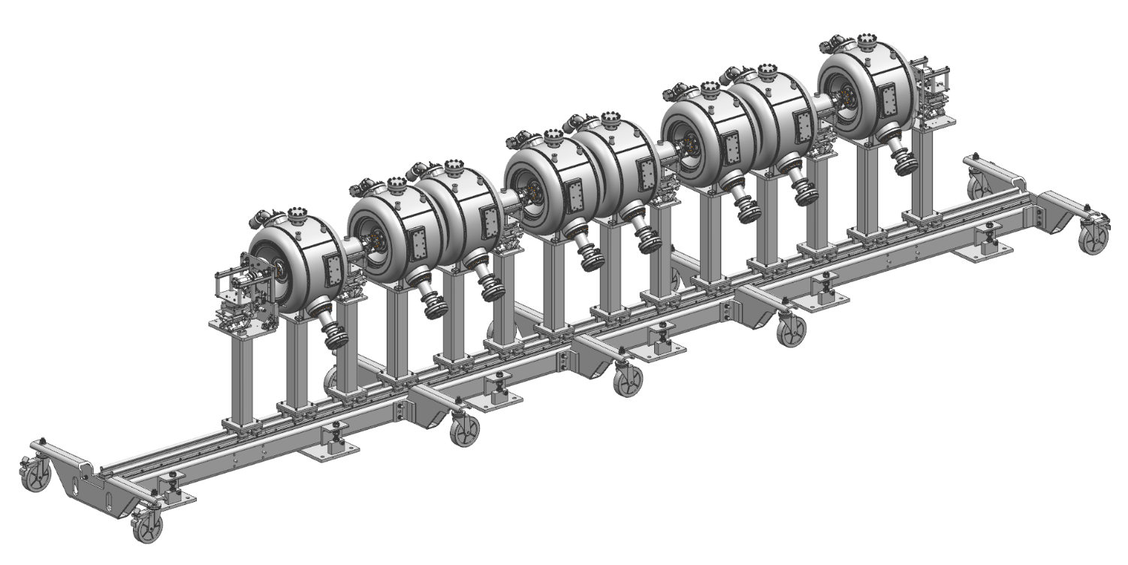
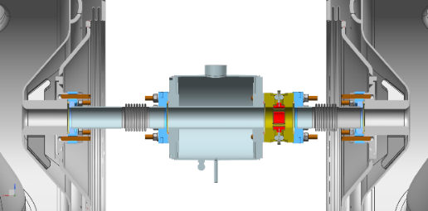
SSR1 string overview
20
mm
Interconnection cavity-cavity
Type
B
Gate Valve
Type
B
Type
A
Edge-welded bellows
Type
B
Type
A
Type
A
Type
B
Type
A
Gate Valve
Vacuum-end coupler
Movable rail system
Solenoid
BPM
Solenoid-BPM subassembly

Slide 4
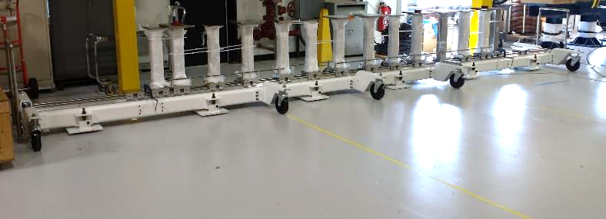
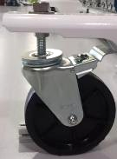
Preparation of the SSR1 string assembly dry-run
Wheels were found to be inappropriate because of unexpected uneven floor
Wheels lose contact with floor during motion leading to the wobbling of the rail system and excessive cavities displacements

Slide 5
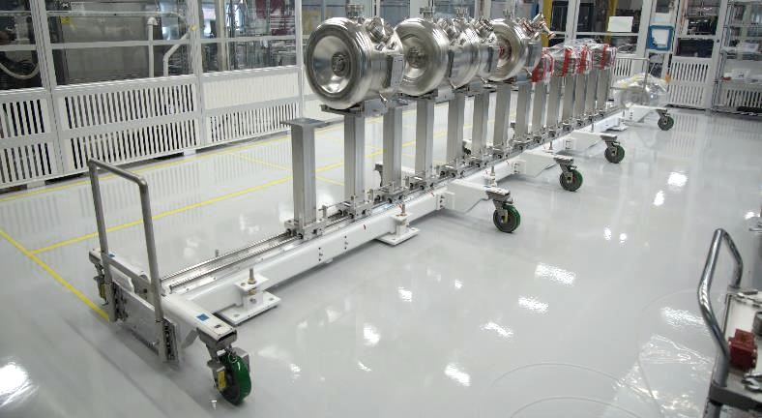
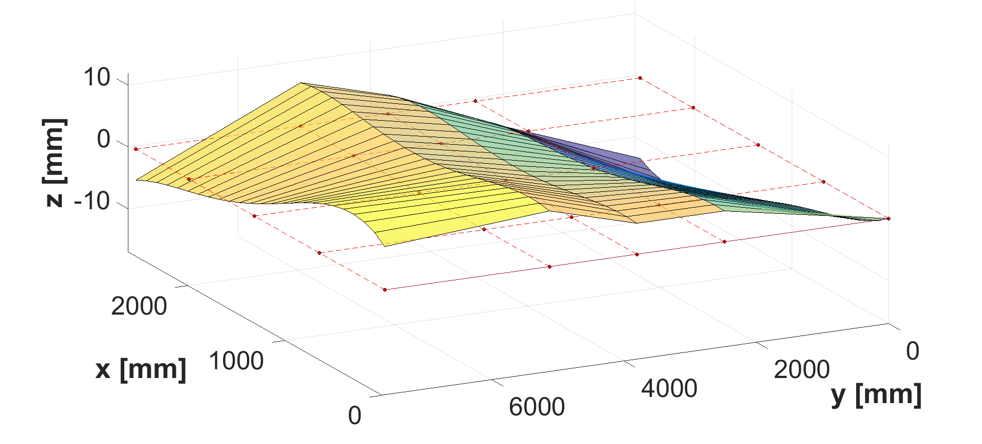
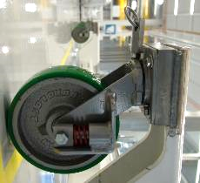
Preparation of the SSR1 string assembly dry-run
Wheels were found to be inappropriate because of unexpected uneven floor
Wheels lose contact with floor during motion leading to the wobbling of the rail system and excessive cavity displacements
New suspension wheels and stiffer connections were procured
Measurement of the cleanroom floor profile
Wheel spring stiffness is optimized to minimize cavity vertical displacement
Cleanroom floor profile
Final
position
Movement
Initial
position

Slide 6
Preparation of the SSR1 string assembly dry-run
Link
Rail system with string weight can be successfully moved to the desired location. The process has been repeated 5 times and final position can be achieved with an uncertainty of ~ 5 mm

Slide 7
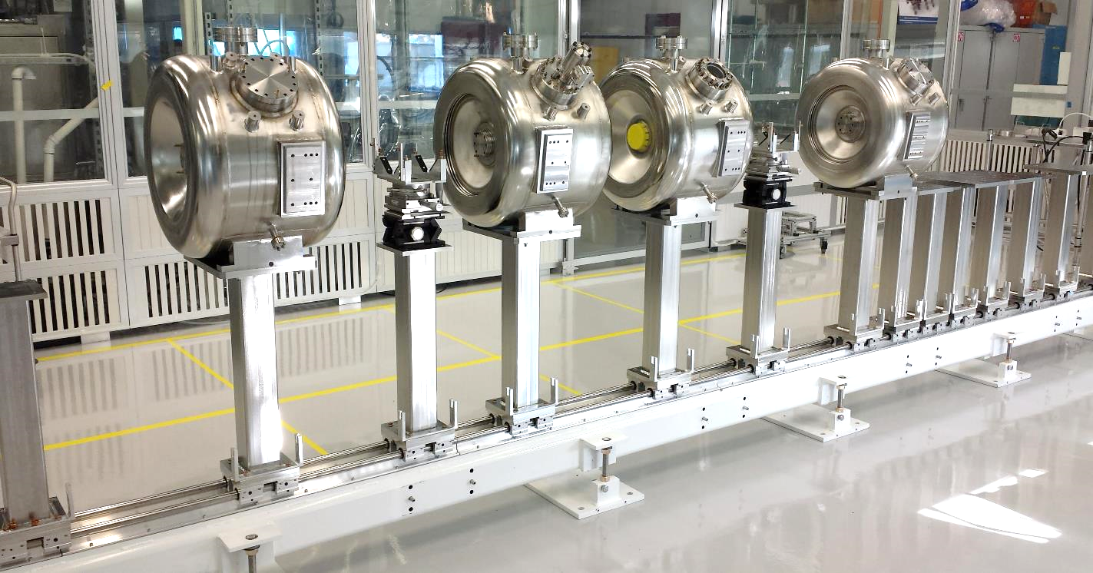
Preparation of the SSR1 string assembly dry-run
Dry-run of SSR1 string assembly is carried out on a half cavity string
The goal is to assess the feasibility of a cleanroom-compatible assembly

Slide 8
Preparation of the SSR1 string assembly dry-run
Solenoid-BPM-Bellows
Cavity connection
Cavity-cavity connection
Dry-run of SSR1 string assembly is carried out on a half cavity string
The goal is to assess the feasibility of a cleanroom-compatible assembly

Slide 9
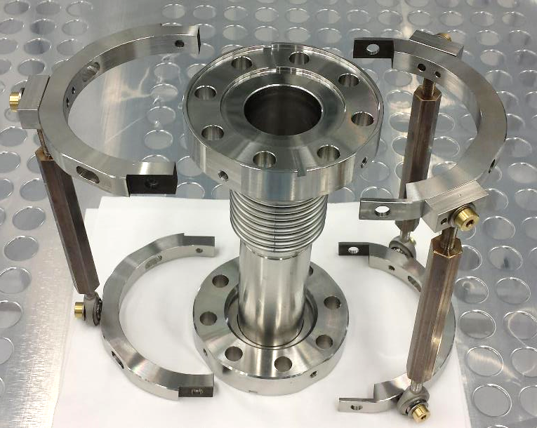
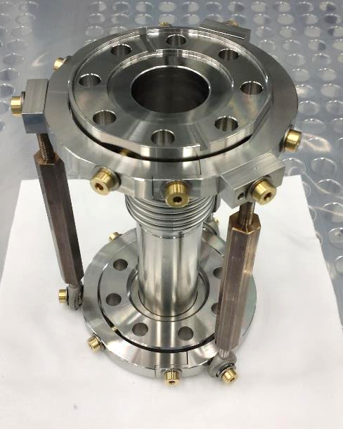
Preparation of the SSR1 string assembly dry-run
Bellows cages provides 2 rotational degrees of freedom at the end flange
Can be splitted in 2 halves so that can be removed prior cryomodule assembly

Slide 10
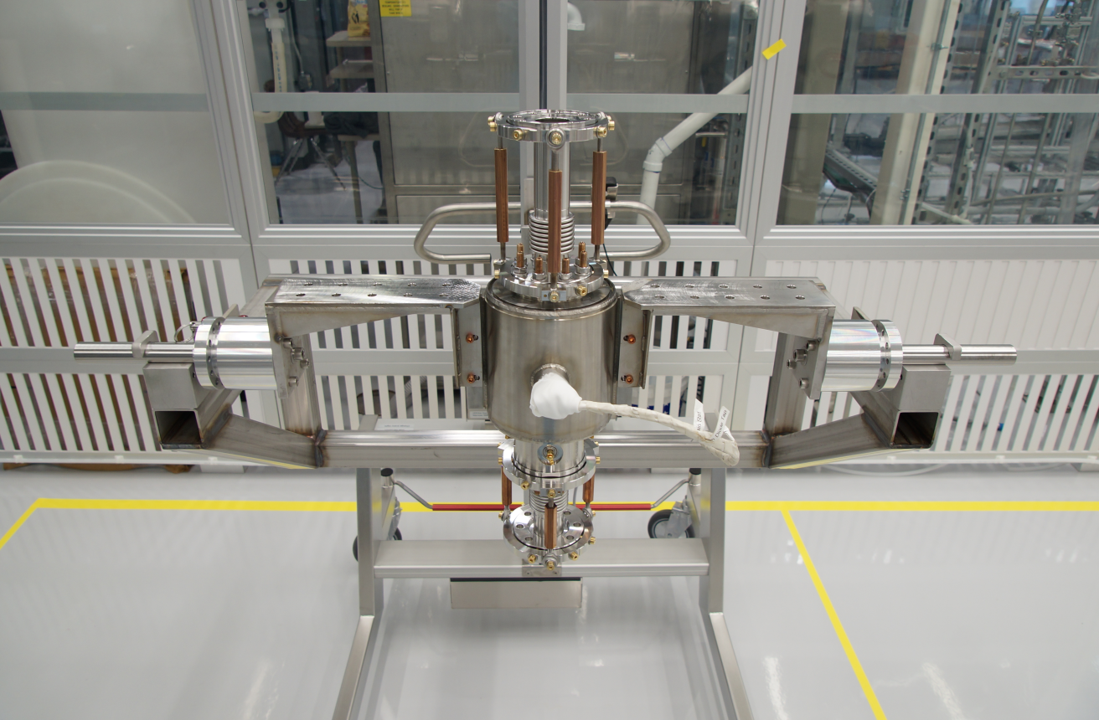
Preparation of the SSR1 string assembly dry-run
Vertical assembly facilitates handling of components
Sub-assembly can rotate 360 degrees for an easy assembly
The movable cart allows easy handling of the heavy sub-assembly

Slide 11
Preparation of the SSR1 string assembly dry-run
Link

Slide 12
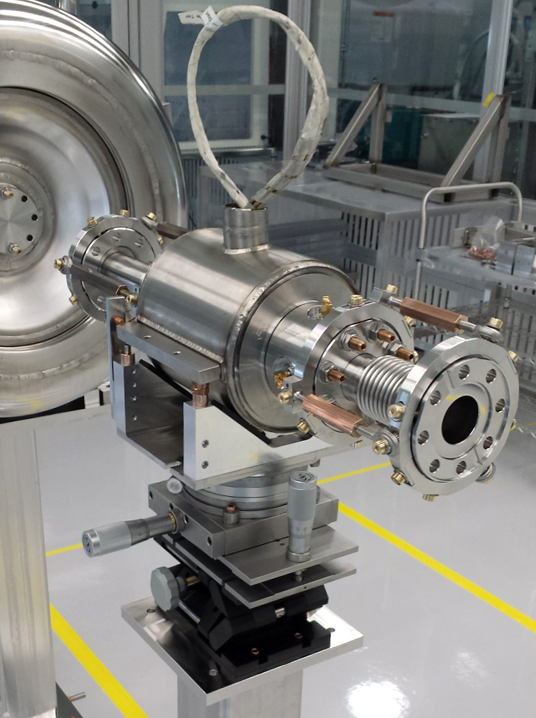
Preparation of the SSR1 string assembly dry-run
Sub - millimeter precise and reliable alignment
Easy to use system
Link

Slide 13
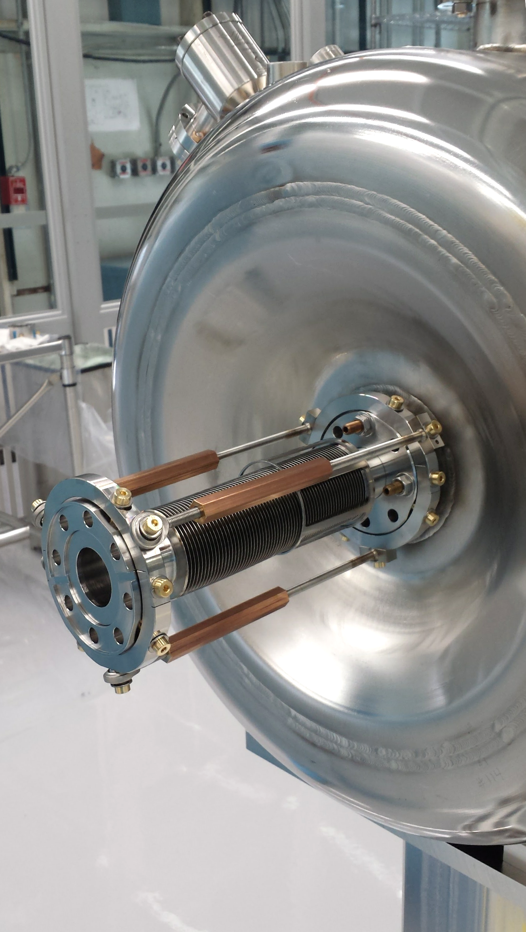
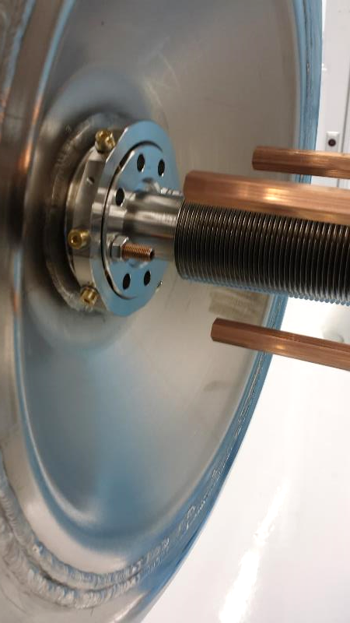
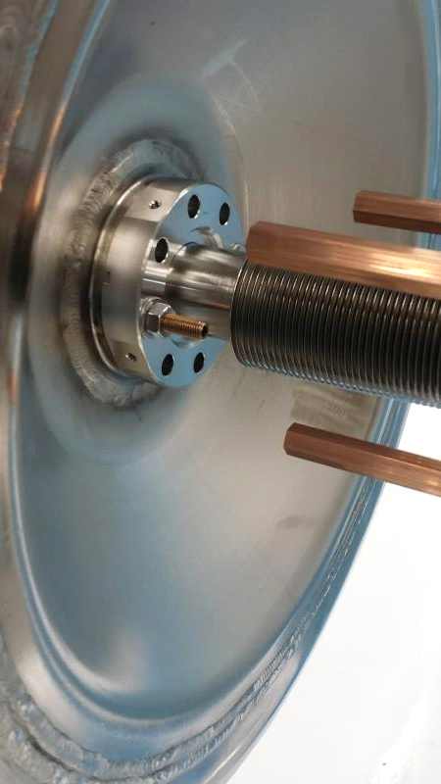
Preparation of the SSR1 string assembly dry-run
Bellows cage is disassembled once the cavity-cavity connection is completed

Slide 14
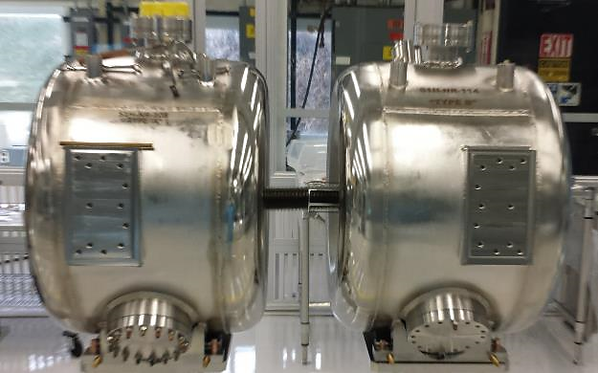
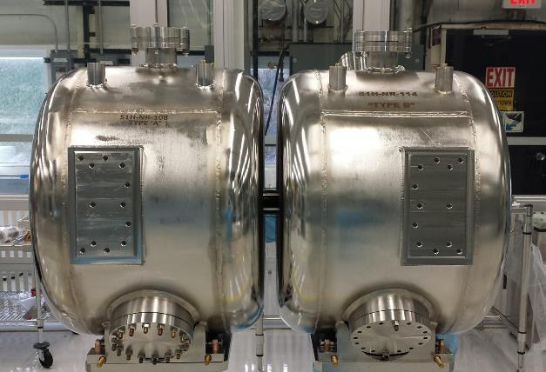
Preparation of the SSR1 string assembly dry-run
Edge welded bellows can be successfully assembled and bellows cage can be removed

Slide 15
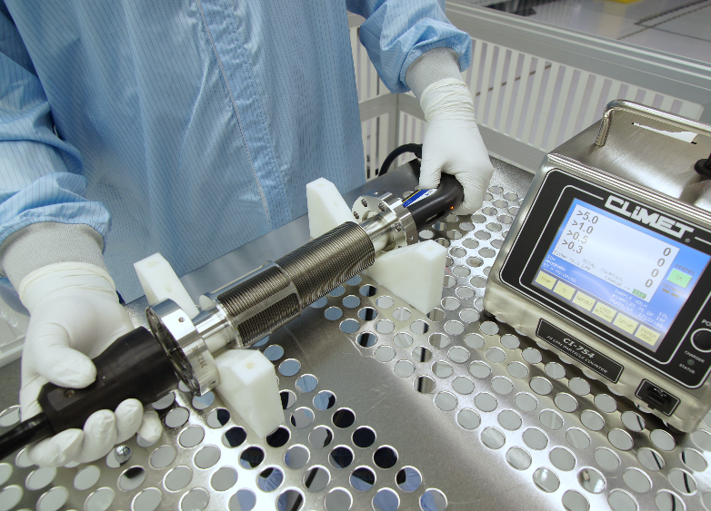
Edge welded bellows particle counts
Edge welded bellows was cleaned and brought inside class 10 cleanroom:
30 min Liquinox (1%) + DI water ultrasonic cleaning at 50 °F
30 min Citranox (2%) + DI water ultrasonic cleaning at 50 °F
30 min DI water ultrasonic cleaning at 50 °F
Handheld HPR
Particle counts of the nitrogen dried bellows approach 0 particles > 0.3 μm in less than 1 minute
3 cycles compression and extension (10 liters sample)
Time [s] | > 0.3 μm | > 0.5 μm | > 1 μm
7 | 2 | 0 | 0
14 | 2 | 1 | 0
21 | 3 | 1 | 0
28 | 1 | 0 | 0
35 | 3 | 0 | 0
42 | 1 | 0 | 0
49 | 1 | 0 | 0
56 | 1 | 0 | 0
63 | 1 | 0 | 0
70 | 1 | 0 | 0
77 | 1 | 0 | 0
84 | 0 | 0 | 0
91 | 2 | 1 | 0
Particle counts during contraction are acceptable

Slide 16
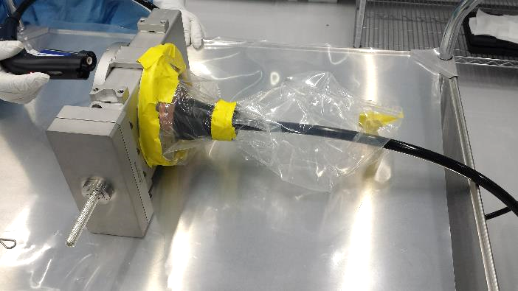
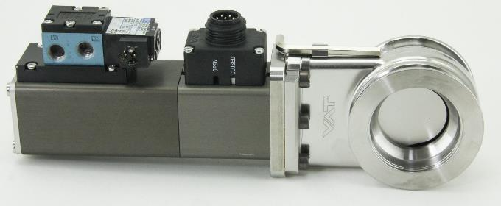
Gate valves particle counts: all metal vs Viton sealed
SSR1 Gate Valve
LCLSII All-Metal Gate Valve
Viton sealed
Pneumatic actuation (<1 sec for opening and closing)
Viton may degrade due to radiation
All metal construction
Manual actuation (~ 5 min for opening and for closing)
Radiation resistant

Slide 17
Gate valves particle counts: all metal vs Viton sealed
SSR1 Gate Valve
LCLSII All-Metal Gate Valve
SSR1 Viton sealed pneumatic actuated gate valve performed better than the all-metal gate valve in terms of particle counts
SSR1 cryomodule is located at the early stage of the LINAC
Damaging of the Viton due to beam radiation is limited at this stage
SSR1 Viton sealed gate valve is compact, generate less particulate, reliable (does not depend on the operator to be actuated) and can be opened/closed in <1 sec

Slide 18
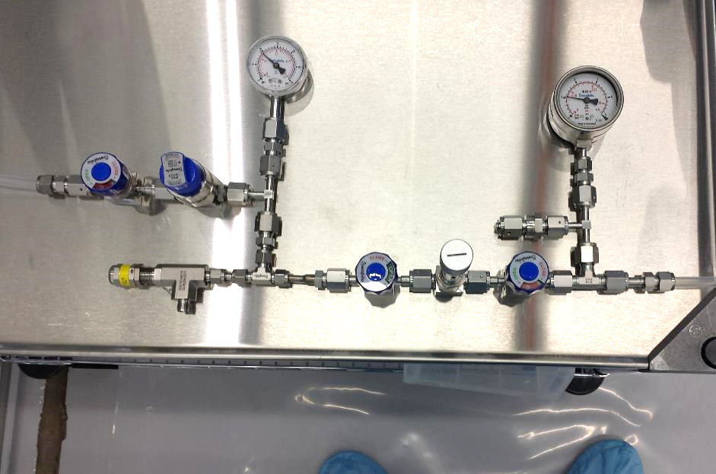
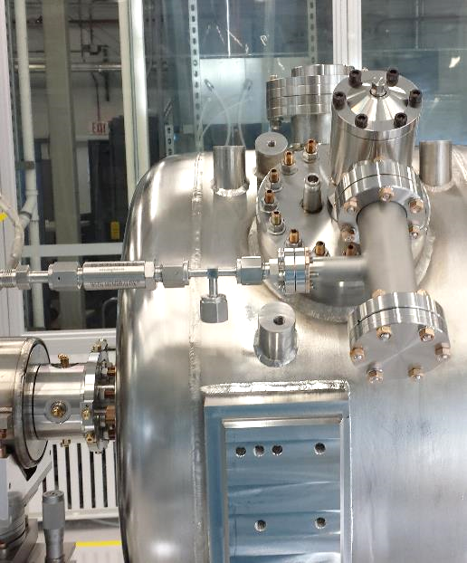
Nitrogen purging line
Nitrogen purging line can provide up to 20 SLPM
Filter is located on the cavity as last element to avoid cavity contamination
Can be manually operated
Mass Flow Controller can substitute the metering valve for a reliable soft start
High pressure gauge
Low pressure gauge
Shut-off valve
Pressure regulator
High purity filter
Pressure relief valve
Shut-off valve
Metering valve
Shut-off valve
To vacuum cart

Slide 19
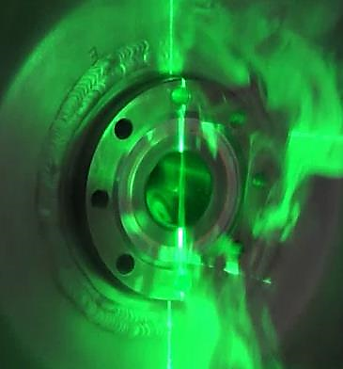
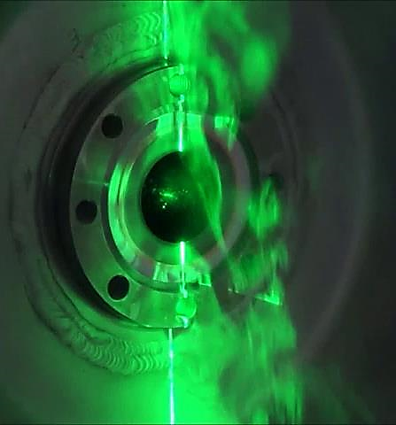
Nitrogen purging line
No Nitrogen purging applied
Nitrogen purging at 4 SLPD purge flow speed 0.1 m/s

Slide 20
Nitrogen purging line
No Nitrogen purging applied
Nitrogen purging at 4 SLPD purge flow speed 0.1 m/s
Back flow inside the beam pipe

Slide 21
Nitrogen purging line
Link

Slide 22
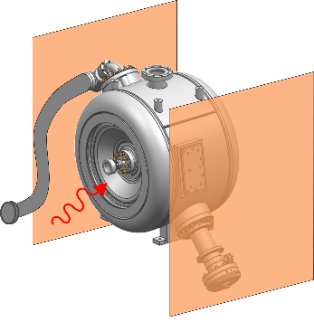
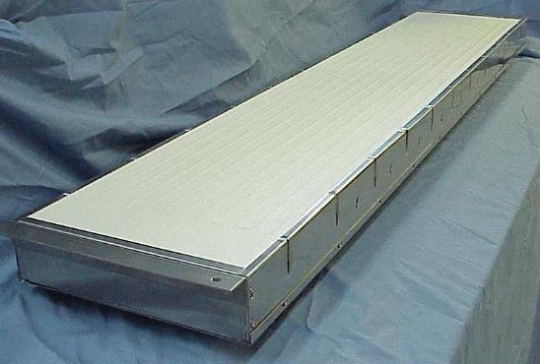
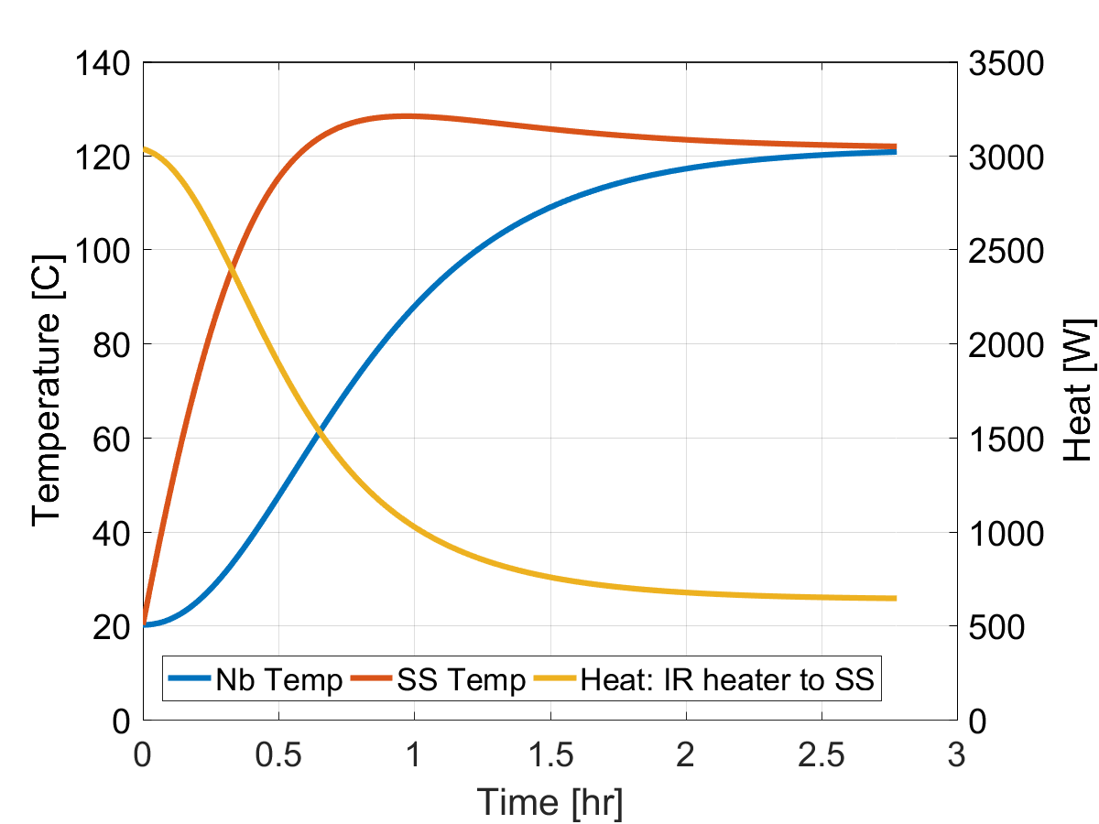
48 hours bake @120°C: a new approach
Quartz fabric Faced Heater
Infrared
heaters
Infrared heater characteristics:
90% energy efficient
5 – 7 min warmup/cooldown time
Elements reach up to 815°C
Output power can be controlled through cavity temperature
to
vacuum
cart
A couple of infrared heaters can bring the cavity up to 120°C in 2 hours
Cavity never leaves the cleanroom
Baking can be performed after the cold test assembly leak check

Slide 23
Thank you for your attention
On behalf of the SSR1 team

Slide 24
Backup slides

Slide 25
Gate valves particle counts: all metal vs Viton sealed
SSR1 Gate Valve (Viton Sealed - Pneumatic actuated)
LCLSII Gate Valve (All-metal - Manually actuated)

Slide 26
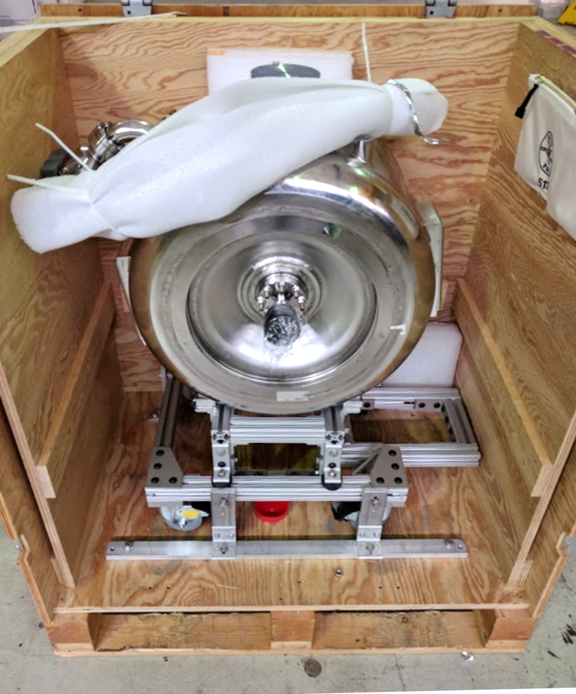
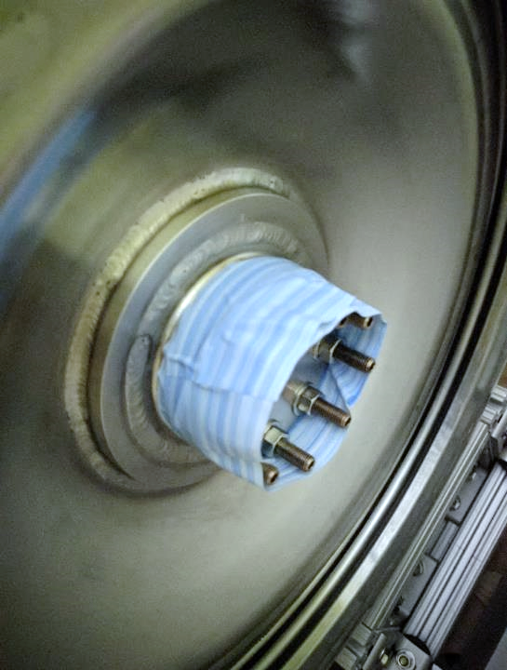
Extra precautions
Extra precautions are taken wrapping the hose with foam. Each time the cavity is crated an Engineer is present to check that all the security precautions are followed
Cavity beam pipes are protected using cleanroom tape and cleanroom plastic to avoid contamination outside of the cleanroom.

Slide 27
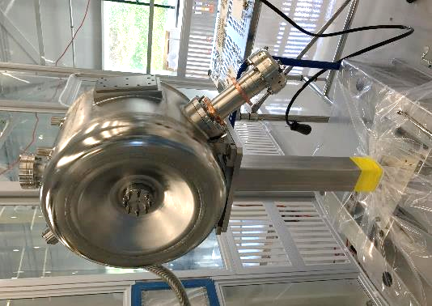
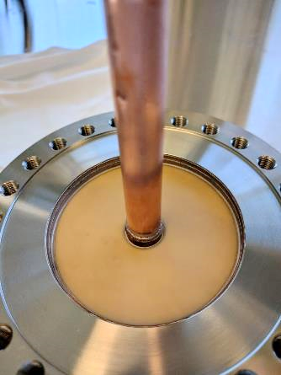
SSR1 vacuum-end couplers
The procurement of coupler antennas presented a series of technical issue that led them to be on the SSR1 CM1 critical path
Vacseal (silicon resin solution) was used on the first 2 antennas on the beam vacuum volume side and it has never been “cured”
The company notified of this unconformity after the 2 antennas were assembled onto 2 different SSR1 cavities
The 2 cavities performed poorly during the cold tests and the RGA scans showed anomalies that can be linked to the Vacseal composition
Vacseal suspected area

Slide 28
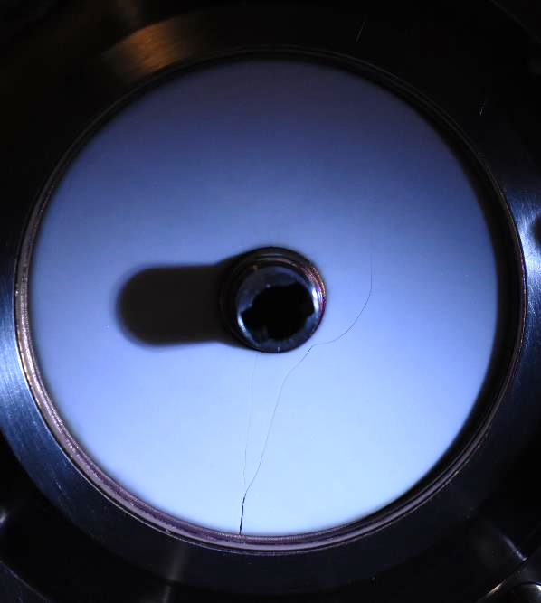
SSR1 vacuum-end couplers
New antenna from current supplier broke during testing at 20 kW, CW full reflection due to high dependence of loss tangent on temperature
Couplers are as important as cavities but in this case, suppliers were not actively followed, leading to several problematics

Slide 29
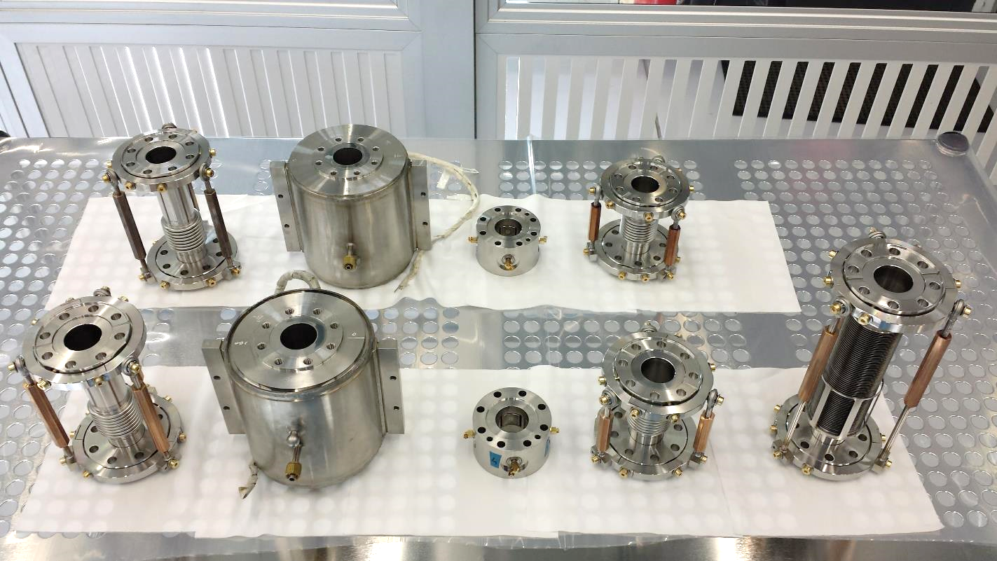
Preparation of the SSR1 string assembly dry-run
Cavity to solenoid bellows
Cavity to BPM bellows
Cavity to cavity bellows
Solenoids
BPMs

Slide 30
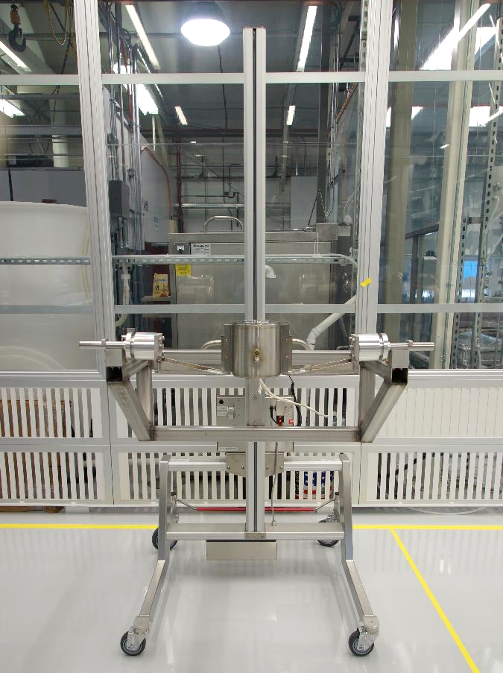
Preparation of the SSR1 string assembly dry-run

Slide 31
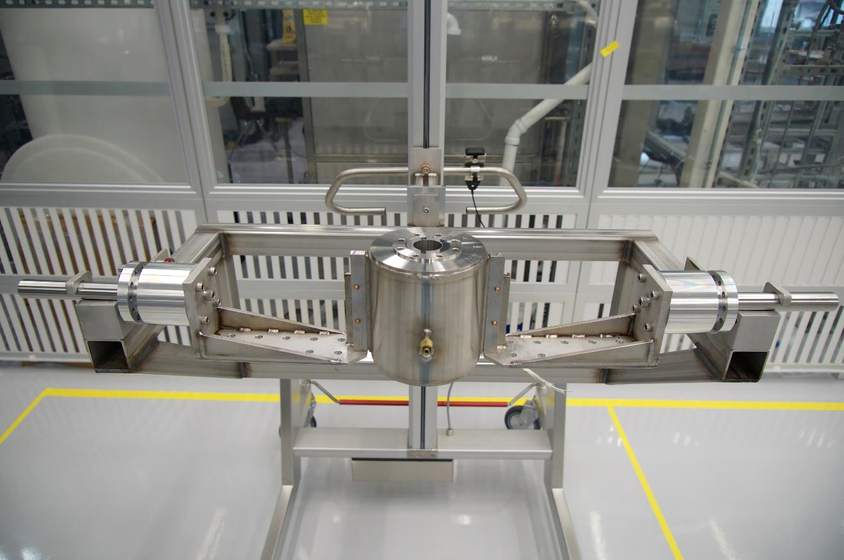
Preparation of the SSR1 string assembly dry-run

Slide 32
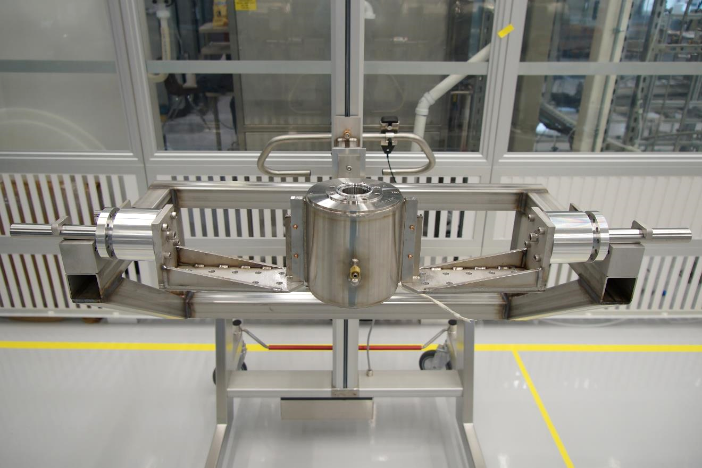
Preparation of the SSR1 string assembly dry-run
Diamond aluminum seal

Slide 33
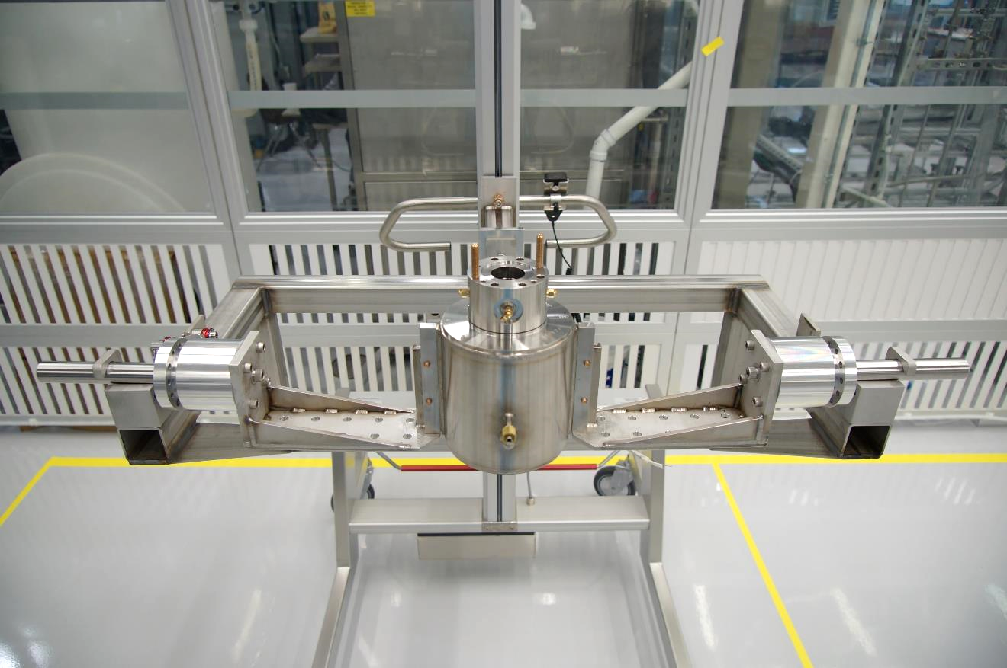
Preparation of the SSR1 string assembly dry-run
BPM

Slide 34
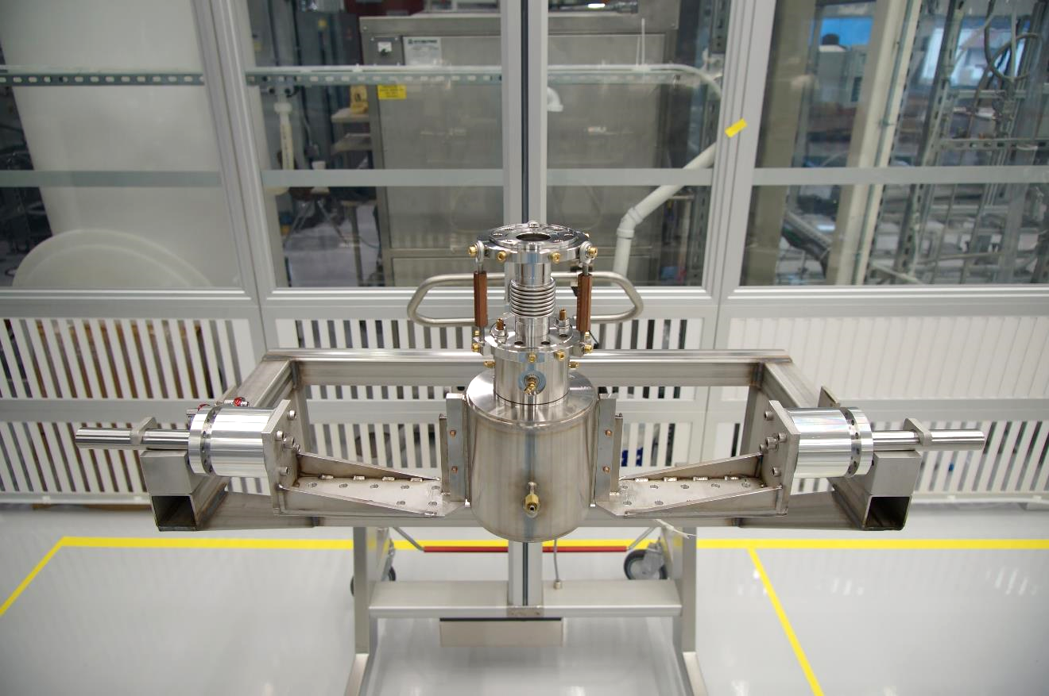
Preparation of the SSR1 string assembly dry-run
Cavity to BPM bellows

Slide 35
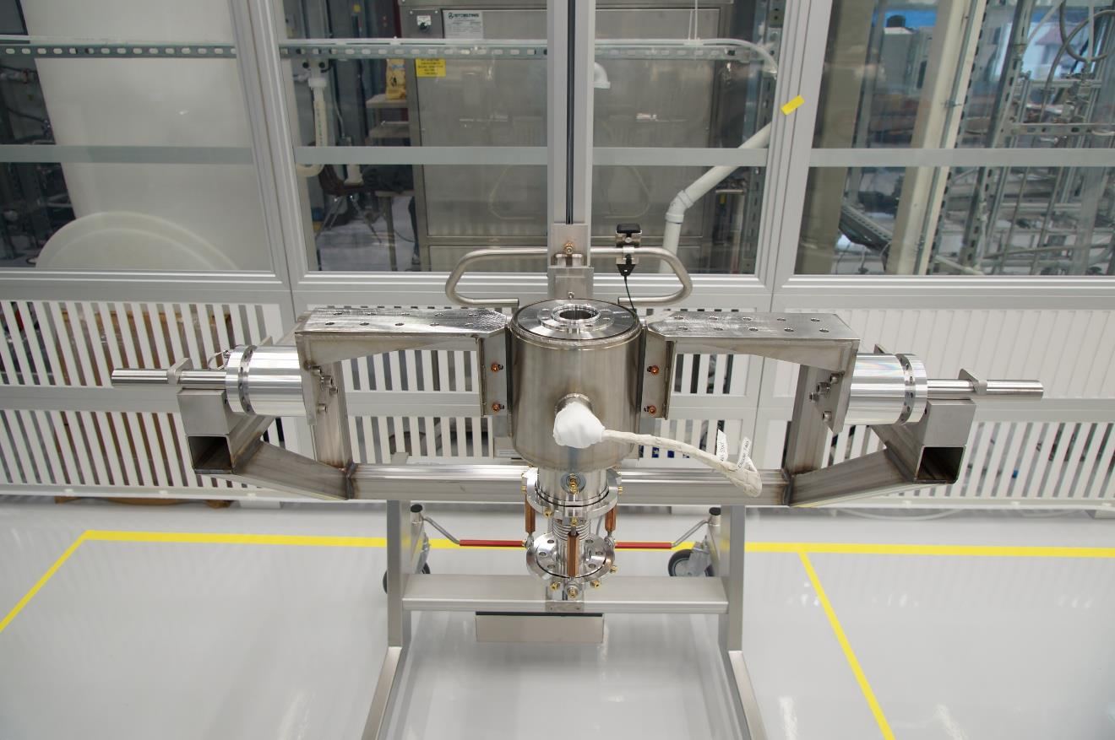
Preparation of the SSR1 string assembly dry-run

Slide 36
Preparation of the SSR1 string assembly dry-run

Slide 37
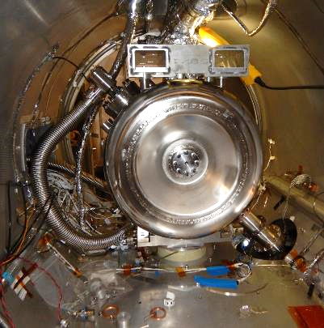
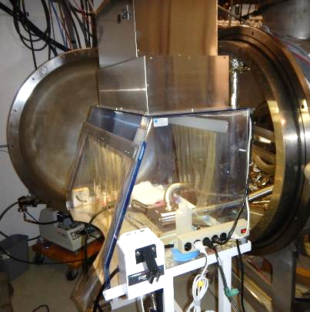
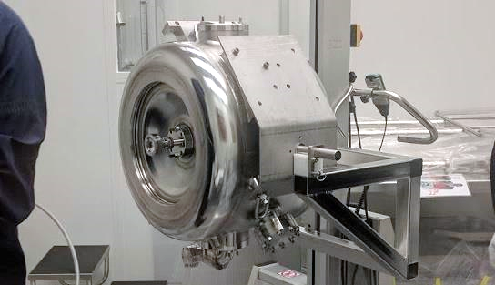
Avoid active pumping: burst disk
With active pumping:
Connection to the vacuum cart was done in a portable glove box
2 days required
Environment is not ideal for a clean connection
Without active pumping: Burst Disk
Potential contaminations during the connection and from the vacuum cart are avoided
Installation time into the test cave is substantially reduced

Slide 38
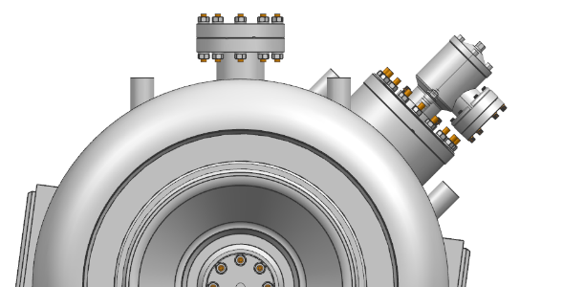
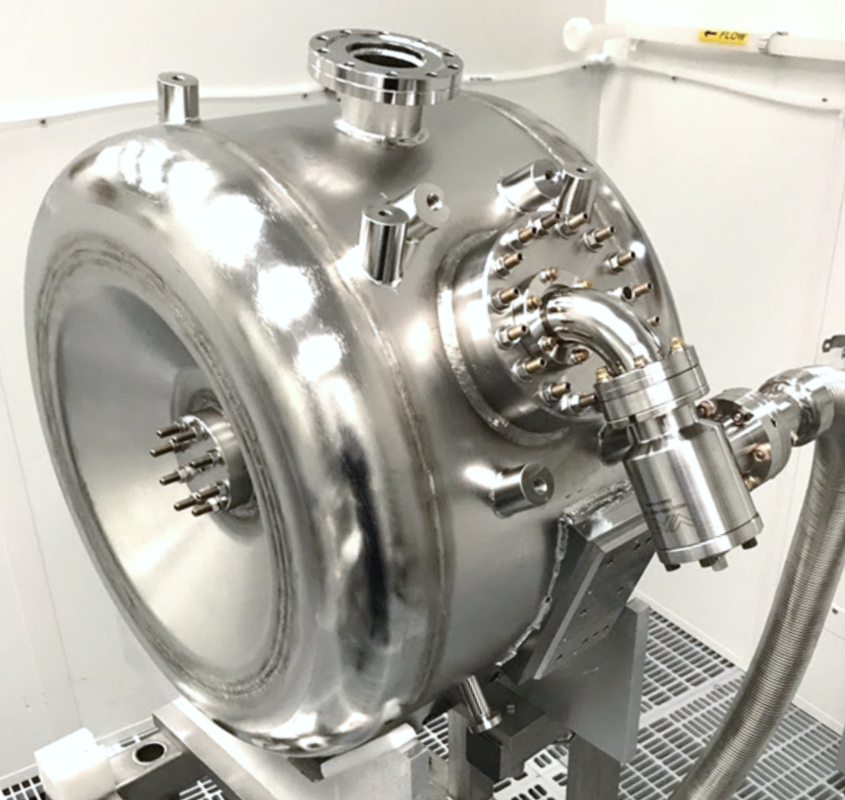
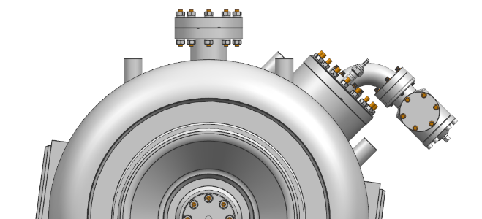
Right Angle Valve (RAV) to cavity connection
RAV was directly sitting on top of the cavity beam volume
Particle may be generated during valve actuation and gravity force or bad venting procedure can move particles inside the cavity beam volume
Gravity

Slide 39
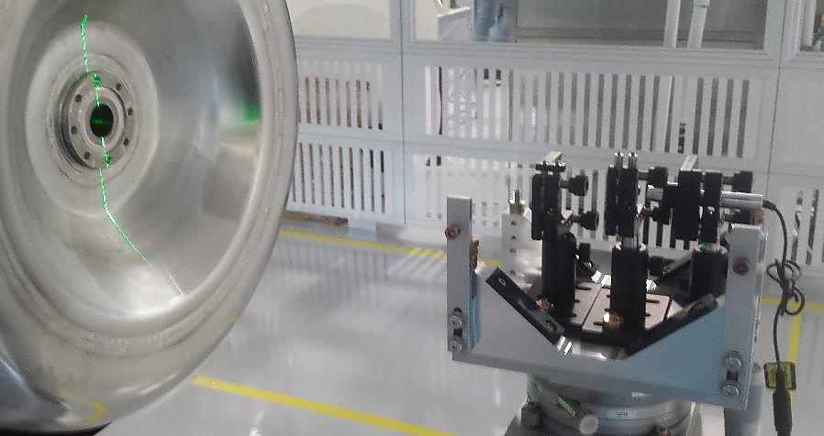
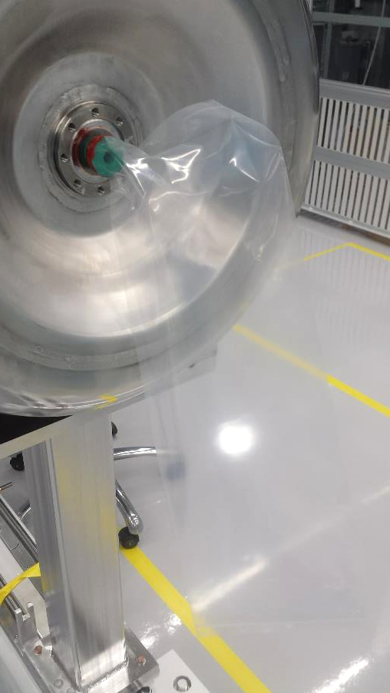
Nitrogen purging line

Slide 40
Preparation of the SSR1 string assembly dry-run
Maximum relative Z displacement is within the bellows specs: ±1.5 mm lateral movement

