Slide 1

WG1
FRIB Cavity Performance
K. Saito
MSU/FRIB SRF Development Manager

Slide 2
Statistics with FRIB VTA Cavity Performance
HFQS
HFQS
HFQS
HFQS

Slide 3
FRIB Cavity Limitation in The VTA
FRIB Spec in VTA and limitation in VTA
Cavity | Eacc [MV/m] Ep [MVm] / Bp [mT] | Q_{O} at operation gradient | Highest Eacc and Limitation
β=0.041 QWR | 5.1 30.8 / 54.6 | 1.4 x 10⁹ | ~11 MV/m, HighQ slope (> 8 MV/m, 85 mT)
β=0.085 QWR | 5.6 33.4 / 68.9 | 2.0 x 10⁹ | ~9.5 MV/m, High Q slope (> 7 MV/m), 85 mT)
β=0.29 HWR | 7.7 33.3 / 59.6 | 6.7 x 10⁹ | ~15 MV/m, High Q slope (>11 MV/m, 85mT)
β=0.53 HWR | 7.4 26.5 / 63.2 | 9.2 x 10⁹ | ~ 14 MV/m, High Q slope ( > 10 MV/m, 85 mT)
Cavity Performance Limitation in the VTA
Gradient is dominantly limited by high field Q slope (HFQS), which starts at ~ 85 mT for every beta family.
Sometimes field emission limited the gradient, for instance by the not well optimized HPR condition, contamination in HPR water (high TOC water)
Q has been limited if material removal was < 120 μm, FRIB spec is 120 -150 μm.
Q was limited by the Indium seal at bottom flange with 0.085QWRs

Slide 4
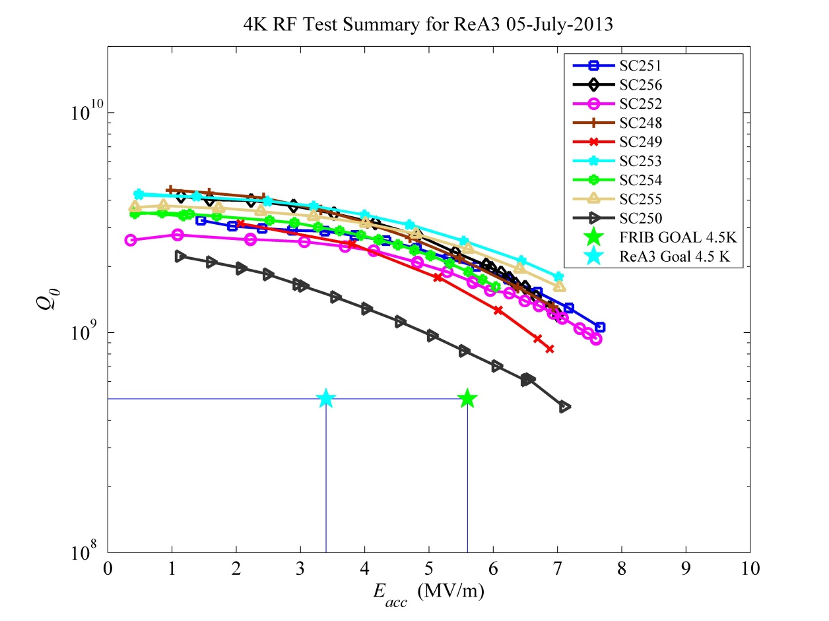
No Bake for FRIB cavities
120^{O}C bake is not apply for FRIB production cavities
120^{O}C 48hr baking has a considerable improvement on 4K Q but less impact on 2K performance on FRIB 0.085QWRs.
  Low temperature bake impacts on BCS surface resistance, reduces about half of that of the none baked cavity.
  FRIB cavity frequency is low 80.5MHz(QWRs) and 322 MHz (HWRs), and BCS surface resistance is small enough at 2K for both frequency.
All baked
Unbaked

Slide 5
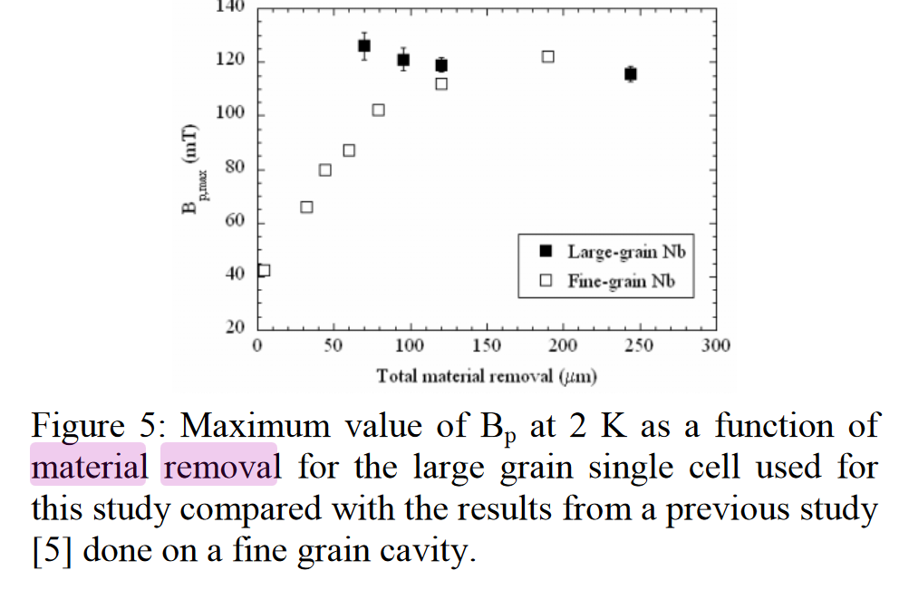
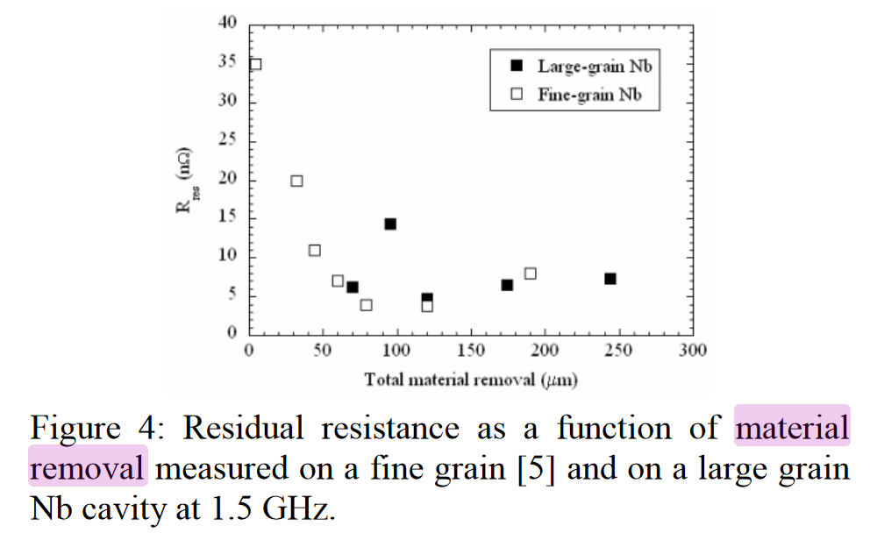
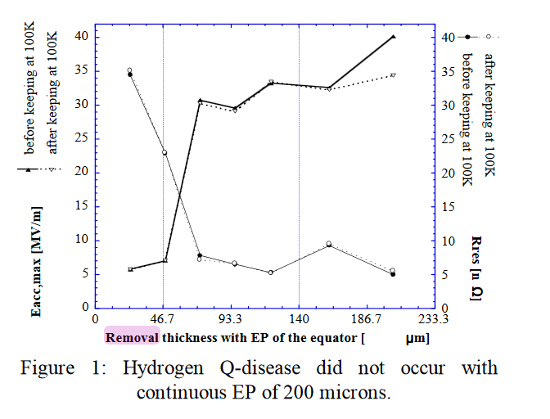
Martial Removal for High Performance
Material removal should be larger than 120 -150 μm to get high performance from ILC type 1.3 GHz cavity R&D experience.
LINAC2006, G. Ciovati and P. Kneisel for BCP cavities
SRF2001, T. Higuchi and K. Saito et al. for electropolished cavities

Slide 6
Cavity Limitation in the Cryomodule Test
FRIB Cryomodule Cavity Test Criteria
  Measure high power performance at 4K up to 20% higher gradient of FRIB goal (administrative limitation)
  Survey X-ray at outside the cryomodule
  Measure the 2K dynamic load at operation gradient or 10% higher
Statistics: all three 0.041QWR CMs, ten 0.085QWR CMs, one 0.29 HWR CM, two 0.53 HWR CMs, and one 0.085 Matching CM have completed the bunker test so far.
No Remarkable Degradation in both Qo and gradient have been observed within measurement error and the FRIB cryomodule test criteria (see later slides).
High Q performance in VTA is reserved after cryomodule assembly
High gradient performance is verified up to +20% of FRIB goal

Slide 7
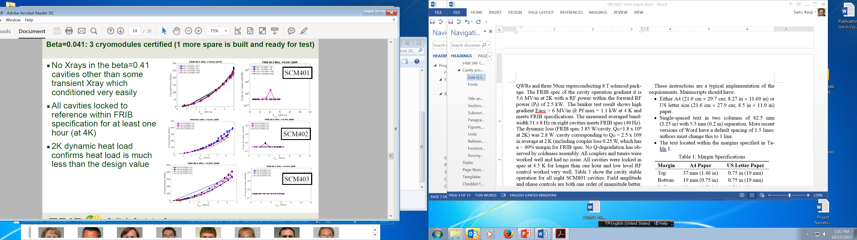
High Power Test of 0.043QWRs in Bunker Test at 4K
K. Saito, TTC201802WG1

Slide 8
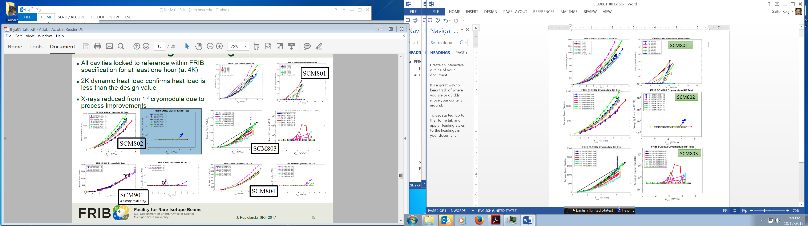
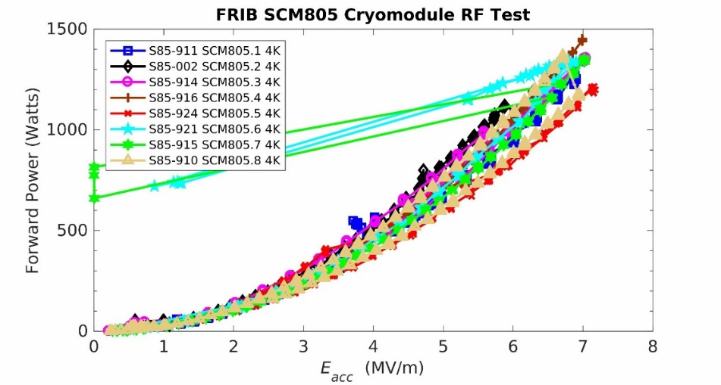
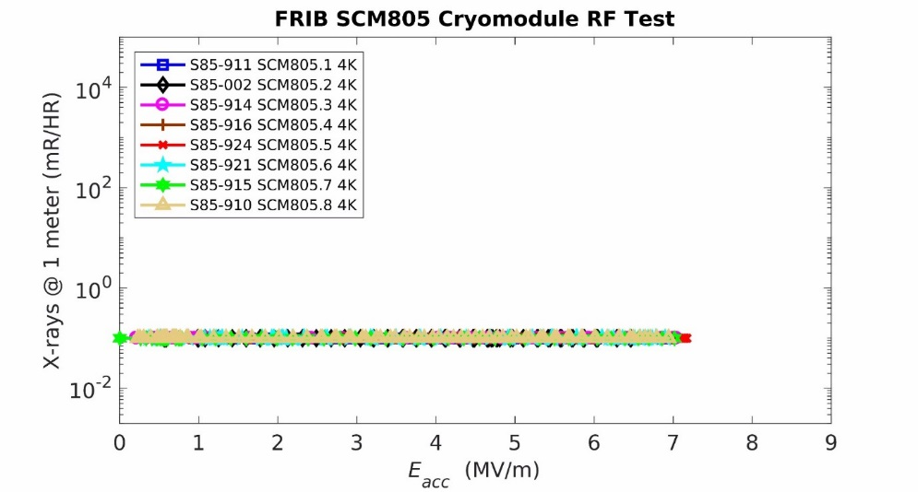
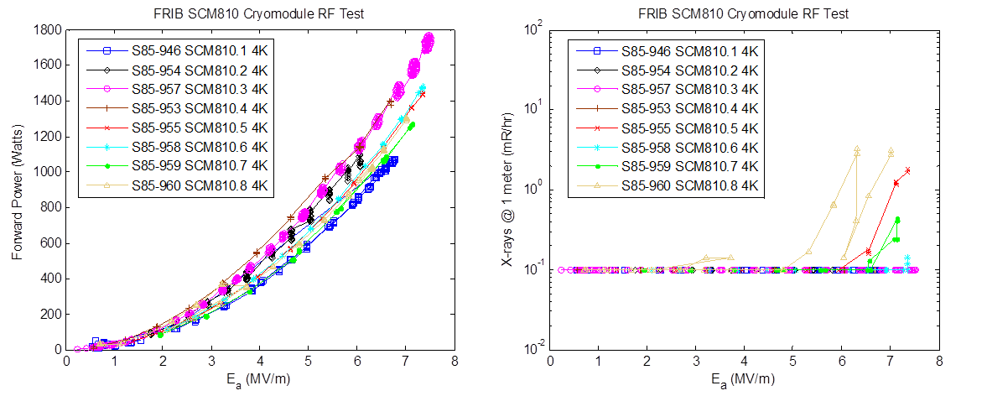
Typical High Power Test Examples of 0.085QWR in the Bunker Test at 4K
SCM802
SCM805
SCM810

Slide 9
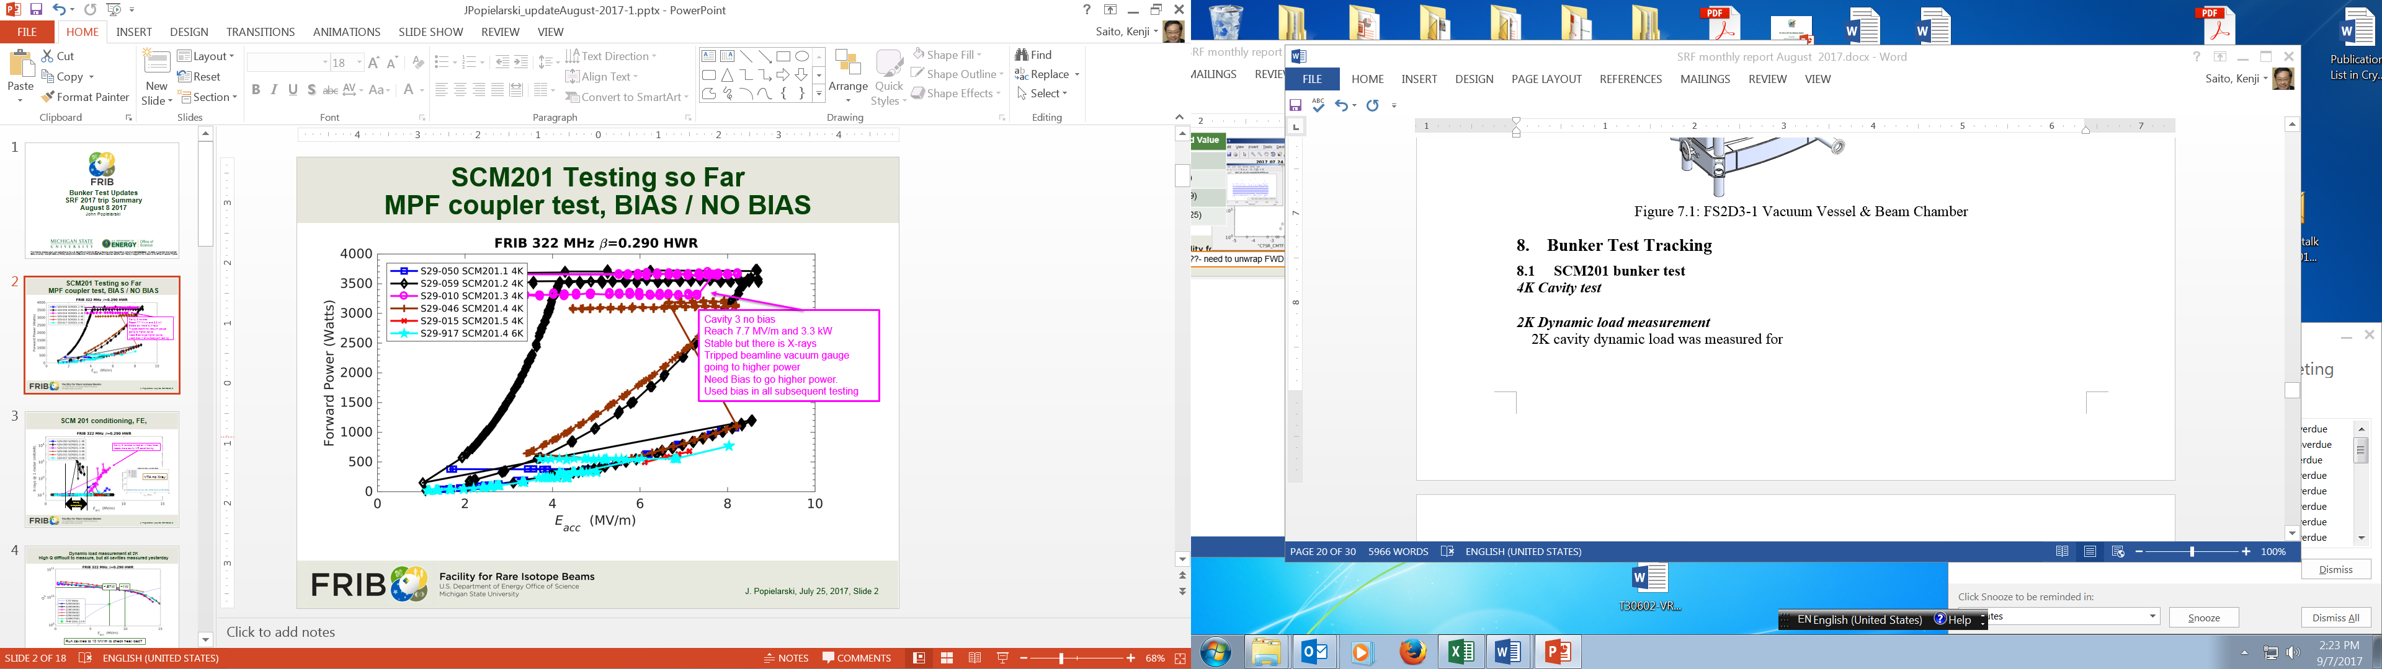
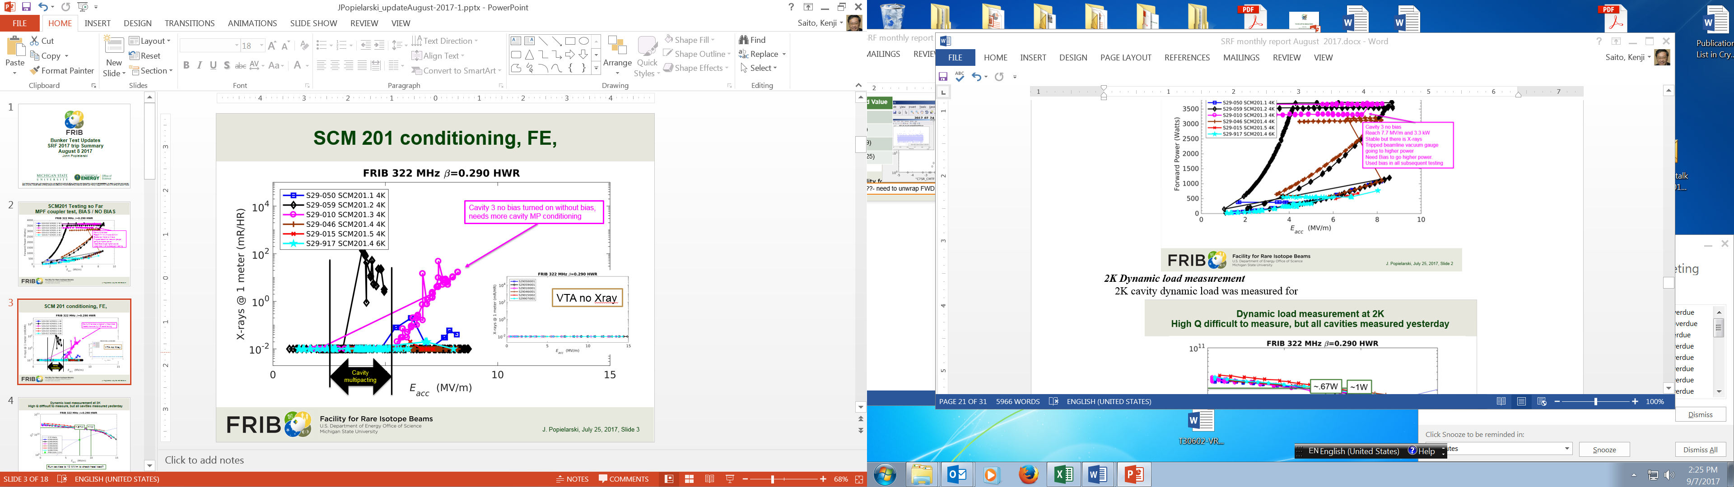
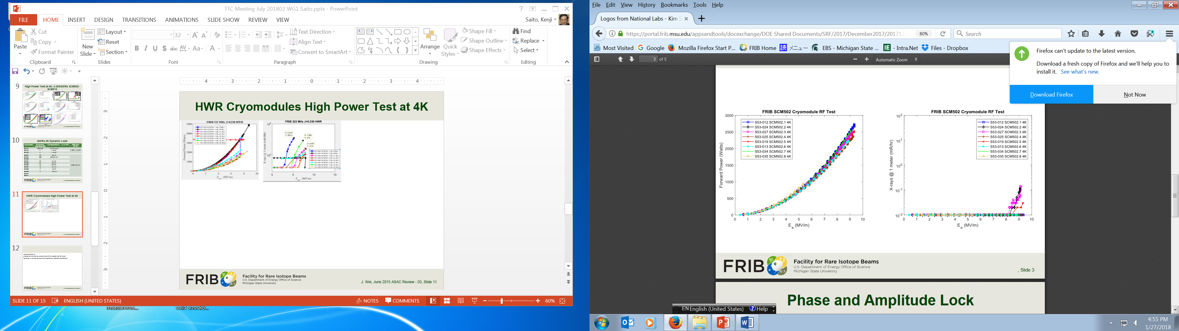
High Power Test Examples of HWRs in the Bunker Test at 4K
SCM202
SCM502

Slide 10
2 K Dynamic Load of QWR CMs and Comparison with VTA Results
Cryomodule | 2 K dynamic load/cavity @ ~ 6 MV/m [W] | Corresponding Q_{O} at 2 K @ ~ 6 MV/m | Q_{O} in VTA | E_{acc,max} in VTA [MV/m] | FRIB Spec Heat load [W] / Q_{O}
SCM401 | 0.58 ± 0.03 | 4.1 ± 0.2 x 10⁹ | 5.2 ± 1.6 x10⁹ | 10.5 ± 1.4 | 1.32 W, 1.2 x10⁹
SCM402 | < 0.5 | > 3.5 x 10⁹ | 6.3 ± 1.6 x10⁹ | 11.1 ± 0.9
SCM403 | < 0.5 | > 3.5 x 10⁹ | 5.0 ± 1.0 x10⁹ | 10.8 ± 0.8
SCM801 | 2.8 | 2.5 x 10⁹ | 2.5 ± 0.3 x 10⁹ | 9.2 ± 0.7 | 3..85 W, 1.8 x 10⁹
SCM802 | 2.8 | 2.5 x 10⁹ | 3.0 ± 1.0 x 10⁹ | 9.5 ± 0.6
SCM803 | < 3.85 | > 1.8 x 10⁹ | 2.7 ± 0.7 x 10⁹ | 9.0 ± 1.0
SCM804 | 2.5 | 2.8 x 10⁹ | 3.8 ± 1.3 x 10⁹ | 9.0 ± 0.9
SCM805 | 2.0 | 3.5 x 10⁹ | 4.3 ± 1.2 x 10⁹ | 8.9 ± 0.9
SCM806 | < 2.0 | > 3.5 x 10⁹ | 3.7 ± 1.2 x 10⁹ | 8.7 ± 0.9
SCM807 | 1.2 | 5.8 x 10⁹ | 5.6 ± 0.6 x 10⁹ | 9.0 ± 0.6
SCM808 | 1.7 | 4.1 x 10⁹ | 4.9 ± 0.8 x 10⁹ | 9.5 ± 1.1
SCM809 | 2.0 | 3.5 x 10⁹ | 4.2 ± 1.5 x 10⁹ | 8.6 ± 0.9
SCM810 | Skipped measurement | - | 4.7 ± 1.2 x 10⁹ | 9.6 ± 0.8
SCM811 |  |  | 5.1 ± 1.5 x 10⁹ | 9.4 ± 0.7
Low Q issue but meet FRIB spec.

Slide 11
2 K Dynamic Load of HWR CMs and Comparison with VTA Results
Cryomodule | 2 K dynamic load/cavity [W] | Corresponding Q_{O} at 2 K @ ~ 8 MV/m | Q_{O} in VTA | Eacc,max in VTA [MV/m] | FRIB Spec Heat load [W] / Q_{O}
SCM201 | 0.67 | 2.9 x 10¹⁰ | 1.8 ± 0.1 x10¹⁰ | 13.2 ± 1.3 | 3.55 W, 5.5 x10⁹
SCM202 |  |  | 1.2 ± 0.2 x10¹⁰ | 12.7 ± 1.1
SCM501 | 4.1 ± 1.5 | 1.5 ± 0.6 x 1 0¹⁰ | 2.8 ± 1.6 x 10¹⁰ | 11.6 ± 0.8 | 7.9 W, 7.6 x 10⁹
SCM502 | 1.6 ± 0.4 | 3.8 ± 0.4 x 10¹⁰ | 1.5 ± 0.2 x 10¹⁰ | 11.4 ± 0.7

Slide 12
Summary
FRIB cavity performance in the VTA is dominantly limited by the high field Q slope, which appears from ~ 85 mT.
Cavity performance degradation is not observed in both gradient and Q_{O} within measurement error and the FRIB bunker test criteria.

