Slide 1
Recent results of cavity infusion at DESY
Outline
Nitrogen infusion
Cavity & sample results
Cross-section of samples
Analysis of precipitates size
Christopher Bate
on behalf of DESY SRF Team
TTC Meeting @ Milan
2018/02/08

Slide 2
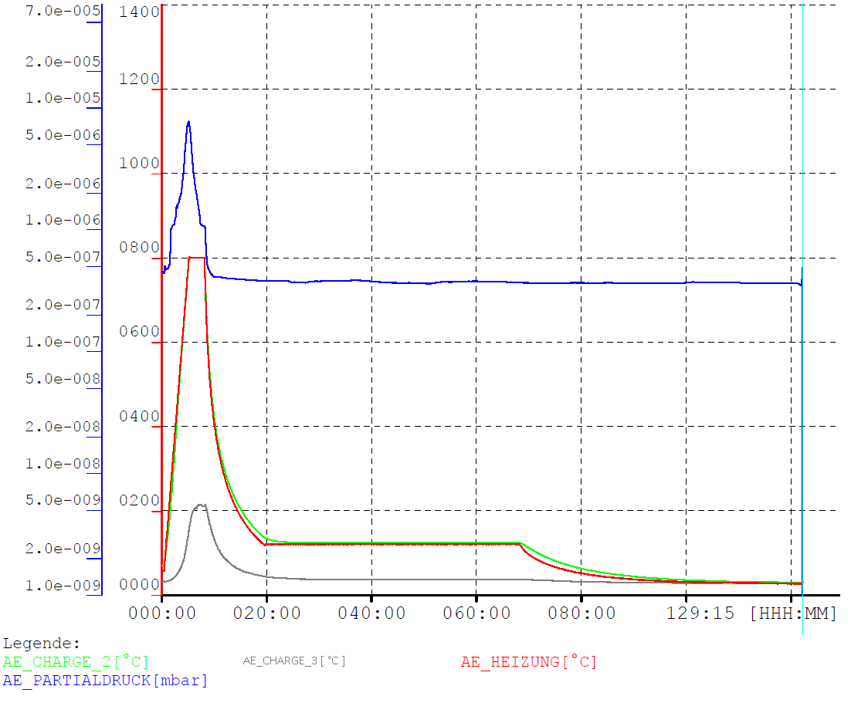
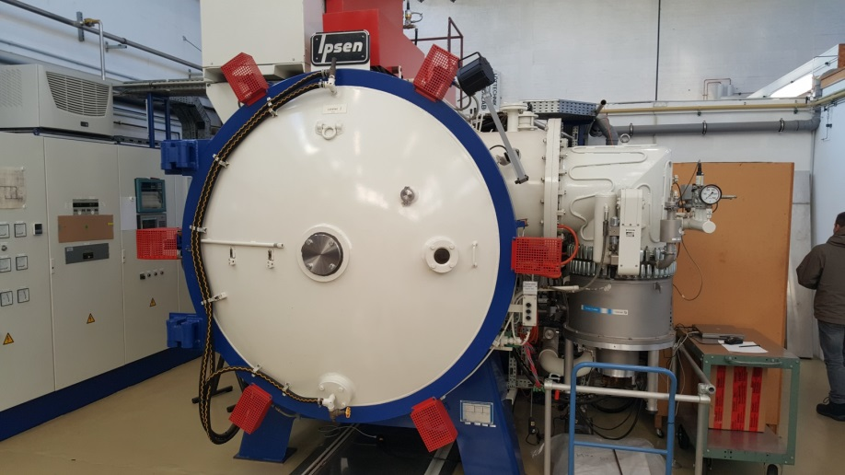
Nitrogen infusion – DESY furnace
2 turbo molecular pumps (Varian, 6000 l/s each , max. intake pressure ~ 10⁻² mbar)
T_{max} ~ 1100°C
V = 1800 x 625 x 660 mm³
EPDM sealed
Roughing pumps (oil sealed):
Rotary vane & roots pump
800C – 3h - vacuum
Cool down to 120C
48h @ 120C + 25 mTorr N2
Cool down
Ofen(Bem. Alter Ofen mit.. Wesentliche Punkte (druck,Ölpumpen)),
Druck/T Kurve von Joern

Slide 3
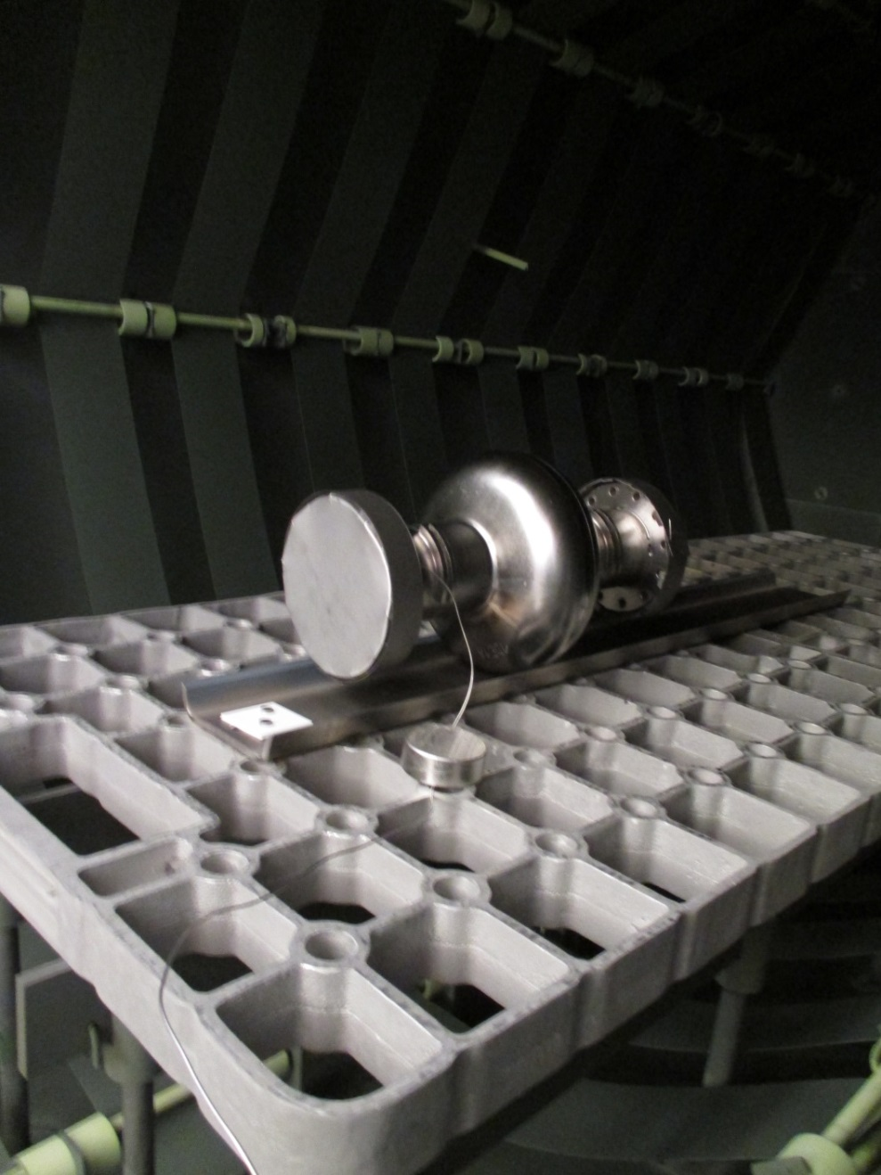
Cavity assembly in furnace

Slide 4
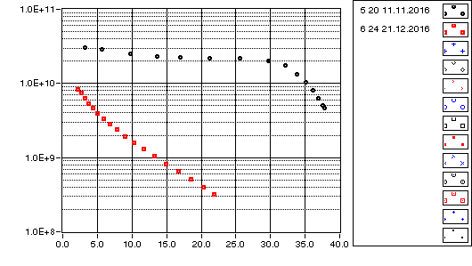
First infusion try at DESY – Q vs E and sample SEM
1DE18
@ 2K
E3
$${\text{Q}}_{\text{0}}$$
Precipitates on sample (BCP)
Although very few
$${\text{E}}_{\text{acc}}\text{[}\text{MV}\text{/}\text{m}\text{]}$$
Infusion recipe | Measured
800°C @ 3h, p$≈$10⁻⁶ mbar, cool down | 800°C @ 2h, p$≈$10⁻⁵ mbar, cool down (slower?)
120°C @ 48h | 120°C @ 48h
p_{N2}$≈$10⁻² mbar | p_{N2}$≈$10⁻⁴ mbar

Slide 5
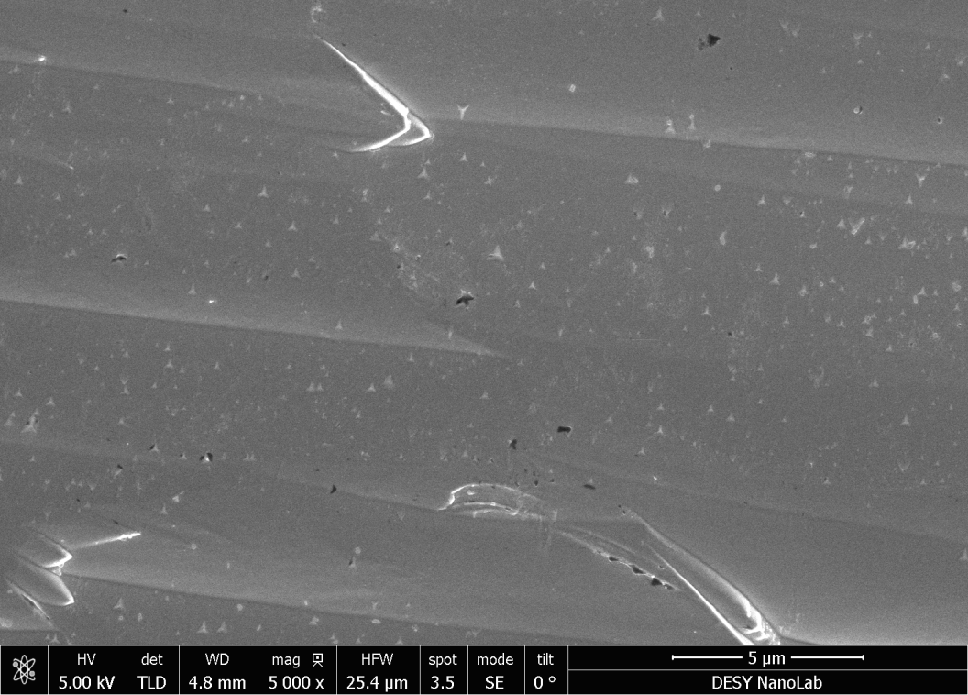
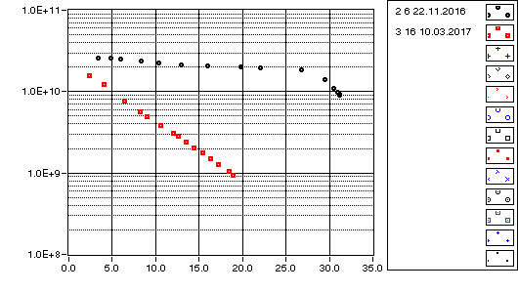
Second run - bakeout same as infusion w/o Nitrogen
1DE17
@ 2K
D4
$${\text{Q}}_{\text{0}}$$
$${\text{E}}_{\text{acc}}\text{[}\text{MV}\text{/}\text{m}\text{]}$$
Furnace parameters
800°C @ 2h, p$≈$10⁻⁵ mbar
120°C @ 48h, p$≈$10⁻⁷ mbar
More precipitates than before (BCP sample)
But same Q-Slope
No correlation between precipitates and cavity performance?

Slide 6
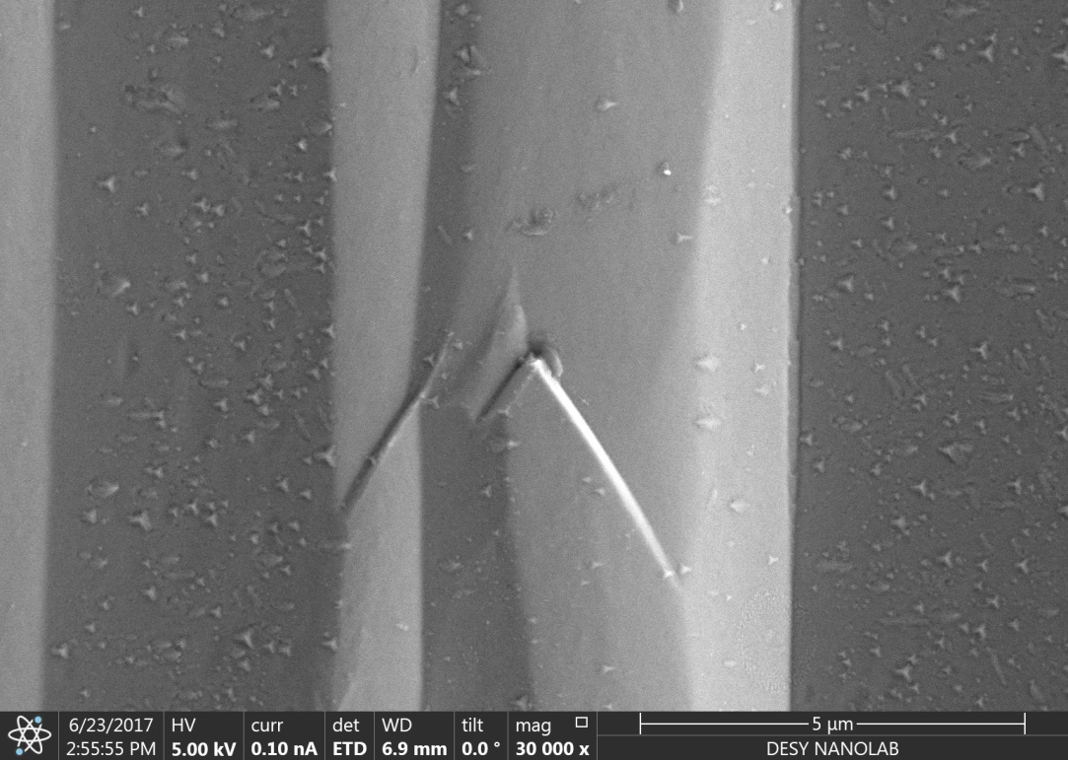
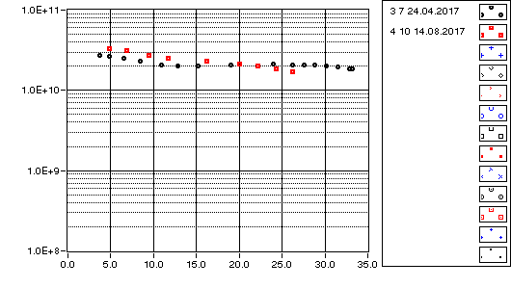
Third try w/o Nitrogen
1DE16
@ 2K
D5
$${\text{Q}}_{\text{0}}$$
$${\text{E}}_{\text{acc}}\text{[}\text{MV}\text{/}\text{m}\text{]}$$
Furnace parameters
800°C @ 3h, p$≈$7.5$∙$10⁻⁶ mbar
120°C @ 48h, p$≈$10⁻⁷ mbar
Still observing precipitates on sample (BCP)
More or less than before?
What are they?

Slide 7
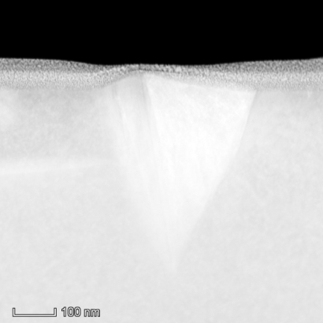
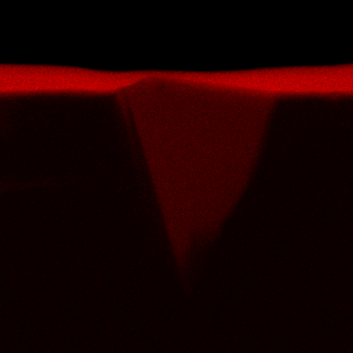
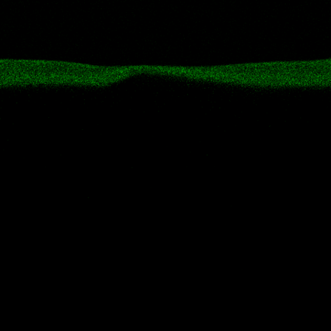
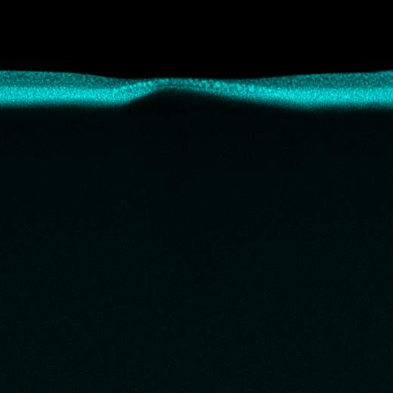
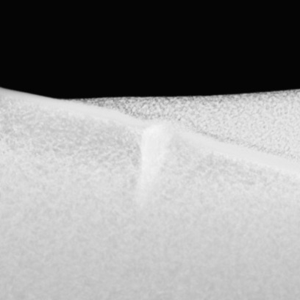
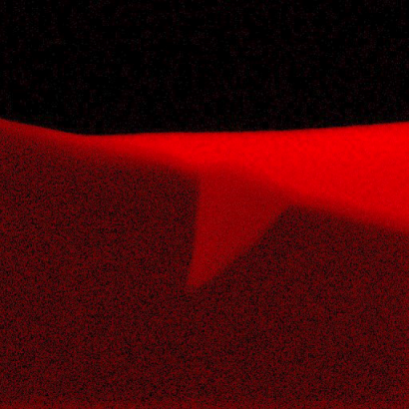
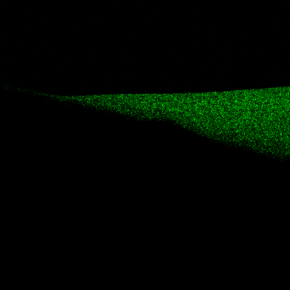
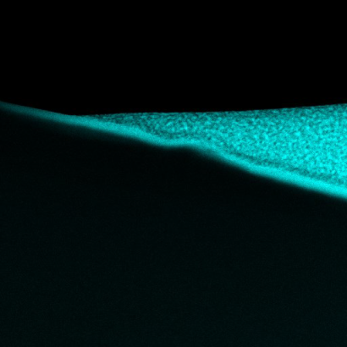
Cross-section EDX map
SE
C
N
Pt
D4
(1DE17)
D5
(1DE16)
Possible phase: Nb₂C

Slide 8
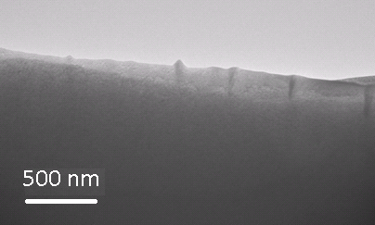
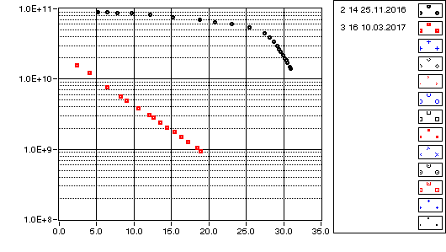
Samples - precipitates size comparison
D5 (1DE16) :
One sample shows deeper and bigger precipitates
D4 (1DE17):

Slide 9
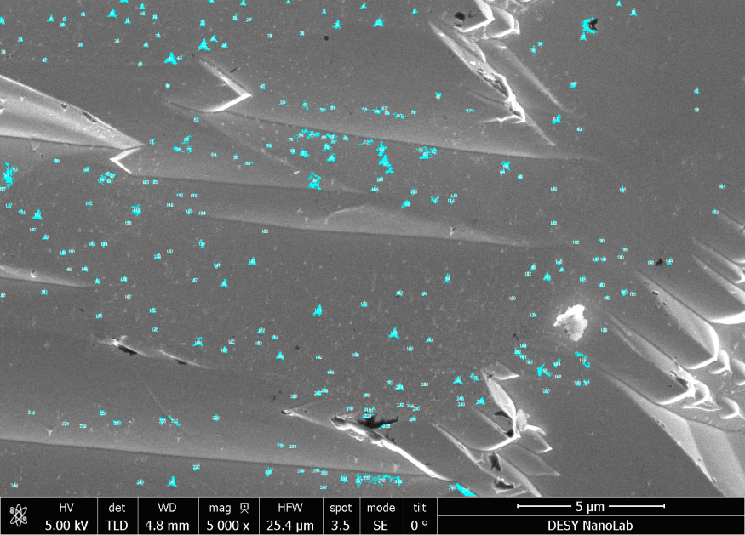
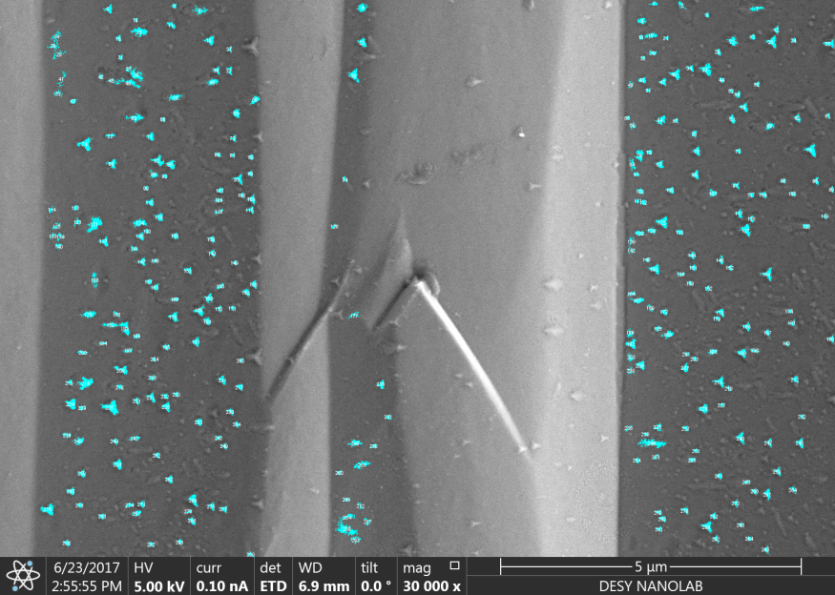
Samples - precipitates size statistics
1DE17
1DE16
D4
D5
Average size: ${0.024 μm}^{2}$
Count: 247
Total area: ${5.961 μm}^{2}$
Average size: ${0.008 μm}^{2}$
Count: 299
Total area: ${2. 312 μm}^{2}$

Slide 10
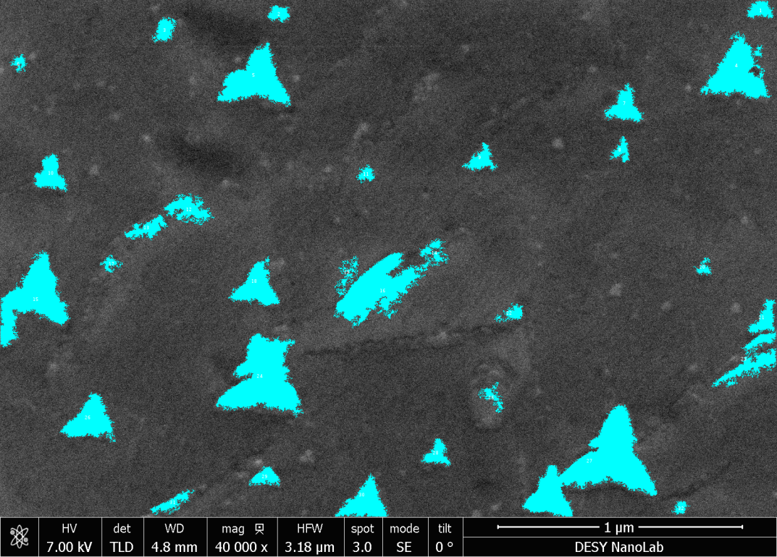
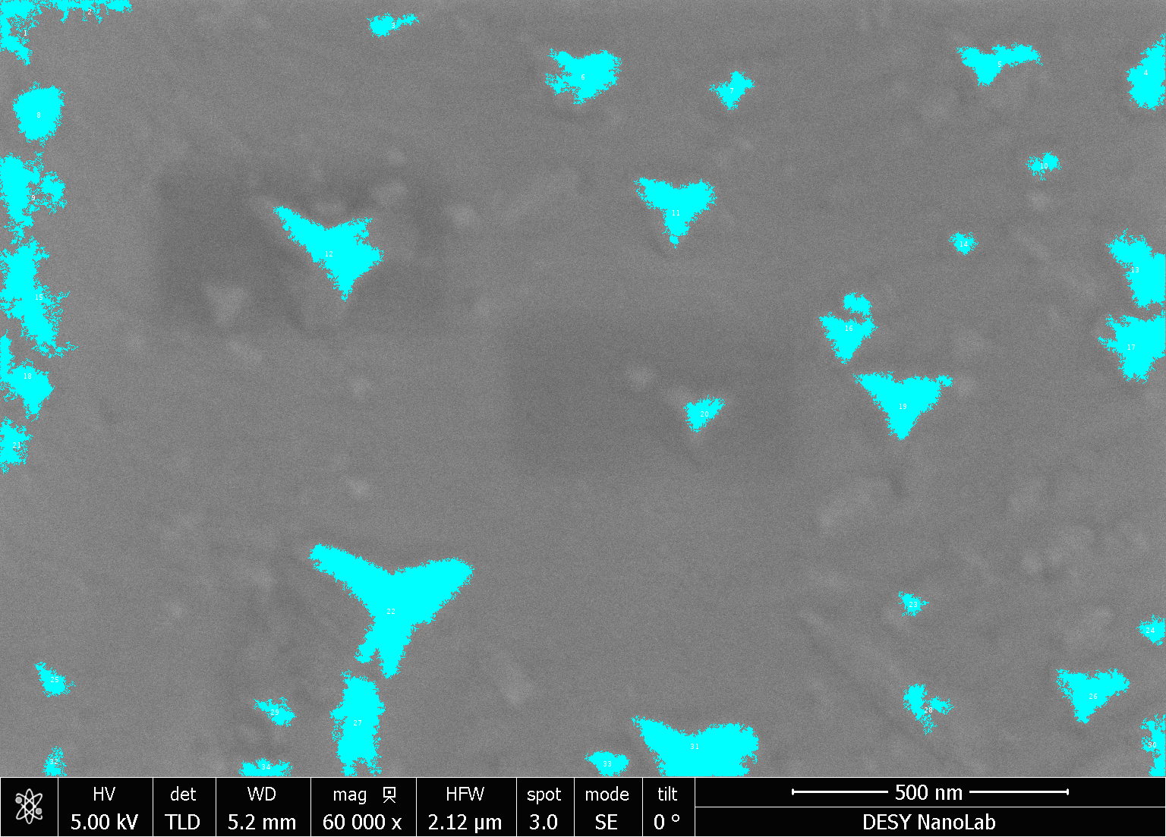
Samples - precipitates size statistics
1DE17
1DE16
D4
D5
Average size: ${0.015 μm}^{2}$
Average size: ${0.006 μm}^{2}$

Slide 11
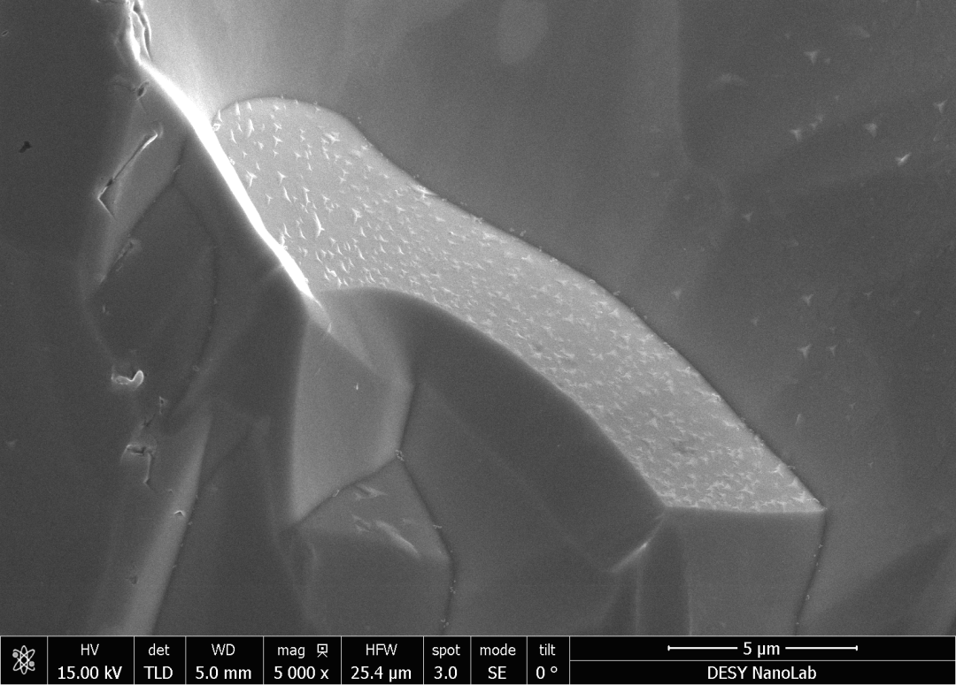
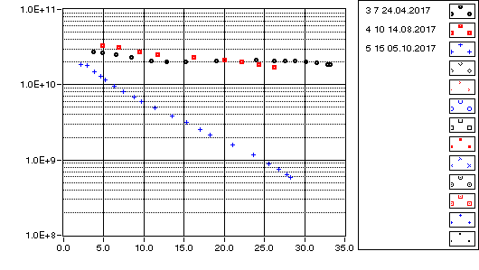
Second run of 1DE16 (w/o Nitrogen)
1DE16
D6
@ 2K
$${\text{Q}}_{\text{0}}$$
$${\text{E}}_{\text{acc}}\text{[}\text{MV}\text{/}\text{m}\text{]}$$
Furnace parameters
800°C @ 3h, p$≈$5.6$∙$10⁻⁶ mbar
120°C @ 48h, p$≈$10⁻⁷ mbar
Observing precipitates on sample (BCP)
Only on certain grains – grow only on certain crystal orientation!
Dense and numerous

Slide 12
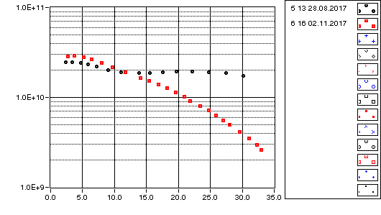
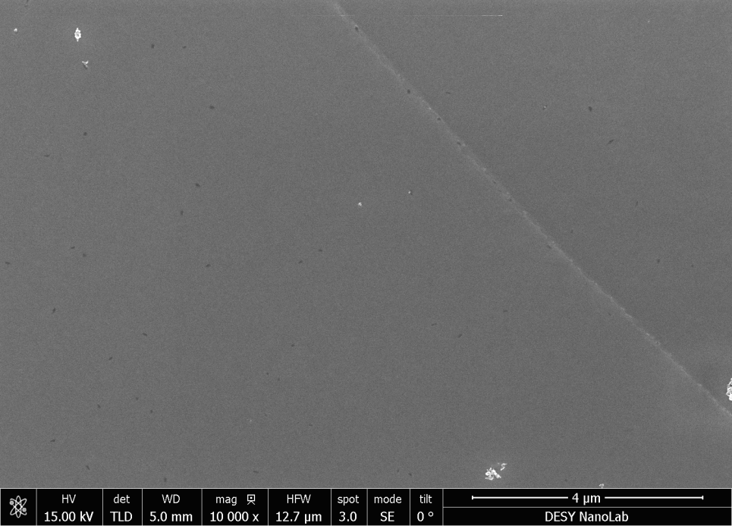
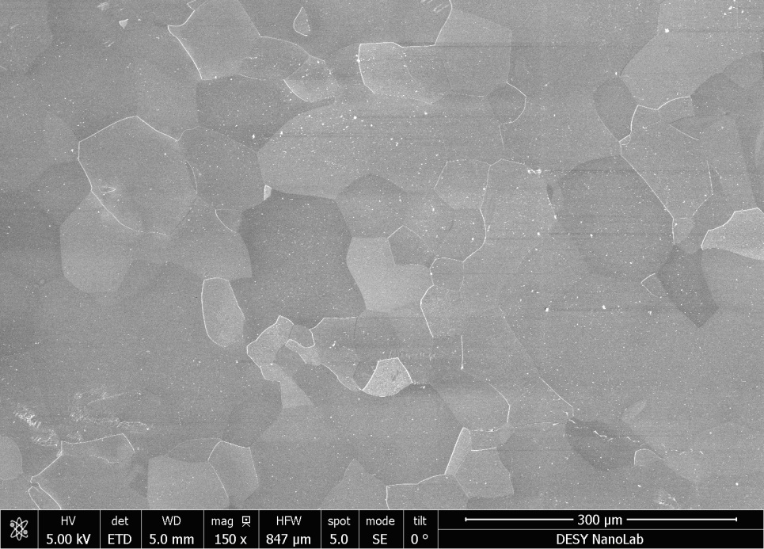
Fifth run with another single cell cavity (w/o Nitrogen)
1DE09
@ 2K
F1
$${\text{Q}}_{\text{0}}$$
$${\text{E}}_{\text{acc}}\text{[}\text{MV}\text{/}\text{m}\text{]}$$
F1
Electropolished fine-grain sample
No precipitates at all!
Furnace parameters
800°C @ 3h, p$≈$5$∙$10⁻⁶ mbar
120°C @ 48h, p$≈$10⁻⁷ mbar

Slide 13
Cavity and sample summary
Cavity (all FG) | Material | Surface chemistry | Furnace cycle | p_max [mbar] @ 800°C |  | Sample | Material/ Surface chemistry | Precipitates | Observations
1DE18 | Ningxia 2005 | 80µm BCP 800°C 100µm EP 130°C | 2h@800°C 48h@120°C w N2 (problems with N2 regulation) | $$2∙{10}^{−5}$$ |  | E3 | LG Heraeus BCP 20 µm |  | Very few
1DE17 | Ningxia 2005 | 80µm BCP 800°C 100µm EP 130°C | 2h@800°C 48h@120°C w/o N2 | $$1.2∙{10}^{−5}$$ |  | D4 | LG Heraeus BCP 10 µm |  | Whole surface covered Average size: ${0.024 μm}^{2}$
1DE16 (1st run) | Heraeus Plansee 2005 | 80µm BCP 800°C 100µm EP 130°C | 3h@800°C 48h@120°C w/o N2 | $$7.5∙{10}^{−6}$$ |  | D5 | LG Heraeus BCP 10 µm |  | Whole surface covered Average size: ${0.008 μm}^{2}$
1DE16 (2nd run) | “ “ | 80µm BCP 800°C 100µm EP 130°C | 17,5h@300°C 3h@800°C 48h@120°C w/o N2 | $$5.6∙{10}^{−6}$$ |  | D6 | LG Heraeus BCP 10 µm |  | Very numerous and dense Only at certain crystal orientations
1DE09 | Heraeus 1997 | 119µm BCP 800°C 100µm EP HPR 138°C/48h dry-ice cleaning | 19,5h@300°C 3h@800°C 48h@120°C w/o N2 | $$5∙{10}^{−6}$$ |  | F1 | FG Heraeus EP 200 µm | X

Slide 14
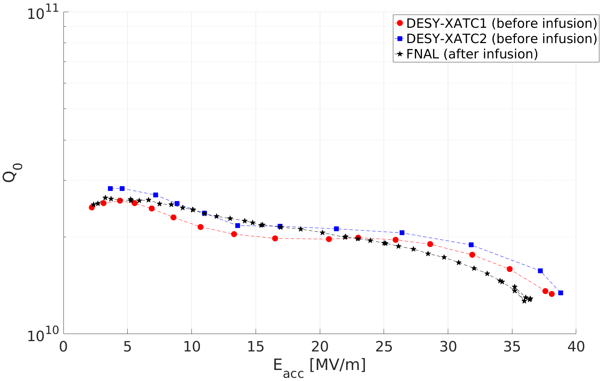
DESY cavity - infusion run at Fermilab
1DE03
Preliminary
@ 2K
Electropolished fine-grain sample
Lots of precipitates!
But: Only on certain grains

Slide 15
Summary
Precipitates
Grow on certain crystal orientation
Size may correlate with cavity performance
Possible phase: Nb₂C
Vacuum got better at every run
More important: partial pressures (analyze RGA's)
Cut 1DE16 for direct surface analysis
Compare samples
BCP and EP
LG & FG
Material (3 EXFEL suppliers)
Future options
Installing oil free pumps
Alternative furnace

