Slide 1
Field Emission Results for LCLS-II Production
Dan Gonnella
2018 TTC Workshop
February 7, 2018

Slide 2
Outline
LCLS-II CM Production and Testing Status
Gradient Limitation in CMs
FE Onset and Presence Over Time
Clean Room Audits and Procedure Changes
Conclusions

Slide 3
LCLS-II CM Production and Testing Status
Production of LCLS-II cryomodules is well under way
A total of 40 cryomodules will be built
7 cryomodules have been tested at FNAL (plus the JLab prototype)
Another 5 cryomodules are at various stages of production
5 cryomdoules have been tested at JLab
Another 6 cryomodules are at various stages of production

Slide 4
FE Difficulties in LCLS-II
By the nature of two independent labs building and testing cryomodules, analysis of field emission can be difficult
Both labs have different radiation detection schemes
As of now:
FE onset is defined when detected radiation is above the background
Usable gradient is defined as the highest field in which a cavity can operate in CW mode generating <50 mR/hr of radiation
Key differences in assembly procedure:
JLab keeps string under vacuum, HPR’s all cavities prior to string assembly and does not keep a constant purge during string assembly
FNAL does not HPR cavities, keeps a constant purge during string assembly, and backfills the string after assembly

Slide 5
Field Emission in VT
Cavity Set | Percentage
All | 37%
RI | 34%
RI ≤70 | 46%
RI >70 | 23%
EZ | 41%
EZ ≤217 | 53%
EZ <253 | 39%
EZ <273 | 35%
EZ ≥273 | 41%
Re-rinse rate has typically decreased as cavity production has gone on
Clean room procedure changes have been implemented at both vendors to improve FE rates

Slide 6
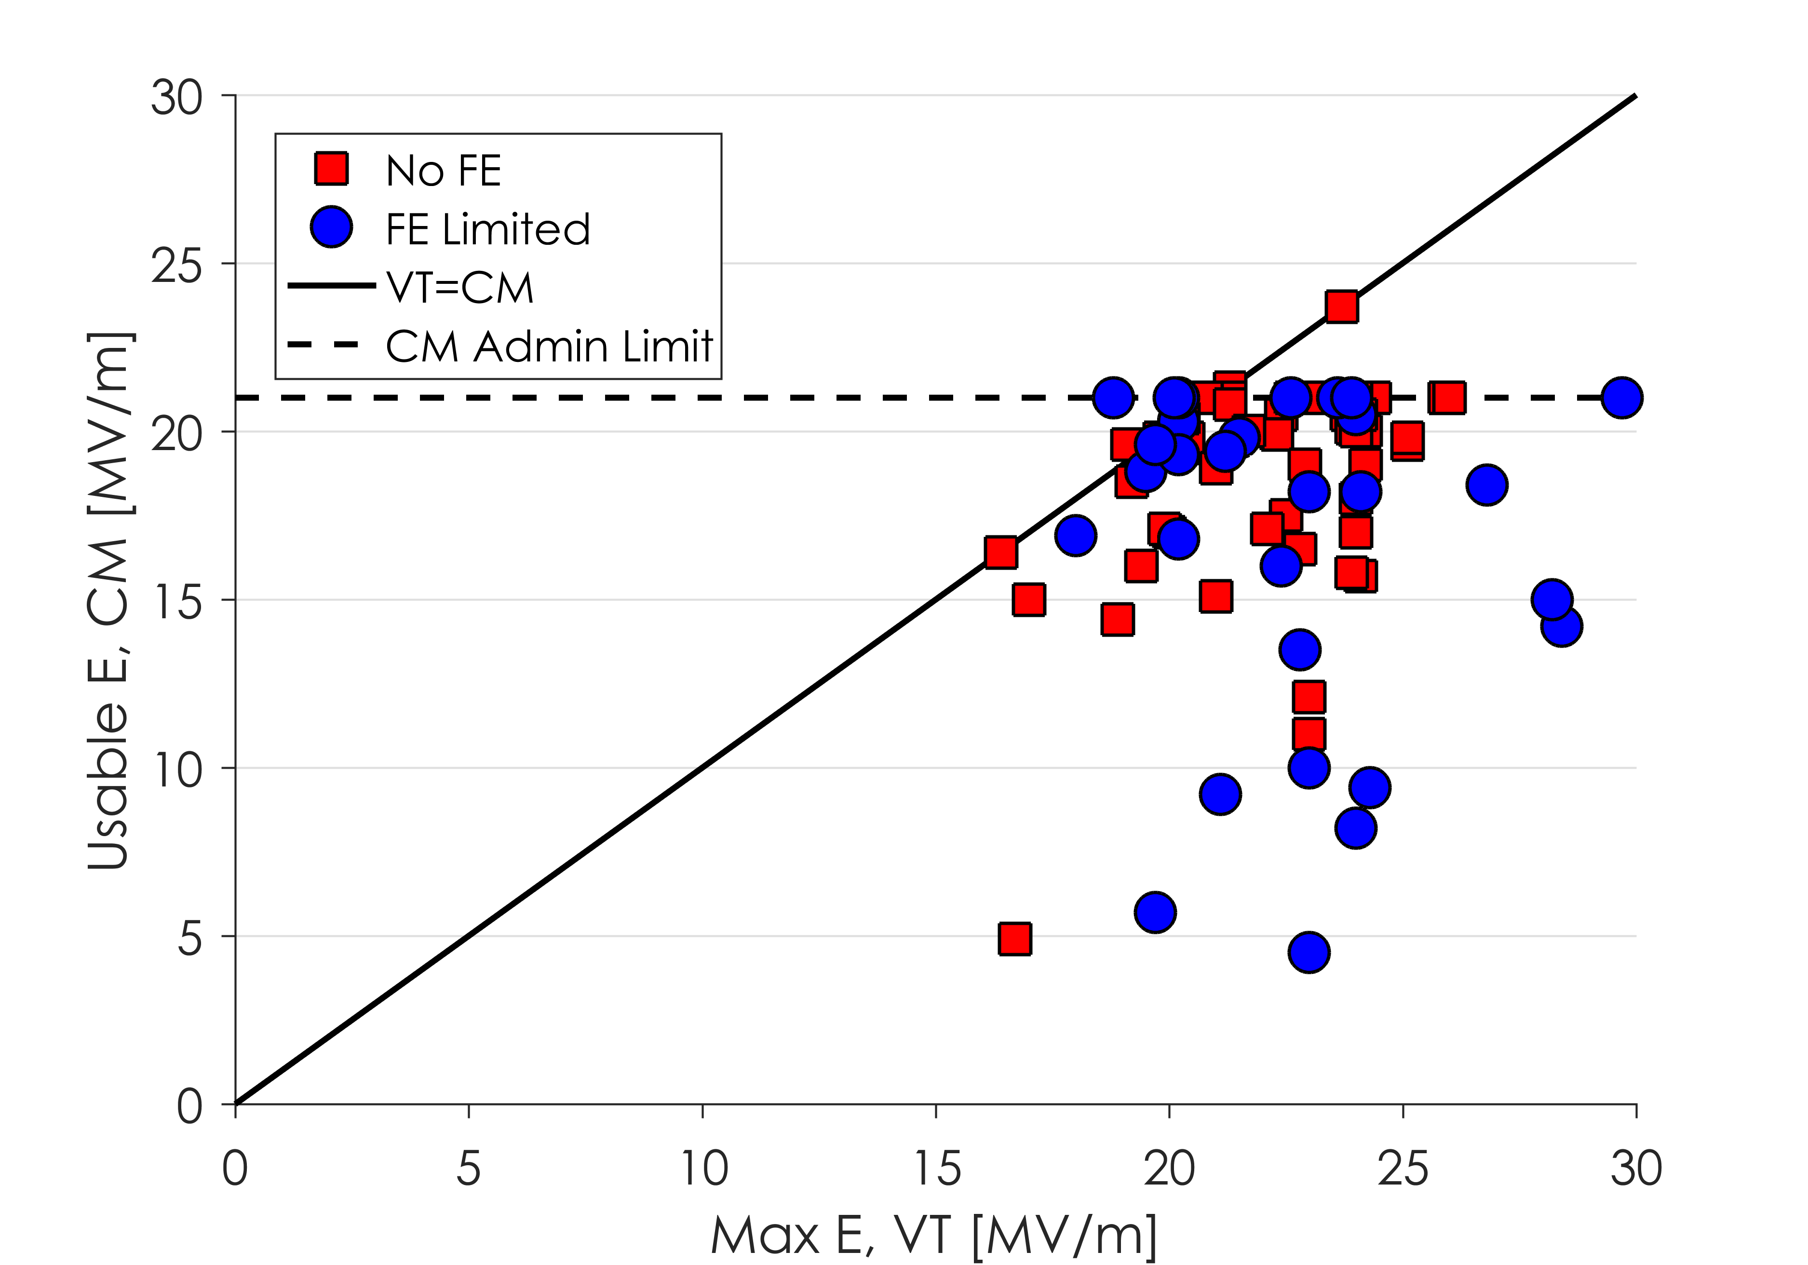
Gradient Limitation in CMs
The majority of cavities do not show a large degradation in gradient reach in CM
The majority of cavities that show a large reduction in gradient are due to FE
Some low performers have been due to other issues: coupler vacuum, end group heating etc.

Slide 7
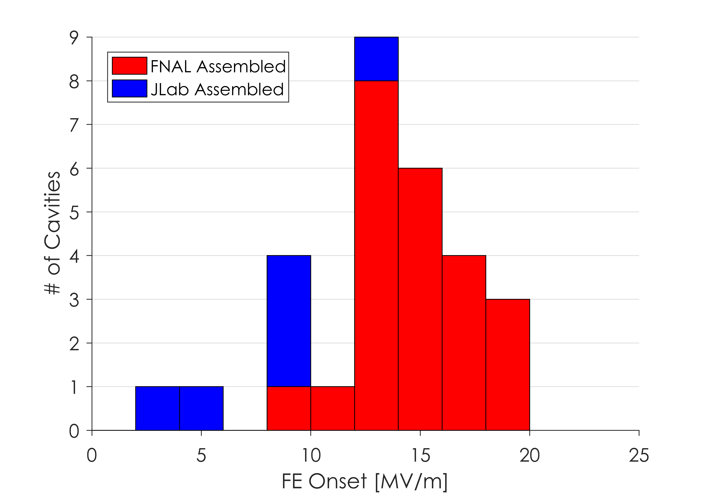
FE Onset
Early CMs were plagued by either:
Large number of cavities with FE (FNAL)
Few cavities with FE but low onset (JLab)
An internal audit at FNAL reduced the number of cavities with FE

Slide 8
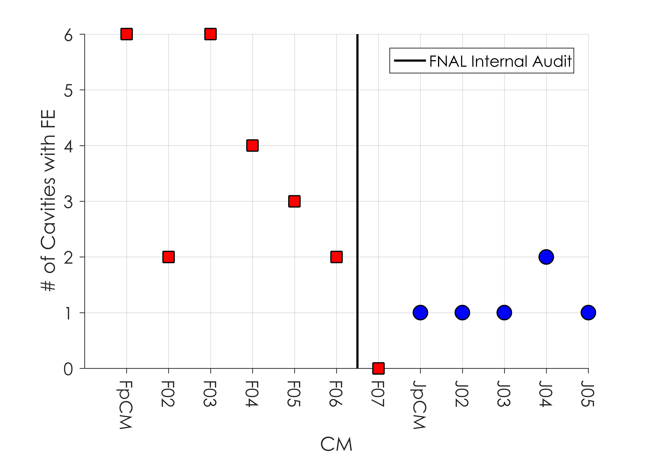
FE Over Time
Early FNAL CMs showed a large number of cavities with FE

Slide 9
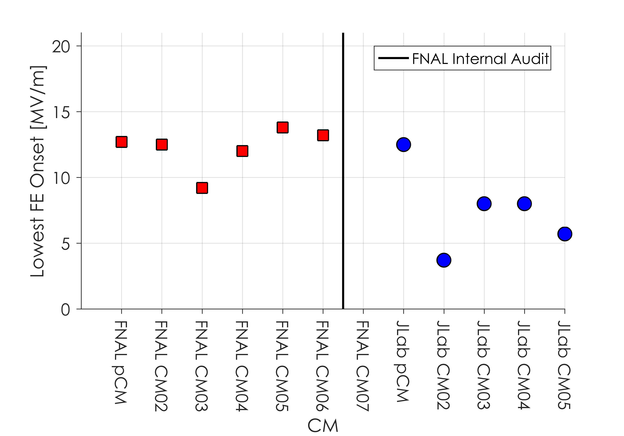
FE Onset Over Time
Early JLab CMs showed cavities with very low FE onset (<10 MV/m)

Slide 10
FE Onset Over Time
Low onset in CMs at both labs has not improved with time (with the exception of F1.3-07)

Slide 11
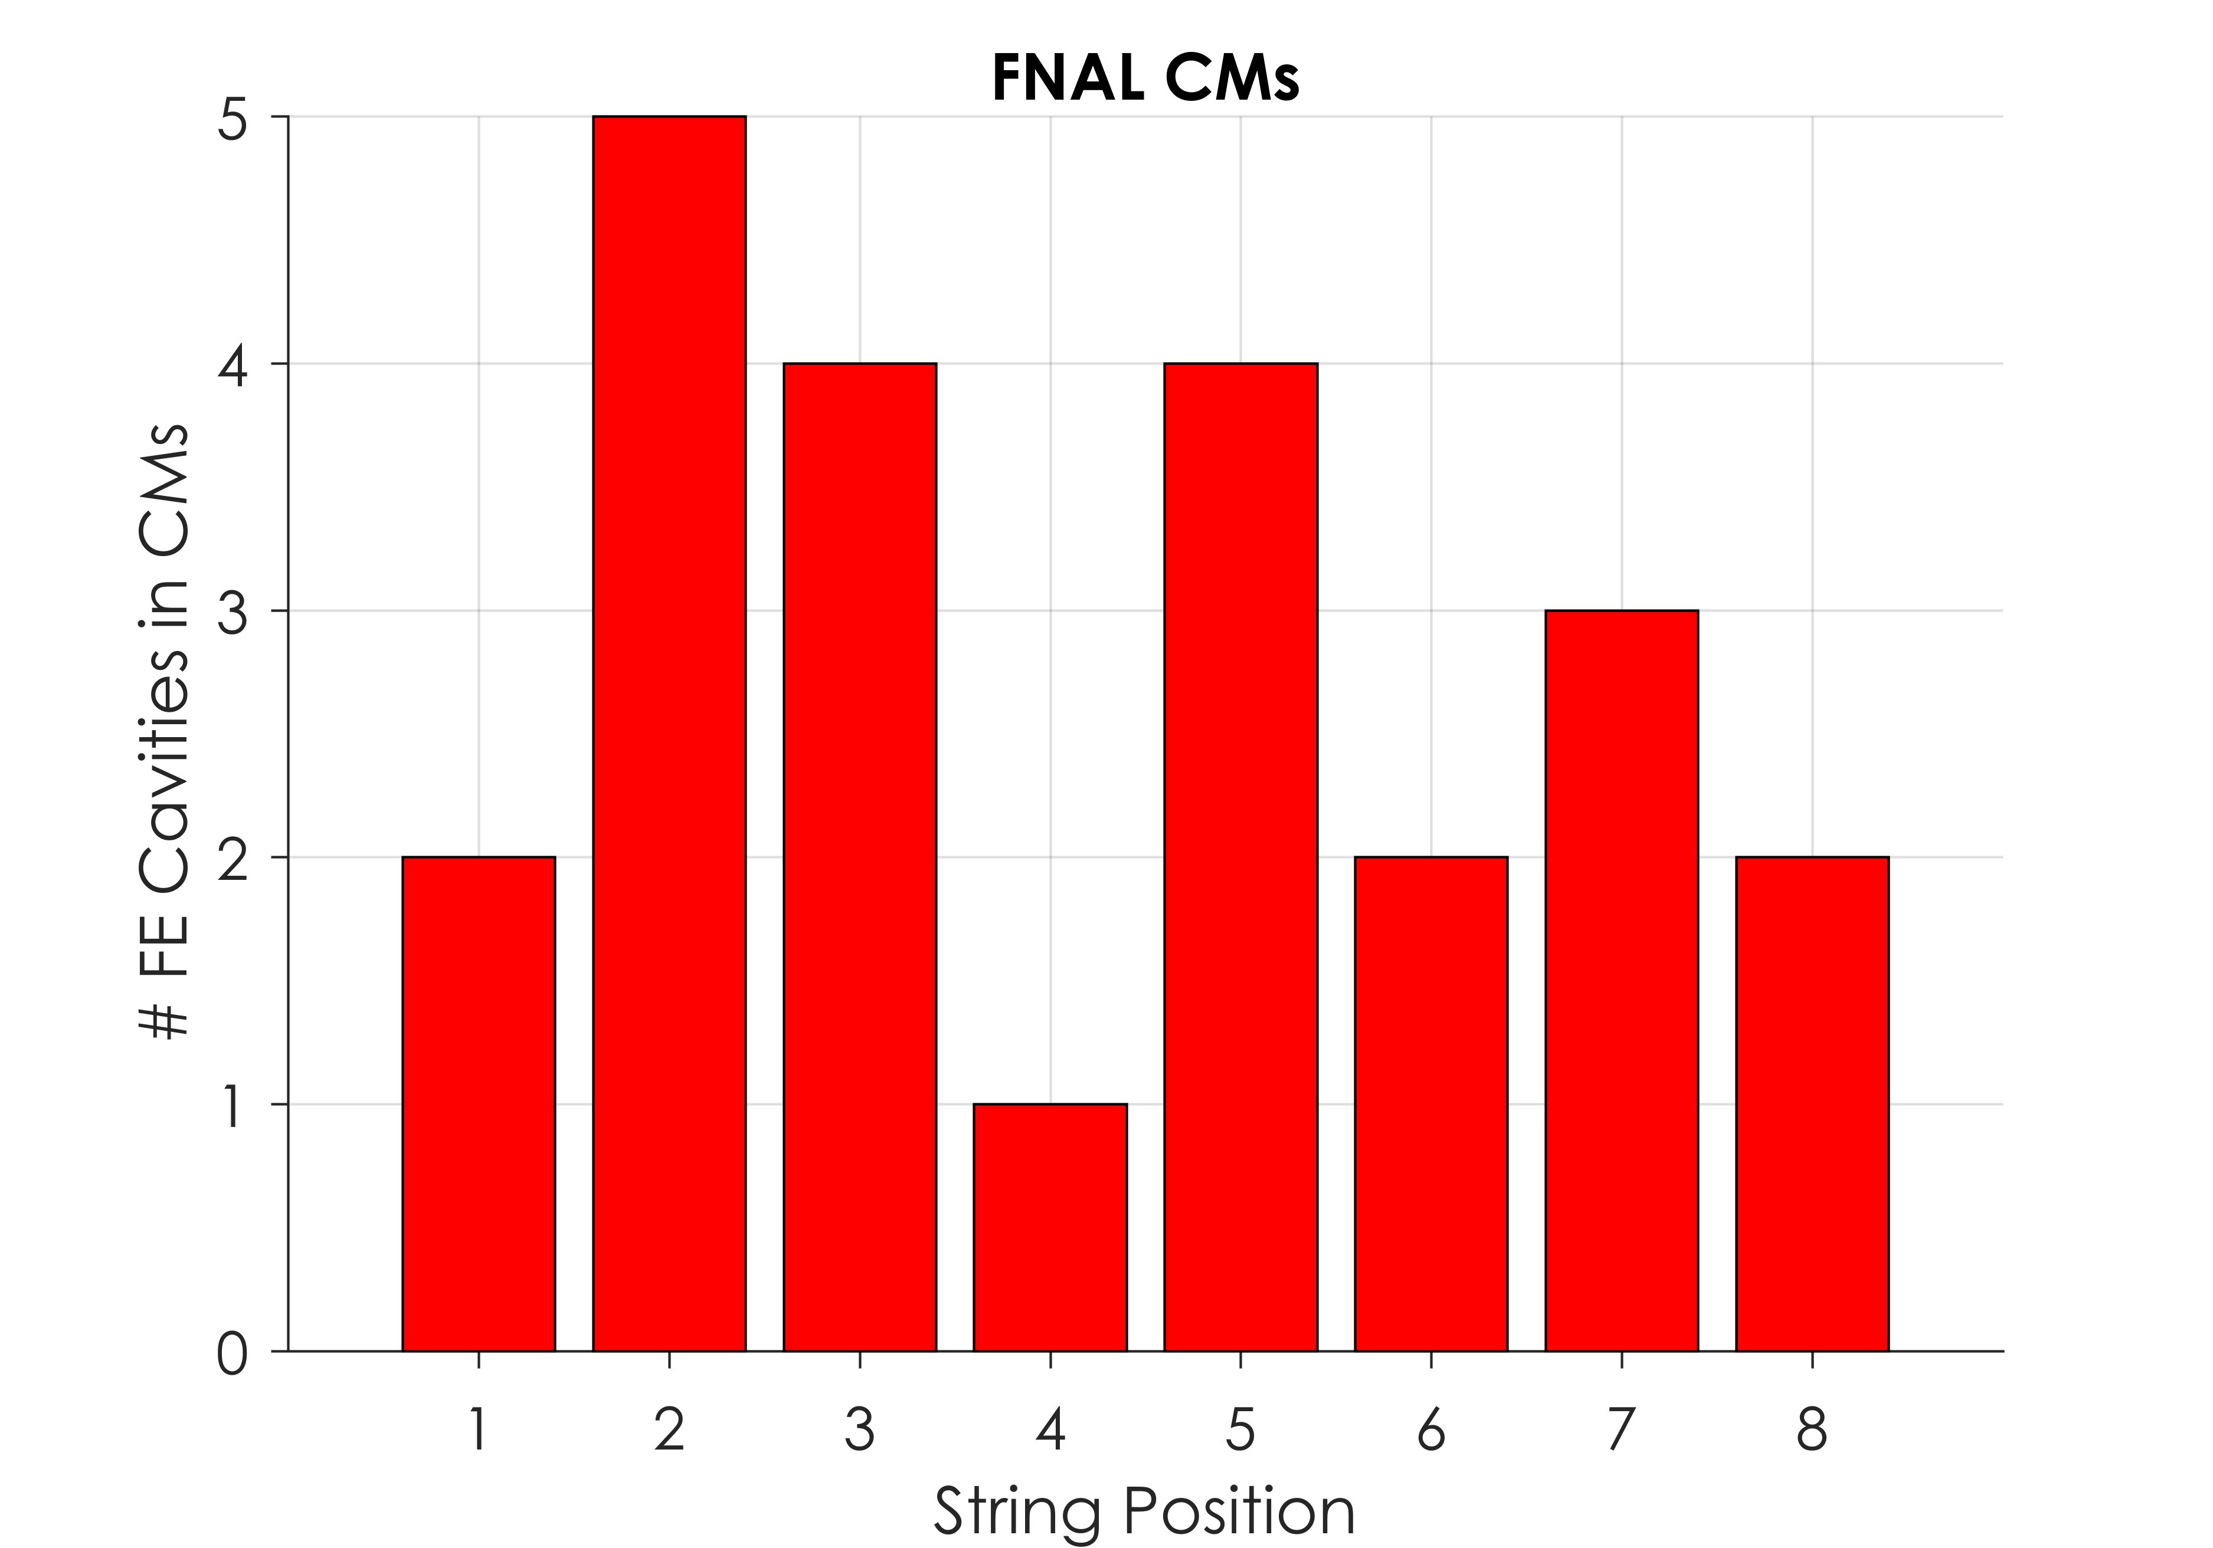
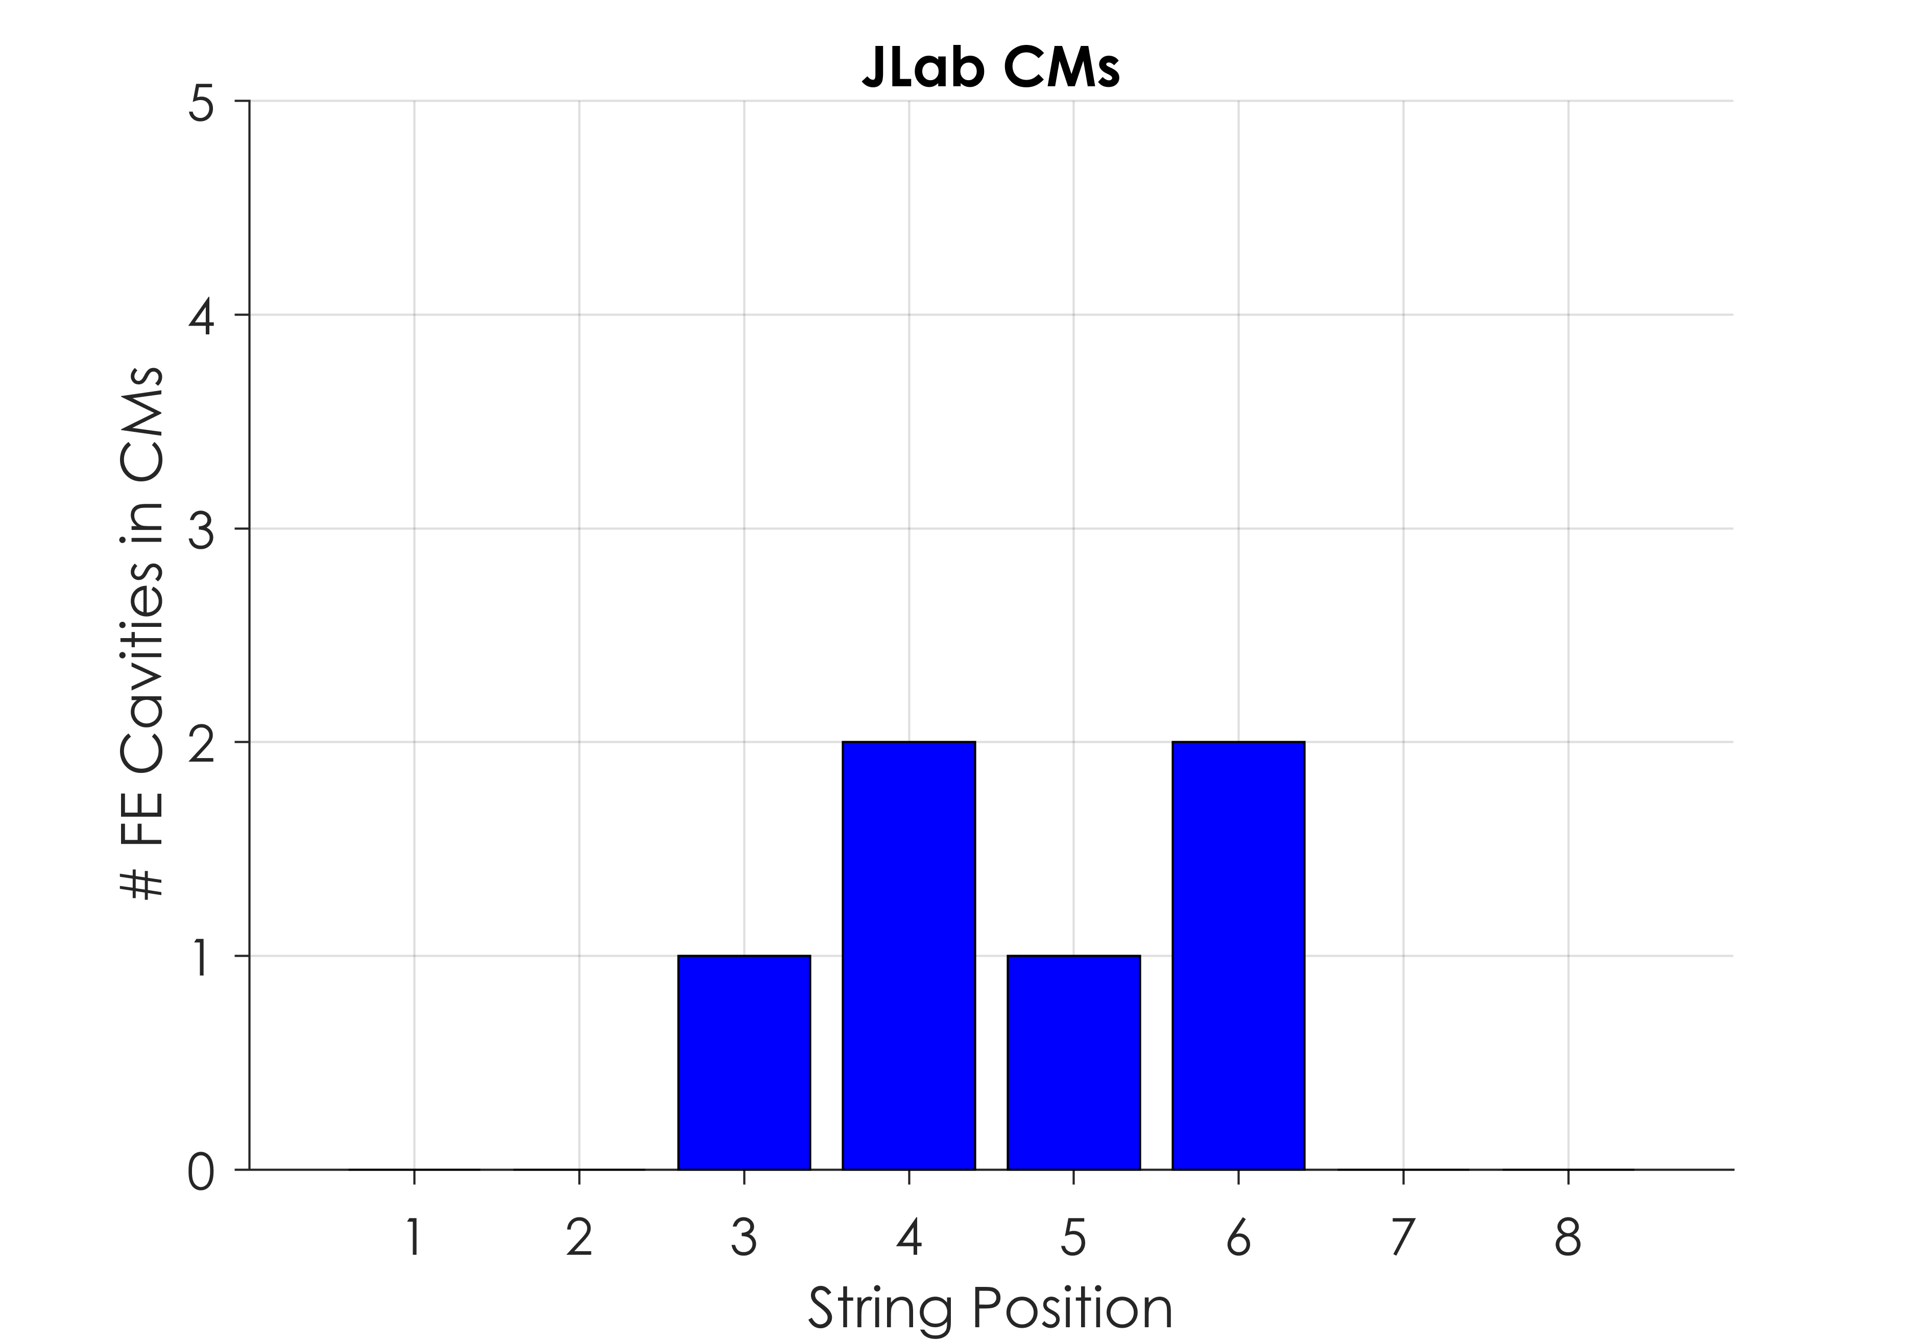
FE vs String Position
No strong correlation between cavity position and field emission

Slide 12
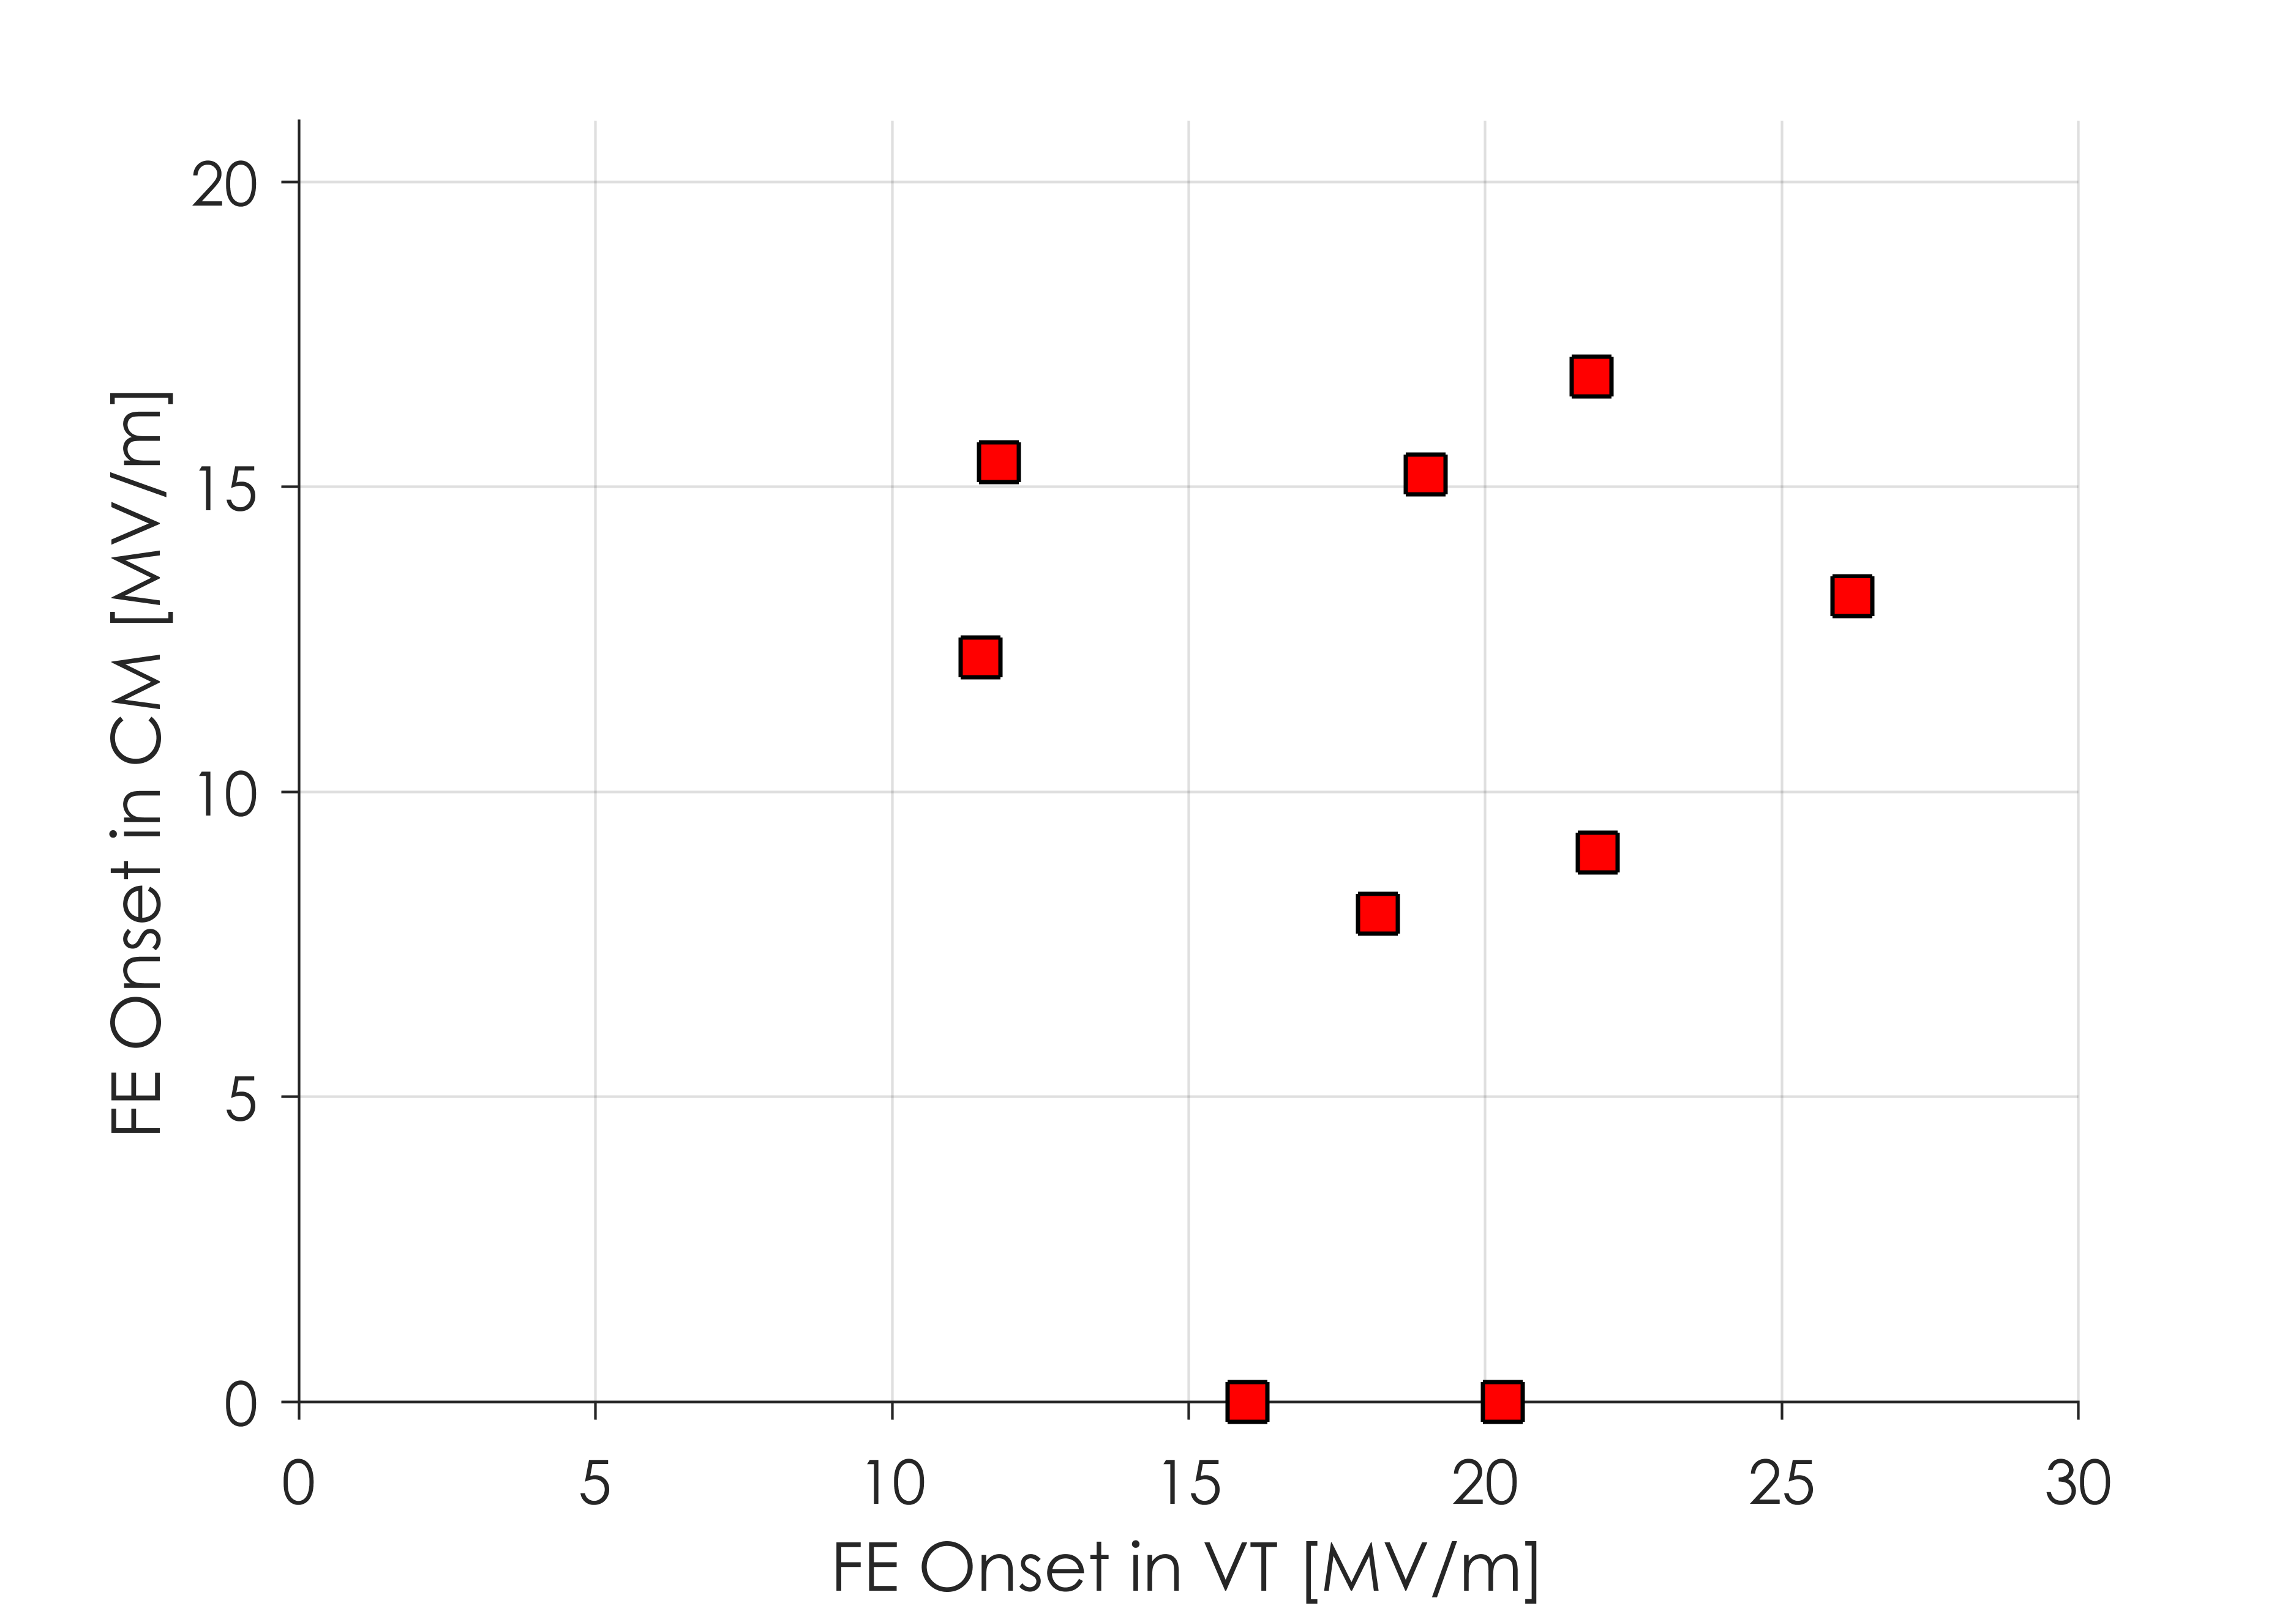
Cavities with FE in VT
10 cavities have been tested in CMs which had FE in VT and were not re-tested
FE conditioned away
Onset was above 19 MV/m
Of these 10, 7 have had FE in the CM
FNAL never put cavities with FE above 19 in strings
JLab has since stopped putting any cavities with FE in strings (starting with CM11)
May indicate that conditioning does not completely remove field emitters
Cavities with FE and No Re-Test

Slide 13
Clean Room Audits - FNAL
Due to the large number of field emitting cavities in early FNAL CMs, an internal clean room audit was completed
Most importantly, the backfill rate of the string was decreased:
30 min to backfill originally
90 min to backfill after audit
The backfill procedure was reworked to ensure cleanliness
These changes went into effect beginning with CM07
Stéphane Berry observed clean room procedures and recommended changes which were implemented on CM10
Increased nitrogen purge rate to 3 L/min from 1 L/min
Additional cleaning of bellows prior to leak checking

Slide 14
Clean Room Audits - JLab
Beginning with CM08, bellows were exercised ±¼ inch prior to final blowdown
Beginning with cavities for CM11:
The VT administrative limit of 24 MV/m was removed
No cavities with any FE on final power rise were sent to string assembly
Prior to CM11, cavities with FE onset above 19 MV/m were deemed qualified
Cavities getting a re-rinse now have a full disassembly and HPR
Stéphane Berry observed clean room procedures and JLab personnel are currently working to implement changes in future string assemblies

Slide 15
Conclusions
FE in LCLS-II CMs is the largest contributing factor to limitations of gradient reach
Early FNAL CMs had a large number of cavities with FE
An internal audit improved performance significantly on one CM so far (no cavities with FE up to 21 MV/m)
JLab CMs have been plagued by low field emission onset in about 1 cavity per CM
Changes to assembly procedures have been implemented and more changes as a result of an audit are currently being implemented
Cavities are now tested to their full gradient reach in VT and are not sent to string assembly if there is any FE present
Even with FE limitations, all CMs so far have met the gradient reach specification for LCLS-II

