Slide 2
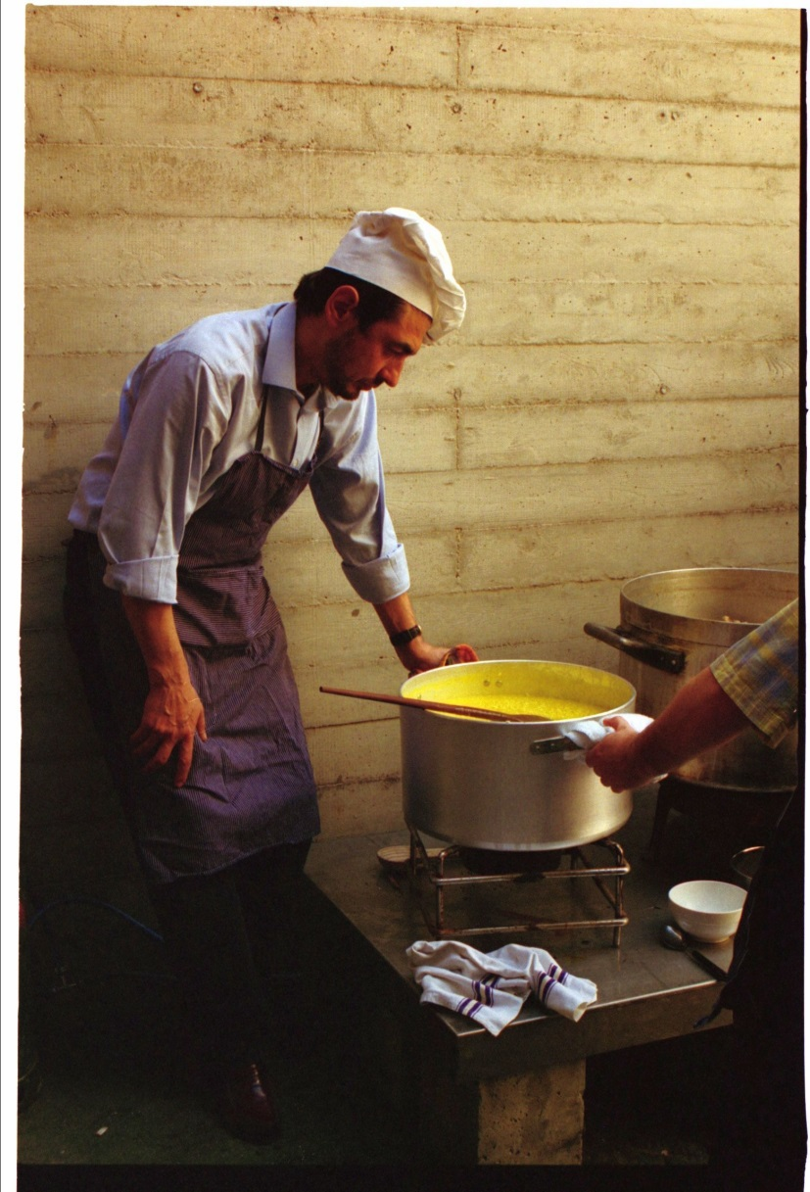
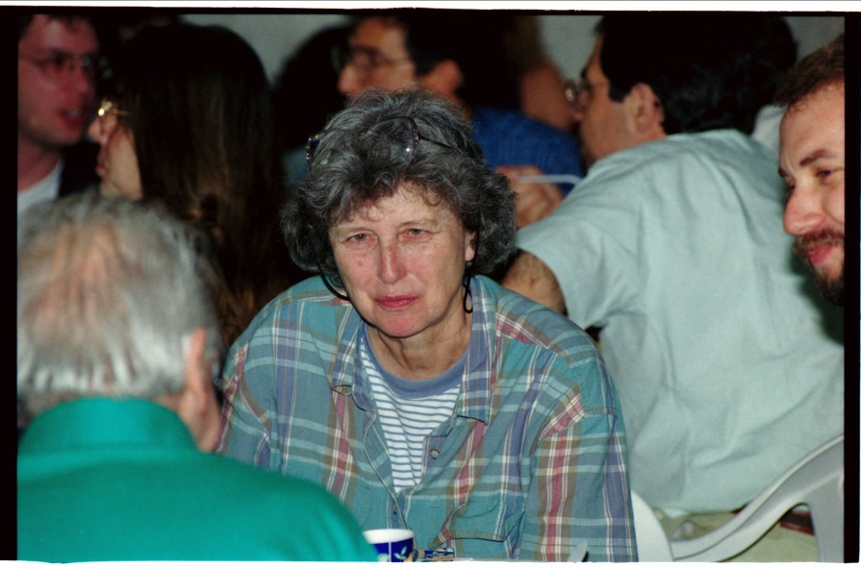
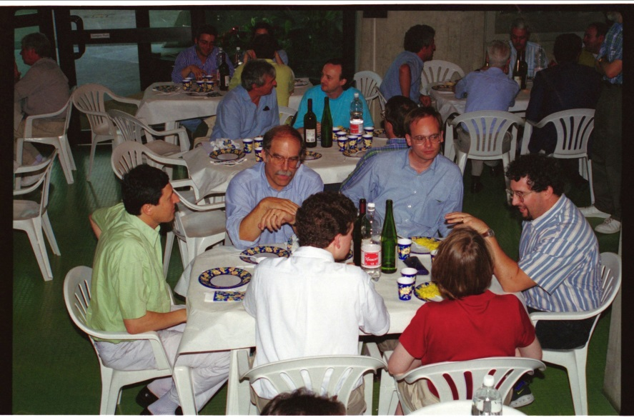
Memories: 1995 Milano TTC Meeting

Slide 3
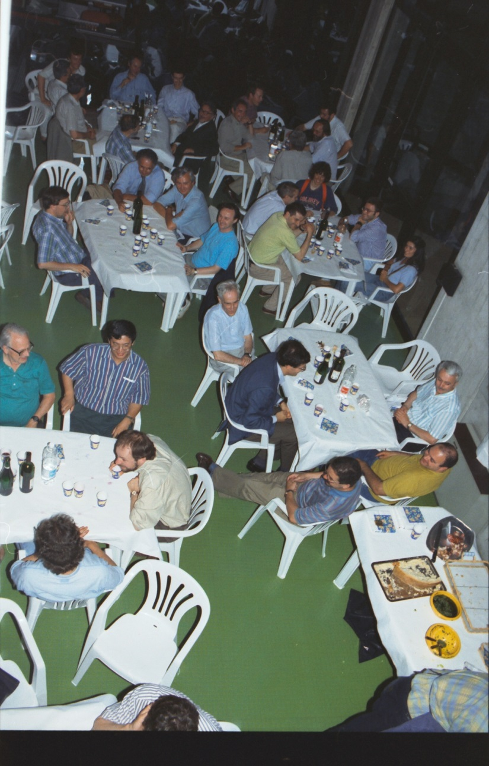
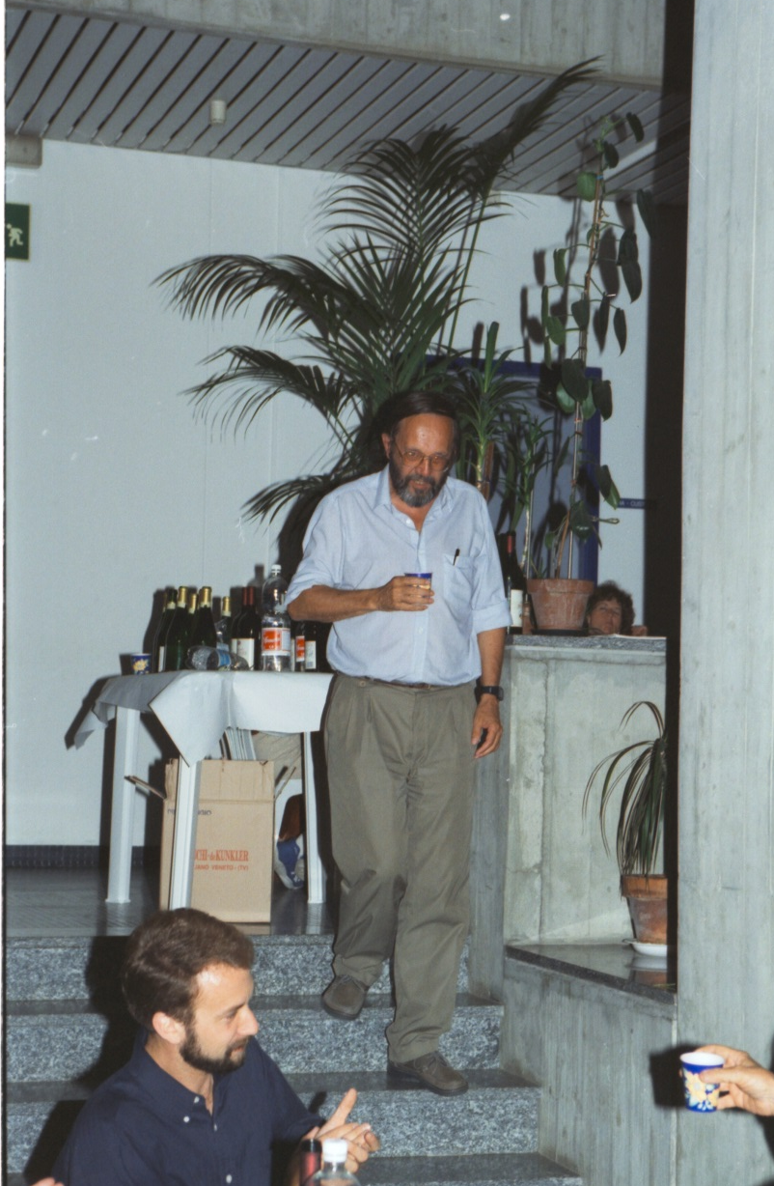
Memories: 1995 Milano TTF Meeting

Slide 4
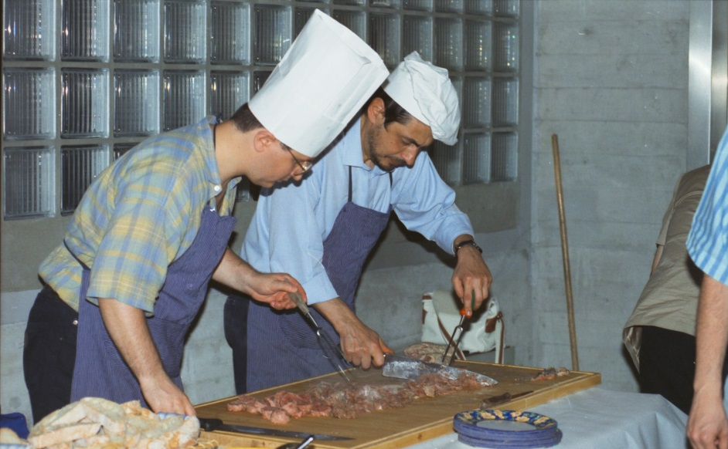
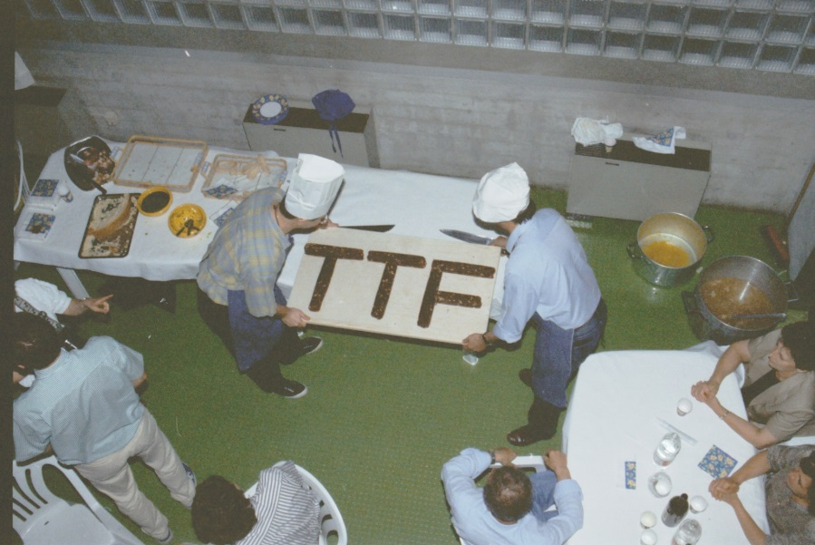
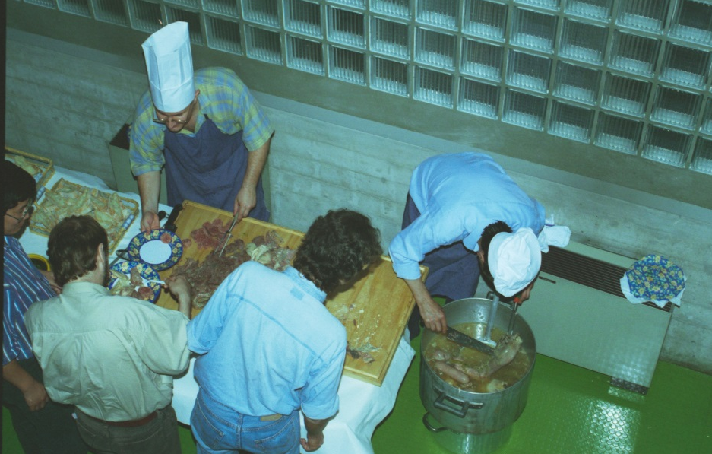
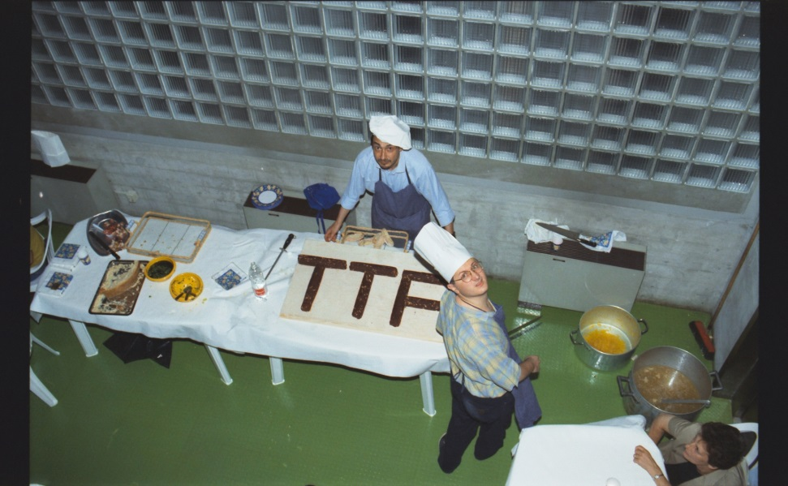
Memories: 1995 Milano TTF Meeting

Slide 5
Many Thanks to:
Local organizing commitee:
Rocco Paparella, Daniele Sertore, Paolo Michelato, Laura Monaco, Angelo Bosotti, Michele Bertucci, Andrea Bignami, ecc.
Local INFN and University Technical team:
Augusto Bassi, Massimo Fusetti, Ambra Gianola,
Giorgio Fornasier, Marco Chiodini, Luca Sagliano, ecc.
INFN Milano: Chiara Meroni (director), Angela Campanale
Dep. of Physics: Giovanni Onida (director), Gianluca Colò

