Slide 1
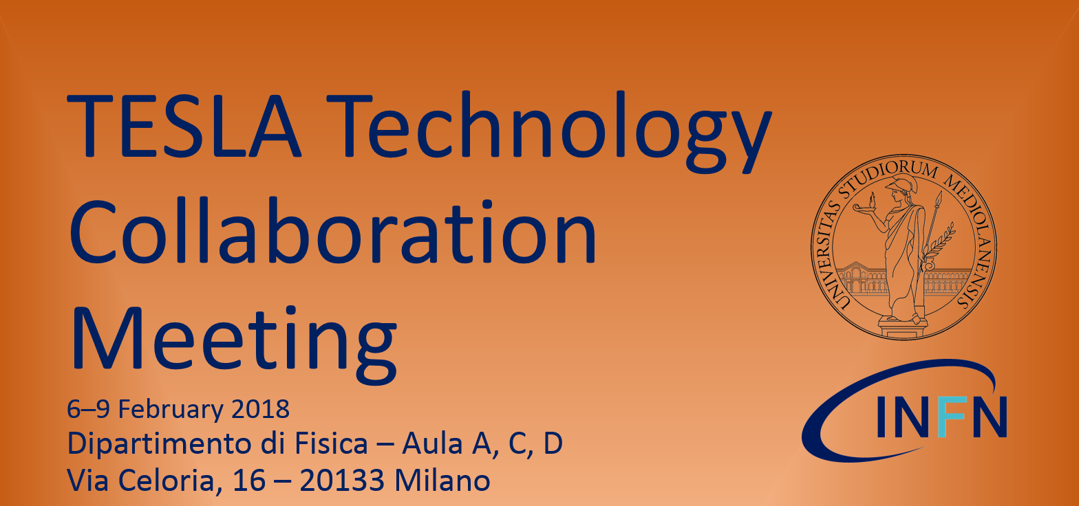
Welcome and Logistics
Carlo Pagani

Slide 2


Two Hosting Institutions
Welcome to Milano!

Slide 3
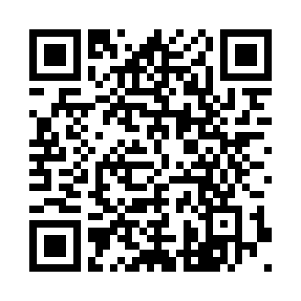
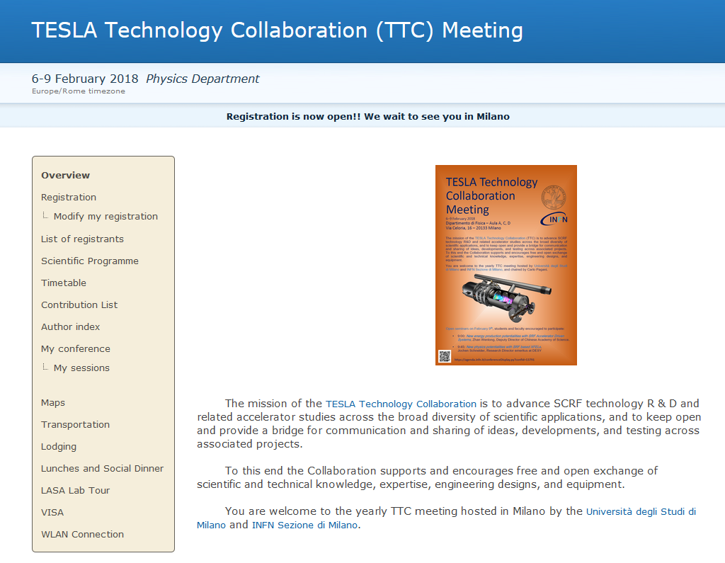
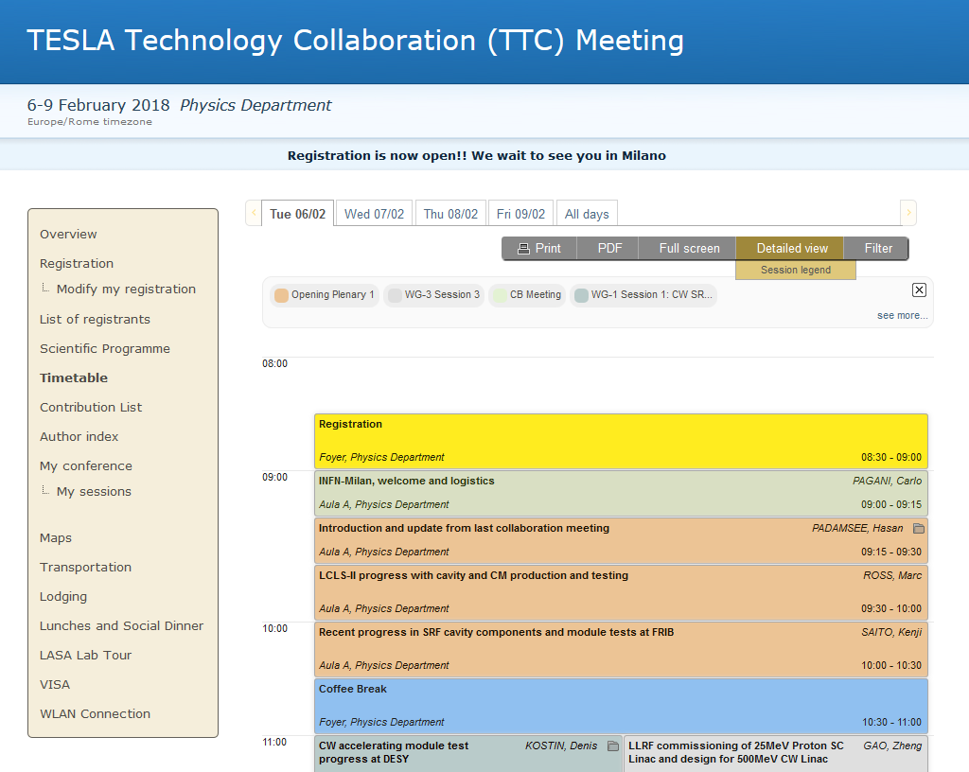
Schedule
Remember to check regularly the meeting website for updates and timetable
A copy of each day’s schedule will be put on display at rooms doors and in the foyer
https://agenda.infn.it/event/TTC2018

Slide 4
Venue
Welcome at the “Aldo Pontremoli” Physics Department of the Università degli Studi.
The plenary sessions will be host in the main Auditorium ("Aula A")
Parallel sessions will also make use of "Aula C“,
"Aula D“ and “Sala Consiglio”.
A room for additional side meetings might be available, just ask.
Rooms are all in close proximity to each other and their entrance is located at the foyer level.
Restrooms are located at this level, on both sides of Aula A

Slide 5
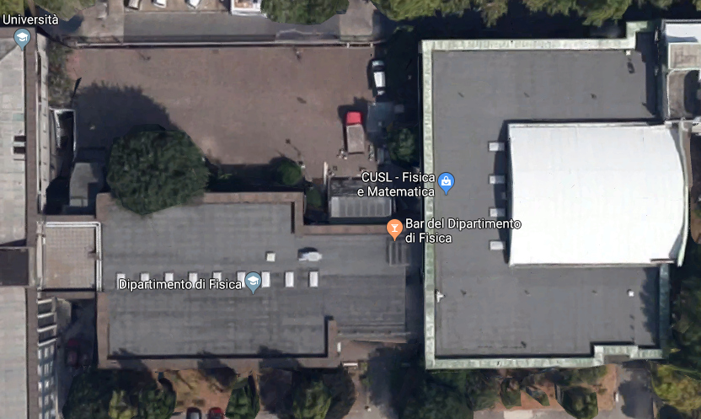
WC
Aula A
Aula C
Foyer
Sala
Consiglio
Aula D
WC

Slide 6
Coffee-breaks and lunches
From Tuesday to Thursday:
  coffee-breaks will be served at 10:30 and 15:30 in the foyer
  A University canteen is located at walking distance
  Some food-shops, restaurant or pizzerias are also available close-by.
  See map …
On Friday:
  No coffee-break at 10:30, just a break.
  A light buffet lunch is served from 12:45 in the foyer

Slide 7
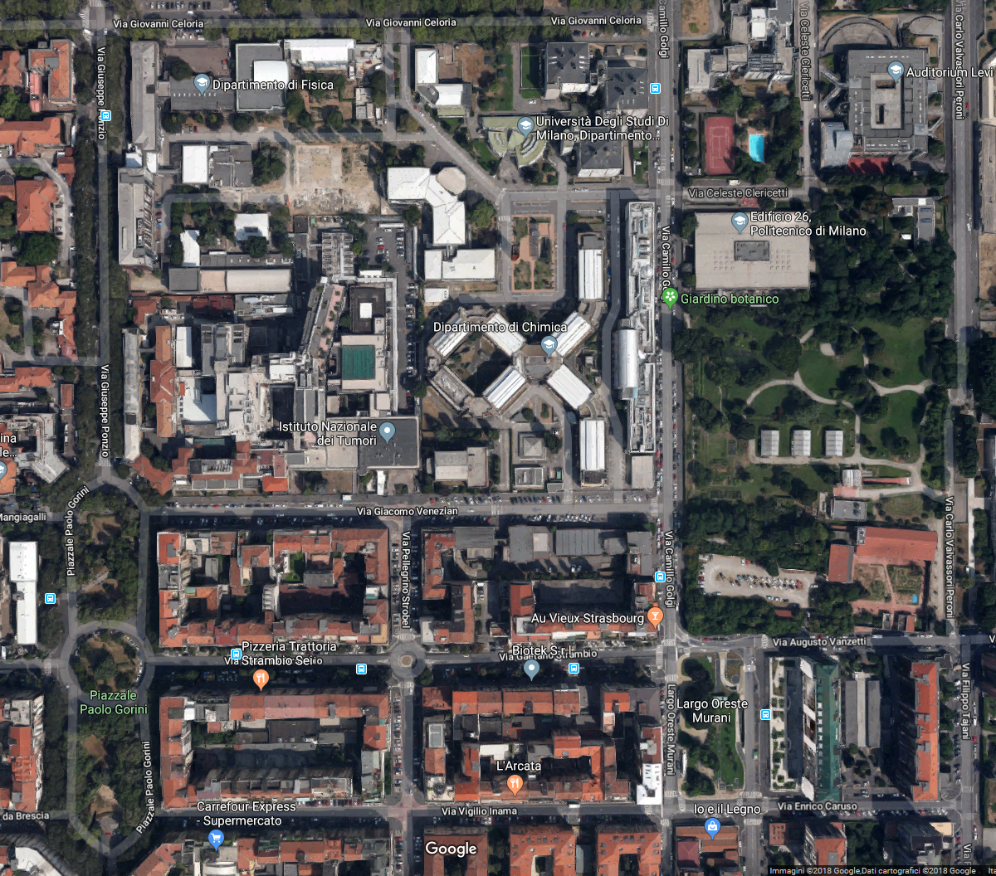
Bar
Canteen
Bar
Pizzerias etc.

Slide 8
Group photo
Please be ready for our TTC 2018 group photo that is going to be shot Thursday 8th at 10:30!
  Possibly in the courtyard right outside the building, we’ll see weather conditions…

Slide 9
Social dinner
The social dinner will be offered on Thursday 8th , more info in your folder.
Don’t forget the dinner ticket!

Slide 10
Two Streamed Seminars
Open seminars on February 9th, students and faculty encouraged to participate:
9:00: New energy production potentialities with SRF Accelerator Driven Systems, Zhan Wenlong, Deputy Director of Chinese Academy of Science.
9:45: New physics potentialities with SRF based XFELs,
Jochen Schneider, Research Director emeritus at DESY
The overall schedule for Friday morning has changed last week!

Slide 11
LASA tour on Friday afternoon
  Shuttles will depart and return to the Meeting Venue
  We presently foresee at least two groups departing at:
    14:00
    15:30
  A sign-in list will be available from Wednesday at Registration Desk

Slide 12
Just ask!
  A Registration Desk will be available most of the time in the foyer for assistance
  In case of any question you might have just feel free to ask to anyone of us!
Carlo Pagani | Paolo Michelato
Michele Bertucci | Laura Monaco
Andrea Bignami | Rocco Paparella
Angelo Bosotti | Daniele Sertore
Ambra Gianola | Augusto Bassi

