Slide 1
Coupler Operation Experience at IMP
Tiancai Jiang, Ruoxu Wang, Shenghu Zhang
SRF Group
On behalf of ADS Linac Team
Institute of Modern Physics, CAS

Slide 2
Outline
Introduction
Impact of Field Emission on coupler ceramic
Temperature-rise of the Cold Window
Summary

Slide 3
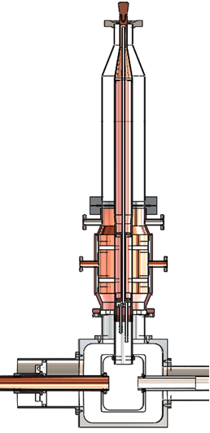
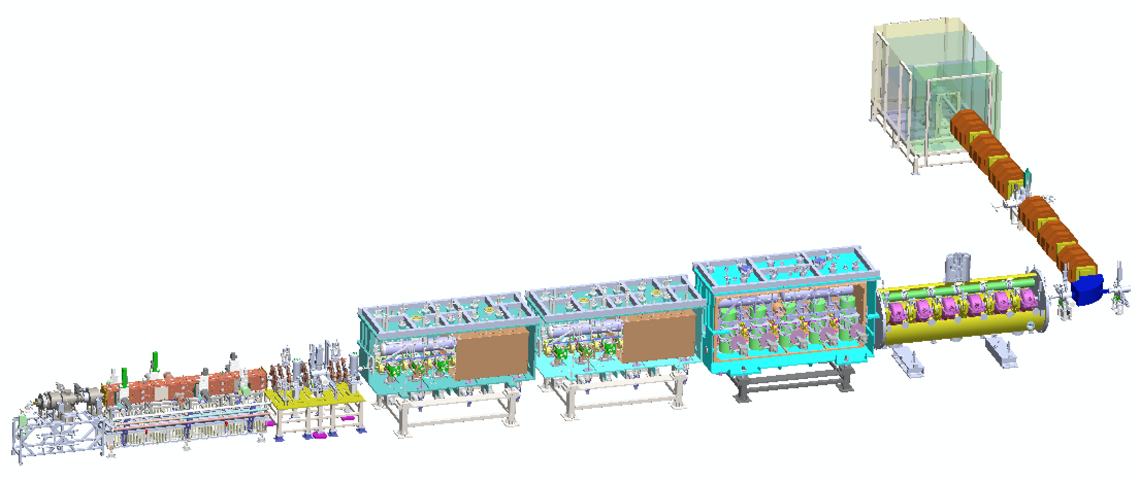
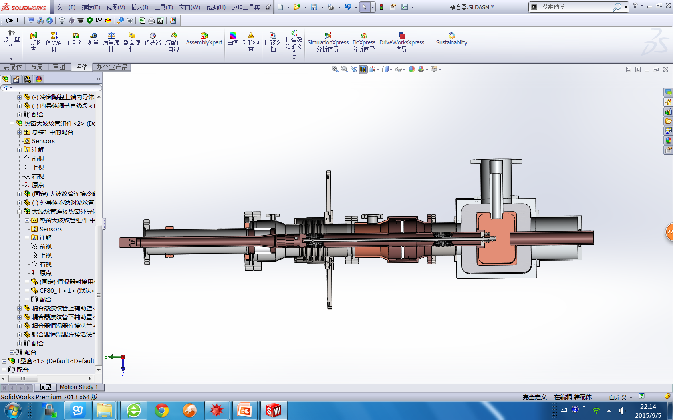
The demo 25 MeV SRF linac
TTF III-like
IMP
Double Warm Ceramics
HEBT
162.5 MHz HWR015
162.5 MHz HWR010
RFQ
MEBT
ECRIS
IHEP
12 Double Warm Ceramic Couplers - IMP
5 TTF III-like Couplers - IMP
6 Single Choke Couplers - IHEP

Slide 4
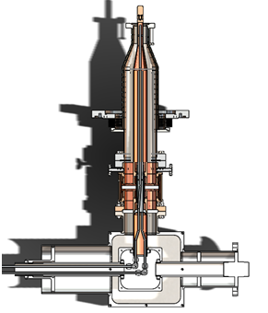
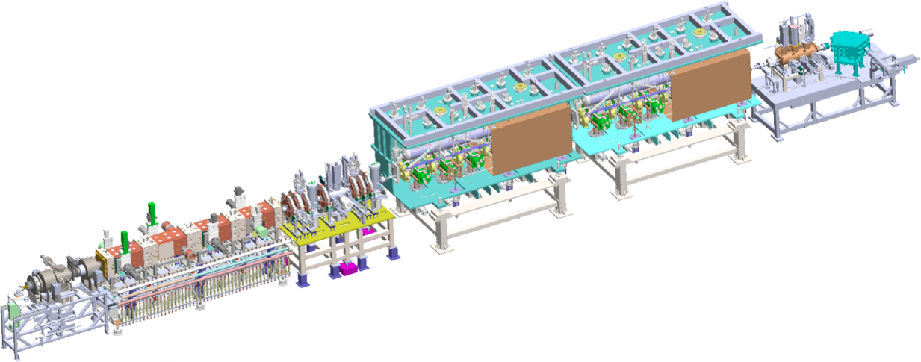
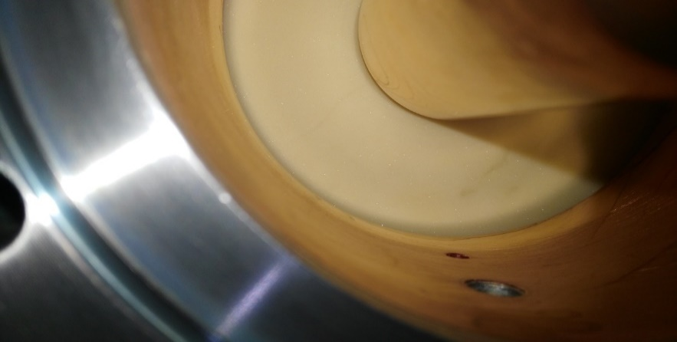
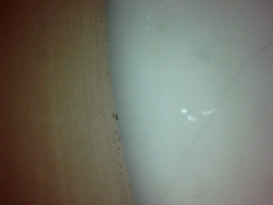
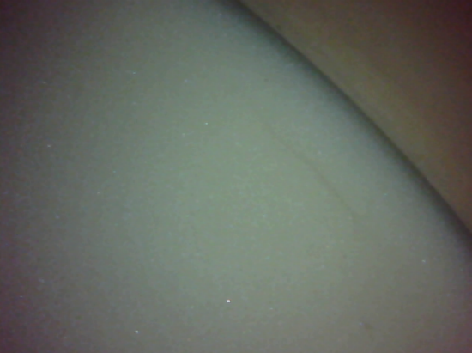
10 MeV coupler operation
Outer conductor: helium cooling, thermal sink. Inner conductor: water cooling
12 single window couplers
(a)Single chock window (b) Fixed Q_{e} (c)No bias
10 MeV operation for 2 months, ceramic windows of 2 couplers were leaking each CM.
Cracks of ceramic window

Slide 5
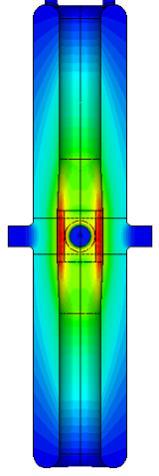
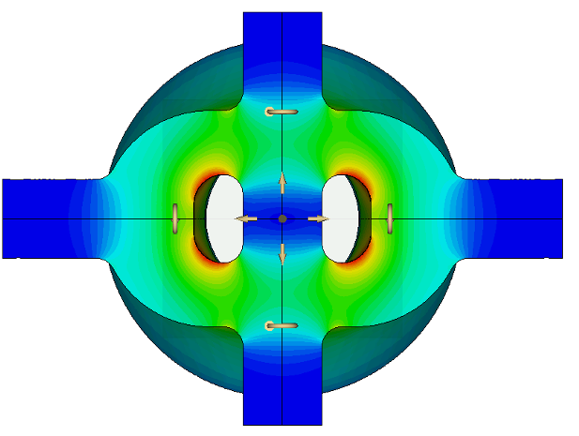
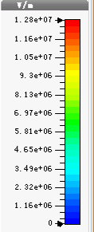
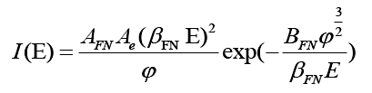
HWR010 field emission

Slide 6
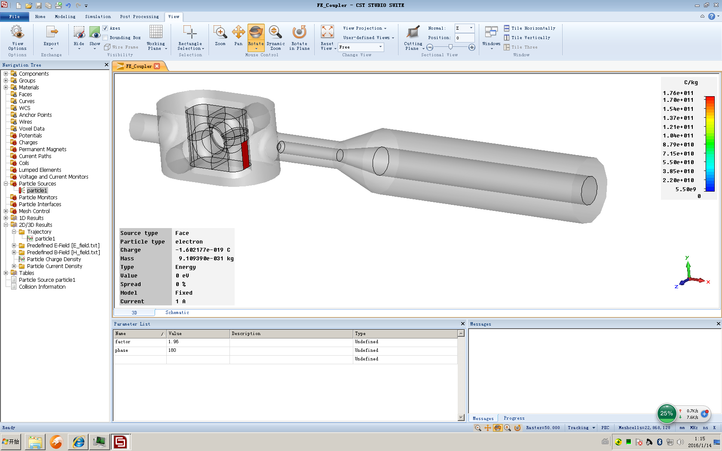
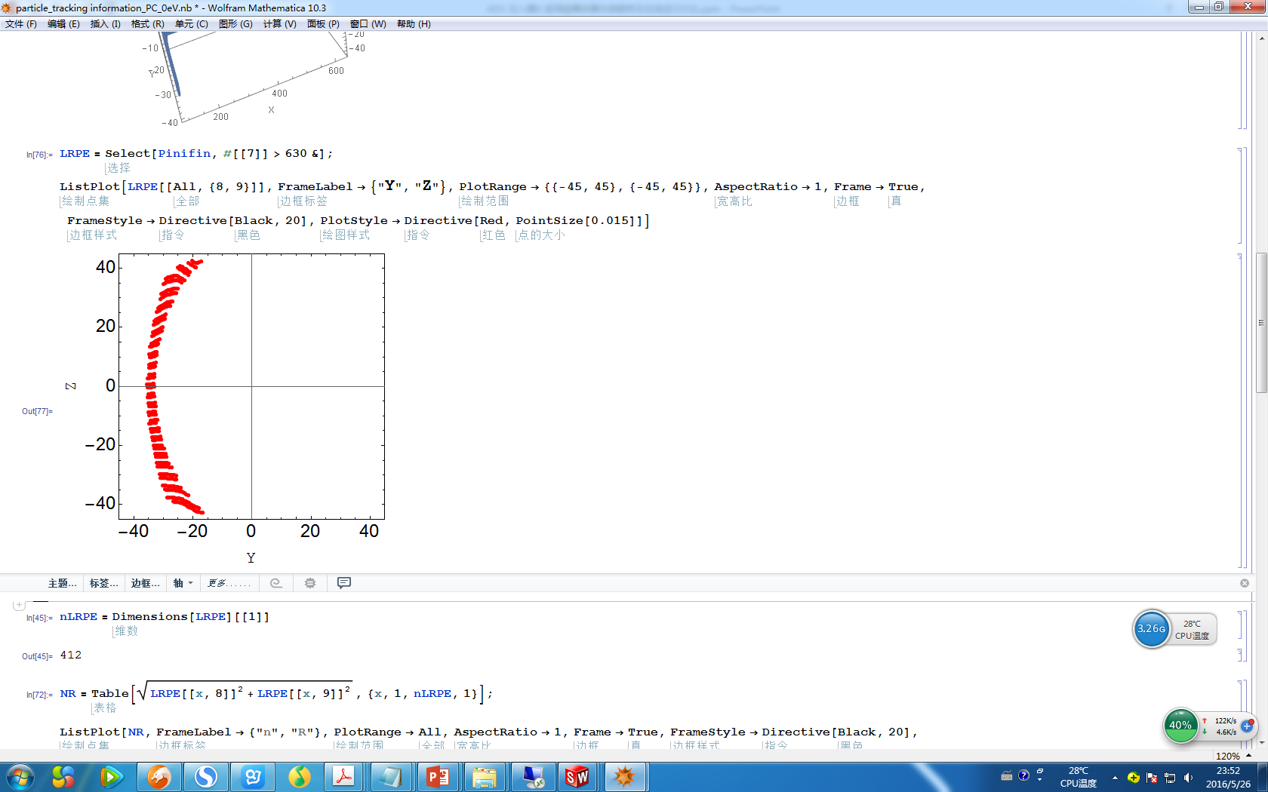
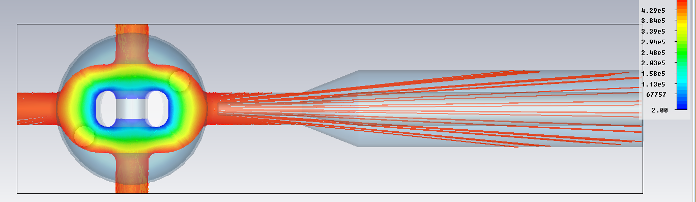
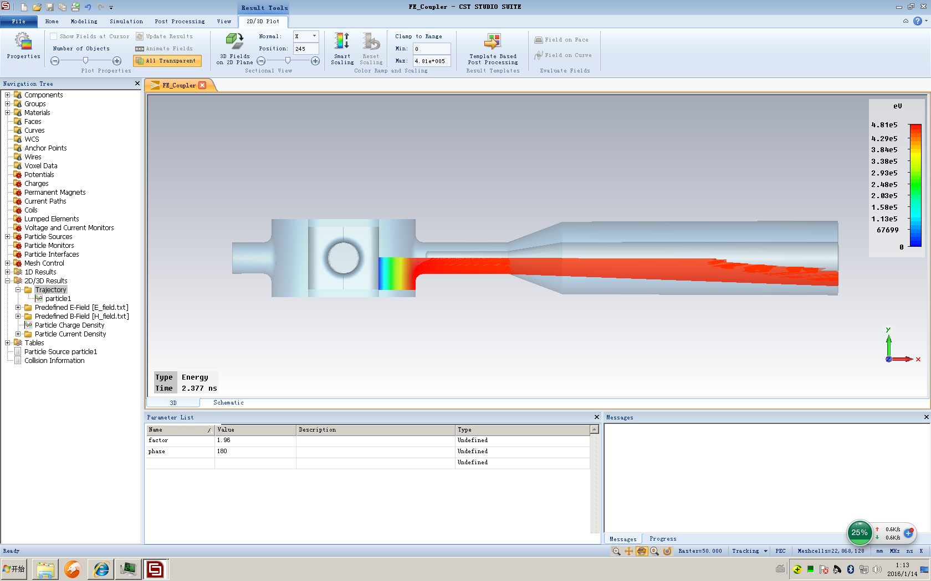
Field emission on coupler
emitters
EP 25MV/m (Cavity), local EP 15MV/m
FE hitting on Window
Trajectory of FE
window
EP 25MV/m, Energy of FE ~400KeV

Slide 7
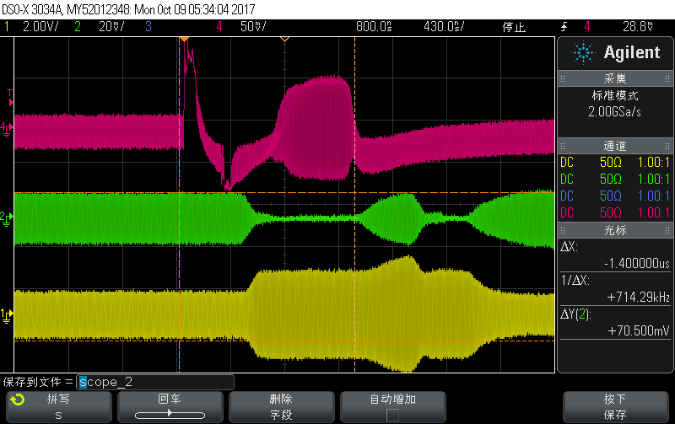
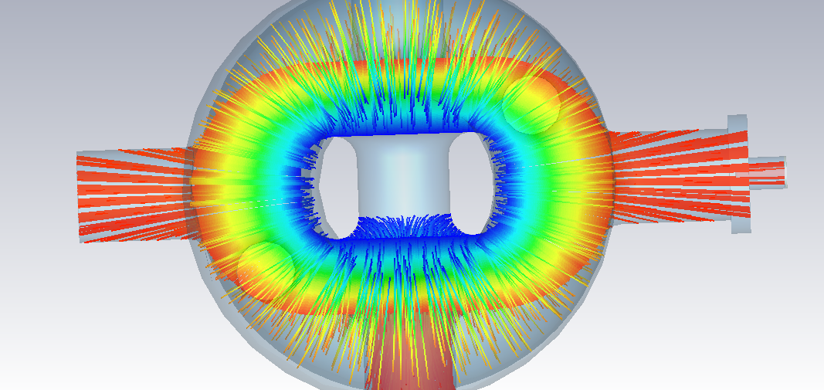
Field emssion on pick-up port
Coupler Port
Pick up from
cavity
Forward
RF signal
Reflected
RF signal
Pick-up Port
*More details will be present in the talk “Troubleshooting and stability analysis of CW RF operation at China ADS front-end demo linac”.

Slide 8
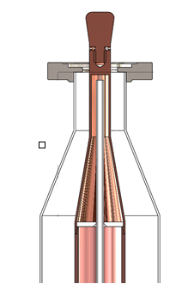
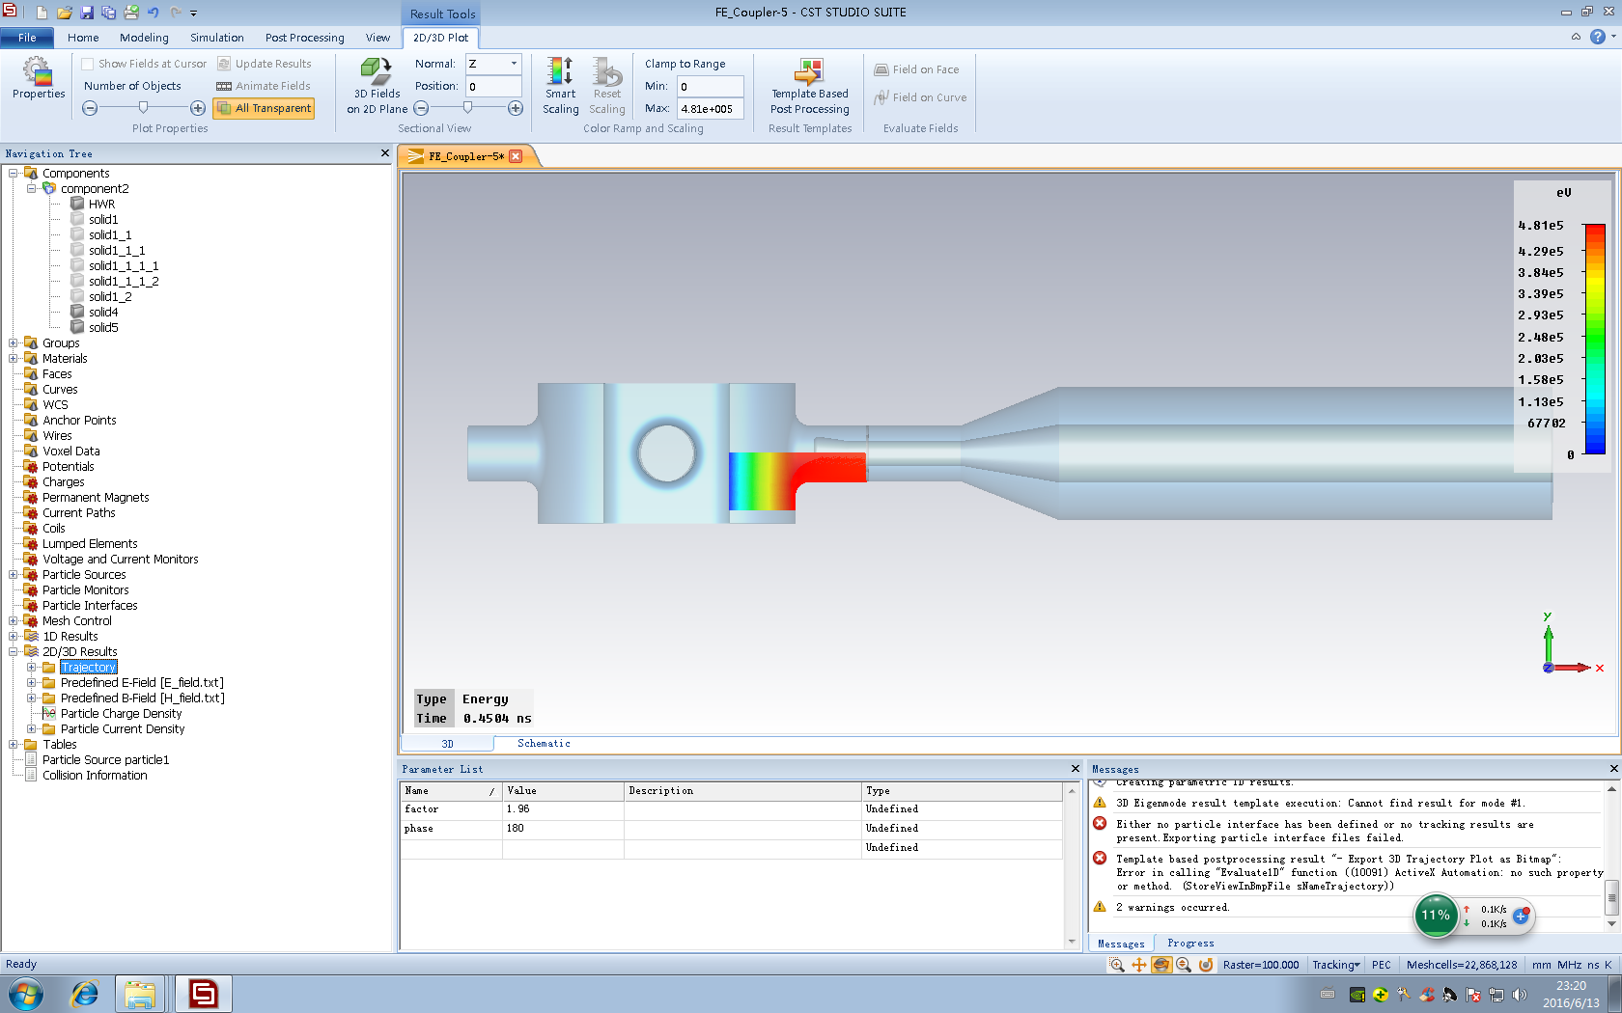
Solutions
windows
FE simulation
Difficult to braze
Not easy for the clean of the space between the dual windows

Slide 9
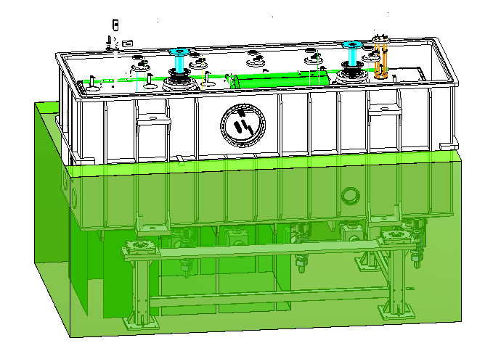
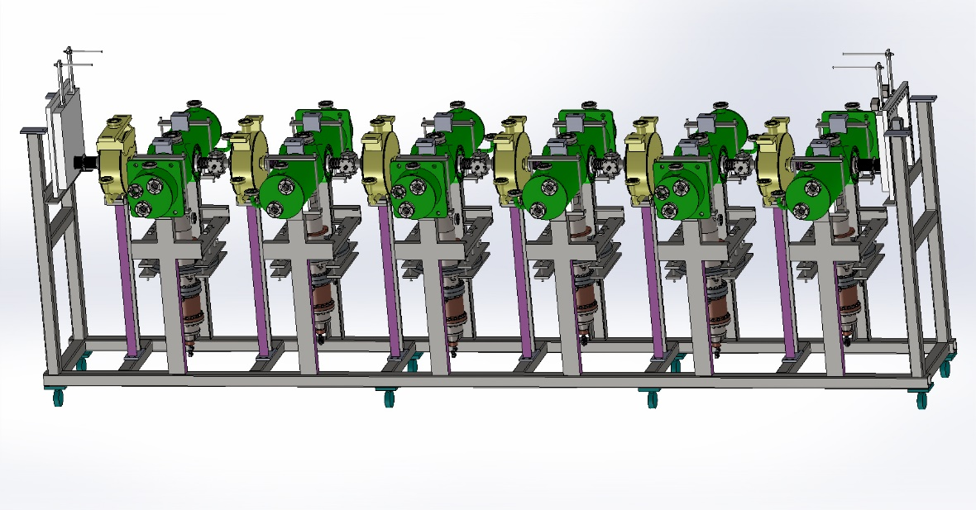
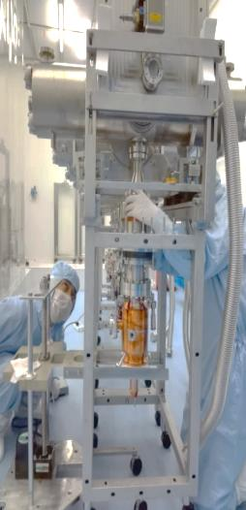
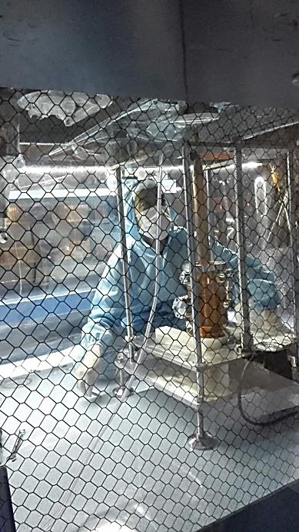
HWR010 coupler replacement
Replacing coupler in line
Replacing coupler in clean room
New couplers has worked for more than 1 year, no leak was found, and the new couplers work very well.

Slide 10
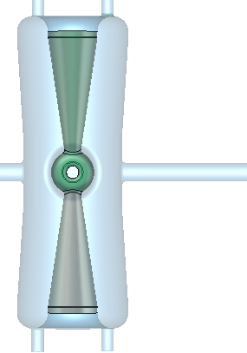
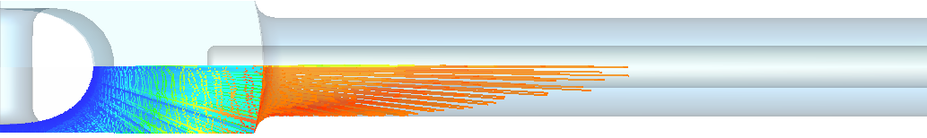
Taper HWR015 feild emission
FE electrons cannot reach the window due to donut ring shape
Couplers has worked for about 1 year, no leak was found.
Donut Ring
80 K (Temperature Sensor)
4.2K
Warm window
Cold window

Slide 11
Temperature-rise of the cold window

Slide 12
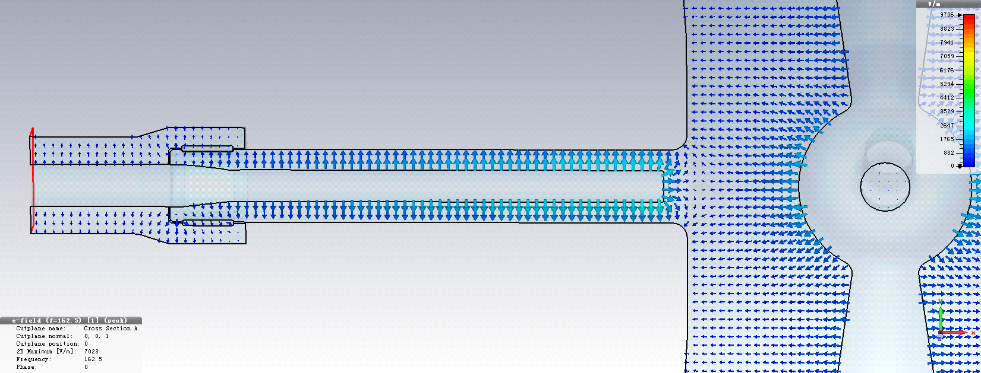
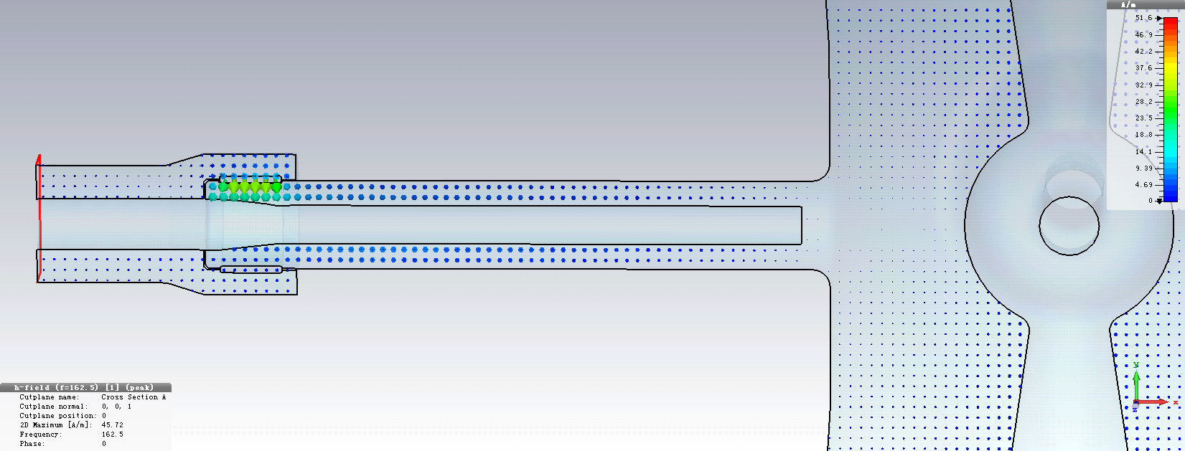
Resonance & off-resonance
Resonance
Resonance (Short)
Off-Resonance (Open)
After repairing the solenoid, RF conditioning the coupler was carried out at room temperature without opening valves of CM.
H
0
L
Temperature-rise of cold window caused by copper sputtering during RF conditioning.

Slide 13
Summary
The ceramic windows can be charged by FE electrons from cavity, which may cause the ceramic windows to be broken.
The temperature-rise of cold window supposed to be caused by copper plating on the surface of ceramic.

Slide 14
Thanks for your attention

