Slide 1


SMI – STEFAN MEYER INSTITUTE FOR SUBATOMIC PHYSICS
Overview of kaonic atom research plans
at J-PARC
Johann Zmeskal
SMI, Vienna, Austria
Strange and non-strange mesons induced processes studies at DAFNE, J-PARC and RIKEN:
present and future
LNF-INFN, Frascati
July 10-11, 2017
WWW.OEAW.AC.AT/SMI

Slide 2
SMI – STEFAN MEYER INSTITUTE FOR SUBATOMIC PHYSICS
Outline
WWW.OEAW.AC.AT/SMI

Slide 3
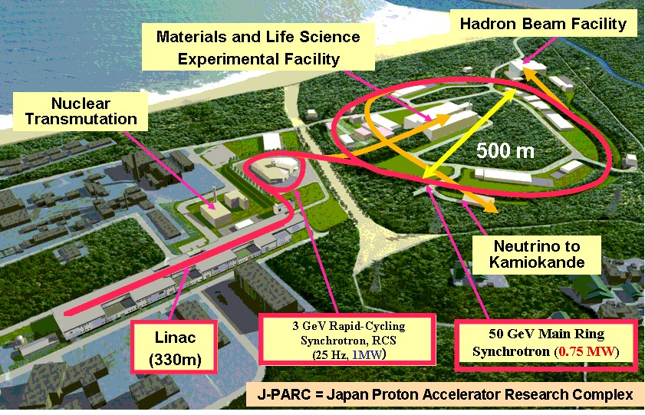
Kaonic Atom Research @ J-PARC

Slide 4
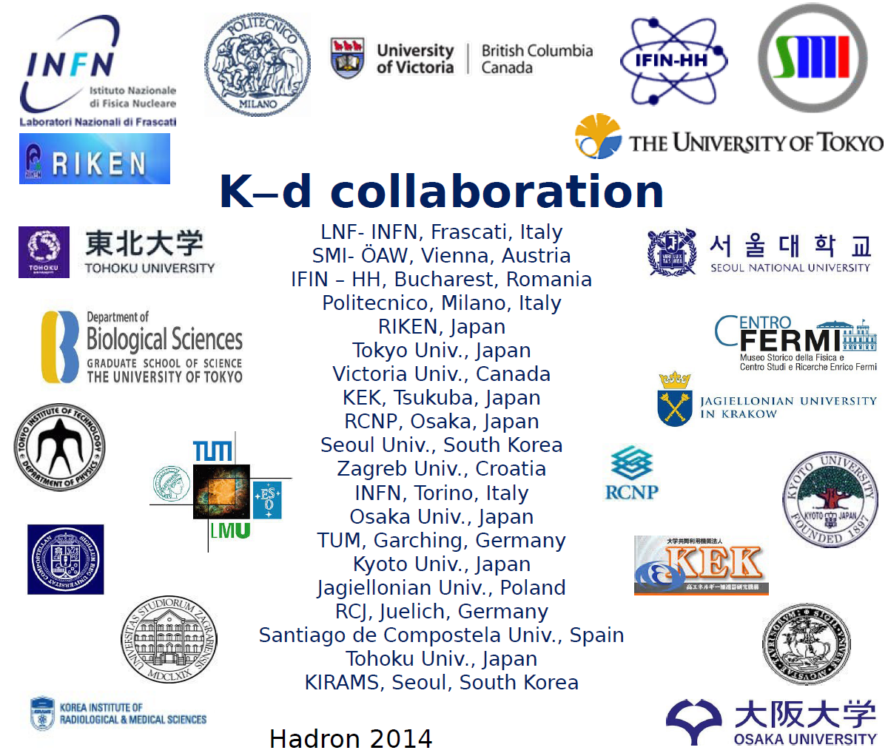
K-d at J-PARC
20 Institutes / 10 Countries

Slide 5
E57 kaonic deuterium
physics goal

Slide 6
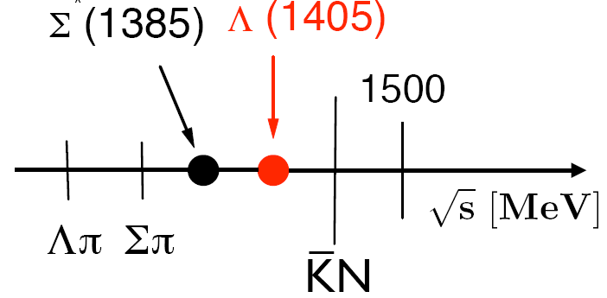
Low-energy KN interaction
Chiral perturbation theory was developed
for πp, ππ is not applicable for KN systems
non-perturbative
coupled channels
approach based on
chiral SU(3) dynamics
Notes:
appropriate framework to analyse the anti-kaon-nucleon system at low energy
In light exotic hadronic atoms the Bohr radius is still much larger than the typical range of strong interaction formulated in QCD, and the average momentum of the bound hadron is very small. Chiral perturbation theory (ChPT) [20–22], with symmetries and symmetry breaking patterns of QCD included, is an appropriate framework to analyse the dynamics of hadrons at low energy and to describe the observable effects in the spectrum of exotic hadronic atoms.
There are non-perturbative coupled-channel techniques based on the driving terms of the chiral effective Lagrangian which generate the Λ(1405) dynamically as a Kbar-N quasi-bound state and as a resonance in the pi-Sigma channel. They have proved useful and successful.
High precision K- p threshold data set important constraints for such theoretical approaches.

Slide 7
Improved constraints on chiral SU(3) dynamics from kaonic hydrogen
Y. Ikeda, T. Hyodo and W. Weise, PLB 706 (2011) 63
Real part (left) and imaginary part (right) of the K⁻p → K ⁻ p forward scattering amplitude extrapolated to the subthreshold region, deduced from the SIDDHARTA kaonic hydrogen measurement.

Slide 8
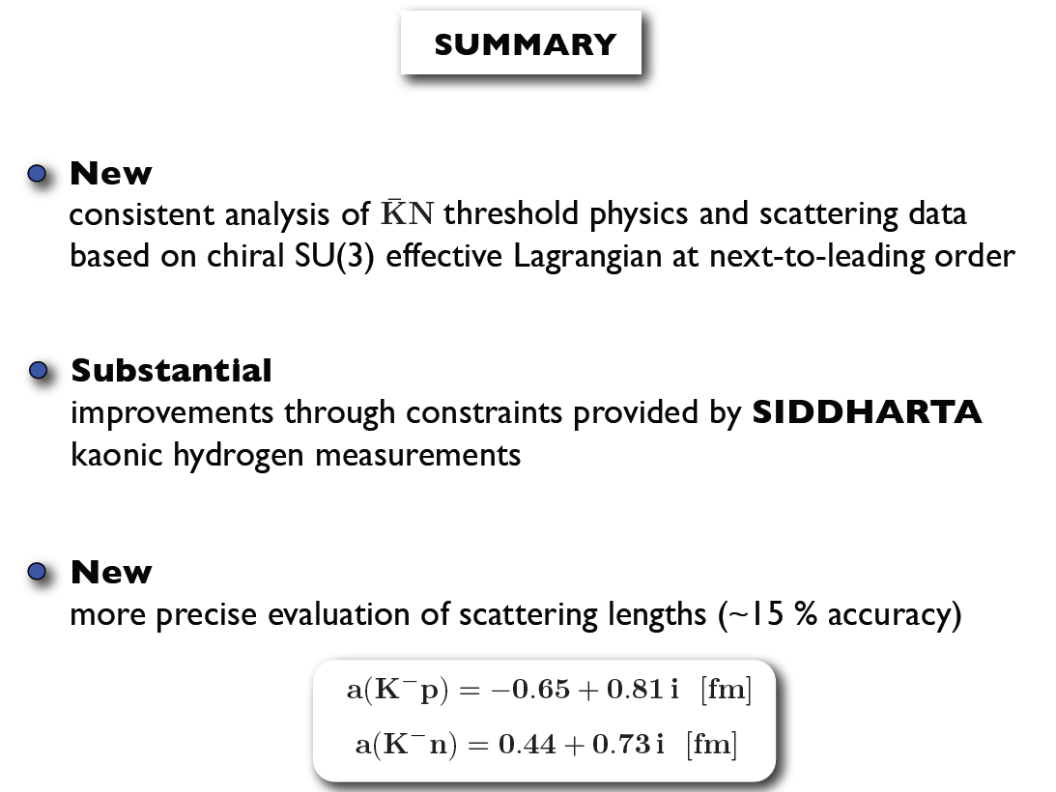
W.Weise, LEANNIS meeting July 2011

Slide 9
Chiral SU(3) coupled channels dynamics
W.Weise
Needed: accurate constrains from antikaon-deuteron threshold measurement

Slide 10
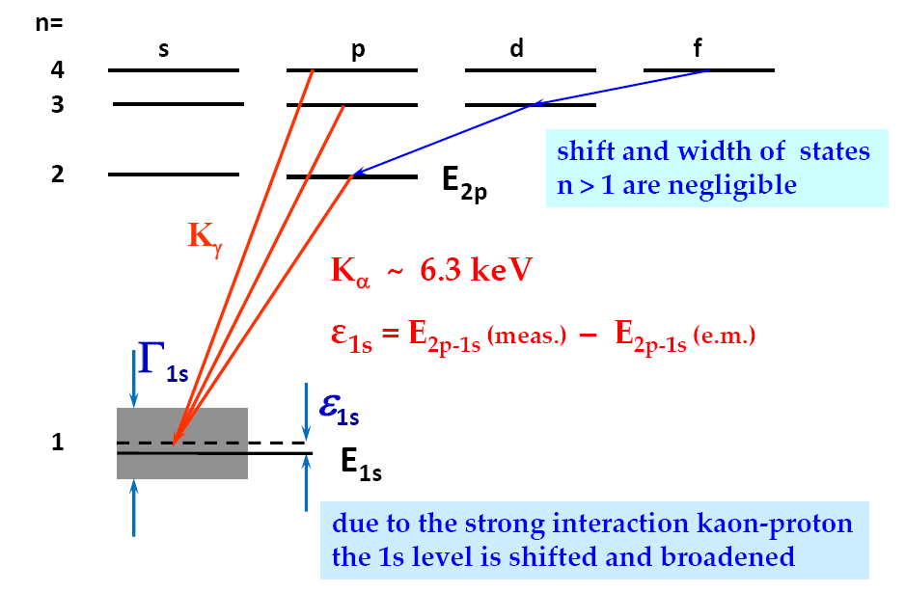
X-ray transitions to the 1s state
n=1
p
e⁻
K⁻
n~25
n=1
n=2
X-ray

Slide 11
SCATTERING LENGTHS
Deser-type relation connects shift ε_{1s} and width Γ_{1s} to the
real and imaginary part of ɑ _{K-p}
(µ_{C} reduced mass of the K⁻p system, α fine-structure constant)
U.-G. Meißner, U.Raha, A.Rusetsky, Eur. phys. J. C35 (2004) 349
next-to-leading order, including isospin breaking

Slide 12
E57 kaonic deuterium
cryogenic X-ray detector

Slide 13
Development of new SDDs
SIDDHARTA
JFET integrated on SDD
lowest total anode capacitance
limited JFET performance
sophisticated SDD+JFET technology
K⁻d @ J-PARC / DAΦNE
radiation entrance window
external CUBE preamplifier (MOSFET)
larger total anode capacitance
better FET performances
standard SDD technology
SDD
cooler
CUBE

Slide 14
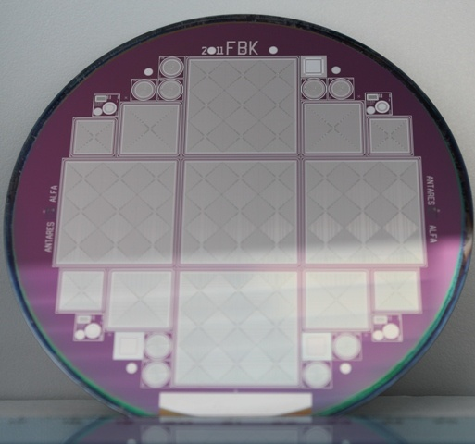
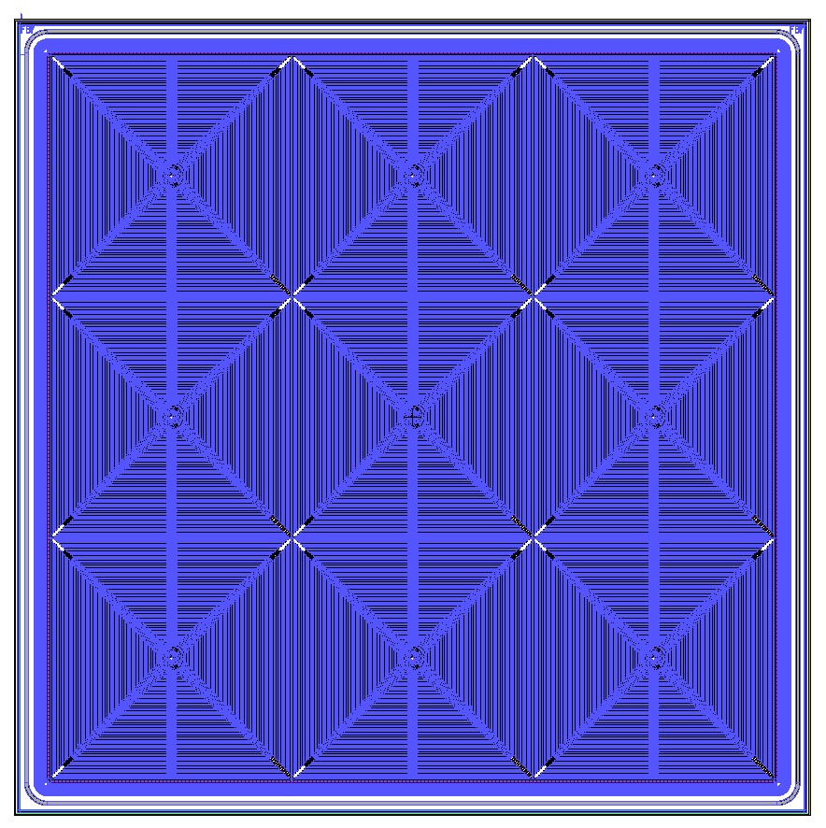
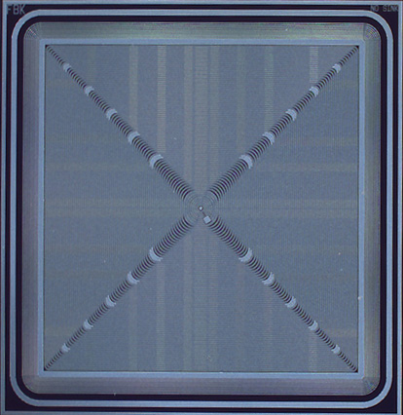
New SDDs - present layouts
developed by Politech Milano and FBK-Trento, Italy
Array: 9 SDDs (8 x 8 mm² each)
8 x 8 mm² single SDD
26mm
12 x 12 mm
single SDD
FBK production:
4’’ wafer
6’’ wafer upgrade just finished

Slide 15
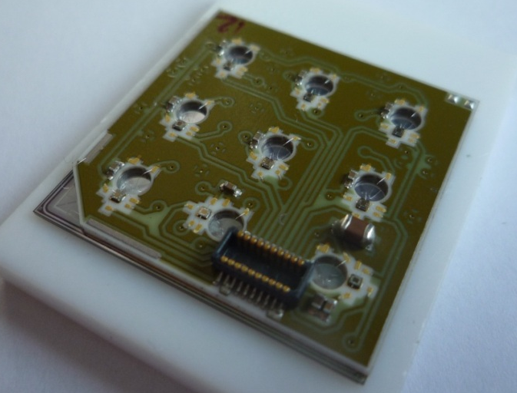
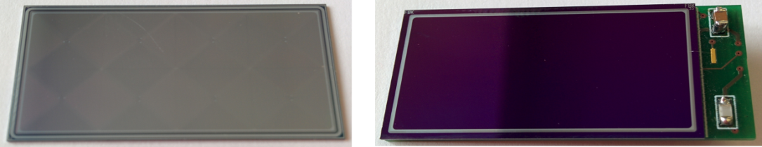
4x2 and 3x3 SDD arrays
SDD-chip back side with bonding pads
SDD-chip glued to ceramic board, bonded to CUBE preamplifier
9 holes for bondings
CUBE
preamplifier
connector

Slide 16
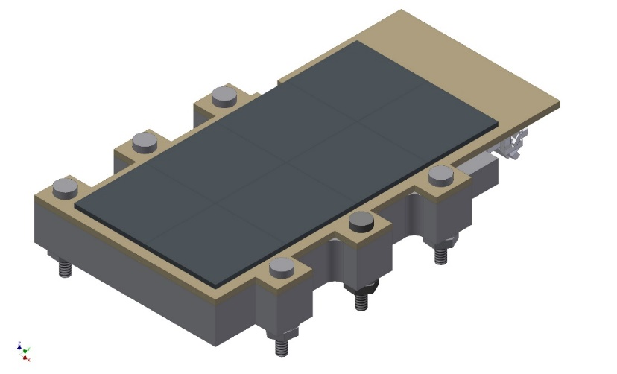
4x2 SDD array:
55 pieces of 4x2 SDD-chips
+ ceramic boards
available
Shipping package
4x2 SDD array
single unit

Slide 17
SDD mounting / bonding
ceramic boards
4x2 SDD chip
device for gluing and bonding
mounting and bonding process under control

Slide 18
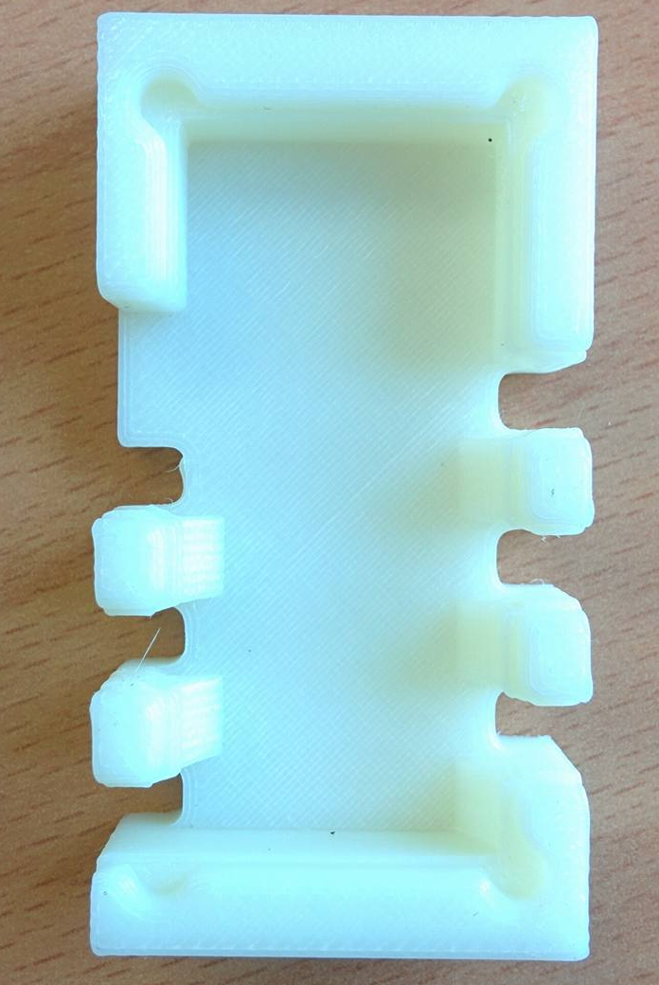
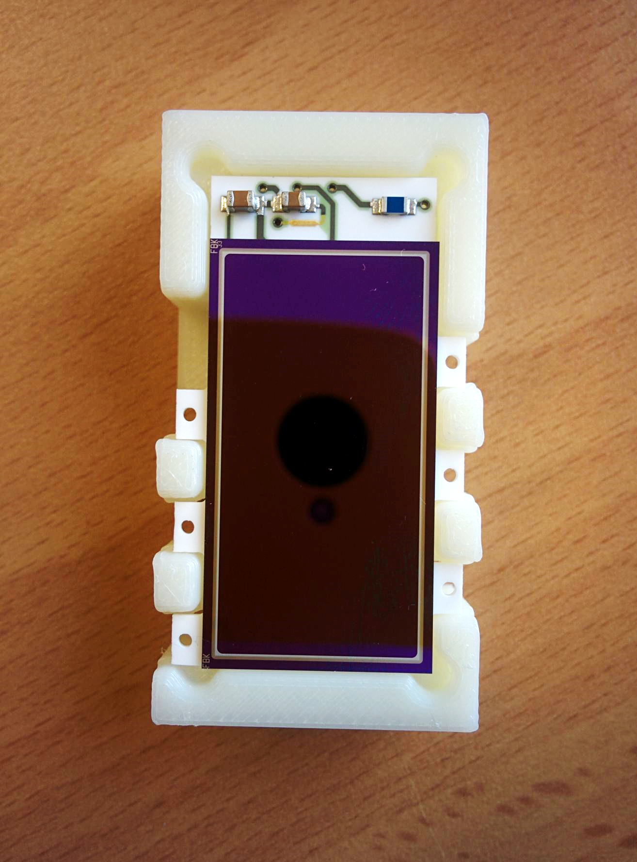
8
9
10
Back Bonding Block
SDD Back side view
Ceramic Back side view
BACK
BONDING
Perform back bonding.
Back Bonding Block
Take the Back bonding block.
Place the ceramic board with SDD Back side up on the Back bonding block.

Slide 19
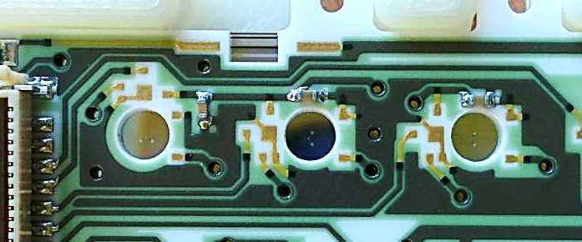
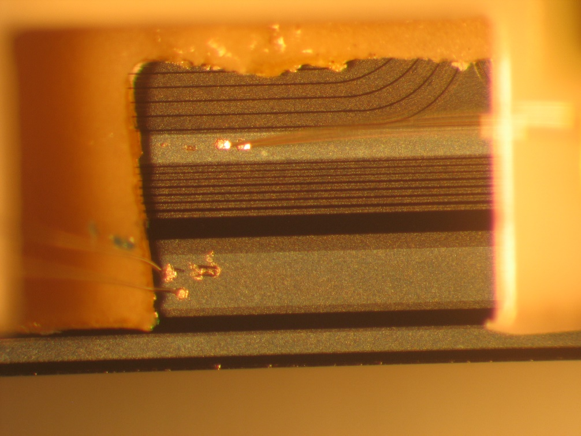
5
SUB
LAST RING
Ring N and Substrate bonding

Slide 20
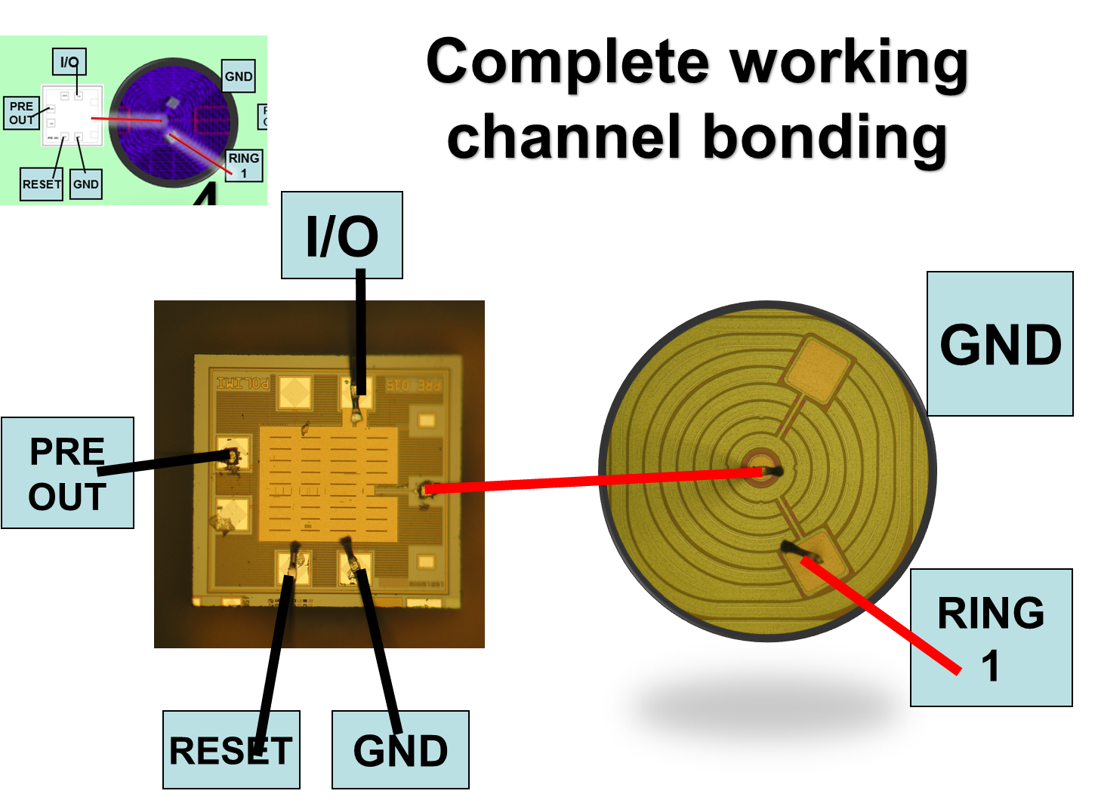
7
Arrows show directions to mount cubes

Slide 21
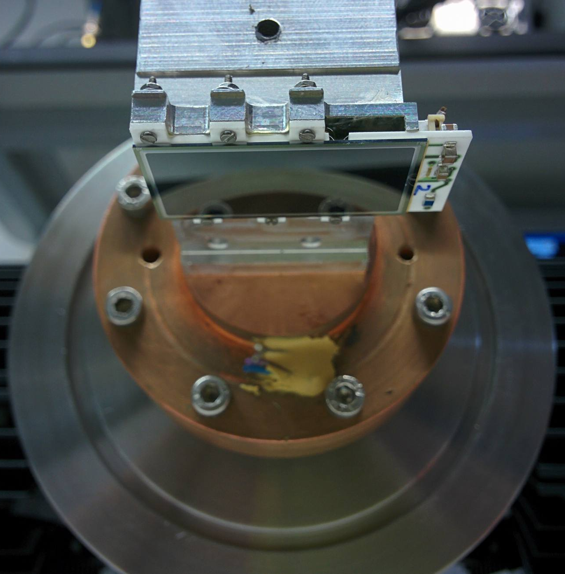
4x2 SDD array cooling test
3 cooling cycles
cryostat set to 65 K
ceramic temperature 73 K
no visual damage of SDD/ceramic

Slide 22
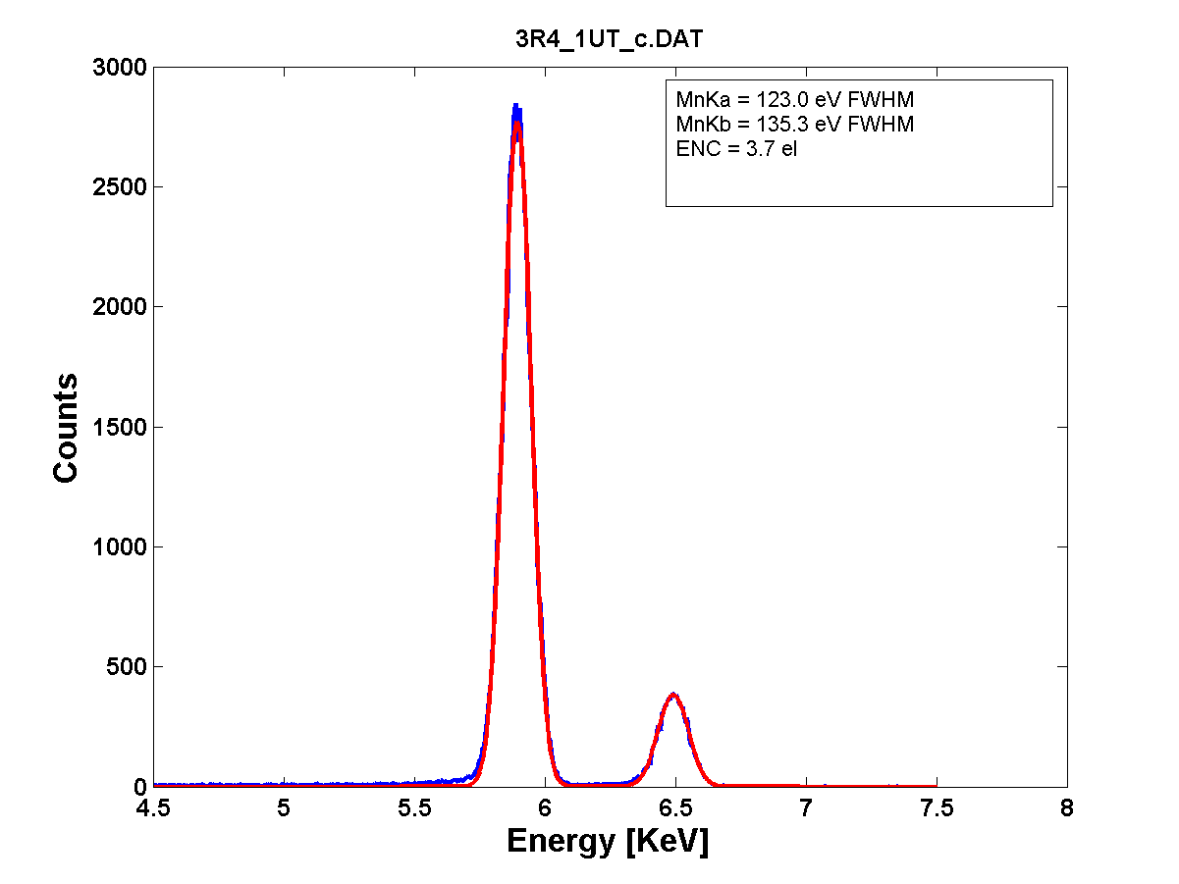
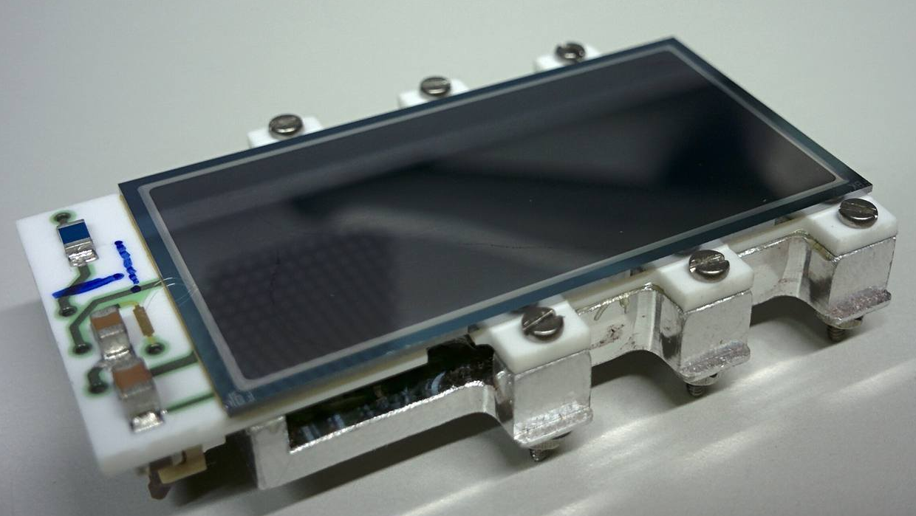
New SDD technology with CUBE preamplifier
SDD characteristics:
area/cell = 64 mm²
total area = 512 mm²
T = - 100°C
drift time < 500 ns
⁵⁵Fe spectrum
123.0 eV FWHM

Slide 23
E57 kaonic deuterium
setup at J-PARC K1.8BR

Slide 24
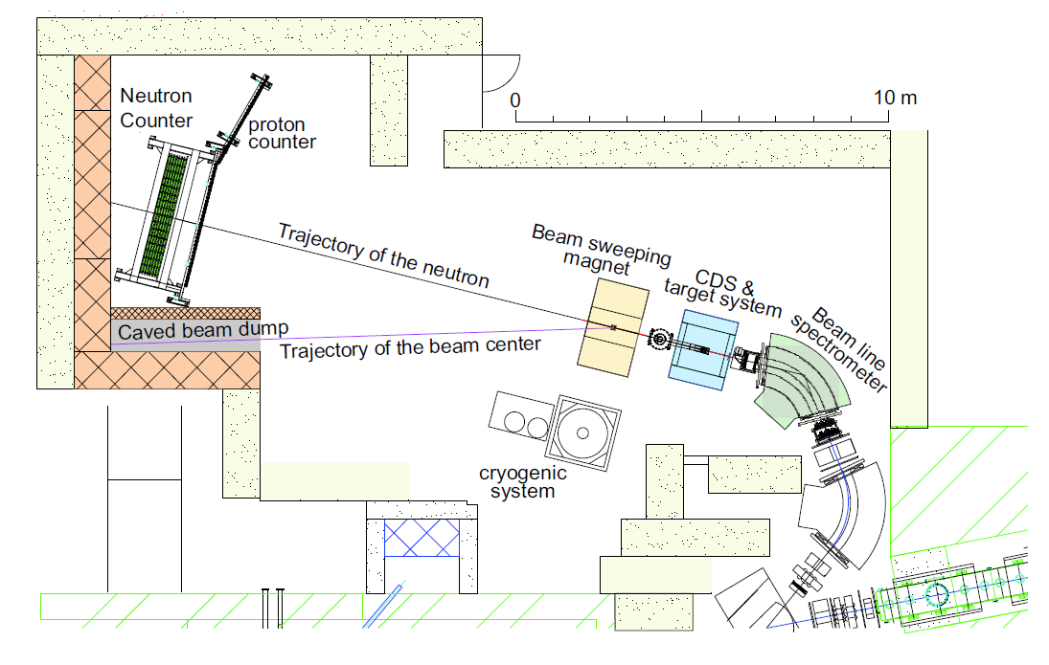
J-PARC K1.8BR spectrometer

Slide 25
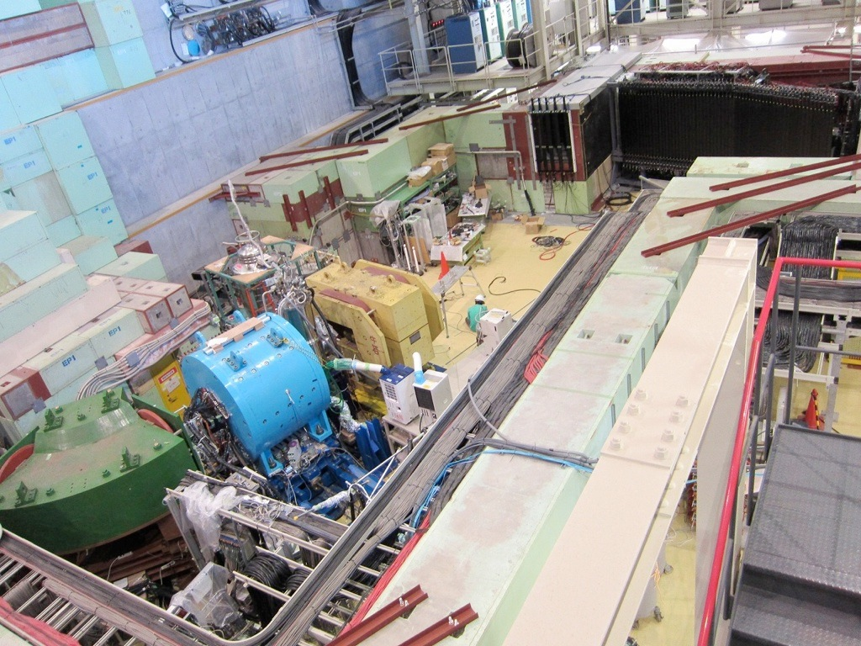
J-PARC K1.8BR spectrometer
K1.8BR experimental area
beam dump
γ, n
p
beam sweeping
magnet
15m
neutron counter
liquid ³He-target
system
CDS
K⁻
beam line
spectrometer

Slide 26
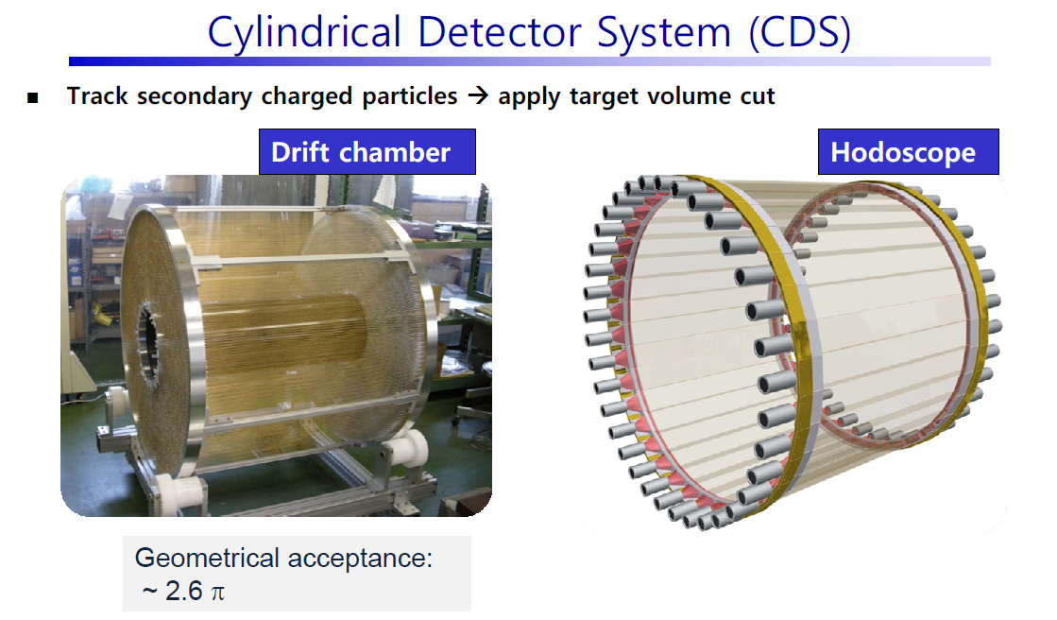

Slide 27
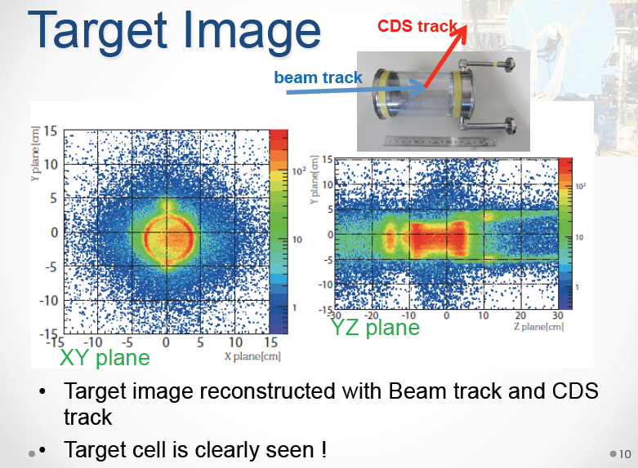

Slide 28
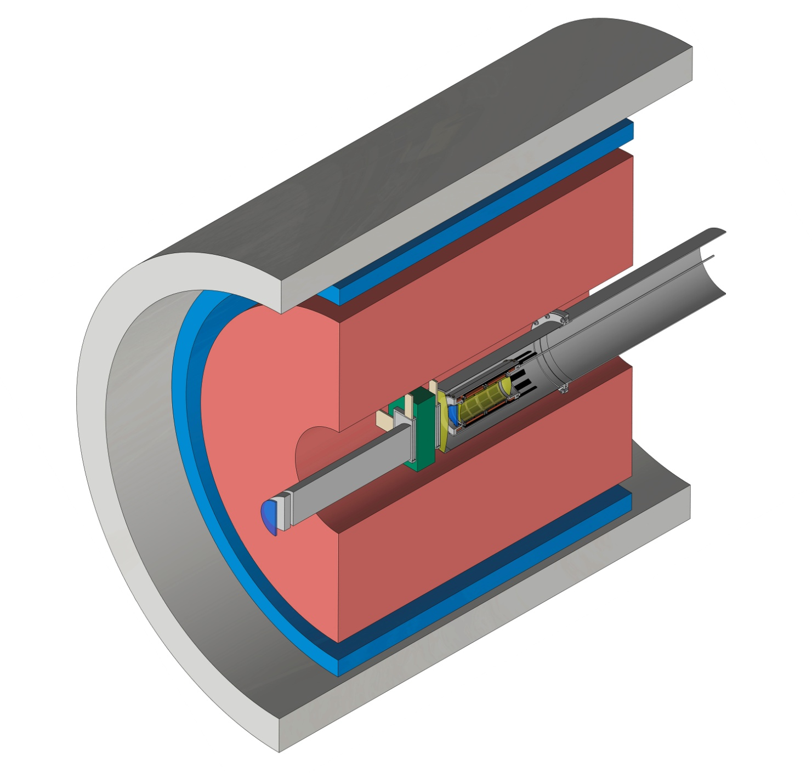
K⁻d setup within the K1.8BR spectrometer
Solenoid
CDH...cylindrical detector hodoscope
CDC...cylindrical drift chamber
T0.......beam line counter
T1.......beam line counter
BLC....beam line chamber
CDH
CDC
main degrader
SDD and
deuterium
target
T0
BLC
T1

Slide 29
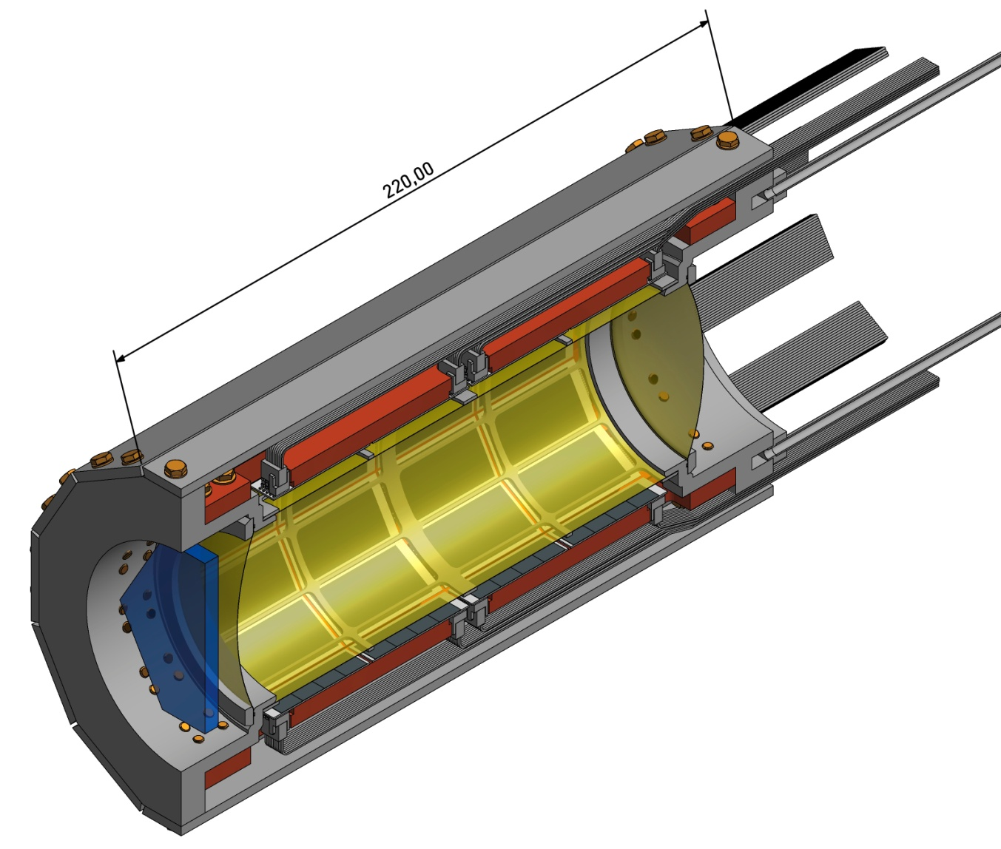
The cryogenic target and SDD design
target cell: l = 160 mm, d = 65 mm
target pressure max.: 0.35 MPa
target temperature: 23 – 30 K
SDD active area: 246 cm²
density: 4% LHD
at 29K/0.35 MPa
SDD cooling and support
12 x 4 SDD arrays
K⁻
Al reinforced side wall 75 µm Kapton
entrance window 75 µm Kapton
start counter T0

Slide 30
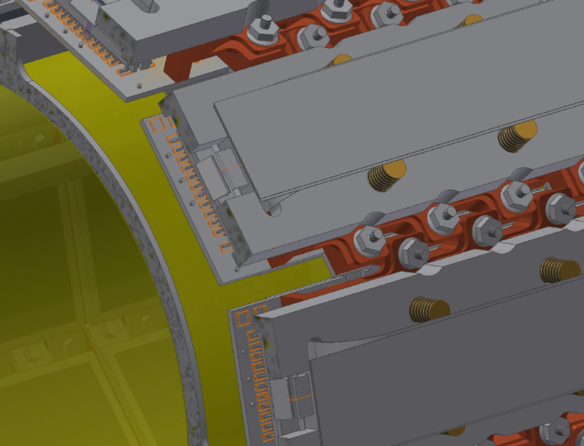
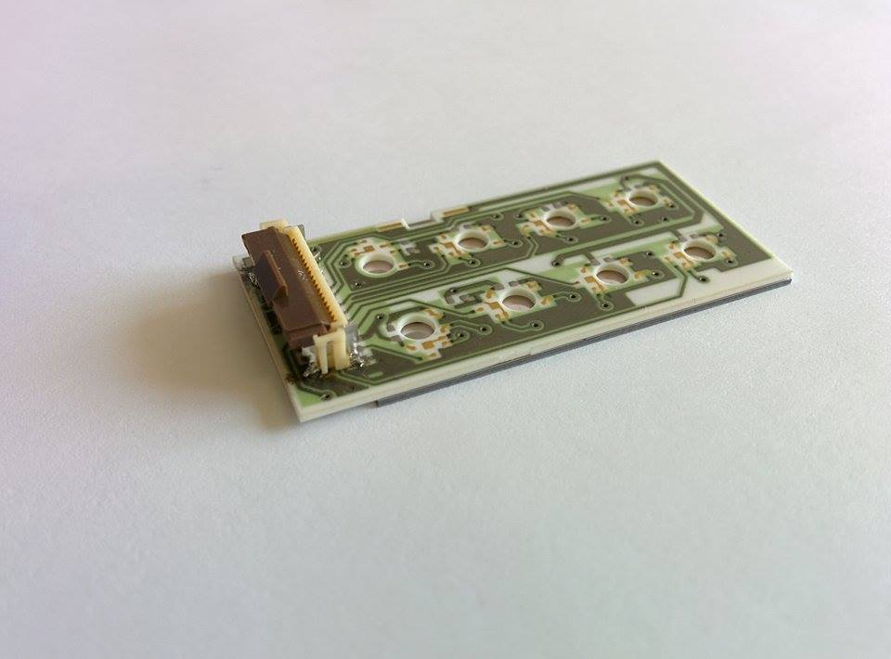
4x2 SDD array – layout + arrangement around target
CUBE

Slide 31
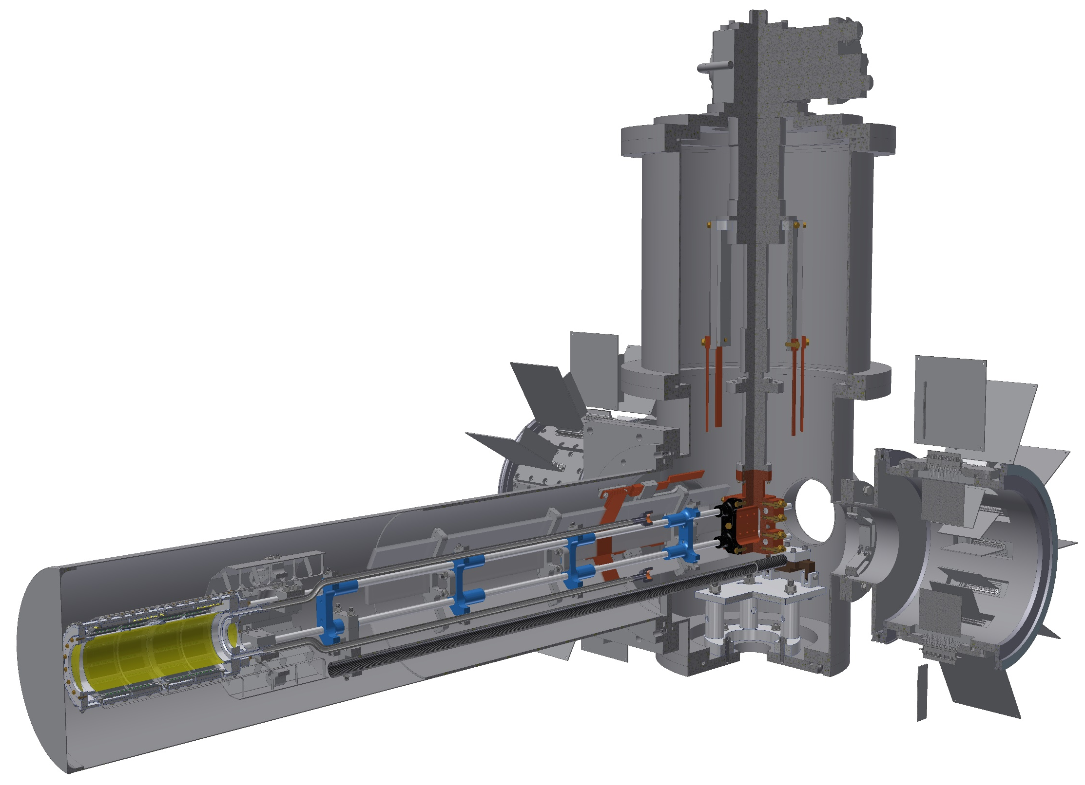
J-PARC E57 K⁻d cryogenic target
and SDD detector setup
2-stage closed cycle cryo-cooler
16-channel amplifier boards
Analogue signal and HV-LV cables
Ultra-pure aluminium cooling lines
Line driver boards
Cryo target + SDD detector

Slide 32
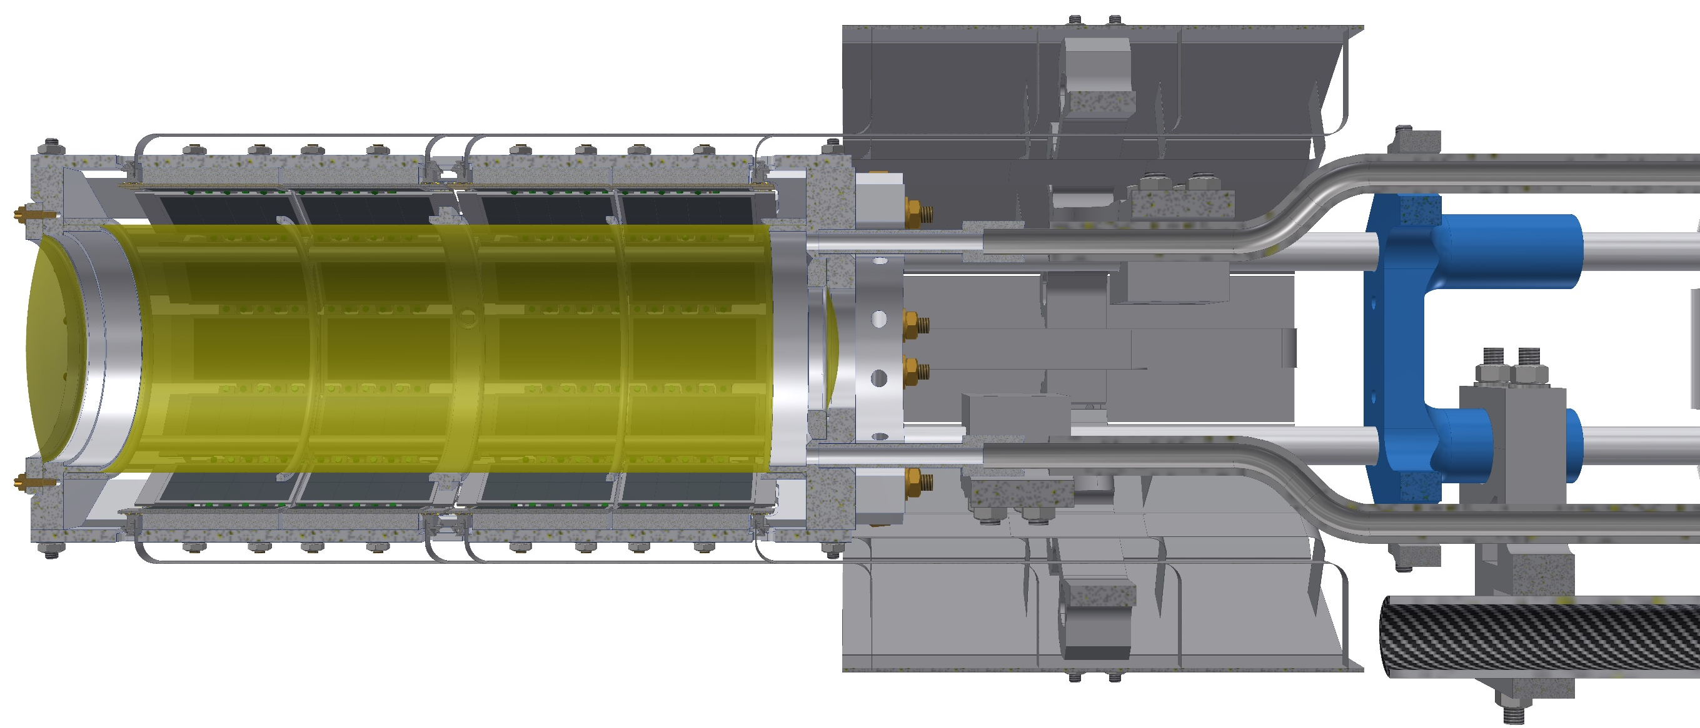
K-d apparatus – cryo target + SDDs + line driver boards

Slide 33
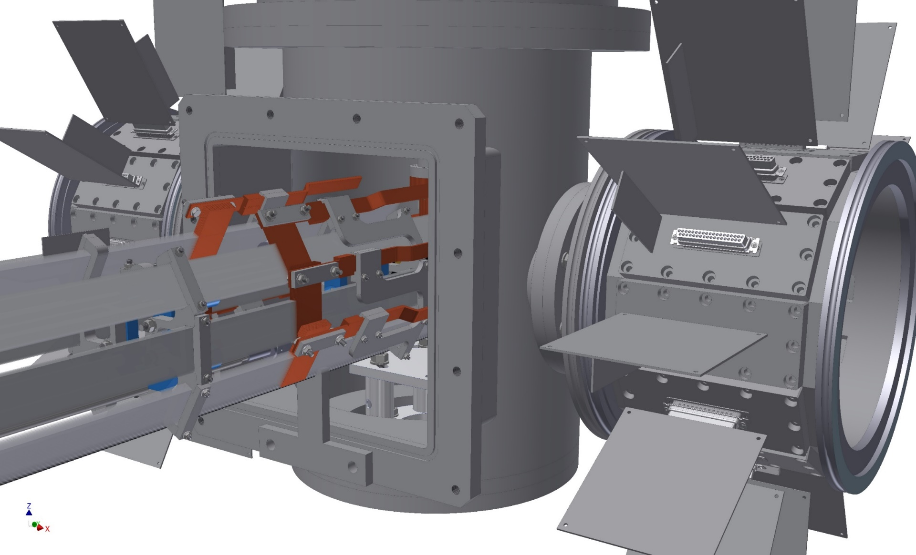
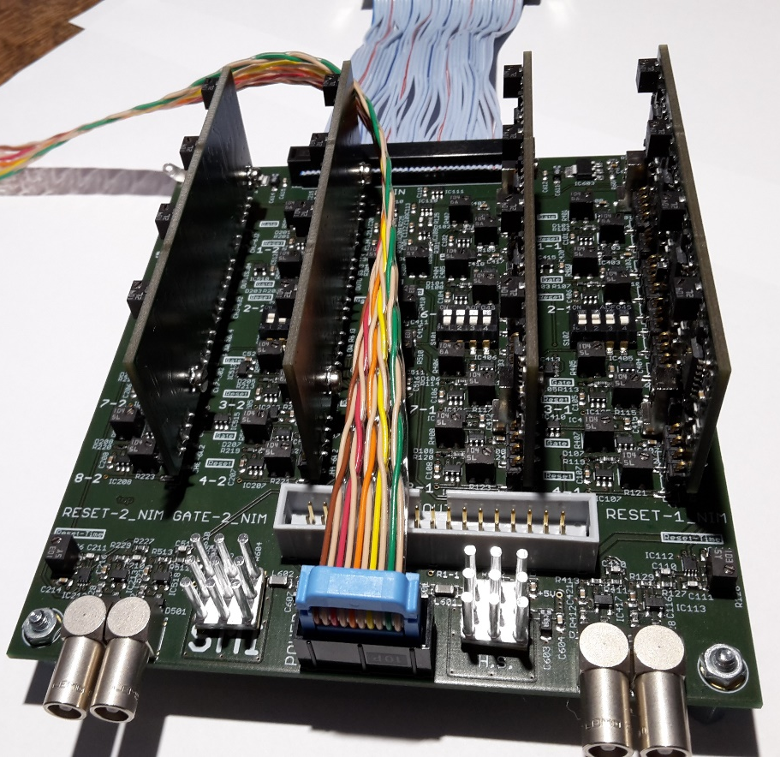
K-d apparatus – vacuum feed-through + amplifier boards
Prototype of the
16-channel amplifier board
37pin D-sub
analogue out
reset
trigger

Slide 34
E57 kaonic deuterium
cryogenic target cell

Slide 35
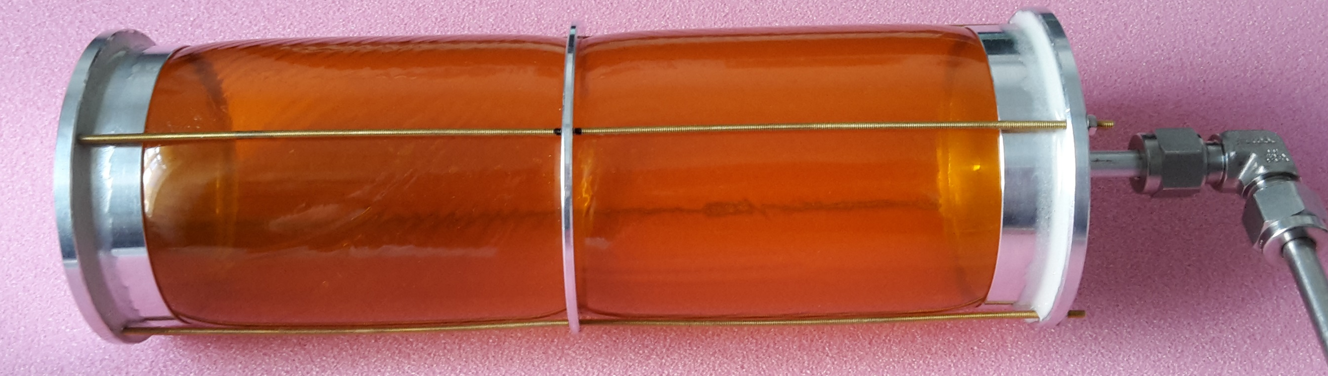
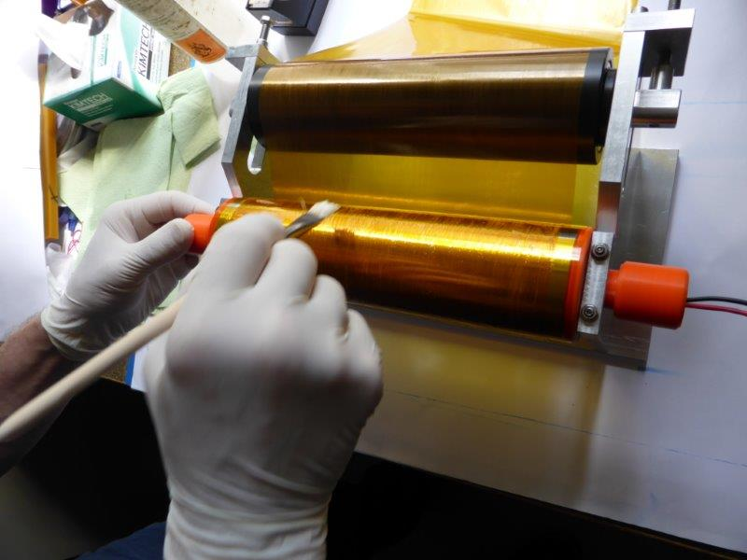
Prototype cryogenic target cell
length: 180 mm
diameter: 65 mm
wall thickness:
one-layer: 75 µm / 100 µm (overlap 10 mm)
  (N-1 and N-2 / N-3 and N-4)
two-layer: < 70 µm (without / with overlap)
  (N-5 / N-8 and N-9 under construction)
three-layer: < 100 µm (with overlap)
  (N-6 and N-7; N-10 and N-11 under construction)

Slide 36
Tool for the production of the cylinder barrel

Slide 37
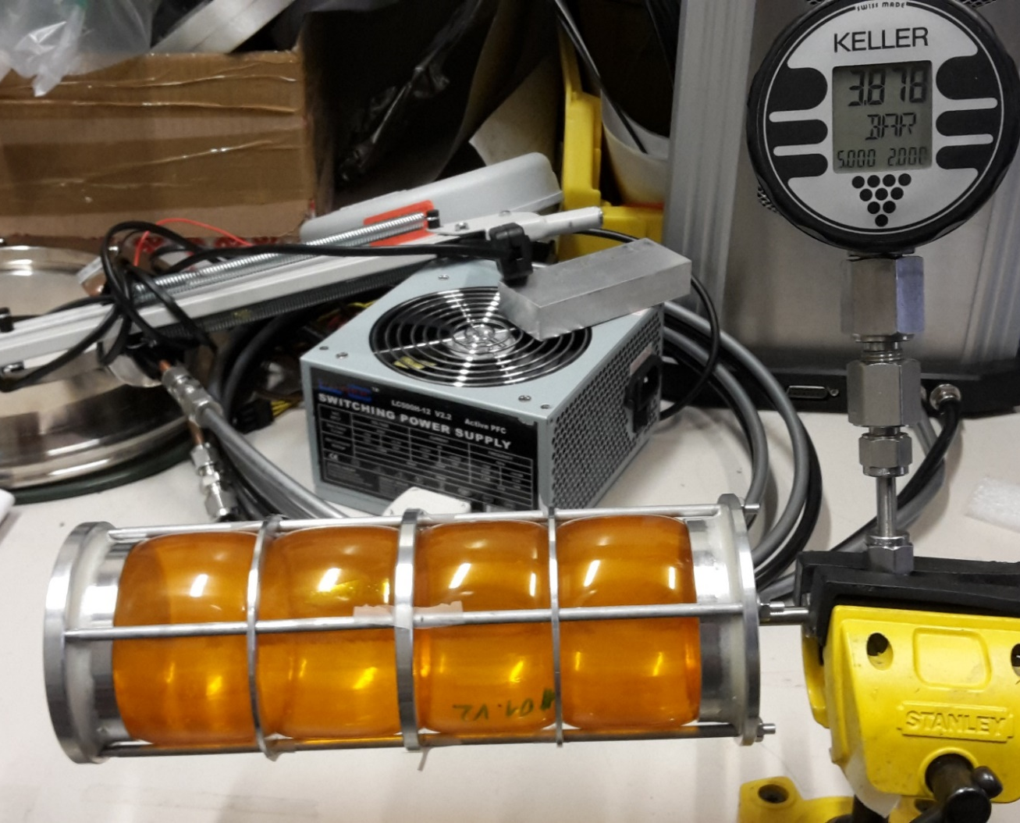
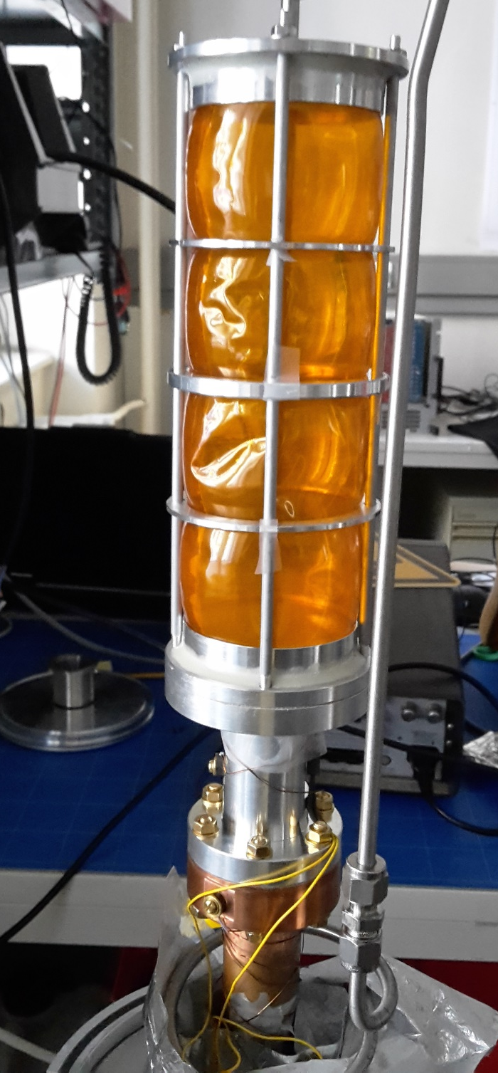
2016-09-22
15:15
Kaonic deuterium target – prototype tests
Cell: #01.V2
2016-09-06
17:56
Pressurised for 16 days
with P = 0.3 MPa (overP)
Cooling/pressure test
2.5 weeks 30 K / 0.19 Mpa
3.5 days 30 K / 0.31 MPa

Slide 38
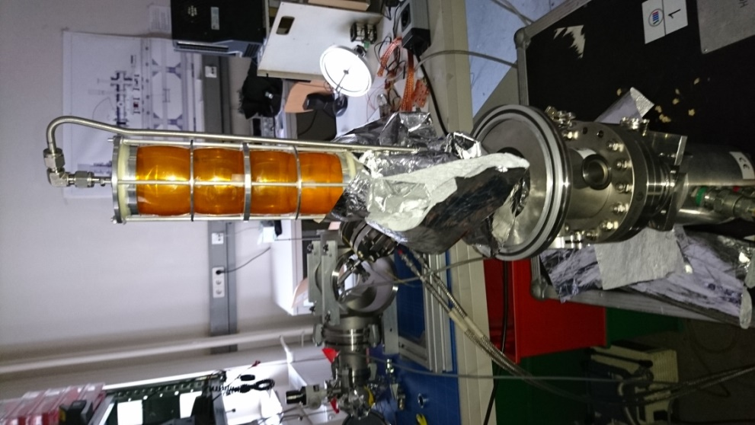
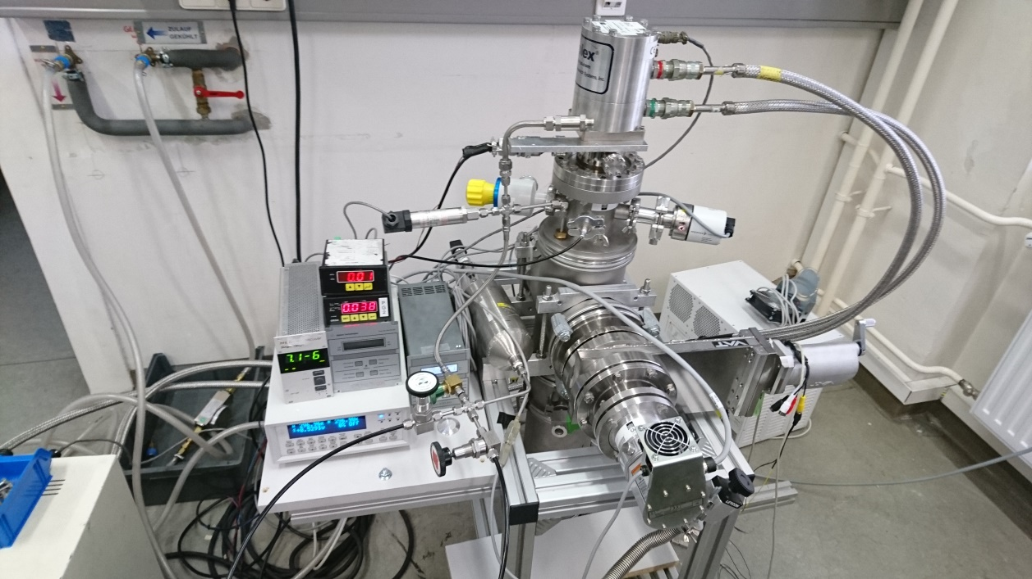
Strength test of the target cell at low temperature (< 77K)
Strength test (< 77 K) to confirm safety factor
Operational (maximum) pressure = 0.35 MPa
Procedure :
(1) Cool down the cell (~ 30 K)
(2) Pressurize the cell with He gas
Cell
gas inlet
Pressure gauge
Thermometer
Refrigerator

Slide 39
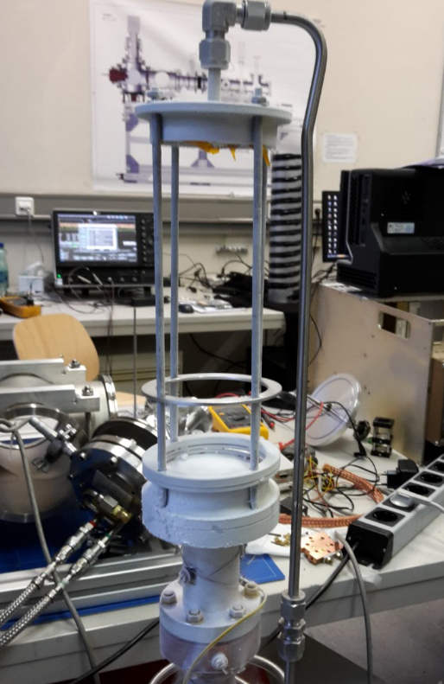
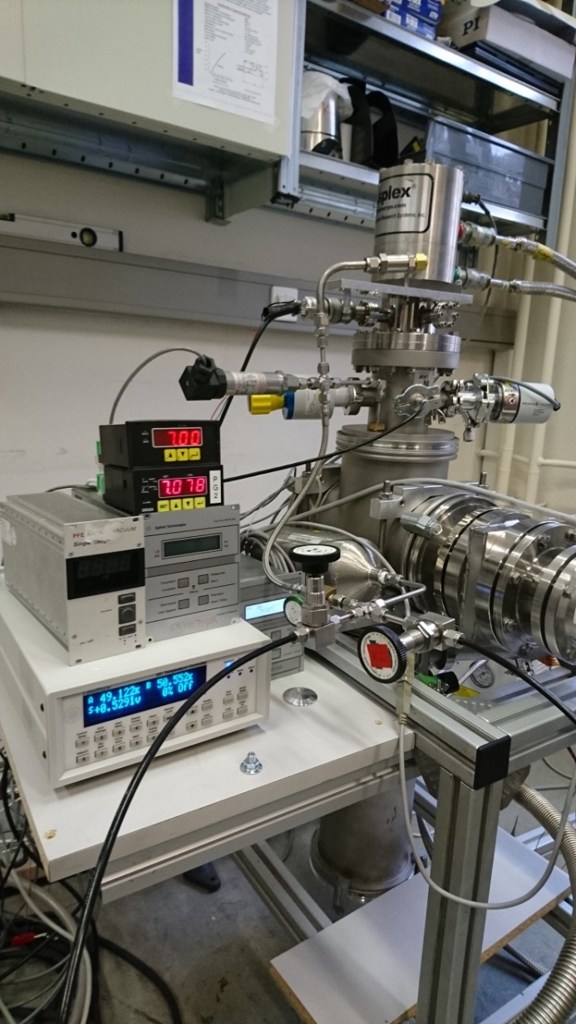
Strength test of the target cell ~ cont’d
snapshot just before burst
pressure
> 7 bar
burst
Temperature
~ 50 K
Safety factor confirmed > 2 at cryogenic temperature

Slide 40
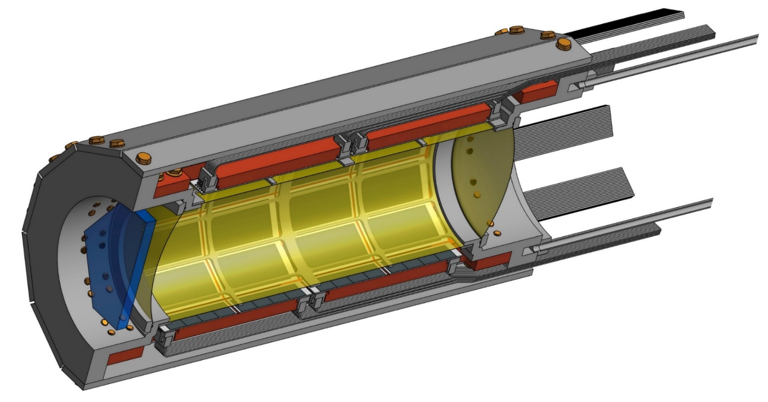
Status of the lightweight cryogenic target cell
working temperature: 30 K
working pressure: 0.3 MPa
wall thickness: < 100 µm
220 mm
Technical safety report was presented at the Facilities Impact and Finance
Committee (FIFC) meeting in December 2016
by Masaharu SATO

Slide 41
E57 kaonic deuterium
kaon beam tune

Slide 42
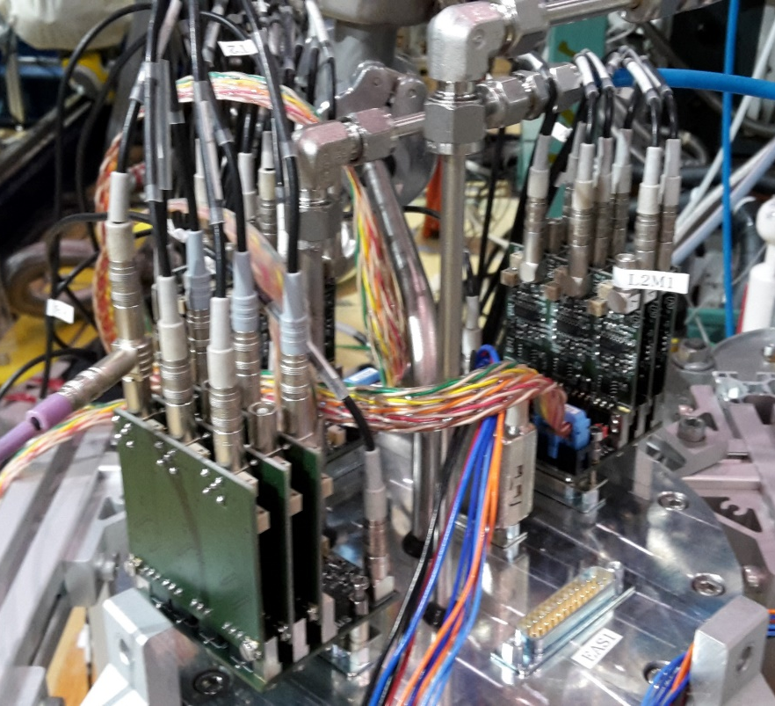
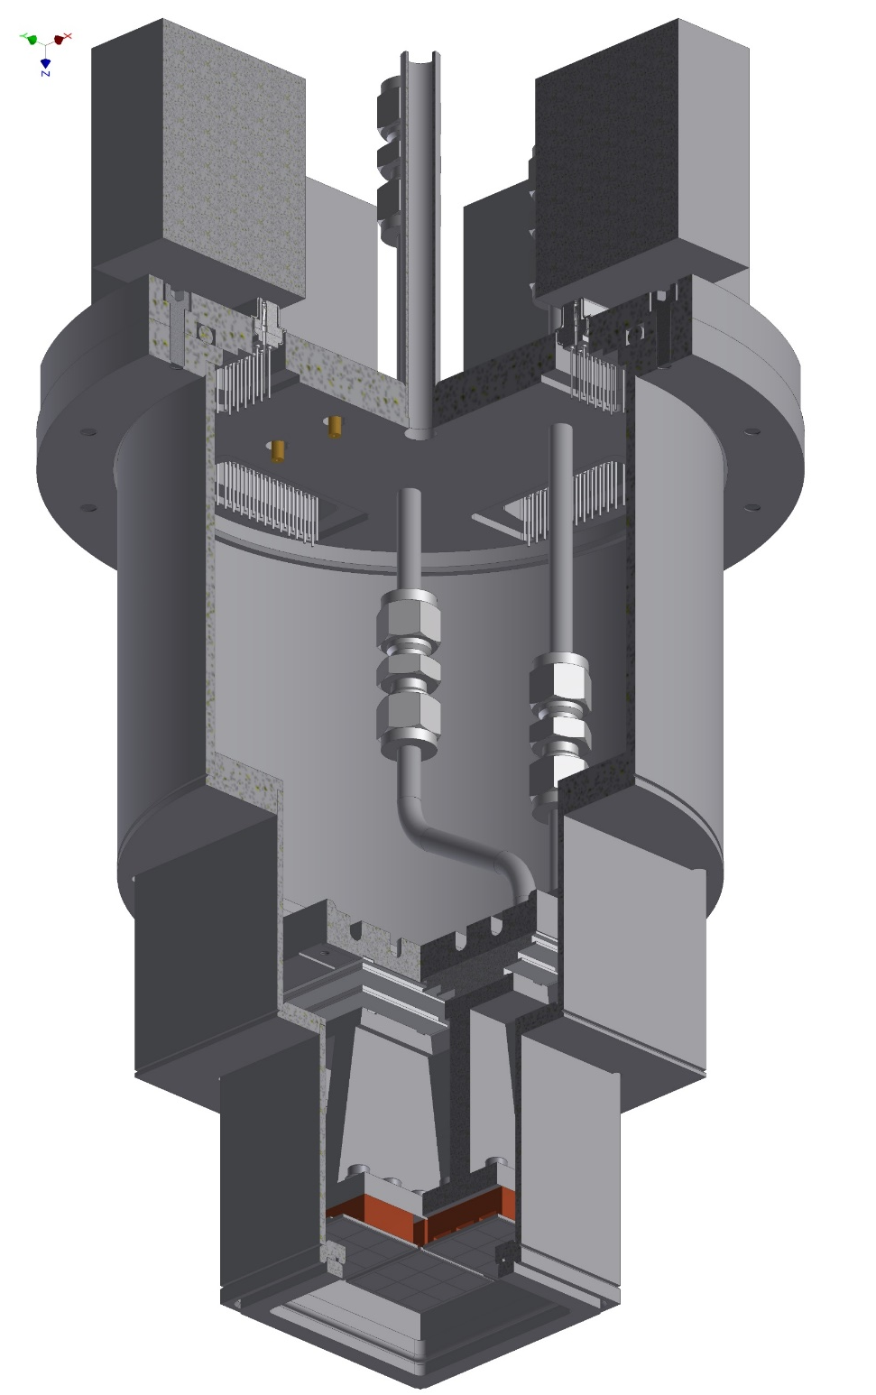
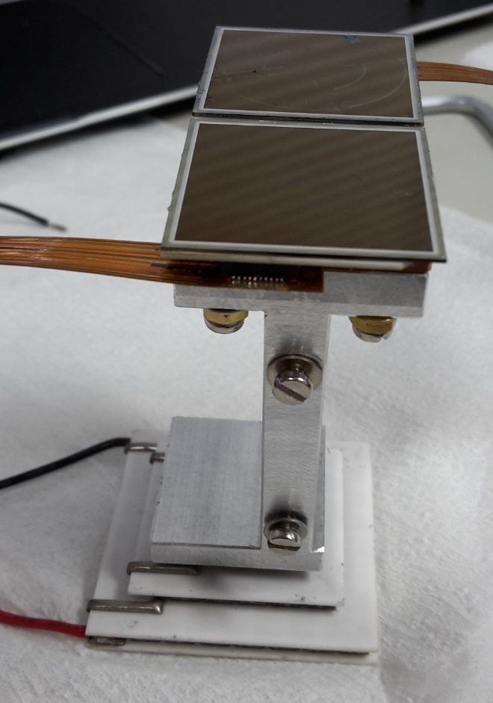
E57 - SDD test setup
3x3 SDD array
pre-amplifier boards
24 (+2) working channels
3-stage Peltier-cooler

Slide 43
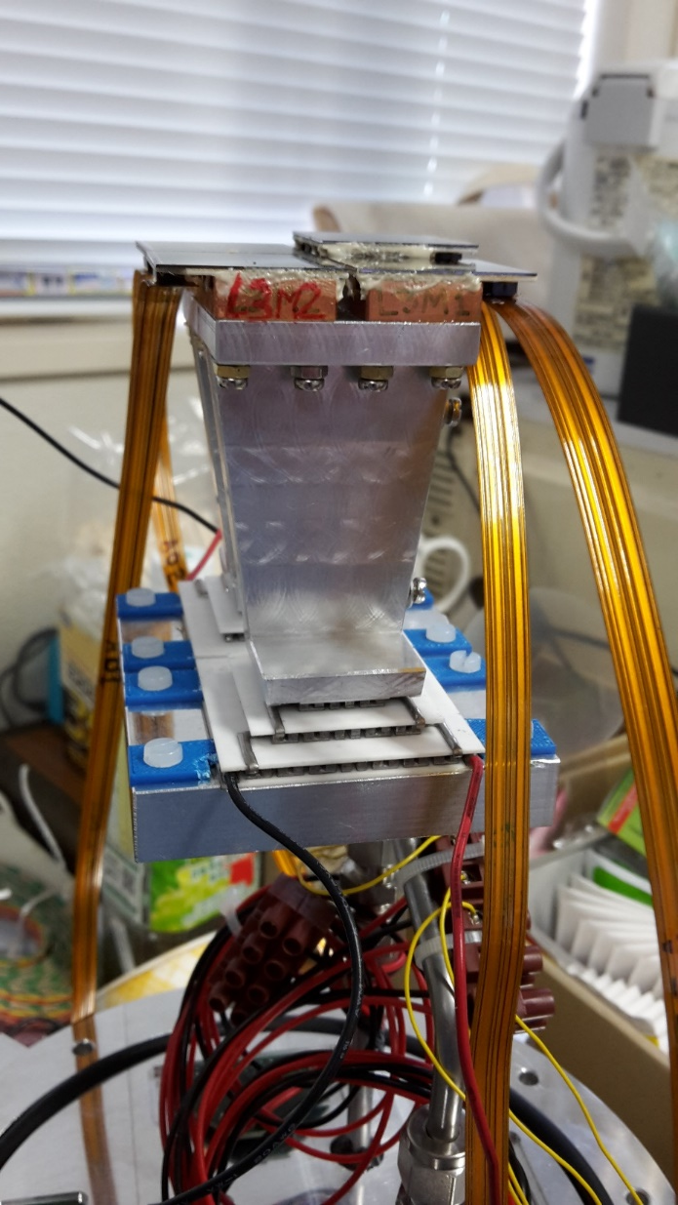
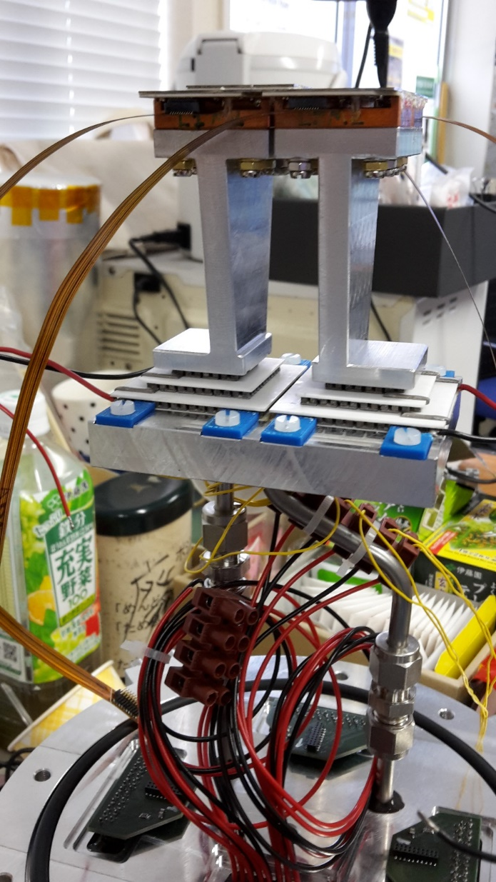
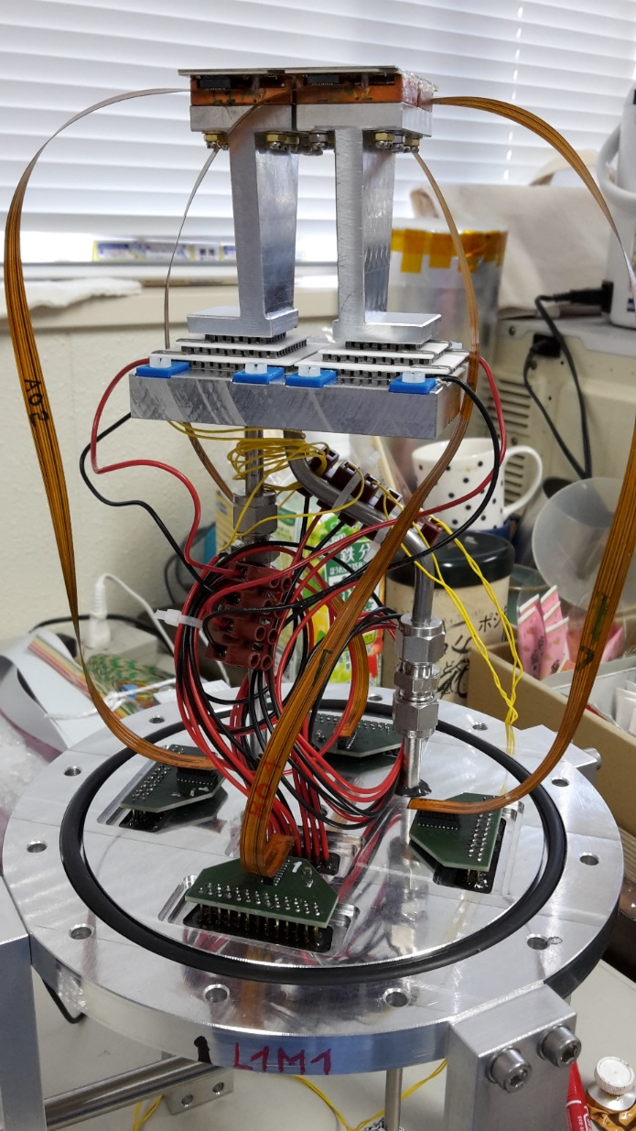
May 25, 2016
16:27

Slide 44
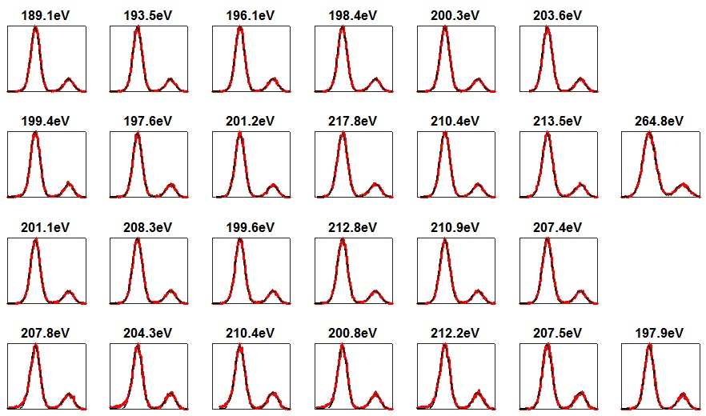
J-PARC SDD setup, calibration run with Fe-55, June 22, 2016; 14:00
SDD temp. - 40°C

Slide 45
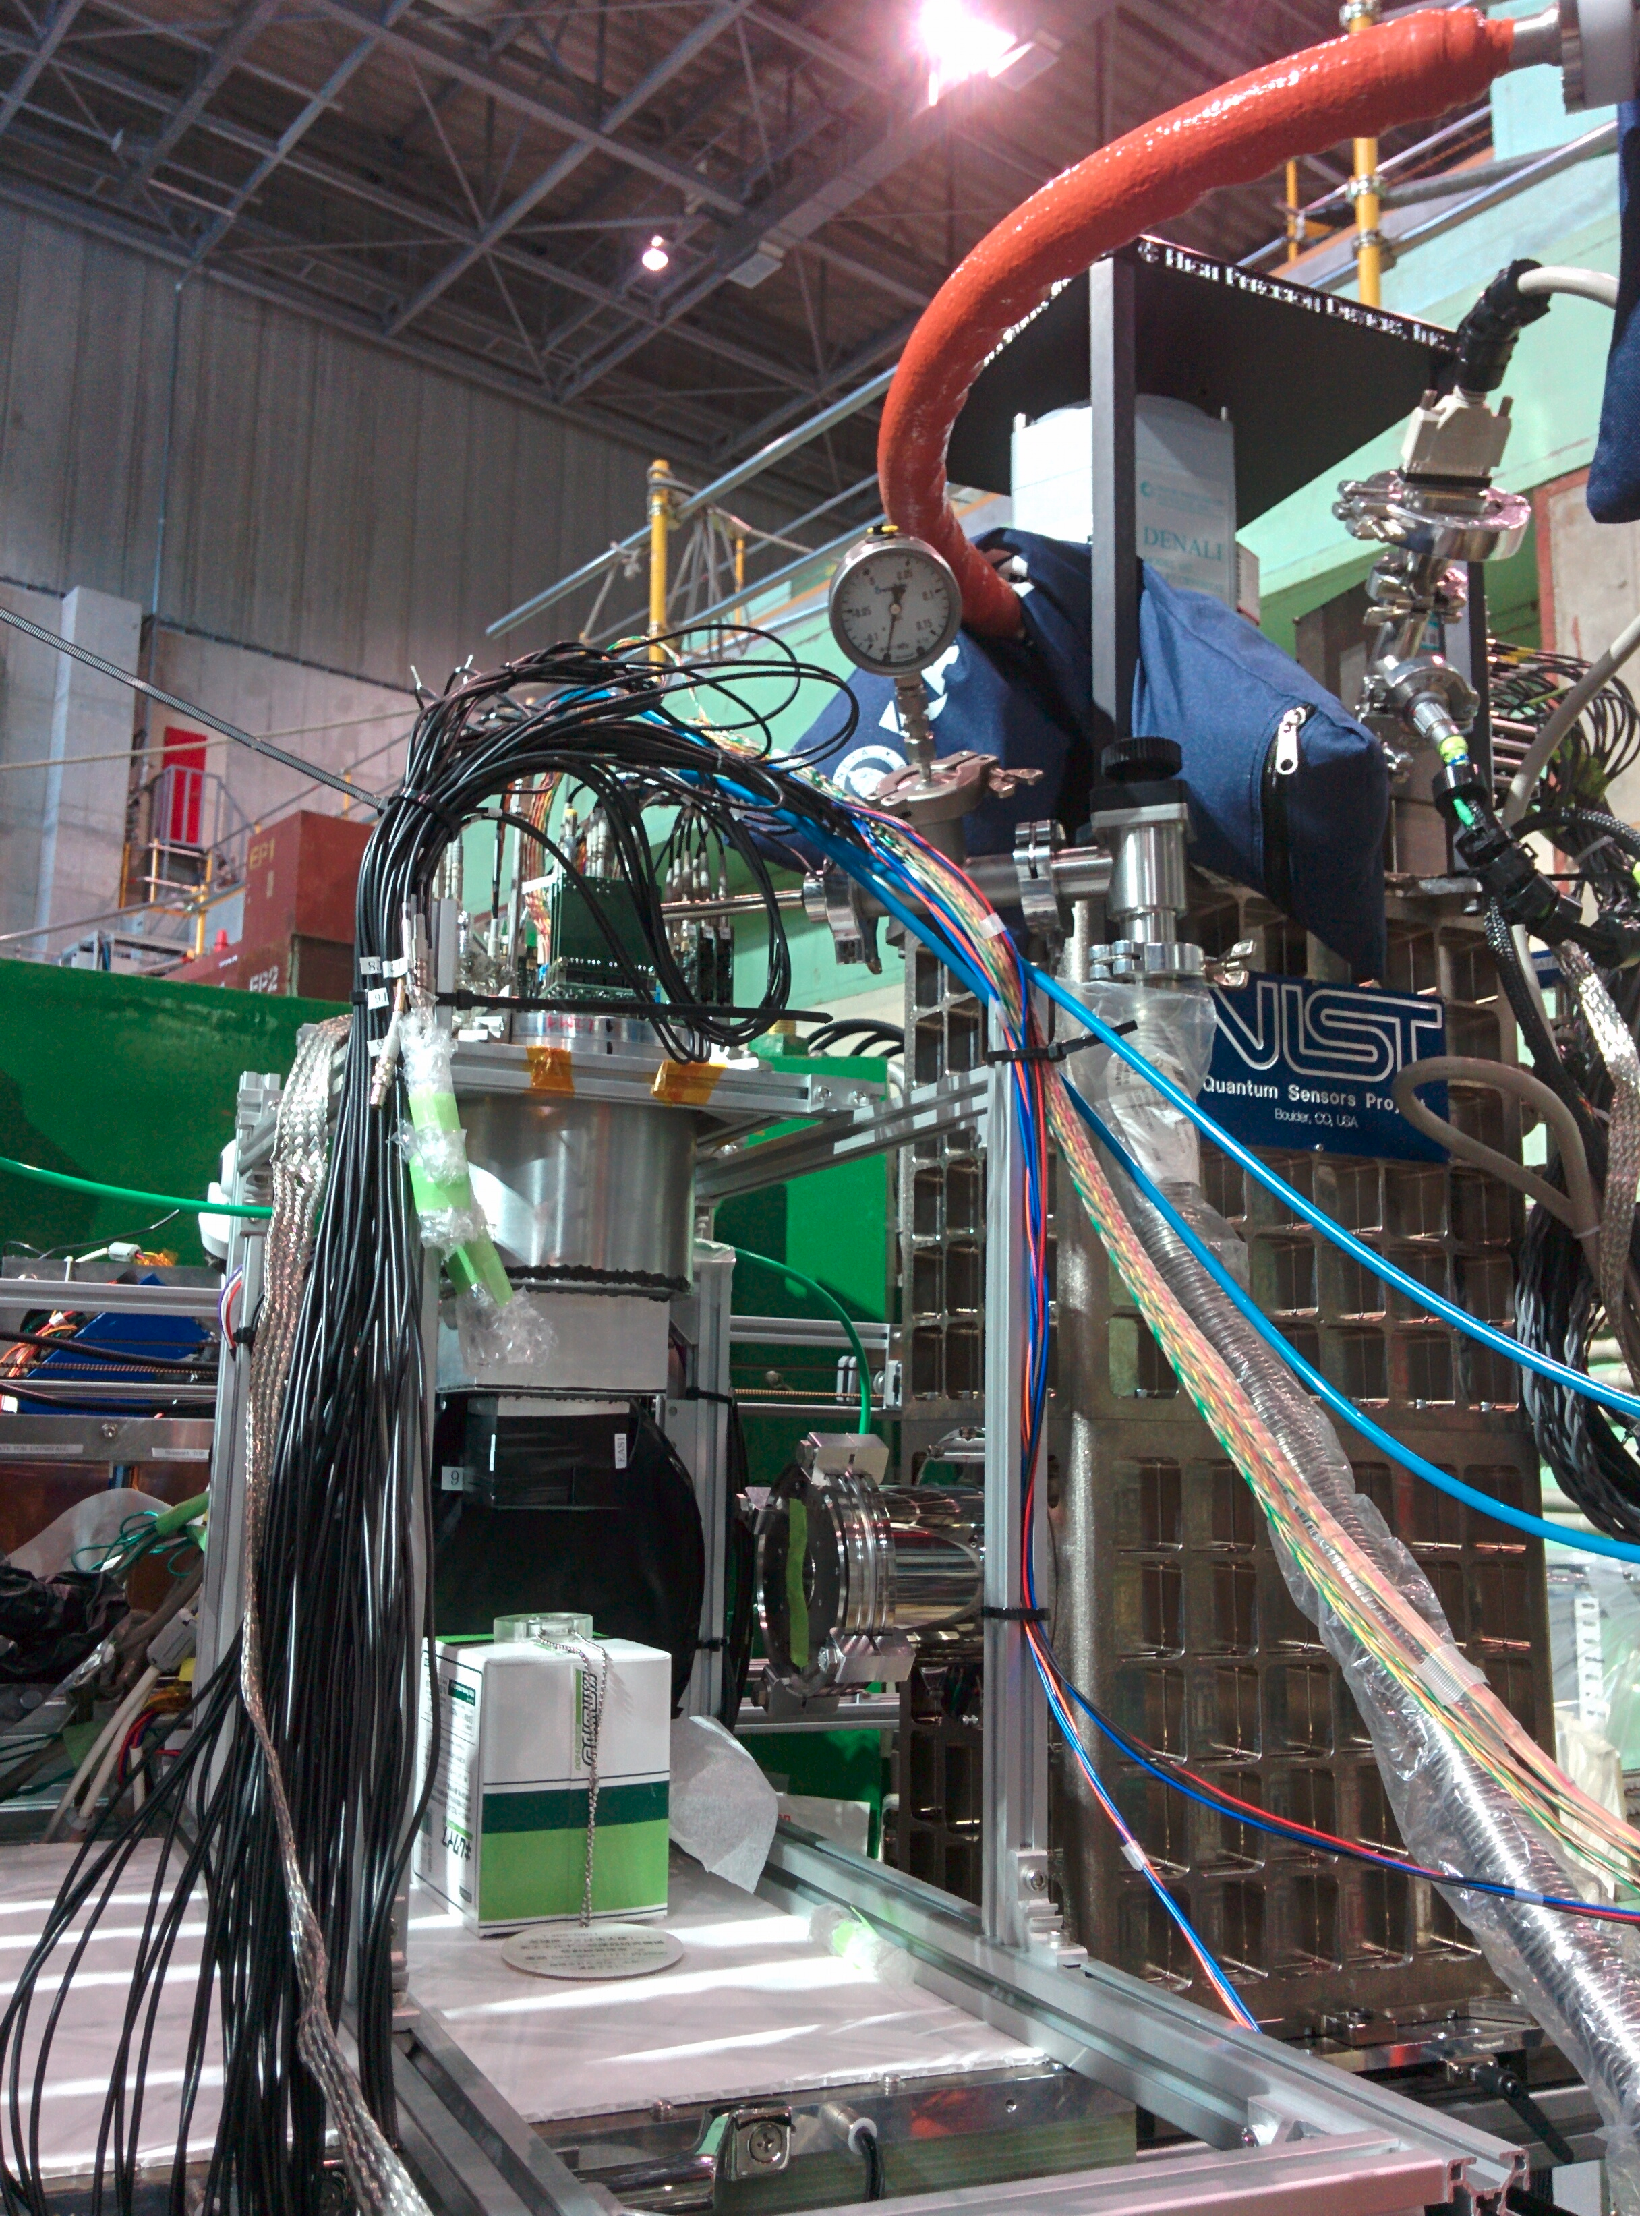
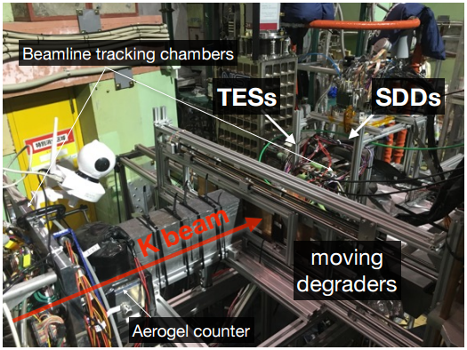
Setup of E57 and E62 in K1.8BR area
SDD
setup
TESs
Li-
block
Co-57
optimisation of stopped kaons in low mass targets
K⁻Li X-ray intensity to background ratio and range tuning in agreement with MC simulation

Slide 46
Range curve comparison

Slide 47
0.9 GeV/c with Cu degrader

Slide 48
Kaonic Lithium 3→2
Sum of all K⁻ runs, extracted
K⁻Li_{Lα} transition:
  15.323 ± 0.008 keV
~ 1200 counts
resolution 160 eV (sigma)
Theory:
    15.330 keV (pure QED)
    J.P.Santos et al.
    Phys. Rev. A 71 (2005) 032501
preliminary
Experiment:
  15.321 ± 0.024 keV
C.J.Batty et al.
Nuclear Physics A282 (1977) 487

Slide 49
Summary beam tune run
optimisation of stopped kaons in low mass targets
SDDs performing very well, as expected
  energy resolution ~ 200 eV (FWHM) at 6 keV @ T ~ - 40°C
  energy shift dependence of counting rate:
  spill-on / spill-off < 6 eV
K⁻Li X-ray intensity / range tuning in agreement with MC simulation, detailed analysis is ongoing

Slide 50
E57 kaonic deuterium
theory + MC simulation

Slide 51
K⁻d scattering lengths - theory
a_{Kd} [fm] | ε_{1s} [eV] | Γ_{1s} [eV] | Reference
-1.55 + i 1.66 | - 969 | 938 | Weise 2015 [2]
-1.58 + i 1.37 | - 887 | 757 | Mizutani 2013 [4]
-1.48 + i 1.22 | - 787 | 1011 | Shevchenko 2012 [5]
-1.46 + i 1.08 | - 779 | 650 | Meißner 2011 [1]
-1.42 + i 1.09 | - 769 | 674 | Gal 2007 [6]
-1.66 + i 1.28 | - 884 | 665 | Meißner 2006 [7]
-1.62 + i 1.91 | - 1080 | 1024 | Oset 2001 [3]
ε_{1s} = (-800 ± 60) eV
Γ_{1s}= (800 ± 140) eV
[1] M. Döring, U.-G. Meißner, Phys. Lett. B 704 (2011) 663
[2] W. Weise, arXiv:1412.7838[nucl-theo]2015
[3] S.S. Kamakov, E. Oset, A. Ramos, Nucl. Phys. A 690 (2001) 494
[4] T. Mizutani, C. Fayard, B. Saghai, K. Tsushima, Phys. Rev. C 87, 035201 (2013), arXiv:1211.5824[hep-ph]
[5] N.V. Shevchenko, Nucl. Phys. A 890-891 (2012) 50-61
[6] A. Gal, Int. J. Mod. Phys. A22 (2007) 226
[7] U.-G. Meißner, U. Raha, A. Rusetsky, Eur. phys. J. C47 (2006) 473
Notes:
Compilation of predicted K⁻d scattering lengths a _{K¯d}
and corresponding experimental quantities ε_{1s} and Γ_{1s}

Slide 52
arXiv:1705.06857v1 [nucl-th] 19 May 2017

Slide 53
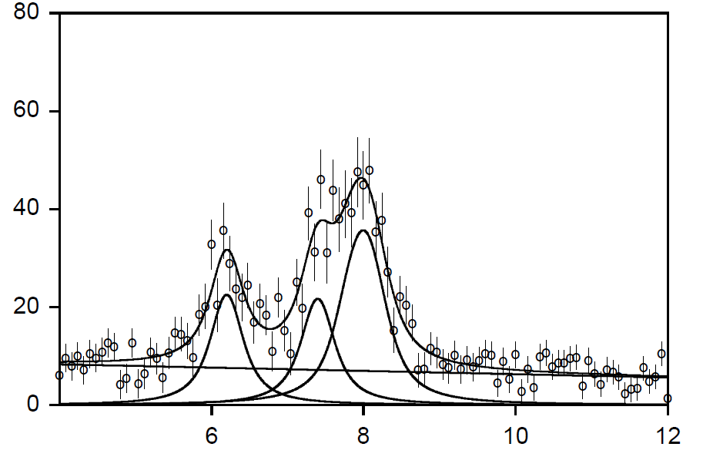

Commissioning of the K⁻d apparatus
for stage-2 approval (proof of principle using K⁻p)
DAQ WITH HYDROGEN
45 kW proton beam, 3 days
detector area 120 cm²
4% LHD
K_{high}
K_{β}
K_{α}
achievable precision:
sigma(shift) ~ 35 eV
sigma(width) ~ 71 eV
ε_{1s} = -283 ± 36(stat) ± 6(syst) eV
Γ_{1s} = 541 ± 89(stat) ± 22(syst) eV
counts per 80 eV bin
X-ray energy [keV]
Notes:
For 250 K-p K(alpha) events, assuming S/B = 4:1
dE = 280 +- 40 width= 540 +- 110

Slide 54
Geant4 simulated K⁻d X-ray spectrum
for 160 kW·weeks
signal: shift - 800 eV
width 800 eV
density: 5% (LDD)
detector area: 246 cm²
Kα yield: 0.1 %
yield ratio as in K⁻p
S/B ~ 1 : 3
achievable precision:
shift: 60 eV
width: 140 eV
vertex cut
charged particle veto
asynchronous BG
QED
ε_{1s}
K_{high}
K_{α}
K_{β}
Γ_{1s}

Slide 55
SDDs for kaonic helium 1s “search”
Solenoid
kaons produced at 27 kW:
1 GeV/c ~ 4·10⁹ kaons/day
stopping: ~2·10⁻³
K-He Kα-yield: ~1·10⁻⁴
tagging eff. ~ 0.5
He Kα events ~ 400 per day
CDH
CDC
main degrader
liquid He target
+ SDDs
T0
BLC
T1

Slide 56
Kaon atom factory at J-PARC
high resolution X-ray spectroscopy

Slide 62
kaonic helium 2p

Slide 68

Sources of experimental data on K⁻N interaction
68

Slide 69

Kaon – nucleon scattering database
cross section figure from: Review of particle physics, Phys. Lett. B667 (2008), 1
J-PARC
J-PARC

Slide 70
Alessandra Filippi, INFN Torino

Slide 71
Low-energy K⁻p / K⁻d scattering
Solenoid
BLC
Cryo-target
CDH
CDC
main degrader
Scattering setup:
double-side Si-strip detectors
TimePix ?
“active” TPC
double-side
Si-strip
~ 100 µm
T0
BLC
T1

Slide 72

Supported by
Thank you
P24756-N20

