Slide 1
Istituto Nazionale Fisica Nucleare - Laboratori Nazionali di Frascati
Strange and non-strange mesons induced processes studies at DAFNE, J-PARC and RIKEN:
present and future
Frascati, 10-11 / 07 / 2017

Slide 2
Spectroscopic characterization of Silicon Drift Detectors for SIDDHARTA-2 experiment
Marco Miliucci
On behalf of SIDDHARTA-2 collaboration
Marco.Miliucci@lnf.infn.it
Frascati, 11/07/2017

Slide 3
Outline
SIDDHARTA
DAQ
Spectroscopic characterization
Conclusions
Frascati, 11/07/2017

Slide 4
Outline
SIDDHARTA
DAQ
Spectroscopic Characterization
Conclusions
Frascati, 11/07/2017

Slide 5
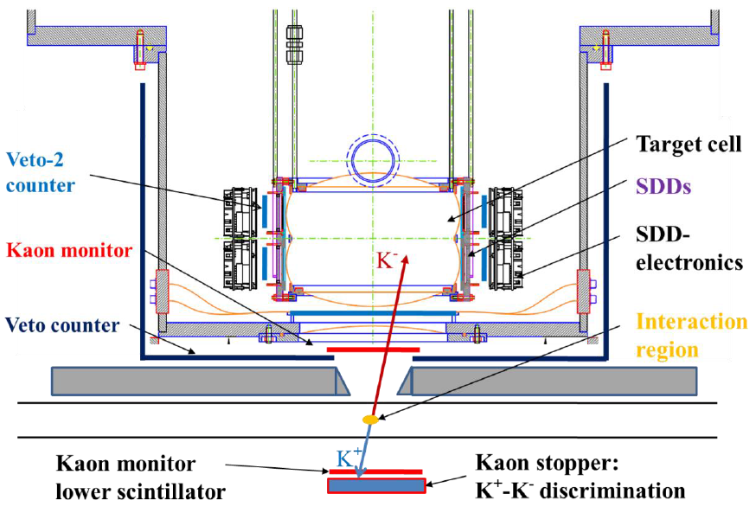
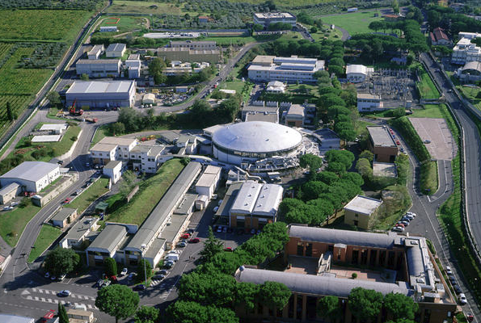
Silicon Drift Detectors for Hadronic Atom Research by Timing Application
Frascati, 11/07/2017

Slide 6
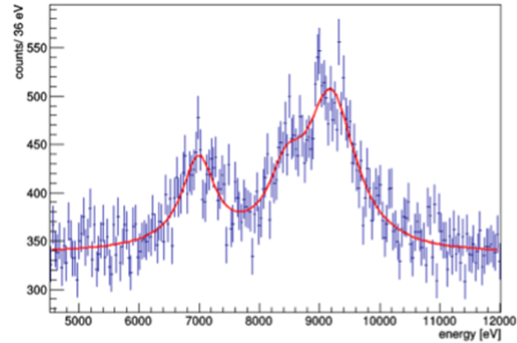
Silicon Drift Detectors for Hadronic Atom Research by Timing Application
Monte Carlo simulation of K⁻ d for SIDDHARTA-2 for 800 pb⁻¹
Region Of Interest
4500 – 12000 eV
Frascati, 11/07/2017

Slide 7
Outline
SIDDHARTA
DAQ
Spectroscopic Characterization
Conclusions
Frascati, 11/07/2017

Slide 8
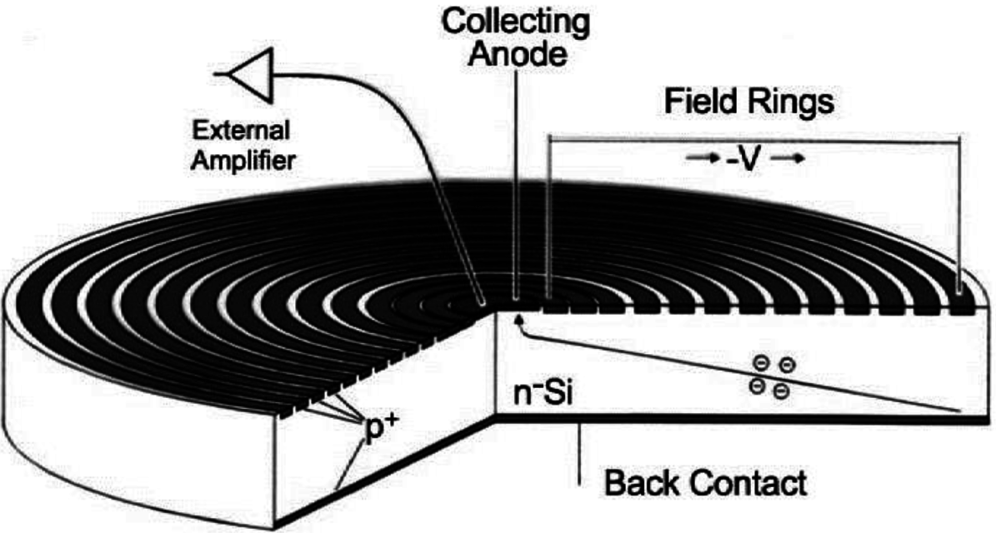
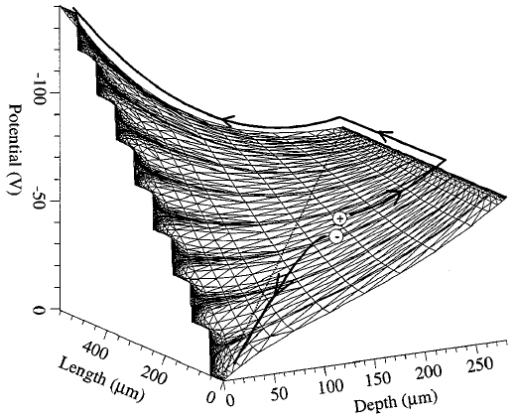
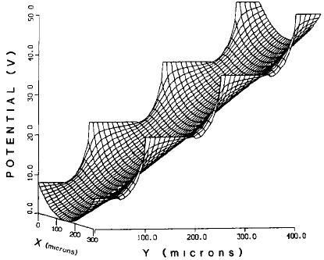
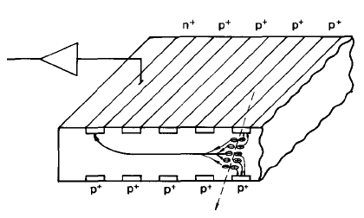
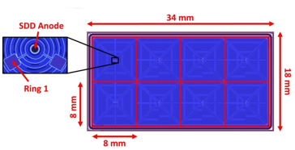
Silicon Drift Detectors
RN
Back
P. Rehak at al, Nucl. Instr. Meth. Phys. Res. A235 (1985) 224-234
Anode
IEEE transactions on nuclear science, vol. 47, no. 4, august 2000 1691
Frascati, 11/07/2017

Slide 9
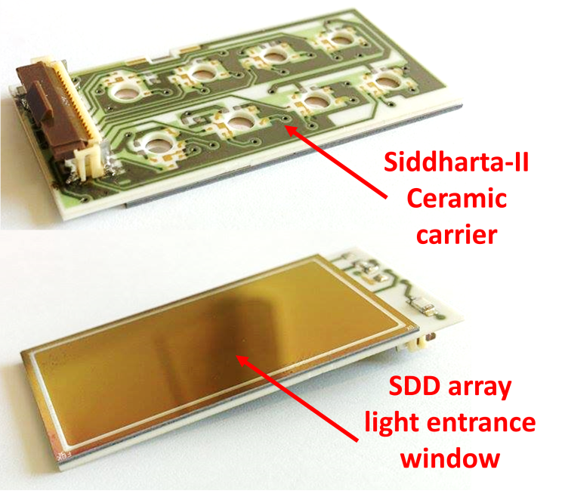
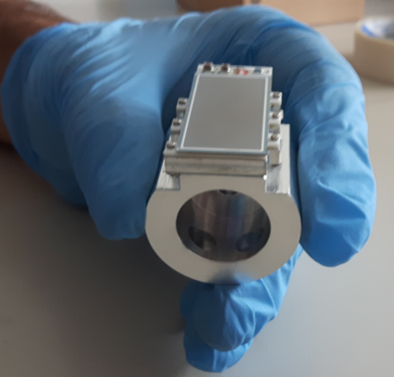
Silicon Drift Detectors
Frascati, 11/07/2017

Slide 10
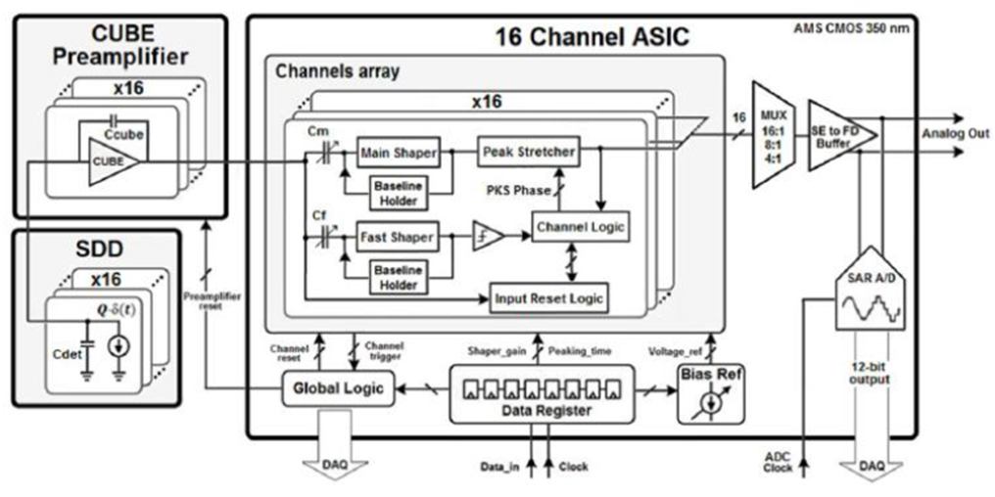
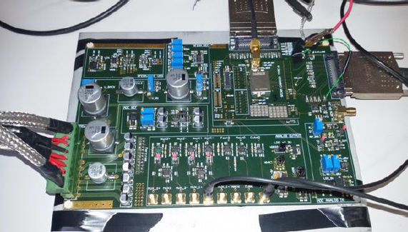
Electronic Chain
Frascati, 11/07/2017

Slide 11
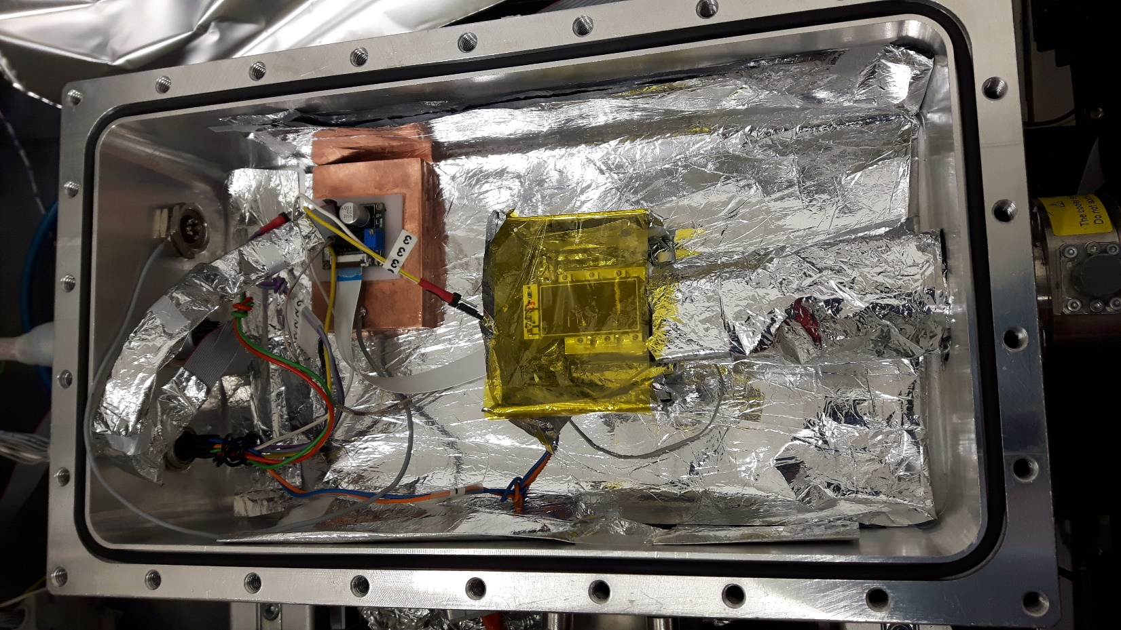
Experimental setup
P < 10⁻⁵ mbar
T = R.T. -> 100 K
CAMERA
Frascati, 11/07/2017

Slide 12
Outline
SIDDHARTA
DAQ
Spectroscopic characterization
Conclusions
Frascati, 11/07/2017

Slide 13
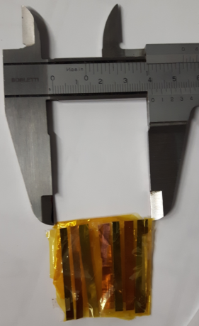
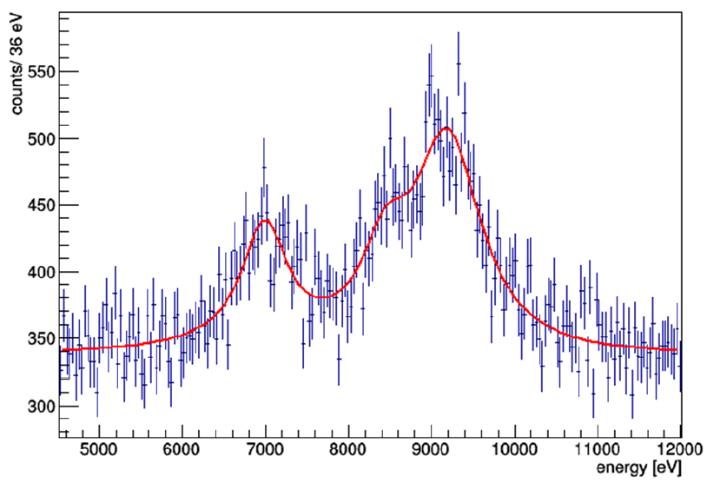
X RAY spectrum
Ti Fe Cu Br
Foto targhetta
Frascati, 11/07/2017

Slide 14
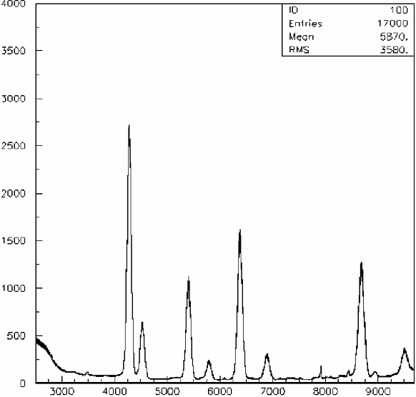
X RAY spectrum
T SDDs: 120 K
Pressure: 8.2 * 10⁻⁶ mbar
R1 Voltage: -15,2 V
High Voltage: -150 V
Xray Tube: 23 KV @ 10μA
Mean Rate on SDD: 1,12 KHz
ROI
Ti Kα
Cu Kα
Fe Kα
Br Kα
Ti Kβ
Cu Kβ
Br Kβ
Fe Kβ
Energy (eV)
Frascati, 11/07/2017

Slide 15
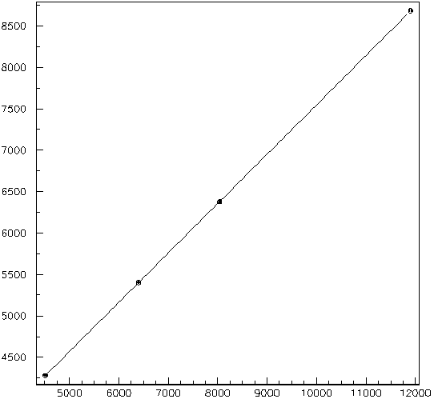
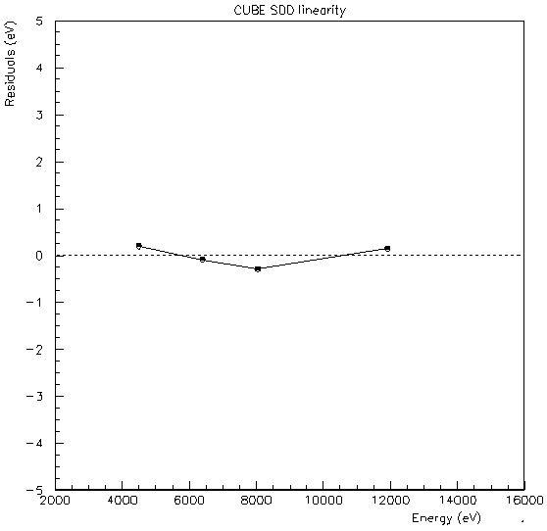
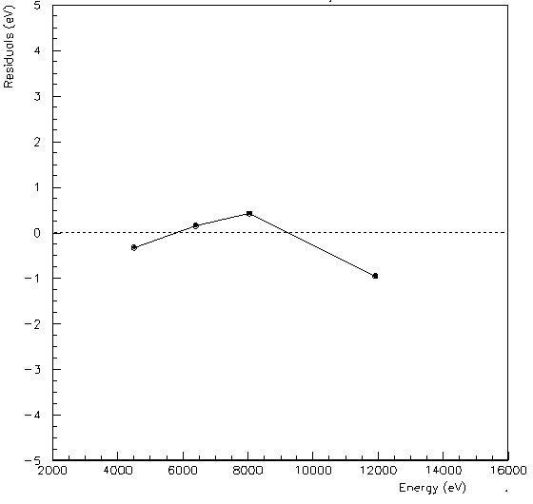
Linearity
Calibration
SDD_1
SDD_7
Calibration
y = p₁*x + p₀
p₀ = 1592.4 ± 0.2 [adc]
p₁ = 0.59472 ± 0.00004 [adc/eV]
Energy (adc)
Energy (eV)
Frascati, 11/07/2017

Slide 16
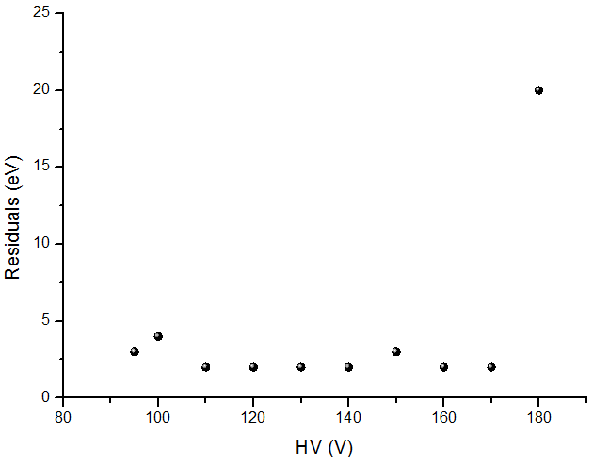
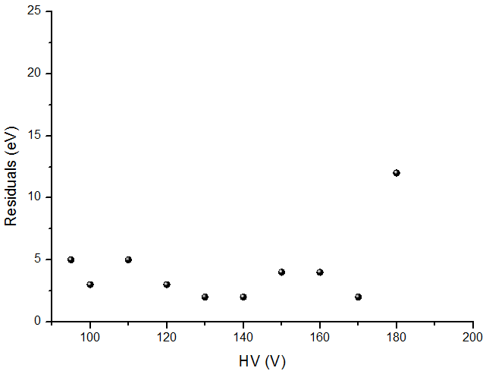
Linearity vs HV
SDD_1
SDD_7
Frascati, 11/07/2017

Slide 17
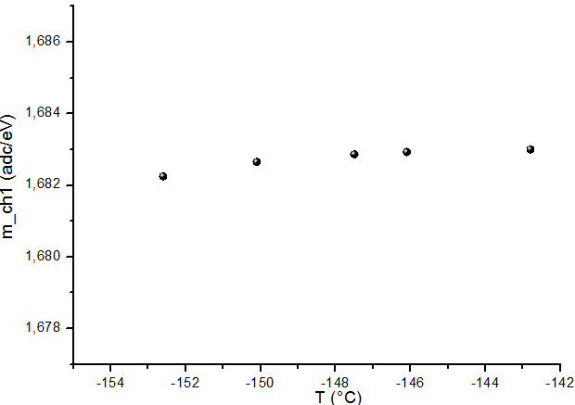
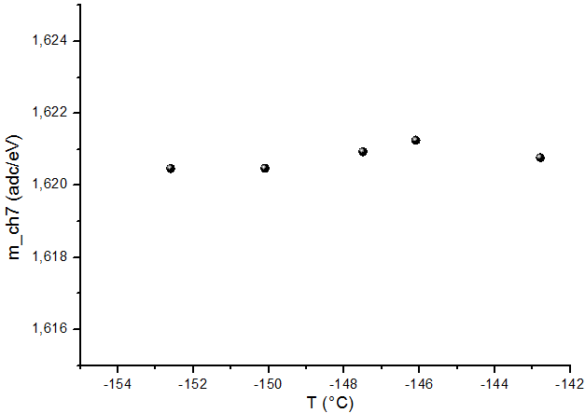
Temperature Stability
SDD_1
SDD_7
Channel | ΔT _{SDD} [°C] | m_{MAX} [adc/eV] | m_{MIN} [adc/eV] | (Δm/m )/ΔT [°C⁻¹]
1 | 9,6 | 1,68301 ± 0,00002 | 1,68225 ± 0,00003 | 5*10⁻⁵
7 | 9,6 | 1,6212 ± 0,0002 | 1,62047 ± 0,00008 | 7*10⁻⁵
Frascati, 11/07/2017

Slide 18
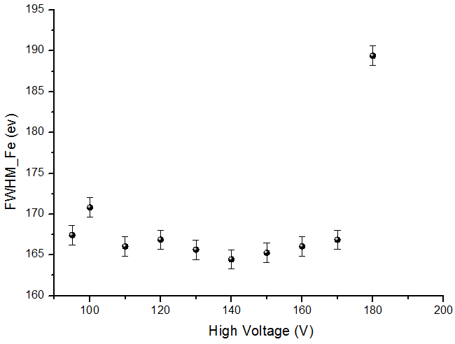
Resolution vs HV
FWHM Mn_CH1 = 161 ± 1 eV
FWHM Mn_CH7 = 158 ± 1 eV
Frascati, 11/07/2017

Slide 19
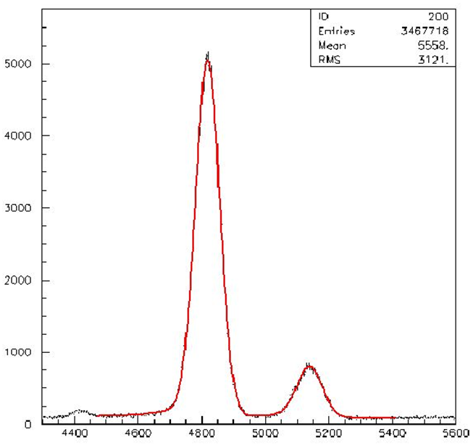
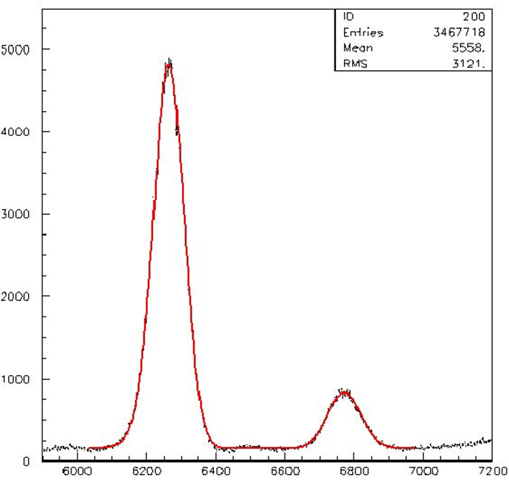
Resolution
@ 120K
Titanium Kα,Kβ
Iron Kα,Kβ
Energy (adc)
Energy (adc)
Ti FWHM = 116.8 ± 0.3 eV
Fe FWHM = 133.9 ± 0.4 eV
Mn FWHM = 128 ± 3 eV
Frascati, 11/07/2017

Slide 20
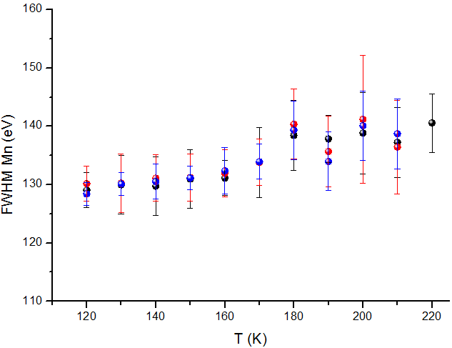
Resolution vs Temperature
SDD_4
SDD_2
SDD_3
*Paper in preparation
Frascati, 11/07/2017

Slide 21
Timing at BTF
BEAM CONVERTER
LINAC
e⁻, e⁺ beam
t₀
Energy Beam: 450 MeV
Multeplicity e⁻= 200-300
Multeplicity e⁺= 30-40
Time Resolution = ΔT_{en}
Drift time = T_{e} = t₁-t₀
e⁻
anode
t₁
Frascati, 11/07/2017

Slide 22
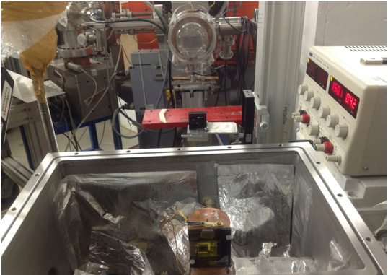
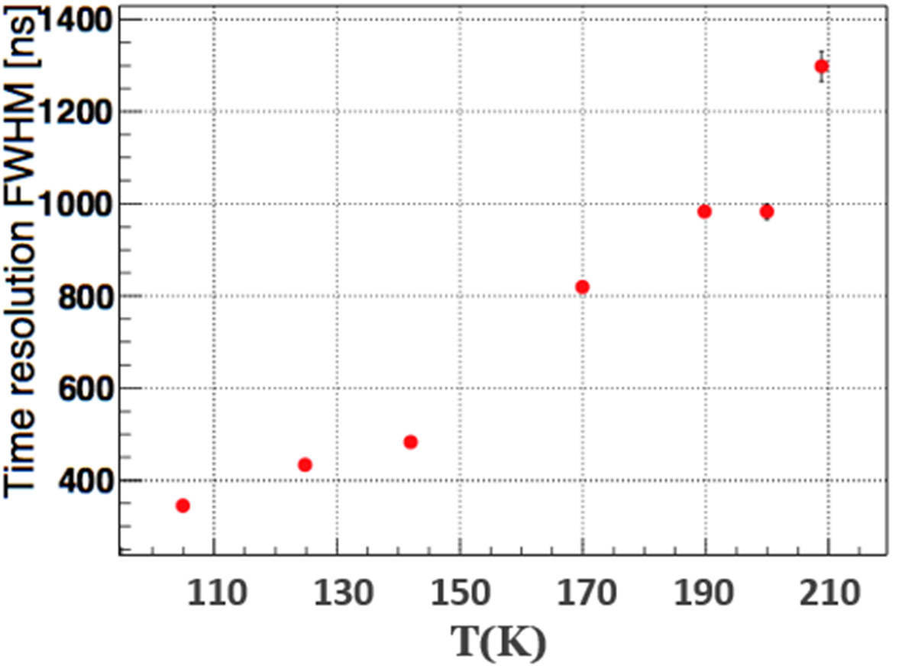
Drift Time vs Temperature
T SDDs: 110 – 210 K
Pressure: 10⁻⁴ mbar
First Ring Voltage: -15,2 V
Last Ring Voltage: -150 V
Scintillator + FADC
*Paper in preparation
Frascati, 11/07/2017

Slide 23
Outline
SIDDHARTA
DAQ
Spectroscopic Characterization
Conclusions
Frascati, 11/07/2017

Slide 24
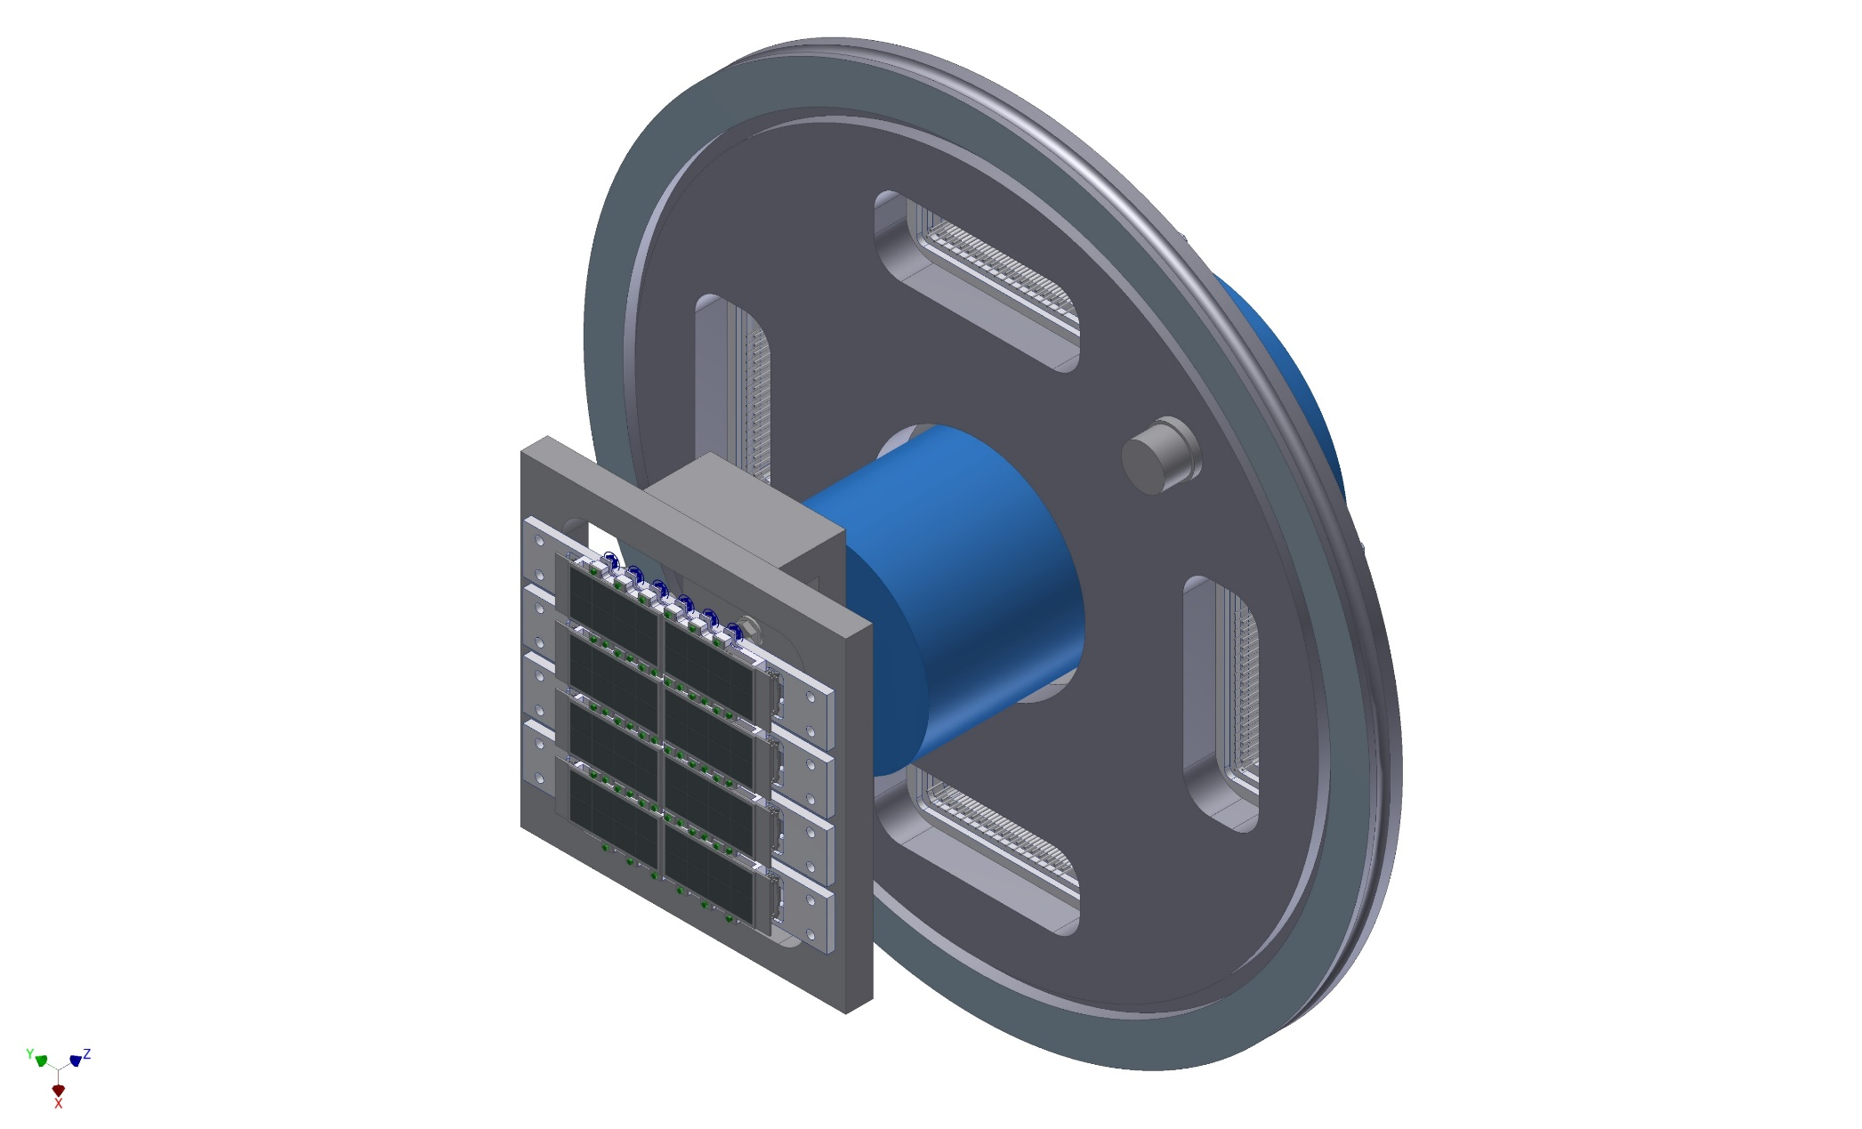
NEW SETUP
NUOVA CAMERA
Dr. J. Zmeskal, Stefan Meyer Institute, Vienna
Frascati, 11/07/2017

Slide 25
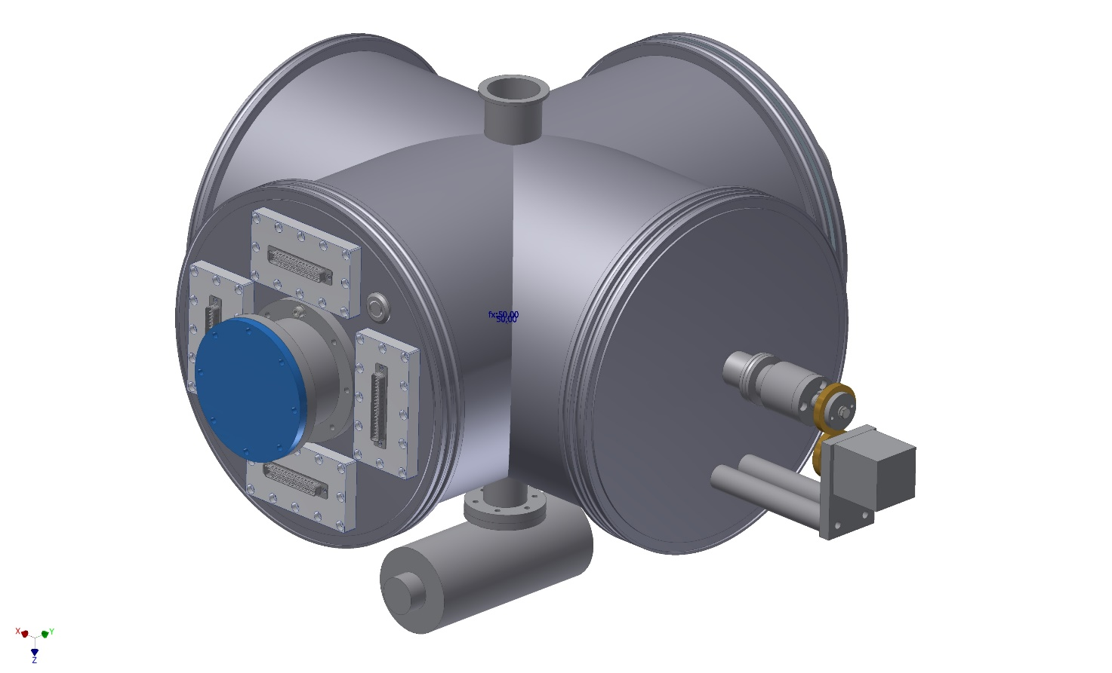
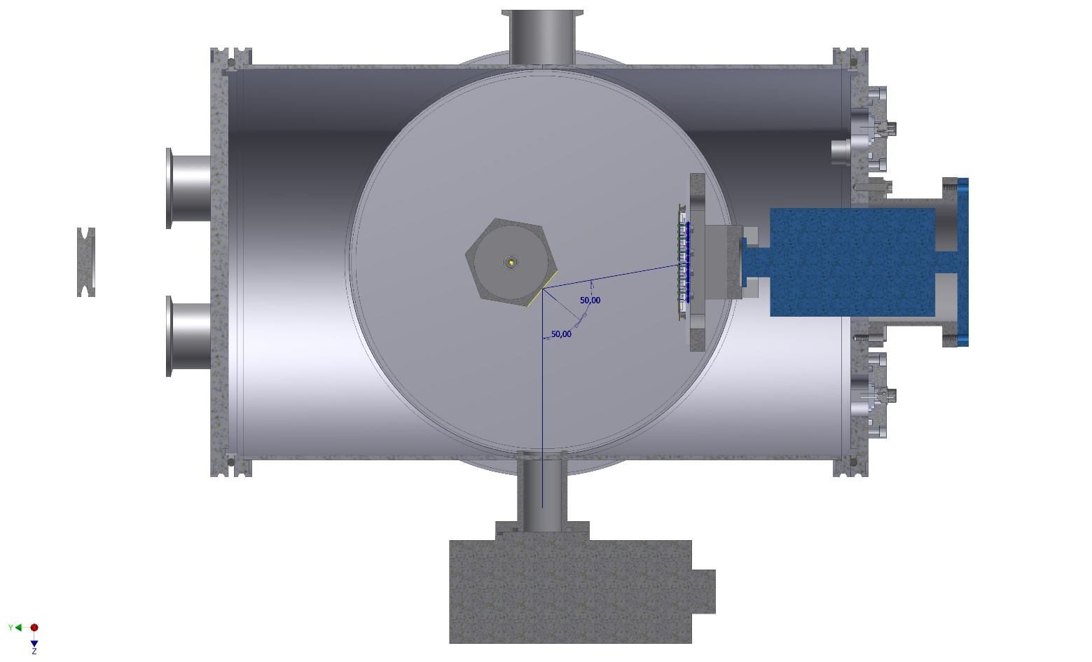
NEW SETUP
Dr. J. Zmeskal, Stefan Meyer Institute, Vienna
Frascati, 11/07/2017

Slide 26
Conclusions
Electronic conversion : Δ = 10⁻⁴
HV independent (100 – 170) V
Thermal Stability (SDD+CUBE) : Δ < 10⁻⁴ °C⁻¹
Resolution: 128 ± 3 eV (@ 120 K)
HV independent (100 – 170) V
T dependent (further investigation)
Drift time : 372 ± 8 ns (@ 110 K)
T dependent (further investigation)
Frascati, 11/07/2017

Slide 27
THANK YOU
Marco.Miliucci@lnf.infn.it

