Slide 1
LEMMA Test Beam
Marco Zanetti, Fabio Anulli
for the LEMMA team

Slide 2
Introduction
First experimental verification of positron induced low emittance muon beam
Test mu pair production at threshold with e+ beam on target
  Beam test in H4 (North Area) with a low intensity 45 GeV (√s~0.215 GeV) e+ beam
Goals:
  Measure emittance of outcoming muon pairs
  Measure production cross section as a function of √s and other properties of the production process
Setup:
  Extend AXIAL setup with extra silicon telescopes and a muon chamber from CMS

Slide 4
Calendar
Move components in experimental area parasitically during AXIAL test beam

Slide 5
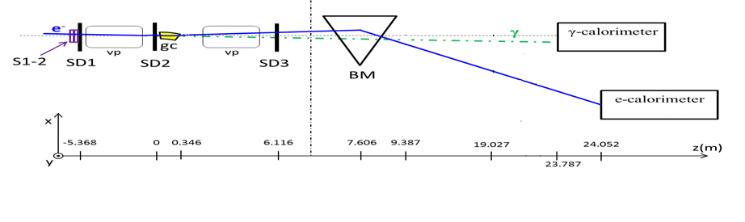
Setup
Si Strip detectors
(2x2 or 10x10 cm²)
μ⁺ line
3-6 cm Be target
absorber (iron)
SD5
CMS ECAL Tower
e⁺ (μ⁺)
SD4
SD6
DT Chamber
deflected e⁺-beam
SD5
30 X₀
SD6
μ⁻ line
Dipole magnet, 2.6 Tm
sampling calorimeter (for Bhabha veto)
23.787
24.052
24.60
25.60
26.20

Slide 6
Setup
Extend AXIAL setup:
  3 stations of 2x2 cm² 5 μm resolution silicon telescopes
  2 e/γ calorimeters
with:
  1 extra 2x2 cm² telescope and 4 10x10 cm² μm resolution telescopes
  1 muon chamber from CMS (Drift Tube, muon barrel chamber)
  Possibly 1 instrumented absorber
Targets:
  3 and 6 cm (1 and 2 X0) Be targets
Others:
  2.6 Tm dipole magnet, vacuum pipe, 30 X0 iron shield

Slide 7
Test Beam schedule
Start with a run (1 shift) of calibration run with a muon beam at various energies
Bulk of the test (6 days) with highest possible intensity e+:
  As high as 5e6 positrons/spill
    Likely to be ~2e6 positrons/spill
  One spill every ~30 seconds
  Aim at integrating 1e4 spills
Originally interested in a “low intensity”run with 45 GeV e+ on crystal target
  Go for that only if “spilled over” from AXIAL
  To be repeated next year with more appropriate target setup

Slide 8
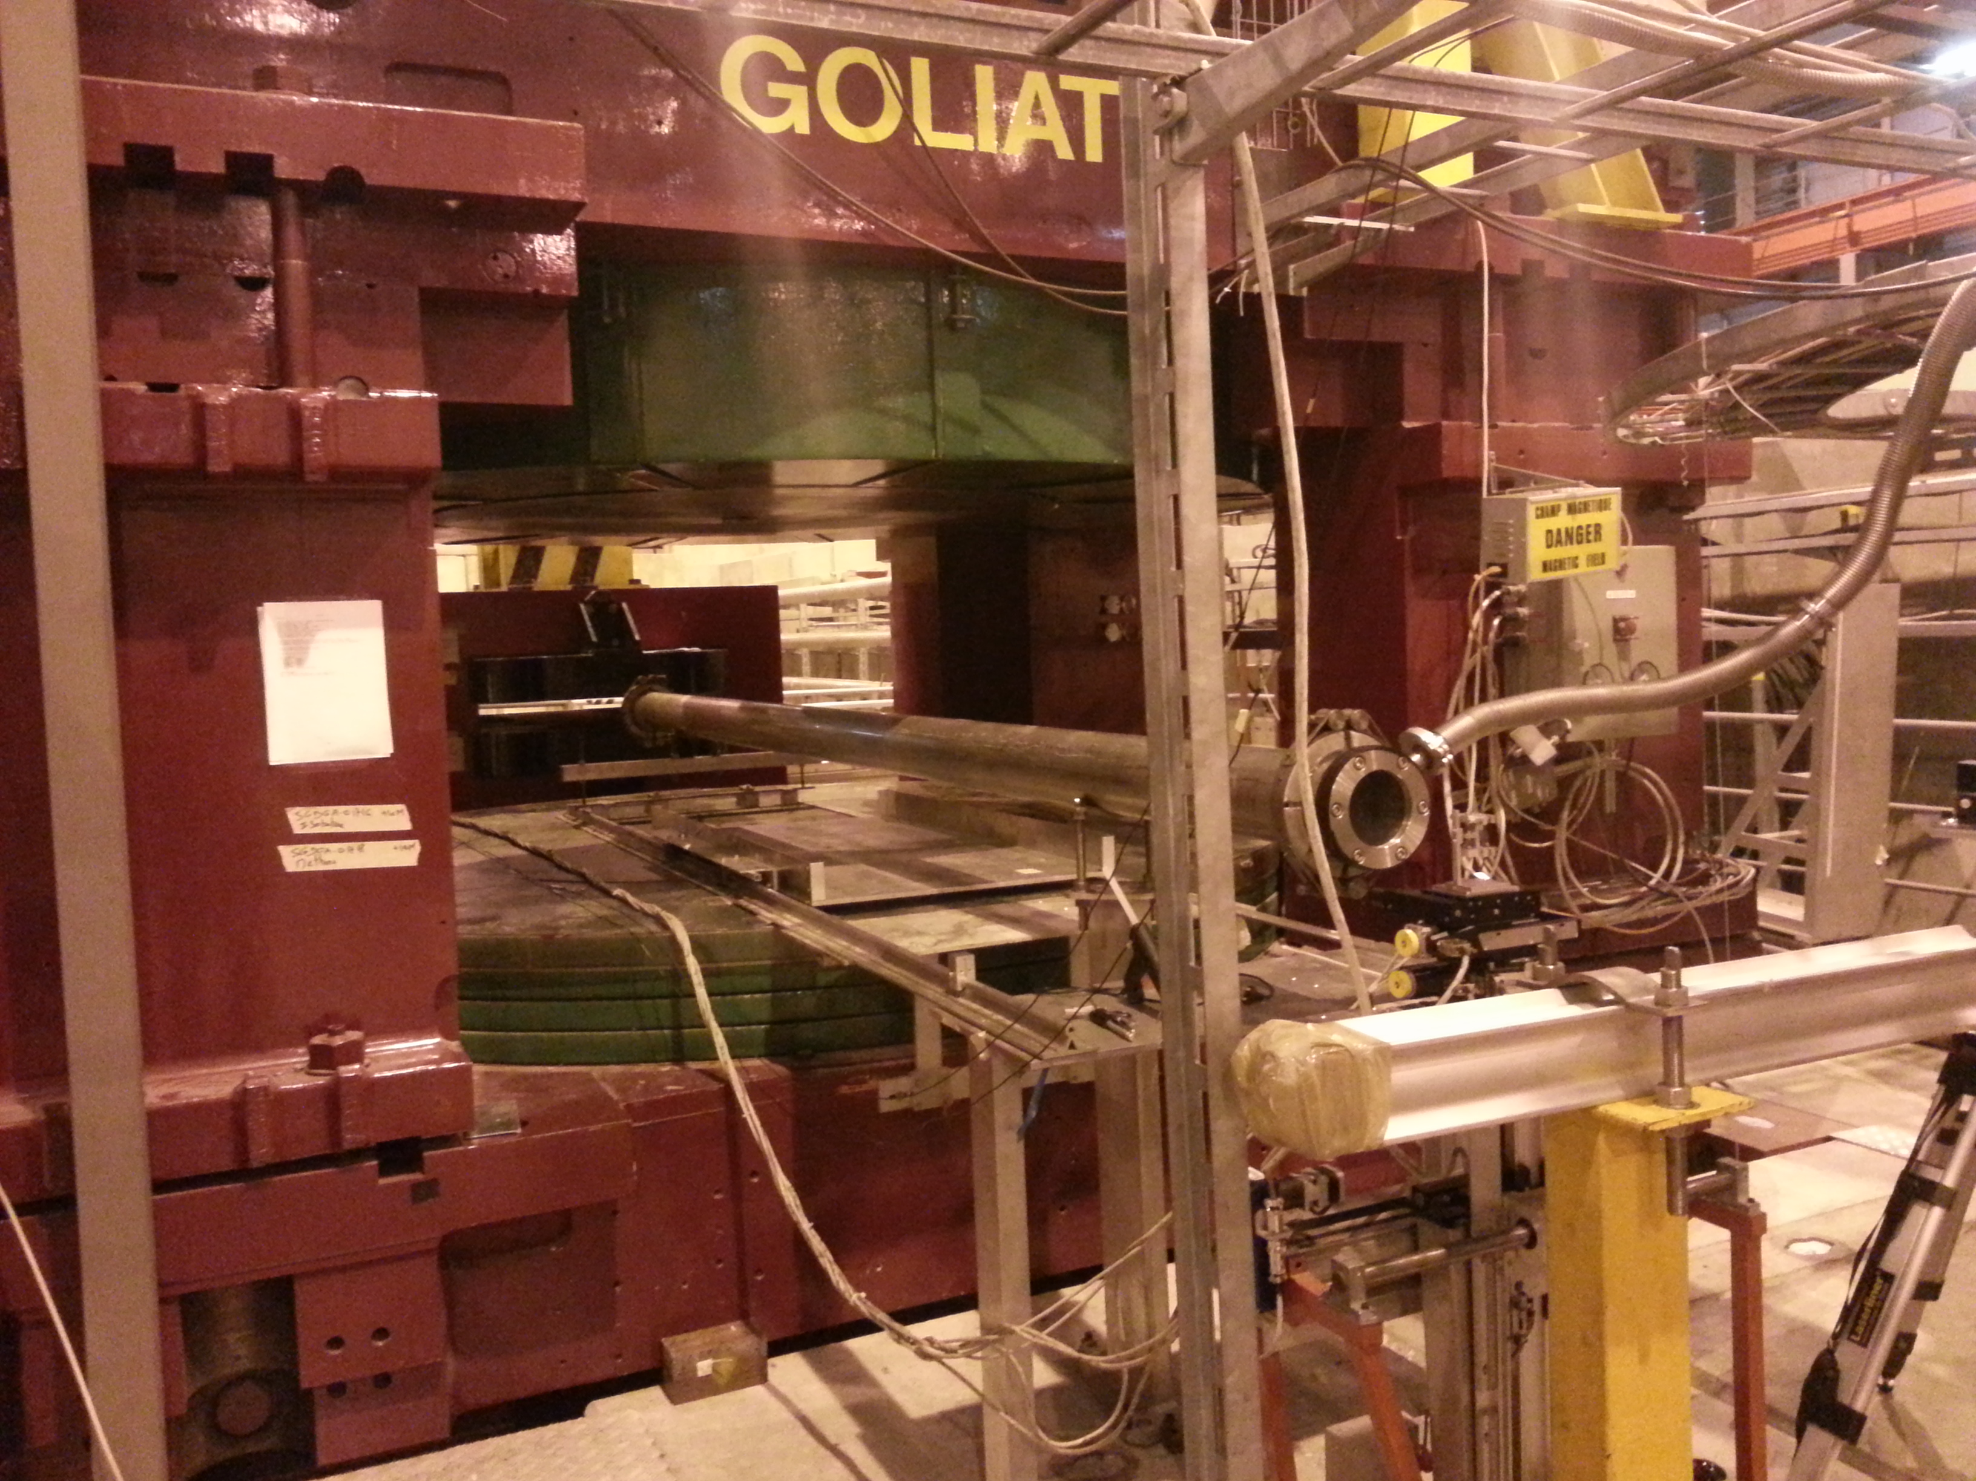
Experimental setup
Target

Slide 9
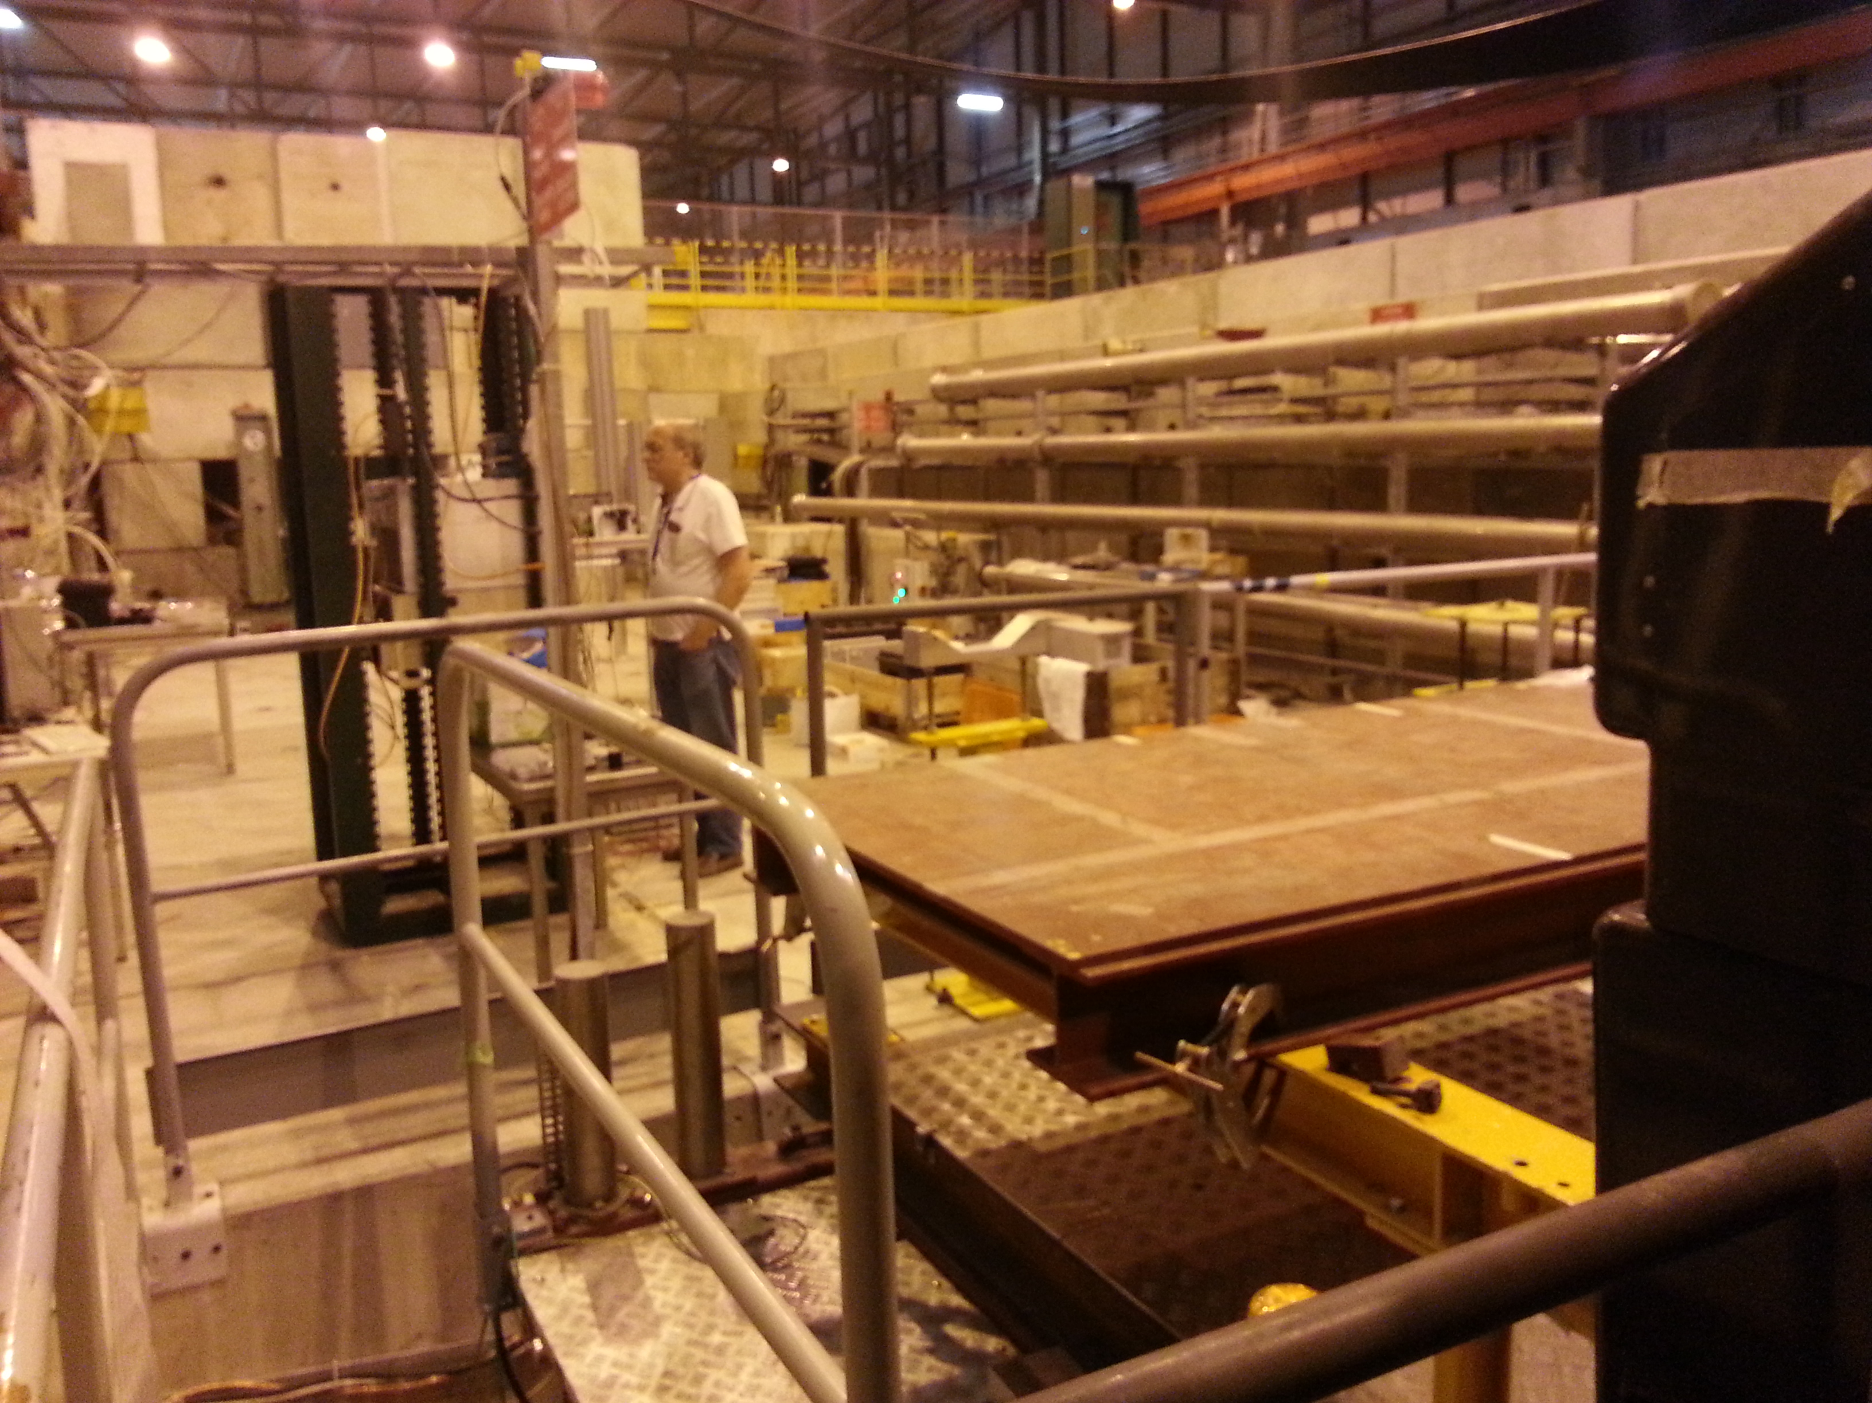
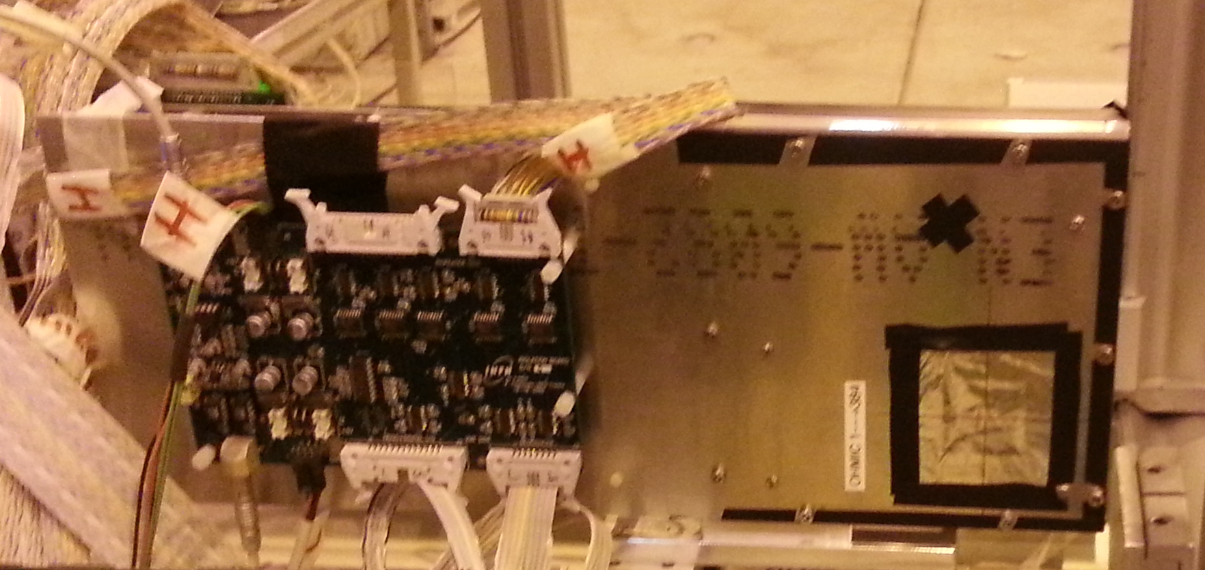
Experimental setup
Magnet
Si Strips

Slide 10
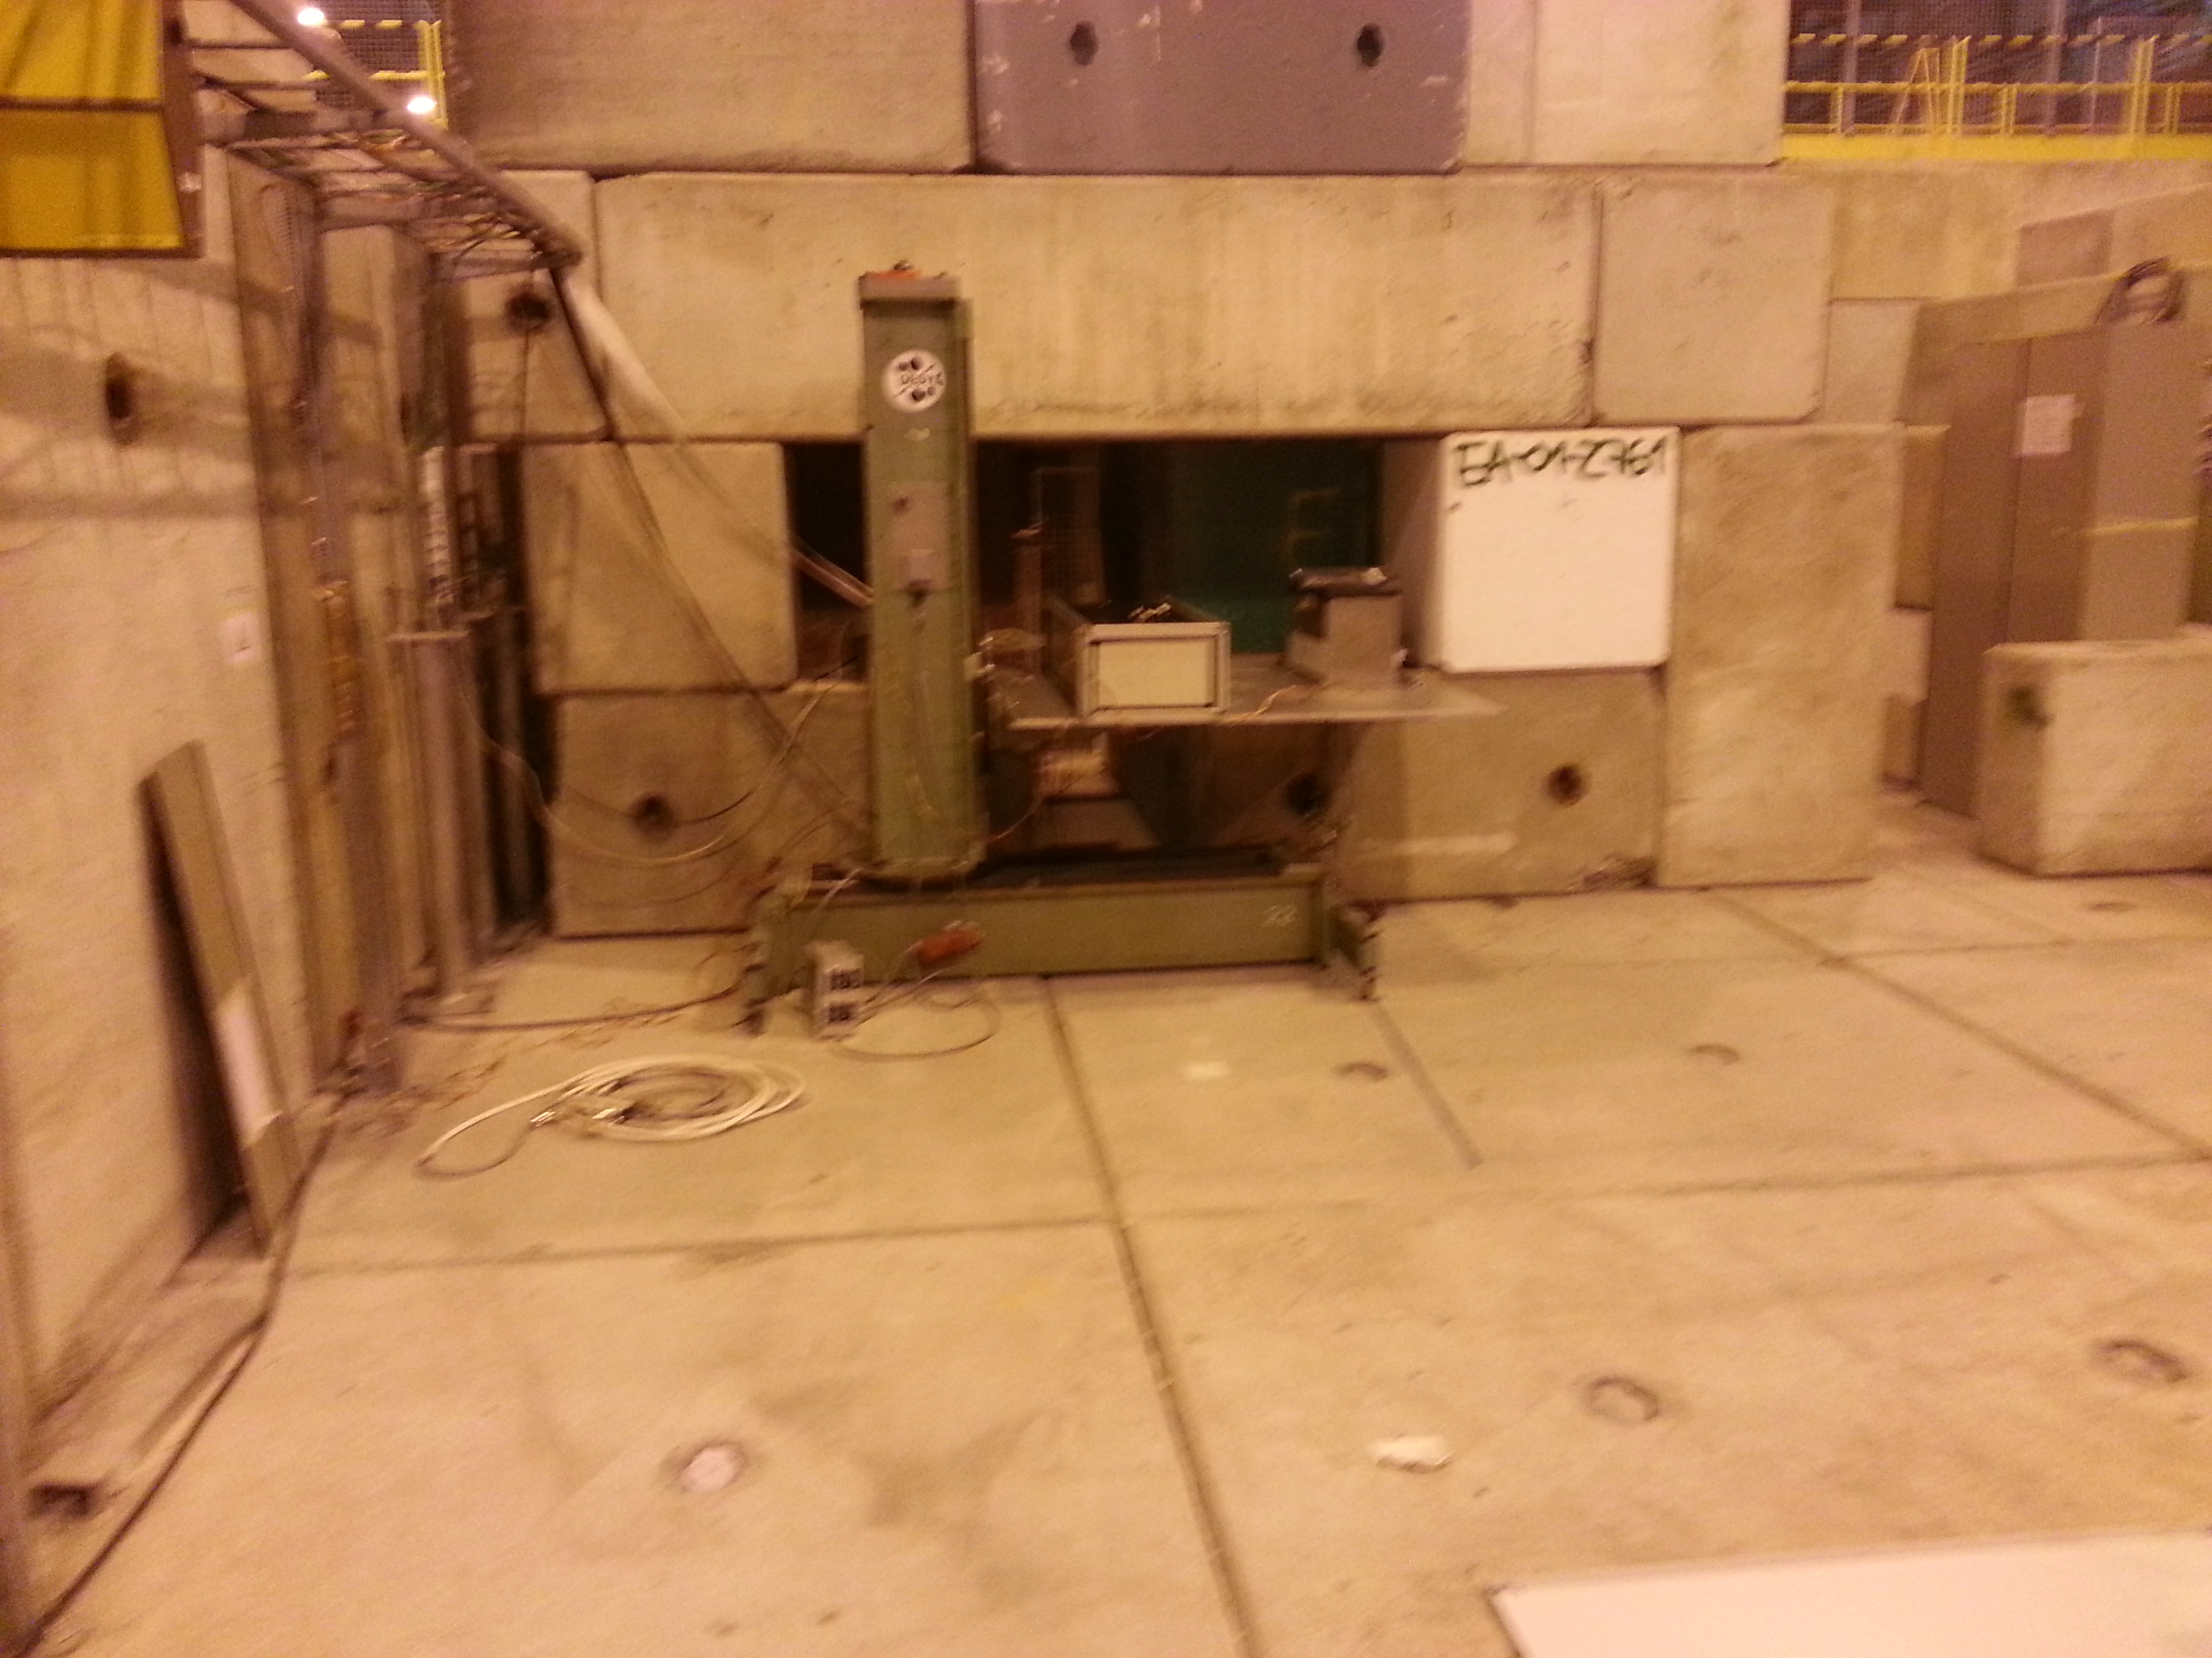
Experimental setup
DT position
Calorimeters
Low rad environment, all electronics can sit in the test beam area

Slide 11
Hardware status
Muon Chamber (CMS spare) moved to H4 in May (next to GIF++)
  Fully dressed up and powered up
  Fully functional, status routinely verified with cosmics runs
  Readout and services ready to be moved to TB area
Silicon telescopes
  Pads are being assambled (~12 kEuro), to be delivered at CERN next week
  Several spares have been validated in a test beam in May
Targets
  Both Be targets delivered to LNF
Instrumented absorber
  On a critical path, not sure can be there on time

Slide 12
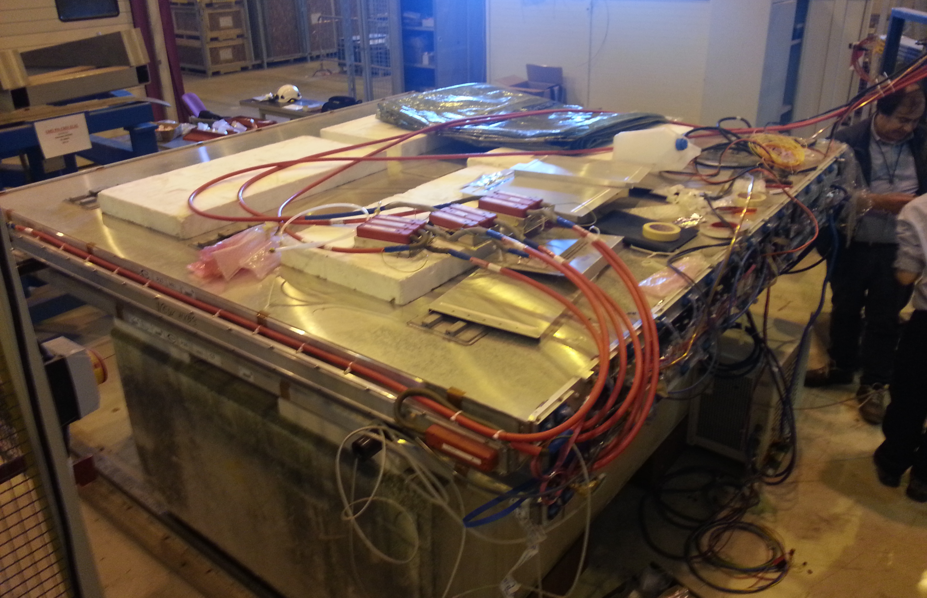
DT chamber in H4
Chamber fully “dressed up” to its final configuration

Slide 13
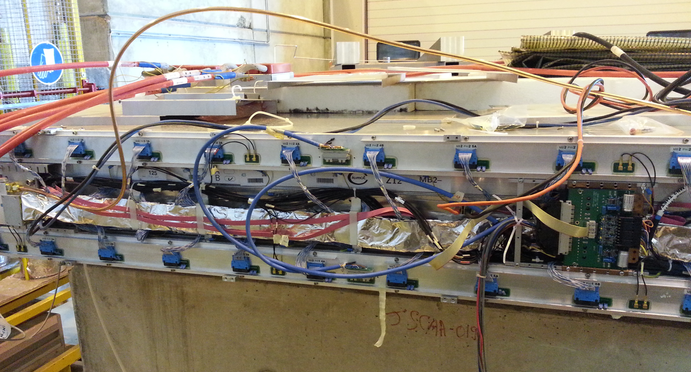
DT chamber in H4
Chamber fully “dressed up” to its final configuration

Slide 14
Instrumented absorber

Slide 15
The μ⁺μ⁻ event
Expected σ (ee→μμ) < 1 μb, 5 order of magnitudes smaller than Bhabha
  ➔ a few muon pairs per spill
Beam features:
  5e6 particle per spill, spot size: 1x1 cm2 (~flat), homogeneous in time
Particles lines:
  Electrons/positrons, muons and photons follow different paths.
  μ⁺ line “polluted” by positrons (mainly from beam)
  μ⁻ line basically clean
    x4 larger rate of electron with similar momentum
    Vetoed by instrumented absorber or by topological requirements
Signal event:
  two tracks in the DT chamber in well defined regions
  corresponding hits in the Si telescopes
    Si telescope dimensions/positions optimized to maximize acceptance

Slide 16
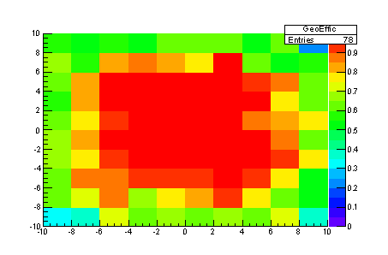
Acceptance
Very good geometrical acceptance assuming the nominal beam dimensions
  Denominator: all muon tracks produced in the target
  Numerator: tracks which crosses all the instrumented stations
in the white box, ± 5 mm, the efficiency is ~ 100 %
on average, WITH THE INPUT FLAT DISTRIBUTION, the efficiency is ~ 75 %

Slide 17
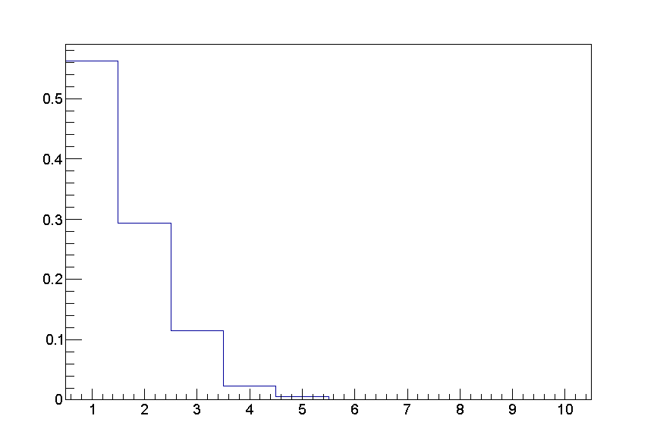
Trigger and readout
The muon chamber (self triggering) will provide the trigger
  >=1 muon stub:
    at least 7/8 hits in mending plane ➔ > 98% eff, <<1% from noise
  Possibly in AND with beam scintillators telescopes (AXIAL)
Si telescopes reading a <1 μs window
  Small “pileup expected”
0.5 ms readout time (from silicon)
  a few percent dead time if trigger rate smalle 100 Hz
Trigger background from cosmics
  ~300 Hz measured with chamber in horizontal position
  Expected to scale to 1/6 at most with a vertical chamber ➔ 50Hz
30 % of 2 positions
10 % of 3 positrons

Slide 18
Simulation setup

Slide 19
Patter recognition
Primary goal is to exploit the measurements from the detectors after the magnet to identify the muon hits in the “shared” Si telescopes
Propagation of muon direction through the magnet exploiting position-momentum correlation
  Can be improved if stubs direction also used
Done for μ⁻ only
  Exploit topological corralation for μ⁺

Slide 20
Extrapolation
Extrapolate hit position on Si telescopes with submillimeter resolution in both x (bending) and y planes

Slide 21
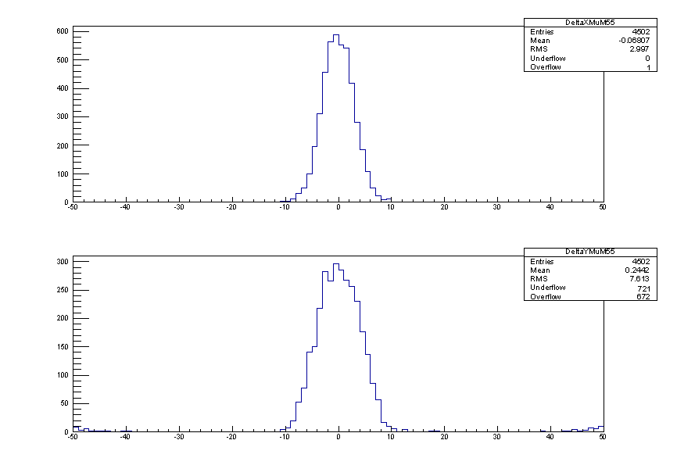
Monitoring
Such extrapolation can provide monitoring information, particularly for alignment purposes
A few millimeter resolution on hit position on 10x10 cm² Si telescopes from muon chamber stub

Slide 22
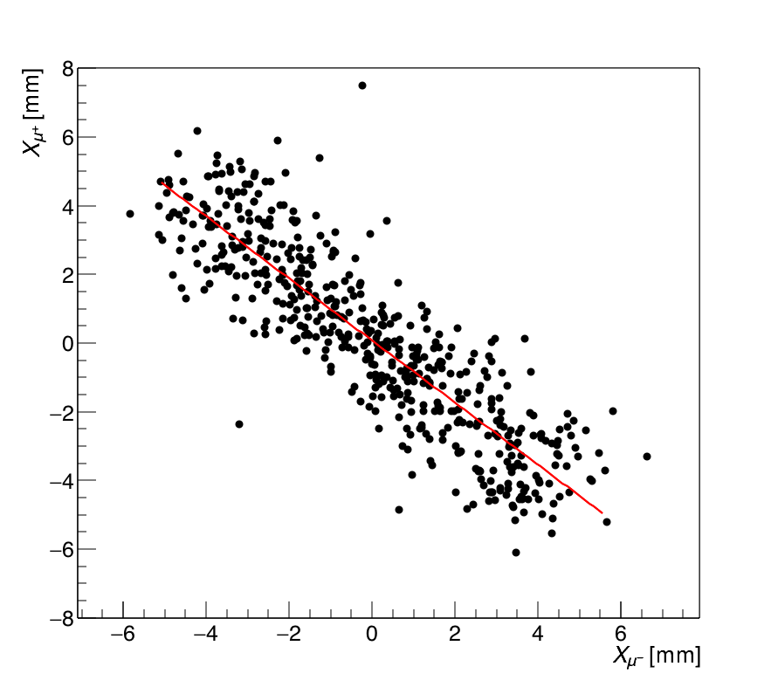
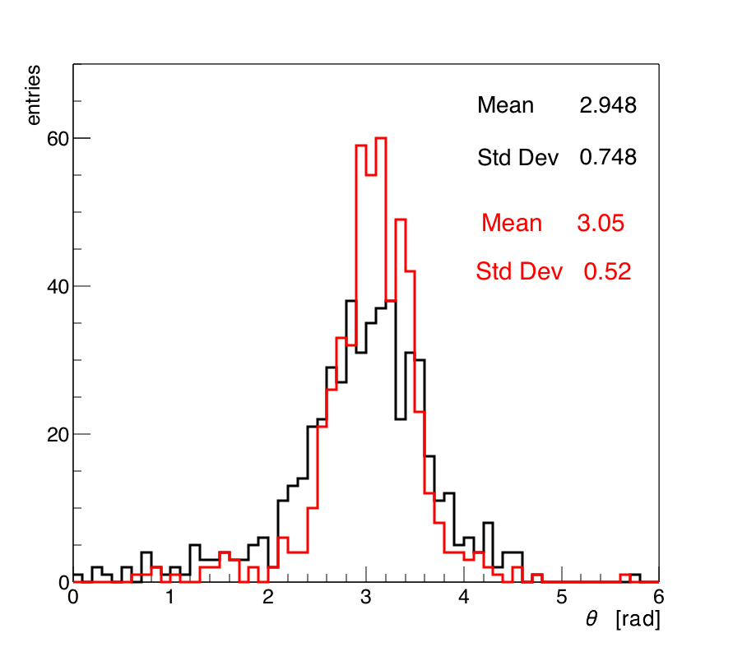
μ⁺μ⁻ position correlation
Bad extrapolation on μ⁺ due to iron shield
Possible however to exploit correlation between muons to identify μ⁺ hits
  Muons are back to back both in transverse plane both in the lab and CM frame
Position and angular correlation confirmed by simulation

Slide 23
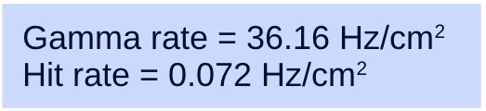
Photons on Muon Chambers
High rate of gammas can affect performances (hit, trigger and reconstruction efficiency) of the muon chamber
Checked on simulation: rate of gammas several order of magnitudes smaller than critical level

Slide 24
Momentum measurement
Once hits are identified, Si telescopes measurements can be used to assess muons momenta
Resolution ~0.3% considering only measurements errors
  B field to be mapped prior to the test

Slide 25
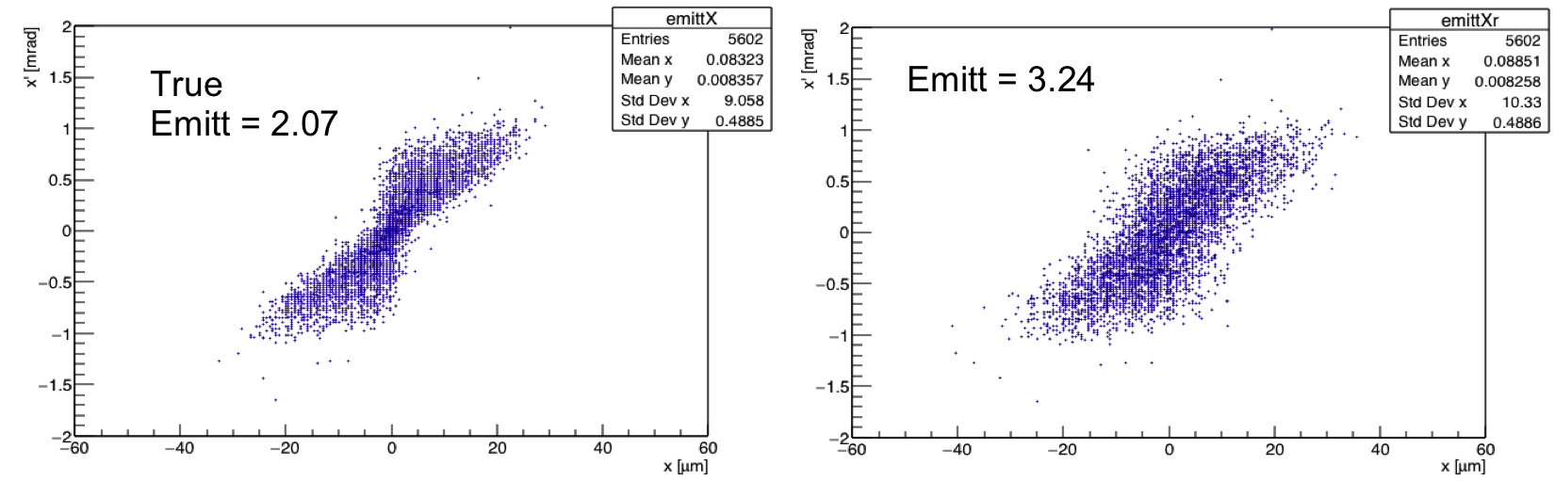
Emittance measurement
Preliminary results on emittance measurement are encouraging
Study to be repeated with final layout and number of telescopes

Slide 26
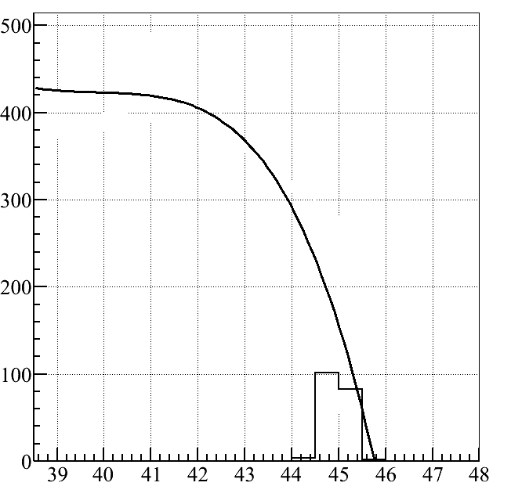
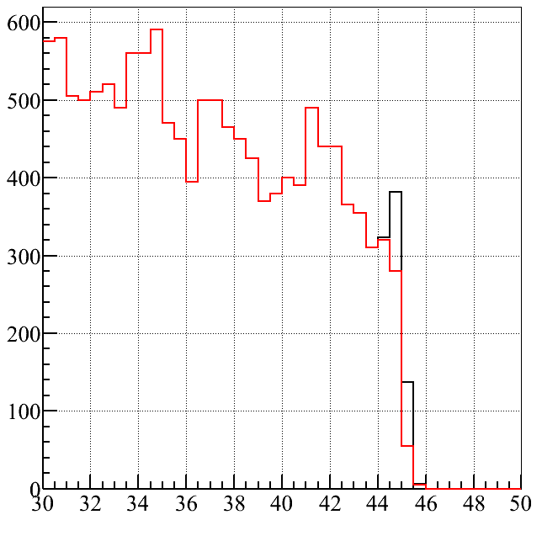
Rate Normalization
Can we use ee→gg to normalize our event rate?
Preliminary studies indicates it will be hard
  Signal overwhelmed by background photons
  ➔ To be further studied

Slide 27
Getting ready
Test Beam is approaching, ~3 weeks from now
Hardware is in good state
Trigger and readout are being worked out
  We plan an integration test with cosmics on July 18
Simulation provided very useful insight on what we will face at the test
  Reconstruction software being developed and validated
Services are being prepared
  Gas system, mechanical supports, chiller, logistic for the muon chamber
  Mechanical supports for the extra Si telescopes
  Alignment, B field measurements and other services from NA team

Slide 28
BACKUP

Slide 29
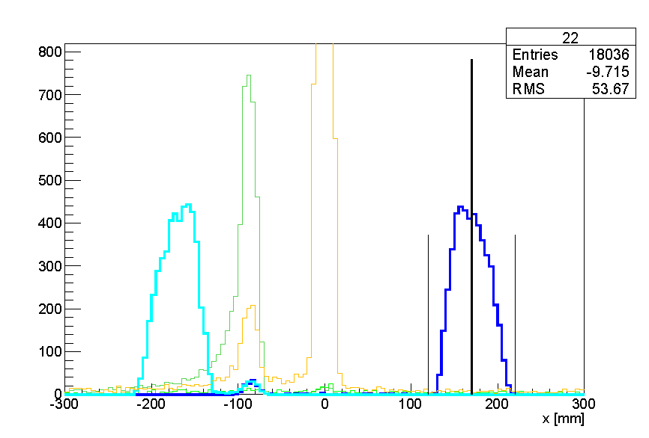
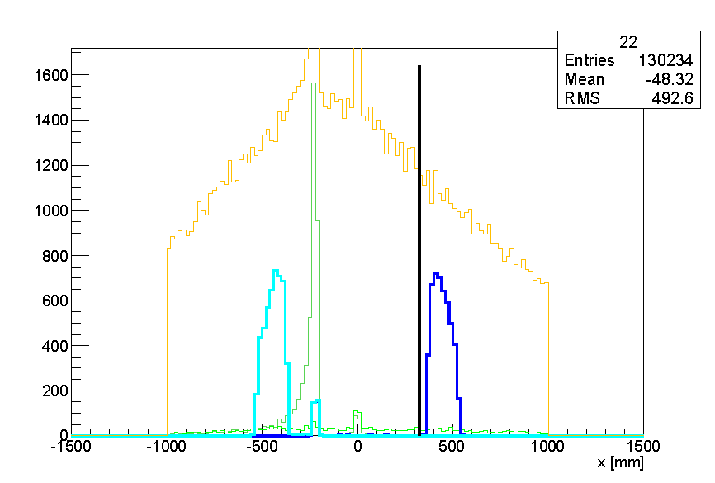
Particles positions

Slide 30
Integration test
Place a silicon telescope (10x10) physically above the muon chamber in H4
Trigger either with muon chamber itself or with a scintillator palette
Use the two crates
  Place them in the same rack
Services
  Aim at having the final set of services for muon chamber
  Telescope with its usual powering system
Could be a good chance to integrate the absorber as well
This will offer an excellent opportunity to test the reconstruction software. Need to get prepare for that!

Slide 31
Integration plan
Agreed setup (Erik – Sandro): separate crates, exchanging trigger/busy/reset signals
Muon Crate
Trigger
Busy
Reset
Event number
Silicons+Cal Crate

Slide 32
Integration plan
Agreed setup (Erik – Sandro): separate crates, exchanging trigger/busy/reset signals
DT crate as master
Writing two different ascii files, to be merged later (quasi online)
Preparation (DT side only):
  Integrate Erik’s board to exchange signals in DT crate
  Need a trigger throttling board (should be plenty of in LNL)

Slide 35
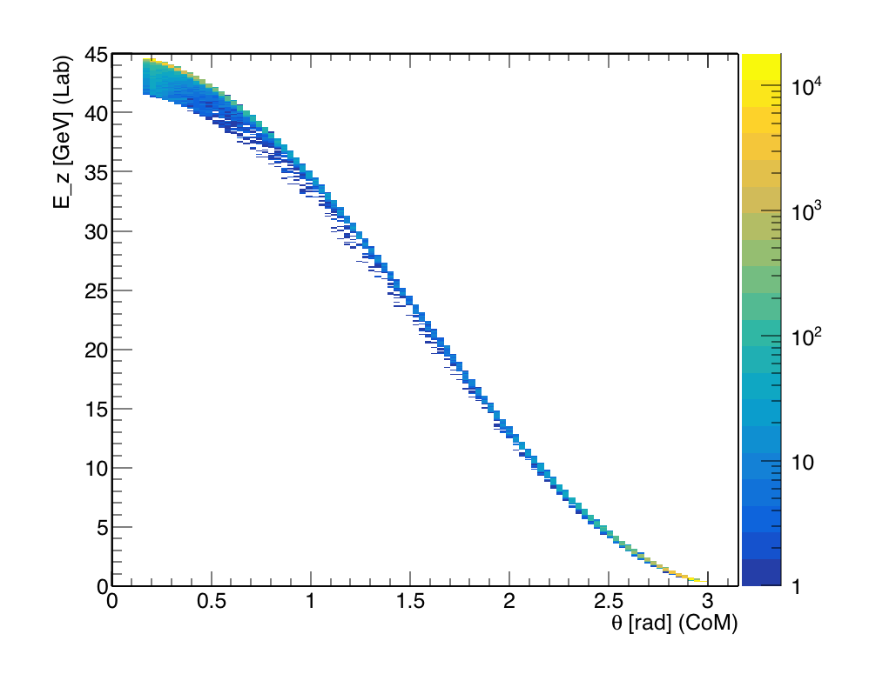
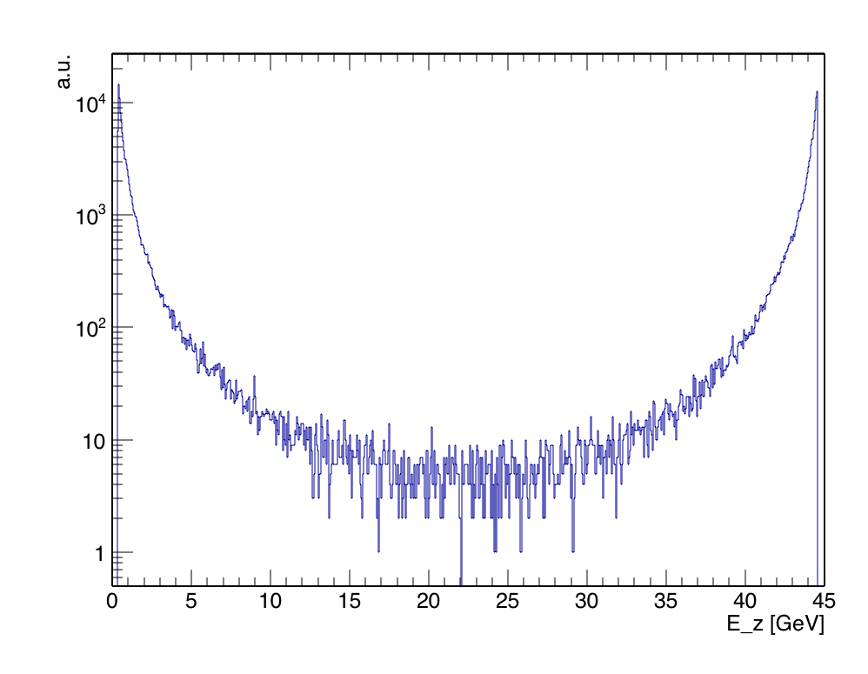
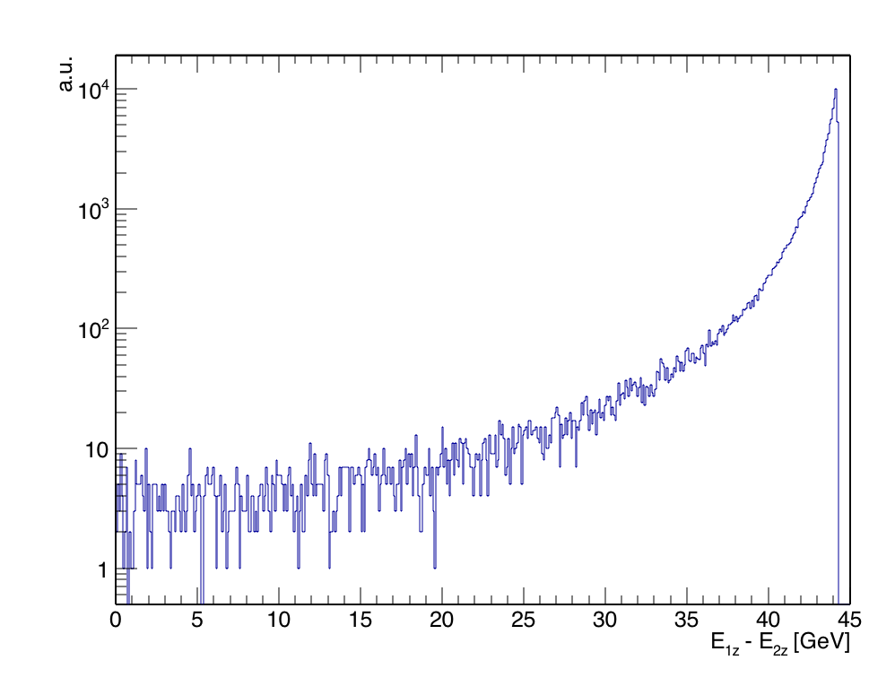
Bhabha
Bhabha cross section diverges at null scattering angle
Longitudinal momentum and angle fully correlated
Bulk of events are completely asymmetric in E_{z}

Slide 36
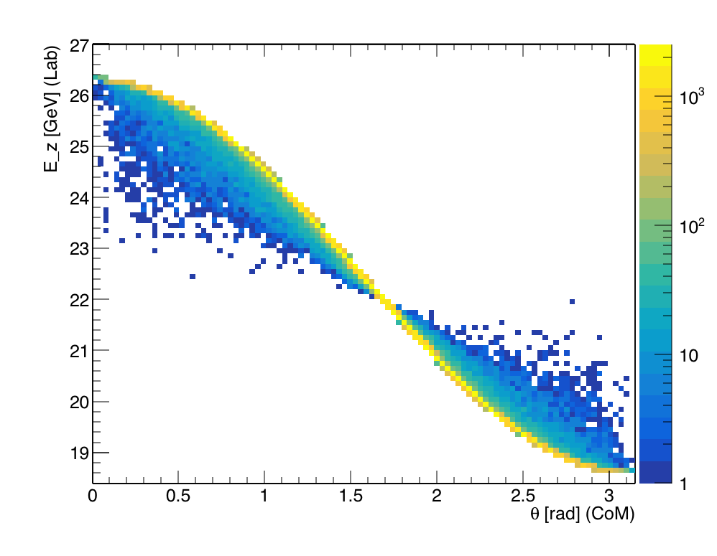
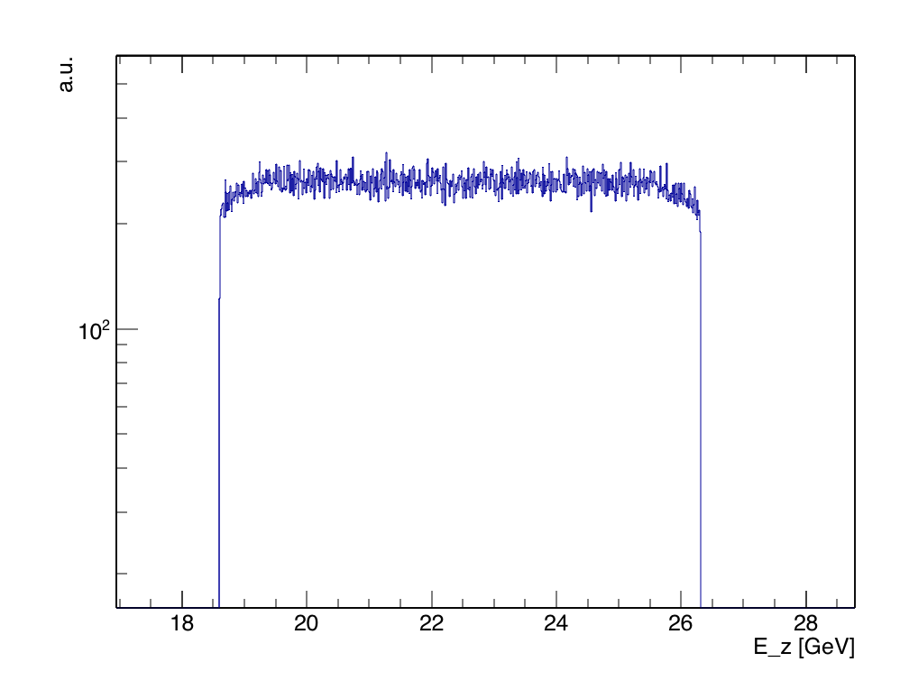
μ⁺μ⁻ production
Same E_{z}-θ correlation as Bhabha
Production at threshold ➔ Events kinematically constrained in a flat E_{z} window a few GeV wide
  ~8 GeV at √s=0.2145 GeV (45 Gev e⁺ beam)

Slide 37
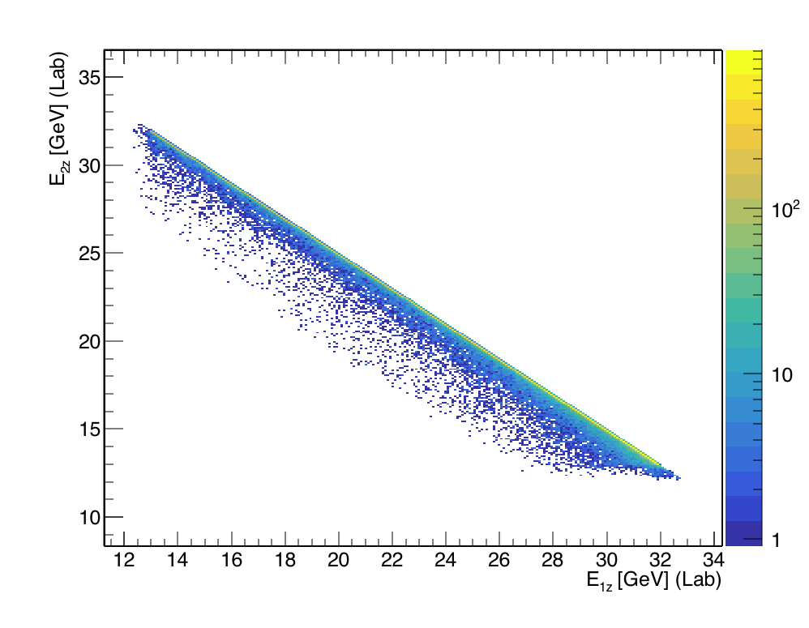
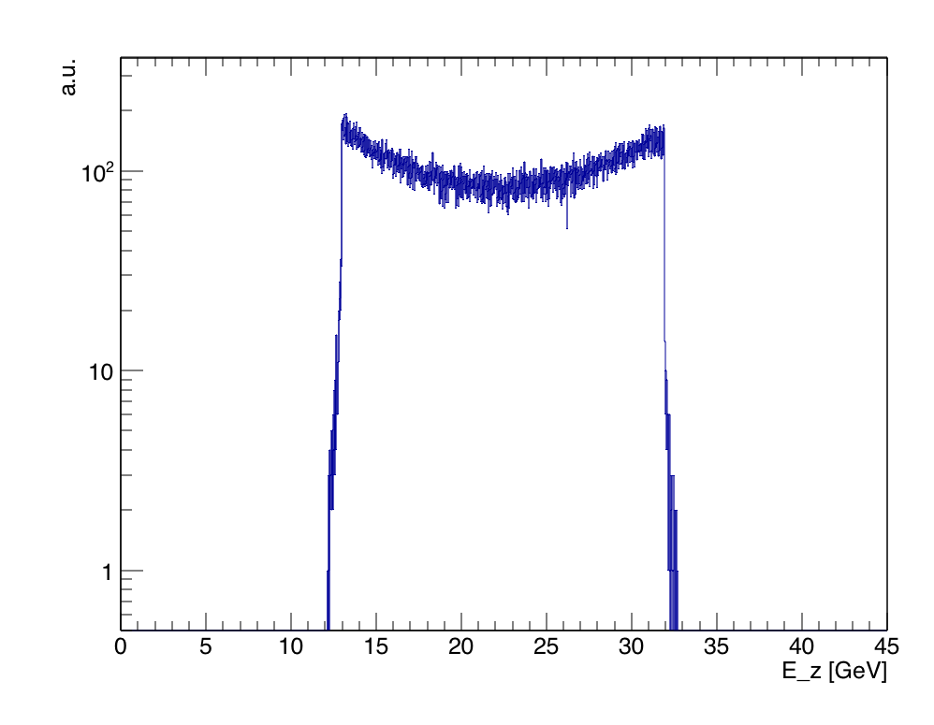
Cross sections comparison
Estimate Bhabha cross section for events kinematically similar to μ⁺μ⁻ from a sample restricted to high scattering angle
  σ(e⁺e⁻→μ⁺μ⁻)=1.88 μb
  Those events should be there in Geant too
To be compared with σ(e⁺e⁻→μ⁺μ⁻)(√s=0.2145) = 0.41 μb
Bhabha
55<θ<115

Slide 38
For discussion
We expect a similar rate (~x5) of Bhabha e⁺e⁻ following the μ⁺μ⁻ trajectories
➔ μ⁻ line still very clean
Can a 20 GeV electron be distinguished from a muon on the muon chamber?
Regardless the answer, the trigger (offline if not also online) is a pair of tracks in the muon chamber
  That is the case exclusively for μ⁺μ⁻ events
Given that, I’d leave the μ⁻ line free of absorbers which could only deteriorate the back-propagation of the muon track and its momentum/direction estimation.

