Slide 1
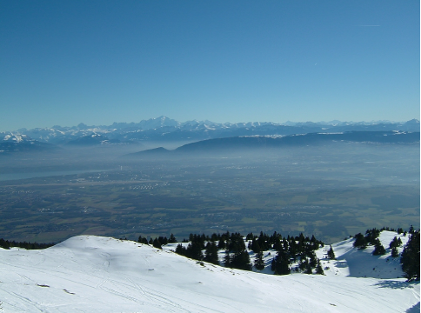


FCC-ee MDI studies
E.Belli
M.Migliorati, G.Rumolo
Acknowledgments: F. Bedeschi, M. Boscolo
RD_FA Collaboration Meeting
July 3, 2017 – CNAF, Bologna

Slide 2

E. Belli - FCC-ee MDI studies
Outline
      The FCC project
      Impedance studies
        Heat load due to resistive wall impedance
        Heat load due to geometric impedance
      Trapped modes
      Electron cloud studies
        EC induced heat load in the IR magnets
      Conclusions
2

Slide 3
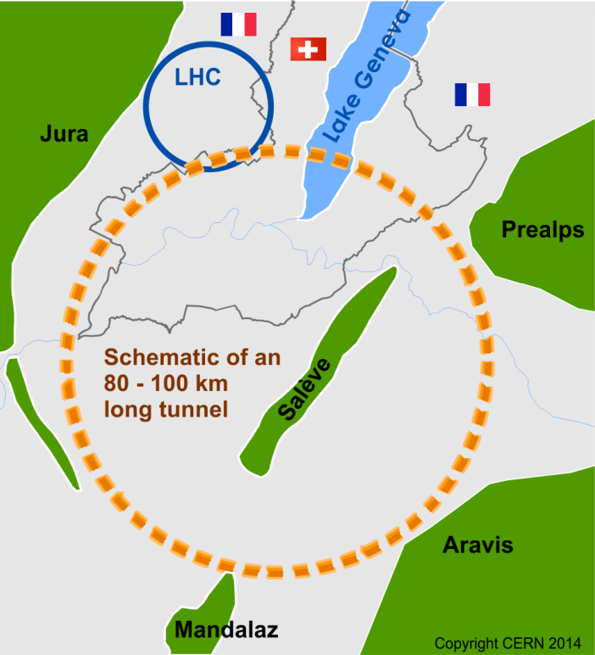
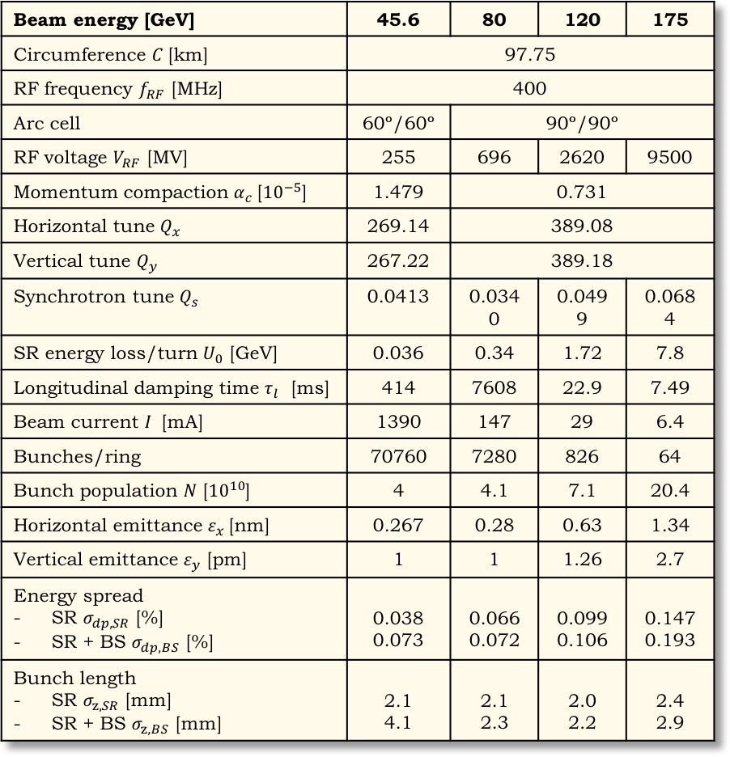
E. Belli - FCC-ee MDI studies
FCC-ee parameters 2017
      Within the Future Circular Collider studies, FCC-ee would be the first step towards the 100 TeV hadron collider FCC-hh
      Motivation: study the physics at the highest energy
Beam energy [GeV] | 45.6 | 80 | 120 | 175
Circumference $C$[km] | 97.75
RF frequency $f_{RF}$ [MHz] | 400
Arc cell | 60º/60º | 90º/90º
RF voltage $V_{RF}$ [MV] | 255 | 696 | 2620 | 9500
Momentum compaction $α_{c}$[${10}^{−5}$] | 1.479 | 0.731
Horizontal tune $Q_{x}$ | 269.14 | 389.08
Vertical tune $Q_{y}$ | 267.22 | 389.18
Synchrotron tune $Q_{s}$ | 0.0413 | 0.0340 | 0.0499 | 0.0684
SR energy loss/turn $U_{0}$ [GeV] | 0.036 | 0.34 | 1.72 | 7.8
Longitudinal damping time $τ_{l}$ [ms] | 414 | 7608 | 22.9 | 7.49
Beam current $I$ [mA] | 1390 | 147 | 29 | 6.4
Bunches/ring | 70760 | 7280 | 826 | 64
Bunch population $N$ [${10}^{10}$] | 4 | 4.1 | 7.1 | 20.4
Horizontal emittance $ε_{x}$[nm] | 0.267 | 0.28 | 0.63 | 1.34
Vertical emittance $ε_{y}$ [pm] | 1 | 1 | 1.26 | 2.7
Energy spread SR $σ_{dp,SR}$ [%] SR + BS $σ_{dp,BS}$ [%] | 0.038 0.073 | 0.066 0.072 | 0.099 0.106 | 0.147 0.193
Bunch length SR $σ_{z,SR}$ [mm] SR + BS $σ_{z,BS}$ [mm] | 2.1 4.1 | 2.1 2.3 | 2.0 2.2 | 2.4 2.9
3

Slide 4

E. Belli - FCC-ee MDI studies
Interaction Region
M. Sullivan
Be pipe at $±$ 80 cm, Cu elsewhere
15 mm radius at IP
15 mm radius for pipes through QC1
20 mm radius for pipes in QC2
30 mm radius outside QC2
4

Slide 5
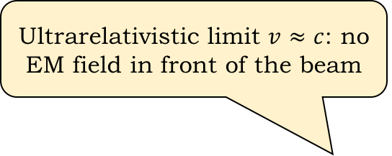



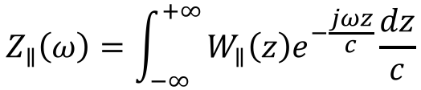
E. Belli - FCC-ee MDI studies
Wake fields and impedances
Ultrarelativistic limit $v≈c$: no EM field in front of the beam
Discontinuity → the source loses energy and the witness feels a force along the length of the discontinuity
Source $q_{1}$
$$z=−cτ$$
$$z$$
$$z$$
Witness $q_{2}$
Perfectly conducting smooth pipe → the witness does not feel any force from the source
Finite conductivity → Delayed EM fields due to a delay in the induced currents and the witness feels a force all along the length
Wake fields (time domain): electromagnetic fields generated by the interaction of the beam with the vacuum chamber
Beam coupling impedance (frequency domain):
$$Z_{∥}\left(ω\right)=\int_{−∞}^{+∞}{W_{∥}\left(z\right)e^{−\frac{jωz}{c}}\frac{dz}{c}}$$
5

Slide 6
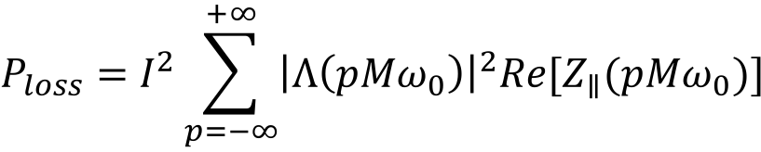
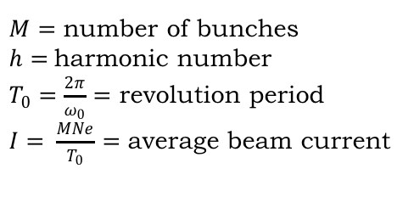
E. Belli - FCC-ee MDI studies
Heat load
      The energy loss of a beam can cause the heating of the environment
      FCC-ee beam pipes at room temperature
        No cryogenic systems
        Heat load can still represent an issue
        For an uniformly filled machine ($M=h$) with bunch spacing $τ_{b}=\frac{2π}{hω_{0}}$, the power loss depends only on the real part of the longitudinal impedance
$$P_{loss}=I^{2}\sum_{p=−∞}^{+∞}{{\left|Λ\left(pMω_{0}\right)\right|}^{2}Re[Z_{∥}(pMω_{0})]}$$
$M=$ number of bunches
$h=$harmonic number
$T_{0}=\frac{2π}{ω_{0}}=$ revolution period
$I= \frac{MNe}{T_{0}}=$ average beam current
Bunch spectrum
        Possible heat load sources in the IR
          RW impedance
          Geometric impedance
          HOMs
          Electron cloud
6

Slide 7
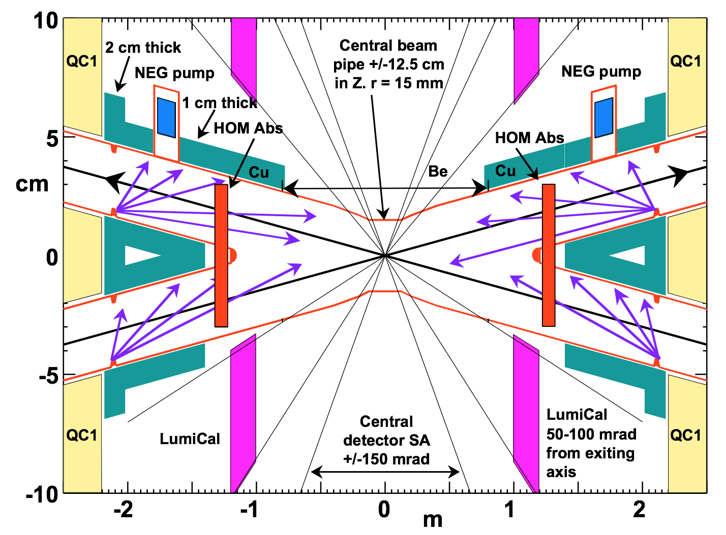
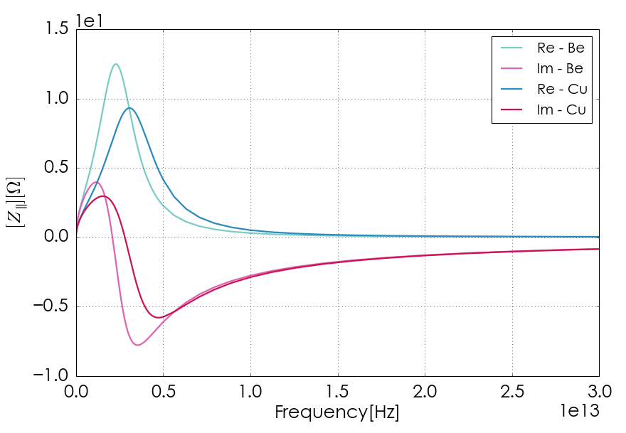
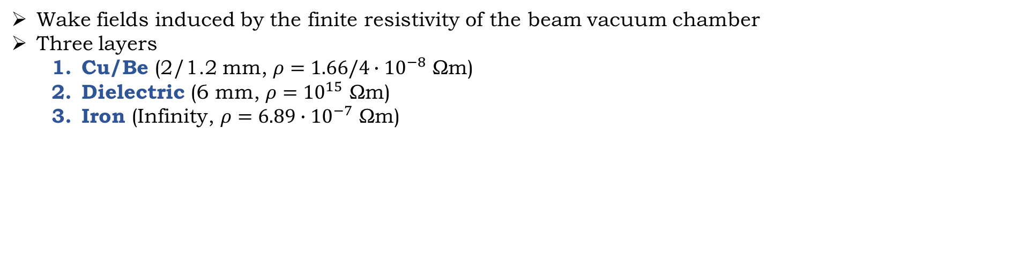
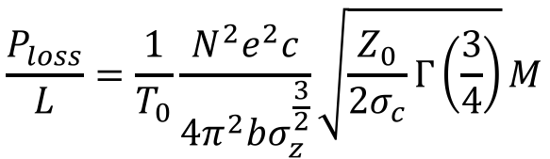
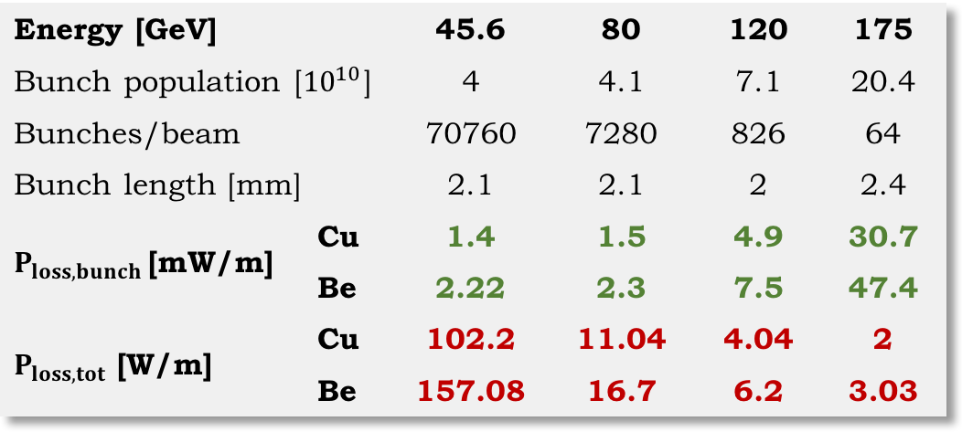
E. Belli - FCC-ee MDI studies
Resistive wall
Wake fields induced by the finite resistivity of the beam vacuum chamber
Three layers
  Cu/Be (2/1.2 mm, $ρ=1.66/4∙{10}^{−8}$ Ωm)
  Dielectric (6 mm, $ρ={10}^{15}$ Ωm)
  Iron (Infinity, $ρ={6.89∙10}^{−7}$ Ωm)
$$\frac{P_{loss}}{L}=\frac{1}{T_{0}}\frac{N^{2}e^{2}c}{4π^{2}bσ_{z}^{\frac{3}{2}}}\sqrt{\frac{Z_{0}}{2σ_{c}}Γ\left(\frac{3}{4}\right)}M$$
Analytic formula for a circular beam pipe with radius $b$
Energy [GeV] |  | 45.6 | 80 | 120 | 175
Bunch population [${10}^{10}$] |  | 4 | 4.1 | 7.1 | 20.4
Bunches/beam |  | 70760 | 7280 | 826 | 64
Bunch length [mm] |  | 2.1 | 2.1 | 2 | 2.4
$P_{loss,bunch }$[mW/m] | Cu | 1.4 | 1.5 | 4.9 | 30.7
 | Be | 2.22 | 2.3 | 7.5 | 47.4
$P_{loss,tot}$ [W/m] | Cu | 102.2 | 11.04 | 4.04 | 2
 | Be | 157.08 | 16.7 | 6.2 | 3.03
IW2D
7

Slide 8
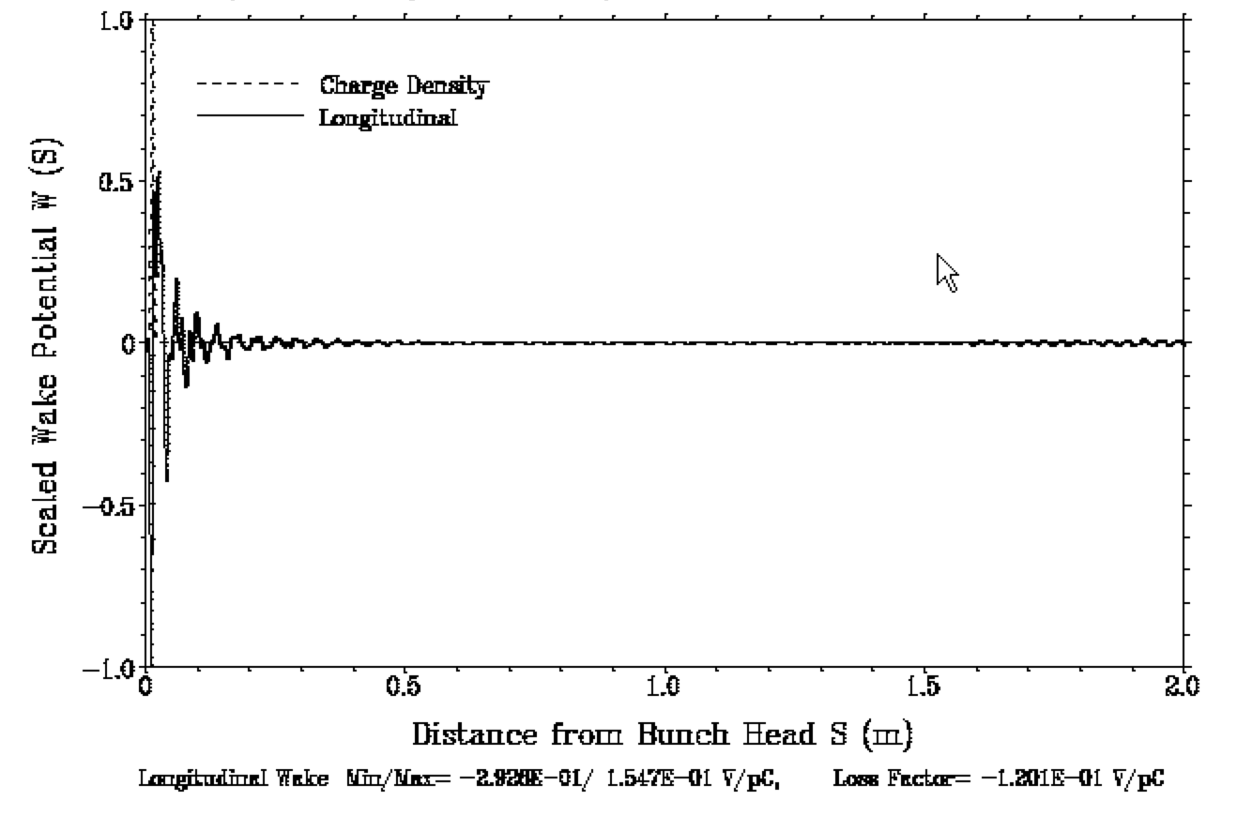
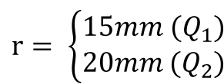
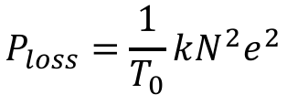
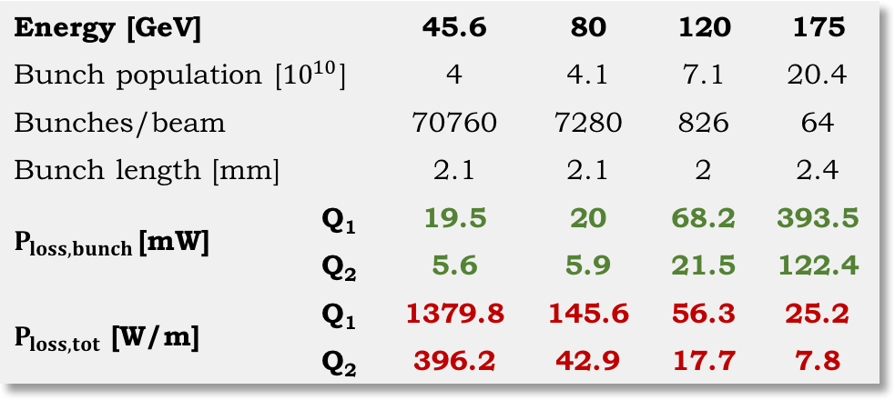


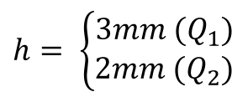
E. Belli - FCC-ee MDI studies
SR masks
ABCI
175 GeV
$$P_{loss}=\frac{1}{T_{0}}kN^{2}e^{2}$$
Energy [GeV] |  | 45.6 | 80 | 120 | 175
Bunch population [${10}^{10}$] |  | 4 | 4.1 | 7.1 | 20.4
Bunches/beam |  | 70760 | 7280 | 826 | 64
Bunch length [mm] |  | 2.1 | 2.1 | 2 | 2.4
$P_{loss,bunch }$[mW] | Q₁ | 19.5 | 20 | 68.2 | 393.5
 | Q₂ | 5.6 | 5.9 | 21.5 | 122.4
$P_{loss,tot}$ [W/m] | Q₁ | 1379.8 | 145.6 | 56.3 | 25.2
 | Q₂ | 396.2 | 42.9 | 17.7 | 7.8
h
r
l_{tr}
l
$$l_{tr}=1cm$$
$$h= \left\{\begin{aligned}3mm (Q_{1}) \\ 2mm (Q_{2})\end{aligned}\right.$$
$$r= \left\{\begin{aligned}15mm (Q_{1}) \\ 20mm (Q_{2})\end{aligned}\right.$$
$$l=2cm$$
8

Slide 9
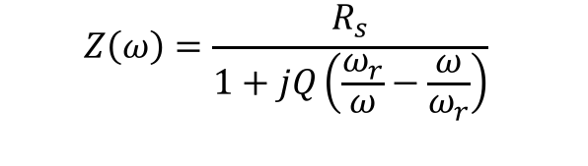
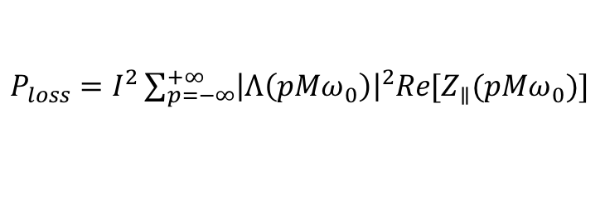
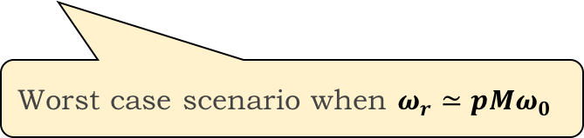
E. Belli - FCC-ee MDI studies
Trapped modes
Small variations in the geometry of the pipe can generate accidental cavities and produce trapped modes
These modes cannot propagate into the pipe and therefore they remain localized near the discontinuity, producing narrow resonance peaks of the impedance.
Possible source of heating
Model: BB resonator
  $$Z\left(ω\right)=\frac{R_{s}}{1+jQ\left(\frac{ω_{r}}{ω}−\frac{ω}{ω_{r}}\right)}$$
$P_{loss}=I^{2}\sum_{p=−∞}^{+∞}{{\left|Λ\left(pMω_{0}\right)\right|}^{2}Re[Z_{∥}(pMω_{0})]}$
Worst case scenario when $ω_{r}≃p{Mω}_{0}$
9

Slide 10
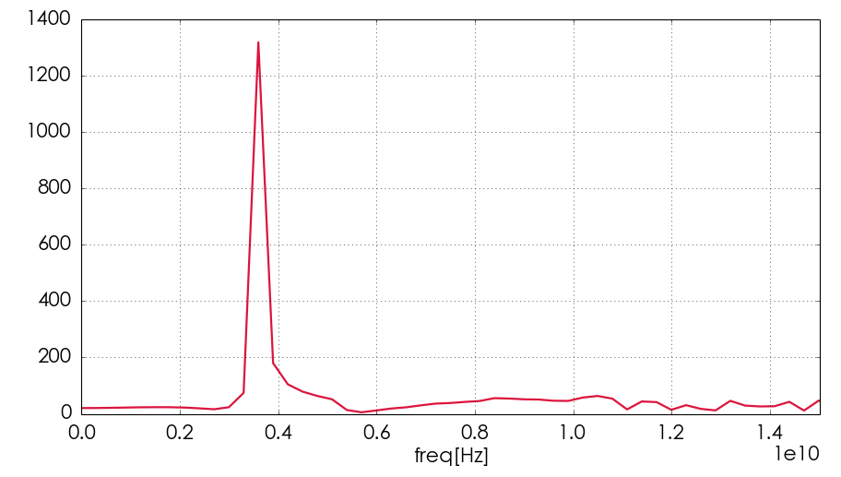
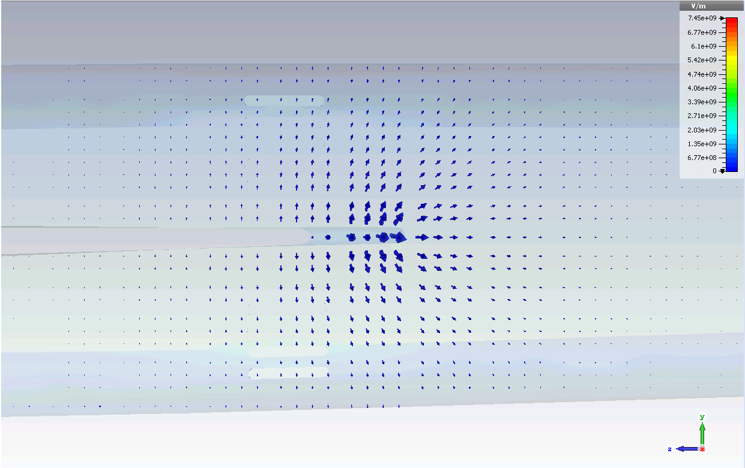
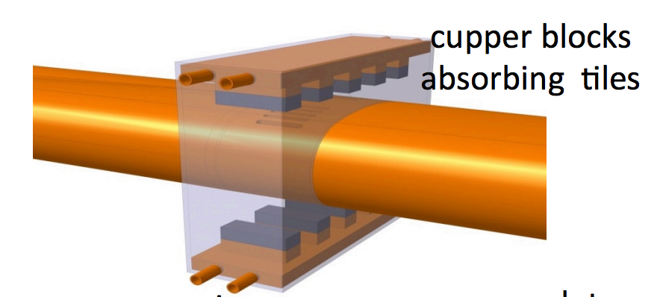

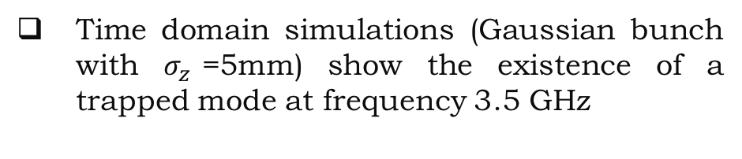
E. Belli - FCC-ee MDI studies
Trapped modes
Time domain simulations (Gaussian bunch with $σ_{z}$=5mm) show the existence of a trapped mode at frequency 3.5 GHz
Frequency domain simulations confirmed the presence of this mode
CST
CST
$$ℱ\{W_{∥}\}$$
Electric field lines perpendicular to the beam trajectory
Longitudinal slots perpendicular to the HOM field
Water-cooled absorber on these slots
A. Novokhatsky
10

Slide 11

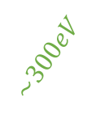








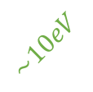
E. Belli - FCC-ee MDI studies
Electron cloud
Positively charged bunches passing through a section of an accelerator
Primary or Seed Electrons
  Residual gas ionization
  Photoemission due to synchrotron radiation (photoelectrons)
$e^{−}$ emitter
$e^{−}$ absorber
1
Primaries attracted and accelerated by the beam to energies up to several hundreds of eV
3
Absorbed or reflected (no secondaries generation)
Property of the surface
Beam pipe
Lost
$e^{−}$ emitter
$$\sim 300eV$$
$$\sim 300eV$$
$$\sim 10eV$$
$e^{−}$ absorber
$$\sim 10eV$$
Bunch
$$\sim 300eV$$
$$SEY(E)= \frac{I_{emit}}{I_{imp}(E)}$$
$$\sim 10eV$$
t
Bunch spacing
2
5
Emission of secondary electrons (energies up to few tens of eV)
4
Avalanche electron multiplication
(multipacting effect)
Accelerated by the following bunch (secondaries production)
11

Slide 12
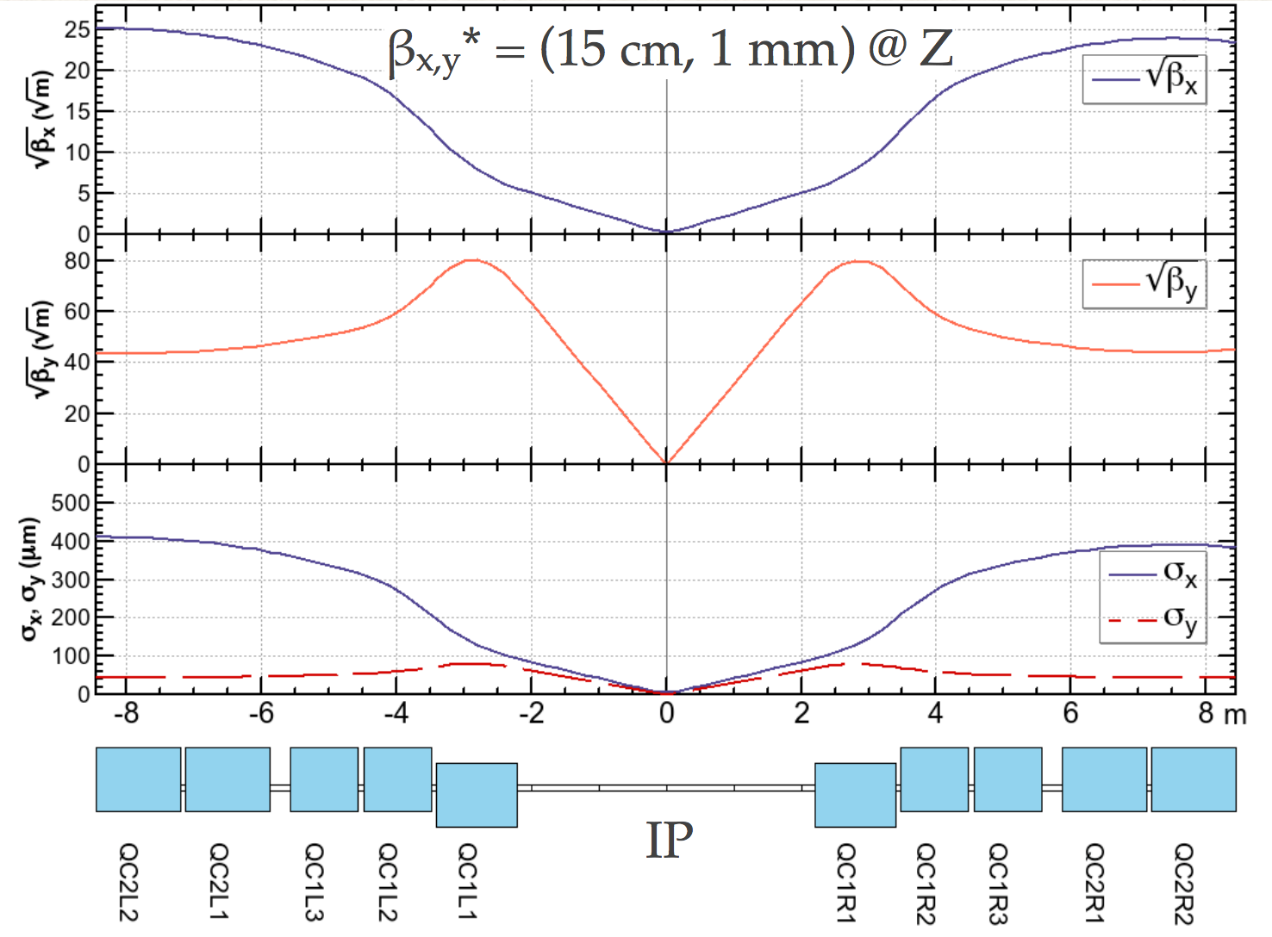
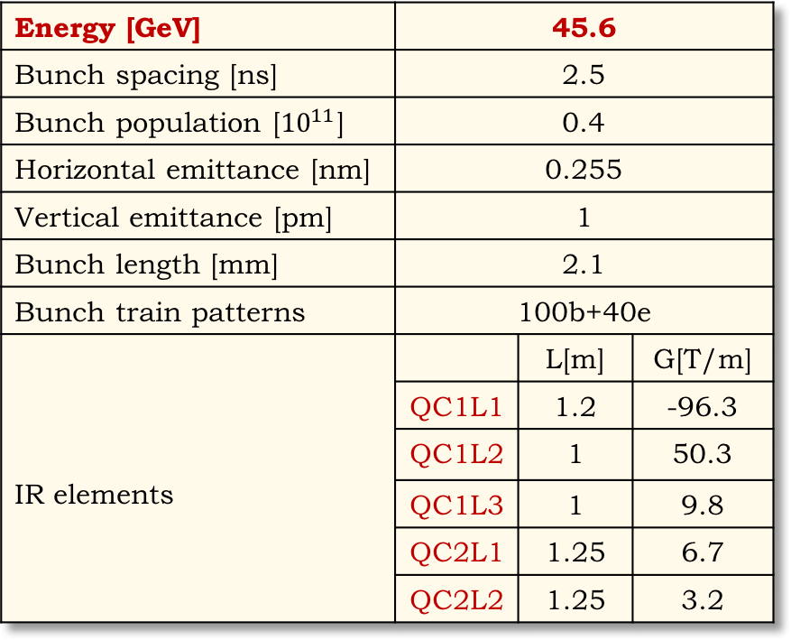
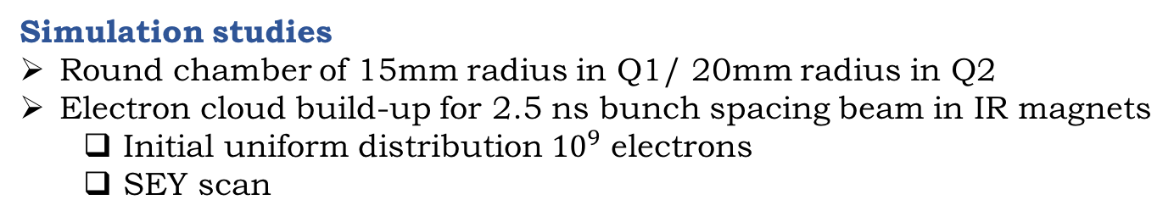
E. Belli - FCC-ee MDI studies
EC build up studies
Energy [GeV] | 45.6
Bunch spacing [ns] | 2.5
Bunch population [${10}^{11}$] | 0.4
Horizontal emittance [nm] | 0.255
Vertical emittance [pm] | 1
Bunch length [mm] | 2.1
Bunch train patterns | 100b+40e
IR elements |  | L[m] | G[T/m]
 | QC1L1 | 1.2 | -96.3
 | QC1L2 | 1 | 50.3
 | QC1L3 | 1 | 9.8
 | QC2L1 | 1.25 | 6.7
 | QC2L2 | 1.25 | 3.2
Simulation studies
Round chamber of 15mm radius in Q1/ 20mm radius in Q2
Electron cloud build-up for 2.5 ns bunch spacing beam in IR magnets
  Initial uniform distribution ${10}^{9}$ electrons
  SEY scan
12

Slide 13
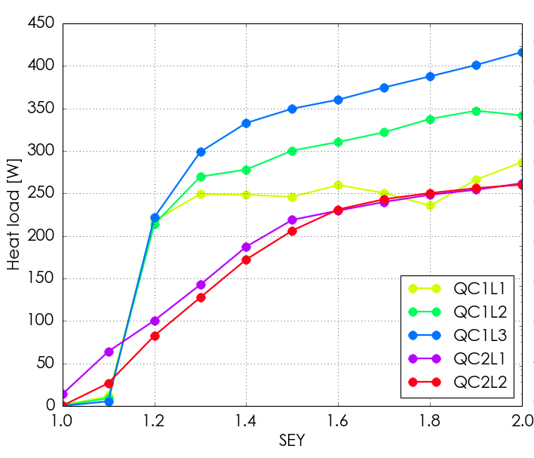
E. Belli - FCC-ee MDI studies
EC induced heat load
SEY < 1 to run the machine IR without electron cloud
13

Slide 14
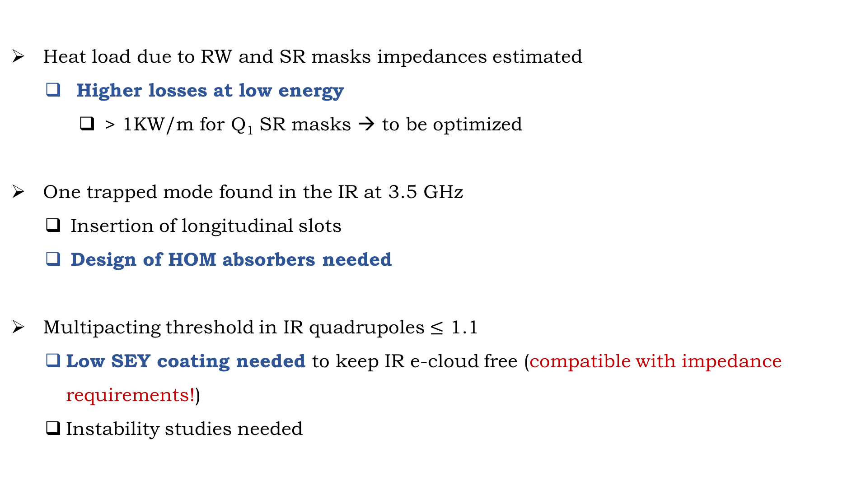
E. Belli - FCC-ee MDI studies
Conclusions
      Heat load due to RW and SR masks impedances estimated
        Higher losses at low energy
          > 1KW/m for Q₁ SR masks → to be optimized
      One trapped mode found in the IR at 3.5 GHz
        Insertion of longitudinal slots
        Design of HOM absorbers needed
      Multipacting threshold in IR quadrupoles $≤$ 1.1
        Low SEY coating needed to keep IR e-cloud free (compatible with impedance requirements!)
        Instability studies needed
14

Slide 15
Thanks for your attention

