Slide 1


WP2: MDI
Stato e piani futuri
M. Boscolo
for the RD_FA MDI group
RD_FA Collaboration Meeting
3-4 Luglio 2017, Bologna

Slide 2
Anagrafica MDI 2018
M. Boscolo (INFN-LNF), N. Bacchetta (INFN-Pd), E. Belli (Rm1),
O. G. Blanco (LNF), F. Collamati (Rm1), M. Migliorati (Rm1), M. Zobov (LNF)
MDI FCC-ee
M. Boscolo (convener), N. Bacchetta (co-convener), E. Belli, O. G. Blanco, M. Migliorati, M. Zobov, F. Collamati
MDI FCC-hh
M. Boscolo, F. Collamati
Activity supported by EU-H2020, EuroCirCol
Anagrafica 2017: M. Boscolo, N. Bacchetta, F. Collamati

Slide 3
Current Activity on MDI
FCC-ee
great progress in the IR layout, now defined in many details, thanks to the combined effort of many people
Two workshops since last collaboration meeting in November:
  two-weeks workshop @CERN only on MDI (Jan.’17) http://indico.cern.ch/event/596695
  FCC WEEK17
  in addition to monthly meetings and weekly meetings by CERN group on detector side
dedicated talk by E. Belli later
FCC-hh
characterization of the SR into the IR together with software tools developments, SR power into the detector estimated
dedicated talk by F. Collamati later
Future Plan: next year will be crucial: studies will be finalized in view of the CDR, to be ready for mid-2019, for the European Strategy Update

Slide 4
Some details on the
Main Features of the FCC-ee MDI design
Present baseline optics works well for all beam energies, L*=2.2 m fulfills the requirements.
Symmetric beam pipes in the FF.
Detector Lumical from 1.0 m to 1.2 m from the IP.
Compensating solenoid in present design starts at 1.25 m.
Warm beam pipe, water cooled .
central beam pipe = 30 mm
beam pipe aperture @QD0 =30 mm
beam pipe aperture masks tip
beam pipe aperture@QF1 = 40 mm
after QF1 = 60 mm

Slide 5
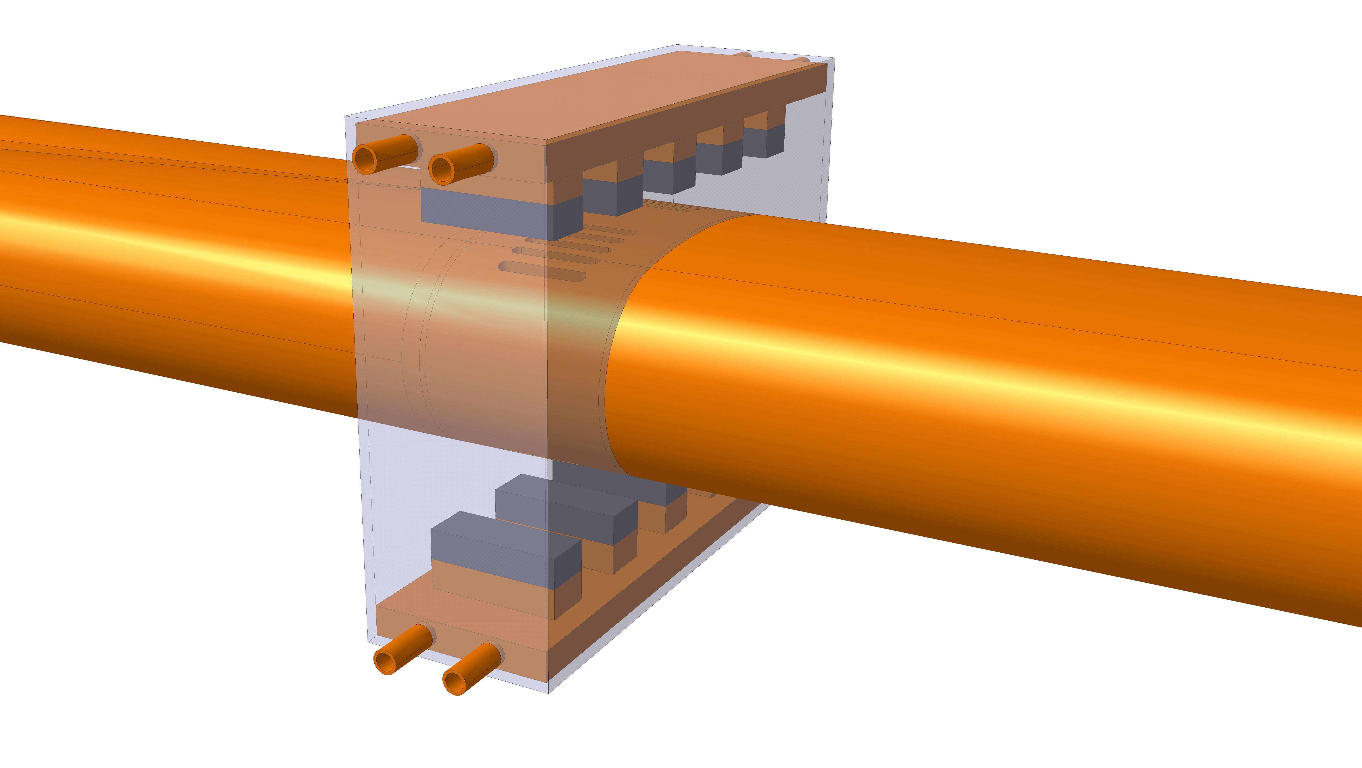
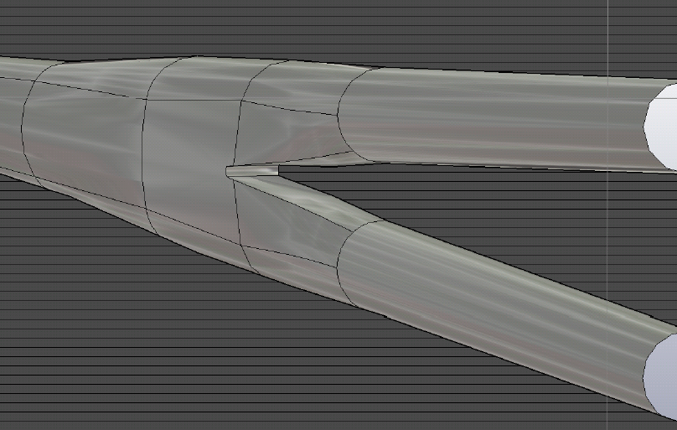
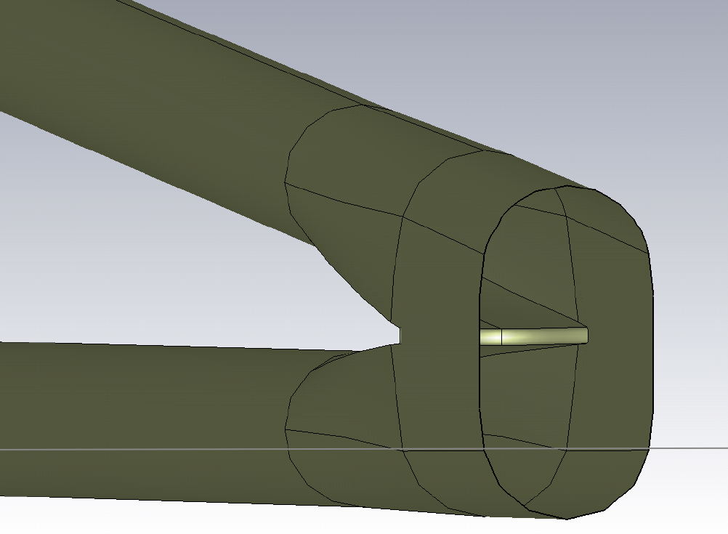
IR Beam pipe design for wake field calculations
Two beam pipes are merged into one central pipe in the IR
Professional CAD design of the complicated IR geometry done,
essential for:
CST/HFSS numerical studies for generated and/or absorbed e.m. fields, propagating or trapped in the IR
water cooling of the beam pipe needed to avoid HOM heating in the IR chamber due to absorption of e.m. fields
HOM absorber design in progress in the central chamber, following the PEP-II experience.
side view
HOM Absorber

Slide 6
Solenoid Compensation Scheme
Constraints:
  2T detector field
  L*=2.2m
  Space (i.e. only 6.6 cm distance at the tip closest to IP for QD0)
  must be inside the lumical acceptance ~140-170 mrad
  final focus quads inside the detector (low βy* and large crossing angle)
  leave space for luminosity detector at small angle
  field quality at each end and all along the FF quads ≲ 10⁻⁴ for all multipoles
  emittance blow-up much smaller than 1 pm
Particles on the beam axis are not on the detector axis, so they will experience vertical dispersion, that brings vertical emittance blow-up. Due to the low nominal ε_{y}~1 pm, this effect needs to be cured. A compensating and screening solenoid scheme has been designed.

Slide 7
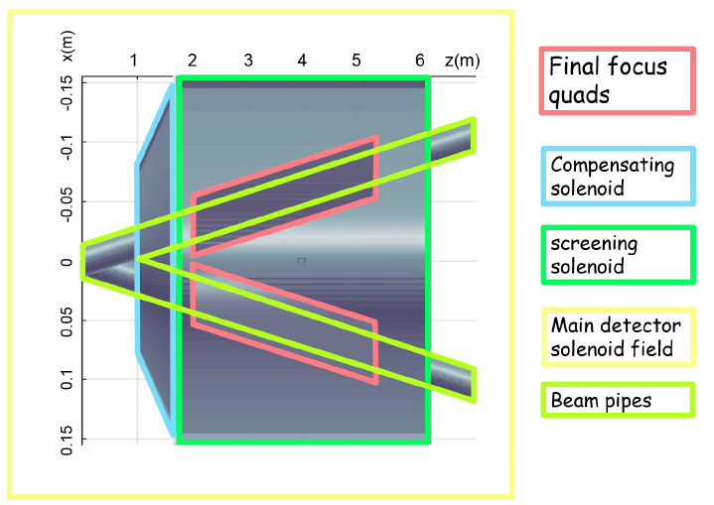
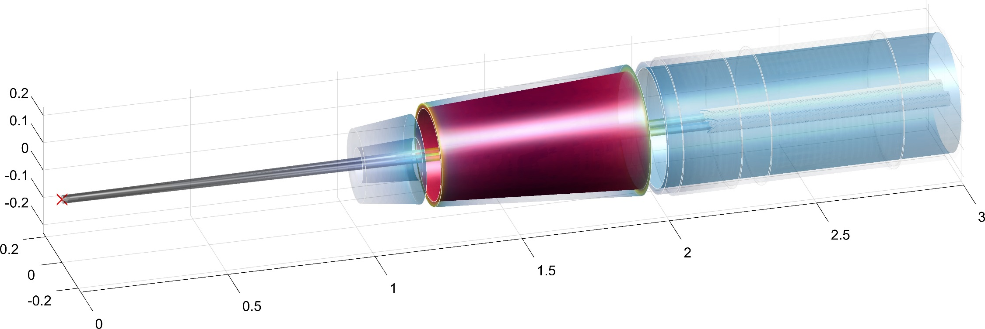
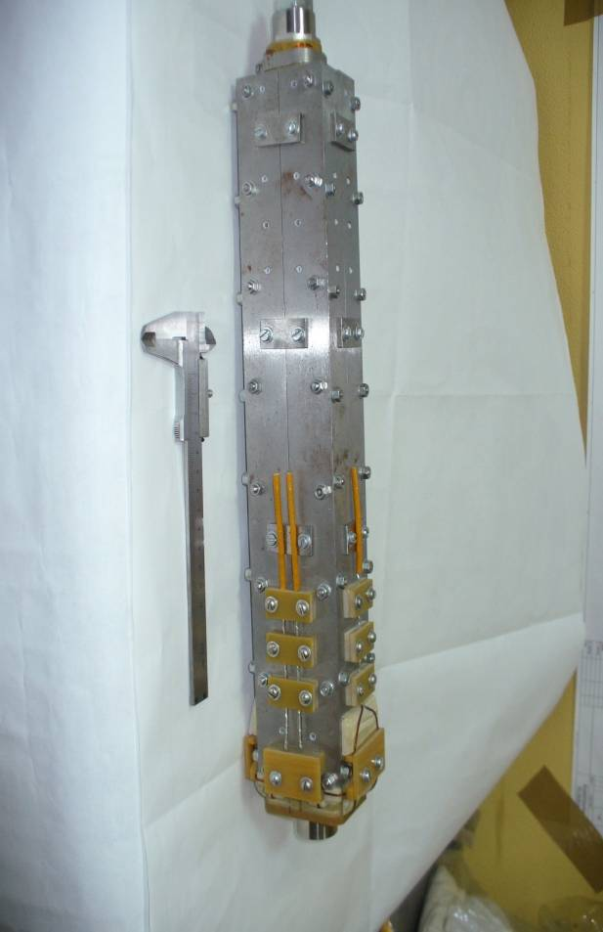
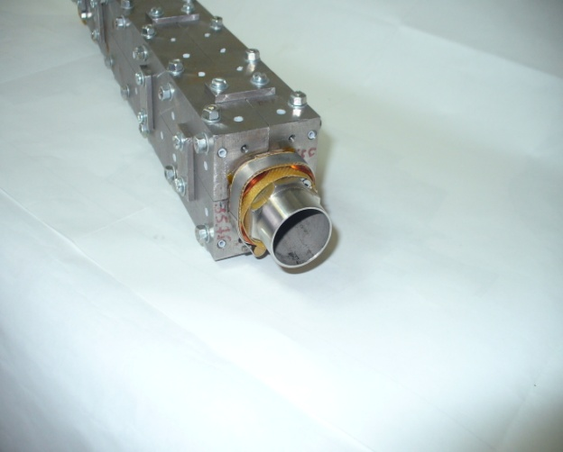
Solenoid Compensation Scheme
screening
solenoid
Compensating solenoid
Luminosity counter
FF quads
Two solenoids are introduced in the IR:
screening solenoid that shields the detector field inside the quads (in the quad net solenoidal field=0)
compensating solenoid in front of the first quad, as close as possible, to reduce the ε_{y} blow-up (integral BL~0)
  0.3 pm is the overall ε_{y} blow-up for 2IPs @Z with this compensation design
A few design choices have been proposed.
Prototyping for a double aperture quadrupole has been going on at BINP.
Stainless steel Bandage of superconducting coils

Slide 8
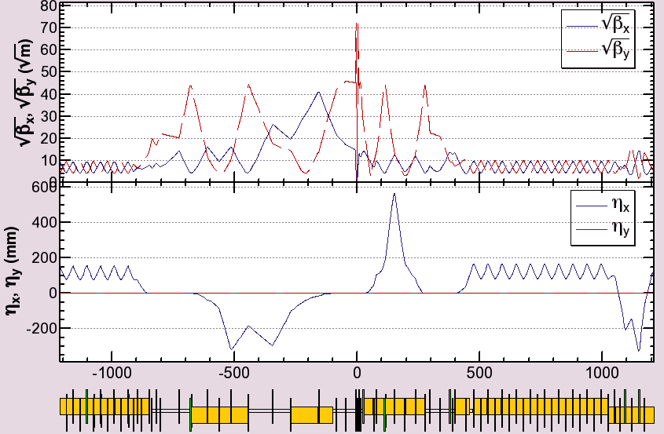
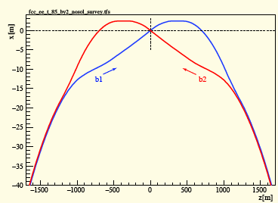
Background considerations for the IR design
Minimization of the effects of SR has been a fundamental driver for the design of the interaction region (and optics)
SR simulation obtained with MDISIM (H.Burkhardt, M.Boscolo) and dedicated software (M.Sullivan)
  Optics main requirements
Crab waist scheme
2 IPs
β*x/y = 0.5m/1mm (1m/2mm)
Vertical emittance 1 pm (@Z energy)
Horizontal emittance ~1 nm (@t energy)
Energy acceptance +/- 2%
Eγ,c < 100 KeV within ±250m from IP
As close as possible to the FCC-hh beam line
K.Oide
version 65_36
H.Burkhardt

Slide 9
Some details on the Main Features of the FCC-ee Synchrotron Radiation in the IR
Synchrotron Radiation is the main constraint for IR design and it drives the IR optics and layout
General requirement for the optics based on LEP experience:
Weak bends E_{critical} < 100 keV (LEP2 was 72 keV)
Weak bends far from IP (LEP2 was 260 m from IP)
Keep Ecr ≲ 1 MeV in whole ring, to minimize n-production (LEP2 0.72 MeV)
Various lattice options have been studied in detail with different approaches*
MDISim (flexible software toolkit developed by H. Burkhardt et al. )
  ROOT based machine detector interface toolbox described by MAD-X sequence
  particle interactions in the IR/detector regions using GEANT4
SYNC_BKG (modified version by M. Sullivan )
SYNRAD+ (R. Kersevan)
[* studies for FCC WEEK2016: M. Boscolo et al., Phys.Rev. AB 19 (2017) 20, 011008]

Slide 10
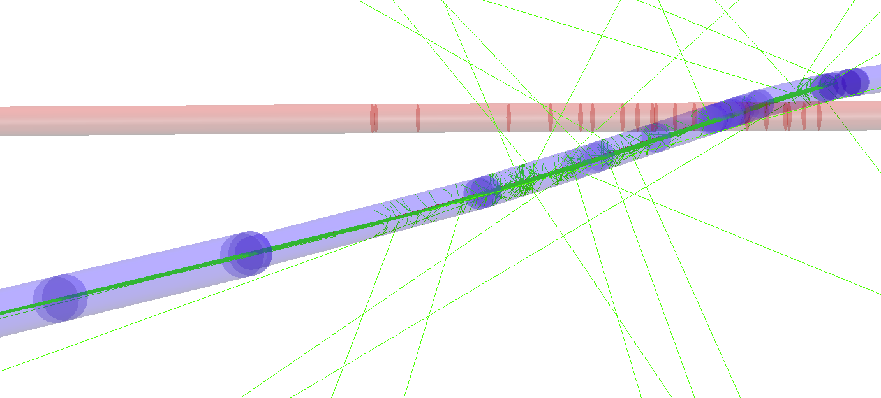
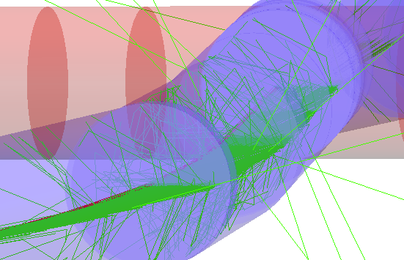
3d display - FCC-ee SR MDISim –
Geant4 simulation
lattice : fcc_ee_t_85_by2_nosol
display : transverse dimension scaled × 50
IP
Beam pipe
Cu r = 3 cm
1mm thick
QC1
QC2
beam 2
QC3
88 m
BWL2
100-150 m
QC4
159 m
rotate / zoom
beam 1
BC1L.2
160 -268 m
BWL2
QC5
272 m
BC1L.2
QC6
346 m
(Gaussian) beam 1, 5000 e+ 175 GeV
tracked 510 m to IP (just after BC3 to Q2)
with SR and standard G4 em processes eIoni, eBrem, annihil, phot, compt, conv, Rayl
28300 SR γ’s generated, first 1000 γ’s shown here
rather fast, < 1 min ( MacMini i7 )
multiply with
2.3e+11/5000 = 4.6e7
to get statistics of 1 bunch
1.3e12 SR γ’s

Slide 11
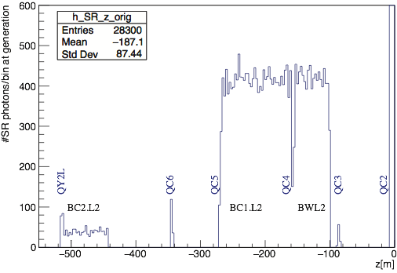
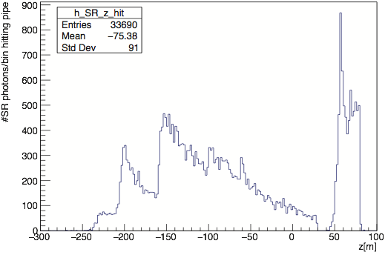
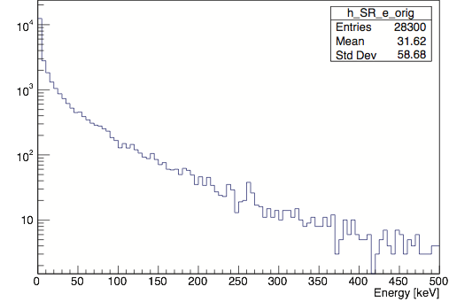
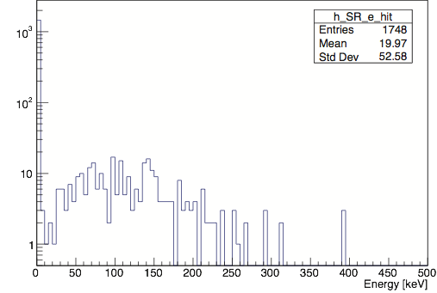
distributions of these photons
z at origin
z hitting beam pipe
IP
γ energy at origin
γ energy when hitting
beam pipe
within 20 m of IP

Slide 12
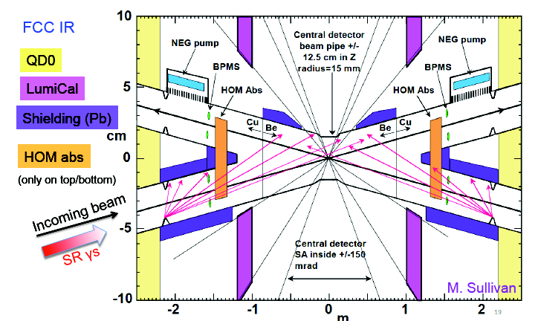
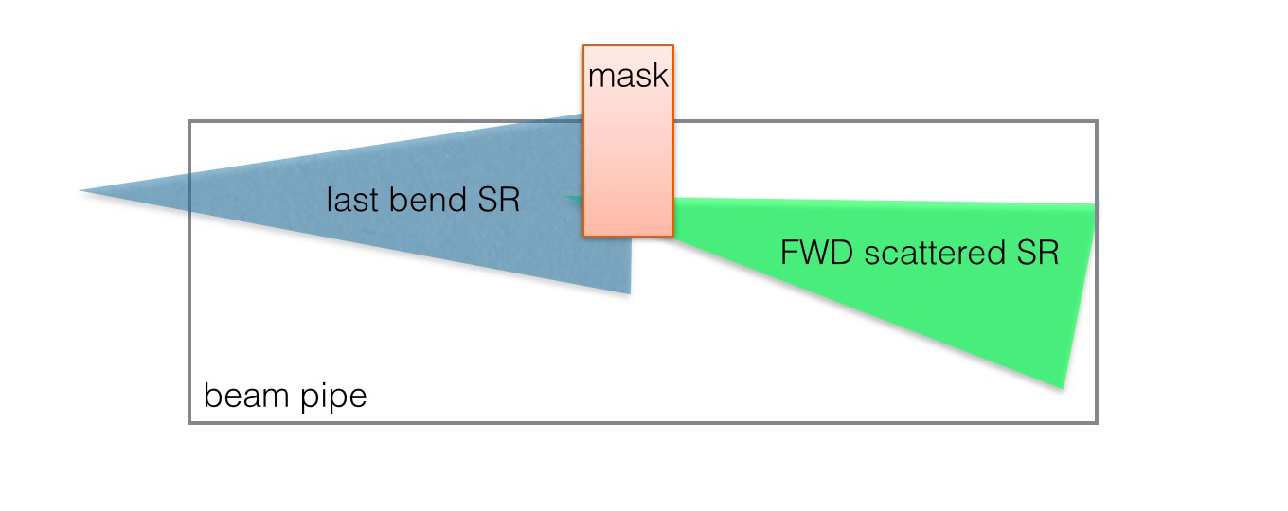
Background considerations for the IR design
IR features driven by background considerations:
SR defines the beam pipe radius, position of masks and shields
Masks shields the detector from direct hits
  Relevant surviving photons are those emerging from the tip of the mask Pb (or Ta) limit the amount of SR reaching the IR
Window left in front of LumiCal in order not to degrade the energy resolution
Extra 5 μm Au layer coating on the central section of the beam pipe:
  Absorbs photon & reduces heat on beam pipe
  Still sufficiently thin not to degrade impact resolution
Detector to stay in region limited to +/- 150mrad
SR mask
For SR, we study the impact on detector elements of the photons emerging from the mask

Slide 13
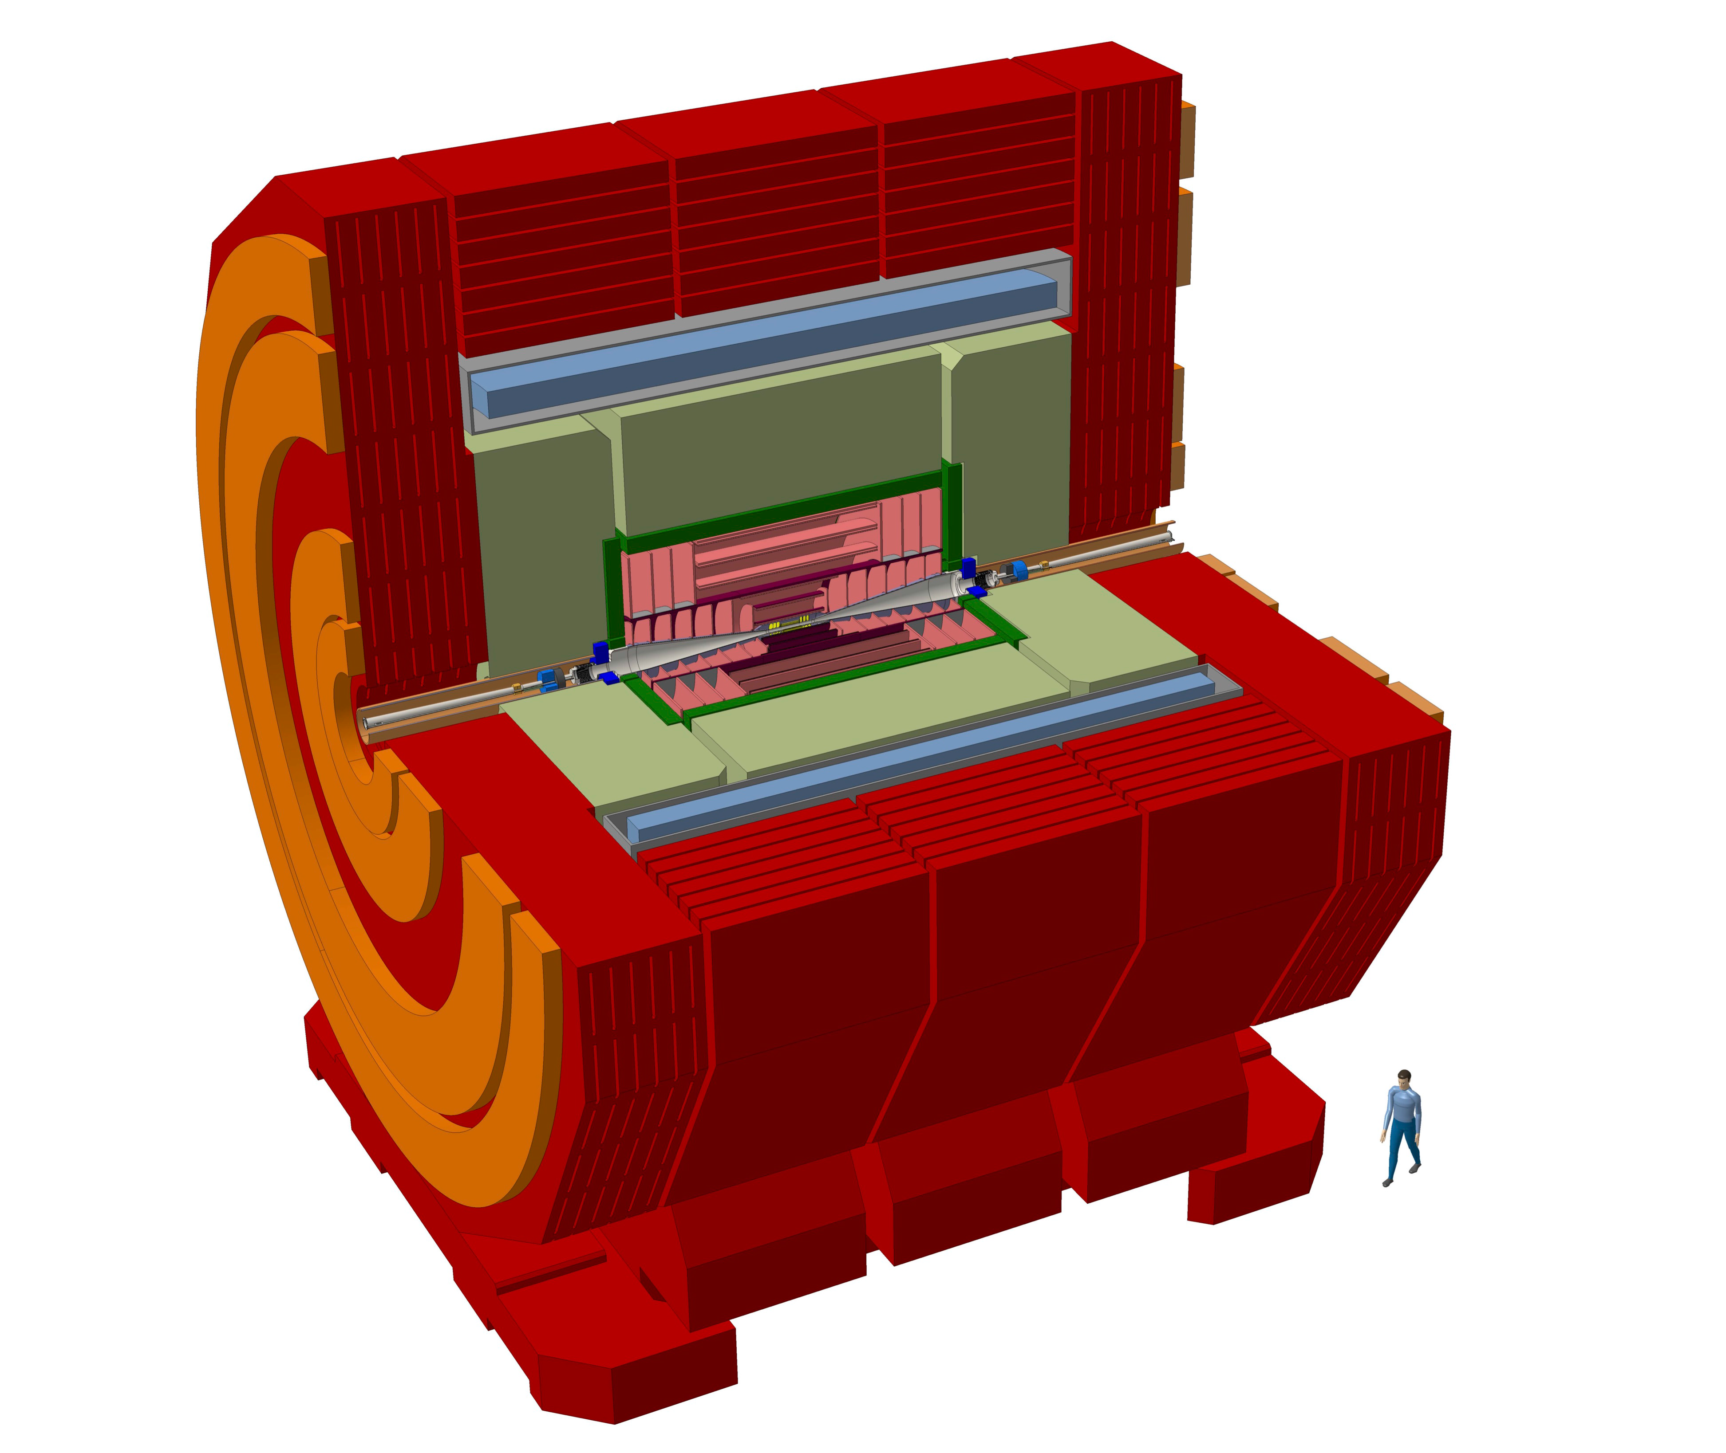
Geant4 description of the interaction region & detector
CLIC Detector
Original CLIC design adapted mainly to cope with FCC-ee IR and 2T magnet:
Vertex layers closer to beam line
Extended Tracker to compensate for lower B
HCAL shrunk to 5.5 interaction lengths
Yoke shrunk for smaller B

Slide 14
Backgrounds
We have performed full simulation studies of effects of various backgrounds mostly on the Vertex and Tracker (more recently also on the luminosity monitor) part of the modified CLIC detector, estimating hit density/ occupancy/ deposited energy.
Focus on Ecm = 350 GeV (tt) as worse case scenario for most of the considered backgrounds.
Studied:
  Synchrotron radiation
  e⁺e⁻ pair production
  γγ to hadrons

Slide 15
Synchrotron Radiation

Slide 16
Pair Production

Slide 17
Combined effect of SR and Pairs

Slide 18
Gamma-gamma to Hadrons

Slide 19
Next
Synchrotron Radiation studies:
  Continue optimization of the SR masks and shielding
  Beam pipe heating due to SR
  Examine efficiency of SR absorption of various beam pipe shapes (masks)
  Ongoing effort on integrating Geant4 simulation of the detector with upstream beamline
Impact of IR backgrounds on Luminosity Calorimeter
Study of other backgrounds:
  Ongoing study on beam-gas interactions
  Ongoing study of radiative bhabhas
  Evaluate touschek backgrounds
Radiation damage to detectors
Impact of backgrounds on sensors readout payload
Repeat these studies for IDEA detector.

Slide 20
Luminosity Detector (I)
M.DAM

Slide 21
Luminosity Detector (II)
Still a big challenge given the available space in the IR
M.DAM

Slide 22
Luminosity Detector (III)

Slide 23
FCC-ee: Conclusion and Future Steps
Wake fields calculations in IR in progress, also different chamber geometries under investigation
HOM absorber in the central chamber needs further optimization
Vacuum Chamber heating estimate and water cooling system
Optimization of SR masks, shielding, collimators, absorbers also with full simulation
Solenoid Field maps for more realistic studies (like SR from fringe solenoid fields, ..)
Study of other IR backgrounds (off-momentum beam particles, beam-gas, radiative bhabha, complete γγ-> hadrons)
Full G4 detector simulation combined with the detailed IR geometry
QD0 design: different proposals and design in progress
Injection backgrounds
Electron Cloud studies in the IR in progress, SEY<1.1 needed to avoid build-up
More work will be needed for a more realistic and engineered design of the IR

Slide 24
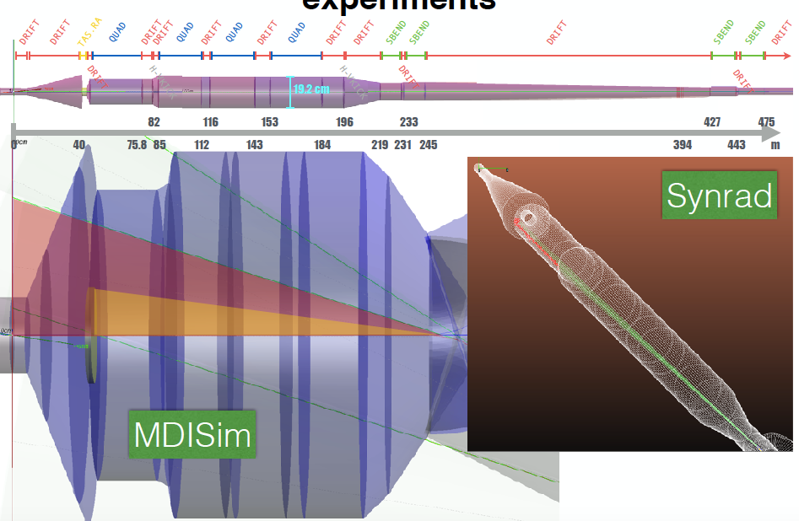
FCC-hh MDI
LNF-INFN is part of WP3-EuroCirCol, with the study on the impact of SR in the Experiments
See next talk by F. Collamati for details

Slide 25
Summary of SR study in EIR for FCC-hh
See next talk by F. Collamati for details
Synchrotron Radiation emitted in the last bends (500m from the IP) is not an issue:
  The emitted Power is IN TOTAL ~100 W (=upper limit in all beam conditions)
  The fraction of this power entering the TAS is ~10 W with/without crossing angle
  Orbit correctors contribute for ~ W (~10x lower than bends)
  The emitted photons, even if numerous (~1E10 per bunch), have a critical energy of 1keV
  They are safely stopped within the pipe (no full simulation needed!)
even in a non-collision scheme (beam separation at IP) we can use as a reference (extreme) value the 100 W limit -> safe limit
Further studies:
  Quantify why 10W is low (where these photons shine to and what needs to be cooled)
  Study the effect of spectrometer bends (even though this is alternative detector model now)
  Evaluate the effect of the high energy photons (tail of the distribution)

Slide 26
Conclusioni & Preventivi
Next year will be crucial: studies will be finalized in view of the CDR, to be ready for mid-2019, for the European Strategy Update
Richieste: spese missione
LNF: 6 kEuro
Roma-1: 4 kE

