Slide 1
RD_FA^{(*)} Collab. Meeting
Franco Bedeschi
RD_FA Collaboration Meeting,
Bologna, July 2018
Outline
Status and progress
Major deadlines
Organization update
^{(*)}RD_FA == R&D on Future Accelerators

Slide 2
Status and progress
EIC (USA)
Genova meeting in January
Meeting in Trieste soon
EIC user group meeting, Trieste, 18-22 July 2017, Italy
Impact of new US budget?
Muon Collider (Anywhere!)
Machine lattice simulation work
Test beam coming up soon at CERN
ARIES/APEC participation

Slide 3
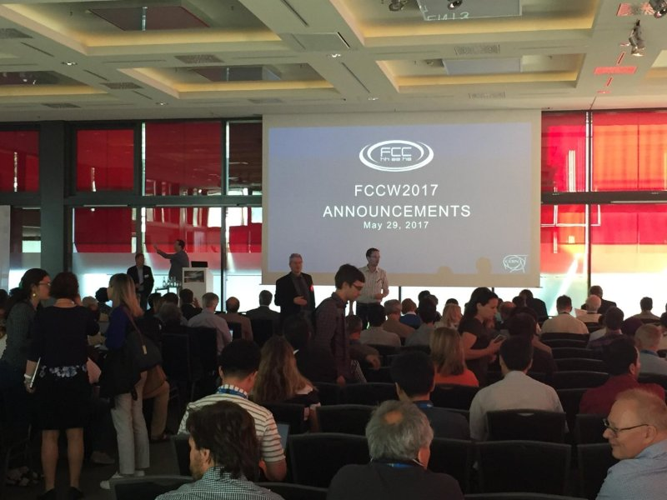
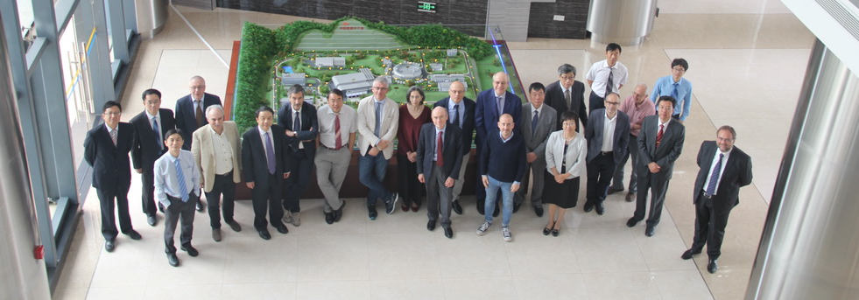
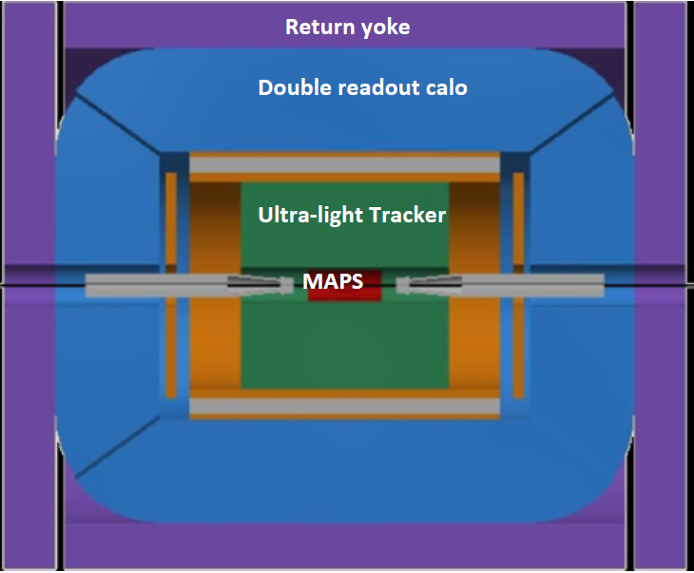
Status and progress
IDEA (Int. Detector for Elect.-positron Accelerators):
FCC/CepC specific detector proposed with innovative, but realistic and tested components: MAPS, DCH, preSh, DR, Muon
FCC (CERN)
F. Grancagnolo new co-coordinator of WG11
Many other coordinators: Boscolo, Bacchetta, Azzi, Piccinini, ...
Large INFN participation at Berlin
Contributions to CDR → to be clearly defined → will discuss
CepC (China)
Dongguan meeting IHEP/INFN support + Chinese vice-minister delegation
Proposals for MAE/NSFC grants submitted for uRwell and DR calo.
Contributions to CDR (chairs of November meeting)
International Workshop on High Energy Circular Electron Positron Collider 2017
IHEP, Beijing from Nov. 6 to 8, 2017

Slide 4
Circular collider schedules (EU)
CERN-FCC schedule recently presented in Berlin 2017
Technically driven schedule – Reality could be worse (F. Gianotti)
M. Benedict, FCC week,
Berlin 2017

Slide 5
Circular collider schedules (China)
China-CepC/SppC schedule recently presented IAS conference on HEP, Hong Kong 2017

Slide 6
R&D deadlines 2017
Simulation for FCC/CepC:
DR test beam modules should be ready about NOW!
Integration in progress to be completed before end of July
IDEA with simple preShower
Write ups for CepC ~ early October
Technical notes on DCH and DR should be ready NOW!
Write ups for FCC ~ early December
Are we missing something?

Slide 7
IDEA studies: major topics
Will be addressed in CDR:
The coil geometry is a major issue to be resolved
coil inside or outside the calorimeter
PID resolution of Drift chamber needs demonstration with beam
Dual Readout performance details must be assessed
Basic pre-shower performance → who takes this job?
Basic key physics benchmarks
Will NOT be addressed in CDR:
Dual readout calorimetry tests with full containment
Many detector optimization issues in particular for the pre-shower
Detailed simulation of full set of physics benchmarks

Slide 8
IDEA CDR goals? (1)
Specify a preliminary detector geometry optimization
Full simulation of all detector components at a basic level
(that is we'll not draw all screws, cables and cooling tubes in the system with GEANT), but all significant components will be there.
Full pattern recognition in the vertex+DCH+Preshower system
PF analysis of the tracker+preshower+DR calorimeter

Slide 9
IDEA CDR goals? (2)
Simulation of a few performance benchmarks including:
Higgs recoil mass distribution from Z→μμ, Z→ee and Z→qq
Highlights performance of tracker, calorimeter and preshower
Higgs → μμ invariant mass resolution
Highlights tracker performance
Invariant mass resolution in Z→qq and W→qq
Highlights performance of calorimeter
Studies of tau polarization in Z→ττ events
Highlights performance of preshower
Studies of precision in acceptance determination with preshower in a few channels
Additional studies may be added depending on time availability

Slide 10
Admin. deadlines 2017
Financial requests 2018 – by July 26
People (w/ formal responsibilities)
Activities (Travel funds strongly correlated)
R&D, Test beams
Expect plan from coordinators during this meeting
Budget 2018 is difficult – 5% travel cut
CSN1 – Pisa July 24-26
Status and future plans requested by president
Structure to be decided: which talks? ~ 1 hr
Very little room for additional requests 2017 – small travel adjustment
Preliminary discussion of FY2018 budget
Expect meeting with referees before/after July CSN1
will forward specific requests

Slide 11
Organization update
New WP on Dual Readout calorimetry joining RD_FA
Coordinator: Roberto (Bob) Ferrari
Reconfiguring Dream/RD52 relation with CERN
Must draft full proposal soon with 3-4 yr plan
Test beam end of July with modified SiPM & coupling to fibers
PG group leaving due to HL-LHC overload
WP 6 will be in the future for DR calo
WP 3 will become container for all silicon tracker related items

Slide 12
Conclusions
Much progress since last November
Preparation phase completed
Now need to start delivering results:
Document: studies/simulations, tests with beam
2° half of 2017 requires much work for CDR’s
Need strong effort from now!
More internationalization of our WGs needed
Relations through CERN can help a lot
INFN support continues in spite of difficult 2018 budget
Must prepare 2018 requests VERY accurately

Slide 13
Additional slides

Slide 14
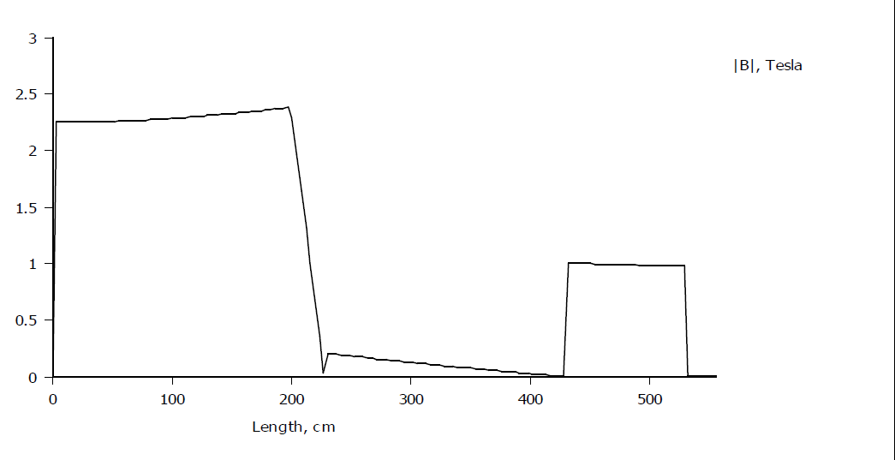
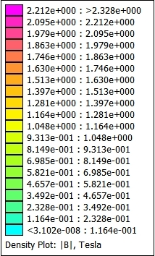
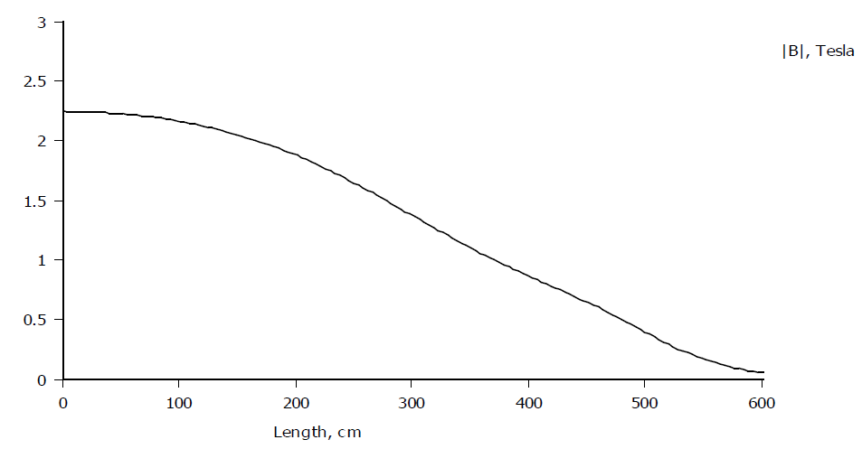
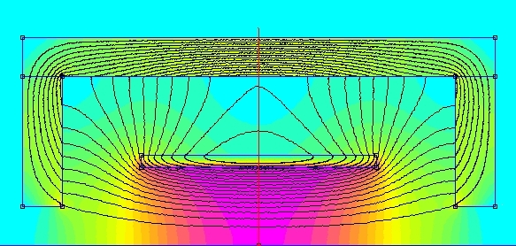
IDEA B field
Radial B field profile
B field on axis along z
Yoke is 1 m thick pure Fe
- Max field in yoke < 1 T

Slide 15
back

Slide 16
back

Slide 17
back

