Slide 1
DGWG: first design for EMC
Claudia Cecchi
for the EMC group

Slide 2
General remarks
Definition of detector configuration for the study of benchmark channels to be studied with Fast Sim.
Main point of discussion and to be studied: yes or not forward PID

Slide 3
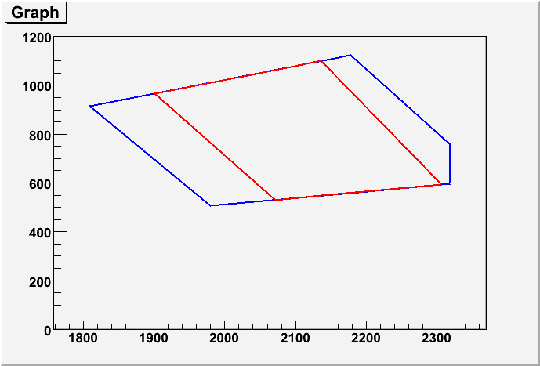
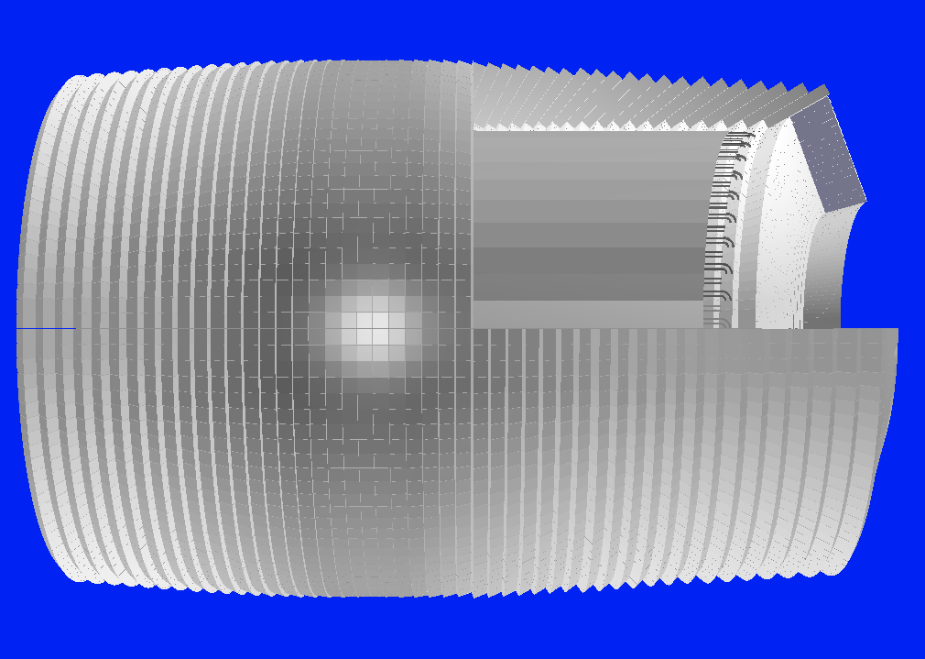
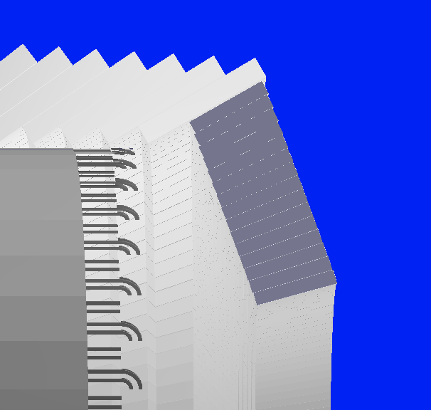
20cm long LYSO crystals will leave space for the forward PID.
TOF
BaBar
SuperB
TOF (?)

Slide 4
Best solution for EMC
LYSO not back of 10cm → bigger volume (+10% cost!), alignment edge barrel/endcap could present problem of performance
material in front of EMC if PID
First approximation for physics study: LYSO aligned with barrel (see next slide)
Second step study effect of backward calorimeter

Slide 5
Different configurations
D. Hitlin

Slide 6
Technical remarks
We can provide xml description of the different configuration we need to implement, or equivalent information (material, geometry, resolution….)
Will produce analysis procedure according to the geometry under study
Which is the timescale to produce xml files (if this is done by subdetector people)?

Slide 7
Benchmark channels
Perugia:
B → K* νν
B → τν
Caltech:
b to s gamma - high hadron multiplicity and a range of photon energies
tau to lepton gamma - high energy photon and PID
tau to three leptons - strong exercise of PID

