Slide 1
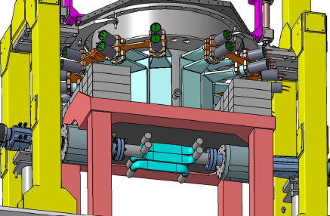
SIDDHARTA - 2
Catalina Curceanu
for the SIDDHARTA-2 Collaboration
CL, 30 Giugno 2017

Slide 2



SIDDHARTA-2 Collaboration
SIlicon Drift Detector for Hadronic Atom Research by Timing Applications
LNF- INFN, Frascati, Italy
SMI- ÖAW, Vienna, Austria
Politecnico, Milano, Italy
IFIN – HH, Bucharest, Romania
TUM, Munich, Germany, Germany
RIKEN, Japan
Univ. Tokyo, Japan
Victoria Univ., Canada
Univ. Zagreb, Croatia
Helmhotlz Inst. Mainz, Germany
CNRS, Paris, France
Indian Inst. of Science, Bangalore, India
StrangeMatter

Slide 3
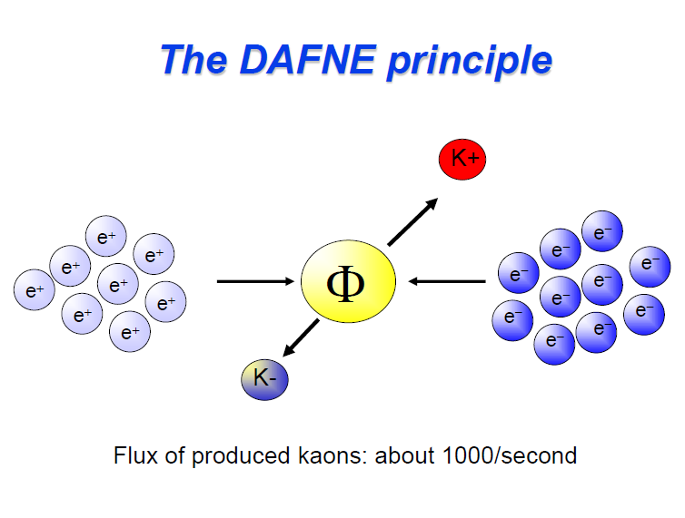

Slide 4
Kaonic atom formation
e⁻
n ~ sqrt(M*/me) n’ ~ 25 (for K-p)
(M* : K-p reduced mass)
highly-excited state
Auger Electron
K⁻
1) Initial capture
deexcite
K⁻
X-ray
2) Cascade
K⁻
Nucleus
3) Strong interaction
4) Absorption
The strong int. width > Radiative trans. width
stopped in a target medium
Shift and Width
of last orbit
e.g.
1s for K-p, K-d
2p for K-He

Slide 5
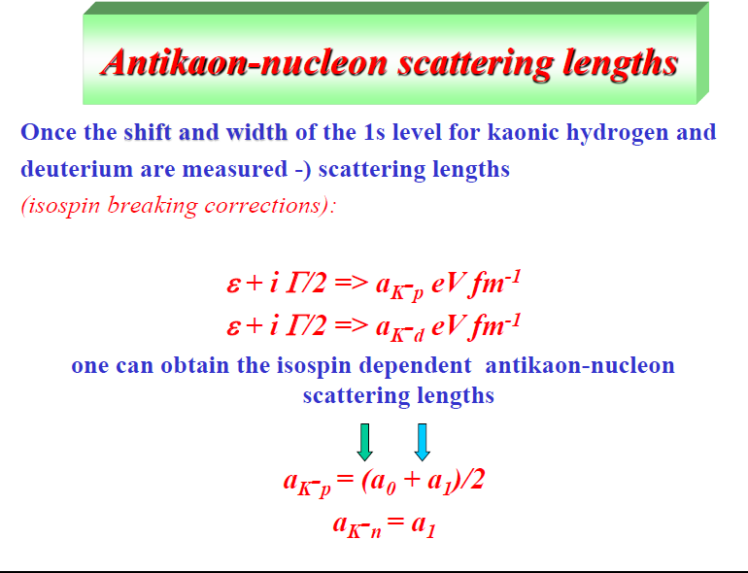

Slide 6
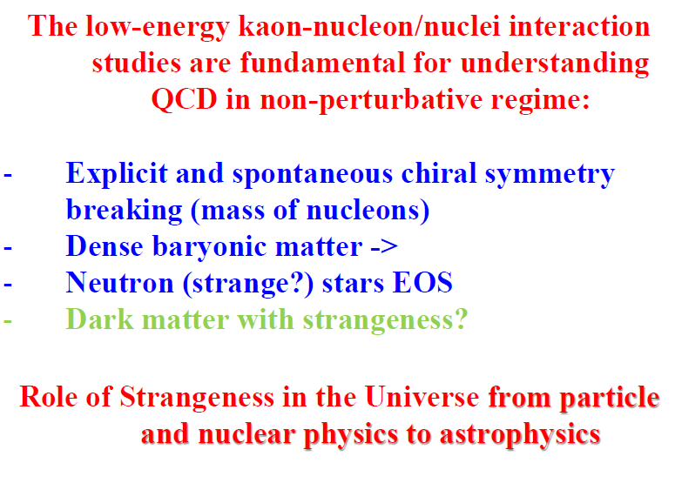

Slide 7
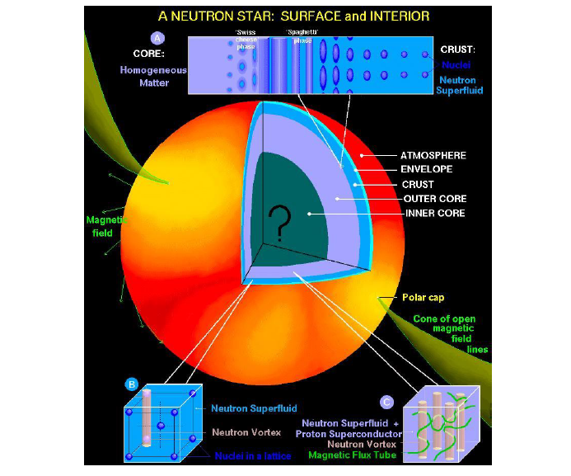
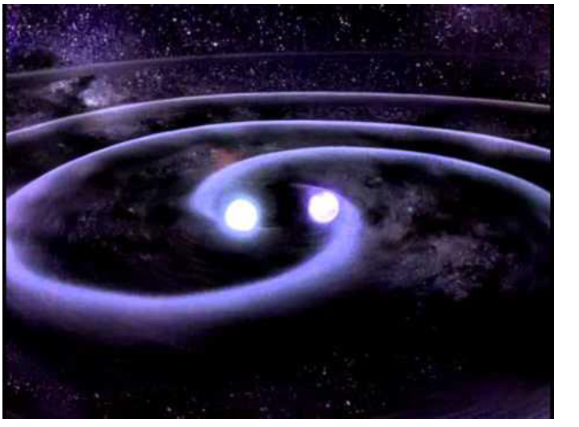

Slide 8
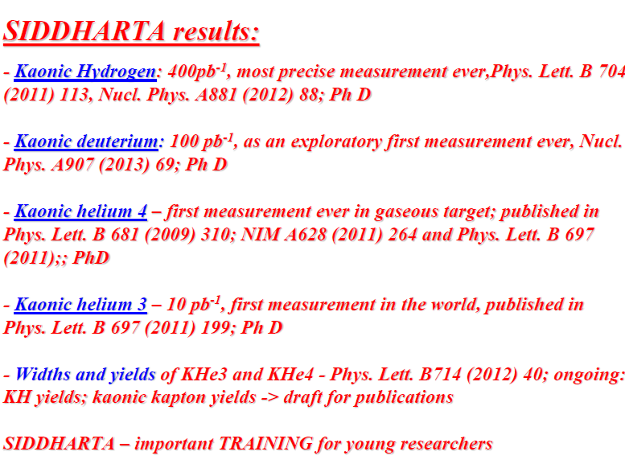
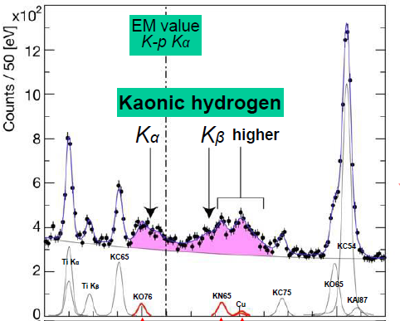
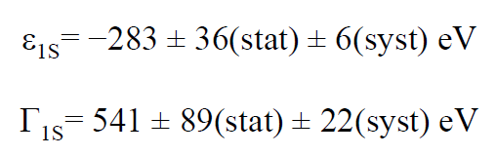

Slide 9
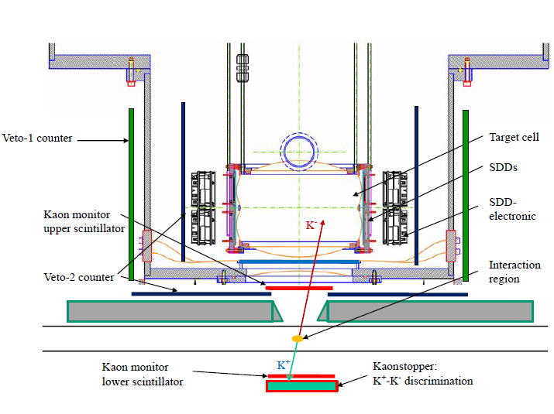
SIDDHARTA-2 apparatus – status with time lines
- Mounting frame
- Beam pipe
- Luminosity monitor
- Kaon trigger
- Cooling system
- Vacuum chamber
- Cryogenic target
- SDD X-ray detector
- Veto system
Overall time schedule

Slide 10
SIDDHARTA-2 setup
    Mounting frame
    Beam pipe
    Luminosity monitor
    Kaon trigger
        Platform

Slide 11
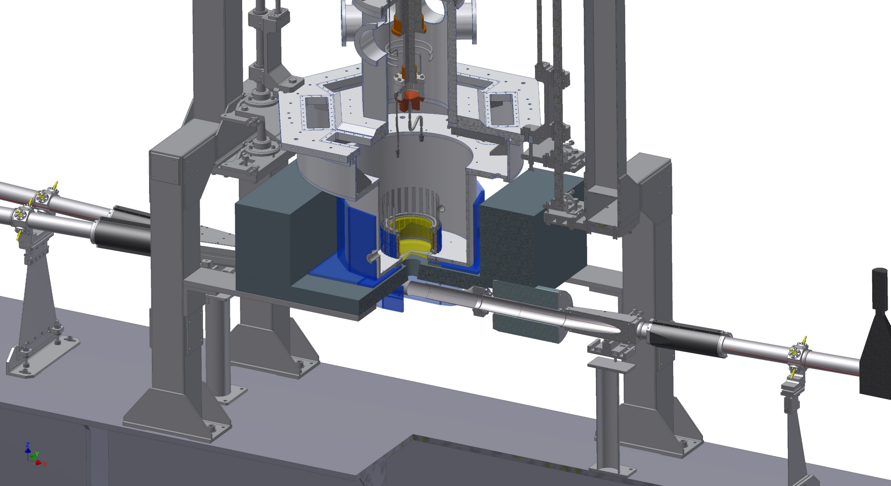
SIDDHARTA-2 apparatus
mounting frame
Cesidio Capoccia
Giovanni Fuga
shielding
beam pipe
luminosity monitor
kaon trigger

Slide 12
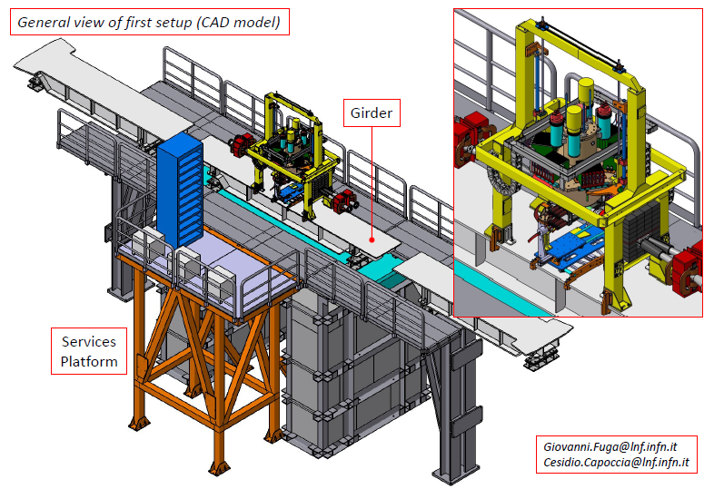

Slide 13
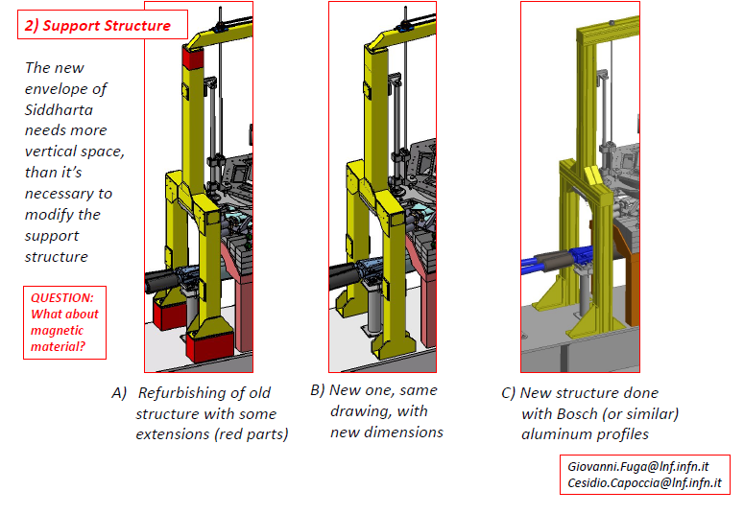

Slide 14
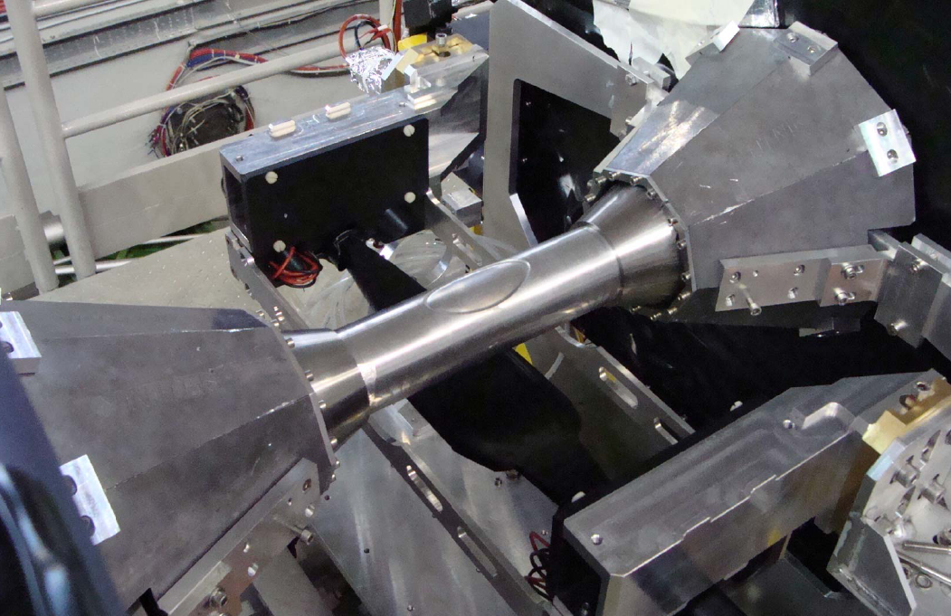
SIDDHARTA – beam pipe

Slide 15
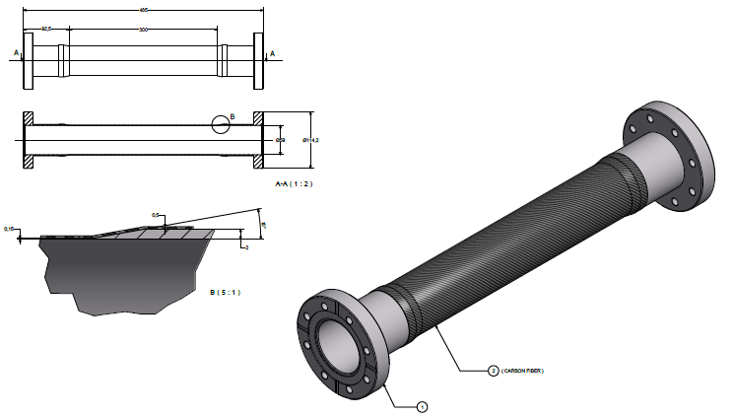
SIDDHARTA-2 beam pipe
design / quotation
  final diameter to be decided – depending
  on new quadrupoles of DAFNE

Slide 16
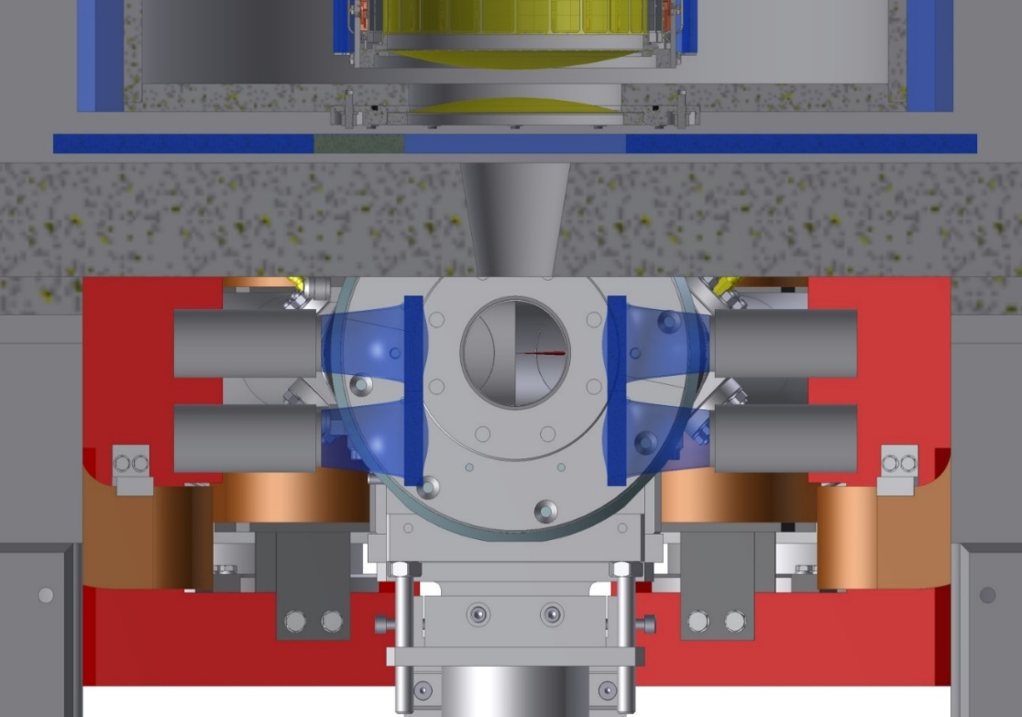
SIDDHARTA-2 - Luminosity monitor (measuring kaons)
Size: 8 x 8 cm² both side of the beam pipe,
made of 2 pieces 8 x 4 cm², thickness = 2 mm
distance y = ± 4 cm off beam
Coincidence rate:
25.7 % per charged kaon pair
single rate at the boost side: 42.7 %
single rate at the anti-boost side: 32.3 %
With a luminosity L = 10³²
→ 37 Hz (coincidence) / 62 Hz (on boost-side)
in 5 seconds:
185 counts (7%) / 310 counts (5.7%)
prototype under construction,

Slide 17
SIDDHARTA-2 setup
    Cooling systems
    Vacuum chamber + feedthroughs
    Cryogenic target

Slide 18
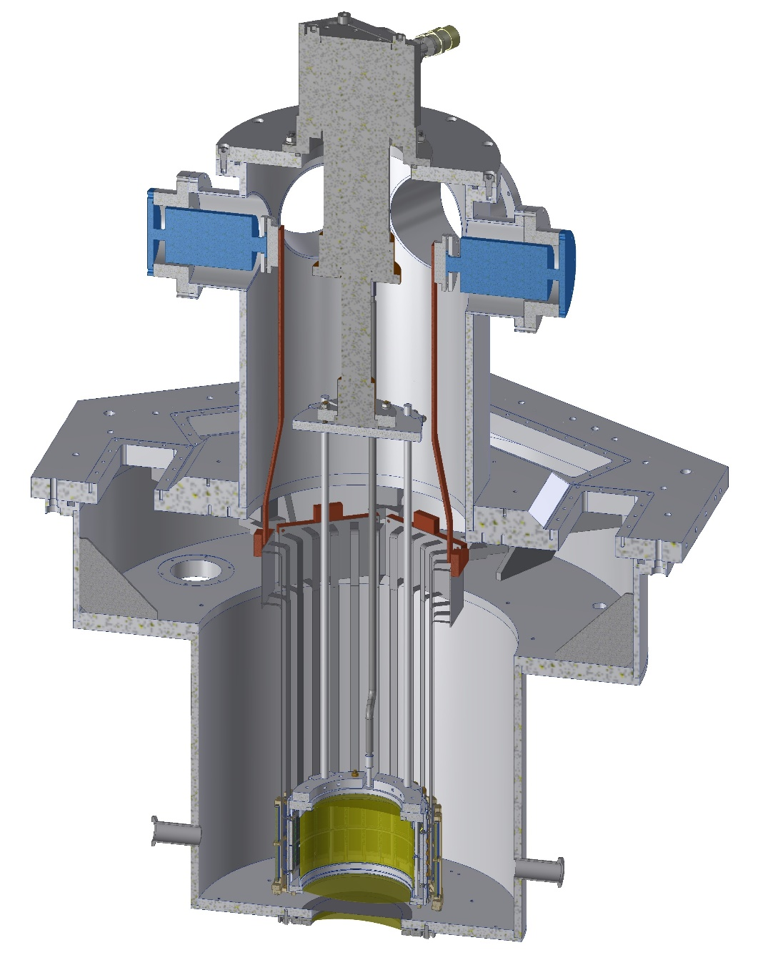
SIDDHARTA-2 cooling
Target + SDD cooling:
1 Leybold MD10 – 16 W @ 20 K
target cell and SDDs will be cooled
via ultra pure aluminum bars
T_{TC} = 30 K
T_{SDD} = 50 K
Line driver boards:
2 CryoTiger – 30 W @ 120 K
copper-band cooling lines
T_{LD} = 120 K
copper-band
ultra pure
Al bars

Slide 19
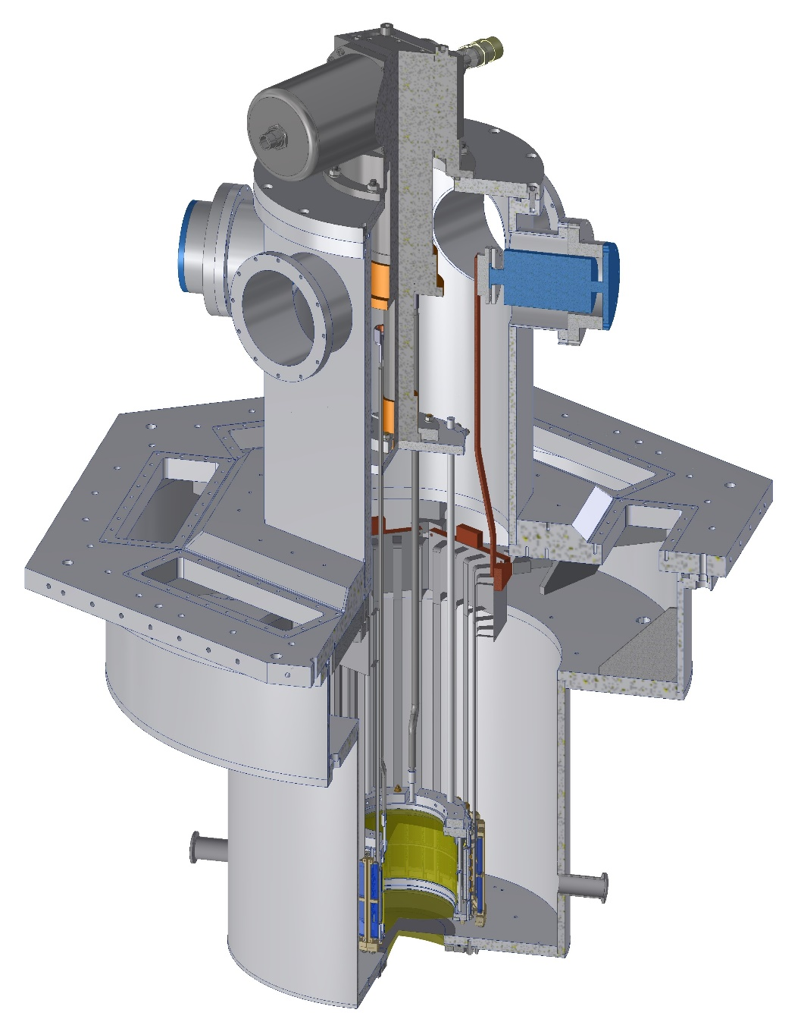
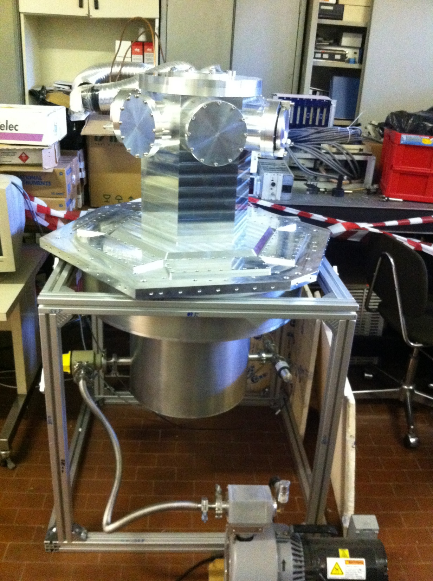
SIDDHARTA-2 vacuum chamber

Slide 20
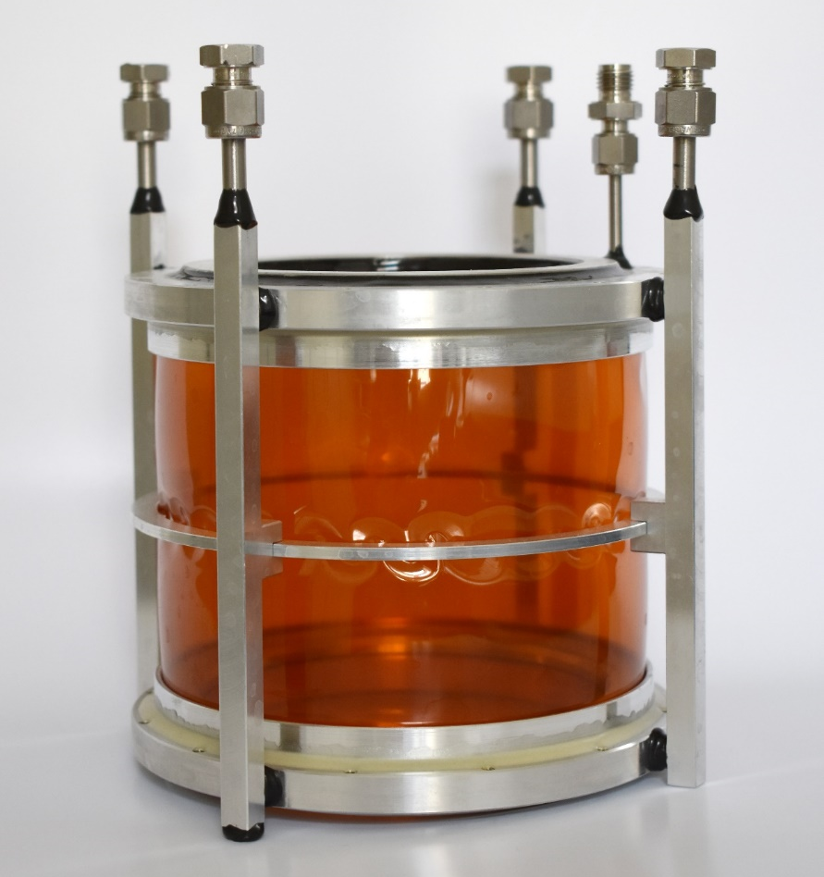
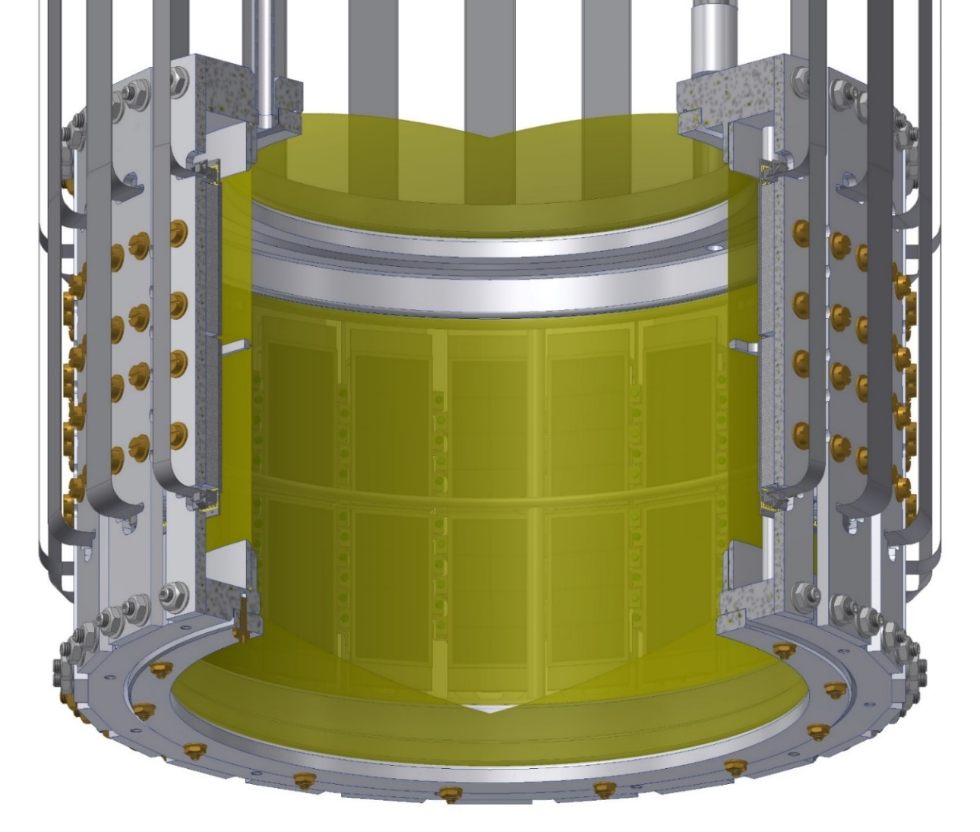
SIDDHARTA-2 cryogenic target
Working temperature: 30 K
Working pressure : 0.3 MPa
Pressurised for 16 days
with P = 0.3 MPa (overP)
Cooling/pressure test
2.5 weeks 30 K / 0.19 MPa
3.5 days 30 K / 0.31 MPa
∅140 mm
Target cell wall is made of a
  2-Kapton layer structure
(25 µm + 25 µm + Araldit < 100 µm)

Slide 21
SIDDHARTA-2 setup
  SDD X-ray detector

Slide 22
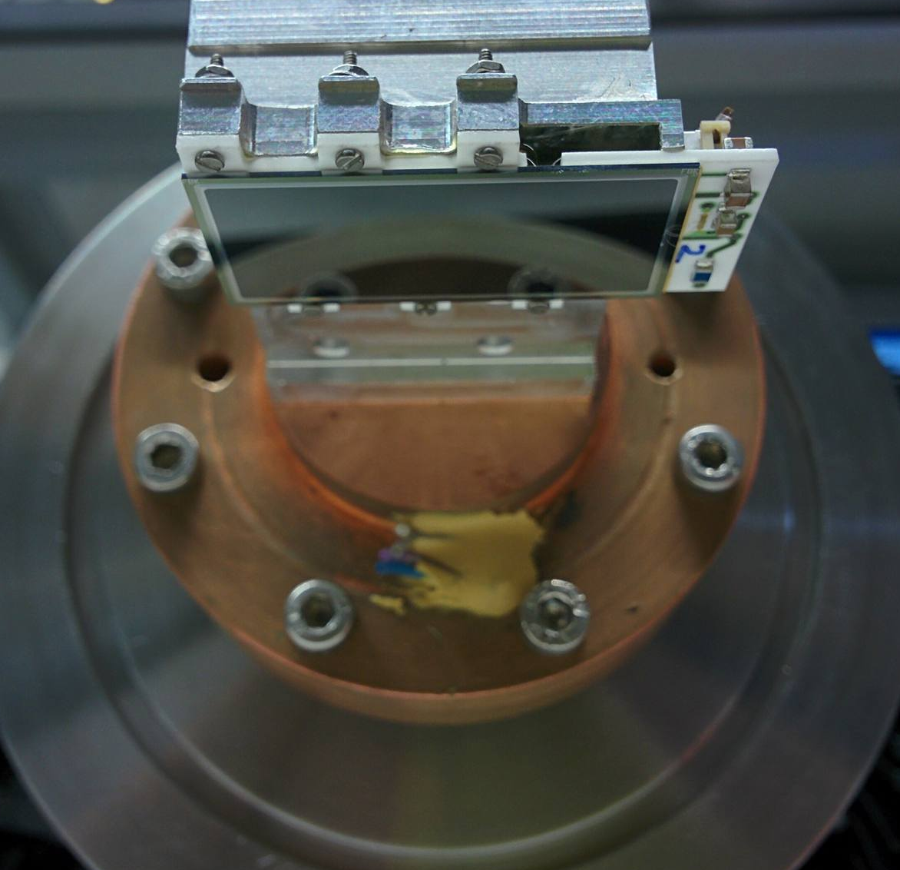
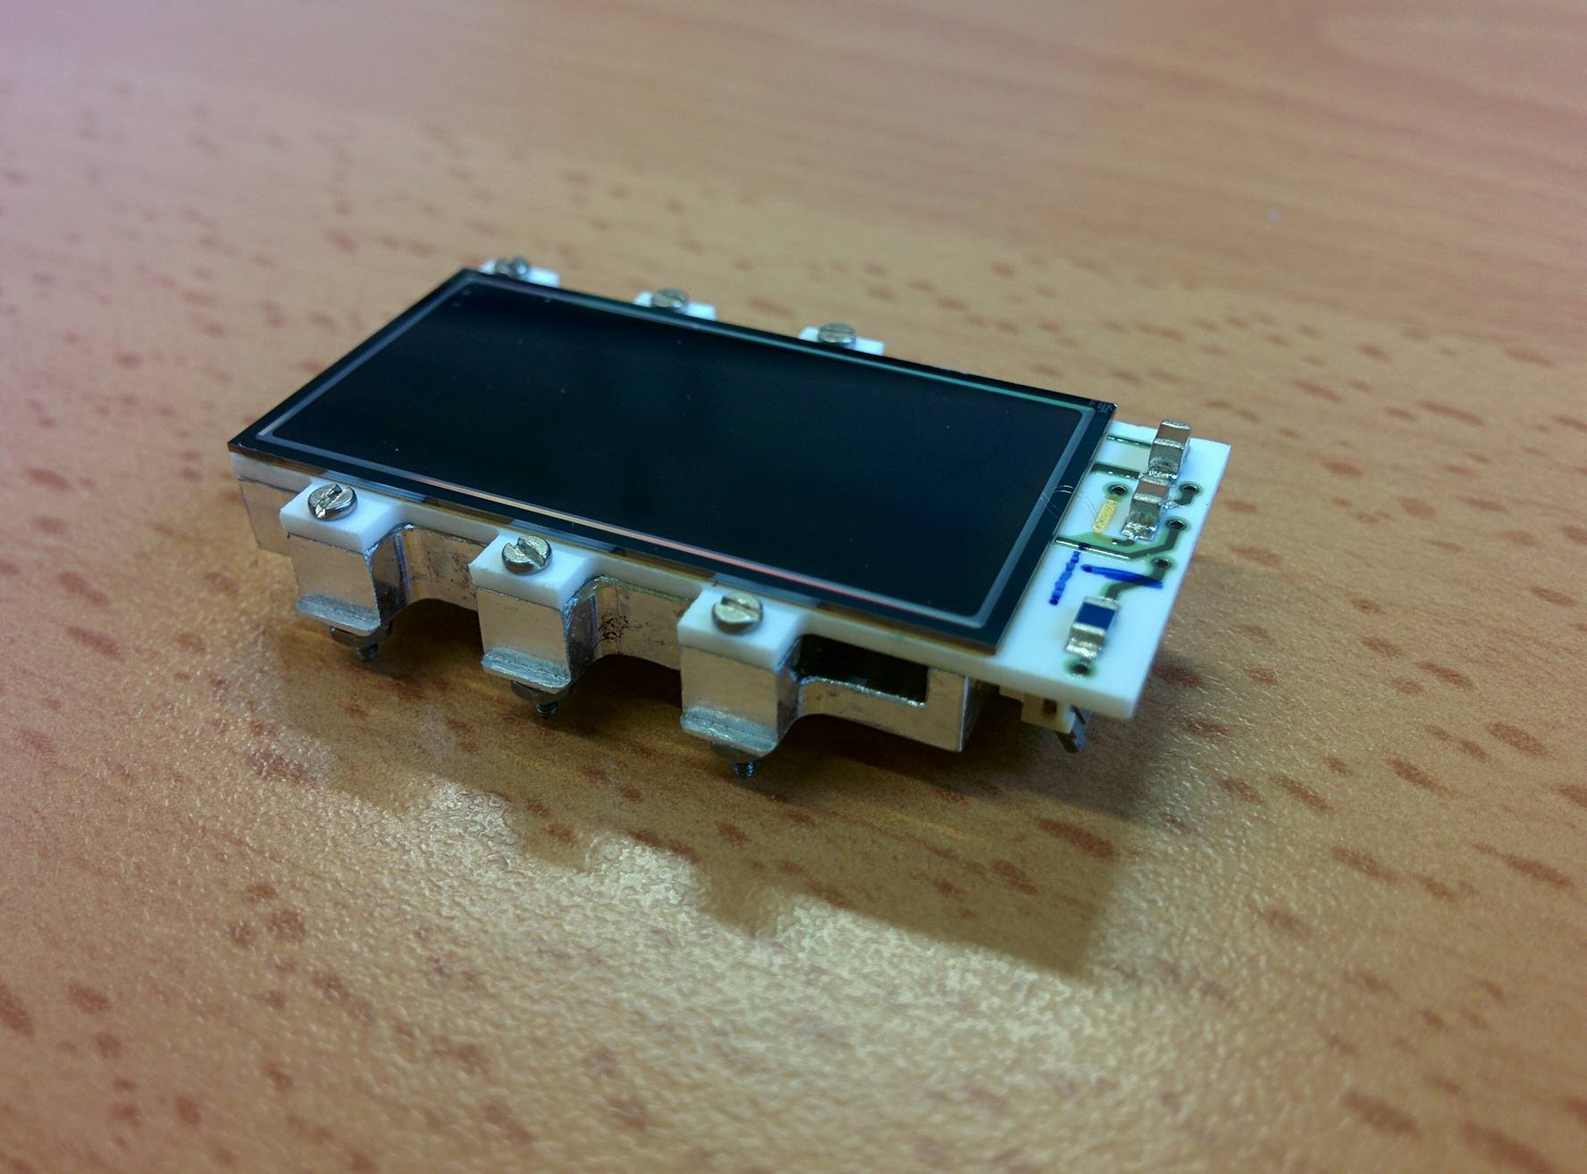
4 x 2 matrix SDD chip - testing
SDD testing facility - Milano

Slide 23
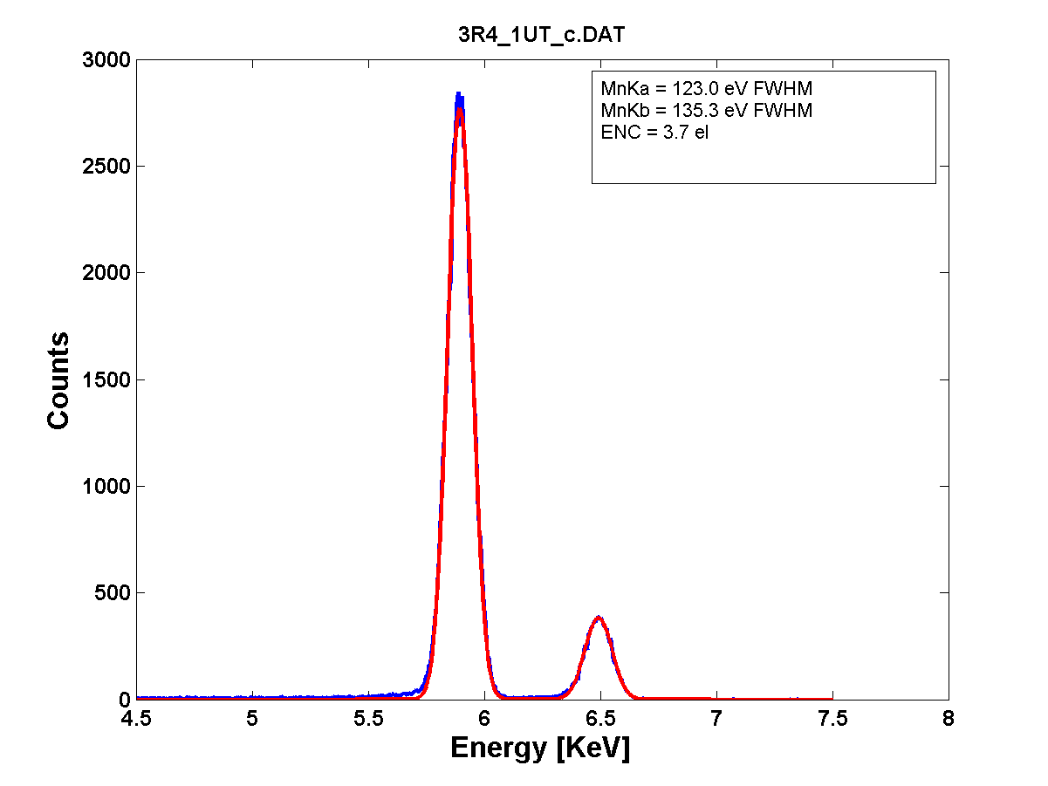
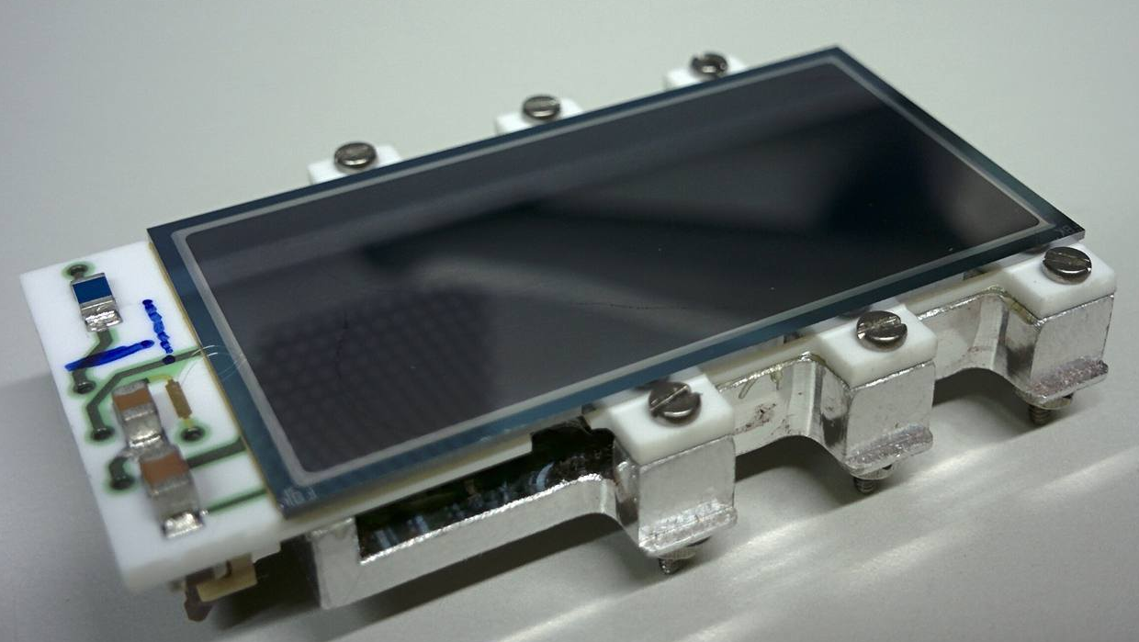
New SDD technology: CUBE preamplifier BTF test - July 2017
SDD characteristics:
area/cell = 64 mm²
total area = 512 mm²
T = - 100°C
drift time < 500 ns
⁵⁵Fe spectrum
123.0 eV FWHM

Slide 24

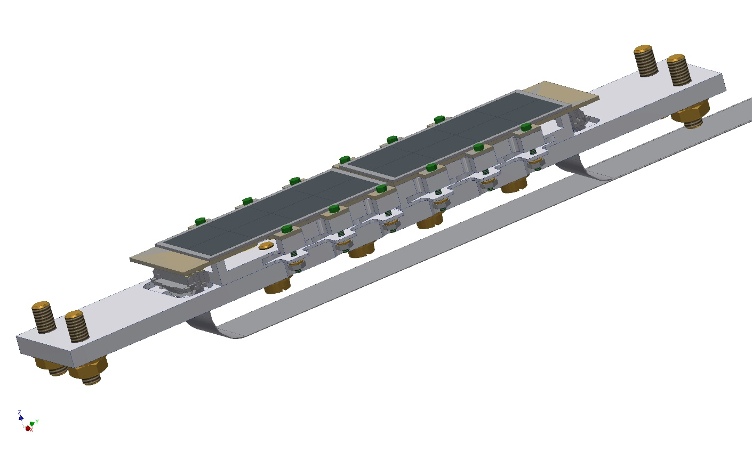
4x2 SDD arrays around the cryogenic target
In total 48 SDDs
will be used

Slide 25
SIDDHARTA-2 setup
    the veto system

Slide 26
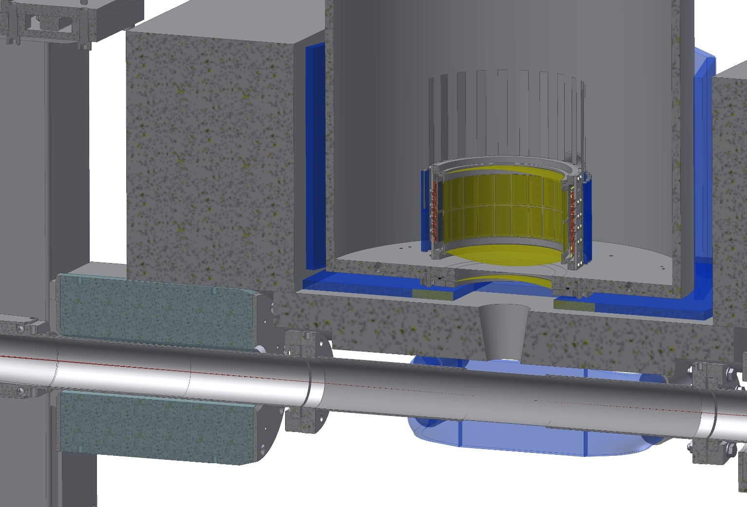
SIDDHARTA-2 setup: Veto-1 + Veto-2
Veto-1
Veto-2

Slide 27
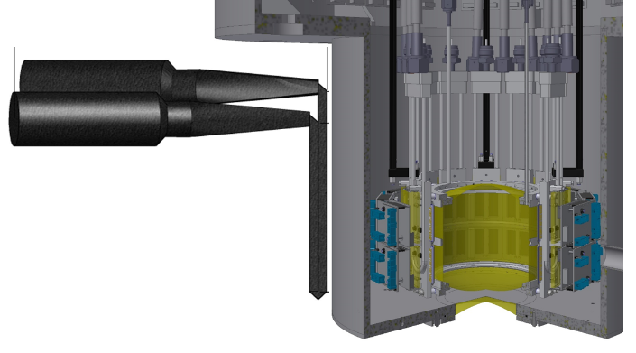
The veto-1 system
To achieve a good timing resolution, (independent of the “hit” position) < 600 ps (FWHM),the scintillator has to be read out on both side.
Because the available space is limited due to shielding material, the photomultiplier tubes have to be on the same side (a special light-guide mirror design was used).

Slide 28
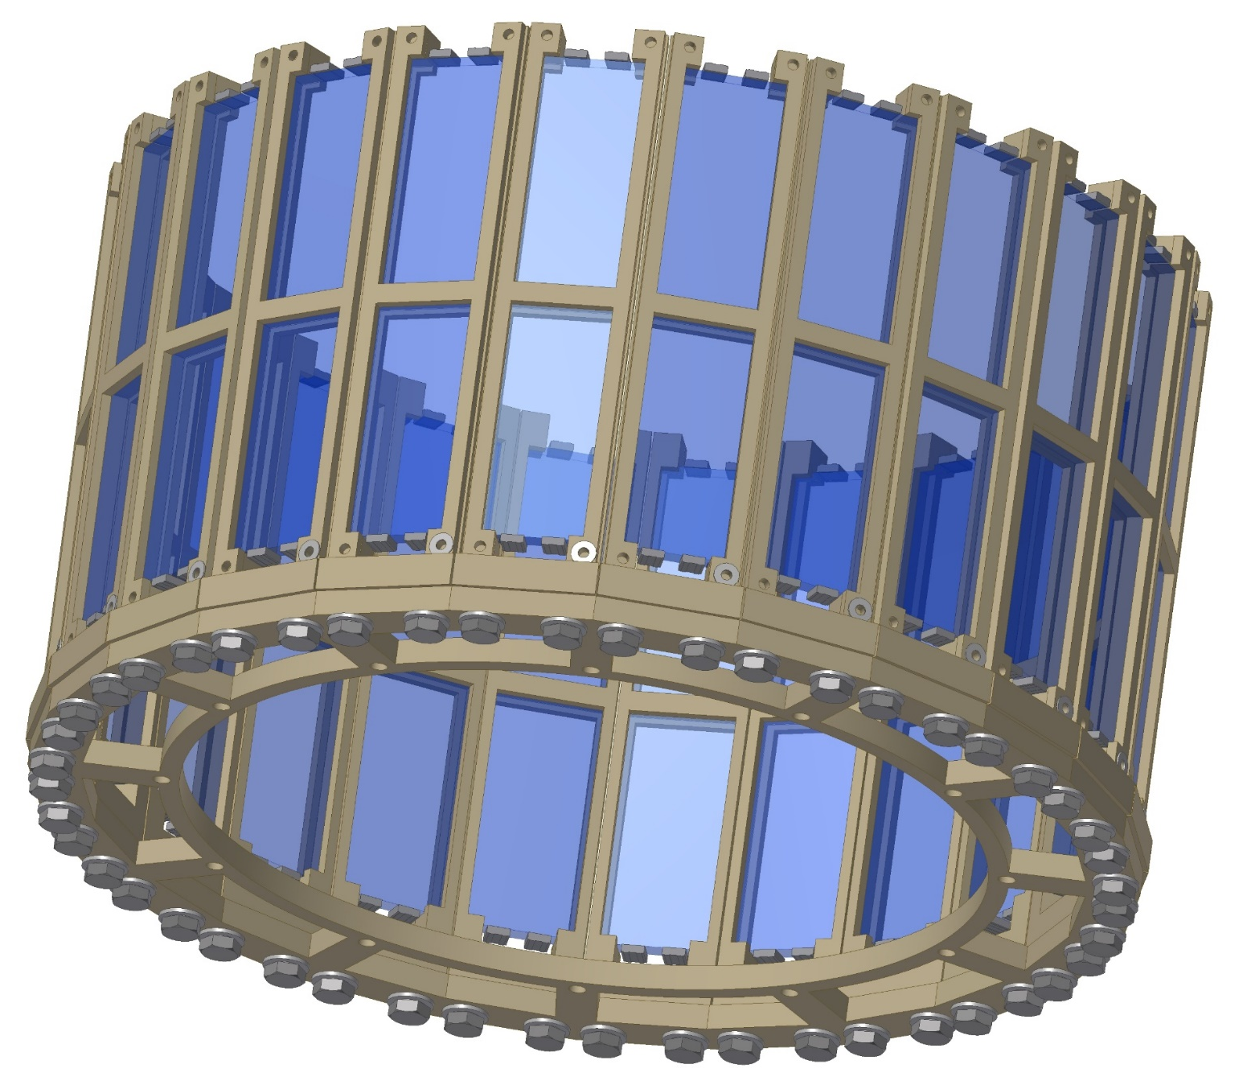
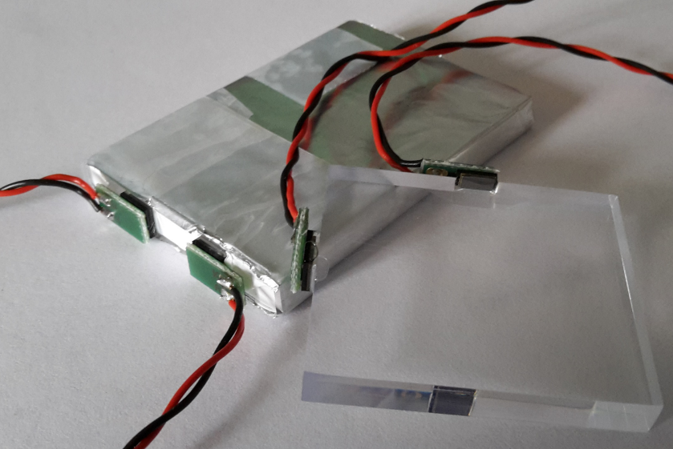
The veto-2 system
Veto-2 arrangement
SiPM – 4x4 NUV-Trento
BC-408
scintillator tile

Slide 29
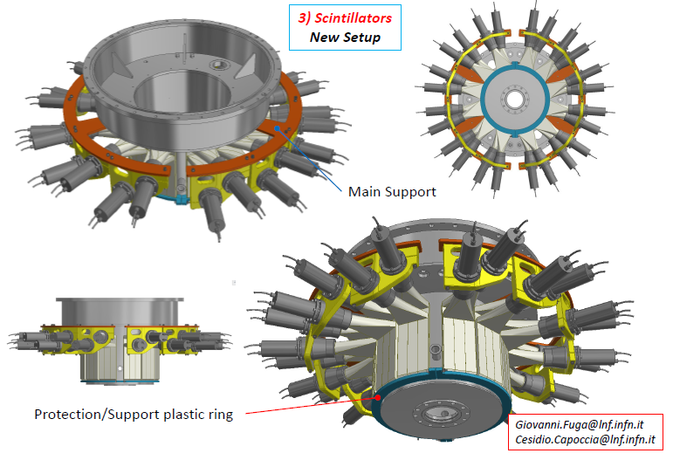

Slide 30
SIDDHARTA-2 setup
    Assembling plan
    Installation at DAΦNE

Slide 31
Gantt chart SIDDHARTA-2:
 | Q4/2016 |  |  | Q1/2017 |  |  | Q2/2017 |  |  | Q3/2017 |  |  | Q4/2017 |  |  | Q1/2018
SIDDHARTA-2 assembling plan
Cryogenic target cells
48 SDDs bonded and mounted SDD final tests (with SFERA + DAQ)
Veto-1 constructed/tested Veto-2 constructed/tested Kaon trigger Luminosity monitor constructed/tested
SIDDHARTA beam pipe
final mounting, debugging and testing
installation
at DAΦNE

Slide 32
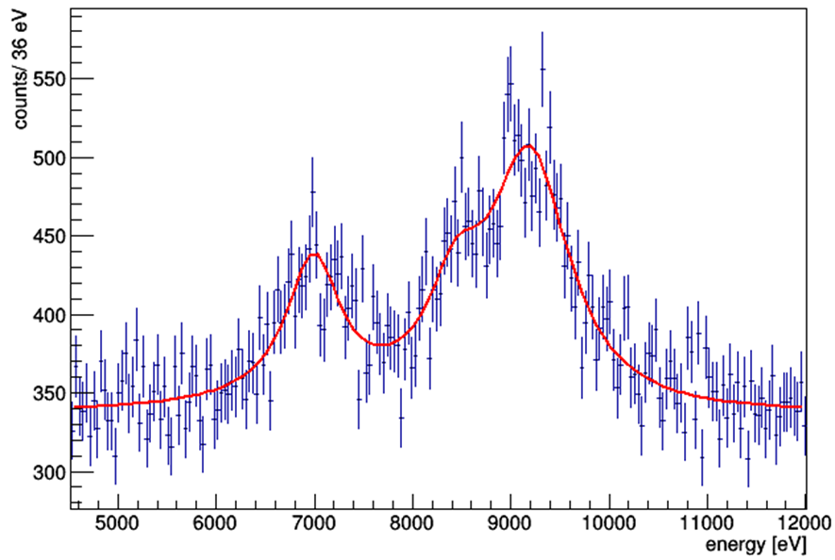
SIDDHARTA-2 plan for the K-d measurement
Installation on DAFNE starting summer 2018
Technical run in 2018
Kaonic deuterium run in 2019:
200 pb⁻¹, to debug and optimize the apparatus
800 pb⁻¹, to perform the first measurement of the strong interaction induced energy shift and width of the konic deuterium ground state (similar precision as K-p) !
achievable precision:
shift: 30 eV
width: 75 eV
K_{high}
K_{β}
Plans to secure personal for beam time and analysis is under discussion!
K_{α}
QED
Notes:
This window of opportunity should be realized.
32

Slide 33
SIDDHARTA-2 future programme and perspectives
Other light kaonic atoms (K⁻ O, K⁻ C,…)
Heavier kaonic atoms (K⁻ Si, K⁻ Pb…)
Kaonic helium transitions to the 1s level
Kaon mass - precision measurement at a level < 7 keV
  Radiative kaon capture – Λ(1405) study
  Investigate the possibility of the measurement of other
  types of hadronic exotic atoms (sigmonic hydrogen ?)

Slide 34
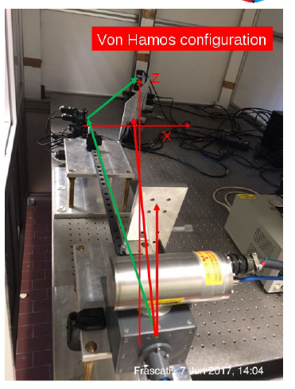
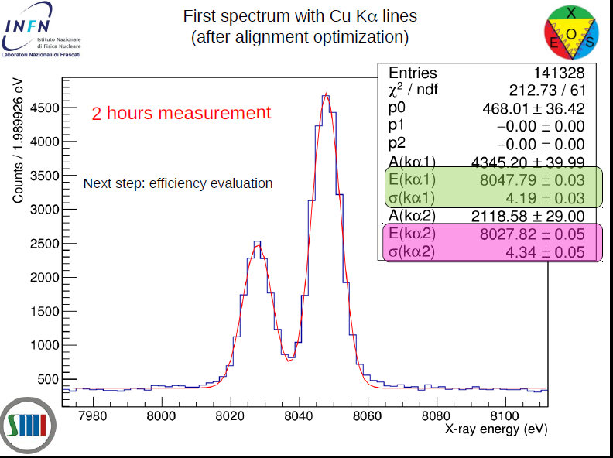

Slide 35
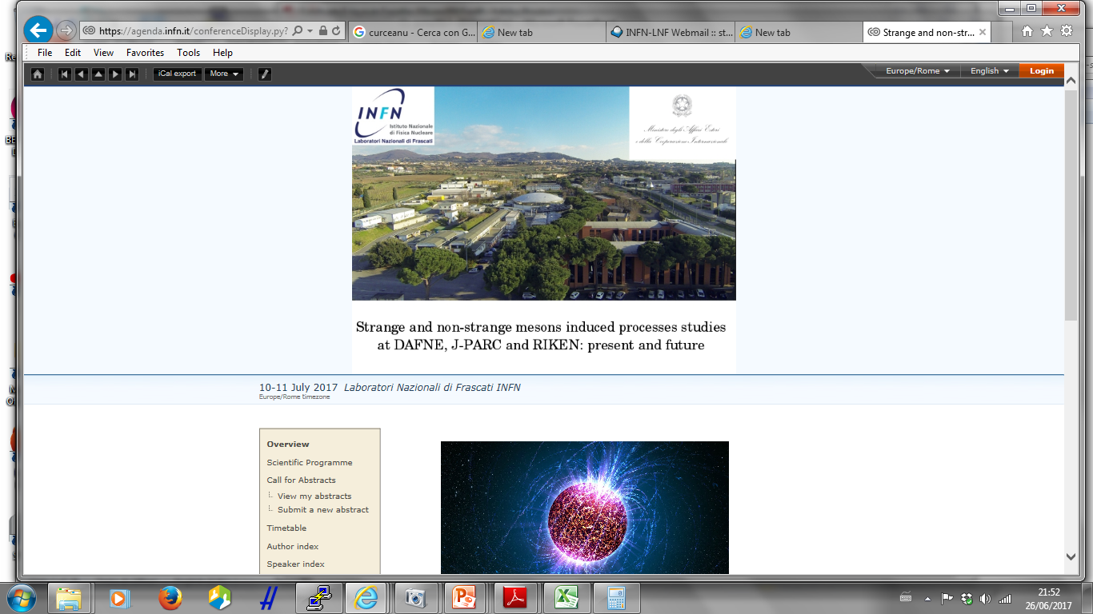

Slide 36
ASTRA: Advances and open problems in low-energy nuclear and hadronic STRAngeness physics
ECT*, 23 Oct 2017 to 27 Oct 2017
Kaonic Deuterium Measurement of SIDDHARTA2: MCurie IF:
I am pleased to inform you that your proposal has been awarded the Marie Sklodowska-Curie Actions Seal of Excellence. This quality label is awarded to all proposals submitted to the MSCA Individual Fellowships Call that scored 85% or more but could not be funded from the call budget.
We will present it to the 2017 call again

Slide 37
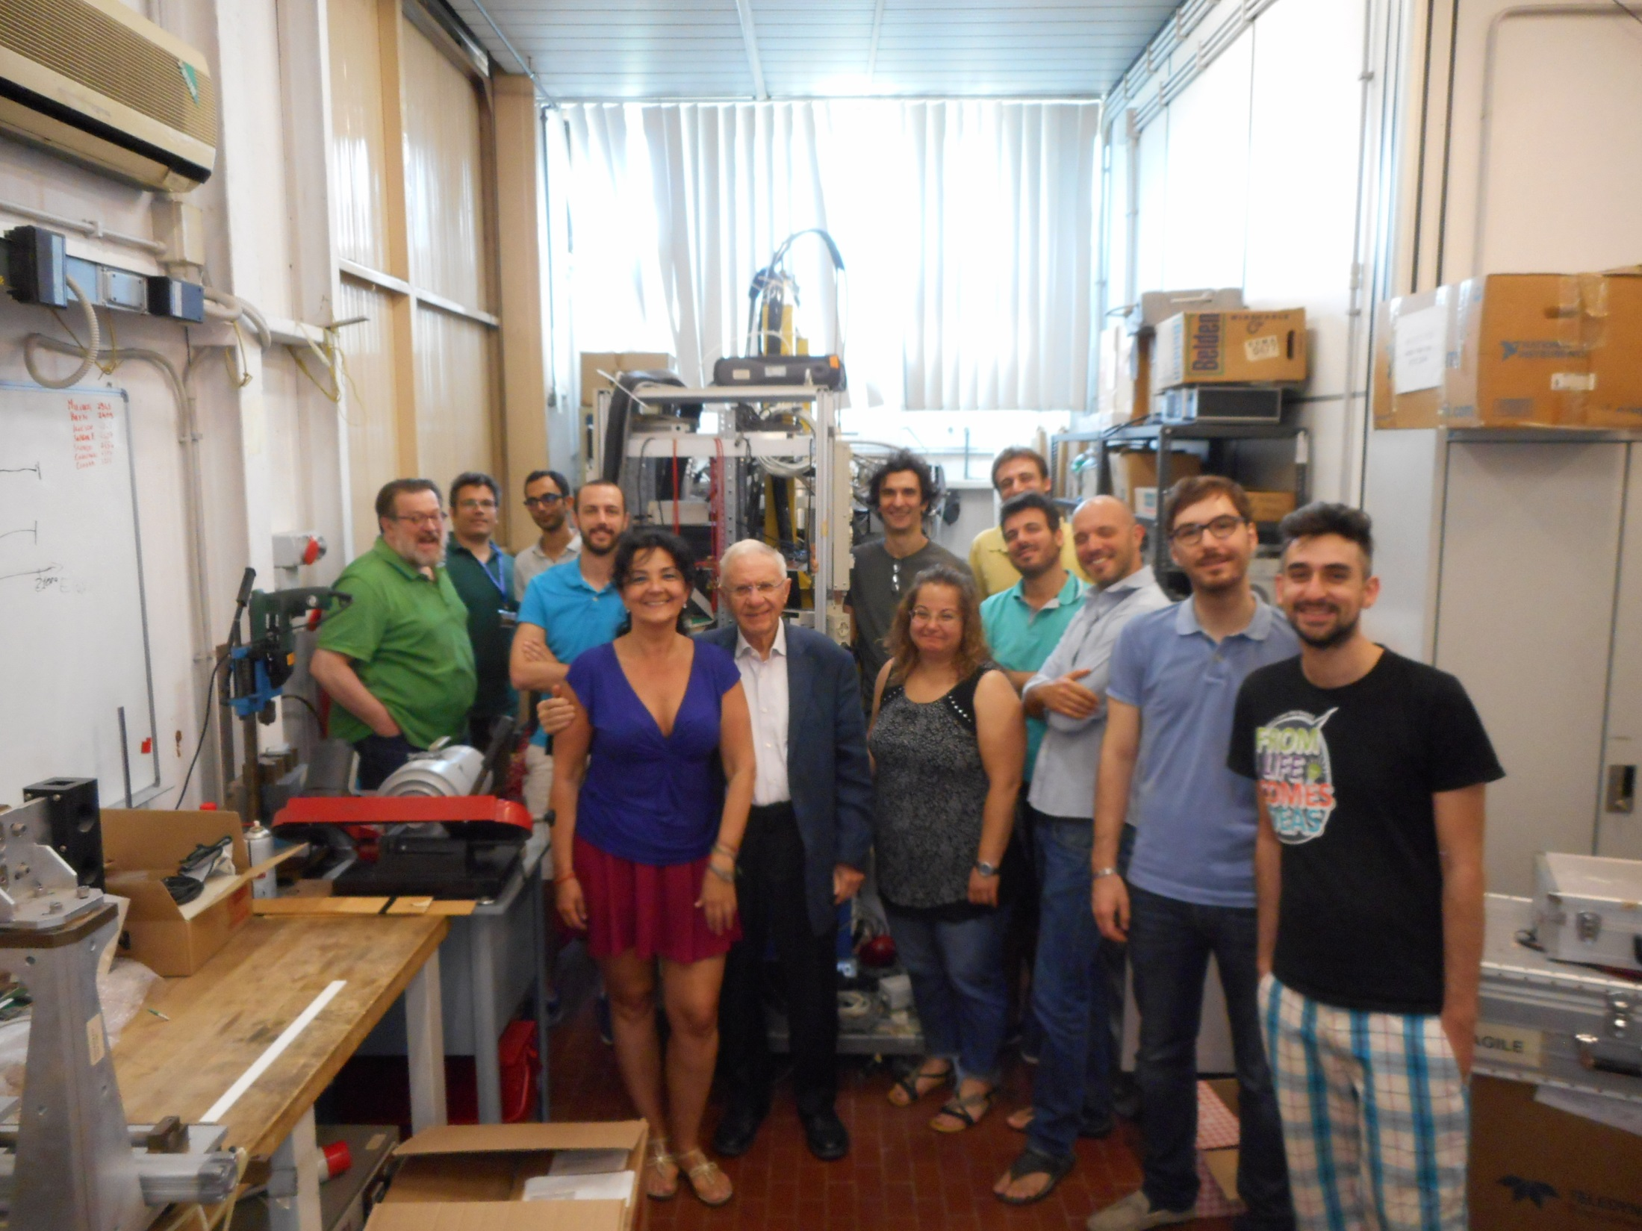

Slide 38
Richieste 2018 (very prelim.)
1. M. Miliucci 0.8
2. M. Cargnelli 0.5
3. A. Clozza 0.15+0.15
4. C. Curceanu 0.5 + 0.2
5. R. Del Grande 1
6. M. Donari 1
7. C. Guaraldo -
8. P. Levi Sandri 0.2
9. M. Merafina 0.2
10. D. Pietreanu 0.6
11. D. Sirghi 0.8
12. A. Spallone 1
13. O. Vazquez 0.5
14. J. Zmeskal 0.5
15. S. Dabagov 0.2
16. E. Pace 0.8
17. M. Iliescu 1
18. M. Bazzi 0.6
19. M. Skurzok 1
20. D. Hampai 0.2
+ 1 borsista
Richieste ai servizi LNF (supporteria, installazione,…):
SEA: 4 mesi/uomo (alimentazioni, readout veto…)
SPAS: 6 mesi/uomo (luminometro, supporteria, integrazione)
SPCM: 8 mesi/uomo (costruzione supporteria, shielding…)
2 tecnici al 50%
Richieste personale: Assegni, borse (post doc) e contratti
Missioni | Manut. | Invent. | Altri cons. | Cons. Lab | Totale
15 | 10 (pompe vuoto, criogenia, DAQ…) | 20 (DAQ, veto2 readout, Lumin. Monitor) | 20 (shield., support, gas cryo, ..) | 30 (lumin., cavi e connettori,, SDDs…) | 99

Slide 39
SDD arrays, delivery and qualification
48 SDDs arrays needed
Delivery status:
52 arrays received
37 bonded (Milano)

