Slide 1
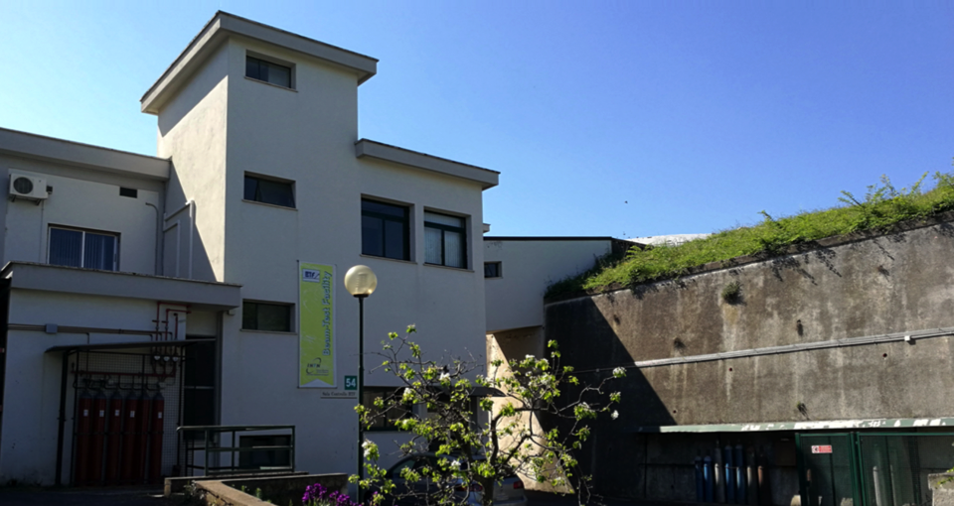
BTF e PADME
Consiglio di Laboratorio – 30 giugno 2017

Slide 2
BTF e PADME teams
Paolo Valente♮
Maurizio Belli, Bruno Buonomo, Bruno Bolli, Sergio Cantarella, Riccardo Ceccarelli, Alberto Cecchinelli, Oreste Cerafogli, Renato Clementi, Claudio Di Giulio, Enrico Di Pasquale, Alessandro Drago, Adolfo Esposito, Luca Foggetta, Oscar Frasciello, Andrea Ghigo, Simona Incremona, Franco Iungo, Stefano Lauciani, Roberto Mascio, Stefano Martelli, Graziano Piermarini, Luigi Pellegrino, Ruggero Ricci, Luis Antonio Rossi, Lucia Sabbatini, Claudio Sanelli*, Franco Sardone, Giancarlo Sensolini, Serena Strabioli, Ugo Rotundo, Alessandro Stecchi, Angelo Stella, Raffaele Zarlenga
Paola Gianotti, Pietro Albicocco, Roberto Bedogni, Fabio Bossi, Bruno Buonomo, Emilio Capitolo, Cesidio Capoccia, Gianni Corradi, Riccardo De Sangro, Claudio Di Giulio, Giuseppe Finocchiaro, Luca Foggetta, , Georgy Georgiev♯, Andrea Ghigo, Paola Gianotti, Venelin Kozhuharov♯, Marcello Piccolo*, Gabriele Piperno, Ivano Sarra, Barbara Sciascia, Tommaso Spadaro, Eleuterio Spiriti, Clara Taruggi§, Ludmil Tsankov♯
♮Osp., INFN Roma
§Ass., Università Tor Vergata
♯Ass., Sofia University
BTF support
Federica Triolo, Maria Rita Ferrazza, Manuela Giabbai, Francesca Casarin
DAΦNE operations group

Slide 3
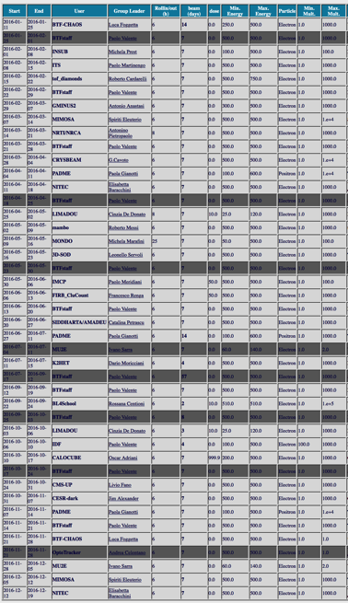
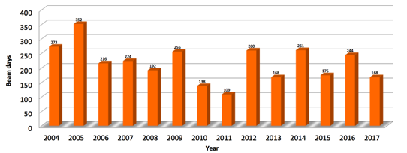
BTF status: Utenti
Utenti 2016
La facility è operativa dal 2002, dal 2004 in modo totalmente opportunistico rispetto all’operazione di DAΦNE come collider e⁺e⁻
Flusso costante di utenti, 90% per attività di R&D di rivelatori, test e calibrazioni
La flessibilità (range dei parametri) e la facilità d’uso sono molto migliorati grazie a continui aggiornamenti e ottimizzazioni, soprattutto dal punto di vista della diagnostica e dei servizi
Per i prossimi anni si prevede di espandere l’uso in due direzioni:
Veri e propri esperimenti di lunga durata di fisica fondamentale
A un primo run di PADME con la tecnica della massa mancante potrebbero seguire ulteriori ricerche nel visibile, esperimenti di dump spessi, con e senza la rivelazione diretta di prodotti di decadimento nel dark sector, ricerca di ALPs, bosone 5th force, eccetera
Uso come facility di irraggiamento, prevalentemente per attività connesse allo spazio

Slide 4
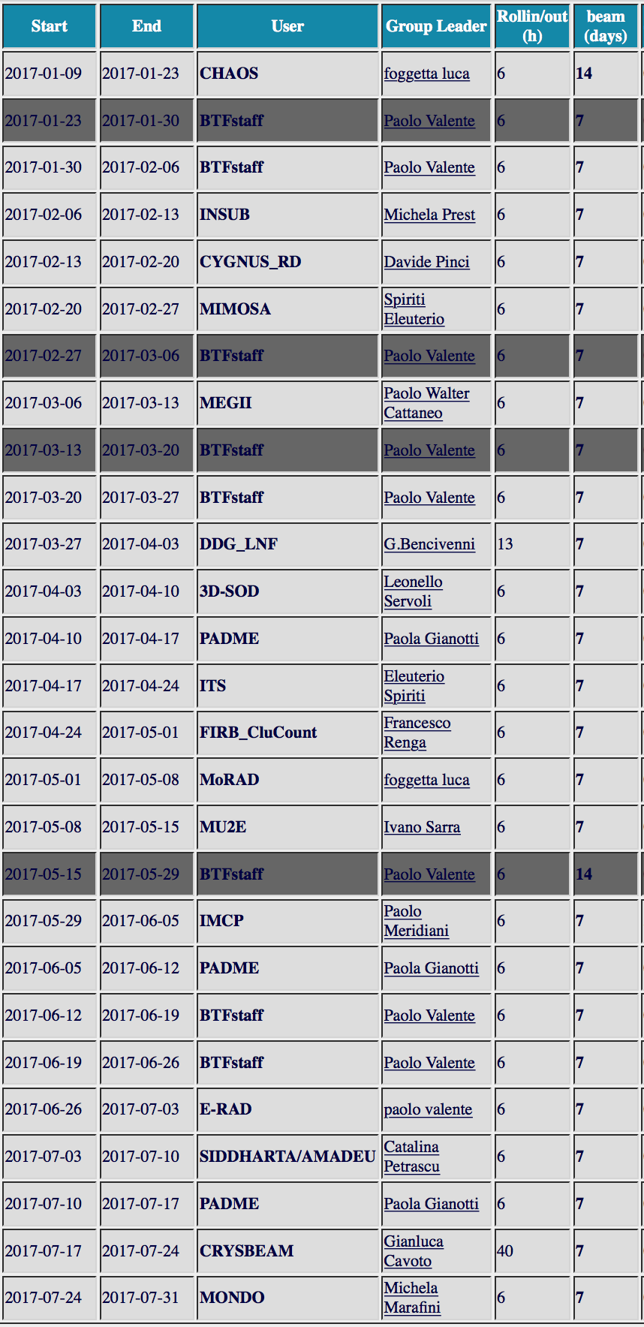
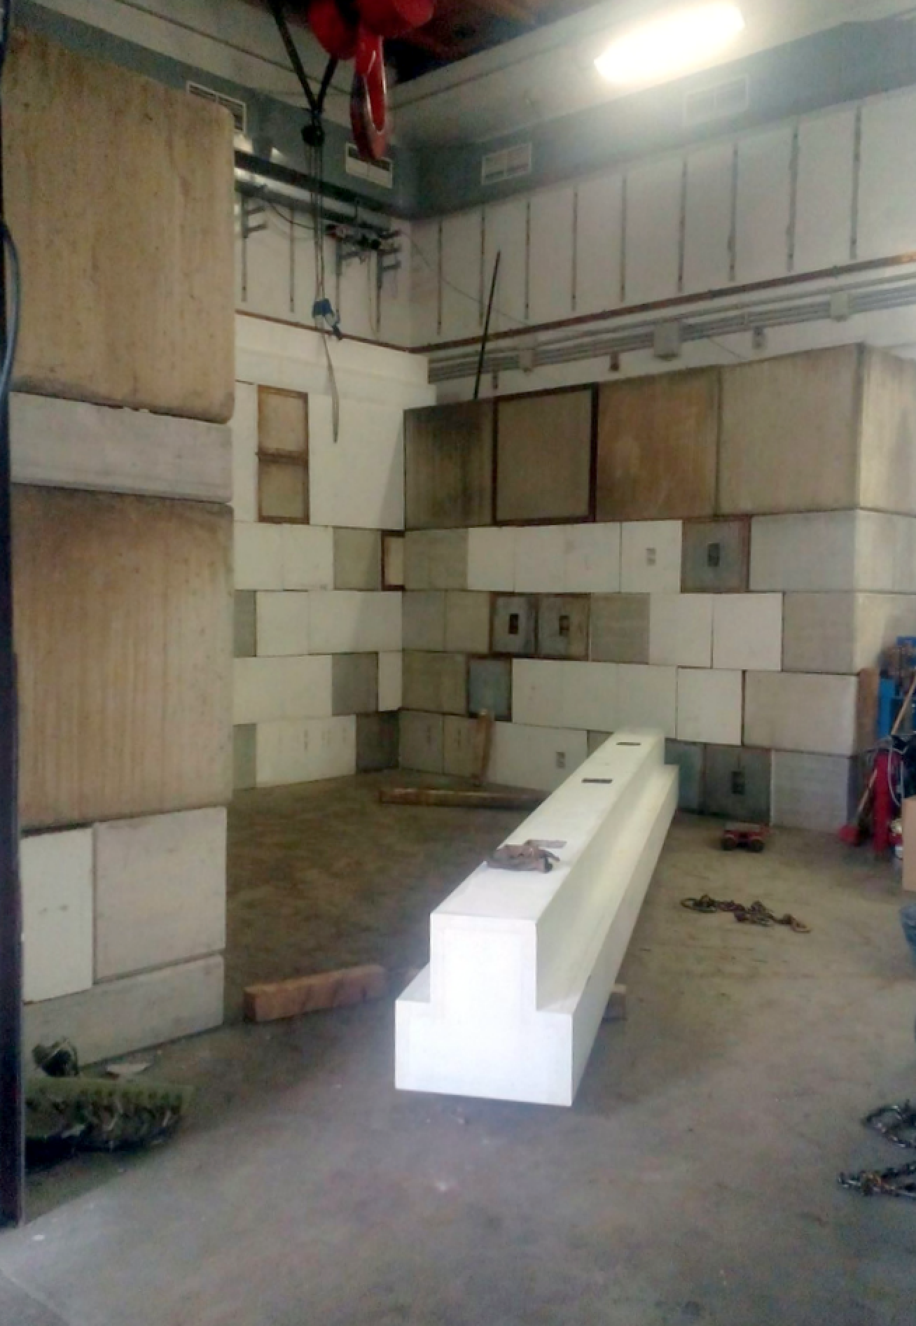
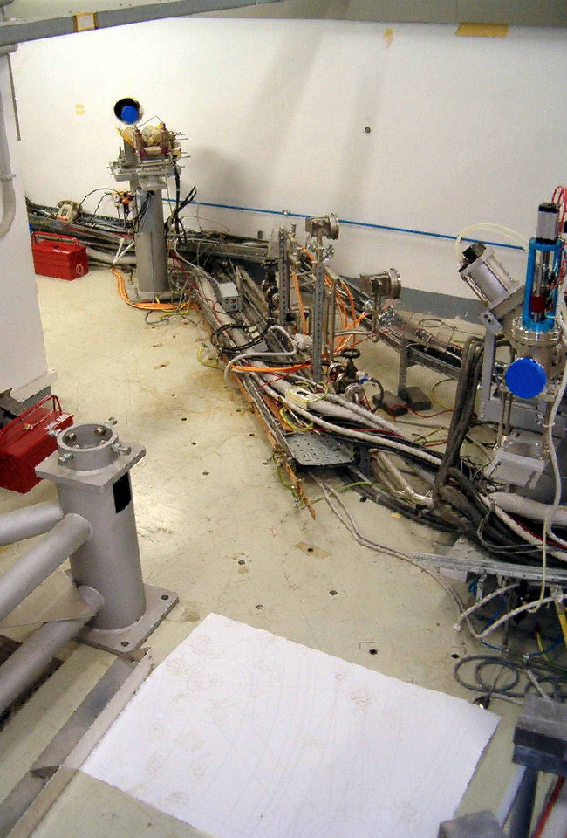
Piani 2017-2018
Utenti 2017
A causa dell’attività di upgrade BTF e dell’installazione di PADME, non ci sarà call per gli ultimi mesi del 2017 e l’inizio del 2018
Esigenze particolari saranno soddisfatte, a richiesta, fino a quando non inizieranno i lavori di edilizia e di smontaggio sulla linea di fascio (previsto per ottobre)
Durante il run di PADME (da aprile 2018) la disponibilità dipenderà dallo stato della seconda linea
Lavori per le schermature: Lug.-Set. 2015
Camera a tre vie: Mar.-Apr. 2004

Slide 5
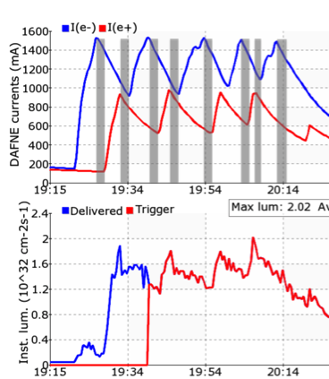
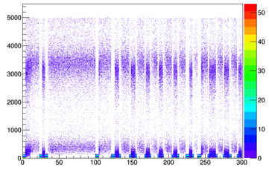
Opportunistic running
No beam (switch of LINAC polarity)
Example: signal in PADME calorimeter
Cut >3σ(ped)

Slide 6
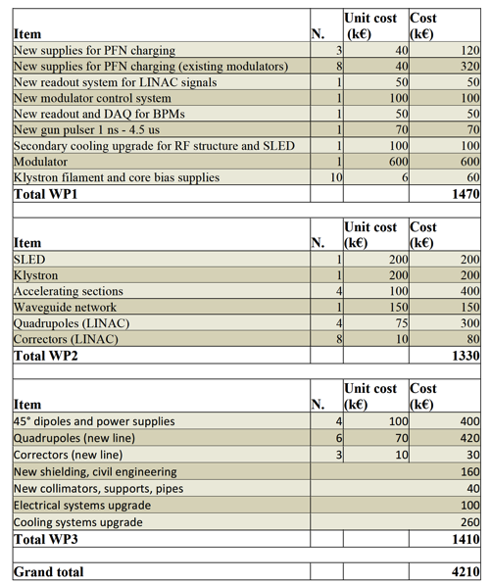
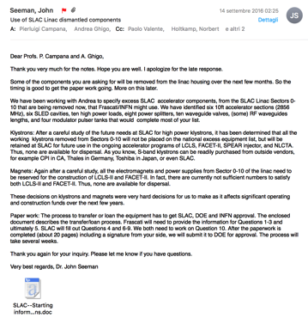
Progetto di consolidamento e upgrade BTF
2.6 M€ dalla GE per consolidamento LINAC e seconda linea di fascio
1.6 2017 (marzo)
1.0 2018
Upgrade in energia (fino a 1 GeV): tentativo di recuperare componenti dal LINAC di SLAC

Slide 7
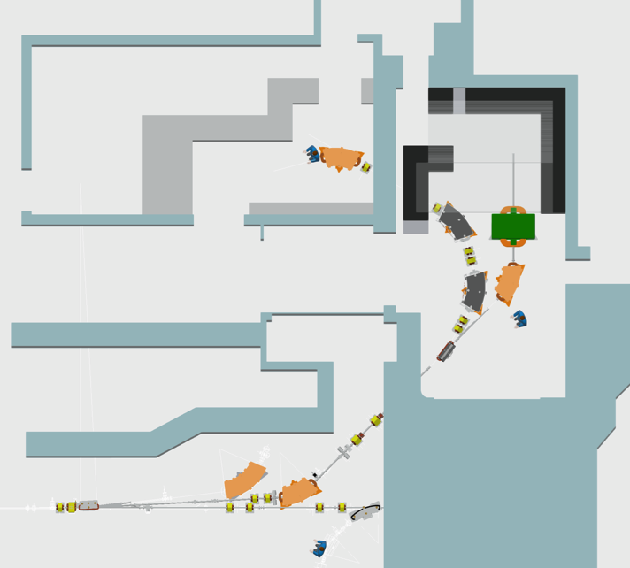
Final layout

Slide 8
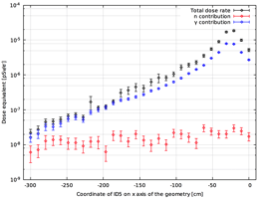
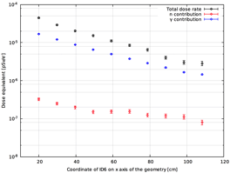
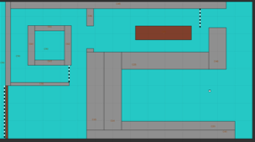
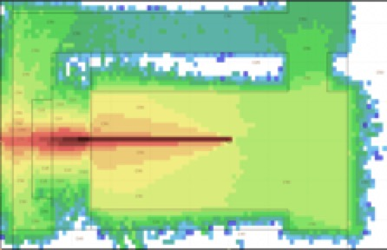
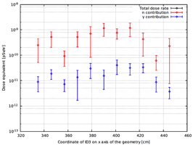
Dossier radio-protezione
13/04/2017: Iniziato iter da parte del servizio FISMEL
Dossier con calcoli e simulazioni praticamente finale
Modificate schermature (spessore aumentato a zero gradi)
Diagnostica addizionale individuata
2 camere a ionizzazione gamma/neutroni (una dietro la schermatura frontale, una al piano superiore zona “alimentatori”)
Spostamento nel bunker dell’attuale camera a ionizzazione della control-room
1 sistema di monitor dei gas
Per stare sotto 0.1 μSv/h, <10⁶/s

Slide 9
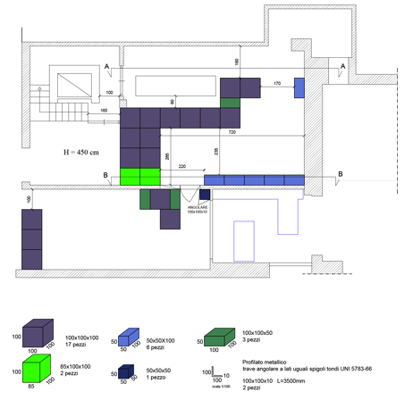
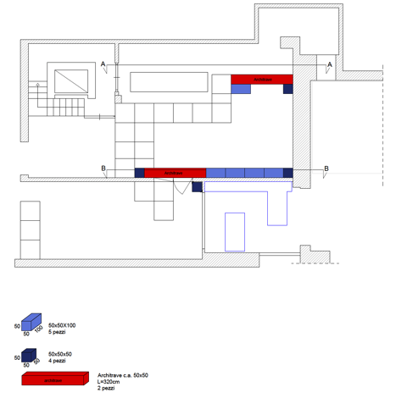
Civil engineering and shieldings/1

Slide 10
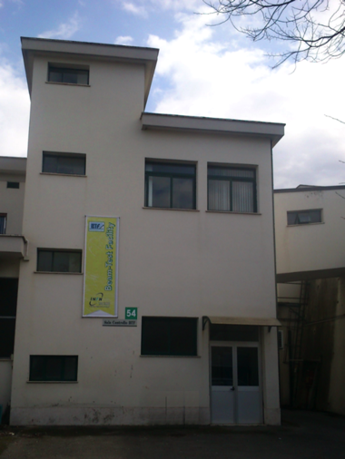
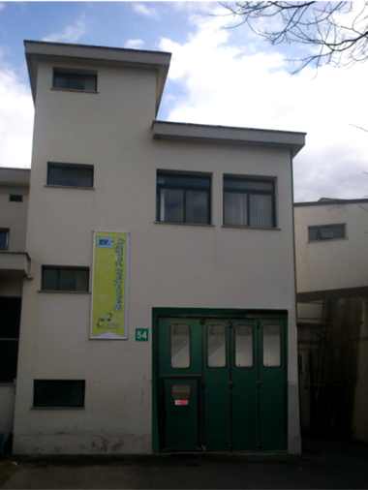
Building modifications
Present situation
Upstairs
Downstairs
Bridge
Shielding blocks
New door
New chicane

Slide 11
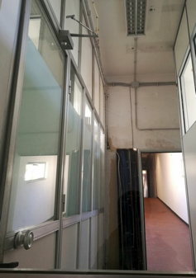
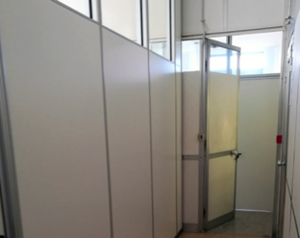
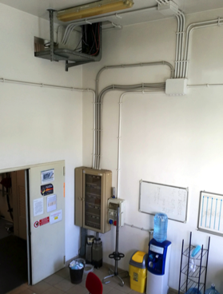
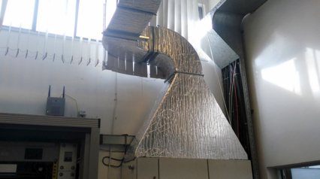
Building modifications
Bridge
Power supplies
Upstairs
Downstairs

Slide 12
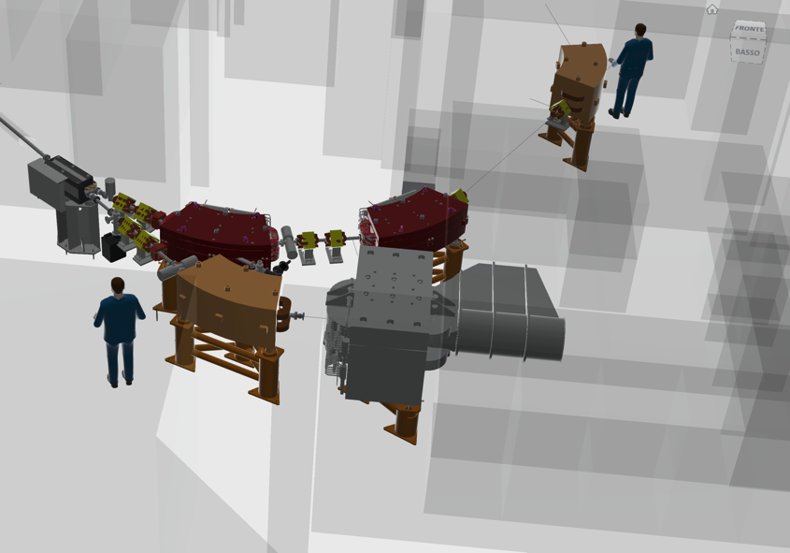
Layout: final 3D

Slide 13
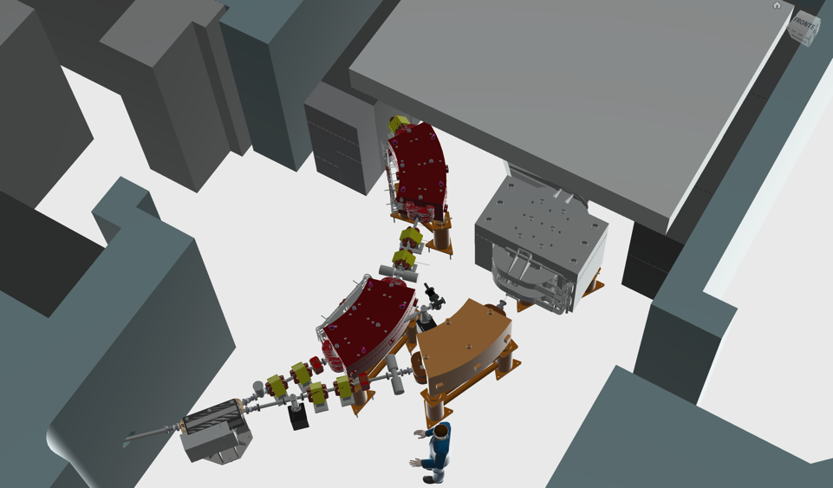
New magnets
DC-01
13 new magnets:
3 types of dipole
Quadrupoles
Correctors
QUA-05/06
DH-02
QUA-03/04
DH-01
QUA-01/02
PADME
(DHSTB02)
(QUATB-03/04)
DP-01

Slide 14
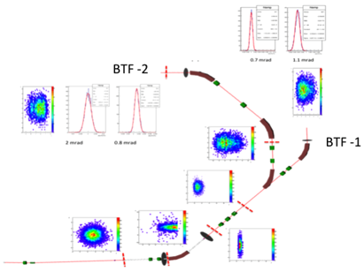
Magnetic design
Main constraints
Fit inside the existing BTF hall for turning by 135° and thus use the former control room as second experimental area
Split the bending into three dipoles in order to control the dispersion
Take into account a possible energy upgrade of the LINAC up to 1 GeV: at least 920 MeV secondary beams
As a consequence, iron core dipoles working close to saturation
Allow the use the parallel of the two lines as much as possible:
Be compatible with present DAΦNE operation without linking too much to it
Pulsed dipole for splitting sequence of LINAC pulses
Iron lamination dipole, making a relatively small angle (15°)
As compact as possible

Slide 15
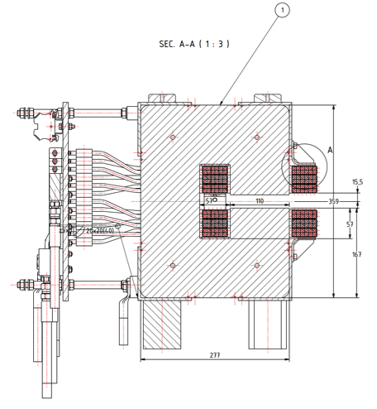
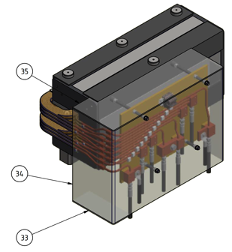
Pulsed dipole DP-01
GENERAL DATA
Beam energy (MeV) | 1000
Curvature radius (m) | 3
Gap (mm) | 25
Pole width (mm) | 110
Nominal flux density (T) | 1,11
Bending angle (deg) | 15
N per pole (turns) | 36
Ampere-turns/pole | 11052
Yoke Width (mm) | 277
Yoke Height (mm) | 359
Yoke Length (mm) | 760
Overall Length (mm) | 329
Overall Height (mm) | 359
Overall Length (mm) | 913
Good Field Region (mm) | ±25
Field quality (ΔB/B) | 6,4E-03
Integrated Field quality (ΔIB/IB) | 2,3E-03
Total weight (kg) | 516
ELECTRICAL INTERFACE
Conductor dimension | 7x7 Φ4
Nominal Current (A) | 316
Nominal Resistive Voltage (V) | 113
Rtot (Ω) | 0,078
Nominal inductance (H) | 0,029
Nominal Power (kVA) | 35
Maximum Line Cable lenght (m) | 20
Proposed cable cross section ( mm²) | 95
Proposed Output PS Current (A) | 330
Proposed Output PS Voltage (V) | 130
Proposed Output PS Power (kVA) | 42,9
WATER COOLING
Number of pancakes per pole | 3
Number of pancake circuits | 6
Number of series circuits | 2
ΔT water (°C) | 15
Maximum Water flow (m³/s) | 0.117
Maximum Water velocity (m/s) | 1,55
Maximum ΔP (bar) | 2,94
IRON
V (mm3) | PACK FAC | d (kg/dm3) | Weight (kg)
6,75E+07 | 0,96 | 7,85 | 509
COILS
V (mm3) | FILL FAC | d (kg/dm3) | Weight (kg)
9.46E+06 | 0,59 | 8,9 | 50

Slide 16
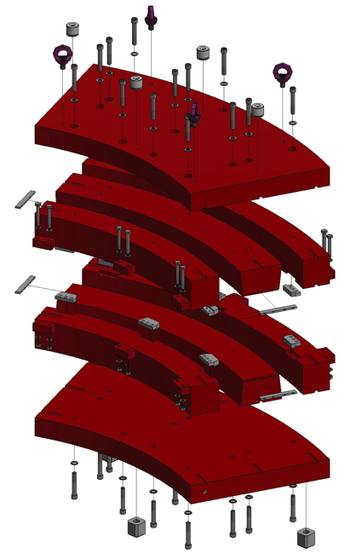
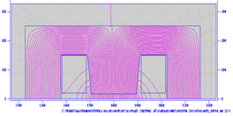
New DC dipoles
GENERAL DATA
Beam energy (MeV) | 921
Curvature radius (m) | 1,8
Gap (mm) | 35
Pole width at the gap (mm) | 190
Pole width at the yoke (mm) | 220
Nominal flux density (T) | 1,7056
Bending angle (deg) | 45,00
N per pole (turns) | 120
Iron Width (mm) | 735
Overall Width | 780
Overall Height (mm) | 503
Overall Lenght (mm) | 1672
Good Field Region (mm) | ±15
Field quality (ΔB/B) | 4,29E-04
Integrated Field quality (ΔIB/IB) | 3,78E-04
Total weight (kg) | 4006
ELECTRICAL INTERFACE
Conductor dimension | 9.5x9.5 Φ5.5
Nominal Current (A) | 262
Nominal Resistive Voltage (V) | 72
Rtot (Ω) | 0,276
Nominal inductance (H) | 0,423
Nominal Voltage on magnet (V) with a 10 s raising time (V) | 83
Nominal Power (kVA) | 22
Maximum Line Cable lenght (m) | 20
Proposed cable cross section ( mm²) | 95
Proposed Output PS Current (A) | 280
Proposed Output PS Voltage (V) | 95
Proposed Output PS Power (kVA) | 26,6
WATER COOLING
Number of pancake per pole | 6
Number of Turn per pancake | (10 H 2 V)
ΔT water (°C) | 15
Maximum Water flow (m³/s) | 3,44E-04
Maximum Water velocity (m/s) | 1,21
Maximum ΔP (bar) | 3,82
IRON
V (mm3) | PACK FAC | d (kg/dm3) | Weight (kg)
3,99E+08 | 1 | 7,86 | 3140
COILS
V (mm3) | FILL FAC | d (kg/dm3) | Weight (kg)
9,5E+07 | 0,599 | 8,9 | 506

Slide 17
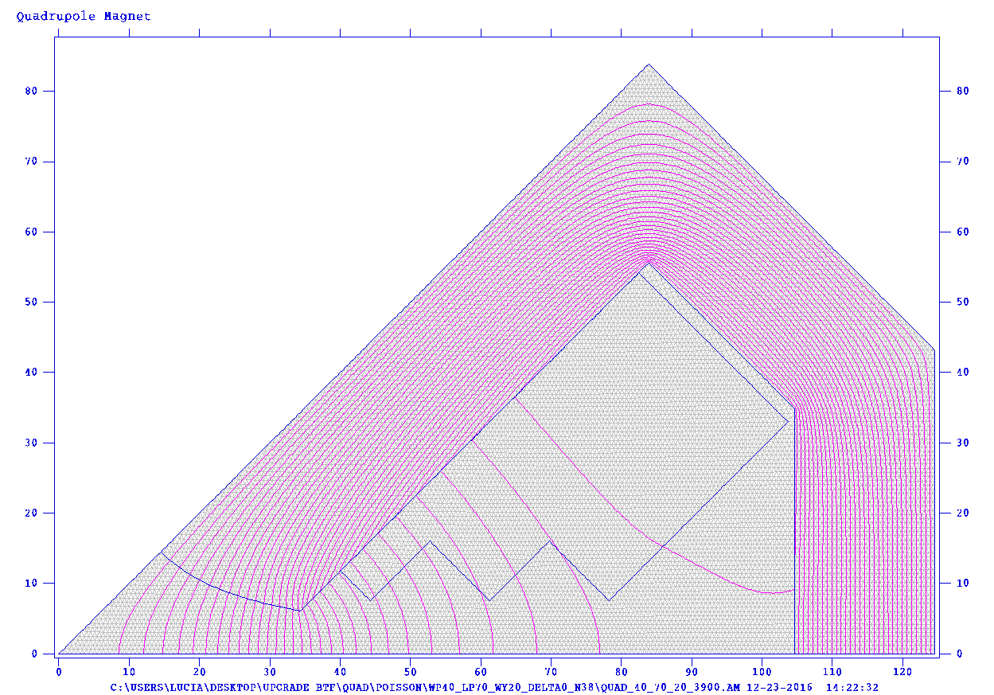
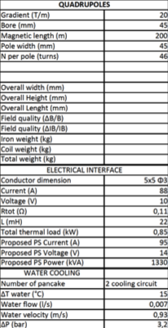
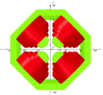
New quadrupoles

Slide 18
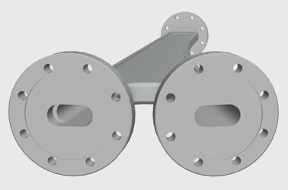
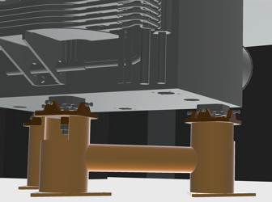
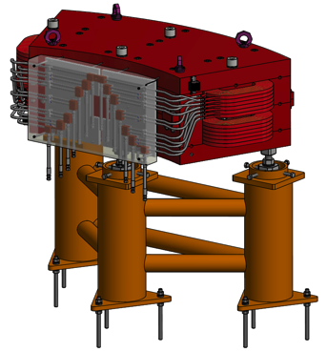
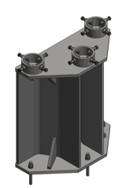
Vacuum, supports, collimators…
Thin vacuum pipe for DP-01 pulsed dipole
Magnet supports
Detailed drawing being prepared
First orders out in July
Supports in many cases included in magnet order

Slide 19
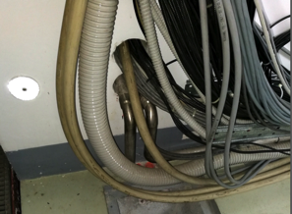
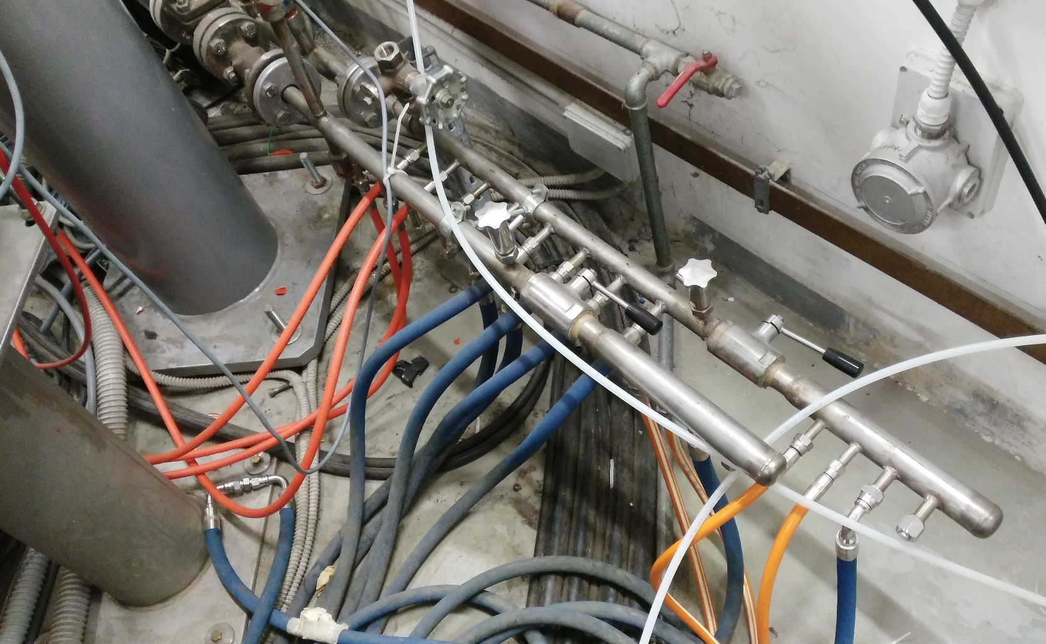
Power, cooling & services
Power supplies specifications almost ready
Detailed estimate of additional electrical and thermal power
Technical solutions both for cooling and power identified
New pumping and secondary circuit distribution for the BTF area
Revision and upgrade of power distribution for the area
Detailed projects being prepared
Impact on civil engineering also being evaluated
Trying to reuse existing LINAC tunnel to BTF area connections

Slide 20
LINAC consolidation/past 4 years
Working on:
Helmoltzs coils power supply
Vacuum System upgrade
Modulators timing system
RF fast syncro timing system
Gun deck and opto-coupling devices
Gun Low voltage power supply
Gun pulser
Cathode and pyrometer
Nd:Ce flags system
Termination loads
Improved multiplexed BPM diagnostics hardware and software
BCM/ICT detectors
Cooling system (primary, secondary and services)
Cooling feedbacks and Supervisor software
LINAC slow control software
LINAC subsystem ETH, WIFI network
LINAC peripherals bus system
LL RF and low power amplifiers
RF measurement system
PFN, Klystron and Transformer upgrade
HVPS and thyratron circuit upgrade
Full hodoscope replacement
…
We plan:
Full replacement with solid state HV power supplies for the PFN
New embedded modulator control system
Add a new Modulator+Kly+SLED
Aiming to:
Increase energy beam up to 1 GeV (e-)
Improve stability
Extend the machine lifetime (already 20 years old) by at least 10 years

Slide 21
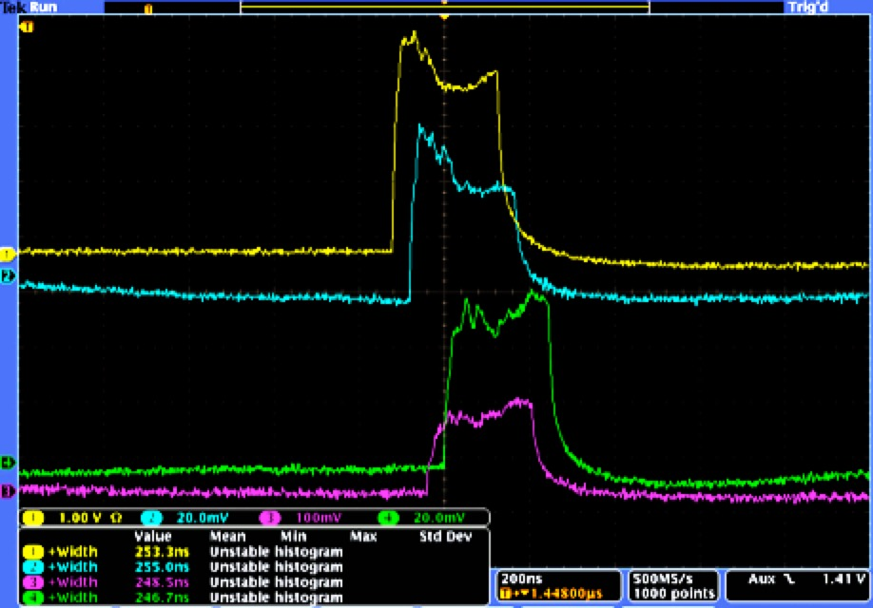
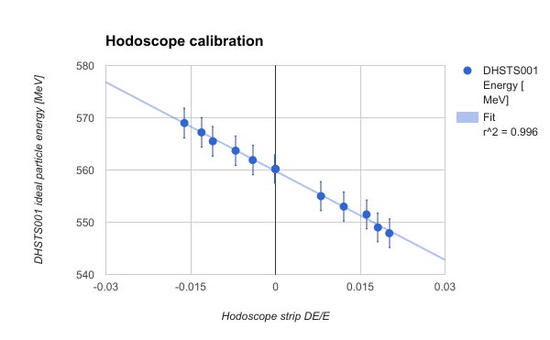
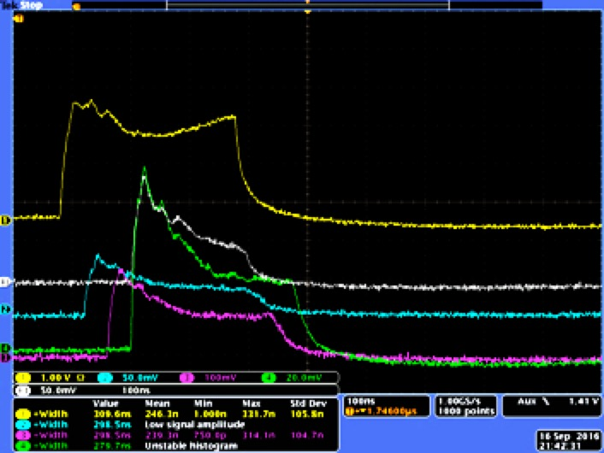
Extending the pulse length
New gun pulser: from 1.5 ns to 5 µs
Tuning delays, power and phase of RF to pre-buncher, buncher and modulators
Beam Particle = Electrons
E = 558 MeV
∆E/E = 0.015
Charge = 2nC
Beam at LINAC exit >250ns!
To be further optimized
Gun
~250ns, good flatness
End of LINAC
Gun
~300ns
End of LINAC

Slide 22
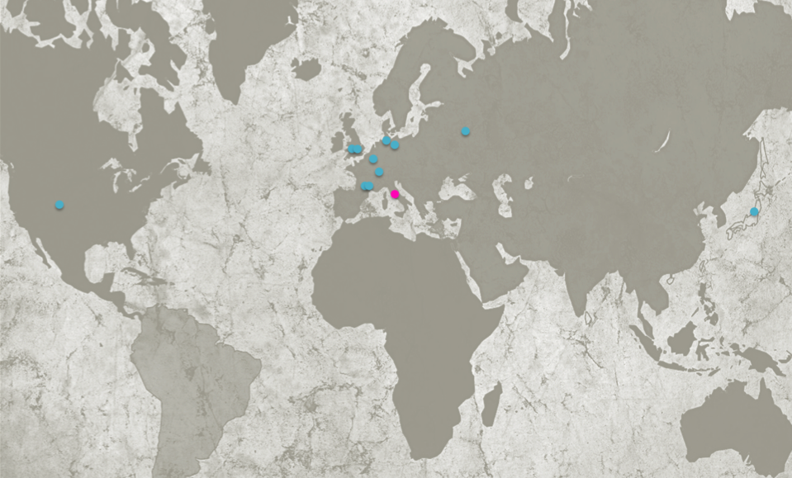
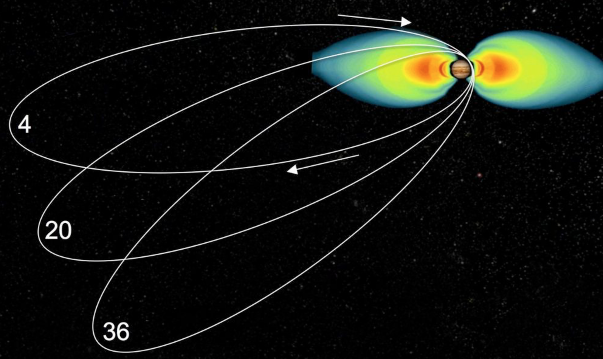
Electron irradiation: map of facilities
Data from CERN DB (AIDA-2020): http://irradiation-facilities.web.cern.ch/publicDB.php
DESY
NRNU
Isotron
NLP
PTB
CSL
Vesper
ONERA
BTF
Aeroflex
TRAD
JAEA
Strongly motivated by missions to Jupiter

Slide 23
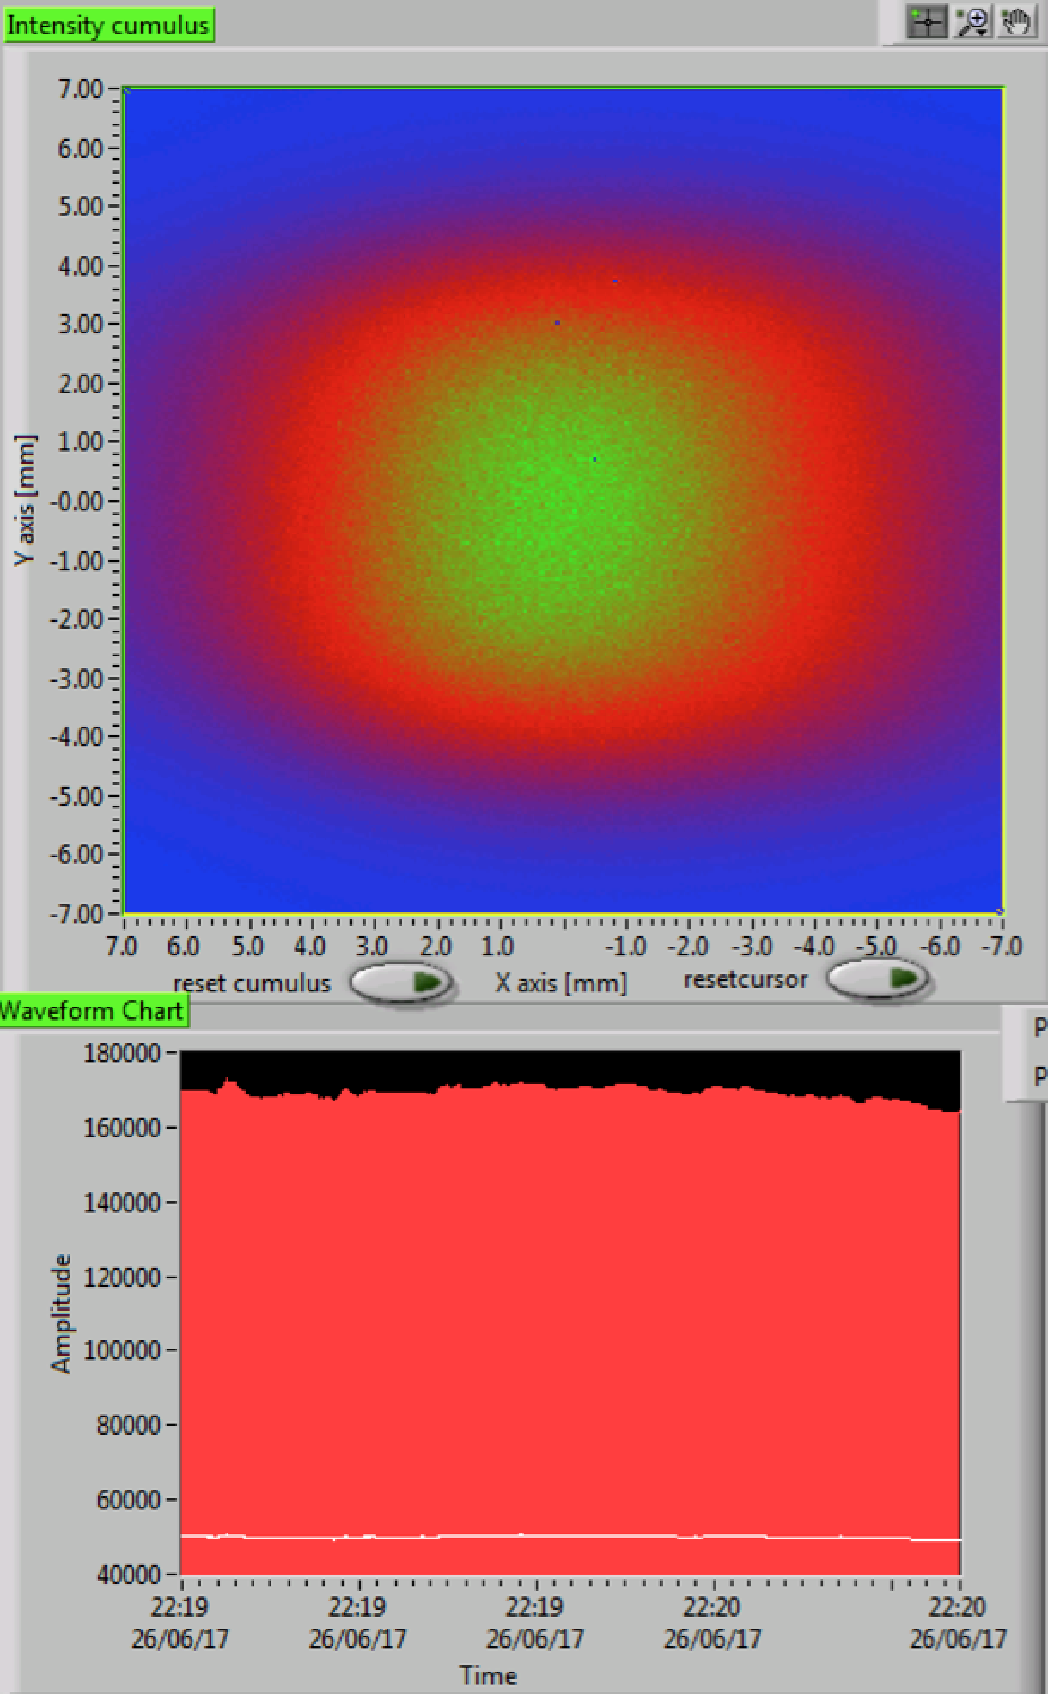
Electron irradiation: parameters of facilities
Data from CERN DB (AIDA-2020): http://irradiation-facilities.web.cern.ch/publicDB.php
DESY
1 GeV
100 MeV
Vesper
BTF
10 MeV
NLP
PTB
TRAD
1 MeV
Aeroflex
Isotron
JAEA
ONERA
CSL
NRNU

Slide 24
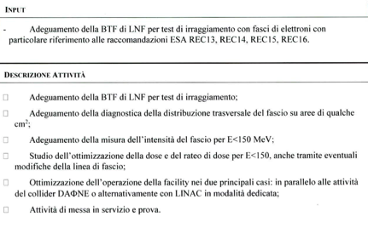
ASIF
Convenzione ASI-INFN-ENEA “ASI Supported Irradiation Facilities”
1 anno, contributo ASI a INFN=523k€
Kick-off meeting 20 giugno 2017
Facilities:
ENEA
Calliope (⁶⁰Co gamma source)
FNG (14 MeV, 2.5 MeV neutrons)
TAPIRO (fast neutrons)
TRIGA (thermal neutrons)
INFN
BTF (electrons), 30k€
LNL (Ions)
LNS (Ions)
FIFPA (Protons 70-273 MeV)

Slide 25
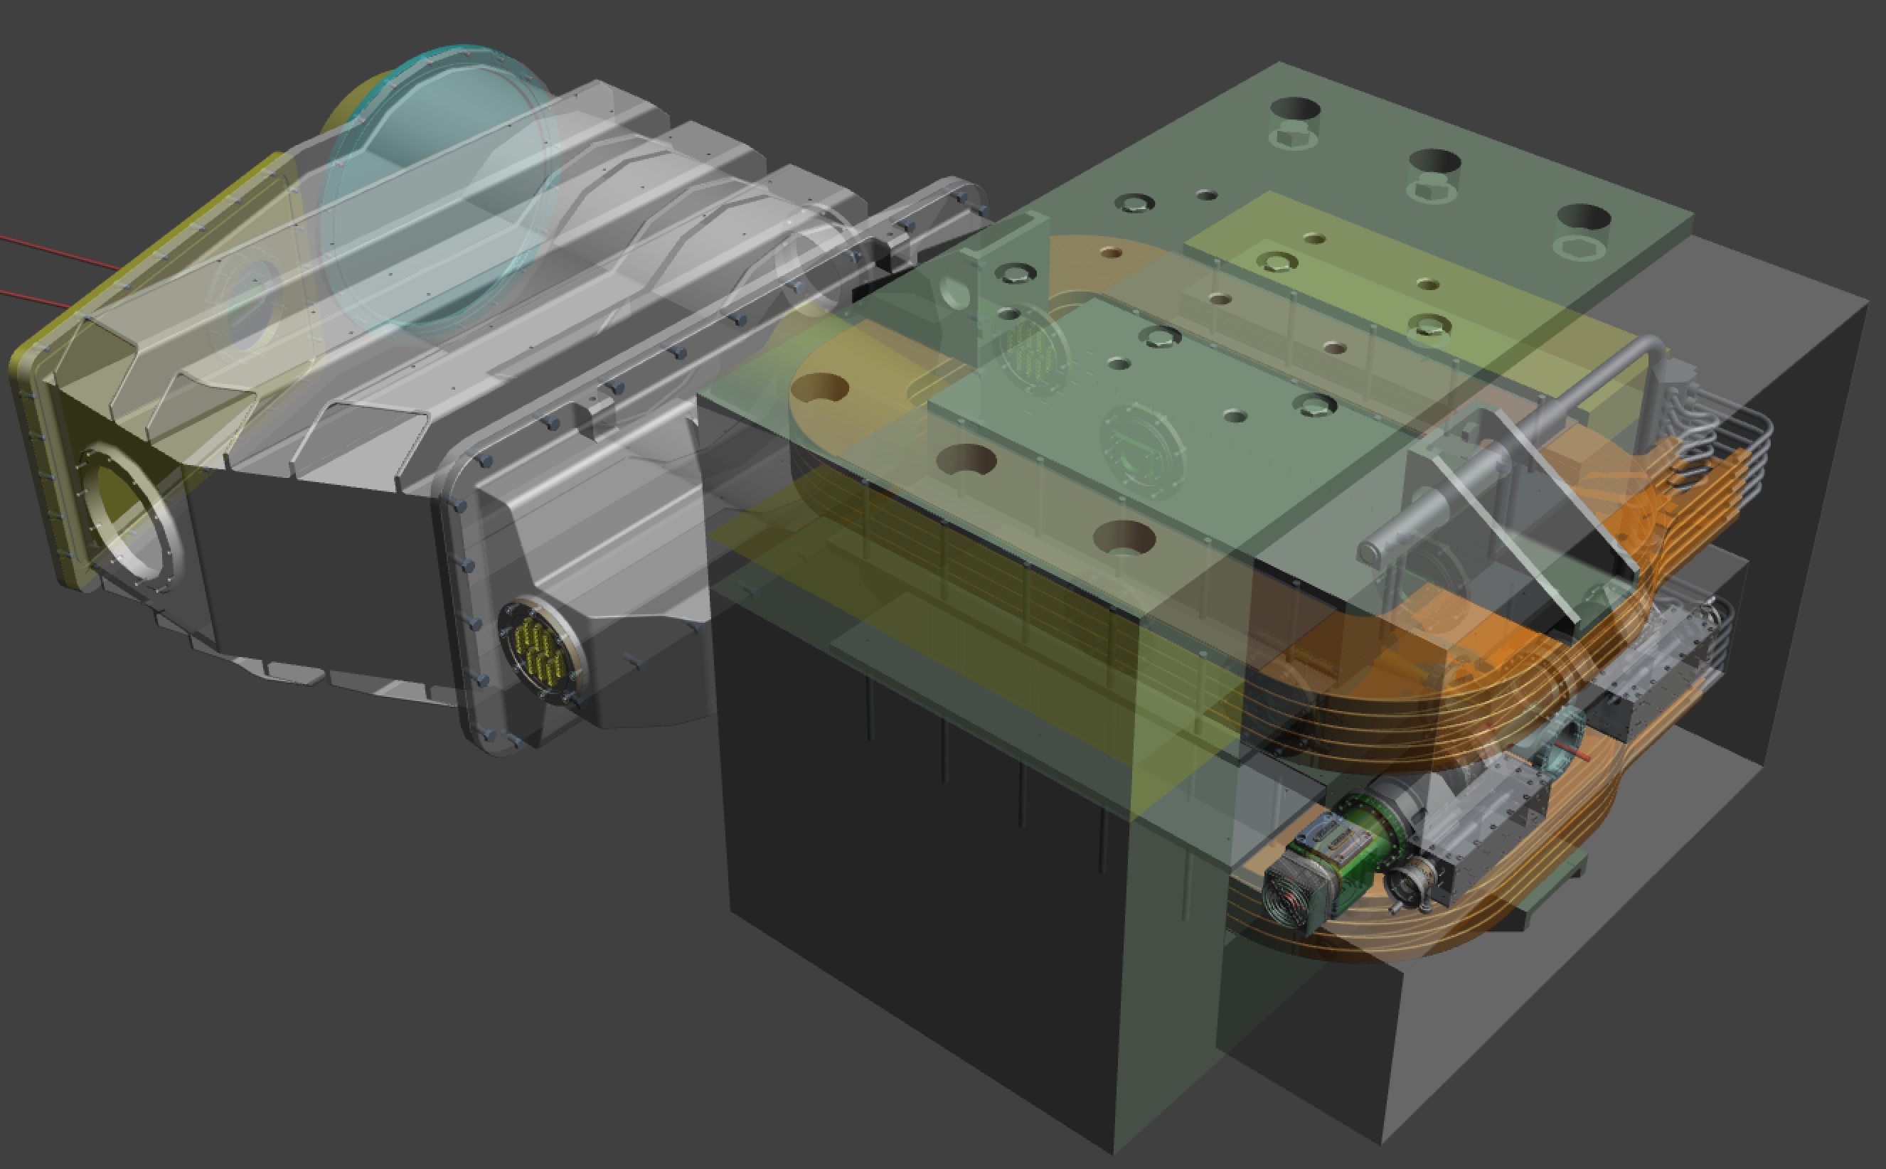
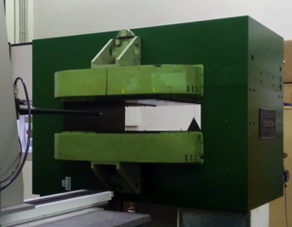
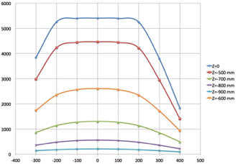
PADME
PADME setup design starts where the BTF line ends
Assume re-using exactly the present vacuum pipe inside DHSTB02, pre-vacuum port, flange, etc.
Pole
Coils
Pole

Slide 26
Beam region and vacuum chamber
Diamond target
Target in diamante con strip sia grafitate sia metallizzate
MIMOSA M28
beam tracker
Movimentazione in vuoto pronta. Scheda carrier in produzione
Lato “diamante” pronto, lato “tracker” design finale

Slide 27
MIMOSA tracking
Based on MIMOSA M28 (monolithic active pixel, 0.35 μm technology), by IPHC Strasbourg, but in vacuum (never implemented, so far)
20.8 μm pitch, 20.2×22.7 mm² area
50 μm thickness
Mechanics and cooling
Linear stage mirrored from the diamond side
Support and cooling structure details designed
New board and cooling support being produced for final testing
Sensors: OK
DAQ, software
In advanced development: April 2017 test-beam successful
Plane 2
Plane 1
Track angle (mrad)

Slide 28
Veto detectors
Time resolution better than 500 ps
Momentum resolution of few % based on impact position
Efficiency better than 99.5% for MIPs
Low energy part inside the magnet gap
High energy part close to not interacting beam

Slide 29
Veto detectors
10×10x180 mm³ scintillator
All scintillator bars delivered
Design of the mechanics ready
Prototype of the assembly ready
Prototype electronics prototype ready
Test-beam in April
Read-out by same digitizing system as calorimeter

Slide 30
Calorimetro
∼600 cristalli BGO
60 cm di diametro
100 MeV electrons spectrum
Nucl.Instrum.Meth. A862 (2017) 31-35
Several test-beams for validating PMT and divider choices, paint, glue, assembly procedure…
Results in line with expectations from L3 experience: ≈2% at 1 GeV, excellent linearity up to ≈1 GeV
Moreover, 13 pC/MeV, 5±1 pC pedestal: threshold well below 1 MeV
Conclusions:
HZC XP1911 PMT’s OK; divider type “B” OK
80 μm paint sufficient for light tightness at few % level, OK from the mechanical point of view
Add TEDLAR foils (50 μm) for dropping optical cross-talk to zero
Recuperati alcuni mq (sufficienti a tutto il calorimetro) a costo e tempo zero da LHCb: GRAZIE!
Polished surfaces of cut crystals OK
No radiation damage on PMT’s
Radiation damage on BGO at the dose level expected from literature recovered by high temperature annealing
All tenders completed: crystal machining, gluing & paiting (Gestione SILO), PMT’s+dividers (HZC Photonics), HV system (CAEN), waveform digitizers (CAEN)

Slide 31
Smontaggio, misura trasmittanza
prima & dopo annealing
(D’Angelo, Nuccetelli + LAB27, CERN)
Rimozione foto-sensore,
Taglio: 21×21×220 mm³
(Gestione SILO, Scandicci)
L3 ECAL half-endcap (CERN)
HZC Photonics (Hainan)
XP1911 19 mm PMT + base
Verifiche dimensionali
Lucidatura
Test con LED (LNF)
Incollaggio PMT e verniciatura
(Gestione SILO)
Calibrazione
Assemblaggio
(fogli di TEDLAR 0,05 mm)

Slide 32
Calorimetro QA/QC
Belle-II lab, ed. 29
Quality assurance/control & calibration:
LED pulsing for PMT QA/QC and gain measurement
Cosmic rays/radio-active source test-stand for finished crystal+PMT assemblies calibration
⁶⁰Co
²²Na

Slide 33
Resources and schedule

Slide 34
Beam, vacuum & target region: critical issues and plans
Aim at having the target region (main vacuum cross and diamond) connected to a BTF secondary vacuum by September 2017
Integrate in the new vacuum configuration (separate LINAC primary vacuum from new BTF & PADME secondary vacuum) by October 2017
Install MIMOSA system & testing
Commissioning with beam as soon as available
Main vacuum vessel coming with the PADME magnet, to be produced by the end of 2017

Slide 35
PADME updated schedule
Crystal preparation slightly behind schedule, but:
Most difficult part – validation of the procedure – done, also checked with beam
Delivery of PMT’s on the critical path:
Project of PMT divider revised: rejected fraction should be low
Can be mitigated parallelizing calibration and assembly
Assembly probably estimated to be shorter, ≈1 month
New manpower
Dedicated manpower for calorimeter construction and installation (Georgiev at LNF for 6 months from Sofia U.)
New help for trigger distribution from Roma 3

Slide 36
BTF-2 updated schedule
Construction of new magnets on the critical path
Try to mitigate by:
Providing a design as detailed as possible (at the level of executive drawings)
Anticipating procurement of raw material
hollow Copper conductors, purchased and delivered at LNF
high-purity iron (?)

Slide 37
Summary/1
New components for LINAC consolidation and BTF-2 available starting from the last months of 2017 (bids started or starting in the next weeks)
LINAC consolidation
Ordinary maintenance during end of 2017 DAΦNE shutdown
First part of new components installation pushed at the end of the KLOE-2 run
Trade-off between reliability of LINAC during PADME run and time subtracted to physics
Installation of new BTF line
Can actually start as soon as the BTF stops, with several weeks advance with respect to the DAΦNE shutdown (≈October 2017)
Civil engineering should come first
Emptying the present control room
Re-routing cabling and preparation for new line installation
Modifications to the building
New shieldings installation
Modifications to cooling plant
Some intervention on the plants, services and inside the LINAC tunnel must be done during the DAΦNE shutdown, but a large part of the work can be prepared without stopping operations
Separation of BTF vacuum from LINAC one will allow performing further activities independently (e.g. new pipes installation, PADME vessel connection, etc.)
End of March as final dead-line for new line commissioning

Slide 38
Ordini consolidamento LINAC
Ordini linea BTF-2

Slide 39
Summary/2
Installation of PADME
PADME dipole should enter the BTF hall before the installation of the BTF new lines
Operation of PADME dipole requires power cables and cooling pipes
Existing cables and pipes probably OK per the PADME magnet but not enough also for the new BTF magnets
Most of the operations for PADME installation can be performed independently from the BTF new lines installation
Critical to complete PADME setup construction by the end of 2017
3 months overall for installation and commissioning in the BTF hall, taking into account interference with BTF upgrade activities
Interference
Commissioning of the new BTF lines will require closing the experimental areas, thus stopping all PADME installation activities (a few days also needed for installation of shielding blocks in the access area)
Early completion of PADME installation implies more time available for testing, both for the new lines commissioning and for the LINAC optimization (for the PADME positron beam)
In principle installation of PADME and components of new lines are compatible, apart from obvious incompatibilities: usage of crane, access to PADME area with large components after second line installation, etc.

Slide 40
Preventivi 2018 – PADME LNF
Assegnazioni di missioni 2017 inadeguate, dati i continui contatti con le aziende (come GESTIONE SILO, CAEN, per la costruzione del calorimetro) e con il CERN (per il recupero dei cristalli e anche altro materiale) più che per partecipazione a workshop e conferenze
Richiesta 2018
Missioni 24 k€
Consumi 20 k€
C. Capoccia ha seguito sostanzialmente tutta la progettazione
E. Capitolo gli assemblaggi, supporti per i calorimetri (tools, prototipi, ecc.) e la lavorazione dei cristalli
Attività progettazione LNF fondamentale almeno ancora nella parte finale del 2017, dovendo chiudere diversi punti:
Dettagli vacuum vessel, passanti, supporti, flange finali, progetto finale tracker in vuoto
Small angle calorimeter
Con l’inizio della fase di costruzione e installazione, crescono le necessità di supporto tecnico:
Arrivo dei materiali e supporto alla fase di QA/QC di fototubi prima e cristalli assemblati poi
Assemblaggio vero e proprio del calorimetro
Costruzione e installazione del vessel nel magnete
Installazione in BTF
4.8+0.9 FTE
(+0.8 rispetto 2017)
Non meno di due tecnici al 50% del loro tempo in più
Il supporto del servizio di metrologia è fondamentale: grazie per quello che si è riuscito a fare fino a ora, per es. il cross-check della qualità dei cristalli lavorati e lucidati
Il supporto dell’officina meccanica è altrettanto importante: molto fatto con stampante 3D, OK per la fase prototipale, prossime necessità supporti dei calorimetri, tools di assemblaggio

Slide 41
Core 2018 PADME
Item del budget 2018 | Costo K€ | Motivazione
Vacuum and mechanics | 40
TimePix charged veto | 150 -50
Computing | 60
Totale | 200
Possibile spitting | 2017 | 2018
Vacuum and mechanics |  | 40
TimePix charged veto | 100
Computing |  | 60
Totale | +100 | 100

