Slide 1
A strange program for LHCb
Diego Martínez Santos
(Universidade de Santiago de Compostela &
The European Research Council)
On behalf of LHCb

Slide 2
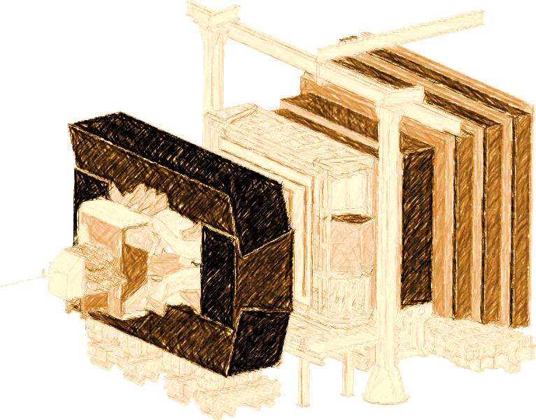
Introduction
LHCb experiment at LHC
Designed mostly for b and c decays
But there is also an ~infinite strangeness production at LHC
Infinite production times zero efficiency requires L’Hopital
We still manage to get world best results
Major improvements in the trigger for s decays are being done
The results I’m going to show correspond to Run –I data
2011: 1fb⁻¹ @ 7 TeV
2012: 2fb⁻¹ @ 8 TeV

Slide 3
Trigger system: status and prospects
L0 (Hardware)
Main bottleneck for K. Can’t be changed
HLT1 (Software)
Not designed for K, but flexible.
K triggers being implemented
HLT2 (Software)

Slide 4
Trigger system: status and prospects
L0 (Hardware)
Main bottleneck for K. Can’t be changed
HLT1 (Software)
Not designed for K, but flexible.
K triggers being implemented
HLT2 (Software)
ε(2011) ~ 1-2%
ε(2016) improved HLT1,2 ~ 15%
Maximum possible ~30% (L0 won’t allow more)

Slide 5
Trigger system: status and prospects
L0 (Hardware)
Main bottleneck for K. Can’t be changed
HLT (Software)
LHCb
Upgrade
HLT1 (Software)
Not designed for K, but flexible.
K triggers being implemented
HLT2 (Software)
(Note: This logo may not be official)
ε(2011) ~ 1-2%
ε(2016) improved HLT1,2 ~ 15%
Maximum possible ~30% (L0 won’t allow more)

Slide 6
Trigger system: status and prospects
L0 (Hardware)
Main bottleneck for K. Can’t be changed
HLT (Software)
LHCb
Upgrade
HLT1 (Software)
Not designed for K, but flexible.
K triggers being implemented
HLT2 (Software)
(Note: This logo may not be official)
ε(2011) ~ 1-2%
ε(2016) improved HLT1,2 ~ 15%
Maximum possible ~30% (L0 won’t allow more)
ε(Upgrade) ~ 80-100%?
Simulation studies show that rate would be under control
V. Chobanova et al,
CERN-LHCb-PUB-2016-017

Slide 7
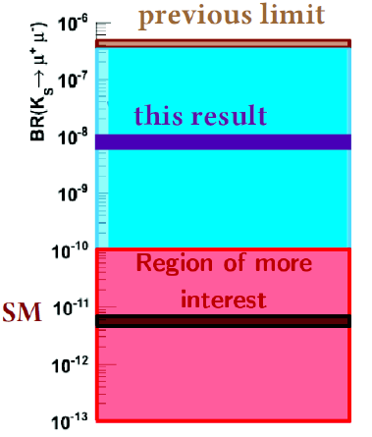
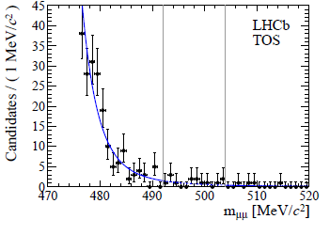
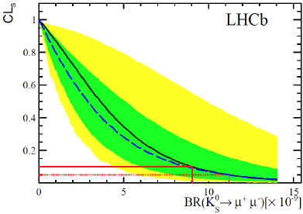
Rare decays of strange particles
Proof of principle
SM prediction: BR(K_{S} → µµ) = (5.1±1.5)x10⁻¹²
JHEP 0401 (2004) 009
K_{S} → µµ sensitive to different physics than K_{L} → µµ (see JHEP 0401 (2004) 009)
LHCb performed a search using 1fb⁻¹ :
JHEP 01 (2013) 090
JHEP 01 (2013) 090
BR(K_{S} → µµ ) < 9(11)x10⁻⁹ @90(95)%CL_{s}
We manage to get world best destpite low trigger efficiency

Slide 8
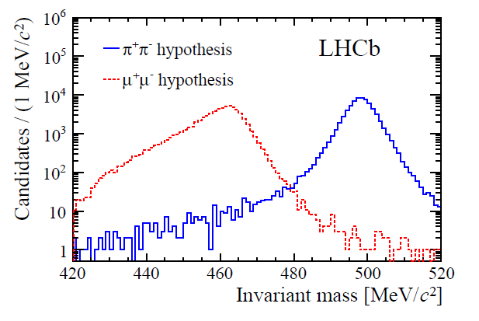
K_{S}→μμ full Run-I analysis
arXiv:1706.00758 [hep-ex]
Update with 2012+ 2011 data
Events classified using a BDT trained against combinatorial background
Dedicated muon identification algorithm trained against K_{S}→ππ
Mass resolution 4 MeV

Slide 9
K_{S}→μμ full Run-I analysis
arXiv:1706.00758 [hep-ex]
Update with 2012+ 2011 data
Events classified using a BDT trained against combinatorial background
Dedicated muon identification algorithm trained against K_{S}→ππ
Mass resolution 4 MeV
Background
K_{L}→μμ negligible: (down to 10⁻¹¹ precision)
K→πμν : negligible
Λ→ pπ removed by a cut in the Armenteros-Podolanski plot.
Combinatorial background
K_{S}→ππ double misid

Slide 10
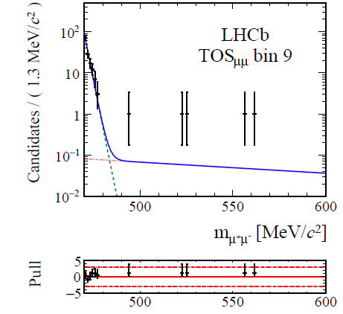
K_{S}→μμ full Run-I analysis
arXiv:1706.00758 [hep-ex]
Event yield extracted from a maximum likelihood fit in BDT categories
Yield translated to BR via normalization to K_{S}→ππ decays
K_{S}→ππ
combinatorial

Slide 11
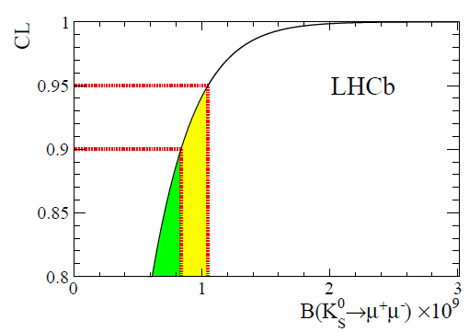
K_{S}→μμ full Run-I analysis
arXiv:1706.00758 [hep-ex]
Event yield extracted from a maximum likelihood fit in BDT categories
Yield translated to BR via normalization to K_{S}→ππ decays
Upper limit obtained integrating the posterior probability, using 2011 result as prior probability
BR< 8 (10)x10⁻¹⁰
@90(95)%CL
K_{S}→ππ
combinatorial

Slide 12
K_{S}→μμ prospects
D. Martinez Santos, FPCP’17
Extrapolating from Run-I result
The most interesting region can be achieved by LHCb upgrade with trigger improvements
Starting to investigate tagged decays, which would allow to access NP in the K_{S}-K_{L} interference
[D’Ambrosio&Kitahara https://arxiv.org/abs/1707.06999]
LHCb-upgrade
Phase-II-upgrade?

Slide 13
Σ→pμμ full Run-I analysis
LHCb-CONF-2016-013

Slide 14
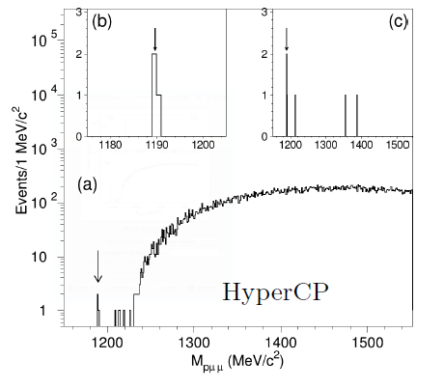
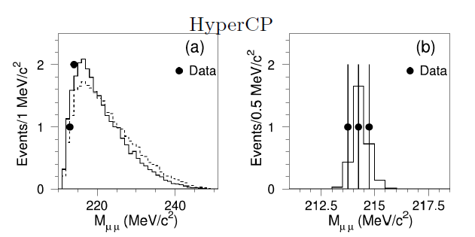
The HyperCP evidence
The HyperCP collaboration found evidence for Σ→pμμ decays, and provided a BR:
This evidence had wide relevance since all 3 observed events had the same dimuon invariant mass (214 MeV)
This suggested the existence of a new neutral particle at that mass

Slide 15
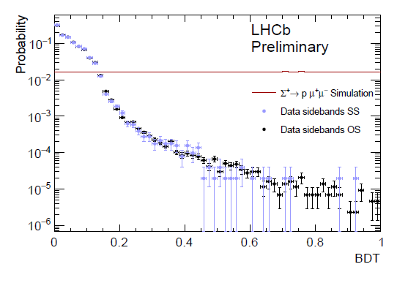
Σ→pμμ full Run-I analysis
LHCb-CONF-2016-013
The background discrimination
A Boosted Decision Tree (BDT) is trained against combinatorial background:
Signal proxy: Simulation
Background proxy: same sign muons

Slide 16
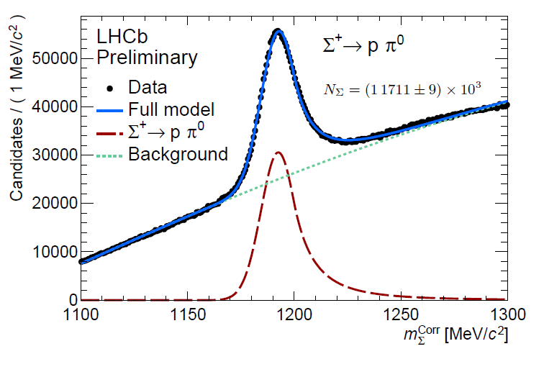
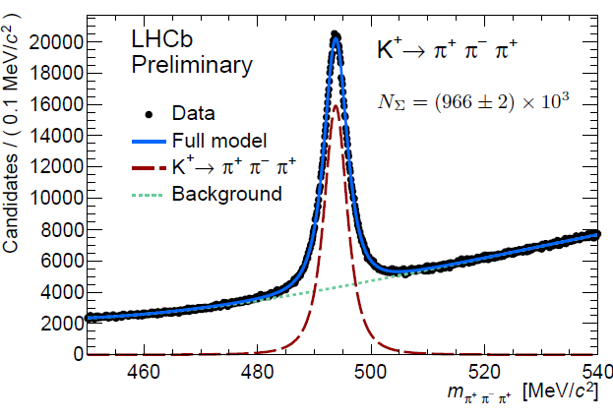
Σ→pμμ full Run-I analysis
LHCb-CONF-2016-013
The control samples
Two main control samples
Σ→pπ : Used for normalization of the signal yield (translate yields into BR’s)
Κ→πππ : used to calibrate mass resolution and peak position

Slide 17
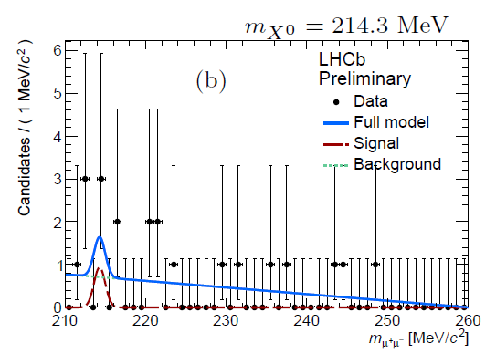
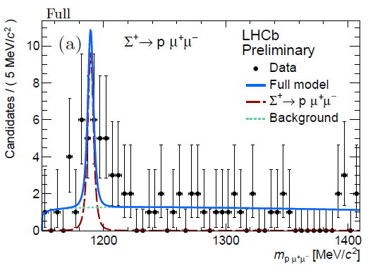
Σ→pμμ full Run-I analysis
LHCb-CONF-2016-013
The preliminary results
Σ→pμμ : Found 4σ evidence in one of the trigger categories (but no normalization)
BR(Σ→pμμ) < 6.3x10⁻⁸ 95% CL in the trigger category with available normalization
X→ μμ : Found no evidence for the 214 MeV particle

Slide 18
K_{S} →π⁰μμ sensitivity study
CERN-LHCb-PUB-2016-017

Slide 19
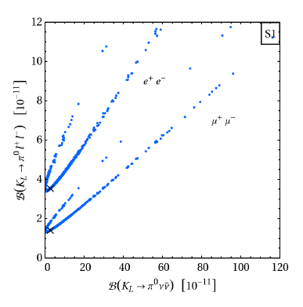
Why? (K_{L} → π⁰μμ and ED)
One of these important s-d transitions is K_{L} → π⁰μμ
~ 1 order of magnitude variation of the BR in models with Extra Dimensions
Randall-Sundrum model
M. Bauer et al, JHEP 1009:017,2010, arXiv:0912.1625 [hep-ph]

Slide 20
Why? (K_{L} → π⁰μμ and ED)
One of these important s-d transitions is K_{L} → π⁰μμ
~ 1 order of magnitude variation of the BR in models with Extra Dimensions
Problem: The SM prediction is not too precise, which makes hard to distinguish small BSM effects from SM uncertainties
Randall-Sundrum model
M. Bauer et al, JHEP 1009:017,2010, arXiv:0912.1625 [hep-ph]

Slide 21
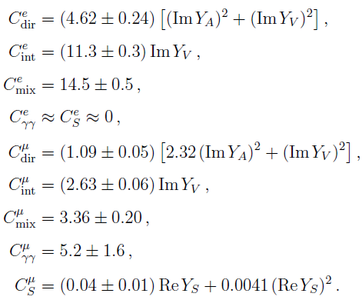
Why? (K_{S} → π⁰μμ and SM errors on K_{L} → π⁰μμ)
Dominant uncertainty, that makes difficult potential BSM interpretation of K_{L} → π⁰μμ
It comes from the experimental uncertainty on BR(K_{S} → π⁰μμ) measured by NA48
NA48
~50% relative error
Improved measurements of BR(K_{S} → π⁰μμ) will translate into improved BSM constraints from K_{L} → π⁰μμ

Slide 22
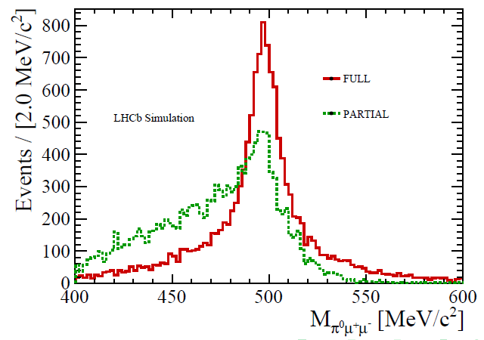
K_{S} →π⁰μμ sensitivity study
V. Chobanova et al,
CERN-LHCb-PUB-2016-017
K_{S} →π⁰μμ is searched for in two channels:
π⁰ (→γγ) μμ: hereafter FULL (low eff.)
π⁰ μμ: hereafter PARTIAL
In order to reconstruct the kaon mass for PARTIAL:
π⁰ mass → PDG
$p_{T}^{π}={−p}_{T}^{μμ}$
The only unknown is $p_{L}^{π}$. But statistically is ≈10GeV
π⁰
μμ
p
p

Slide 23
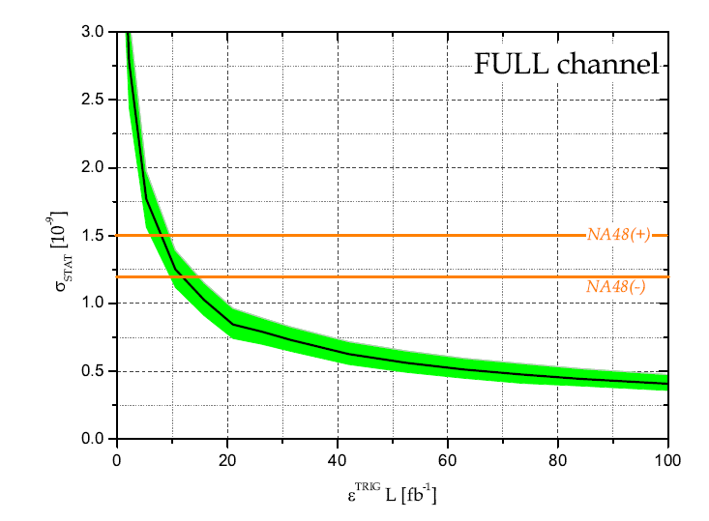
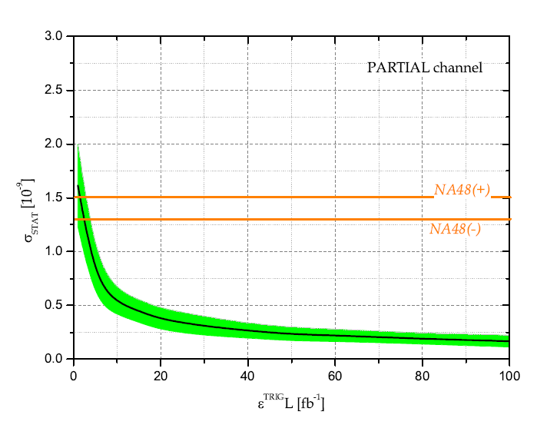
K_{S} →π⁰μμ sensitivity study
V. Chobanova et al,
CERN-LHCb-PUB-2016-017
Normalize yields to K_{S} →ππ → sensitivity to BR
FULL
channel
PARTIAL
channel
LHCb Upgrade, 100 % eff
LHCb HL-LHC
100 fb ⁻¹ 100 % eff
or 300 fb ⁻¹ 33 % eff

Slide 24
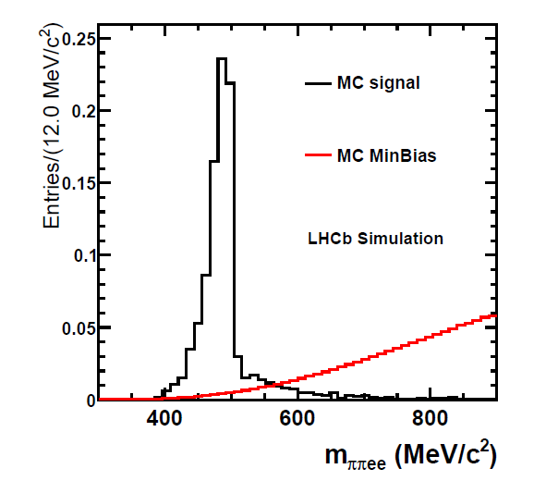
K_{S} →π⁺π⁻ee sensitivity study
C.Marin et al,
CERN-LHCb-PUB-2016-016
Based on simulation:
Expected a signal yield of
$${N=120}_{−100}^{+280}$$
For the full Run-I dataset
Expected background yield is not well known yet

Slide 25
Ongoing/future studies
K+ mass
Semileptonic hyperon decays
Kaons from Φ decays (Φ factory mode)
K→X⁰μμ, (X whatever neutral system: eg γ)
K→X⁰πμ (X whatever neutral system: eg sterile neutrino)
Workshop in 2013 and 2017 to discuss with TH community
https://indico.cern.ch/event/280883/overview
link
For info in future workshops you can subscribe to
rare-N-strange_at_cern_dot_ch

Slide 26
Conclusions
There is an LHCs community in the LHCb village
Trigger is constantly improving
We aim for LHCb upgrade to reach efficiencies s as high as for b’s
Available measurements for: Σ→pμμ, BR(K_{S} → µµ)
Published prospects for K_{S} →π⁰μμ , K_{S} →π⁺π⁻ee
Some more channels in our TODO list
Workshops to discuss with the TH community

Slide 27
Backup

Slide 28
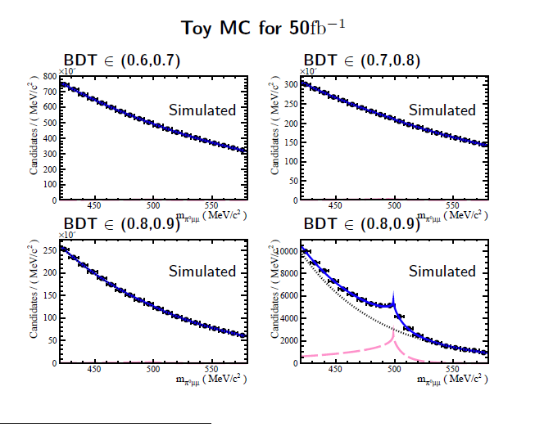

Slide 29
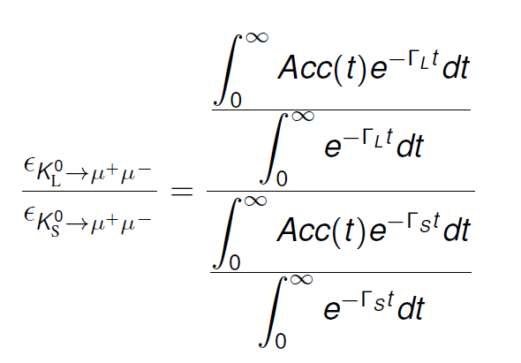
Lifetime acceptance and K_{L}→μμ background
K_{L} and K_{S} are distinguishable only by the decaytime…
… and that is in theory. In practice, LHCb decaytime acceptance is not great for kaons
$$ε\left(t\right)\sim e^{−βt}$$
With β $≳$ 5xΓs (>> Γ_{L}).
This makes the two lifetime distributions to look similar
But the overall efficiency ratio is of course different
And makes K_{L} →μμ to become a negligible background for the current level of precision
But can be relevant when we approach the 10⁻¹¹ level
= O(10⁻³)

Slide 30
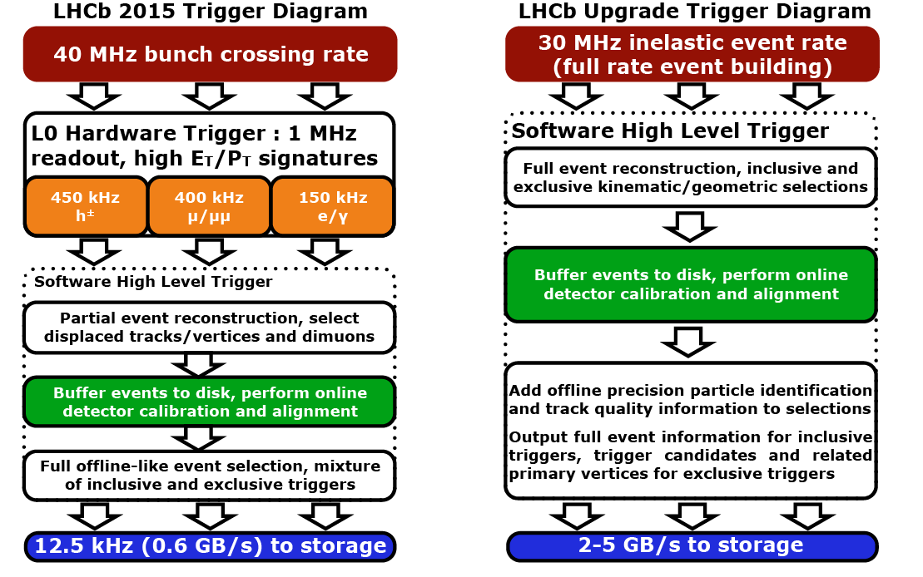

Slide 31
Normalization of event yield
Converting a signal yield into a branching ratio
$K_{s}^{0}$ production crossection
Absolute efficiency
$$Ν\left(K_{s}^{0}→πμμ\right)=σ\left(K_{s}^{0}\right)ΒR\left(K_{s}^{0}→πμμ\right)εL$$
Integrated luminosity

Slide 32
How? (normalization of event yield)
Converting a signal yield into a branching ratio
$K_{s}^{0}$ production crossection
Absolute efficiency
$$Ν\left(K_{s}^{0}→πμμ\right)=σ\left(K_{s}^{0}\right)ΒR\left(K_{s}^{0}→πμμ\right)εL$$
Integrated luminosity
$$\frac{Ν\left(K_{s}^{0}→πμμ\right)}{Ν\left(K_{s}^{0}→ππ\right)}=\frac{σ\left(K_{s}^{0}\right)ΒR\left(K_{s}^{0}→πμμ\right)εL }{σ\left(K_{s}^{0}\right)ΒR\left(K_{s}^{0}→ππ\right)ε′L }$$
Introduce in the ntuples a $K_{s}^{0}→ππ$ decays counter
Very well known
(69.20±0.05)%

Slide 33
Dilepton mass distribution
Take formulae from hep-ph/9808289
z= m² ➔ dΓ/dm = 2m dΓ/dz

Slide 34
Remind of Bmm sensitivity

Slide 35
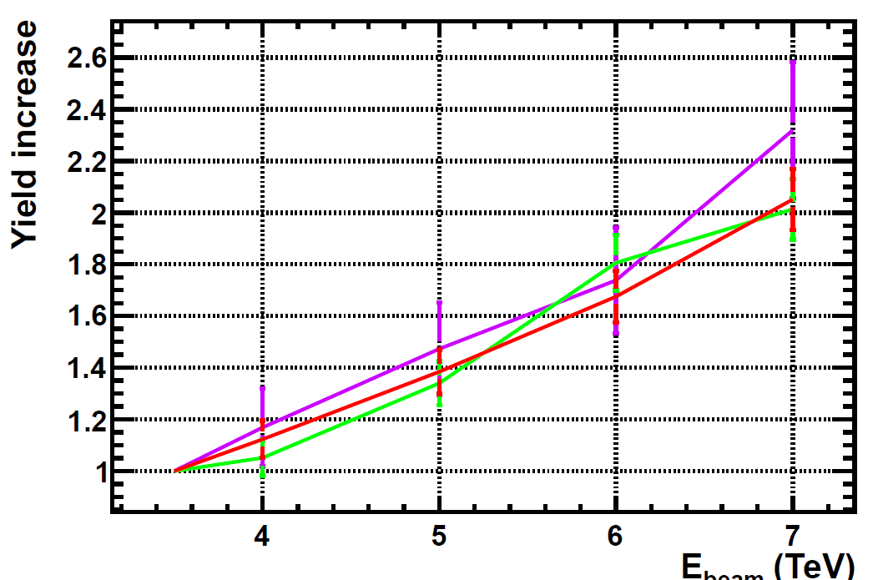
B mesons
We check that we get right the expected increase of B meson yields (i.e, a factor ~2)
B0s
B0d
B+/-

Slide 36
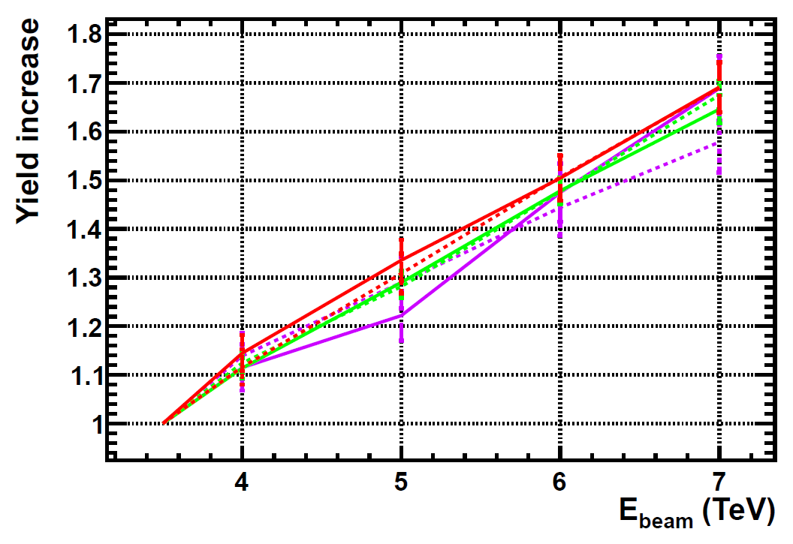
D mesons
For D mesons the increase is slightly smaller (~1.6- 1.7)
D+
D-
D0
Ds

Slide 37
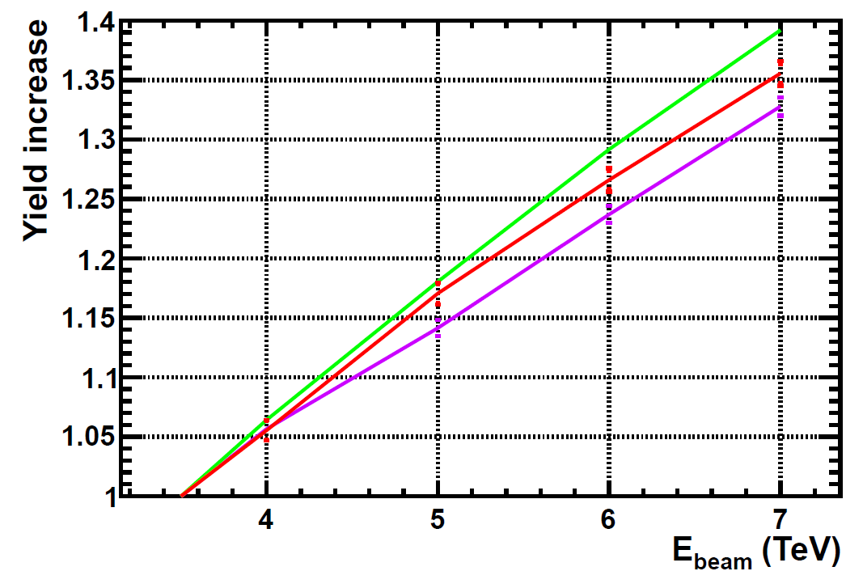
Strange particles
Increase for most of them is ~40%
A bit less for baryons (note: baryons, not anti-baryons)
However, the momentum is also different w.r.t 7 TeV.
K⁰s, K⁰_{L} ,K^{+/-/0}, φ(1020), K*
As well as anti baryons
Σ
Λ
In particular, for the K0s decaying in the VELO the increase is “only” ~30% → This is the number we really care for Ks → μμ studies

Slide 38
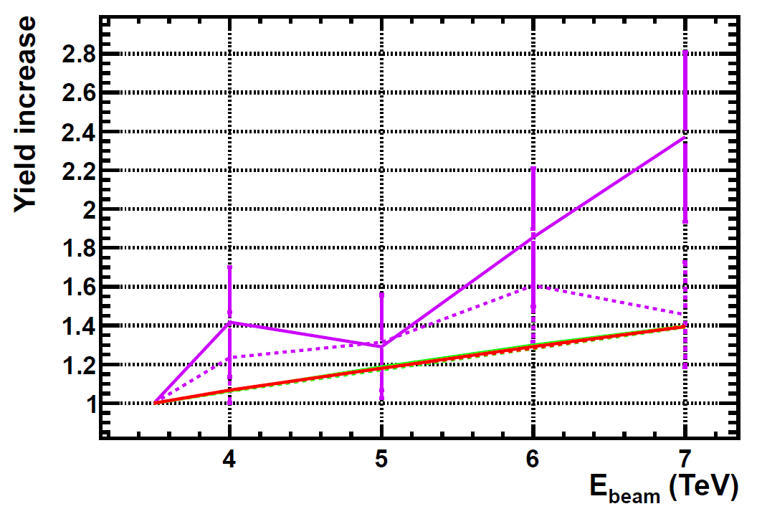
Leptons
Increase in tau yiled consistent with ~ 2 , expected by the fact that most of them come from b’s and c’s
Check with more stats if the asymmetry +/- is still there
τ+
τ-
Electrons, muons

Slide 39
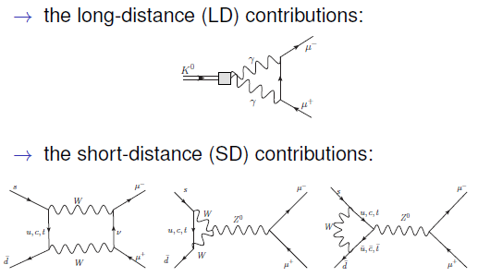

Slide 40
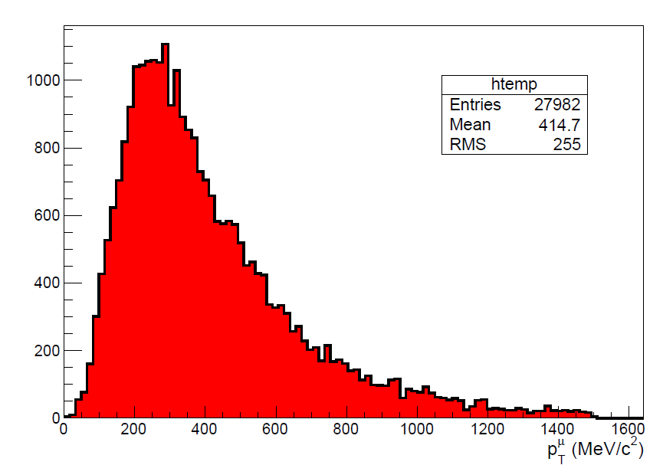

Slide 41
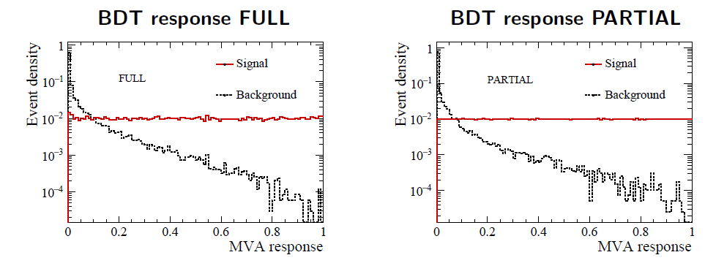
K_{S} →π⁰μμ sensitivity study
The background discrimination
V. Chobanova et al,
CERN-LHCb-PUB-2016-017
As usual: BDT trained against combinatorial background
Specific backgrounds: K_{S} →ππ, K_{L}→πππ, K_{S/L} →μμγγ (negligible)
Don’t affect the sensitivity estimate

Slide 42
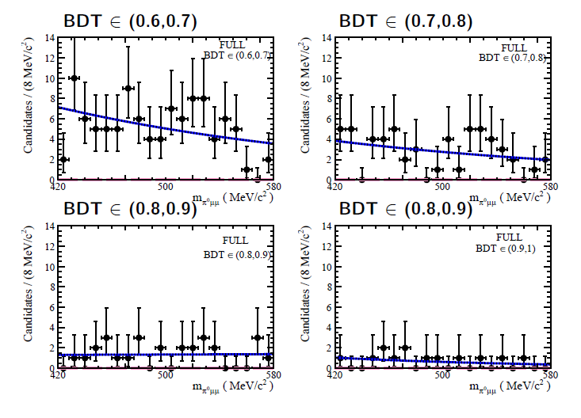
K_{S} →π⁰μμ sensitivity study
Fit, FULL
V. Chobanova et al,
CERN-LHCb-PUB-2016-017

Slide 43
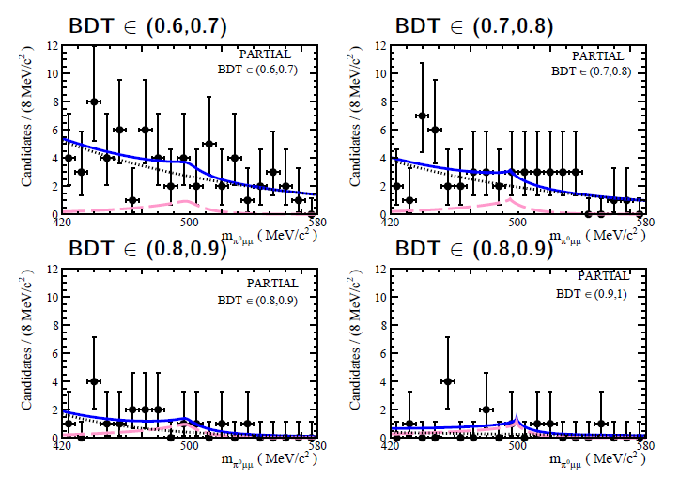
K_{S} →π⁰μμ sensitivity study
Fit, PARTIAL
V. Chobanova et al,
CERN-LHCb-PUB-2016-017

Slide 44
The LHCb experiment

Slide 45
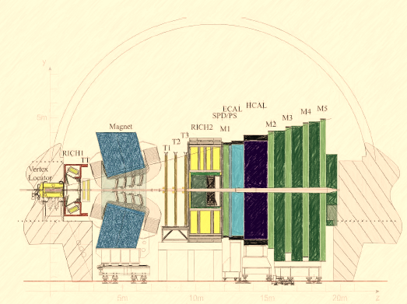
The LHCb experiment
Forward spectrometer at P8 of LHC
2 < η < 5
Best LHC detector for:
Vertex resolution (~100 microns)
Invariant mass resolution
Access to moderately low p
Particularly good a (di) muons
Recorded luminosity: 3 fb⁻¹
1 fb⁻¹ at 7 TeV (2011)
2 fb⁻¹ at 8 TeV (2012)
~2 fb⁻¹ at 13 TeV (2015, 2016)

Slide 46
The LHCb experiment
Forward spectrometer at P8 of LHC
2 < η < 5
Best LHC detector for:
Vertex resolution (~100 microns)
Invariant mass resolution
Access to moderately low p
Particularly good a (di) muons
Less good at reconstructing charged hadrons
Recorded luminosity: 3 fb⁻¹
1 fb⁻¹ at 7 TeV (2011)
2 fb⁻¹ at 8 TeV (2012)
~2 fb⁻¹ at 13 TeV (2015, 2016)

Slide 47
The LHCb experiment
Forward spectrometer at P8 of LHC
2 < η < 5
Best LHC detector for:
Vertex resolution (~100 microns)
Invariant mass resolution
Access to moderately low p
Particularly good a (di) muons
Less good at reconstructing charged hadrons
Even less good at photons
Recorded luminosity: 3 fb⁻¹
1 fb⁻¹ at 7 TeV (2011)
2 fb⁻¹ at 8 TeV (2012)
~2 fb⁻¹ at 13 TeV (2015, 2016)

Slide 48
The LHCb experiment
Forward spectrometer at P8 of LHC
2 < η < 5
Best LHC detector for:
Vertex resolution (~100 microns)
Invariant mass resolution
Access to moderately low p
Particularly good a (di) muons
Less good at reconstructing charged hadrons
Even less good at photons
Doesn’t detect neutrinos
Recorded luminosity: 3 fb⁻¹
1 fb⁻¹ at 7 TeV (2011)
2 fb⁻¹ at 8 TeV (2012)
~2 fb⁻¹ at 13 TeV (2015, 2016)

Slide 49
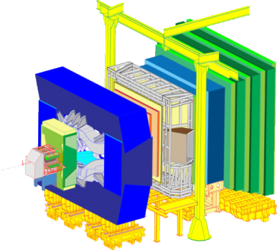
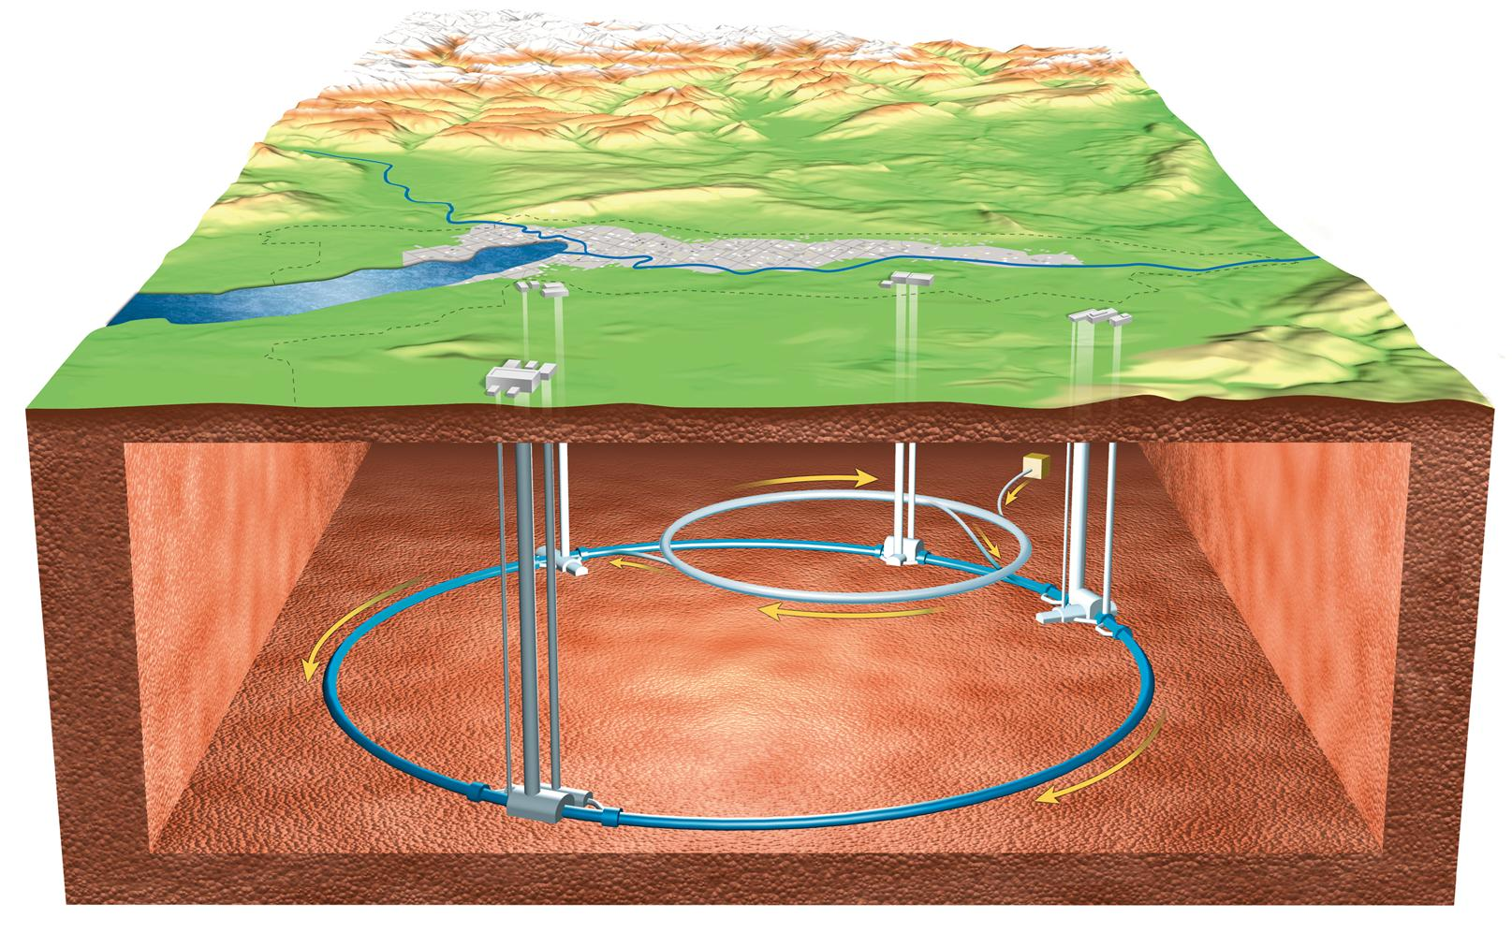
Rare decays of strange particles
Making a new experiment inside LHCb
LHCb collects world leading samples of b and c quark decays. Everything else is rejected because of bandwidth reasons
(used to be)
b and c
b , c , s etc…
rest
s
LHC
LHCb
However, if BSM above few TeV (LHC energy scale), s-hadron decays are very important (very sensitive to non-MFV). But most of them are lost !

Slide 50
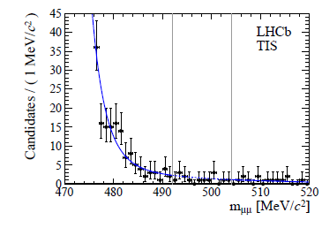
Rare decays of strange particles
Proof of principle
SM prediction: BR(K_{S} → µµ) = (5.1±1.5)x10⁻¹²
JHEP 0401 (2004) 009
K_{S} → µµ sensitive to different physics than K_{L} → µµ (see JHEP 0401 (2004) 009)
LHCb performed a search using 1fb⁻¹ despite low trigger performance:
JHEP 01 (2013) 090
JHEP 01 (2013) 090
BR(K_{S} → µµ ) < 9(11)x10⁻⁹ @90(95)%CL_{s}
We manage to get world best destpite low trigger efficiency

Slide 51
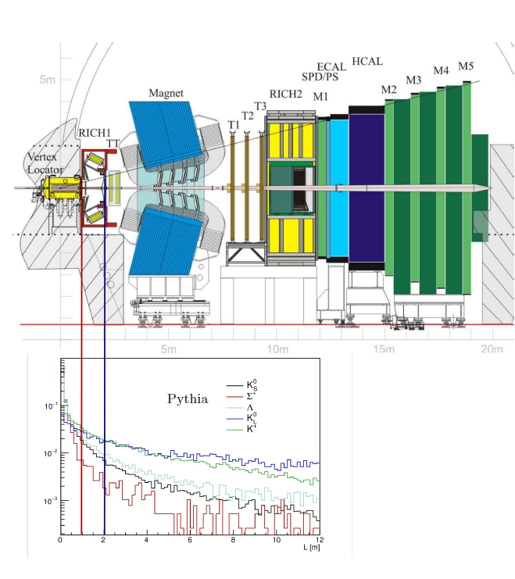
Strangeness production/detection at LHCb
The pp collisions @ LHC produce a ‘kaon flux’ of 10¹³ K_{S} per fb⁻¹ of luminosity in the LHCb acceptance
Charged decay products can be reconstructed using Long Tracks or Downstream Tracks
We use Long Tracks for RnS
Downstream will be investigated (extra yield, but worse reconstruction quality)
K_{L} , K_{S} produced in equal amounts. Acceptance ratio is ~2x10⁻³
(for Long Tracks)

Slide 52
Ongoing stuff
LHCb Fictitious
BR(K_{S} →X⁰μμ )
90% CL exclusion
X
γ
π⁰
m_{X}

Slide 53
K⁺ studies
Large samples of charged kaon decays are available
K⁺ mass is not very well known
K⁺→πμμ ?

Slide 54
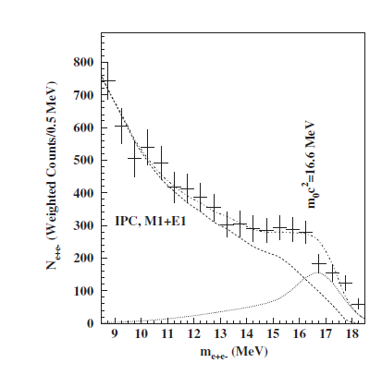
K_{S} →X⁰μμ
The K_{S} →π⁰μμ PARTIAL analysis can be recasted for general/inclusive K_{S} →X⁰μμ. With X being whatever neutral system:
K_{S} →γμμ. Can also be completed with photon reconstruction
K_{S} →(l+l-)μμ. Some of them are also being searched for explicitly
Some exotic, eg, 17 MeV neutral boson of Phys. Rev. Lett. 116, 042501 (2016)
Limits can be provided as a function of X⁰ mass
LHCb Fictitious
BR(K_{S} →X⁰μμ )
90% CL exclusion
X
γ
π⁰
m_{X}

Slide 55
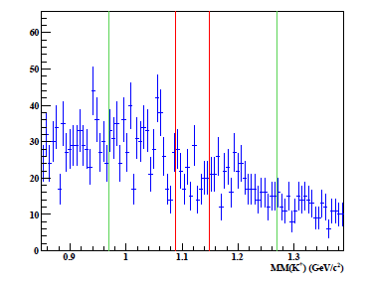
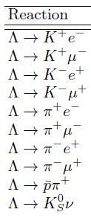
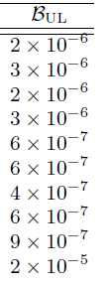
B and L violation (very low priority)
CLAS collaboration (Jefferson Lab):
Limits on B and L violation
We can easily do many of CLAS’ decays
…as well as others:
Σ→ 3μ
Λ→ π3μ
…and many other crazy (J conserving) combinations.
Currently very low priority, since we assume that BSM contributions can only be as much as BR ~10⁻⁵⁶
arXiv:1507.03859 [hep-ex]

Slide 56
Semileptonic decays?
Semileptonic Hyperon decays
Camalich et al point out BSM is allowed on these decays
K_{S} →X⁰πμ , in a similar way as K_{S} →X⁰μμ. In this case the X⁰ could be some (sterile) neutrino.
Actually current world best limits come from kaon decays in bubble chambers

