Slide 1
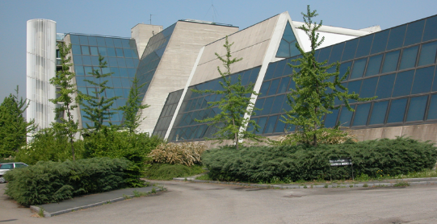
LASA
Attività gruppo SRF
Paolo Michelato

Slide 2
Riassunto
Attività relative al contributo LASA per European Spallation Source
E-XFEL: attività in corso, primo fascio FEL nella zona sperimentale
Installazione nella seconda metà anno della meccanica del telescopio STRIP del gruppo Astrofisica di UNIMI, di Marco Bersanelli, per le prove di funzionamento della parte meccanica
Situazione generale lavori di ristrutturazione: tutto fermo.
Possibili solo limitati investimenti per sistemare i punti critici? Antincendio? Infiltrazioni acqua?

Slide 3
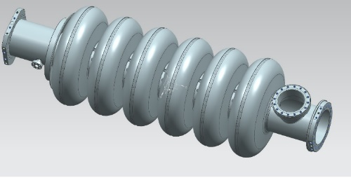
Ongoing activities at LASA for ESS
From the design to the Vertical Test of the cavity prototype integrated in the tank

Slide 4
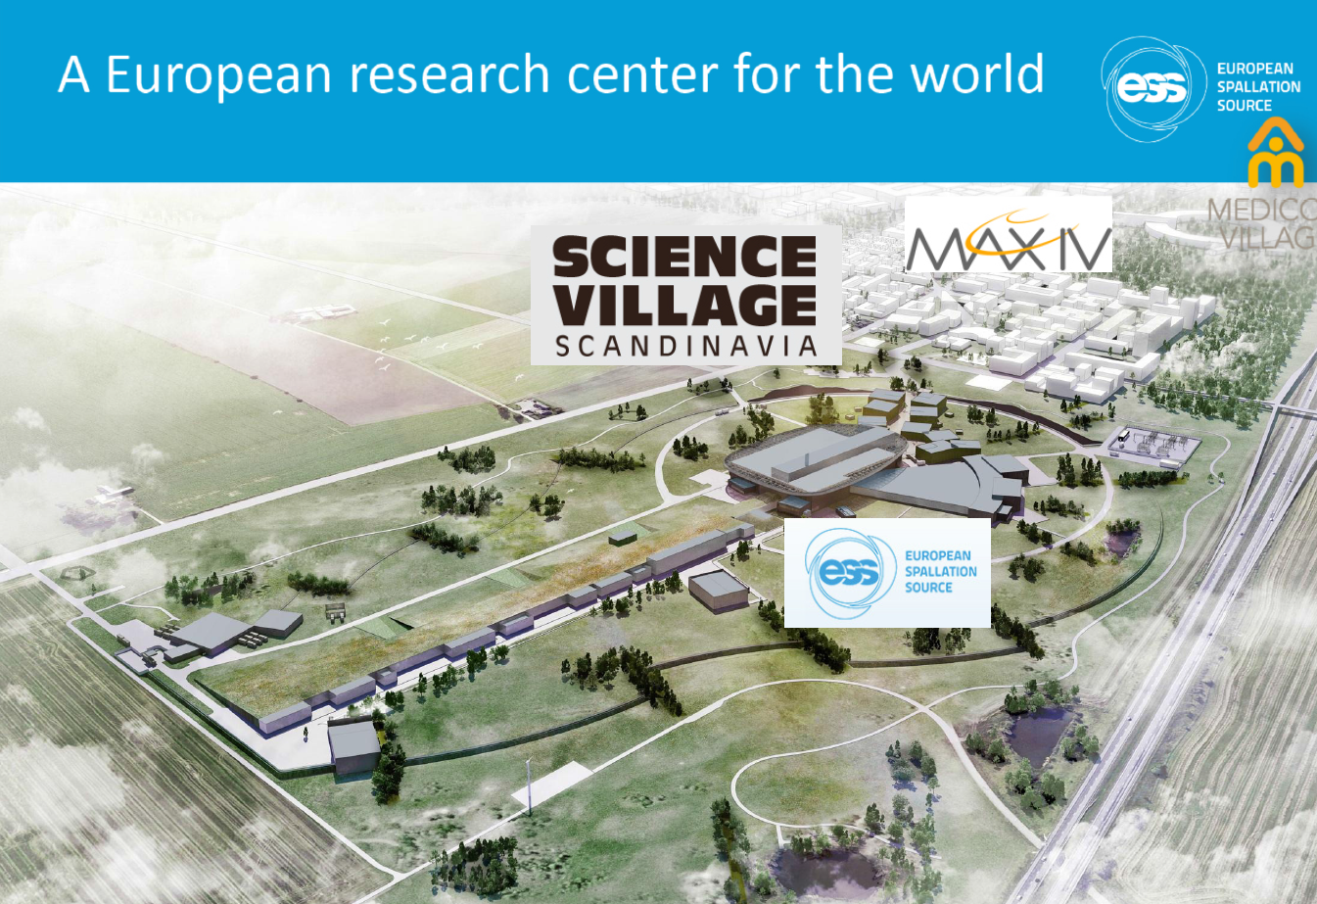
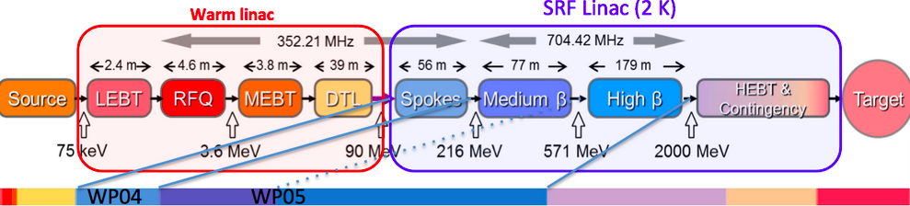
LUND (Sweeden)
ESS &
MAX IV

Slide 5

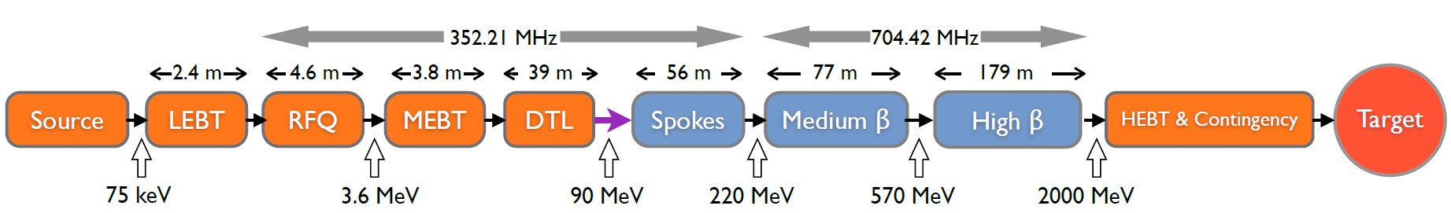
ESS linac
Acceleration to 2 GeV
Average beam power of 5 MW
Peak beam power of 125 MW
Peak proton beam current of 62.5 mA
Pulse length of 2.86 ms at a rate of 14 Hz (4% duty factor)
96% of acceleration will be provided by superconducting cavities supplied by 150 high power RF sources (one per cavity):
80% of the RF power sources delivering over 1.1 MW of peak RF power
The RF system is the cost driver for the ESS accelerator.
8

Slide 6

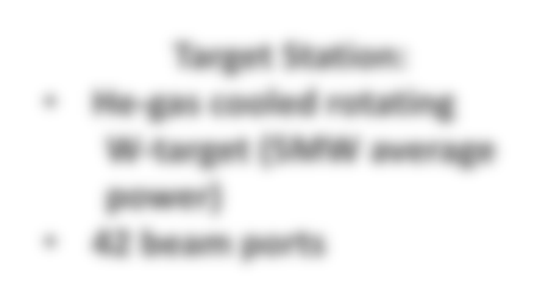
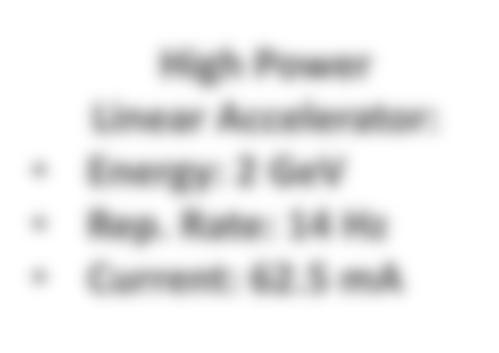

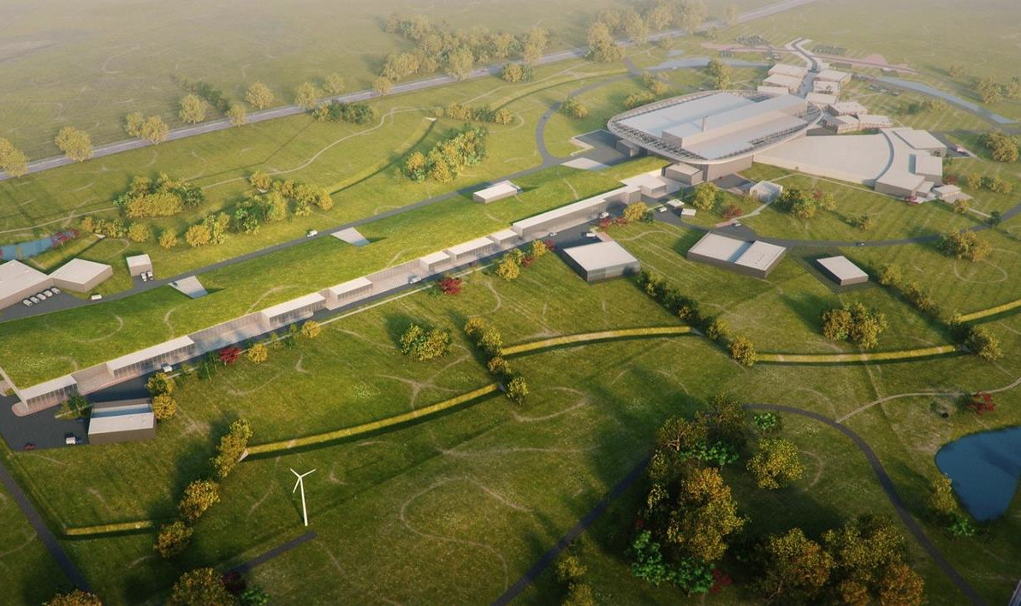








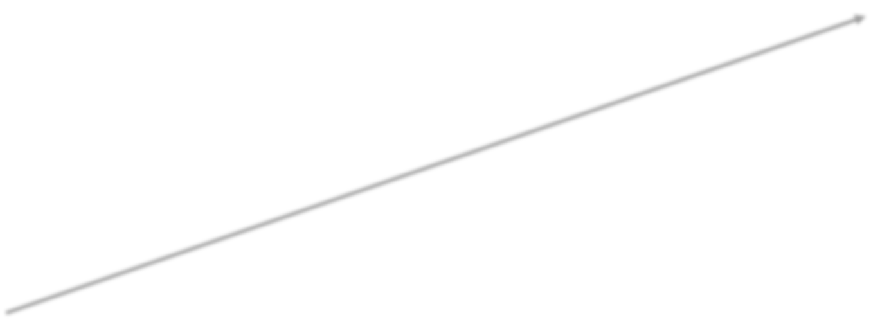






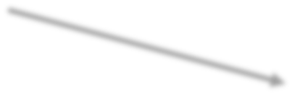






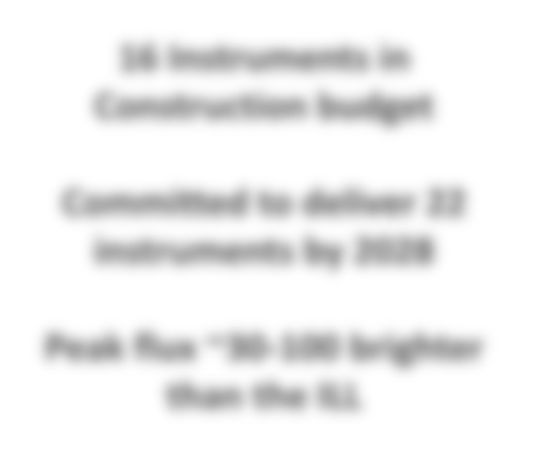






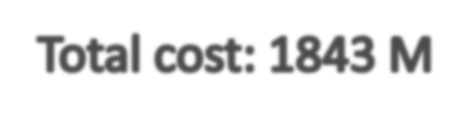
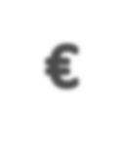

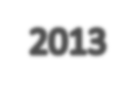


ESS design
High Power Linear Accelerator:
Energy: 2 GeV
Rep. Rate: 14 Hz
Current: 62.5 mA
Target Station:
He-gas cooled rotating W-target (5MW average power)
42 beam ports
16 Instruments in Construction budget
Ion Source
Environmental goal (“Sustainability”)
Committed to deliver 22 instruments by 2028
Energy responsible
Renewable energy
Recyclable heat
Peak flux ~30-100 brighter than the ILL

Slide 7

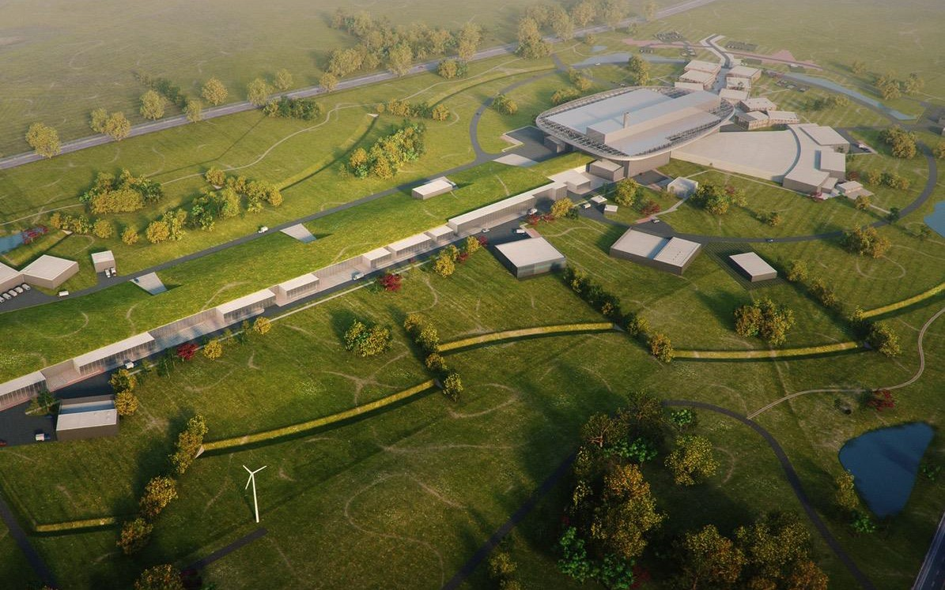





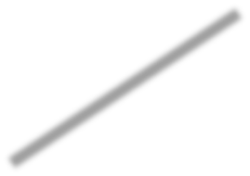








Construction plan
4
2025
ESS Construction Phase Complete
2014
Construction Starts
2023
2009
ESS Starts User Program
ESS in Lund
2019-20
Machine Ready for 1st Beam on Target
2012
ESS Design Update Phase Complete
2003
European Design of ESS Completed

Slide 8
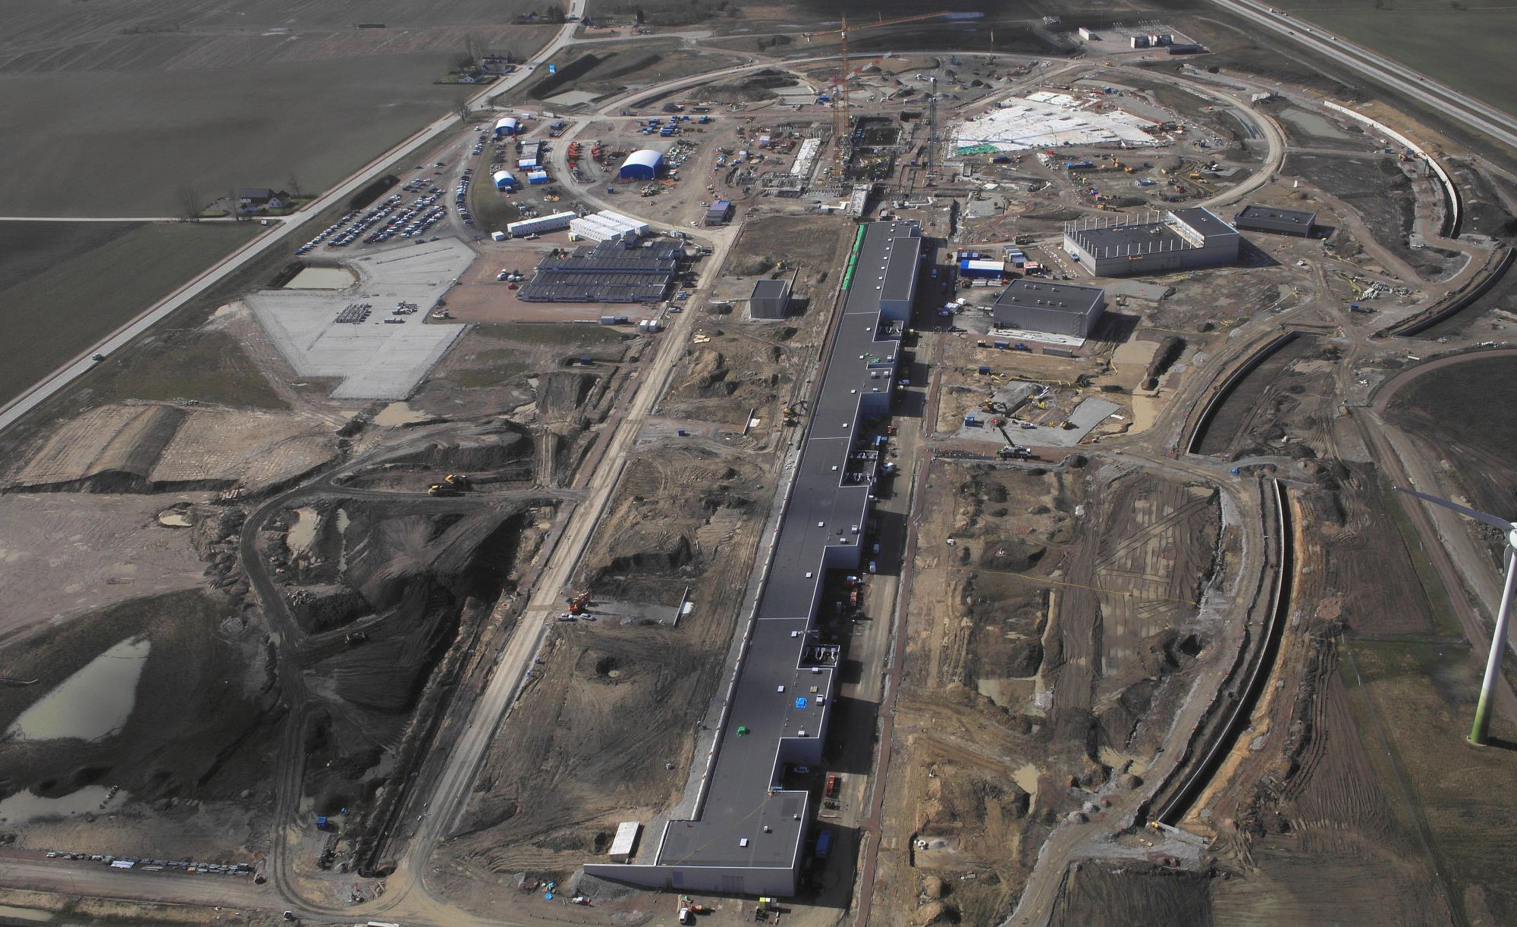
ESS: European Spallation Source
Lund, Sweeden.

Slide 9

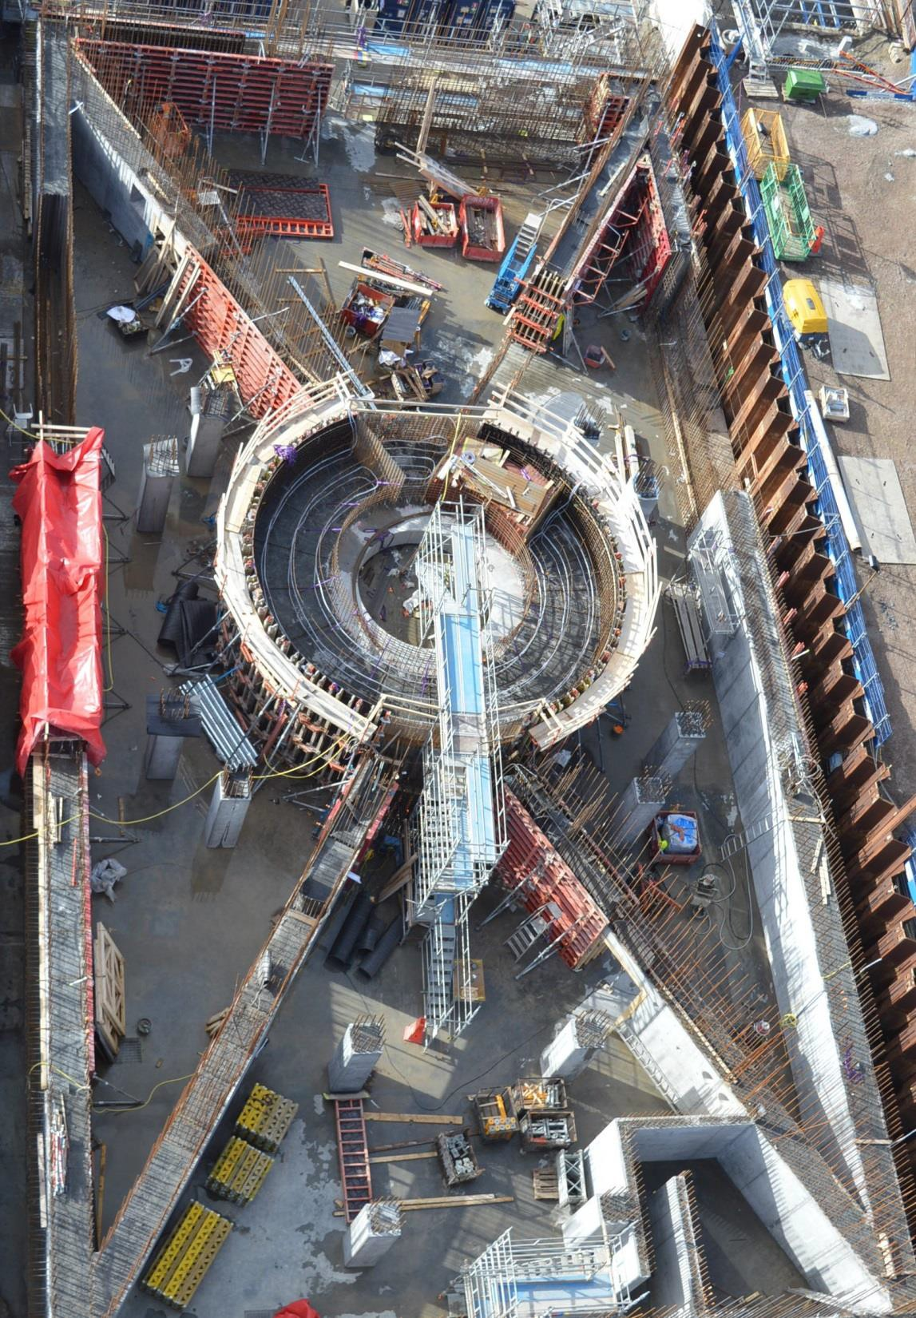

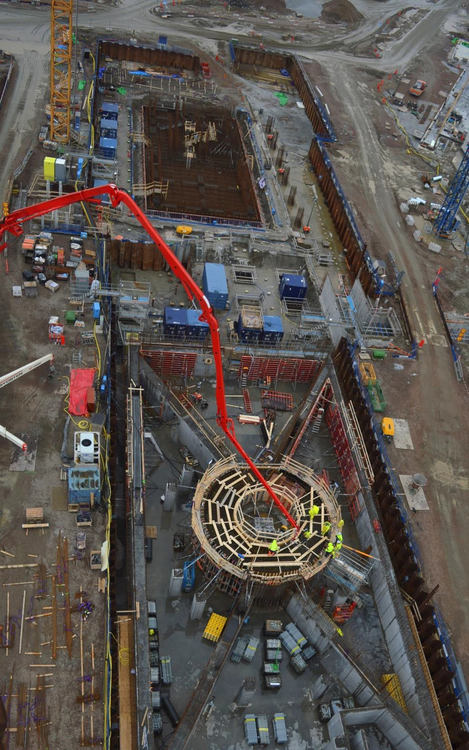
36
Target
Monolith & Active Cells

Slide 10
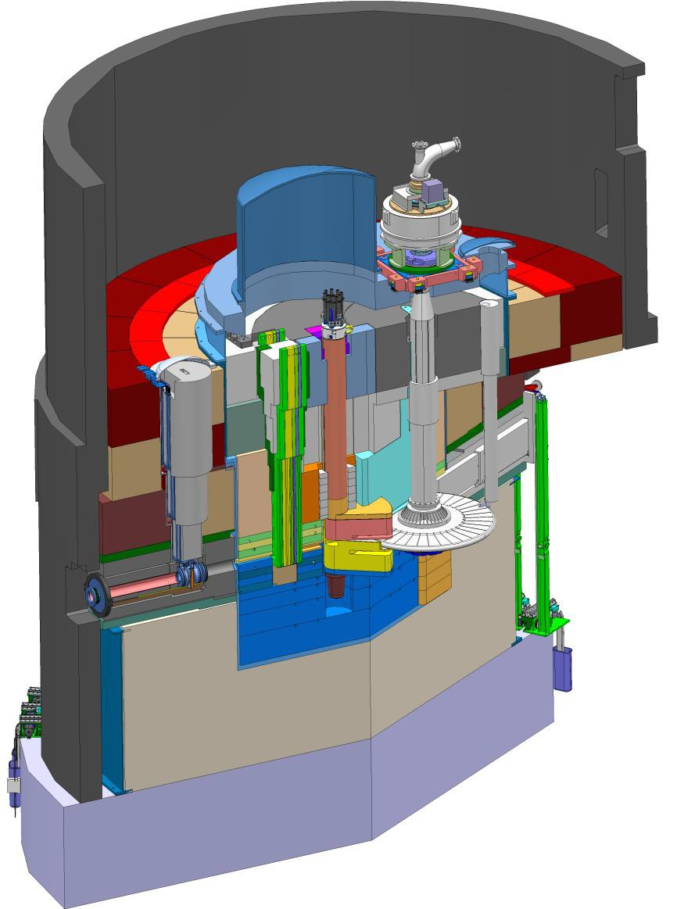







Target, monolith, moderators etc.
Main components:
Monolith:
Vessel (6 m diameter x 8 m height)
Steel shielding (6000 tons)
Instrumentation plugs
Proton beam window
Neutron shutters
Neutron beam extraction system
Rotating Tungsten target
monolith vessel
2.5 m diameter x 10 cm height
7500 Tungsten bricks (3.5 tons)
• 0.39 rev./s
neutron beam extraction port
target diagnostics plug
Target He gas-cooling
3 MW capacity
3 kg/s flow rate
Dt = 200 degrees C
target wheel
moderator- reflector plug
proton beam window
proton beam instrumentation plug
High brightness moderators
2 liquid H₂ moderators
Water premoderators and moderators
He cryoplant (35 kW – 16 K)
24

Slide 11
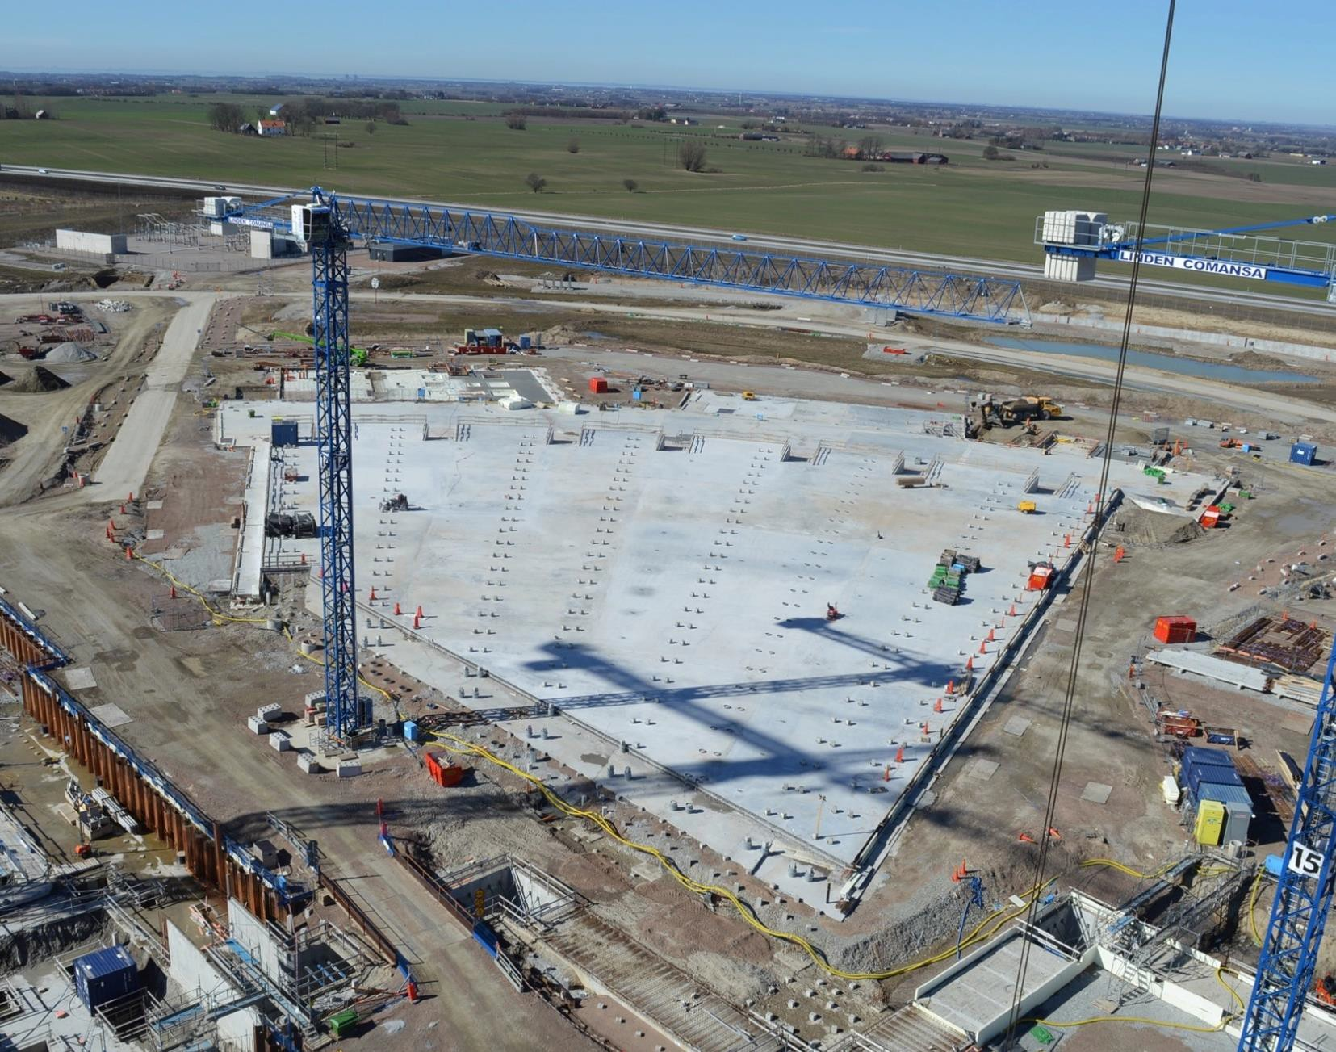
Beam Line Gallery
8,000 m² base slab – last casting 14/03/2017
37

Slide 12
ESS linac
Acceleration to 2 GeV
Average beam power of 5 MW
Peak beam power of 125 MW
Peak proton beam current of 62.5 mA
Pulse length of 2.86 ms at a rate of 14 Hz (4% duty factor)
LNL
INFN LASA
96% of acceleration will be provided by superconducting cavities supplied by 150 high power RF sources (one per cavity):
80% of the RF power sources delivering over 1.1 MW of peak RF power
The RF system is the cost driver for the ESS accelerator.
LNS
8

Slide 13
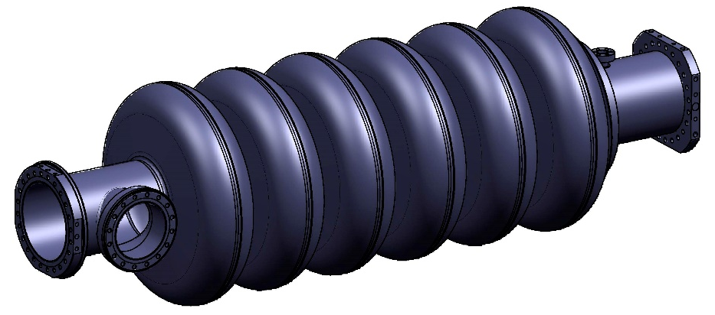
INFN LASA in-kind contribution: medium beta SC cavities
INFN In-Kind contribution:
Niobium procurement for the fabrication of 36 medium beta cavities.
Cavity fabrication of 36 medium beta cavities in the industry, including treatments, tuning, Helium tank integration. Full treatment at the vendor.
Ancillaries, certification activities, documentation.
Cold test in a qualified infrastructure (DESY). Test can be done also LASA, but not with the occurrence needed for the series.
Transportation in special boxes and delivery at CEA cryomodule assembling facility.
R&D on prototypes (already done):
Built 2 prototypes of medium beta cavities.
INFN design, using Large and Fine Grain Nb, plug compatible with ESS cryomodule.
Full treatment at the industry.
Final handling and test done in the qualified infrastructure at LASA.
MB cavity technical requirements
Frequency (MHz) | 704.42
Number of cells | 6
Geometric beta | 0.67
Nominal Acc. Gradient (MV/m) | 16.7
E_{peak} (MV/m) | < 45
RF peak power (kW) | 1100
Q external | 5.9-8 10⁵
Q₀ at nominal gradient | > 5 10⁹

Slide 14
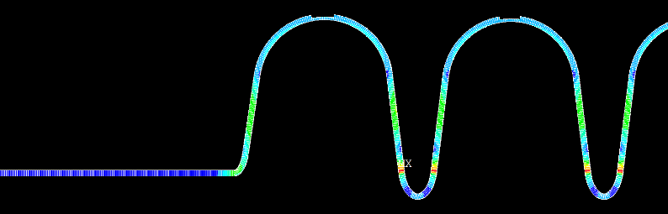
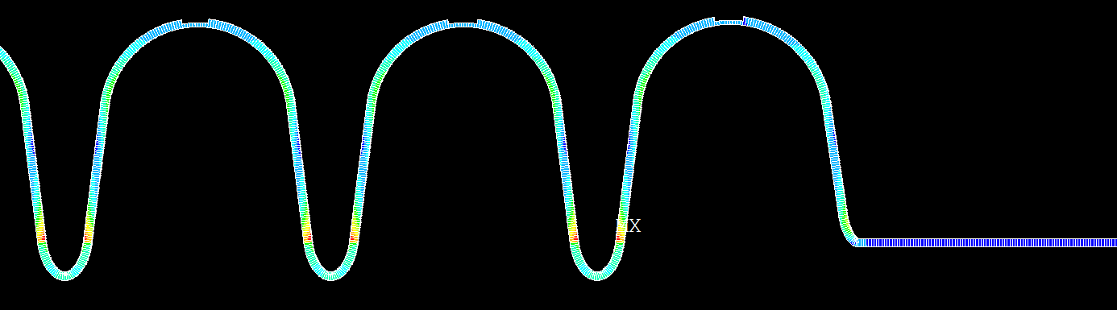
Cavity Prototype Mechanical Parameters INFN Design
Pressure test scenario:
Cavity fully constrained
Pressure in the tank
The maximum pressure difference allowable is
2.60 bar for 50 MPa VM (worst scenario)
3.64 bar for 70 MPa VM (best scenario)
Mechanical parameter | INFN Design
Cavity wall thickness (mm) | 4.5
Stiffening ring radius (mm) | 70
Internal volume (l) | 69
Cavity internal surface (m²) | 1.8
Stiffness (kN/mm) | 1.7
Tuning sensitivity K_{T} (kHz/mm) | 210
Vacuum sensitivity K_{V} for K_{ext} ~ 21 kN/mm (Hz/mbar) | 31
LFD coefficient K_{L} for K_{ext} ~ 21 kN/mm (Hz/(MV/m)²) | -1.7
Scenario:
Cavity with one free end
Increasing displacement on free end
The maximum displacement allowable is
2.59 mm for 50 MPa VM (worst scenario)
3.60 mm for 70 MPa VM (best scenario)

Slide 15
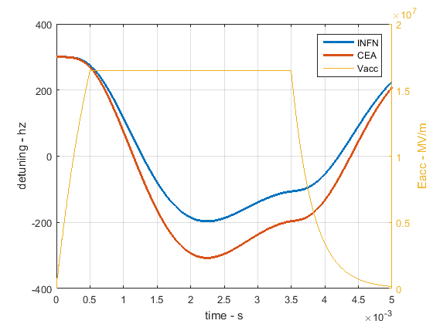
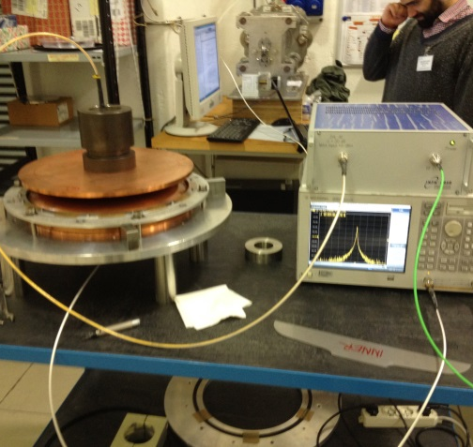
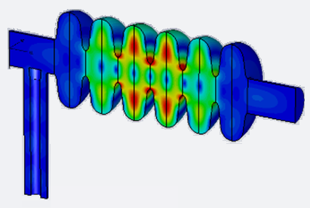
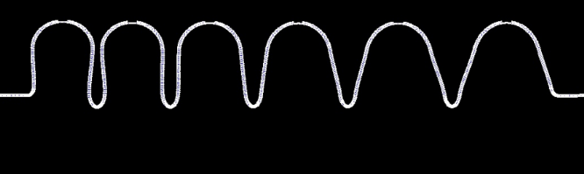
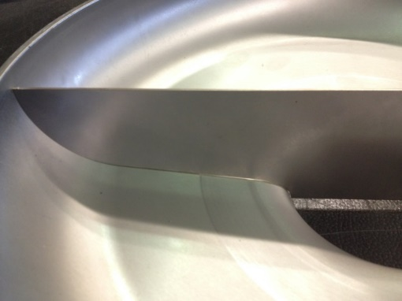
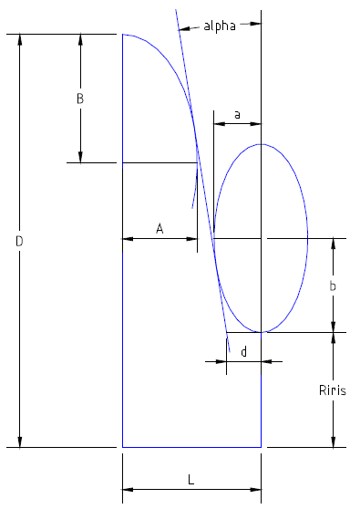
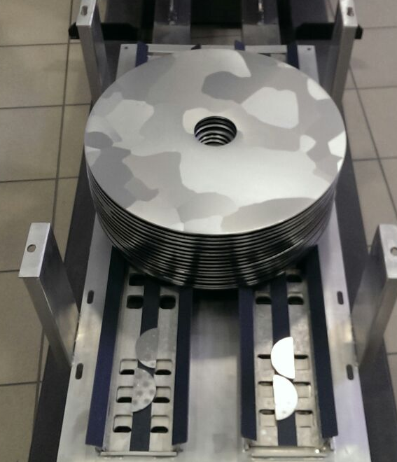
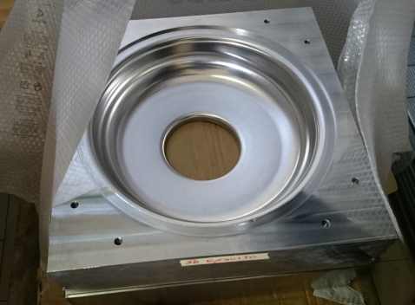
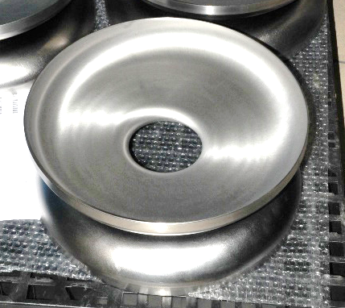
From design to prototype test 1/2
F=1742.4 MHz
Max R/Q=23Ohm
Qext=9.6×10^5
HOM analyses
RF measures
LFD from cavity simulator
Dynamical analyses: natural modes
Dumb-Bells
Cell shape design
Deep Drawn Die
Large Grain Nb

Slide 16
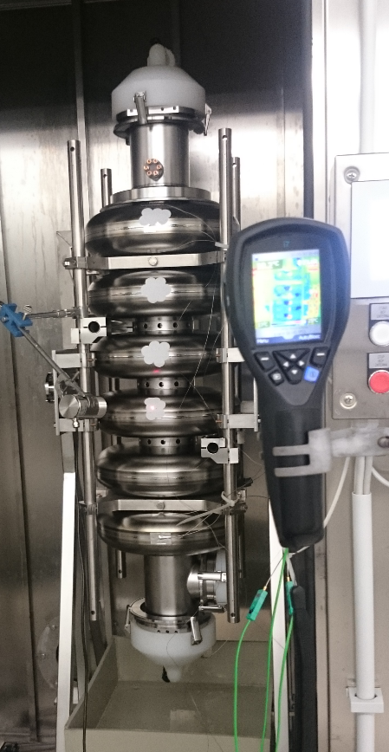
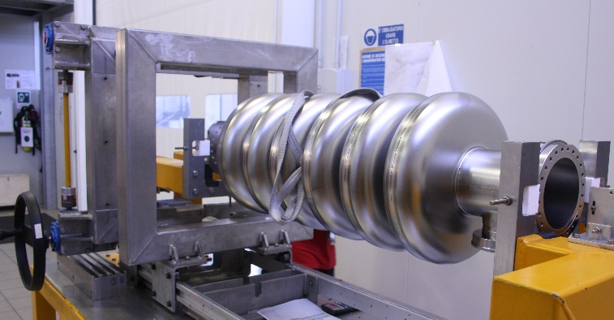
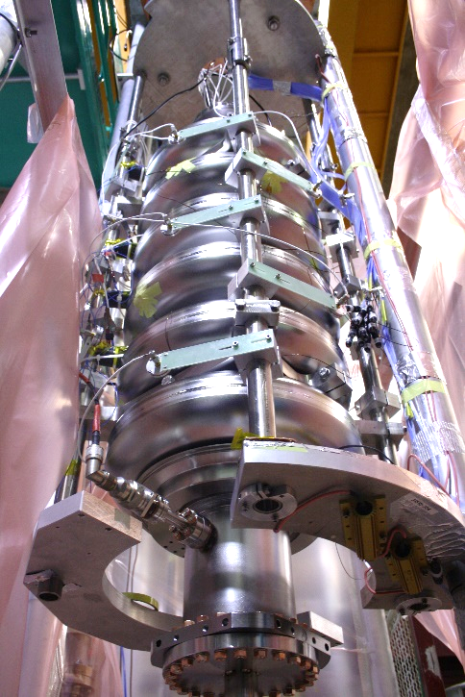
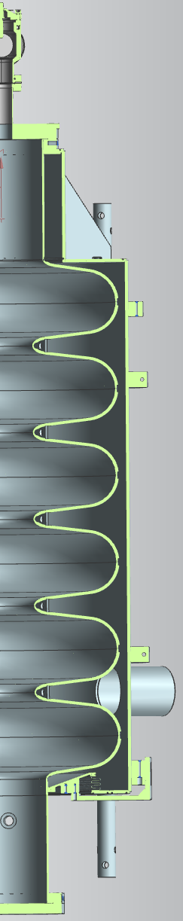
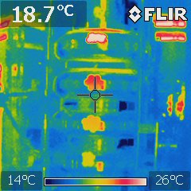
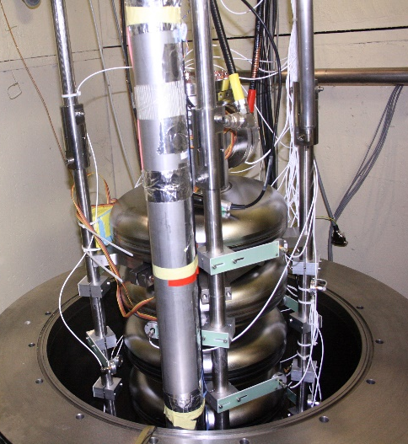
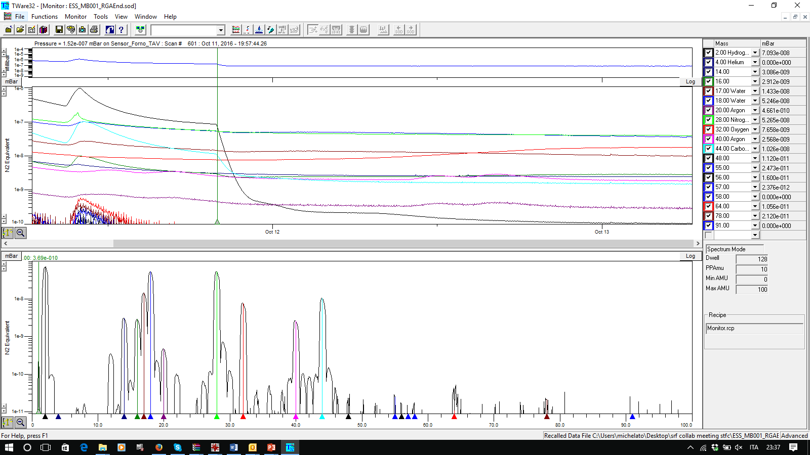
From design to prototype test 2/2
Final Tuning
Surface Treatments
VT installation
Annealing

Slide 17
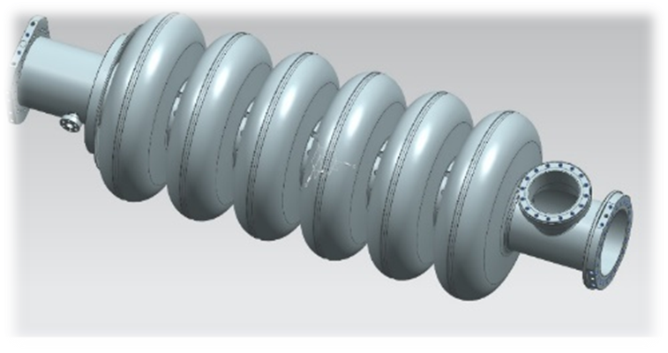
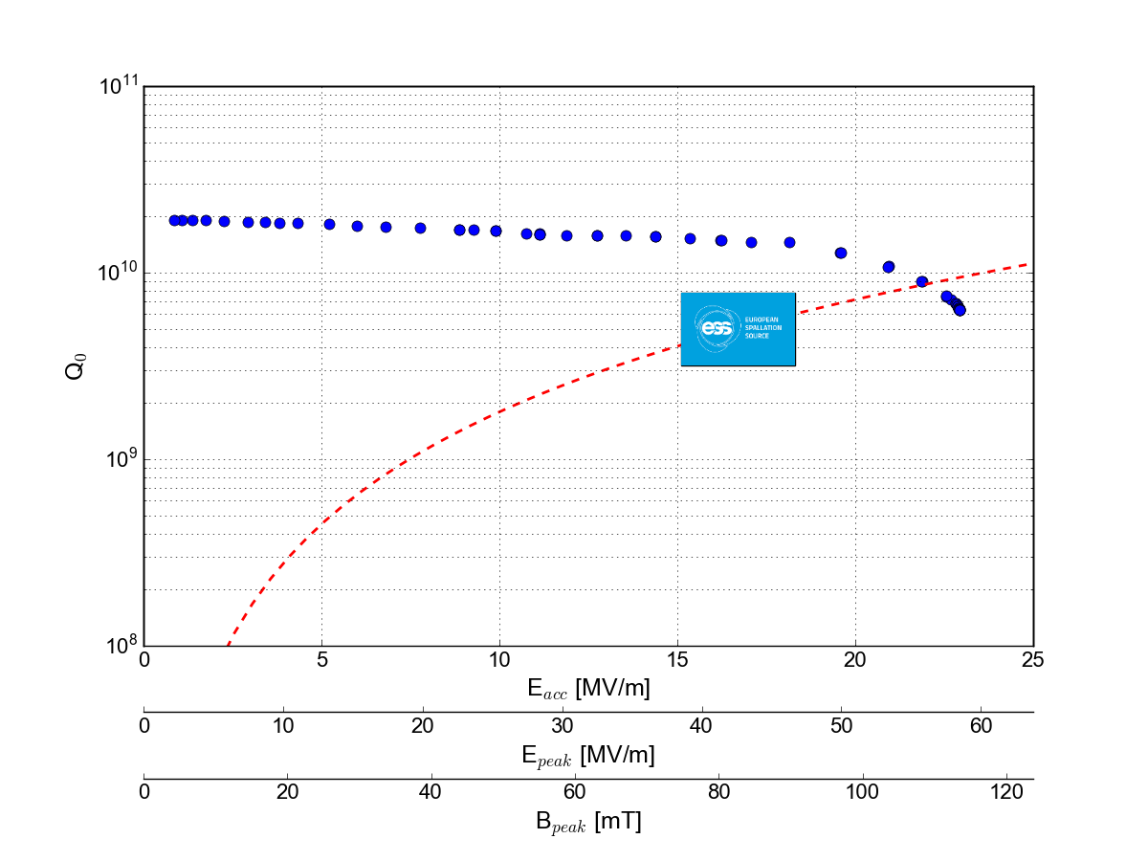
ESS cavity qualification at 2.0 K
100 W CW cryo power, i.e. 16,7 MV/m @ Q₀ 5e9

Slide 18

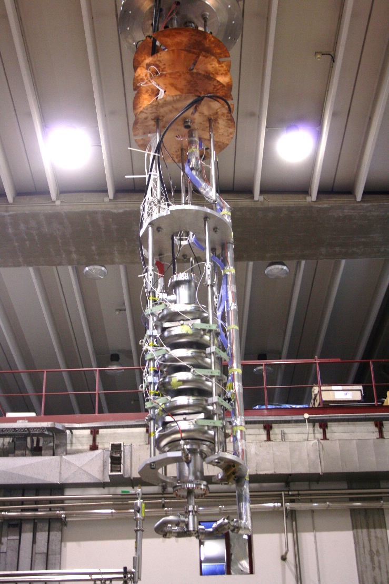


LASA Installation of the naked cavity for cold test

Slide 19


Cavity integration
After successful cold test the cavity was integrated in the He tank
Frequency change: 35 kHz. OK!
Pressure test: done
New Final BCP: 15 min, 20 μm
Successful cold test after integration done. No performance change.
Installation in the medium beta cryomodule demonstrator at CEA near completed

Slide 20



Cavity with tank cold test preparation at LASA

Slide 21



ESS cavity box and transportation
Two prototype boxes built
Four soft rubber dampers in place of foam supports
5 shipments made so far and OK
4 EZ to LASA
1 LASA to CEA
Data analyses on prototypes:
g-shock reducing factor > 8
Residual oscillations < 7 Hz
Damping τ₀ about 0.25 s
Series box design under finalization

Slide 22
Status and perspectives
First LASA prototype cavity outperformed ESS specifications:
Design Review by ESS successful. Committee and reviewers were “impressed by both the level of detail of the work and the application of LASA’s previous experience in SRF cavity design and production”.
An additional test on the integrated cavity confirmed no degradation of performances
Currently at CEA being part of the first medium-beta demonstrator cryomodule that is under assembly

Slide 23




Series cavities CFTs and more
Nb sheets (RRR 300 and RRR 40) for the cavities, CFT in two lots.
CFT closed. Contract under finalization.
CFT budget: ∼ 3.0 M€
Construction and treatment of the full set of medium beta SC cavities:
CFT closed. Bids under evaluation.
Procurement budget: 4.6 M€
Many ancillaries required:
Cryogenic feedthroughs with HiQ antenna and pick-up: 100 k€, started
Vacuum valves: 30 k€, transports, boxes, etc
Agreement with DESY for the vertical tests of series cavity: under finalization
QA/QC strategy fully developed at LASA:
Document management based on INFN ALFRESCO
Inspection template under finalization
Based on E-XFEL experience

Slide 24





















The European XFEL Facility
Experimental Hall
Photon Beam Lines
Undulators
Beam Dumps
Electron Beam
Distribution
Collimation
Linear Accelerator
Bunch
Compressors
Injector

Slide 25


The European XFEL
Some specifications
Photon energy: 0.3-24 keV
Pulse duration ~ 10-100 fs
Pulse energy: few mJ
Superconducting linac: 17.5 GeV
10 Hz (27 000 b/s)
5 beamlines / 10 instruments
Start version with 3 beamlines and 6 instruments
Several extensions possible:
More undulators
More instruments
…….
SASE2
(= SASE1)
17.5 GeV
SASE1, λ_{u}= 40 mm
0.2 – 0.05 nm
SASE3, λ_{u}= 68 mm
1.7 – 0.4 nm

Slide 26



Italian Contribution (based on INFN LASA know-how)
IN-KIND contribution for 33 M Euro (2005)
400 Bulk Nb 9 cell 1.3 GHz cavities
45 cryomodules
Tuners for SC linac
3.9 GHz Cryomodule with 8 SC Nb cavities (+ spares)
4 WPs co-leaded INFN - DESY
All components produced by Italian Industry

Slide 27






800 SC 1.3 GHz Nb cavities (VT): two recipes (BCP & EP), two companies (RI & EZ)
Retreated Cavities (~30%)
Reasons:
Bad performances (15%)
Bad inc. insp. & other (15%)
Kind of retreatment:
HPR (86%)
BCP (9%)
Special recovery (grinding) (4%)
Final Performances
E_{max} = 33.0 ±4.8 [MV/m]
E_{usable} = 29.8 ±5.1 [MV/m]
Q₀ (23.6MV/m) = 1.37 ±0.25 [10¹⁰ ]
(E_{goal} = 23.6 [MV/m], Q₀ ≥1·10¹⁰)
Best Performance Cavities
Both recipes are OK

Slide 28

WP3: accelerating cryomodules

Slide 29



Injector tunnel
Transverse deflecting structure
Beam dump
Fast kickers and screen stations
1.3 GHz gun
1.3 GHz cryo module A1 (XM29)
Spectrometer dipole
Laser heater
3.9 GHz cryo module AH1
Diagnostic section

Slide 30





XFEL 3rd Harmonic System (3.9 GHz)
String Assembly (DESY)
Blade Tuner
Due to alternating couplers requirement, for coupler kick compensation, and to the position of the 2-phase pipe there are two dressed cavity configurations (left and right)
Blade tuner updated to the “slim” type, concept derived from ILC tuner work by INFN. Lighter, cheaper, motor to the side.
Design of the Module is “Plug compatible” with XFEL modules

Slide 31









XFEL 3rd Harmonic System (3.9 GHz): fabrication, treatments and tests at LASA
VT preparation (LASA)
RF VT (LASA)
3 rd Harmonic Module in Operation
Beam image on screen in the spectrometer beamline
← AH1 off
AH1 on →
X (i.e. E)
y
Weld inspection
XFEL Injector with Beam
All cavities above specifications!
Time resolved
Cavity Tests

Slide 32

E-XFEL: Actual Status
23 June 2017 First XFEL beam in experimental hall (SPB/SFX Experiment)
E_{e-} = 14 GeV, λ_{ph} = 1.5 Å

Slide 33







Photocathodes for High Brightness RF Guns
Transport Box
QE Production Stability
Characterization of Cs₂Te film
Preparation Chamber at LASA
The Cs₂Te deposition
INFN-LASA activities:
Cs₂Te photoemissive film deposited on Mo plugs (since ‘90s, > 140 produced photocathodes)
10 % average QE @ λ = 254 nm
> 180 days operative lifetime (24h/24h 7d/7d)
High robustness and QE spatial uniformity
UHV condition (~10⁻¹⁰ mbar range)
Hg lamp
Prep. chamber viewport
Shutter
Filter wheel
Reflected power
Incident power
Photodiode
Cs₂Te films
Photocurrent signal
Remote controller
The INFN Mo plugs

Slide 34










Photocathodes for High Brightness RF Guns
INFN-LASA photocathodes for accelerator facilities:
Collaboration with:
DESY (FLASH and E-XFEL at Hamburg, PITZ at Zeuthen)
FNAL (FAST)
LBNL (APEX)
SLAC (LCLS II)
How it works
Collaborazioni Internazionali
RF Gun transfer system for LCLSII
INFN Transport Box
RF Gun transfer system in FLASH tunnel
Trasferimento
Produzione
Production & Transfer
Production
Transfer

Slide 35

Montaggio e test telescopio STRIP @ LASA
Il gruppo di Cosmologia Sperimentale di UniMI di Marco Bersanelli monterà e testerà la meccanica e le movimentazioni del telescopio STRIP nel capannone del LASA.
Verrà agganciato a due grosse travi in acciaio già disponibili nel capannone, e che faranno da robusto e stabile basamento e supporto.
Il telescopio STRIP, come Daniele Mennella ha illustrato nel suo seminario tenutosi al LASA, fa parte di attività relative alla caratterizzazione della polarizzazione della radiazione di fondo a microonde, (Cosmic Microwave Background, CMB) nell’ambito del LSPE, The Large Scale Polarization Explorer.
Il telescopio verrà poi installato a Tenerife

Slide 36

Observation site
Tenerife, Izana site
2390 m s.l.m.

Slide 37


STRIP Telescope
Baseline:
Clover telescope offered by M. Jones, Oxford 1.5m aperture (20 arcmin resolution)
Mount:
H/W parts mostly built Develop I/F S/W, Rotary joint

Slide 38

LSPE in a nutshell
Mount
Telescope
Max. height of the telescope + mount: ~ 6 m
STRIP
●
●
●
43, (90) GHz
QUIET coherent polarimeters
Dragone side-fed telescope (~ 0.5° - 1° angular res.)

Slide 39

LASA experimental area
UPW production
Area montaggio telescopio
Nuclear dosimetry area
Clean room
class 100 & HPR
High field solenoids
SC wire testing area
Vertical test area
He pumping system for subatm ops He Recovery balloons
High current PS

Slide 40




Area montaggio e test del telescopio STRIP

Slide 41

Telescope and mount testing
T/M integr.
In UK
In Italy
T/M testing
Alignment plan
In UK
Telescope test
T/M test in Italy
Shipment UK→I Shipment I→ES
Telescope and mount arrive at LASA
Telescope and mount are tested at LASA

Slide 42


Personale
ESS XFEL
Giorgio Fornasier, Tecnologo, art. 36
Saeid Pirani, dottorando Uni LUND

