Slide 1
ATLAS Itk
Mario Paolo Giordani (Università di Udine & INFN)
representing the ITk-Italy team
BO – CS – GE – LE – LNF – MI – TIFPA – UD

Slide 2
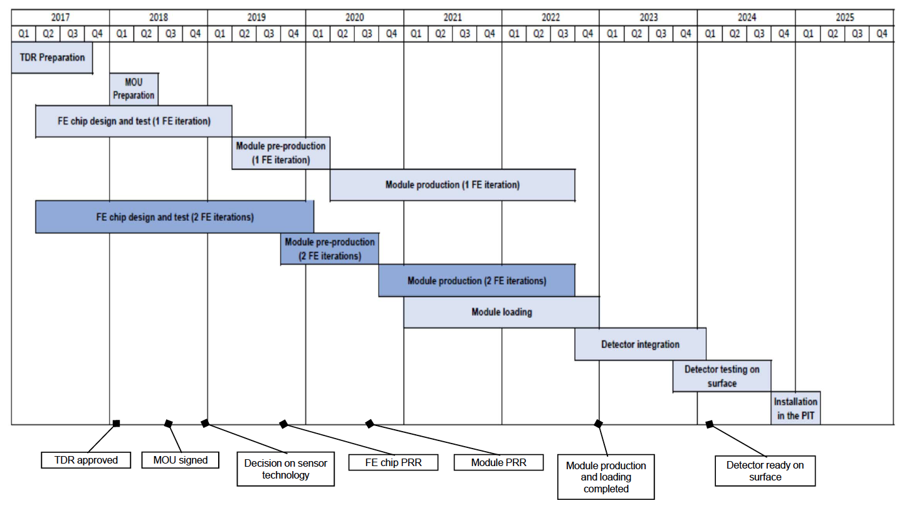
RD_FASE2 & beyond: timeline
Phase-II pixel project accelerating due to approaching TDR deadline (Dec 2017)
Optional two FE submission included in the schedule. Module optimization can start with first chip.
Module production and loading: ~27-33 months
Zoom on 2017
Layout definition will allow groups to take commitments on parts of detector
and preliminary design of the local supports
RD53-A submitted in spring 2017 → technological demonstrator of the 65 nm technology and module prototypes with small pixel size
Bump bonding market survey
Sensors: identify baseline designs to be used in the detector. Preliminary design of data transmission and power distribution to be included in TDR
Start of ATLAS chip design

Slide 3
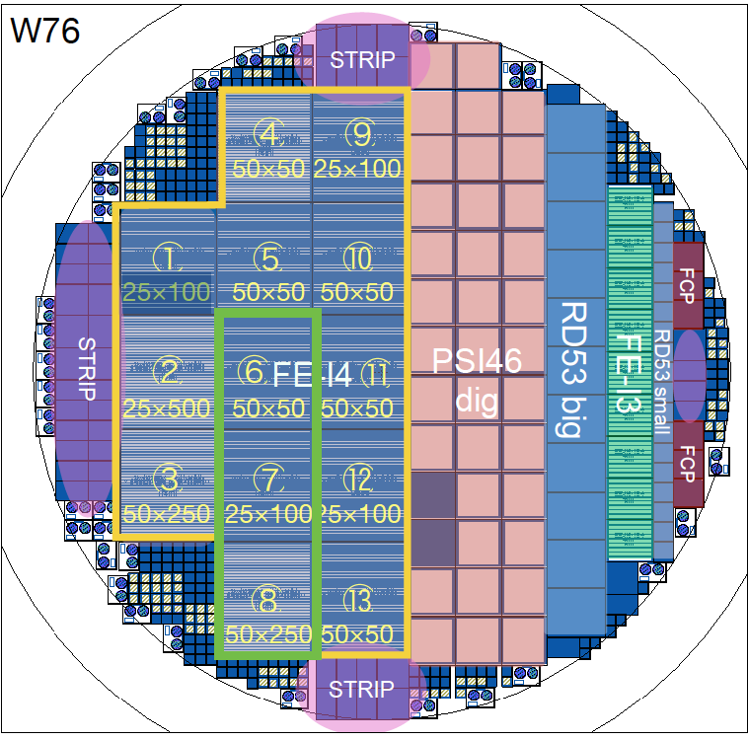
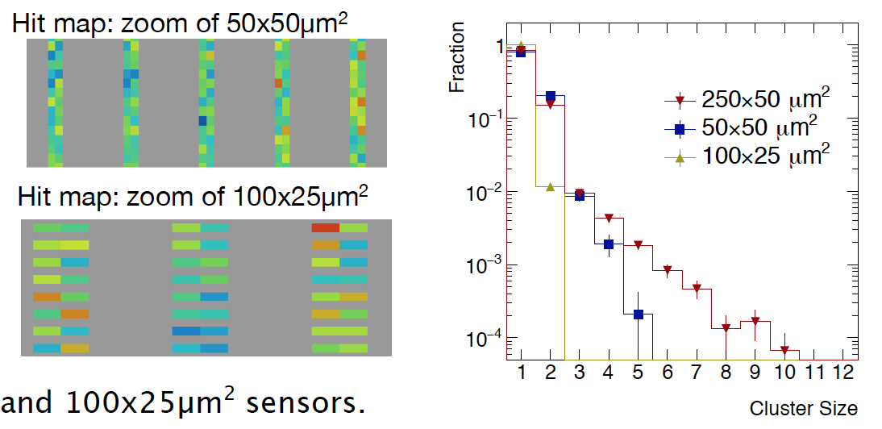
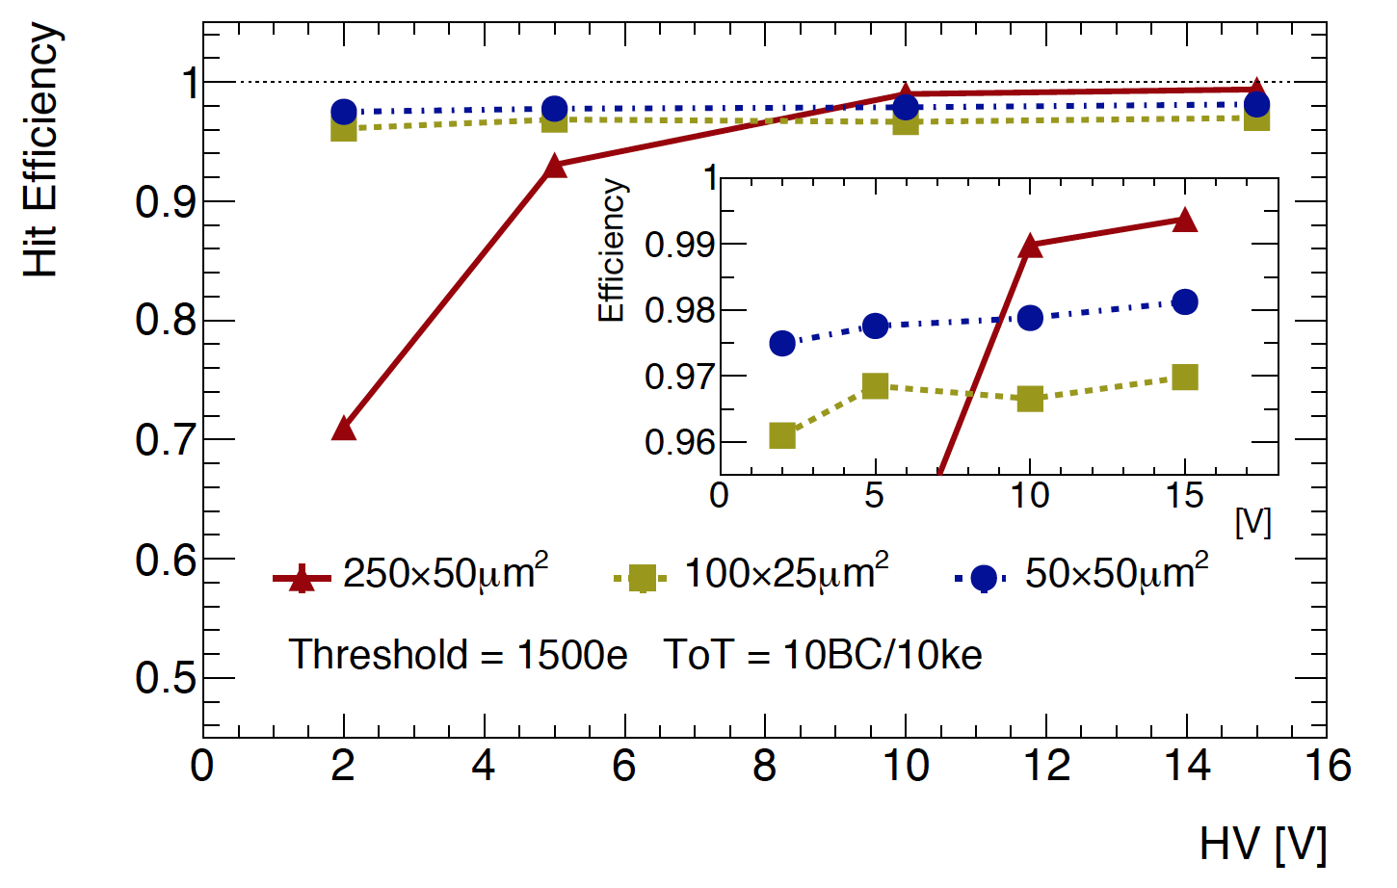
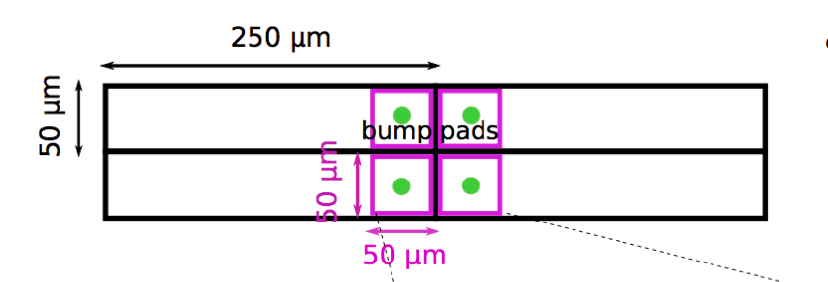
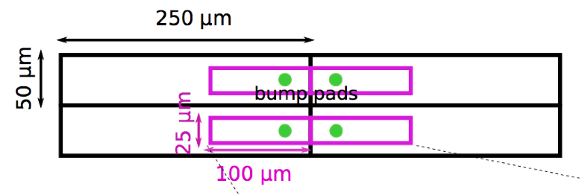
RD_FASE2: 3D sensors
Achieved so far:
feasibility of small pitch demonstrated, tested with large pitch read-out
extensive testing underway with promising results, also from irradiated test structures
GENOVA
TRENTO
UDINE
Towards the TDR: qualify FBK as 3D sensor vendor
qualify sensors for extreme radiation hardness
on-going irradiations on FE-I4, RD-53A for the next future (fall 2017)
2016 RD_FASE2 funded batch awaiting for FBK-INFN agreement renewal another batch, another one (AIDA 2020 funding) submitted

Slide 4
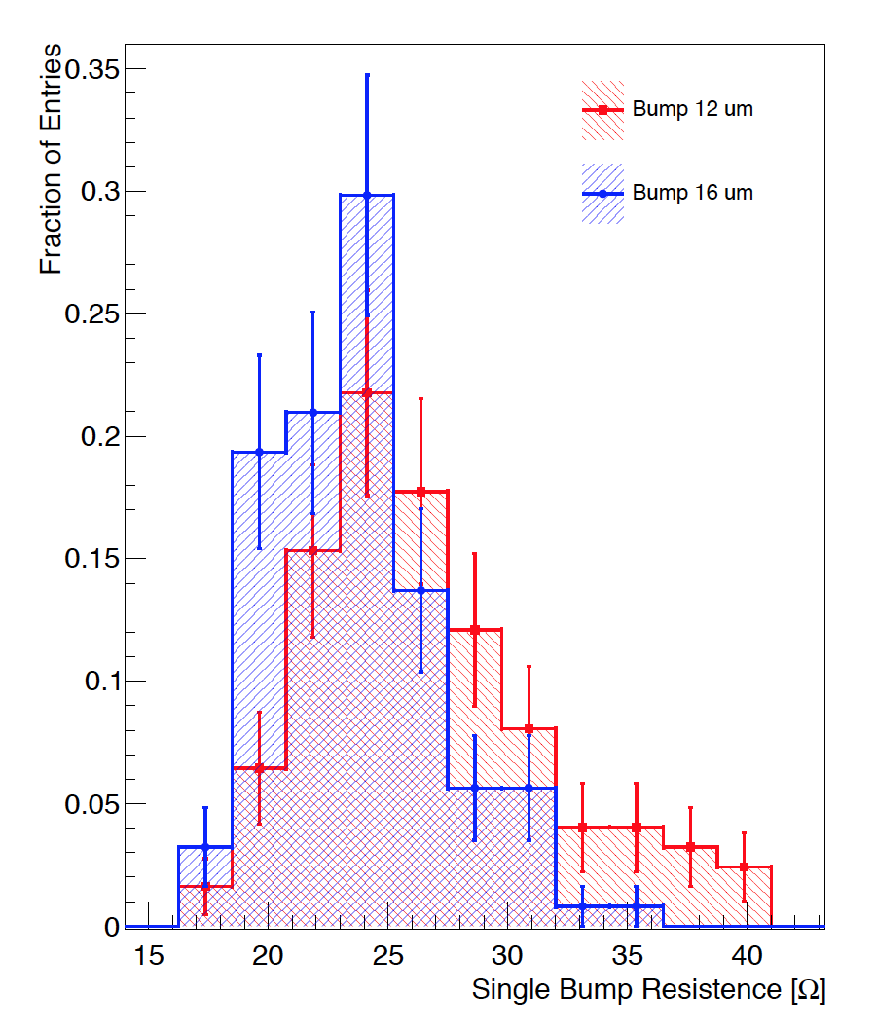
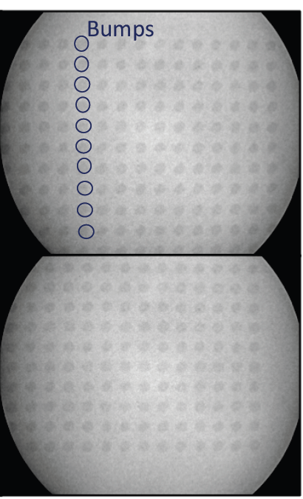
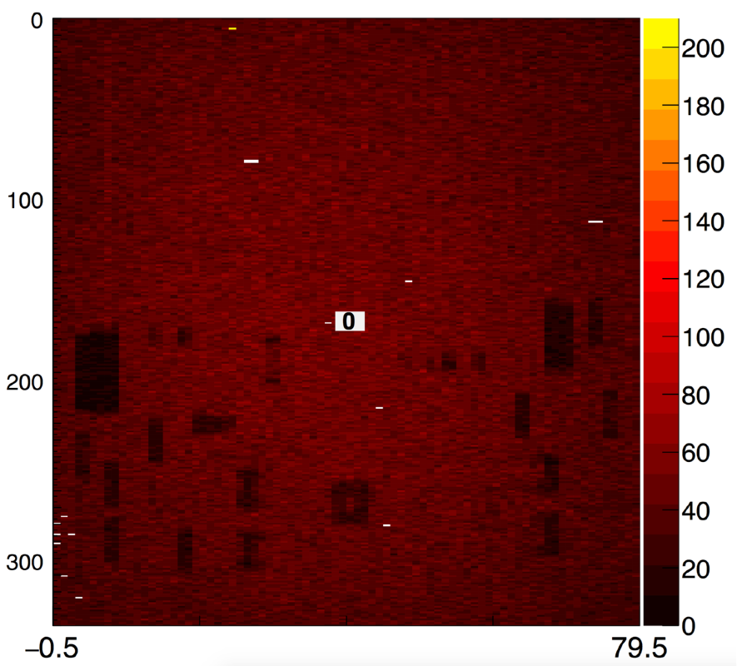
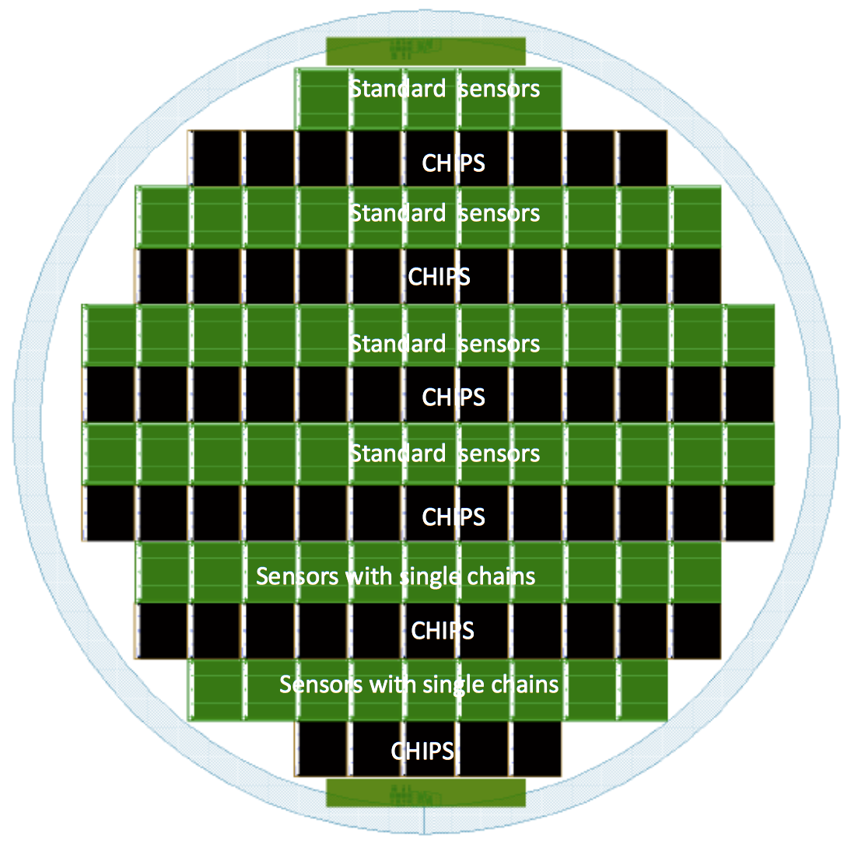
RD_FASE2: bump-bonding @ Leonardo
Achieved so far:
high density indium bump deposition (50×50μm² over 2×2cm²) validated by electrical and visual inspection on 6” wafers with dummy chains
started validation of high density bump-bonding on 12” wafers (bare silicon by now)
Source scan of a FE-I4 3D module bump bonded by Leonardo
GENOVA
Bump R of dummy chains
MILANO
High density bumps X-ray
12” dummy chain wafer
Towards the TDR: qualify Leonardo as a bump-bonding and flip-chipping vendor
bump deposition on 12” wafer with resistive chains and on RD-53A wafer

Slide 5
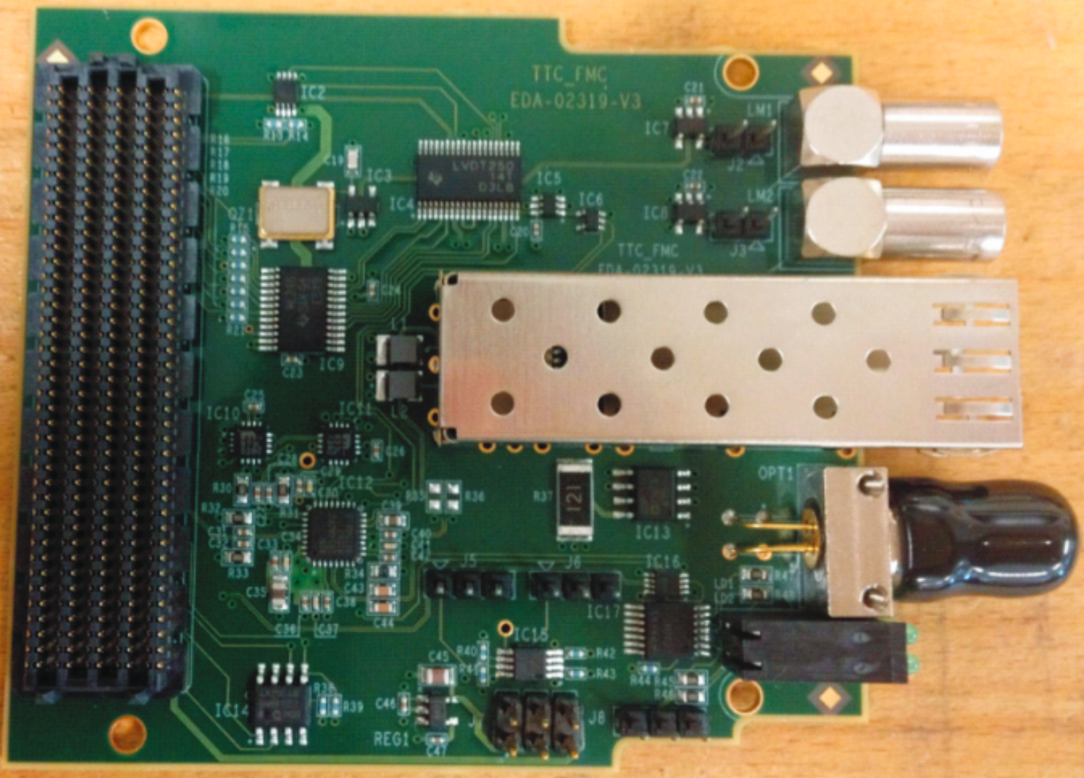
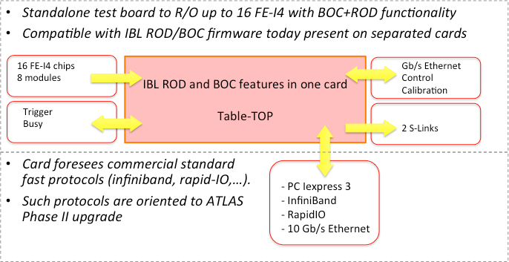
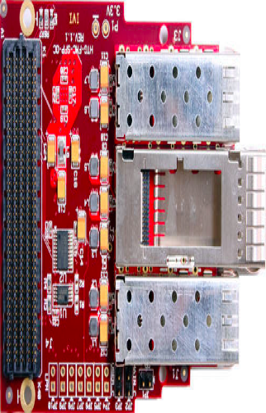
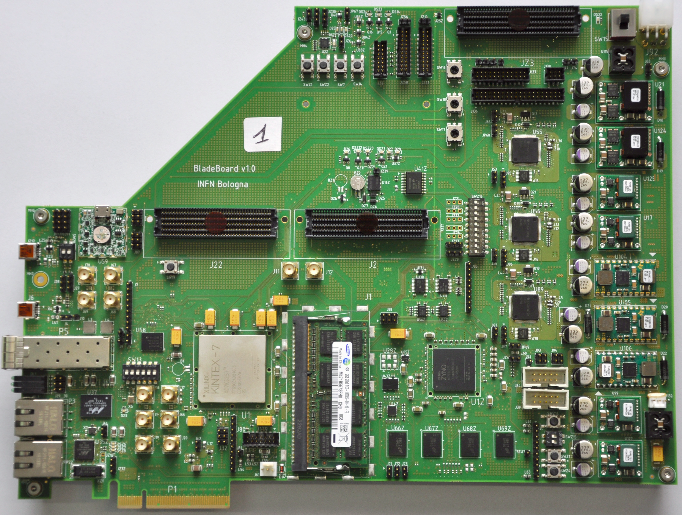
RD_FASE2: read-out
Achieved so far:
profiting of IBL (and Pixel L2/1 on-going upgrades) experience in R/O card design, production and qualification
design table-top card with features of ROD+BOC current pit implementation
two boards produced (2016 RD_FASE2 funding)
Towards the TDR: qualify the crd for detector offline read-out
LHC-commercial
mezzanines
PIXROD
BOLOGNA

Slide 6
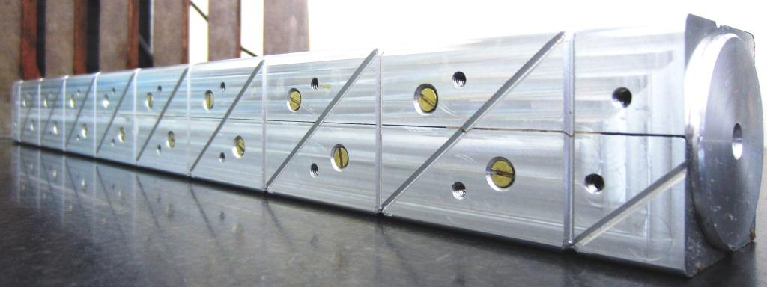
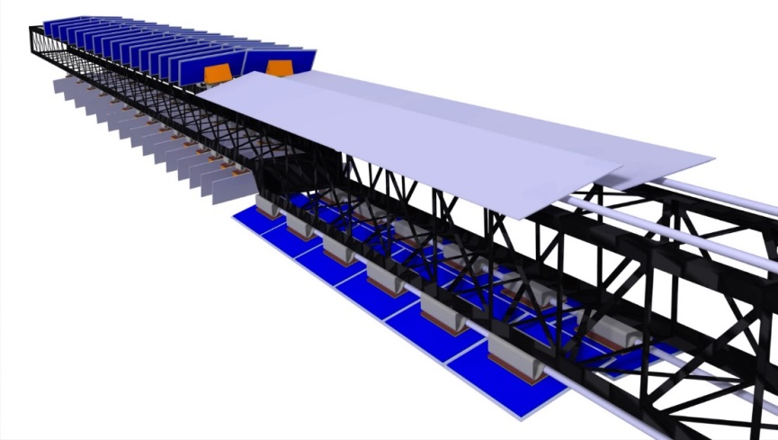
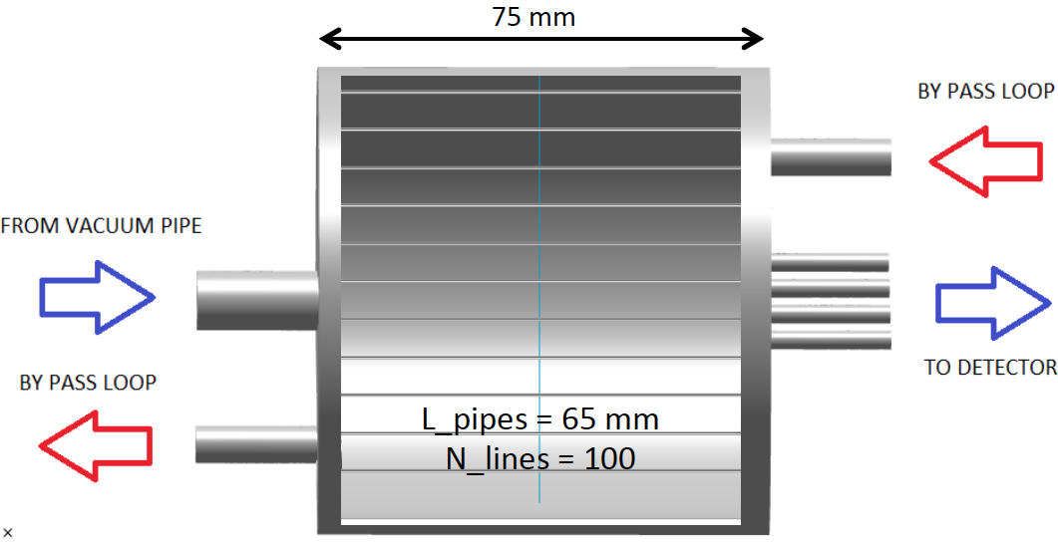
RD_FASE2: mechanics and Cooling
Achieved so far:
participation to ITk cooling system with design, construction and test of splitting box
prototypes to be delivered at CERN for QA by summer 2017
manufacturing of Al moulding of slim longeron (support for barrel inclined layout)
thermo-mechanical FEA: stress in critical interfaces and thermal radiation effects
Cell FEA studies
MILANO
GENOVA
PP1 splitting box
SLIM Local Support for Inclined Layout
Al mould long prototype
planned CO₂ tests of cooling circuits with 2PACL Traci unit
planned measurement of solder/tin interfaces before & after cooling and pressure cycles

Slide 7
RD_FASE2: wrap-up
RD_FASE2 2014-17 funding, additional 2017 and 2018 costs

Slide 8
from RD_FASE to Fase2
Towards the end of RD_FASE2 it was realized that building the ITk pixel innermost barrel layers – as originally proposed to better match our sensor interests – is difficult
strong US interest
weakness on our side on engineering side
At the last AUW we anticipated the possibility of building one pixel endcap, so far uncovered
the other endcap being built by UK
It is an ambitious project, but is an opportunity to boost the Italian contribution
new groups have shown interest in this project (Cosenza, Lecce, LNF)
on the contrary, the Italian participation in the IBL project was limited by the size of the detector

Slide 9
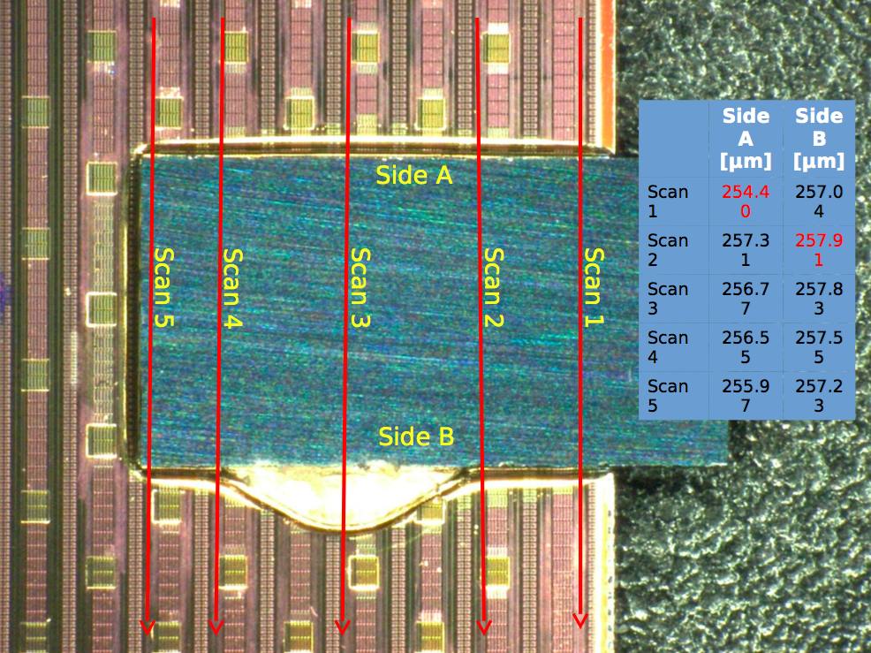
from HVR_CCPD to FASE2?
Option for outermost barrel layer targeting monolithic solution
¼ of hybrid planar modules cost, rate comparable with 130-180nm integration scale
R&D completion by 2017-2018
choice of sensor type (large or small fill-factor)
readout architecture definition
assess cross-talk between analog cell and read-out
estimate performance as a function of particle rate
full size demonstrators in the two detector layouts in 2018
module architecture to be defined
quad-modules for compatibility w/ mechanics and services of baseline
lpGBT or custom ASIC as quad-module concentrator flex-hybrid-stiffener or ceramic hybrid
Schedule: prelim review (2017), technology decision (2018), production (mid 2019)
BOLOGNA
GENOVA
MILANO
Monolithic prototypes in AMS H180 process
Hybridization test on FE-I4

Slide 10
towards fase2
Interests of individual institutes have been probed with tentative WBS
Modules
production, bump-bonding, module flex, assembly, QA, DAQ
Half-Rings
mechanical structure w/ cooling, type-0, EoS card, assembly, QA
Module Loading
loading, QA, system test
Services
cooling distribution, electrical services, PP1 design
Integration
half-shell construction, half-ring fitting, QA, half-shell integration

Slide 11
towards fase2
This new strategy would not weaken our interest and leadership in the 3D sensor field as module production & test is decoupled from installation on the detector
Activities started under RD_FASE2 fit coherently into FASE2 project aimed at endcap construction
 | RD_FASE2
GE,TIFPA,UD | 3D Sensors
GE,MI | Bump-Bonding
GE,MI | Modules
BO,GE | Read-out
GE,MI,CS | Mechanics and Cooling
FASE2
Modules | CS,BO,GE,MI,TIFPA,UD
Local Supports | GE,MI
Module Loading | GE,LE/LNF
Services | LNF
Integration | LNF/LE,MI
In our evaluations we have assumed common development and/or production activities with our UK partners, who are available to share their preliminary results and designs

Slide 12
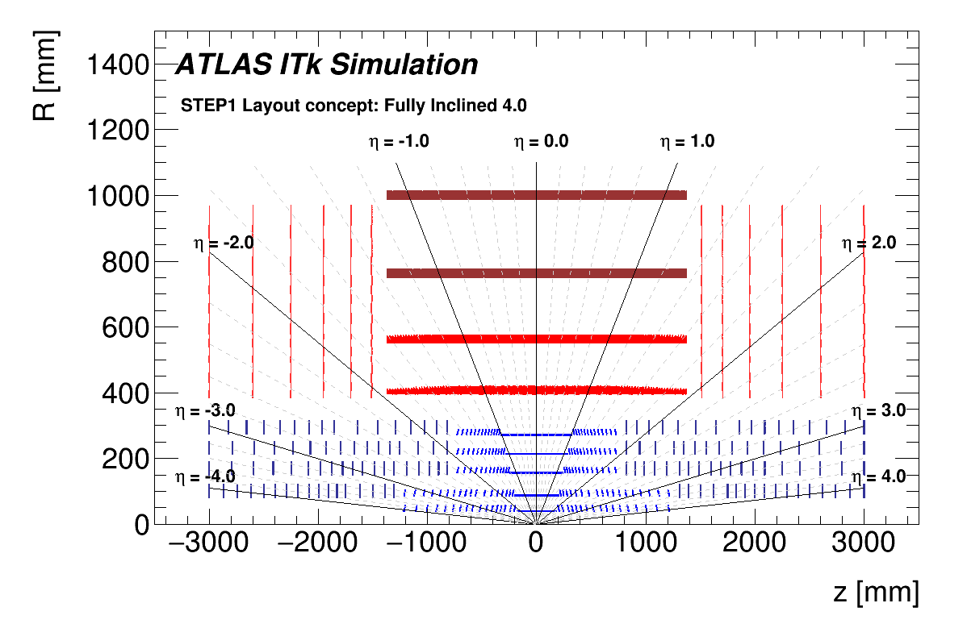





Detector layout
End cap
Outer
barrel
End cap
Innermost

Slide 13
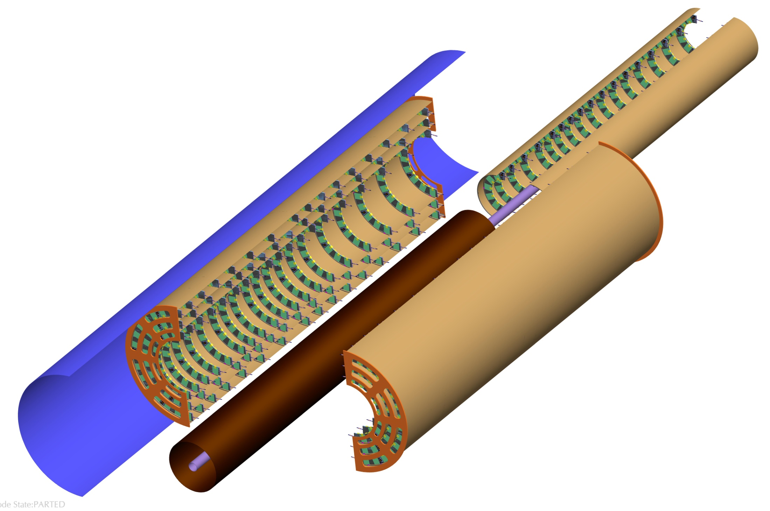
Pixel Endcap layout: exploded View

Slide 14
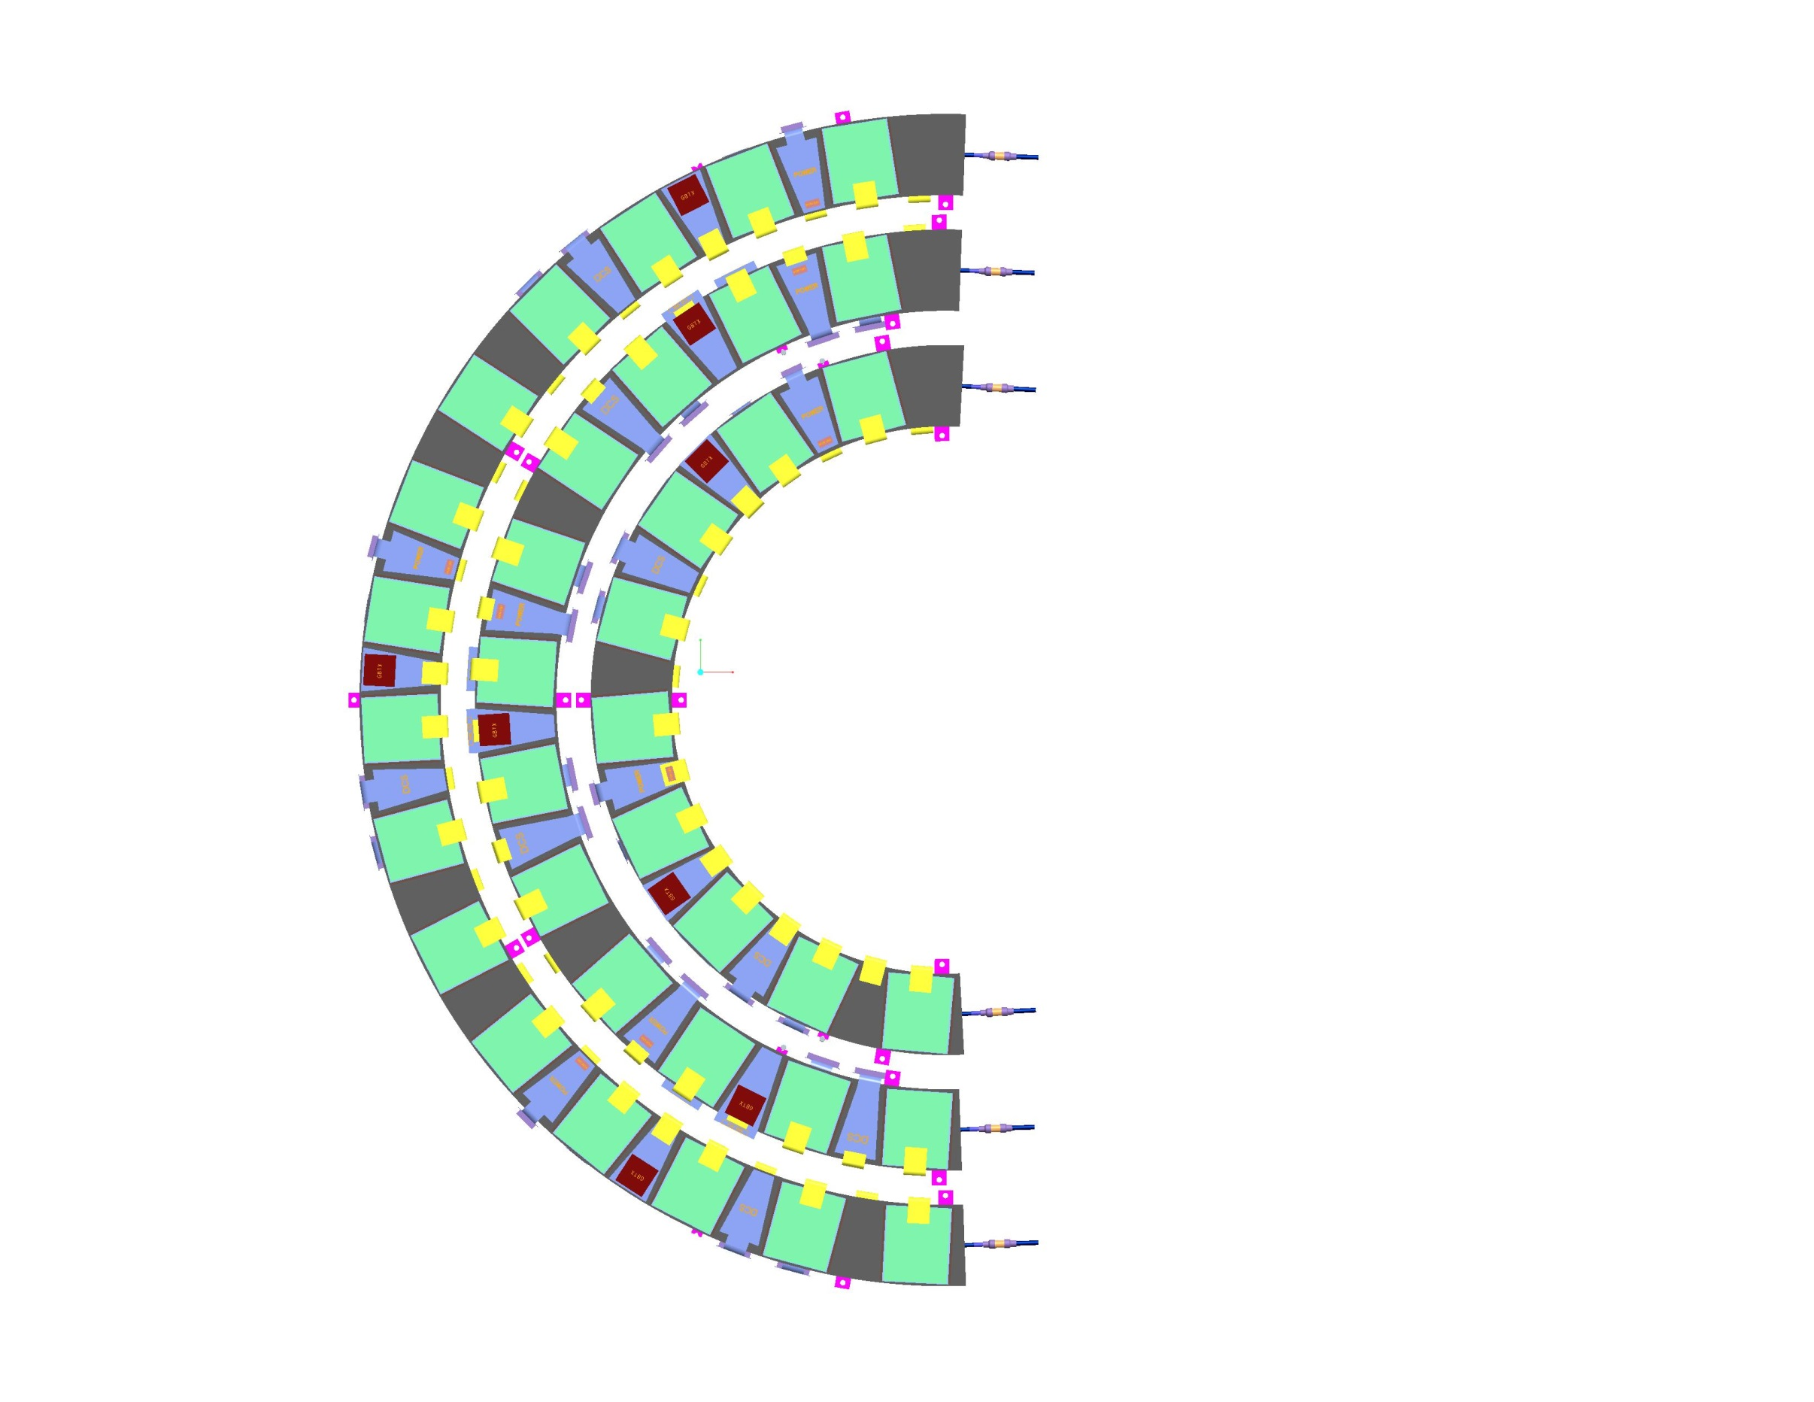
pixel endcap layout: half-rings

Slide 15
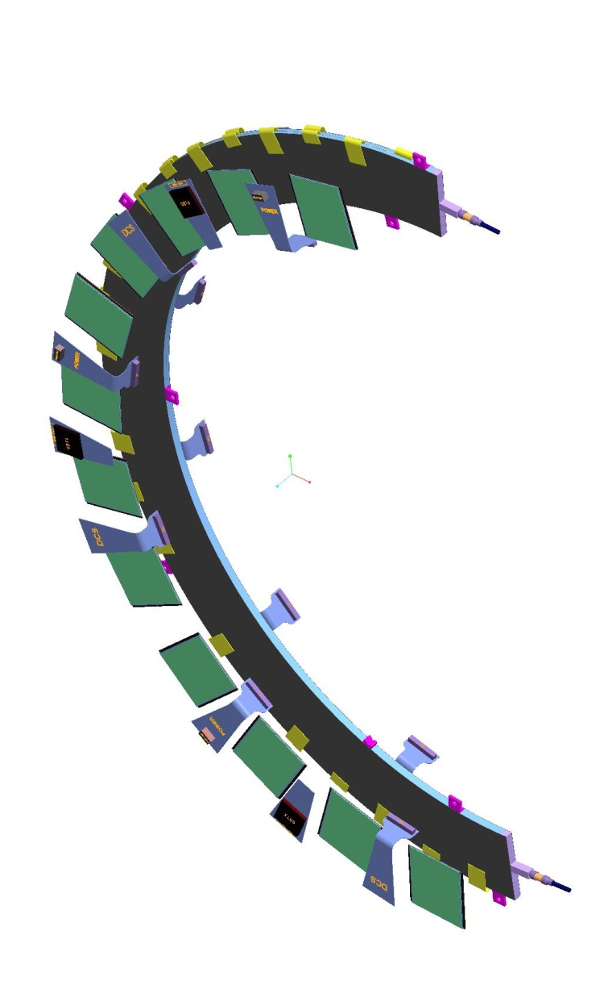
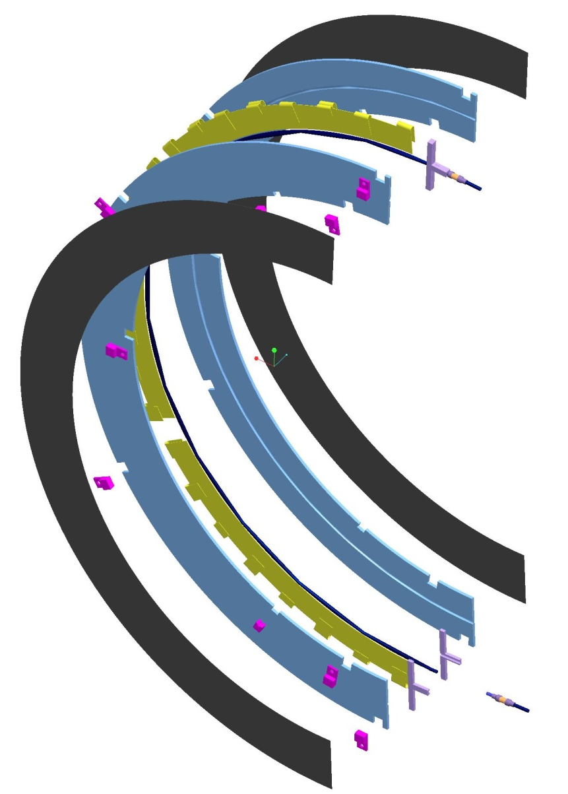
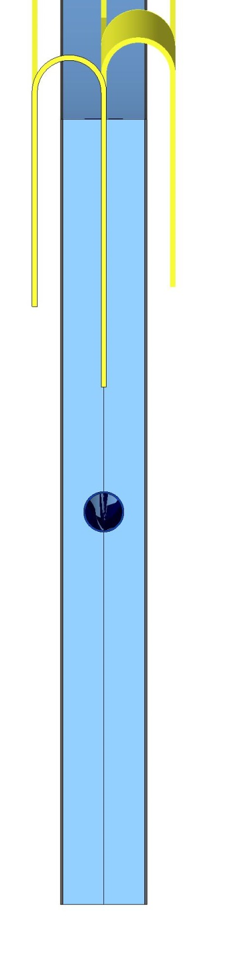
pixel endcap layout: half-rings

Slide 16
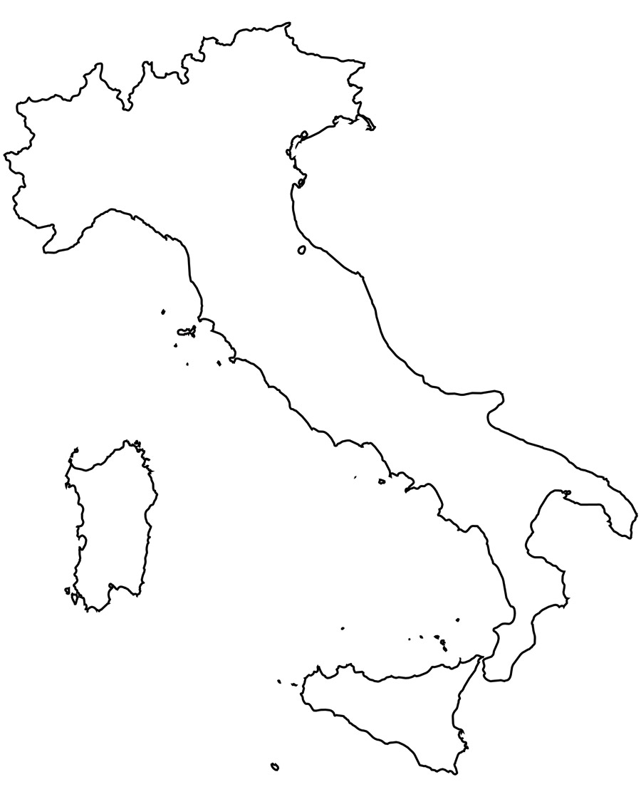
collaboration
TRENTO
Pixel 1998
Pixel 2012
ITK 2017
Genova, Milano, Udine were involved in the construction of current Pixel detector
bump-bonding (Leonardo-Selex)
module assembly, QA & loading
mechanical structure
support for integration at CERN
Bologna and Trento joined for IBL programme
50% of IBL 3D sensors were made in FBK
electrical services
development of off-detector read-out
Cosenza, Frascati and Lecce have been involved in other detector construction
UDINE
MILANO
BOLOGNA
GENOVA
FRASCATI
LECCE
COSENZA

Slide 17
Overall organization
Based on our & UK experience, we foresee:
one (3D) module production site: FBK/TIFPA
two module assembly sites: Genova + Milano
QA could be delegated to other sites
HV/HR-CMOS module assembly could come into play together with 3D
two/three module loading sites: Genova + Lecce and/or LNF
each site requires o(500W) CO₂ cooling system
QA to be performed in loading sites in order to reduce stress on loaded half-rings
one integration site: LNF (baseline), Milano LAMA or CERN (back-up)
requires large clean room, cold room and o(2kW) CO₂ cooling system
other sites can provide engineering support (design and construction of dedicated tools)
electrical services and PP1 endplate to be built by LNF

Slide 18
local supports
None of the institutes has in-house production/prototyping nor machining capabilities on composite materials (half-rings and half-shells)
After considering different options, two possibilities remain viable
baseline: equip Genova laboratories with dedicated facility to produce half-rings
half-shells can be commissioned to UK partner
back-up: outsource half-ring prototyping and production to external partner
needs to be pursued in parallel with baseline in order to start prototyping on short timescale
Type-0, EoS cards and cooling pipes can be provided by Genova and Milano, which can perform also the metrology and QA after assembling the half-rings
Udine can provide on-detector cooling preliminary studies
engineer already at CERN working within CO₂ group

Slide 19
MANPOwer
2018/19 | BO | CS | GE | LE | LNF | MI | TIFPA | UD
Phy | 1.5 | 0.3-05 | 5.0 | 0.7-1.0 | 1.0 | 2.5 | 1.8 | 1.5
Eng |  | 1.9-0.9 | 1.0 |  | 1.5 | 1.7 | 3.2
Tech | 0.7 |  | 4.7 | 0.5 | 1.0 |  |  | 1.0

Slide 20
ATL_FASE2 and beyond
ATL_FASE2 fund requests for 2018-2020

