Slide 1
Analysis Higgs Boson

Slide 2
Introduction
Martina Marcedula
Birthday: 09/11/2000
Liceo Galvani (^Q)
Chiara Ventura
Birthday: 06/12/2000
Liceo Galvani (^Q)

Slide 3
Our hobbies are:
Painting
Gymnastics
Photography

Slide 4
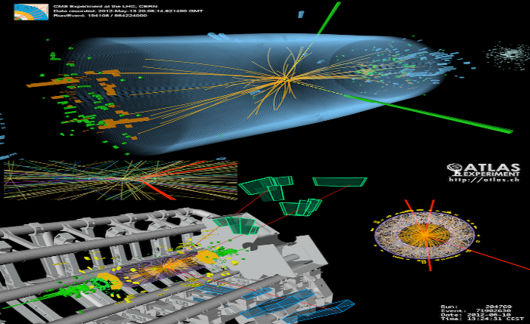
Higgs boson
Definition:
Higgs boson is an elementary particle in the Standard Model of particle physics.
It is significant because it is the particle associated with Higgs field, which explains why some fundamental particles have mass when, based on the symmetries controlling their interactions, they should be massless.

Slide 5
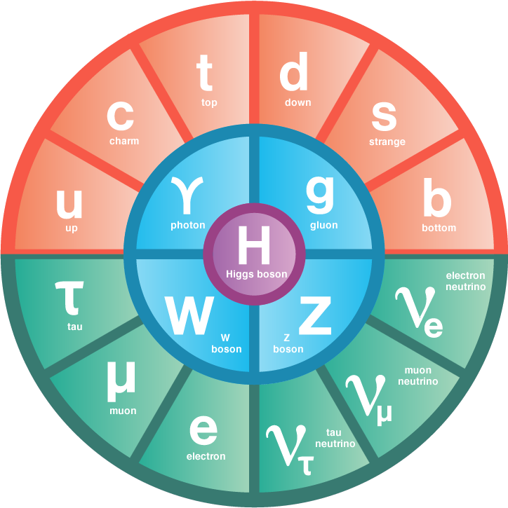
The Standard Model of particle physics is the theory describing three of the four known fundamental forces, as well as classifying all known elementary particles allowing us to study their behaviour.
The elementary components are: leptons, quarks, bosons and Higgs boson itself.

Slide 6
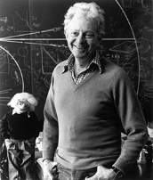
Why is it also called « The Goddamn Particle»? It is due to Leon Lederman that Higgs boson is nicknamed this way. A name such as «The Goddamn Particle», could have indeed softened the members of the congress in order to obtain a loan to build an accelerator.
Leon Lederman

Slide 7
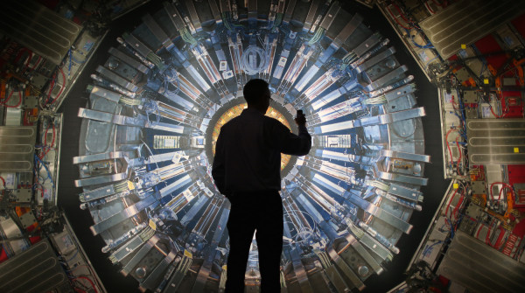
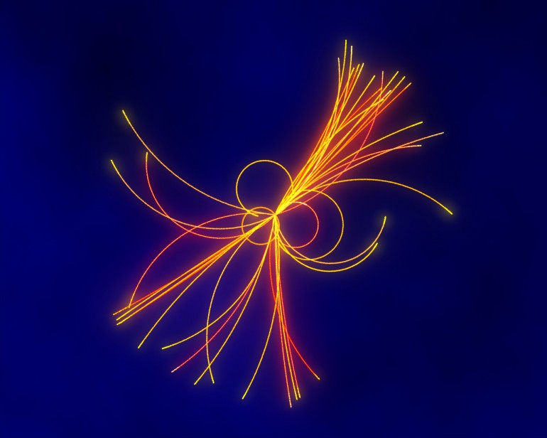
Why is it so much sought-after ? Because it is the only particle that gives us confirmation on how we think some things work in the visible universe. In case this theory wasn’t true, others models would need to be taken into consideration.

Slide 8
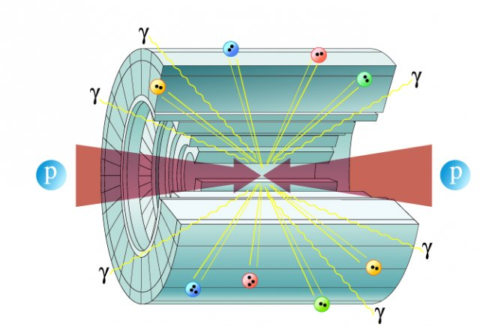
How can it be found? By throwing bundles of high-energy protons into the particle accelerator and making them clash. Collisions generate many elemental particles (leptons, quarks, bosons W and Z, etc.). Higgs could also be formed. Among the data coming out of accelerators scientists looks for the unexpected.

Slide 9
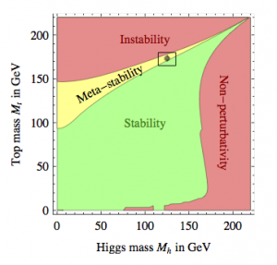
Why is it so difficult to be observed? Being it so unstable, the Higgs almost immediately declines. For the same reason it can not be observed directly in the huge pile of particles produced at each collision in the accelerator, but its decay products have to be examined. However, the particles that can be generated can be formed in many different ways.

Slide 10
Our analysis
Missing Energy

Slide 11
Impulse Leadleptons

Slide 12
Leptons Charge

Slide 13
Visible Mass

Slide 14
Conclusions
Why do we like Physics?
Because it is profound, it does not just explain what we see but it brings us far beyond things.
What do we think now after this experience?
Physics is far more complicated than we expected.
Especially because we didn’t have basic notions about the topic.

