Slide 1
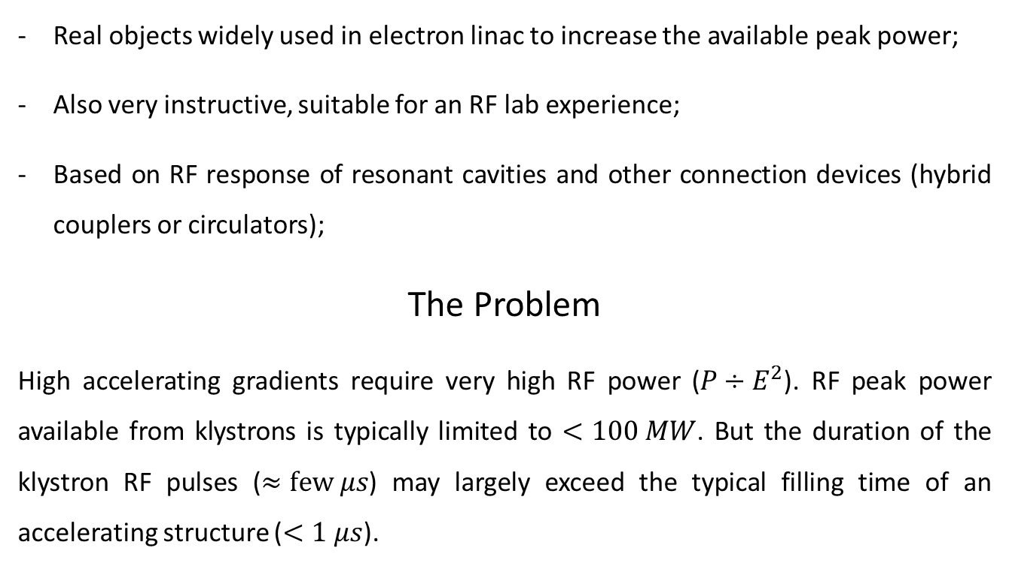
Experimental activity #2: RF pulse compressors
Real objects widely used in electron linac to increase the available peak power;
Also very instructive, suitable for an RF lab experience;
Based on RF response of resonant cavities and other connection devices (hybrid couplers or circulators);
The Problem
High accelerating gradients require very high RF power ($P÷E^{2}$). RF peak power available from klystrons is typically limited to $<100 MW$. But the duration of the klystron RF pulses ($≈few μs$) may largely exceed the typical filling time of an accelerating structure ($<1 μs$).

Slide 2
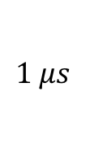
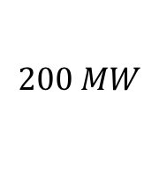
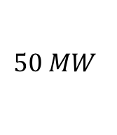
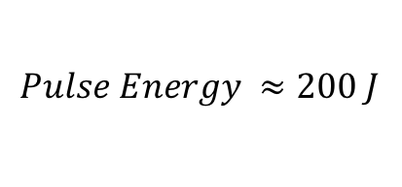

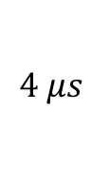
The Idea: SLED (Stanford Linac Energy Doubler)
Let’s compress the energy of the RF pulse in about 1 filling time to increase the peak power to the maximum!
$$50 MW$$
$$200 MW$$
Pulse Compression
$$4 μs$$
$$klystron RF pulse$$
$$Pulse Energy ≈200 J$$
$$1 μs$$
A factor of 4 in power corresponds to a factor of 2 in accelerating gradient, i.e. In beam energy. Smart idea! But how a large RF power flowing in a waveguide can be manipulated in order to be compressed?
This idea has been firstly implemented at SLAC in the 70’s [1]. The compression is obtained by capturing the RF power reflected by high-Q resonant cavities.
[1] Farkas et al. - SLED A method of doubling SLAC energy

Slide 3
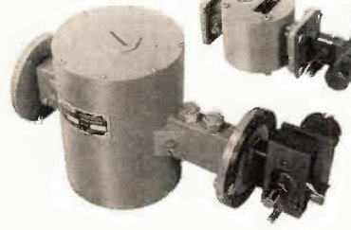
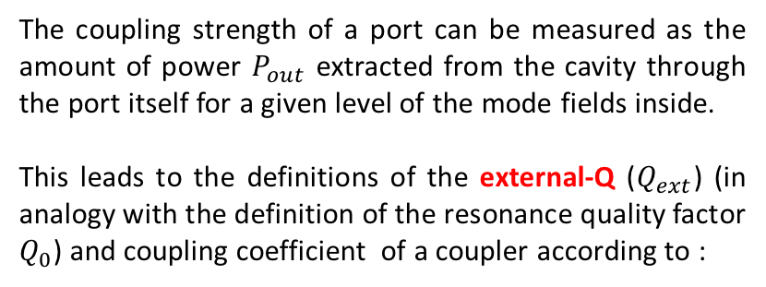
Coupling coefficients of a resonant cavity
«Real» resonant cavities are NOT perfectly closed volumes, i.e. at least 1 opening (port) must be present to allow the RF power to flow in (and out).
The coupling strength of a port can be measured as the amount of power $P_{out}$ extracted from the cavity through the port itself for a given level of the mode fields inside.
This leads to the definitions of the external-Q ($Q_{ext}$) (in analogy with the definition of the resonance quality factor $Q_{0}$) and coupling coefficient of a coupler according to :
where $Q_{0}$ is the usual quality factor of the resonant mode, related only to the dissipation on the cavity walls.
The extra-power flow through the cavity couplers, in addition to the power loss in the walls, may significantly change the characteristics of the resonance. This effect is known as “cavity loading”. The loaded cavity Q-factor is lowered by the power coupled out through the cavity ports and results to be:

Slide 4
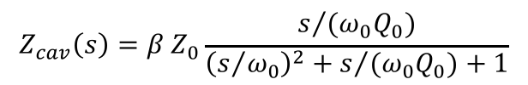
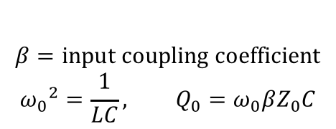
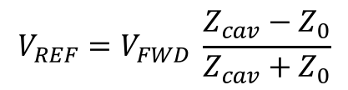
Wave reflection in guide terminated on a resonant load
A resonant cavity is a non-matched load for a waveguide or a transmission line, and can be modeled as an RLC parallel circuit.
$$Z_{cav}\left(s\right)=β Z_{0}\frac{s/{(ω_{0}Q_{0})}}{{\left(s/{ω_{0}}\right)}^{2}+s/{{(ω}_{0}Q_{0})}+1}$$
$$β=input coupling coefficient$$
$${ω_{0}}^{2}=\frac{1}{LC}, Q_{0}=ω_{0}βZ_{0}C$$
An RF wave travelling from the generator toward the cavity is always partially reflected at the cavity input. The reflected wave can be calculated according to:
$$V_{REF}=V_{FWD} \frac{Z_{cav}−Z_{0}}{Z_{cav}+Z_{0}}$$

Slide 5
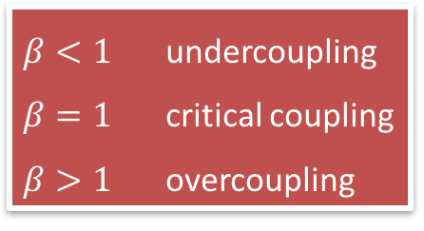
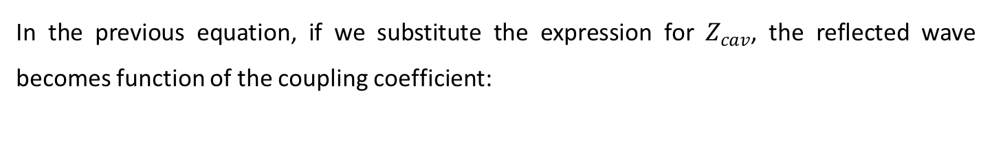
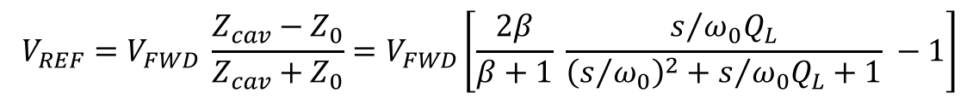
Cavity reflected waves and input coupling coefficient
In the previous equation, if we substitute the expression for $Z_{cav}$, the reflected wave becomes function of the coupling coefficient:
Lorentzian network transfer function
$$V_{REF}=V_{FWD} \frac{Z_{cav}−Z_{0}}{Z_{cav}+Z_{0}}=V_{FWD}\left[\frac{2β}{β+1} \frac{s/{ω_{0}Q_{L}}}{{\left(s/{ω_{0}}\right)}^{2}+s/{ω_{0}Q_{L}}+1} −1\right]$$
Depending on the value of the input coupling coefficient $β$, 3 practical situations can occur:
$β<1$ undercoupling
$β=1$ critical coupling
$β>1$ overcoupling
Let’s calculate and plot the wave reflected by a cavity excited by a pulsed source.

Slide 6
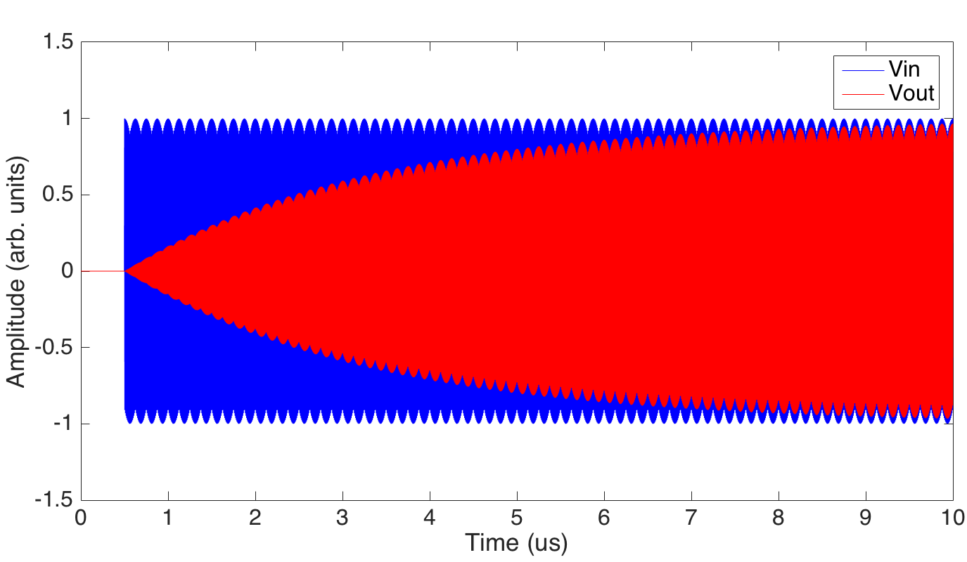
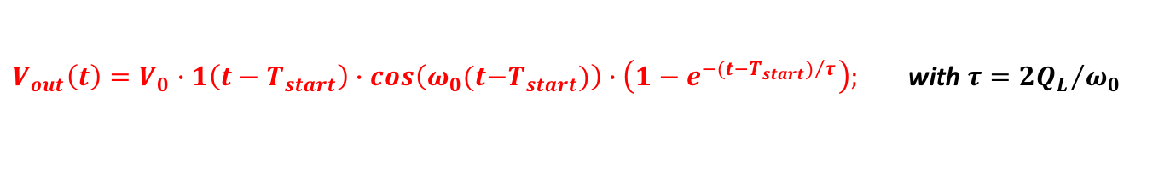
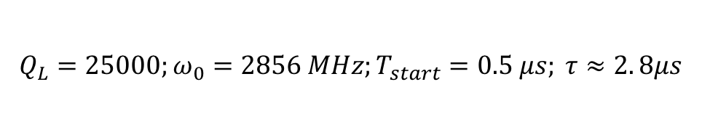

Lorentzian network response to RF Pulses
The response of a Lorentzian network to an RF step pulse is:
$$V_{in}(t)=V_{0}∙1(t−T_{start})∙cos\left(ω_{0}(t−T_{start}\right))$$
$V_{out}\left(t\right)=V_{0}∙1\left(t−T_{start}\right)∙cos\left(ω_{0}(t{−T}_{start})\right)∙\left(1−e^{−{(t−T_{start})}/τ}\right);$ with $τ={2Q_{L}}/{ω_{0}}$
$$T_{start}$$
$$Q_{L}=25000;ω_{0}=2856 MHz;T_{start}=0.5 μs; τ≈2. 8μs$$

Slide 7
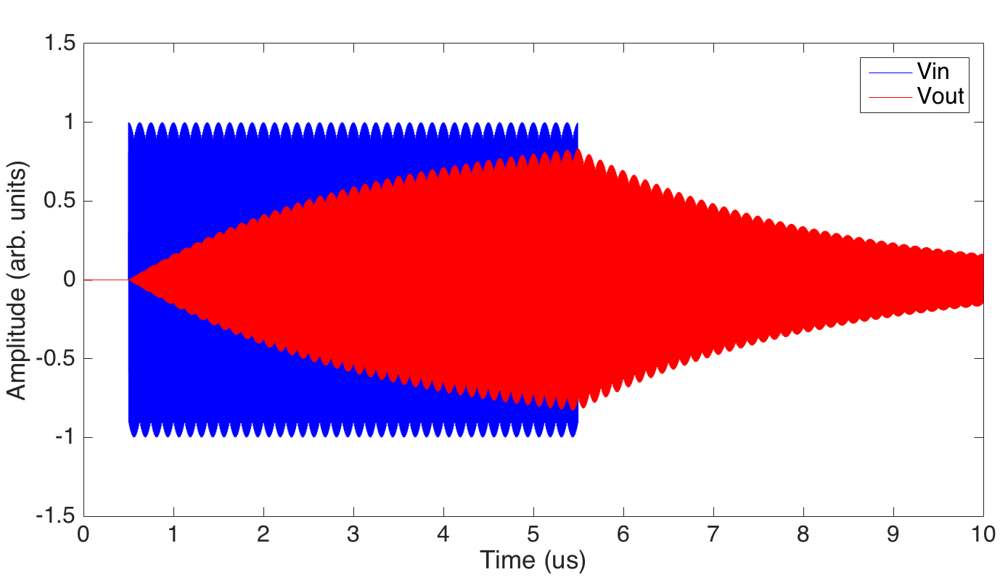
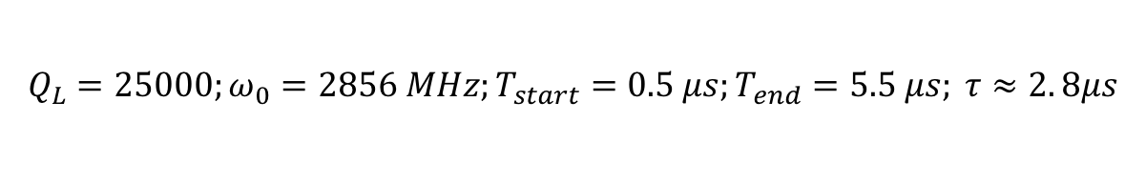


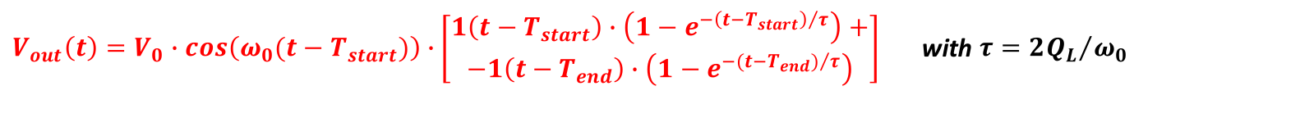
Lorentzian network response to RF Pulses
The response of a Lorentzian network to an RF rectangular pulse is:
$V_{in}(t)=V_{0}∙cos\left(ω_{0}(t−T_{start})\right)$ $∙\left[\begin{aligned}1\left(t−T_{start}\right)+ \\ −1(t−T_{end})\end{aligned}\right]$
$V_{out}\left(t\right)=V_{0}∙cos\left(ω_{0}(t−T_{start})\right)∙\left[\begin{aligned}1\left(t−T_{start}\right)∙\left(1−e^{−{\left(t−T_{start}\right)}/τ}\right)+ \\ −1\left(t−T_{end}\right)∙\left(1−e^{−({t−T_{end})}/τ}\right)\end{aligned}\right]$with $τ={2Q_{L}}/{ω_{0}}$
$$T_{start}$$
$$T_{end}$$
$$Q_{L}=25000;ω_{0}=2856 MHz;T_{start}=0.5 μs;T_{end}=5.5 μs; τ≈2. 8μs$$

Slide 8
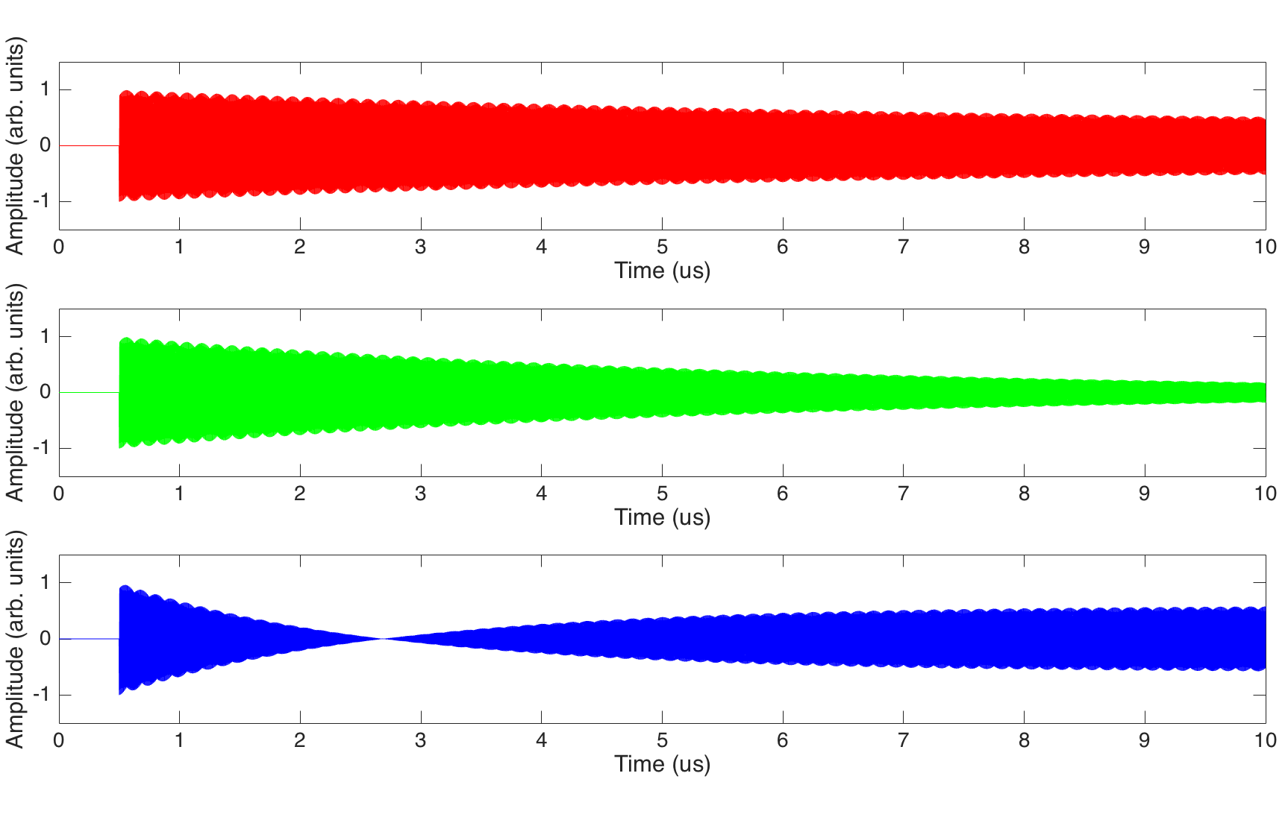

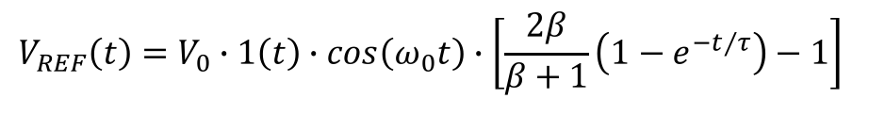



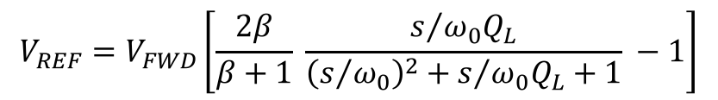
RF step pulse reflected by a resonant cavity
The reflected power of a Lorentzian network to an RF step pulse has the following transfer function:
$$V_{REF}=V_{FWD}\left[\frac{2β}{β+1} \frac{s/{ω_{0}Q_{L}}}{{\left(s/{ω_{0}}\right)}^{2}+s/{ω_{0}Q_{L}}+1} −1\right]$$
In time domain:
$$V_{REF}\left(t\right)=V_{0}∙1\left(t\right)∙cos\left(ω_{0}t\right)∙\left[\frac{2β}{β+1}\left(1−e^{−t/τ}\right)−1\right]$$
$V_{FWD}(t)=V_{0}∙1(t)∙cos\left(ω_{0}t\right)$;
Undercoupled, $β<1$
Critically coupled, $β=1$
Overcoupled, $β>1$

Slide 9

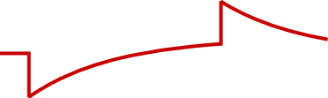

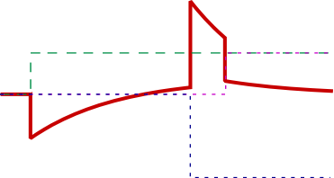




RF rectangular pulse reflected by an over-coupled resonant cavity
The wave reflected by an over-coupled cavity excited by a rectangular RF pulse is:
$$V_{FWD}(t)=V_{0}∙cos\left(ω_{0}t\right)∙\left[1\left(t\right) −1(t−T_{p}) \right]$$
$$V_{RFL}\left(t\right)=V_{0}∙cos\left(ω_{0}t\right)∙\left\{1\left(t\right)\left[\frac{2β}{β+1}\left(1−e^{−t/τ}\right)−1\right]−1\left(t−T_{p}\right)\left[\frac{2β}{β+1}\left(1−e^{−{\left(t−T_{p}\right)}/τ}\right)−1\right]\right\}$$
$$T_{p}$$
The RFL peak field is maximum at the end of the FWD pulse, and its value exceeds the peak of the FWD itself.
This effect can be enhanced by forcing a 180° phase jump in the driving pulse at a certain time before the end of the pulse. By doing that we induce an equivalent step in the driving signal of double amplitude which adds in phase with the signal originated by the first rising front of the driving RF pulse.
$$V_{FWD}(t)=V_{0}∙cos\left(ω_{0}t\right)∙\left[1\left(t\right) −2∙1\left(t−T_{s}\right)+1(t−T_{p}) \right]$$
$$T_{s}$$
$$V_{RFL}\left(t\right)=V_{0}∙cos\left(ω_{0}t\right)∙\left\{1\left(t\right)\left[\frac{2β}{β+1}\left(1−e^{−t/τ}\right)−1\right]−2∙1\left(t−T_{s}\right)\left[\frac{2β}{β+1}\left(1−e^{−{\left(t−T_{s}\right)}/τ}\right)−1\right]+1\left(t−T_{p}\right)\left[\frac{2β}{β+1}\left(1−e^{−{\left(t−T_{p}\right)}/τ}\right)−1\right]\right\}$$

Slide 10

But...

Slide 11
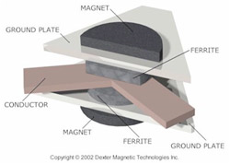
All this power has to be delivered to the accelerator and not to the power units (e.g. klystrons)
Circulators are non-reciprocal (typically) 3-ports devices whose scattering matrix is ideally given by:
90° hybrids are non-reciprocal (typically) 4-ports devices whose scattering matrix is ideally given by:

Slide 12
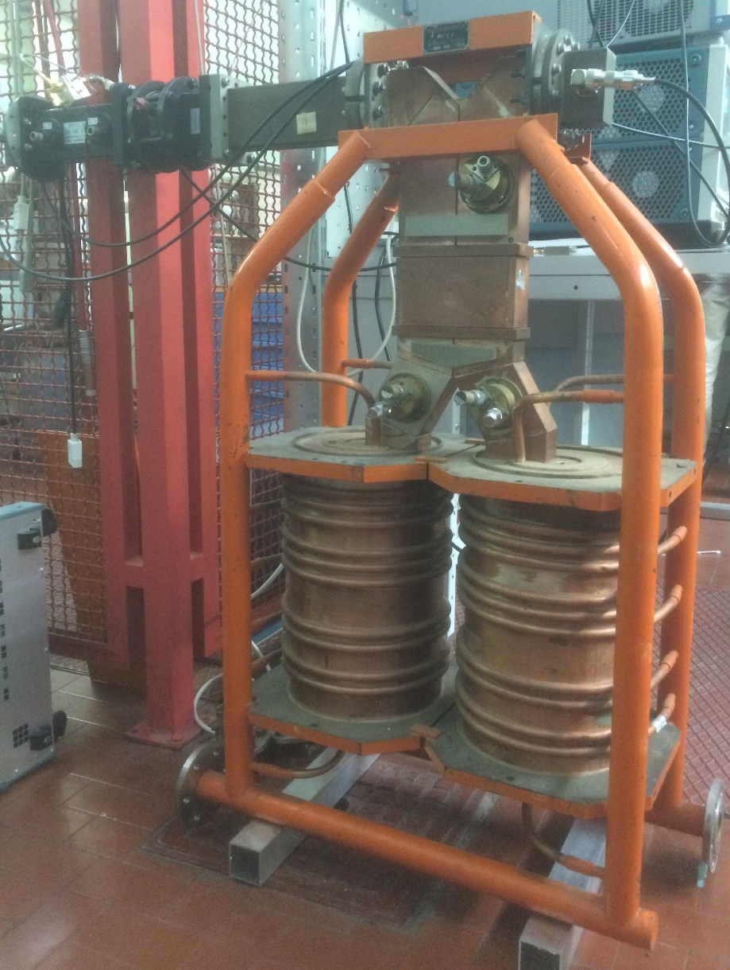
Experimental activity #2
Frequency domain: tuning demonstration
Time domain: set-up of the RF pulse
  CW signal at 2856 MHz
  Pulsed signal at 2856 MHz (5 us length, 100 Hz rep. rate)
Time domain: visualization of SLED output pulse w/o 180° phase jump
  Resonant frequency fine tuning
Frequency domain: realization of the 180° phase jump
  Design of a 180° phase shifting circuit
  Functionality cross-check of the 180° phase shifter provided
  Actual phase shift measurement
  Timing of the trigger signals
Time domain: visualization of SLED output pulse with 180° phase jump
  Eventual optimization of the SLED pulse
  Qualitative measurement of energy/power gain
  Scan T_{jump} vs energy gain
90°
hybrid
Output
port
Input
port
High Q
cavities

