Slide 1
Experience #1: RF characterization of an Aluminum model of the ELI-NP S-band RF-Gun

Slide 2
RF photocathode electron Gun
Main Electron sources:
Thermionic cathode
Electrons generated by thermionic emission
Photo-electric cathode
Electrons are generated by photoelectric effect.
Very short pulse laser (picosecond) strikes a metallic photocathode, which is embedded in an electromagnetic accelerating structure.
SW structure composed by two RF cavities
The emitted bunch of electrons is trapped and accelerated in the device
Employ fast laser pulses to produce bunch-trains. Picosecond bunches can be formed at the RF repetition rate, easing the following electron-bunching structure system
The ratio of the number of electrons emitted per incident photon is called Quantum Efficiency (Q_{e}) which is a function of the photon energy. For metals, the minimum-energy photons are typically in the ultraviolet range (λ(Cu) < 267nm).
klystron
Master Oscillator
RF signal
Drive Laser
Solenoid
Electron beam

Slide 3
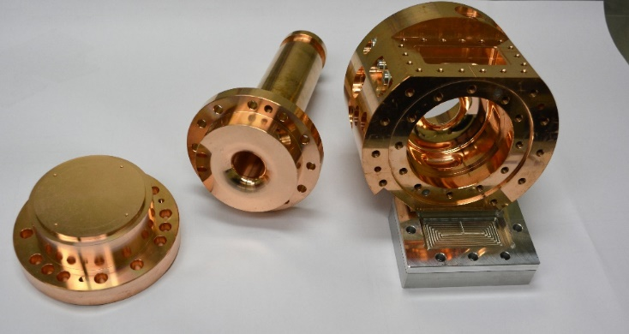
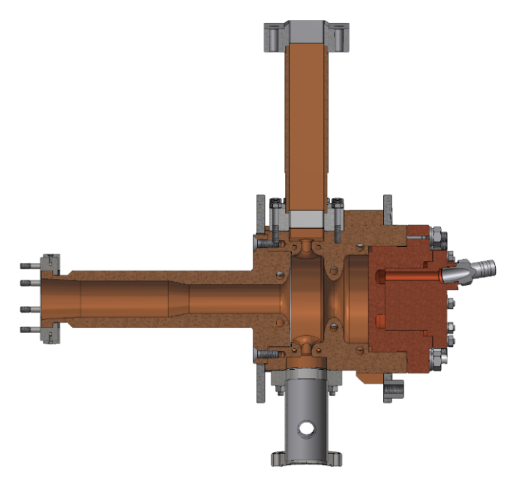
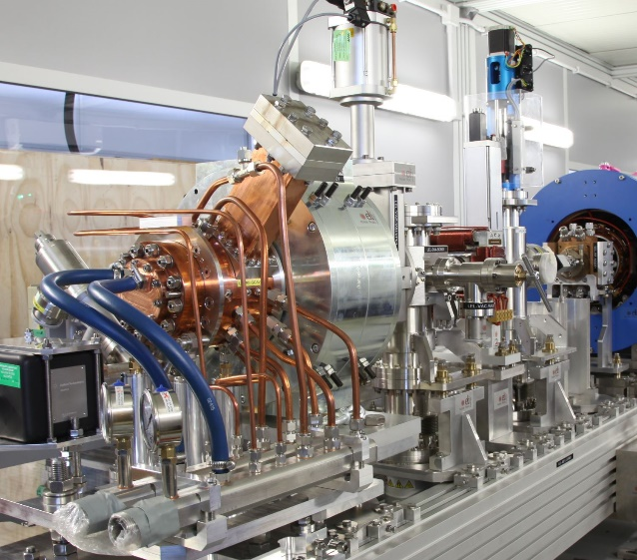
ELI-NP Linac RF electron Gun
1.6 cell photoinjector of the BNL/SLAC/UCLA type with new features:
elliptical shaped irises with larger aperture
Symmetric port to compensate the dipole field component
coupling hole rounded to reduce the pulsed heating
cooled cathode
fabrication without brazing using the clamping gasket technique
RF frequency | GHz | 2.856
Rep. Rate | Hz | 100
Working Mode | π mode (SW)
Max Rf input power | MW |  | 16
RF peak field at the cathode | MV/m |  | 120
Average dissipated power | kW |  | 1.5
Unloaded Q factor | 14500
Coupling coefficent β | 3
Working temperature | °C |  | 33 -34
Filling time | ns |  | 420
Shunt Impedance | MΩ/m |  | 1.64
Type of cathode | copper
waveguide
cathode
Beam tube
pumping port

Slide 4
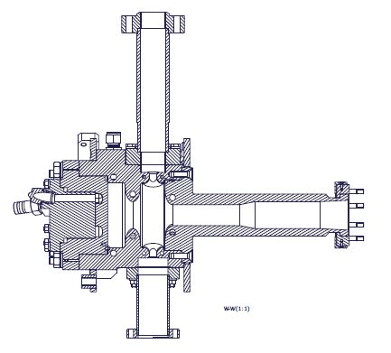
ELI-NP RF electron Gun Prototype
Two cavities coupled together -> Two resonant modes
The π mode is used as accelerating mode
Main Parameters | π-mode | 0-mode
Mode frequency
Freq. separation
Input coupling coeff. (ß)
Q_{L}
Q₀
R/Q factor |  | -
Filling time |  | -
Input waveguide
cathode
Full cell
Beam pipe
Vacuum tube
½ cell

Slide 5
ELI-NP RF electron Gun Prototype
Main Parameters | π-mode | 0-mode
Mode frequency | 2855.9 GHz | 2814.5 GHz
Freq. separation | 41 MHz
Input coupling coeff. (ß) | 1.88 | 0.9
Q_{L} | 3200 | 4800
Q₀ | 9216 | 9100
R/Q factor | 117 Ω | -
Filling time | ≈350 ns | -
Input waveguide
cathode
Full cell
Beam pipe
Vacuum tube
½ cell
General measurement
settings:
IF BW 500 Hz
# points 1601
f_{center} = 2.83 GHz
f_{span} = 100 MHz
Single mode measurement
settings:
IF BW 500 Hz
# points 1601
f_{center} = f_{res}
f_{span} = 5 MHz

Slide 6
Slater theorem
For a cavity on resonance, the electric and magnetic stored energies are equal. If a small perturbation is made on the cavity wall, this will generally produce an imbalance of the electric and magnetic energies, and the resonant frequency will shift to restore the balance. The Slater perturbation theorem describes the shift of the resonant frequency, when a small volume ΔV is removed from the cavity of volume V. The general result is
Where U is the total stored energy.
This theorem can be used also to measure the field profiles in the cavity by inserting a perturbing object and measuring the frequency shifts while moving it along selected paths. The theorem mathematical expression is different in this case and form factors need to be introduced because field lines are strongly deformed in this case, while they are almost unperturbed when the boundary is slightly deformed.

Slide 7
Bead Drop Measurement
If the perturbing object (bead) is a perfectly conducting sphere the values of the form factors are:
If a sphere of radius a is moved along the beam axis of a cavity the E field profile and the R/Q of a resonant accelerating mode can be estimated according to:
Sign of the E-field profile
Network Analyzer
Nylon wire
Probe
bead

Slide 8
RF Gun characterization in reflection with Network Analizer
Localize the two resonating modes (no calibration needed) measuring the S11 in reflection with a big span (100 MHz).
Estimate the frequency separation between the two modes. (Why is it important?)
Measure the frequency and the coupling factor ß for the two modes (calibration needed)
RF Gun characterization in transmission with Network Analizer
Measure the S21 of the device and using the «Bandwidth» function (Marker Search -> Bandwidth) measure the Loaded Quality Factor Q_{L}
Calculate the Unloaded Quality Factor Q₀
Longitudinal electric field profile measurement with “bead-drop” technique (mode π):
Ticks drawn on the Nylon wire are equally spaced every 5 mm
Fill an excel spreadsheet with 2 columns: bead position (z) and measured f_{res} (use your laptop)
Calculate and plot ∆f/f vs z;

Slide 9
Accelerating voltage and R/Q calculation:
From the same spreadsheet, calculate V_{acc} and then R/Q
The spherical bead radius is 0.0018 m, ε=8.85418781762E-12, c=299792458
Filling time measurement (time domain with realistic RF pulse)
The filling time, is the time for the energy stored in the cavity with loaded Q = Q_{L} to build to 1/e of its saturation point
Connect the RF signal generator through a switch and an amplifier to the Gun and read the output probe through the oscilloscope
100Hz, few us pulses
5V
switch
scope
f_{π}
Measure the filling time τ of the gun. Compare it with the one evaluated from Q_{L}
Longitudinal electric field profile measurement with “bead-drop” technique (mode 0)
Repeat the procedure of point 3 for the 0 mode

Slide 10
Useful Formulae and definitions
Perturbation measurements:

