Slide 1
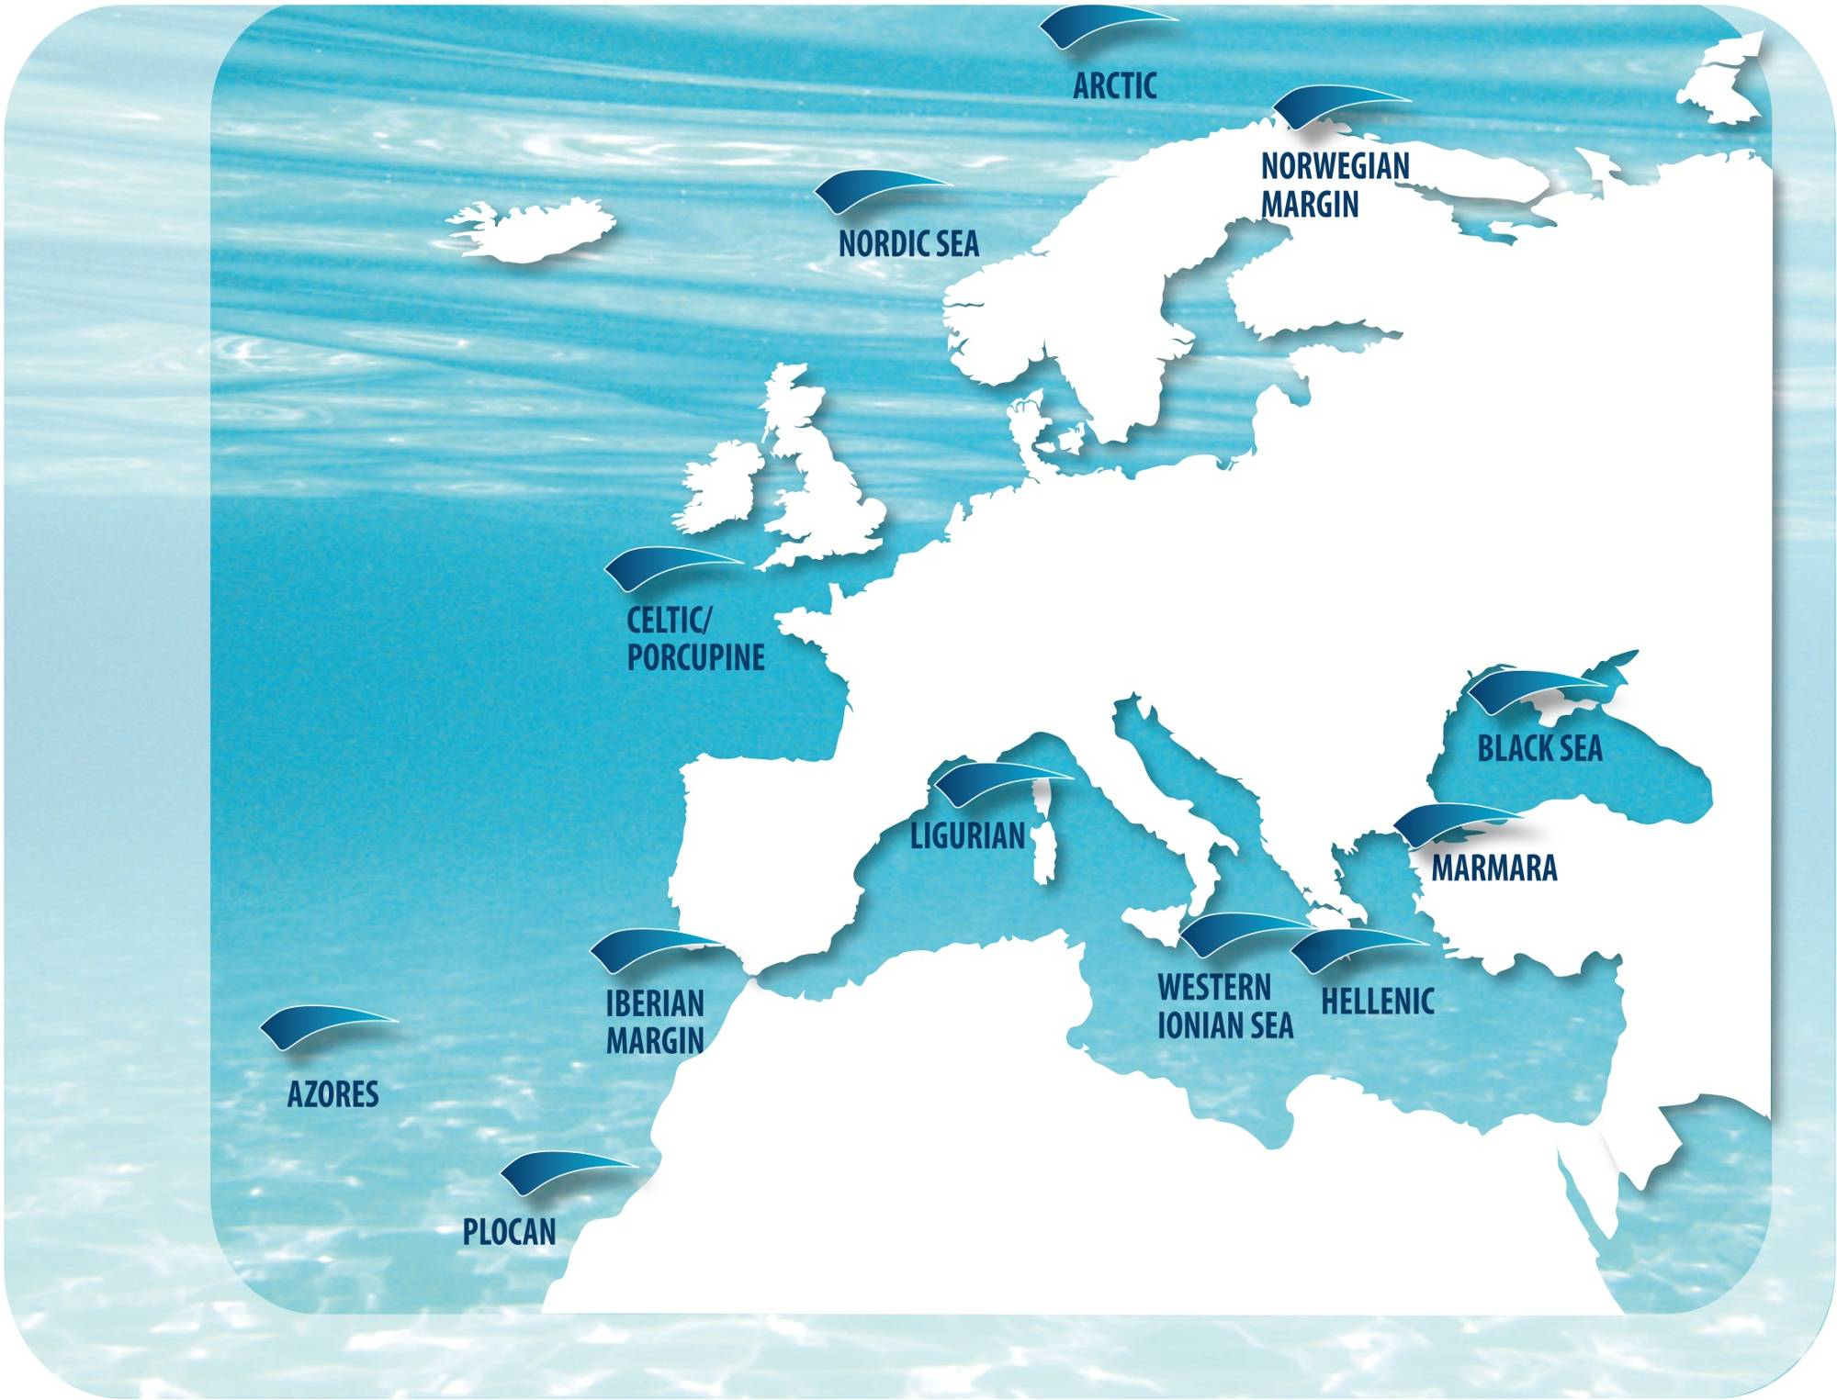

EMSO ERIC
European Multidisciplinary Seafloor and Water-Column Observatory - European Research Infrastructure Consortium
Paolo Favali
EMSO Spokesperson
www.emso-eu.org

Slide 2


EMSO ERIC Research Infrastructure
EMSO ERIC is the Research Infrastructure of fixed seafloor and water-column observatories constituting a technologically advanced, distributed infrastructure around the European seas. This supports long-term monitoring of marine environmental processes and a truly multi- and interdisciplinary range of research areas, including biology, geology, chemistry, physics, engineering, and computer science
EMSO ERIC provides power, communications, sensors, and data infrastructure for continuous, high resolution, real-time and near-real-time, interactive ocean observations from polar to tropical environments, down to the abyss
The observation data are collected from the ocean’s surface, through the water column to sub-seafloor across geo-hazard, physical, biogeochemical, and ecological themes. Presently, 11 deep-sea and 4 shallow nodes span from the Arctic through the Atlantic and Mediterranean, to the Black Sea
  RI for Challenges such as:
  Global ocean warming and
  acidification
  Impact and sustainability of
  marine resource exploitation
  Real-time observations of
  earthquakes and tsunamis

Slide 3
From ESFRI Roadmap to ERIC
EMSO entered ESFRI 1st ROADMAP April 2006 EMSO entered ESFRI ROADMAP 2016 as Landmark RI March 2016 EC decision: EMSO ERIC just started (EU Official Journal L268/59) 1 October 2016
8 Participating Countries
  Italy (Host)
  Greece
  United Kingdom
  France
  Ireland
  Portugal
  Spain
  Romania
  The EMSO ERIC membership is open to growth including other countries
  Germany, Sweden, Norway, the Netherlands and Turkey continue to be part of the discussion
  Initial contacts have already started with other potentially interested countries, such as Malta, Croatia, Iceland, Cyprus, and Tunisia
  and .... others ....

Slide 4
EMSO ERIC Participating Countries
  8 Full Members: AoM Delegates:
  Italy (Host) Salvatore La Rosa (salvatore.larosa@miur.it)
  Greece Vasilios Lykousis (vlikou@hcmr.gr)
  United Kingdom Richard S. Lampitt (r.lampitt@noc.ac.uk) AoM Chair
  France Alain Lagrange (alain.lagrange@recherche.gouv.fr)
  Ireland Peter Heffernan (peter.heffernan@marine.ie)
  Portugal Daniel J.M. Carapau (daniel.carapau@fct.pt) AoM Vice-Chair
  Spain Laura Yuste Cano (laura.yuste@mineco.es)
  Romania Viorel Vulturescu (viorel.vulturescu@ancs.ro)

Slide 5
EMSO ERIC Participating Countries
  8 Full Members: Advisors:
    Italy (Host) Laura Beranzoli, John B. Picard*, Giorgio Budillon, Giuseppa
    Buscaino, Emanuela Fanelli, Riccardo Papaleo, Franco
    Andaloro, Vanessa Cardin, Raffaella Casotti
  Greece Maria Koutrokoi, George Petihakis
  United Kingdom Henry A. Ruhl
  France Mathilde Cannat, Clément Godreau, Didier Marquer,
  Jean-François Rolin
  Ireland Michael Gillooly, Fiona Grant, Eleanor O’Rourke
  Portugal Eduardo A. Pereira da Silva, Pedro A. Gancedo Terrinha
  Spain José Joaquin Hernandez-Brito, Juan José Dañobeitia
  Romania Vlad Radulescu
  * AoM Secretary

Slide 6
EMSO ERIC Participating Countries
Pool of Advisors to the AoM Italian Delegate
Link between EMSO ERIC and the Joint Research Unit (JRU) EMSO-Italy
Name | Affiliation/e-mails | Expertise
Giorgio Budillon | CONISMA giorgio.budillon@uniparthenope.it | Oceanography & Atmospheric Physics
Giuseppa Buscaino | CNR giuseppa.buscaino@cnr.it | Marine Bioacoustics
Emanuela Fanelli | ENEA emanuela.fanelli@enea.it | Marine Biology
Riccardo Papaleo | INFN papaleo@lns.infn.it | Marine Technology
John B. Picard | INGV jpicard.interimofficeemso-eu.org | Government Relations & Innovation
Laura Beranzoli | INGV laura.beranzoli@ingv.it | Marine Geophysics
Franco Andaloro | ISPRA franco.andaloro@isprambiente.it | Marine Biology
Vanessa Cardin | OGS vcardin@inogs.it | Physical Oceanography
Raffaella Casotti | SZN raffaella.casotti@szn.it | Marine Ecology

Slide 7
Leading National R&D Players Team Up to support EMSO
EMSO-Italy JRU-Joint Research Unit
  INGV - National Institute of Geophysics and Volcanology (www.ingv.it)
  CNR - National Research Council (www.cnr.it)
  INFN - National Institute of Nuclear Physics (www.infn.it)
  OGS - National Institute of Oceanography and Experimental Geophysics
  (www.ogs.trieste.it)
  SZN - Zoological Station“Anton Dohrn” of Naples (www.szn.it)
  ISPRA - Italian Higher Institute for the Protection and Environmental
  Research (www.isprambiente.gov.it)
  ENEA - National Agency for New Technologies, Energy and
  Sustainable Economic Development (www.enea.it)
  CONISMA - National Consortium on Marine Sciences - involving 33 Universities
  (www.conisma.it)

Slide 8
Rationale JRU EMSO-Italy
WHAT’S JOINT RESEARCH UNIT (JRU)?
JRU is a collaborative agreement among research institutions (universities or research centres) recognized by EC and by the Country
JRU includes National partners to favour the realization of projects sharing resources in a defined research area
EMSO-Italy can benefit of the European research infrastructure EMSO ERIC

Slide 9
EMSO ERIC first 3-years goals
  In the first 3 years EMSO ERIC will:
    confirm the Regional Teams managing the nodes
  implement 4 Service Groups:
  Science
  Data
  Engineering & Logistics
  Communications
  Also through the EC Projects:
  EMSODEV (2015-2018): Development of 3 EGIMs-EMSO Generic Instrument Modules
  to ensure increased coordination, integration, interoperabi-
  lity and standardisation across sites and disciplines
  & DMP-Data Management Platform
  to guarantee the data accessibility to the scientific users
  and stakeholders
  EMSO-Link (2017-2020): Enabling EMSO ERIC Objectives
  to add other member states and industrial partners, to coordinate the construction of
  additional nodes and provide pilots of access, and to perform market studies and
  investigate additional funding
(www.emsodev.eu)

Slide 10

Major International Initiatives
  Europe/Global
  Cross collaborations with:
  other ESFRI RIs, like: ECCSEL, EMBRC, EPOS, KM3NeT and SIOS
  established or incoming ERICs, such as EURO-ARGO, ICOS and LIFEWATCH
  new entry in the ESFRI Roadmap 2016, like: ACTRIS, and DANUBIUS RI
  Cooperation with all Environmental RIs in the EU project ENVRIplus
  Links with other EU initiatives (e.g., EUROFLEETS-2, SeaDataNet, EMODnet)
  Cooperation and co-investment with industry
  (e.g., oil & gas, renewable energy, deep-sea mining,
  fisheries)
  Contacts and exchanges with sister research
  infrastructure initiatives (COOPplus):
  ONC-Ocean Networks Canada (Canada)
  OOI-Ocean Observatories Initiative (USA)
  IMOS-Integrated Marine Observing System (Australia)
  DONET-Dense Oceanfloor Network for Earthquakes &
  Tsunamis (Japan)
  ECSSOS- East China Sea Seafloor Observation System
  (China)
  MACHO-MArine Cable Hosted
  Observatory (Taiwan)
ONC
DONET
ECSSOS
MACHO
OOI
IMOS

Slide 11
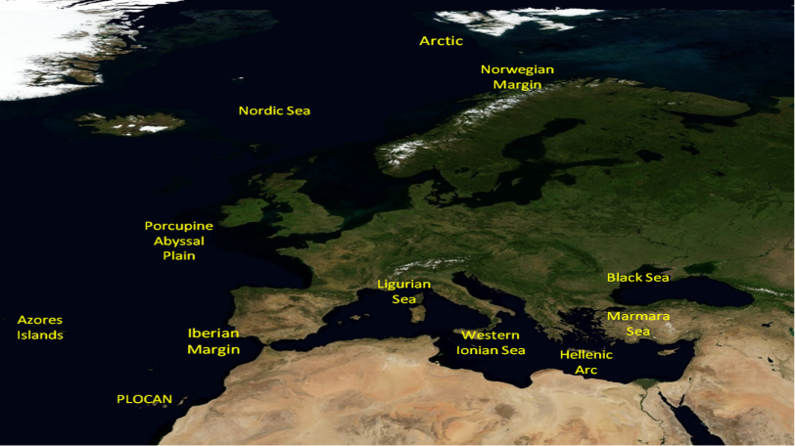







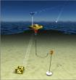






Present Implementation Status
Koljö Fjord
SmartBay
MeDON
Molène
OBSEA
presently 11 nodes
9 out 11 nodes operating
(cabled & autonomous)
4 test sites active
(3 cabled)

Slide 12
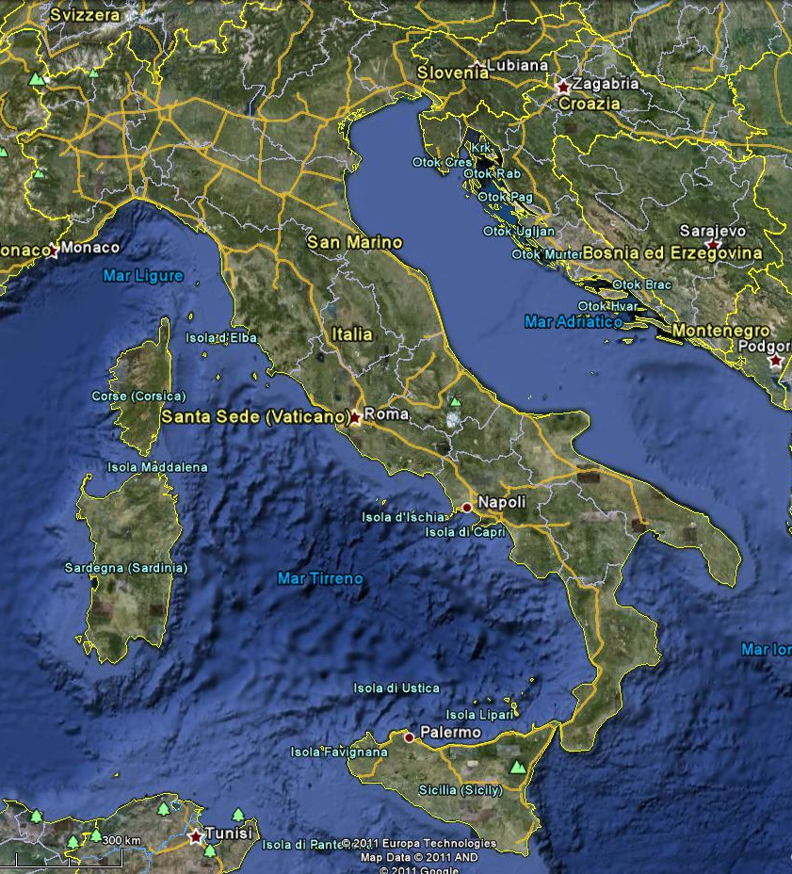
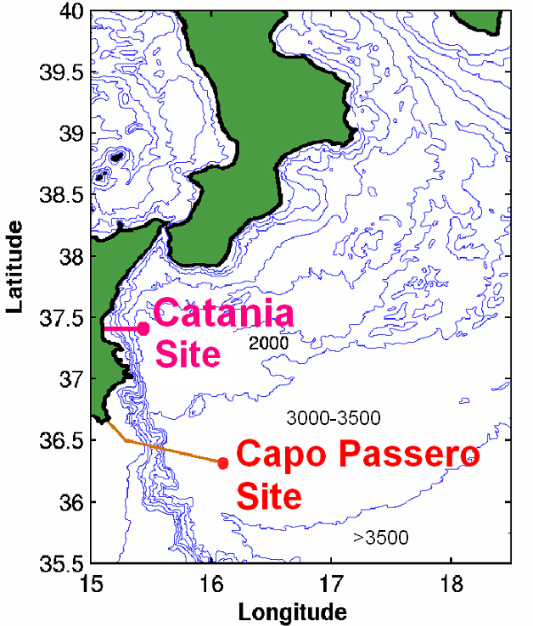
EMSO nodes: Western Ionian Sea
Cabled observatories
North-eastern
Sicily (2100m bsl)
South-eastern
Sicily (3500m bsl)

Slide 13

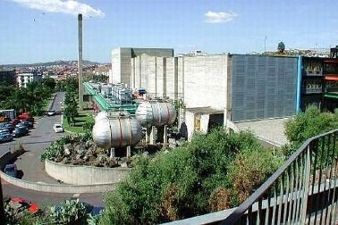
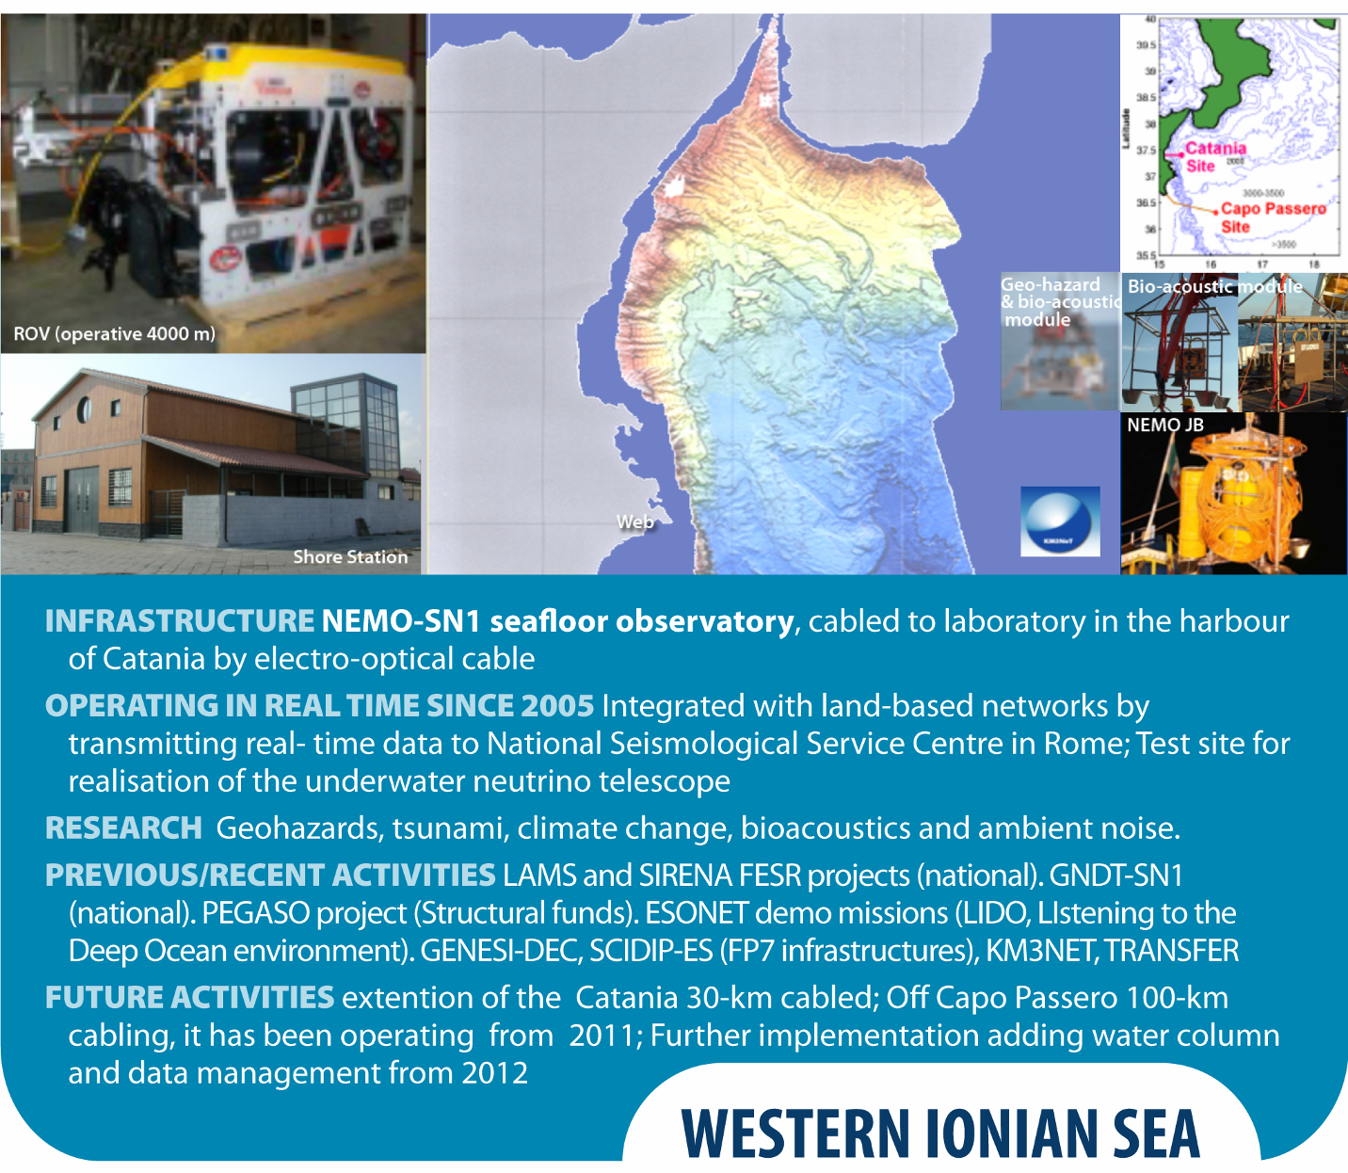
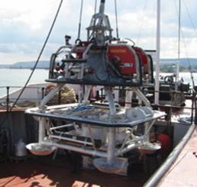

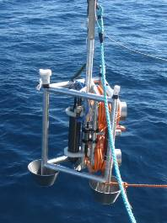
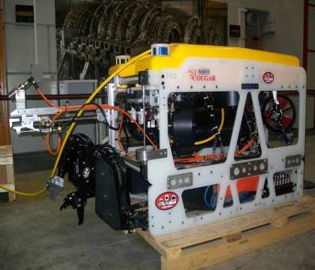
EMSO nodes: Western Ionian Sea
Geo-hazards
(earthquakes, tsunamis, volcanic activity)
Bio-acoustics
(mammal tracking)
Oceanography
(e.g., deep water circulation, current intensity and direction, temperature, salinity)
LNS-INFN Catania
10 Gbit GARR-X
SN1
Web
Radio Link @ 100 Mbps
5 km
20 km
OνDE2
5 km
Stand-alone 2002-2003 - Cabled 2005-2008 &
2012-2013 real-time data
ROV (operative 4000 m)

Slide 14
NEMO-SN1 sensors
Sensor | Rate | Model
3-C broad-band seismometer * | 100 Hz | Guralp CMG-1T (0.0027-50 Hz)
Differential Pressure Gauge (DPG) | 100 Hz | Prototype Univ. California-St. Diego
Hydrophone (Geophysics) | 100 Hz | OAS E-2PD
Hydrophone (Geophysics) | 2000 Hz | SMID (0.05-1000 Hz)
4+4 Hydrophones (Bio-acoustics) | 96 /192 kHz** | SMID (100-70000 Hz)
Absolute Pressure Gauge (APG) * | 15 s | Paroscientific 8CB4000-I
3-C Accelerometer + 3-C Gyro (IMU) * | 100 Hz | Gladiator Technologies Landmark 10
Gravity meter | 1 Hz | Prototype IFSI-INAF
Scalar magnetometer | 1s/min | Marine Magnetics Sentinel (3000 m)
Vectorial magnetometer | 1 Hz | Prototype INGV
ADCP | 1 profile/h | RDI Workhorse Monitor (600 kHz)
CTD | 1 s/h | SeaBird SBE-37SM-24835
3-C single point current meter | 2 Hz | Nobska MAVS-3
Favali et al., 2011; 2013; Chierici et al., 2012
* tsunami early warning system - Geo-Hazard
Western Ionian Sea
** 96 kHz at TSN, 192 kHz at TSS - Marine Environment

Slide 15
Daily/monthly data rate
daily/monthly by NEMO-SN1 observatory (Western Ionian Sea)
INSTRUMENT | byte/day | byte/month
Oceanographic sensors | 13 M | 390 M
Gravity meter | 5 M | 150 M
Magnetometers | 2.5 M | 75 M
Seismic sensors | 933 M | 28 G
DACS monitor | 11 M | 330 M
Bio-acoustic Hydrophones | 372 G | 11 T
Station monitoring | 163 M | 5 G
Lossless data compression algorithms (e.g., FLAC) may reduce file-size to 30% of the original size

Slide 16
NEMO-SN1 Tsunameter
(cabled configuration)
Western Ionian Sea
Chierici et al., 2012; Favali et al., 2013

Slide 17







EMSO-MedIT - Enhancement of multidisciplinary marine infrastructures in Sicily, Campania and Puglia to contribute to ESFRI EMSO
Funding Agency: MIUR (Italian Ministry for Education, University & Research)
Funds 20 M€ for “Enhancement of research infrastructures”
(2013-2016)
Partners: INGV (coord.), CNR, INFN, SZN, ISPRA
NATIONAL OPERATIONAL PROGRAMME
RESEARCH & COMPETITIVENESS 2007-2013
ACTION AND COHESION PLAN

Slide 18
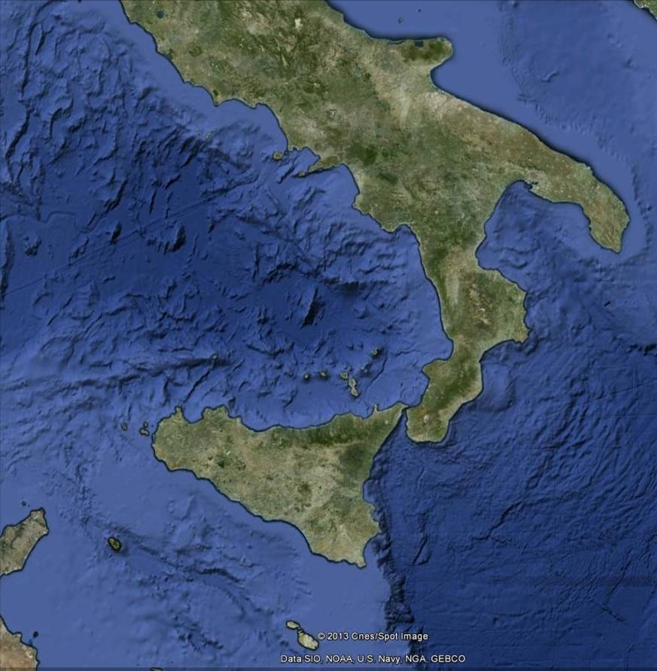
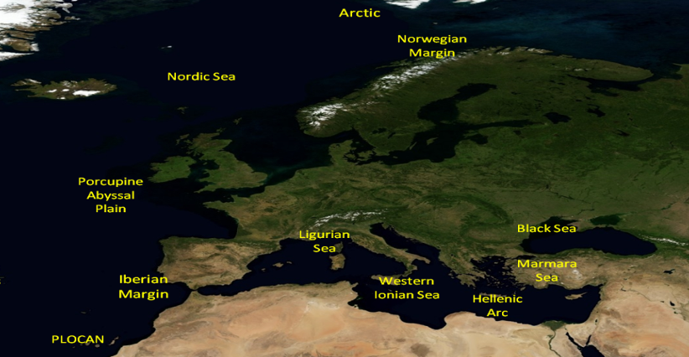

EMSO-MedIT in the context of
EMSO and EMSO-Italy
CNR
PUGLIA
CAMPANIA
INGV
SZN
CNR
EMSO-Italy
Azores
Islands
EMSO-MedIT
North-Western
SICILY
North-Eastern
SICILY
INGV
ISPRA
ISPRA
INGV
CNR
CNR
CNR
INGV
Fixed Infrastructures
INFN
EMSO
Cabled nodes
Cabled infrastructures
INFN
Relocatable infrastructures
South-Western
SICILY
Eastern
SICILY

Slide 19
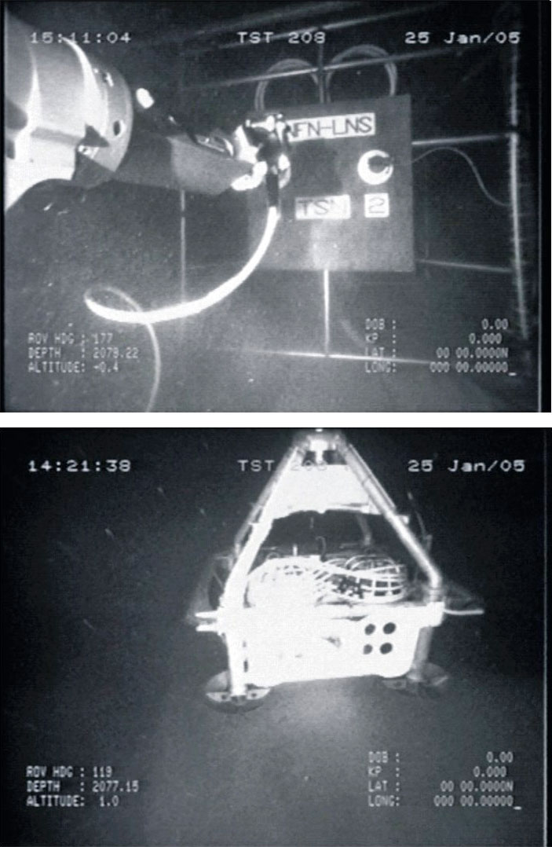
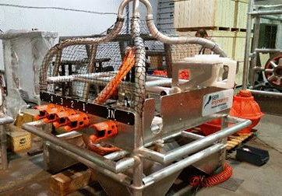
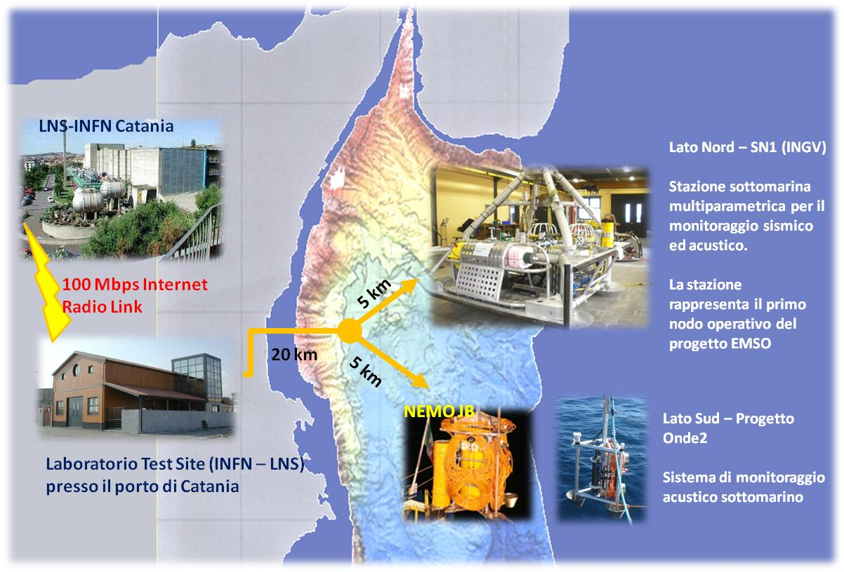
EMSO nodes: Western Ionian Sea
North-eastern Sicily (2100m bsl) (Catania site) - cabled observatories
Water-Column monitoring
WC-SN1 (37°32.4026’ N, 15°23.8388’E)
Junction box
(with multiprobe connections)
Water column (mooring)
Storage
Computing
Connection

Slide 20
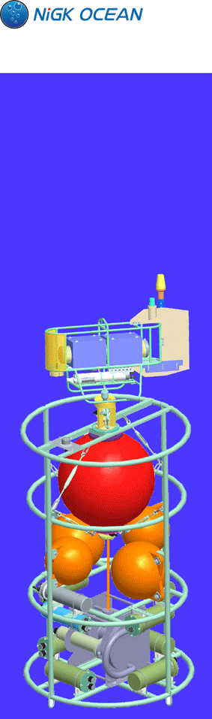
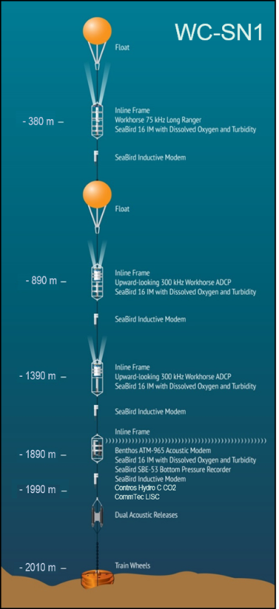

Water Column (mooring) - WC-SN1
EMSO nodes: Western Ionian Sea
Physical and biogeochemical parametres
Phase 2 implemented
March 2016
INGV
INFN
EMSO
Cabled nodes
INFN
Eastern
SICILY
Phase 1 implemented
March 2015
Temperature
Salinity

Slide 21
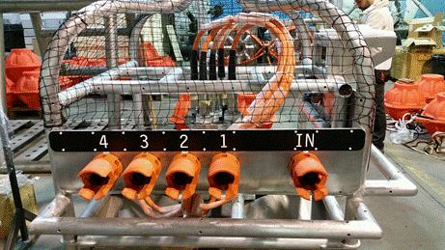
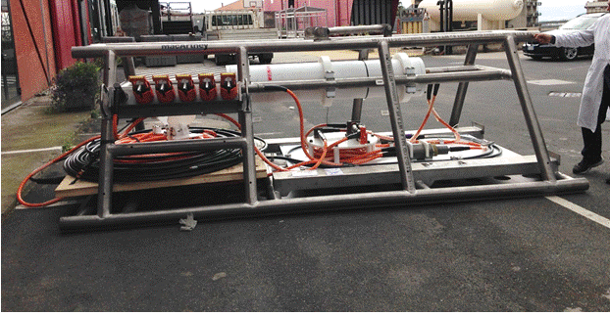
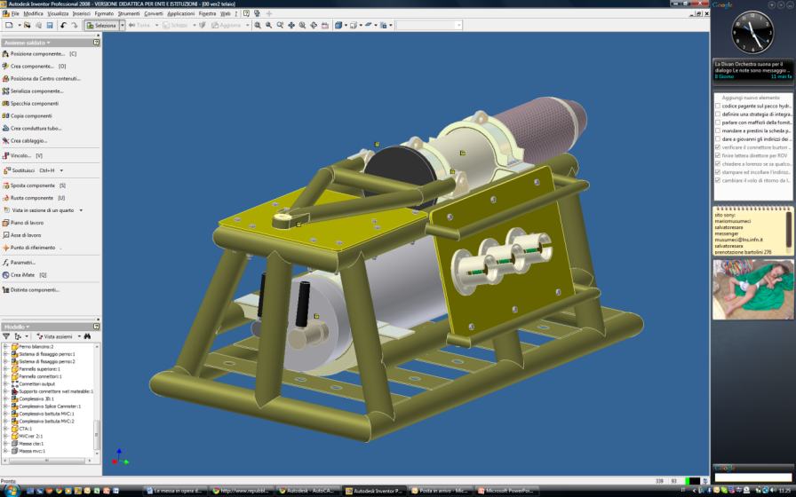



EMSO nodes: Western Ionian Sea
Cabled Observatories
Junction box
(with multiprobe connections)
Seafloor multidisciplinary observatory
Cable termination
South-eastern Sicily (3500m bsl, 80km from coast) (Capo Passero site)

Slide 22
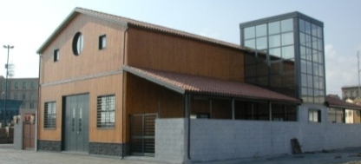
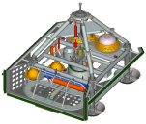

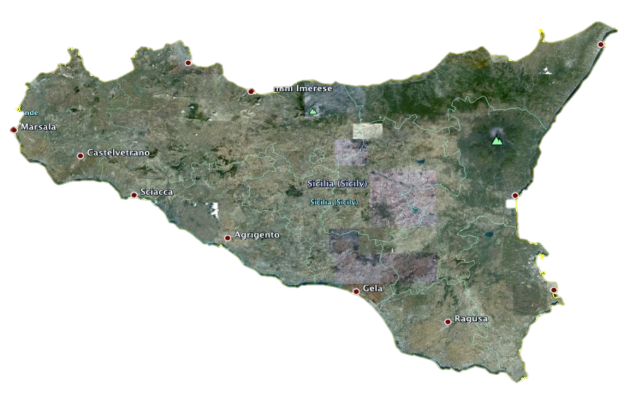


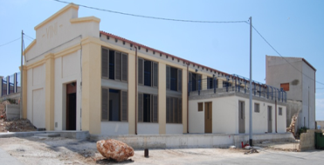


EMSO nodes: Western Ionian Sea
CLOUD
Catania Shore Lab
10 Gbit link
GARR-X
North-eastern
Sicily (2100m bsl)
25 km-long cable
The Capo Passero site is the first with high-speed optical fibre connection directly from the deep sea to a node of the European GRID-computing Infrastructure
South-eastern
Sicily (3500m bsl)
85 km-long cable
1 Gbit link
INFN LNS:
Main Data Repository
Catania EGI node
Porto Palo
Shore Lab

Slide 23
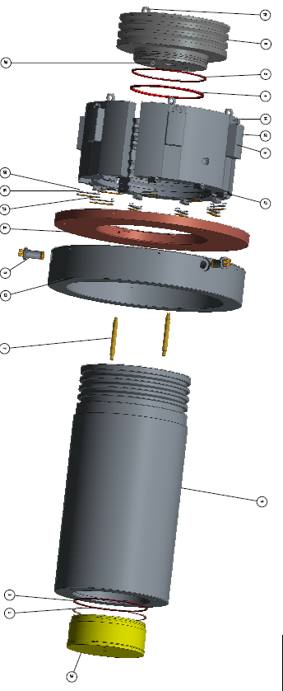
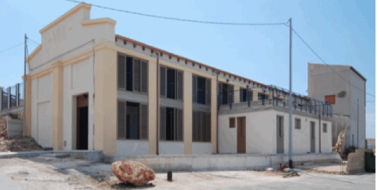
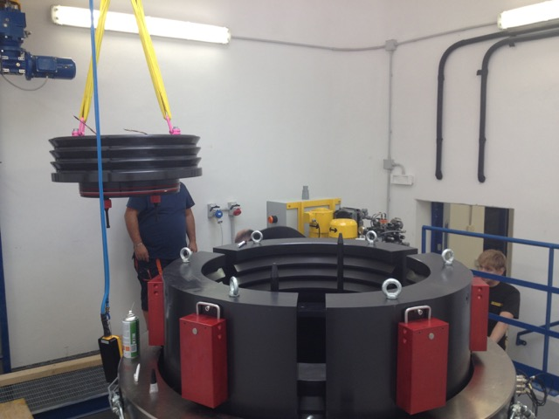
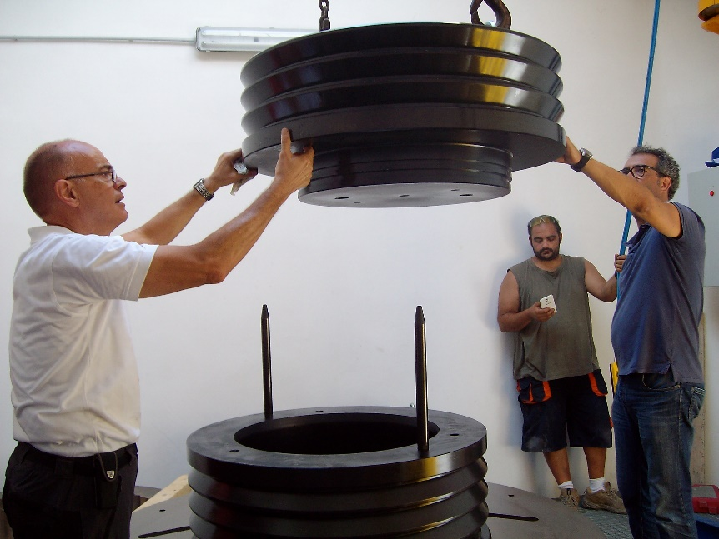
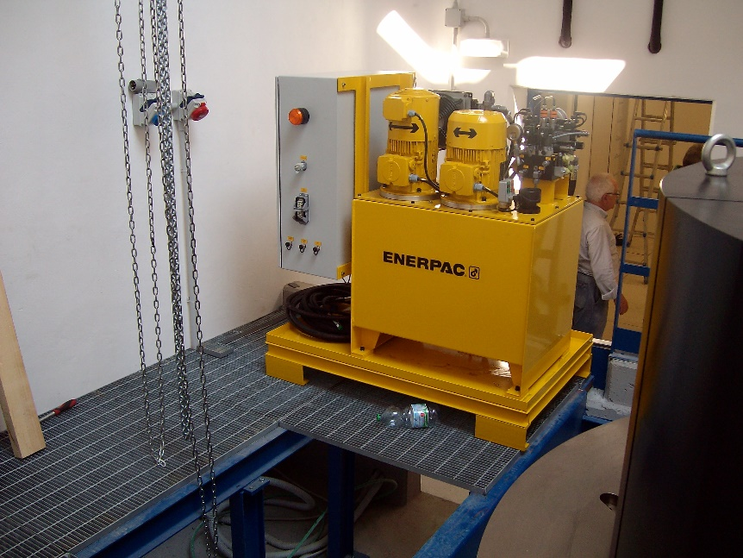
EMSO nodes: Western Ionian Sea
Porto Palo Shore Lab
Enhancement of testing infrastructures
Max pressure 650 bar
Internal size 600 ᴓ x 1500mm h
volume 425 l
High-pressure test chamber
PED2 category

Slide 24
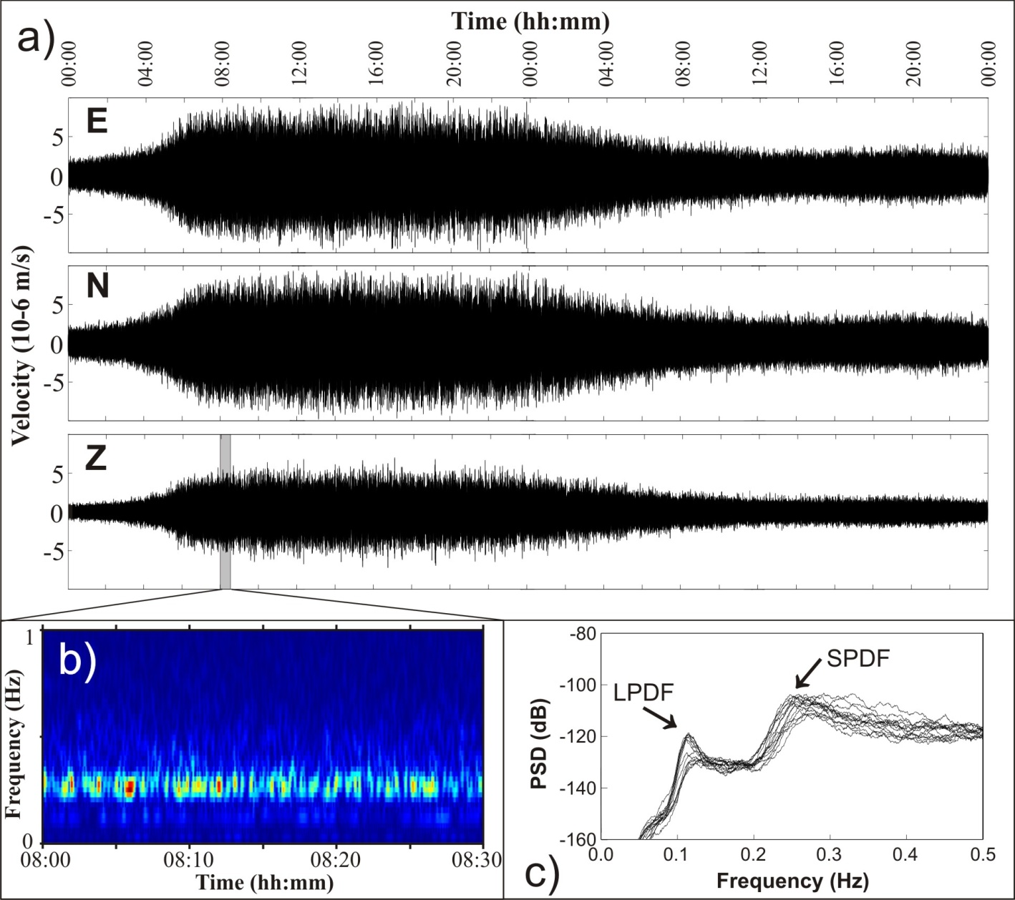
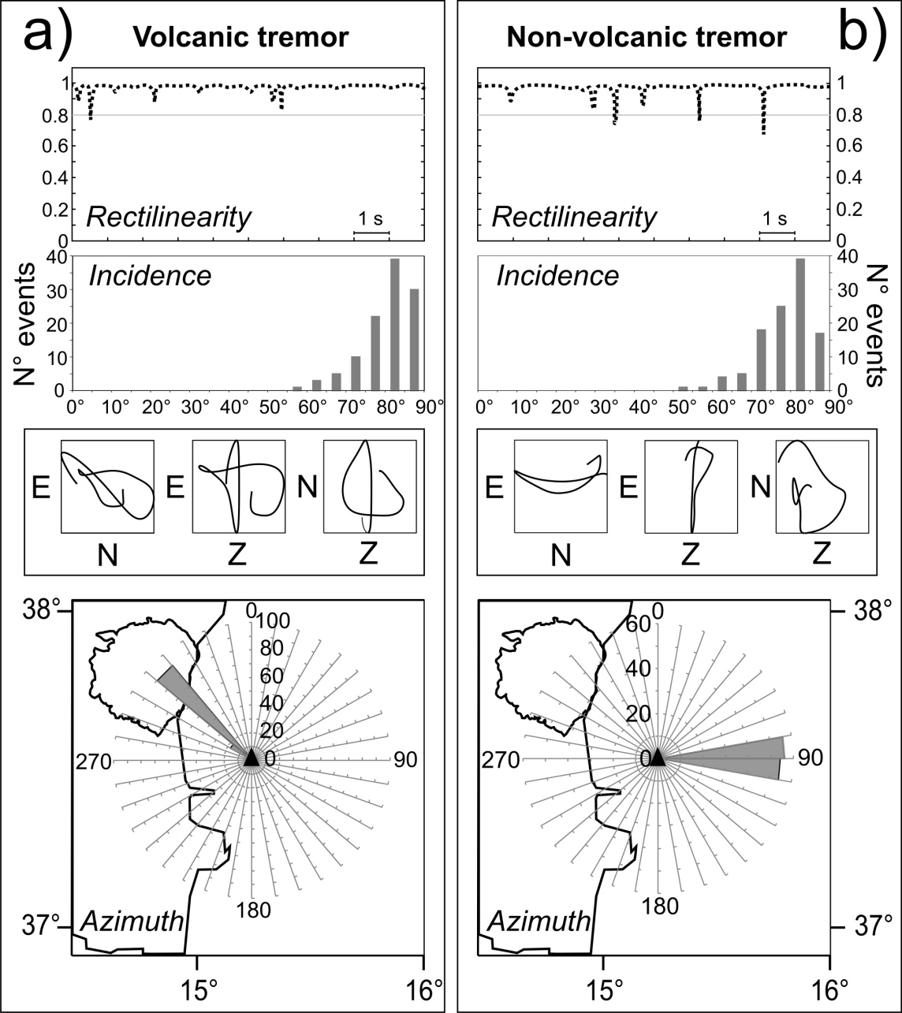
EMSO data examples
Non-volcanic tremor
Polarization & particle motion
21-22 November 2002
Local winds
Sgroi et al., 2017 (in prep.)
Western Ionian Sea

Slide 25

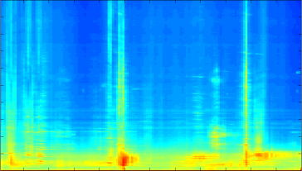
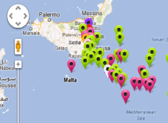
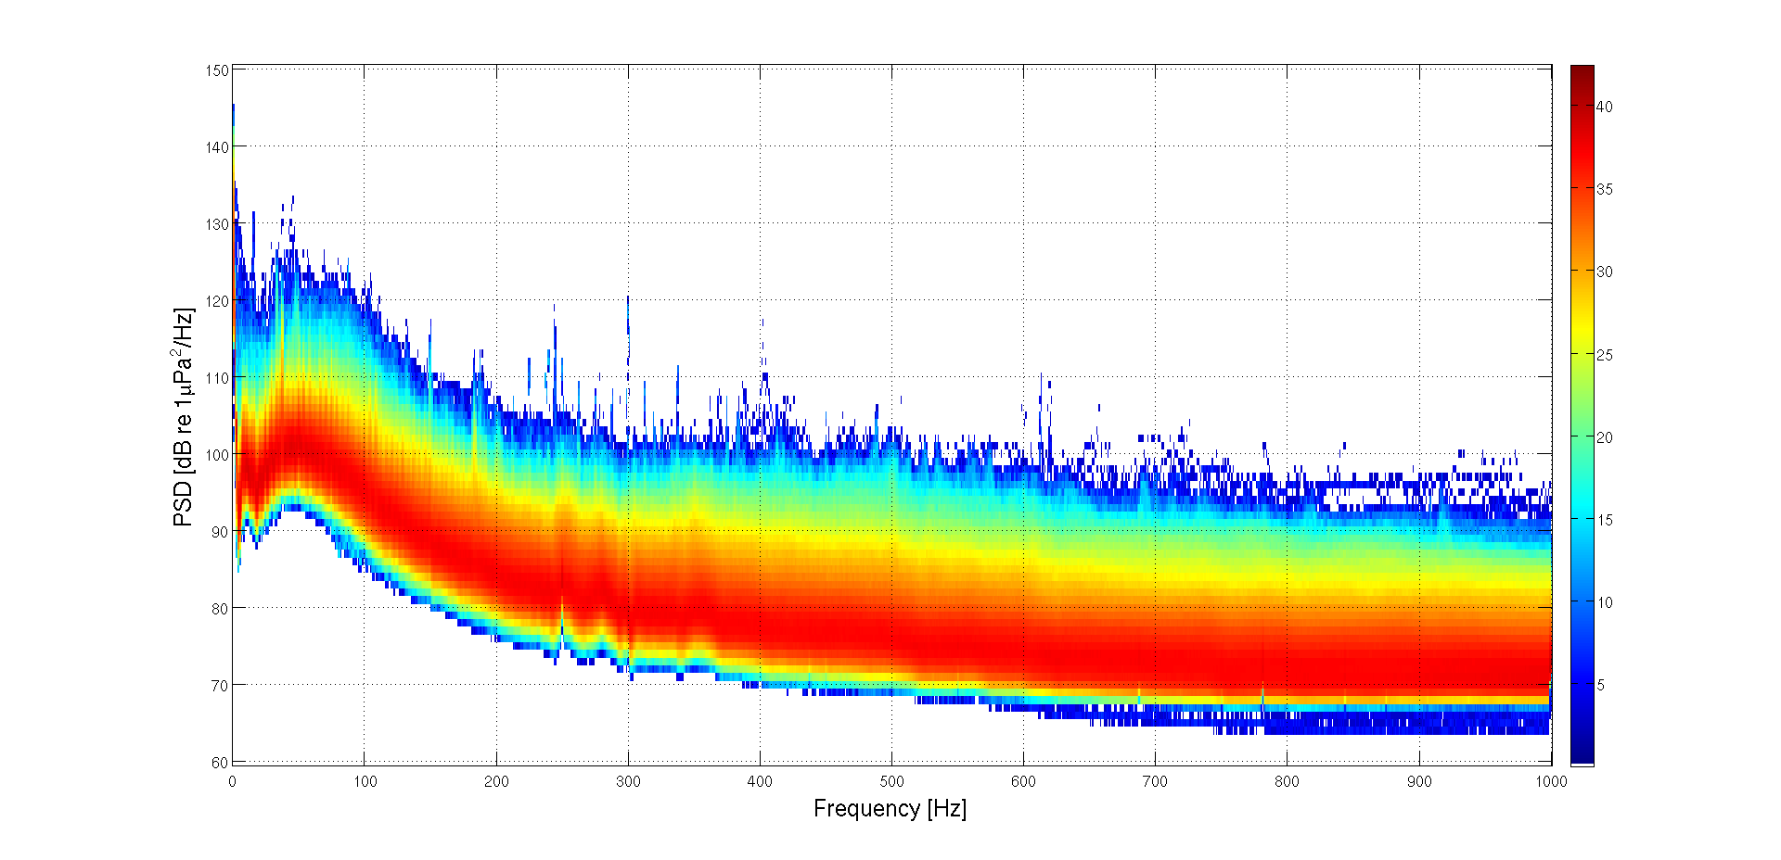
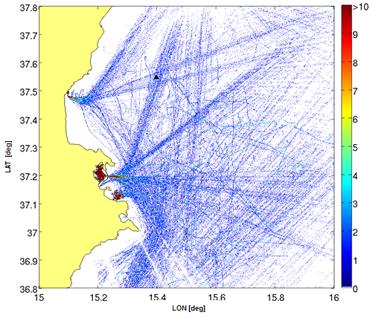
EMSO data examples
Acoustic Data
Acoustic noise and correlation with AIS data
Proprietary AIS data in real time on Google map web page (custom app)
June 2012 - May 2013
Noise distribution studies (1 y)
for European Marine Strategy
Western Ionian Sea

Slide 26
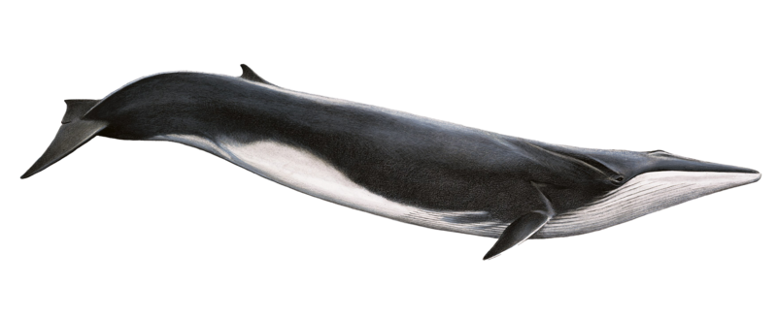
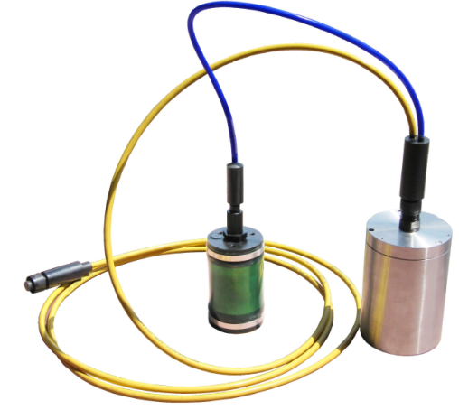
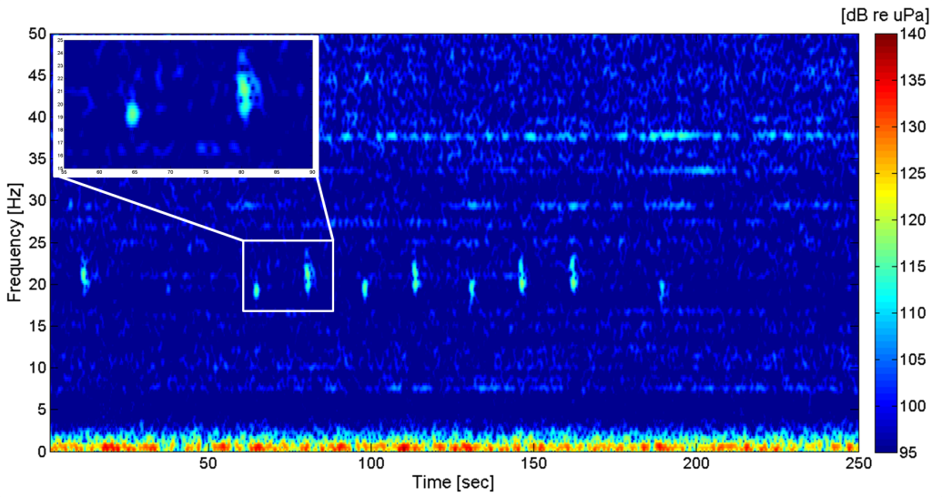
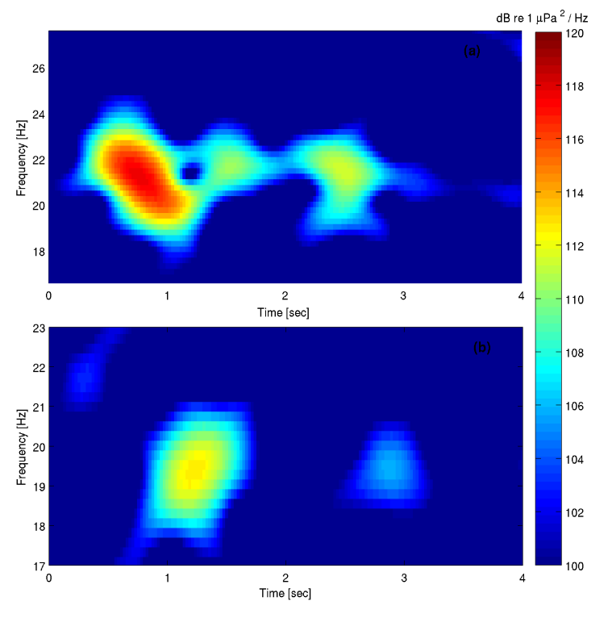
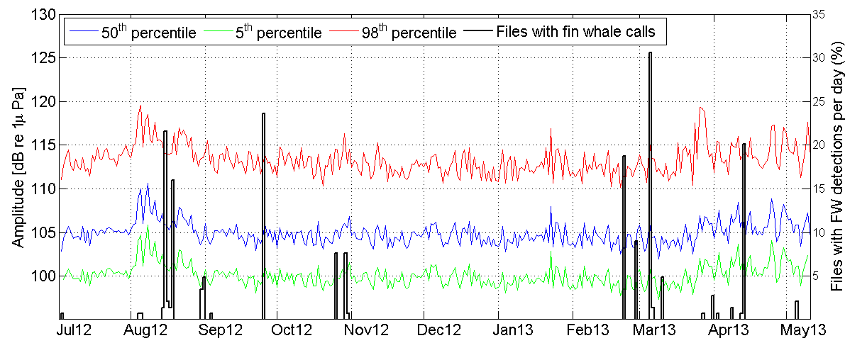
EMSO data examples
Western
Ionian Sea
18-20 Hz Calls
SMID LF-Hydrophone DT-405D(V)1
A typical detected sequence of fin whale calls
1-year monitoring
Sciacca et al., 2015 PLOS ONE

Slide 27
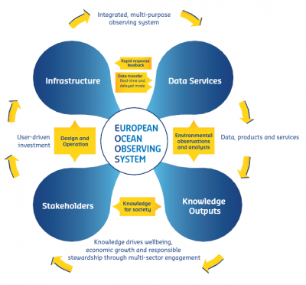
Final Remarks
EMSO ERIC contributes in-situ observations for the Global Monitoring for Environment and Security Initiative, COPERNICUS, and is aligned with the challenges and key priorities of Horizon 2020 and, in particular, with the Marine Strategy Framework Directive (MSFD, www.msfd.eu)
EMSO ERIC contributes to BLUEMED research
and innovation initiative for blue jobs and
sustainable growth in the Mediterranean Area
EMSO ERIC represents a fundamental contribution to the long-term vision of the EOOS (European Ocean Observing System, www.eoos-ocean.eu), that will integrate in-situ (spatial and temporal) and the satellite observations, taking into account the already existing infrastructures, such as the ERICs EUROARGO, ICOS and EMSO

Slide 28
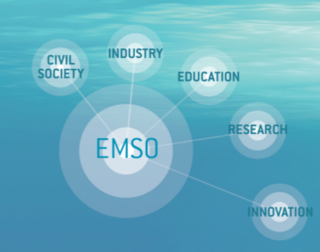
Thank you for your attention !
www.emso-eu.org

Slide 29
Involved personnel
INGV: Laura Beranzoli (form.), Francesco Italiano, Giovanni Iannaccone, Giuseppe D’Anna, Giuditta Marinaro, Gabriele Giovanetti, Sergio Guardato, Massimo Bilotta, Pasquale Guidace, Cristina La Fratta, Matteo Migliari, Manuela Di Santo
CNR:
ISMAR: Stefania Sparnocchia, Mireno Borghini, Raffaele D’Adamo, Carolina Cantoni, Sara Durante, Virna Meccia, Elio Paschini, Pierluigi Penna, Katrin Schroeder, Marco D’Adduzio, Giuseppina Ciurlia, Giacobbe Ignazzi
IAMC: Giuseppa Buscaino (pot.), Antonino Adamo (form.), Domenico Spoto, Francesco Filiciotto, Giorgio Tranchida, Antonio Bonanno, Antonino Viviano, Franca Cuguttu, Pietro Fiducioso, Nicola Cardellicchio
INFN: Riccardo Papaleo, Giorgio Riccobene, Klaus Leismuller, Gaetano Frascadore, Rosanna Cocimano, Mario Musumeci, Mario Sedita, Antonio Pagano, Alberto Rovelli, Alfio Mirabella, Romeo Di Biasi, Gaetano Squillaci, Franco Ferrera, Giovanni Barbagallo, Salvatore Viola, Virginia Sciacca, Giorgio Bellia, Domenico Santonocito
SZN: Raffaella Casotti, Fabio Conversano, Augusto Passarelli, Salvatore Orfano, Salvatore Addezio, Daniela Iudicone, Crhistophe Brunet, Mariella Saggiomo, Francesca Margiotta, Giualuca Zazo, Marco Cannavacciuolo, Nando Stafanino
ISPRA: Franco Andaloro, Teresa Romeo, Simonpietro Canese, Pierpaolo Consoli, Gianfranco Scotti, Luigi Manzueto, Maria Siclari, Marica Federici, Alessia Di Caprio, Enrico Tarulli, Pietro Vivona, Gianpaolo Stasi, Luciano Bonci, Lucia Gigante

