Slide 1
Radiobiological
needs for FOOT
E. Scifoni, F. Tommasino

Slide 2
  Target Fragments in proton beam irradiation (inverse kin)
  Projectile Fragments in Oxygen beam irradiation (direct kin)
Notes:
2

Slide 3
oVe IT
Modeling and Verification for Ion beam Treatment planning
Sebastian Hild (TIFPA)
MG Pugliese (NA)
Giorgio Russo (LNS)
Pablo Cirrone (LNS)
WP1
RB modeling for TPS
WP2
NTCP/TCP
WP3
Biological Dosimetry
WP4
Facilities
T1.1: RBE modeling for protons
T2.1: NTCP models on proton patient data including RBE
T3.1: Devices for spatially resolved proton RBE measurement
T4.1: CNAO/TIFPA/LNS lines development for beam delivering
T4.2: MC Simulations for beamlines/target stations for in vitro/in vivo exp
T3.2: Hypoxic, Coculture and Stem cells devices
T1.2: OER and ITH modeling
T2.2: TCP/NTCP including hypoxia for different ions
T4.3: Detectors for beam flux and beam energy measurement
T3.3: In vivo and Molecular biomarkers
WP0
Coordination& Dissemination
Emanuele Scifoni (TIFPA)

Slide 4
Interaction with INFN projects
FOOT
(CSN III)
MoVeIT
MC-INFN
Fragment spectra
FLUKA/GEANT4 tools for beamline description
Assessment of bio impact
and input for experimental design
Radiobiological models for plan recalculation
+ Feed from previous related projects: TPS, RDH, UFSD

Slide 5
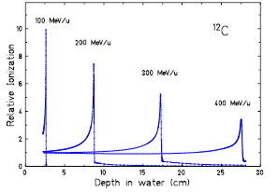
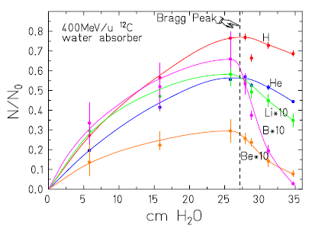
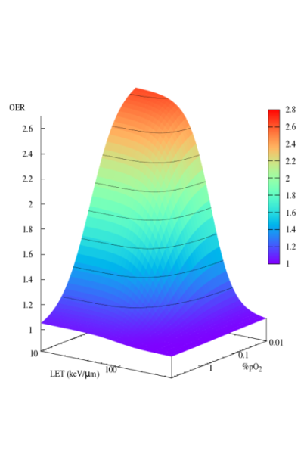
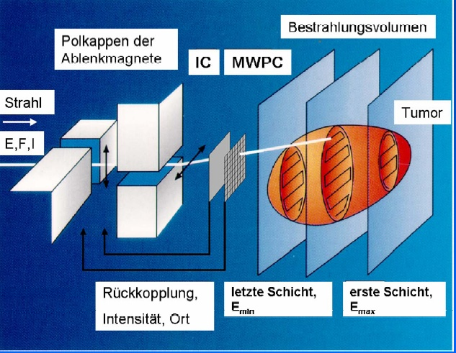
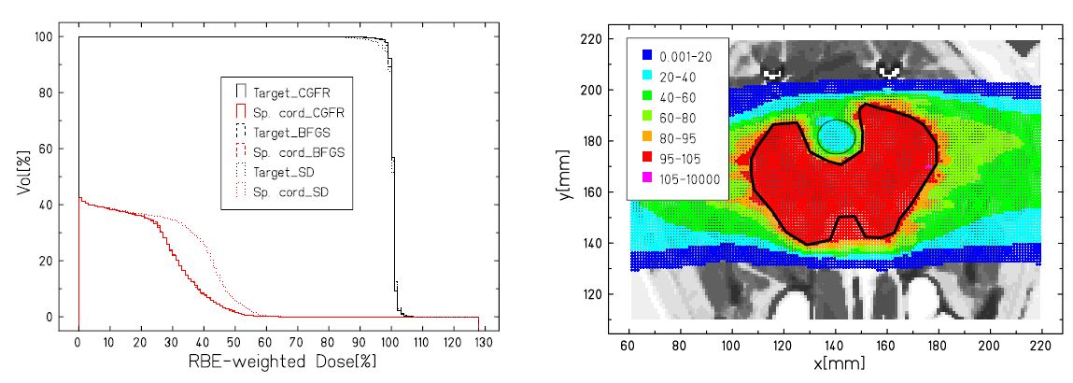
TRiP98 – Biological Based Treatment planning for Particles
Clinical use in pilot project, Research use in GSI, HIT, Aarhus, Lyon etc.
Reference for: Siemens SynGo/PT, RaySearch
Schardt et al. Rev Mod Phys 2010
OER
Tinganelli et al. Sci.Rep.2015
Kraemer et al.
EPJD 2014
LET
pO₂

Slide 6
Biological-based treatment planning
Bio-TPS for ion beams aims to include as much as possible biological effect information in the planning strategy.
Relevant for plan recalculation but ideally needed for inverse planning.
Substantial for assessing differential benefits of different irradiation modalities and selecting the most suitable choice for a given patient case.
Additional physics data needed, since the different components (E,Z) of the mixed field in a beam should be properly accounted in order to get an overall biological effect.

Slide 7
SHIELD-HIT (MC) + TRiP98
C beam
20% in xs => only 3% in RBE

Slide 8
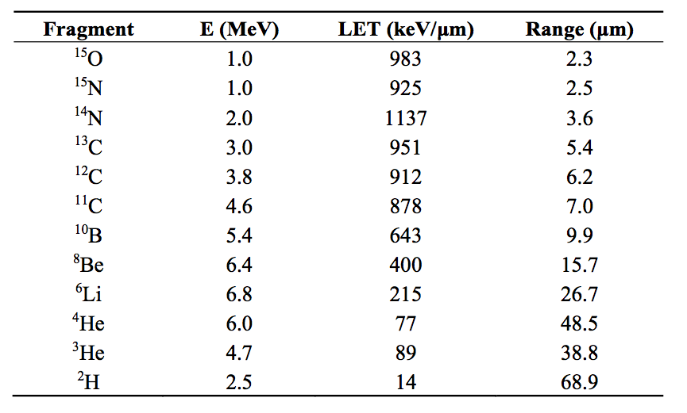
Role of Target fragmentation in proton therapy
Differently from Projectile fragments, their Energy distribution being peaked at very low E
Combines with the peak of RBE at low E
Heavy fragments have low residual energies and release low doses -> high RBE
Tommasino & Durante 2015 Cancers
Notes:
Entrance channel 0.5 KeV/mum and 0.2 Gy -> about 3% cell killing
Bragg peak 2.5 keV/mum and 2 Gy ‘_ about 60% cell killing

Slide 9
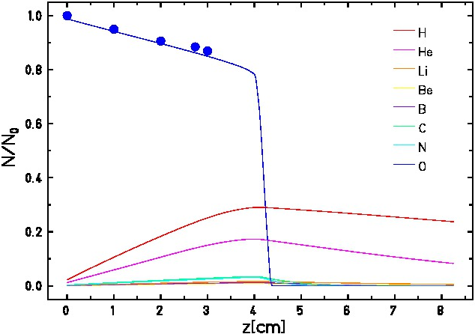
¹⁶O beam in TRiP
Yield of secondary particles with depth
in water for ¹⁶O at 160 MeV/u (TRiP98)
Large number of fragments
Few experimental data available
New data for full spectral characterization are highly needed to assess impact of fragments
Exp attenuation data courtesy of C. La Tessa (BNL)

Slide 10
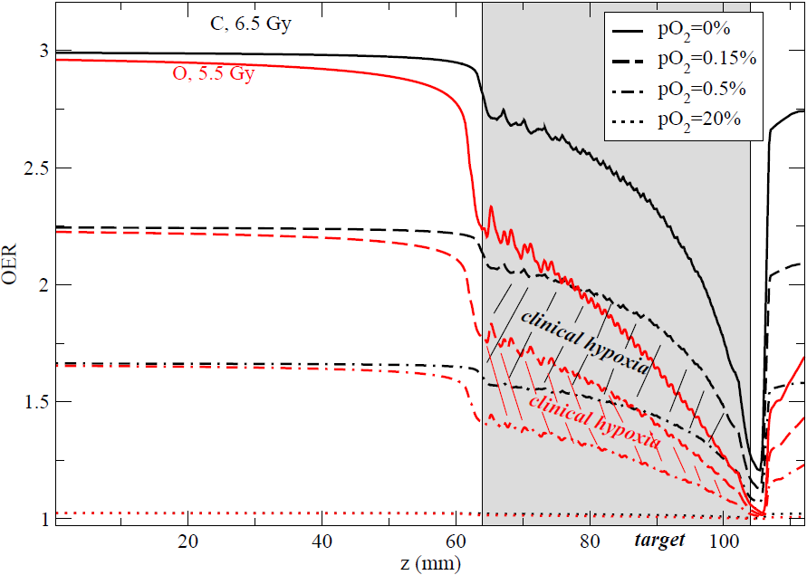
Exploiting O beams for hypoxia
Scifoni et al PMB 2013
Submitted to PMB

Slide 11
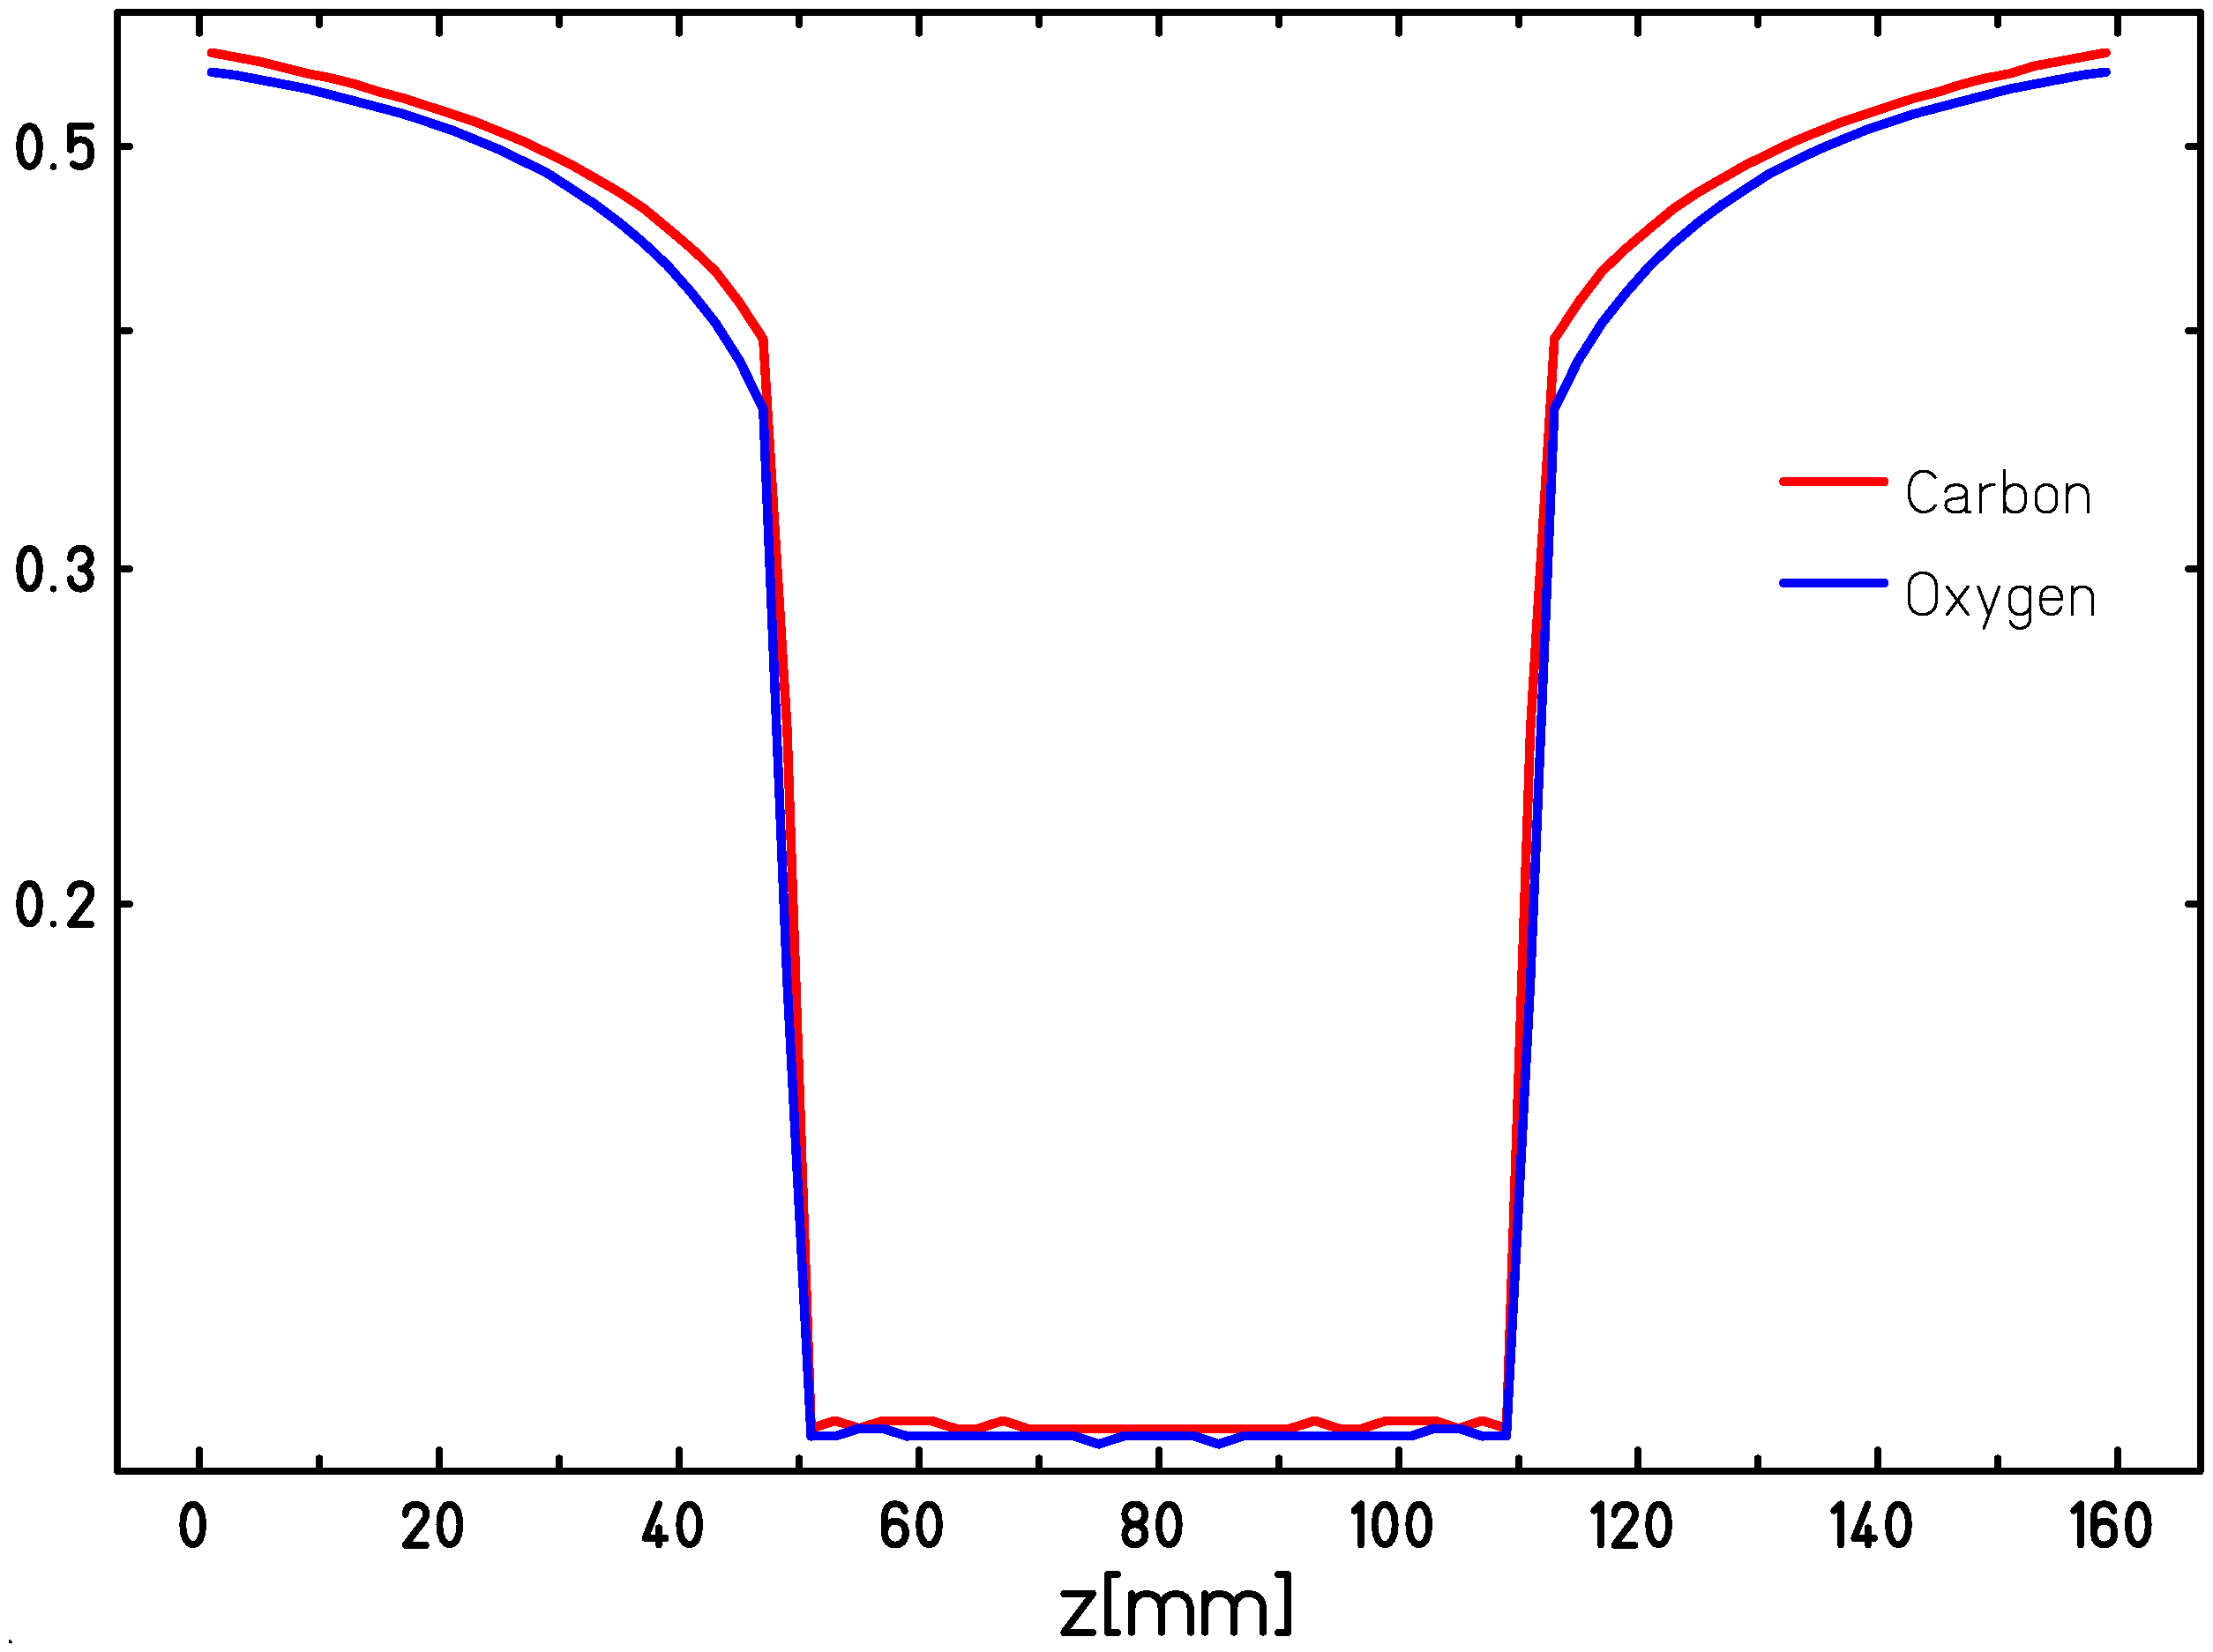
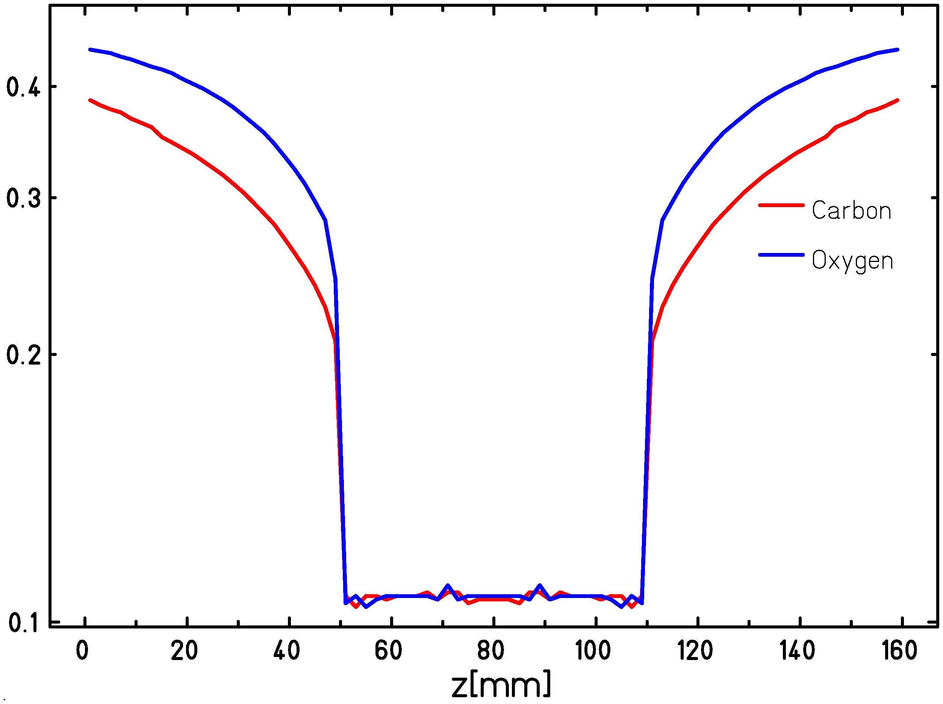
OER optimized plans with O (kill painting)
Normoxic
Variable oxygenation
Survival
Sokol et al. submitted to PMB
In case of hypoxia, proper optimization accounting for OER may lead to Inverted peak-to-entrance ratios as compared to a normoxic case
According to actual oxygenation, O beam may overcome the price of larger entrance channel with the LET advantages
Trade-off between better LET distribution and worse Fragmentation in entrance and tail

Slide 12
Impact of “high” fragments
Survival profile (CHO)
along an O beam SOBP, optimized on physical flat dose (4Gy)

Slide 13
Desiderata for Protons
Target fragment producton, at 100-200 MeV:
• Heavy fragment (Z>2) production cross section with uncertainty < 5%
• Fragment energy spectrum (i.e. dσ/dE) with energy resolution of ≈1 MeV/u
• Charge ID at the level of 2-3%
• Isotopic ID at the level of 5%
• Not needed accurate angular measurement
• Study light ions production at large angle

Slide 14
Desiderata for Oxygen
Projectile Fragment producton, at 150-400 MeV/u:
• Cross section of projectile fragments with maximum uncertainty of 5-10%
• Fragment energy spectrum (i.e. dσ/dE) with an energy resolution of ≈10 MeV/u
• Charge ID at the level of 2-3%
• Isotopic ID at the level of 5%
• Angular distribution needed for out-of-field biological dose

Slide 15
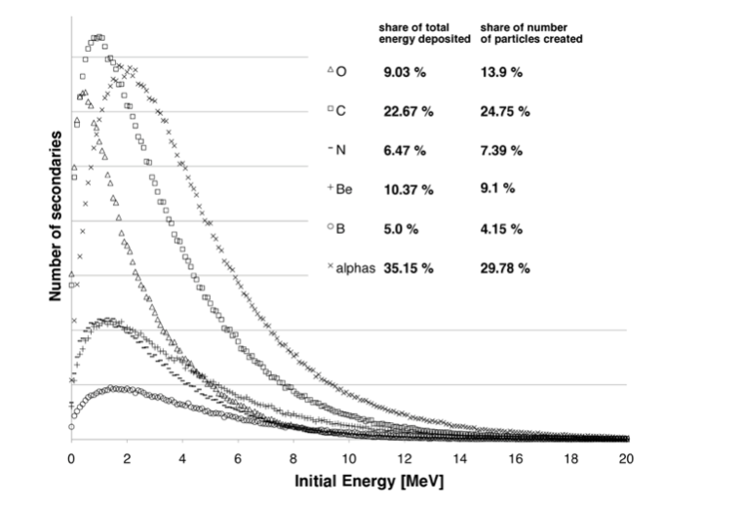
Our strategy for better figures design
MC Spectra from WP4 (LNS-GEANT4, MILANO-FLUKA)
2 options:
• Voxelized (layered) Spectra dN/dE(Z,z,E,E₀) including eventual buidup
• Pure Fragment Spectra dN/dE(Z,E,E₀) -> YIELD-> TRiP98

Slide 16
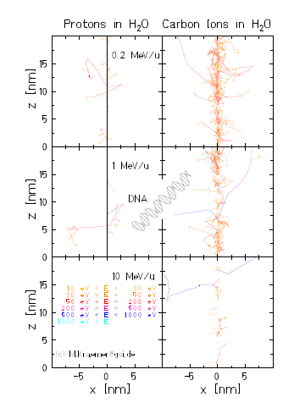
Parallel approaches for T_frag
impact assessment
Track structure simulations of low energy ions
-with no Energy/space cutoff in secondary electrons-
• TRAX
• GEANT4DNA

Slide 17
Milestones related to FOOT
Milestone | Description | Date
M1.1.1 | Initial RBE description with tentative cross sections | November 2017
M1.1.2 | Final RBE description with FOOT cross sections | July 2019
M2.1.2 | Comparison between proton NTCP estimations | November 2019
M2.2.1 | NTCP/TCP estimations with different ions, on imported plans | April 2019

Slide 18
Thank you
H
He
O
C

