Slide 1
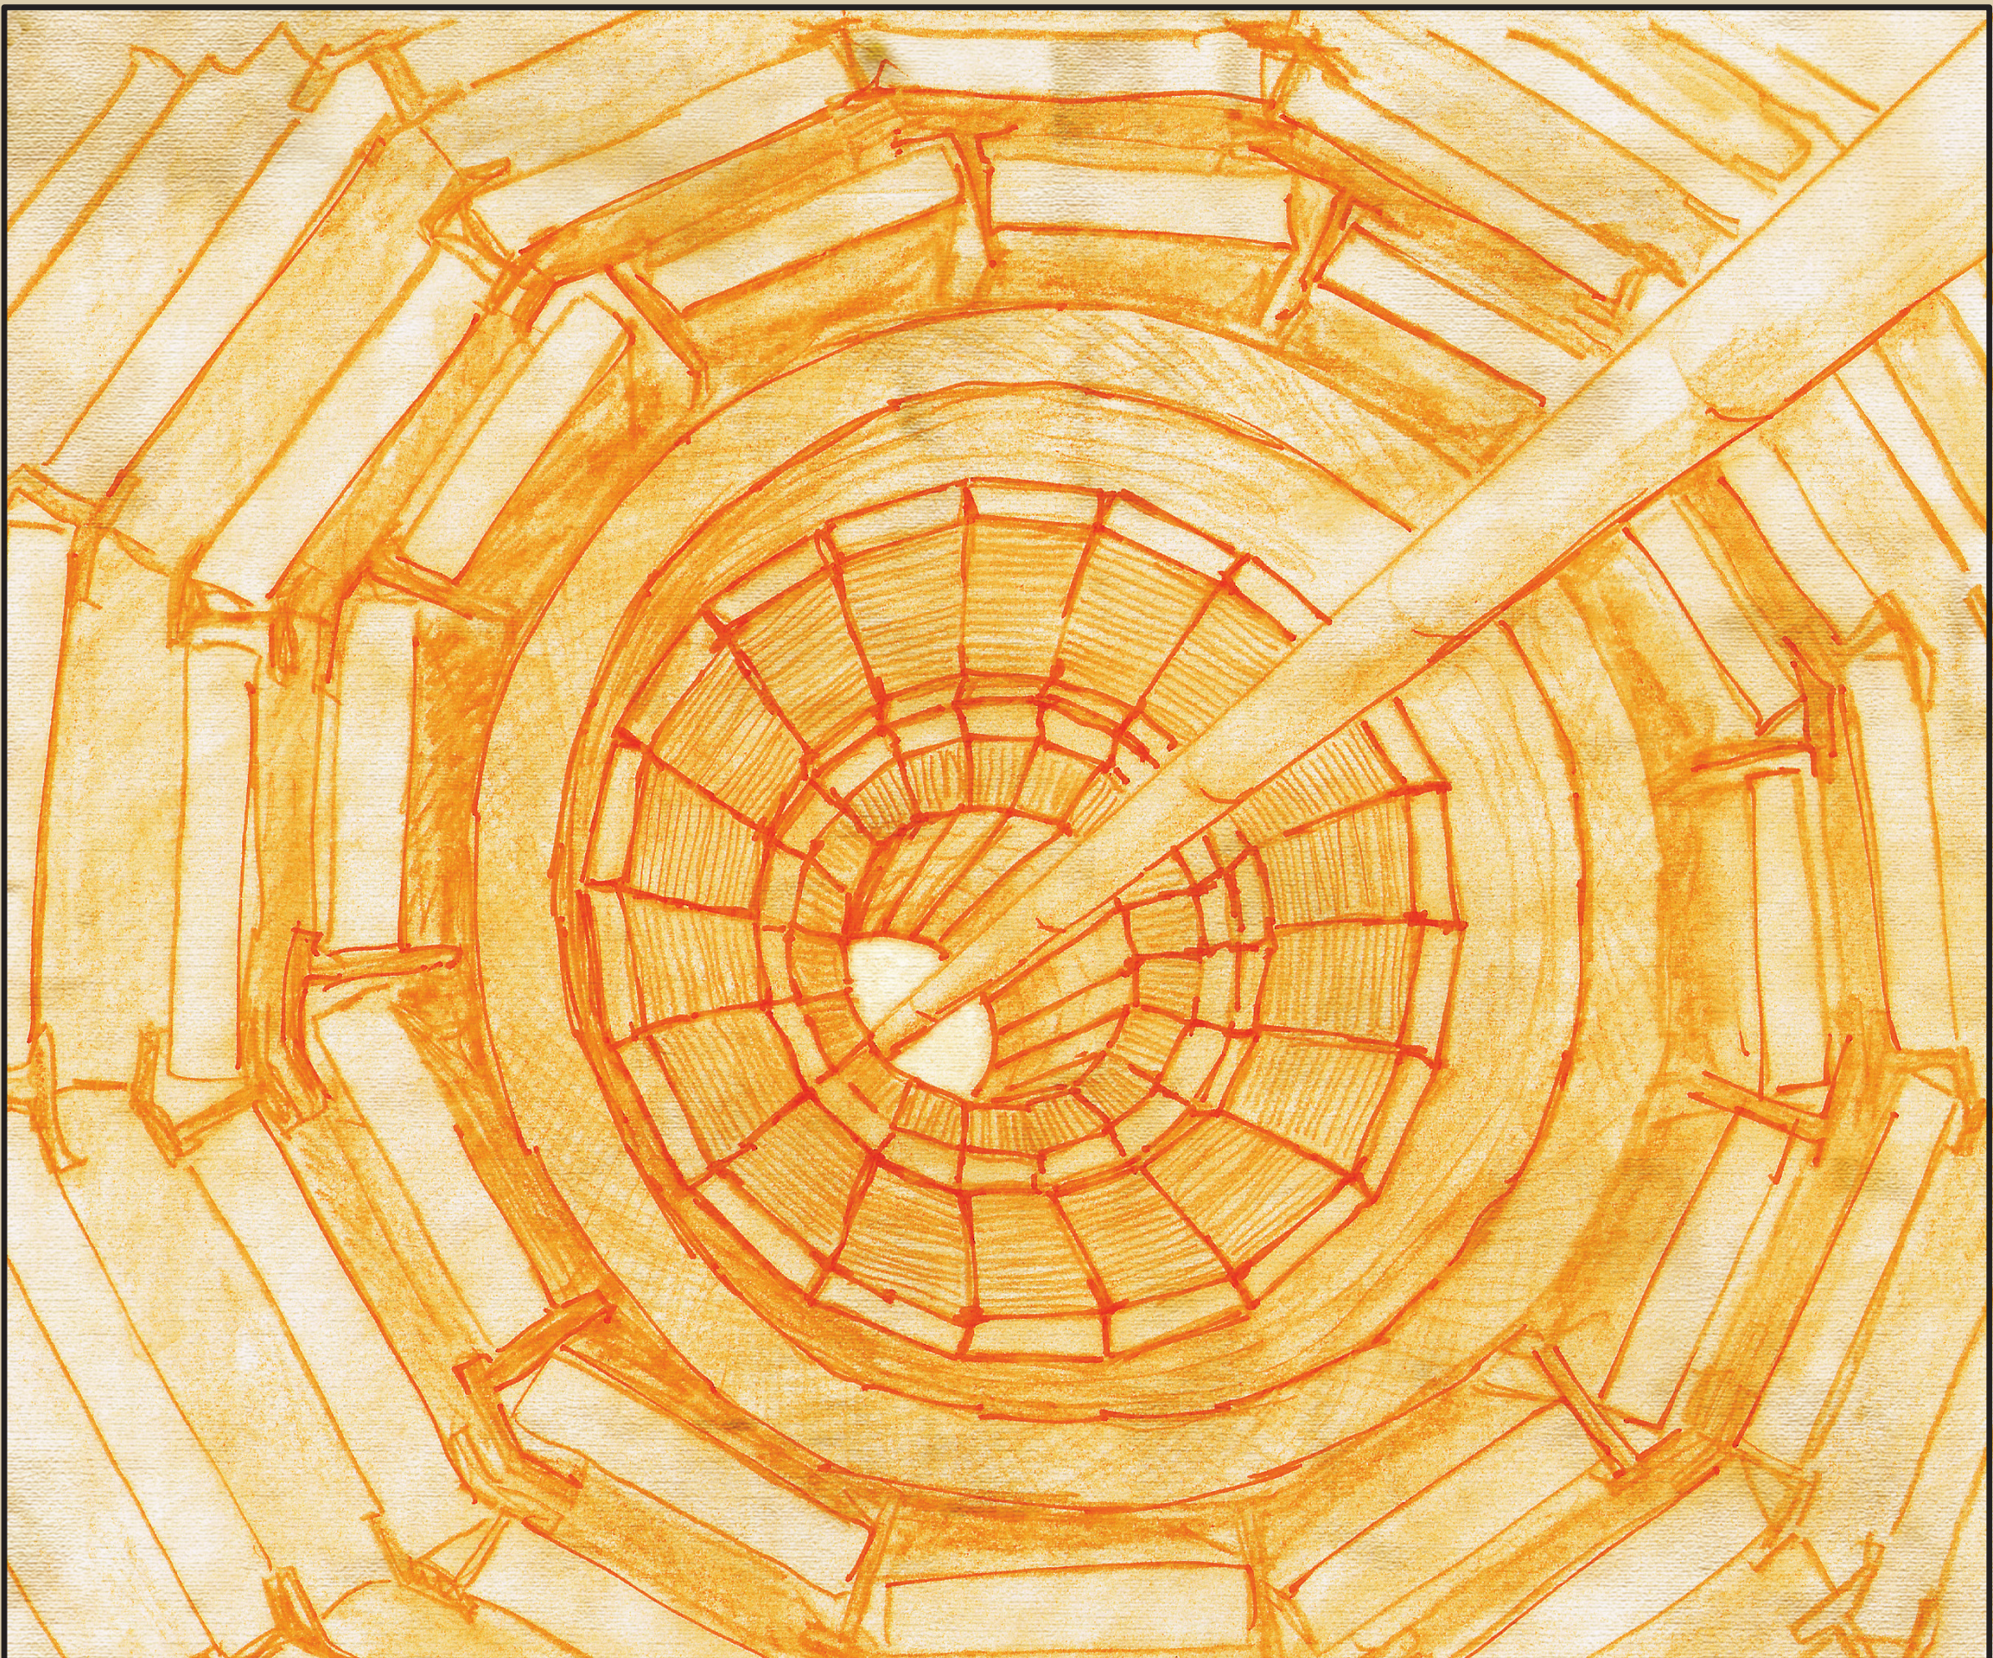
ECAL Upgrade per HL-LHC Contributo Italiano
Stefano Argirò per ECAL Italia
CMS Italia, Piacenza, 29 Novembre 2017

Slide 2
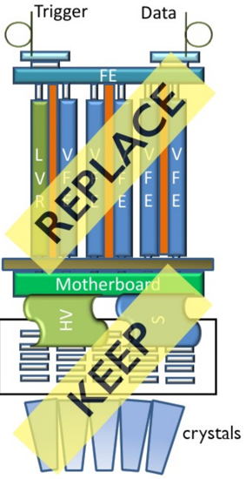
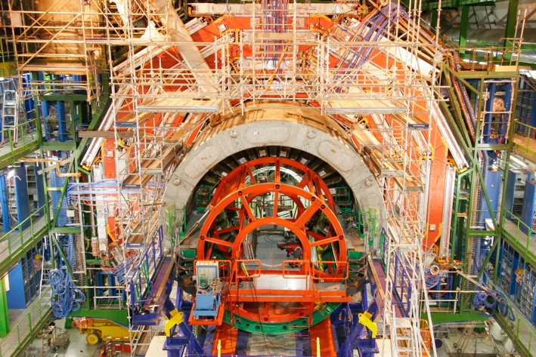
ECAL upgrade
What will be upgraded
EB electronics, from APD (excluded, as MB) to off-detector
Requires extraction and refurbishment of all Supermodules
EB cooling to 9±0.02 C to limit noise (1/2 APD dark current)
Cabling and services (HV,LV,DCS)

Slide 3
ECAL barrel electronics upgrade
Goals
Move L1 trigger off-detector for max flexibility
Cope with increased latency
Improve timing (30 ps) for vertexing and spike rejection (99.9% L1)
How to meet the goals
Faster analog response (shaping ~20 ns) -> TIA Asic
40-> 160 Mhz sampling with 12 bit resolution, 15 bit dynamic range -> LiTE-DTU Asic
Ship all samples off-detector -> new off-detector electronics

Slide 4
Since Spoleto …
TDR released
Specifications frozen
Design (almost completely…) frozen
and validated by test beam campaigns (and presented at confs)
TIA prototype
FE demonstrator
Schedule is credible
Costs are (almost everywhere …) well defined
ADC IP contract close to signature

Slide 5
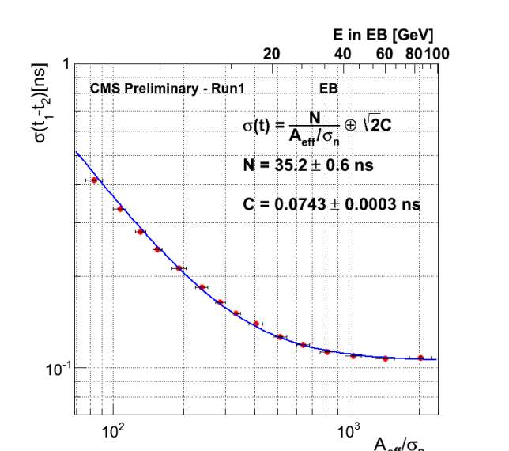
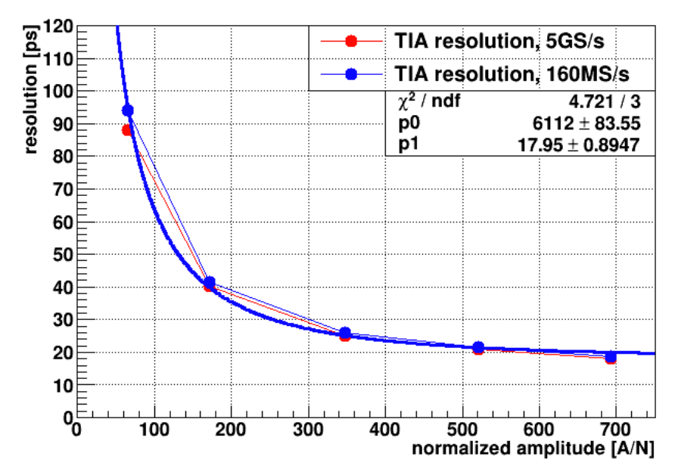
Legacy vs. Upgrade
25x better trigger granularity
Better shape-based spike rejection at trigger
Current
Upgrade

Slide 6
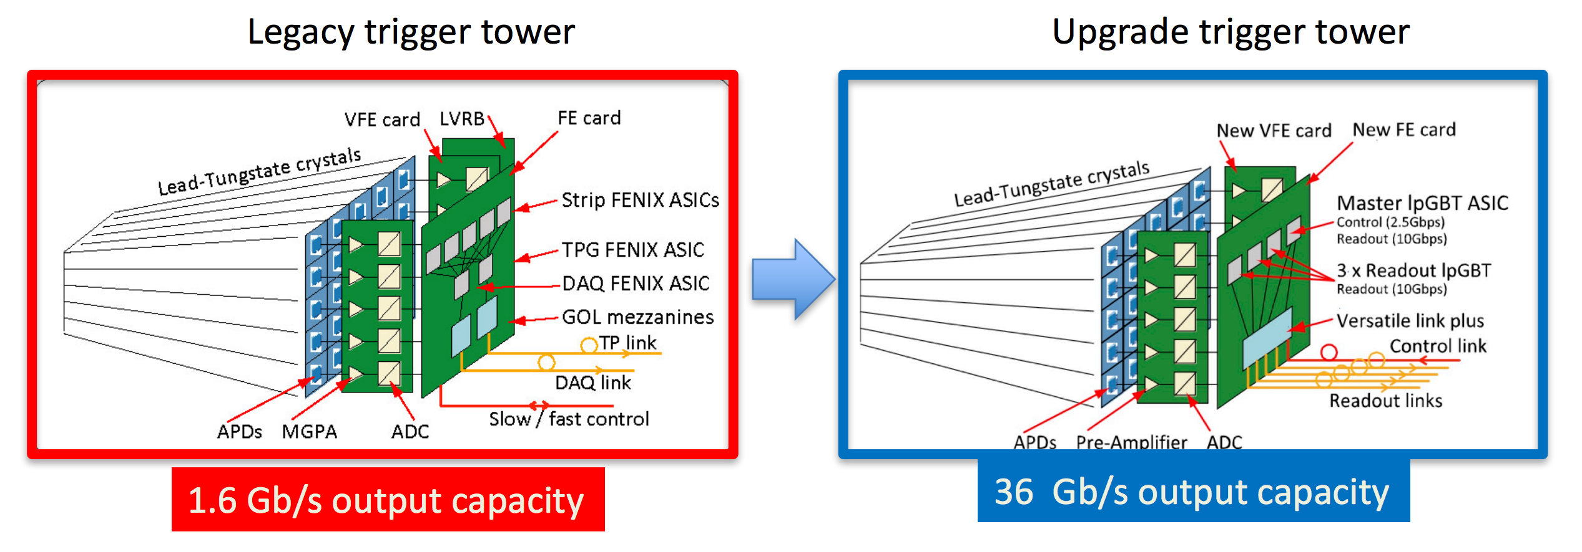
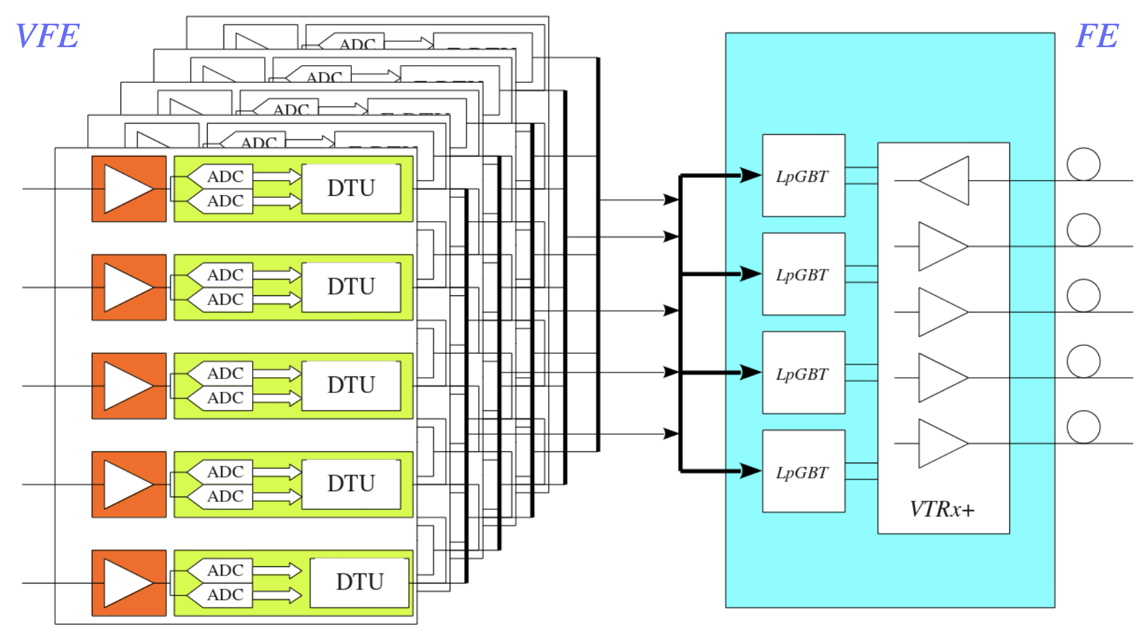
EB electronics upgrade, overview
Upgrade: L1 trigger formed off-detector.
All samples shipped off-detector @160 Mhz
Torino
Next slide

Slide 7
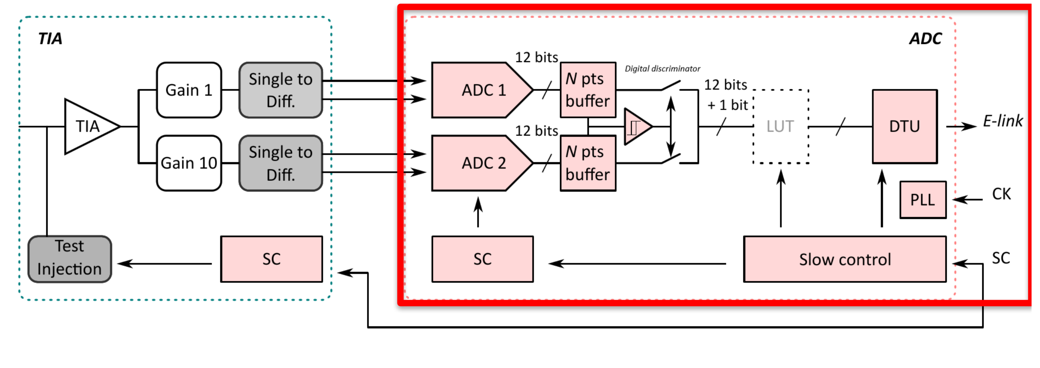
Analog set, ADC, LiTE-DTU (Torino)
Lisbon-Torino-Ecal
Logic to trasmit N samples in case of gain switch
Compression
LUT or Huffman encoding
Data Transmission Unit
Compression is necessary to cope 12 bit/160 Mhz with the available optical link (lpGBT) bandwidth.
The basic idea is that large signal are rare, and 6/7 bits are sufficient to code small signals
La parte DTU è pronta

Slide 8
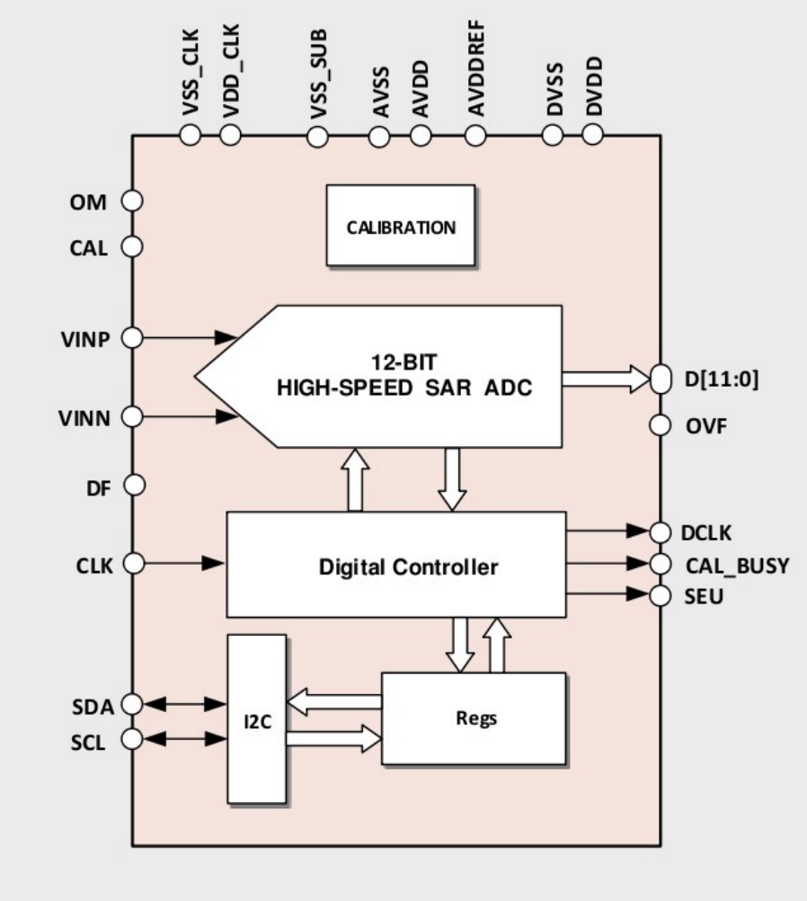
ADC Specs
Sampling rate : 160 MS/s
Resolution : 12 bits @ 50 MHz
SNDR > 63.2 dB
DNL < 0.9 LSBs, INL<1.5 LSB
Temperature range : ­20 °C ÷ 85 °C
Power consumption <30 mW
TID tolerant up to 20 kGy
SEU tolerant control logic
Designed by S3. Contract should be signed any day

Slide 9
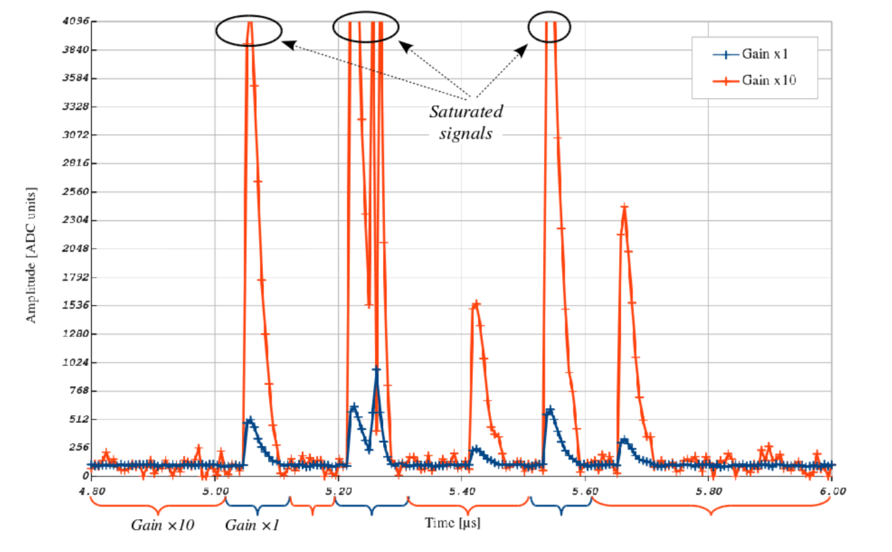
ASIC workflow and schedule
ASIC
ADC ­IP core delivery ; May 2018 Prototype 1 submission : Aug 2018 Prototype 1 testing : Q4 2018 Prototype 2 submission : Jun 2019 Prototype 2 testing: Sept 2019 Production ready : Aug 2020 – Engineering Run Chip delivered & tested : Oct 2021
S3 Inc.
INFN TO
ADC IP
DTU
INFN TO
(2x proto)
Integration
IMEC
Foundry
INFN TO
Wafer Testing
EXT.
Packaging
?
Final Test
DTU Design and Simulation well advanced

Slide 10
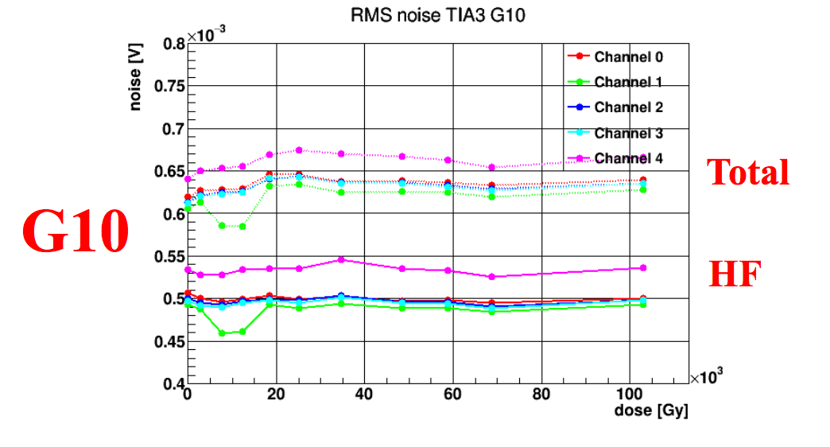
Demonstrator VFE/FE– Test Beam
Protype TIA Asic 130nm has been submitted in fall 2016
VFE with CATIA ASIC; used in test beam October 2017
Commercial ADC: 14 bits, 160 MHz
Irradiation tests
HF

Slide 11
FE Design / Demonstrator – Test Beam
lpGBT
lpGBT based FE card
One control link
2.56 Gbps, effective 1.6 Gbps
Four lpGBT data links
10.24 Gbps up effective 8.96 Gbps
Requires data compression (baseline), or use two more data links
lpGBT
10Gbps
lpGBT
10Gbps
lpGBT
lpGBT
10Gbps
lpGBT
2.5Gbps
lpGBT
10Gbps
lpGBT
Versatile link
GBTx
GBT- based demonstrator
Tested on-beam while waiting for
lpGBT availability
GBT-SCA

Slide 12
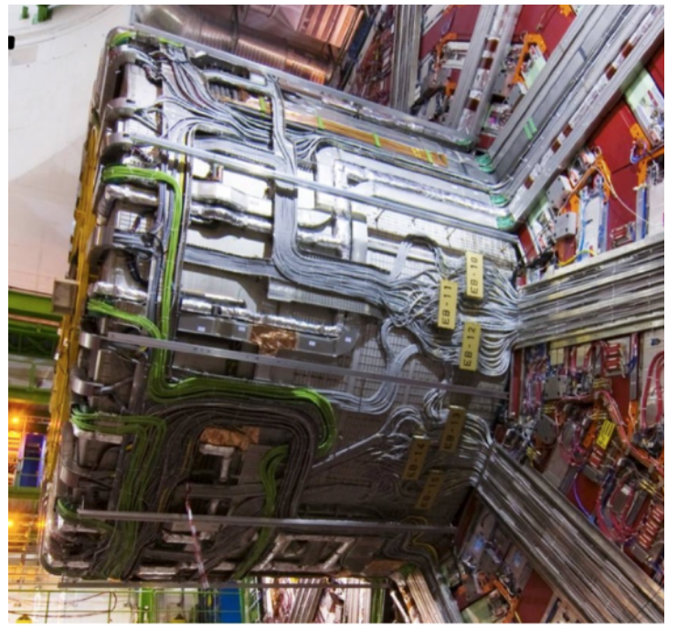
Mechs, High Voltage, Services
To speed-up installation, a second enforneur will be required.
Enforneur 1 has been refurbished
Drawings updated
New alignment system
Counterweight added
Enforneur 2
To be built under italian (RM) responsibility
High Voltage (IT, Roma)
Cables USC-CMS (uncable YB0)
[HV boards and crate ] (obsolence)

Slide 13
Italian Involvement in ECAL upgrade, summary
Roma: nuovo Enforneur, HV system
Torino: LiTE-DTU design, integration with ADC, prototype and testbed. Production and full-scale test.
Mi, To, Ts, Rm : performance studies, simulation, testbeam validation. Installation and integration ( 1 out of 6 integration lines).

