Slide 1
Impegni Italiani per il progetto Tracker di Fase 2
CMS Italia Piacenza, 29 Nov. 2017
G.M. Bilei – INFN Perugia
On the behalf of INFN and Universities of
Bari, Catania, Firenze, Genova, Padova, Pavia, Perugia, Pisa,
Milano Bicocca, Torino

Slide 2
Tracker layout in the TDR
Tracking acceptance up to η = 4
L1 Track Trigger up to η = 2.4
Inner Tracker : 4.9 m², 2x10⁹ pixels
Outer Tracker : 192 m² 42 M strips, 170 M Macro Pixel (25 m² )
Much reduced Material Budget
TB2S = Barrel Strip Strip
flat TBPS = Barrel Pixel Strip
tilted
TBPX TFPX TEPX
TEDD = Endcap Disks
TBPX = Barrel Pixel
TFPX = Forward Pixel. TEPX = Endcap Pixel
CMS Italia Piacenza 29 Nov. 2017

Slide 3
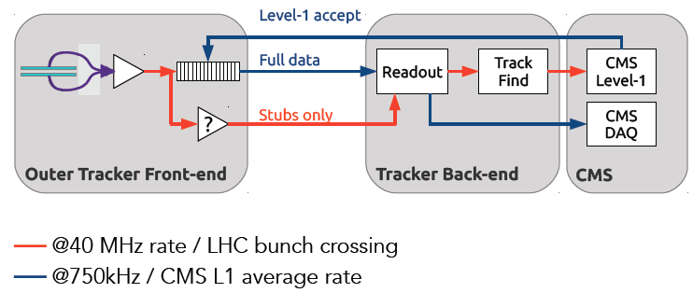
Remind: General design concept – L1 TK Trigger
Silicon modules provide at the same time “Level-1 data” (@ 40 MHZ), and “readout data” (upon positive Level-1 trigger decision)
  The whole tracker sends out data at each BX
Level-1 data require local rejection (~ 90%) of low-p_{T} tracks
  To reduce the data volume, and simplify track finding @ Level-1
  Threshold of ~ 2 GeV ⇒ reduction of one order of magnitude or more
Design modules with p_{T} discrimination (“p_{T} modules”) benefiting 4T B field
  Correlate signals in two closely-spaced sensors
    Exploit the strong magnetic field of CMS
Level-1 “stubs” are processed in the back-end
  Form Level-1 tracks, p_{T} above ~ 2 GeV
    To be used to improve different trigger channels
CMS Italia Piacenza 29 Nov. 2017

Slide 4
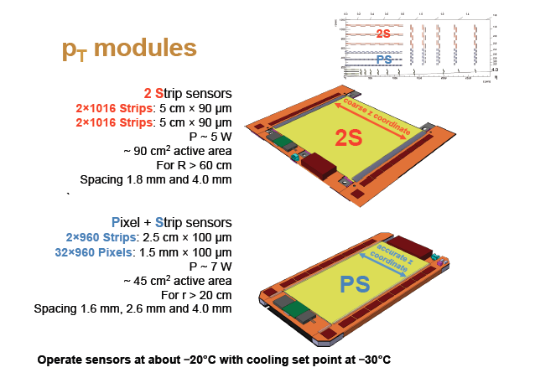
Outer Tracker P _{T} modules
# 2S modules = 7680
# OT Modules = 13.296
Area = 192 m² Silicon Sensors
# PS modules = 5616
CMS Italia Piacenza 29 Nov. 2017

Slide 5
Inner Tracker Pixel modules
  # Inner Tracker Modules: 4.352 and ~ 5 m² Pixel silicon sensors
  Small pixels: 25x100um² or 50x50um²
  Large Pixel Readout Chip (PROC): ~ 1.6 cm x 2 cm and ~ 144.000 pixels/PROC.
  Only 2 type of modules 1x2 and 2x2 PROC
Exploited view 1x2 PROC Module
Pixel Modules 1x2 PROC in
Layers 1&2 and Rings 1&2
Pixel Modules 2x2 PROC in
Layers 3&4 and Rings 3&4
CMS Italia Piacenza 29 Nov. 2017

Slide 6
Overview Inner Tracker INFN progress and plan
  Silicon Pixel sensors (planar&3D) Firenze, Pisa, Mi-Bicocca, Torino, Perugia, Bari
  Few submissions processed and others planned, to select technologies and configurations
  FBK Planar and 3D sensors Beam Tested. Very good results. Decision on technology 3D vs planar summer 2019
  PROC Chip – RD53 and Chipix65 Torino, Bari, Pavia, Padova, Perugia, Pisa
  Developments of 2 Analog FE, IP blocks, digital architecture, verification environment and simulations,
  characterization of radiation hardness
  CHIPIX65 INFN ROC demonstrator (64x64 pixel matrix) has shown very good results.
  Good rad tolerance tested up to 630 Mrad (and possibly more)
Strong INFN contribution to RD53 project. RD53A prototype in delivery these days
Pixel modules Firenze, Pisa
  Design and simulation started. Prototype activity will start as soon as ROC chip from RD53 will become available
Serial Power distribution Firenze
Serial powering test setup operational (for now with FEI4). Shunt LDO regulator IP block prototype
working well (RD53). System studies and test with current source CAEN prototype ongoing
Barrel Mechanics Pisa, Torino
Design and studies are progressing in Pisa.
CMS Italia Piacenza 29 Nov. 2017

Slide 7
CMS Italia Pavia, 29 Nov. 2017

Slide 8
CMS Italia Pavia, 29 Nov. 2017

Slide 9
Results from CHIPIX65
Excellent results from the INFN Pixel Readout Chip (CHIPIX65) precursor of RD53A Readout Chip
Good performance also after irradiation (tested up to 630 Mrad)
CMS Italia Piacenza 29 Nov. 2017

Slide 10
RD53A Wafers expected in few days from the fab
CMS Italia Pavia, 29 Nov. 2017

Slide 11
Proposed INFN Inner Tracker (IT) Phase 2 construction
Deliver 1128 Pixel modules (1x2 ROCs) installed in inner layers (Barrel L1, L2) and inner rings (R1,R2 in Disks 1-4 Epix) integrate, test and deliver 4-Layers Barrel Pixel
Contribution to development, qualification, RD53 ROC, Sensors, Hybrids
  ROC qualification and testing (Torino, Pavia)
  sensors testing (Pisa)
  hybrids testing (Bari, Pavia)
Construction and integration of Inner Modules for Inner layers/disks
  bare module testing (Pisa)
  module assembly, wire bonding and testing (Firenze)
  module burn in and calibration (Torino)
  module mechanical integration and qualification in the Barrel structure (Torino)
Bpix Mechanics development and construction (Pisa, Torino)
Contribution to development, qualification of common systems
  serial power system and Power Supply (Firenze)
  DAQ and Control Systems (Milano, Torino, Firenze)
  safety system (Pisa)
CMS Italia Piacenza 29 Nov. 2017

Slide 12
INFN Inner Tracker Pixel Module construction and Integration plan
CMS Italia Piacenza 29 Nov. 2017

Slide 13
Inner Tracker Pixel modules
INFN
INFN
INFN delivery 1128 good modules (1x2 PROC each, with 2.256 PROC in total)
installed in TBPX L1&2 and TEPX R1&2 in Disks 1-4.
Pixel Modules 1x2 PROCs in
Layers 1&2 and Rings 1&2
in the inner region
4.4 cm
2 cm
Exploited view 1x2 PROCs Module
CMS Italia Piacenza 29 Nov. 2017

Slide 14
Inner Tracker Schedule
Pisa
Torino & Pavia
Firenze
Bari & Pavia
Pisa & Torino
Firenze Power
Torino
CMS Italia Piacenza 29 Nov. 2017

Slide 15
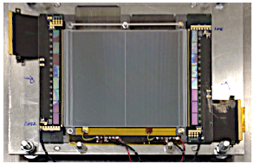
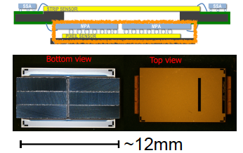
Overview Outer Tracker INFN progress and plan
PG
  Sensors 2S sensors “in hand”. PS-p&s prototype batches submitted to
  HPK and IFX. Process Qualification Control/simulation in PG
  Readout chips all front-end ASIC proto-designs completed
    Expect delivery of MPA/SSA FE chips in these days
  FE and Service Hybrids developments ongoing at CERN
  and Aachen. Setting up for qualification in CT and GE
  Modules 2S prototypes assembled and tested in beam
    29 µm hit resolution, stub efficiency close to 100%
    First dummy modules produced in PG and BA. Good results
  Power System System studies started. Working on defining the specs.
  New R&D POR Toscana submitted together with CAEN.
  Track Trigger Full FPGA approach selected by the collaboration as baseline.
  Pisa will continue to participate to the Track Trigger effort.
  Developments of algo for Track Trigger. Contribution to the design of TF boards, FW and SW for testing
PV
CT, GE
Full-size 2S module with CBC ASICs
PG, BA
FI, PG
MaPSA-light module
PI
CMS Italia Piacenza 29 Nov. 2017
G.M. Bilei

Slide 16
Outer Tracker Si Sensors Status
INFN Perugia will be responsible for the Process Quality
Control during production:
Perugia development activities ongoing since 2-3 years
Measurements on test structures before and after X-ray
irradiation.
TCAD Simulation and optimization of sensors design layout
Surface damage studies on test structures on different vendors
Definition of test structures for PQC together with Wien
Qualification of potential vendors ongoing
CMS Italia Piacenza 29 Nov. 2017

Slide 17
Outer Tracker modules status
Perugia and Bari will be the centers for module
production in Italy.
Excellent past expertise, good contributions to
the developments module concept.
First assembly jigs built in Perugia and Bari.
First 2S dummy modules built in Perugia with
tolerances within the requirements.

Slide 18
Track L1 Trigger
Need to form tracks from stubs at the back-end
Three methods were under development since 2013
AM for pattern finding + track fit in FPGA (INFN, USA, Fra., Germ.)
Tracklet (road search, seed & extrapolate) in FPGA (USA)
Hough transform in FPGA for pattern finding + track fit (UK, Germ.)
  The outcome of the review held last Dec. 2016
  All three systems give excellent performance above 3 GeV with similar output rates and ~no pileup dependence
  All three systems demonstrated and measured latencies < 4 µs (requirements)
  AM approach due to the special development of 28nm ASIC wrt to full FPGA approaches contains higher risks.
  A Track Trigger Task Force (TTTF) was setup :
  TK decided to adopt as baseline the FULL FPGA approach and consider the AM approach fall back solution
  A Back-End System Development WG was launched
  INFN interested in
    Pisa TF FW developments, FW/SW for system test
    Catania OT DTC offline software (commissioning)
    Milano Bicocca IT DTC User interface, middleware
    Genova TF/OT DAQ FW still evaluating
stub
CMS Italia Piacenza 29 Nov. 2017

Slide 19
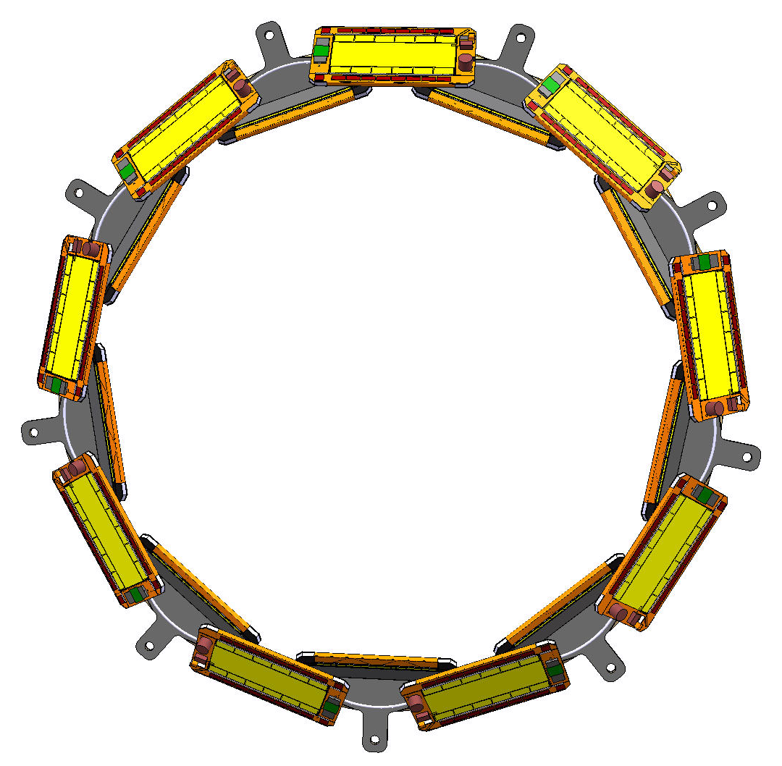
Proposed INFN Outer Tracker (OT) Phase 2 construction
Deliver Tilted Inner Tracker (36x2 rings per side) mounted, integrated and tested with 1920 PS modules (≈ 40 m² surface detector) and contribute to Track Trigger
Development and Qualification
  Service (Power and Opto) Hybrids testing (Genova)
  FE Hybrids testing (Catania)
  Silicon Sensors Process Qualification and Sensor Testing (Perugia)
Construction and integration of PS Modules (1920 installed)
  Module assembly, wire bonding and testing (Bari, Perugia)
  Module Burn in and Calibration (Pisa)
  Module mechanical integration and testing in 72 rings (Pisa + all)
Contribution to development, qualification of commons systems
  Track Trigger system (Pisa)
  DAQ and Control Systems (Pisa, Catania, Genova)
  Power supply system (Firenze, Perugia)
  Safety System (Pisa)
CMS Italia Piacenza 29 Nov. 2017

Slide 20
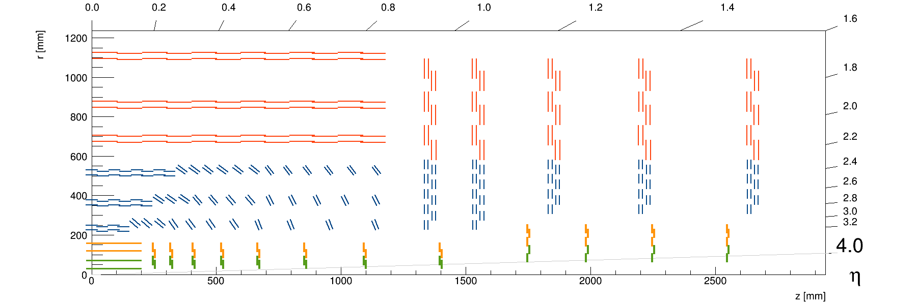
Proposed INFN contribution to Outer Tracker PS modules
OptoHybrid
Cut view of PS module
SSA Asics
FE Hybrids
Strip Sensor
PowerHybrid
MaPSA
Spacer
MPA Asics
Macro Pixel Sensor
INFN delivery:
72 tilted Rings (36 each side) equipped with total
of 1920 PS modules
Ring
Tilted Barrel PS detector
CMS Italia Piacenza 29 Nov. 2017

Slide 21
INFN Outer Tracker module construction and integration plan
CMS Italia Piacenza 29 Nov. 2017

Slide 22
Outer Tracker Schedule
Perugia
Catania FE
Genova SH
Perugia & Bari
Firenze
Perugia
Power
Pisa
CMS Italia Piacenza 29 Nov. 2017

Slide 23
Summary
The proposed CMS Phase 2 Tracker is very challenging and bold project.
Entering into a new phase focusing and finalizing R&D and starting some pre-prototyping
TK CORE cost estimate is about 112 MCHF. Good coverage by Funding Agencies.
Sharing of construction responsibilities among agencies ongoing and getting well balanced.
INFN is well placed in several key R&D areas with leadership role and continue to hold
several high level managerial positions within the Tracker.
CMS Italia Piacenza 29 Nov. 2017

