Slide 1
A SHORT REPORT ON
DT AGING TESTS AT CERN-GIF
AND LEGNARO NATIONAL LAB.
F.Gonella , J.Pazzini *, A.Meneguzzo,G.Mocellin**,L.Barcellan,D.Dattola
D.Fasanella……….some Spanish colleagues
and FG
UNIVERSA
UNIVERSIS
* now Boston U. ** now Aachen 3
PATAVINA
LIBERTAS

Slide 2
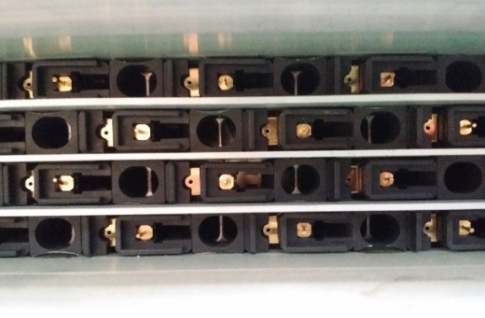
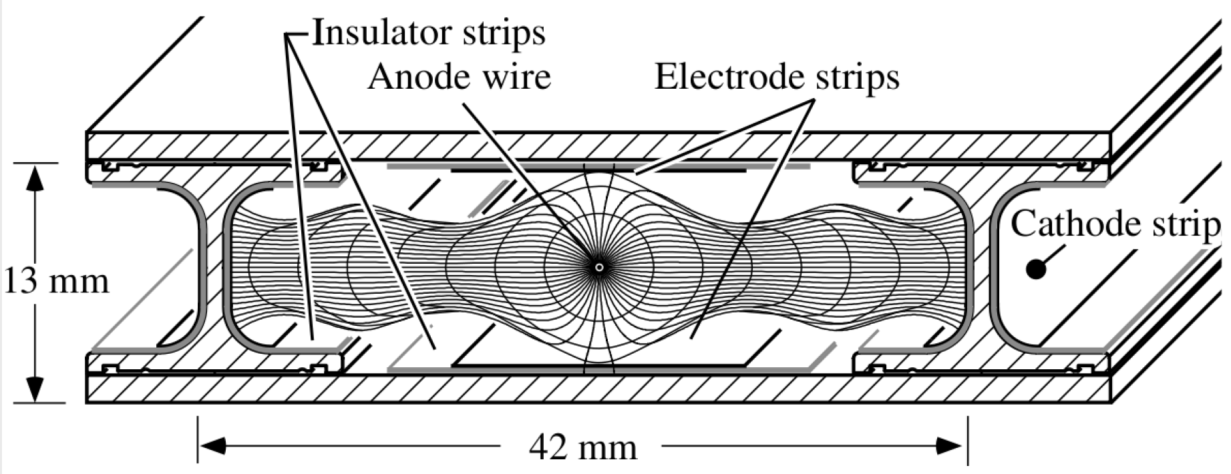
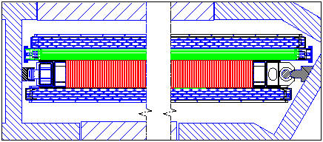
DT: is a glued structure 13 Al plates, 700 strips/plate, ~ 700 Al I beams 1400 cathode strips
A thick Honeycomb plate
The smallest is MB1 in the frist station:
Size ~ 5 m2 weight ~ 780 Kg gas Volume ~ 650 liters Gas flow : 500~ 600 cc/min)
608 tubes, 4 x 13 cm2 ~ One liter/tube in three groups of four layers/ flushed in parallel
Four electrodes : Grounded Al plate, wire, field shaping central strips, cathodes on I beams
Standard High Voltage wire 3600, strips 1800 ,cathodes 1200
Ar/CO₂ (85%/15%)

Slide 3
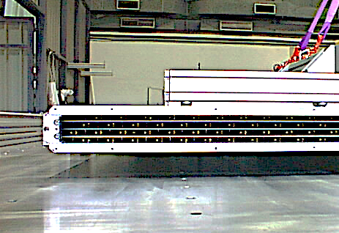
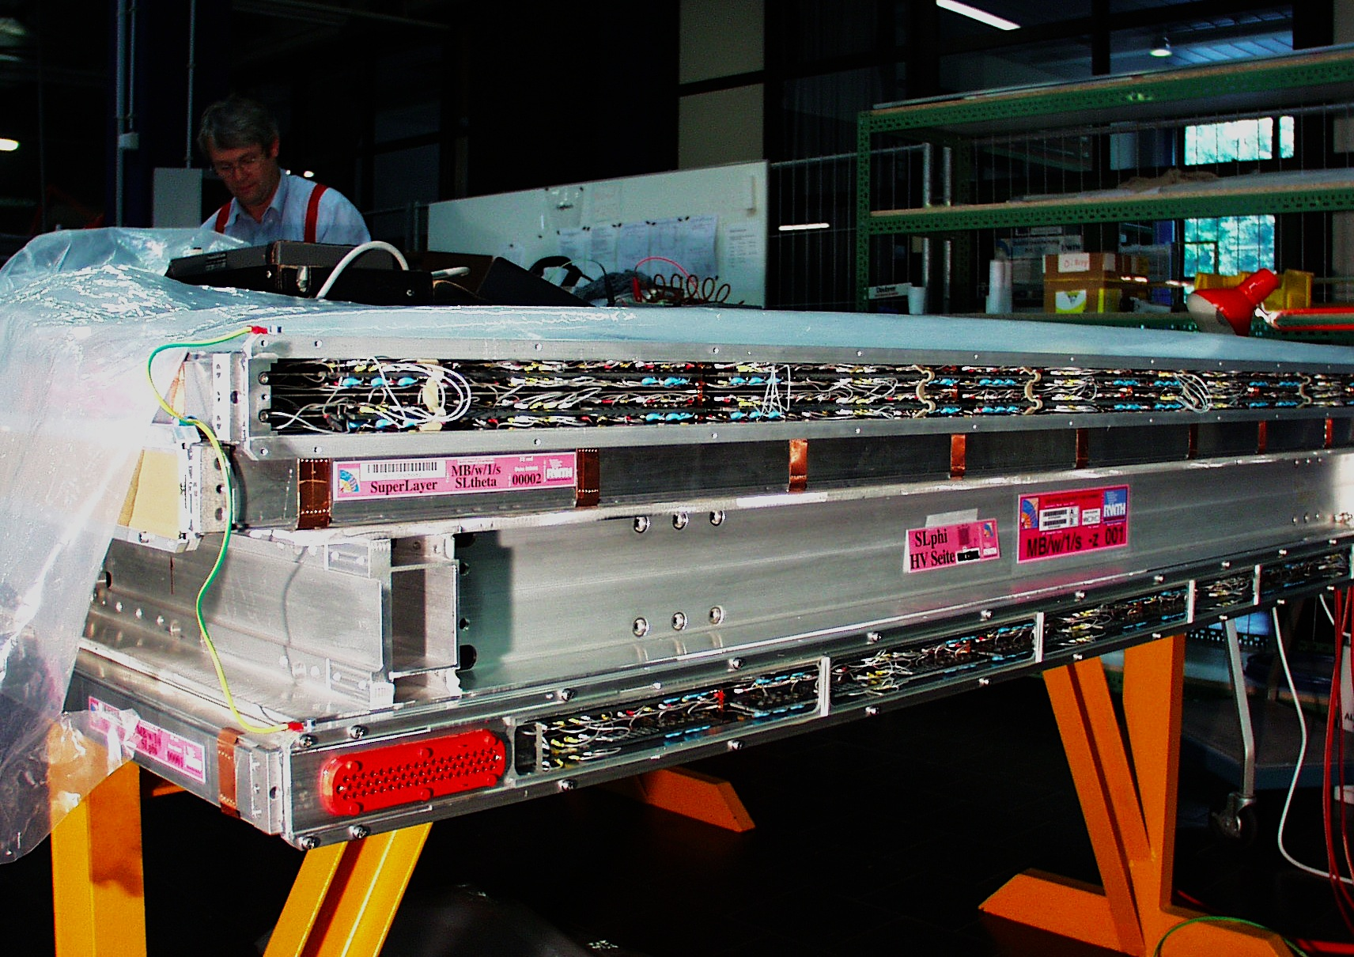
Lot of cables and boards are in the
Superlayers active gas volume.
RIGHT : an open and naked
Superlayer,
BELOW: the same dressed with HV
stuff and ready to be closed

Slide 4
All chambers components and materials were positively tested for rad tolerance and
Harmless outgassing properties before the construction.
It has been a surprise to find, during a first irradiation in September 2015 at the
Gamma Irradiation Facility (GIF) at CERN, that a DT chamber ages and looses a
large fraction of its Gain in presence of an intense photon radiation.
MU TDR: (next slide)
“The maximum expected figure of charge integrated by a DT wire at HL LHC
is ~ 10 mC/cm In the MB1 chambers of the outer wheels”
This is the charge that every cm of a non aged DT wire should have Integrated at
the end of HL LHC.
linear relation between wires current and instatntaneous Luminosity is ssumed

Slide 5
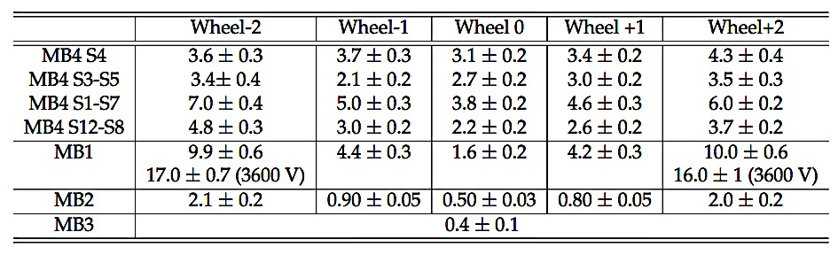
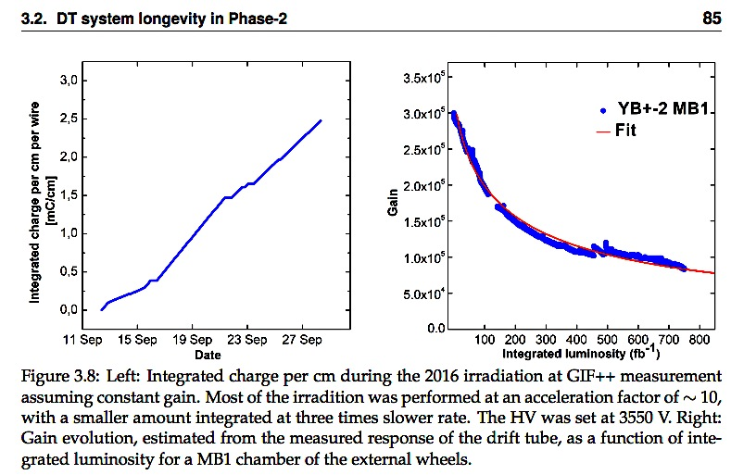
From MUON TDR
Page 85
charge
Wire gain
The MB1 test at GIF
16 days of operation
acceleration ~ 10
Integ. charge 2,5 mC/cm gain loss dG/G=73%
The charge that had to be integrated in absence of aging is ~ 3,1 mC/cm

Slide 6

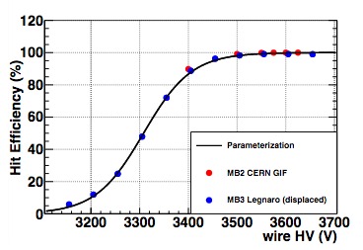
TDR fig 3.7 page 84
4 x 10⁵
dG/G =68%
dE/E = 5%
dG/G=80%
dE/E =13%
Comparison between measured efficiency and gain curves in
function od the HV in a non non aged DT chamber allows to
obtain the next table.
Different tables may be obtained playing with HV and threshold
Finding the optimum one is a major goal……..

Slide 7
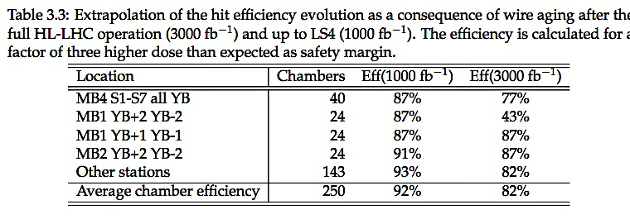
BELOW THE EXPECTED HIT EFFICIENCY/ DT CELL
MU
TDR
1/3 HL LHC
HL LHC
A large gain degradation will affect the 10 ~15 % of the Barrel
NEW phase 2 ELECTRONICX (multihit & lower thresholds) should mitigate those figures.
Note that Barrel operates at very high gain (4x10^5) for high time resolution (<2 nsec) for Trigger and
Pt cuts at Level 1.
The trigger requirements to the MU in the HL LHC phase is more relaxed with respect to now because
of the presence of Tracker at L1
Detection efficiency per cell drops only of ~ 5% at a gain 68% lower i.e. 1,3x10^5…..
But the loss is very serious and merits a deeper investigation
(to prevent the case of a worse reality)

Slide 8
.
POSSIBLE ACTIONS
Test a second chamber: the observed behavior could not be common to all the 250 chambers of the Barrel but it could be an accident due to the specific one.
2) find the origin of the poison and try to cure it (this talk)
3) Find procedures of analysis of the current behavior of the chambers in P5
that allow a quick detection of any aging or malfunctioning effect in CMS.
4) Find optimum setting for HV and threshold for optimum performance and and
“ milded” aging. Electrical noise reduction allowing lower tH. (e.g. below 30mV)
Is one of themajor target for the new electronics.
4) And take appropriate actions as soon as possible (from the generic ones: no gas recirculation, separate gas circuit for the more exposed chambers. lower operation voltage, to the more targeted hopefully found )

Slide 9
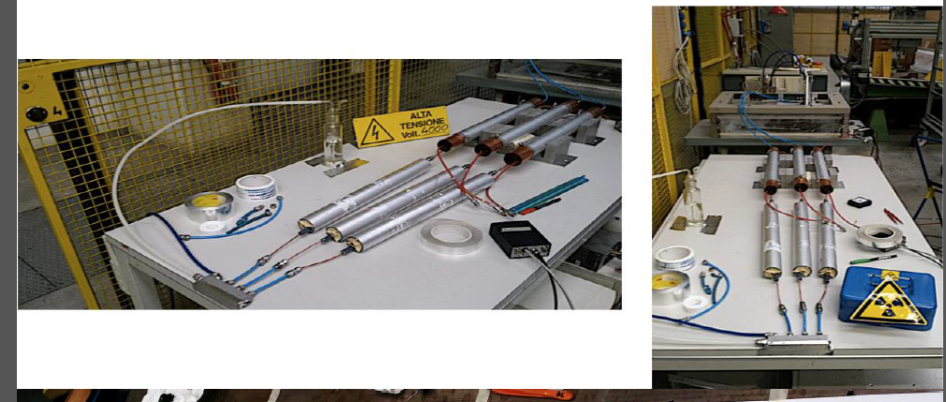
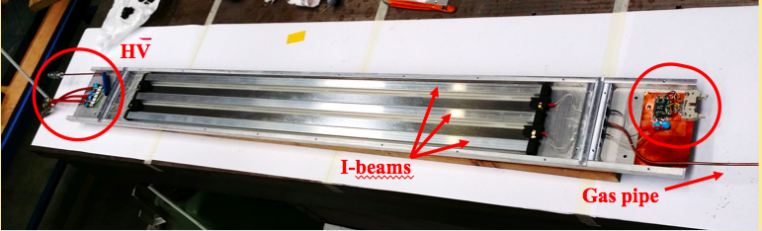
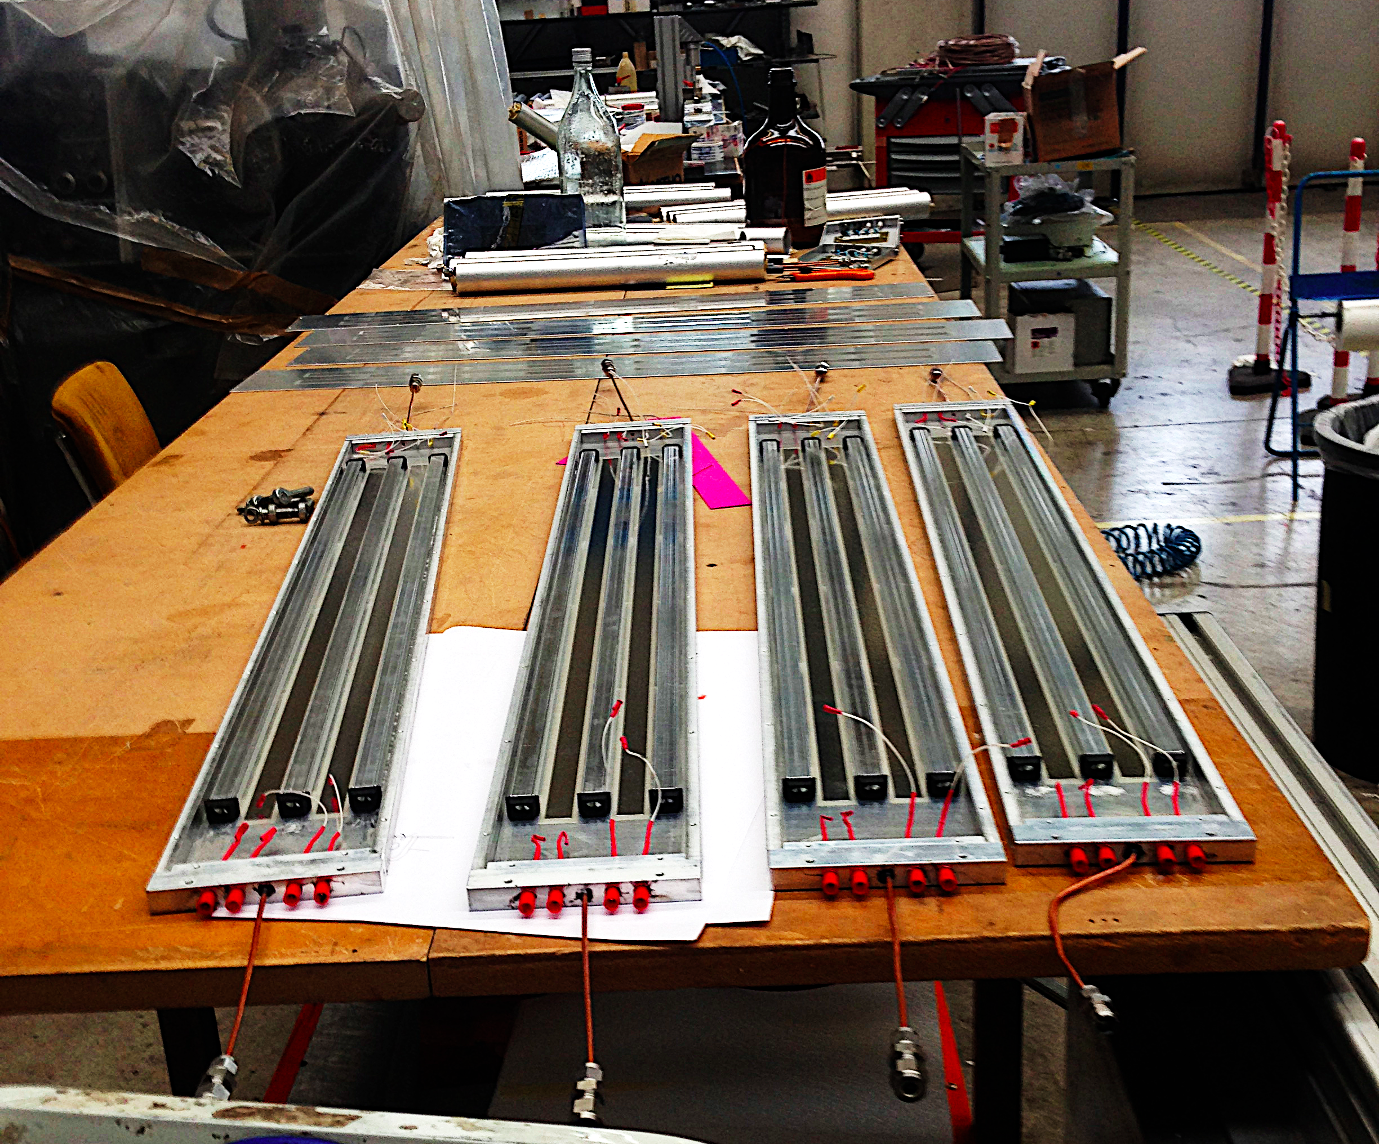
To face point 2) it was agreed to build and study the behavior of naked tubes
A tube with only the basic elements inside the gas volume (Al covers, I-Beams
and field Shaping electrodes) excluding all electronics stuff.
a set of 6 small “naked” chambers (Bicells) with two wires ~one meter long, was assembled in Legnaro
at end 2016 and spring 2017. They are identical to the DT and made out of material still available
from the mass construction of the big chambers
AND
a set of Single wire tubes (Monotubes) (50 cm long,5 cm of diameter) certified aging-free to check the
aging properties of different materials or of the gas from other detectors.
Simple, for easy handling in the GIF and easy opening for inspection,
wire extraction, analysis and substitution.

Slide 10
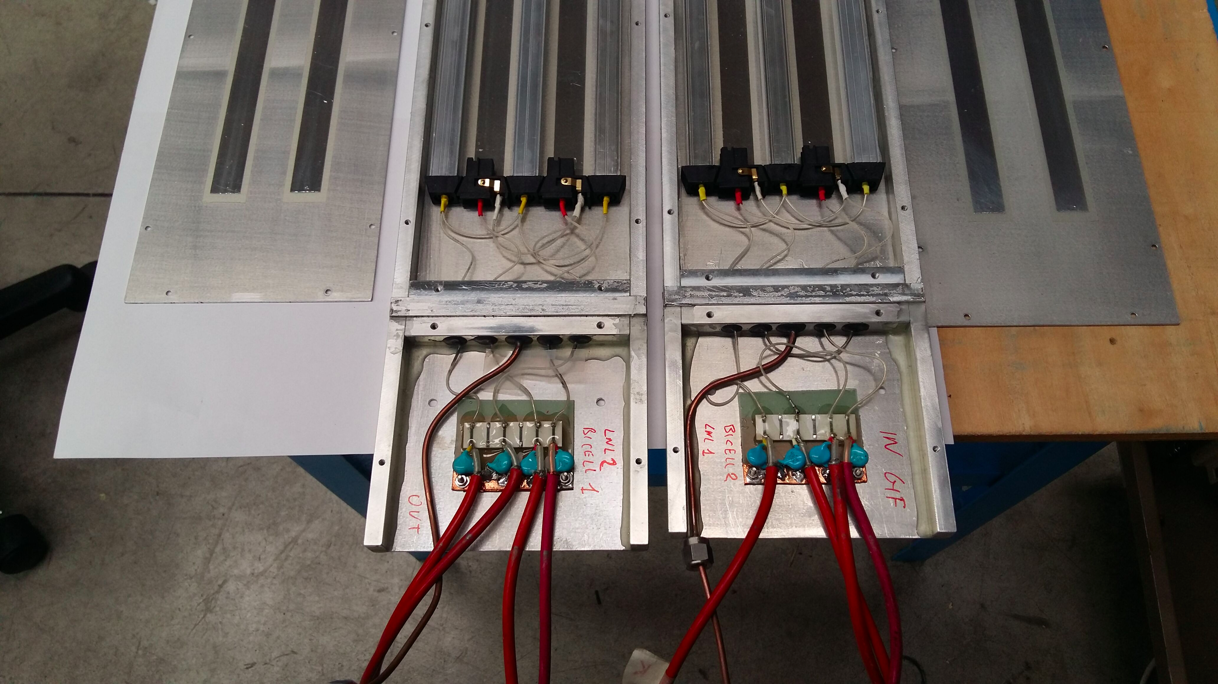

Slide 11
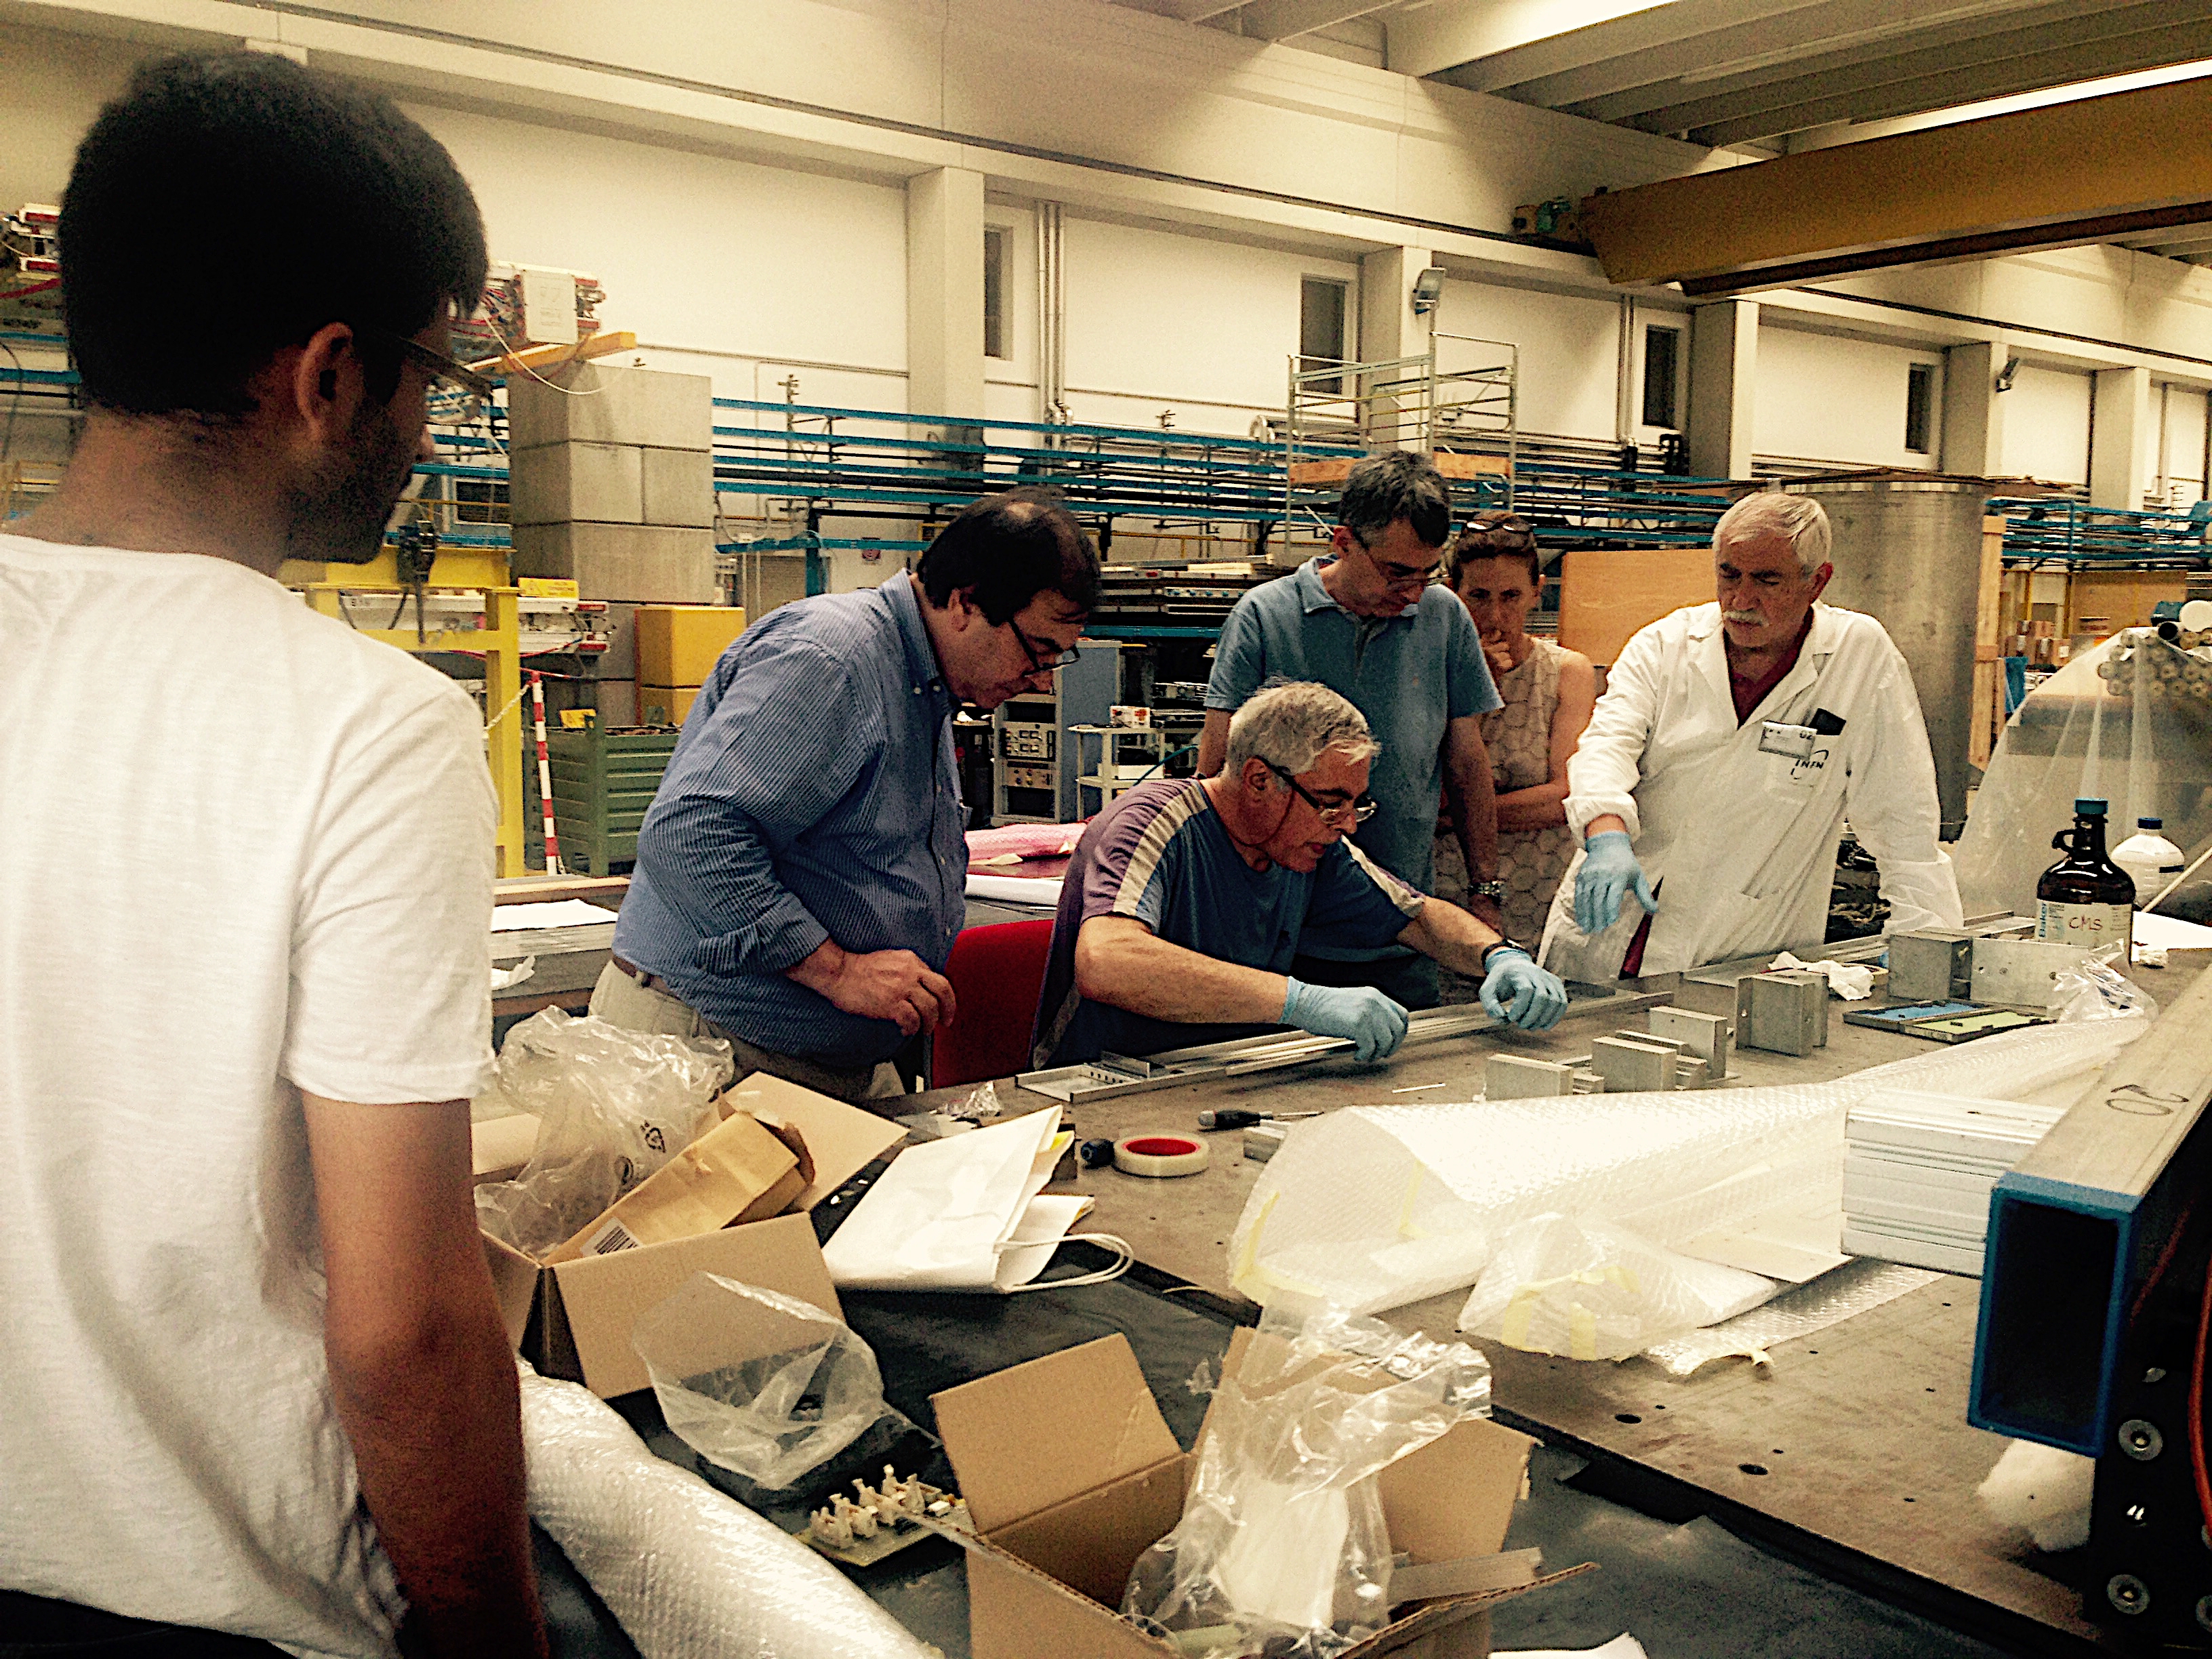
THE BICELL ASSEMBLY IN A “CLEAN ROOM”
of the Laboratori Nazionali di Legnaro
Extensive test of the bicells done in Legnaro showed they behave exactly as a DT cell
Efficiency,time resolution,space resolution along the drift path, HV behavior…..
The next slides display wire pictures, spectra and some temporary conclusion

Slide 12
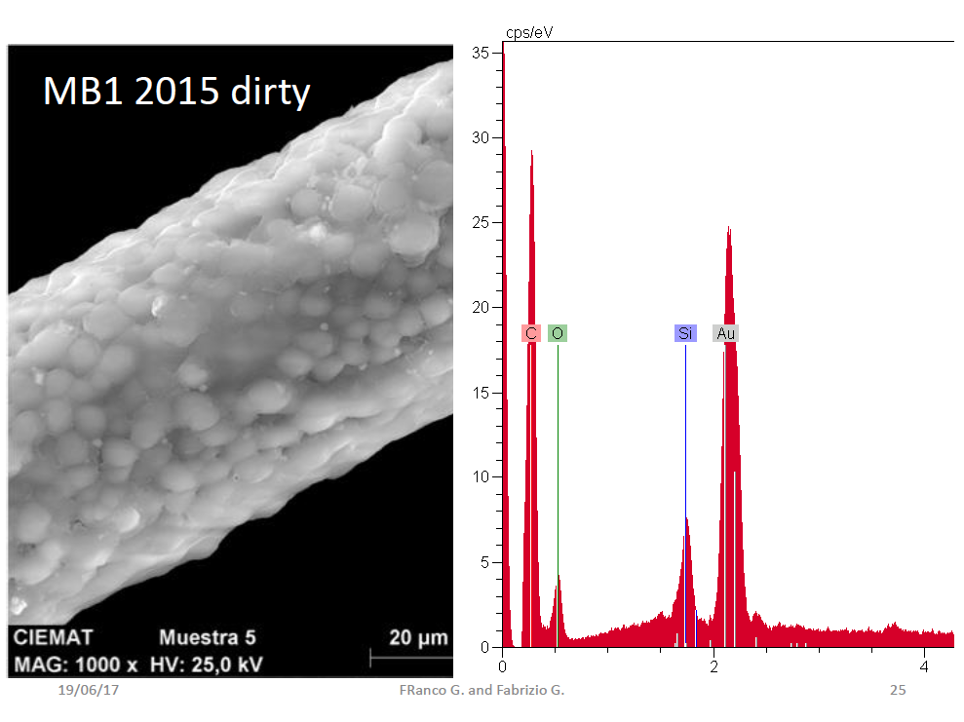
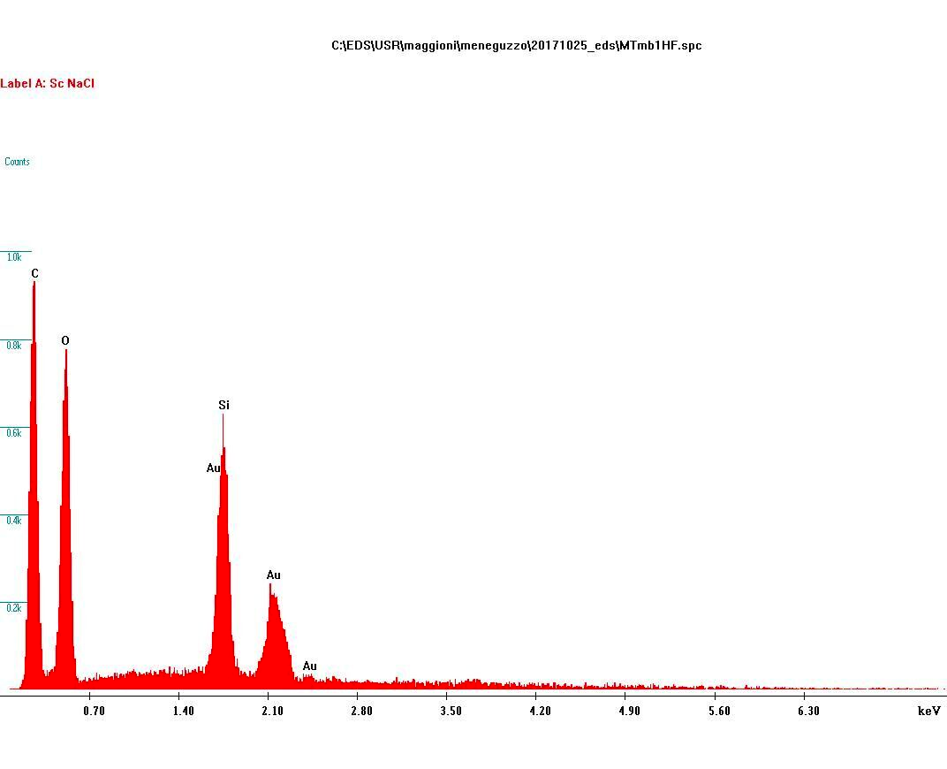
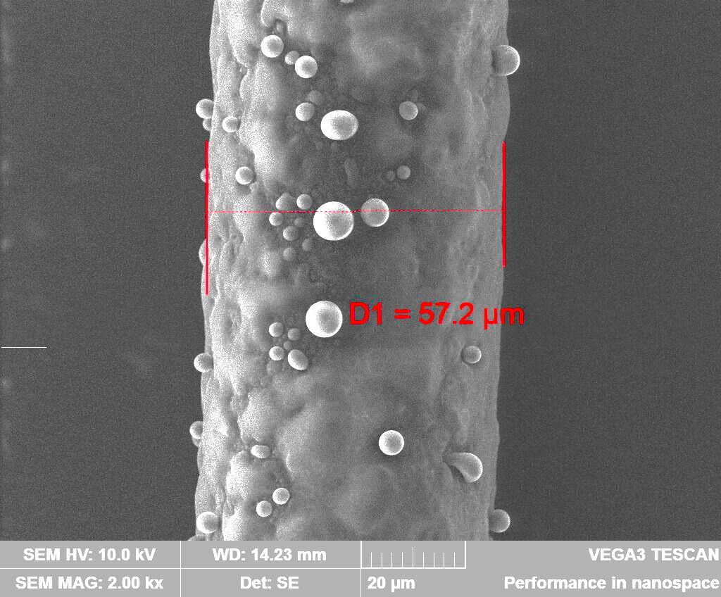
THE MB1 test
Microscopic scan at 10 kV
of the MB1 wire
2,5 mC/cm 750 fb-1
A wire from the aged MB1
Monotube
After MB1
Picture and microscopic scan
Of the wire of a Monotube
flushed with gas from MB1

Slide 13
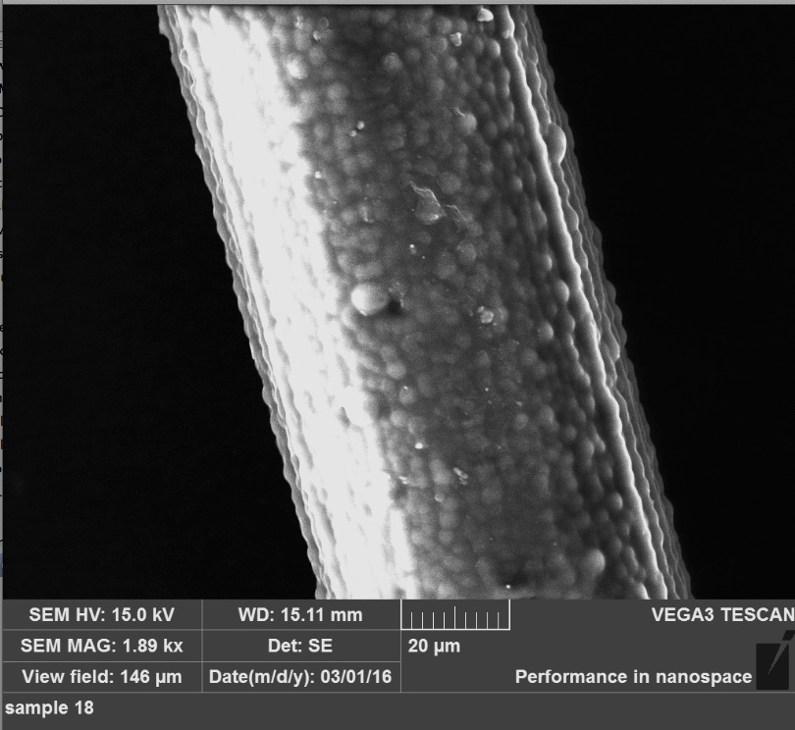
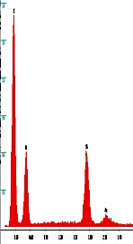
MB1 wire again analized in Legnaro

Slide 14
Typical arrangement of detectors at the GIF
Downstream monotube
(the passive smoker)
Pulsed Monotube
HV on 1/100 of time ,no age
Reference Monotube
on independent gas line:
monitor the source intensity,
the effect of atmospheric press.
Bicell
(or
MB1)
electronics
Gas pipe

Slide 15
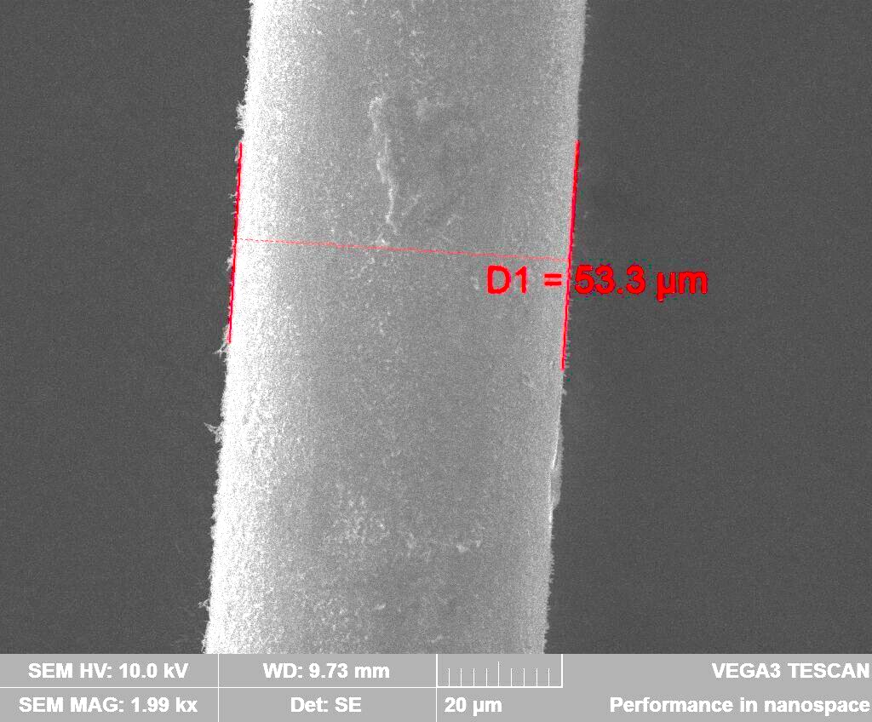
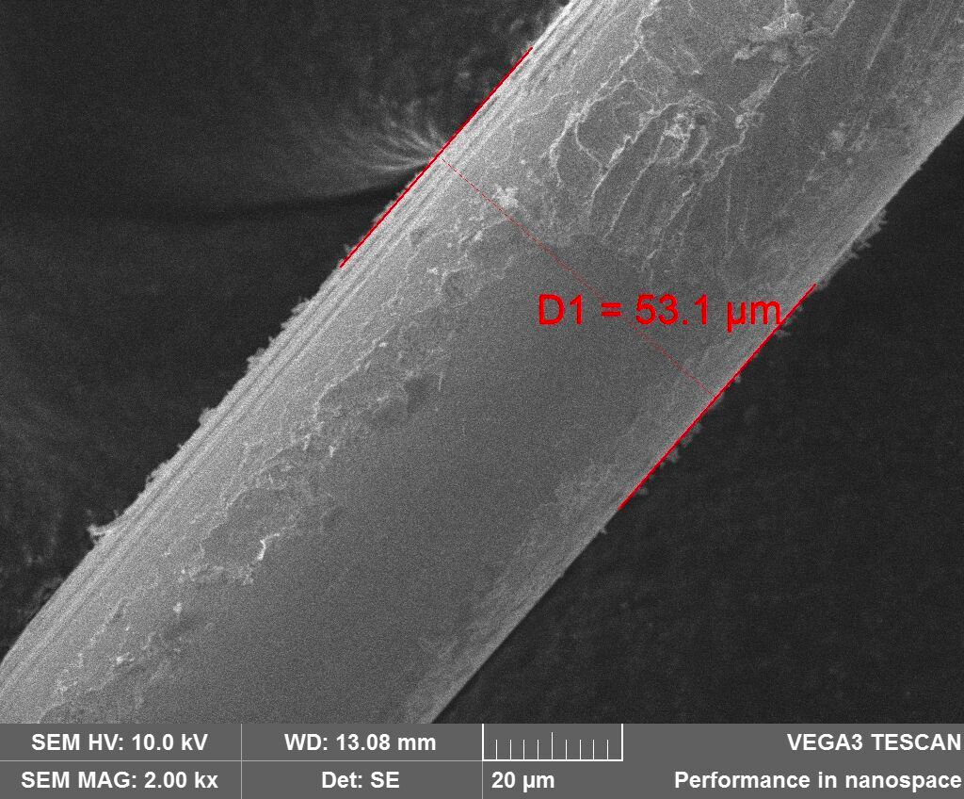
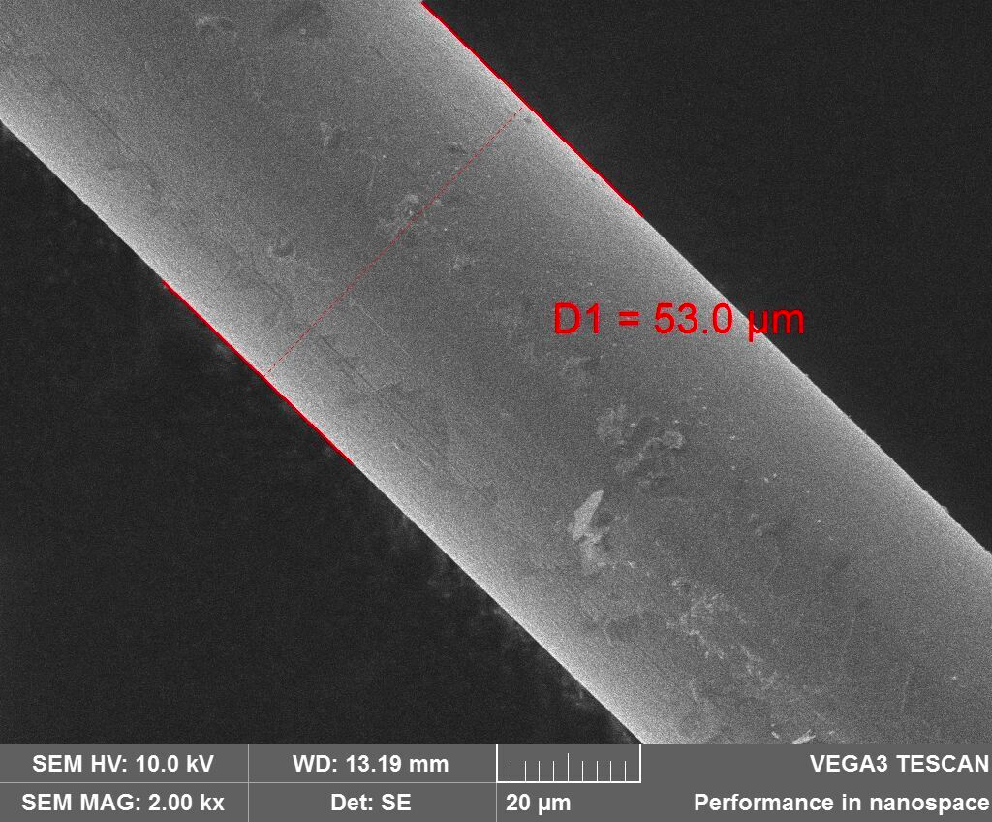
T3
Mtube
after
Bicell
90 mC/cm
Bic. W1
20 mC/cm
BICELL 1 FIRST TEST AT GIF
Dec 2016 to June 2017017
> 20 mC/cm gain loss ~ 20%
Bic. W2

Slide 16
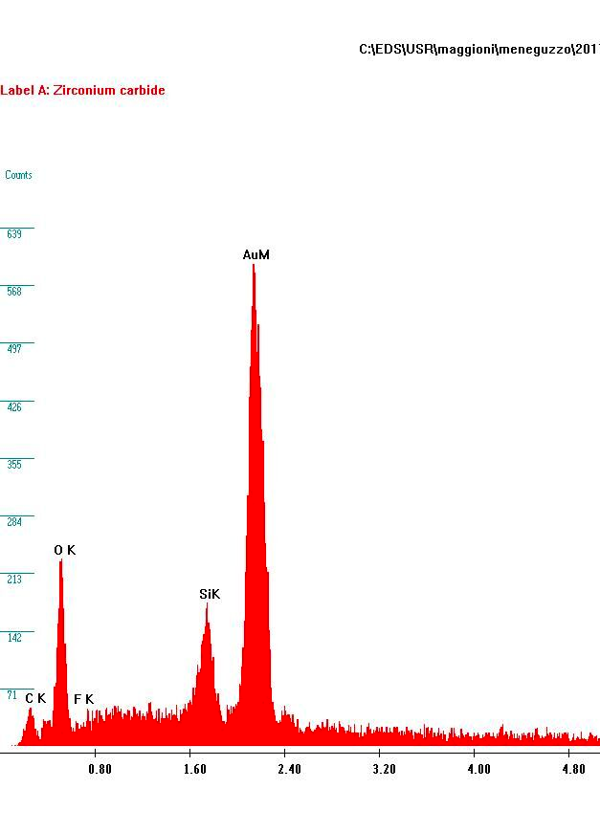
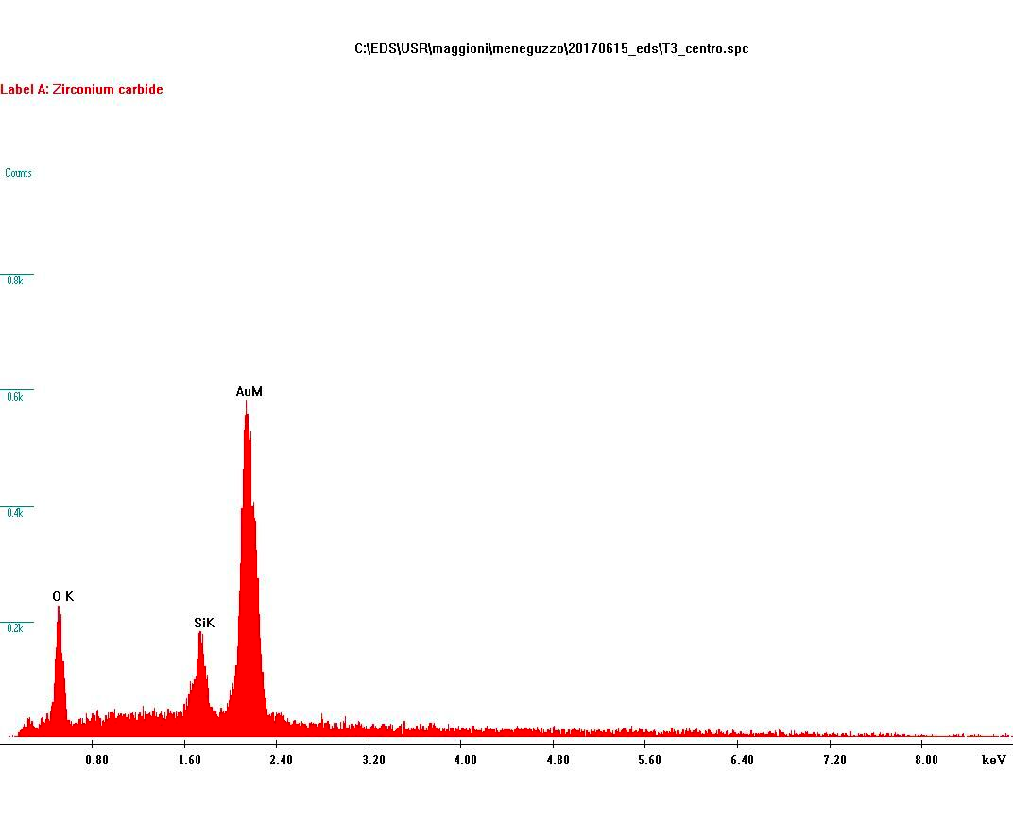
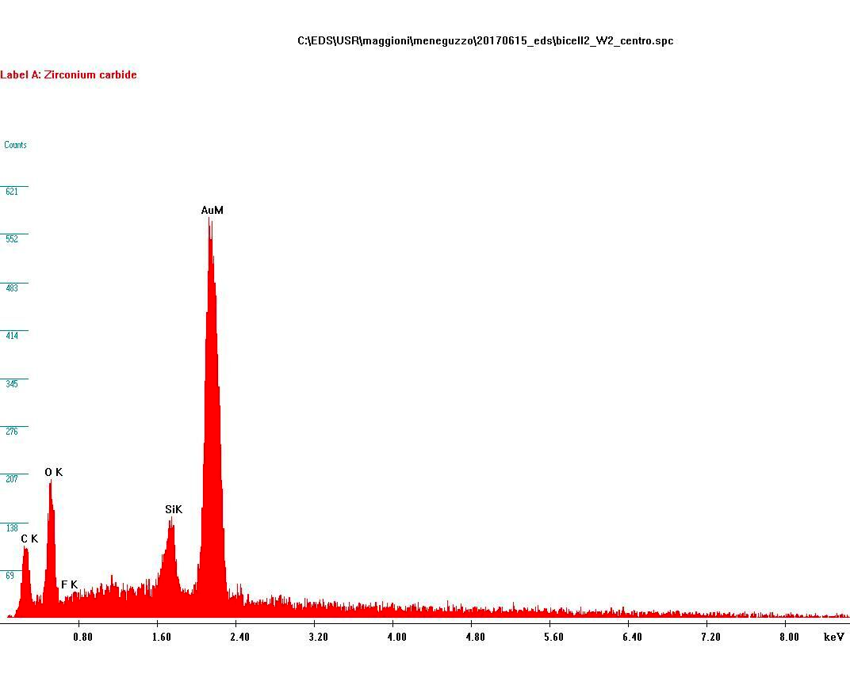
Bicell 1 W1
T3 monotube
After bicell
Bicell wires and Monotube wire (no C peak)
at the GIF from Dic 2016 to June 2017.
Compared to MB1 wire
Bicell 1 W2
MB1 wire

Slide 17
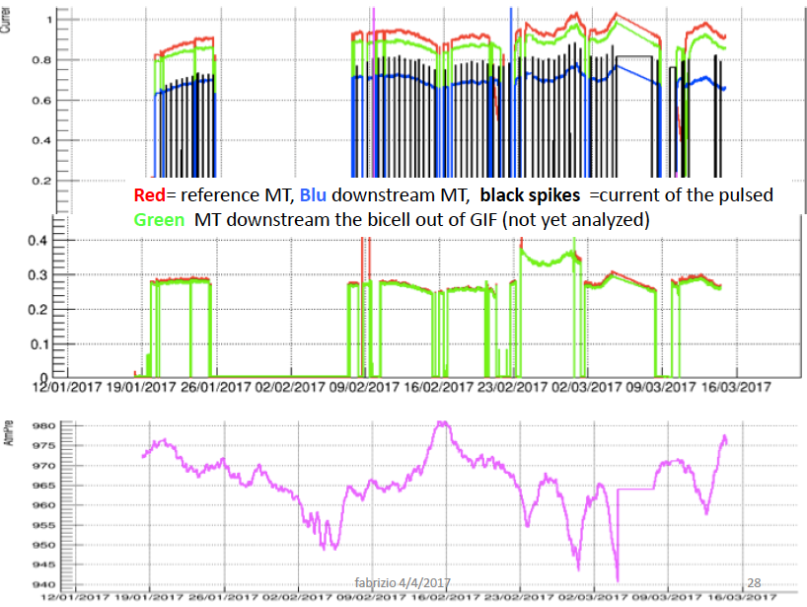
Fig 8/3
Red : wire 1
Green : wire 2
MB1
Atmospheric pressure

Slide 18
FURTHER STEPS AFTER THE FIRST TEST
Four bicells have been irradiated at GIF during summer 2017
They were operated at different gas flows and gain ,
They confirmed that a naked tube ages, as observed in the first bicell
~12 mC/cm with
gain loss between 8 and 10 %
A negligible figure, compared to the MB1 chamber (2,5 mC/cm and 73% losses).
In the same time in LNL (using the Monotubes) the outgassing properties of the
Materials present in the gas volume of a DT chamber were checked…
(and are again under check).
.
.

Slide 19
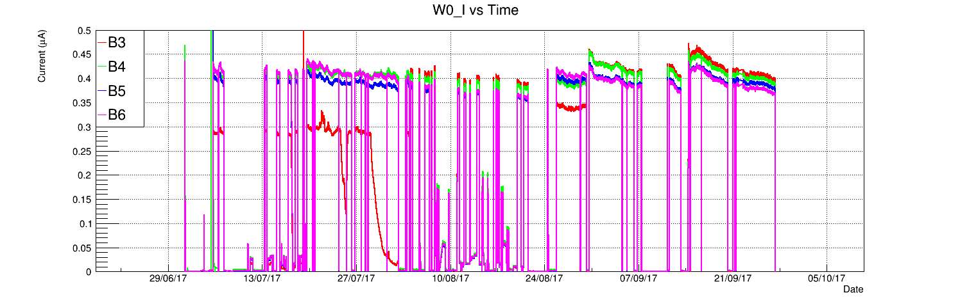
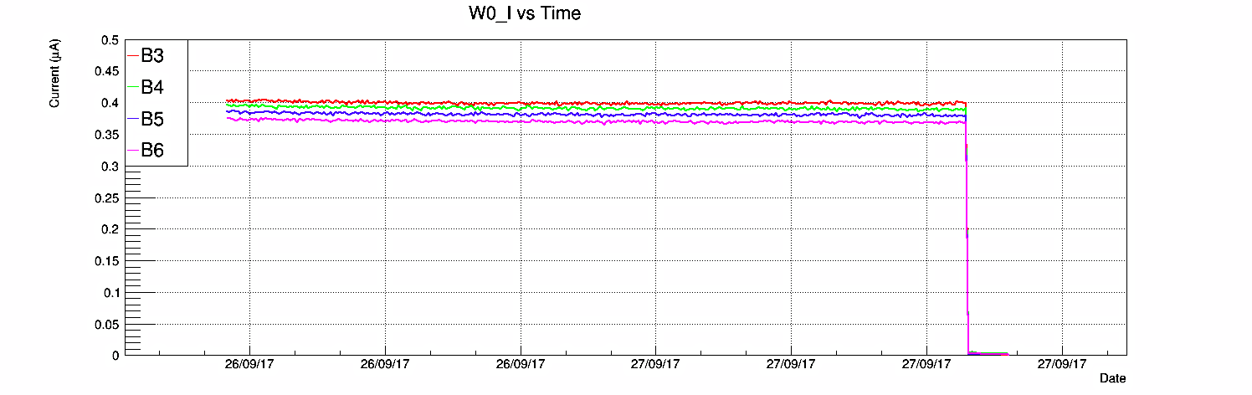
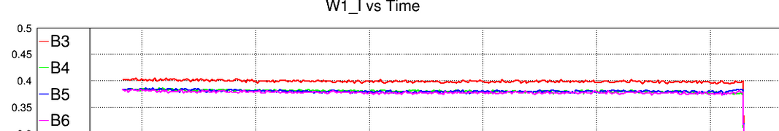
The four bicell test June – Oct 2017
~ 12 mC/cm
B3 e B5 ~ 1,2 cc/min
B4 e B6 ~ 5 cc/min
after a collected charge of ~ 12 mC/cm (` 1,2 times the full HL LHC) the gain loss of the four bicells is in the range of 8~9 %. (MB1 new wires loose 54% after 0,6 mC/cm)
No, or very low dependence on the gas flow within a factor >4

Slide 20
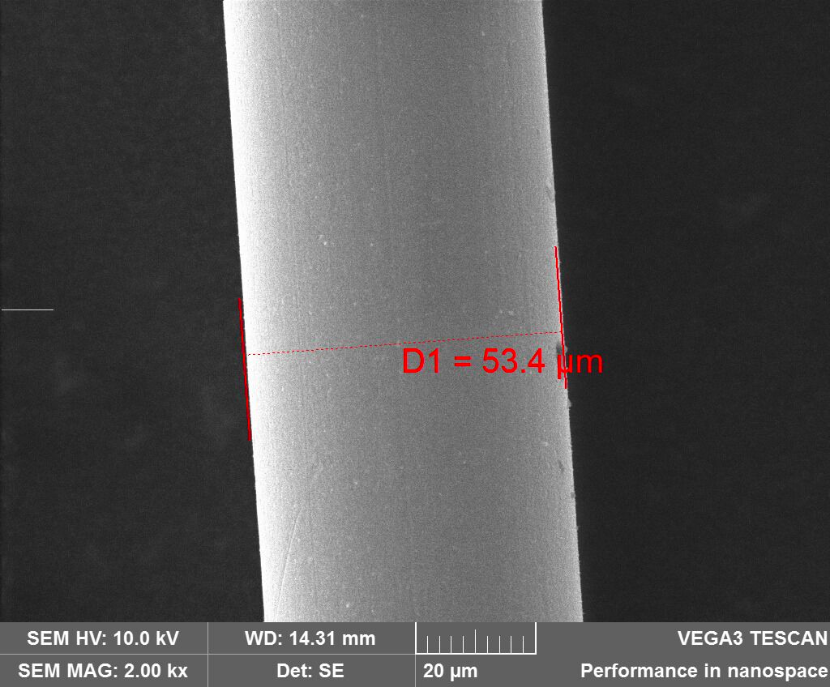
B3
Wire 1
From the Four
bicells
summer test

Slide 21
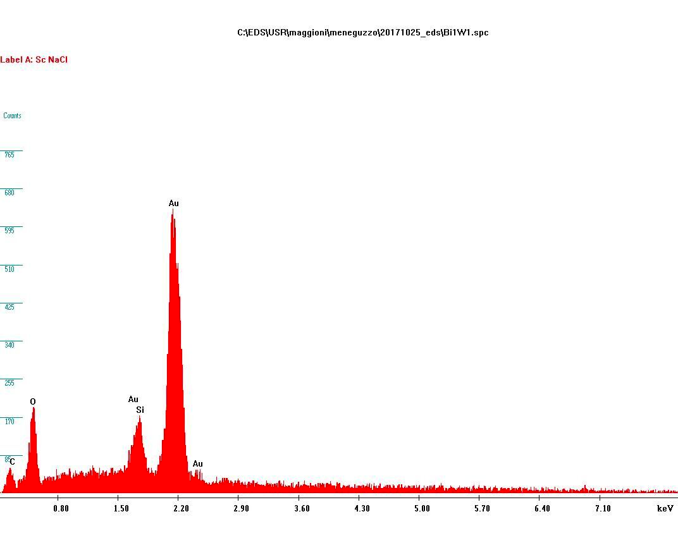
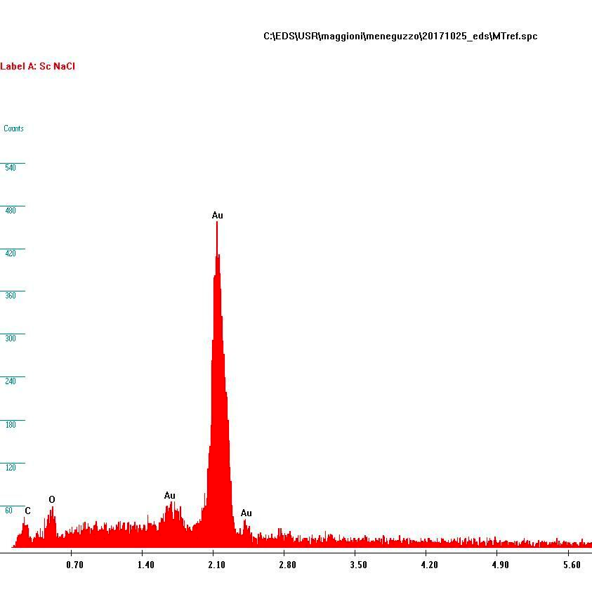
Wire of the non aged
Reference MT
B3 Wire 1

Slide 22
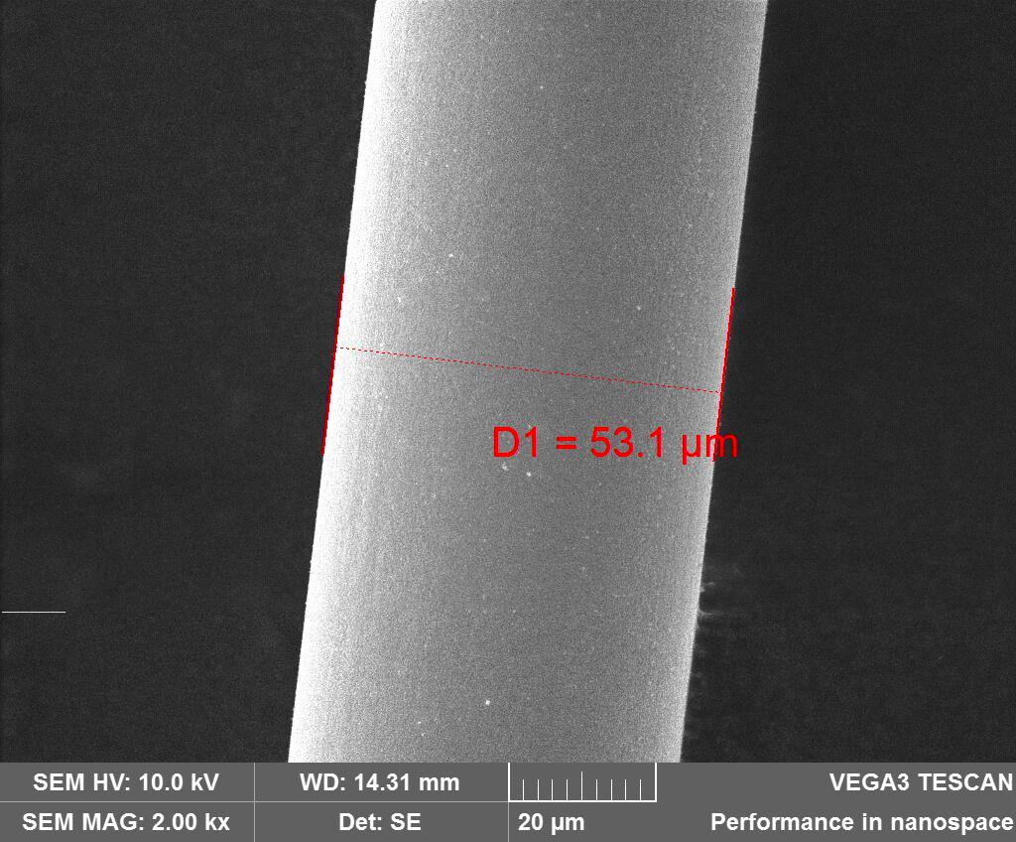
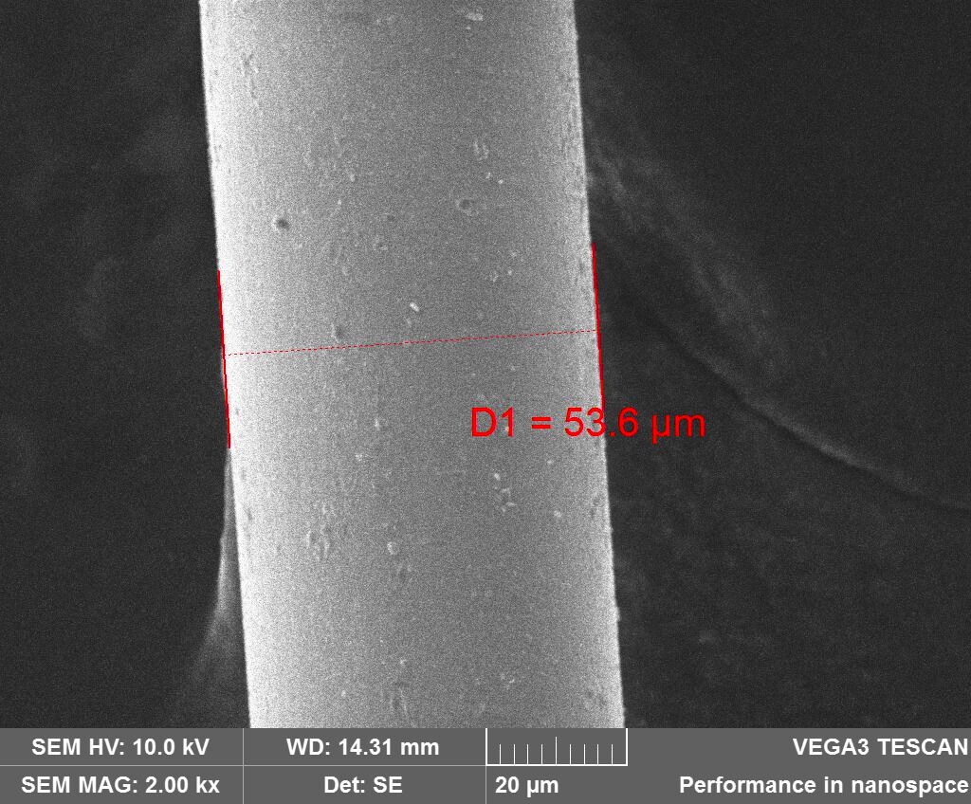
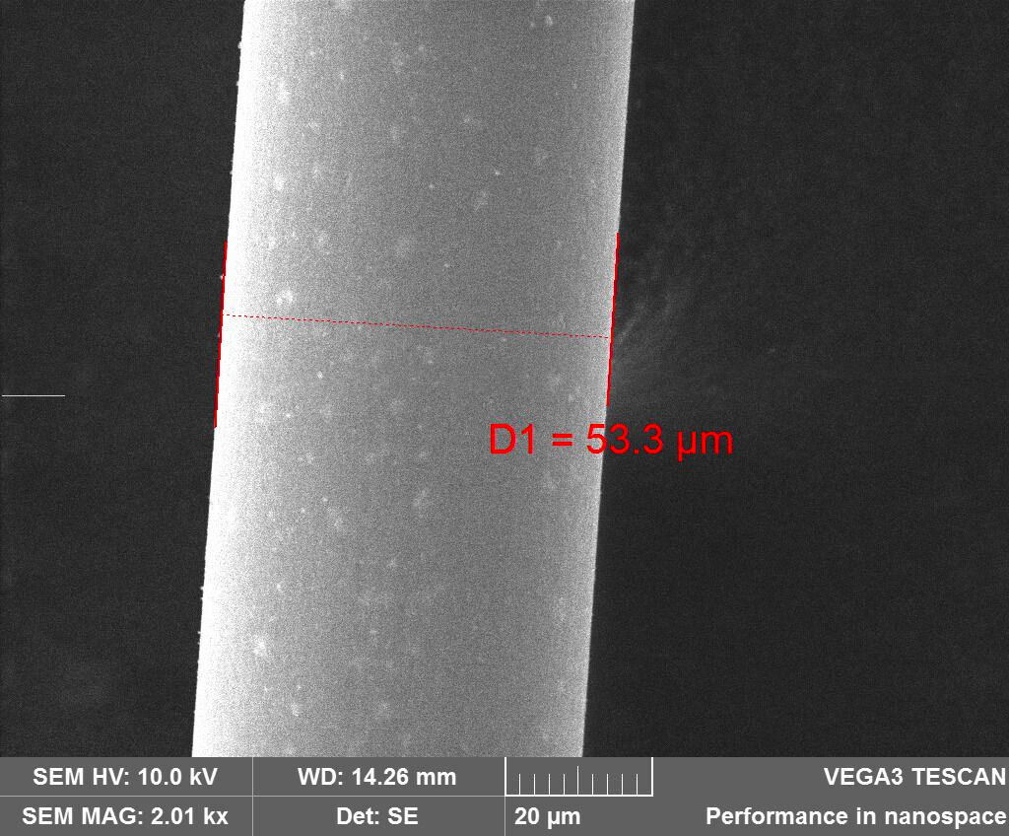
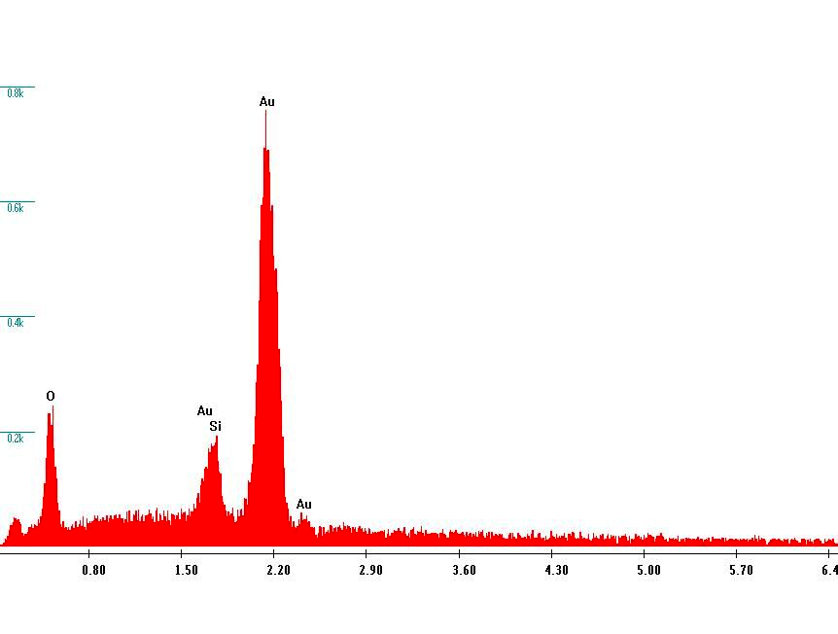
B4 Wire2
B5
Wire 1
Four bicells
summer test
B6
Wire1
B6 wire 2

Slide 23
A short summary of the results :
Remind that HL LHC Charge = 10 ~ 20 mC/cm
Monotubes per se do not age
They age when put downstream an aging detector
The loss of gain of monotube comparable to that of the upstream
detectors, wire spectra very similar.
MB1 wires age (test 1) dG/G = 73 % 3mC/cm 1/3 HL LHC
(test 2) dG/G = 54% 0,6 mC/cm
Monotube after MB1 (test2) dG/G = 59 % 1,3 mC/cm
Bicell 1 (naked DT tube) ages dG/G = 20% 20 mC/cm 2 X HL
Monotube after bicell 1 dG/G = 20% 90 mC/cm
Four Bicells dG/G = 9% 12 mC/cm

Slide 24
“final” considerations 1 :
Five bicells (naked DT Tubes) behaved perfectly and in exactly in the same way:
they showed that a naked tube ages.
Extensive, and time consuming, aging test are going on in Legnaro on all the materials supposed to be in the DT gas volume.
Up to now the only possible responsible for the poisoning might be the glue between the mylar strips,that support the field shaping electrodes, to the aluminum plates to the double T shaped Al beams that separate the DT tubes.
No other credible candidate has been found…….
But the size of the aging and the “face” of the wires in the Bicells are very different from what was found in the tested MB1 big chamber

Slide 25
“final” considerations 2 (and current plans):
This difference may indicate that irradiation induecs or enhances the outgassing
of some of the materials present in the gas volume of the DT chambers.
This implies that the out-gassing tests of all the materials should be repeated
under Irradiation at GIF.
Some caveats:
The aging of the MB1 chamber might be an accident (inherent to that specific
chamber). We need to cross check with a second chamber .
The choice has been in favor of a MB2 assembled in Madrid.
The MB1 was assembled in Aachen. Chambers were not assembled in clean rooms ,
may be local dust, different assembling devices ….. may have some influence.
The test on the chamber and on the bicells were not performed at the same time.
Different conditions (irradiation,gas mix….) might be responsible for the difference.
MB2 and bicells should be exposed together at the same time to grant the same
conditions. (This test is currently starting at GIF )

Slide 26
A conclusion might be that results from models,
as accurate they might be, are not easily exportable to a
realistic big object.
A famous precedent can be found in the history of the America Cup sailing race:the UK designer
Watson after his boat was defeated in the 1902 race by the US one designed by Herreshof
was keeping complaining that:
“ it is because Herreshof had the big chance of not having,like me, the possibility of testing the model
of his design n a naval tank !! “
OGNI AIUTO E’ BENVENUTO !

Slide 27
Back up

Slide 28
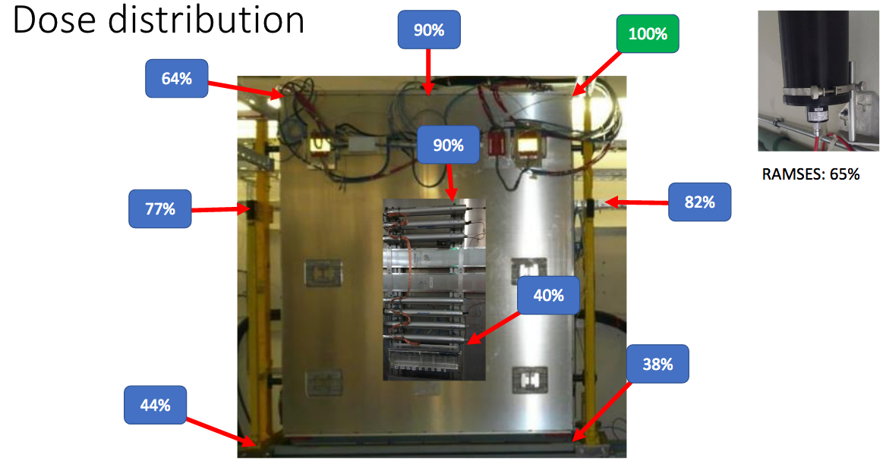

Slide 29
There is a last caveat:
Which is the effect of the size of the gas flow on the aging ?
The volume of a tube of a bicell is 1/3 of a tube in MB1 (or MB2).
The gas flow in the DT is ~ 1 cc/minute per tube …the bicells were operated at 0,8 ~ 1 cc/minute
per tube. The limit comes from the gas tightness .
The gas renewal rate is tree times larger :
we are preparing to go with the bicell to 0,2 ~0,3 cc/minute.
The four bicells were operated for 45 days at different gas flows :from o,8 to 5 cc/min.
No clear difference was found between their aging performance: willing to fid a sign it seems
Aging is worse at higher flux. but that it might be ( this in agreement with what observed by
the Spanish colleaguesduring the MB 1 test).
This is in disagreement with current mantra.
Test with Monotubes in Legnaro did not show any large difference in the range 1 to 10 cc/min.
The improved gas tight bicell should clarify this aspect in the next months.

Slide 30
