Slide 1
Synchrotron radiation interaction with
cryosorbed layers for astrochemical investigations
Rémi Dupuy
Laboratoire d’Etude du Rayonnement et de la Matière en Astrophysique et Atmosphère
Sorbonne Université, Observatoire de Paris
M. Bertin, G. Féraud, X. Michaut, T. Putaud, M. Hassenfratz, L. Philippe, P. Jeseck, M. Angelucci, R. Cimino, V. Baglin, C. Romanzin and J.-H. Fillion

Slide 2
Introduction : photon-stimulated desorption
UV
X-ray
Photon-stimulated desorption
Accelerators : vacuum dynamics
Astrochemistry
Our approach : using synchrotron radiation to study photodesorption
Molecular ice (CO, N₂ H₂O, CH₄..)
Cold Substrate
(10 - 100K)

Slide 3
Introduction : photon-stimulated desorption
UV
X-ray
Photon-stimulated desorption
Accelerators : vacuum dynamics
Astrochemistry
Our approach : using synchrotron radiation to study photodesorption
Outline
Molecular ice (CO, N₂ H₂O, CH₄..)
I. Astrochemistry & photon-stimulated desorption
II. UV photodesorption : DIET & indirect desorption
III. X-ray photodesorption
Cold Substrate
(10 - 100K)

Slide 4
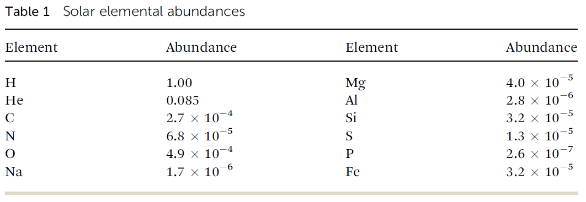
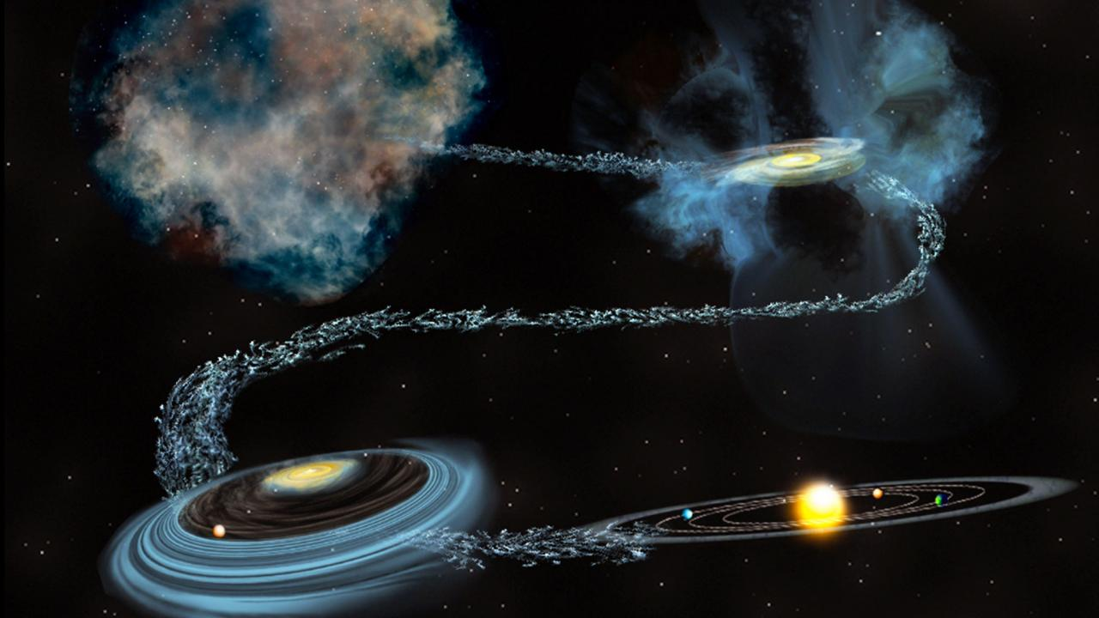
Matter in the universe
Matter in space exists in several forms :
Van Dishoeck, FD 168 9 (2014)
Ionised
Atomic
Molecular
Molecular cloud
10³-10⁵ cm³ / 10 K
Protostellar enveloppe
>10⁵ cm³ / 10 - 100 K
Protoplanetary disk
10⁶-10¹³ cm³⁻ / 10 - 300 K
Planetary system
Credit : Bill Saxton

Slide 5
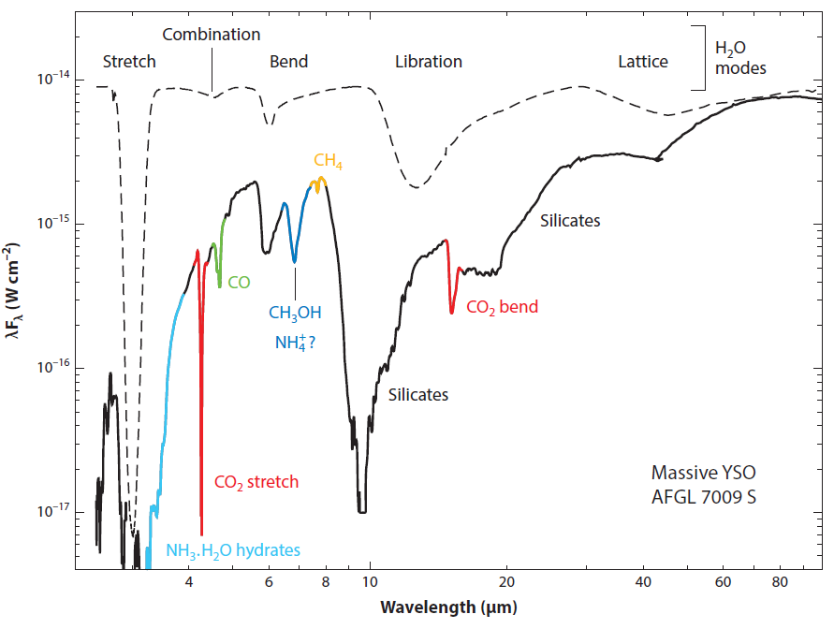
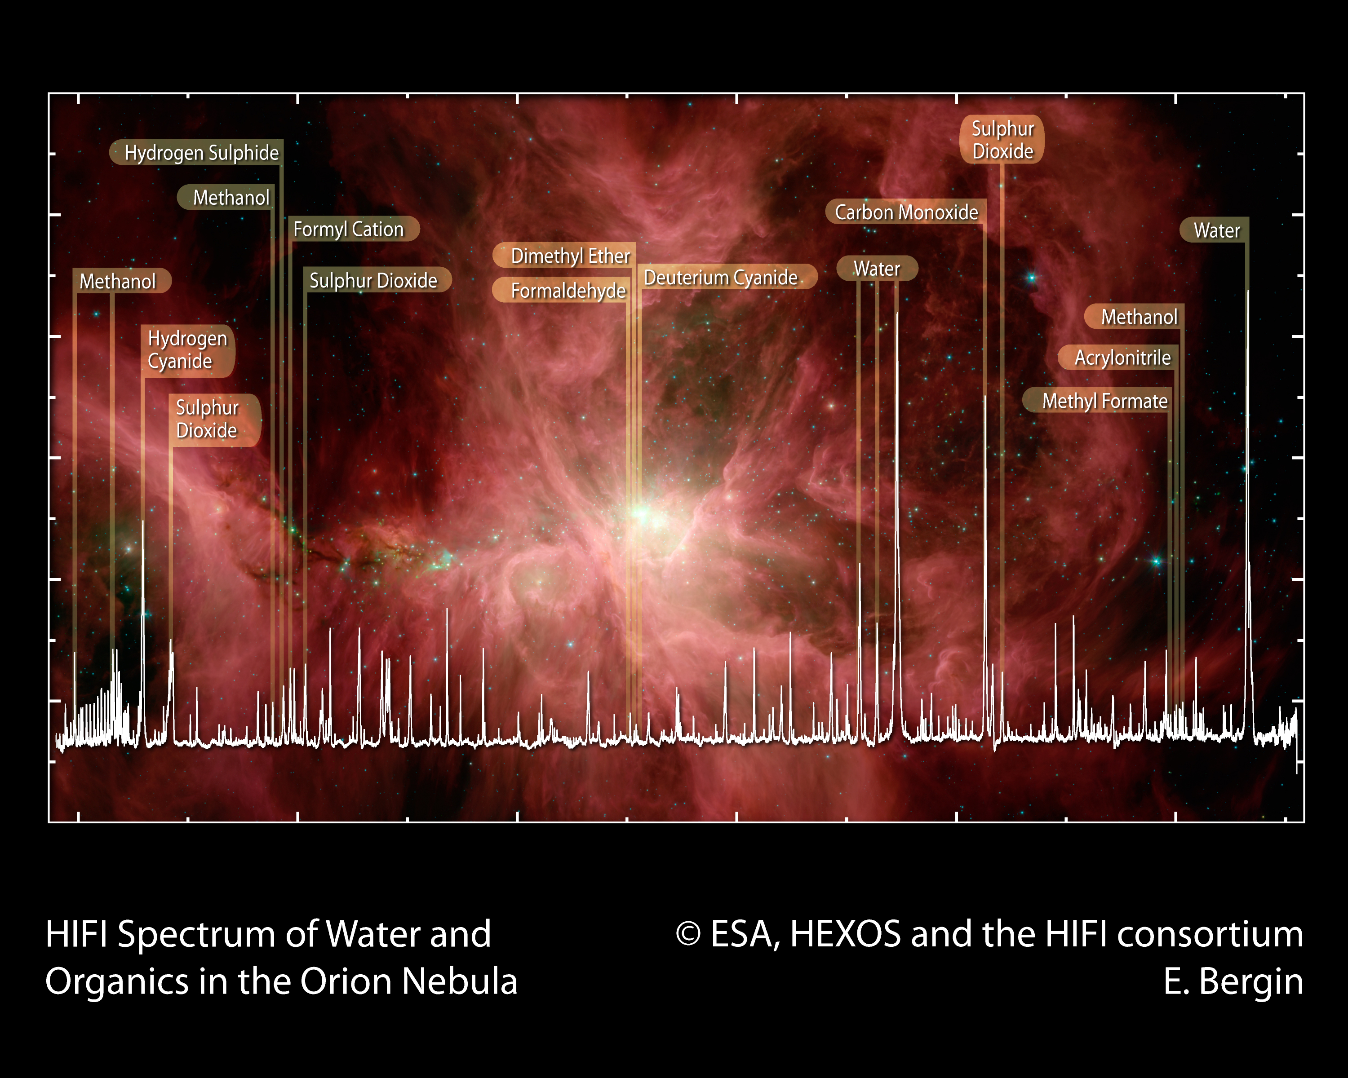
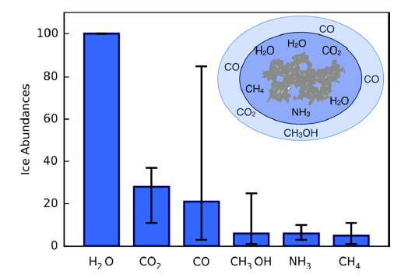
The interstellar medium : a gas and a solid phase
Solid phase
Gas phase
Dust grains (1-1000 nm) Silicate/carbon core + ice mantle in cold regions
Reaction catalysts
In cold regions, sink for molecules (main molecular reservoir)
Molecules detected mostly through radio-astronomy (rotational lines)
>200 species detected so far
Öberg Chem. Rev
116 9631 2016
Boogert et al. Annu. Rev. Astron. Astrophys. 2015.53:541-581.

Slide 6
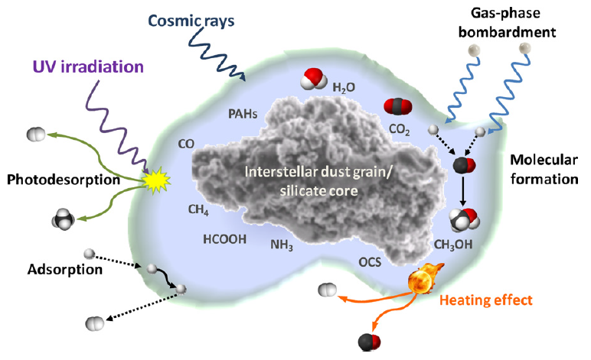
Non-thermal desorption
In cold regions
Non-thermal desorption
Meinert et al, Phys. Life Rev. 8 3 307 (2011)
Energetic particles
Chemistry
Sputtering in shocks
Photodesorption
Thermal desorption
In hot regions
Astrochemical models need input from laboratory experiments
Both quantitative (numbers) and qualitative (how to implement these processes)

Slide 7
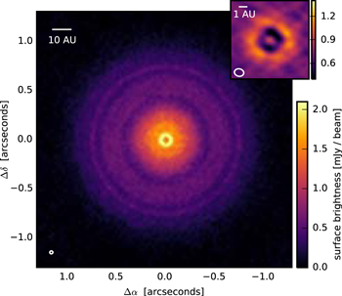
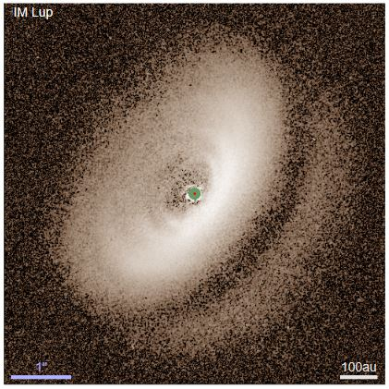
Example : protoplanetary disks
UV
X-ray
(external)
Sketch by C. Walsh
Sketch from C. Walsh
ALMA image of the TW Hydrae protoplanetary disk (dust continuum emission @ 870 µm)
Andrews et al 2016, ApJ, 820, L40
SPHERE image of the IM Lup disk (Optical/NIR scattered light)
Avenhaus et al 2018, arXiv:1803.10882

Slide 8
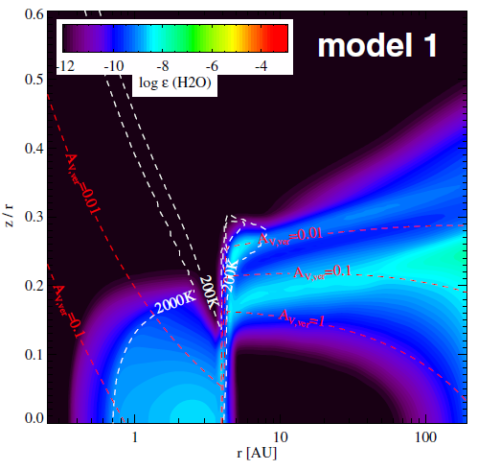
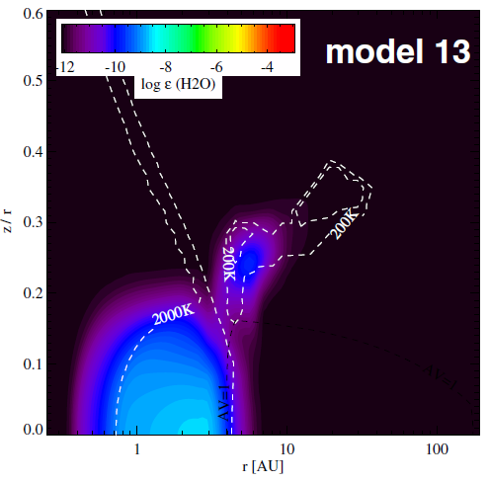
Example : protoplanetary disks
Explaining cold gas phase water observations (Hogerheijde et al. 2011) :
Disk model in Kamp et al. (2013) (spatial distribution of gas phase water) :
With UV photodesorption
Without UV photodesorption
Height/radius
Height/radius
Radius (AU)
Radius (AU)
Non-thermal desorption needed to explain “complex” organic molecules observations (CH₃CN, CH₃OH…)
Some yields are still unknown, others need better exploration of the parameters
The X-ray photodesorption process is not taken into account at all yet!

Slide 9
Accelerators & space
Interstellar medium
LHC
Cold grains (10 – 200 K)
Chemical composition : H₂O, CO, CO₂, CH₄…
Low density gas phase (10³ – 10¹⁰ mol/cm³)
Energetic particles and radiation (UV, X-rays, cosmic rays)
Need to understand the interplay between gas-phase and grains
Cold surfaces (2 – 20 K)
Residual gases : H₂, H₂O, CO, CO₂, CH₄…
Ultra-high vacuum (10⁶ – 10⁸ mol/cm³)
Energetic particles and radiation (synchrotron radiation, electrons)
Need to understand vacuum dynamics
Quantitative & qualitative investigations of ESD and PSD are needed

Slide 10
The experimental set-up: SPICES (Surface Processes on ICES)
Ice dosing system
Ultra-high vacuum
P ~ 1.10⁻¹⁰ Torr
Rotating samples
10K < T < 300K
IR
IR
FT-IR Spectrometer
IR Detector
neutrals
+ion
-ion
VUV
QMS
(Balzers)
Synchrotron
Coupling
(VUV or Soft X-ray beamline)
QMS
(Hiden Analytical)
The mass and quantity of desorbed molecules can be measured as a function of photon energy
thanks to synchrotron radiation

Slide 11
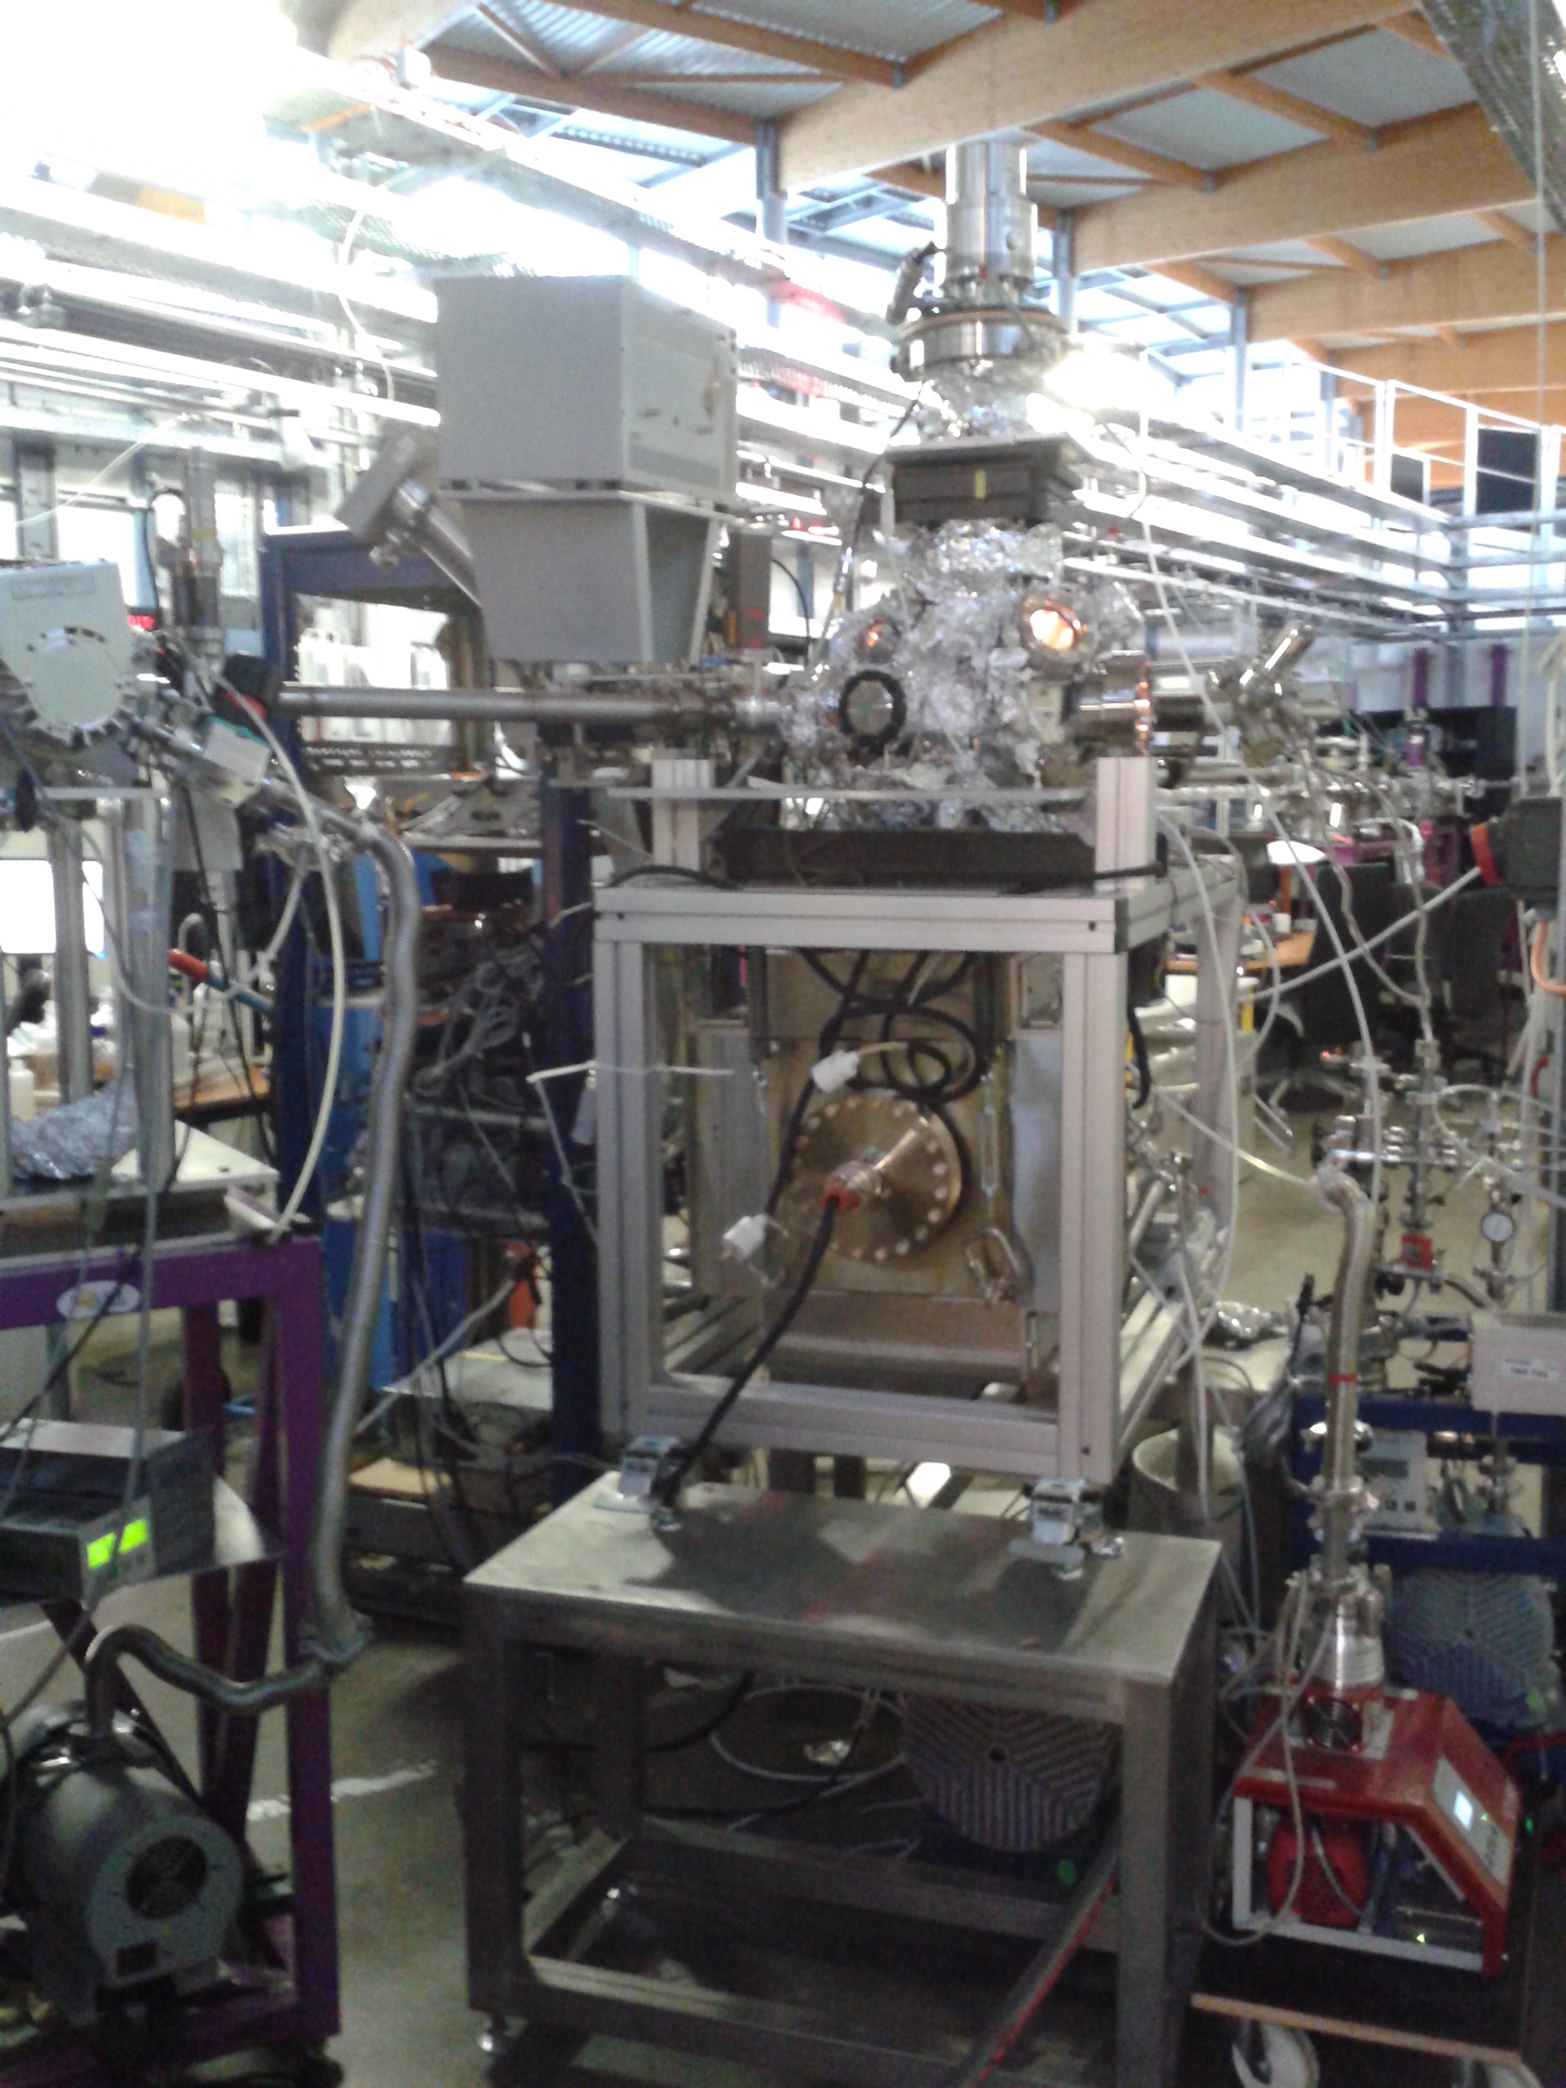
SPICES @ DESIRS beamline
SPICES 2
DESIRS Beamline:
Undulator-based + monochromator
Gas filter for second harmonics 5 – 40 eV
SPICES
Here:
7 – 14 eV
ΔE ~ 25 meV
Flux ~ 5 – 14 x 10¹² ph.s⁻¹
on a 0.7 cm² spot

Slide 12
A prototypical example: CO
Fayolle et al. 2011
Dupuy et al. 2017
Pure CO ice, 20 ML
Strong dependence of the photodesorption yield on the photon energy
CO Ice 20 ML

Slide 13
A prototypical example: CO
Molecular signature of an electronic transition in the desorption spectrum
Fayolle et al. 2011
Dupuy et al. 2017
E
Ionization threshold
A¹Π(v’) ← X¹Σ⁺(0)
2π
v’ =
0
1
2
3
5
6
7
4
8
hυ
5σ
Desorption Induced by Electronic Transitions (DIET)
Pure CO ice, 20 ML
Strong dependence of the photodesorption yield on the photon energy
(Question then: how is the electronic energy converted to a desorption event?)
CO Ice 20 ML

Slide 14
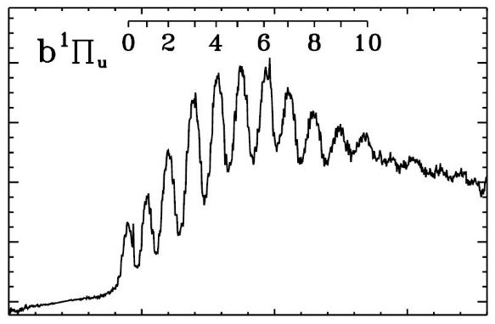
N₂ molecule
Fayolle et al. 2013
Pure N₂ ice, 30 ML
The DIET mechanism implies very different photon energy dependance & yields for different molecules

Slide 15
Layering different molecules
N₂ layer 1 ML
Fayolle et al. 2013
CO Ice 20 ML
Pure N₂ ice, 30 ML
The DIET mechanism implies very different photon energy dependance & yields for different molecules

Slide 16
Layering different molecules
N₂ layer 1 ML
Fayolle et al. 2013
CO Ice 20 ML
Pure N₂ ice, 30 ML
Bertin et al. 2013
The DIET mechanism implies very different photon energy dependance & yields for different molecules
CO absorption signatures

Slide 17
Layering different molecules
N₂ layer 1 ML
Fayolle et al. 2013
Energy transfer
CO Ice 20 ML
Pure N₂ ice, 30 ML
Bertin et al. 2013
The DIET mechanism implies very different photon energy dependance & yields for different molecules
CO absorption signatures
« Indirect » DIET
Energy is transfered from underlying CO to surface N₂

Slide 18
CH₄ molecule: opening the dissociation channel
New possible desorption channels:
Dissociative electronic states of CH₄
(CH₄)* → CH₃ + H
~4.5 eV that can be used for desorption
1
CH₃ + H → CH₄ + Δ_{r}H
And several other possible reactions involving CH, CH₂, H₂…
Dupuy et al. 2017
2
« Hot » H atom → kick-out of other molecules
« photochemical »
desorption
1
2
Kick-out

Slide 19
CH₄ molecule: indirect desorption
Dupuy et al. 2017
Desorption of surface molecules
CH₄ layer 1 ML
Energy transfer
CO Ice
20 ML
Combination of CO + CH₄ spectra
→ indirect desorption works as well

Slide 20
CH₄ molecule: indirect desorption
Dupuy et al. 2017
Desorption of surface molecules
CH₄ layer 1 ML
Energy transfer
~1.5e-3 mol/ph
CO Ice
20 ML
Combination of CO + CH₄ spectra
→ indirect desorption works as well
Compare with N₂ indirect CO-induced desorption efficiency:
~3e-2 mol/ph
What parameters drive the efficiency of indirect desorption?
Binding energy: unlikely (all ~100 meV)
Mass mismatch?
Intra-molecular relaxation?
Inter-molecular energy transfer?
Much left to investigate

Slide 21
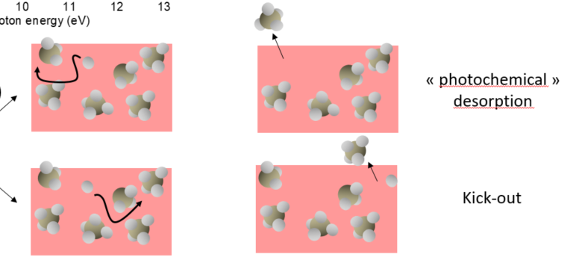
Desorption mechanisms: summary
Desorption is initiated by an electronic transition (→ information brought by synchrotron radiation) Mechanism of conversion of electronic energy to desorption?
The electronic energy can be used to dissociate the molecule if the electronic state is dissociative (e.g. for CH₄)
Recombination creates a « hot » molecule that can desorb
Energetic H atoms can kick out other molecules
For non-dissociative molecules (N₂, CO) the exact mechanism is not elucidated. Calculations can help (e.g. Van Hemert et al. 2015).
Desorption can be indirect (→ information brought by synchrotron radiation)
Parameters driving the efficiency?
N₂ layer 1 ML
Energy transfer
In project!
CO Ice 20 ML

Slide 22
Back to astrophysics
UV fields in the ISM
In the case of protoplanetary disks:
Spectrum of the stellar radiation (TW Hya):
Pure N₂
« Average » yields
Ly-α
Stellar 7e-3 mol/photon
ISRF 2e-2 mol/photon
Johns-Krull et al. 2007
x
External radiation: InterStellar Radiation Field (ISRF)
N₂ on CO
Stellar 9e-3 mol/photon
ISRF 2.2e-2 mol/photon
Mathis et al. 1983

Slide 23
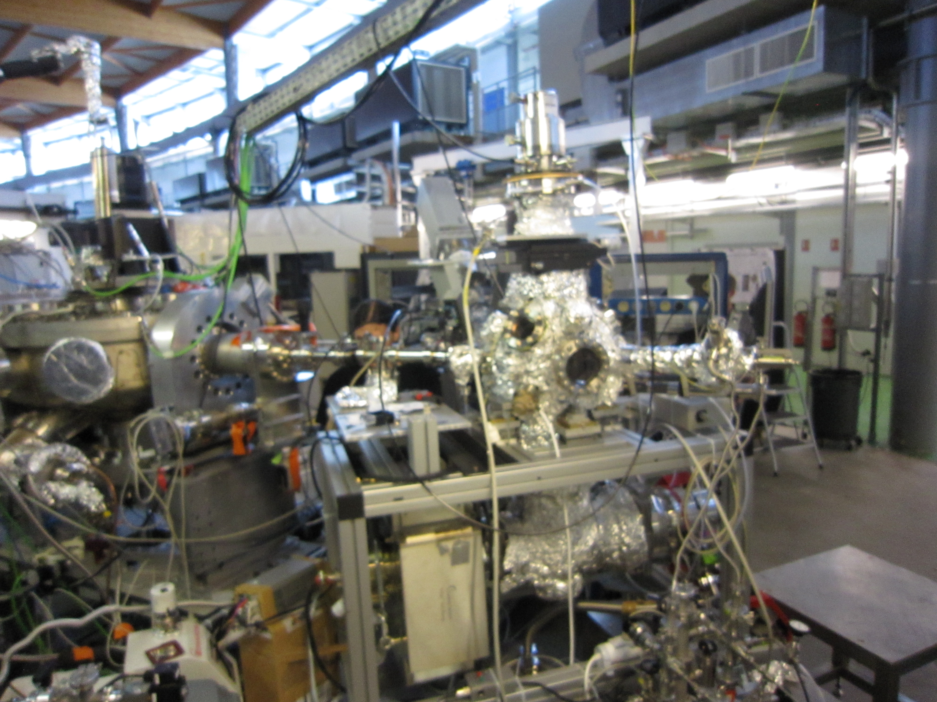
SPICES @ SEXTANTS beamline
Quadrupole mass spectrometer
(+ kinetic energy analysis)
X-ray photons
(500 – 600 eV)
ΔE ~ 150 meV
Flux ~ 2 – 14 x 10¹² photon.s⁻¹
on a few mm² spot
Quadrupole mass
spectrometer
SPICES 2
+ions
-ions
neutrals
Amorphous solid
water (ASW)
~100 monolayers (ML)
Copper substrate
(15 – 90K)
Sample current
Kapton isolation
Total Electron Yield (TEY)

Slide 24
How X-ray photodesorption works
UV photodesorption
X-ray photodesorption
Valence electron excitation/ionization
Core electron excitation/ionization
E
E
4a₁
4a₁
hυ
(~10 eV)
1b₁
1b₁
3a₁
3a₁
hυ (~540 eV)
O 1s (1a₁)
- Energy conversion
- Dissociation
- Chemical recombination
- Kick-out
?
Desorption
Desorption
Notes:
Ref feigelson utile ?

Slide 25
What happens when a molecule absorbs an X-ray photon ?
Auger decay
Auger
electron (500 eV)
X-ray
X-ray induced Electron Stimulated Desorption (XESD)
Ionization threshold
4a₁
Excitation migration
Auger
electron
1b₁
3a₁
Secondary electrons
& excitons
O 1s (1a₁)
Molecular orbitals of water
« True » photon stimulated desorption

Slide 26
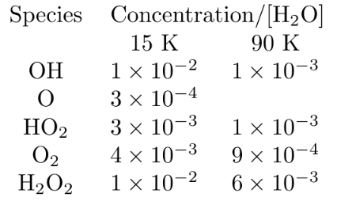
Near-edge X-ray spectroscopy
Total Electron yield (TEY) ~ Absorption spectrum
H₂O resonances
EXAFS oscillation
Pre-edge features Spectroscopic signatures of photo-produced radicals & products
Concentration wrt H₂O : (cf. Laffon et al. 2006)

Slide 27
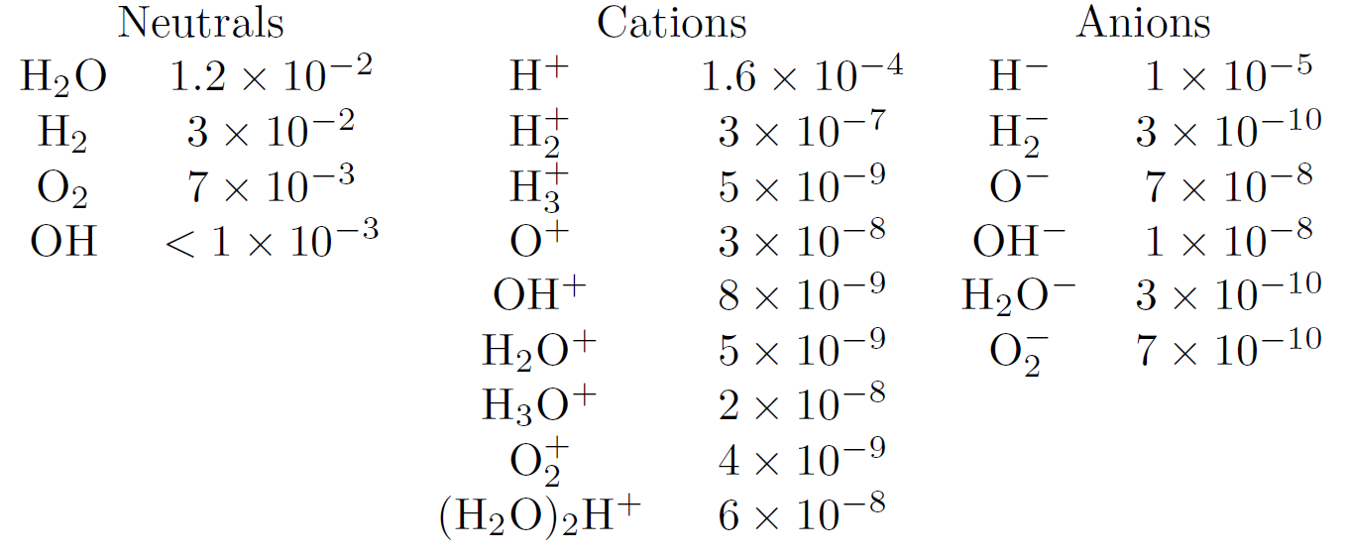
What desorbs
Photodesorption yields @ 540 eV for ASW at 90K
(molecule or ion per incident photon)
+ (H₂O)H⁺ clusters from n = 3 to 11
+ ~0.2 electron/photon
Many different species are observed
Desorption of neutral species dominates
Dupuy et al., accepted in Nature Astronomy

Slide 28
Parenthesis on chemistry: CO ice
X-ray
CO Ice 100 ML
Numerous C_{x}O_{y}⁺ chains & more
When carbon (and some hydrogen) is involved, the chemical complexity increases rapidly

Slide 29
Neutral desorption
H₂O
Photodesorption spectra of neutrals follow the absorption
Presumably dominated by XESD
Astrophysical yields can be derived (-> see Dupuy et al., accepted in Nature Astronomy)
H₂
O₂
T = 15 K

Slide 30
Desorption of ions : O⁺
The O⁺ desorption spectrum provides evidence that O⁺ desorption is dominated by direct dissociation (and not electron-mediated dissociation) of a secondary product : H₂O₂
Other O-bearing fragments (OH⁺, H₂O⁺, O, OH) also have this spectral signature!
O – H bond breaking: the light H fragment takes away most of the kinetic energy
O – O bond breaking: the kinetic energy is equally partitioned

Slide 31
Conclusion
Yields: vary a lot depending on the molecule, but also on other parameters (temperature, ice thickness…).
Therefore: understanding the mechanisms instead to make proper extrapolations is crucial!
Perspectives:
More tools to elucidate mechanisms: kinetic energy, internal energy of desorbing particles (kinetic energy filter, REMPI spectroscopy…)
Systematic investigation of some layer model systems for understanding indirect desorption
Interaction of UV or X-ray photons, electrons etc with cold surfaces: understanding the fundamental mechanisms can be fruitful for different communities!

Slide 32
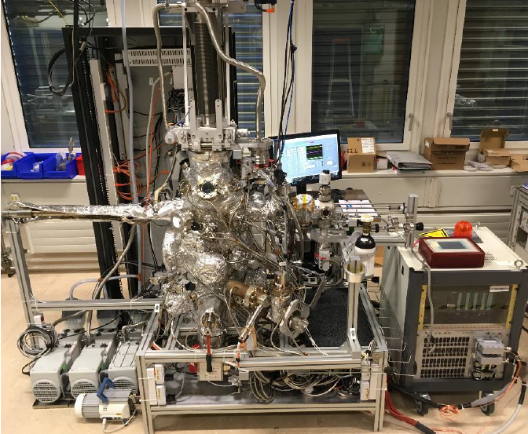
Multisystem @ CERN
Set-up at CERN designed by V. Baglin and B. Henrist, installed by M. Haubner and B. Henrist
Current status : operational !
Goal (for me): studying electron-stimulated desorption
First measurements on N₂ and CO have been performed
See the talk of B. Henrist right after!

Slide 33
Thanks page
People at LERMA
Collaborations
… and all the SPICES team
T. Putaud
L. Philippe
P. Jeseck
P. Marie-Jeanne
X. Michaut
LCP (Univ. Paris Sud)
C. Romanzin
CERN
V. Baglin
« Photodesorption » team
M. Bertin
G. Féraud
J.-H. Fillion
LNF (INFN)
R. Cimino
Support

Slide 34
H⁺ and the role of the ice surface
Resonances in this region are strongly affected by H-bonding
The H+ resonances correspond to surface molecules with a dangling H:
At low H⁺ kinetic energies, different features appear
-> surface molecules in particularly distorted configurations

Slide 35
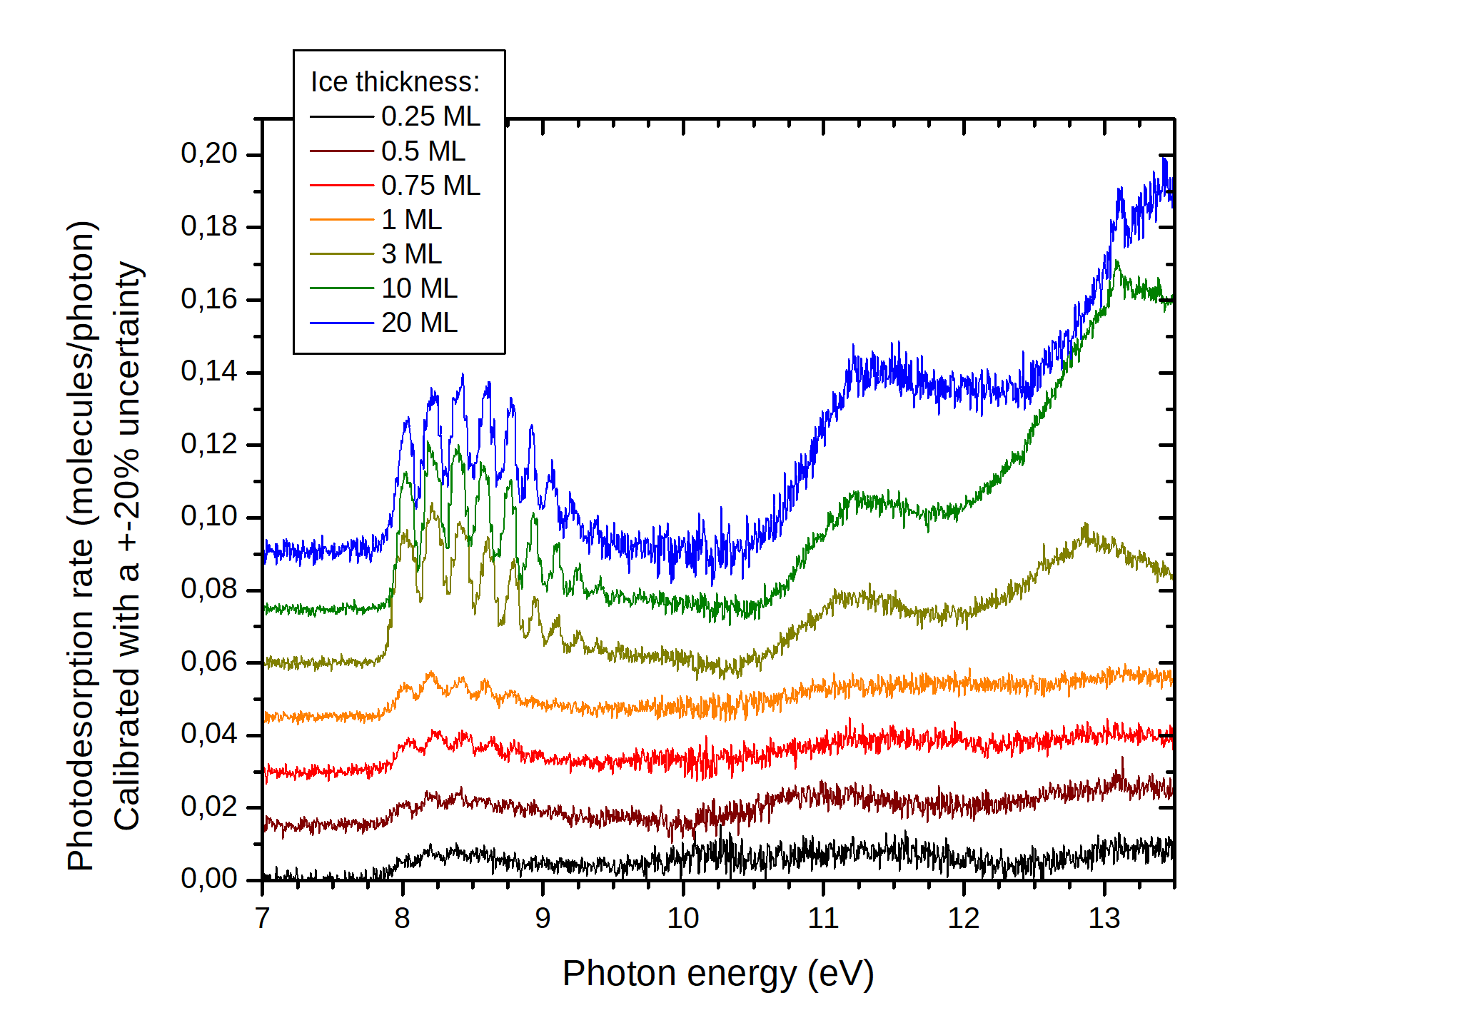
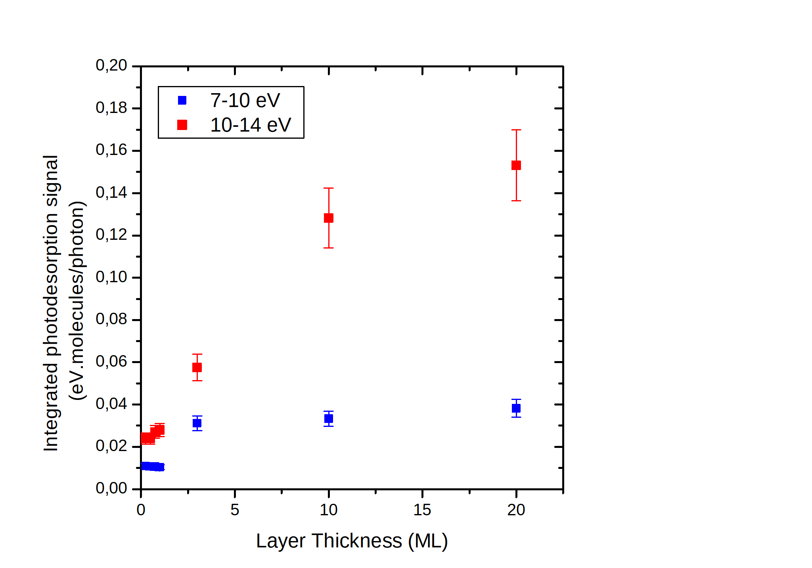
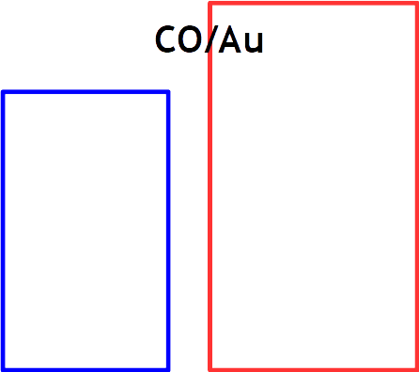
Thickness effects: CO ice
Distinct behaviour for different electronic states!
For the A – X state: saturation @ 3 ML
For the states above 11 eV : much more thickness effect, up to 20 ML

Slide 36
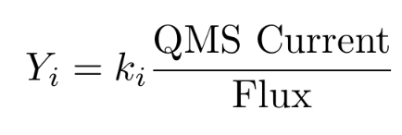
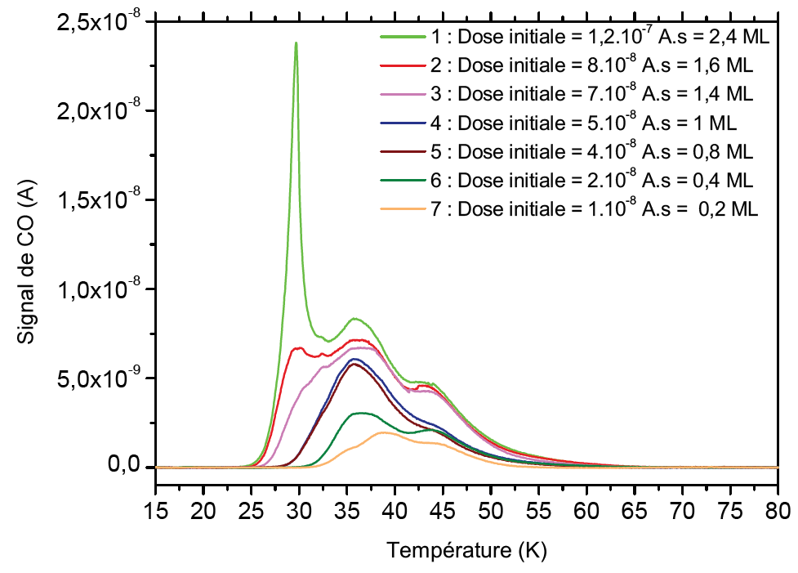
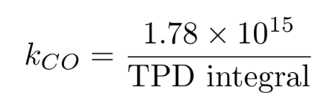
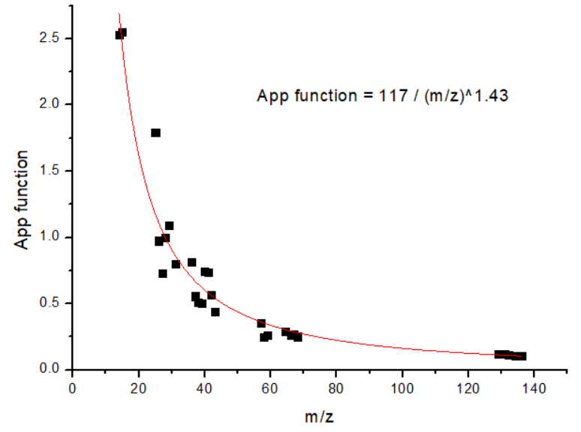
Absolute yields
Neutral desorption calibration
* Finding k_{CO} :
(1) The dose required for depositing 1ML of CO
is determined by TPD
(2) 1 ML on a 15x15 mm surface => 1.78.10¹⁵ molecules
(3)
1 ML
* Deducing k_{H2O} (and others) :
Calibrated with
acetone and xenon
Electron impact
ionization cross-sections
QMS apparatus
function

Slide 37
Absolute yields
Ion desorption calibration
* Efficiency of detection of our QMS for C⁺ ion : determined by comparing our
results on C⁺ desorption from CO to the yield derived by Rosenberg et al. (1985).
=> Detection efficiency at m/z = 13 : 2 %.
For other ions : correction by the apparatus function.

