Slide 1


Experimental challenge in linear and circular accelerators driven by impedance issues
A. Mostacci
Sapienza, University of Rome and INFN-Rome, Italy
Discussions with J. Byrd, E. Chiadroni, L. Faillace, L. Ficcadenti, M. Migliorati, B. Salvant

Slide 2
OUTLINE
Experimental challenge in linear and circular accelerators driven by impedance issues
Impedance/wakes issues
Big circular machines
(FCC-ee)
”Small” circular machines
(Low ε ring)
Compact linacs (plasma acc.)
Measurement issues in ring and Linacs
Experimental challenges for impedance measurements in future accelerators
Slide 2

Slide 3
Resistive wall impedance @ FCC-ee
Resistive wall impedance is responsible of quite low intensity thresholds, for both the microwave instability in the longitudinal plane and the transverse mode coupling instability (TMCI) in the transverse plane.
A thin layer of coating is foreseen to reduce the secondary electron yield for electron cloud mitigation and, in some cases, to help the pumping process.
Resistive wall contribution to the total broad band impedance is proportional to the machine length (not true for other machine devices, i.e. bellows, RF cavities, etc.). It is critical for microwave instability.
A bit less critical contribution to the transverse impedance, but the effective transverse impedance is slightly below the threshold.
The dominant effect of the coating comes mainly from the thickness of the coating while it depends only marginally on its conductivity, as long as the thickness of the coating remains much smaller that the skin depths (see E. Belli talk on Tuesday).
Resistive wall impedance is driving the impedance budget for FCC-ee
M. Migliorati et al., Impact of the resistive wall impedance on beam dynamics in the Future Circular e ⁺ e ⁻ Collider, PRAB, 041001 (2018)
Slide 3

Slide 4
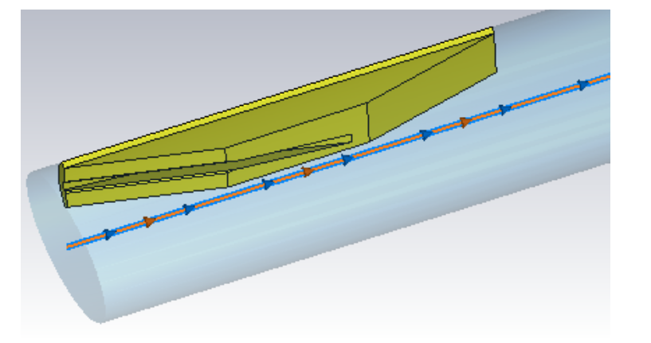
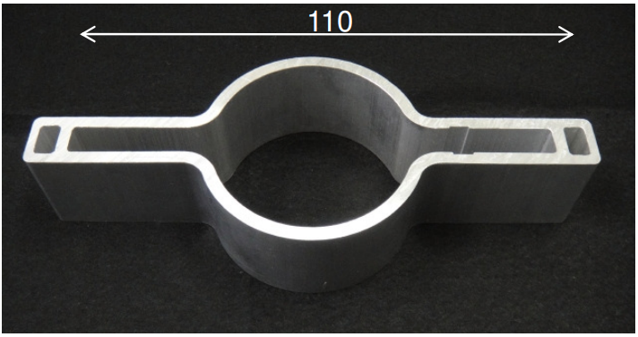
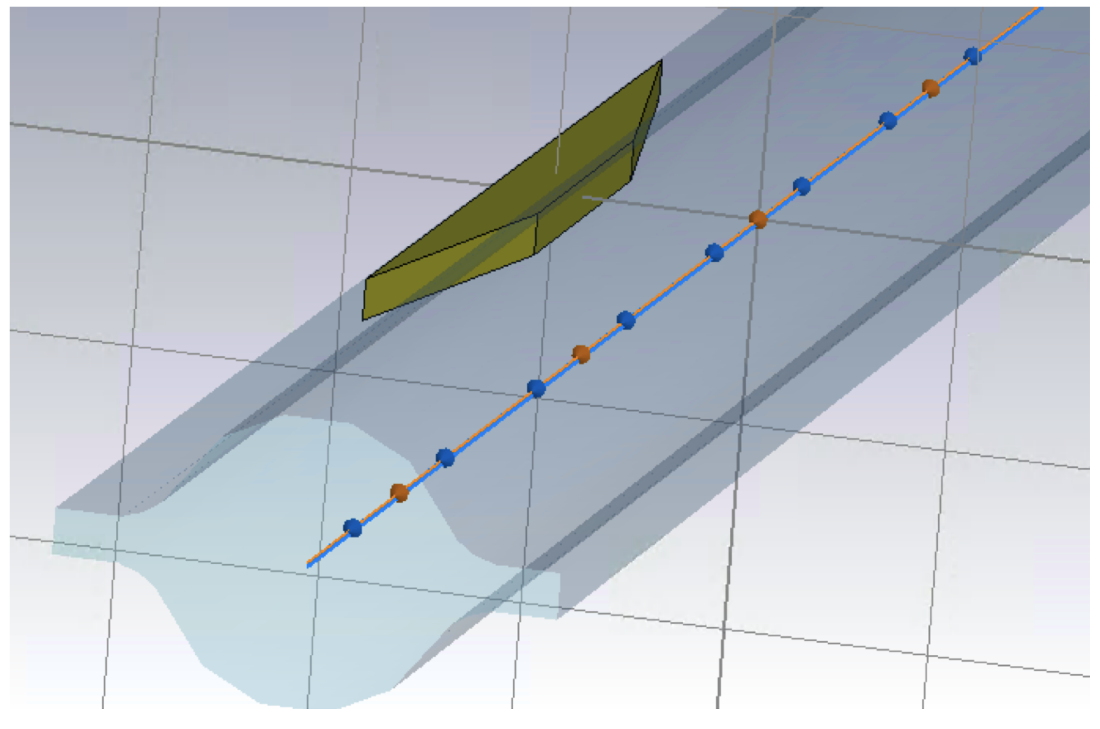
Synchrotron radiation absorbers @ FCC-ee
Original design
Improved design
Elliptic chamber
Ref. Y. Suetsugu, KEK
Metallic absorbers every 4-6m
(total number ~9300)
Round vacuum chamber in order to avoid large incoherent betatron tune shift due to the quadrupolar resistive wall wake fields.
Racetrack profile slots for vacuum pumps in front of the absorbers
Behind the slots, a cylindrical volume and a flange will be installed to support a NEG pumping.
Courtesy of M. Migliorati
Slide 4

Slide 5
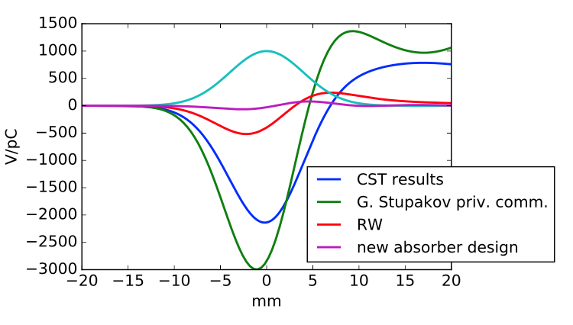
Synchrotron radiation absorbers @ FCC-ee
Courtesy of M. Migliorati
Initial absorber design
Simplified model
Resistive wall
New absorber design
The new absorbers design gives a contribution smaller than RW one, but
- the simulation result is close to the noise (single device)
Independent evaluation with dedicated measurements?
- the estimations are done only by codes
- any error in the impedance estimation will be multiplied
Slide 5

Slide 6
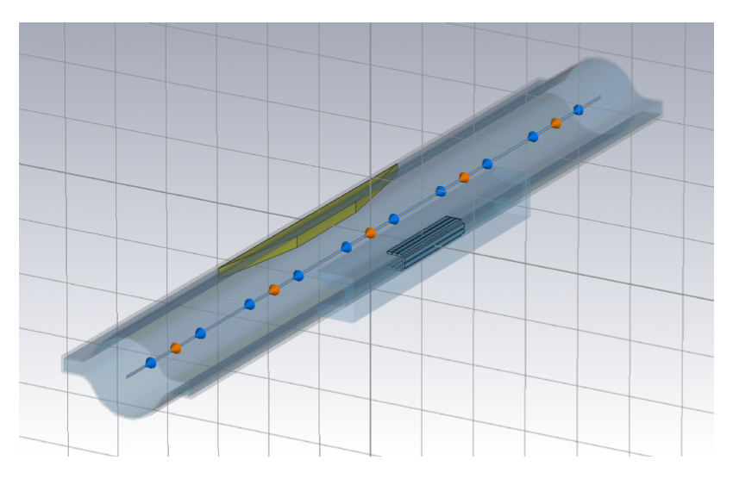
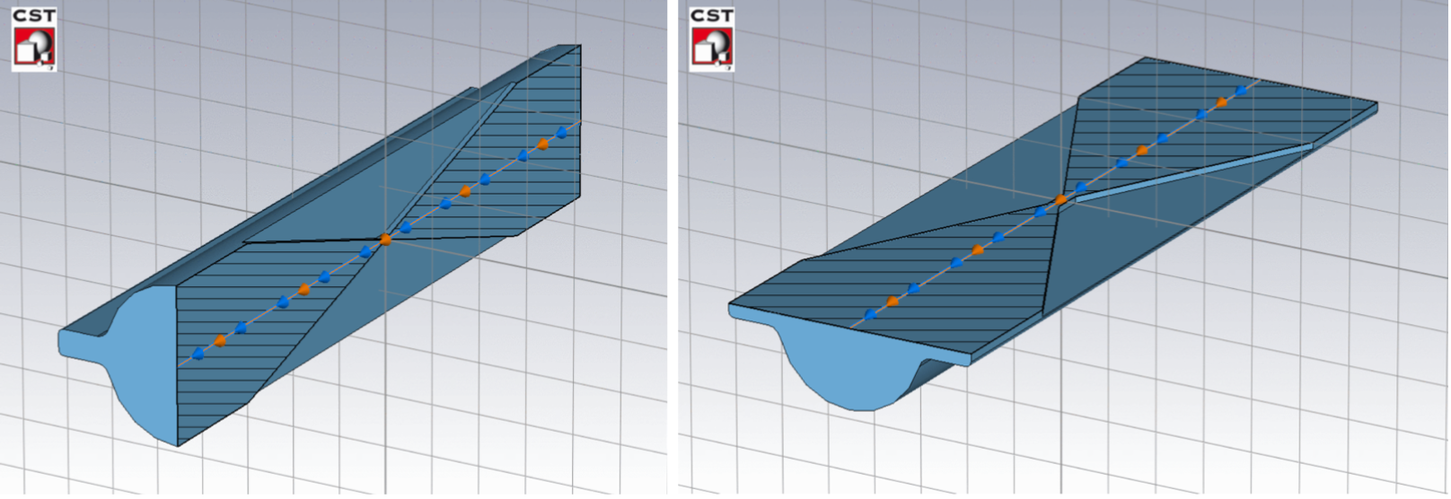
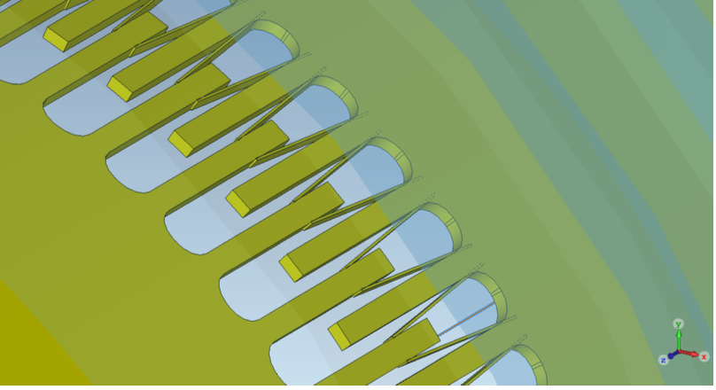
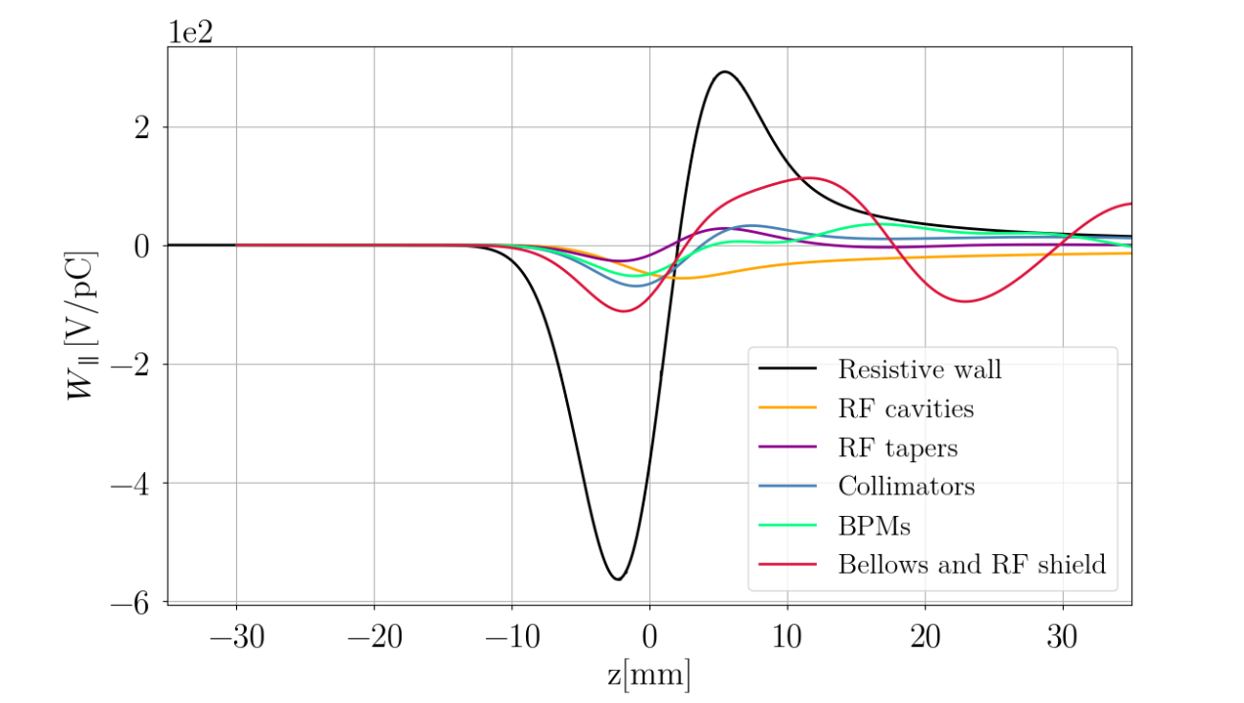
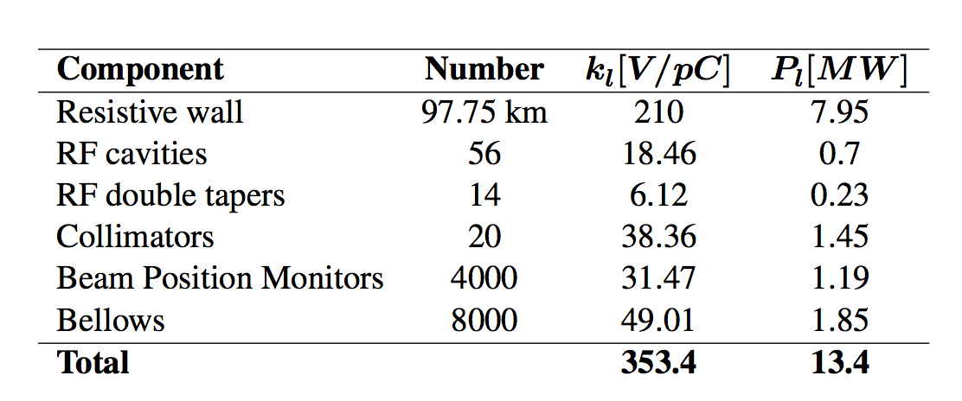
Challenge for impedance design @ FCC-ee
Many small impedance devices
Courtesy of M. Migliorati
Since impedance optimisation has become a standard procedure, it happens for many devices.
SR absorbers
Collimators
RF fingers inside bellows
Slide 6

Slide 7
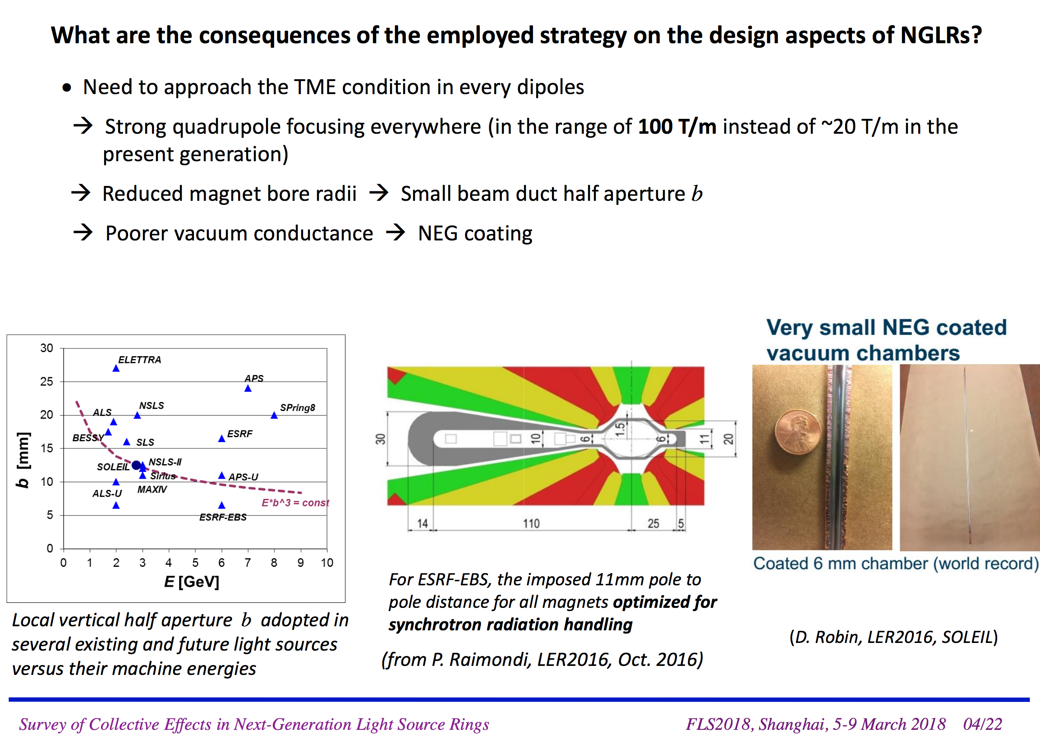
Design issue of low emittance rings
Next Generation Light source Rings (NGLRs) aim to ultra-low emittance and high beam current.
R. Nagaoka (2018)
Slide 7

Slide 8
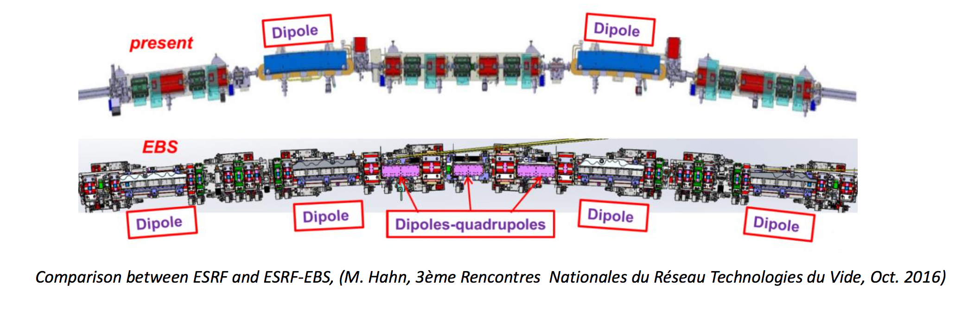
Design issue of low emittance rings (2)
Multi Bend Achromat lattice generally requires the magnet lattice to be tightly packed with dipoles, quadrupoles, sextupoles and plus all other standard elements such as flanges, BPMs, ...
The strategy of the design of NGLR enhance impedance: smaller pipe radius and NEG coating.
Due to reduced pipe radius, larger relative contributions of tiny slits, holes, steps, ... as well as Z_{RW}.
Courtesy of R. Nagaoka (2018)
Slide 8
Notes:
BB impedance is dominated by the BPMs. There has to be a better way to do this. Each BPM forms a small cavity and there are hundreds of them.
The main problems is the very small beam pipe ranging from 7-20 mm in diameter and the fact that full bunch lengthening from harmonic cavities is required. The atypical longitudinal dynamics combined with the impedance makes for an interesting problem.

Slide 9
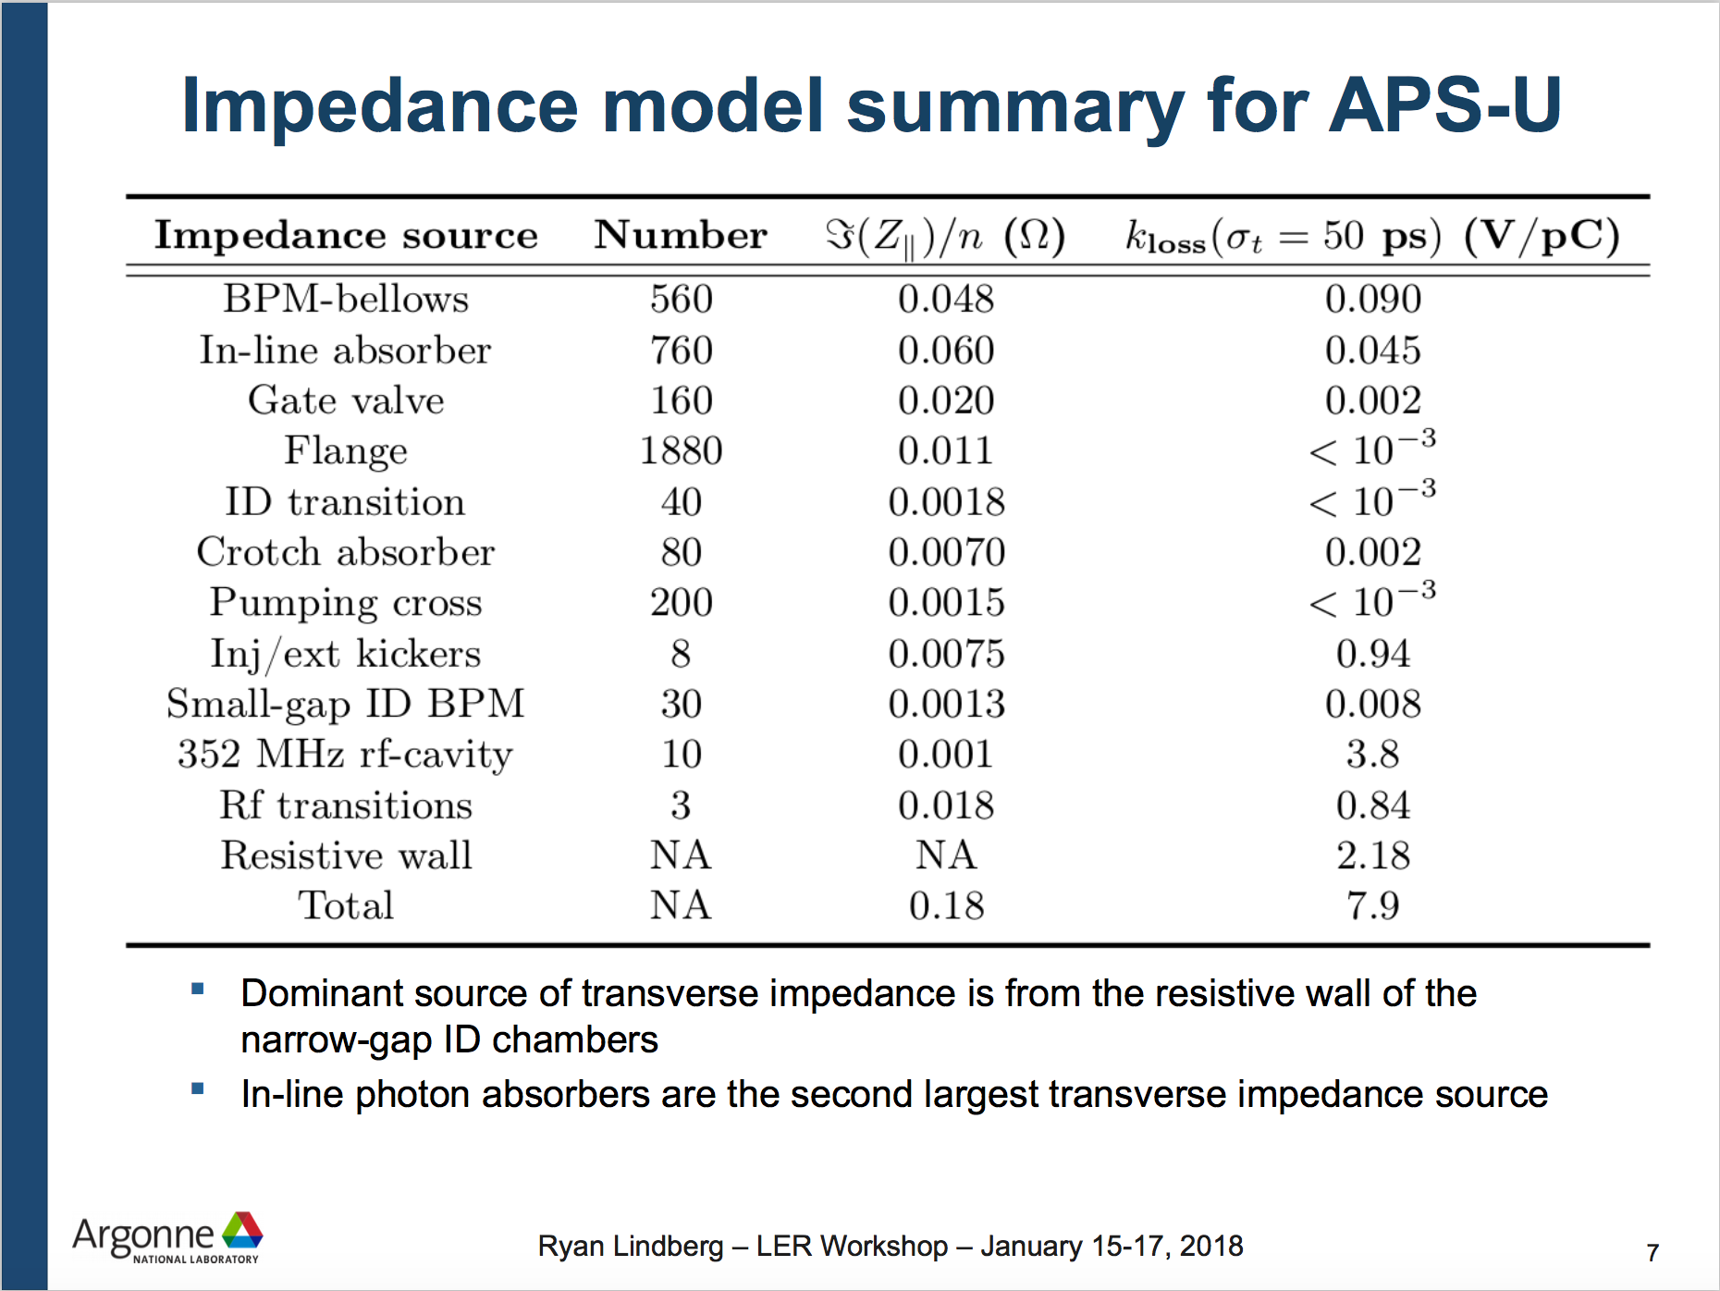
Design issue of low emittance rings (2)
Multi Bend Achromat lattice generally requires the magnet lattice to be tightly packed with dipoles, quadrupoles, sextupoles and plus all other standard elements such as flanges, BPMs, ...
The strategy of the design of NGLR enhance impedance: smaller pipe radius and NEG coating.
Due to reduced pipe radius, larger relative contributions of tiny slits, holes, steps, ... as well as Z_{RW}.
Courtesy of R. Nagaoka (2018)
Slide 9
Notes:
BB impedance is dominated by the BPMs. There has to be a better way to do this. Each BPM forms a small cavity and there are hundreds of them.
The main problems is the very small beam pipe ranging from 7-20 mm in diameter and the fact that full bunch lengthening from harmonic cavities is required. The atypical longitudinal dynamics combined with the impedance makes for an interesting problem.

Slide 10
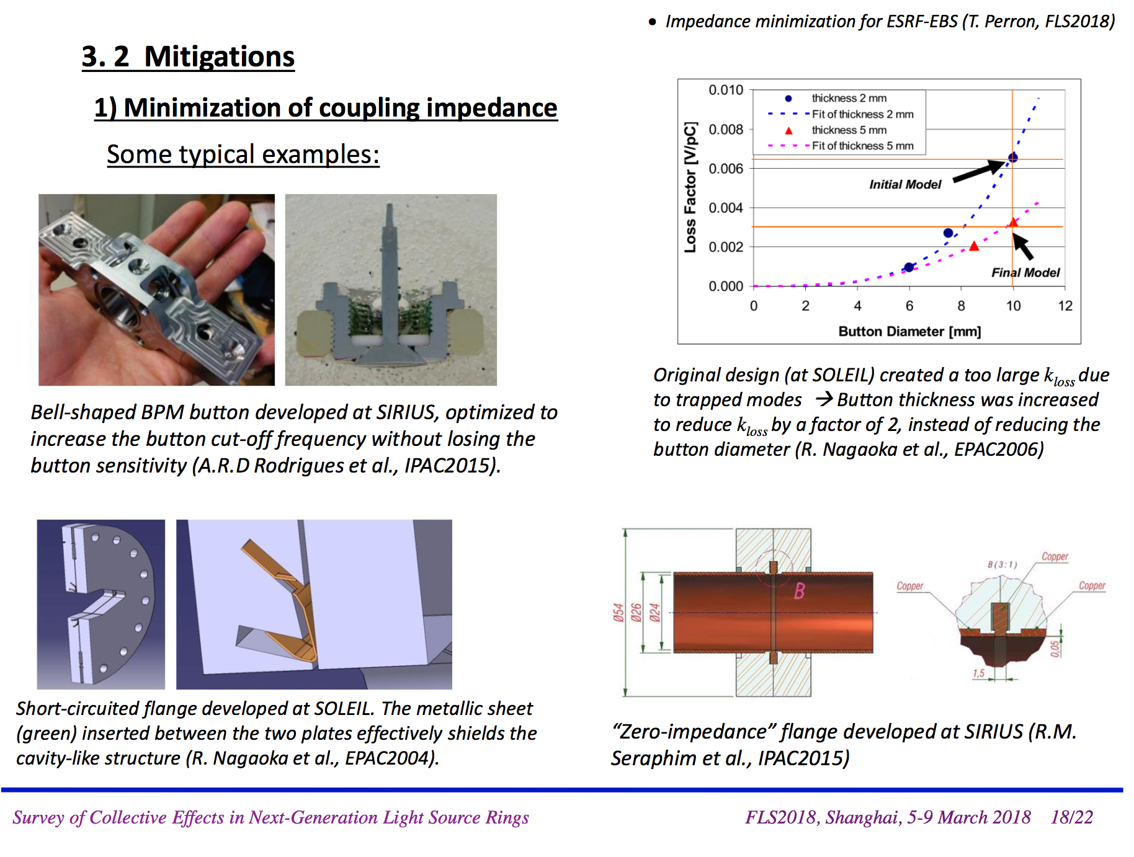
Challenge for NGLR: many small impedance
R. Nagaoka (2018)
Slide 10

Slide 11
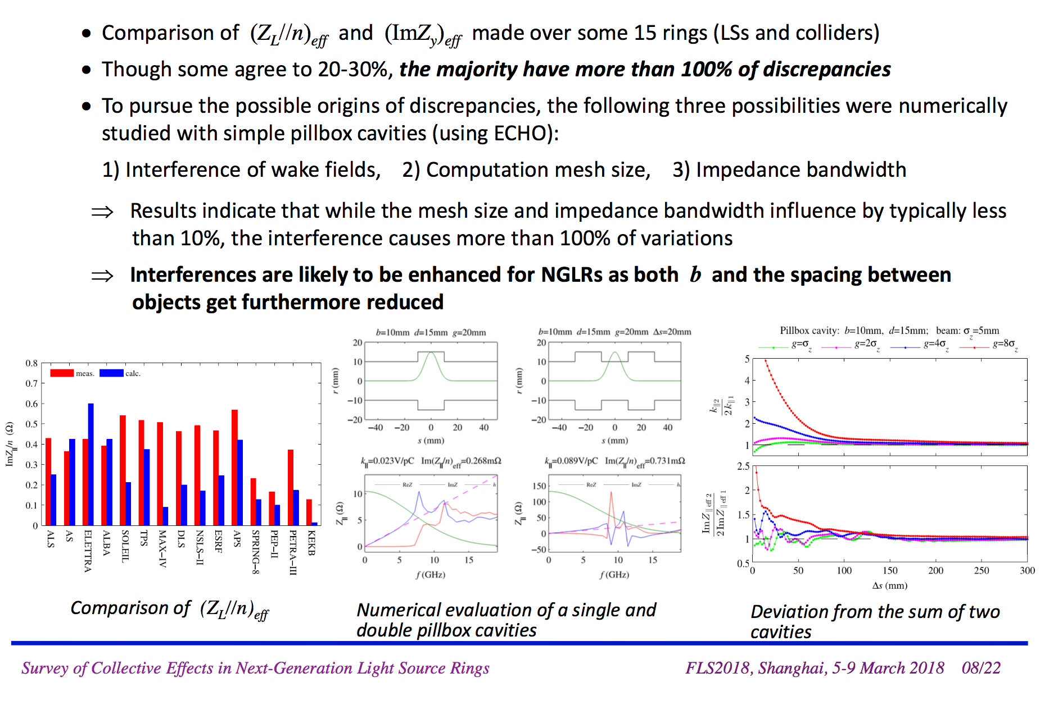
Challenge for NGLR: interference among devices
R. Nagaoka (2018)
Slide 11

Slide 12
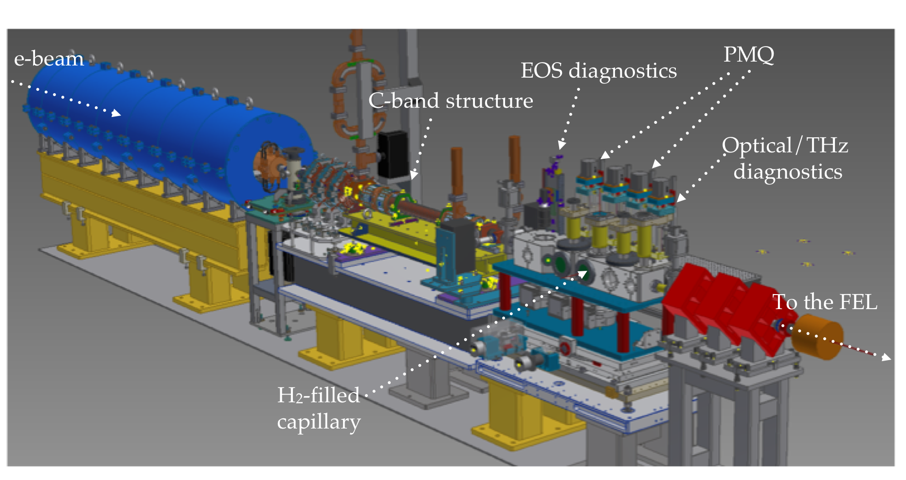

Particle driven plasma accelerator
M. Ferrario et al., SPARC_LAB present and future, NIM B 309, 183–188 (2013)
Slide 12

Slide 13
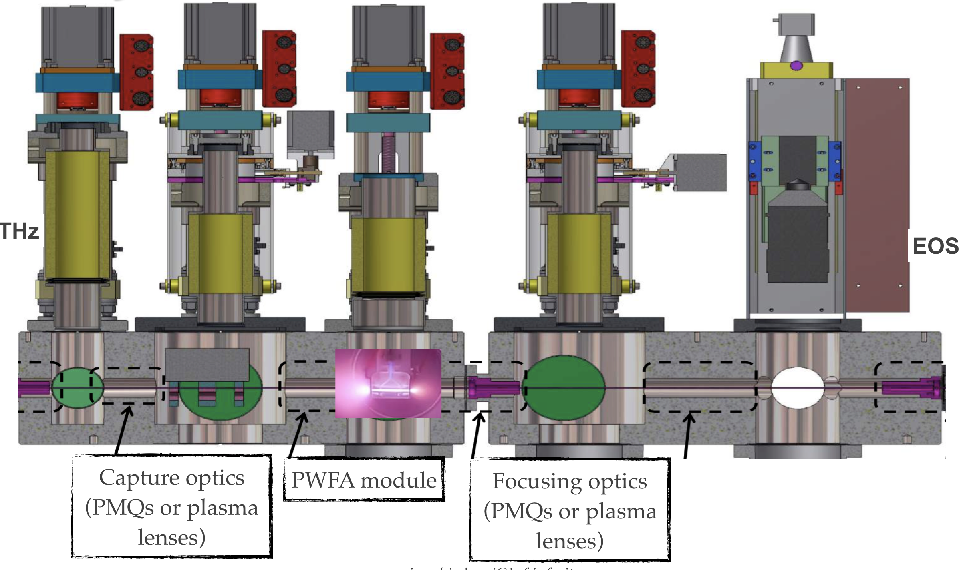
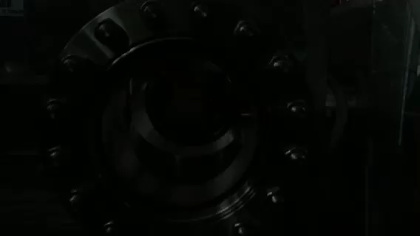
Plasma interaction vacuum chamber
Small beam pipe to avoid the H₂ gas leakage into the accelerator.

Slide 14
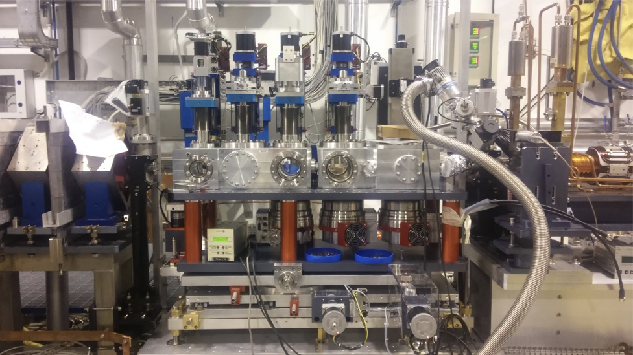
Plasma interaction vacuum chamber @ Sparc

Slide 15
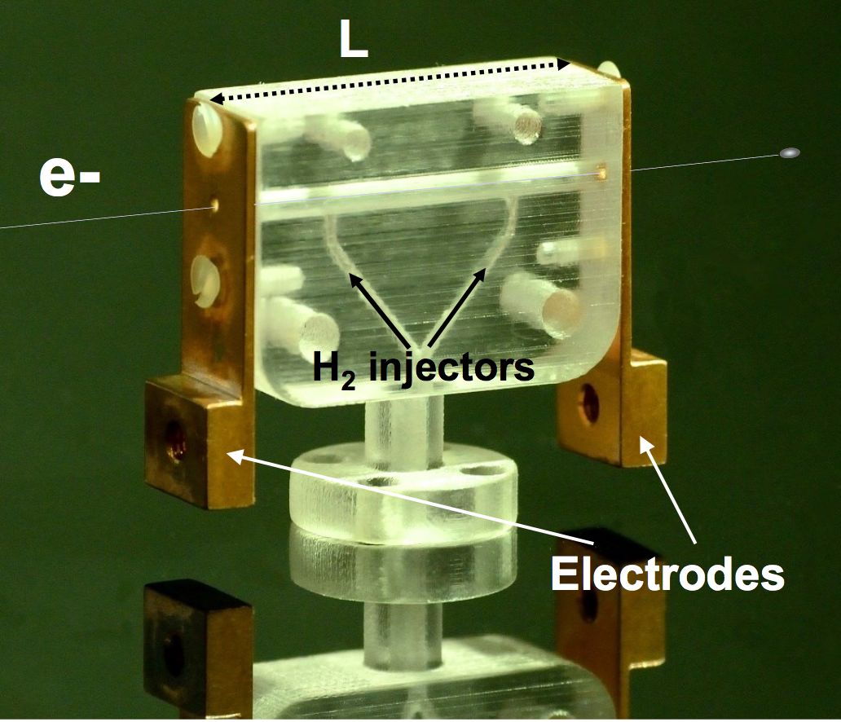
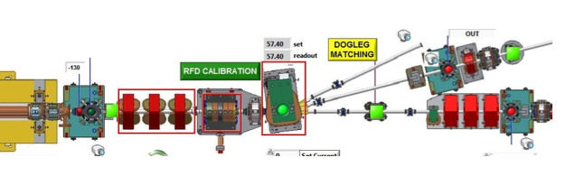
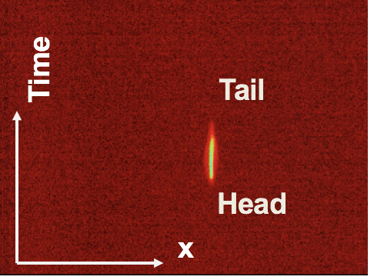
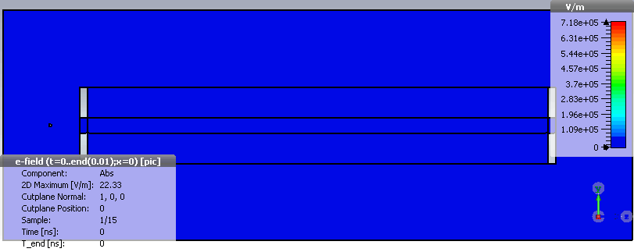
Dielectric wakefield in the plasma capillary
Charge 100pC
Bunch length 1ps (rms)
Courtesy of L. Ficcadenti
Slide 15

Slide 16
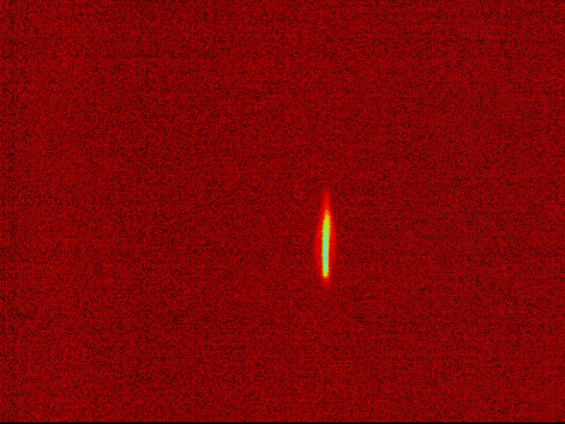
Dielectric wakefield in the plasma capillary
Charge 100pC
Bunch length 1ps (rms)
Courtesy of L. Ficcadenti
Time
Tail
Head
x
Slide 16

Slide 17
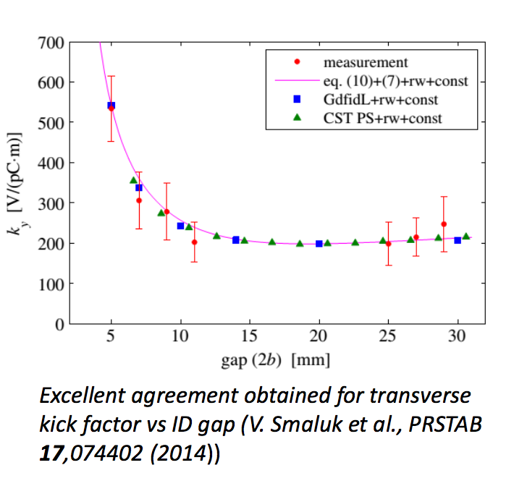
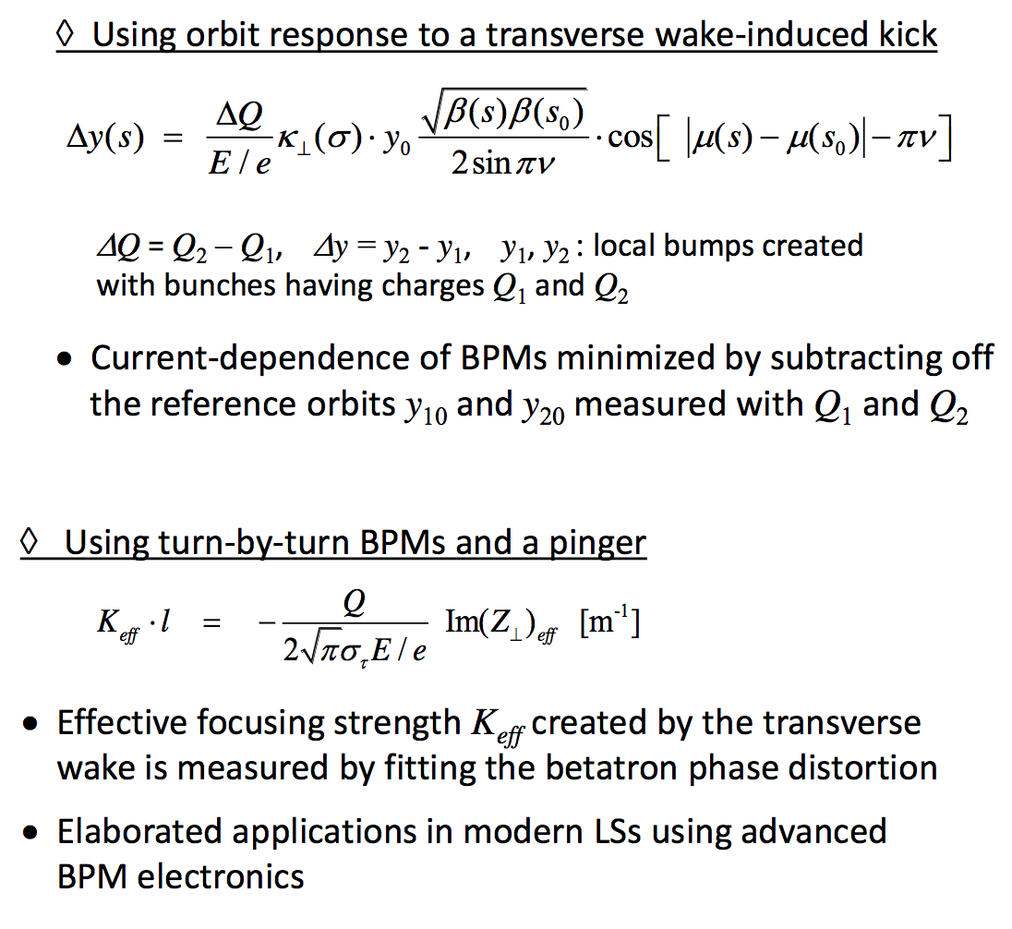
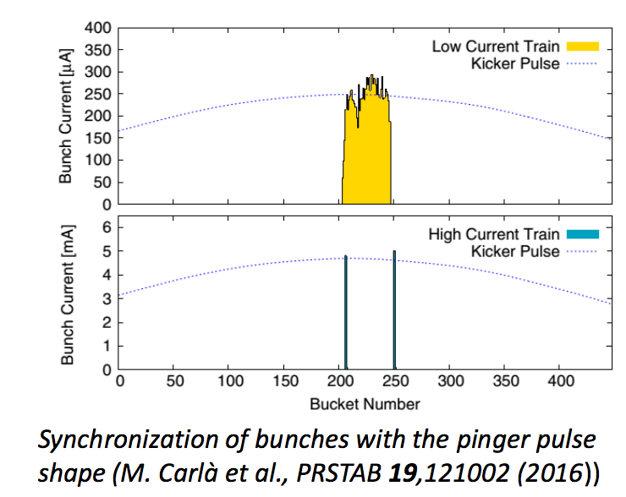
Beam-based local impedance measurement
These methods could also help us evaluate interference effects of wakes experimentally in rings.
See also N. Biancacci, ”Improved techniques of impedance calculation and localization in particle accelerators”,
PHD thesis
Courtesy of R. Nagaoka (2018)
Slide 17

Slide 18
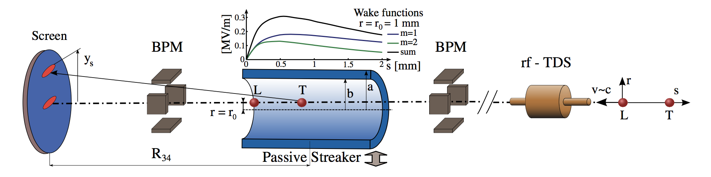
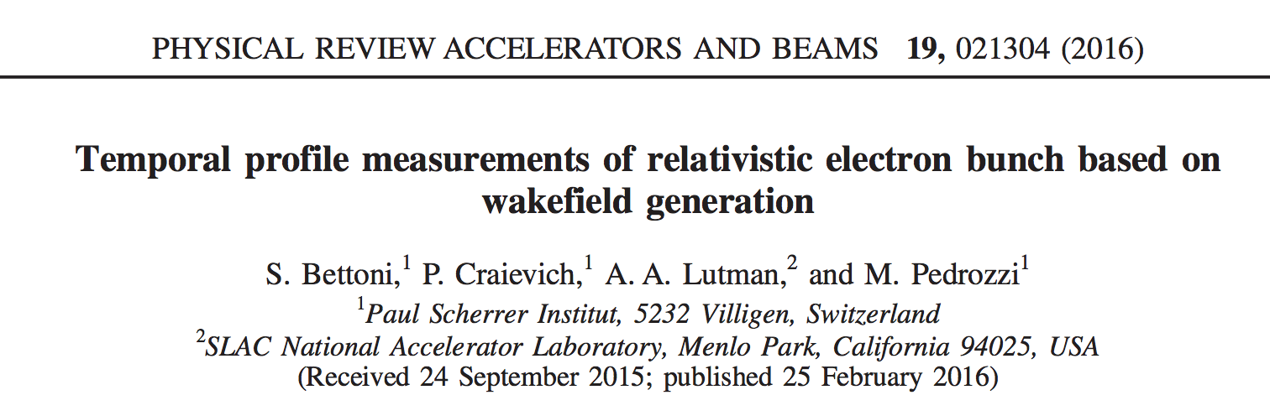
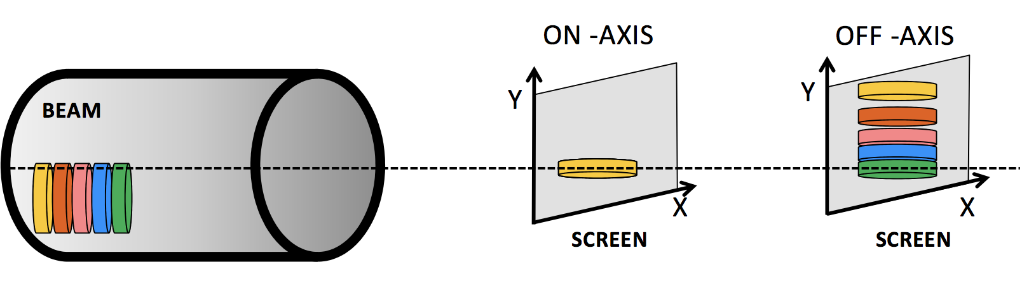
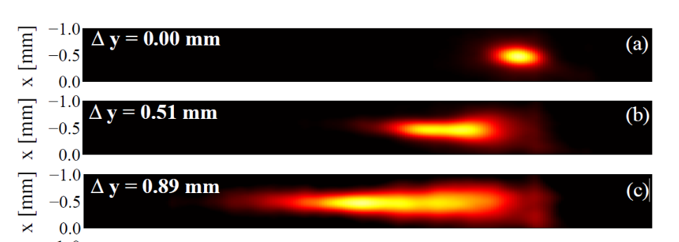
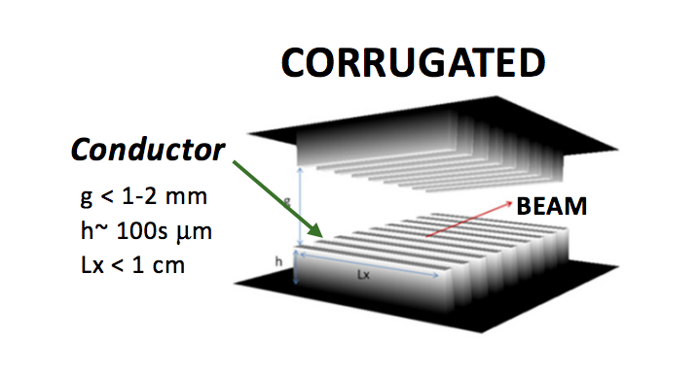
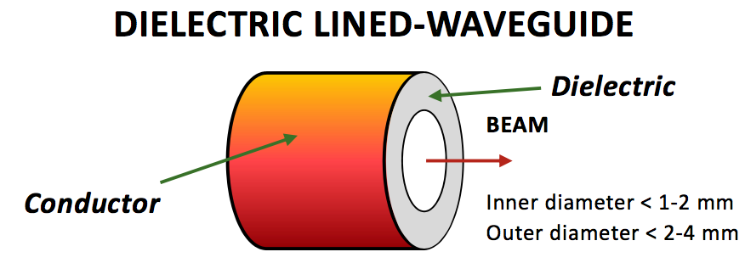
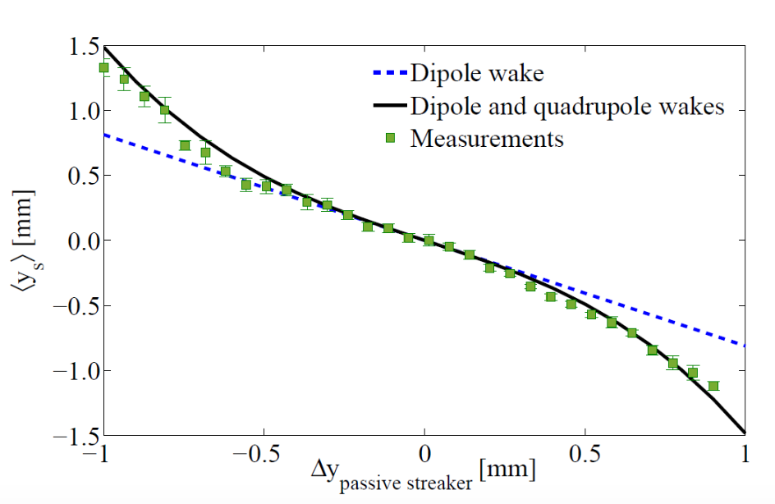
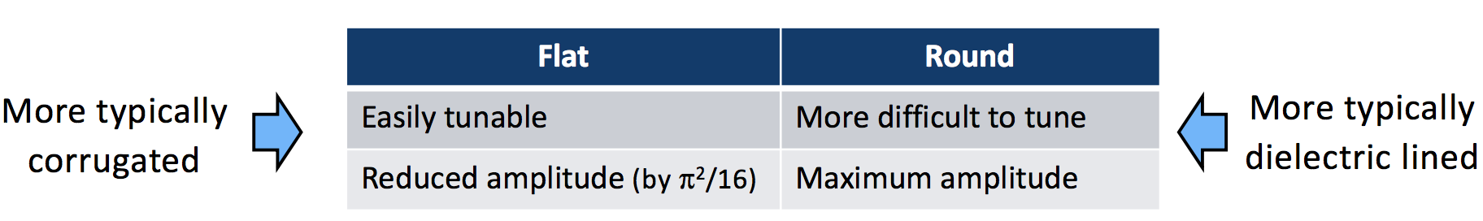
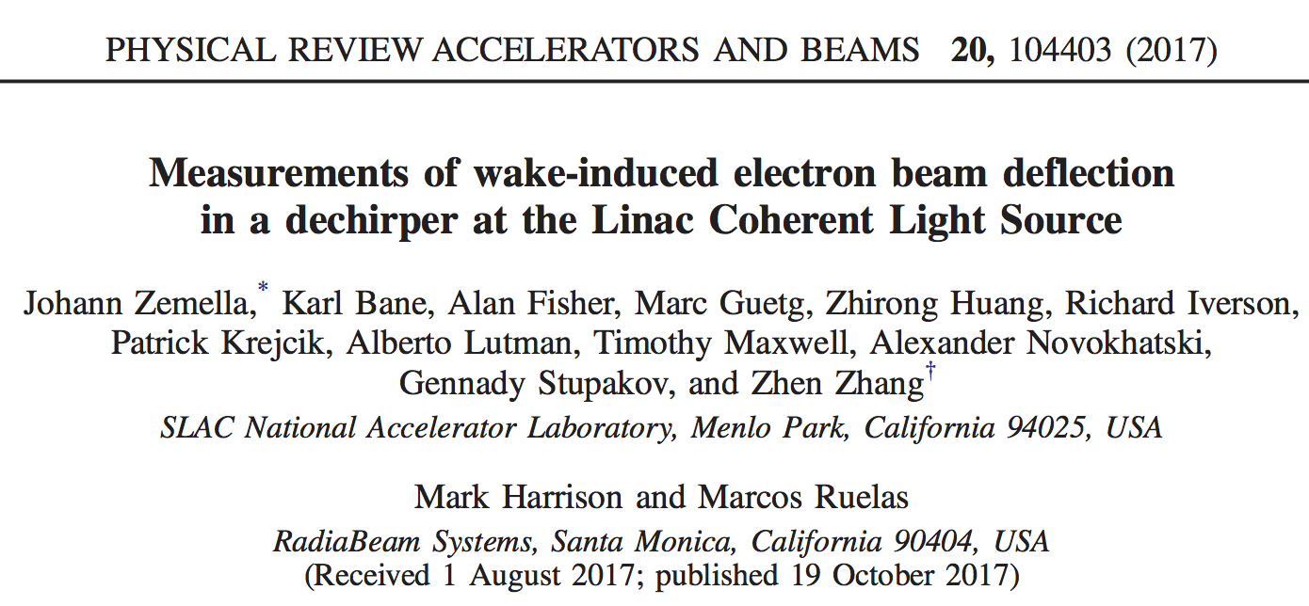
Passive streaking in high brightness linac
140MeV, 200pC
Slide 18

Slide 19
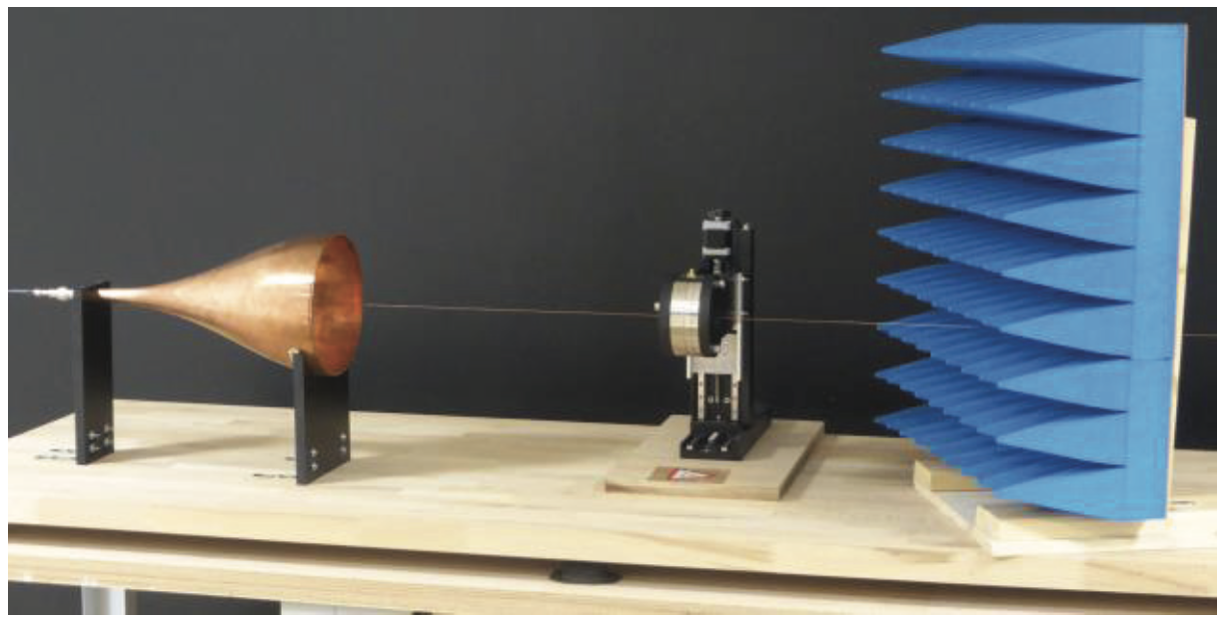
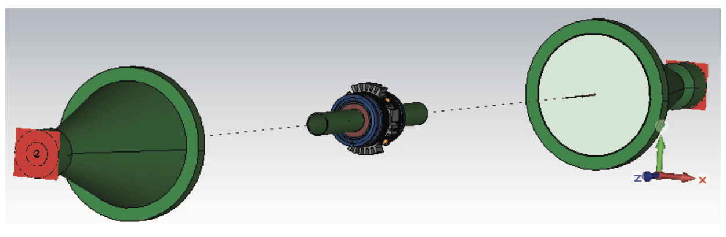
Small aperture vacuum components
Relevant for novel advanced photon sources with multi-bend achromat lattice.
Traditional coaxial wire method needs too large wire diameter in DUT for reasonable matching.
The Gobau line (G-line) is a dielectric coated single wire transmission line based on surface waves. A surface wave propagates in the interface between the central conductor and thin dielectric material coated on its surface. Surface-wave based transmission line permits RF energy to be launched on the wire, travel though a beamline component, and then finally be absorbed in a load.
Cones to excite the field and to match the single wire impedance to the 50Ohm. Very flexible set-up.
M. Sangroula et al., WEPVA134, IPAC 2017
F. Stulle et al., WEPG41, IBIC 2016
Slide 19

Slide 20
Why such a discussion @ e-cloud18?
Actual solutions to e-cloud, such as NEG coating or Laser Ablation Surface Engineered surfaces, may increase slightly the impedance.
At the moment, the only approach is an estimation based on simulation. Such effect may become an issue only when the whole machine is built …
The design of future electron machines is facing similar problems.
Many small impedance devices
Interference between highly packed devices
Impedance sources close to the beam
FCC-ee
Low Emittance Rings
Plasma accelerators
Worldwide effort is ongoing to make relevant measurements on machines (e.g. DAFNE, J. Byrd @ APS-U, …) using the modern impedance localization techniques (initially developed in the context of existent machines upgrade).
Impedance measurements in high brightness (i.e. high current) linacs may be an option (e.g. CLEAR, …)
Bench measurements are following as well (e.g. small beam pipe components for NGLS)
Slide 20

Slide 21
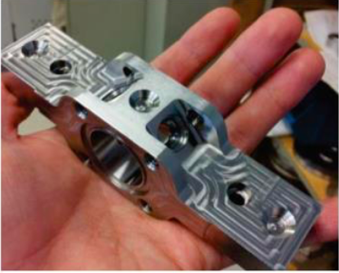
CONCLUSIONS
Experimental challenge in linear and circular accelerators driven by impedance issues
Big circular machines (FCC): many small impedances devices.
”Small” circular machines (NGLR): small beam pipes, NEG coating, interference between the devices.
Compact linacs (Plasma acc.): high current issue, devices close to beam trajectory.
Test measurement on existent circular accelerator can be done using modern impedance localization techniques.
Test measurement on existent high brightness Linacs may be also feasible (several wakefield based devices)
Novel accelerator design solution may be in conflict with impedance reduction policy.
Slide 21

Slide 22

Thanks for your attention!

