Slide 1
Overview on heat loads in the LHC
G. Iadarola
with input many colleagues from the
CERN e-cloud working group
and the Beam Induced Heat Load Task Force
Special thanks to the CERN cryogenics team for the work done to setup and improve the heat load measurements

Slide 2
Outline
Introduction and main observations
Comparison against beam energy loss
Heat load distribution along the machine
Effect of shutdown periods
Inferred SEY_{max}
Observed dependence on the beam properties
Data from special instrumented cells

Slide 3
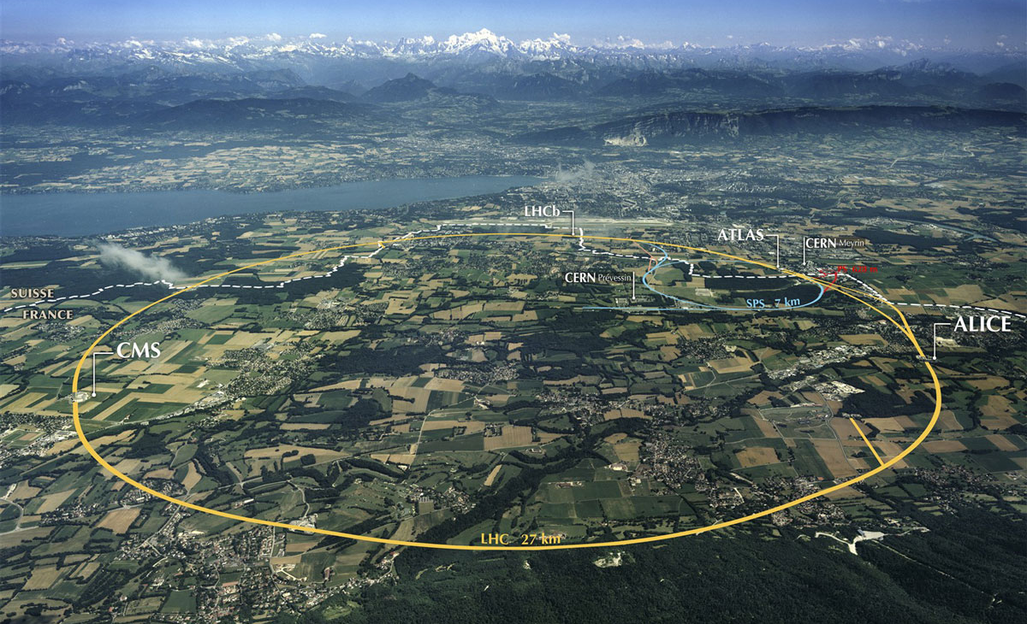
The Large Hadron Collider (LHC)
27-km proton (and ion) collider:
Energy: injection at 450 GeV → collisions at 7 TeV (6.5 TeV achieved)
Beam intensity: 2800 bunches (2556 achieved), 1.1e11p/bunch, 25 ns
Luminosity: L = 1e34 cm⁻²s⁻¹ (L = 2.0e34 cm⁻²s⁻¹ achieved)
Beam 2
Beam 1

Slide 4
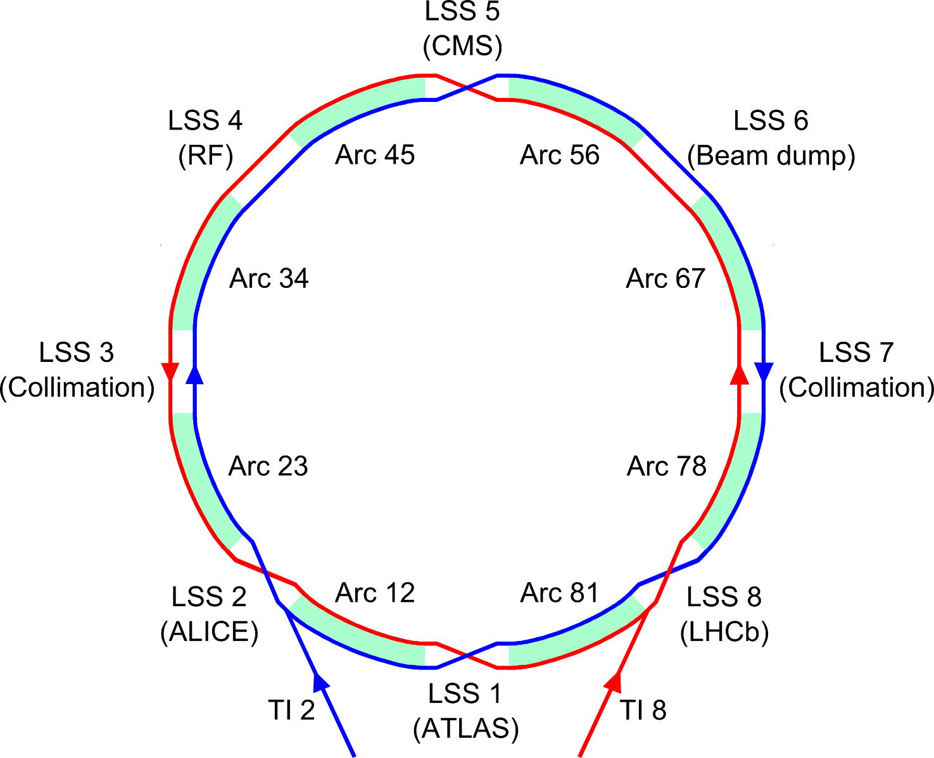
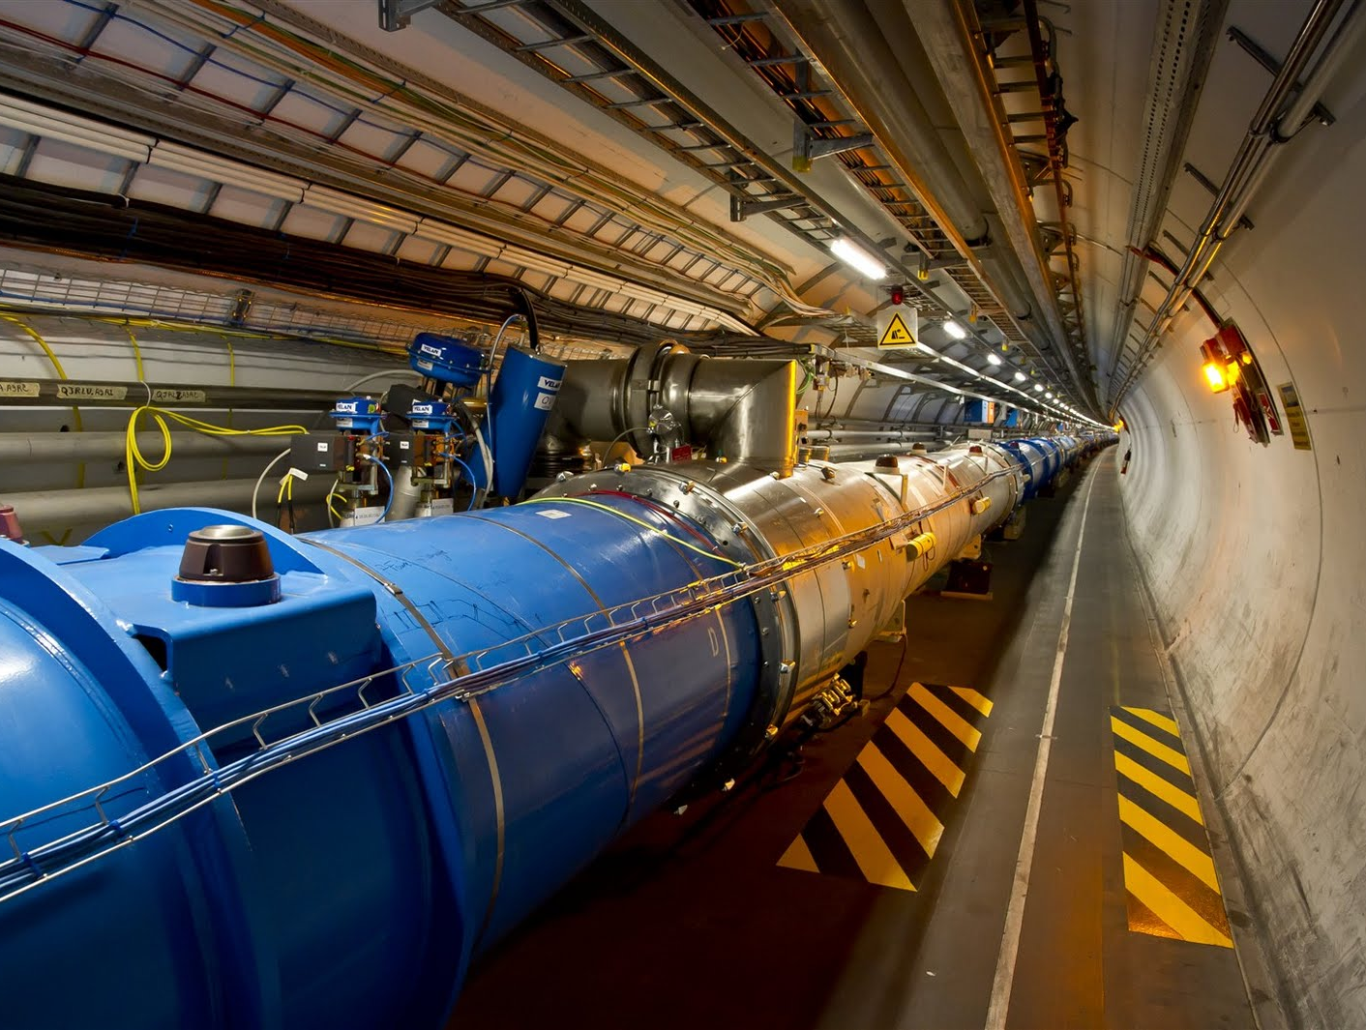
The Large Hadron Collider (LHC)
8-fold symmetric structure:
8 Long Straight Sections (LSS) to host experiments and other equipment
8 Arcs (2.45 km each - Periodic magnet lattice, to bend and focus the beams)
Main magnets
(superconducting)
8.33 T dipoles
223 T/m quadrupoles

Slide 5
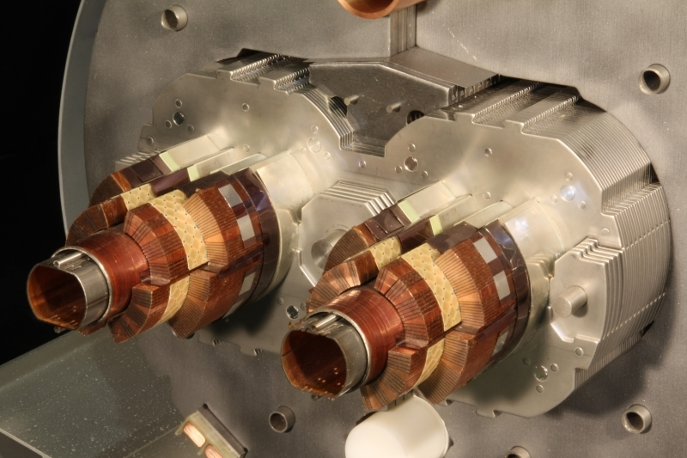
The LHC beam screens
To avoid too high power deposition on the superconducting coils a beam screen is inserted in installed inside the 1.9 K cold bore
The beam screen intercepts beam-induced heat loads (RF heating, synch. radiation, e-cloud)
It is held by low conductivity supports and is actively cooled with a helium flow to operate in the range 5-20 K
By measuring the thermodynamic properties of helium, it is possible to know the heat load on the screen
Magnets in each “half-cell” (53.4 m long) share the same cooling circuit
Heat load is measured per half-cell
Section of a main dipole
Beam screen cooling circuit
(helium)
Superconducting coils (1.9 K)
Beam screen
(5 – 20 K)
More details in B. Bradu’s talk
Half-cell (53.4 m)
Half-cell (53.4 m)
Half-cell (53.4 m)
Quad
(3.1 m)
Quad
(3.1 m)
Quad
(3.1 m)
Quad
(3.1 m)
Dipoles (3 x 14.3 m)
Dipoles (3 x 14.3 m)
Dipoles (3 x 14.3 m)

Slide 6
Run 1 and Run 2: the two eras of the LHC history
Today
2010
2013
2015
2019
2021
Run 1
LS1
Run 2
LS2
Run 3
Run 1 - data taking with:
Beam energy: 3.5 - 4 TeV
Bunch spacing: 50 ns
Max. n. of bunches: 1380
Bunch intens.: 1.7e11p
Run 2 - data taking with:
Beam energy: 6.5 TeV
Bunch spacing: 25 ns
Max. n. of bunches: 2556
Bunch intens.: 1.2e11p
Long Shutdown 1:
No beam
Consolidation and maintenance
All arcs were warmed up and vented

Slide 7
Heat loads on beam screens: Run 1 vs Run 2
Run 1 configuration
4 TeV, 50 ns, 1.7e11 p/bunch
Run 2 configuration
6.5 TeV, 25 ns, 1.2e11 p/bunch
Avg. half-cell load
In Run 1 heat loads were very modest (~10 W/hcell)
Compatible with estimated heat from impedance and synchrotron radiation
Heat loads were extremely similar for the eight arcs
In Run 2 heat loads became much larger (>100 W/hcell)
Need for new feed-forward control on the cryo regulations (see B. Bradu’s talk)
Much larger than estimated loads from impedance and synchrotron radiation
Very large differences among for the eight arcs (up to a factor of 3). Not at all expected!

Slide 8
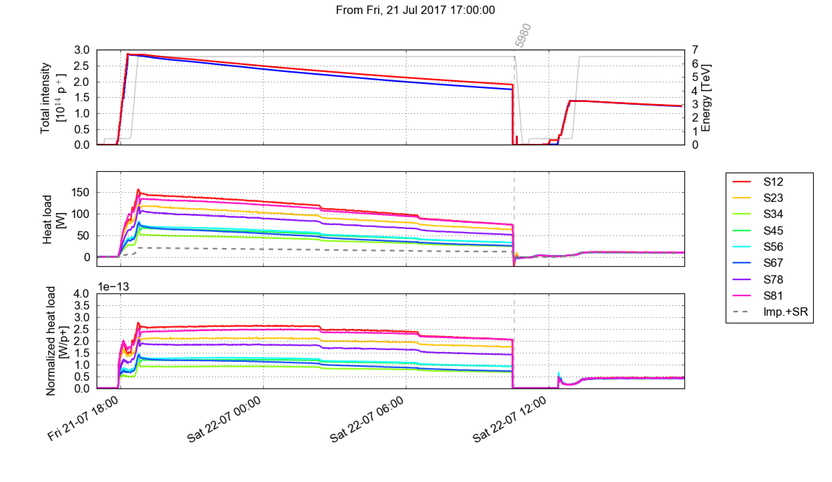
The key parameter is the bunch spacing
Dedicated tests showed that the change that causes such a radical heat load increase, is the reduction of the bunch spacing
This behavior is not compatible with impedance and synchrotron radiation heating while is expected for e-cloud effects
Test with 50 ns beams in Run 2 (2017)
25 ns
50 ns
Avg. half-cell load

Slide 9
Evolution during Run 2
2015
2016
2017
2018
Heat load evolution has been closely monitored during the entire Run 2
Conditioning observed on all sectors but only until mid-2016
Differences among the eight sectors remained basically unchanged during the entire process!
Differences are unexpected (the eight arcs are by design identical) and remain unexplained!
Vented
Short bunch trains

Slide 10
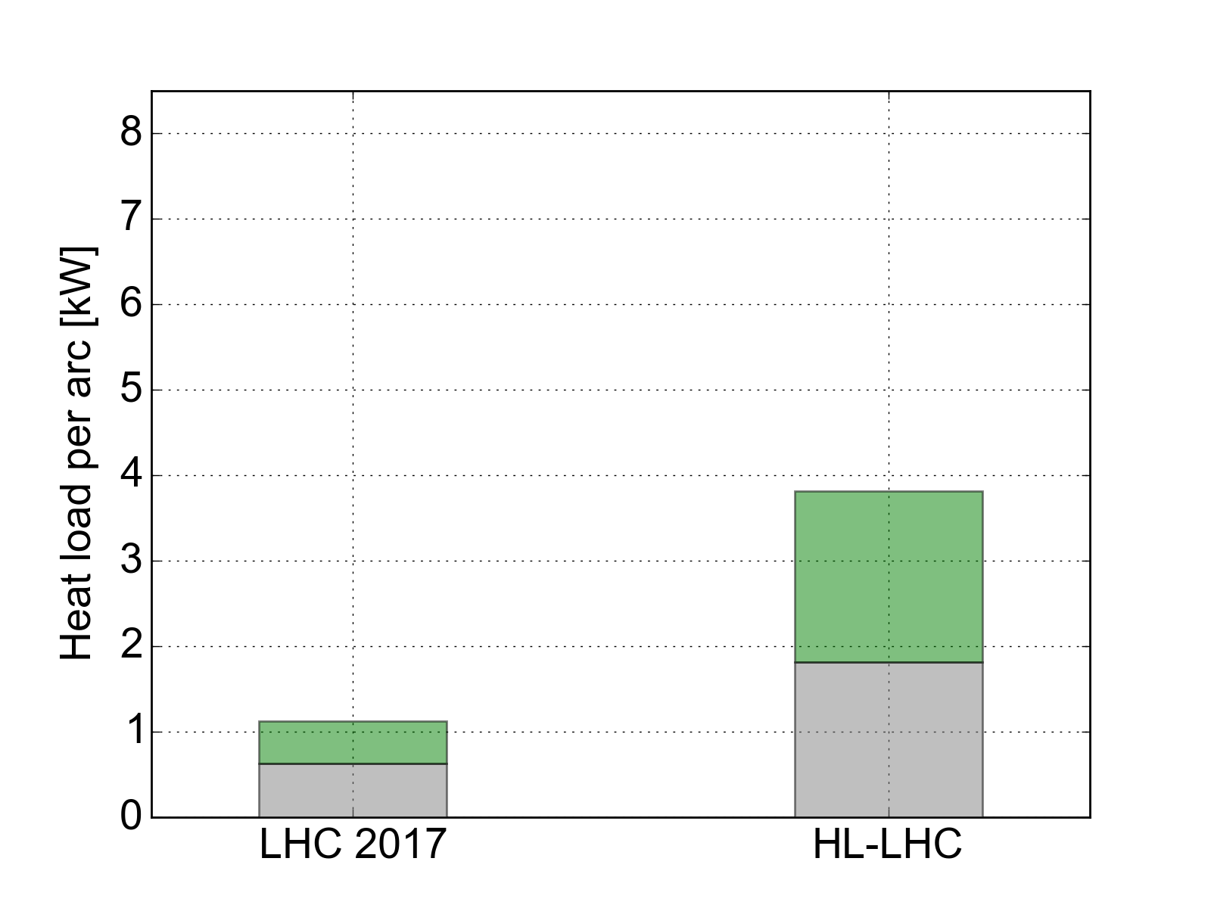
Implications for the High-Luminosity upgrade (HL-LHC)
In present configuration: small contributions from impedance and synchrotron radiation → large available margins to cope with e-cloud
When moving to larger beam intensities (and to 7 TeV) the margin reduces strongly
In the high load sectors margin is not sufficient to stand the intensity increase
Maximum allowed by cryogenics
Margin
~7 kW
Margin
~4 kW
Dedicated Task Force setup at the end of 2017 for in-depth analysis
Considered also heating mechanisms different from e-cloud:
They were all discarded
e-cloud heating remains the most solid hypothesis
e-cloud S12
(2017)
~6 kW
e-cloud S34
(2017)
~2kW
2556b
1.1e11 p/bunch
6.5 TeV
2748b
2.2e11 p/bunch
7 TeV

Slide 11
Outline
Introduction and main observations
Comparison against beam energy loss
Heat load distribution along the machine
Effect of shutdown periods
Inferred SEY_{max}
Observed dependence on the beam properties
Data from special instrumented cells

Slide 12
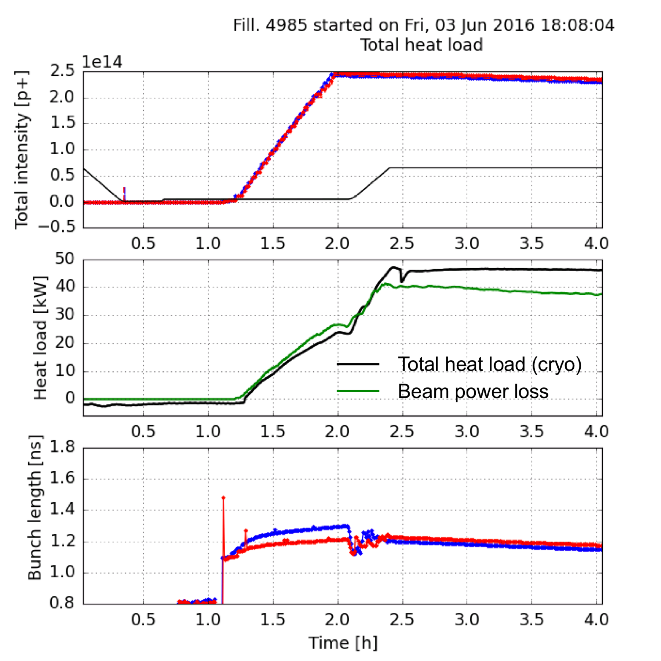
Comparison against beam power loss
The power deposited in the form of the heat load ultimately comes from the beam
The power lost by the beam can be inferred from RF stable phase measurements
Found to be consistent with heat load measurements from the cryogenics
For details on the RF measurements see: J. Esteban Muller, “Synchronous Phase Shift at LHC”, ECLOUD12

Slide 13
Comparison against beam power loss
RF stable phase measurements also provide bunch-by-bunch power loss measurements
e-cloud pattern is clearly visible
Heat load is generated mainly by bunches at the tail of the trains
At 6.5 TeV

Slide 14
Outline
Introduction and main observations
Comparison against beam energy loss
Heat load distribution along the machine
Effect of shutdown periods
Inferred SEY_{max}
Observed dependence on the beam properties
Data from special instrumented cells

Slide 15
Distribution along the ring
The heat loads are distributed very unevenly along the machine
It is possible to identify two families
A group of high-load sectors (including S12, S23, S78, S81)
A group of low-load sectors (including S34, S45, S56, S67)
High-load sectors are contiguous
The machine is practically split in a good and a bad part
S45
S56
S34
S67
S23
S78
S12
S81

Slide 16
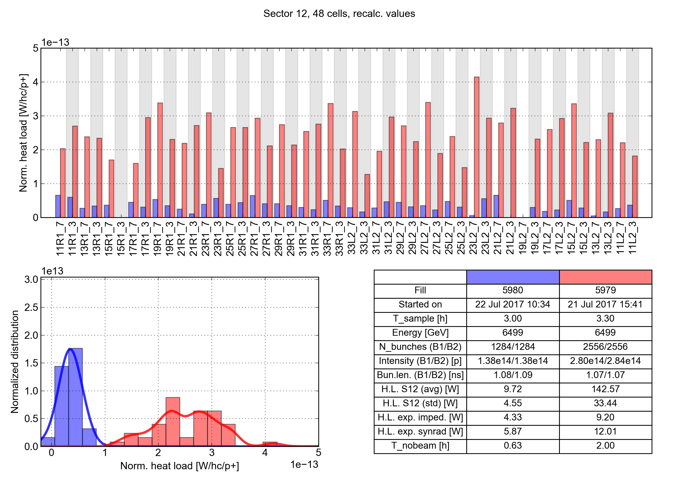
Distribution along the machine: cell-by-cell observations
Increase with respect to 50 ns is observed in all cells
Large differences are present from cell to cell
Sector 12 (high load)
50 ns
25 ns

Slide 17
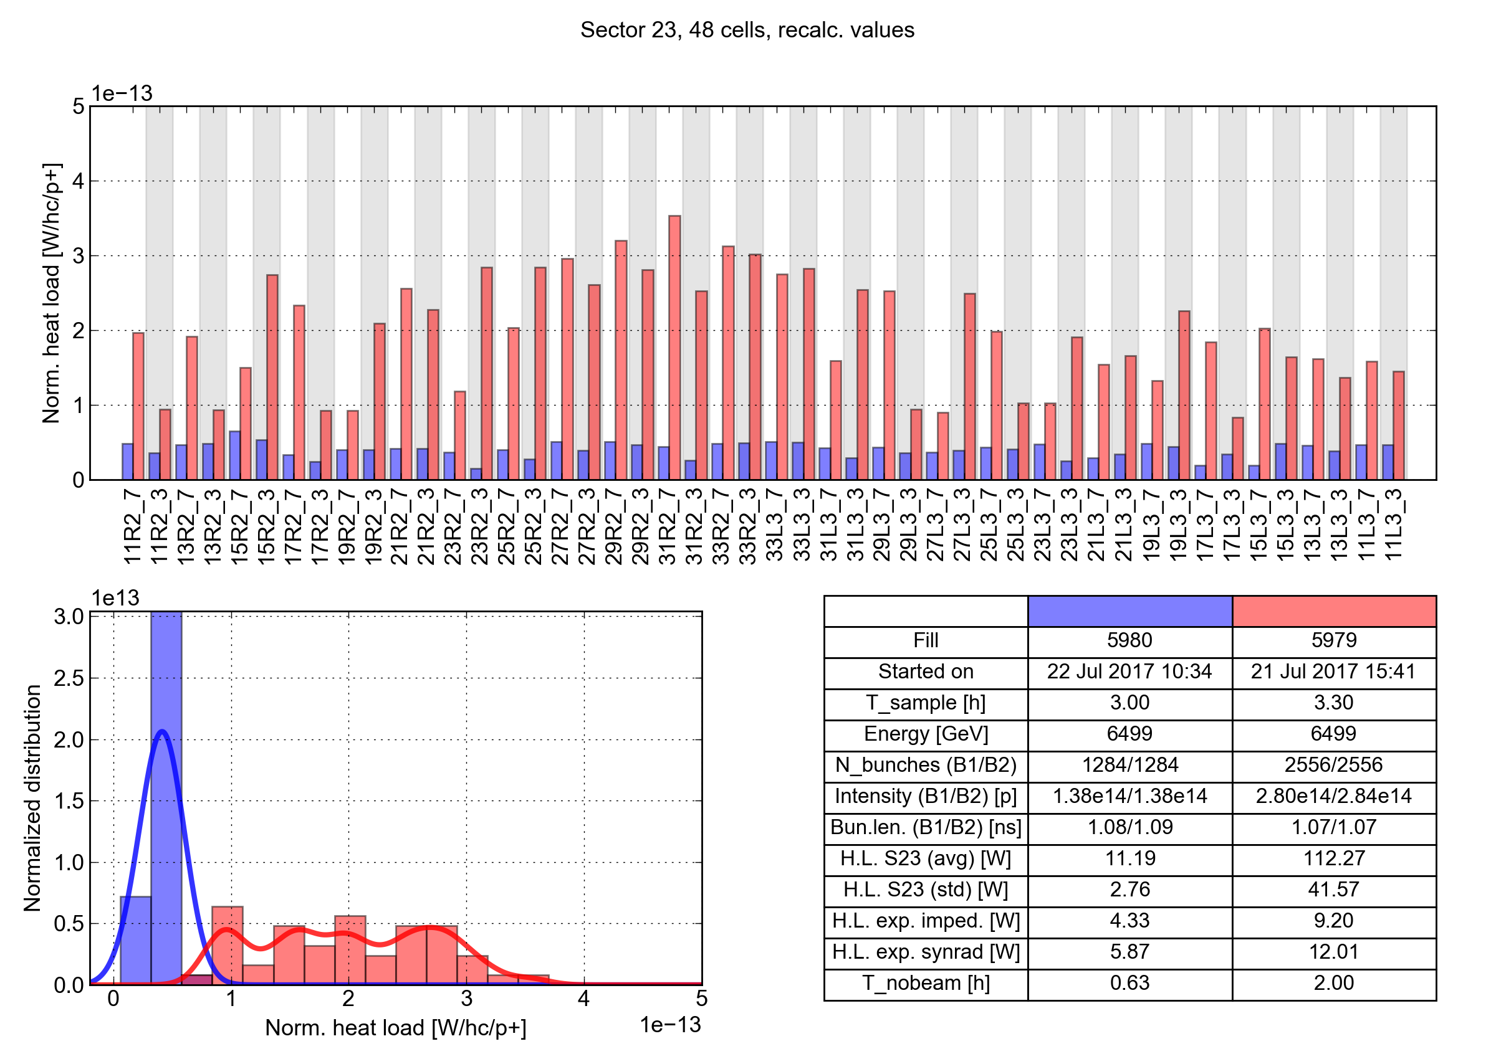
Distribution along the machine: cell-by-cell observations
Increase with respect to 50 ns is observed in all cells
Large differences are present from cell to cell
Sector 23 (high load)
50 ns
25 ns

Slide 18
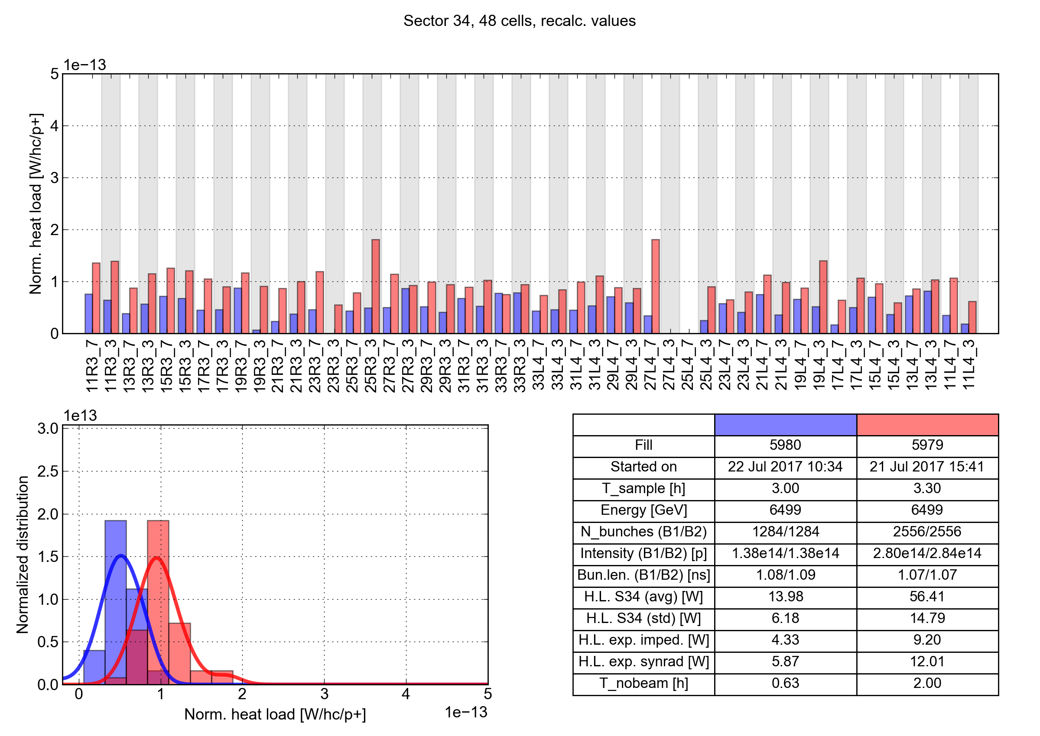
Distribution along the machine: cell-by-cell observations
For low-load sectors, heat load per bunch is much more similar for 50 ns and 25 ns
A few outliers are present
Sector 34 (low load)
50 ns
25 ns

Slide 19
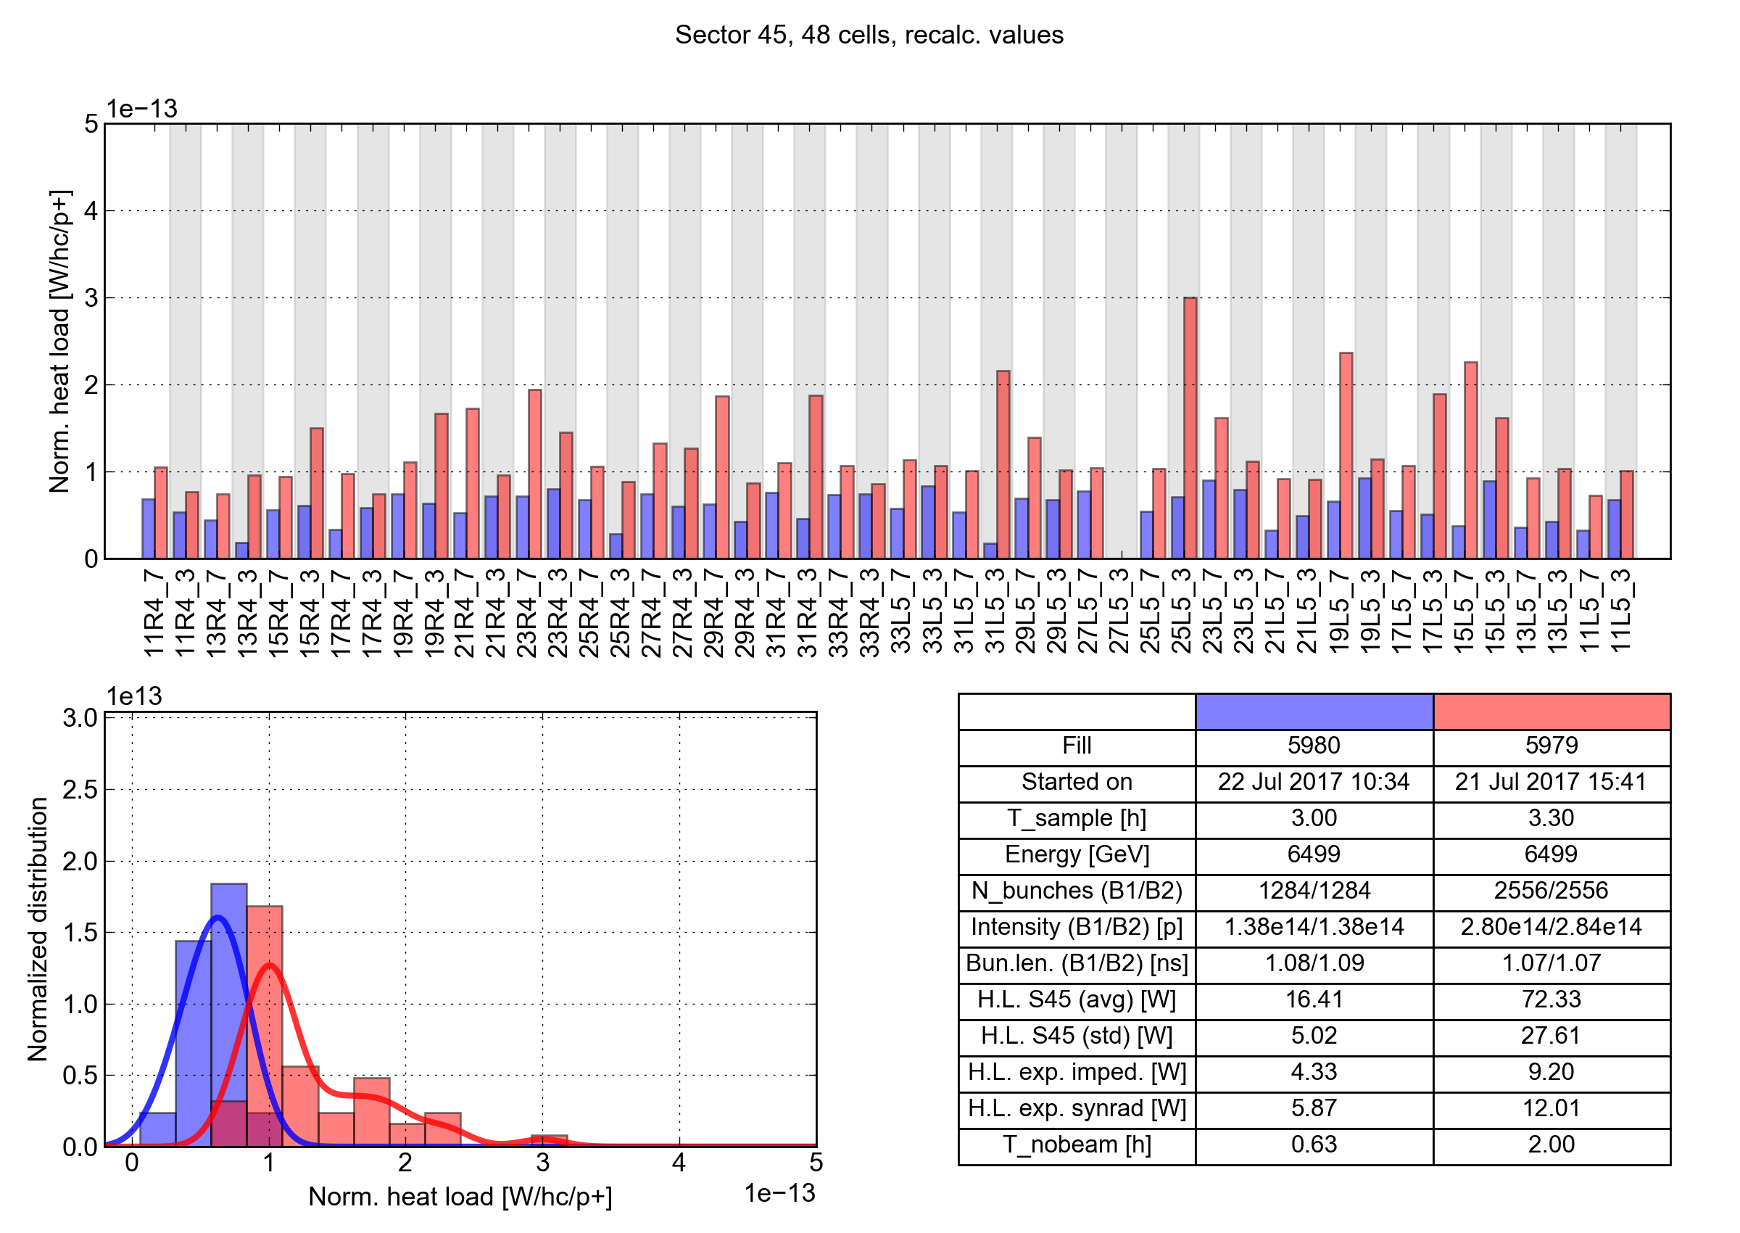
Distribution along the machine: cell-by-cell observations
For low-load sectors, heat load per bunch is much more similar for 50 ns and 25 ns
A few outliers are present
Sector 45 (low load)
50 ns
25 ns

Slide 20
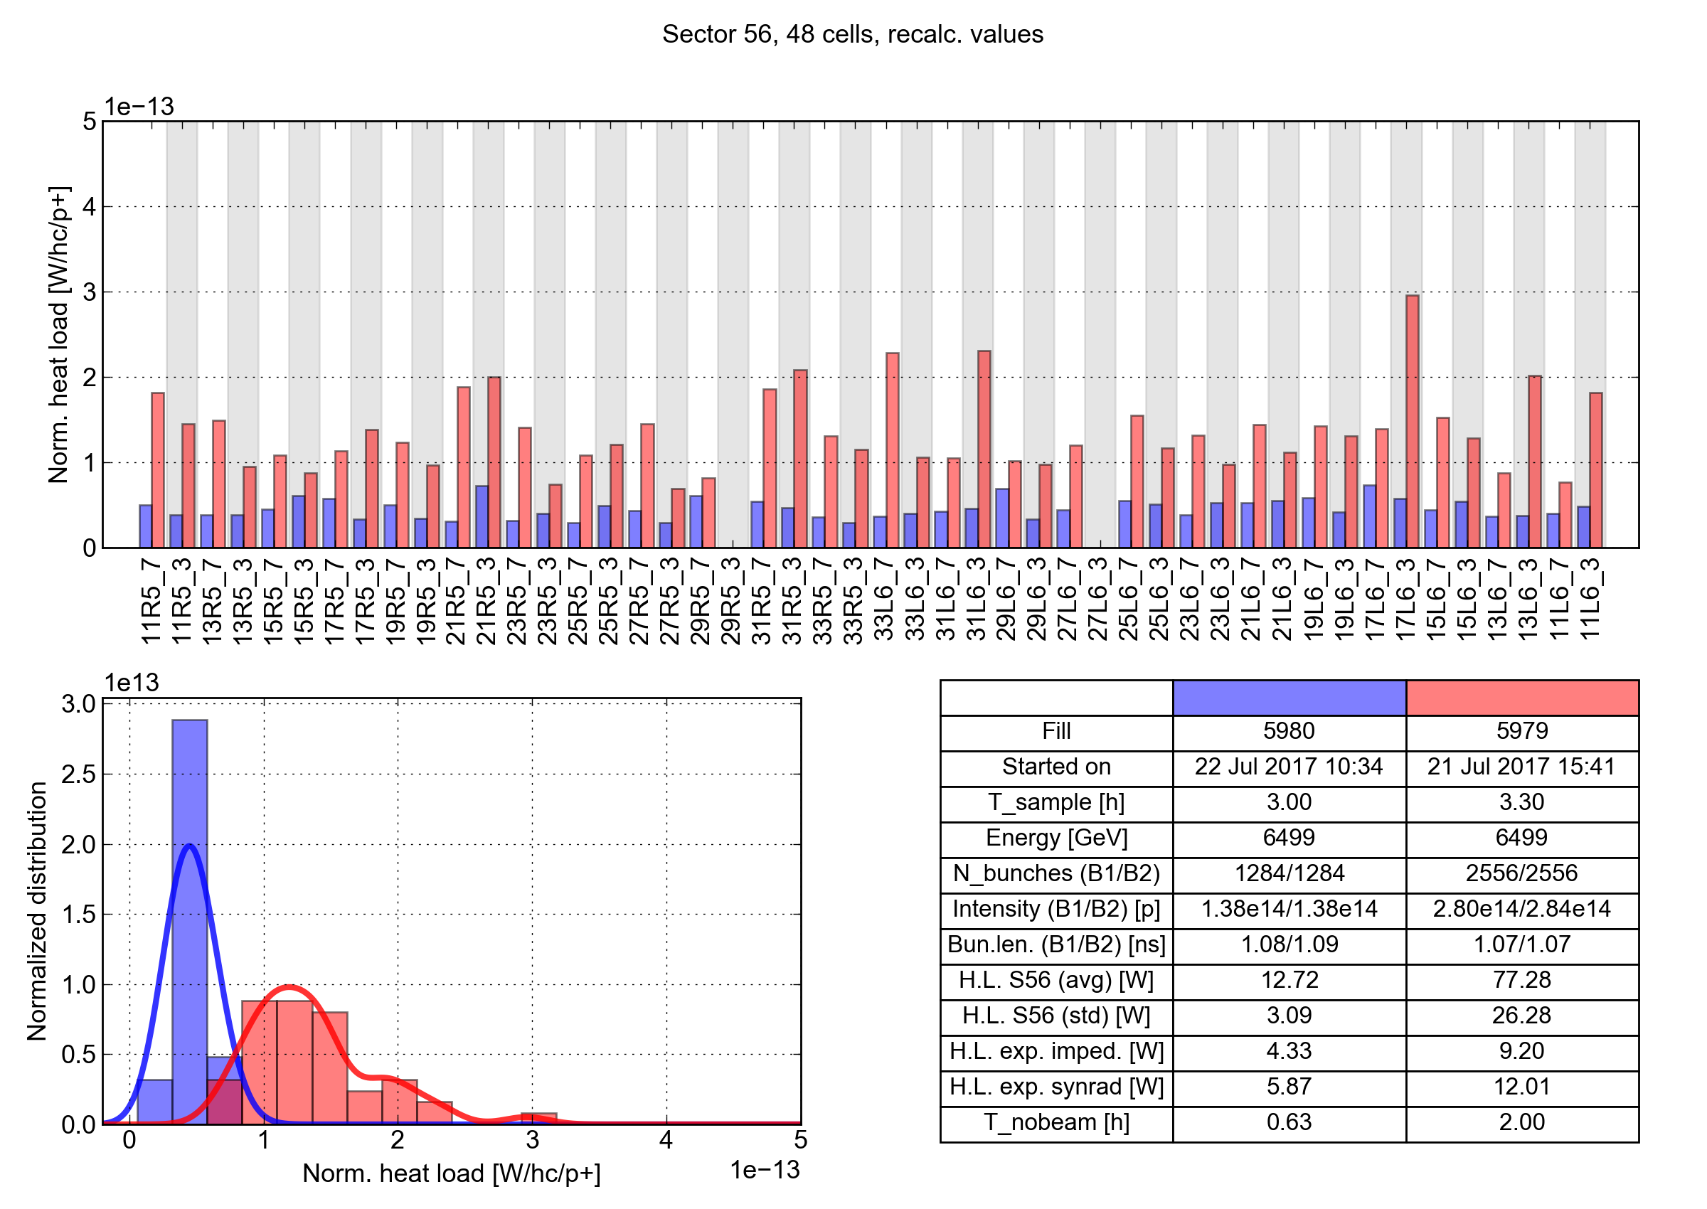
Distribution along the machine: cell-by-cell observations
For low-load sectors, heat load per bunch is much more similar for 50 ns and 25 ns
A few outliers are present
Sector 56 (low load)
50 ns
25 ns

Slide 21
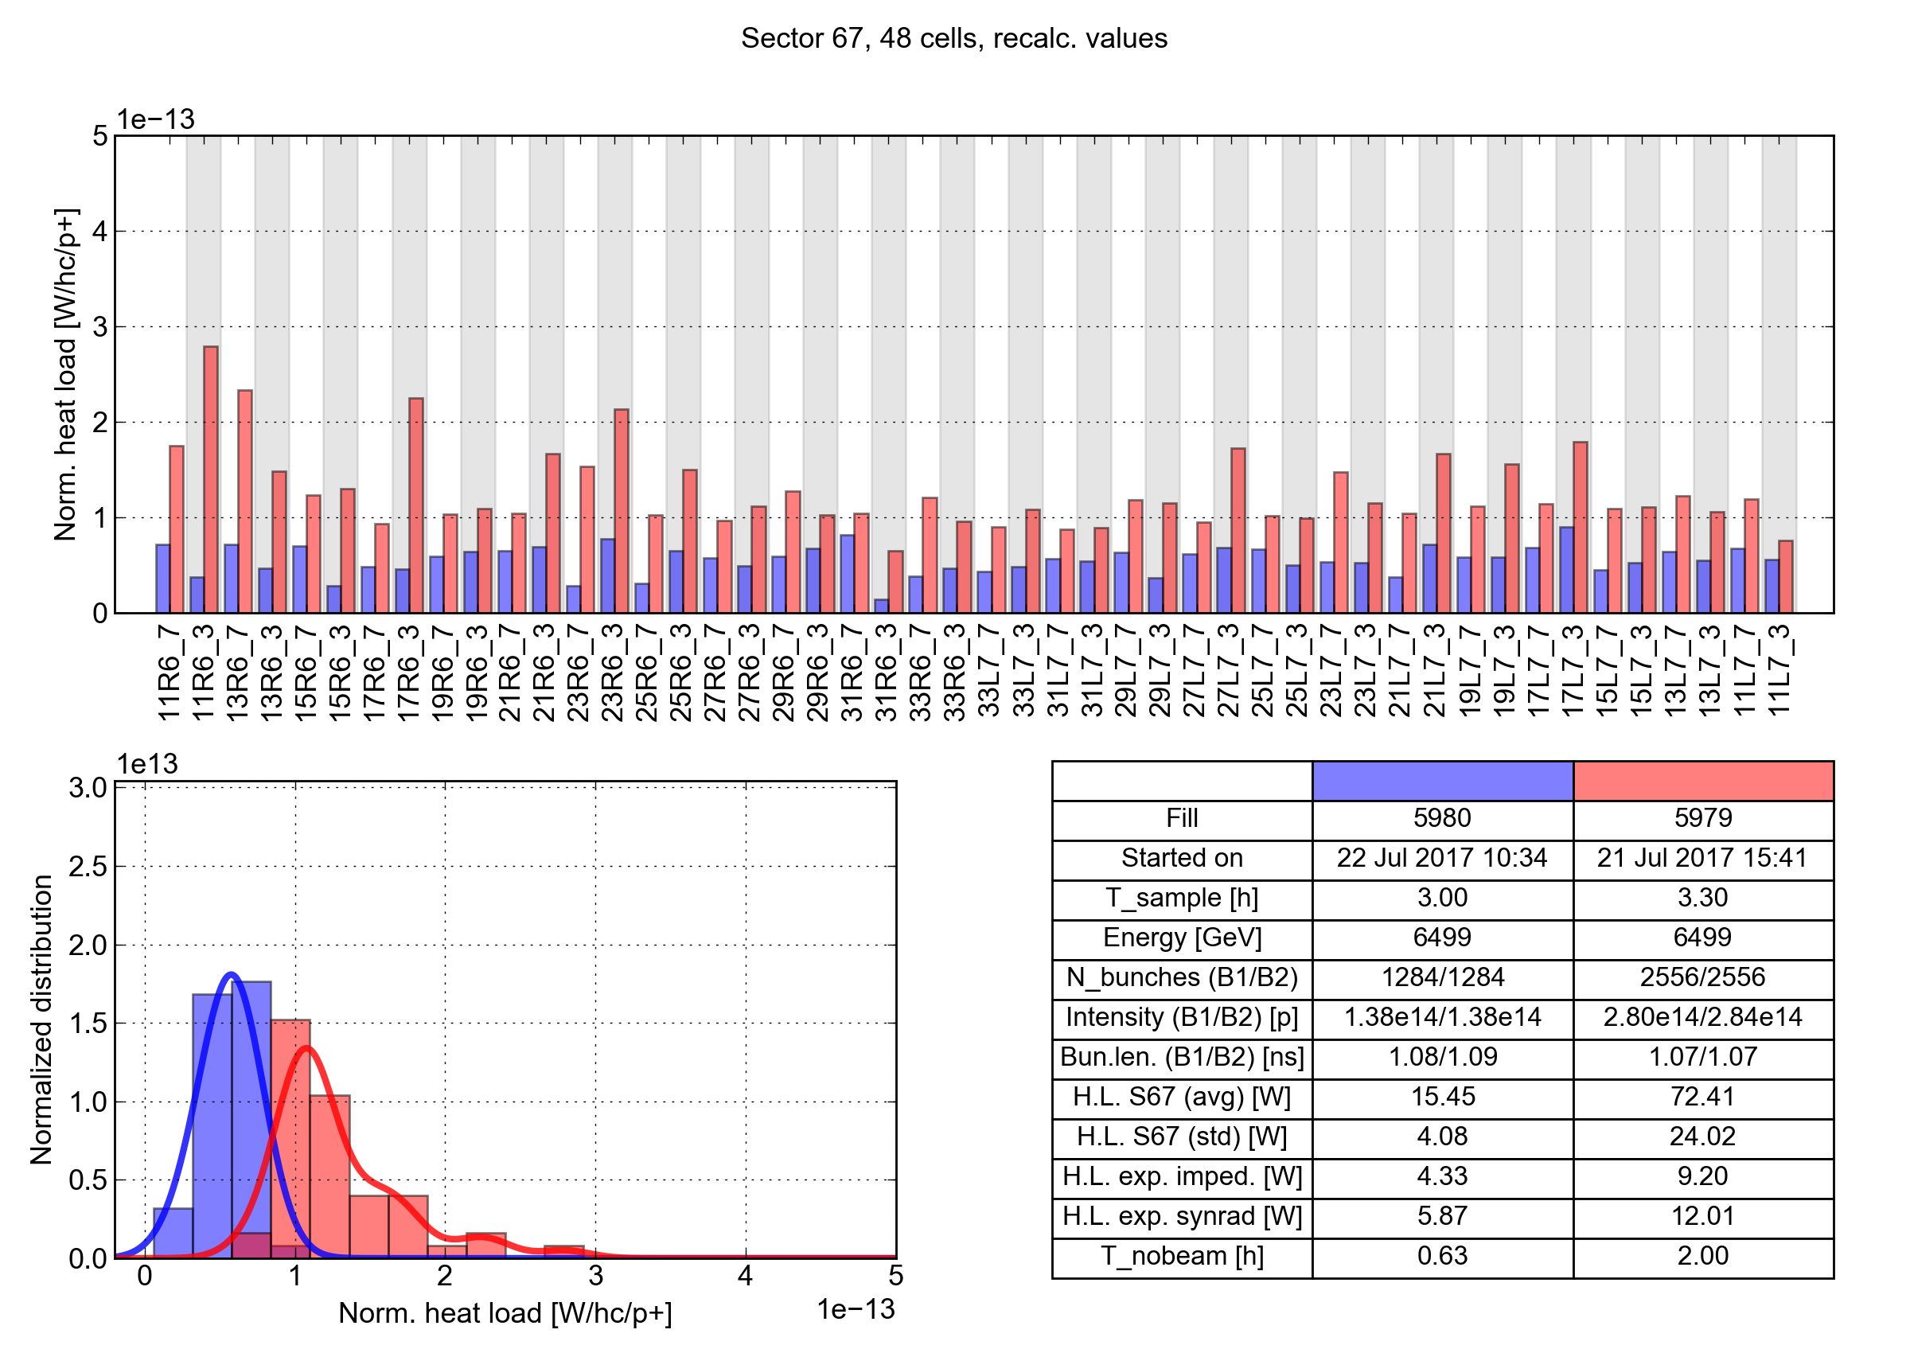
Distribution along the machine: cell-by-cell observations
For low-load sectors, heat load per bunch is much more similar for 50 ns and 25 ns
A few outliers are present
Sector 67 (low load)
50 ns
25 ns

Slide 22
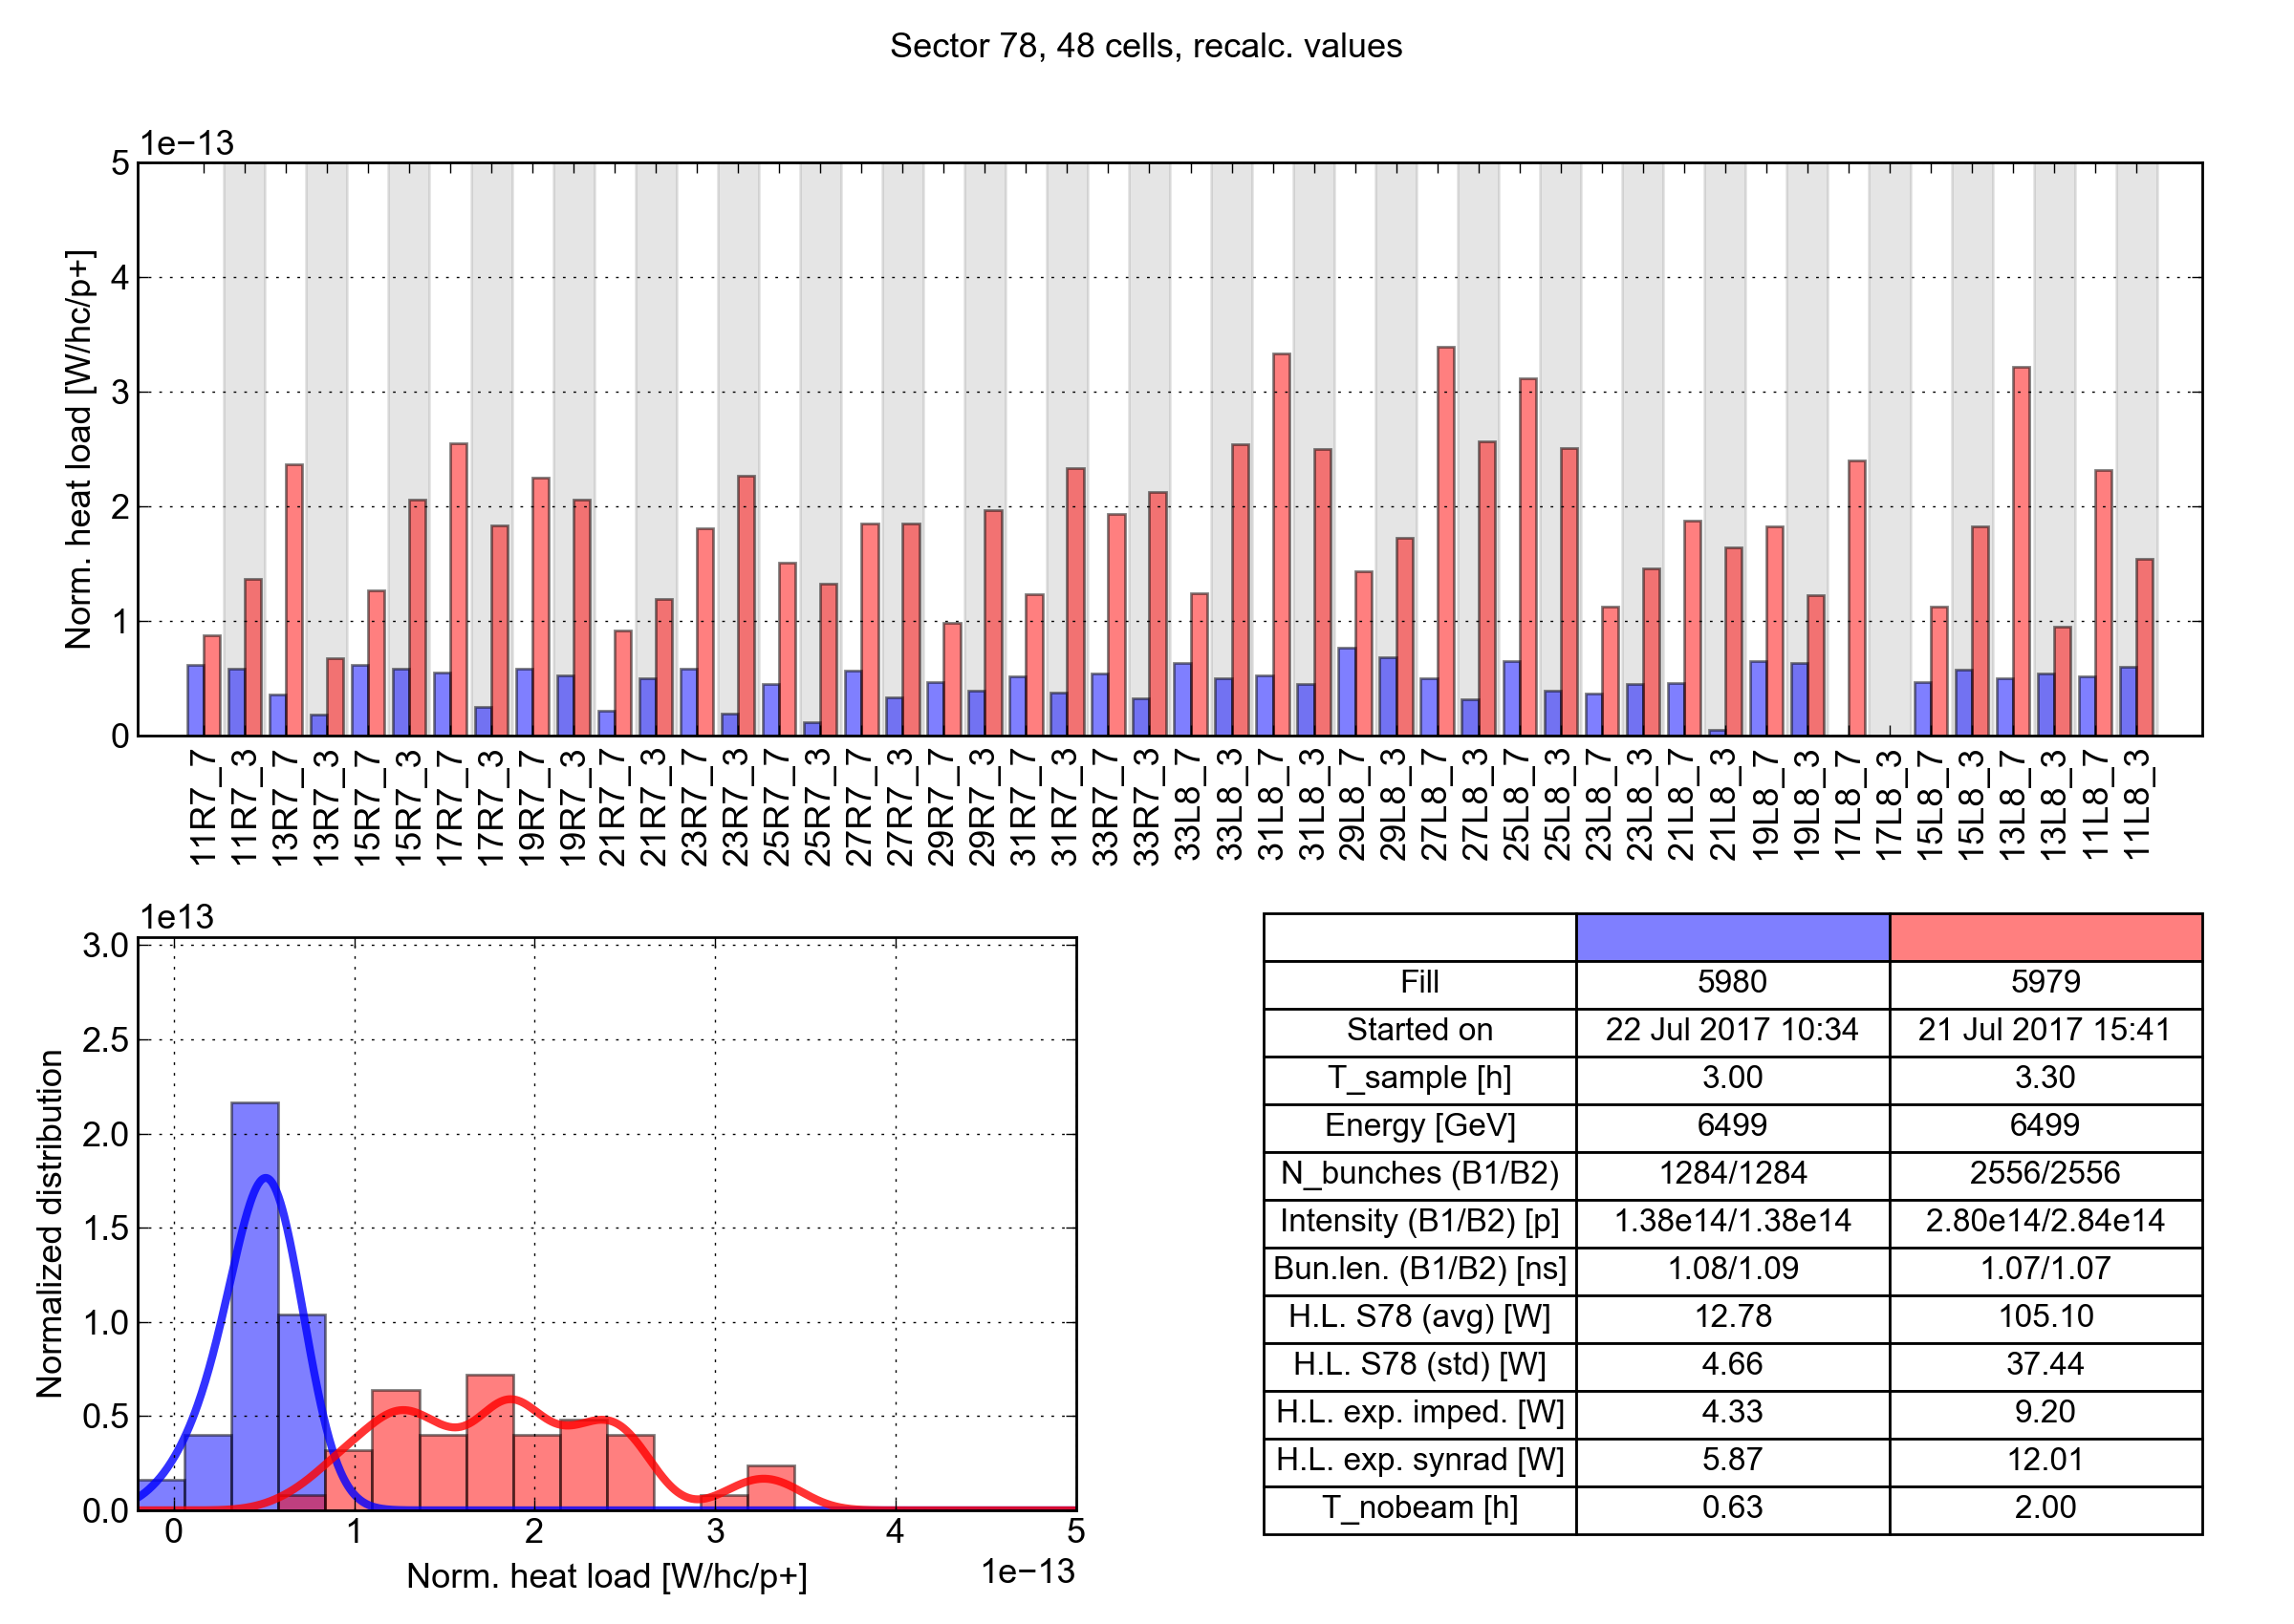
Distribution along the machine: cell-by-cell observations
Sector 78 (high load)
50 ns
25 ns

Slide 23
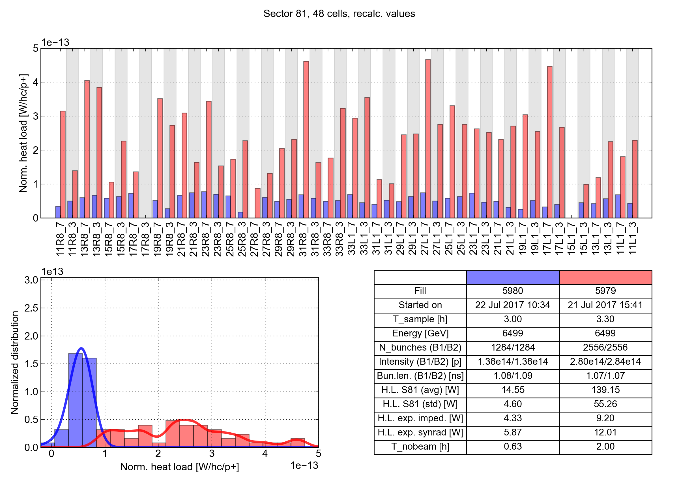
Distribution along the machine: cell-by-cell observations
Sector 81 (high load)
50 ns
25 ns

Slide 24
Outline
Introduction and main observations
Comparison against beam energy loss
Heat load distribution along the machine
Effect of shutdown periods
Inferred SEY_{max}
Observed dependence on the beam properties
Data from special instrumented cells

Slide 25
Were the heat load differences always present?
2010
2013
2015
2019
Run 1 (50 ns)
LS1
Run 2 (25 ns)
LS2
Test period
with 25 ns beams
Today
A test period with 25 ns beams took place in 2012, data can be directly compared against Run 2
Heat load differences appeared only after LS1 (in which all sectors warmed up and vented)!
Before LS1
After LS1
In the high load sectors, loads are 4 times larger than before LS1
Differences were not present in 2012!

Slide 26
Can a thermal cycle change the situation?
In the 2016-17 winter shutdown, Sector 12 had to be warmed-up and vented to replace a faulty main magnet
Situation right after the the cool-down, before conditioning:
Large deconditioning observed in S12 (as expected)
Conditioning of other sectors (which stayed cold) was basically preserved
2016 (end)
2017 (before scrubbing)
(450 GeV)
Vented

Slide 27
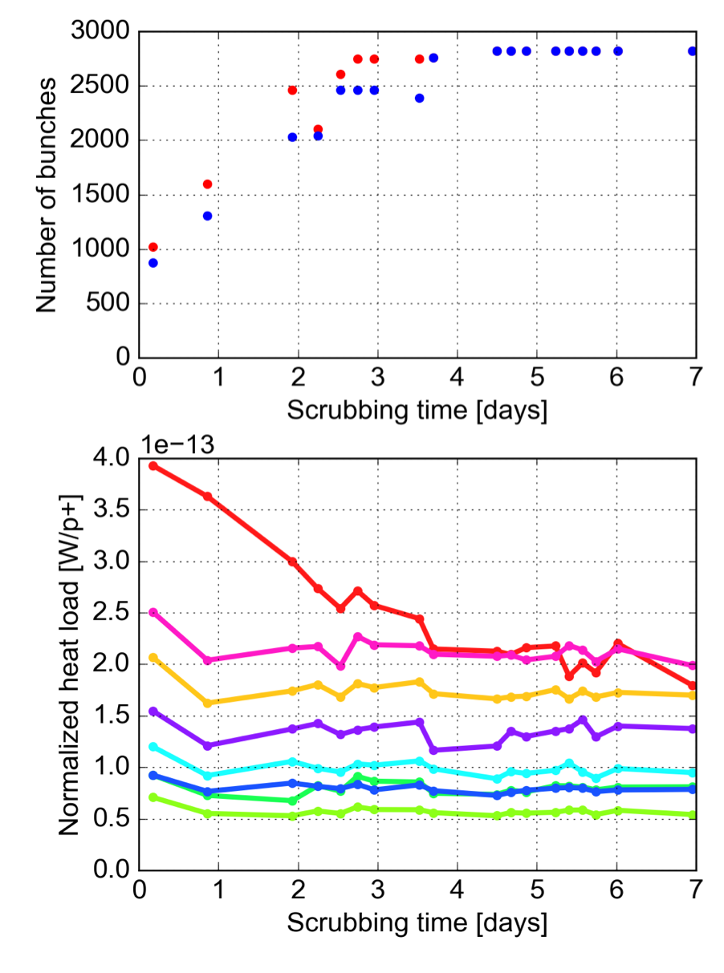
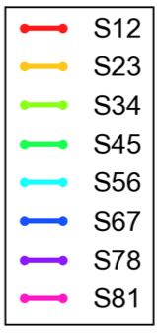
Arc heat loads during the 2017 scrubbing run
Seven days of scrubbing were allocated at the beginning of 2017 re-condition Sector 12
Evident conditioning observed over the first 4 d
On day 4 heat load similar to end-2016 were reached
No evolution observed thereafter (important info for planning future scrubbing runs)
Impossible to get back to 2012 levels
Nb inj.
72
144
144/288
288
S12-2016
S12-2012

Slide 28
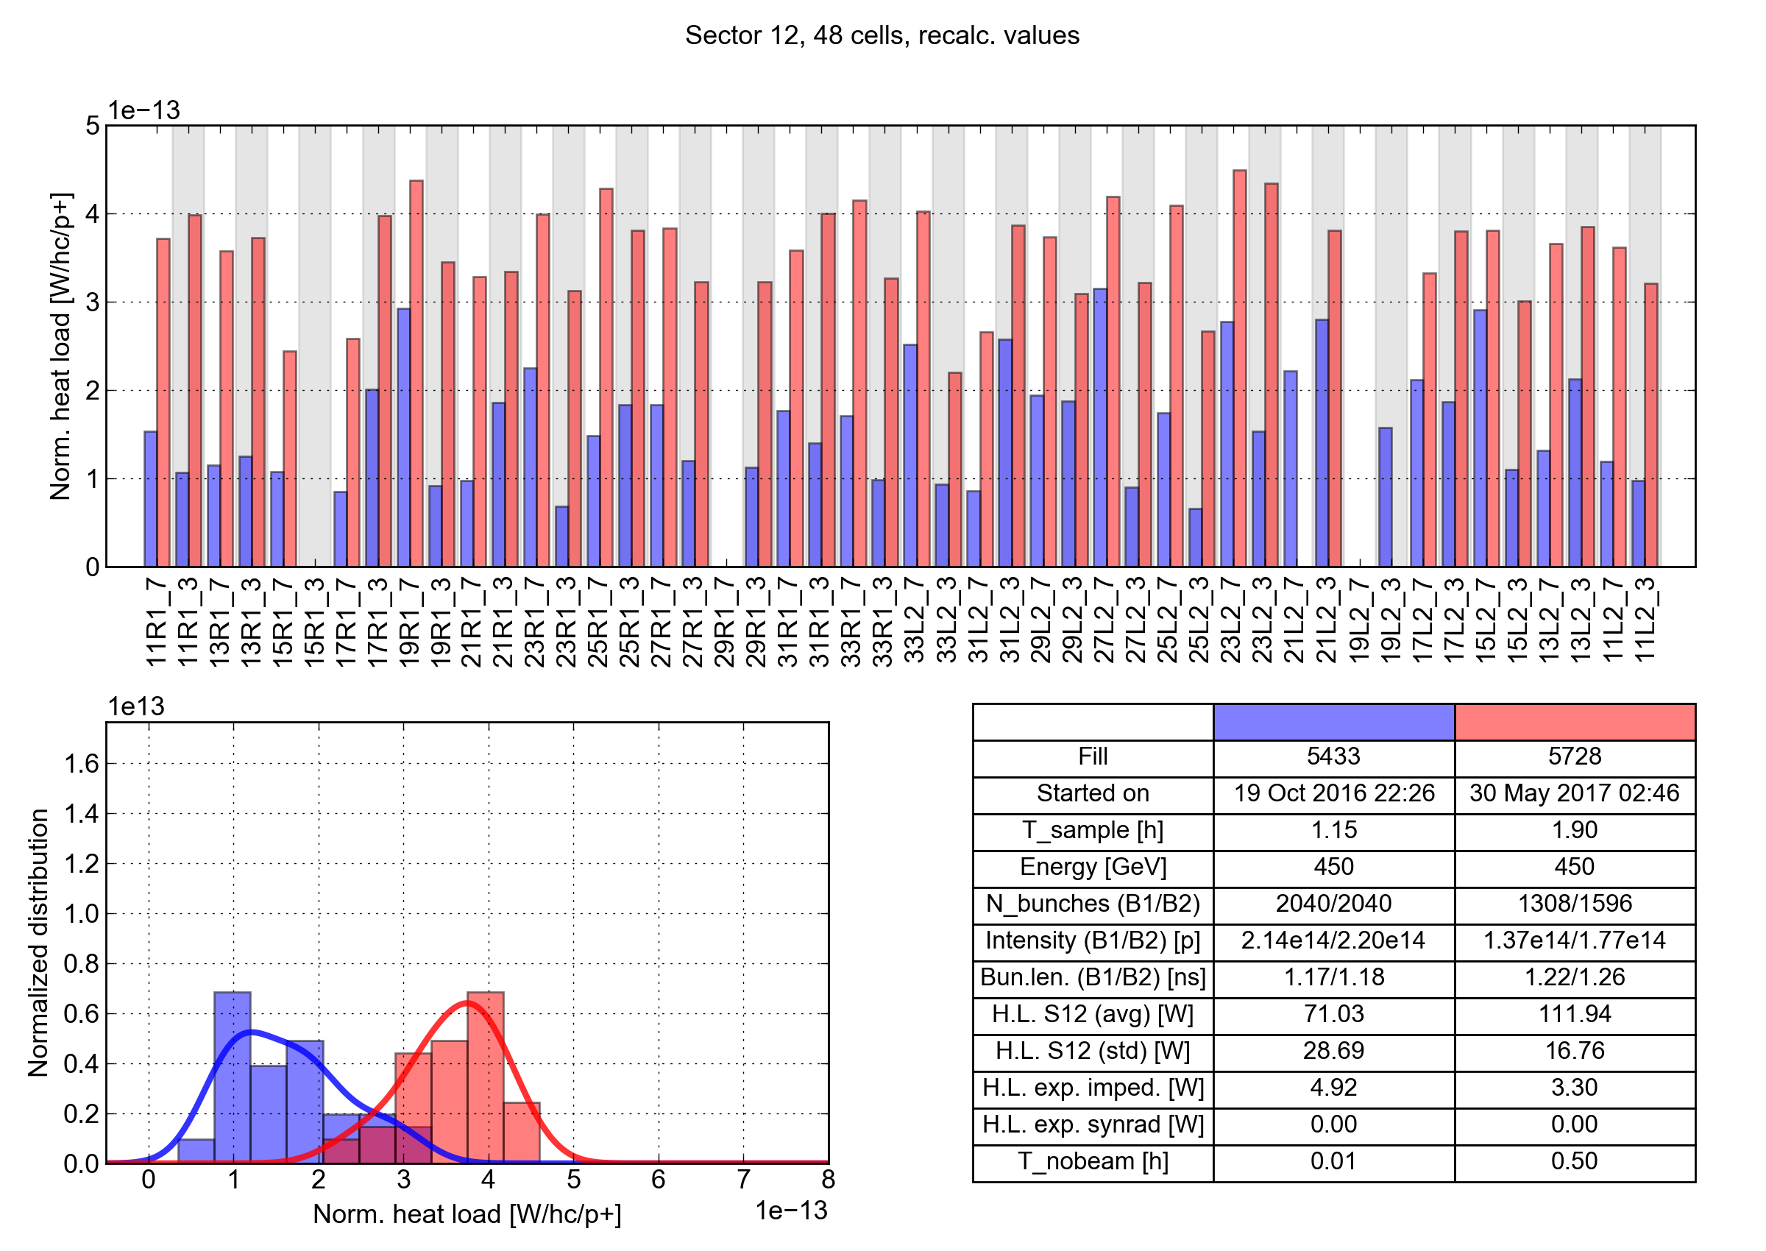
Cell-by-cell analysis at 450 GeV: S12
Particularly interesting to look at cell-by-cell behavior
Heat load increase observed on all cells
End 2016 2017 – beginning of scrubbing

Slide 29
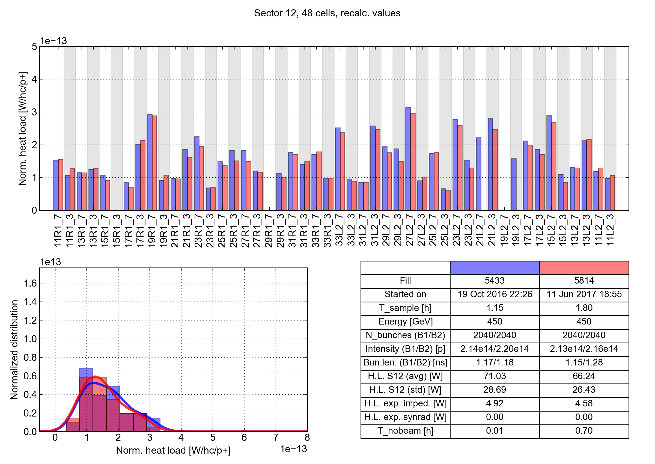
Cell-by-cell analysis at 450 GeV: S12
Situation at the end of scrubbing run was practically identical to end-2016
→ Effect of LS1 is somehow more permanent than effect of 2016-17 venting
End 2016 2017 – end of scrubbing

Slide 30
Outline
Introduction and main observations
Comparison against beam energy loss
Heat load distribution along the machine
Effect of shutdown periods
Inferred SEY_{max}
Observed dependence on the beam properties
Data from special instrumented cells

Slide 31
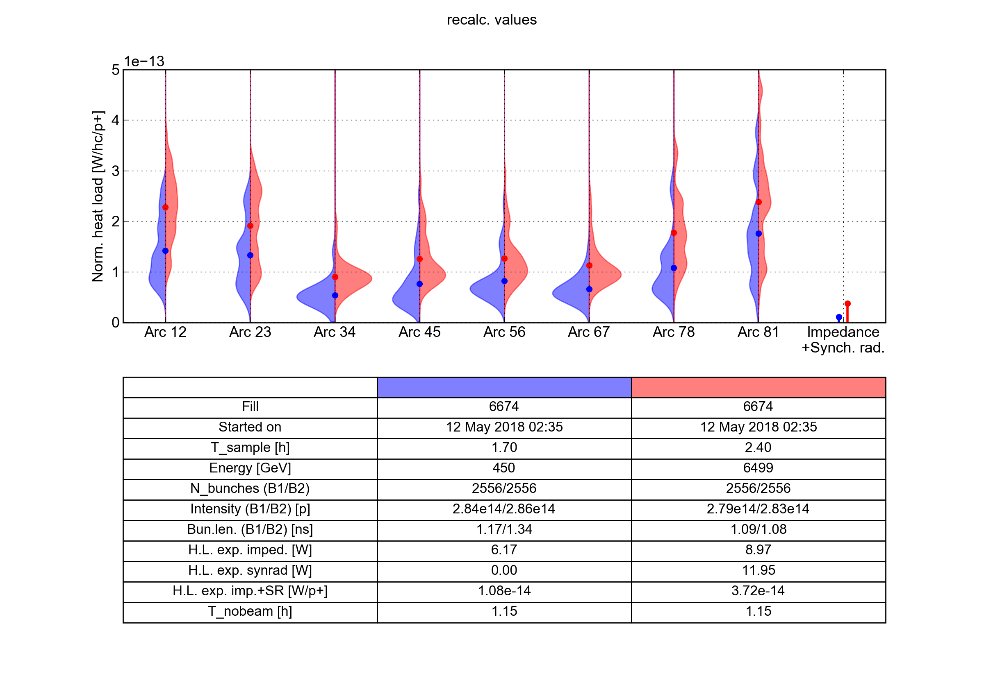
Inferred SEY_{max} range
A ballpark estimate can be made comparing the average arc loads against simulations
Simulations
Measurements
6.5 TeV
450 GeV
6.5 TeV
High-load
Low-load
For details on simulation model see talk by P. Dijkstal

Slide 32
Inferred SEY_{max} range
A ballpark estimate can be made comparing the average arc loads against simulations
Simulations
Measurements
450 GeV
450 GeV
6.5 TeV
High-load
Low-load
For details on simulation model see talk by P. Dijkstal

Slide 33
Outline
Introduction and main observations
Comparison against beam energy loss
Heat load distribution along the machine
Effect of shutdown periods
Inferred SEY_{max}
Observed dependence on the beam properties
Data from special instrumented cells

Slide 34
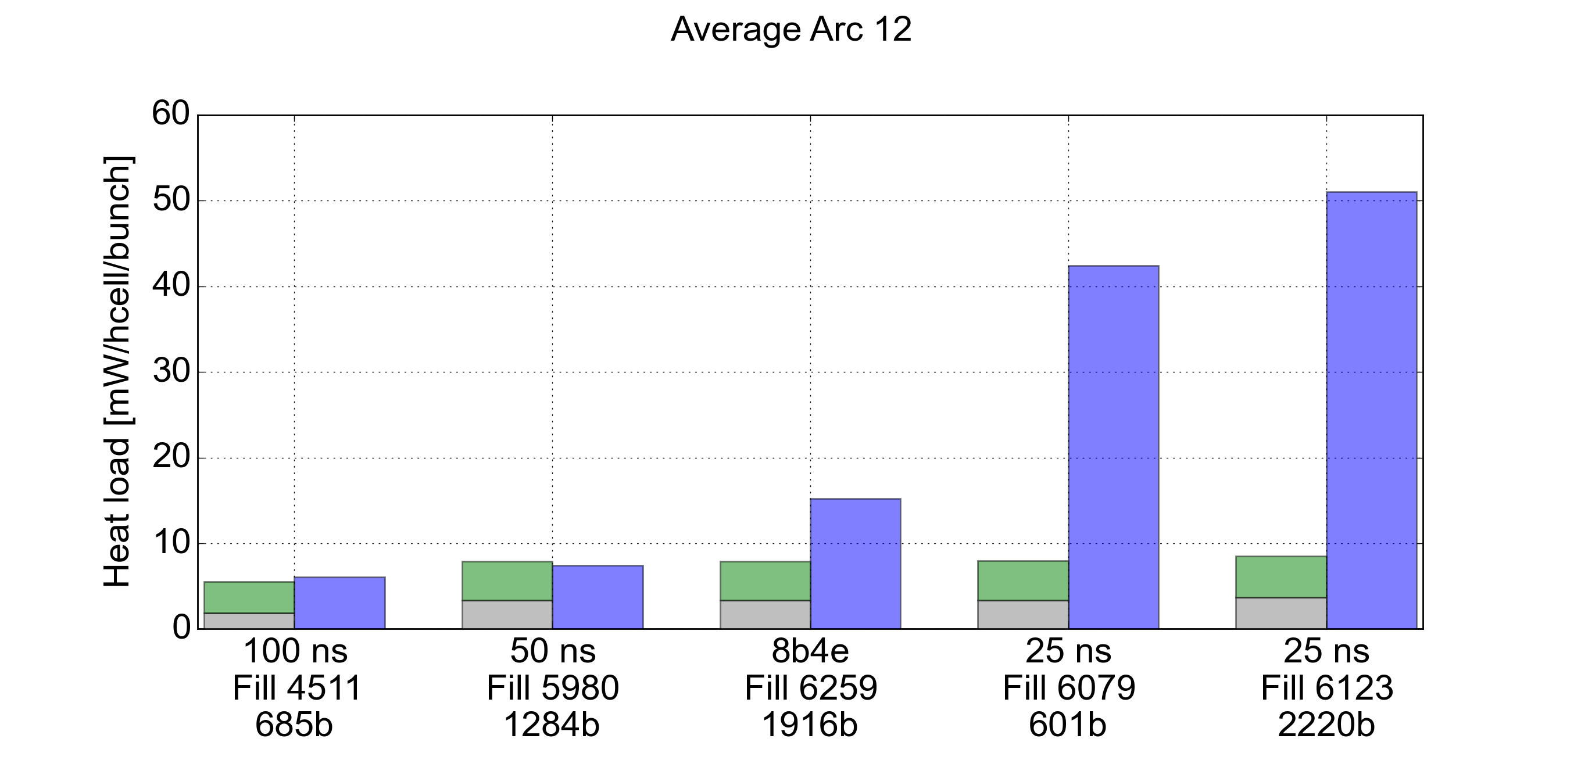
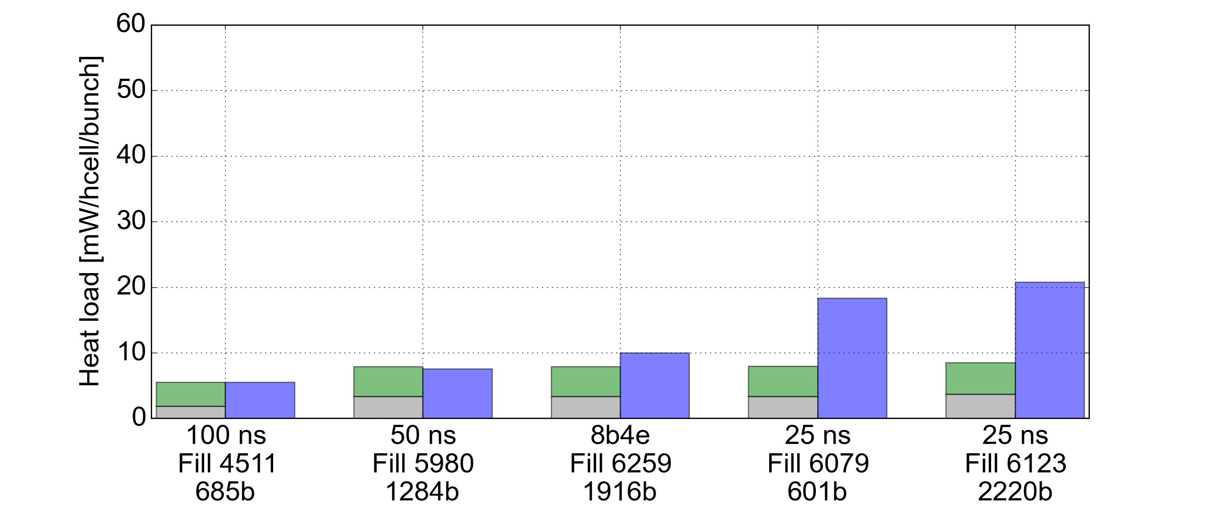
Dependence on the bunch spacing
Different bunch patterns have been explored:
Excess w.r.t. impedance and synchrotron radiation and differences among sectors visible only with the 25 ns variants
Sector 12 (high load)
(*) 8b+4e: scheme interleaving 25 ns trains of 8b with empty gaps of 125 ns
(*)
Sector 34 (low load)
(*)

Slide 35
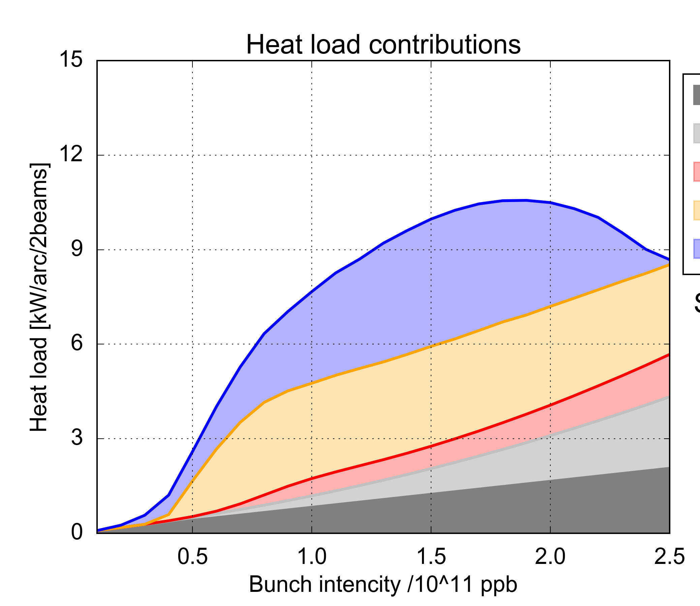
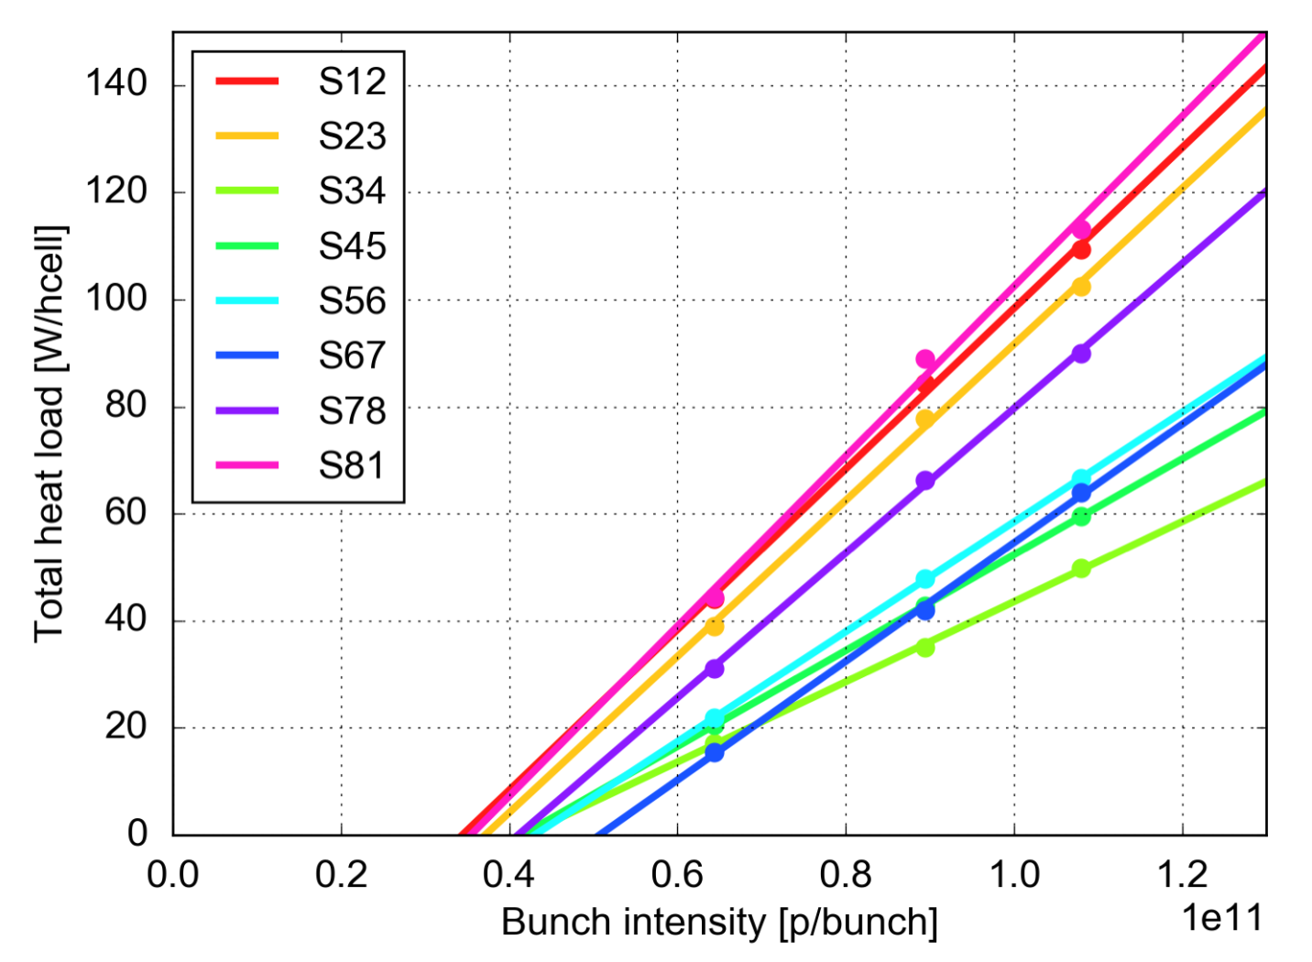
Dependence on the bunch intensity
Measurements have been taken with 25 ns beams with different bunch intensity
Inferred intensity threshold around 0.4e11 p/bunch
Consistent with e-cloud simulations
Simulations
Measurements
e-cloud in dipoles
SEY_{max} = 1.35
e-cloud in quadrupoles
e-cloud in drifts
Impedance
Synchrotron radiation

Slide 36
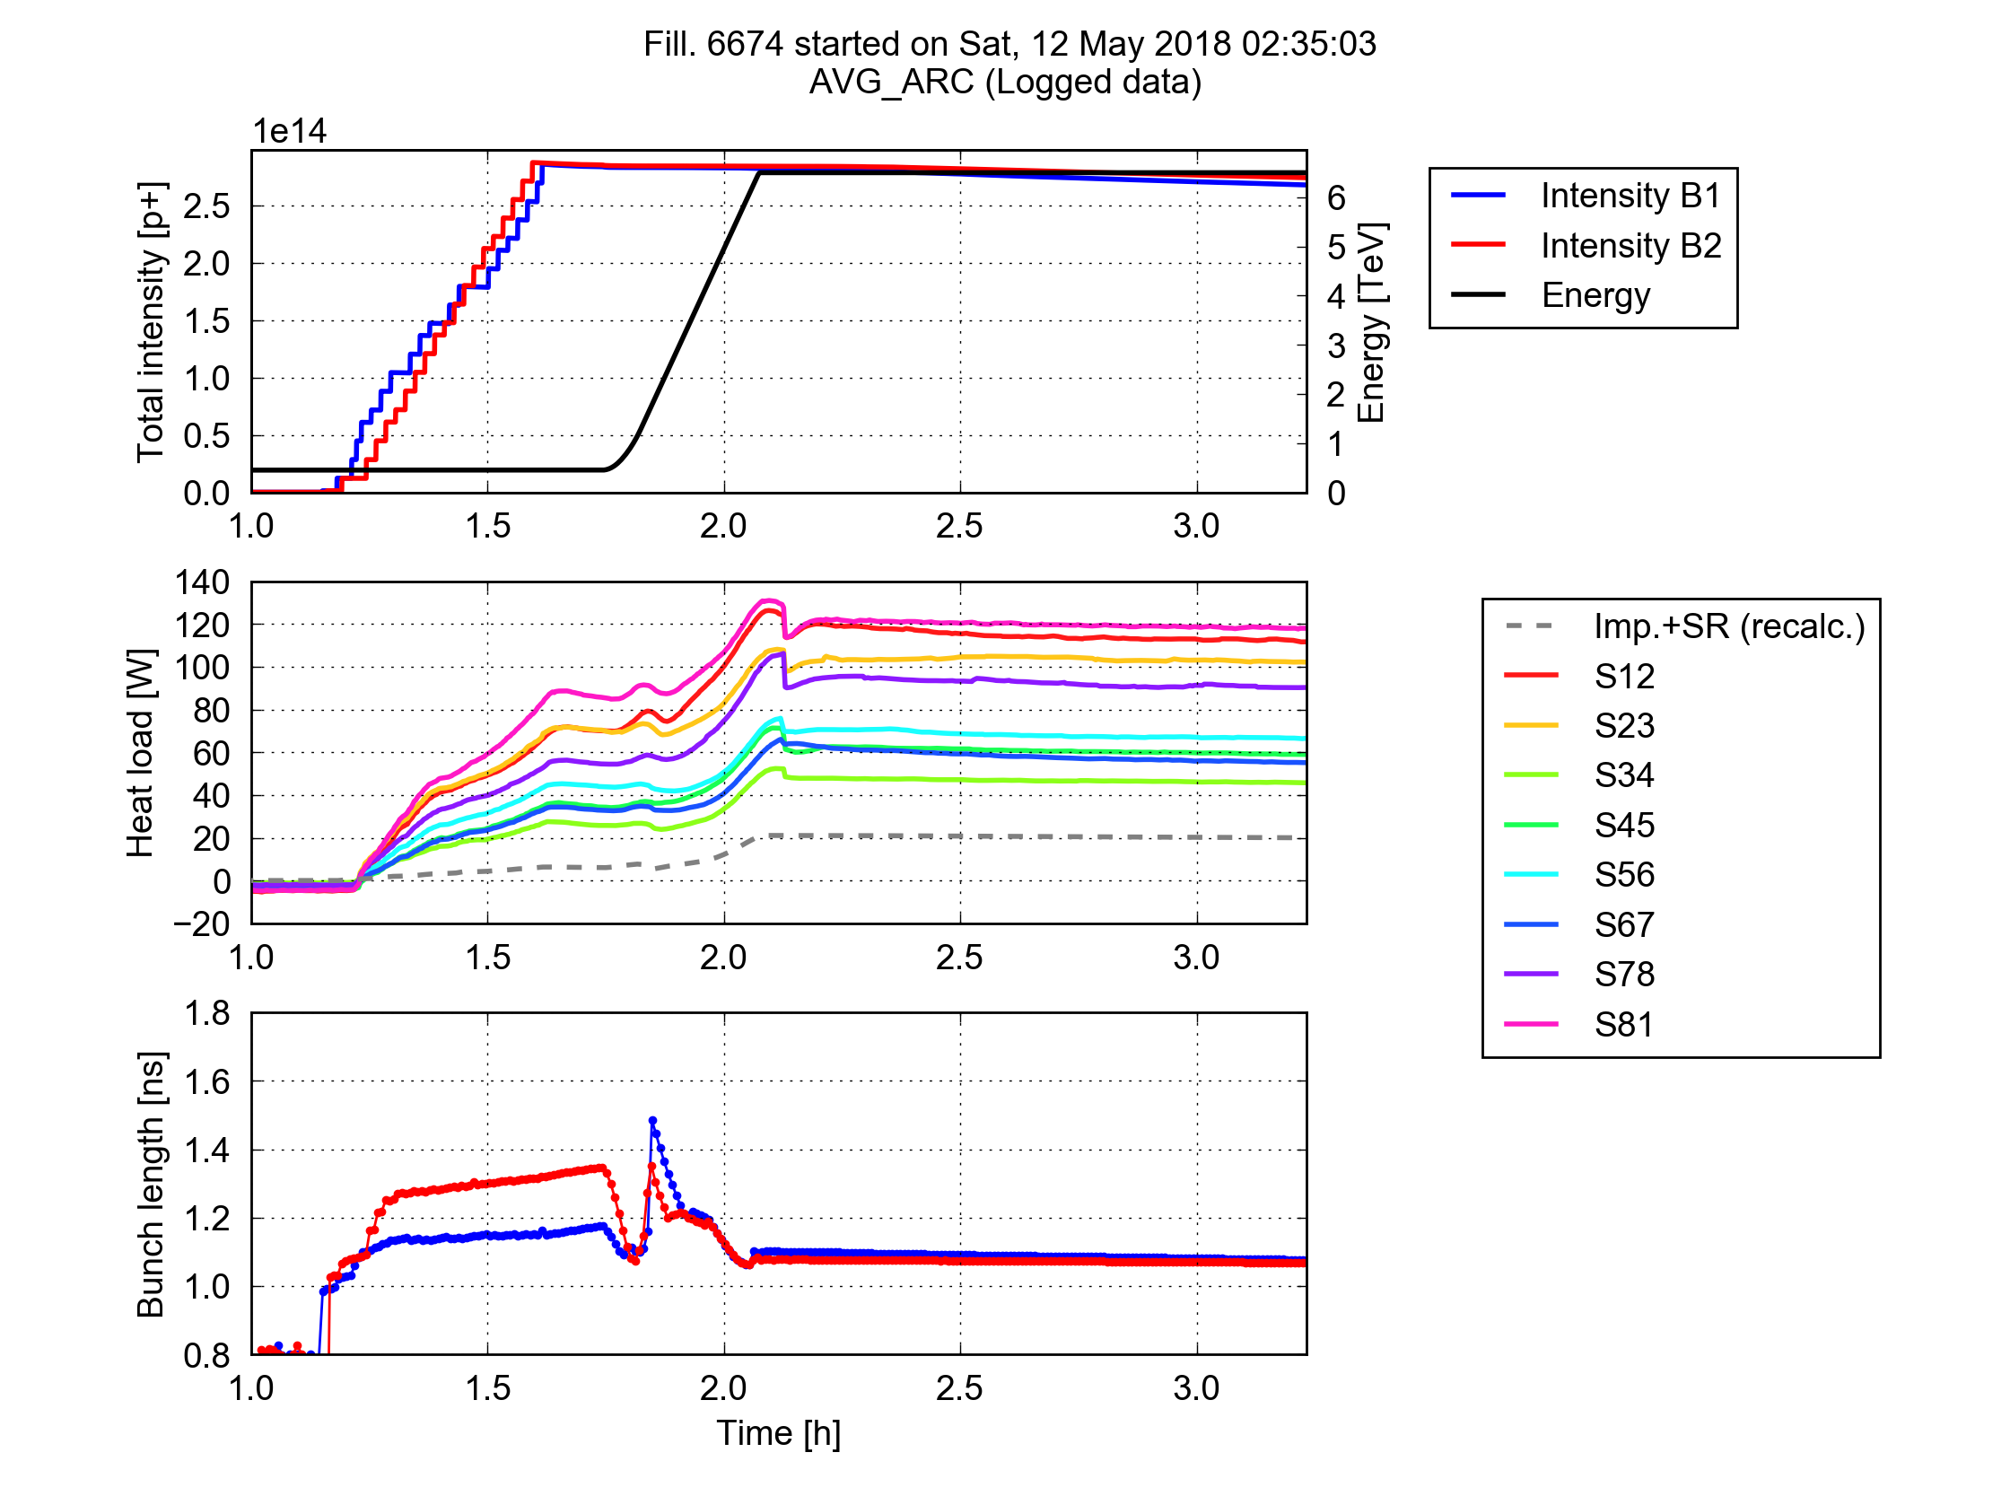
Dependence on the beam energy
Large heat loads and heat load differences are already present at injection energy (450 GeV) and increase only moderately during the energy ramp
→ It is unlikely that photoelectrons from synchrotron radiation play a major role
Acceleration
Collisions

Slide 37
Outline
Introduction and main observations
Comparison against beam energy loss
Heat load distribution along the machine
Effect of shutdown periods
Inferred SEY_{max}
Observed dependence on the beam properties
Data from special instrumented cells

Slide 38
Special instrumented half-cells
A small selection of arc half-cells have been equipped with extra thermometers to measure the heat loads magnet by magnet
3 cells in S45 were instrumented during LS1 (they always showed relatively low heat loads 2016-17)
1 cell in S12 instrumented during the 2016-17 winter shutdown when one of the magnets had to be exchanged (it shows a large heat load)
Q1
D2
D3
D4

Slide 39
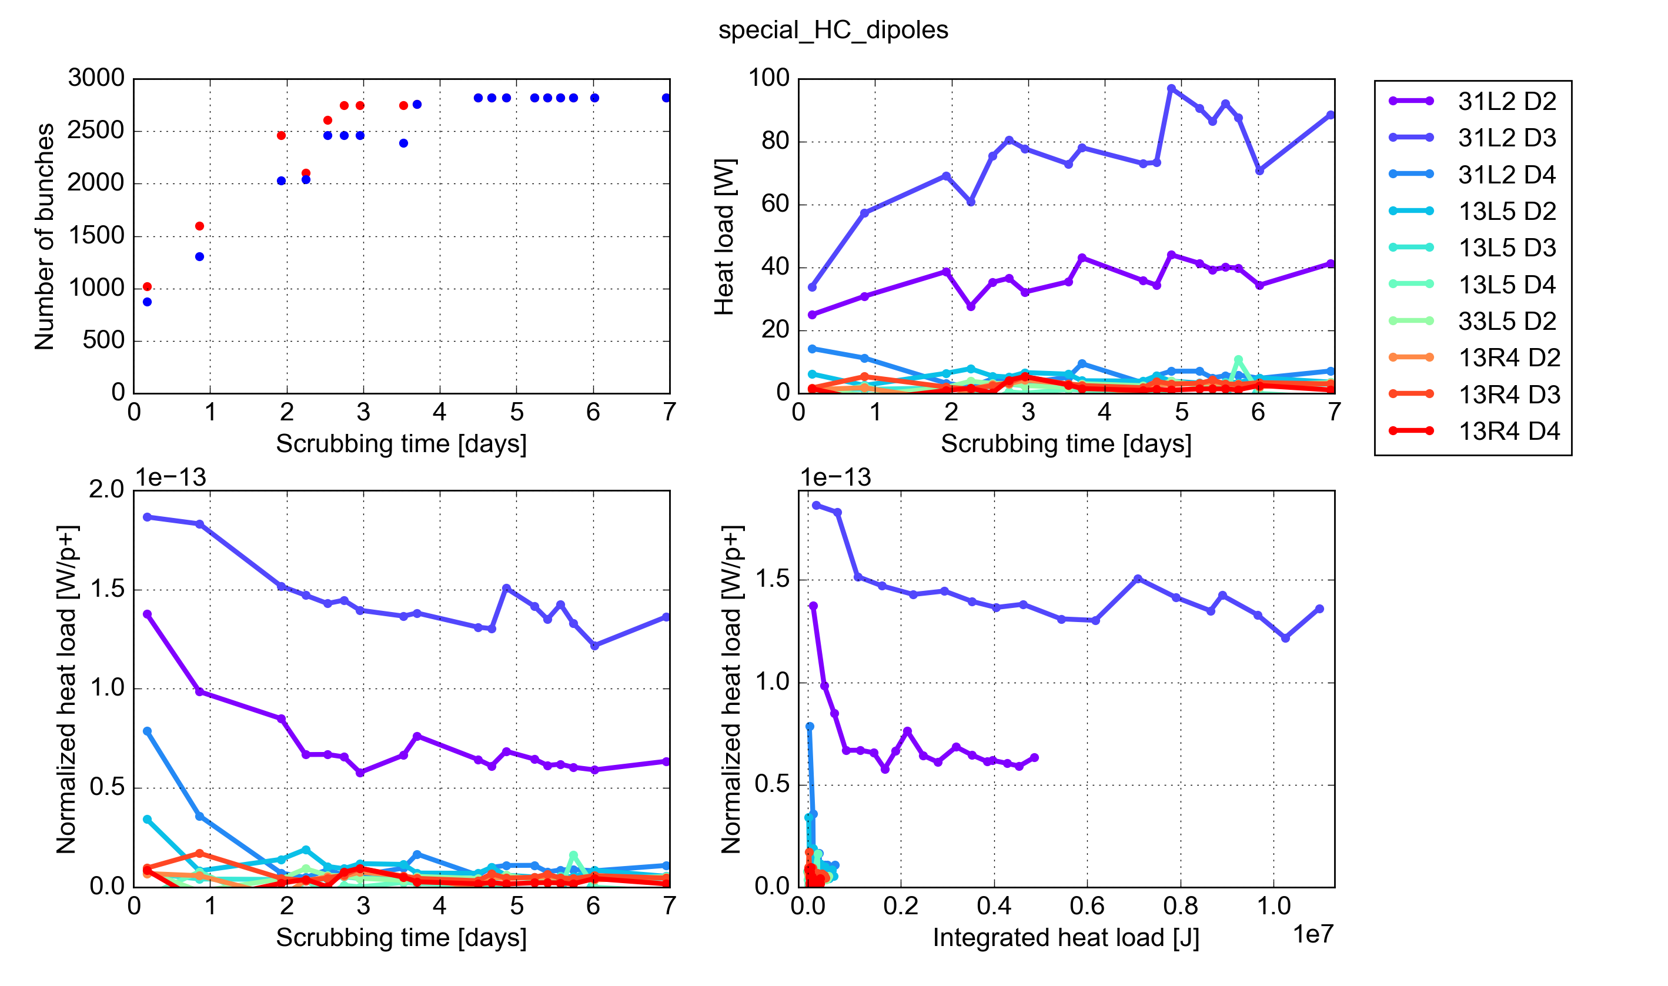
Dipole magnets: scrubbing run data
Particularly interesting to look at what happened right after the 2016-17 winner shutdown when S12 vented, 31L2-D4 dipole exchanged
Nbun inj.
72
144
144/288
288
S12
S45
Low heat load observed in existing instrumented cells in S45

Slide 40
Dipole magnets: scrubbing run data
Particularly interesting to look at what happened right after the 2016-17 winner shutdown when S12 vented, 31L2-D4 dipole exchanged
Nbun inj.
72
144
144/288
288
S12
S45
Newly installed magnet in 31L2 conditioned very rapidly to the level of those in S45

Slide 41
Dipole magnets: scrubbing run data
Particularly interesting to look at what happened right after the 2016-17 winner shutdown when S12 vented, 31L2-D4 dipole exchanged
Nbun inj.
72
144
144/288
288
S12
S45
Other dipoles at 31L2 show a much larger heat load and very little conditioning
Most likely, also other high-load cells have this kind of behavior in some of their magnets

Slide 42
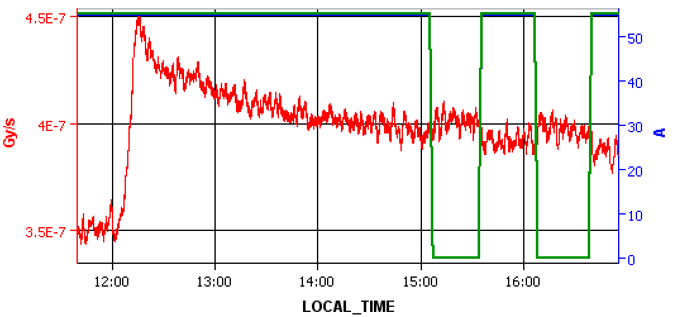
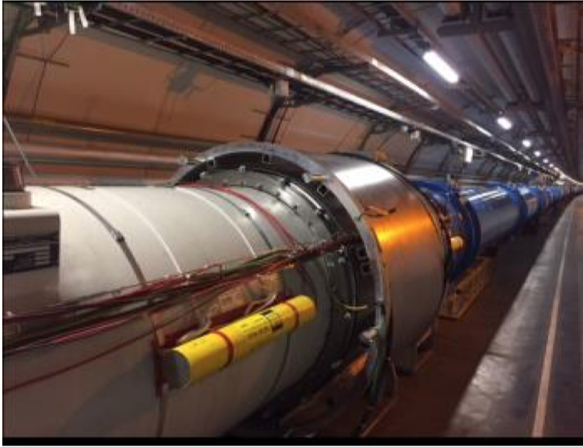
Tests at the interconnection
Plug-in module
Efforts are ongoing to further localize the source:
Analysis of heat load transients
Solenoid installed at interconnection between magnets (where Plug-In Modules are installed)
Additional ionization chamber sensors (BLMs) installed to measure beam-gas interactions
Effect of solenoidal field on BLM signal visible but small
Solenoid current
BLM signal

Slide 43
Summary
Large heat loads on the arc beam screens are observed only when operating with 25 ns bunch space spacing. Worrisome when scaling to HL-LHC.
Heat loads are very different when moving from arc-to-arc, from cell-to-cell and from magnet-to-magnet, which are identical by design
Large differences appeared only after the 2013-15 shutdown in which the arcs were warmed-up and exposed to air, but no further change was observed when the operation was repeated on one of the sectors in 2016-17
Several observed features are compatible with e-cloud effects, and very difficult to explain with other considered mechanisms (e.g. impedance, synchrotron radiation, beam losses):
Dependence on the bunch spacing
Dependence on bunch intensity
Bunch-by-bunch patter on beam power loss (RF)
Dependence on energy

Slide 44
Thanks for your attention!

Slide 45
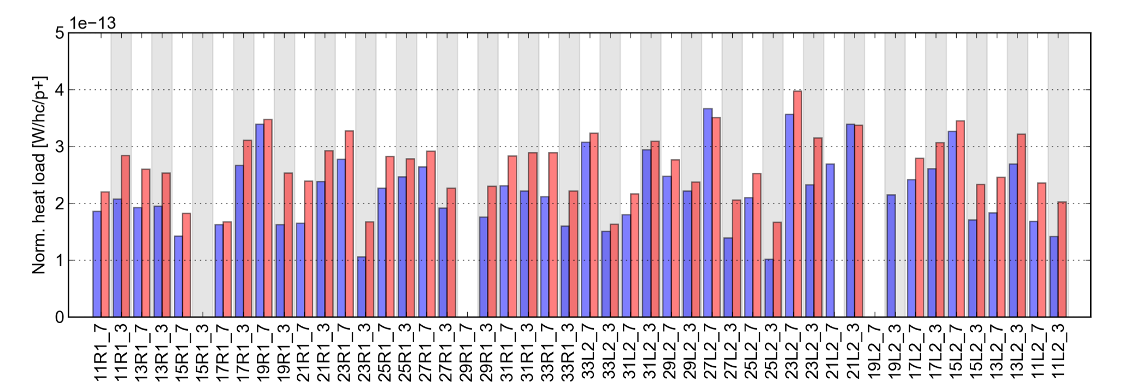
What about the dipole that was taken out?
No magnet-by-magnet diagnostics in 31L2 before the EYETS but:
Total cell heat load measured now is extremely similar to end-2016 values
Other cells show that other magnets have practically recovered the end-2016 conditioning state
This means that the old magnet was behaving similarly to the newly installed one
The extracted magnet was a low-load magnet (consistent with the fact that no issue was revealed by the lab analysis by TE-VSC)
End 2016 2017 – last fill before TS1

Slide 46
Investigation on possible causes and sources of abnormal beam induced heating (1/2)
Category | Abnormal beam-induced heating cause or source | Credibility
Measurement artefact | Measurement inaccuracy | Low
 | All beam-screens receive the same power but in low-load sectors, part of the beam-induced heating is transferred to the cold-mass. | Low
BS manufacturing and tolerances | Beam-screen manufacturing process | Low
 | Beam-screen angular position | Low
LS1 intervention on beam pipes | Plug-ins module exchange and endoscopic inspection on the beam vacuum | Low
 | RF ball material, air quality during venting or RF ball processing | Low
 | Magnet change and training activities during LS1 | Low
 | Duration of vented and pump-down periods | Low
 | Beam vacuum pressure before cooldown start | Low
 | Effect of venting with beam-screen below room temperature | Low
 | Regenerative heating of beam screens | Low

Slide 47
Investigation on possible causes and sources of abnormal beam induced heating (2/2)
Category | Abnormal beam-indued heating cause or source | Credibility
Beam operation | Collisions in detectors | Low
 | Bump in S81 to avoid the ULO | Low
 | Degradation of sectors during the Run 2 | Low
Heat load deposition process | Direct loss of proton particle energy in the beam screen wall | Low
 | Image current on beam-screen wall | Low
 | Beam instabilities | Low
 | Degradation by beam losses (SEY,…) | Low
 | Electromagnetic dissipation in new protective half-shells | Low
 | Power loss from impedance | Low
 | Heat deposited in the magnet interconnect | ?
 | Driven by hardware non-conformity | ?
 | Driven by the position in the machine | ?
 | E-cloud deposition | ?

Slide 48
Intensity ramp-up with 25 ns beams: heat loads
In the first stages, even with relatively low number of bunches, strong transients of the beam screen temperatures were observed, leading to loss of cryo-conditions :
Intensity ramp-up performed in “mini-steps” for fine tuning of cryo-regulations
During the first stages, injection speed often decreased to control beam screen temperatures
Limitation from transients strongly mitigated over the year by (see talk by K. Brodzinsky):
Modified Cryo Maintain rules to allow for larger temperature excursion
Improvement on cryogenic feed-forward control
Around ~1450b. (1.5x10¹⁴ p) we started approaching the limit of the available cooling capacity on the arc beams screens. Additional margin gained by:
Increased longitudinal emittance blow-up on the ramp
optimized filling scheme to gain additional margin
By the end of the proton run reached 2244b. (in trains of 36 b.) with 1.2x10¹¹ ppb
High β*
Filling pattern
72 bpi
144 bpi
72g72
72g72
(4x36) bpi
100 ns
Target b. length
1.25 ns
1.3 ns
1.35 ns
1.35 ns

Slide 49
Evolution during run 2

Slide 50
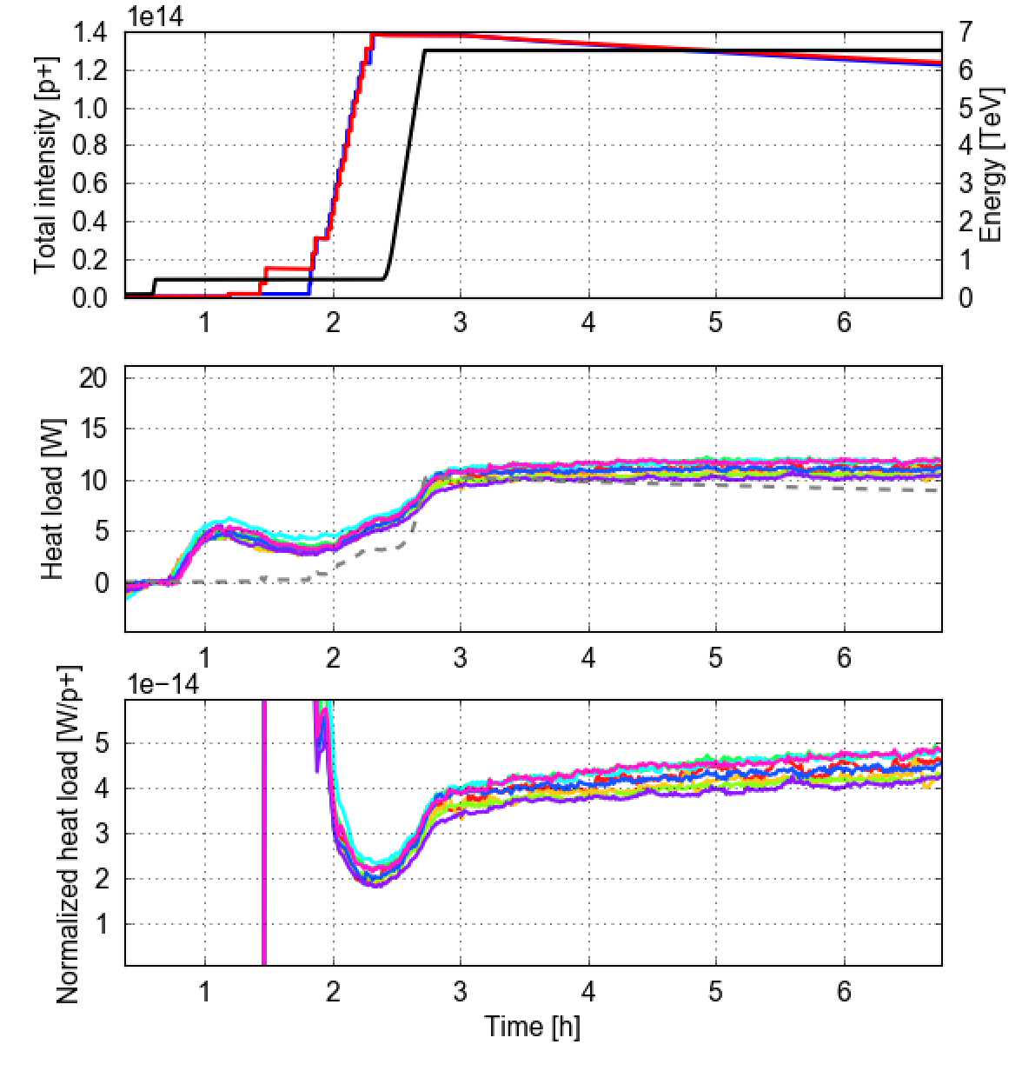
Heat loads are strongly dependent on bunch spacing
Electron cloud suppression with 50 ns confirmed by heat load measurements on the beams-screens
Consistent with expectations from impedance and synchrotron radiation
Large differences between sectors observed with 25 ns are not visible with 50 ns
25 ns
50 ns
More data on 50 ns test in 2017 can be found here

Slide 51
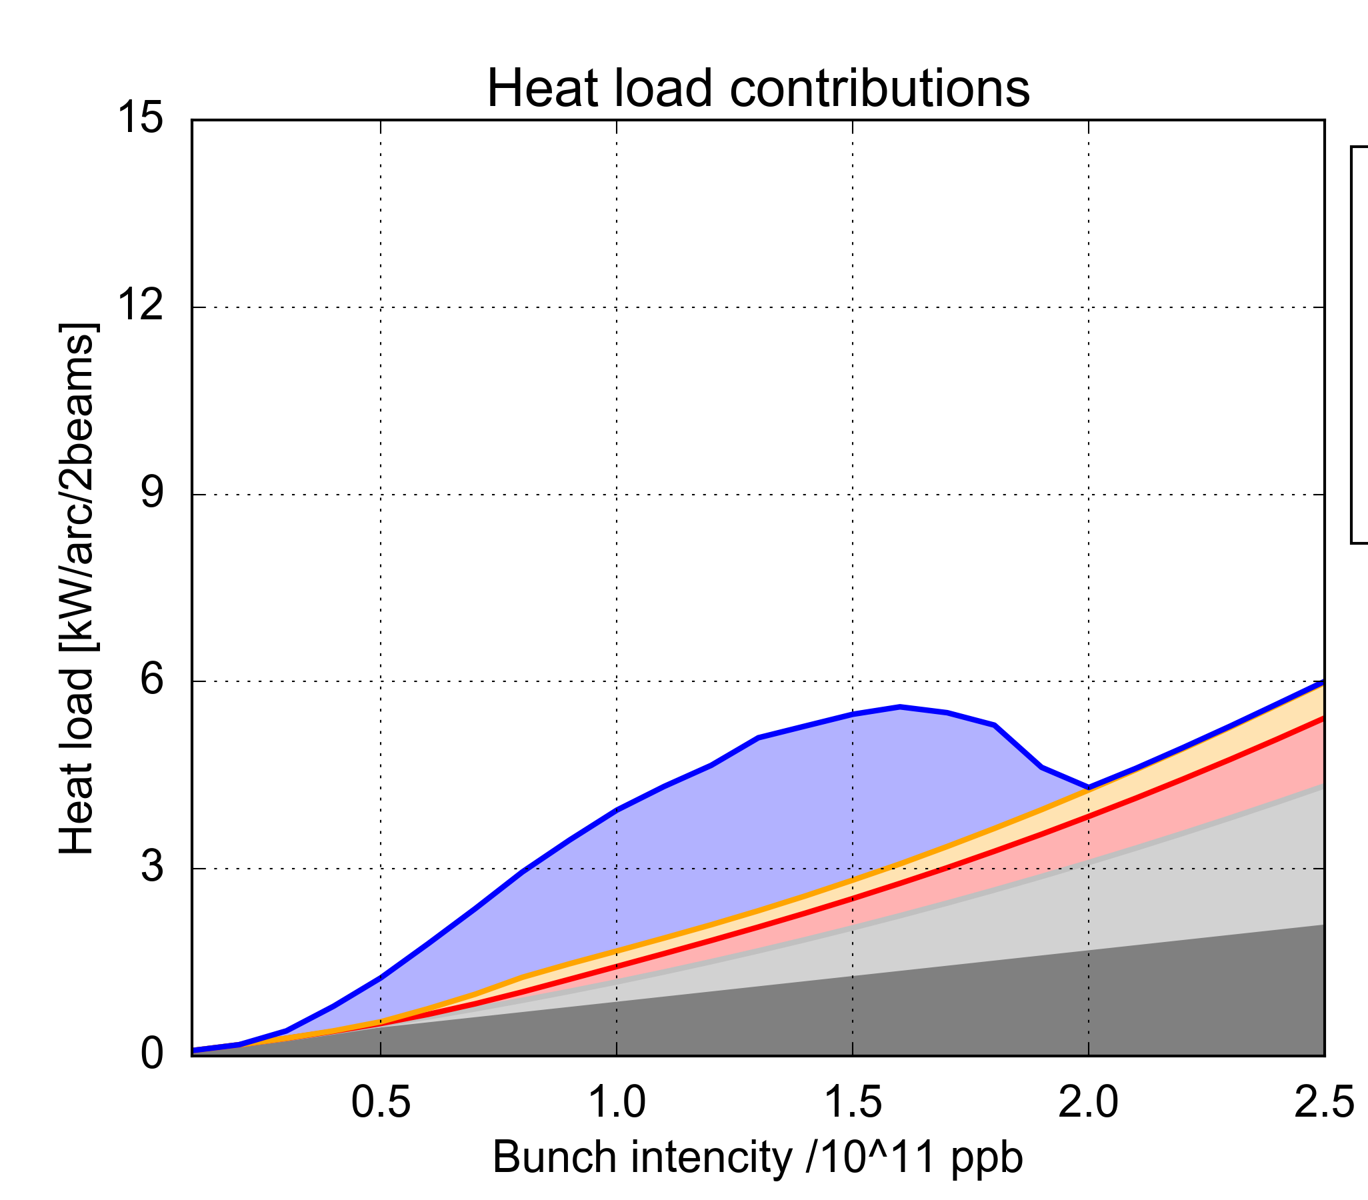
Arc heat loads - scaling with bunch intensity
Assuming surface properties are uniform along the arc half-cell (probably optimistic):
Present conditioning achieved in the low-load sectors is compatible with HL-LHC
Expected heat load for the high-load sectors is ~10 kW/arc → not acceptable
Ongoing work to identify and suppress the source of differences among arcs is very important for HL-LHC
A solid backup plan must be available…
Present state of the low-load sectors
(Sec. 34, 45, 56, 67 - SEY = 1.25)
Present state of the high-load sectors
(Sec. 12, 23, 78, 81, SEY = 1.35)
e-cloud in dipoles
Present situation in the low-load sectors
e-cloud in quadrupoles
e-cloud in drifts
HL-LHC
HL-LHC
Impedance
Synchrotron radiation
Heat load [kW/arc]
8 kW/arc (~160W/hcell)
Heat load [kW/arc]
8 kW/arc (~160W/hcell)
Bunch intensity [10¹¹ p/bunch]
Bunch intensity [10¹¹ p/bunch]
G. Skripka

