Slide 1

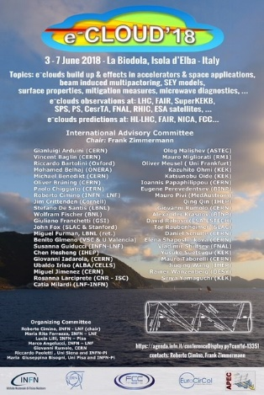
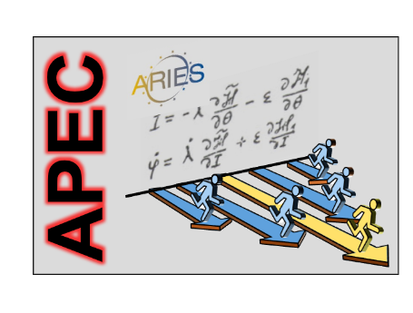

Electron Cloud Effects in Accelerators
Frank Zimmermann
ECLOUD’18, La Biodola, 3 June 2018
Work supported by the European Commission under the HORIZON 2020 project ARIES, grant agreement 730871

Slide 2
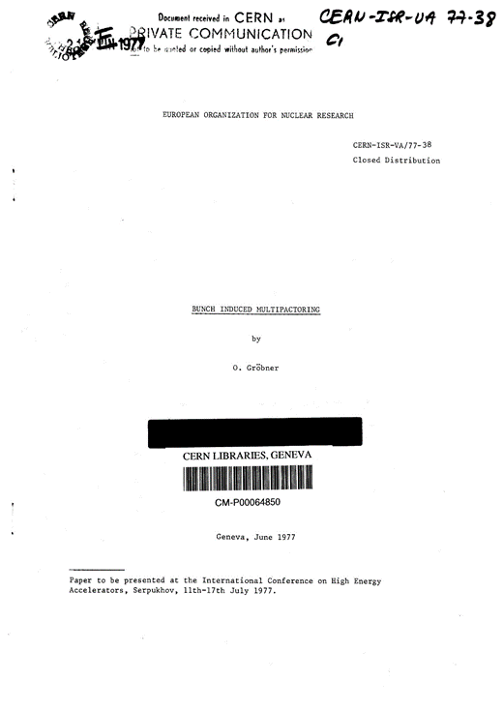
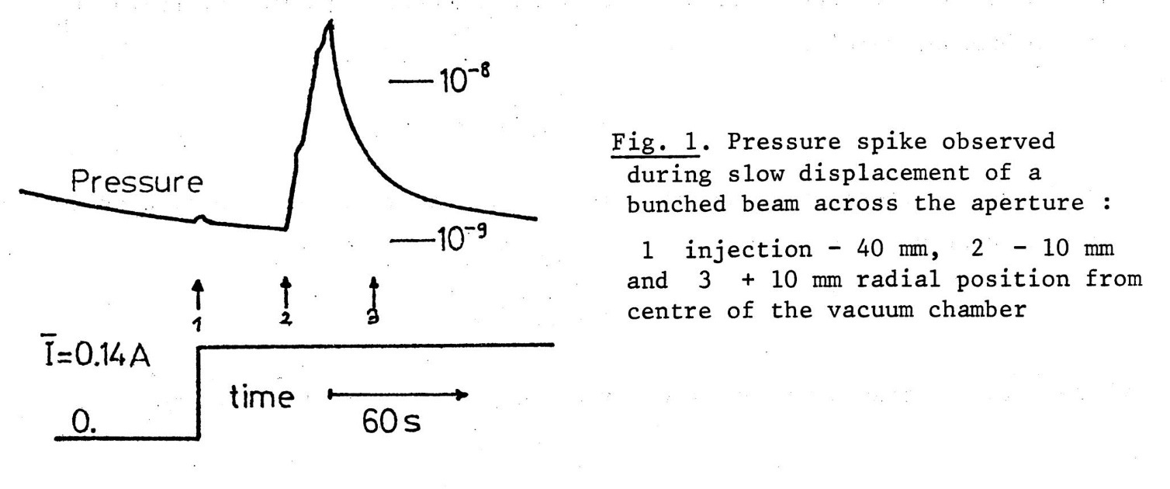
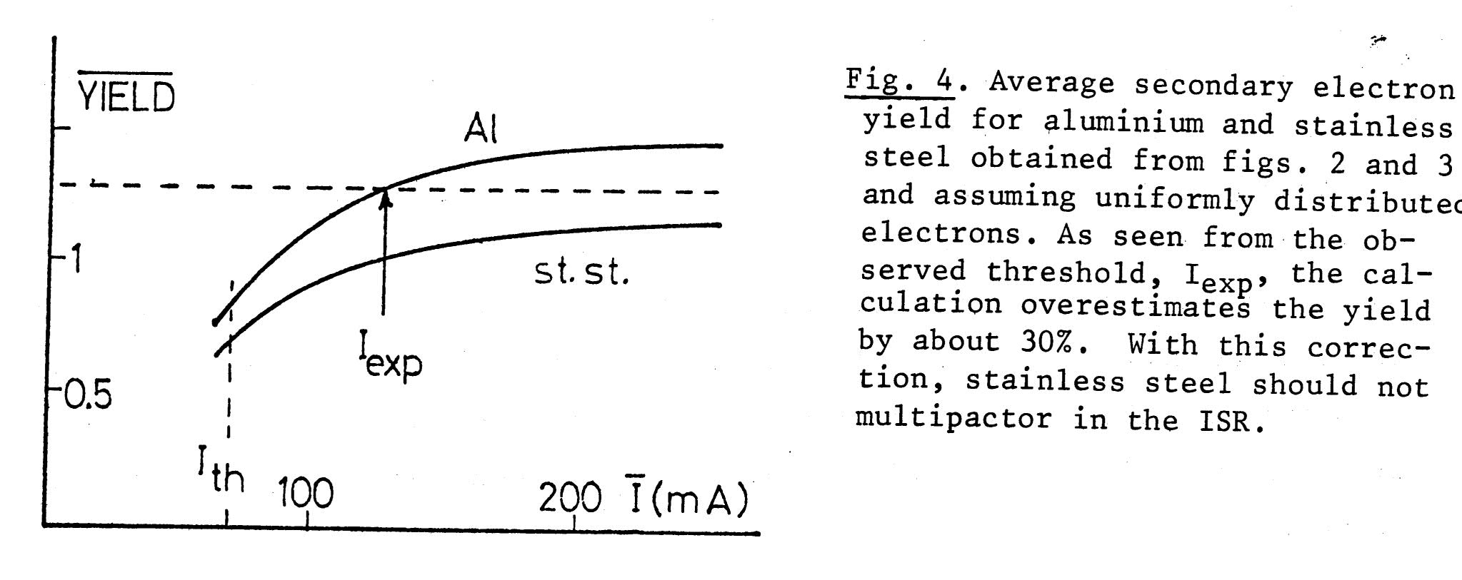
pressure rise in 7-m long Al chamber with bunched beam in ISR due to “bunch-induced multipactoring”
O. Gröbner, 1977

Slide 3
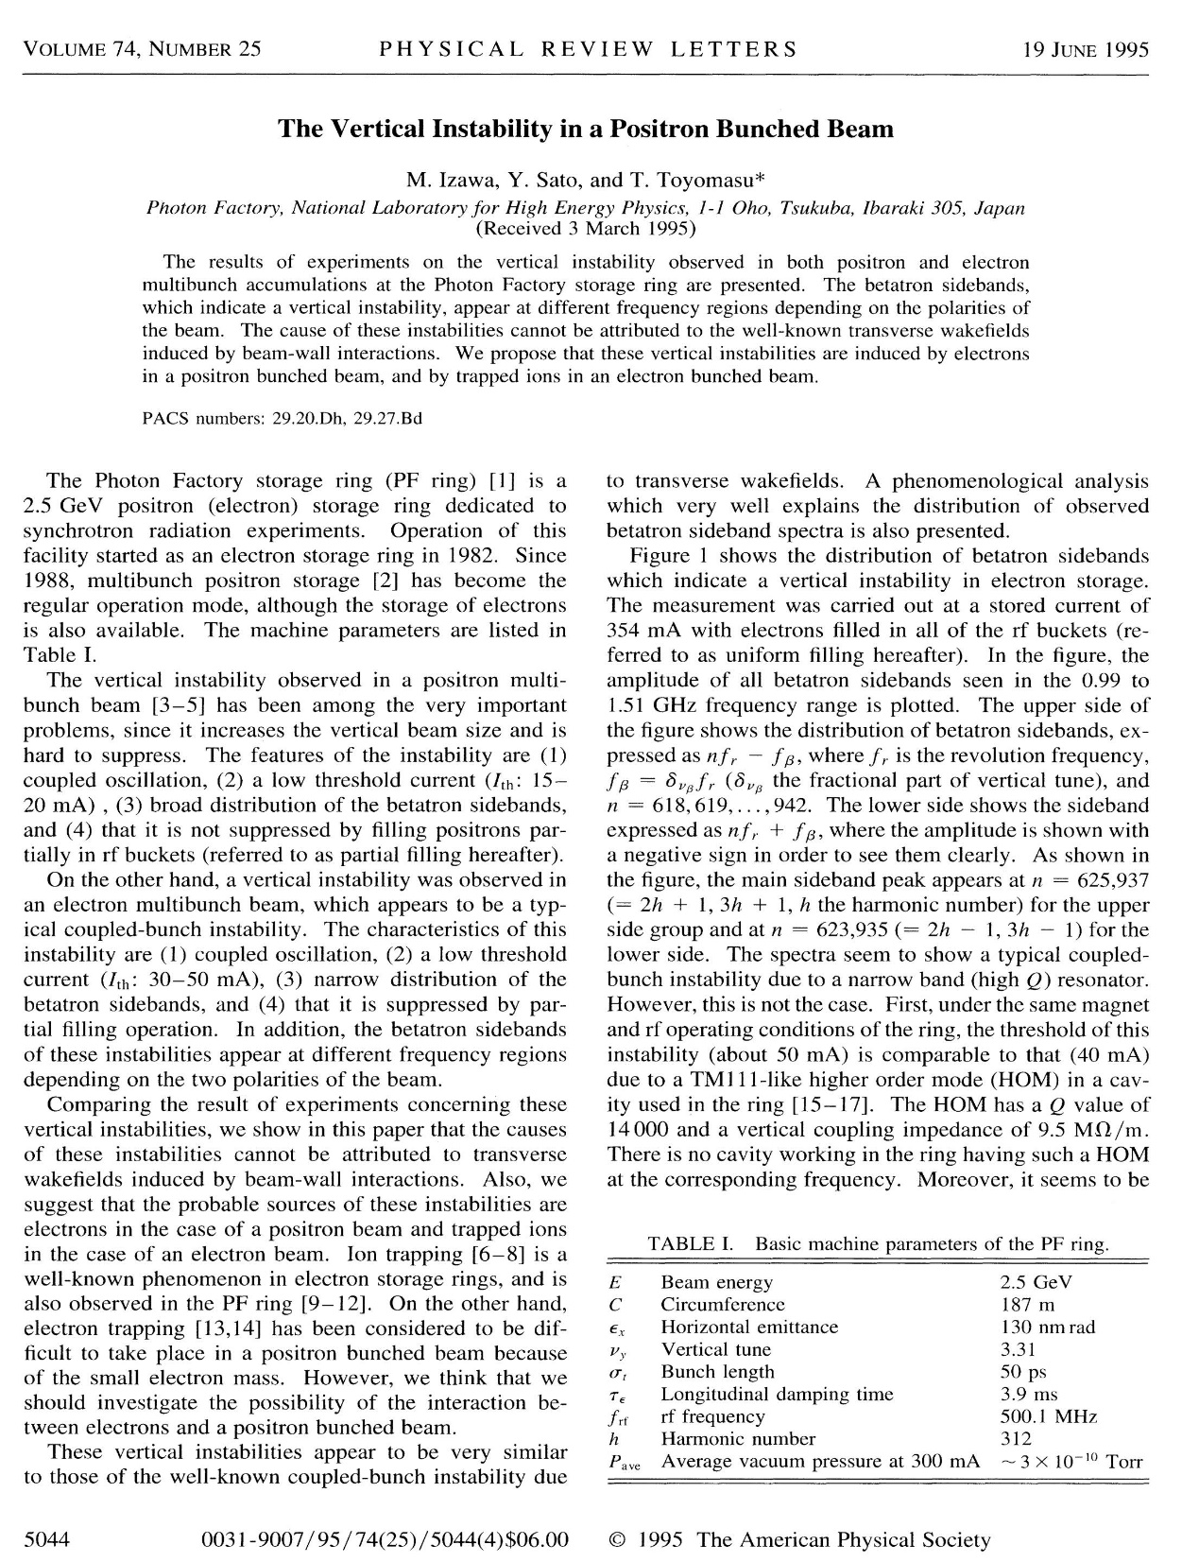
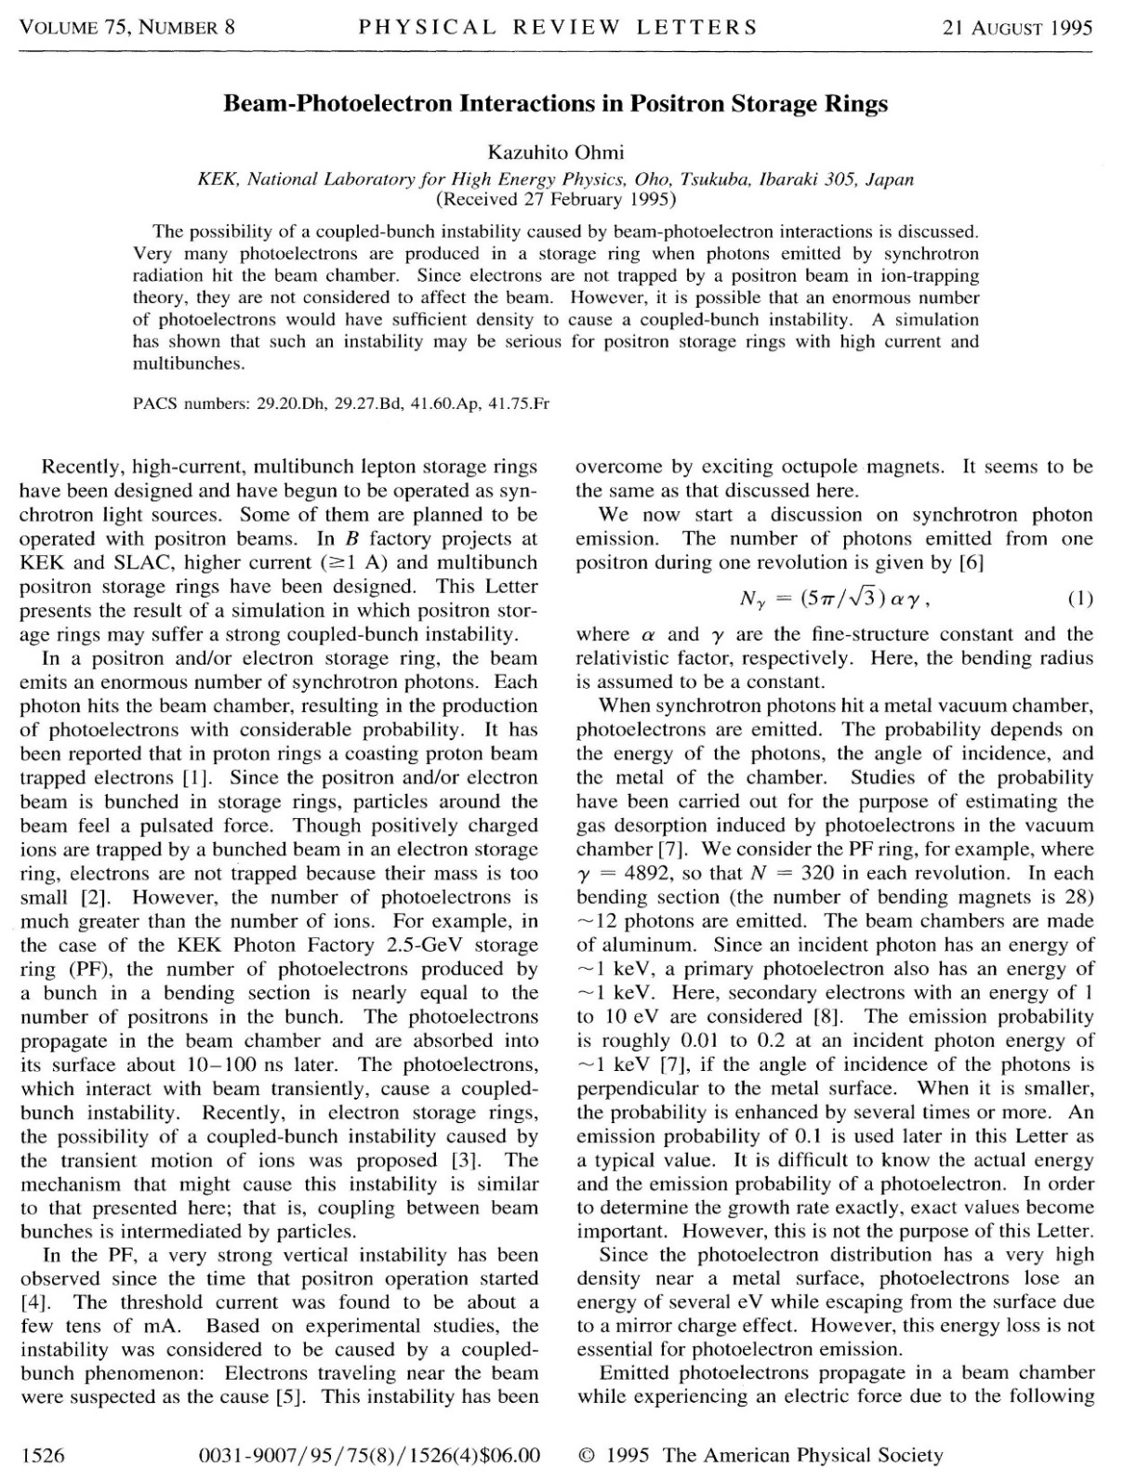
multi-bunch e⁺ beam instability driven by photoelectrons
explains observations in KEK Photon Factory
M. Izawa et al., 1995
K. Ohmi, 1995

Slide 4
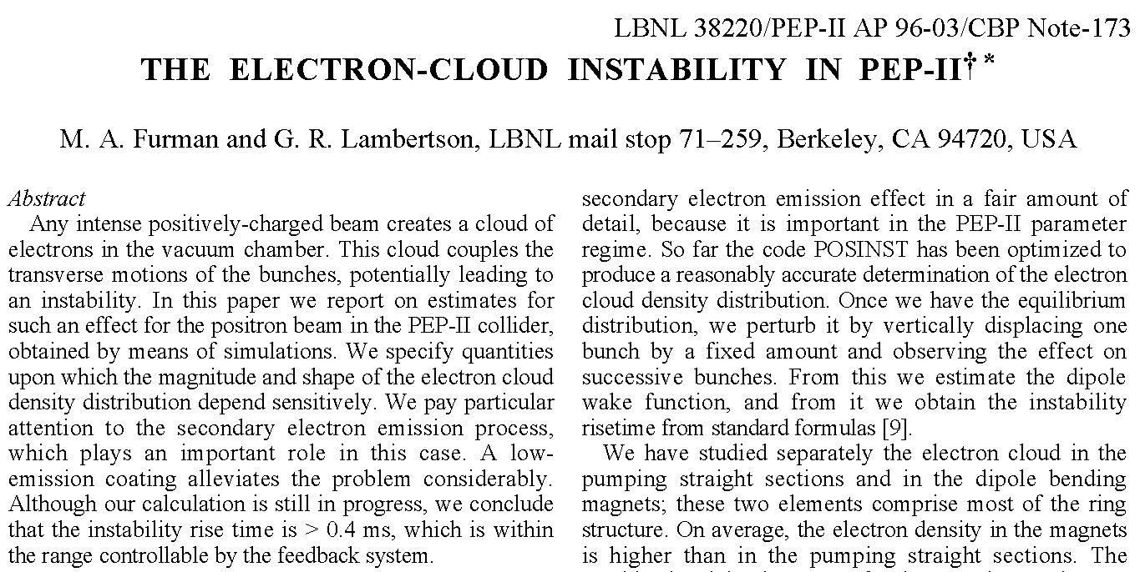
first e-cloud simulation for PEP-II
M. Furman, G. Lambertson, 1996

Slide 5
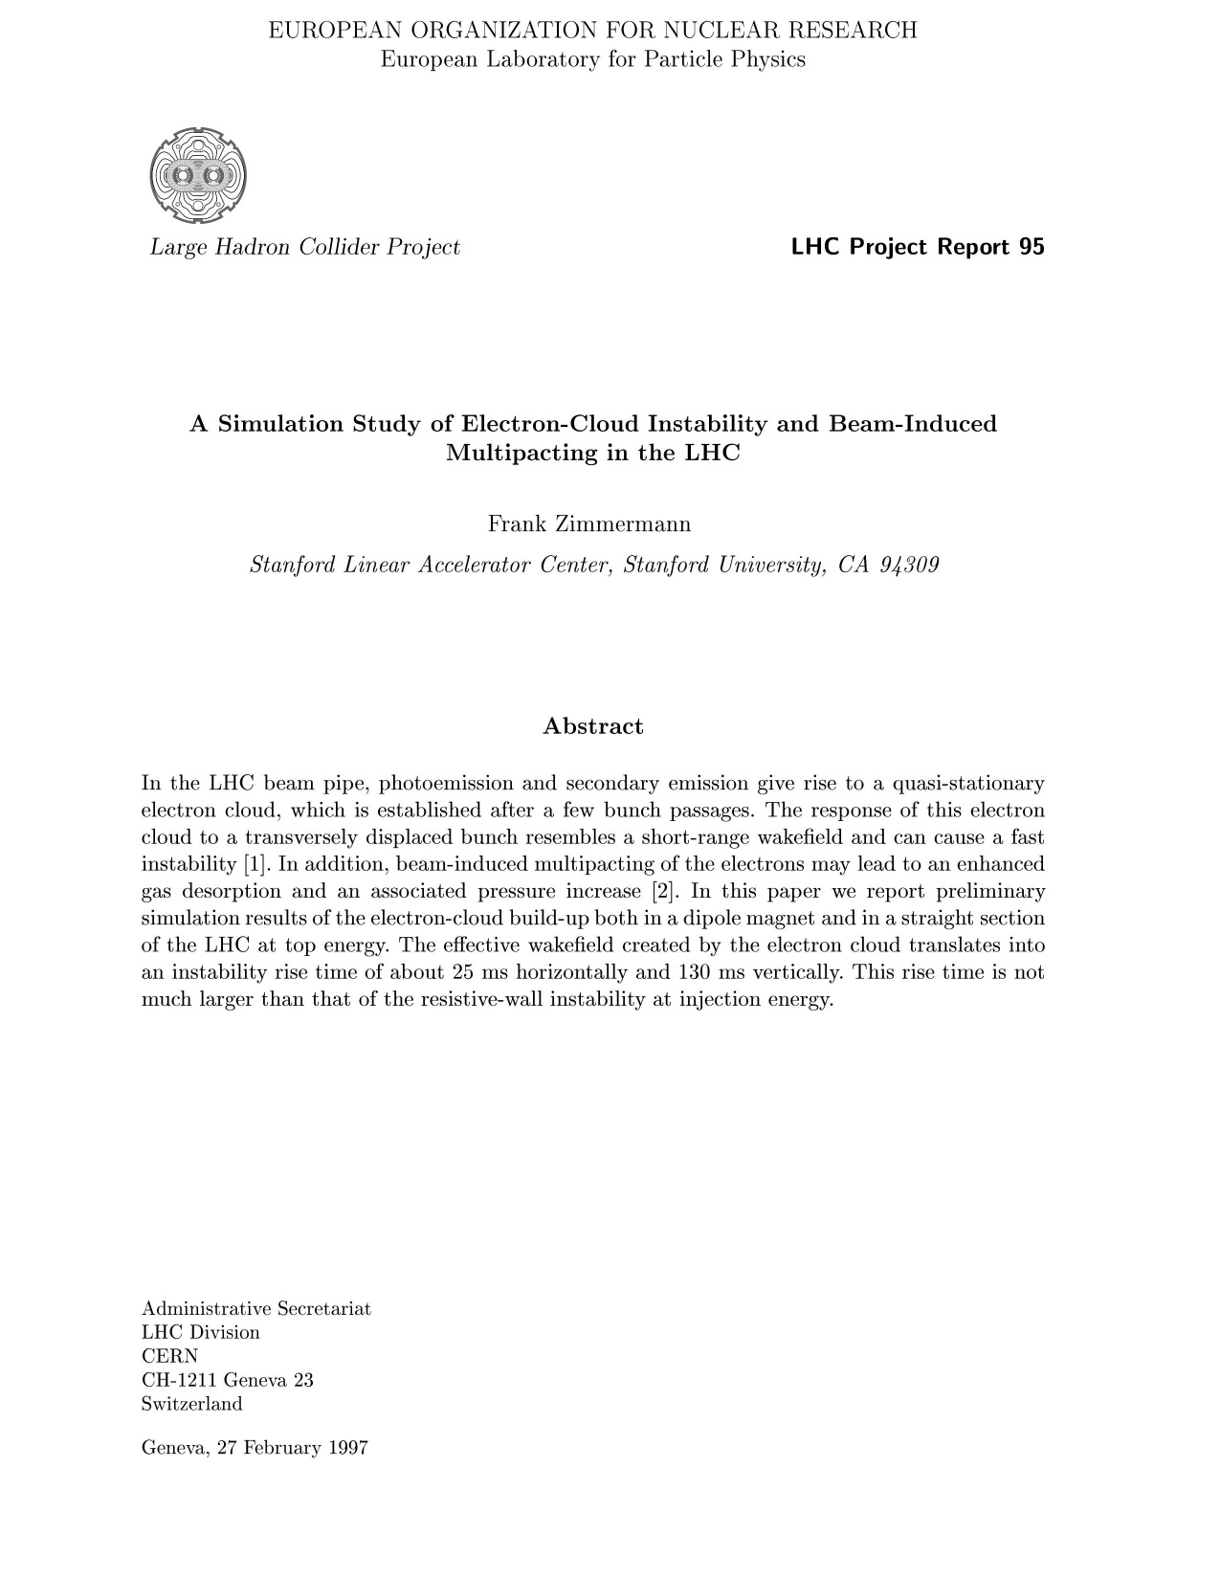
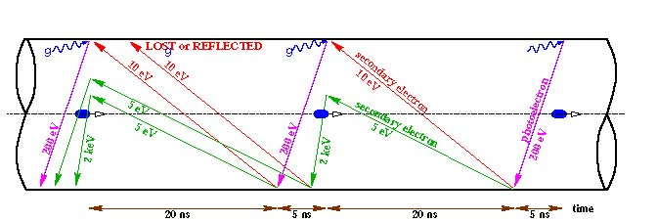
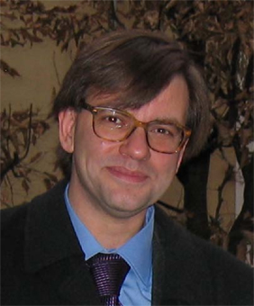
LHC prediction:
electron cloud build up due to both (or either) photo-electrons and secondary electrons
LHC e-cloud crash program launched in 1997
schematic of e- cloud build up in the arc beam pipe
F. Zimmermann, 1997
F. Ruggiero, 1998

Slide 6
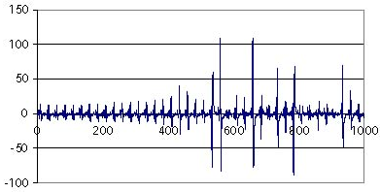
1999 “surprise”: e-cloud driven beam instabilities seen
with first “LHC beam” in the SPS
G. Arduini, K. Cornelis, et al., 1999

Slide 7
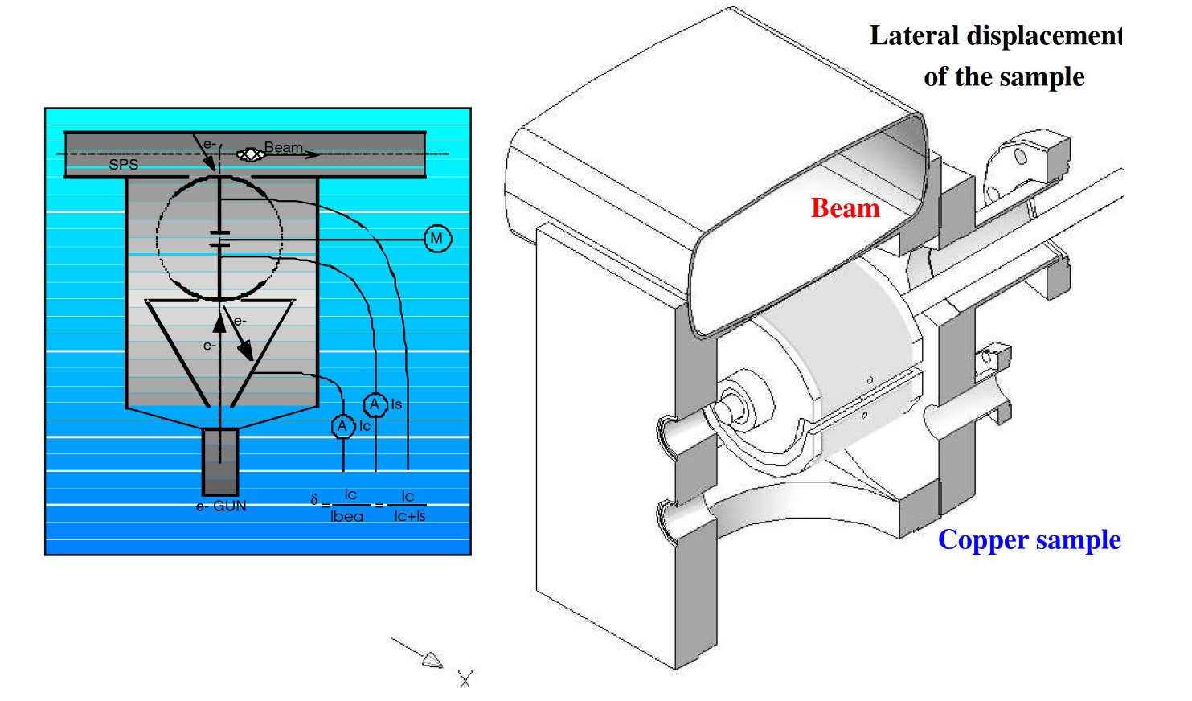
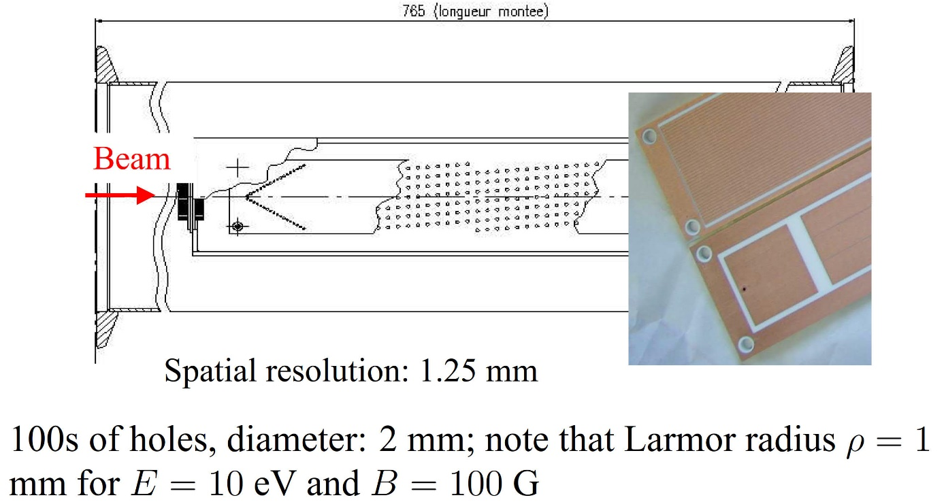
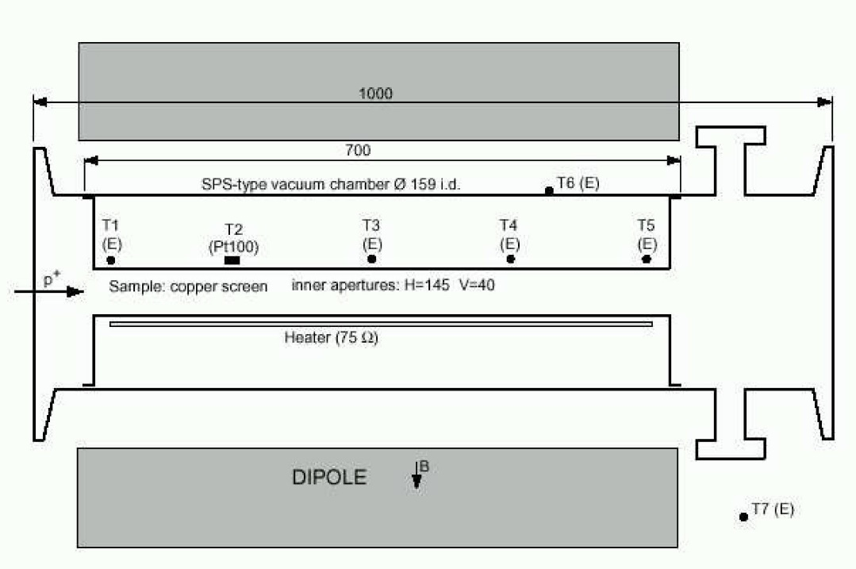
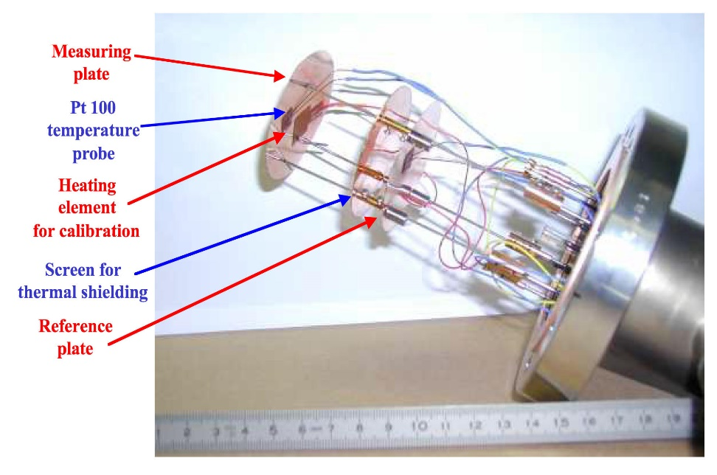
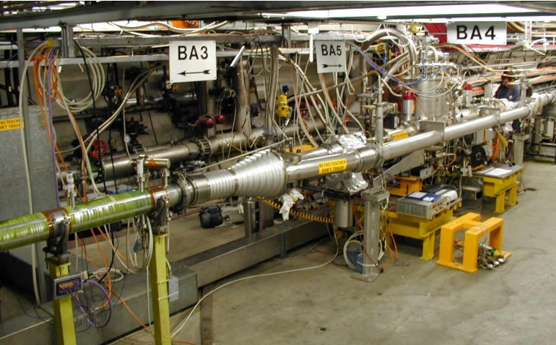
strip detectors (spatial distribution)
in situ SEY (scrubbing)
B. Henrist, N. Hilleret, M. Jimenez, 2002
pick-up calorimeter (heat-load
& energy spectrum))
2000-2002
SPS measurement program
M. Jimenez et al, 2000-2002
cold chamber COLDEX
warm calorimeter (heat)
V. Baglin, 2002
B. Henrist, N. Hilleret, M. Jimenez, 2002

Slide 8
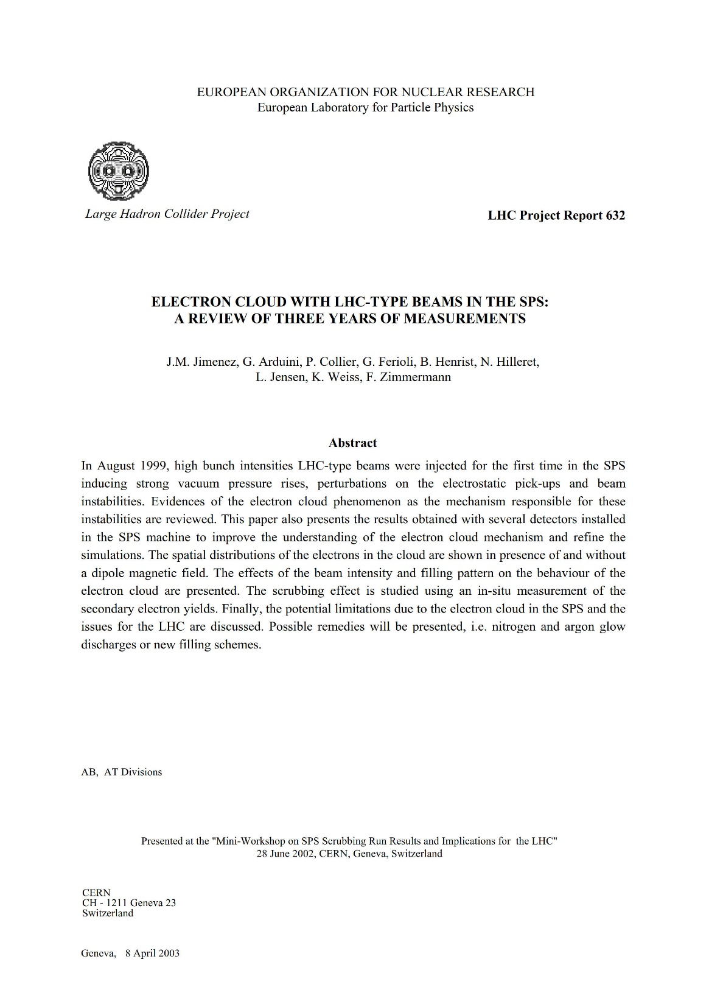
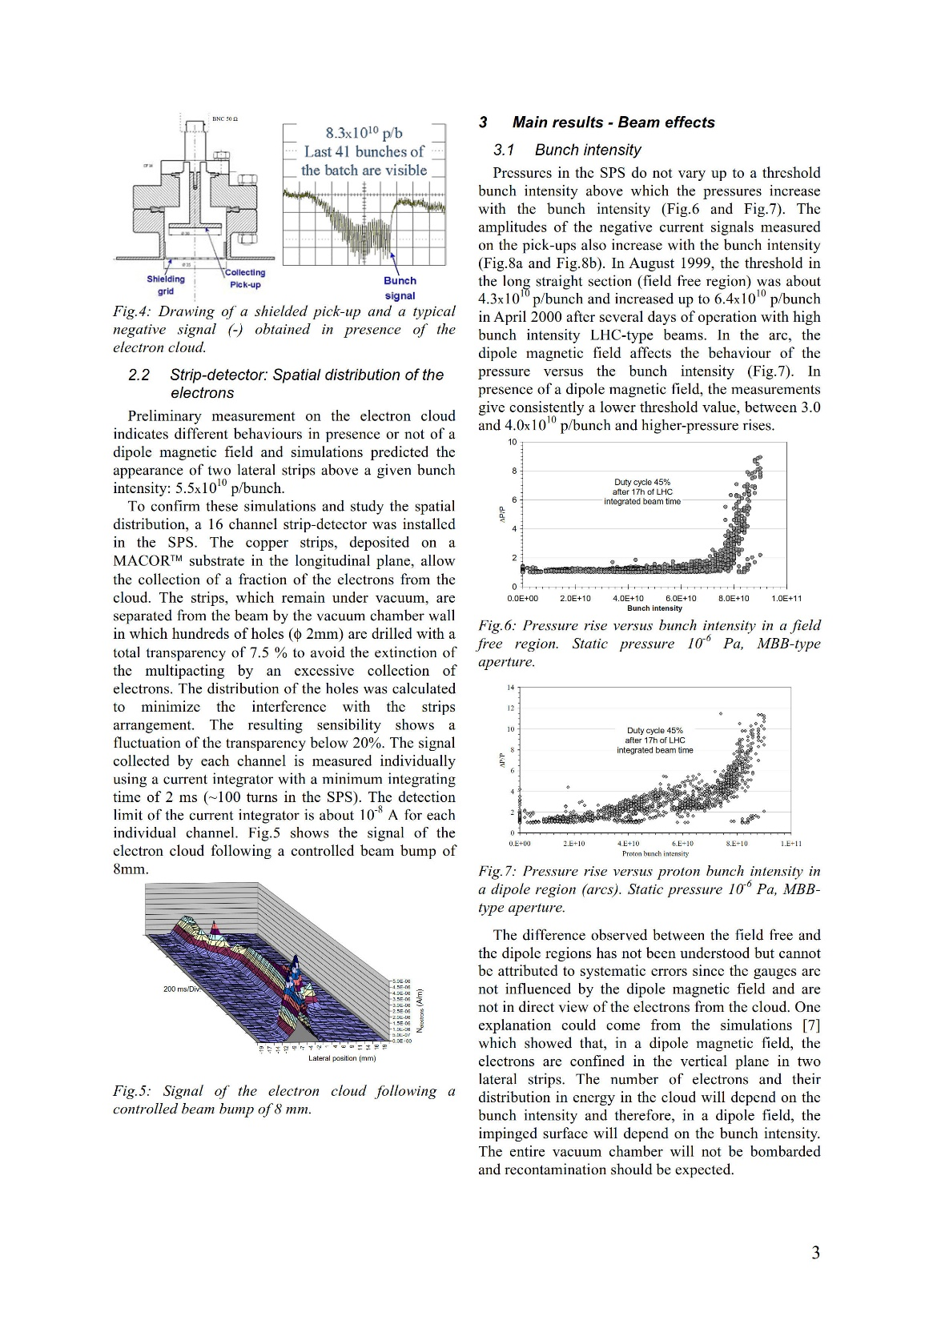
a review of 3 years of
SPS e-cloud measurements
M. Jimenez et al, 2002

Slide 9
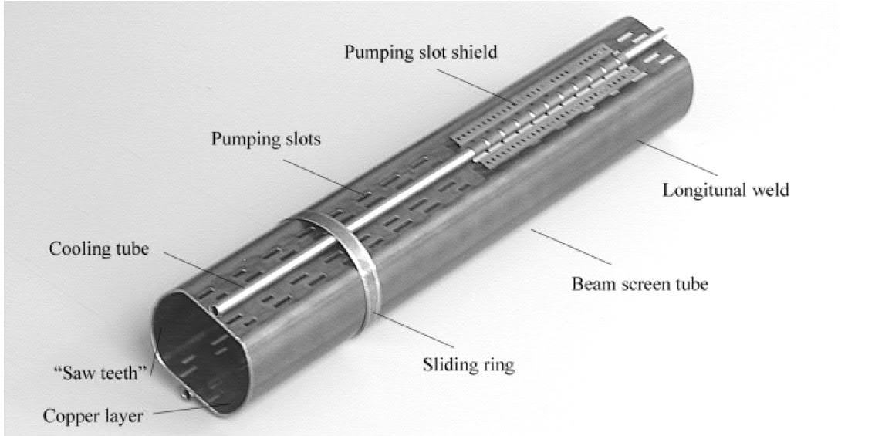
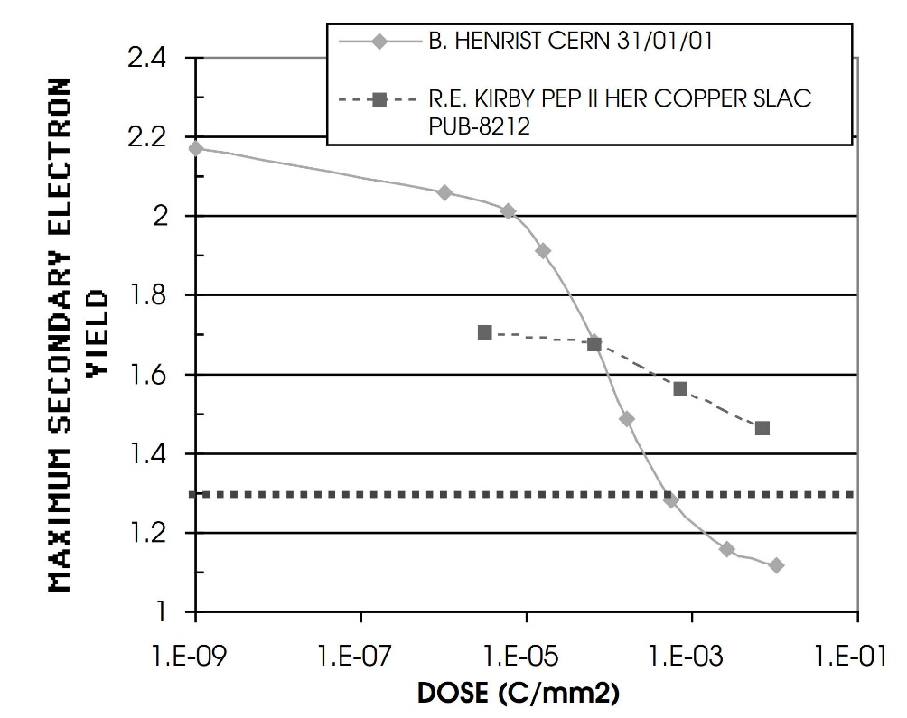
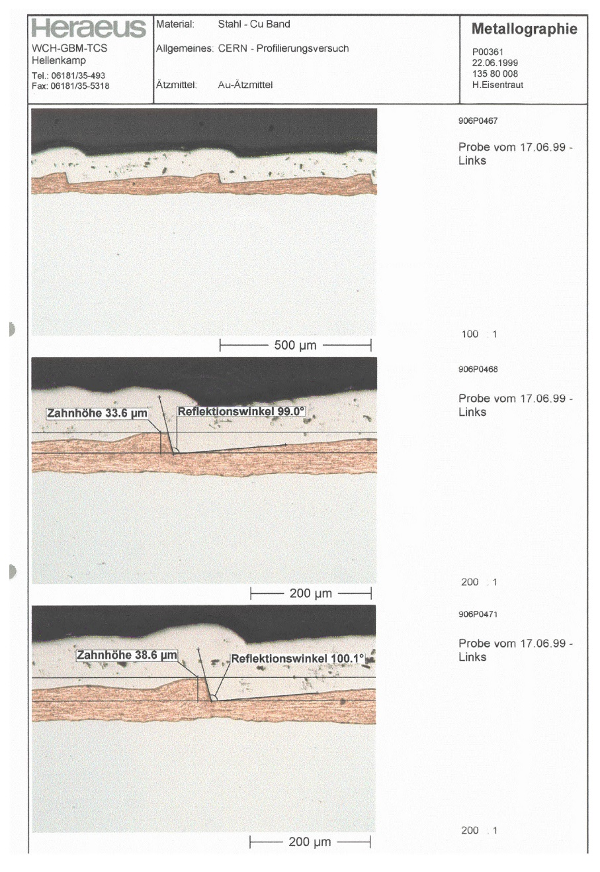
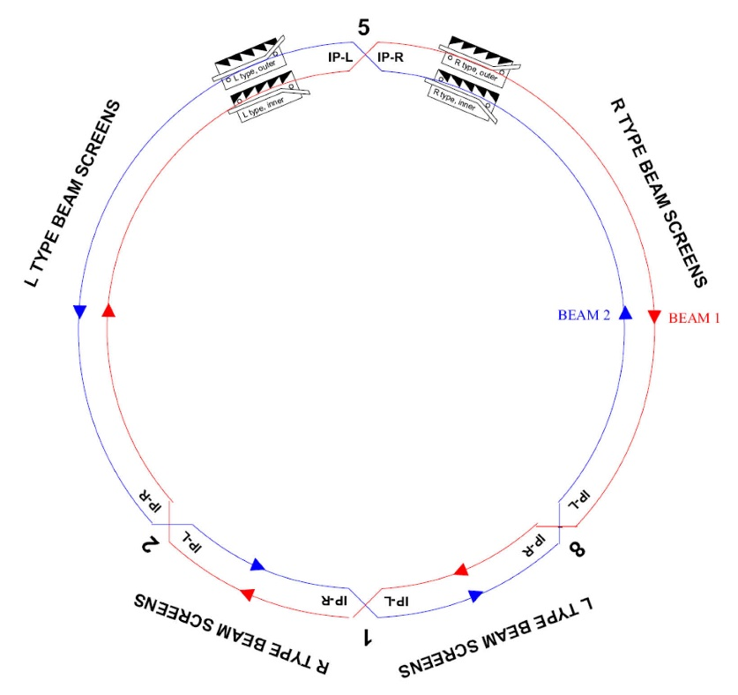
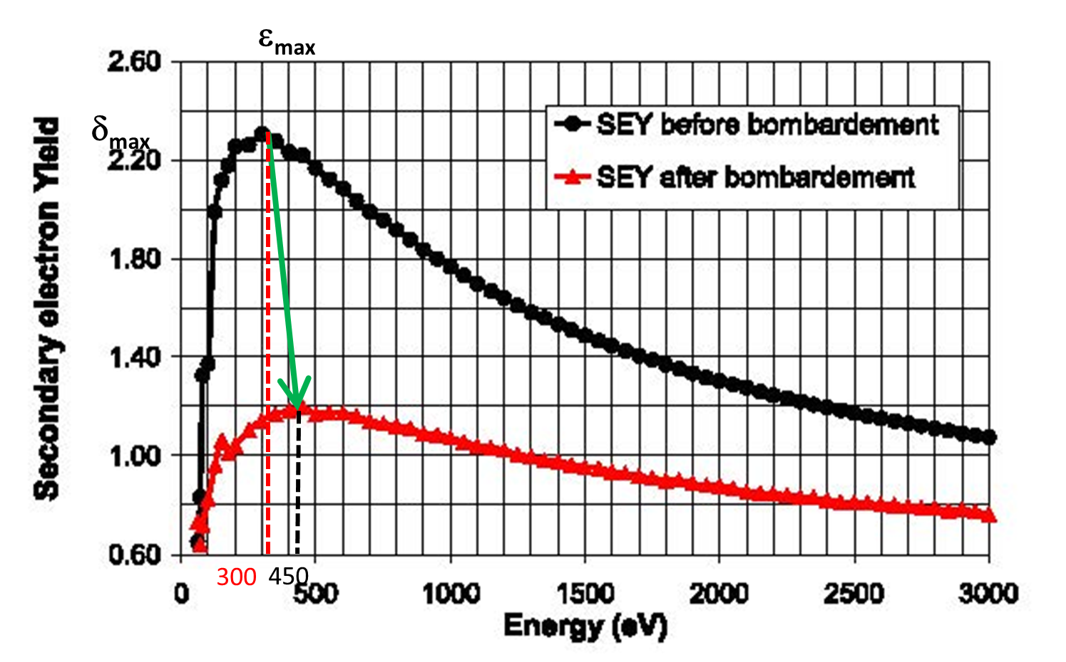
LHC beam screen with sawtooth and shields
conditioning/scrubbing
LHC strategy:
beam screen,
sawtooth, scrubbing
V. Baglin, N. Kos, et al., 1997-2004
I. Collins, 1999
N. Hilleret, 1999

Slide 10
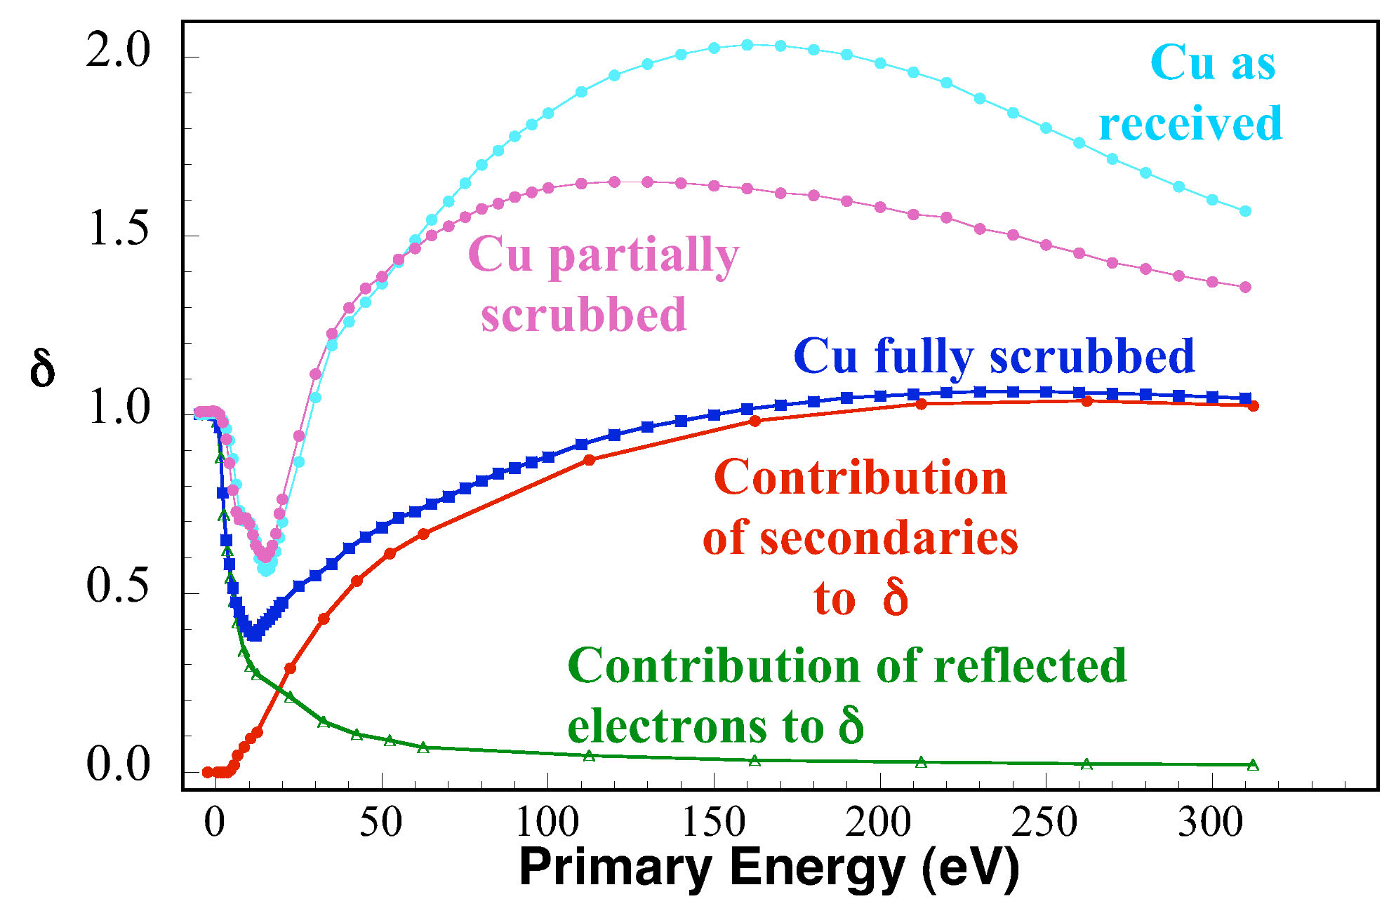
conditioning of Cu sample at 10 K
yield
Can Low-Energy Electrons Affect High-Energy Physics Accelerators?
400 eV e⁻
>1 C/cm²
R. Cimino,
I. Collins et al, PRL 93, 1, e014801, July 2004
probability of elastic e- reflection R may approach 1

Slide 11
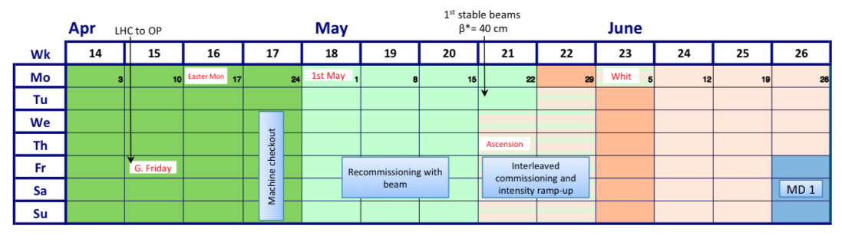
illustration LHC scrubbing routine
during 2017 start up
main goal: reconditioning of S12 after thermal cycle and venting
1 week of dedicated scrubbing was done with standard 25 ns beam
4 days were needed to get S12 back to pre EYETS value
1 day was enough for all other sectors
G. Iadarola,
2017
M. Solfaroli, 2017

Slide 12
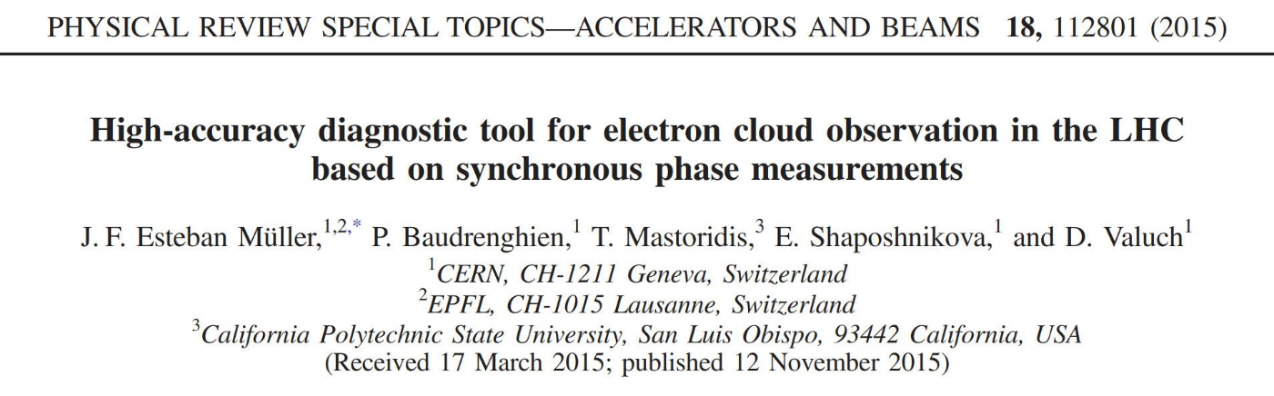
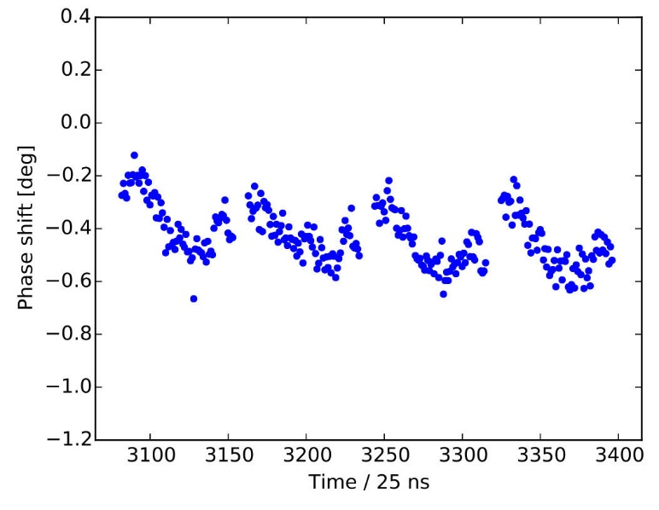
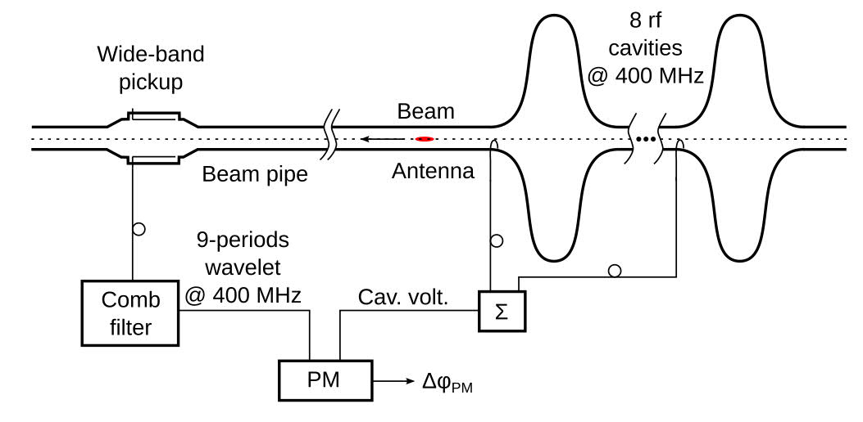
detecting electron cloud – synchronous phase shift at LHC
consistent with heat load detected by LHC cryogenic system
J. Esteban Muller et al., 2015

Slide 13
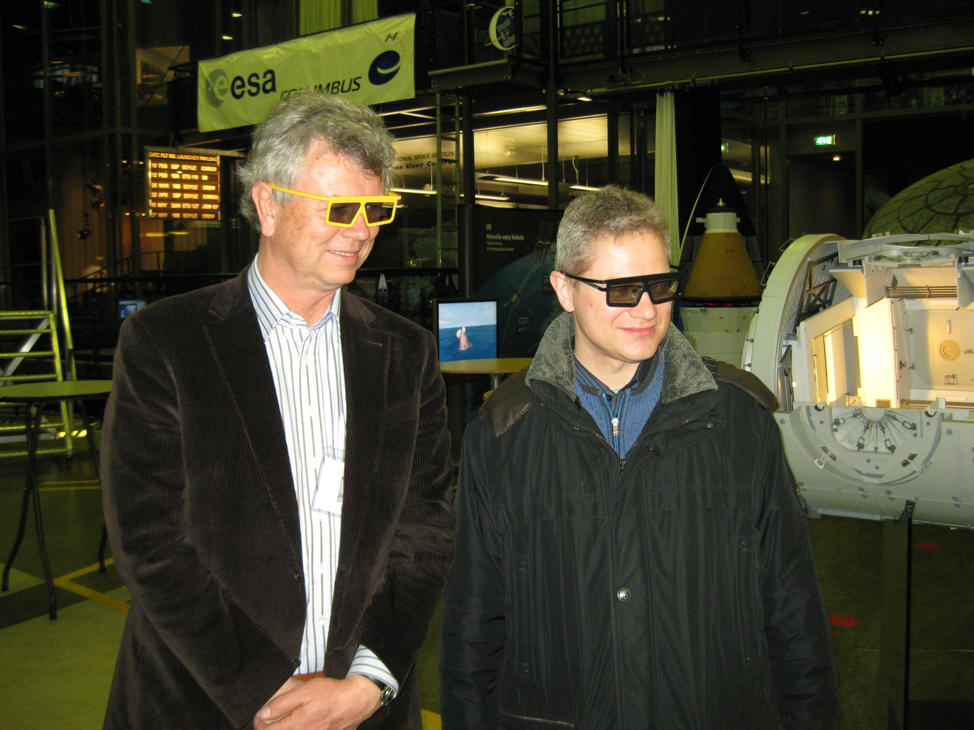
visit to ESA/ESTEC in February 2009

Slide 14
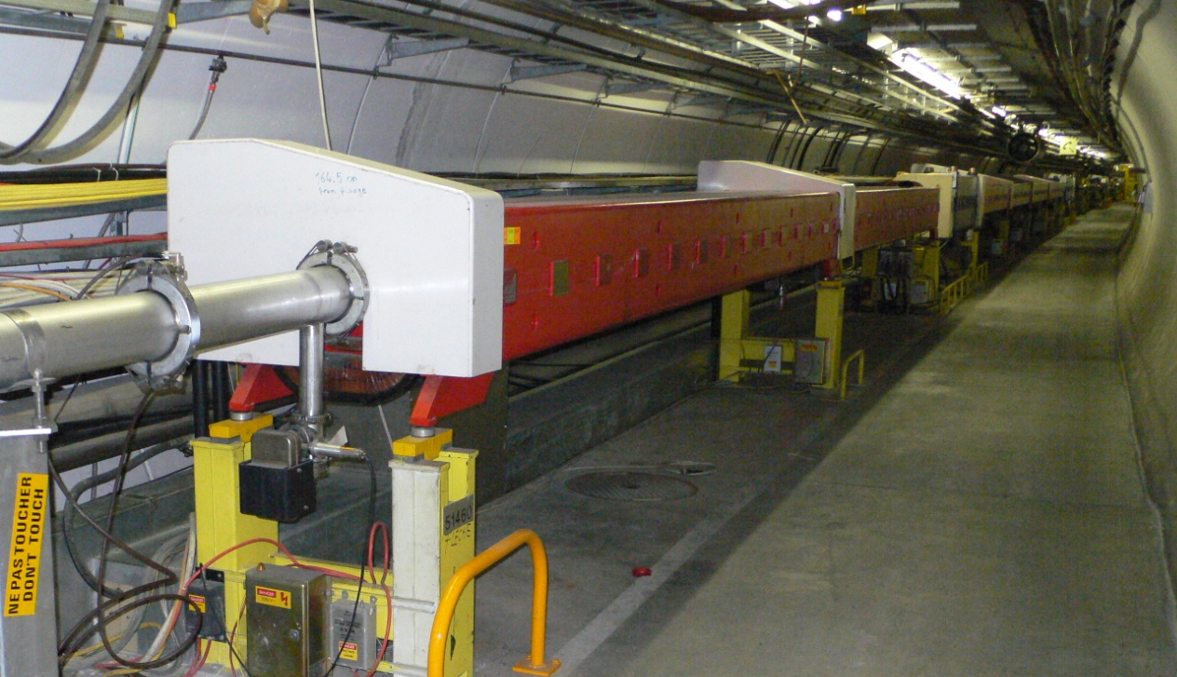
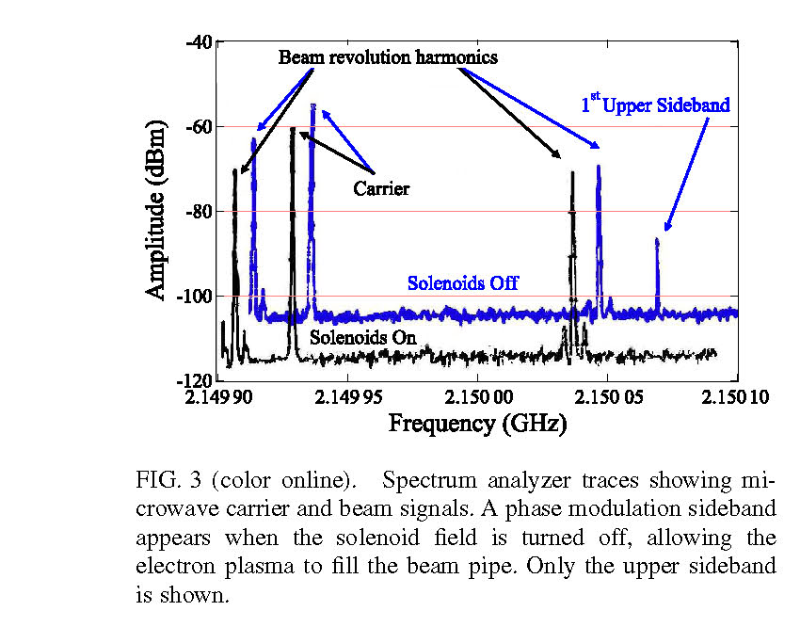
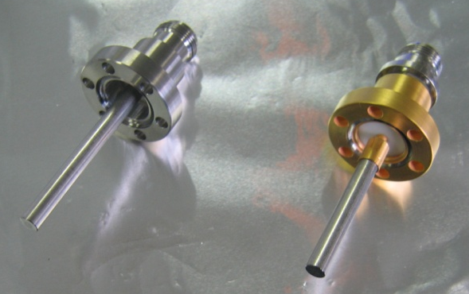
detecting electron cloud – phase modulation of μwave signal
PEP-II
SPS
Antenna1
Antenna2 (excitation)
Antenna3
quad
dipole
14.4 m
33.1 m
Principle idea:
“When electromagnetic waves are transmitted
through a not too dense plasma, they
experience a phase shift and possibly a small
attenuation”
F. Caspers, T. Kroyer et al., 2004, 2008
S. De Santis et al., 2008

Slide 15
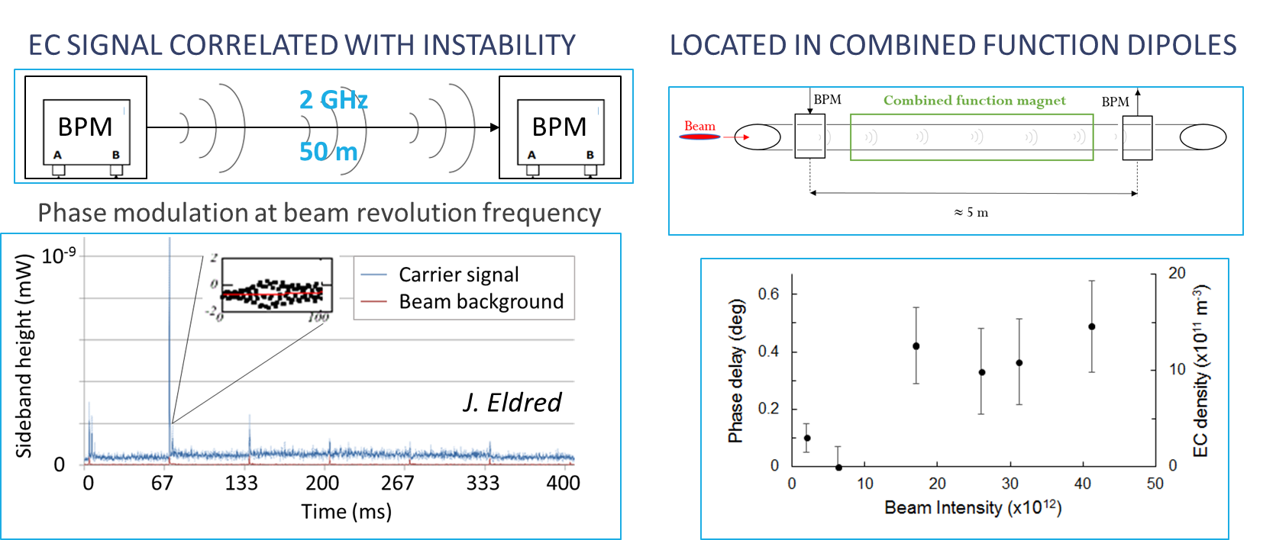
μwave transmission at FNAL Recycler
S. Antipov, 2017

Slide 16
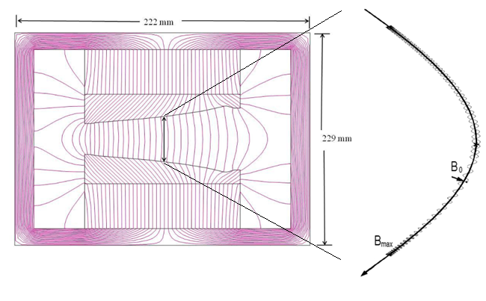
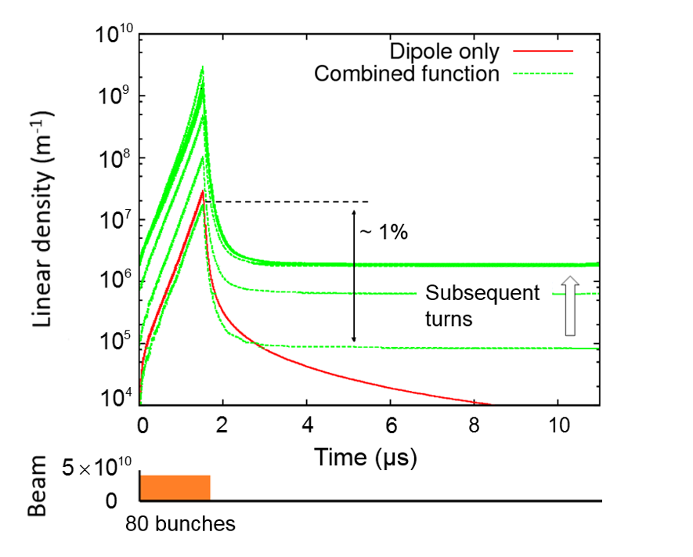
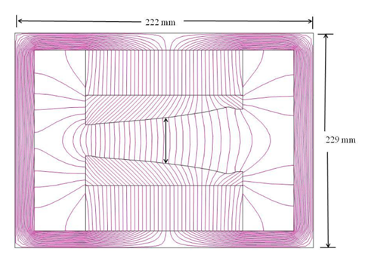
e-cloud trapped in combined function magnets
trapping in quadrupole & sextupole fields demonstrated by L. Wang et al. (EPAC2002)
Cross-section of a Recycler permanent combined function dipole
e-cloud presence inside combined-function nmagnet
confirmed by μwave measurement
About 10⁻² of electrons are trapped by magnetic field
Central field | Gradient
1.38 kG | 3.4 kG/m
S. Antipov, 2017

Slide 17
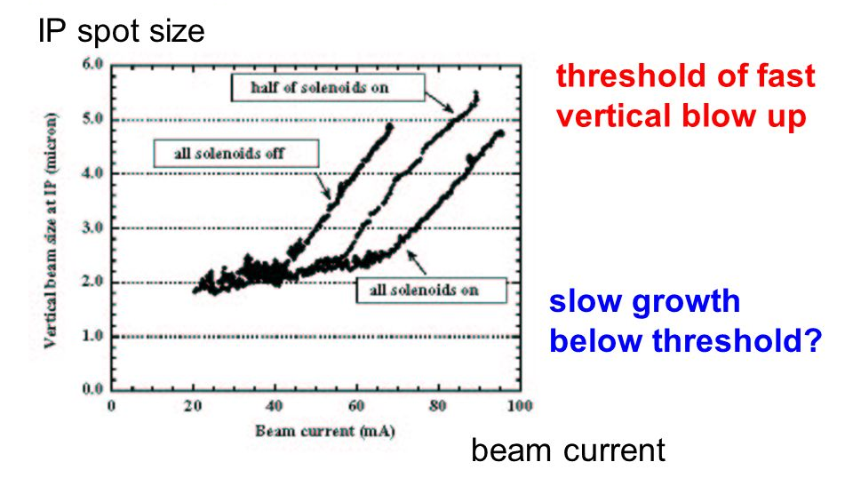
KEKB commissioning
1999: vertical blow up of KEKB positron beam;
in the following years suppressed by solenoids
H. Fukuma et al., ~1999 - 2001

Slide 18
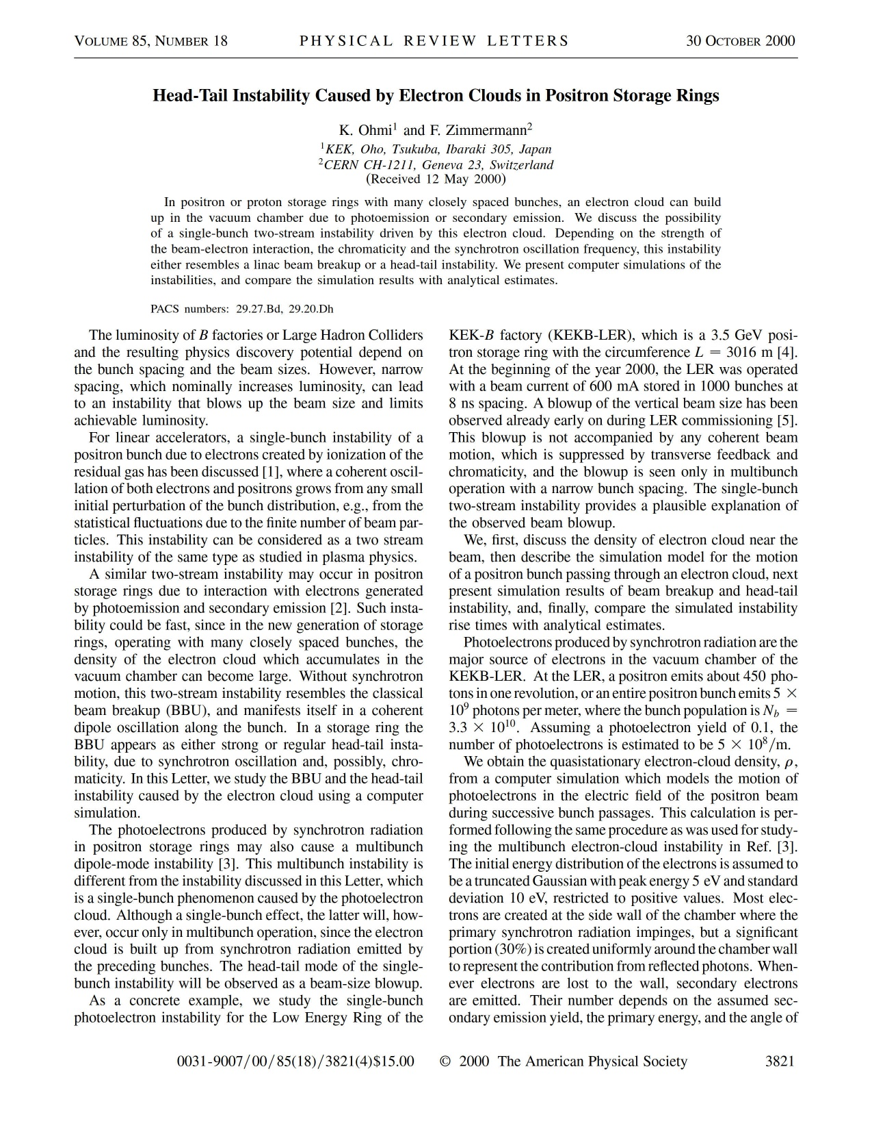
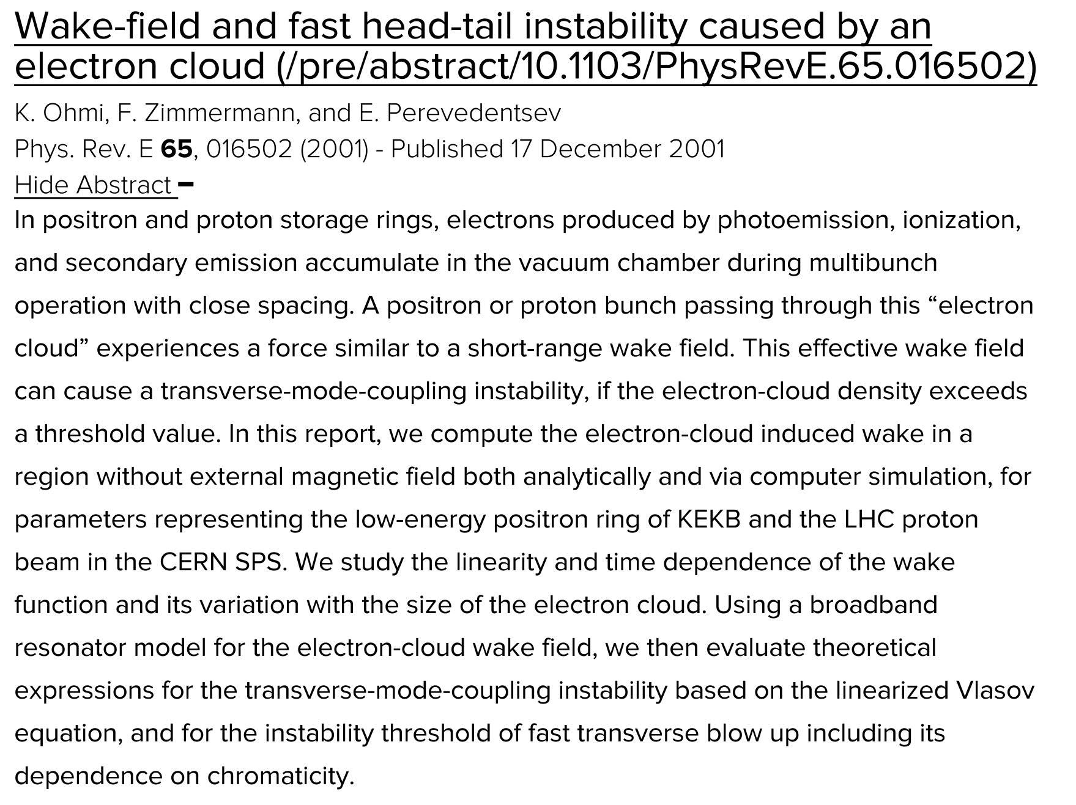
KEKB LER e⁺ vertical blow up explained by
single-bunch e-cloud instability, simulations, 2-particle model
resonator impedance model and TMCI-like description
K. Ohmi, F. Zimmermann, 2000
K. Ohmi, F. Zimmermann, E. Perevedentsev, 2000

Slide 19
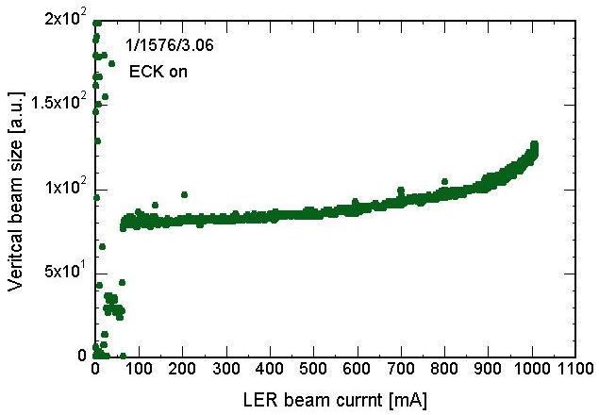
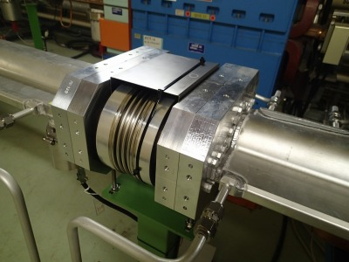
SuperKEKB commissioning phase 1
many countermeasures
σ_{y} blowup
after installing permanent
magnets at bellows
900 mA
design current: 3.6 A
Y. Suetsugu, K. Ohmi et al., 2016

Slide 20
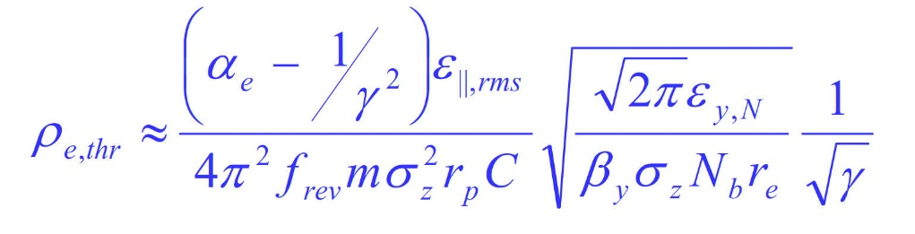
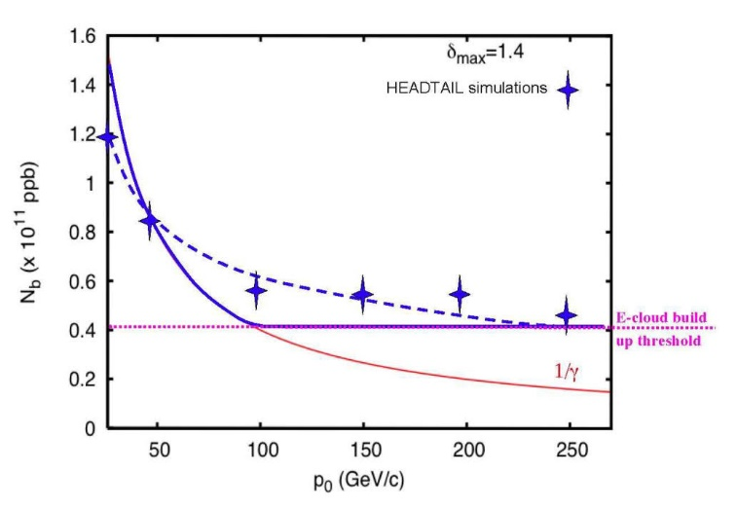
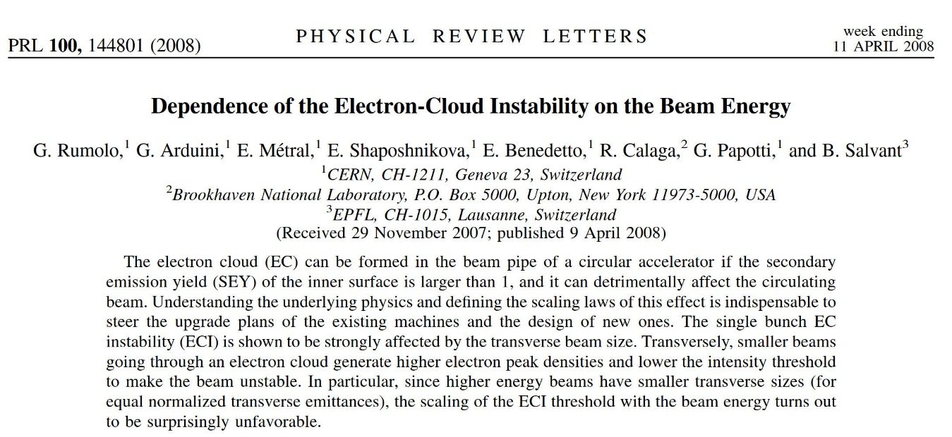
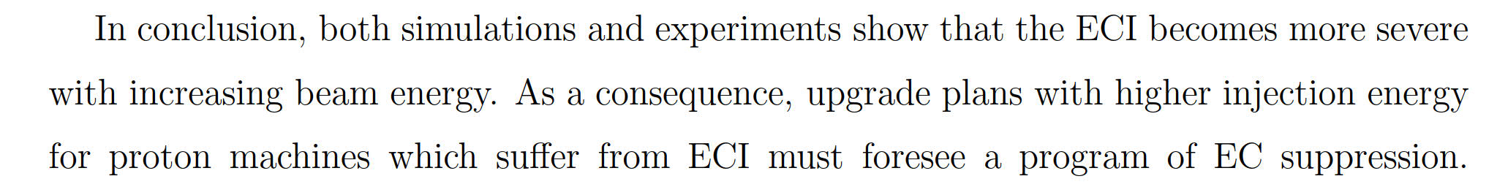
single-bunch e-cloud instability – worse at higher p beam energy!
G. Rumolo et al., 2008
F. Zimmermann, presented at CERN, ABP-RLC Meeting , 18 Nov. 2005; also CERN-GSI bilateral meeting, 30 March 2006

Slide 21
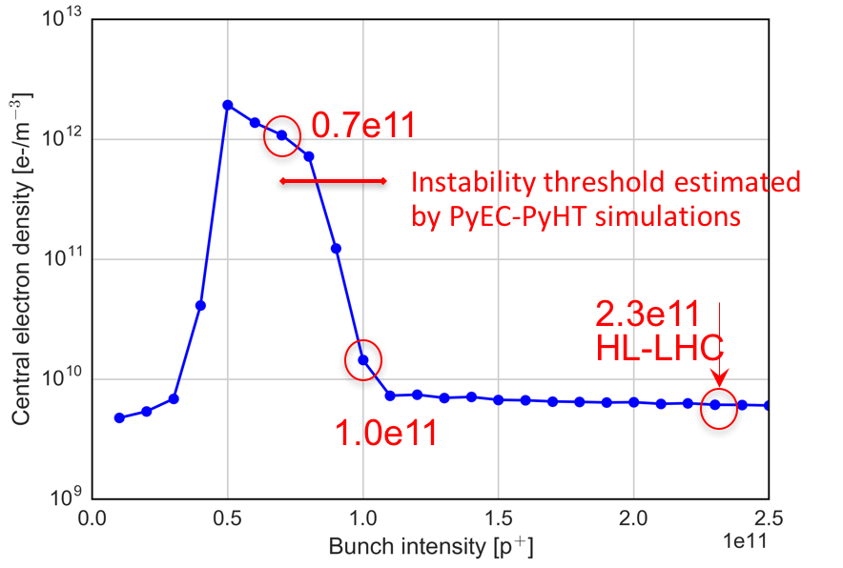
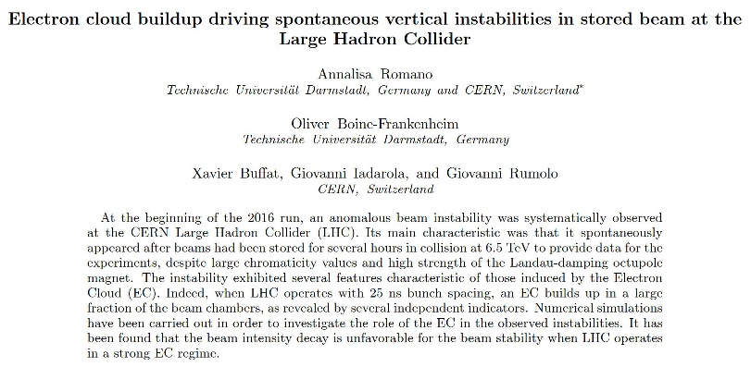
single-bunch e-cloud instability – worse at lower p intensity!
consistent with LHC observations
accepted for publication
In PRAB
A. Romano et al., 2017

Slide 22
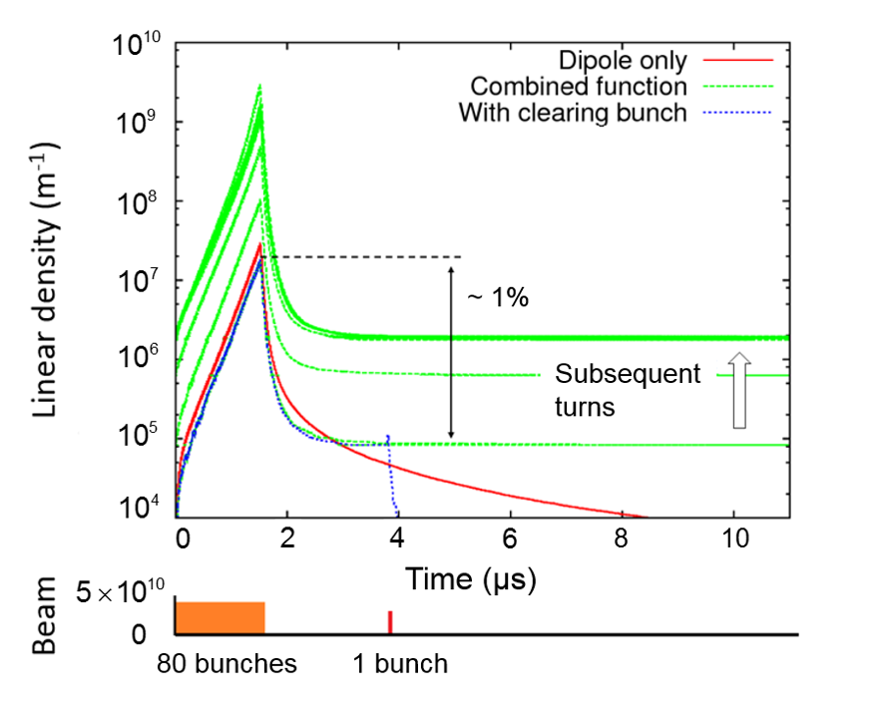
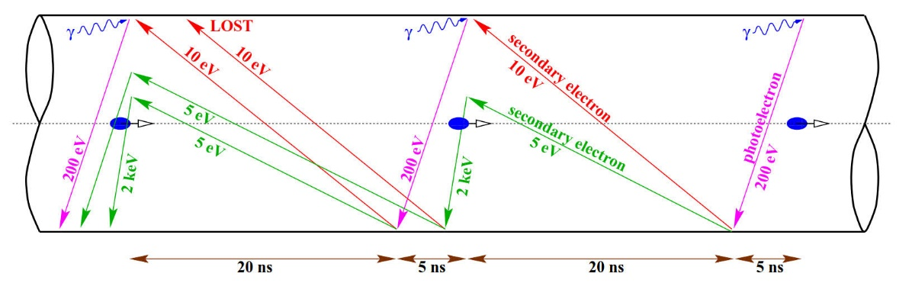




beam manipulations - satellites and clearing bunches
F. Ruggiero, X.L. Zhang, Workshop on Instabilities of High Intensity Hadron Beams in Rings, Upton, NY, USA, 28 Jun - 1 Jul 1999, pp.40-8
S. Antipov, 2017
F. Ruggiero, 1999
satellite

Slide 23

how far can we push “beam scrubbing”? – special beams
G. Iadarola
G. Rumolo,
Evian 2014

Slide 24



Laser Ablation Surface Engineered (LASE) surfaces for e-cloud mitigation
O. Malyshev et al.,
2018
SEY < 1 can be achieved on Cu, Al and stainless steel
first accelerator test in the SPS

Slide 25





in-situ installation of clearing electrodes proposed for the LHC
P. McIntyre, 2005

Slide 26


in-situ coating under development for eRHIC
excellent adhesion; resistivity of coated RHIC tube close to Cu @ room T; cabling system developed; magnetron carriage features spring-loaded guide wheel assembly; successfully crossed bellows & adjusted for different tube diameters, while keeping magnetron centered
next steps: optimize RF conductivity at cryogenic temperatures; need for ion assisted deposition (IAD); magnet quench and thermal cycling tests on copper coated RHIC cold bore tubing; perform coating inside a RHIC dipole to determine coating speed…
50-cm long cathode magnetron spring loaded guide wheels; leading edge guide wheels are inserted in a RHIC tube
50-cm long cathode magnetron mole assembly
A. Hershcovitch, 2018
Cu, TiN, NEG, a-C coatings..

Slide 27






twostream instabilities 2001, KEK
ECLOUD02, CERN
La Biodola
Daegu
Napa

Slide 28

CARE HHH-2004 dream:
complete e-cloud simulation?
F. Zimmermann, 2004

Slide 29








Warp-Posinst fully self-consistent simulation (many bunches, many turns): e-cloud build-up & beam dynamics
Turn 1
CERN SPS
at injection (26 GeV)
Turn 500
J.-l. Vay, 2012

Slide 30
Warp-Posinst enabled first direct simulation of a train of 3x72 bunches
-- using 9,600 CPUs on Franklin supercomputer (NERSC, U.S.A.)
average electron cloud density history at fixed station
substantial density rise in tails of batches between turns 0 and 800
J.-l. Vay, 2012

Slide 31


J.-l. Vay, 2012

Slide 32

stability diagram with pinched electron cloud
model: quasi-parabolic profile
assumed
bunch
profile
linear tune shift along the bunch
ΔQ
ΔQ_{ec,max}
→
assumed e-cloud
tune shift along bunch
z
→
F. Zimmermann, 2006 – unpublished

Slide 33

combine results from Hereward, Möhl-Schönauer, Chao, Metral-Ruggiero
& assume synchrotr
period is long compared with
instability rise time
→
dispersion relation
though e- potential moves with beam, the e-cloud alone creates non-trivial stability diagram!??
trace when ΔQ
runs along real axis;
computed by
Mathematica
note: ΔQ_{ec,max} can be huge ~0.1-0.2!
F. Zimmermann, 2006 – unpublished

Slide 34


2017-18L “16L2” problem in the LHC – mitigated by empty buckets and adding weak magnets fields (e-cloud signature!)
high electron cloud with frozen air/water on surface
loss spike evolution, May 2018
F. Bordry, 2018
D. Mirarchi, A. Meregheti, 2018

Slide 35





electron cloud in FCC-hh, HE-LHC and FCC-ee (e+ ring)
antechambers & coating/LASE
HE-LHC
FCC-hh
R. Kersevan,
C. Garion, et al., 2013-2018
FCC-ee
Vacuum chamber cross section: 70 mm ID with ”winglets” in the plane of the orbit (SuperKEKB-like);

Slide 36


electron cloud in the HE-LHC
FCC chamber indeed more efficient
L. Mether, 2017

Slide 37

extra-thin low-impedance NEG coating for FCC-ee
E. Belli et al., 2017

Slide 38


photo-absorption
photo-electrons
FCC-ee w 46 GeV e⁺ beam: high-energy photo-electrons - preliminary
photo-electrons via classical photo-effects, and
electrons from atomic de-excitation, threshold ~1 keV
J. Crittenden,D. Sagan et al., 2018

Slide 39
back to the LHC

Slide 40

G. Iadarola, L. Tavian, et al, 2018
arc heat loads already challenge for LHC Run 2 with 25 ns
  close to cryogenics limits in some of the arcs
  heat load much larger than expected from impedance and synchrotron radiation
  large differences observed between sectors
  e-cloud most plausible explanation
8 Aug 2017
Heat load
per half cell
  extrapolated HL-LHC heat loads for high-load sectors not acceptable!

Slide 41


what is different in the high-load sectors?
Jura shielding from cosmic rays?
installation/production sequence,…?
lowest heat in sectors around CMS
cooler sectors
high heat load
highest heat in sectors around ATLAS

Slide 42



effect of inverted/no/different sawtooth?
G. Guillermo, D. Sagan et al., 2017
H. Maury, G. Guillermo, 2018

Slide 43

“LHC electron cloud is top priority. If e-cloud heat differences between sectors are not understood and HL-LHC not mastered, CERN may be shut down!”
Norbert Holtkamp, Chair CERN MAC, 28 January 2018

Slide 44
help us rescue CERN
and
enjoy this week!

