Slide 1

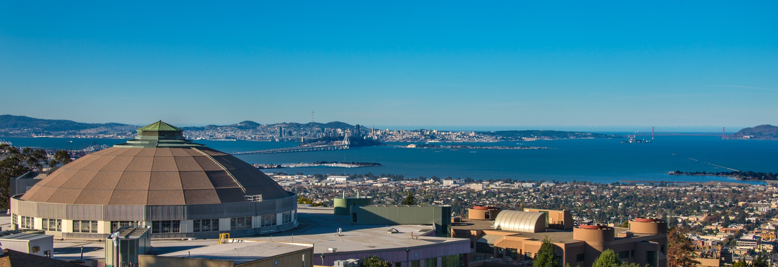
Progress with 3D modelling of beam dynamics in presence of electron cloud
Ecloud 2018, Elba Island, Italy – June 3-7, 2018
Jean-Luc Vay
Lawrence Berkeley National Laboratory

Slide 2
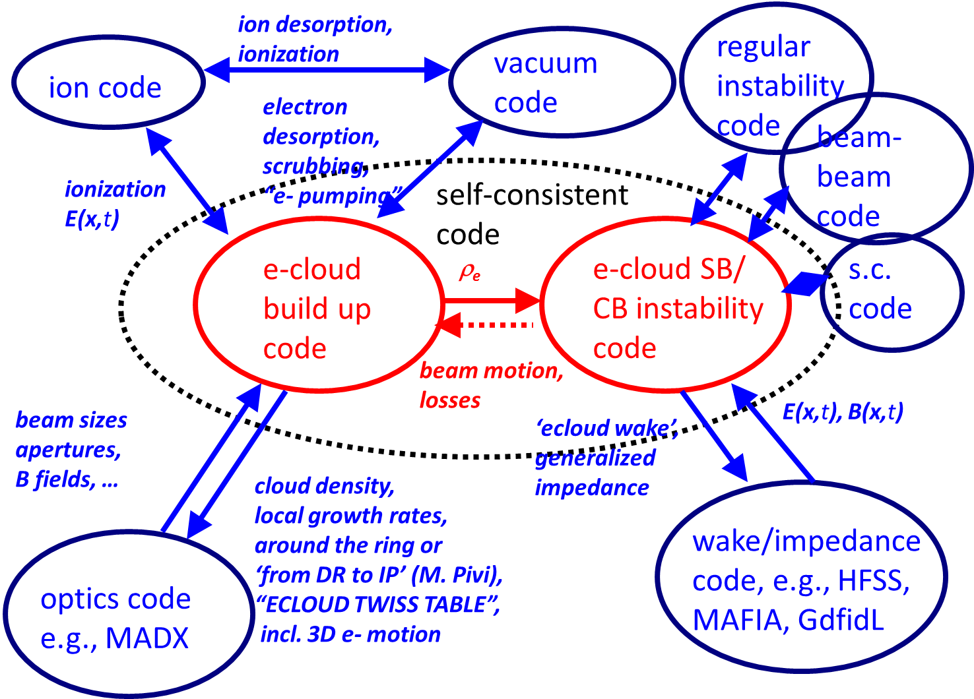
F. Zimmermann’s “I had a dream”.
CARE HHH-2004 dream:
complete e-cloud simulation?
F. Zimmermann, 2004
2

Slide 3
Outline
Introduction of the BLAST toolkit and Warp code
Examples of application to
  Full 3-D PIC simulation of low-energy ion beam interaction with e-cloud
  Fully self-consistent modeling of e-cloud build and beam dynamics in SPS
Other developments
  Optimal Lorentz boosted frame and application to the modeling of wakefields
  Arbitrary order Maxwell solver
Summary & outlook

Slide 4

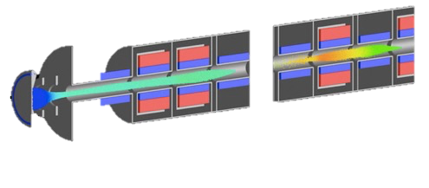
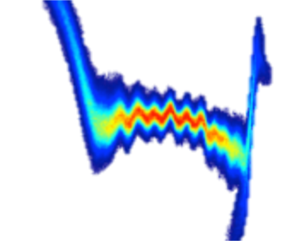

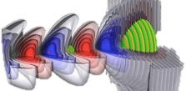

Berkeley Lab Accelerator Simulation Toolkit for conventional & advanced concepts accelerators
State-of-the-art simulation tools*:
Multi-physics frameworks: IMPACT, Warp, WarpX.
Specialized codes: BeamBeam3D, FBPIC, LW3D, POSINST.
Library: PICSAR.
Wide set of physics & components:
beams, plasmas, lasers, structures, beam-beam, e⁻ clouds, ...
linacs, rings, injectors, traps, …
At the forefront of computing:
novel algorithms: boosted frame, particle pushers, etc.
SciDAC, INCITE, NESAP, DOE Exascale.
blast.lbl.gov
*Most codes open source, available at blast.lbl.gov or upon request.

Slide 5
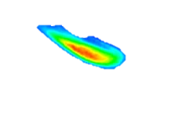
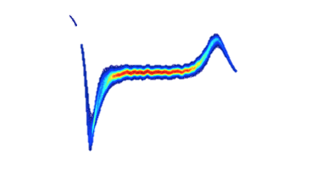
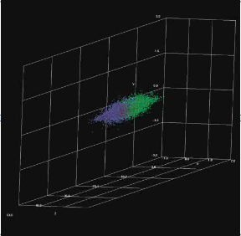

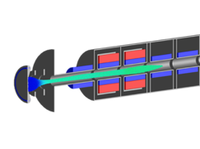
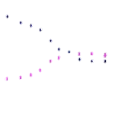
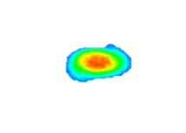
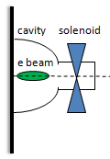

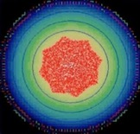
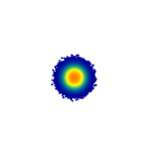
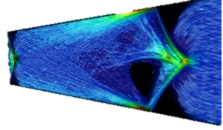


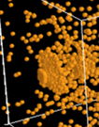

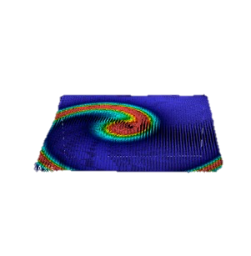
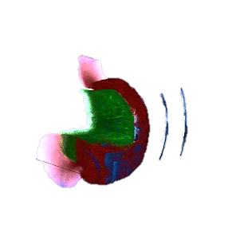

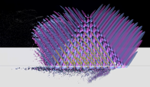
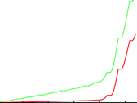
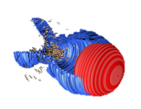
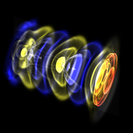

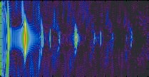
Sample applications of BLAST codes
Beam dynamics in rings & linacs
High space-charge beams
Injectors
Beam-Beam effects
Montague resonance
Warp
Impact
PS
SNS
Warp
Impact
Beam-Beam3D
Impact
LCLS-II, IOTA, UMER , …
LHC, RHIC, Tevatron, KEK-B
Traps
Multi-charge state beams
Electron cloud effects
SEY physics from Posinst
Multi-pacting
Warp
Courtesy H. Sugimoto
Warp
Impact
Warp-Posinst
Warp
Alpha anti-H trap
Paul trap
LEBT – Project X
FRIB
SPS, PS, …
Posinst
“Ping-Pong” effect
Impact
Plasma acceleration
Laser/beam plasma interactions
3D Coherent Synchrotron Radiation
Free electron lasers
Warp
Warp
WarpX
CSR3D
in development
IMPACT+Genesis
FBPIC
Warp
BELLA, FACET-II, …
Plasma mirrors, ion acceleration, plasma lens, …
LCLS-II

Slide 6
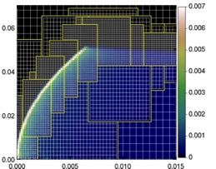
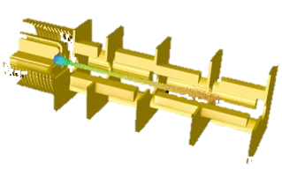
Warp: A Particle-In-Cell framework for accelerator modeling
Geometry: 3-D XYZ axisym. RZ, RZ^{mθ} 2-D XZ 2-D XY
Reference frame: lab moving-window Lorentz boosted
        z z-vt γ(z-vt); γ(t-vz/c²)
Field solvers
electrostatic/magnetostatic - FFT, multigrid; AMR; implicit; cut-cell boundaries
Fully electromagnetic – Yee/nodal mesh, arbitrary order, spectral, PML, MR
Accelerator lattice: general; non-paraxial; can read MAD files
  solenoids, dipoles, quads, sextupoles, linear maps, arbitrary fields, acceleration.
Particle emission & collisions
  Particle emission: space charge limited, thermionic, hybrid, arbitrary.
  Secondary e- emission (Posinst), ion-impact electron emission (Txphysics) & gas emission.
  Monte Carlo collisions: ionization, capture, charge exchange.
x
y
z
Versatile conductor generator accommodates complicated structures
Automatic meshing around ion beam source emitter
R (m)
Z (m)

Slide 7

Warp is parallel, combining modern and efficient programming languages
Parallelization: MPI (1, 2 and 3D domain decomposition)
Python and FORTRAN*: “steerable,” input decks are programs
I/O now based on openPMD standard*: using the common HDF5 data format
  OpenPMD 1.0 provides standard for particles and fields. OpenPMD 2.0 to support accelerators.
  adopted/in adoption by several codes: ACE3P, BeamBeam3D, BMAD, FBPIC, Impact, Osiris, PIConGPU, QuickPIC, SIMEX, Smilei, Synergia, UPIC-EMMA, Warp.
  Leverages open-source visualization tools: python/Jupyter openpmd-viewer, gui-based viewer, plugins for Paraview, VisIt, Yt.
From warp import *
…
nx = ny = nz = 32
dt = 0.5*dz/vbeam
…
initialize()
step(zmax/(dt*vbeam))
…
Imports Warp modules and routines in memory
Sets # of grid cells
Sets time step
Initializes internal FORTRAN arrays
Pushes particles for N time steps with FORTRAN routines
*http://hifweb.lbl.gov/Forthon (wrapper supports FORTRAN90 derived types) – dpgrote@lbl.gov
openpmd.org
*Initiated & led by Axel Huebl (HZDR, Germany)

Slide 8
Outline
Introduction of the BLAST toolkit and Warp code
Examples of application to
  Full 3-D PIC simulation of low-energy ion beam interaction with e-cloud
  Fully self-consistent modeling of e-cloud build and beam dynamics in SPS
Other developments
  Optimal Lorentz boosted frame and application to the modeling of wakefields
  Arbitrary order Maxwell solver
Summary

Slide 9
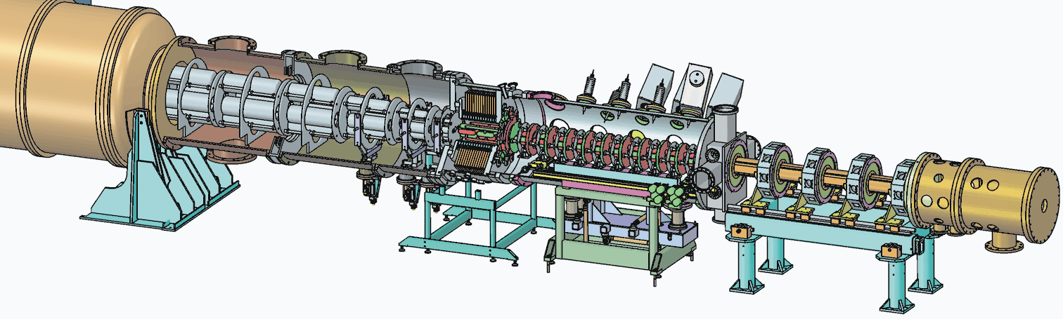
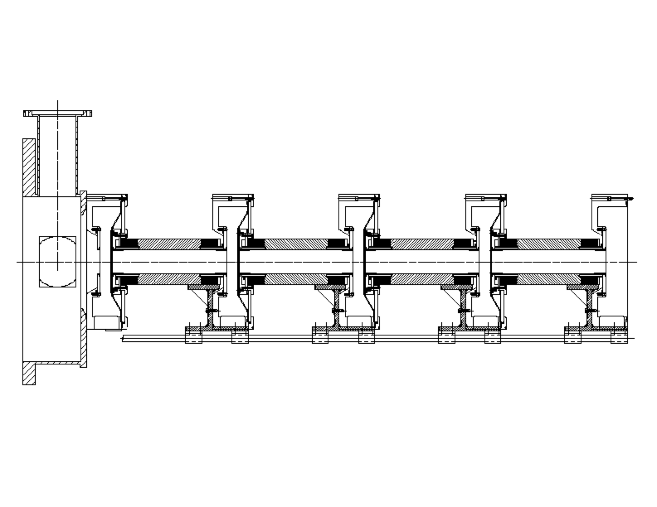
Gas/electron experiment at High-current experiment (HCX)*
MATCHING
SECTION
ELECTROSTATIC
QUADRUPOLES
Location of Gas/Electron Experiments
INJECTOR
MAGNETIC
QUADRUPOLES
0.18 A, t ≈ 5 μs K⁺ beam @ 1 MeV.
Clearing electrodes
(a)
(b)
(c)
Suppressor
*Heavy Ion Inertial Fusion program
K⁺
e⁻
Q1
Q2
Q3
Q4
End plate
Short experiment => need to deliberately amplify electron effects:
let beam hit end-plate to generate copious electrons which propagate upstream.

Slide 10
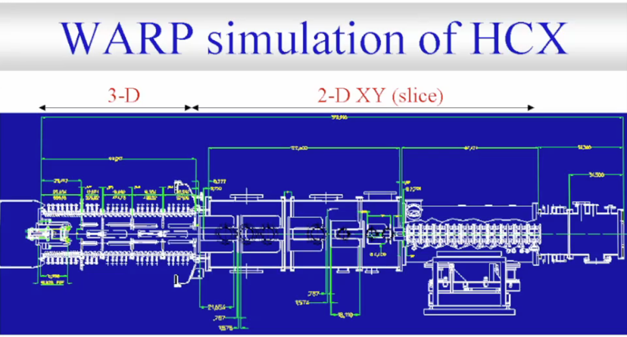
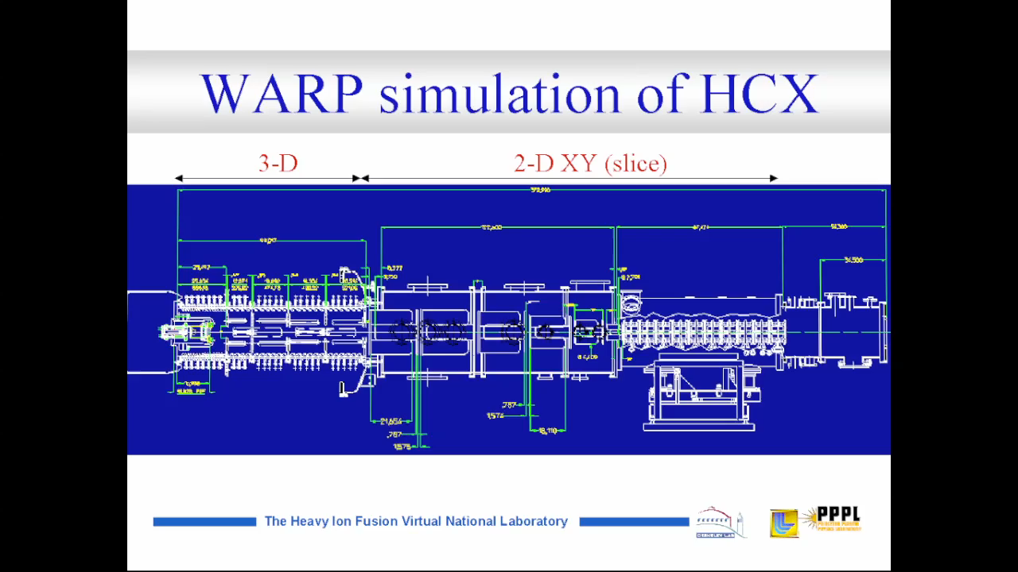
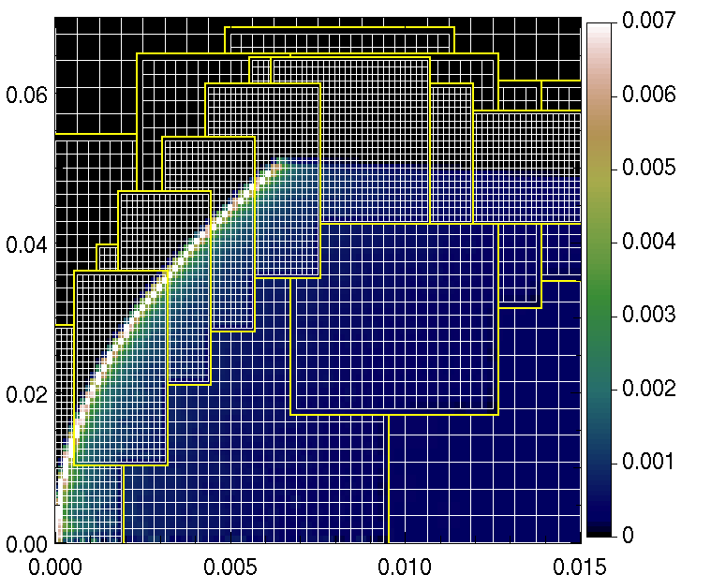
Full PIC (3-D+2-D) modeling of injector and linac
Modeling of source using adaptive mesh refinement
10

Slide 11
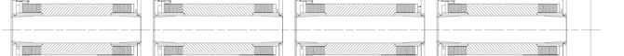
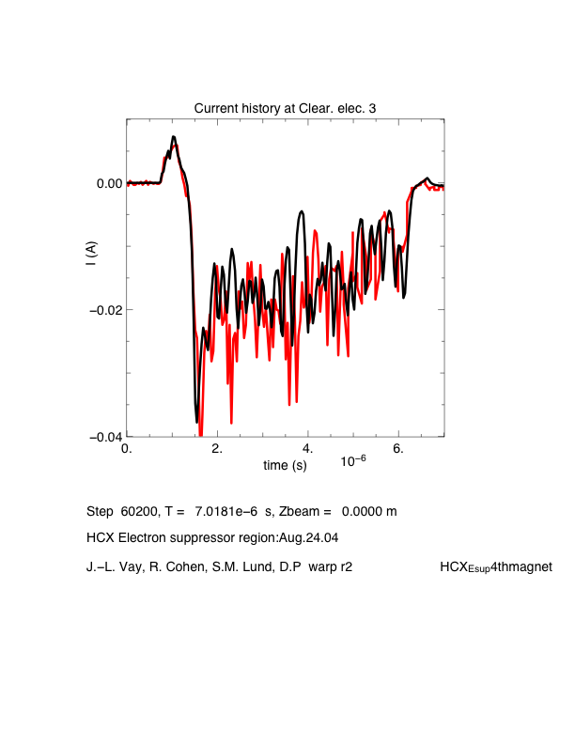
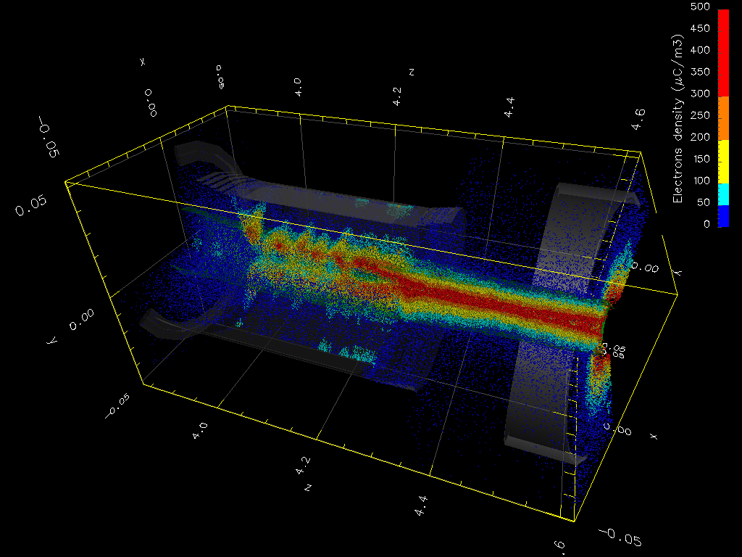
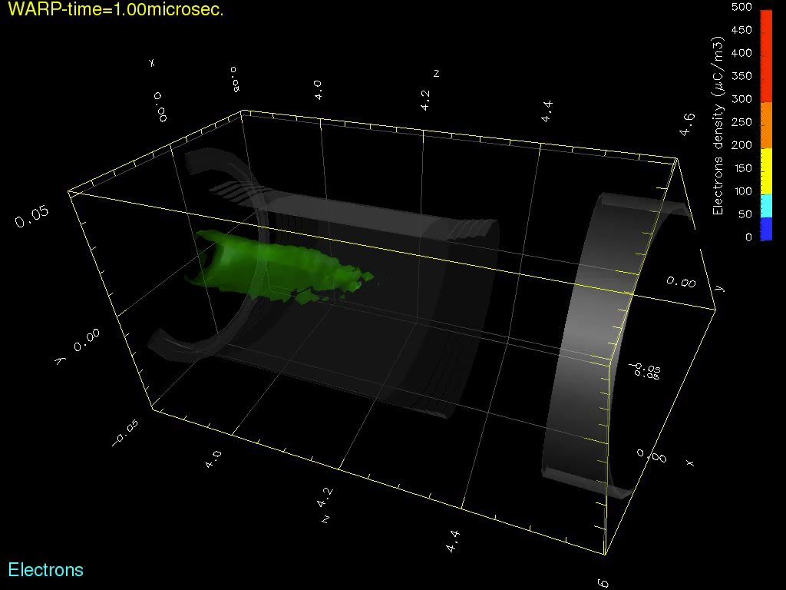
Simulations predicted electron bunching oscillations on HCX when the ion beam was deliberately directed onto the end wall
0V 0V 0V/+9kV 0V
Simulation
Experiment
200mA K⁺
e⁻
0.
-20.
-40.
I (mA)
Q1
(a)
Q2
(b)
Q3
(c)
Q4
~6 MHz signal at (C)
(c)
WARP-3D
T = 4.65μs
Electrons
0. 2. time (μs) 6.
Beam ions hit end plate
200mA
K⁺
Electron
bunching
Oscillations

Slide 12
Outline
Introduction of the BLAST toolkit and Warp code
Examples of application to
  Full 3-D PIC simulation of low-energy ion beam interaction with e-cloud
  Fully self-consistent modeling of e-cloud build and beam dynamics in SPS
Other developments
  Optimal Lorentz boosted frame and application to the modeling of wakefields
  Arbitrary order Maxwell solver
Summary & outlook

Slide 13
Modeling of electron-cloud-driven two-stream instability in high-energy accelerators is more challenging

Slide 14
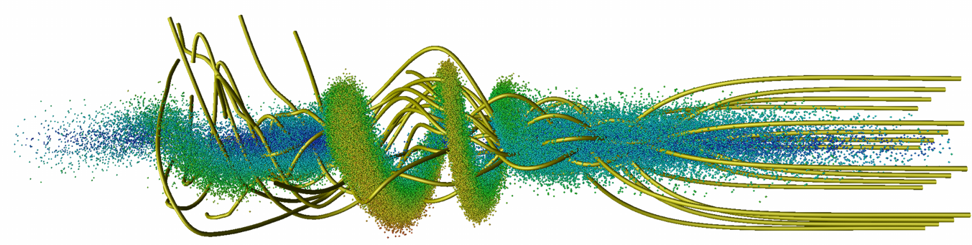
Relativistic proton beam crossing electron cloud
n_{e}(m⁻³)
Proton beam
(γ=500, σ_{z}=13 cm)
10¹⁵
0
z (km)
0
1
2
3
4
5
6
7
8
9
electron
streamlines
beam
Notes:
The basics of the new observation lies in a direct consequence of the space and time dilation/contraction via Lorentz tranformation. For two objects crossing each other at relativistic velocities, the range of space and time scale is not a Lorentz invariant. For some reason, this direct and simple consequence of Lorentz transformation does not seem to be well known. However, its implications are potentially significant, especially for numerical simulation from first principles, for which the cost is generally proportional to the space and time scale range. For systems where the components cross with large relative gamma, the difference in numerical cost can be huge (orders of magnitude) depending on the choice of frame of calculation.

Slide 15
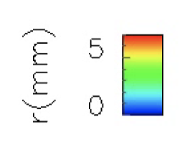
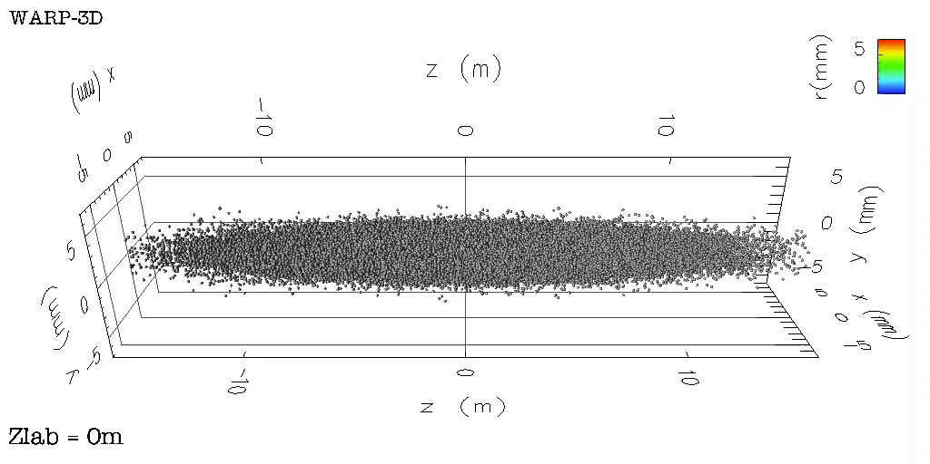
Modeling of two-stream instability is expensive
Need to follow:
short (σ_{z}=13 cm) and stiff (γ=500) proton beam for kilometer
mobile background electrons reacting in fraction of beam length
➔ many small time steps
  Two solutions:
  separate treatment of slow (beam) and fast (electrons) components ➔ quasistatic approximation
  solve in a Lorentz boosted frame which closes beam & electrons length & time scales
Notes:
The basics of the new observation lies in a direct consequence of the space and time dilation/contraction via Lorentz tranformation. For two objects crossing each other at relativistic velocities, the range of space and time scale is not a Lorentz invariant. For some reason, this direct and simple consequence of Lorentz transformation does not seem to be well known. However, its implications are potentially significant, especially for numerical simulation from first principles, for which the cost is generally proportional to the space and time scale range. For systems where the components cross with large relative gamma, the difference in numerical cost can be huge (orders of magnitude) depending on the choice of frame of calculation.

Slide 16
Warp quasi-static run mode
(similar to pyHEADTAIL, PEHTS, QuickPIC, CMAD…)
2-D slab of electrons (fast time scale)
3-D beam
(long time scale)
s
lattice
s_{n}
quad
drift
bend
drift
2-D slab of e- stepped backward with small steps through beam + e- self-field (solving 2-D Poisson at each step),
2-D e- fields are stacked in 3-D array & added to beam self-field,
3-D field is used to kick 3-D beam,
3-D beam is pushed to next station with large steps,
Solve Poisson for 3-D beam self-field.
repeat

Slide 17
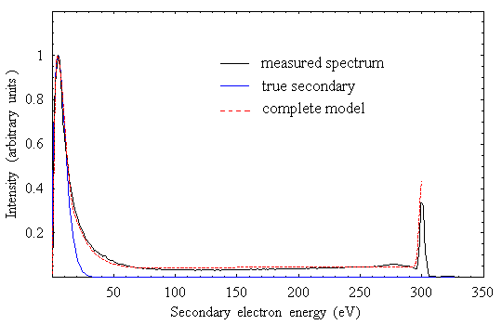
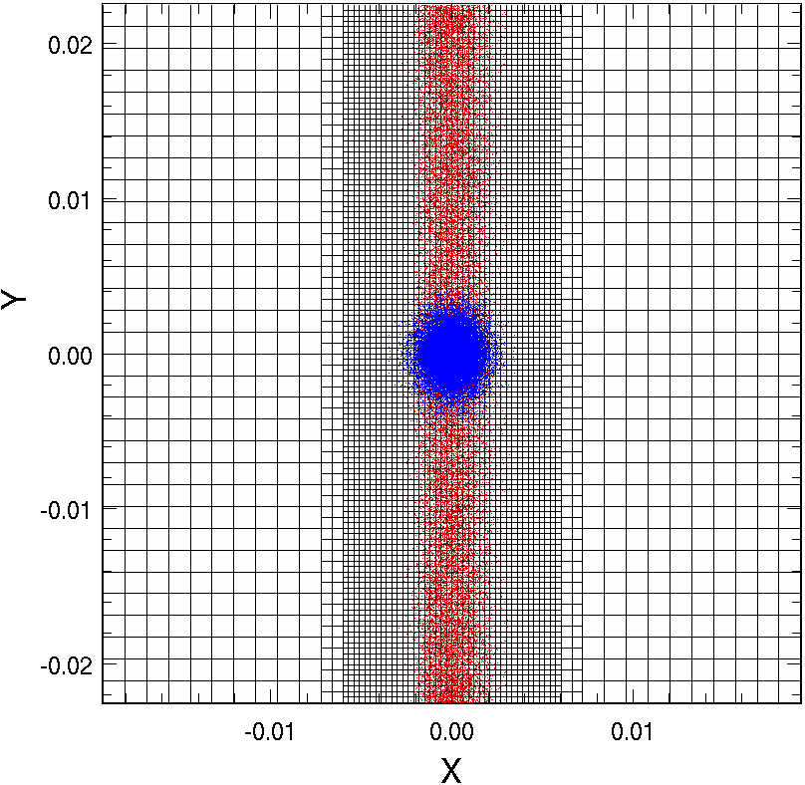
Warp-POSINST package was put together to study e-cloud effects self-consistently
2-D slab of electrons
parallellized using pipelining
proc 1 2 N/2 N/2+1 N-1 N
Station n n+1 n+N/2-1 n-N/2 n+N-2 n+N-1
3-D beam
s
Posinst provides advanced secondary electrons model
Warp’s mesh refinement & parallelism provide efficiency
true sec.
Beam ions
Electrons
back-scattered
elastic
Monte-Carlo generation of electrons with energy and angular dependence.
re-diffused

Slide 18
Simulation parameters for SPS at injection
  Bunch
    energy W=26. GeV
    population N_{p}=1.1×10¹¹
    RMS length σ_{z}=0.23 m (Gaussian profile)
    momentum spread δp/p=2×10⁻³
    transverse normalized emittance ε_{x}= ε_{y}=2.8 mm.mrad
    longitudinal normalized emittance ε_{z}=0.3 eV.s
  ⊥ : continuous focusing
    beta functions β_{x,y}= 33.85, 71.87
    betatron tunes ν_{x,y}= 26.13, 26.185
    chrom. Q_{x,y}=0.,0.
  // : continuous focusing
    momentum compaction factor α=1.92×10⁻³
    cavity voltage V = 2 MV
    cavity harmonic number h = 4620.
  Bunch train 3
    # bunches/batch 72
    bucket length 5 ns
    bunch spacing 25 ns
    batch spacing 200 ns
    # slices/bucket 64
  Electron clouds
    assumed in 100% dipole
    Peak SEY 1.18
    Seed gas ionization
  Bunch-to-bunch horiz. feedback (g=0.1)
  Ring:
    Circumference 6.911 km
    # stations/turn 10
  # computer cores: 9,600

Slide 19
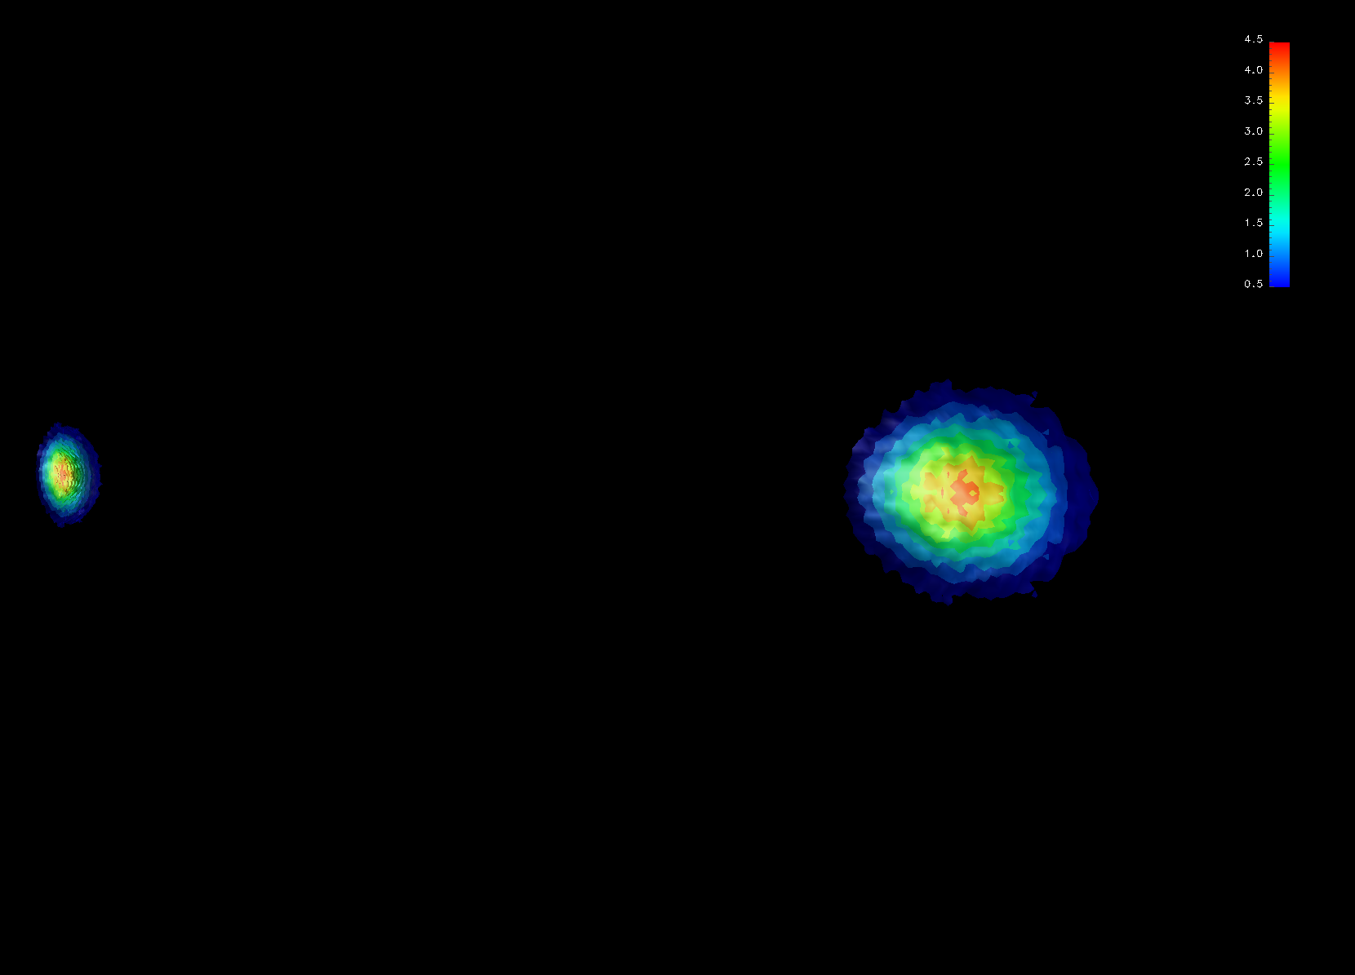
This enabled fully self-consistent simulation of e-cloud effects in SPS
(build-up & beam dynamics)
3D view
Pipe
chamber wall
Turn 1
Bunch 35
Bunch 36
Beam direction
Beam density (x10¹⁵) at t=0 (bunches 35-36 = buckets 176-181)
SPS – 26 GeV

Slide 20
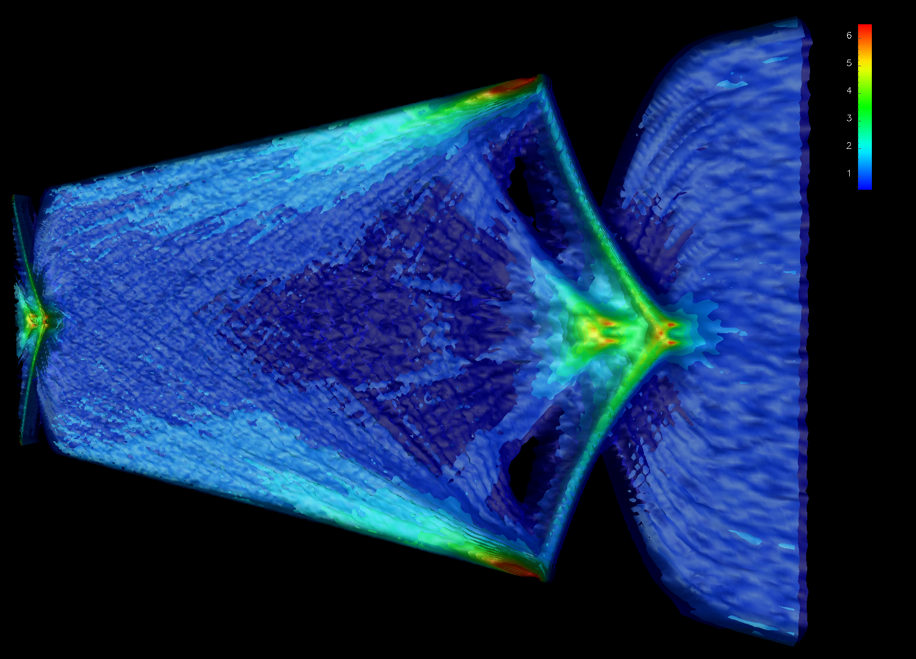
This enabled fully self-consistent simulation of e-cloud effects in SPS
(build-up & beam dynamics)
3D view
chamber wall
Turn 1
Bunch 36
1. Electrons are focused by bunch
Electron density (x10¹²m⁻³) at turn 0 (bunches 35-36 = buckets 176-181)
SPS – 26 GeV

Slide 21
This enabled fully self-consistent simulation of e-cloud effects in SPS
(build-up & beam dynamics)
3D view
chamber wall
Turn 1
Bunch 36
2. High-density spikes eject electron jets
Electron density (x10¹²m⁻³) at turn 0 (bunches 35-36 = buckets 176-181)
SPS – 26 GeV

Slide 22
This enabled fully self-consistent simulation of e-cloud effects in SPS
(build-up & beam dynamics)
3D view
3. Secondary emission from impact of e- jets on walls
chamber wall
Turn 1
Bunch 36
Electron density (x10¹²m⁻³) at turn 0 (bunches 35-36 = buckets 176-181)
SPS – 26 GeV

Slide 23
This enabled fully self-consistent simulation of e-cloud effects in SPS
(build-up & beam dynamics)
3D view
chamber wall
Turn 1
4. Electrons fill the chamber
Electron density (x10¹²m⁻³) at turn 0 (bunches 35-36 = buckets 176-181)
SPS – 26 GeV

Slide 24
This enabled fully self-consistent simulation of e-cloud effects in SPS
(build-up & beam dynamics)
3D view
chamber wall
Turn 1
5. Electrons interact with next bunch
Electron density (x10¹²m⁻³) at turn 0 (bunches 35-36 = buckets 176-181)
SPS – 26 GeV

Slide 25
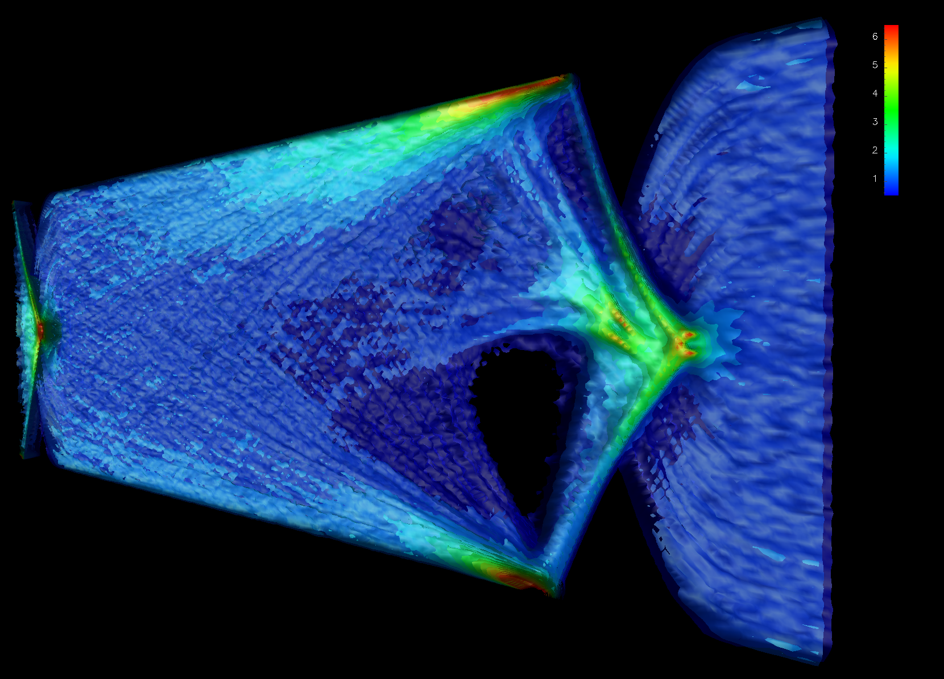
This enabled fully self-consistent simulation of e-cloud effects
(build-up & beam dynamics)
3D view
chamber wall
Turn 500
Electron density (x10¹²m⁻³) at turn 500 (bunches 35-36 = buckets 176-181)
SPS – 26 GeV

Slide 26
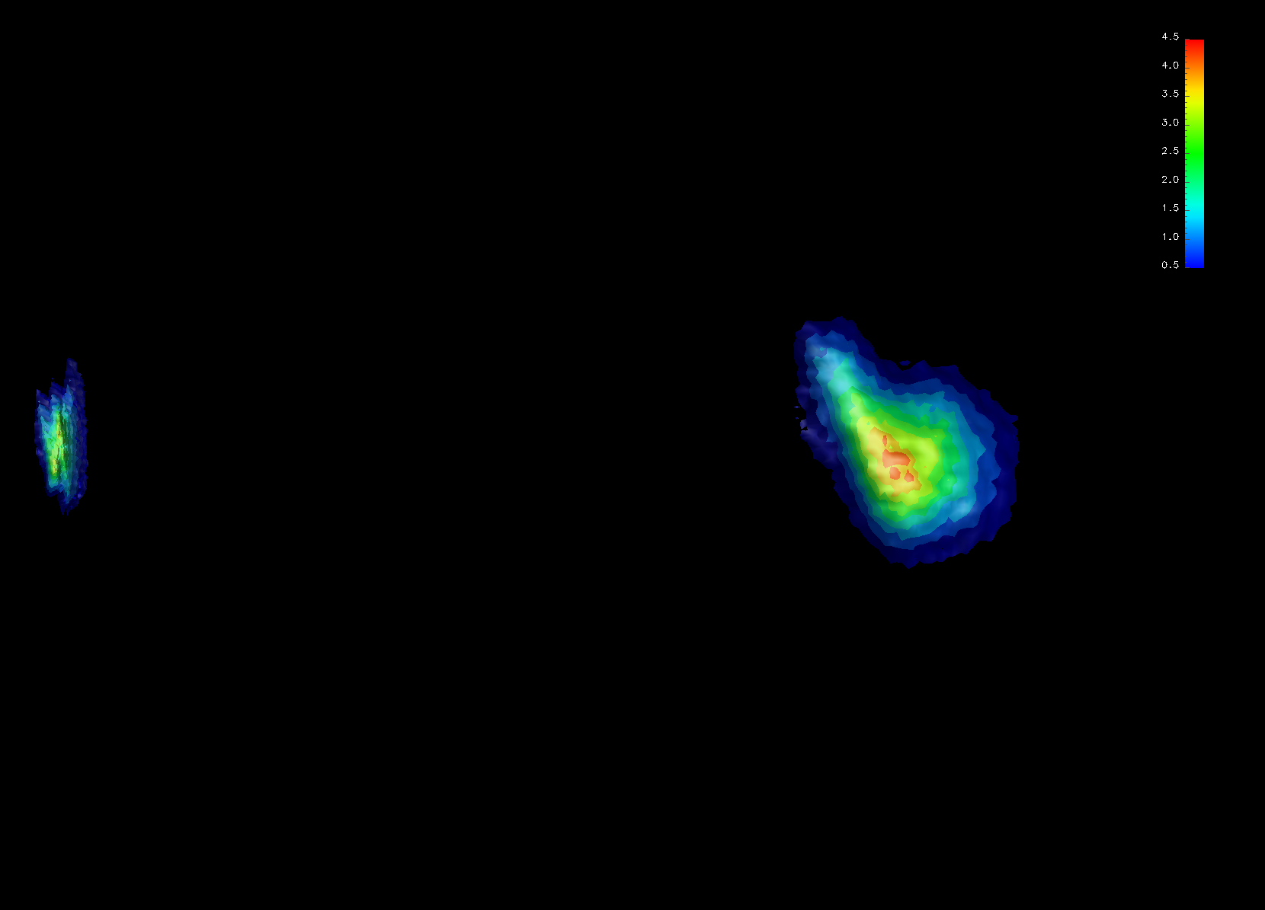
This enabled fully self-consistent simulation of e-cloud effects in SPS
(build-up & beam dynamics)
3D view
chamber wall
Turn 500
Bunch 35
Bunch 36
Beam density (x10¹⁵m⁻³) at turn 500 (bunches 35-36 = buckets 176-181)
SPS – 26 GeV

Slide 27
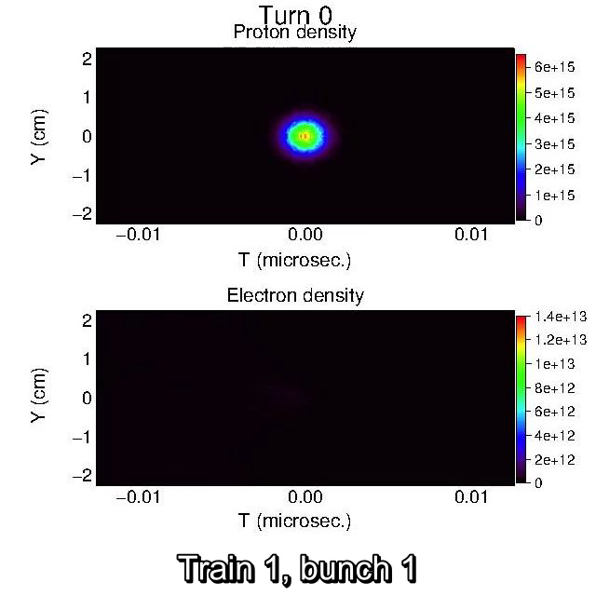


Feedback between beams & e-clouds leads to enhanced instability
Result that standard decoupled buildup & beam dynamics simulations gives.
Sefl-consistent simulation leads to higher level of instability.

Slide 28


Feedback with proton beams leads to increased average e- density
Average electron cloud density history at fixed station
Substantial density rise in
tails of batches between turns 0 and 800.
J.-L. Vay, et al, IPAC12 Proc., (2012) TUEPPB006
SciDAC-II
Compass

Slide 29
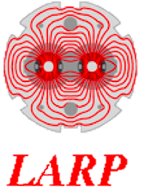
Electron density on axis exhibits similar trend
On axis electron cloud density history at fixed station
x2 between turns 400 and 600
E- density on axis doubled between turns 400 and 600.

Slide 30
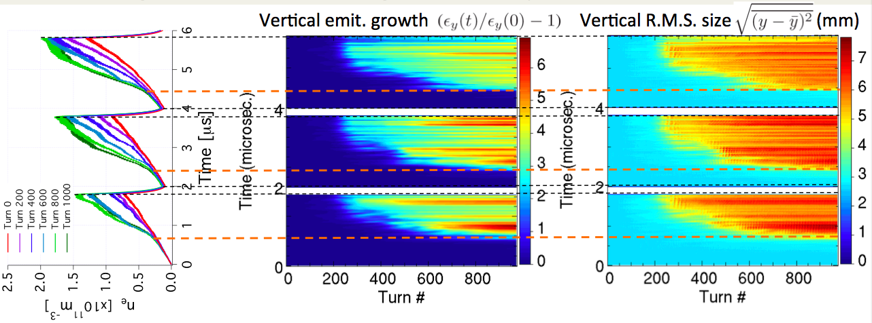
E-cloud density raise correlates with growth of vertical emittance
=> Positive coupling between the e-cloud buildup and the bunches dynamical response.

Slide 31
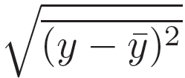
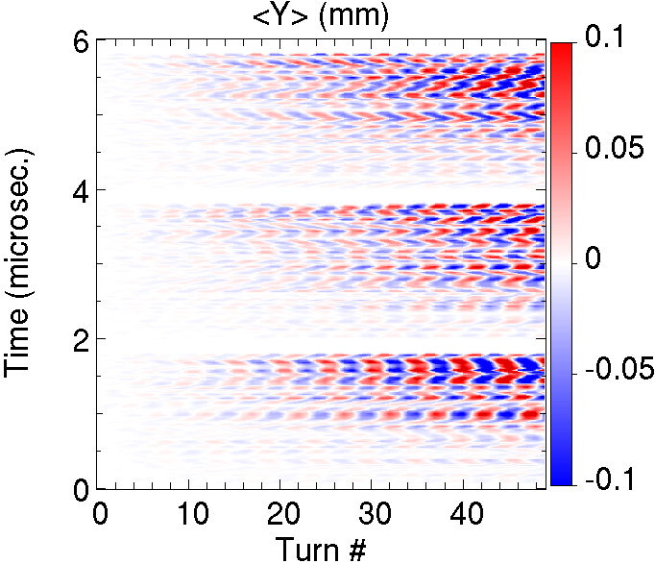
Vertical offsets history reveals bunch coupling via e-clouds
Vertical offset (mm)
Stripe pattern ➔ phase of the oscillations is not purely random
E-cloud provides coupling between bunches.

Slide 32
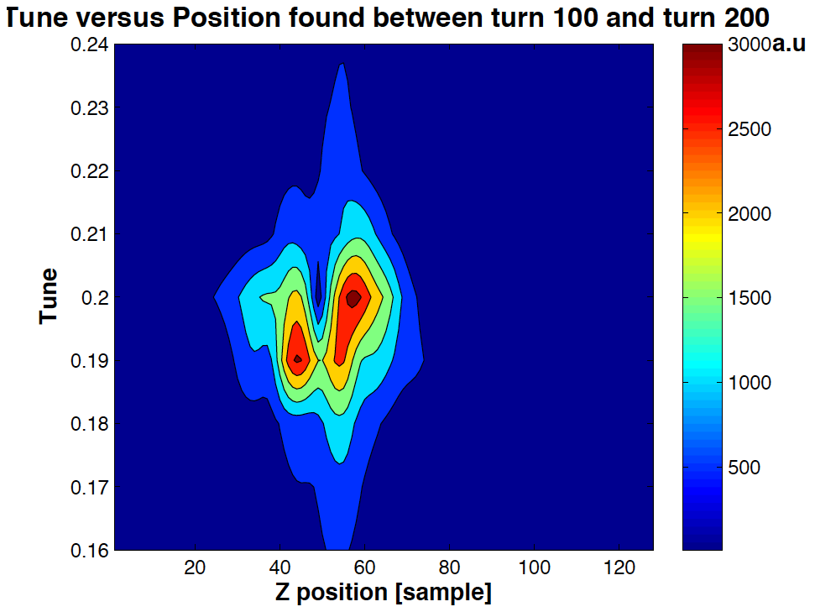
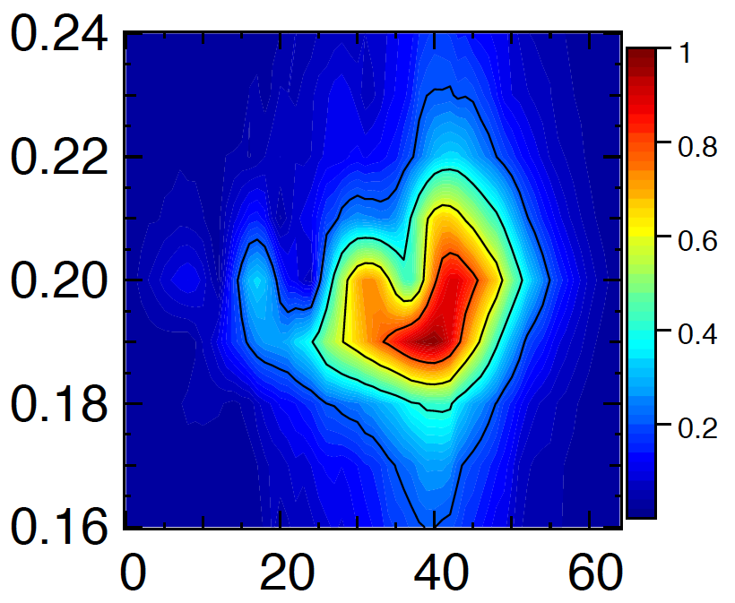
collaboration with SLAC/CERN
Simulation results can match experimental data
Experiment¹
Warp-Posinst²
Bunch 119, Turn 100-200
Bunch 29, Turn 100-200
Good qualitative agreement: separation between core and tail with similar tune shift.
Fractional tune
Fractional tune
head
tail
head
tail
Nominal fractional tune=0.185
Bunch slice
Bunch slice
¹J. Fox, et al, IPAC10 Proc., p. 2806 (2011)
²J.-L. Vay, et al, Ecloud10 Proc., (2010)

Slide 33
Outline
Introduction of the BLAST toolkit and Warp code
Examples of application to
  Full 3-D PIC simulation of low-energy ion beam interaction with e-cloud
  Fully self-consistent modeling of e-cloud build and beam dynamics in SPS
Other developments
  Optimal Lorentz boosted frame and application to the modeling of wakefields
  Arbitrary order Maxwell solver
Summary & outlook

Slide 34

Pushing the state-of-the-art in beam/accelerator modeling
➔ nurturing the development of new algorithms
Algorithm/method | Reference | Originated | Adopted by
Integrated Maps for rf cavity dynamics | Ryne, LANL Report 1995 | ML/IMPACT | D. Abell nonlinear model
Stochastic Leap-Frog for Brownian motion | Qiang & Habib, PRE 2000 | IMPACT
Spectral-finite difference multigrid solver | Qiang & Ryne, CPC 2001/2006 | IMPACT
Improved Perfectly Matched Layers | Vay, JCP 2000/JCP 2002 | Warp | Osiris
AMR-PIC electrostatic | Vay et al, LPB 2002/PoP 2004 | Warp | pyPIC, WarpX
PIC w/ shift-Green function method | Qiang et al, PRSTAB 2002/CPC 2004 | BBeam3D
Secondary emission of electrons algorithm | Furman & Pivi, PRST-AB 2003 | Posinst | TxPhysics, Warp, spacecraft charging codes
AMR-PIC electromagnetic | Vay et al, CPC 2004 | Emi2D | Warp, WarpX
3D Poisson solver with large aspect ratio | Qiang & Gluckstern, CPC 2004 | IMPACT
PIC w/ integrated Green function | Qiang et al, PRSTAB 2006 | ML/IMPACT | BB3D, Pyheadtail, Opal
Hybrid Lorentz particle pusher | Cohen et al, NIMA 2007 | Warp | PICSAR (UCB)
Lorentz boosted frame | Vay, PRL 2007 | Warp | INF&RNO, JPIC, Osiris, V-sim, FBPIC, WarpX
Explicit Lorentz invariant particle pusher | Vay, PoP 2008 | Warp | Tristan, QED, PIConGPU, Osiris, Photon-Plasma, etc.
New convolution integral w/ smooth kernel | Qiang, CPC 2010

Slide 35
is ongoing
Algorithm/method (cont.) | Reference | Originated | Adopted by
Mixed Particle-Field decomposition method | Qiang & Li, CPC 2010 | BBeam3D
PIC with tunable electromagnetic solver | Vay et al, JCP 2011 | Warp | V-sim, Osiris
Efficient digital filter for PIC | Vay et al, JCP 2011 | Warp | V-sim, Osiris
Laser launcher from moving antenna | Vay et al, PoP 2011 | Warp | V-sim, Osiris, FBPIC, WarpX
High-precision laser envelope model | Benedetti et al, 2011 | Inf&rno
Domain decomposition for EM spectral solver | Vay et al, JCP 2013 | Warp | PICSAR, WarpX
Mitigation of num. Cherenkov instability | Godfrey&Vay, JPC/CPC 2014-15 | Warp | Osiris, WarpX
Adaptive unified differential evolution algo. | Qiang & Mitchell, OO dig. 2015
Spectral solver with azimuthal decomposition | Lehe et al, CPC 2016 | FBPIC
Galilean PSATD w/wo azimuthal decomp. | Lehe, Kirchen, PRE/PoP 2016 | FBPIC/Warp | WarpX
Arbitrary order stencil variations analysis | Vincenti et al, CPC 2016
Novel algorithm for vectorization | Vincenti et al, CPC 2017 | PICSAR | Warp, WarpX, SMILEI
Novel Poisson solvers in pipe with open BC | Qiang, CPC 2017 | IMPACT
Fully symplectic tracking model | Qiang, PRAB 2017 | IMPACT

Slide 36
Can we realize F. Zimmermann’s dream further?
CARE HHH-2004 dream:
complete e-cloud simulation?
F. Zimmermann, 2004
36

Slide 37
Outline
Introduction of the BLAST toolkit and Warp code
Example of application to
  Full 3-D PIC simulation of low-energy ion beam interaction with e-cloud
  Fully self-consistent modeling of e-cloud build and beam dynamics in SPS
Other developments
  Optimal Lorentz boosted frame and application to the modeling of wakefields
  Arbitrary order Maxwell solver
Summary

Slide 38

Optimal Lorentz boosted frame approach
Lorentz
transformation
Lab frame
Boosted frame
Beam
Beam
Accelerator
Accel.
Many time steps needed to follow short stiff high-energy beam into long accelerator filled with fast reacting electron clouds.
Much less time steps needed to follow long low-energy beam into shorter accelerator filled with stiffer electron clouds.
Number of time steps divided by (1+β)γ²
With high γ, orders of magnitude speedups are possible.
J.-L. Vay, PRL 2017

Slide 39

Application to modeling of two-stream instability
Calculation of e-cloud induced instability of a proton bunch
  Proton beam: γ=500, σ_{z}=13 cm
  L=6 km, continuous focusing
electron
streamlines
beam
proton bunch radius vs. z
CPU time (on 8 cores in 2006):
  lab frame: >2 weeks
  frame with γ²=512: <30 min
Speedup x1000
Notes:
The basics of the new observation lies in a direct consequence of the space and time dilation/contraction via Lorentz tranformation. For two objects crossing each other at relativistic velocities, the range of space and time scale is not a Lorentz invariant. For some reason, this direct and simple consequence of Lorentz transformation does not seem to be well known. However, its implications are potentially significant, especially for numerical simulation from first principles, for which the cost is generally proportional to the space and time scale range. For systems where the components cross with large relative gamma, the difference in numerical cost can be huge (orders of magnitude) depending on the choice of frame of calculation.

Slide 40

Could also speedup some simulations of wakefields
-- E.g. open space, metallic or finite-conductivity pipe
Pipe – length=10 cm
EM field measured along pipe at x=Rpipe/2.
Beam (Gaussian): 10 GeV protons (γ~11.7), radius=length=0.2mm RMS.
Fully EM simulations without pipe (absorbing boundaries PML) or with (metalic or conductor σ=2.).
Longitudinal E field
Example:
finite conductivity σ=2
X [m]
Z [m]
40

Slide 41
Running in boosted frame up to γ=4 gives speedups up to 10
Modeling of wakefield in boosted frames
Pipe
Frame
Run times:
T(γ=2) = T(γ=1)/5
T(γ=4) = T(γ=1)/10
None
Metal
σ=2
γ=1 (lab)
γ=2
γ=4
41

Slide 42
Could this be used to speed-up some simulations?
42

Slide 43
Outline
Introduction of the BLAST toolkit and Warp code
Examples of application to
  Full 3-D PIC simulation of low-energy ion beam interaction with e-cloud
  Fully self-consistent modeling of e-cloud build and beam dynamics in SPS
Other developments
  Optimal Lorentz boosted frame and application to the modeling of wakefields
  Arbitrary order Maxwell solver
Summary & outlook

Slide 44
Arbitrary-order Maxwell solver offers flexibility in accuracy
(on centered or staggered grids)
Finite-difference
Higher order
N→∞ = Pseudo-spectral (FFT)
cΔt/Δx~0.45
Kronecker δ pulse
Smaller time steps
cΔt/Δx~0.045
Accurate but Expensive
(with leapfrog integrator)
44

Slide 45
Analytical integration in Fourier space offers infinite order
Pseudo-Spectral Analytical Time-Domain¹ (PSATD)
F⁻¹
F
F⁻¹
F
F⁻¹
F
with
PSATD cΔt/Δx=50
1 time step
Easy to implement arbitrary-order n with PSATD (k=k⚯ → k^{n}).
Also does not have Courant condition.
¹I. Haber,R. Lee,H. Klein & J. Boris,Proc. Sixth Conf. on Num. Sim. Plasma, Berkeley, CA, 46-48 (1973)
45

Slide 46
Spectral solvers involve global operations ➔ harder to scale to large # of cores
    Spectral Finite Difference (FDTD)
    global “costly” local “cheap”
    communications communications
    vs
    Harder to scale Easier to scale
○ | ○ | ○ | ○ | ○
○ | ○ | ○ | ○ | ○
○ | ○ | ○ | ○ | ○
○ | ○ | ○ | ○ | ○
○ | ○ | ○ | ○ | ○
○ | ○ | ○ | ○ | ○
○ | ○ | ○ | ○ | ○
○ | ○ | ○ | ○ | ○
○ | ○ | ○ | ○ | ○
○ | ○ | ○ | ○ | ○
Finite speed of light ➔ local FFTs ➔ spectral accuracy+FDTD scaling!
Local FFT
J.-L. Vay, I. Haber, B. Godfrey, J. Comput. Phys. 243, 260 (2013)
H. Vincenti, J.-L. Vay, Comput. Phys. Comm. 200, 147 (2016)
46

Slide 47


Applied successfully to modeling of plasma mirrors in cases where standard low-order solvers fail
Laser
Plasma mirror
Source spot size for all harmonics on plasma mirror
Stencil order 100 needed to reach convergence
For generation of attoseconds laser/e- pulses
A. Leblanc, S. Monchoce, H. Vincenti, S. Kahaly, J-L. Vay, F. Quere, Phys. Rev. Lett. 119, 155001 (2017)
Other publications related to new solver:
[1] G. Blaclard, H. Vincenti, R. Lehe, J. L. Vay, Phys. Rev. E 96, 033305 (2017)
[2] H. Vincenti, J.-L. Vay, Comput. Phys. Comm., in press
47

Slide 48
Could new arbitrary order solver be of use to reduce numerical effects in fully electromagnetic simulations for conventional accelerators: impedance, …?
Can be used in combination to boosted frame to speedup simulations (demonstration of coupling already done in application to plasma accelerators).
48

Slide 49
Outline
Introduction of the BLAST toolkit and Warp code
Examples of application to
  Full 3-D PIC simulation of low-energy ion beam interaction with e-cloud
  Fully self-consistent modeling of e-cloud build and beam dynamics in SPS
Other developments
  Optimal Lorentz boosted frame and application to the modeling of wakefields
  Arbitrary order Maxwell solver
Summary

Slide 50
Summary & outlook
BLAST assembles a simulation toolkit for modeling of particle accelerators.
Can perform full PIC and self-consistent modeling of e-cloud modeling and beam dynamics.
Lorentz boosted frame, arbitrary order Maxwell solver offer potential applications to the modeling of wakefields.
Further integration of codes will take advantage of common file data standard OpenPMD.org (version 2.0 to support accelerators).
Also working on common standards PICMI/AMI for standardized input scripts.

Slide 51
Thank you for your attention.

