Slide 1
Cryogenic SEY measurement Facility at Daresbury
Taaj Sian
Reza Valizadeh, Oleg Malyshev

Slide 2
Motivation
LASE is the baseline for FCC-hh e-cloud mitigation
My PhD project is part of EuroCirCol WP4
Optimising LASE surfaces on Cu with various lasers and parameters to create surfaces with SEY < 1
Testing these surfaces at room temperatures
Testing the best surfaces at cryogenic temperatures with and without cryosorbed gasses

Slide 3
Sample Production
Produced and tested more than 100 different LASE samples
With different laser parameters treated with the following lasers:
Nanosecond 355 nm
Nanosecond 1064 nm
Picosecond 355 nm
Picosecond 1064 nm
In different atmospheres:
Air
Ar
CH₄
More than 40 samples have SEY_{max}<1
More in talk my R. Valizadeh
What about cryogenic temperature and condensed gas?

Slide 4
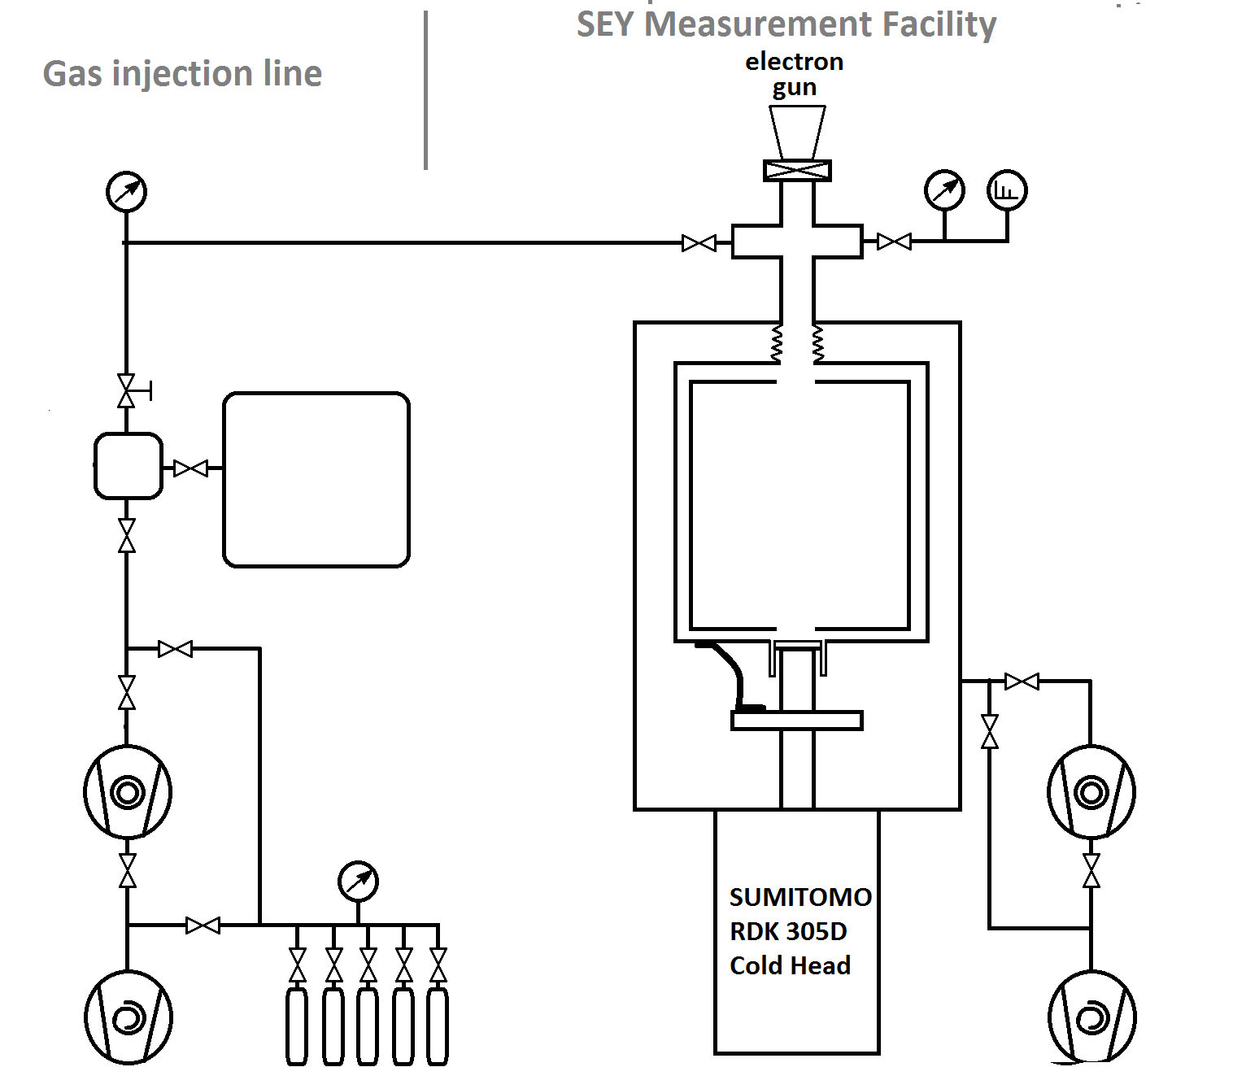
Cryogenic Experiment Schematic
Known amount of gas injected Q=P_{1*} (V₁ + V₂ + V₃)
All volumes are known
After opening valve 2 while T_{s} =T₂: $\text{Q}\text{=}\text{P}\text{1}\text{ (}\text{V}\text{1}\text{ + }\text{V}\text{2}\text{ + }\text{V}\text{3 }\text{+ }\text{V}\text{4}\sqrt{\frac{T_{2}}{T_{1}}}\text{)}$
Then sample temperature is reduced to 4.2 K< T_{s} < 80 K to cryosorb the gas.
Surface coverage is: $s=\frac{Q}{A}$ , where A is the sample area
Valve 2
P₁
V₃
Valve 1
T₁
V₂
V₁
V₄
T_{S}
T₂

Slide 5
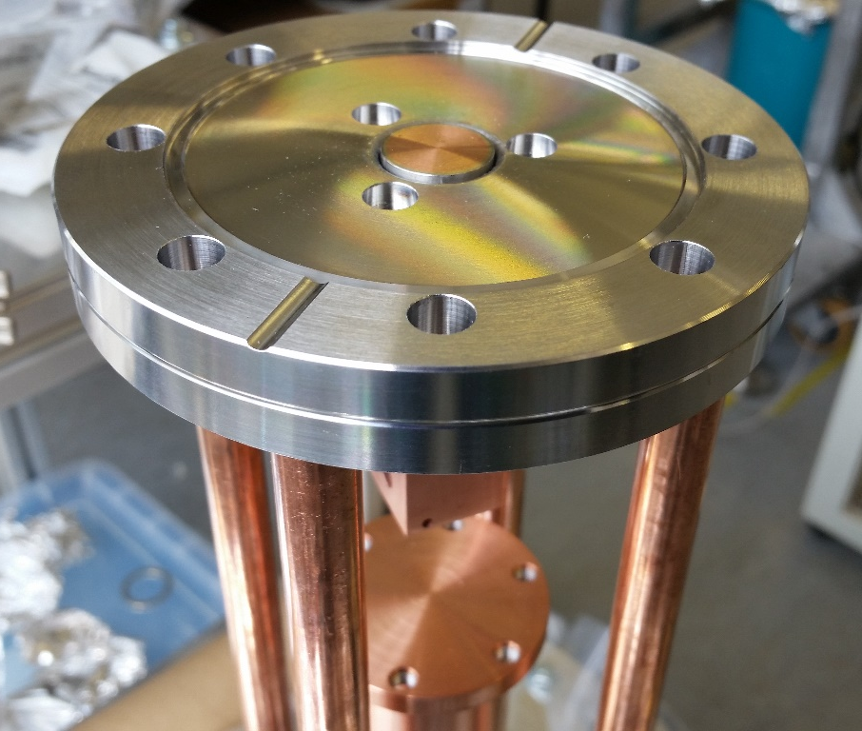
Sample Holder
Sample at 4-80 K
1 mm gap between the flange and sample to reduce lost gas
Bottom flange of test chamber at 60-80 K
Thin stainless steel tubes used to reduce conductance to sample
Holes near the sample holder for the supports for the Farraday cup
Conductor
from 1st stage
to a sample
2nd stage
Easy to design but
It took 8 months to manufacture
this piece (and delayed the
research programme)

Slide 6
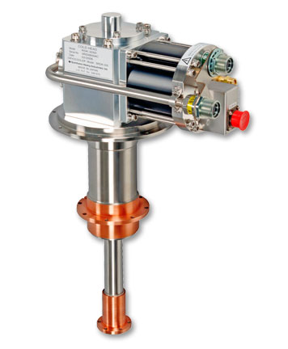
Initial Design
Electron Gun, Gauge,
RGA, Pumping,
Gas injection
RDK-305D 4K Cryocooler (RDK-305D Cold Head with CNA-31C/D Compressor)
Bellows
Test chamber
2nd stage
Conductor
from 1st stage to heat shield
1st stage
Insulation vacuum

Slide 7
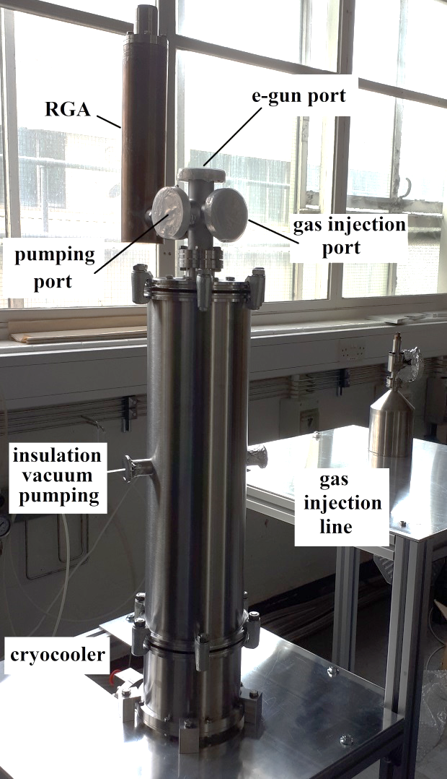
Current design
Bellows
Test chamber
Faraday cup
2nd stage
Conductor
from 1st stage to heat shield
1st stage
Insulation vacuum

Slide 8
Injection line
Baratron
Small Volume
Large Volume
Gauge
Pumps
Gasses (CO, CO₂, CH₄, N₂, Ar and H₂)

Slide 9
Conclusions
SEY < 1 has demonstrated on more than 40 samples produced with different lasers and various parameters
A new facility for SEY studies will allow the measurement of LASE surfaces at cryogenic temperatures with and without cryosorbed gasses
Facility will be tested shortly after this workshop

