Slide 1
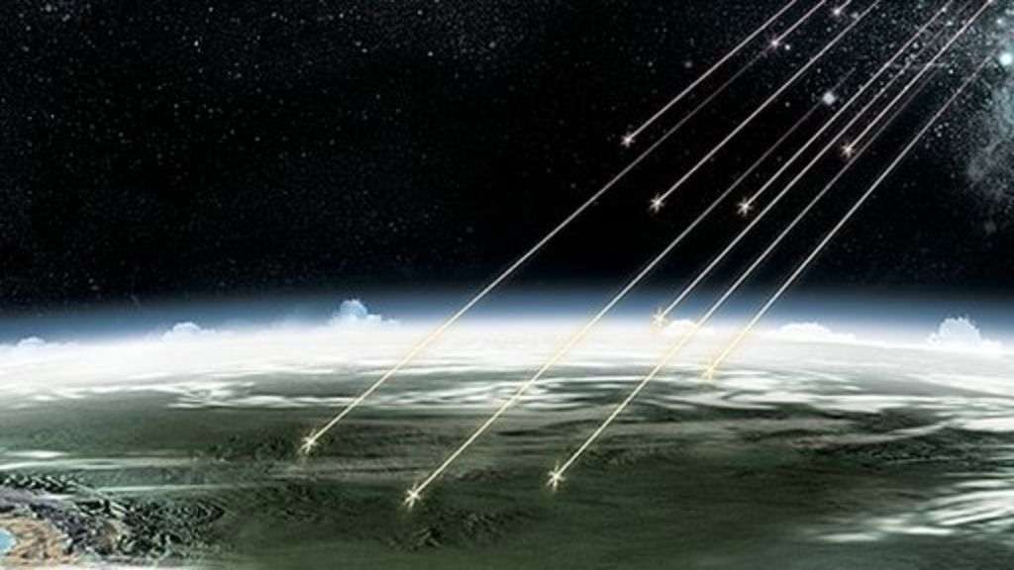
Cosmogenic Muon Background

Slide 2
Goals of Project
Measurement of the Underground Cosmic Ray Muon Flux at SUPL (Extension of John Koo’s work)
Complete Analysis of Cosmogenic Induced Background at SUPL
Annular Modulation
Seasonal
Temperature
Atmospheric Density

Slide 3
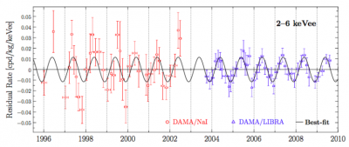
DAMA/LIBRA Modulation
Sensitive to annual modulation of signal due to drift into DM wind
Detected a signal 2-6keV @ (0.0116$±$0.0013)${\text{cpd} \text{kg}}^{−1} {\text{keV} }^{−1}$

Slide 4
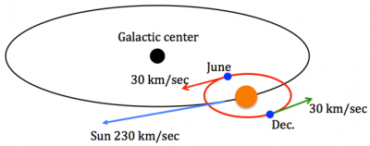
SABRE
Test of DAMA/LIBRA results
Two SABRE detectors in opposite terrestrial hemispheres will simultaneously measure the dark matter wind
Gran Sasso
Stawell
An annual modulation of muons would result in an opposite phase in these two detectors

Slide 5
Why are Muons Bad?
Muons interactions themselves are easily distinguished at SABRE because muons deposit energy well above expected DM signal $\sim$2-6 keV
Neutrons spallation occurs when muons interact with surrounding rock/detector
Neutrons spallation can mimic DM signal in detector
Precise measurement of muon flux and energy required to reduce this background

Slide 6
Why are Muons Bad?
One of main criticisms of the DAMA/LIBRA result is an alternative source of annual modulation
Neutrons spallation from solar neutrinos and atmospheric muons.
The phase of the muon modulation lags 30 days behind the data however adding the modulated neutrino component shifts the phase forward

Slide 7
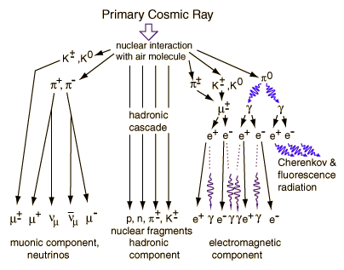
Cosmic Rays
Cosmic rays are high energy particles such as protons (90%), alpha particles (9%) and electrons (1%)
When CR particles enter the atmosphere, they generate a hadronic cascade where mesons are produced such as pions and kaons.
These mesons can either interact again or decay into muons.

Slide 8
Cosmic Rays
Muons > 50% of cosmic radiation @ sea level
$\sim$ 4 GeV
Muons generally produced $\sim$15km above seal level and travel in conical showers with 1$°$ of primary particles

Slide 9
Temperature Dependent Muon Production
The relative probability of decay or interaction depends on the local density of the atmosphere which in turn depends on temperature
As temp increases, density decreases = more muon background
Pions and Kaons have a longer mean free path
less interactions $→$ more muon flux at underground detectors
Seasonal/temperature variation in muon flux has been seen at Borexino

Slide 10
Borexino - Gran Sasso
$3.8$km water equivalent underground
Muon flux of ($3.41±0.01)×{10}^{−4}{\text{m}}^{−1}{\text{s}}^{−1}$
Seasonal modulation of amplitude $1.29±0.07$ %
Phase was $1.79±6$ days
Maximum muon flux on $28$^{th} June
Modulation of muon flux with temperature - Bellini et al

Slide 11
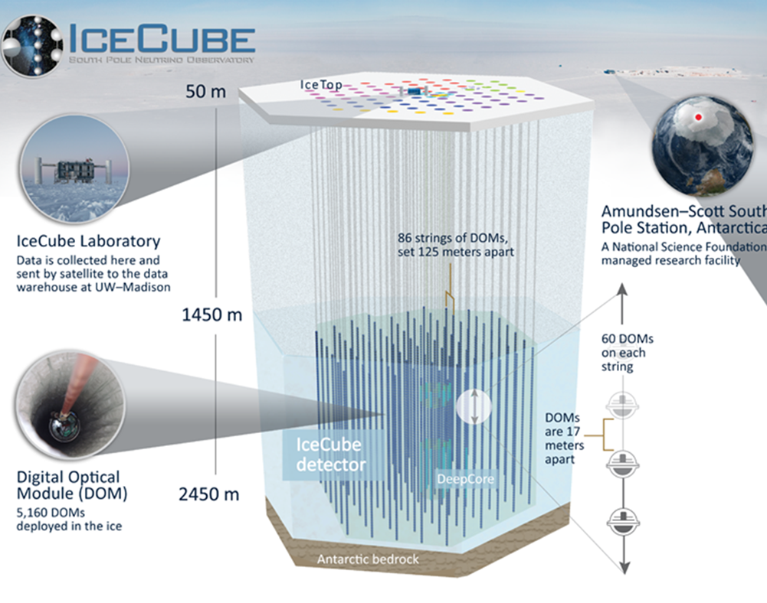
IceCube Neutrino Experiment
Detector is triggered at rate 3000 ${\text{s}}^{−1}$ by muons

Slide 12
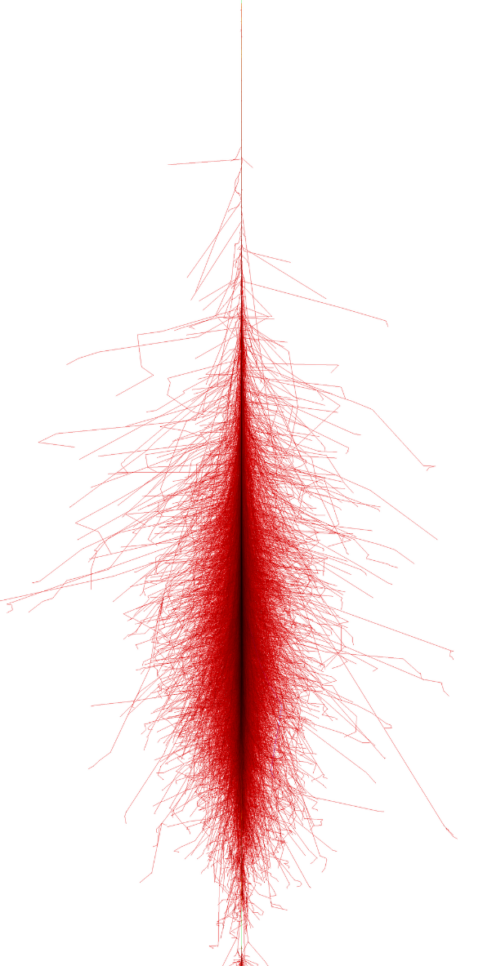
IceCube Muon Simulation
Atmospheric muons events are simulated through detailed modelling of individual CR induced showers
CORSIKA
COsmic Ray SImulation for KAscade
Specific local conditions
Seasonal temp/density variations
Direction of magnetic field
Atmospheric profile
Energy spectra for each type of CR primary nucleus

Slide 13
IceCube Measured Muon Flux
150 billion events collected by IceCube over 4 years,
Muon rate was found to be highly correlated with daily variations of the stratospheric temperature
exhibits a ± 8% annual modulation
Correlation between muon rate and upper atmospheric temp related to the relative contribution of π and K in the extensive air showers.

Slide 14
Stawell - MUSUN

Slide 15
Stawell - MUSUN

