Slide 1
Power System for GEM and RPC detector
P. Paolucci, A. Boaino, F. Tyssen, S. Meola,
G. Passeggio, F. Cassese, Electronic service of Napoli
&
CAEN company

Slide 2
Strategia per GEM e RPC
RPC fino a LS3:
  Continuare con il sistema EASY
    120 A3009 + 150 A3512
  Upgrade necessari:
    30 FAN EASY, 3 SY1527 e dei 7 A3485
  RE31 e RE41 (se approvati)
    necessitano di 24 A3512 + 20 A3009
GE11 (2016-2019):
  Sistema HV distribuito sito in USC
  A1515TG Floating High Voltage Power Supplies: (70-80 ?)
  Low voltage standard con sistema EASY: (50 ?)
GE21 (2023): simile a GE11
ME0 (2023) è in fase di definizione

Slide 3
Proposed requirements for GEM
  Assure a very high stability of the detector
    No over-voltage during the ramping
    Voltage stability = 0.01%/ºC
    Voltage stability at fixed temperature < 0.01%
  Low noise induced on the chamber and front-end
  Very fast feedback in case of local discharge
  Operating Range 0-5 KV and 0-1 mA
  Accessibility (great part of the system)
    To disconnect malfunctioning area
    To replace part of the hardware
  Hardware and software voltage limitation
  Compatible with CMS DCS and DSS system
  P/T correction

Slide 4

Power Schema
Individually floating stacked channels

Slide 5
Single Channel schema
Bi-polar power supply
Designed to be fully floating up to 5 kV
Ultra low noise sine-wave DC-HVDC converter with dual current range (CAEN design):
  0-100 μA range (100 pA current resolution) (1 ppm)
  0-1 mA (1 nA current resolution) (1 ppm)
  Bipolar current sensing to measure ion backflow currents
Opto-insulated channel to board communication with SYNC (all channels are in synchronous switching operation)
On-channel Microcontroller to manage the channel operation:
  Voltage & Current Set and Monitor (with 24bit ADC)
  Temperature Monitor
  Calibration settings stored in an internal memory
  Alarms Handling
  Smart Diagnostics
Micro
Optical Link
Floating power
supply
DC/DC
HV

Slide 6
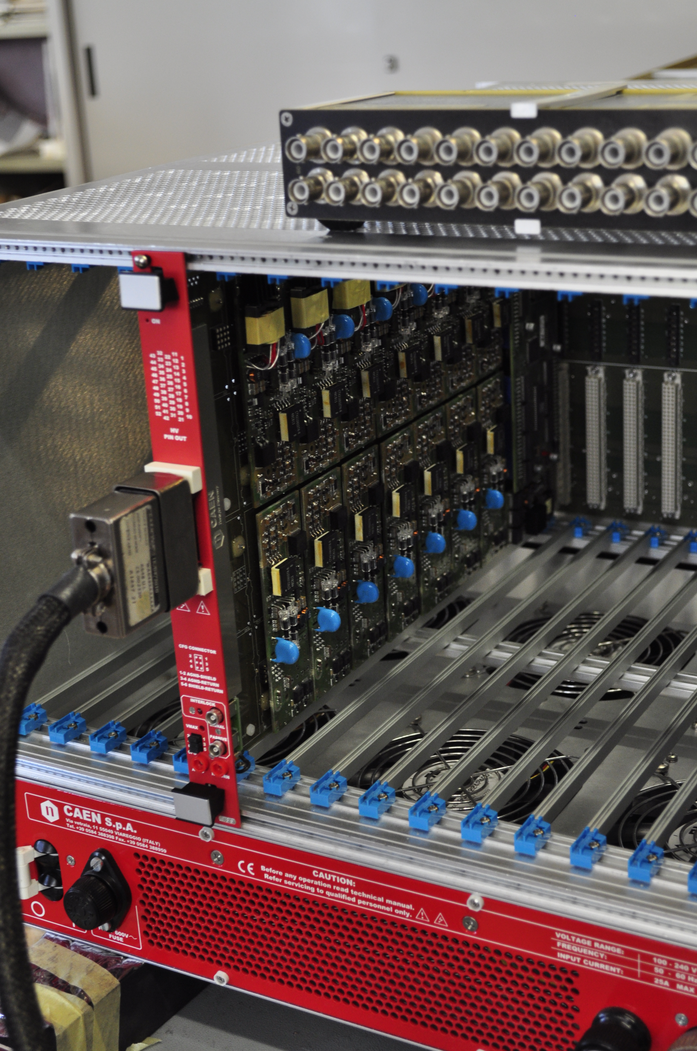
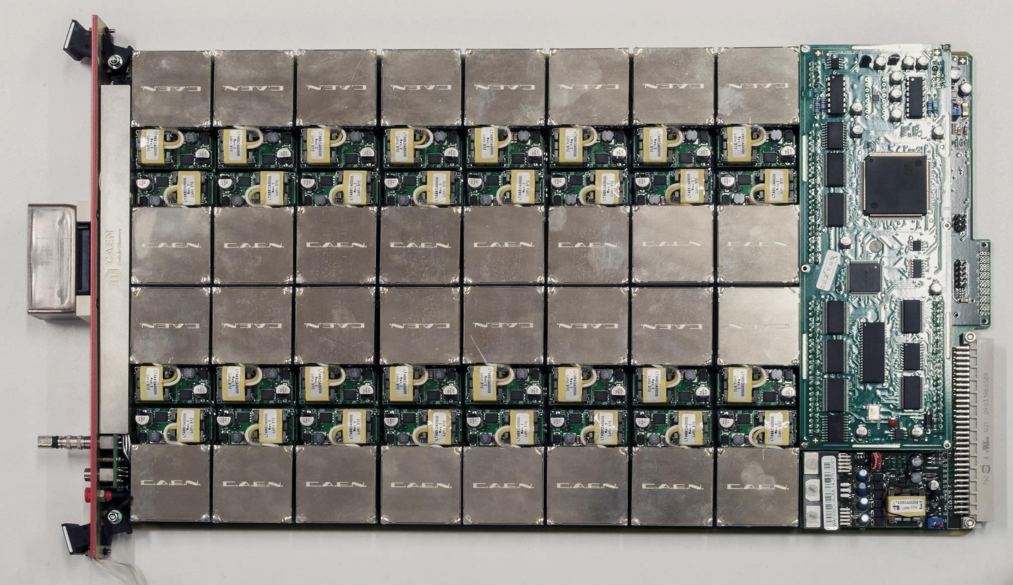
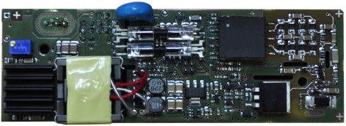

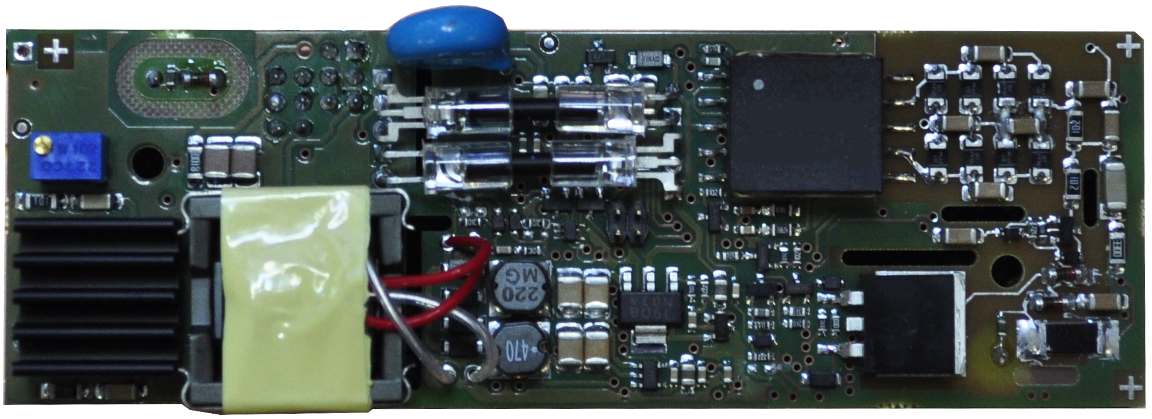
A1515TG board
Grounding: Each channel floating up to 5 kV
Voltage set: 0-1000 V
Voltage set resolution: 20 mV (20 ppm)
Voltage monitor resolution: 20 mV
Current set: 0-1 mA
Current set resolution: 20 nA (20 ppm)
Current monitor: 1 mA/100 uA dual range
Current monitor resolution: 1 nA (High range) / 100 pA (Low Range)
Ramp Up/Down: programmable from 1 V/s to 500 V/s
Voltage Ripple common mode: < 15 mV
Voltage Ripple differential mode: < 10 mV

Slide 7
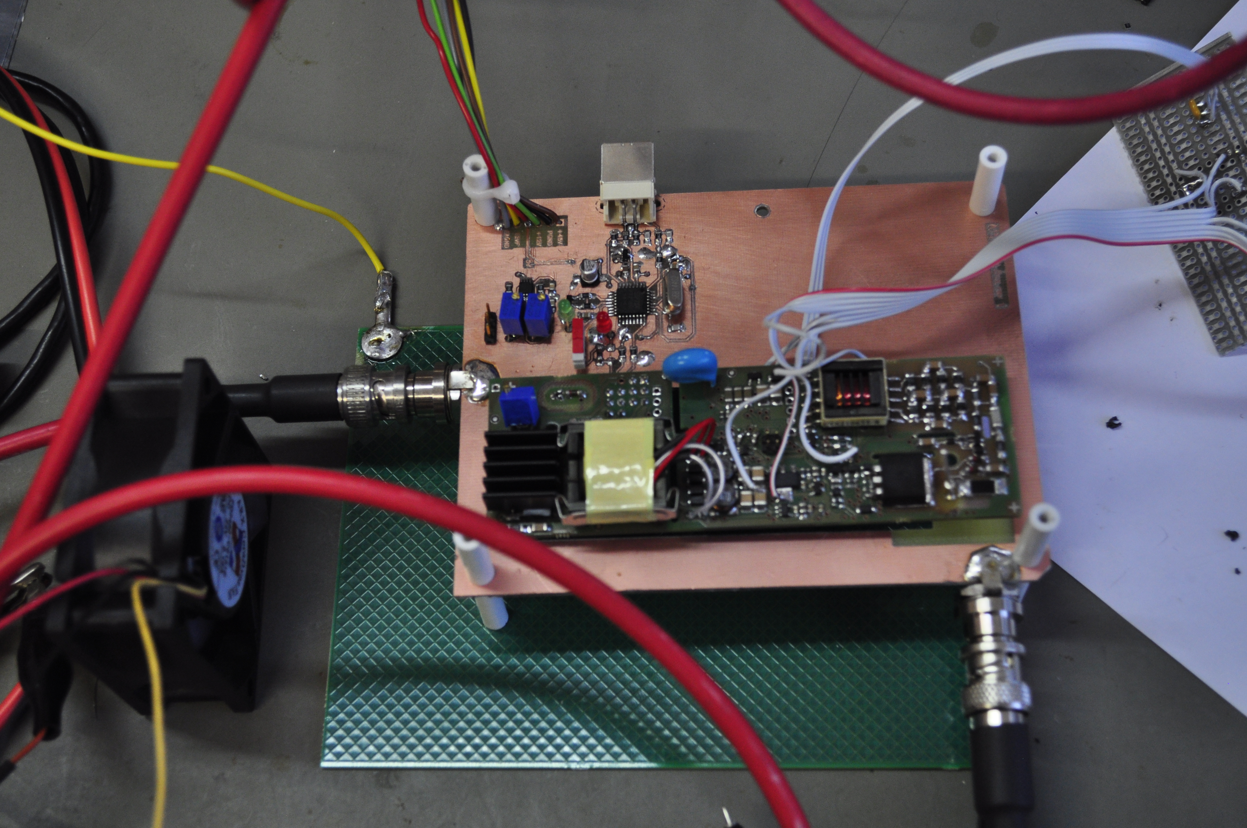
Channel test in lab.
Board clock = 312 kHz
DC-HV clock = 160 kHz
DC-HV out clock = 80 kHz
Channel Diagnostic
Optical link
Micro-Controller
V/I/T
Noise has been measured with different charges (1-5 MΩ) and at different voltages (50 – 1000 V)
Present results have shown a common mode noise of about 10 mV and a differential noise of about 6 mV (worst case in the Lab.)
Noise is at 360 kHz (board clock) with a small component (< 2-3 mV) at low frequency (10 Hz).
Feb & Apr 2015

Slide 8
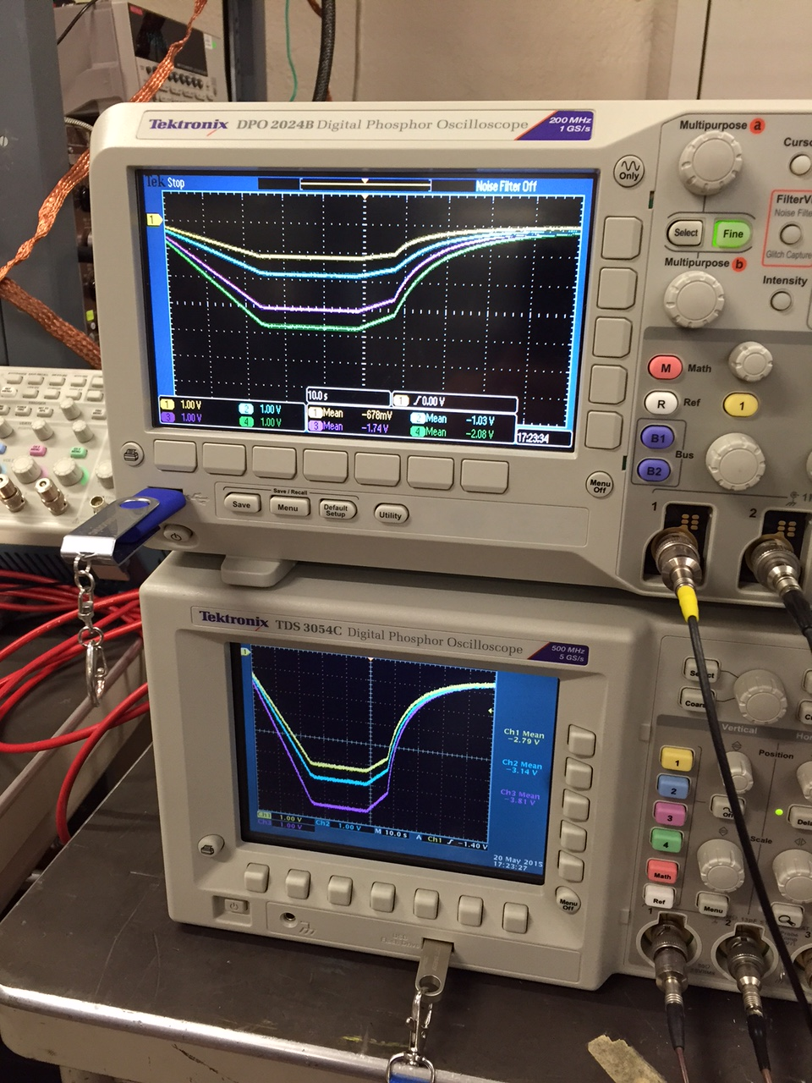
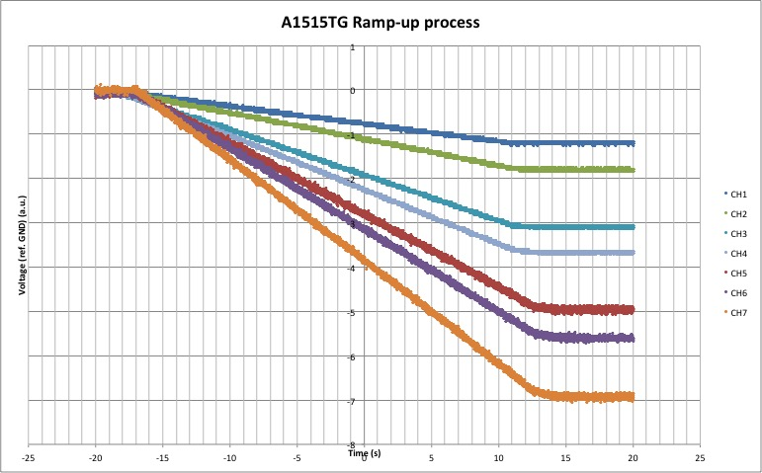
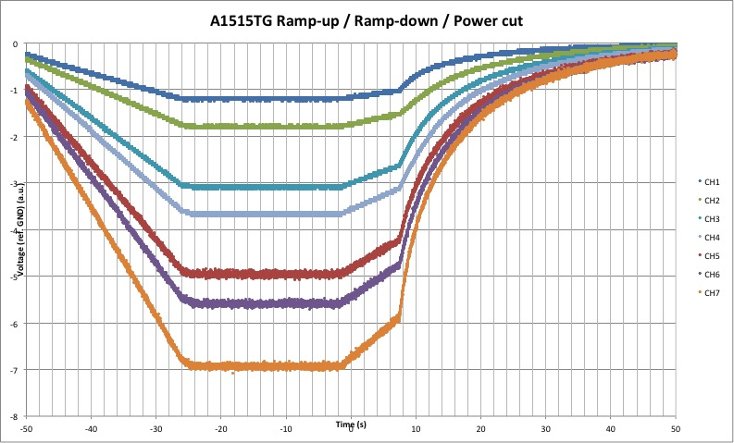
Test at RD51 (May/July 2015)
A small size triple-GEM with a without resistor partition has been tested for 3 days with RD51 experts.
What we did:
  Stability during the rump-up and rump-down
  Behavior during discharges
  Noise measurements

Slide 9
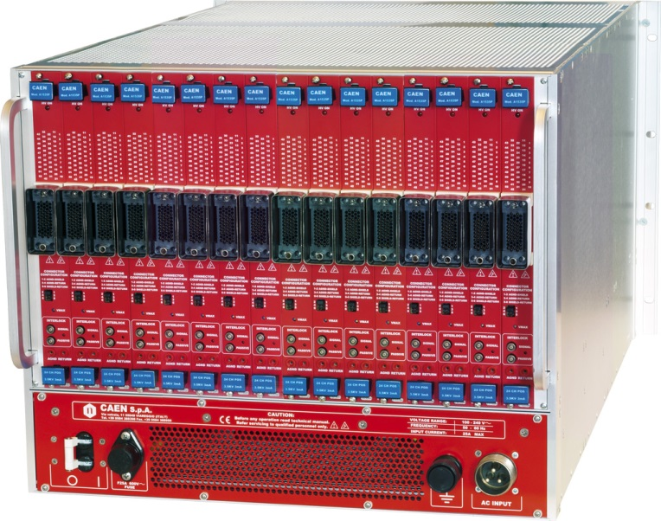
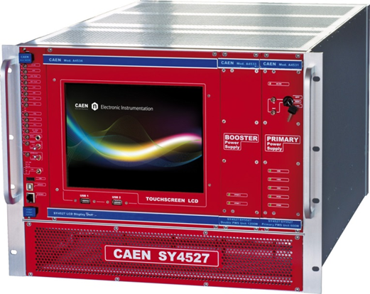
Overall Schema
GEM HV distr.
(1 to 2 or 1 to 1)
1
UXC
GEM HV distr.
(1 to 2 or 1 to 1)
n
1
GEM 1
filter
USC
7
1
GEM 2
filter
7
Mainframes and HV boards in USC
HV distributors placed in USC
  100% of the hardware is accessible
Multi-conductor cable from USC to UXC
Filter close to the chamber (if necessary)
GEM n
filter
Ethernet
Wireless
USB

Slide 10
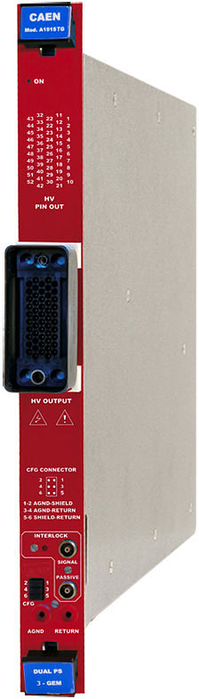
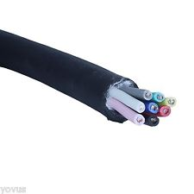
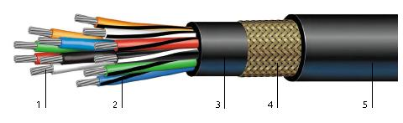
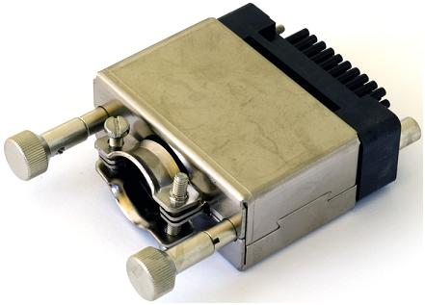
High Voltage schema for GE11
GEM
USC
UXC
GEM
Feet
Panel
1
1
52 pins
2
23 pins
8 multicondutor
16 multiconductor cable (100 mt)
15
29
30
23 pins
52 pins
Ground and Shield:
Not Connected on the board
Connected on both sides of feet panel
Connected on the chamber PP

