Slide 1
Status di EMC (forward) e richieste finaziamenti
Physics analysis
Mechanical test
Electronics
Simulation
Test beam
Richieste finanziarie
C. Cecchi Università di Perugia e INFN

Slide 2
Detector geometry working group
Open questions on the overall detector geometry
  Do we need a forward PID (eventually backward) ?
  Do we need a backward EMC ? Which is the best choice for the internal geometry of the forward EMC (dead material and energy resolution...)
  Which is the needed ammount of absorber on the IFR?
  Which is the best choice for the internal geometry of SVT / space between SVT and DCH ?
Use golden channels to answer
Br(B → Xs n n)
Br(B → Xs l l )
Br(B → t n)
S(Ks p⁰ g)
Br, ACP (B → Xs g)
b
t → m g
11/03/2009

Slide 3
Exploting Recoil Physics
In many BaBar analysis, one of the 2 B’s is reconstructed in hadronic or semileptonic modes:
High statistic and clean sample
Allow to search for rare decays with missing energy (RECOIL TECNIQUE)
  B → τν
  B → K⁽*⁾ν ν
  B → invisible
  .....
SL Breco
B→D^{(*)}lν
HAD Breco
B→D^{(*)}n₁π n₂K n₃ K_{s} n₄ π⁰
reconstruction efficiency O(10⁻³)
D^{(*)}
K*
Y(4S)
B_{sig}
B_{reco}
n
n
golden channels for
the physics program
11/03/2009

Slide 4
Perugia’s contribution
Implement the reconstruction of Hadronic B modes (Had Breco) in FastSim
Study the impact of the different PID devices (DIRC, FW TOF, BW TOF)
in the HAD Breco reconstruction
Reconstruct rare decays (B->K^{(*)}νν, B->τν) recoiling against HAD Breco
and evaluate the impact of
  PID devices
  backward EMC
  different energy resolution due to different forward EMC geometry
11/03/2009

Slide 5
Mechanical test
Some test already performed in Ancona:
    - measurement of elastic module via Laser Doppler Vibrometry (LDV), hammer with charge amplifier, non destructive test;
    - measurement of ultimate strength and of elastic module via compression test, destructive;
    E1= 131±12 GPa
    (Measured on PbWO 70 – 80 Gpa
    litterature 130 GPa)
    E2 ≈ 4 - 5 GPa
    Ultimate strength 300 – 400 MPa, one order of magnitude bigger than in PbWO, 20 – 30 Mpa, (used a different technique, test has to be redone)
11/03/2009

Slide 6
Mechanical test cont’d
Small crystals bought to perform definitive tests: delivered from St. Gobain
13 pcs, 6 in Casaccia for annealing, test will start next week.
Mechanical tests are very important for the definition of the mechanical structure, a first study has been accomplished by C. Gargiulo more is in definition.
11/03/2009

Slide 7
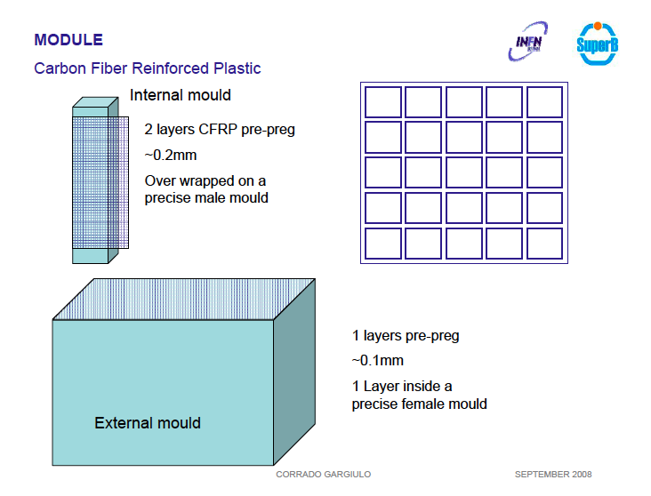

Slide 8
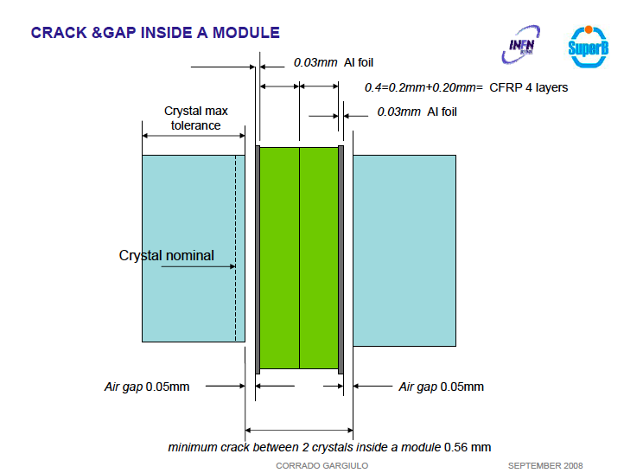

Slide 9
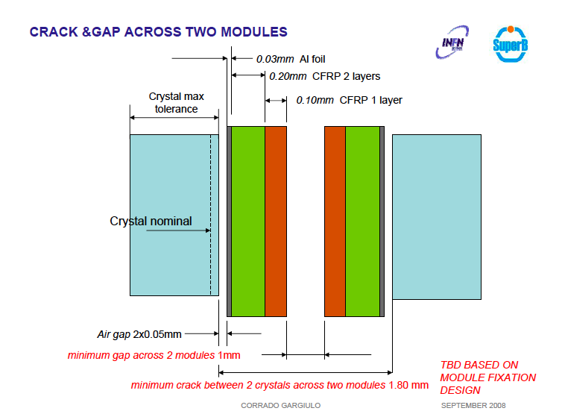

Slide 10
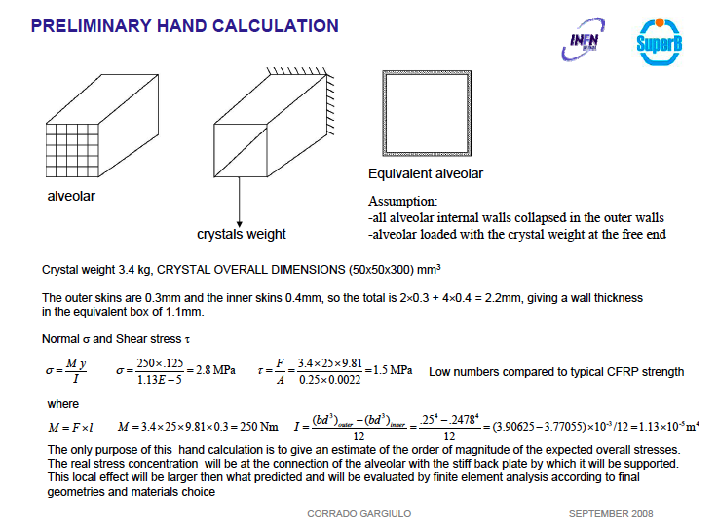

Slide 11
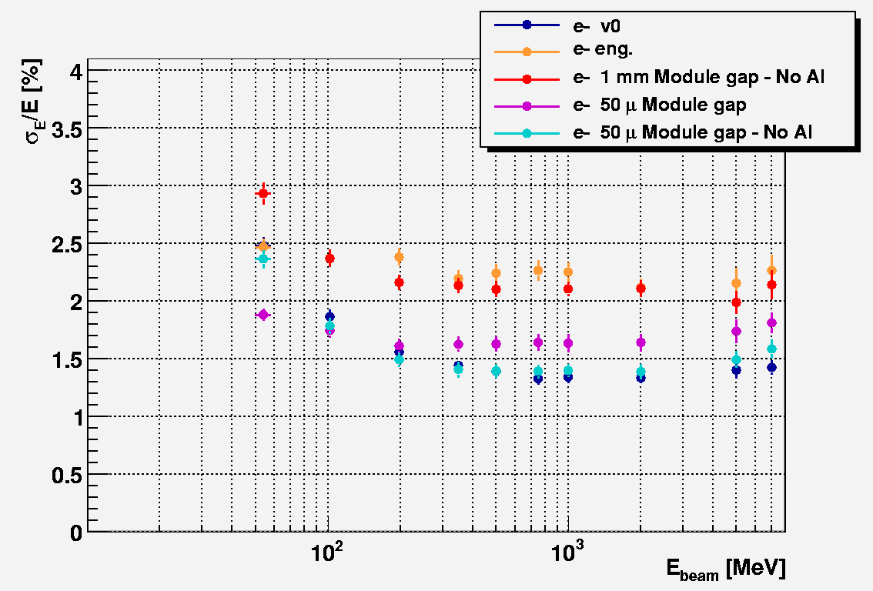
11/03/2009

Slide 12
Mechanics
More study is needed to understand the effect of the space between modules.
What about a whole structure not modular design? Not recommended by engineer ( problems of integration, handling, recovery)
Proposal from D. Hitlin maintain the Babar structure, putting inside a single hole 4 LSO crystals (dimensions of BaBar crystals are half of superB design)
What about a geometry with LSO crystals the same size of BaBar ones?
All under investigation, first point with engineer, second and third need simulations and more detailed occupancy study (related to bkg events simulation).
11/03/2009

Slide 13
Electronics
First discussion between Rome1 and Perugia has started to study all the possible solutions for the readout and the electronics.
First task readout and electronics for the BT, in parallel with the study and the design for the whole detector.
Next/first “productive” meeting to prepare a to do list and a sharing of the tasks March 23rd.
Electronics for the BT will be CMS based, 25 channels available, power supply crate not available, range ADC has to be studied (saturation around 1.5 GeV).
11/03/2009

Slide 14
Simulation
Simulation of the EMC is well established and running.
Different geometry have been investigated and others will be studied (see mechanics ad bkg studies ).
Material in front of EMC has been simulated as a total amount of radiation length.
Projective geometry is implemented in the simulation.
Standalone G4 simulation is available for the BT
Geometry of the EMC has been integrated as gdml description in the full simulation
Missing: single particle shoot + background in the full simulation to study the occupancy
(started)
11/03/2009

Slide 15
TEST BEAM
2 LSO crystals (already tested in the lab) will be tested at BTF first week of April (PMT, APD) and in June.
TB with 25 crystals:
BTF end of 2009 50 -750 MeV + tagged photons
CERN first half of 2010 up to 3.5 GeV
Procurement of crystals: 8 pcs ordered in St. Gobain in 2008 (4.9 Keuro/pc T.V.A. not included) will be produced as soon as we give them final dimensions (in discussion with D.H.) , 17 crystals missing, part from INFN part from USA.
Mechanical structure: 32Keuro assigned to Perugia in 2009
Electronics: will use CMS, plus what has to be redone/adjusted according to our needs (under study)
11/03/2009

Slide 16
Institutions involved in the EMC project
Bergen Backward EMC
Caltech Forward EMC (calibration, DG optimization, DAQ, crystals)
Perugia Forward EMC (mechanics, electronics, simulation analysis)
Roma1 Electronics Barrel + forward
Queen Mary, London

Slide 17
Perugia - people
C. Cecchi 30%
P. Lubrano 30%
E. Manoni 100%
Rossi 100 %
(S. Germani) (50%)
+ officina meccanica ed elettronica
+ ingegnere elettronico (da confermare)
3.1 FTE
11/03/2009

Slide 18
Perugia – richieste
(consumo, MI e ME vedi tabella generale Forti)
Sblocco di 59Keuro SJ (acquisto cristalli + realizzazione preamplificatori)
Lo sblocco è SJ alla partecipazione economica da parte degli USA.
In attesa di una risposta, auspicabile che arrivasse entro 30 Marzo.
Item che potrebbe prevedere una partecipazione di finanziamento con i fondi della regione per R&D. Deadline per ordine cristalli inizio Giugno.
MI: 2 riunioni italiane 3 persone
TB BTF (Aprile, Giugno, fine anno) 3 persone 1 settiman ogni TB
collaborazione con Roma
ME: workshop fisica 1 persona
general meeting SLAC 2 persone
Aprile – Giugno test 2 cristalli con PMT e APD (scheda senza circuito stampato), per Giugno sarà pronta una scheda di lettura degli APD e nuovi PD (già ordinati) su circuito stampato.
Fine anno TB con matrice 5x5
11/03/2009

Slide 19
Roma 1 – contributi
Partecipazione ad IFR (storica) ad esaurimento
  Studi di irraggiamento dei SiPM al Frascati Neutron Generator dell’ENEA
Partecipazione ad EMC (in stretta collaborazione con PG)
  Design meccanica (Ing. Meccanico)
  design elettronica barrel+endcap(Tecnologo Elettronico + officina elettronica).
    Con particolare focus sull’integrazione nel DAQ
  Setup readout ed elettronica per il TB
    Si prevede di utilizzare 25 canali di APD di CMS
      Manca crate per alimentazione e range dinamico ADC non appropriato
      Necessita’ di stabilizzare in temperatura
    In alternativa un sistema a fotodiodi andrebbe attrezzato ex-novo
11/03/2009

Slide 20
Roma1 – finanziamenti
(solo consumi come sopra)
Schede valutazione elettronica per design DAQ (Xilinx):
  Link ottici 2.5K
  ADC 2.5K
Elettronica 25 canali TB ad LNF (fine anno)
  Use pin-diodes reusing L3 pre-amps
    pin diodes for 25 channels 3KEuro
    Schedine per preamp 3KEuro
  Varie TB: meccanica e guide di luce 3KEuro
11/03/2009

