Slide 1

Accelerators and Experiments for the Future Energy Frontier
Brian Foster (Uni Hamburg/DESY/Oxford)
LFC17
ECT* Trento
September 11th, 2017

Slide 2
Outline
Overview of ideas for future facilities
  Hadron-hadron machines – LHC (& beyond)
  Lepton-lepton Machines
    e⁺e⁻ - linear, circular; μ⁺μ⁻
  Lepton-hadron (-ion) machines
  Plasma-wave acceleration
Summary

Slide 3
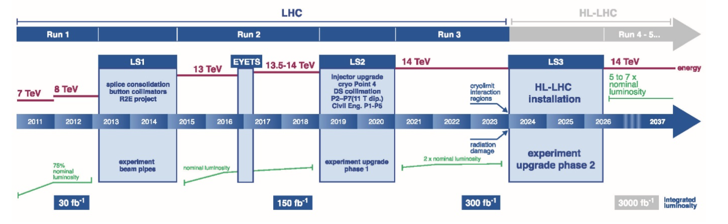
LHC Schedule
LS2 (2019-2020):
LHC Injectors Upgrade (LIU)
Phase-1 upgrade of LHC experiments
LS3 (2024-2026):
HL-LHC installation
Phase-2 upgrade of ATLAS and CMS

Slide 4
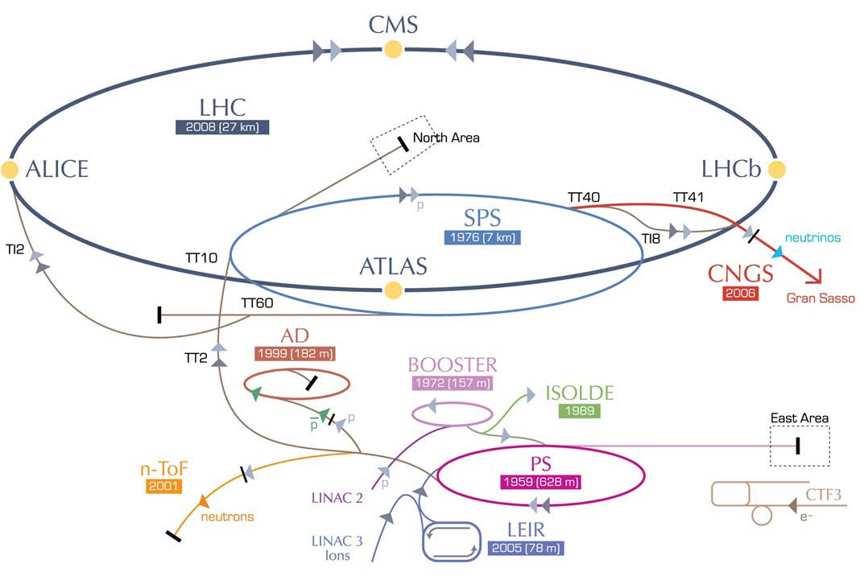
High Energy LHC
HE-LHC 33TeV
>2035
SPS+,
1.3 TeV, >2035
2-GeV Booster
Linac4

Slide 5

FCC Overview
FCC-hh hadron collider with 100TeV proton cms energy
FCC-ee a lepton collider as a potential intermediate step
FCC-eh lepton hadron option
International collaboration
Site studies for Geneva area
CDR for EU strategy update in ~ 2019
~16 T ⇒ 100 TeV pp in 100 km
~20 T ⇒ 100 TeV pp in 80 km
(FCC slides thanks to D.Schulte.)

Slide 6
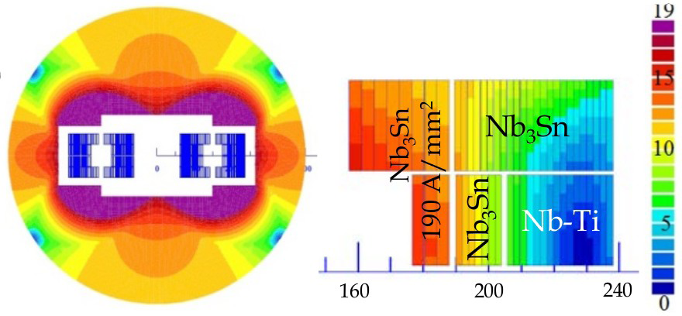
FCC Magnets
Arc dipoles are the main cost and parameter driver
Baseline is Nb₃Sn at 16T
HTS at 20T also to be studied as alternative
Coil sketch of a 15 T magnet with grading, E. Todesco
Field level is a challenge but many additional questions:
Aperture
Field quality
Different design choices (e.g. slanted solenoids) should be explored
Goal is to develop prototypes in all regions, US has world-leading expertise
Machine protection major issue – stored energy 24 times bigger than LHC > 8 GJ/ beam. Small losses can quench magnets & activate entire machine. Backgrounds into experiments acceptable from single beams?
Notes:
LHC magnets are 8.3 T

Slide 7
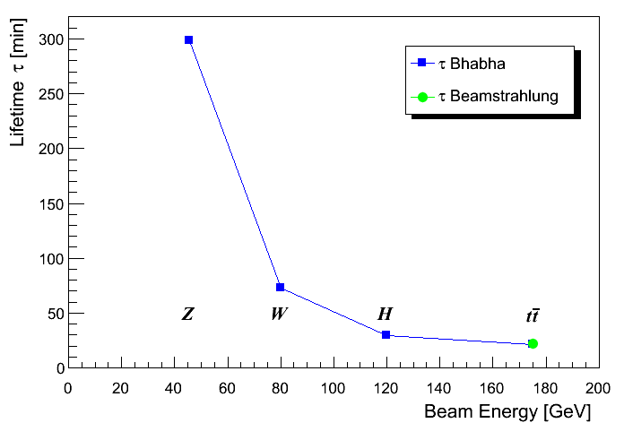
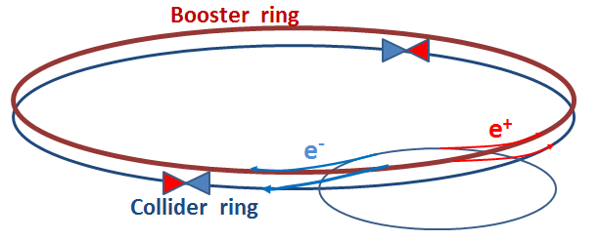
FCC-ee Luminosity Lifetime
Large particle energy loss in IPs and limited energy acceptance (2%) cause limited lifetime
Radiative Bhabha scattering is proportional to luminosity
Beamstrahlung as in linear colliders
Beam dynamics not solved in detail.
n_{ip} = 4
Need continuous injection (top-up)
Notes:
Next turn to CPC!

Slide 8
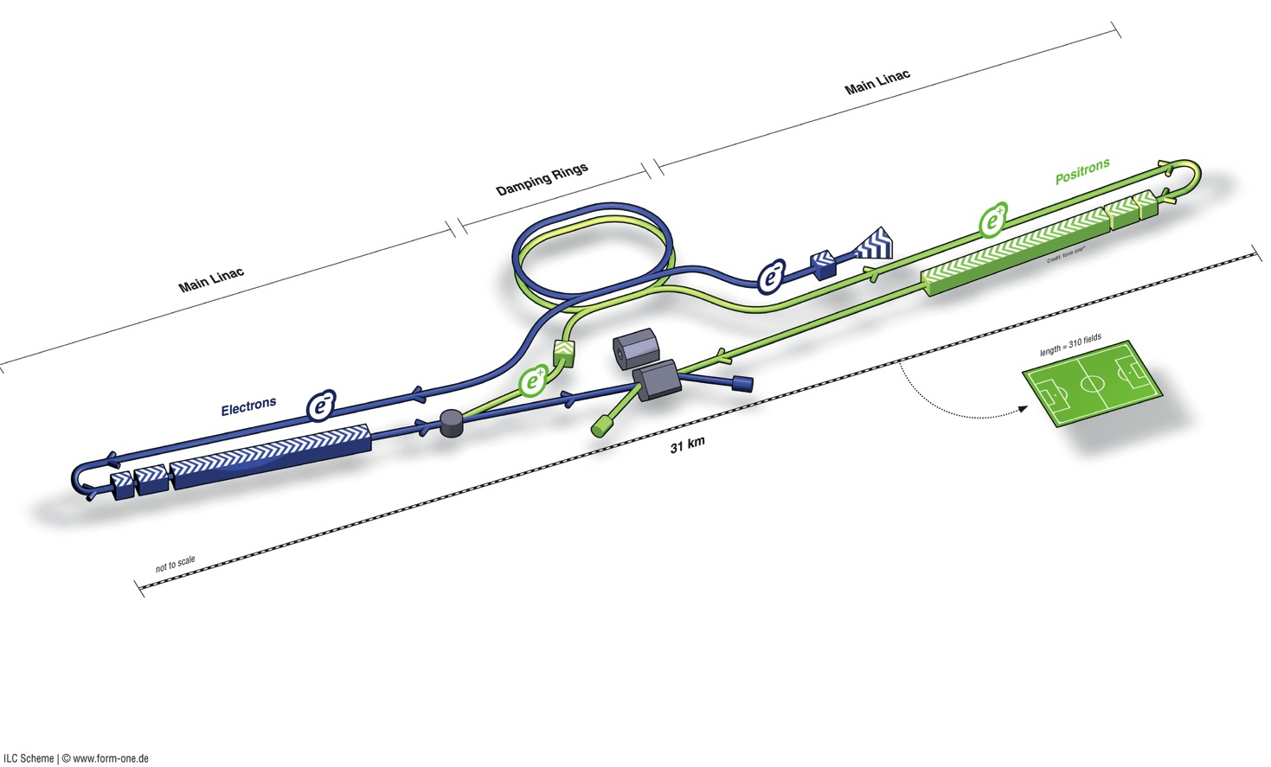
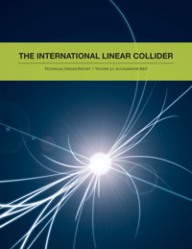
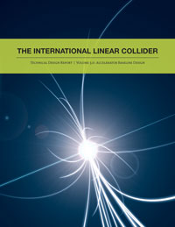
ILC Overview
Polarised electron source
Damping Rings
Ring to Main Linac (RTML)
(inc. bunch compressors)
e+ Main Linac
Beam Delivery System (BDS) & physics detectors
Polarised positron
source
Beam dump
e- Main Linac
not to scale

Slide 9
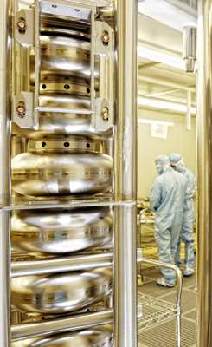
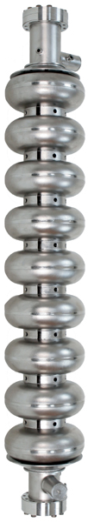
SCRF Linac Technology
solid niobium
standing wave
9 cells
operated at 2K (Lqd. He)
35 MV/m
Q₀ ≥ 10¹⁰
1.3 GHz Nb 9-cell Cavities | 16,024
Cryomodules | 1,855
SC quadrupole package | 673
10 MW MB Klystrons & modulators | 436 / 471*
* site dependent
Approximately 20 years of R&D
Worldwide → Mature technology

Slide 10
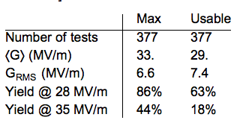
Industrial production - XFEL
One vendor following ILC baseline recipe
TDR
acceptance
Field emission
Limit (XFEL spec.)
Quench (or power)
limit
require retreatment
status:01.06.2016
(Thanks to Nick Walker)

Slide 11
CLIC

Slide 12
CLIC Accelerating Structures
CLIC acceleration travelling wave – too high Ohmic losses from standing wave
Bunches induce wakefields in the accelerating cavities
Later bunches are perturbed by these fields
Can lead to emittance growth and instabilities
Effect depends on a/λ (a iris aperture) and structure design details
Transverse wakefields roughly scale as W┴ ∝ f ³
Long-range minimised by structure design

Slide 13
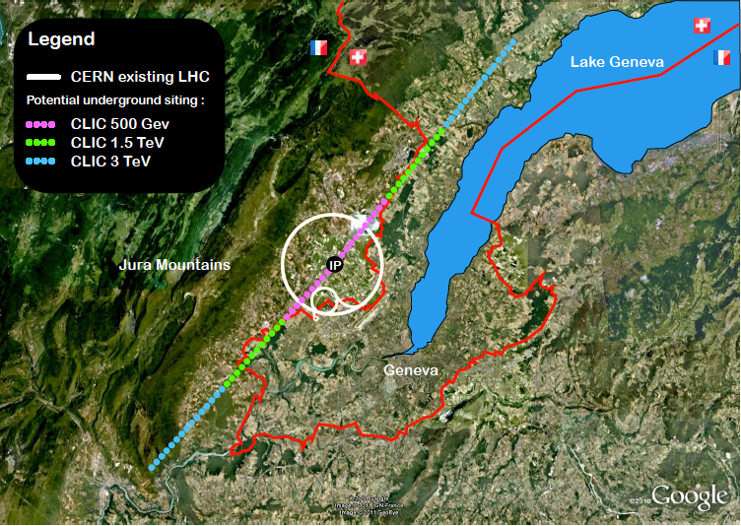
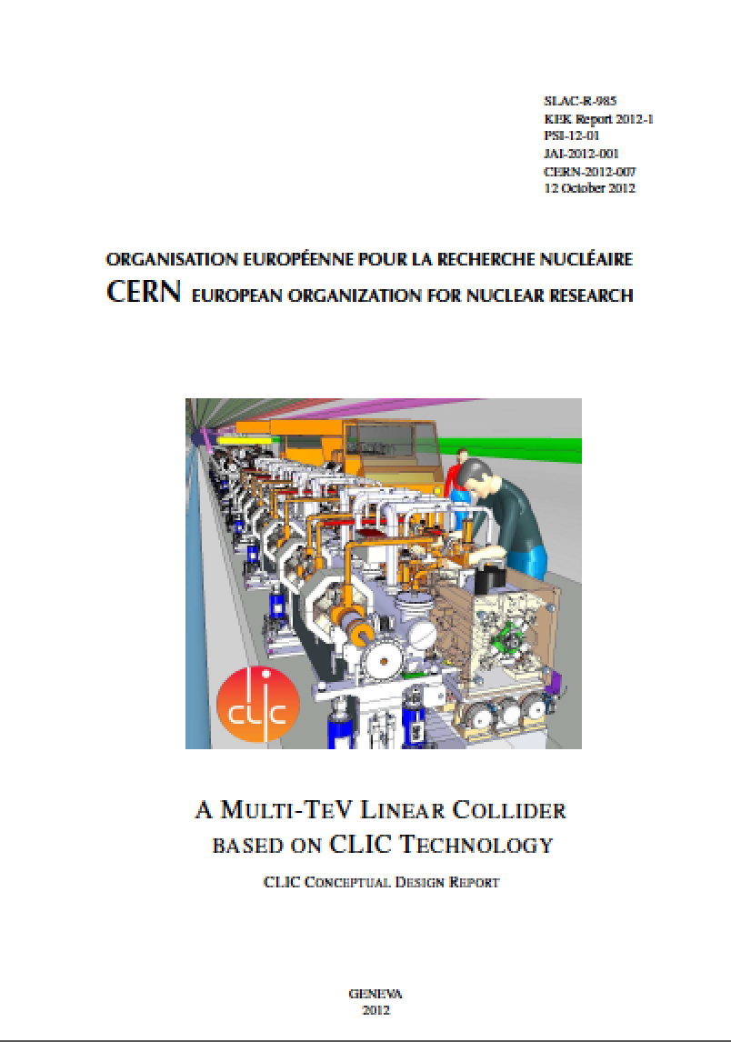

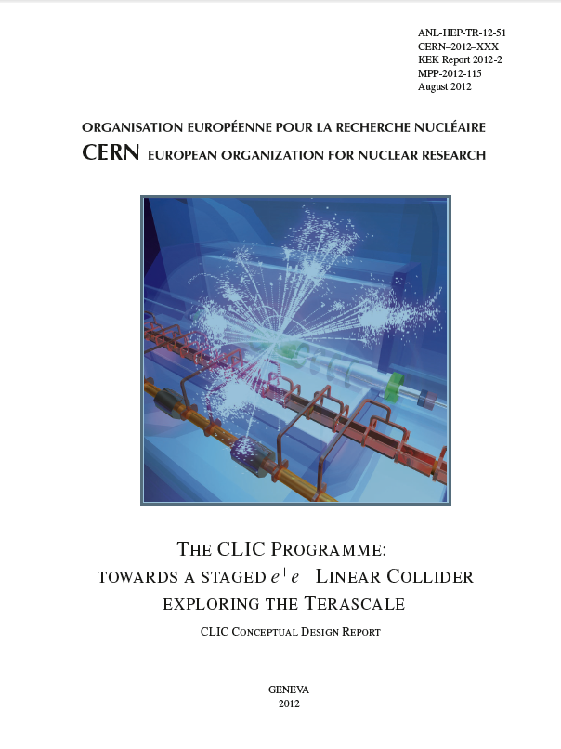
Current status
Luminosity
Luminosity
Damping ring like an ambitious light source, no show stopper
Alignment system principle demonstrated
Stabilisation system developed, benchmarked, better system in pipeline
Damping ring like an ambitious light source, no show stopper
Alignment system principle demonstrated
Stabilisation system developed, benchmarked, better system in pipeline
Simulations on or close to the target
Conceptual design complete
Operation &
Machine Protection
Start-up sequence and low energy operation defined
Most critical failure studied and first reliability studies
Implementation
Consistent staged implementation scenario defined
Schedules, cost and power developed and presented
Site and CE studies documented
Design optimisation for 350 GeV machine input for next European Strategy

Slide 14
Circular e⁺e⁻ machines
Very approximate cost
LC vs circular based on
minimum of cost model
Cost = aE⁴/R + bR
where a,b “fixed” from
LEP – two curves are
most optimistic and
pessimistic LEP cost.
BUT – luminosity of
circular machine in
this picture dropping
steeply with E.
N. Walker & BF
LEP scaling
ILC RDR (~ CLIC)

Slide 15
Circular e⁺e⁻ machines

Slide 16
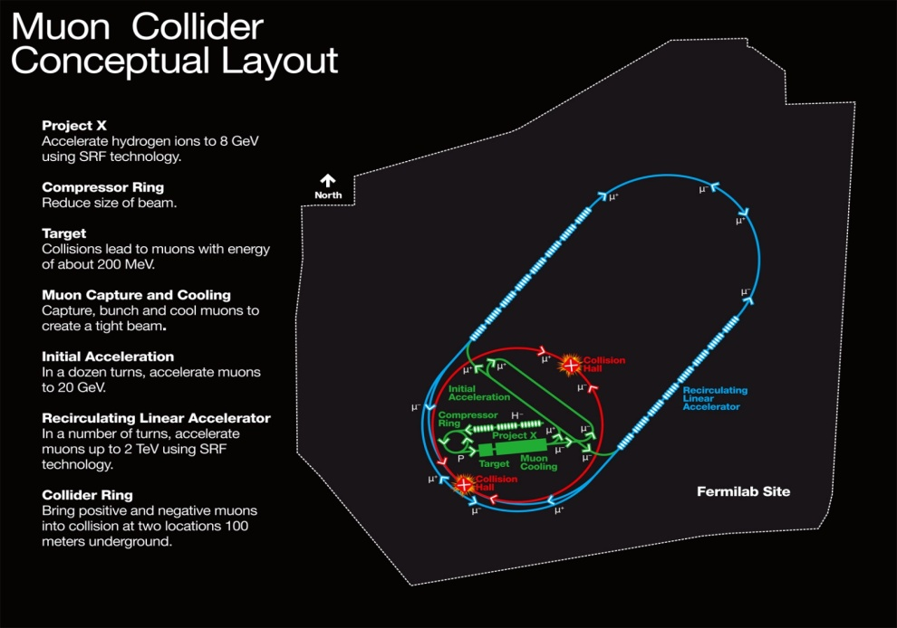
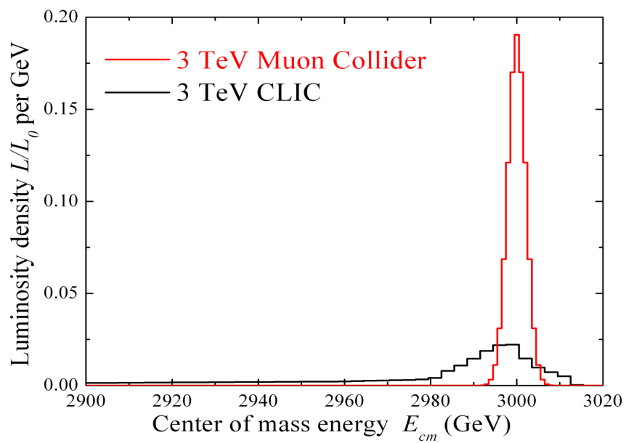
Muon Collider
COMPACT
  Fits on FNAL laboratory site
MULTI-PASS ACCELERATION
  Cost Effective
MULTIPASS COLLISIONS IN
A RING (~1000 turns)
  Relaxed emittance requirements
  & hence relaxed tolerances
NARROW ENERGY SPREAD
  Precision scans, kinematic constraints
TWO DETECTORS (2 IPs)
- ΔT_{bunch} ~ 10 μs … (e.g. 4 TeV collider)
  Lots of time for readout
  Backgrounds don’t pile up
(m_{μ}/m_{e})² = ~40000
  Enhanced s-channel rates for
  Higgs-like particles
COST
PHYSICS
Beamstrahlung in
any e+e- collider
δE/E ∝ γ²

Slide 17
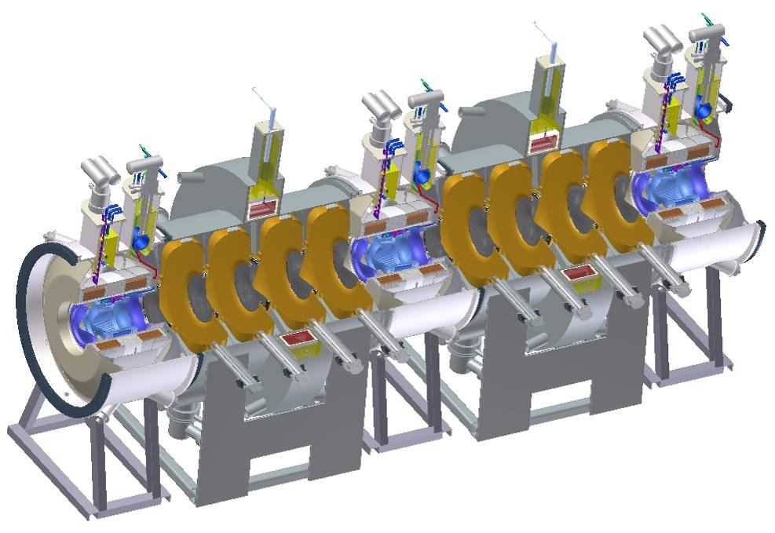
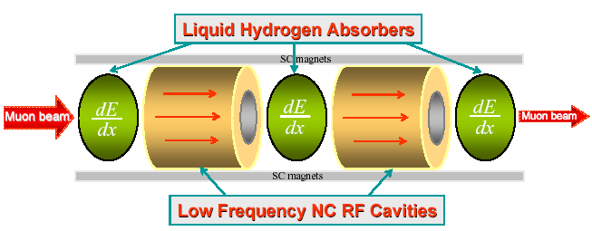
Muon Collider Cooling
Ionization cooling analogous to familiar SR damping process in electron storage rings
  energy loss (SR or dE/ds) reduces p_{x}, p_{y}, p_{z}
  energy gain (RF cavities) restores only p_{z}
  repeating this reduces p_{x,y}/p_{z} (⇒ 4D cooling)
MICE

Slide 18

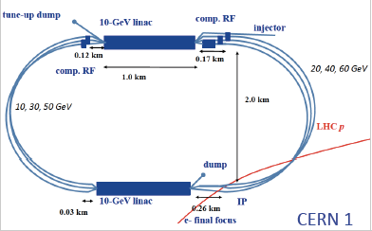
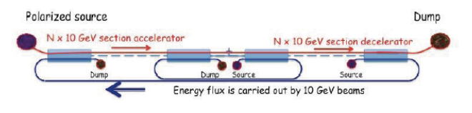
LHeC (FCC-eh) Linac
Option
THREE-PASS ERL
LHeC workshop
Started tody
Circum. ~ 9 km
Future 150 GeV e ERL linac

Slide 19
Electron-Ion Collider

Slide 20
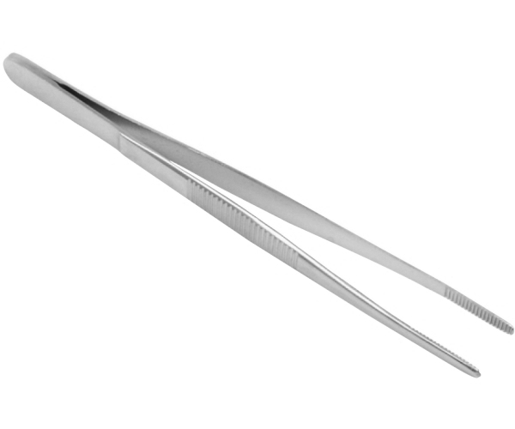
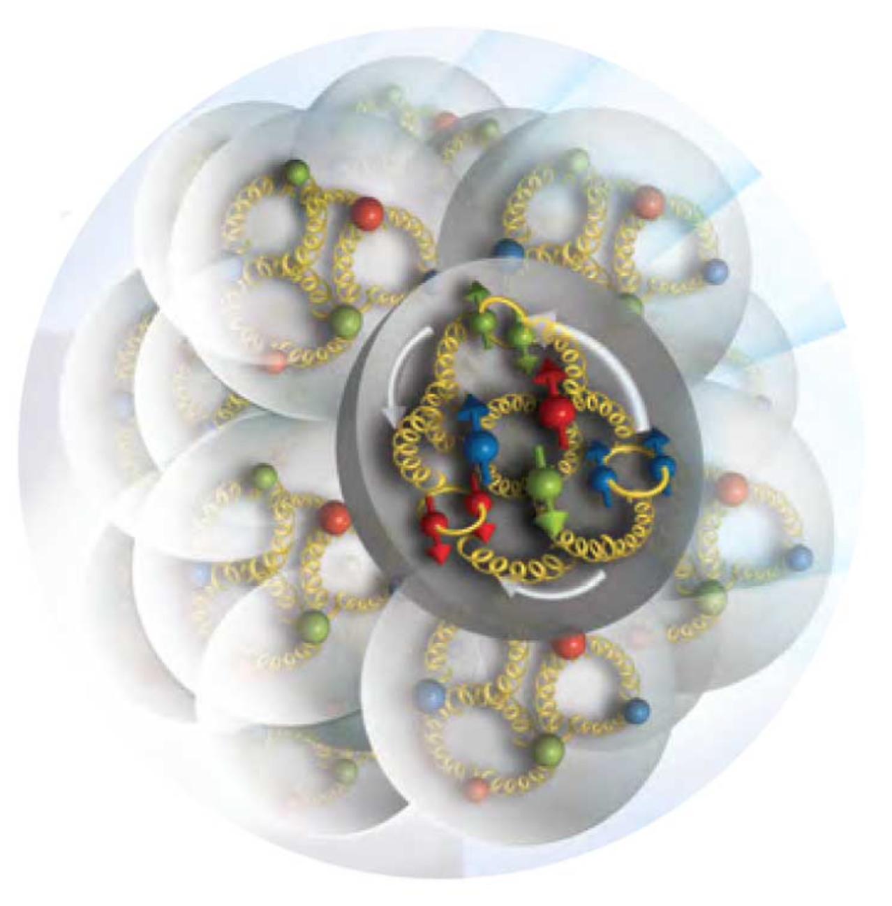
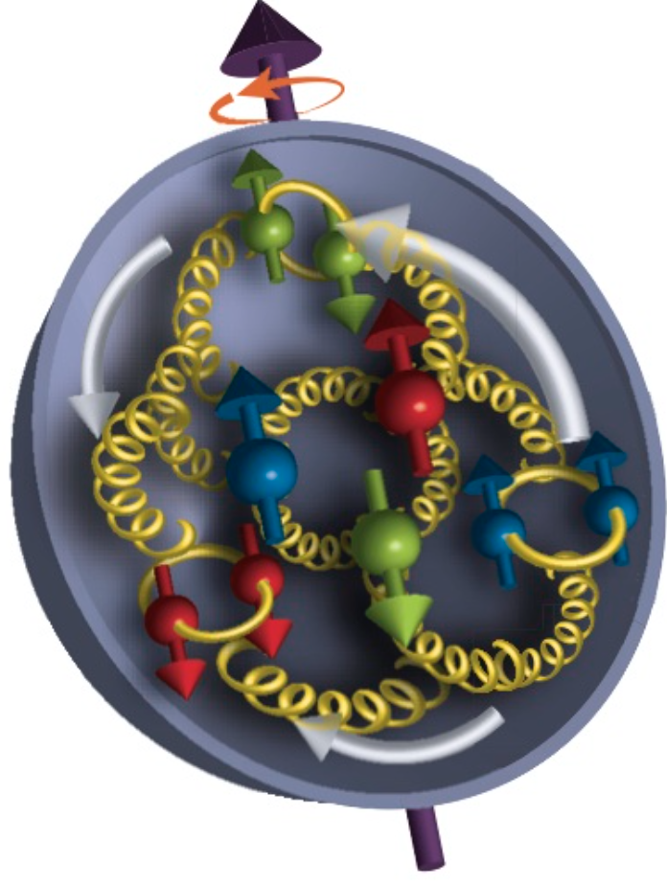
Electron-Ion Collider
Program aim: Revolutionize the understanding of nucleon and nuclear structure and associated dynamics. Explore new states of QCD.
small fraction of a fm
Programme
Probe the nucleon in the many-body regime (down to x ≈ 0.005) at large Q²
Probe the nuclei in the N-N and multi-N interaction regime at large Q²
Extend our understanding of QCD (saturation, jets in cold nuclear matter)

Slide 21
Cavities accelerate particles via EM standing waves
RF Cavity
20 – 40
MV/m
10 – 1000
GV/m
Plasma
wakefield
Enables “table-top”
Accelerators & promises major reduction in pp collider length/cost

Slide 22
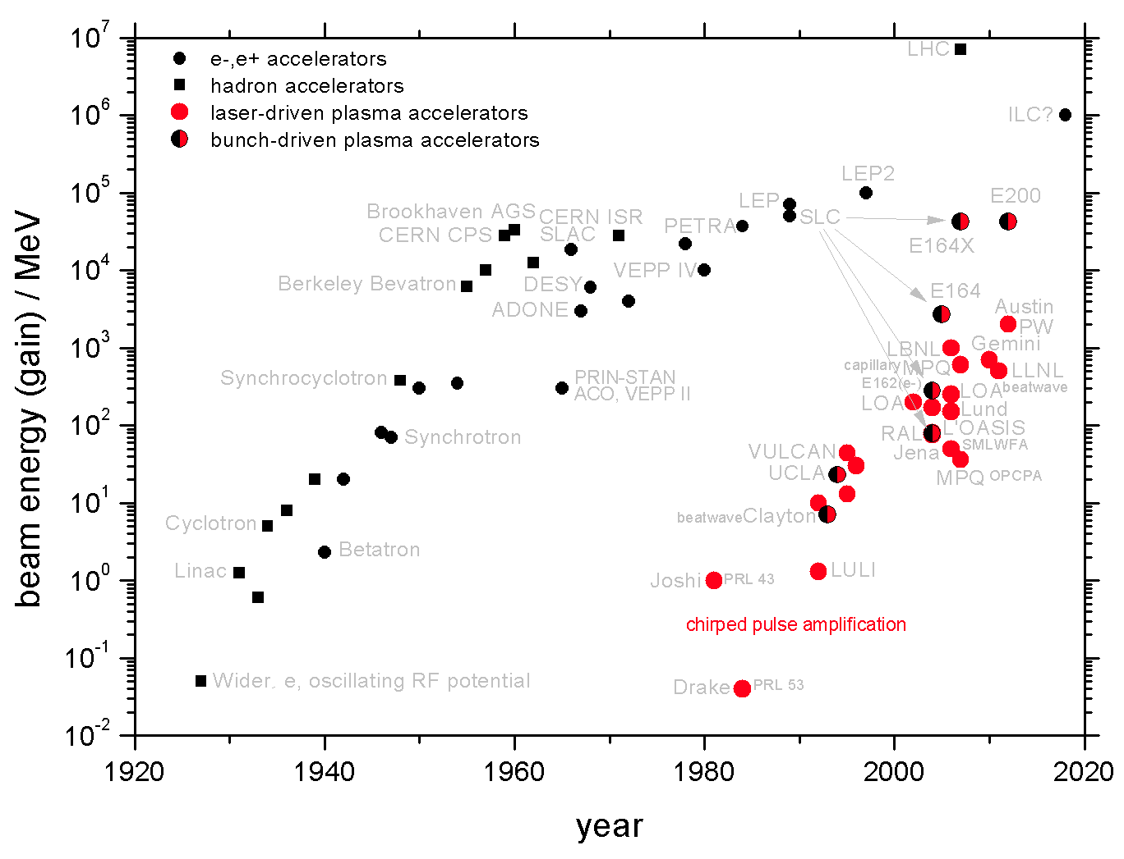
The New Livingston Plot
B. Hidding (Strathclyde/Hamburg)

Slide 23
Beam-driven PWFA LC?
D. SCHULTE

Slide 24
Proton Drivers
The problem with both LWFA and PWFA is point-like
nature of pp processes requires high lumi = power.
BUT PW laser like BELLA has typically 40J/pulse and
wall-plug efficiency << 1%.
Electron PWFA facilities like FACET have 30J/bunch
Accelerating 10¹⁰ (ILC bunch size) particles to 1 TeV
needs a few kJ.
SPS bunch has 20kJ/bunch; LHC has 300 kJ/bunch
So either multi-accelerating stages for LWFA/PWFA
or use proton bunches. Staging difficult/not yet done.
Use p machines? Long bunch length – 10s of cm.
(Thanks to A. Caldwell)

Slide 25
Proton Drivers
Induced electric field goes like
Fortunately, for once, Nature is on our side:
Passing a proton bunch through a plasma generates
instabilities which causes the bunch to naturally form
microbunches which have separation = plasma
wavelength.
This not only produces bunches of the right size but
also produces a resonance effect in accelerating
electrons. There are lots of subtleties that make life
difficult, but it might just work….

Slide 26
AWAKE

Slide 27
AWAKE
Plasma source 10m long, 4cm diameter
Density 10¹⁴ – 10¹⁵cm⁻³
Results from Dec. 2016 run
Optical Transition Radiation from
beam viewed with streak camera.
Clear observation of microbunching.

Slide 28
Detectors

Slide 29
Detector R&D
(Thanks to E. Sicking – TIPP17 proceedings)

Slide 30
AWAKE Detector
E_{e} = 3 TeV, E_{p} = 7 TeV => √ s = 9 TeV
Can vary electron beam energy, Ee = 0.1 – 5 TeV ⟹ √s = 1.7 – 11.8 TeV
• Electron beams, but possibility of positron beams
• Possibility of polarisation
• Integrated luminosity of 10 - 1000 pb−1
• Also electron–ion (e.g. electron–lead) collisions
(Thanks to M. WIng)

Slide 31
AWAKE Kinematics
E_{e} = 3 TeV, E_{p} = 7 TeV => s = 9 TeV
(Thanks to M. WIng)

Slide 32
Summary and Outlook
Recently, great upsurge of interest in new large rings, aimed at ~ 100 TeV pp but with possibility of initial e⁺e⁻
ILC – technically mature but expensive. 250 GeV Higgs factory?
CLIC – significant development required – < 1 TeV, cost ~ ILC
Circular e⁺e⁻ – Higgs factory cheaper than LC – but not trivial
accl. physics & no energy-upgrade path…
μC – It’s a great idea but don’t hold your breath….
LHeC/FCC-eh – technically “OK” once protons there. Could use
p-driven PWA (AWAKE@CERN). Cost/physics?
EIC – attractive idea for looking at new QCD phase space, etc.
PWA – very exciting, but long way from a LC for particle physics
In the immediate future, Japanese interest in hosting ILC is being discussed. A strong physics case exists, irrespective of LHC results. Decision on 250 GeV machine within ~ 1.5 years.

Slide 33
Backup slides

Slide 34
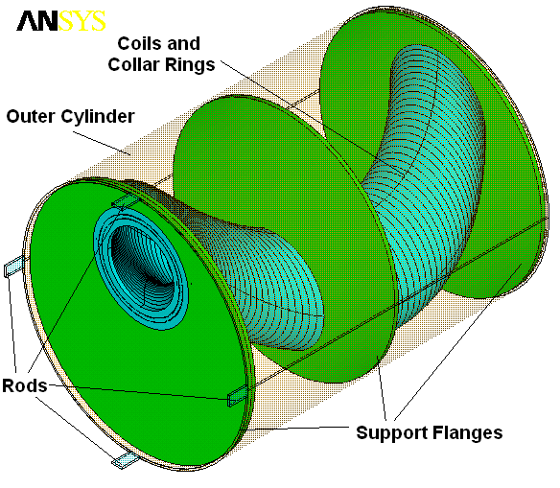
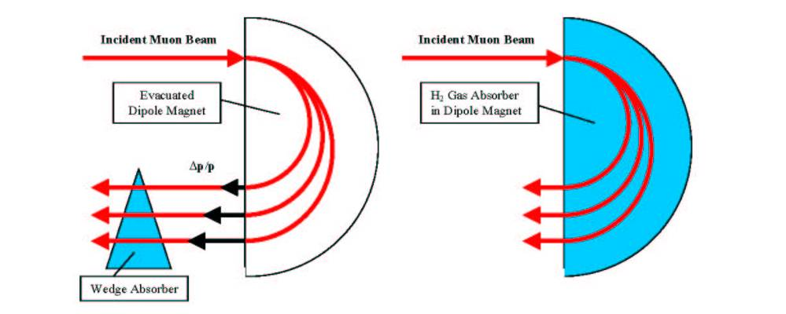

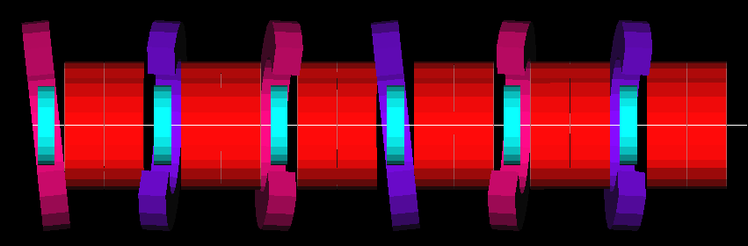
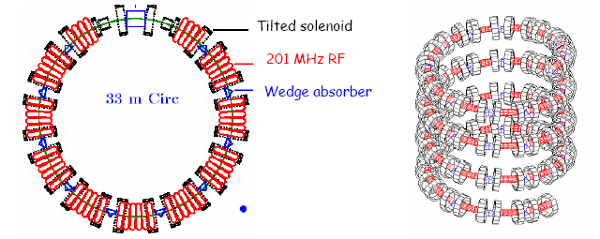
Muon Collider Cooling
Need 6D cooling (emittance exchange)
  increase energy loss for high-energy compared with low-energy muons
    put wedge-shaped absorber in dispersive region
    use extra path length in continuous absorber
HCC
FOFO Snake
Cooling ring
Single pass; avoids injection/extraction issues
“Guggenheim” channel

Slide 35
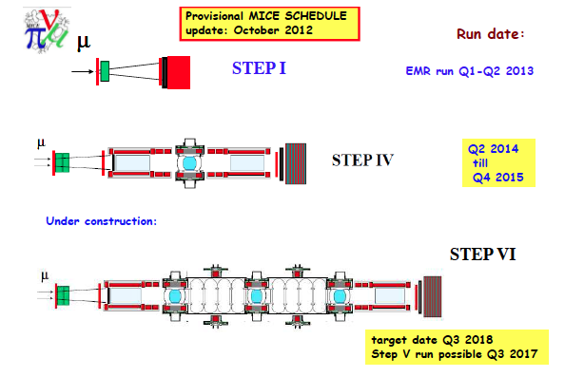
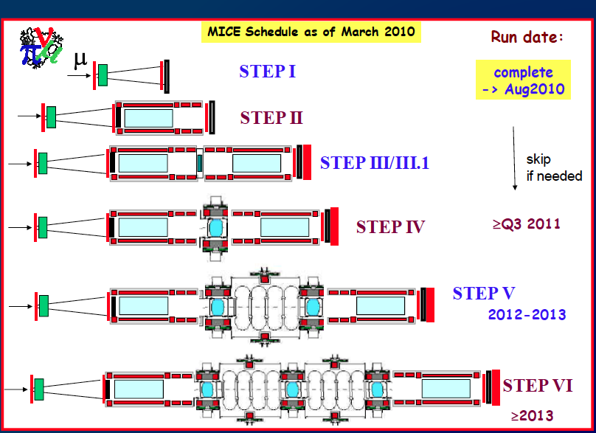
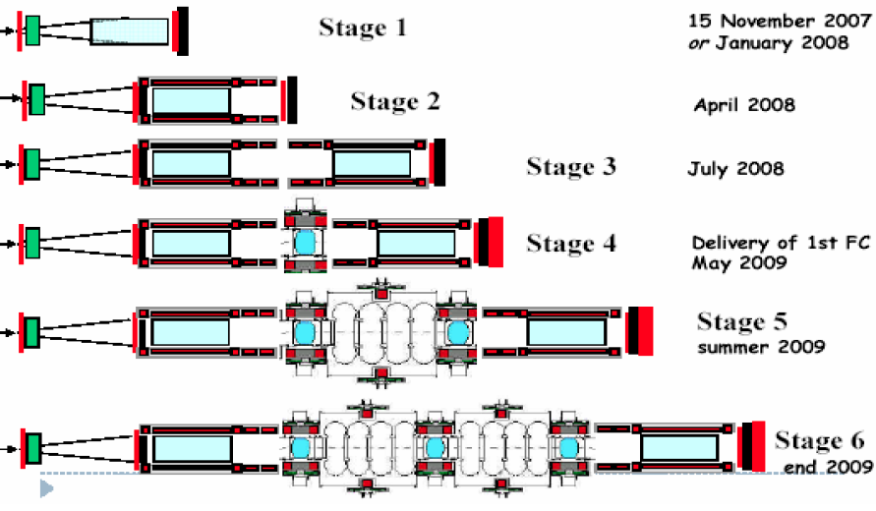

MICE Schedule
Provisional MICE SCHEDULE
update: November 2014
μ
Run date:
STEP I
EMR run Oct 2013
Q3 2015
to Q3 2016
STEP IV
Under construction:
STEP 3π/2
Target date Q1 2017
Run complete Q2 2017

Slide 36
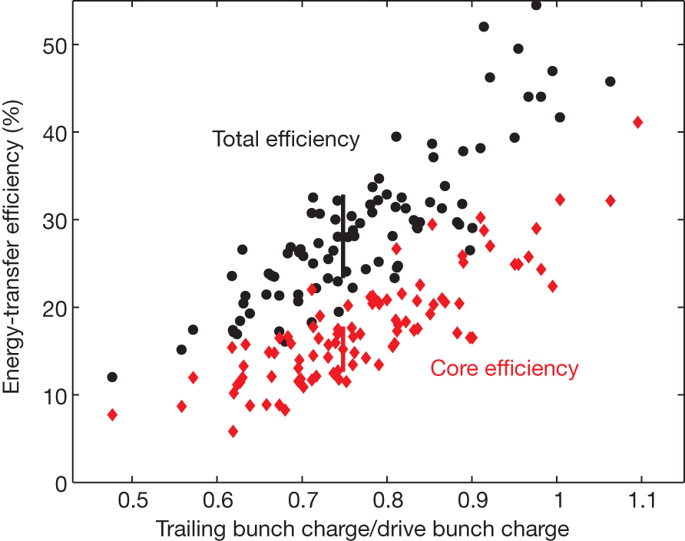
Inject beam
To understand acceleration in plasma, inject high-quality beam
into plasma – requires excellent time and spatial precision..
Litos et al., Nature 515, 92-95 (06.11.2014)
Notes:
Electron bunch length must be small fraction of the plasma wavelength – otherwise energy spread too large; and jitter small fraction of inverse plasma frequency.
Some facilities under development at DESY have the right properties – PITZ – and FLASHForward could be an ideal research instrument.

Slide 37
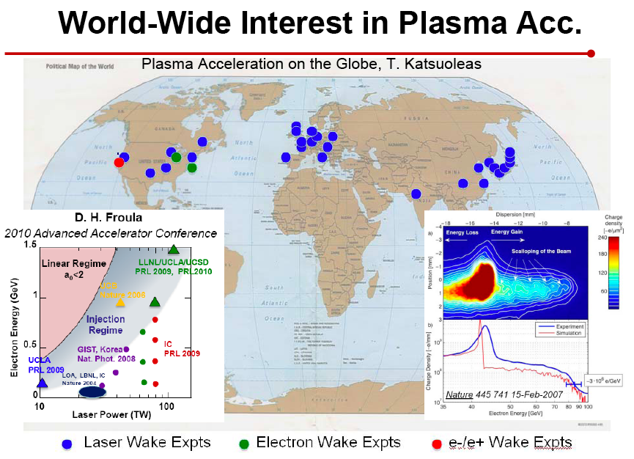
World-wide acceleration
Enormous growth in activity world-wide –
interesting experiments can be done at
Universities but most activity at accelerator
labs.
LAOLA:
Helmholtz VI,
ELI, FLASH,
PITZ, REGAE
BELLA
FACET, FACET2
Proton driven
Notes:
Electron bunch length must be small fraction of the plasma wavelength – otherwise energy spread too large; and jitter small fraction of inverse plasma frequency.
Some facilities under development at DESY have the right properties – PITZ – and FLASH II could be an ideal research instrument.

Slide 38
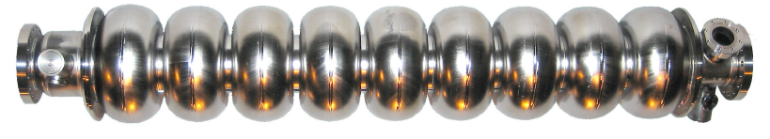
Plasma
Wake-Field Acceleration
Development of much higher gradient
accelerator not only pushes back frontier for
particle physics – also permits current
accelerators to be built much smaller/cheaper.
1 GeV electron beams on “table top”.
Leemans et al., Nature Physics 2, 696 (2006)
Notes:
Contrast with conventional cavities….
Work at Lawrence Berkeley Laboratory. 40 TW laser pulse (3 * 10 18 W/cm2) – 1 GeV in 3.3 cm
produced 33 GV/m fields. Beam quality lousy! Florian is at forefront of this table top infra-red FELs.

Slide 39
Site-specific work plan
2014 |  | 2015 |  | 2016 |  | 2017 |  | 2018
Planning
Basic Design
Detailed Design
Tendering
Cost Estimate
Geological Survey
Basic Survey
Detailed Survey
Additional.
Topographical Survey
Basic
Detailed
Construction works
Land Acquisition
Compensation
Site Decision
Land Negotiation
Acquisition
Environmental Impact Study
Preparation
Environmental Impact Survey
Permission
2014 |  | 2015 |  | 2016 |  | 2017 |  | 2018

Slide 40
Access Tunnel ex.
Beam Tunnel excavation
BDS Tunnel excavation
Survey & supports set-out
Concrete Lining
BDS Service Tunnel excavation
Electrical general services
Cavern ex.
Invert & Drainage
Piping & ventilation
Hall ex.
Shield Wall
Cabling
Supports
Machine installation
AH-4
AH-3
AH-2
AH-1
AH+1
AH+2
AH+3
AH+4
RTML
(1.35km)
e- Main Linac
(11.19km)
e-BDS
(3.33km)
e+BDS
(2.25km)
e+ Main Linac
(11.07km)
RTML
(1.35km)
1
2
3
4
5
61.9
61.9
62.0
60.3
61.9
61.9
6
7
120m/week
8
250m/week
9
100m/week
10
40

Slide 41
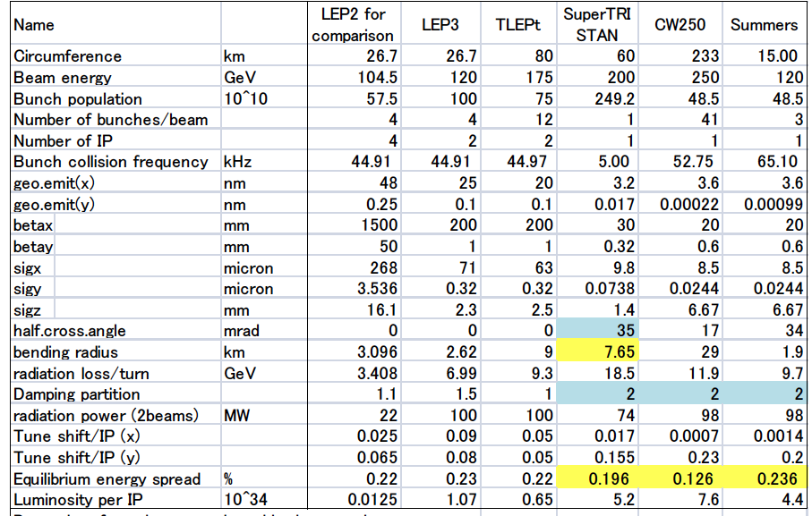
Ring collider parameters

Slide 42
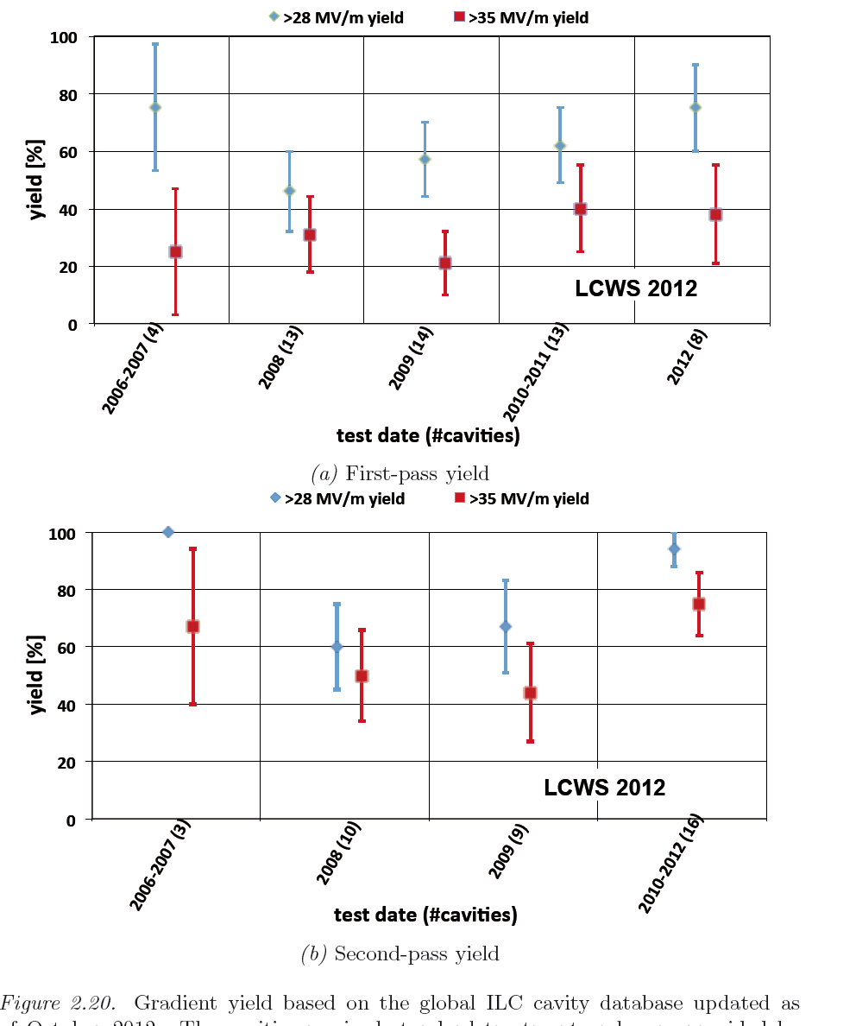
SCRF Linac Technology

Slide 43
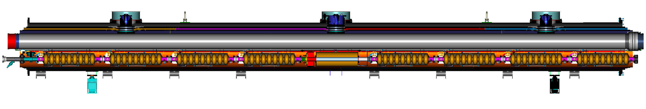
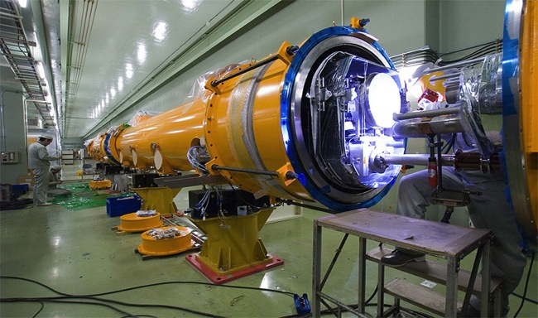
Cryomodule
Type-B module
Type-A has 9 cavities and no quadrupole
cavities (8)
SC quad package
12.652 m (slot length)

Slide 44
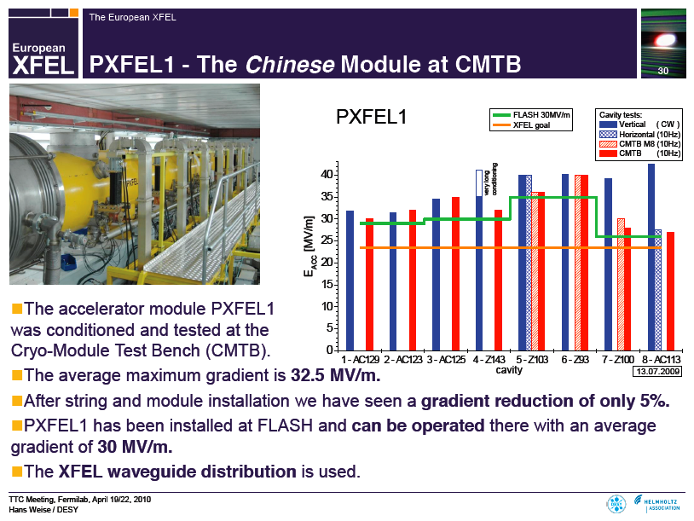
Cryomodule at FLASH

Slide 45
FLASH Achievements
High beam power and long bunch-trains (Sept 2009)
Metric | ILC Goal | Achieved
Macro-pulse current | 9mA | 9mA
Bunches per pulse | 2400 x 3nC (3MHz) | 1800 x 3nC 2400 x 2nC
Cavities operating at high gradients, close to quench | 31.5MV/m +/-20% | 4 cavities > 30MV/m
Gradient operating margins (Feb 2012)
Metric | ILC Goal | Achieved
Cavity gradient flatness (all cavities in vector sum) | 2% ΔV/V (800μs, 5.8mA) (800μs, 9mA) | <0.3% ΔV/V (800μs, 4.5mA) First tests of automation for Pk/Ql control
Gradient operating margin | All cavities operating within 3% of quench limits | Some cavities within ~5% of quench (800us, 4.5mA) First tests of operations strategies for gradients close to quench
Energy Stability | 0.1% rms at 250GeV | <0.15% p-p (0.4ms) <0.02% rms (5Hz)

Slide 46
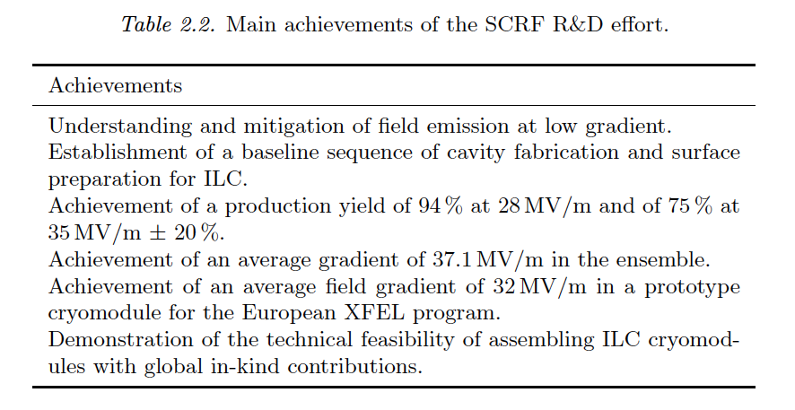
SCRF Linac Technology

Slide 47
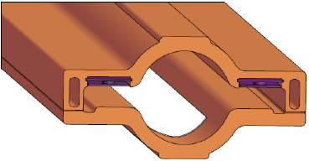
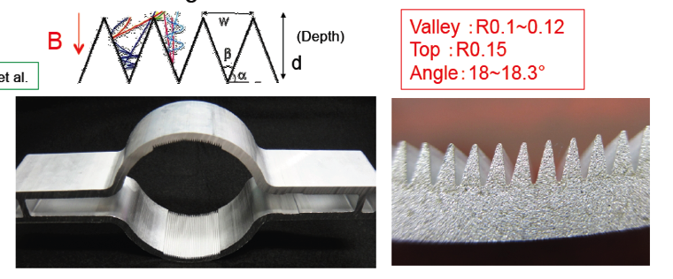
DR: Vacuum (Electron Cloud)
Reduction of electron cloud build-up in e+ ring critical for ILC parameters
Full e-cloud mitigation concepts included into vacuum design
  CesrTA (and other) R&D results
Vacuum System Design/Costing
  Super-KEK-B VCs in production with similar designs to ILC DR
DR Wiggler chamber concept with thermal spray clearing electrode – 1 VC for each wiggler pair.
SuperKEKB Dipole Chamber Extrusion
Conway/Li
Y. Suetsugu

Slide 48
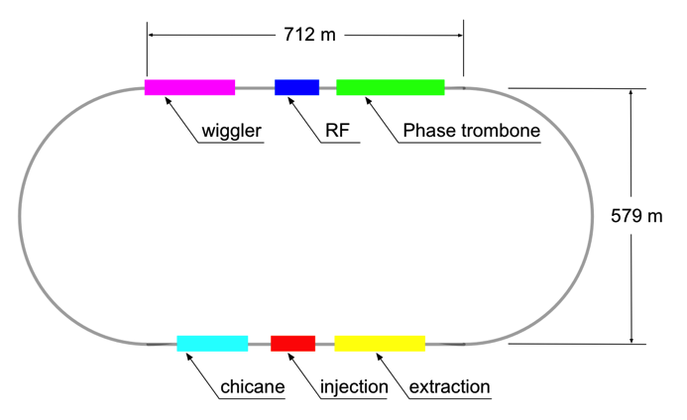
Damping Rings
Circumference |  | 3.2 | km
Energy |  | 5 | GeV
RF frequency |  | 650 | MHz
Beam current |  | 390 | mA
Store time |  | 200 (100) | ms
Trans. damping time |  | 24 (13) | ms
Extracted emittance | x | 5.5 | μm
(normalised) | y | 20 | nm
No. cavities |  | 10 (12)
Total voltage |  | 14 (22) | MV
RF power / coupler |  | 176 (272) | kW
No.wiggler magnets |  | 54
Total length wiggler |  | 113 | m
Wiggler field |  | 1.5 (2.2) | T
Beam power |  | 1.76 (2.38) | MW
Values in () are for 10-Hz mode
Many similarities to modern 3rd-generation light sources

Slide 49
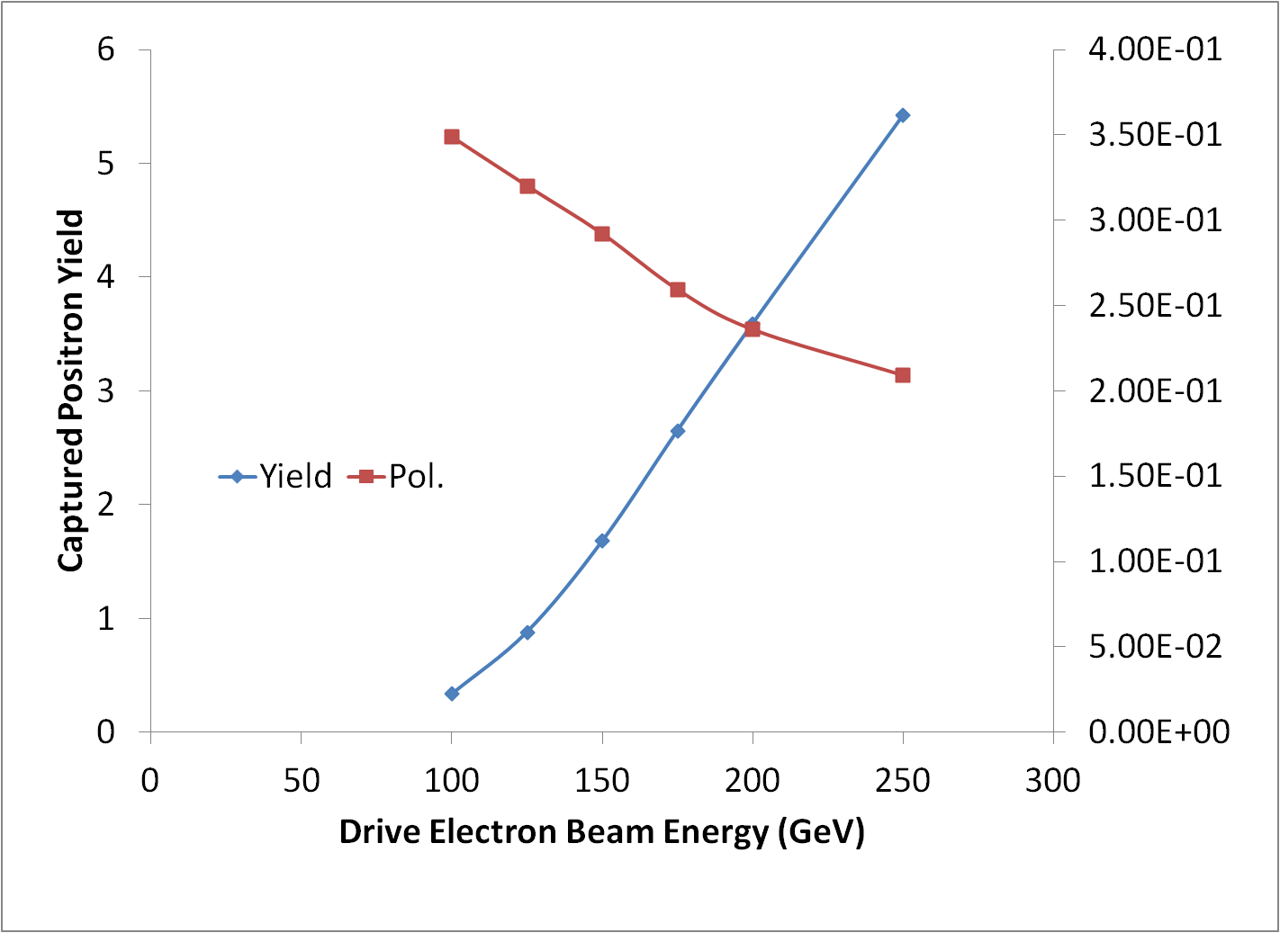
Positron Source
located at exit of electron Main Linac
147m SC helical undulator
driven by primary electron beam (150-250 GeV)
produces ~30 MeV photons
converted in thin target into e⁺e⁻ pairs
yield = 1.5
not to scale!

Slide 50
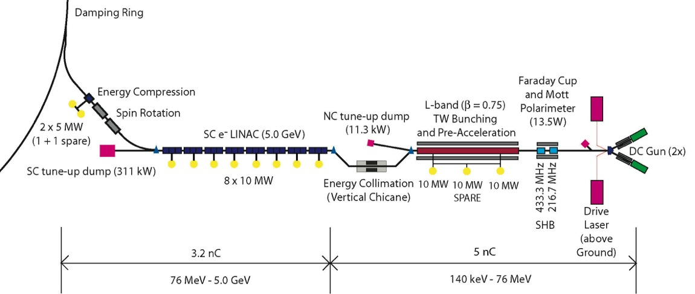
Polarised Electron Source
Laser-driven photo cathode (GaAs)
DC gun
Integrated into common tunnel with positron BDS

Slide 51
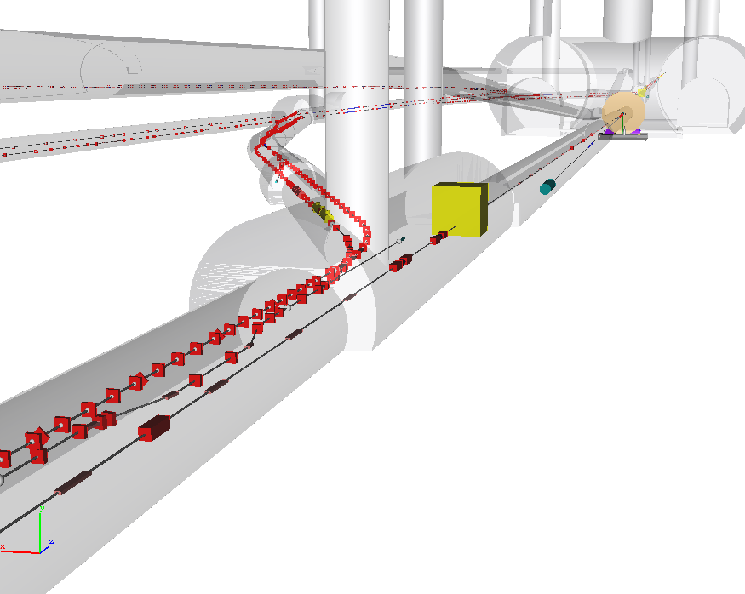
Central Region Integration
Damping Rings
detector
RTML return line
e⁺ main beam dump
e⁻ BDS muon shield
e⁺ source
e⁻ BDS
3D CAD has been used to developed beamline layouts and tunnel requirements.
Complete model of ILC available.

Slide 52

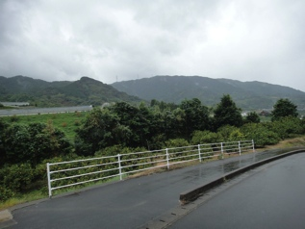
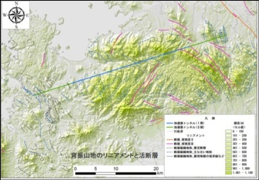
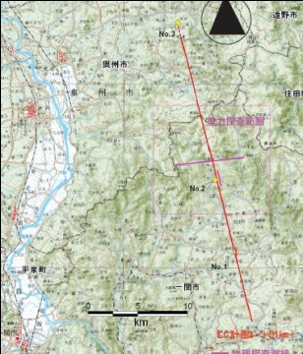
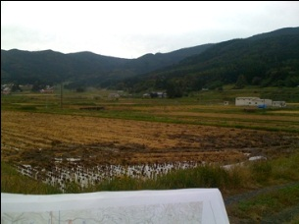


Japanese Sites
GDE-CFS group visited two sites, Oct., 2011.
GDE EC visit in Jan. 2012.

Slide 53
250 GeV CM (first stage)
Relative to TDR 500 GeV baseline
POSITRON linac straightforward
~50% ML linac cost (cryomodules, klystrons, cryo etc.)
~50% ML AC power
Half linacs solution
G = 31.5 MV/m
ELECTRON linac needs 10Hz mode for e+ production
ΔE = 135 GeV instead of 110 GeV (+25 GeV)
~57% ML linac cost (cryomodules, klystrons etc)
10Hz needs (1/2 linac × 10Hz/5Hz):
100% ML AC power
(1/2 linac × 10Hz/5Hz)
80% cryo cost
(50% static + 100% dynamic)
Main Linac infrastructure
Linac components: 50%
Cryogenics: 65%
RF AC power: 80%

Slide 54

Increasing SCRF Gradient
R.L. Geng
Understanding in gradient limits and inventing breakthrough solutions are responsible for gradient progresses. This has been a tradition in SRF community and rapid gradient progress continues. Up to 60 MV/m gradient has been demonstrated in 1-cell 1300 MHz Nb cavity. 45-50 MV/m gradient demonstration in 9-cell cavity is foreseen in next 5 years.

Slide 55
Collider ‘Wall Plug’ AC Power
ILC and 80 km ring: | ILC -H | ILC-nom | Ring - H | Ring - t
E_cm (GeV) | 250 | 500 | 240 | 350
SRF Power to Beam (MW) | 5.2 | 10.5 | 100 | 100
Eff. RF Length (m) | 7,837 | 15,674 | 600 | 1200
AC to RF efficiency (%) | 10 | 14 | 45 | 45
klystron operating margin, HVPS, Klystron Aux and klystron water cooling (%) |  |  | 20* | 20
Cryo (MW) | 16 | 32 | 20 | 40
Normal Conducting (exc. Injector complex) (MW) | 6 | 10 | 120** | 120
Injector complex | 32 | 32 | 16*** | 16
Conventional (Air, lighting, ..) | 6 | 6**** | 18 | 18
Total (exc. detector) | 112 | 153 | 396 | 416
* 5% for operating margin, 2% for auxiliaries, 3% for HVPS and 10% for water cooling
** assume 1.5 kW / m tunnel inclusive (ILC avg. 3 kW / m)
*** from SSC / Fermilab injector (linac + LEB + MEB)
**** 6 MW for 30 km beam tunnel complex; ~3x more for 80 ring
Cf. Blondel et al. est.
~ 260 MW

Slide 56

gamma-gamma
(Yokoya LCWS12)

Slide 57
Parametric ‘value’ costing for TeV–class machines (KILCU)*:
Civil Construction: 35 / m
Utilities: 5000 / MW
Superconducting RF 180 / m (inclusive)**
‘Conventional Acc.’ 35 / m
 |  | TLEP-t quantity | MILCU | ILC quantity | MILCU
Civil Construction | km | 80 | 3000 | 34 | 1200
Power and cooling | MW | 416 | 2000 | 162 | 800
SRF (incl. packing) | km | 1.2 / .7 | 250 | 22 | 4000
‘Conventional’ | km | 160 | 5500 *** | 12 | 800
Installation | km | 80 | 100 | 34 | 100
Total |  |  | 11000 |  | 7800**
* 1 ILCU = USD 01.2012
** cryogenics not included – reuse LHC assumed; 900 MILCU included for ILC
*** Conventional cost – scale reduced 2x for ring
Institutional Labor is part of the project cost and must also be analyzed.

Slide 58
Upgrades
Shown is initial 500 GeV -> 1 TeV. Similar scenario for starting with 250 GeV Higgs factory – or could build complete 500 GeV tunnel and half-populate.

Slide 59

gamma-gamma
(Yokoya LCWS12)

Slide 60


Fermilab CM2 results
CM-2 installed in ASTA cave
courtesy E. Harms (FNAL)
NEW!

Slide 61

Magnet Design Issues
Field level
  Higher field level allows to use a smaller ring
  But is technically challenging
Aperture
  A larger aperture means more volume with the magnetic field
  Larger stored energy and larger forces
  Higher cost
The field quality
  Unwanted non-linear field components
  Especially at injection (low field)
  Can make particles move chaotic and be lost
The cost
  The most costly component in the machine

Slide 62


Circular e⁺e⁻ machines
At Beamstrahlung &
tune-shift limit, assuming
100 MW power consumption:
(Telnov via Yokoya)

Slide 63

CEPC & SppC Layout
e+
IP1
e-
LTB
High Energy Booster(7.2Km)
Medium Energy Booster(4.5Km)
e+ e- Linac
(240m)
BTC
BTC
Low Energy Booster(0.4Km)
Proton Linac
(100m)
IP4
IP3
Booster(50Km)
CEPC Collider Ring(50Km)
IP2
SppC Collider Ring(50Km)
SC predicts 2020 China GDP = $24.6 Trillion
=> Cost of CEPC ~ 0.07*24.6*6 B ~ $10B
Current Status – last week International
Advisory Committee met in Beijing and
were very supportive of plans. Request for
$100M 5-year R&D plan being considered
by government

Slide 64

FCC Machine Protection
>8GJ kinetic energy per beam
  Airbus A380 at 720km/h
  24 times larger than in LHC at 14TeV
  Can melt 12t of copper
  Or drill a 300m long hole
  Machine protection
Also small loss is important
  E.g. beam-gas scattering, non-linear dynamics
  Can quench arc magnets
  Background for the experiments
  Activation of the machine
  Collimation system
O(160GJ) in magnets
O(20) times LHC
Serious protection issue

