Slide 1





ITS Upgrade Activity at Frascati
Federico Ronchetti INFN-Laboratori Nazionali di Frascati ALICE Meeting 14/03/2017

Slide 2
Outline
Status
Infrastructure
Tools
Soldiering procedure and stations
Mechanical ”Stave-0” assembly
ALPIDE test setup → (Marco, Pavel, Paula)
Meetings
Preparing for production
Computing: cluster installed with CentOS 8, batch system ongoing
ALICE Collaboration News

Slide 3
Infrastructure
White and Grey Rooms were cleaned
Vacuum for HS base, HB, grippers:
Two pump system being activated
Pressure gauge: installed
T-junction tube: to be installed
… then electrical setup
CMM compressors:
Still issue with ATLAS-CORP machine (Technical Division contacted)
Secondary line still missing (filter and dryer)
Need to clear safety protocol (Technical Division contacted)
ASTRA 11 kW conditioning system:
Replacement with 25 kW system being prepared (inspection with TD today)
Secondary
Primary

Slide 4
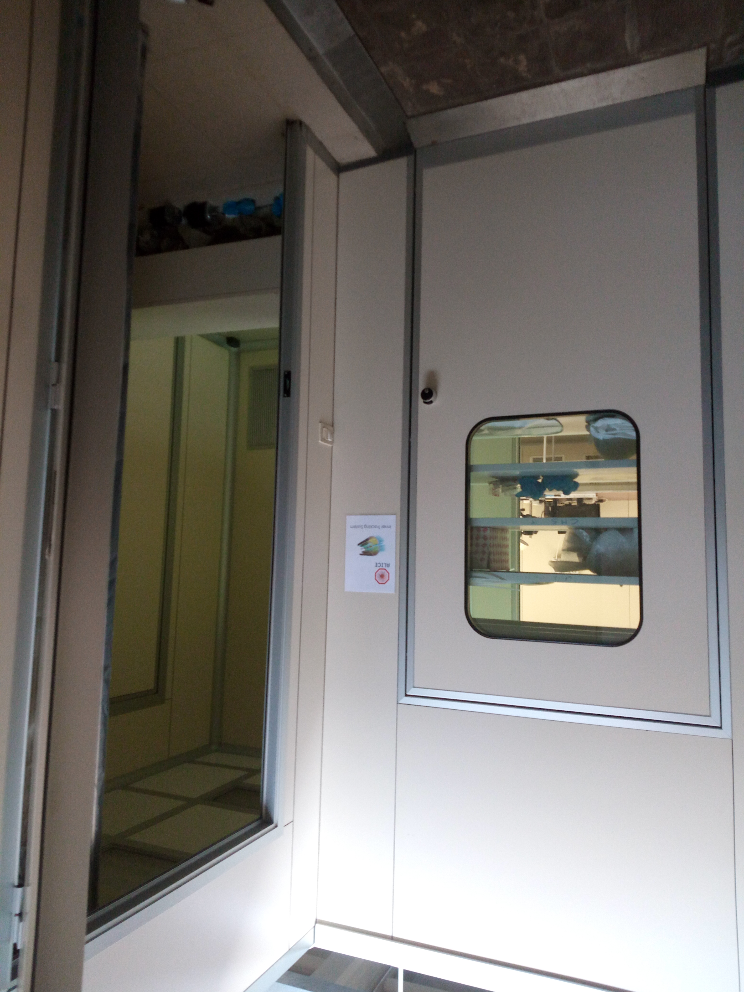
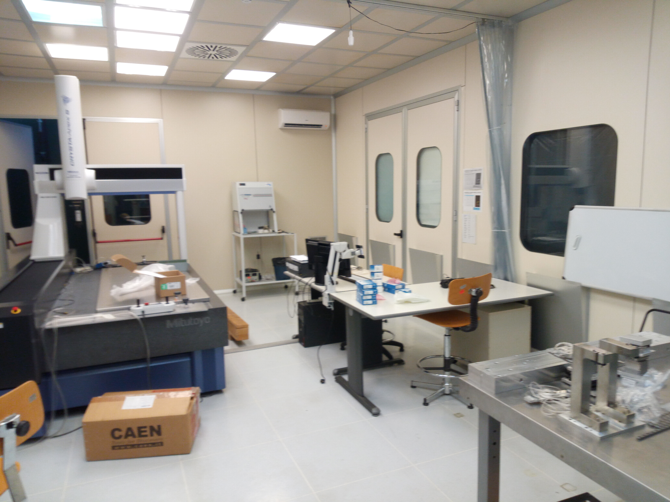
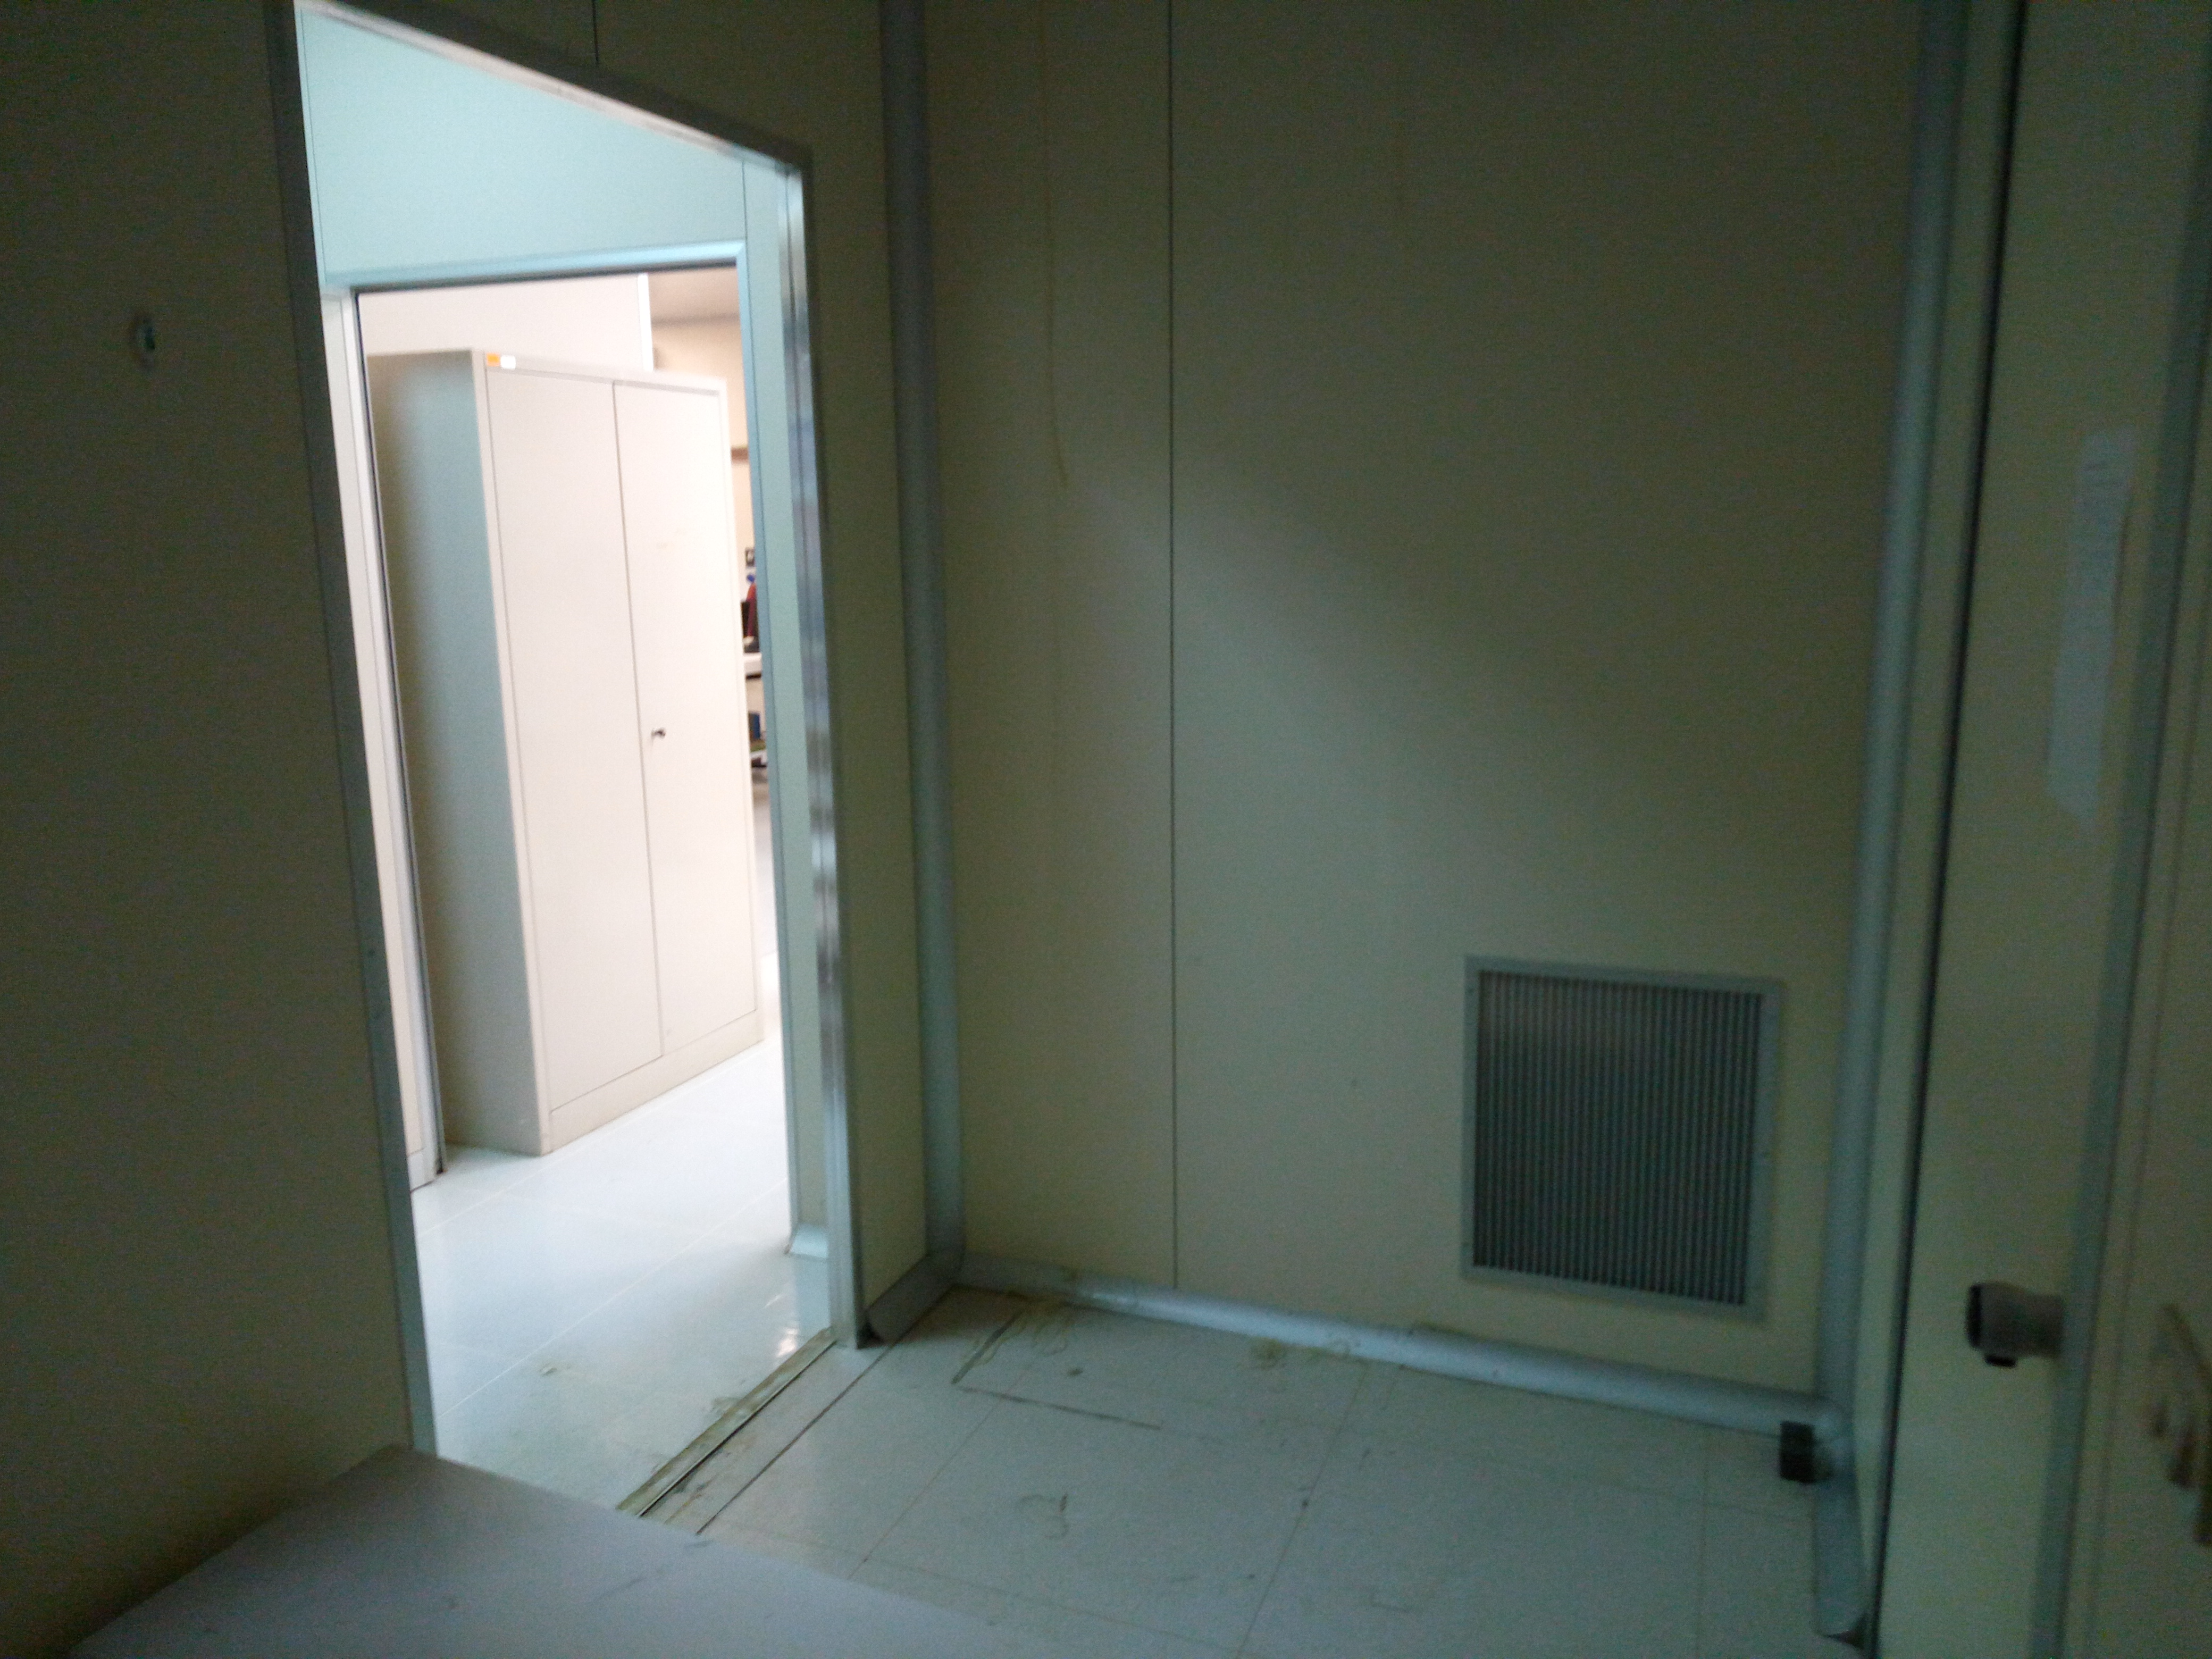
Infrastructure

Slide 5
Mechanical Stave Assembly
Tools coming in
Back from Torino/SEL
1 jig
2 Half Stave stainless steel Bases
1 reworked gluing mask positioner
1 cross-cable compatible Handling Bar
Final handling bar coming later (~mid April)
C- brackets masks to be glued for the ruby pads (need Torino assistance) for Space Frame placing
Power bus soldering jig (for gray area → relocate ALPIDE test station)
2 Ecobond cartridges in from CERN
Tab cutting tool from Nikhef
PB jig

Slide 6
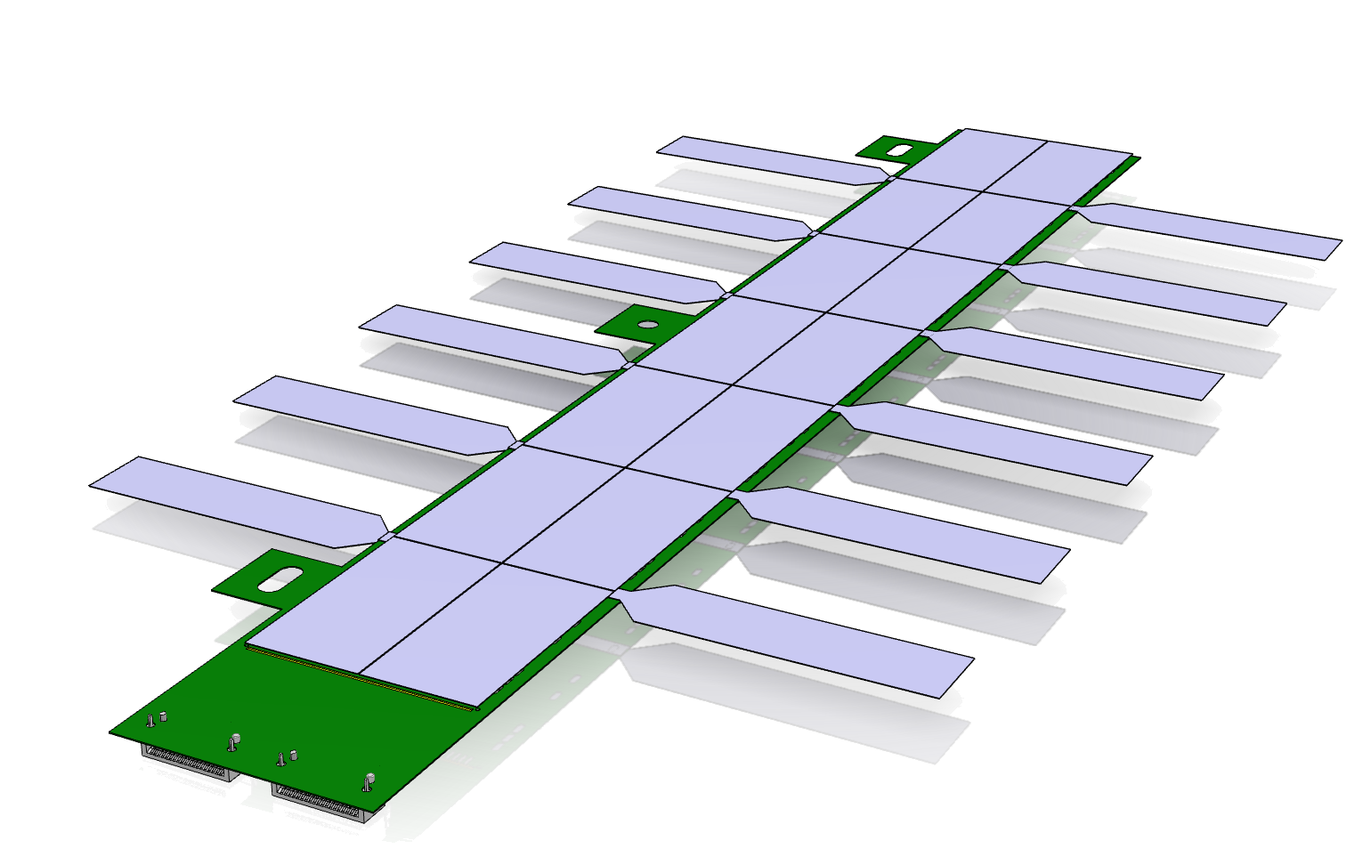
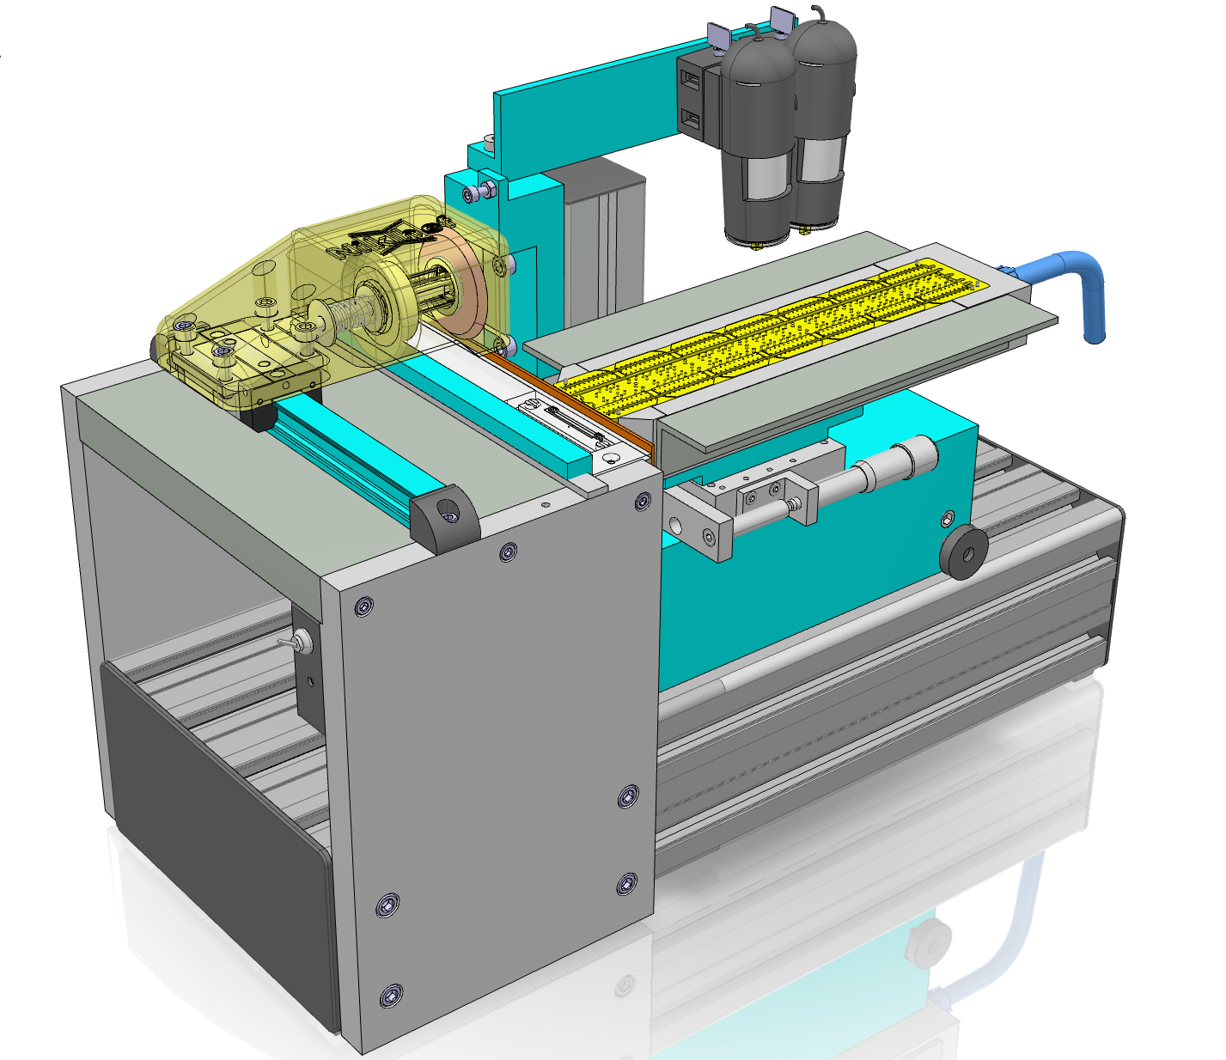
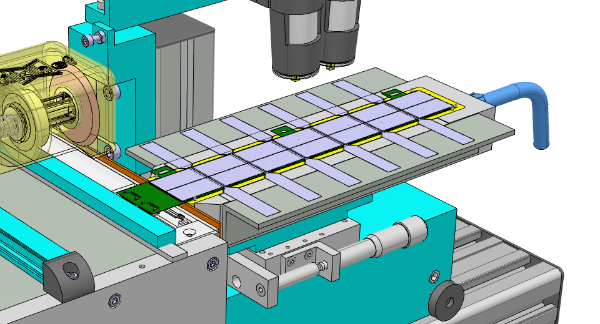
Tab Cutting Tool
FPC extension cutting
Considerations:
The cut has to be within 100 μm from the silicon
Fine positioning needed
The FPC is flexible
needs to be clamped close to the cut
Need to fix the FPC not the Silicon
Flipping of the module is required
3
4
2
5
1
Rough positioning (0.2mm) of module
with 5 dowel pins in module gripper

Slide 7
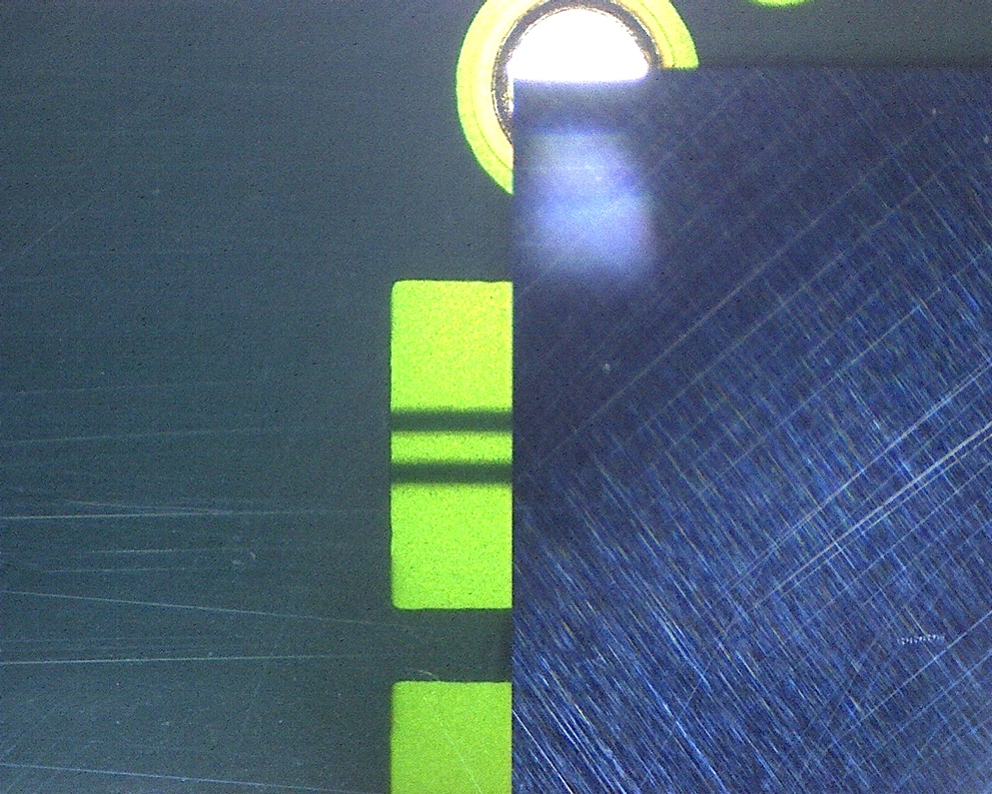
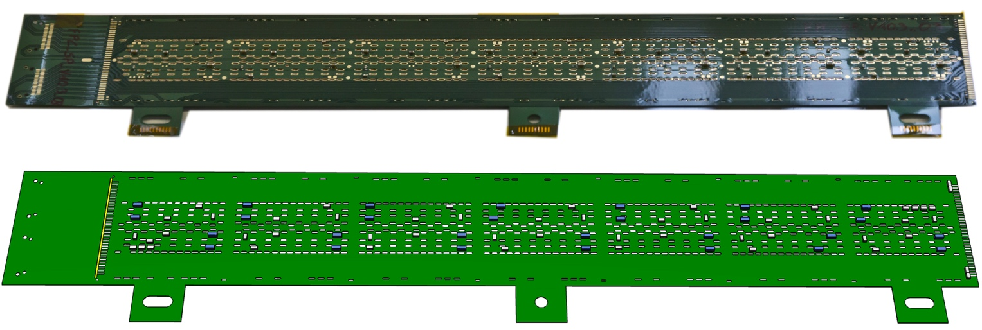
Tab Cutting Tool
Copper removed in new design
Alignement of HIC
Metalized
Kapton
2 mm view around both edges of silicon
We align the shadow of the knife wrt the silicon
Silicon
0.55 mm
window

Slide 8
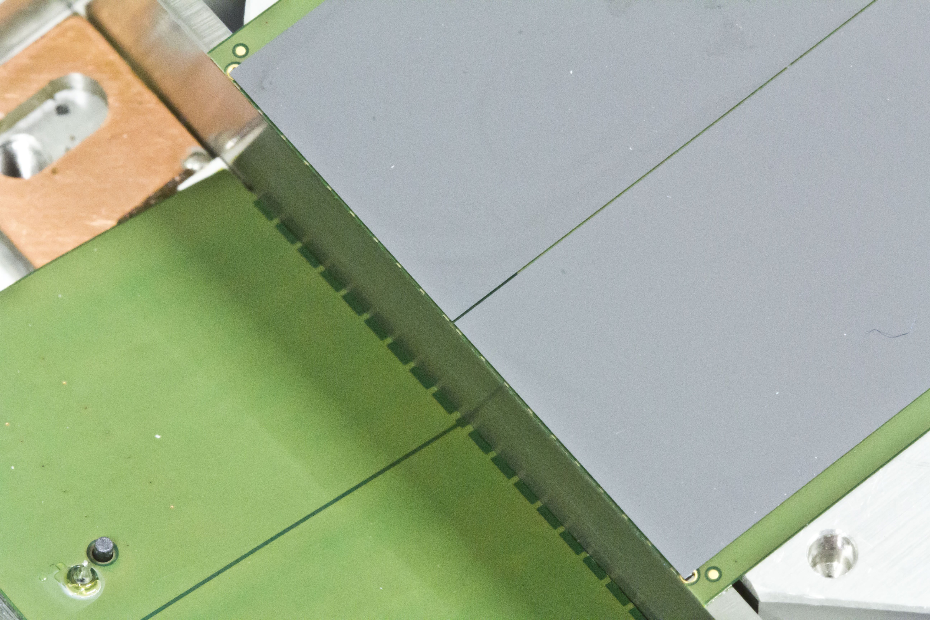
Tab Cutting Tool
50 um

Slide 9
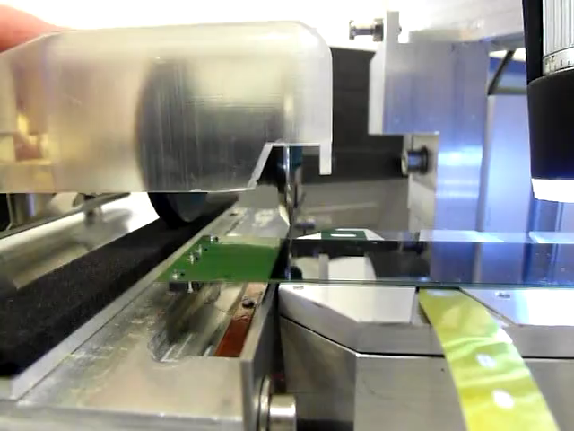
Tab Cutting Tool

Slide 10
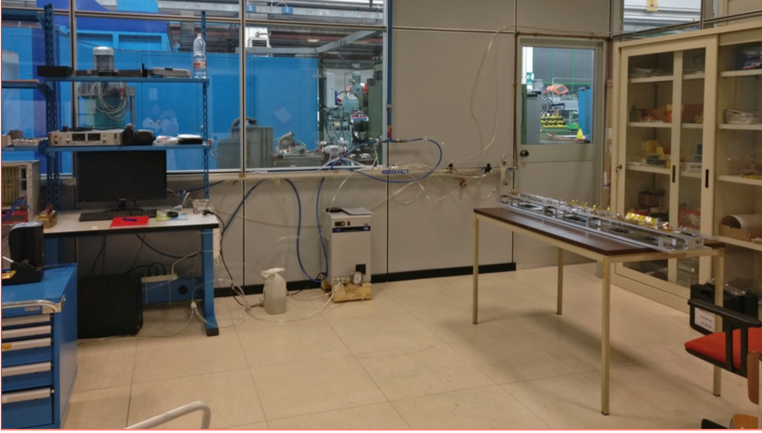
Soldering
Half Stave
New FPC-FPC interconnection structures received from Torino to be tested at LNF
EDSYN Sn62Pb36Ag2 ø=0.35 mm T= 183˚C wire (2reels) available
Power Bus
Chiller setup: detailed cooling loop design from Torino
Torino

Slide 11
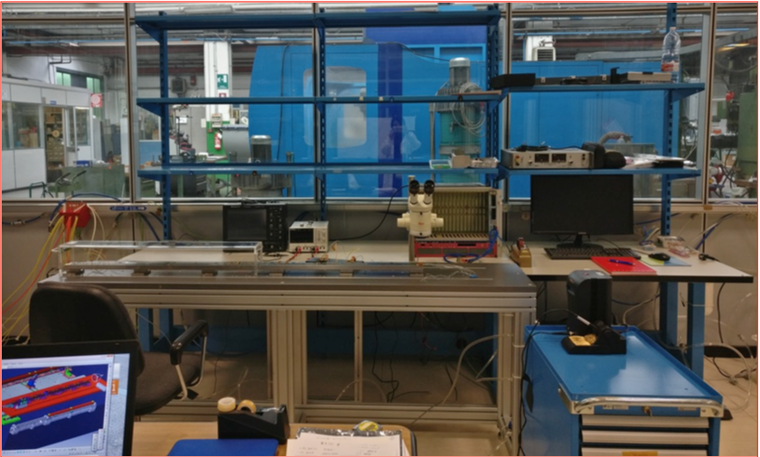
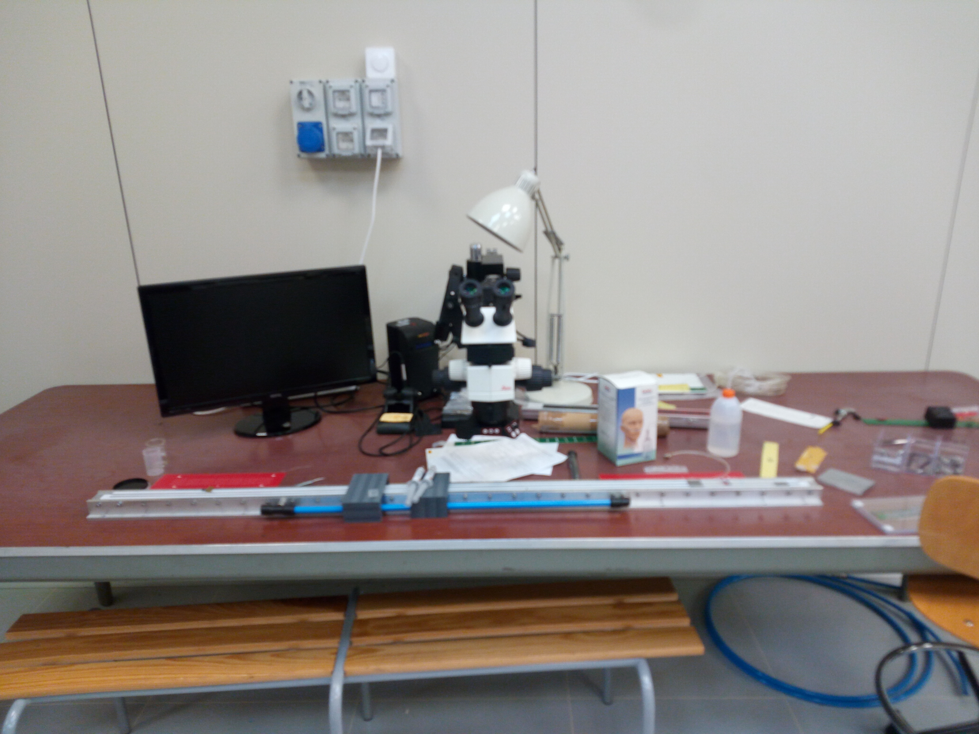
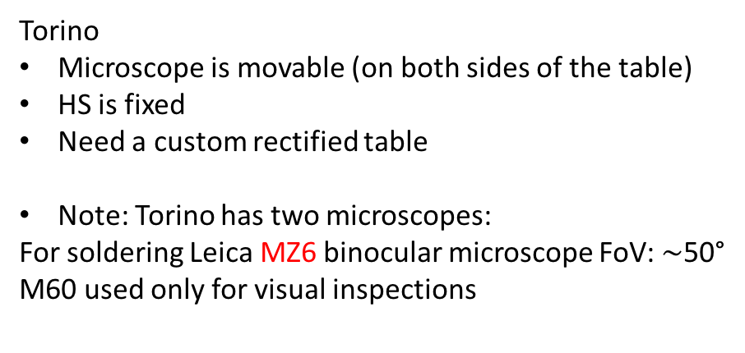
Half Stave Soldering and Test
LNF
Microscope (M60) is fixed (heavy and has cables to screen)
HS base moves
Need a 3000 mm jig which would rest on a non-rectified table
Microscope
Torino
Microscope is movable (on both sides of the table)
HS is fixed
Need a custom rectified table
Note: Torino has two microscopes:
For soldering Leica MZ6 binocular microscope FoV: $\sim$50°
M60 used only for visual inspections
Half Stave Base

Slide 12
Outline of Stave Construction and Test Procedure
Each HIC is tested for power and readout
Tab is cut
HIC is re-tested for power
HIC is positioned on CP and lowered on glue
HIC is tested for power, if fails HIS is removed immediately before glue polymerizes
Repeat for 6 HICs
Type B HIC (with long tab) is glued and tested, if fails, removed
HS ready for soldering station
HS FPC-FPC interconnections are soldiered
HS is tested on the soldering table for power (need ad hoc service Power Bus, no cooling)
If a HIC is not fully connected, rework the missing/bad soldering
HS is moved to back to CMM table for flipping with Handling Bar
HS is aligned to SF and glued
Second HS construction starts (repeat 1-13)
Completed Stave moved to PB jig in Gray area
PB is soldered
Stave is tested with cooling for power and redout
Power Busses are folded over
Stave is re-tested for power

Slide 13
LNF Expected Production Rate
108 Outer Layer Stave to be produced (1 Stave = 2 HS)
4 production sites (LNF, To, Liverpool, Nikhef)
For LNF the nominal is 27 staves: assume 24-31 with contingency
Production is by lots. LNF lots (nominal)
September 1, 2017 → November 20, 2017 → 6 Staves
November 21, 2017 → February 27, 2018 → 7 Staves
February 28, 2018 → June 5, 2018 → 7 Staves
June 6, 2018 → September 11, 2018 → 7 Staves
Note: the beginning of the above schedule could drift to October/November 2017

Slide 14
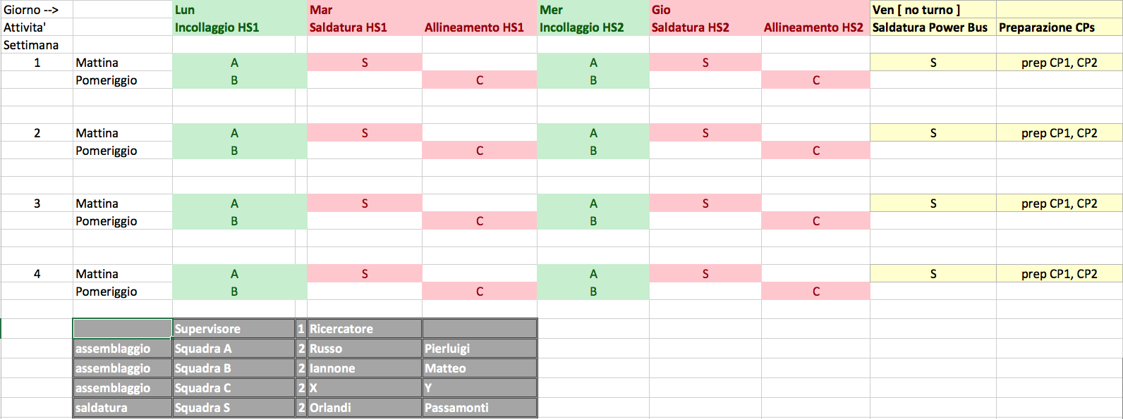
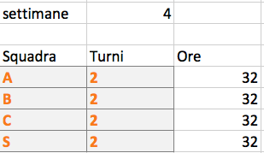
Possible Production Shifts Scenario
Discussed with LNF director
Identification of X and Y ongoing
Note: we have 2 Half Stave Bases: in principle assembly work could be parallelized
However this will not match the manpower availability

Slide 15
Mechanical Stave-0 at LNF
Request to our group from CERN to build a realistic stave for vibrational and bending tests
Use of realistic dummy HICs with bonded pad chips with tabs
Soldering would be needed
In principle should be ready for the PRR on April 27, however its likely that the PRR will be delayed
Material procurement
CP + SF: delivery at CERN March 20th
Modules: availability of 14 dummy modules of defines the stave assembly start date
FPC-FPC interconnection Bridges: available in LNF, being tested on dedicated test structures. More will be sent in the next days
PB: ?? do we foresee assembly of dummy stave with real PB ?? – no cooling probably
Vibrational test: Corrado alerted SERMS, Stave box needed to ship the Stave to Terni (INFN carrier)
Bending test: will take place at CERN, shipping from SERMS to CERN must be arranged

Slide 16
Mechanical Stave-0 at LNF
 |  | March |  |  |  |  |  |  |  |  |  |  |  |  |  |  |  |  |  |  |  |  |  | April
 |  | 10 |  |  | 13 |  |  |  |  |  |  | 20 |  |  |  |  |  |  | 27 |  |  |  |  |  |  | 3
 |  | Fri | Sat | Sun | Mon | Tue | Wed | Thu | Fri | Sat | Sun | Mon | Tue | Wed | Thu | Fri | Sat | Sun | Mon | Tue | Wed | Thu | Fri | Sat | Sun | Mon | Tue | Wed
COLD PLATE AND SPACE FRAME
Production at CERN: DONE | Corrado/Elisa
Parylene coating | Company
Delivery at CERN
Delivery to LNF
Metrology | LNF
GLUING TOOLS
Mask printing (14+4spares) | Silvia
Mask delivery to LNF
GLUE, Spatula, glue dispenser, needles preparation | LNF
TAB cutting tools
TAB cutter production | NIKHEF
TAB cutter test at LNF | LNF+NIKHEF
ASSEMBLY TOOLS finalization
Stainless steel tools delivery
Assembly and metrology | LNF
CMM Software
HS assembly | Fabrizio
Stave assembly | Fabrizio
Migration to LNF | Fabrizio/Emiliano

Slide 17
Mechanical Stave-0 at LNF
 |  | April
 |  |  |  | 3 |  |  |  |  |  |  | 10 |  |  |  |  |  |  | 17 |  |  |  |  |  |  | 24
 |  | Sat | Sun | Mon | Tue | Wed | Thu | Fri | Sat | Sun | Mon | Tue | Wed | Thu | Fri | Sat | Sun | Mon | Tue | Wed | Thu | Fri | Sat | Sun | Mon | Tue | Wed | Thu | Fri
DUMMY STAVE ASSEMBLY (needs dummy modules)
TAB cut | LNF+Nikhef
HS_0_R assembly | LNF
HS_0_R FPC-FPC interconnections
HS_0_L assembly
HS_0_L FPC-FPC interconnections
HS_0_R gluing to SF
HS_0_L gluing to SF
Power Bus soldering
STAVE 0 MECHANICAL CHARACTERIZATION
Vibrational test | SERMS (Terni)
Bending test | CERN

Slide 18
Outer Layer Workshop at LNF
Only possible date is second part of May (from Luciano Musa, who supports the proposal)
30-40 people max
Organization load would go mostly on Alessandra and Lia (if they are available)

Slide 19
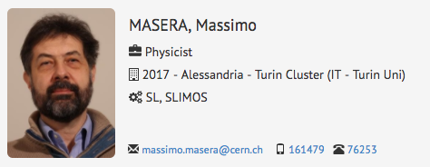
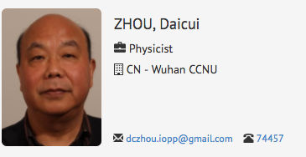
ALICE Collaboration News
New elected Management Board member at the last CB

Slide 20
Backup

