Slide 1

Nucleon structure phenomenology
Umberto D’Alesio
Università & INFN - Cagliari
Motivations
3D nucleon structure
hard semi-inclusive/exclusive (polarized) processes
Open issues

Slide 2
Motivations (general statements)
Nucleon: the most abundant piece of matter in the visible Universe…
still a mysterious object (charge radius, spin content…??)
QCD and confinement: still to be understood
Semi-inclusive/exclusive processes w/wo spin:
tools to study the inner structure of a composite system
such as a nucleon

Slide 3

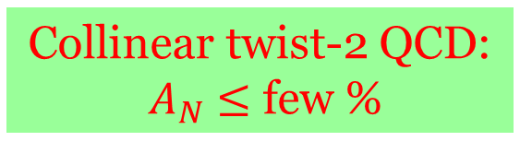
Transverse Spin effects
$A_{N}$ in $p^{↑}p →$ π X… “the origin”…a long-standing puzzle
$$x_{F}=2P_{L}/\sqrt{s}$$
Collinear twist-2 QCD:
$A_{N}$ $≤$ few %
Almost energy independent

Slide 4
1-D picture of the nucleon
inclusive DIS
DIS Structure
Functions
Collinear PDFs

Slide 5
(open) Physics issues
Parton orbital motion and its correlation to the nucleon spin
Parton intrinsic transverse momentum
Spatial distribution of partons and the nucleon shape
3D structure
Non perturbative effects in high-energy processes
Origin of transverse/azimuthal spin asymmetries
Observables
Role of local colour gauge invariance of QCD
Factorization, universality, resummation
QCD at work

Slide 6



This talk
$$t=0$$

Slide 7
Proton spin puzzle
Role of
TMDs and GPDs
Non trivial decomposition [Leader, Lorcé (2014)]

Slide 8
Elastic scattering
GPDs
Form Factors:
Information on position
not on quark momentum
Virtual Compton scattering
unpolarized quark and transversely polarized nucleon
unpolarized quark and nucleon
GPDs: Information on position
and quark momentum fraction

Slide 9
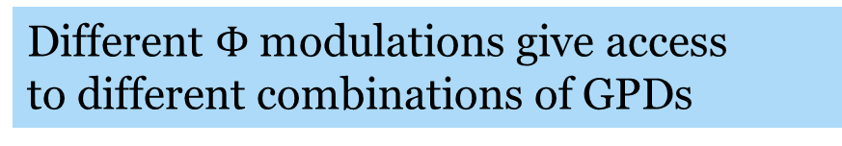
DVCS Factorization
Collins et al. (1998)
Compton
Form Factor
GPD
Different $Φ$ modulations give access
to different combinations of GPDs

Slide 10

Physics issues in GPDs
- DVCS: golden channel. HERMES, COMPASS, JLab, H1, ZEUS
Silvia Niccolai
- DVMP (virtual meson production): uncertainty on meson distribution amplit.
- Extraction of GPDs: model-dependent (4 GPDs in DVCS & integrated over $x$ CFFs)
- Parameterizations: different families, not always able to describe all data,
qualitatively good (different observables, few parameters and assumptions)
- Major role in the nucleon spin decomposition
Ji (1997)
$H, E$ non-flip GPDs

Slide 11
Proton tomography from JLab data
Dupré et al (2017)
Distribution in the transversal space
Mean squared radius in the T space
Silvia Niccolai

Slide 12

GPD measurements
$$x$$

Slide 13



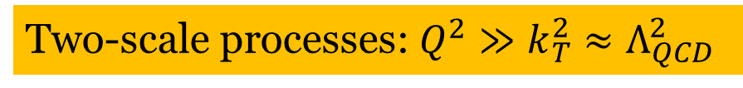
Direct access to TMDs:
Two-scale processes: $Q^{2}≫k_{T}^{2}$ $≈Λ_{QCD}^{2}$
SIDIS $lp→l^{′}h X$
$$e^{+}e^{−}→ ππ X$$
Drell-Yan $pp → l^{+} l^{− } X$
TMD factorization proven

Slide 14

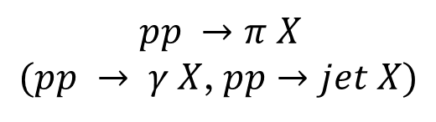



And possibly in processes like
Single-scale processes: large $P_{T}$
Access to Gluon TMD
$$pp→D X$$
$$pp→ π jet X$$
Two-scale process
$$pp →π X$$
$(pp → γ X$, $pp→jet X)$
And more

Slide 15


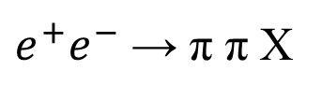
Where can we access TMDs?
EIC
SIDIS
Drell-Yan
$e^{+}e^{−}$ → π π X
$pp→h X , pp→ π jet X$
AFTER@LHC

Slide 16
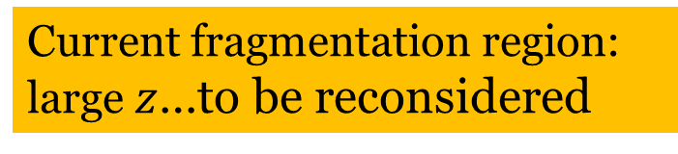

TMDs and unpolarized cross sections
$$l p →l^{′}h X$$
SIDIS multiplicities
Current fragmentation region:
large $z$…to be reconsidered
Factorized
Gaussian
forms

Slide 17


${<k}_{⊥}^{2}>$ = 0.57-0.38 ${GeV}^{2}$
<$p_{⊥}^{2}>$ = 0.12-0.18 ${GeV}^{2}$
Anselmino, et al. (2014)
Signori, Bacchetta, Radici, Schnell (2013)

Slide 18
Theory: factorization and evolution
Collinear approach
Evolution → DGLAP eqs.
TMD approach…more involved

Slide 19
TMD factorization approaches
Seminal paper
TMD framework
Tremendous progress

Slide 20
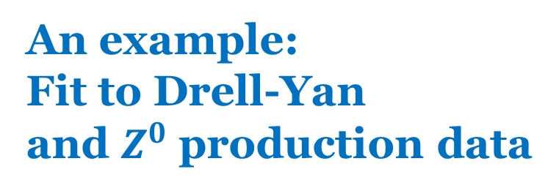
An example:
Fit to Drell-Yan
and $Z^{0}$ production data
TMD evolution at NNLL (SCET)
UD, Echevarria, Melis, Scimemi (2014)
(223 data points)
Low energy
Tevatron

Slide 21
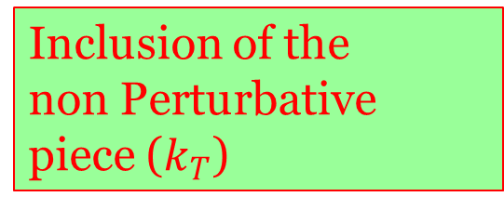

TMDs at LHC
Predictions from NNLL fit
$$pp→Z X$$
Pure resummed pQCD
Inclusion of the
non Perturbative
piece ($k_{T}$)

Slide 22
Gaussian width correlations
Bacchetta et al. (2017)
Fit of DY, Z and SIDIS + TMD evol.
Bacchetta et al (2017)
Fit of SIDIS - NO TMD evol.
Signori et al (2013)
Fit of SIDIS - NO TMD evol.
Schweitzer et al (2010)
Fit of SIDIS - NO TMD evol. Anselmino et al (2014)
Fit of SIDIS, DY, Z + TMD evol. Echevarria et al (2014)

Slide 23
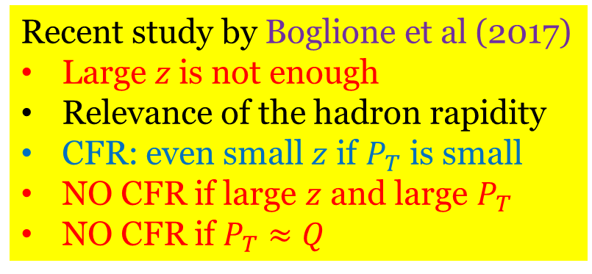
Current fragmentation region in SIDIS
Recent study by Boglione et al (2017)
Large $z$is not enough
Relevance of the hadron rapidity
CFR: even small $z$ if $P_{T}$ is small
NO CFR if large $z$ and large $P_{T}$
NO CFR if $P_{T}≈Q$
To be further explored

Slide 24
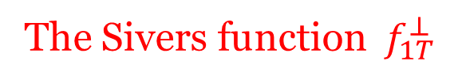
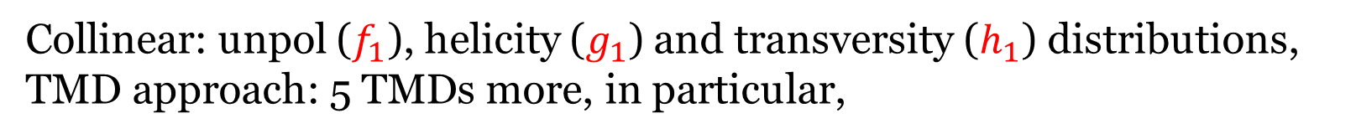
TMDs and SPIN
Collinear: unpol ($f_{1}$), helicity ($g_{1}$) and transversity ($h_{1}$) distributions,
TMD approach: 5 TMDs more, in particular,
The Sivers function $f_{1T}^{⊥}$
Sivers (1989)
Correlation between the spin of the proton and the parton transverse momentum

Slide 25
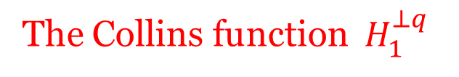
As well, a relevant TMD in the fragmentation process:
The Collins function $H_{1}^{⊥q}$
Collins (1992)
Correlation between the spin of the fragmenting quark and
the hadron transverse momentum

Slide 26
Sivers and Collins functions extensively studied
theoretically, experimentally and phenomenologically
CLEAR evidence from data
HERMES, COMPASS
SIDIS
Collins
Sivers
First phase: analysis with DGLAP evolution
Second phase (just started): TMD evolution
Marco Contalbrigo

Slide 27
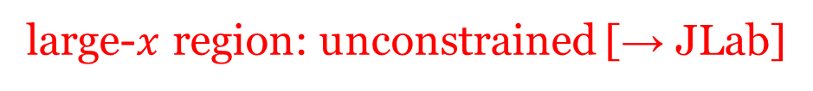
Extracted Sivers functions
TO-CA and PV groups
large-$x$ region: unconstrained [→ JLab]
sea region: unconstrained [→ EIC]
Aybat, Collins,
Qiu, Rogers (2012)
Effect of the TMD evolution

Slide 28
Distortion in the transverse plane
Non zero Sivers effect related to parton orbital angular momentum

Slide 29
Modified universality of the Sivers function
Collins (2012)
Final state interactions in SIDIS
Initial state interactions in DY
A clear-cut test
If falsified:
- misunderstanding of final-state interacts. leading to T-odd effects
- missing points in QCD factorization (TMD and collinear) [most severe scenario]

Slide 30
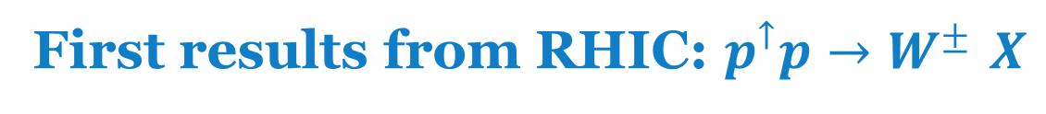
First results from RHIC: $p^{↑}p→W^{± }X$
STAR Collaboration (2016)
First hint at the sign change,
but large exp. errors and …
New analysis:
Anselmino, Boglione, UD,
Murgia, Prokudin (2016)
Kang et al (2016)
No TMD evolution

Slide 31

Sivers asymmetry for Drell-Yan at COMPASS
$$π^{−} p→ μ^{+}μ^{−}X$$
Change
of sign
Same kinematical
region as that for
SIDIS extraction
Without
Sign change
(B. Parsamyan @DIS2017)

Slide 32
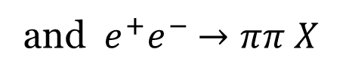
Collins function & transversity
Combined analysis of
SIDIS
and $e^{+}e^{−}$ $→ππ X$
Without TMD evolution
Same analysis but with TMD evolution
Kang, Prokudin, Sun, Yuan (2015)
Compatible with LO analysis
No compelling TMD evolution yet
Remember: SSAs are ratios….
Anselmino, Boglione, UD, Melis, Murgia, Prokudin (2015)

Slide 33
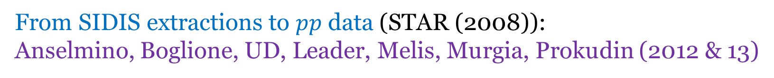
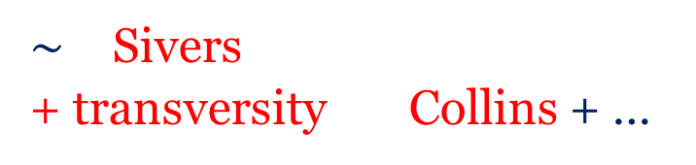
Back to $A_{N}$ : further evidence of Sivers and Collins effects
$\sim$ Sivers
+ transversity Collins + …
In a phenomenological TMD scheme (GPM)
Non separable
From SIDIS extractions to $pp$ data (STAR (2008)):
Anselmino, Boglione, UD, Leader, Melis, Murgia, Prokudin (2012 & 13)
Sivers effect alone
Collins effect alone
Proper
combination?
in progress

Slide 34
SSAs for Quarkonium production:
direct access to the GLUON Sivers function
UD, Murgia, Pisano, Taels (2017)
AFTER@LHC
Maximized contribution
GPM: parton model with universal TMDs
CGI: TMD approach with initial/final state interactions
(DY/SIDIS sign change)
Luciano Pappalardo

Slide 35
Open issues in TMD phenomenology
TMD evolution and its relevance
Kang (2015)
Role of non perturbative input choices
w/o TMD evolution
Transverse momentum dependence in SIDIS and its consistency with DY
Proper definition/selection of the current fragmentation region in SIDIS
TMD factorization breaking effects in $pp→ π X , pp→jet jet X$ (sizeable???)
Gluon TMDs at low x, TMD factorization vs. Color Glass Condensate

Slide 36
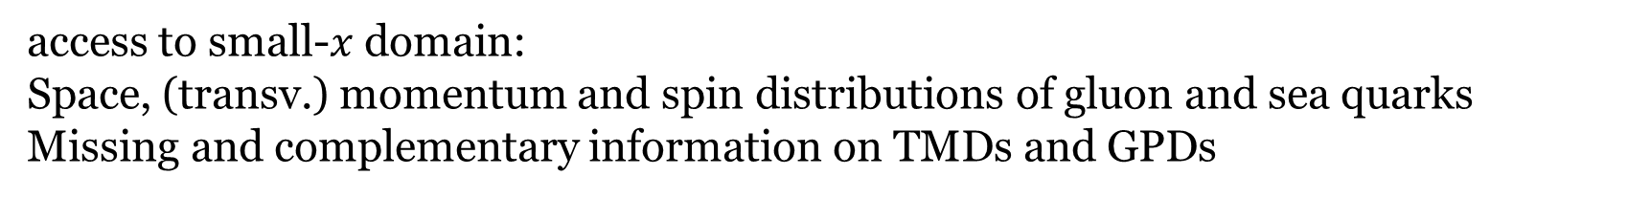
Future → EIC
JLAB
access to small-$x$domain:
Space, (transv.) momentum and spin distributions of gluon and sea quarks
Missing and complementary information on TMDs and GPDs
Marco Radici

Slide 37
Conclusions and open issues
Nucleon STRUCTURE: mysterious and fascinating
Experimental evidence to go beyond a simple collinear (1D) picture
DATA Interpretation towards a true 3D image of the nucleon
Spin-TMD effects and GPDs well established: orbital angular momentum
Transverse single-spin asymmetries: challenging and tool to learn deeper on the nucleon structure and QCD
Waiting for COMPASS, Jlab-12, RHIC, and eventually EIC results
Phenomenology issues
- GPDS: modelling, algorithms in fitting,…
- TMDS: evolution, non perturbative inputs,…
THANK YOU

Slide 38
BACK-UP SLIDES

Slide 39
TMD Factorization and evolution (I)
DY processes
Collins approach (2011)
Collinear PDF
pQCD
Non perturbative parts

Slide 40
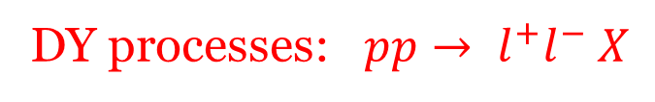
TMD Factorization and evolution (II)
DY processes: $pp→ l^{+}l^{−} X$
Echevarria, Idilbi, Scimemi (2012,13,14)
UD, Echevarria, Melis, Scimemi (2014)
TMD in b space

Slide 41

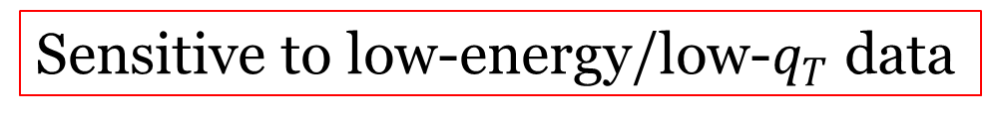
Non-perturbative input and accuracy
Both needed
Relevant for $Z^{0}$ data
Sensitive to low-energy/low-$q_{T}$ data

Slide 42

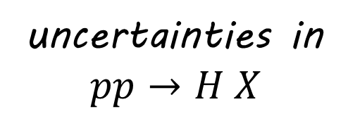
TMDs at LHC (II)
Ferrera (2014)
$$pp→Z X$$
uncertainties in
$$pp→H X$$
Inclusion of the non perturbative piece

Slide 43

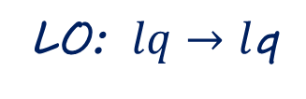
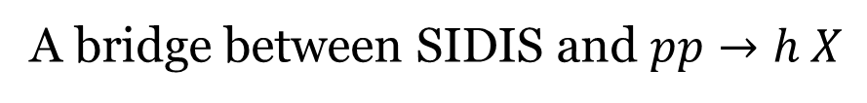

$A_{N}$ in $l p→ π X$ (single-scale process)
Inclusive process
One hard scale $P_{T}$
A bridge between SIDIS and $pp→h X$
From SIDIS to $l p→h X$: test of a unified TMD approach
LO: $lq→l$q
Anselmino, Boglione, UD, Melis, Murgia, Prokudin (2010&14)
Fairly good description of HERMES data but
Inclusive events: final lepton scattered almost collinear $Q^{2}≈0$

Slide 44
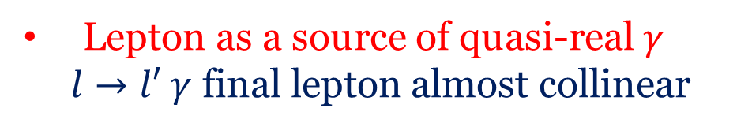
Quasi-real photon exchange
Lepton as a source of quasi-real $γ$
$l→l′ γ$ final lepton almost collinear
Weizsäcker-Williams approximation
Reanalysis of SSAs (and unpol. xsecs): UD, Flore, Murgia 2017

Slide 45



SSAs: Only Sivers and (marginally) Collins effects sizeable
HERMES data (2014)
Predictions from SIDIS extractions
0.1
Inclusive data
$$π^{−}$$
0.1
Anti-tagged
0
0
$$π^{+}$$
$$π^{−}$$
-0.1
-0.1
WW: big improvement!
TMD scheme seems fine

Slide 46

Collins effect: from SIDIS to $pp→ π jet X$
$$A_{N}^{W}=$$
Sivers effect
Collins effect
Collins-like effect
UD, Murgia, Pisano (2011)

Slide 47
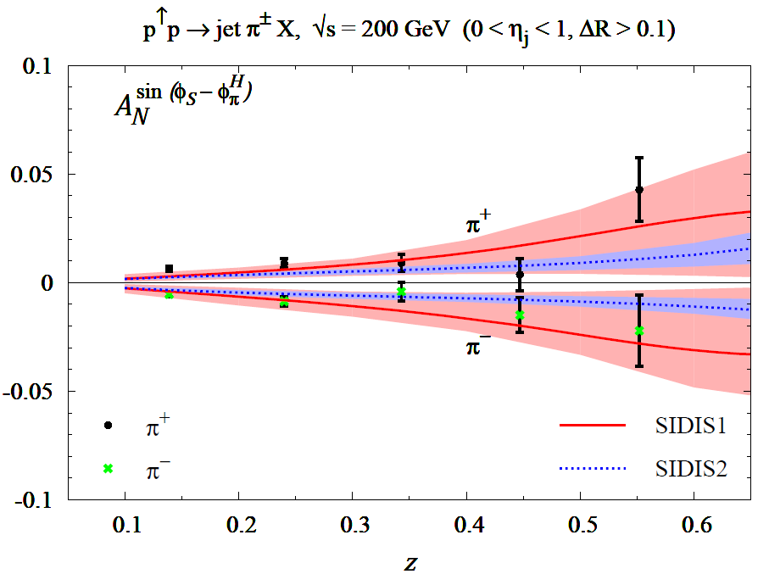
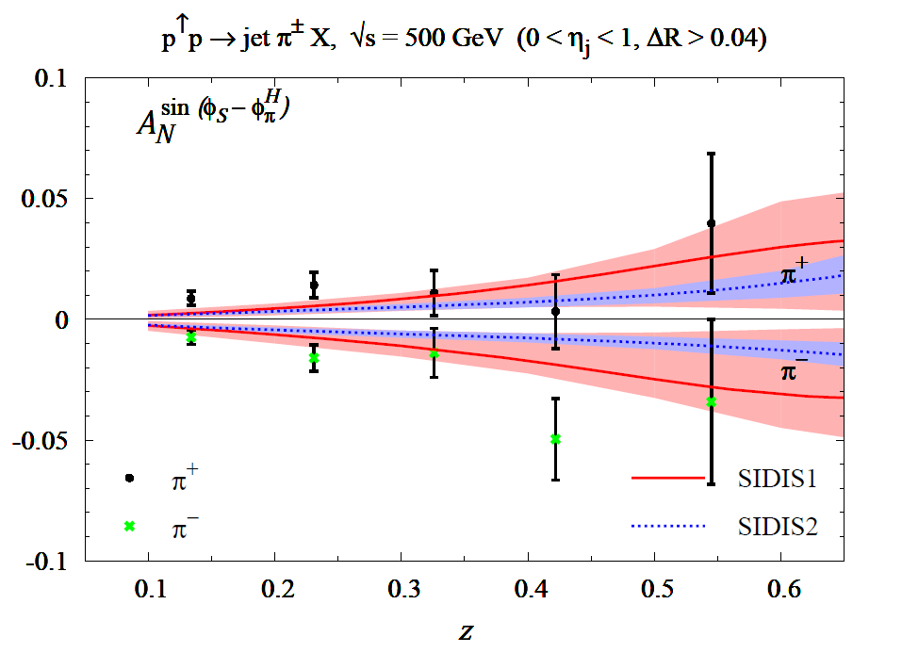
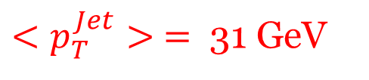
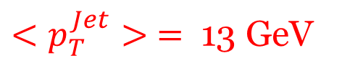
$<p_{T}^{Jet}> =$ 13 GeV
$<p_{T}^{Jet}> =$ 31 GeV
200 GeV
500 GeV
Predictions
without TMD evolution
UD, Murgia, Pisano,
in progress
Data: PHENIX Coll. (2015)
Universality of the Collins function
mild (or no) TMD evolution

Slide 48
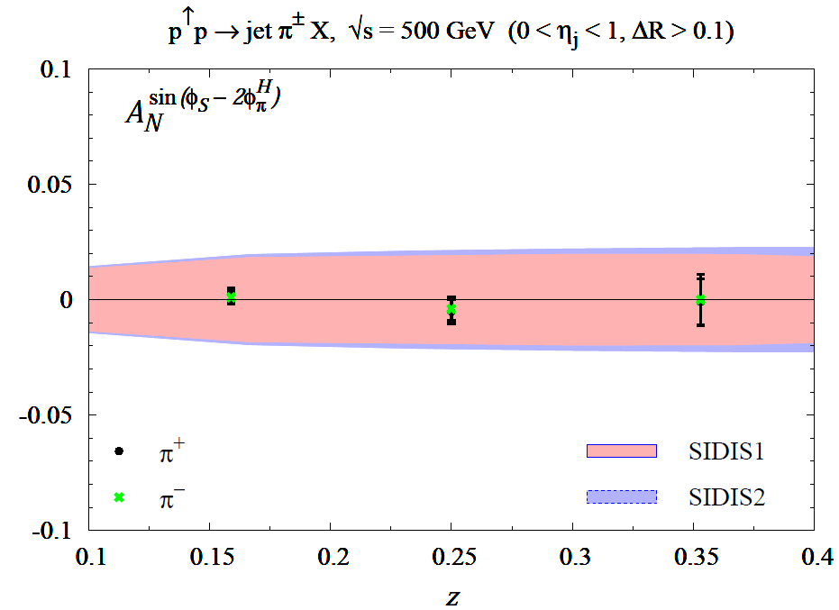
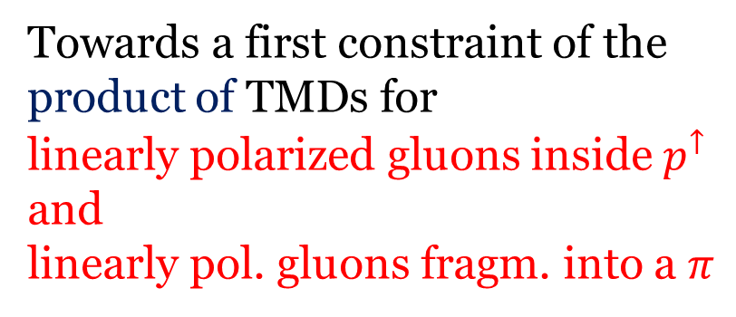

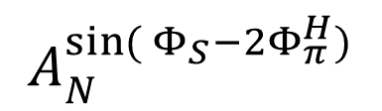
Collins-like contribution
Defined modulation
$$sin({Φ_{S}−2Φ_{π}^{H})}$$
$$A_{N}^{sin({Φ_{S}−2Φ_{π}^{H})}}$$
Positivity bound
helicity flip of the gluon
Towards a first constraint of the
product of TMDs for
linearly polarized gluons inside $p^{↑}$
and
linearly pol. gluons fragm. into a $π$
PHENIX

Slide 49
TMDs and spin
collinear
T-odd

Slide 50
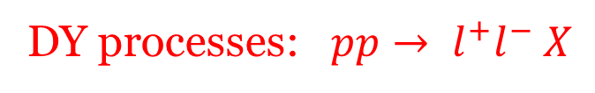
An example: DY process
Extra gluons:
Wilson lines, operators between parton fields in the correlator function
Soft factors, vacuum expectation values of further Wilson lines, absorbed in the TMDs)
DY processes: $pp→ l^{+}l^{−} X$
Wilson lines: path-ordered exponential of the gauge field ensuring local gauge invariance, but inducing some process dependence

Slide 51

Access to the gluon Sivers function
$A_{N}$ at mid-rapidity
PHENIX Collaboration data (2014)
All other effects are washed out
UD, Murgia, Pisano JHEP09 (2015)

Slide 52

Higher-twist contributions to $A_{N}$
- Collinear factorization: proven
Qiu, Sterman (1991)
- Twist-three functions could be related to TMDs:
Boer, Mulders, Piljman (2003)
- A completely new twist-3 fragm. function seems to be able (necessary) to explain $A_{N}$
Kanazawa, Koike, Merz, Pitonyak (2014)
- Recent analysis with use of Lorentz Invariant Relations: Gamberg et al (2017)
$A_{N}$ in $pp→γ X$ ideal to disentangle the two approaches ($A_{N}$ with different sign)

